Slide 1
Influence of Nozzle Type on Peanut Weed Control Systems
O.W. Carter* and E.P. Prostko
Department of Crop & Soil Sciences

Slide 2
Peanuts and Cotton in Georgia
315,000 hectares harvested in 2015
49.5% of US Total
453,000 hectares harvested in 2015
13.6% of US Total
Source: USDA/NASS, Crop Production (January 2016)

Slide 3
New Technologies
2,4-D and dicamba-resistant crops
Application requirements
Nozzle requirements!!!!

Slide 4
Nozzle Type Classification by Droplet Size
Category | Symbol | Color Code | Approximate VMD² (Microns)
Extremely Fine | XF | PURPLE | < 60
Very Fine | VF | RED | 61-105
Fine | F | ORANGE | 106-235
Medium | M | YELLOW | 236-340
Coarse | C | BLUE | 341-403
Very Coarse | VC | GREEN | 404-502
Extremely Coarse | XC | WHITE | 503-665
Ultra Coarse | UC | BLACK | >665
¹Estimated from sample reference graph in ASBAE/ANSI/ASAE Standard S572.1
²VMD = Volume median diameter

Slide 5
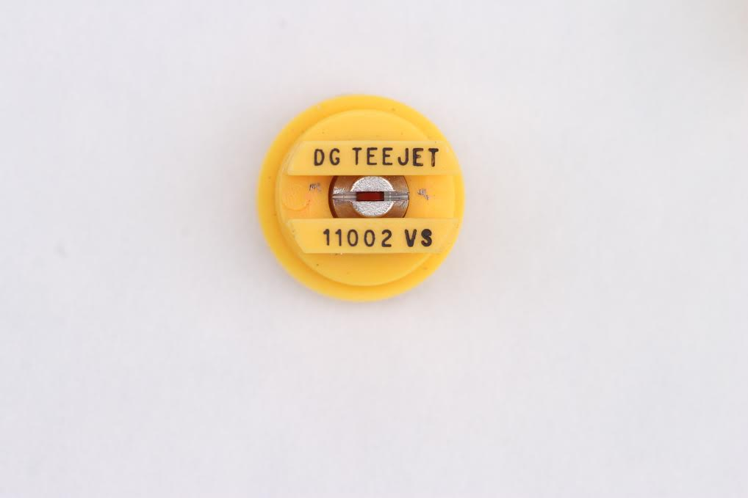
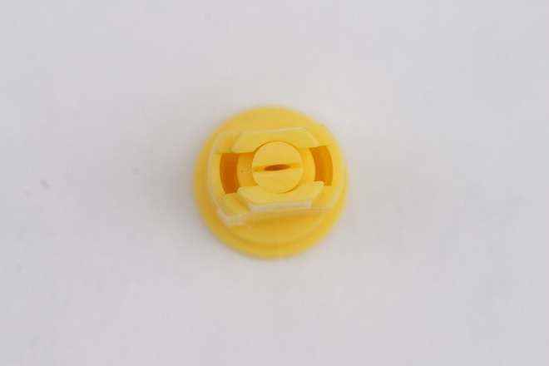
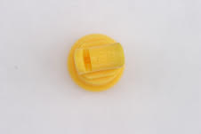
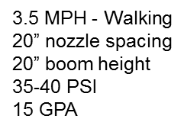
VMD for Common Nozzle Types
?
11002DG
VMD₅₀ = 322 (M)
AIXR 11002
VMD₅₀ = 402 (C)
TTI 02
VMD₅₀ = 524 (XC)

Slide 6
Nozzle Size and Efficacy
Typically, smaller droplet sizes are recommended for contact herbicides because thorough coverage essential for adequate control
Decreased control of broadleaf signalgrass and common cocklebur when using contact herbicides: glufosinate and paraquat. (Etheridge et al. 2001).

Slide 7
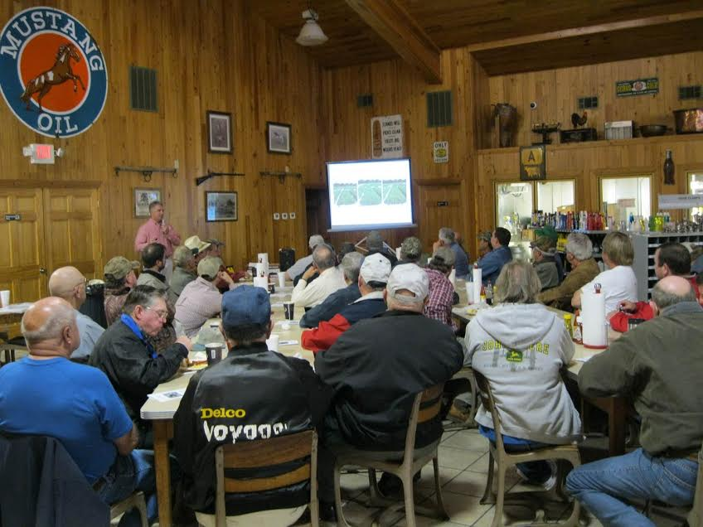
Grower Realities

Slide 8
Research Question and Hypothesis
Research Question: Will nozzle type have an influence on peanut weed control systems?
Hypothesis: The efficacy of contact herbicides, such as acifluorfen, paraquat, and lactofen, will be reduced when using a nozzle that provides a very coarse to ultra coarse droplet

Slide 9
Materials and Methods Bare Ground Study
Site: Ponder Research Farm- Tifton, GA
3 nozzle types: 11002DG, AIXR 11002, TTI02
4 Treatments:
1. Imazapic + 2,4-DB + S-metolachlor (S-moc)
2. Paraquat + Bentazon + Acifluorfen + S-moc
3. Lactofen + 2,4-DB + S-moc
4. Acifluorfen + 2,4-DB + S-moc
3 replications
Application Equipment:
Backpack sprayer, 262 kPa, 4.83 km/h, 50-cm nozzle spacing, 50-cm boom height

Slide 10
Results- Bare Ground

Slide 11
Influence of Nozzle Type on AMAPA Control in Bare Ground Study
P = 0.6346
P = 0.5662
P = 0.7183
*Averaged over all treatments

Slide 12
Treatment Effects on AMAPA Control - Bare Ground - 13 DAT
LSD (0.10) = 7
*Averaged over all nozzle types

Slide 13
Influence of Nozzle Type on Annual Grass Control - Bare Ground
P > 0.41
*Averaged over all treatments

Slide 14
Treatment Effects on Annual Grass Control - Bare Ground - 13 DAT
LSD (0.10) = 22
*Averaged over all nozzle types

Slide 15
Nozzle Type Effects on Paraquat + Acifluorfen + Bentazon + S-metolachlor - bare-ground - 13 DAT.
AIXR11002
TTI02
11002DG

Slide 16
Materials and Methods Peanut Trials
2 locations
Ponder Farm, Tifton, GA
Attapulgus Research Station
3 Nozzle Types- 11002DG, AIXR 11002, TTI02
4 replications at each location
Planting Date:
Tifton- Apr 27, 2015
Attapulgus- May 4, 2015
Application equipment- backpack sprayer 262 kPa, 4.83 km/h, 50-cm nozzle spacing, 50-cm boom height

Slide 17
Treatments
Flumioxazin System
Paraquat System
Flumioxazin+ Diclosulam (PRE) +
Imazapic or lactofen (POST) +
S-metolachlor + 2,4-DB (POST)
Paraquat + Bentazon+ Acifluorfen + S-metolachlor (EPOST) +
Imazapic or lactofen (POST) +
S-metolachlor + 2,4-DB (POST)
*Pendimethalin applied PRE with all treatments
*EPOST-15 DAP
*POST- 42 DAP

Slide 18
Results – Peanut Trial

Slide 19
Influence of Nozzle Type on AMAPA Control in Peanut - 21 DAT(Tifton)
P = 0.6254
After PRE + EPOST
*Averaged over all treatments

Slide 20
Influence of Nozzle Type on AMAPA Control in Peanut - 48 DAT(Tifton)
P = 0.7146
After PRE + EPOST+ POST
*Averaged over all treatments

Slide 21
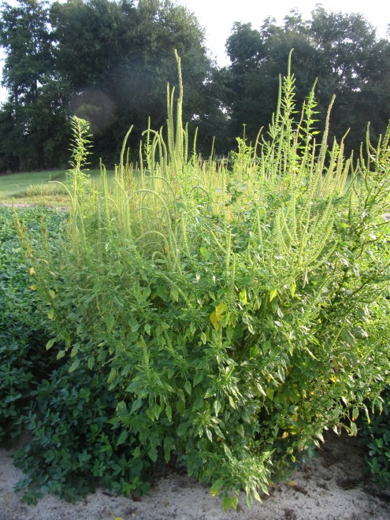
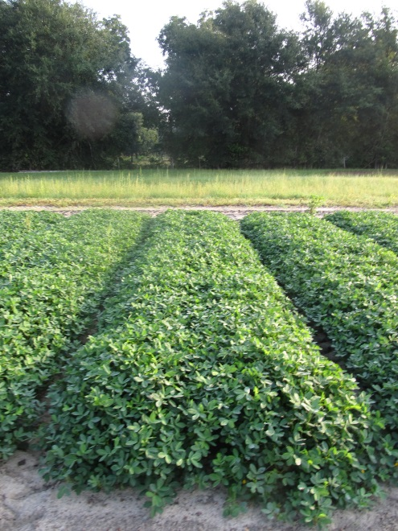
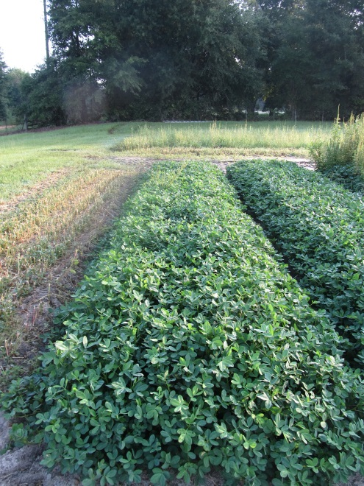
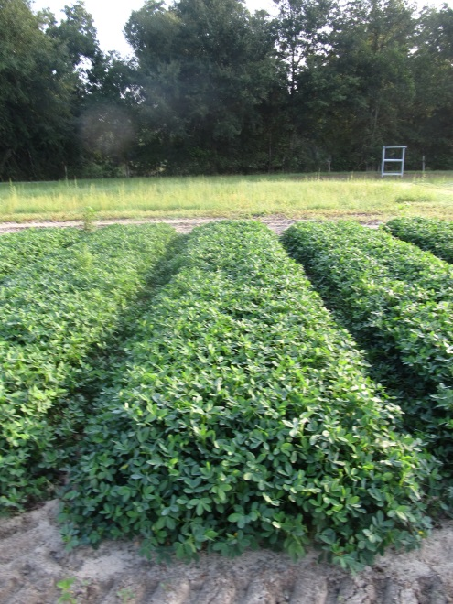
Nozzle Type Effects on Peanut Weed Control – Tifton (Paraquat/Imazapic System)
NTC
11002DG
AIXR 11002
TTI 02
PE-05A-15
July 29
90 DAP

Slide 22
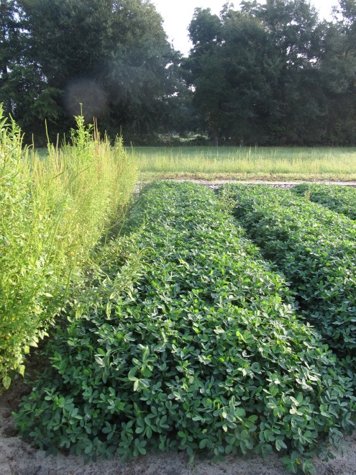
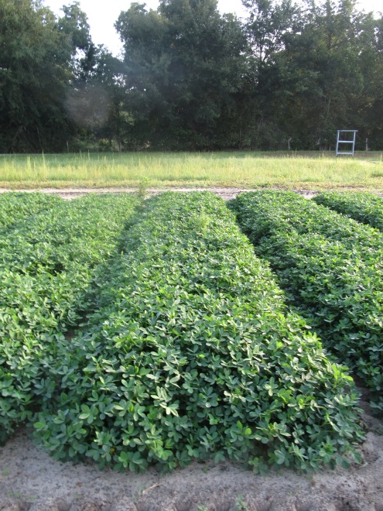
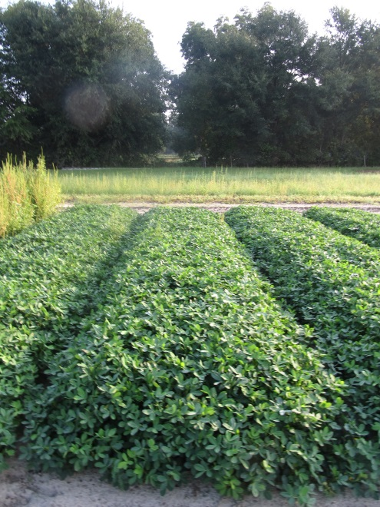
Nozzle Type Effects on Peanut Weed Control – Tifton (Paraquat/Lactofen System)
NTC
AIXR 11002
PE-05A-15
July 29
90 DAP

Slide 23
Influence of Nozzle Type on Peanut Yield - Tifton
P = 0.6051
*Averaged over all treatments

Slide 24
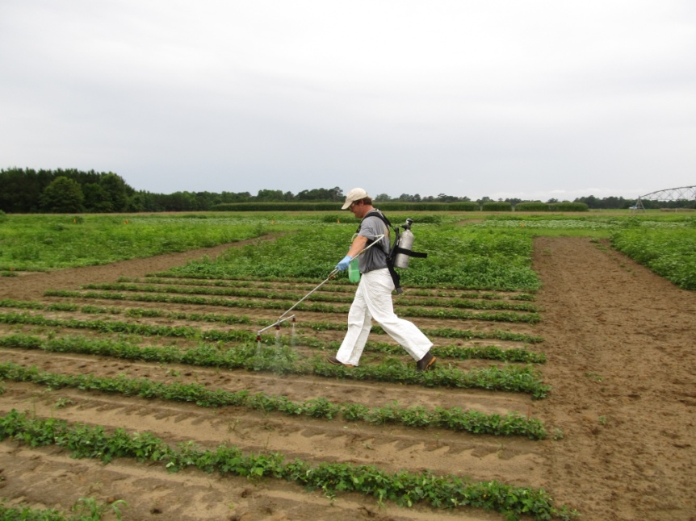
Summary
Nozzle type had no effect on Palmer amaranth control or annual grass control in bare ground study
Nozzle type had no effect on Palmer amaranth control or yield in peanut trial

Slide 25
Hypothesis
The efficacy of contact herbicides, such as paraquat and lactofen, will be reduced when using a nozzle that provides a very coarse to ultra coarse droplet.
Berger et al. (2014) found that lactofen efficacy in field was not reduced when using AI nozzle types (Peanut Science 41:120-123)
Ramsdale and Messersmith (2001) found that paraquat efficacy is not reduced when using drift-reducing nozzles as compared to conventional flat fan nozzles (Weed Technology 15:453-460).
Other studies have shown reduced efficacy with reduced coverage
Etheridge et al. 2001 Weed Technology 15:75-80
McKinlay et al. 1974 Weed Science 22:31-34

Slide 26
Future Research
Repeating tests in 2016
On-farm test using commercial sprayer
10+ MPH
Boom height

Slide 27
Questions?

