Slide 1
Peanut Weed Control Update - 2020
Eric P. Prostko, Ph.D.
Professor and Extension Weed Specialist
Department of Crop & Soil Sciences

Slide 2
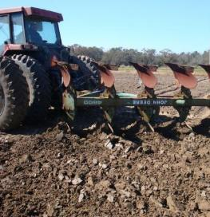
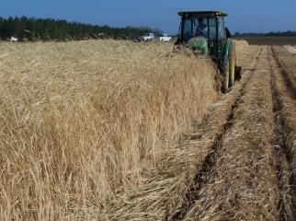
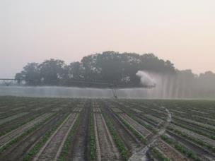
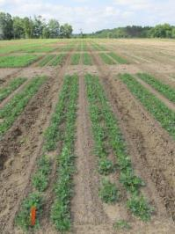
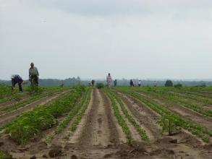
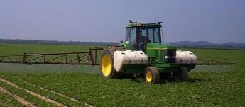
Peanut Weed Control Integrated Program Approach
Tillage
Irrigation
Rye Cover Crop
Hand-Weeding
Twin Rows
Herbicides

Slide 3
Twin vs. Single Rows
Better control of TSWV
Better control of some weeds
~10%
Yield/Grade????

Slide 4
The Peanut Herbicide Toolbox 23 Active ingredients, 9 MOA’s
PPI/PRE
Sonalan
Prowl/Pendimax
Dual Magnum/Generics
Outlook/Propel
Pursuit
Spartan Charge
Solicam
Strongarm
Valor
Zidua
POST
Aim (Harvest Aid)
Gramoxone/Firestorm/Parazone
Basagran
Ultra Blazer
Cadre/Impose
Classic
Cobra
ET (harvest aid)
Fusilade
Poast/Poast Plus
Pursuit
Select/Arrow/Trigger
Storm
2,4-DB

Slide 5
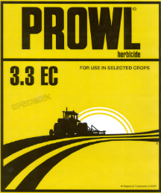
The foundation of weed management in peanuts in GA are the yellow/DNA herbicides!
Sonalan, Prowl, Pendimax, Prowl H₂O
inexpensive
(< $9/A)
Texas panicum
Florida pusley
must be incorporated by tillage or irrigation
Flip a coin or personal preference or strip-till

Slide 6
Others (chloroacetamides, isoxazolines)
Flip a coin or personal preference?

Slide 7
Irrigated Peanut Yield Response to PRE Applied Pyroxasulfone
-19%
PE-01-15
GA-06G
LSD 0.10 = 906
CV = 13.06

Slide 8
Peanut Weed Control - 2019
Prowl H₂0 @32 oz/ (PRE)
Valor SX@ 3 oz/A (PRE)
Cadre @ 4 oz/A (27 DAP)
Dual Magnum @ 16 oz/A (27 DAP)
2,4-DB @ 16 oz/A (27 DAP)
PE-14-19
July 17
71 DAP
NTC
~$35/A
(5 MOA)

Slide 9
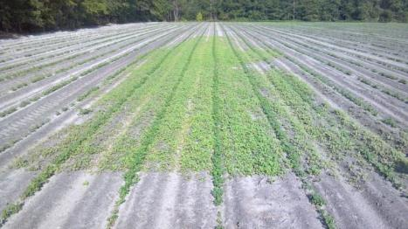
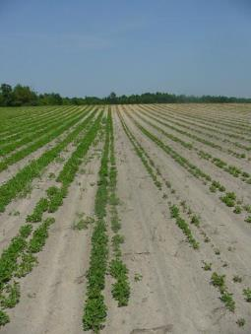
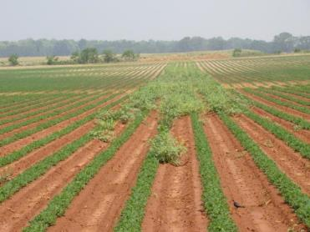
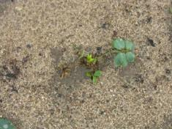
Valor Great Weed Control vs. Crop Injury
Valor SX 51WG @ 3 oz/A = $8.34/A

Slide 10
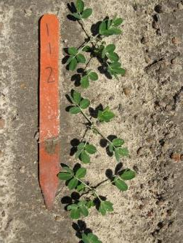
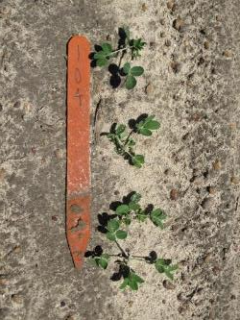
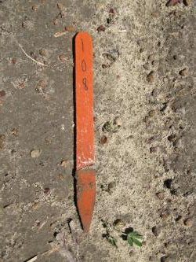
Valor Injury - 2019
NTC
3 oz/A
6 oz/A
PE-07-19
May 14
13 DAP

Slide 11
Valor Effects on Peanut Yield High Moisture Conditions - 2019
lbs/A
PE-07-19
- Weed-free
- 8.3” rainfall/irrigation
first 30 DAP
*averaged over 4 Dual Magnum rates
P = 0.7798
CV = 10.6

Slide 12
Peanut Weed Control - 2019
Prowl H₂0 @ 32 oz/A (PRE)
Gramoxone 2SL @ 12 oz/A (10 DAP)
Storm @ 16 oz/A (10 DAP)
Dual Magnum @ 16 oz/A (10 DAP)
Cadre @ 4 oz/A (27 DAP)
Dual Magnum @ 16 oz/A (27 DAP)
2,4-DB @ 16 oz/A (27 DAP)
PE-14-19
July 17
71 DAP
NTC
~$45/A
(7 MOA)

Slide 13
Strongarm/Peanut
PPI/PRE/POST
very closely related to FirstRate (soybean)
0.45 oz/A
$19.50 in 2019
annual MG, eclipta, copperleaf, starbur, c. cocklebur, c. ragweed
rotation restrictions

Slide 14
Strongarm Crop Rotations

Slide 15
Paraquat in Peanut
CHEAP!
12 oz/A of 2SL = $1.69/A
if not using Valor or Strongarm
apply early
alone = before 14 DAC
tank-mixes = before 28 DAC
tank-mixes with Basagran, Storm, 2,4-D, Dual, Warrant, Zidua, Outlook
Tips
15 GPA
flat-fan nozzles
slower tractor speeds
2 or 3 lb ai/A formulations so watch your use rates!

Slide 16
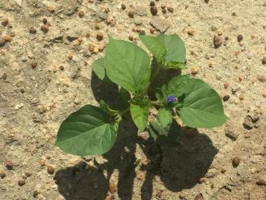
Why do we use Storm or Basagran with paraquat?
Improves control of smallflower mg and tropic croton
Reduces peanut injury but does not really influence yield (cosmetic)
Reduces control of sicklepod, beggarweed, Texas panicum

Slide 17
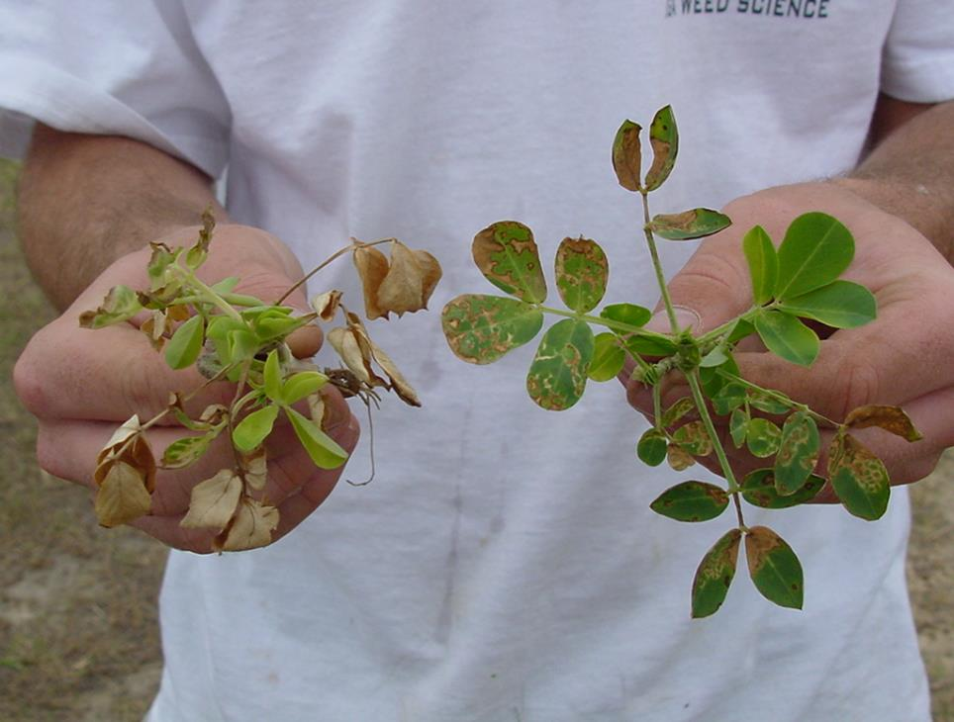
Treatments applied 6 DAC; Photo at 3 DAT
GA-02C
GI @ 8 oz/A +
NIS @ 0.25% v/v
GI @ 12 oz/A + Basagran @ 8 oz/A +
NIS @ 0.25% v/v

Slide 18
Peanut Yield (GA-16HO) As Influenced by Gramoxone Timing (Averaged over 9 Gramoxone treatments)
PE-07-18
weed-free
irrigated
THSD (0.10) = 246
CV = 6.5

Slide 19
New Paraquat Training Requirements

Slide 20
Cadre: The glyphosate of peanuts?
Yellow/purple nutsedge
sicklepod, pigweeds, morningglory, cocklebur
Does not control common ragweed, tropic croton, eclipta, spurges, purslane, and hophornbeam copperleaf
Is it worth the rotational crop risk??
ALS-resistance???
HUGE drop in price since 1996?
$6.49/A in 2019

Slide 21
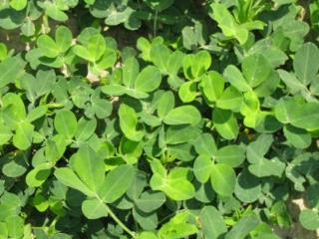
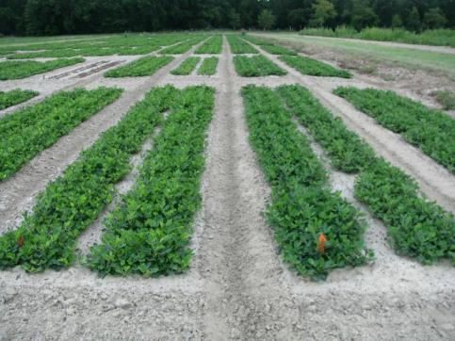
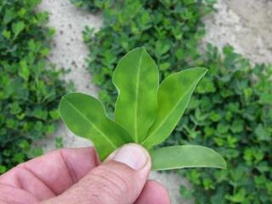
Cadre “Yellow Flash” – 3 DAT
TREATED
NTC
June 25, 2010
GA-06G

Slide 22
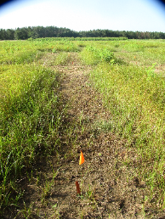
Yellow Nutsedge Control with Cadre @ 4 oz/A + Agridex @ 1% v/v - 2019
May 31
9 DAT
June 3
12 DAT
June 12
21 DAT
June 24
33 DAT
July 16
55 DAT
PE-17-19
Applied May 22

Slide 23
Cadre/Cotton

Slide 24
Cadre/Impose Rotational Restrictions

Slide 25
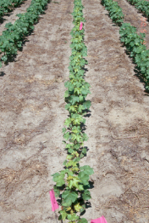
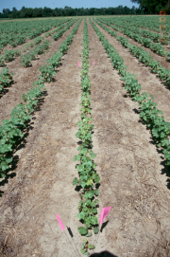
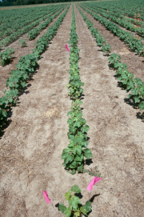
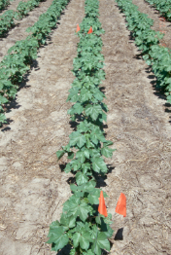
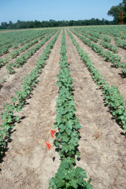
Cadre Carryover in Cotton Brooks County, GA - 2000
674 lbs
770 lbs
770 lbs
738 lbs/A
(lint yield)
1540 lbs
1348 lbs
1220 lbs
1369 lbs/A
**46% yield loss
6/09/00

Slide 26
Brief History of Metolachlor
Synthesized by Ciba-Geigy in 1972
50/50% mixture of R + S isomers
Registered for corn in 1977
Registered for peanut in 1980 (February)
S-metolachlor registered for use in 1997 (Novartis)
12/88% mix of R + S isomers
Patent expiration
EPA Reduced Risk Pesticide Program
Novartis stopped selling “old” metolachlor in 1999, phased out completely by 2001.
Novartis + AstraZeneca became Syngenta in 2000
Generic companies started producing “old” metolachlor in 2003 (i.e. 50/50 mix of R + S isomer).

Slide 27
Valor/Dual High Moisture Tests – 2017-2019
11.315" OF TOTAL IRRIGATION/RAINFALL IN FIRST 30 DAYS AFTER APPLICATION (2018)

Slide 28
Peanut Response to Valor + Dual Magnum - 2018
11.315" OF TOTAL IRRIGATION/RAINFALL IN FIRST 30 DAYS AFTER APPLICATION
PE-09-18
July 24
83 DAT
NTC
Valor @ 3 oz/A + Dual Magnum @ 16 oz/A
PRE

Slide 29
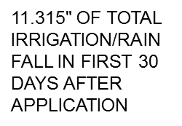
Valor/Dual Magnum High Moisture Results - 2018
No interactions between Valor and Dual Magnum
No effect on J-rooting
Valor and Dual reduced early season peanut biomass (stunting)
Valor @ 3 or 6 oz/A had no effect on yield
Dual Magnum reduced peanut yields under these weed-free and high moisture conditions.
16 oz/A = 4.2% loss
21 oz/A = 5.4% loss
42 oz/A = 10.8% loss

Slide 30
Valor/Dual Magnum High Moisture Results - 2019
No interactions between Valor and Dual Magnum
Valor had no effect on J-rooting. Dual Magnum @ 42 oz/A increased J-rooting by 25%
Valor and Dual reduced early season peanut biomass (stunting)
Valor @ 3 or 6 oz/A had no effect on yield
Dual Magnum only reduced peanut yields @ 42 oz/A under these weed-free and high moisture conditions.
16 and 21 oz/A = No yield loss
42 oz/A = 6.5% loss
8.3” rainfall/ irrigation
first 30 DAP

Slide 31
Peanut J-Rooting No Valor or Dual
PE-07-19
May 23
21 DAP

Slide 32
Late-Season MG problems Harvest Aid (Aim or ET)

Slide 33
What do the top Georgia peanut growers do? 2018 Georgia Peanut Achievement Club Winners
15 growers
6118 lb/A average yield
GA State Avg. = 4450 lb/A
100% - irrigated
73% - bottom plow
93% - twin rows
Herbicides
60% - Sonalan
80% - Valor
27% - Dual
80% - Cadre
53% - 2,4-DB
33% - Prowl
40% - Strongarm

Slide 34
Off-Target Dicamba/Peanuts

Slide 35
Dicamba/Peanuts – I (Stem Epinasty)

Slide 36
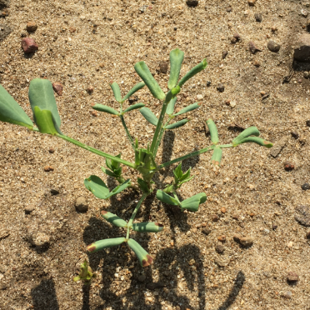
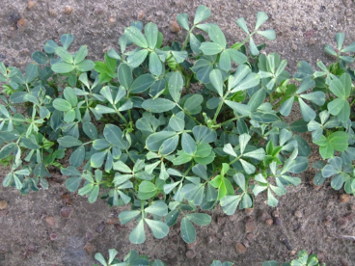
Dicamba/Peanuts – II (leaf strapping)

Slide 37
Dicamba/Peanuts – III (leaf roll)

Slide 38
Peanuts/Dicamba Summary
No tolerance is currently established
Peanut injury dependent upon rate and time of event
Drift rates or volatility rates (1/50thX and lower) will cause symptomology but should not reduce yields
grade/abnormal pods?
Pay attention!

Slide 39
Roundup P-Max + Xtendimax Effects on Peanut Grade - 2019
PE-06-19
TSMK = $4.784/pt
Averaged over 2 timings
LSD (0.10) = 1.49
CV = 2.05
Averaged over 2 timings
LSD (0.10) = 0.56
CV = 21.76

Slide 40
Roundup P-Max + Xtendimax Effects on Peanut Pods - 2019
PE-06-19
LSD (0.10) = 1.6
CV = 33.65
(Averaged over 2 timings)
1/50th

Slide 41
Pay Attention to Detail!

Slide 42
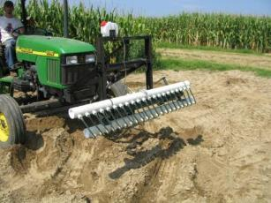
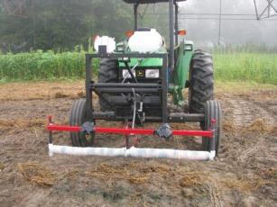
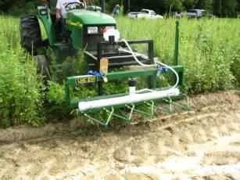
Non-Selective Applicators (Last Resort)

Slide 43
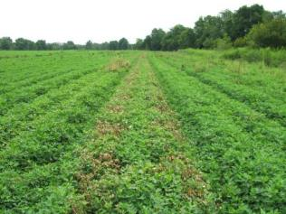
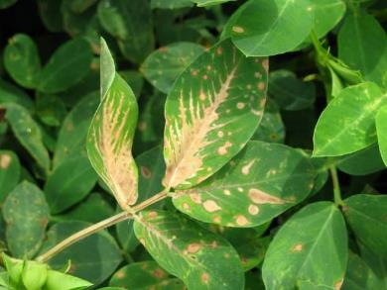
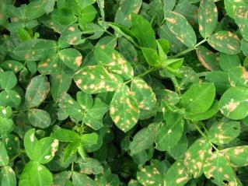
Our First Attempt in a Real Field Tift County, August 2010 (3 DAT)
Potential Problems
No gauge wheel
Hydraulic lift problem
No check valve on pump
Roller Speed
Tall peanut variety (GA-02C)
Dumb A** Scientist
Part science and part art!

Slide 44
Weed Wiper Randolph County – August 20, 2018
Treated 8/8/18

Slide 45
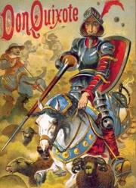
Tank-Mixtures The Impossible Dream
12 POST herbicides
20 fungicides
16 insecticides
B or Mn
NIS or COC
7 am, 12 pm, 5 pm, 10 pm
~62,000 possible combinations
4 reps = 248,000 plots
I do ~2640 plots/year
Thus, it would take me 94 years if I dropped everything else

Slide 46
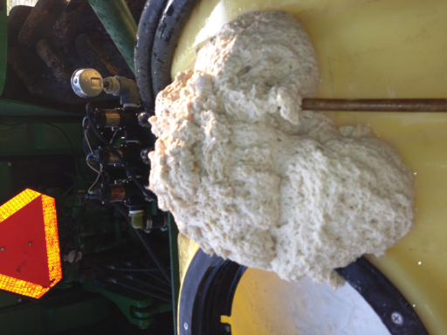
The Tank-Mixes Blues!
Reflex
Zidua
B-Moly
Glyphosate
Brandt Smart Trio
(N + S + B + Mn + Zn)
*Always pre-slurry dry formulations
in water before adding to tank!!!

Slide 47
Headline + Cadre + Strongarm + 2,4-DB + Dyne-Amic

Slide 48
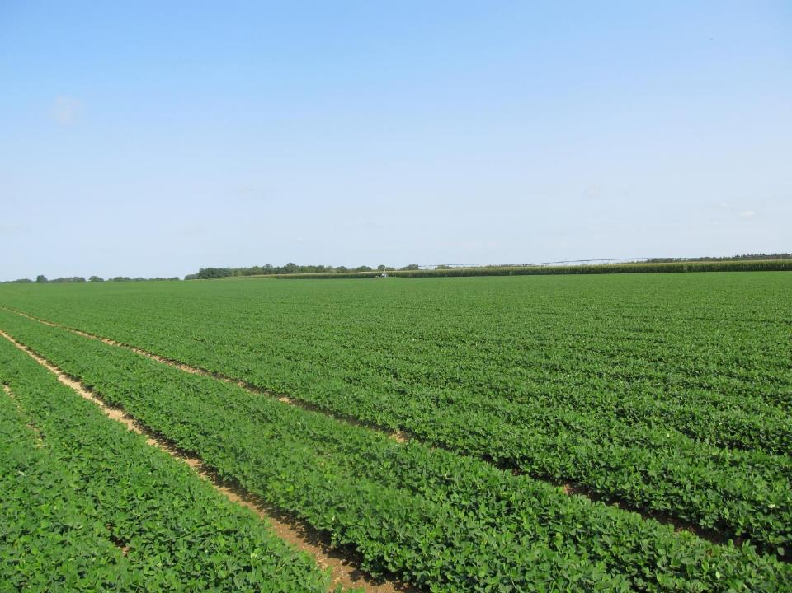
Peanut weed control is not impossible!
- Do your homework!
- Start clean, twin rows, residuals, timely POST’s

Slide 49
Questions/Comments

