Slide 1
Sprayer Nozzles and Droplet Size
Eric P. Prostko
Professor & Extension Weed Specialist
Dept. of Crop & Soil Sciences
ANR Training
November 2019

Slide 2
Coverage vs. Drift Control (It’s all about droplet size)
Larger (coarser) Drops
Less coverage but better drift control
Smaller (finer) Drops
Better coverage but less drift control
Coverage is pesticide dependent
Contact = smaller drops
Liberty, Gramoxone
Systemic = larger drops
Roundup, 2,4-D, dicamba

Slide 3
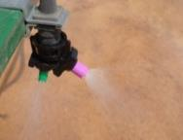
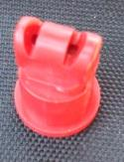
Droplet Size
Goal = larger droplets; eliminating fines
micron (µm) is a unit of measure equivalent to 1/25,000 of an inch.
Notes:
You must understand spray droplet size if you are going to be successful. Micron is a word that sounds complex but it really isn’t as it is simply a measure of the droplet size. This chart provides you with a few comparisons to make you more comfortable with the terminology. For example a 100 micron droplet is the size of human hair where a 400 micron droplet is the size of a staple. In the past with products like Liberty a 300 micron droplet was ideal because it works like a contact herbicide where you have to help out by getting throughout coverage of the herbicide on the weed. Now with dicamba and 2,4-D, being systemic, you still have to get them on the weed but they can do a lot of the work themselves by moving throughout the plant so a larger droplet is a better choice (green arrow). Now why do we want a larger droplet.

Slide 4
Volume Median Diameter (VMD)
value where 50% of the total volume or mass of liquid sprayed is made up of droplets larger than this value, and 50% is made up of droplets smaller than this value.
D_{v0.5}
Measured in microns

Slide 5
Spray Tip Classification by Droplet Size
Category | Symbol | Color Code | Approximate VMD² (Microns)
Extremely Fine | XF | PURPLE | < 60
Very Fine | VF | RED | 61-105
Fine | F | ORANGE | 106-235
Medium | M | YELLOW | 236-340
Coarse | C | BLUE | 341-403
Very Coarse | VC | GREEN | 404-502
Extremely Coarse | XC | WHITE | 503-665
Ultra Coarse | UC | BLACK | >665
¹Estimated from sample reference graph in ASBAE/ANSI/ASAE Standard S572.1
²VMD = Volume median diameter

Slide 6
Distance of Visual Dicamba Damage from Drift in Cotton. Moultrie GA. 2018.
188 feet
128 feet
68 feet
Medium
(236-340)
Course
(341-403)
Ultra Course
(>665)
Droplet Size (µm)
Notes:
I want to stress even with the right tip it is not zero. In fact one of our greatest concerns, is that you guys think all you need is to get the right tip and you are bullet proof.

Slide 7
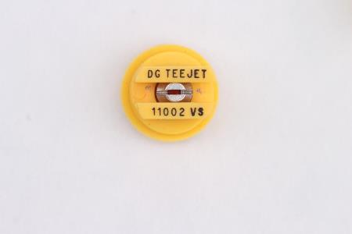
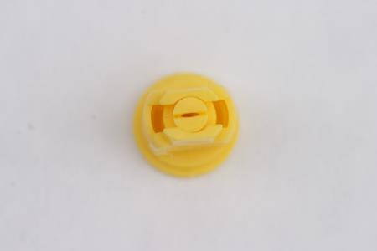
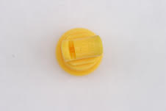
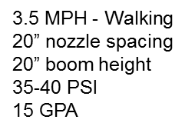
VMD for common nozzle types
11002DG
VMD₅₀ = 322 (M)
AIXR 11002
VMD₅₀ = 402 (C)
TTI 02
VMD₅₀ = 524 (XC)

Slide 8
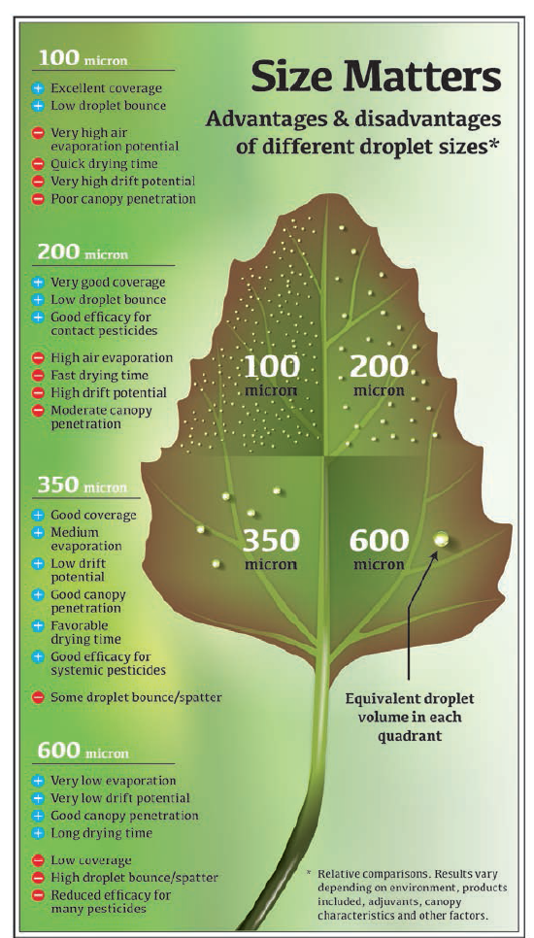

Slide 9
You Can Put More than 1 Nozzle on a Boom

Slide 10
What Nozzles Do I Like?

Slide 11
Other Common Nozzle Questions
How much do they cost (2019)?
TTI-11004-VP-CE = $9.86
XRC-11004-VP = $2.96
How long do they last?
How many acres? What was sprayed? What are they made of? (brass, stainless steel, polymer, ceramic)
Replace when flow exceeds 10% of new nozzle

Slide 12
Nozzle Requirements for Auxins (tolerant cotton and soybeans)
Enlist One™
Xtendimax®

Slide 13
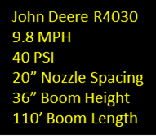
How do “auxin” nozzles work in real world?
Henley Farm, Miller County, April 10, 2017

Slide 14
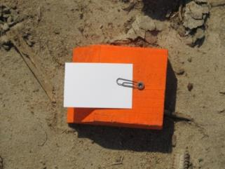
2017/2018/2019 Nozzle Tests VMD₅₀ and Coverage
R3
R2
10 feet
R1
tractor
10 feet

Slide 15
Commercial Sprayer Nozzle Tests - 2019
JD4730, 90’ boom, 20” nozzle spacing, 12.5 MPH, 20 GPA, 42-57 PSI
Patterson Farm, Worth County, April 4, 2019

Slide 16
Worth County Nozzle Test April 4, 2019 (Rep 2, card #2)
XRC-11006
TTI-11006
JD 4730, 90’ boom, 20” spacing, 20 GPA, 12.5 MPH, 42-57 PSI, 36” boom height

Slide 17
Commercial Sprayer Nozzle Tests - 2019
JD4630, 90’ boom, 15” nozzle spacing, 11.6 MPH, 12 GPA, 18-20 PSI
Sikes Farm, Bulloch County, March 21, 2019

Slide 18
Bulloch County Nozzle Test March 21, 2019 (Rep 2, card #4)
XRC-11004
TTI-11004
TDXL-11004D
JD 4630, 90’ boom, 15” spacing, 12 GPA, 12 MPH, 28 PSI, 36” boom height (avg.)

Slide 19
Commercial Sprayer Nozzle Tests - 2019
JD4730, 100’ boom, 15” nozzle spacing, 11.6 MPH, 15 GPA, 18-20 PSI
Waters Farm, Pierce County, March 26, 2019

Slide 20
Pierce County Nozzle Test March 26, 2019 (Rep 1, card #5)
XR-11006
TTI-11006
JD 4730, 100’ boom, 15” spacing, 15 GPA, 11.6 MPH, 18-20 PSI, 36” boom height (avg.)

Slide 21
Droplet Size and Spray Coverage from 2019 Nozzle Tests with Commercial Sprayers
 | Bulloch^{1,3} |  |  | Pierce^{1,4} |  | Worth^{2,5}
 | TTI- 11004 | XRC- 11004 | TDXL- 11004 | TTI- 11006 | XR- 11006 | TTI- 11006 | XRC-11006
VMD₅₀ (microns) | 456 a⁶ | 182 b | 411 a | 381 a | 196 b | 481 a | 348 b
Coverage (%) | 11.8 a | 8.1 b | 12.0 a | 5.3 a | 3.4 b | 10.0 a | 7.4 a
¹According to DepositScan
²According to DropletScan
³JD4630, 90’ boom, 15” nozzle spacing, 12.0 MPH, 12 GPA, 28 PSI, 36” boom height
⁴JD4730, 100’ boom, 15” nozzle spacing, 11.6 MPH, 15 GPA, 18-20 PSI, 36” boom height
⁵JD4730, 90’ boom, 20” nozzle spacing, 12.5 MPH, 20 GPA, 42-57 PSI, 36” boom height
⁶Means in the same row within same location with the same letter are not significantly different (THSD 0.10).
Means from 21 kromekote water sensitive cards.

Slide 22
2019 Nozzle Tests (Weeds, Insects, Disease, Yield)

Slide 23
2019 Peanut Nozzle Tests
County | Rotation | Variety | Irrigated (I) or Dryland (D) | Tillage | Row Pattern | Planting Date | Digging Date | Harvest Date
Bulloch | cotton cotton peanut | GA-06G | D | ST | Single | May 17 | Oct. 3 | Oct. 8
Pierce | cotton cotton peanut | GA-06G | D | CT | Single | May 18 | Oct.1 | Oct. 5
Worth | peanut cotton peanut | GA-06G | I | CT | Twin | May 9 | Sept. 21 | Sept. 24

Slide 24
2019 Nozzle Tests Pesticides/Fertilizers Applied
County | Total Applications (#) | Herbicides | Fungicides | Insecticides | Other
Bulloch | 6 | Valor Strongarm Cadre Dual Magnum 2,4-DB | Approach Prima Equus Elatus Convoy Tebusol | Dimilin | Boron PegPower
Pierce | 6 | Valor Dual Magnum Cadre 2,4-DB | Bravo Priaxor Provost Silver Tebuconazole | Dimilin | Boron
Worth | 6 | Gramoxone Dual Magnum Warrant Basagran Cadre | Headline Topsin Tebuconazol Convoy Chlorothalinol | Orthene Dimilin | Boron Manganese Ascend

Slide 25
Late-Season Insect, Weed, and Disease Ratings from 2019 Nozzle Tests with Commercial Sprayers**
 | Bulloch¹ |  |  | Pierce² |  | Worth³
 | TTI- 11004 | XRC- 11004 | TDXL- 11004 | TTI- 11006 | XR- 11006 | TTI- 11006 | XRC-11006
Total # of insects (#/15 sweeps) | 8.0 | 10.0 | 9.8 | 7.8 | 7.8 | 22.8 | 20.0
Total # of weeds (#/m²) | 0 | 0 | 0 | 1.4 | 0.2 | 0 | 0
Leaf Spot (1-10) | 1.0 | 1.0 | 1.0 | 1.0 | 1.0 | 1.2 | 1.1
White Mold (%) | 7.3 | 8.9 | 7.1 | 4.1 | 5.3 | 8.7 | 6.9
¹JD4630, 90’ boom, 15” nozzle spacing, 12.0 MPH, 12 GPA, 28 PSI, 36” boom height
²JD4730, 100’ boom, 15” nozzle spacing, 11.6 MPH, 15 GPA, 18-20 PSI, 36” boom height
³JD4730, 90’ boom, 20” nozzle spacing, 12.5 MPH, 20 GPA, 42-57 PSI, 36” boom height
**No significant differences were observed between nozzle type at any location (P>0.10).

Slide 26
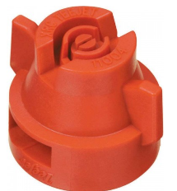
2019 Nozzle Test XRC-11004-VP
Bulloch Co.
9/9/19
115 DAP

Slide 27
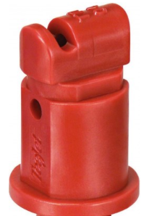
2019 Nozzle Test TTI-11004-VP
Bulloch Co.
9/9/19
115 DAP

Slide 28
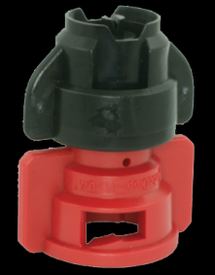
2019 Nozzle Test TDXL-11004-D
Bulloch Co.
9/9/19
115 DAP

Slide 29
Peanut Yield As Influenced By Nozzle Type from 2019 Nozzle Tests with Commercial Sprayers
 | Bulloch¹ |  |  | Pierce² |  | Worth³
 | TTI- 11004 | XRC- 11004 | TDXL- 11004 | TTI- 11006 | XR- 11006 | TTI- 11006 | XRC-11006
lbs/A⁴ | 4312 | 4338 | 4188 | 5037 | 4994 | 6588 | 6581
 | P = 0.7624 CV = 7.03 |  |  | P = 0.7596 CV = 3.63 |  | P = 0.9823 CV = 6.36
¹JD4630, 90’ boom, 15” nozzle spacing, 12.0 MPH, 12 GPA, 28 PSI, 36” boom height
²JD4730, 100’ boom, 15” nozzle spacing, 11.6 MPH, 15 GPA, 18-20 PSI, 36” boom height
³JD4730, 90’ boom, 20” nozzle spacing, 12.5 MPH, 20 GPA, 42-57 PSI, 36” boom height
⁴Adjusted to 10% moisture.

Slide 30
Summary - 2019
Spray card analysis
VMD₅₀ larger with auxin nozzles (381-481 microns vs. 182-348 microns)
Coverage better with auxin nozzles in 2/3 tests
No differences in weeds, insects, disease, and yield between nozzles were observed in large, on-farm field trials.
Pierce Co.
10/05/19

Slide 31
Conclusions
6 on-farm, large plot replicated trials in 2018 and 2019
+ 4 site-years small-plot (weed control)
No differences between nozzle type for insects, disease, weeds, and yield.
Suggestions
use at least 12 GPA
good rotations
timely applications
grass control??
Worth Co.
09/24/19

Slide 32
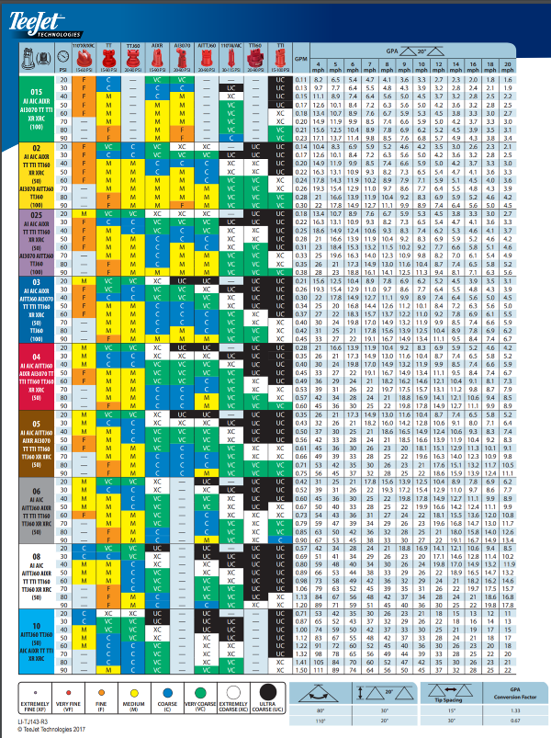
Liberty (glufosinate) - Nozzles
“Use nozzles and pressure that generate a MEDIUM to COARSE size spray droplet. NOTE: Weed control with very coarse, extremely coarse or ultra-coarse nozzles will not provide adequate coverage and will cause unsatisfactory weed control”

Slide 33
What nozzle should I use?
What are you spraying?
contact/systemic
label information
multiple nozzle body
flat fat/ AIXR/”auxin”
One nozzle for everything??????
Are you timely or late?

Slide 34
Questions/Comments?

