Slide 1

2020 Soybean Weed Control Update
Eric P. Prostko
Professor and Extension Weed Specialist
Dept. Crop & Soil Sciences

Slide 2
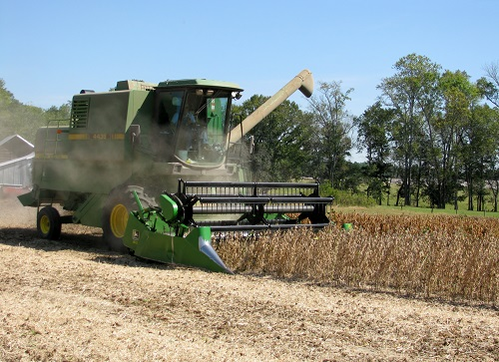
Soybean Weed Control (Currently)
Start clean, use residuals, timely POST
Narrow rows (<30”)
Systems
Conventional
RR (glyphosate)
LL (glufosinate)
GT27 (glufosinate + glyphosate + isoxaflutole)
Xtend (dicamba)
Enlist (2,4-D choline)

Slide 3
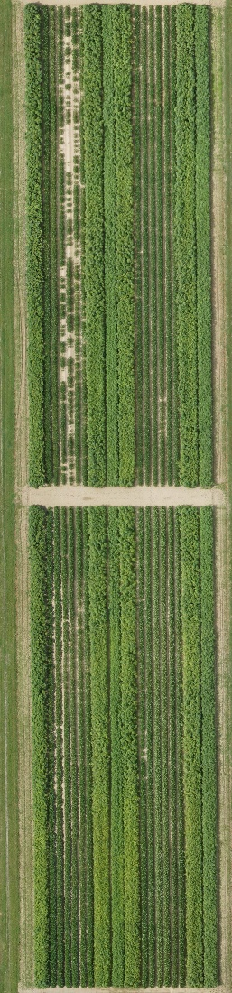
Soybean Weed Control - 2019
Enlist
XtendFlex
Liberty
Xtend
SB-02-19
July 7
53 DAP

Slide 4
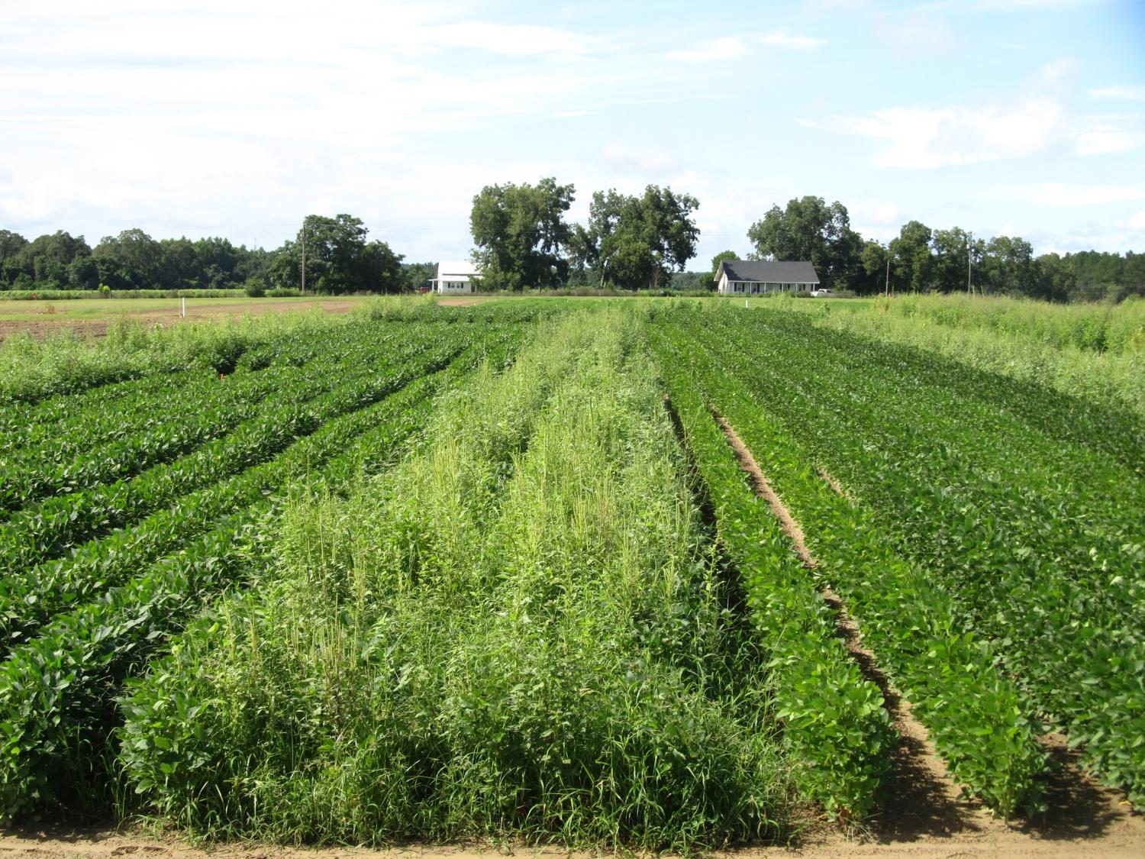


Soybean Weed Control - 2018
SB-01-18
August 3
SB-01-18
July 20

Slide 5



Old + Cheap + Still Good (i.e. metribuzin)
Not a PPO (Valor or Reflex)
Good on pigweed and sicklepod
Can be applied PPI
Dryland fields?
Issues (Be careful!!)
soil texture, OM, pH
Varieties
Rotations
TriCor 75DF
Metribuzin 75DF

Slide 6
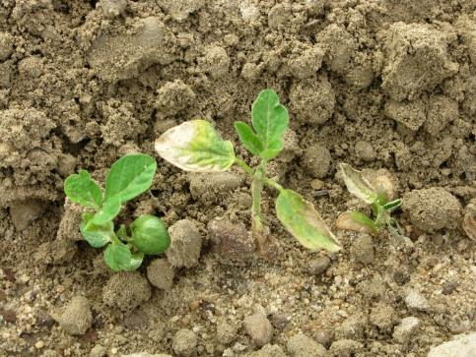
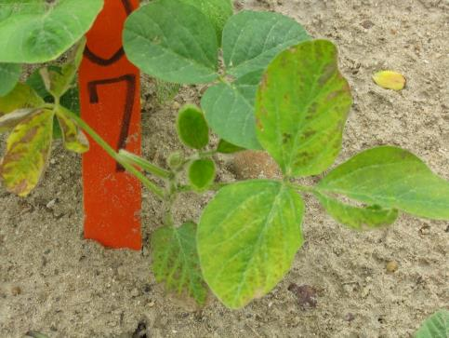
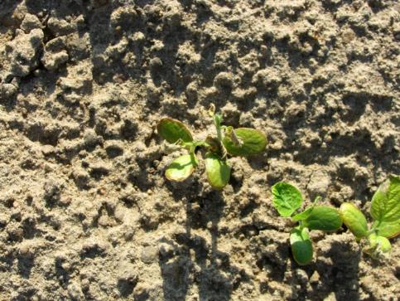
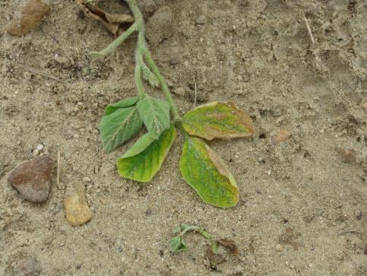
Metribuzin Injury

Slide 7
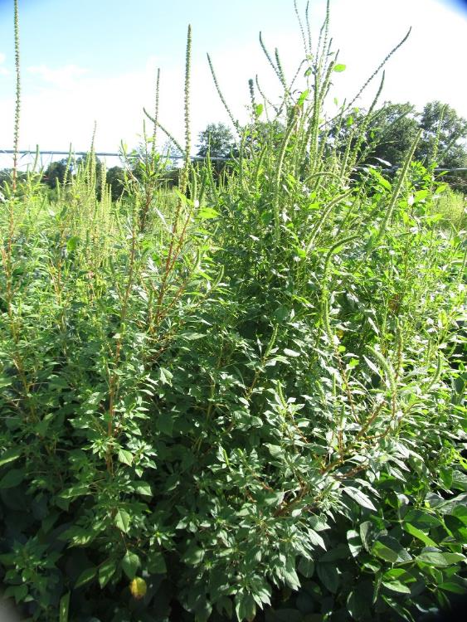
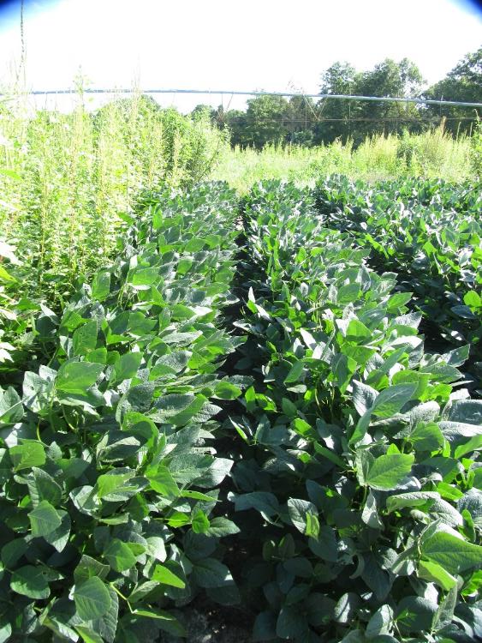
Soybean Weed Control - 2019
NTC
Tricor 4L @ 8 oz/A (PRE)
Roundup Powermax 5.5SL @ 32 oz/A +
Reflex 2SL @ 24 oz/A (22 DAP)
SB-04-19
July 22
69 DAP

Slide 8





Liberty-Link® Soybeans
Liberty 2.34SL @ 32-43 oz/A or generics
VE-R1 (beginning bloom)
2 applications (5 days apart)
(87 oz/A/year total)
Tank-mixes with POST grass herbicides may reduce grass control
Assure (10-21%); Fusilade (8-12%); Poast (25-41%); Select (4-22%)
Residuals still needed
15 GPA, medium-coarse droplet size, small weeds, 9 am - 6 pm

Slide 9
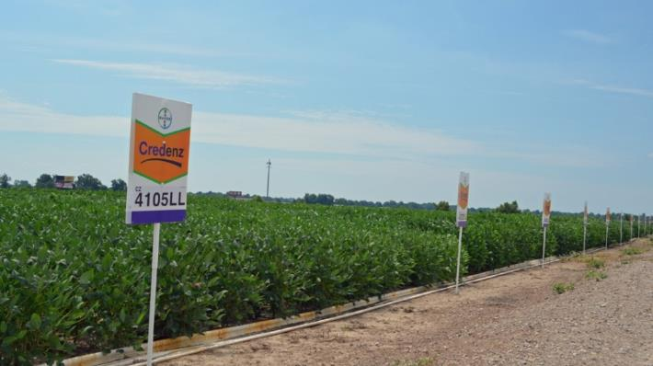
Liberty-Link Soybean Varieties
Getting better and better!
G13LL-7 and G13LL-44 developed by UGA Soybean Breeding Team
Group VII’s
AGS 747LL (G13LL-7)
AGSouth
Southern Harvest 7418LL (G13LL-44)
Meherrin
Others

Slide 10
Statewide Average Yield of UGA Developed LL Soybeans*
*Source: UGA OVT (6 locations/year, irrigated)

Slide 11











2,4-D/Dicamba Technologies
2,4-D choline
dicamba

Slide 12

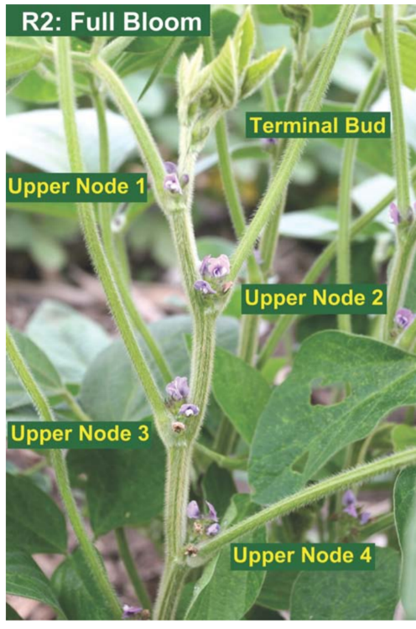

Enlist Soybeans
China approval in Jan 2019
Enlist One
2,4-D choline
Enlist Duo
2,4-D choline + glyphosate
POST up to R2 (full bloom)
2 apps (12 days)
Can be tank-mixed with glufosinate (Liberty) or others
Check label/web-sites for restrictions (nozzles, wind speed, buffers, etc.)
Varieties for GA????

Slide 13


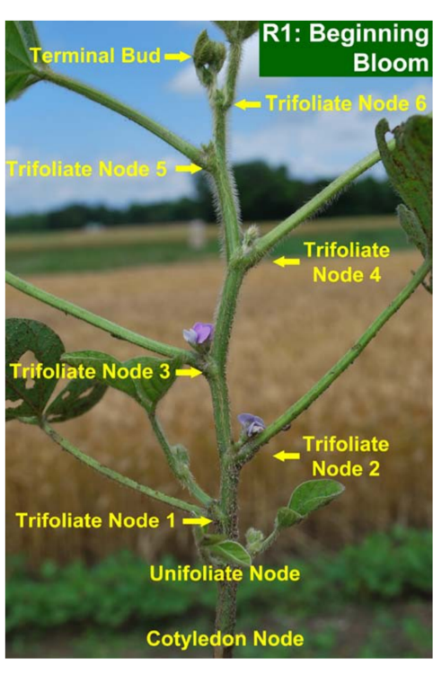
Xtend Soybeans
Xtendimax 2.9SL, Engenia 5SL, FexaPan 2.9SL
Dicamba
POST up to R1 (beginning bloom) or 45 DAP
2 apps (7 days)
Add a residual
Tavium 3.38SC
dicamba (1.12 ae) + s-metolachlor (2.26 lb)
56.5 oz/A
POST up to V4 or 45 DAP
tank-mixes
Check Xtendimax label/web-sites for tank-mixes and restrictions (nozzles, wind speed, buffers, etc.)
Engenia information
Photo: Dr. Shaun Casteel, Purdue Univ.

Slide 14

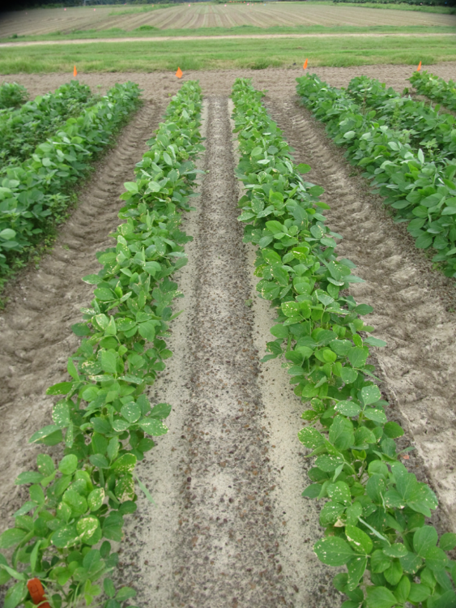
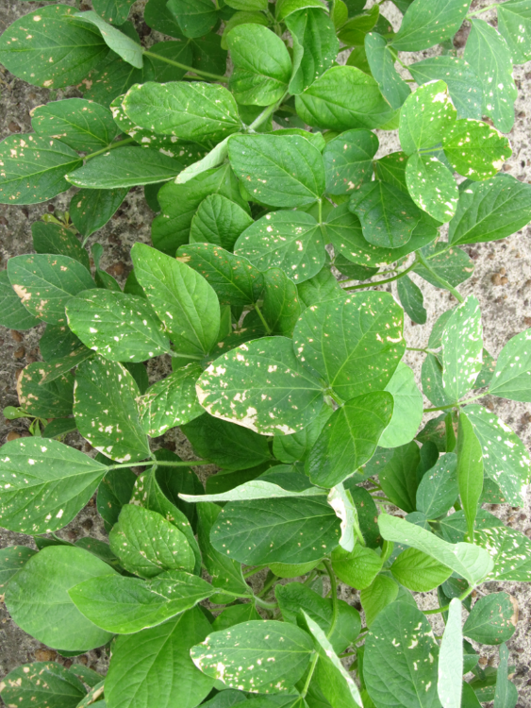
Roundup P-Max @ 28.4 oz/A + Tavium (VG) 56.5 oz + Intact @ 0.5% v/v + Class Act Ridion @ 1% v/v
SB-07-18, June 15, 2 DAT, Plot #402

Slide 15

Future Soybean Weed Control Technologies
HT3
glufosinate + glyphosate + dicamba
Xtendflex
MGI
mesotrione + glufosinate + isoxaflutole (HPPD)

Slide 16
Harvest Aids Soybeans
Herbicide | Rate/A (oz) | Adjuvant | Time of Application |  | PHI (days)
 |  |  | Determinate | Indeterminate
paraquat 2 lb gal 3 lb/gal | 16 10.7 | NIS @ 0.25% v/v | Fully mature 50% leaf drop Yellow leaves | <30% moisture or 65% of pods mature brown | 15
Sharpen 2.85SC | 1-2 | MSO @ 1% v/v | Fully mature 50% leaf drop Yellow leaves | > 65% mature brown pods and > 70% leaf drop or < 30% seed moisture | 3
*Glyphosate and Aim are also labeled (more for weed control than
crop dessiccation).

Slide 17
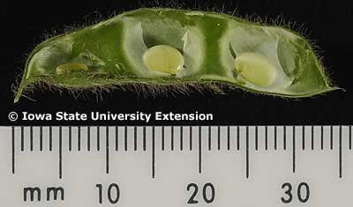
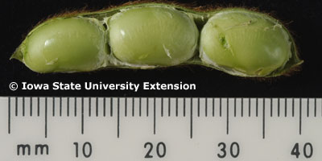
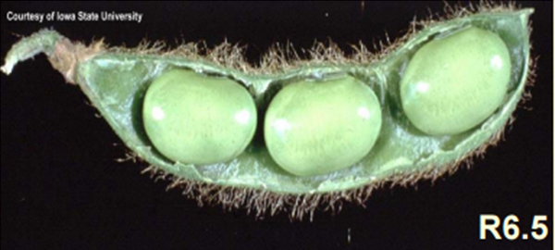
Important Soybean Stages for Harvest Aids
R5-BS
R6-FS
or later
R5-R6 = 11-20 days (15 avg.)
R6-R7 = 9-30 days (18 avg.)

Slide 18
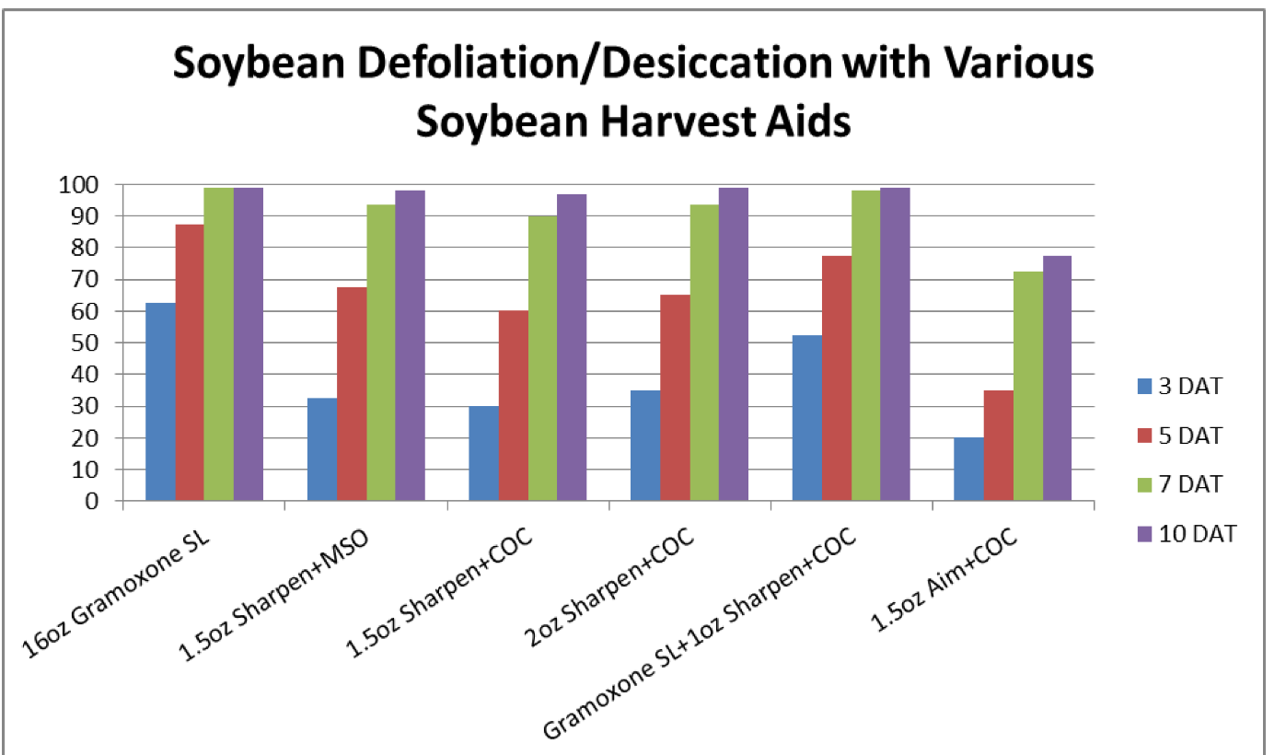
Harvest Aids
Source: Mississippi State Univ.

Slide 19
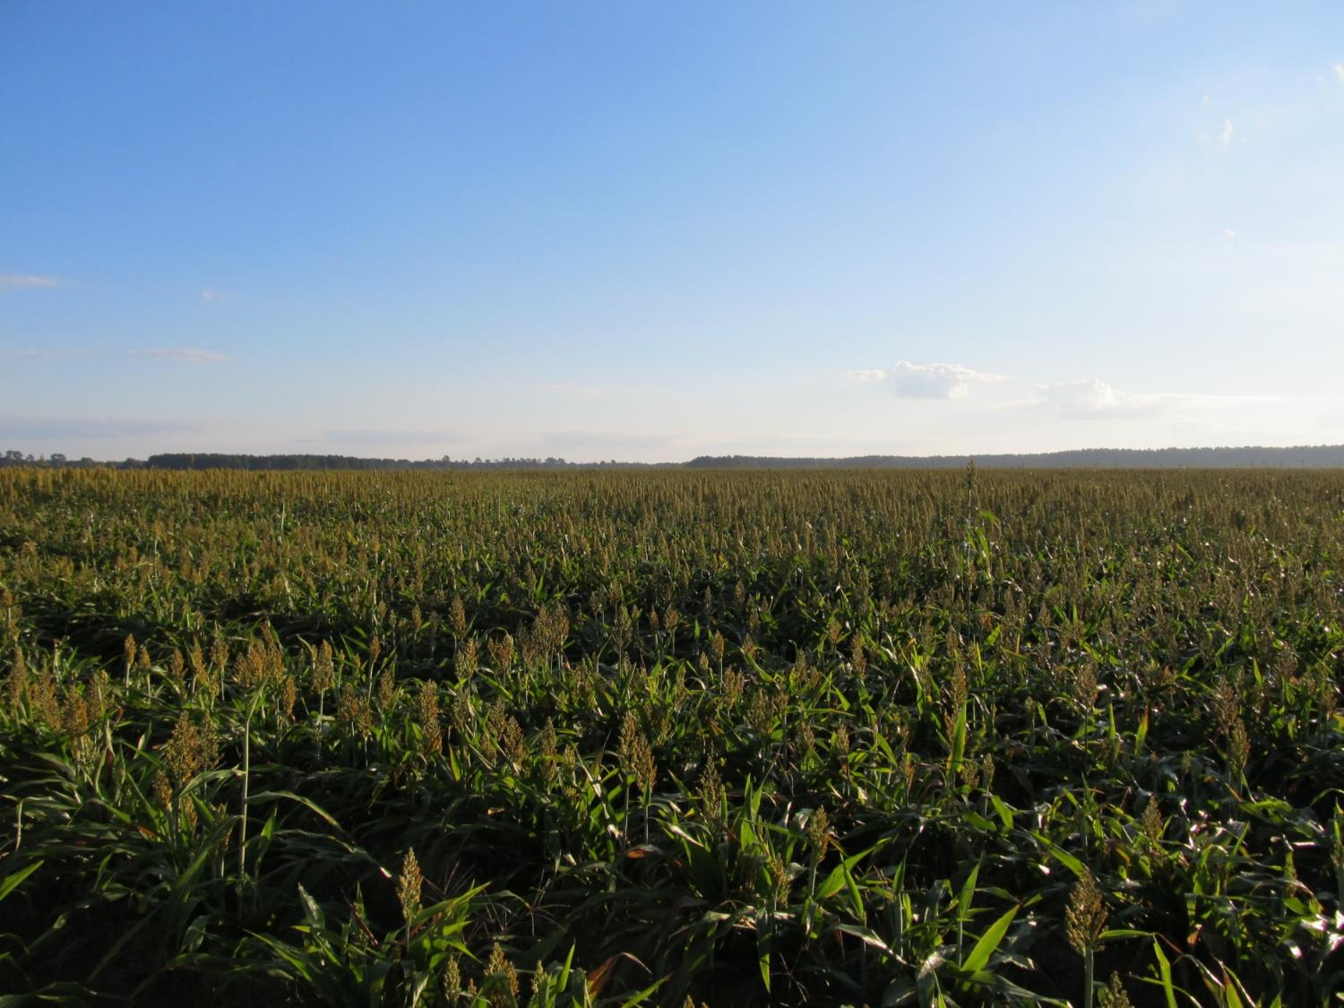

GRAIN SORGHUM WEED CONTROL UPDATE - 2020
Eric P. Prostko, Ph.D.
Professor/Extension Weed Specialist
Dept. Crop & Soil Sciences

Slide 20
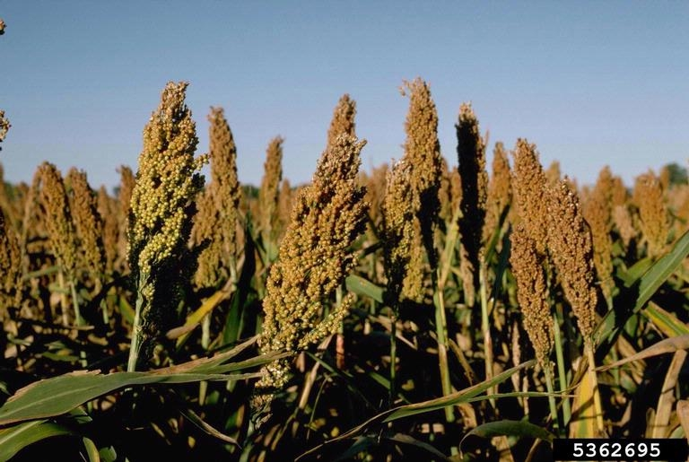
Grain Sorghum Weed Control
Start clean!
Concep treated seed
Dual Magnum or Warrant (PRE)
Atrazine 4L @ 1.5 QT/A (EPOST)
Add Huskie if you have ATZ resistance
Paraquat (Hooded sprayer)
Mechanical Cultivation

Slide 21
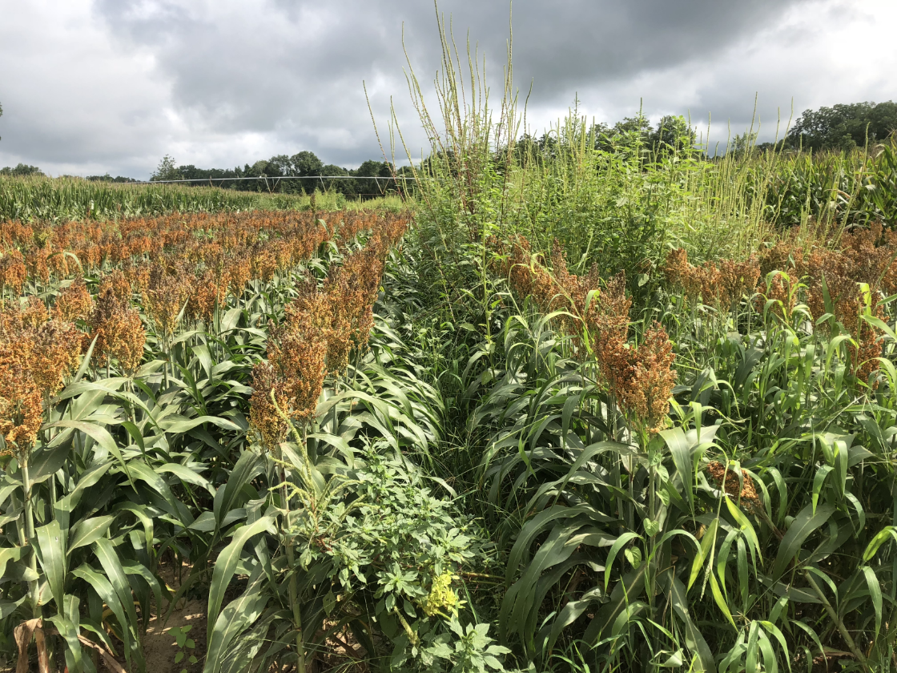
Grain Sorghum Weed Control - 2018
Dual Magnum 7.62EC
24 oz/A (PRE)
NTC
GS-01-18
July 20
86 DAP

Slide 22
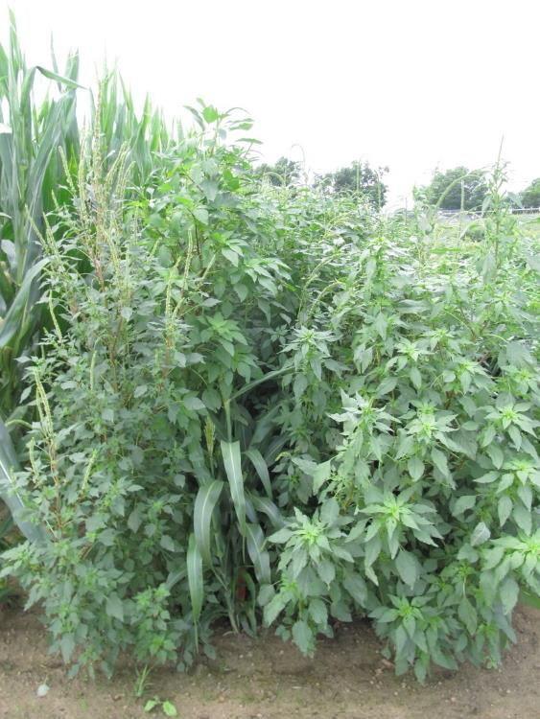
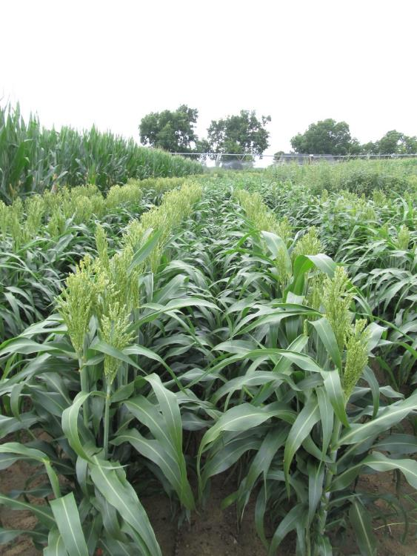
Grain Sorghum - 2017
NTC
Dual Magnum 7.62EC @ 16 oz/A (PRE)
Atrazine 4L @ 48 oz/A (30 DAP)
COC @ 1% v/v (30 DAP)
SG-02-17
June 8
59 DAP

Slide 23

A New Product to Consider?
Huskie 2.06EC
Bayer CropScience
Buctril (1.75 lbs/gal) + pyrasulfotole (0.31 lbs/gal)
MOA = 6 + 27
Postemergence (13-16 oz/A)
3-leaf to 12” tall sorghum
Broadleaf weeds, good on pigweed
Tank-mix with atrazine (16 oz/A)

Slide 24
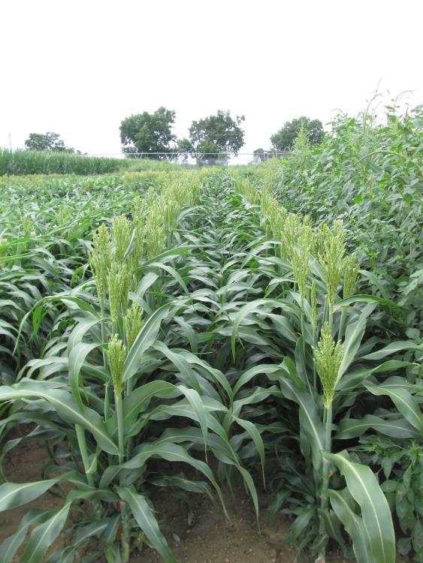

Grain Sorghum - 2017
Dual Magnum 7.62EC @ 16 oz/A (PRE)
Huskie 2.06EC @ 13 oz/A (30 DAP)
Atrazine 4L @ 16 oz/A (30 DAP)
AMS Xtra 3.4SL @ 2.5% v/v (30 DAP)
NIS @ 0.25% v/v (30 DAP)
NTC
SG-02-17
June 8
59 DAP

Slide 25
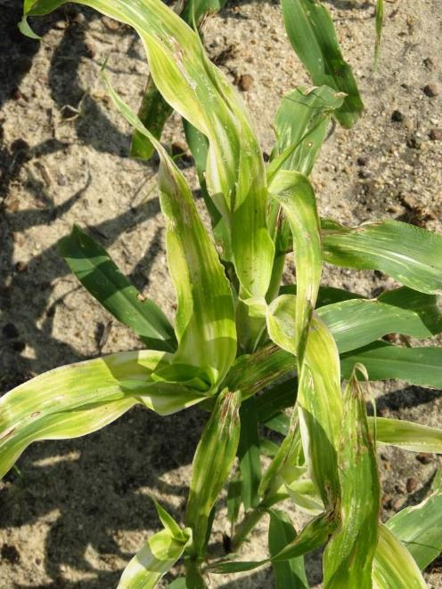
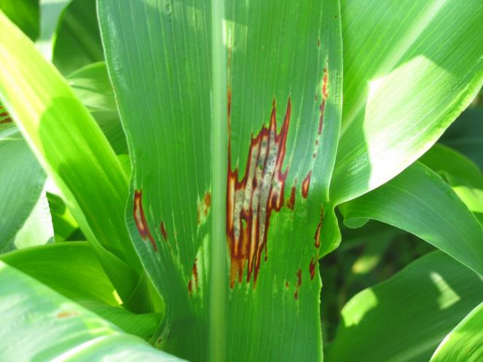

Huskie Injury on Sorghum

Slide 26
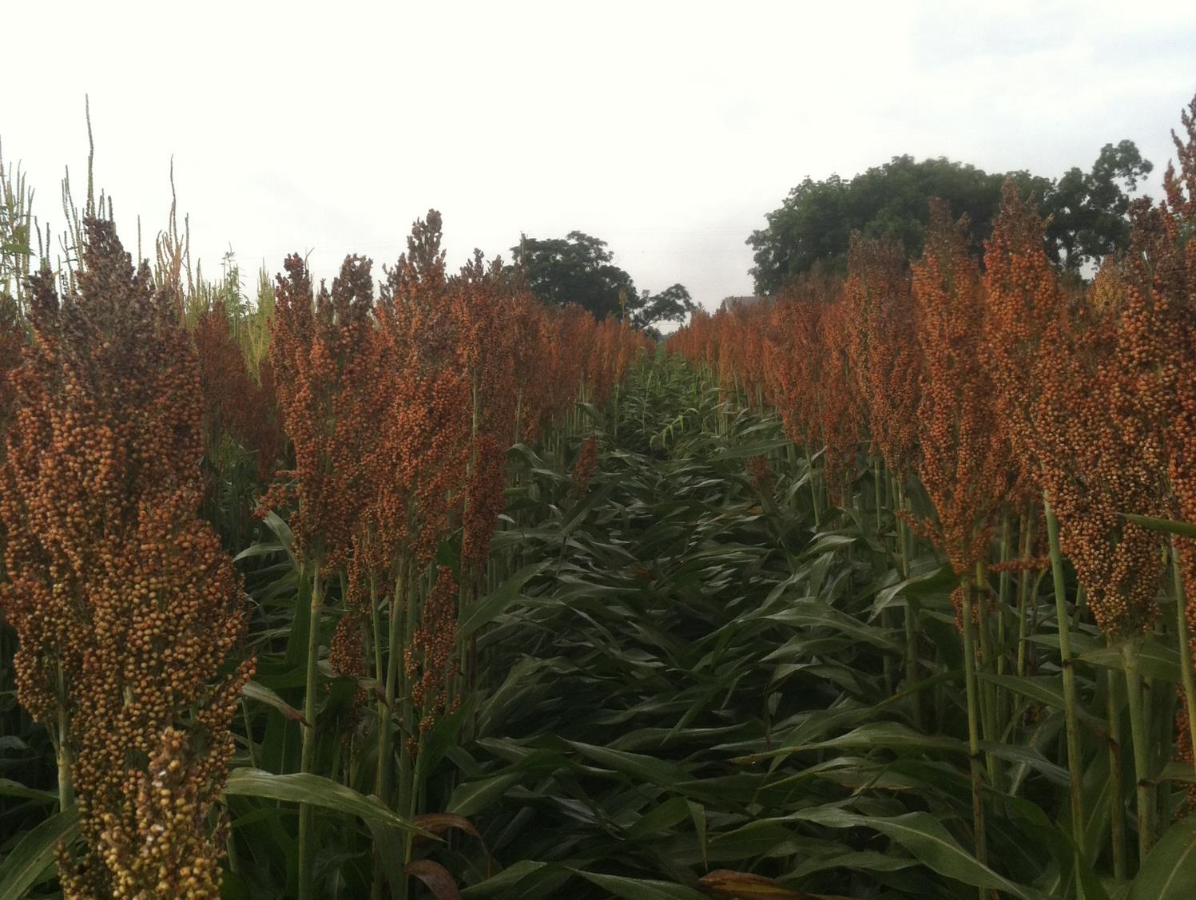

Other Sorghum Options
Sandea/Permit – nutsedge
Auxin Herbicides
2,4-D
Dicamba
Rate/Stage
Weed size
Injury
Off-target movement
Newer formulations are better (i.e. less volatile)

Slide 27
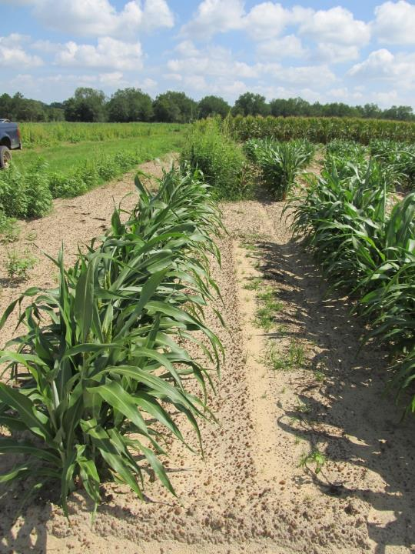
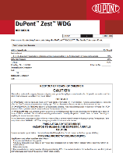
Inzen™ Z Grain Sorghum
Kansas State Univ.
DuPont/Corteva
Resistance to POST applications of ALS herbicides
Zest (nicosulfuron)
Non-GMO
Gene from wild genotype of sorghum
Varieties for GA?
Not yet
Stewardship!
Inzen™ Cultivar (left row)
Conventional Cultivar (right row - dead)
Ponder Farm 2012

Slide 28
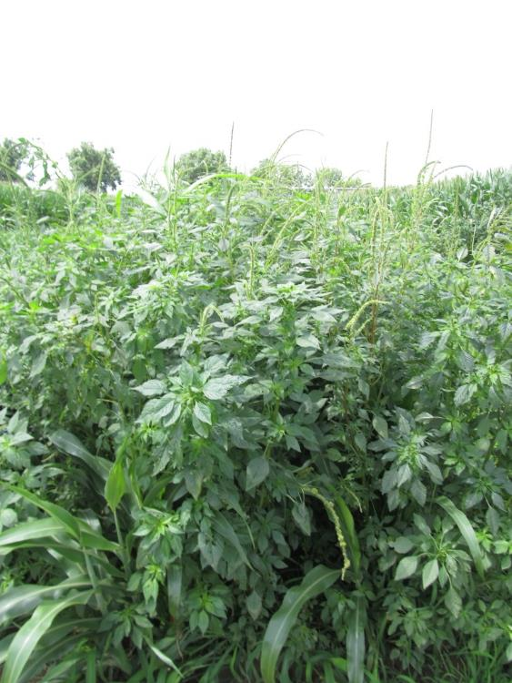
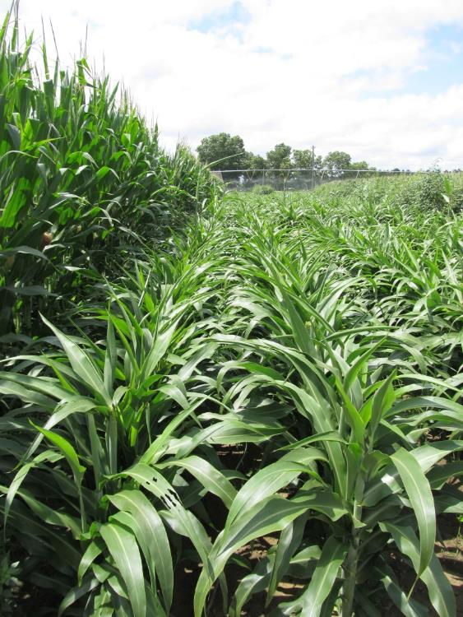
Inzen Sorghum - 2017
Cinch 7.64EC @ 16 oz/A (PRE)
Zest 75WG @ 0.67 oz/A (30 DAP)
Atrazine 4L @ 24 oz/A (30 DAP)
COC @ 1% v/v (30 DAP)
AMS Xtra 3.4SL @ 2% v/v (30 DAP)
NTC
SG-01-17
June 8
59 DAP

Slide 29
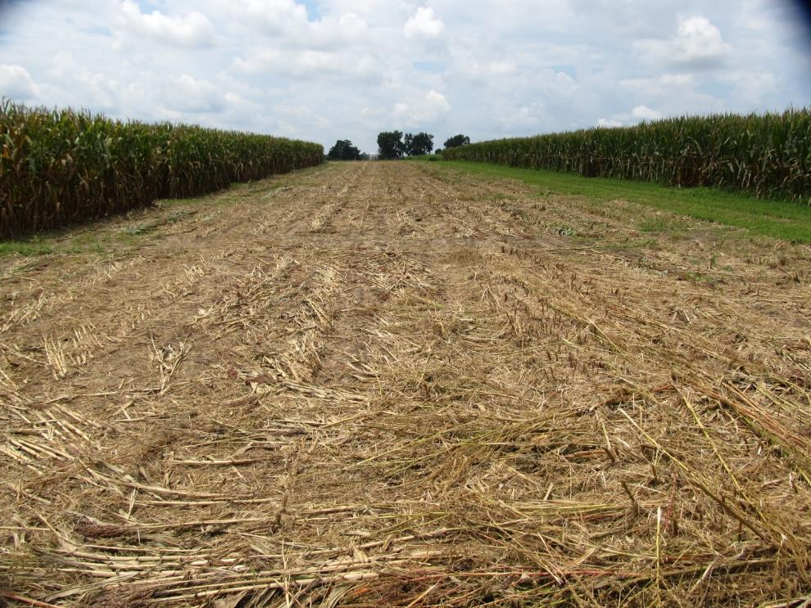
Ratoon Grain Sorghum Demo – 2018 July 27 – 1 DAT
Gramoxone @ 3 pts/A + Dual Magnum @ 16 oz/A
(Applied 2 days after mowing stalks to ~4’-8” tall)

Slide 30
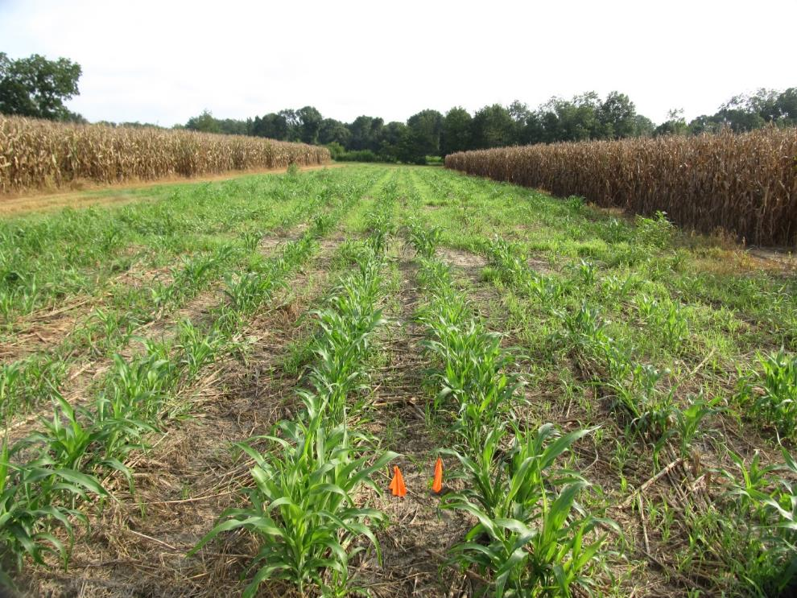
Ratoon Grain Sorghum Demo – 2018 August 14 - 19 DAT

Slide 31
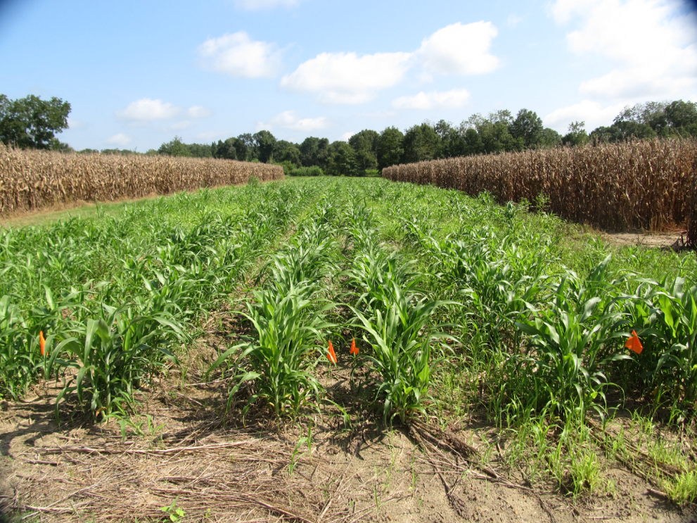
Ratoon Grain Sorghum Demo – 2018 August 22 - 27 DAT

Slide 32
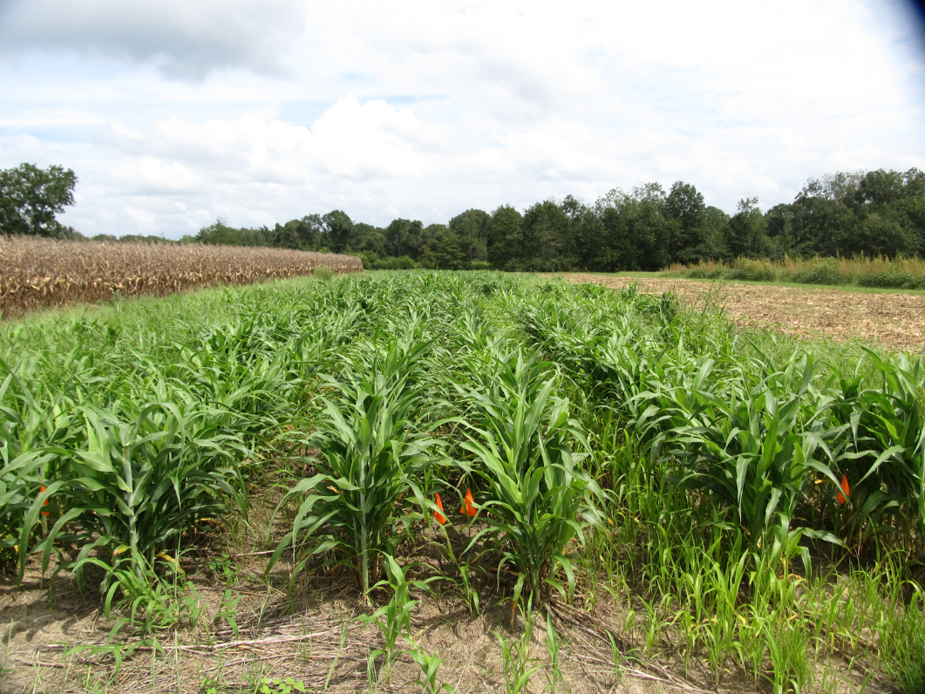
Ratoon Grain Sorghum Demo – 2018 September 4 - 40 DAT

Slide 33
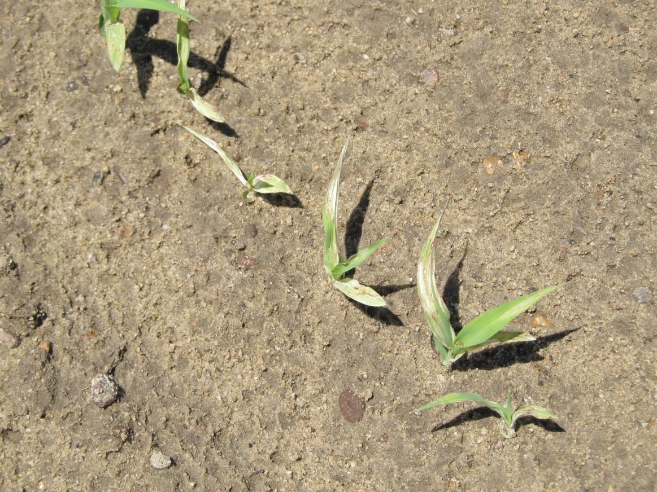
Grain Sorghum After Reflex? (10 month rotation restriction)
**Average ½-life in south GA soils was 80 to 128 days (~100 days) Potter et al. 2016. J. Agric. Food Chem. 64:5156-5163

Slide 34
Reflex Concentrations in Soil After PRE Applications Under Assorted Mulches
*Myakka sand (1% OM, 6.8 pH; 95% sand, 4% silt, 1% clay); Reflex concentration at application was 139-176 µg/kg
Source: Reed et al. 2017. Weed Science (FL)

Slide 35
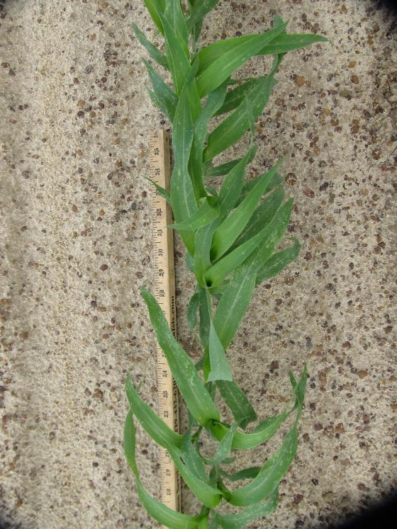
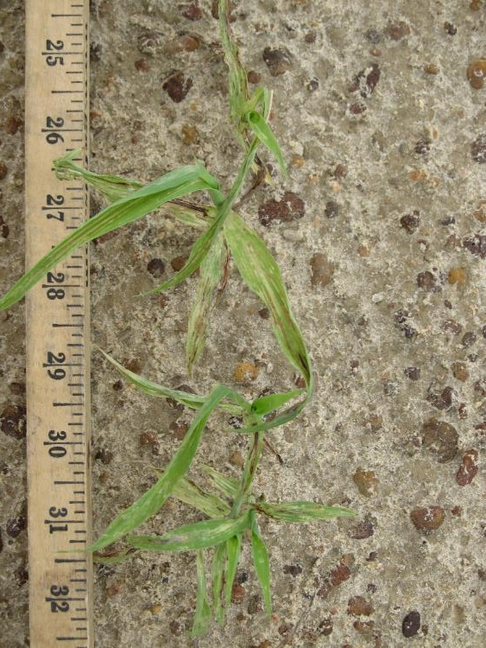
Reflex 2SL @ 12 oz/A Carryover Injury on Grain Sorghum - 2019 (Applied to Bare-Ground)
GS-01-19
July 23
14 DAP
Rep 4
NTC
Reflex 2SL @ 12 oz/A
Applied 90 DBP

Slide 36
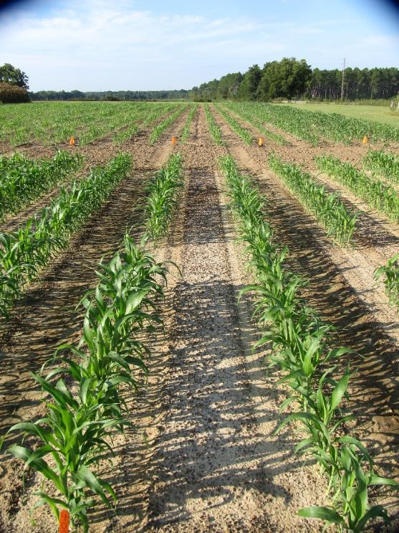
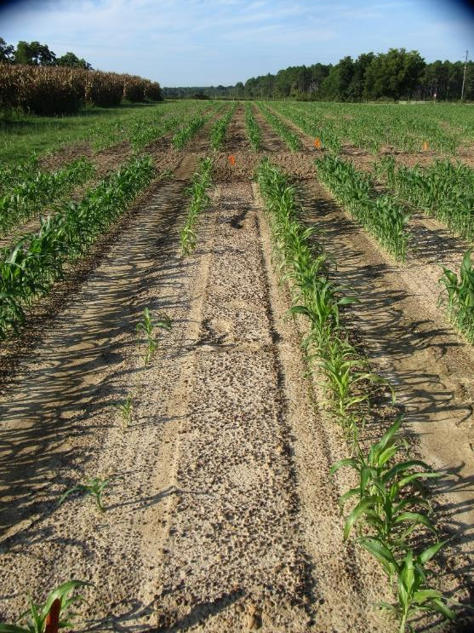
Reflex 2SL @ 12 oz/A Carryover Injury on Grain Sorghum - 2019 (Applied to Bare-Ground)
GS-01-19
August 1
23 DAP
Rep 4
NTC
Reflex 2SL @ 12 oz/A
Applied 90 DBP

Slide 37
Grain Sorghum Fresh Weight - 14 DAP - Following Herbicides Applied to Bare-Ground - 90 DBP
grams/3 row feet
Treatment
GS-01-19
July 23
LSD (0.10) = 12.8
CV = 28.71

Slide 38
Grain Sorghum Yield Following Herbicides Applied to Bare-Ground - 90 DBP
Bu/A
Treatment
GS-01-19
October 28
LSD (0.10) = 8.9
CV = 10.52

Slide 39
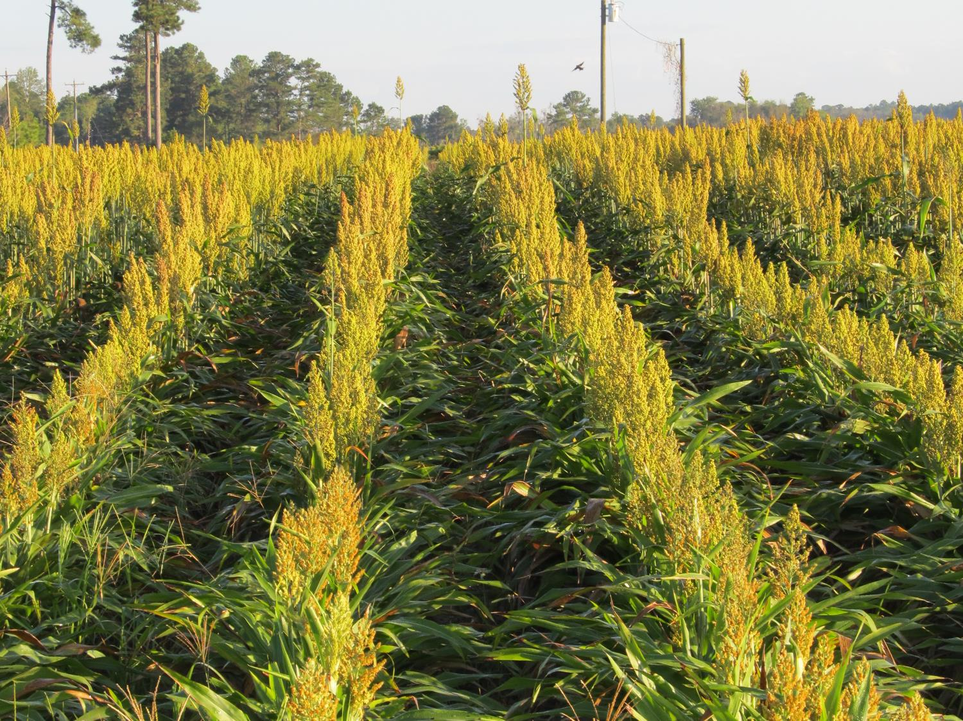
Questions/Comments?
eprostko@uga.edu
gaweed.com

