Slide 1

2019 Soybean Weed Control Update
Eric P. Prostko
Professor and Extension Weed Specialist
Dept. Crop & Soil Sciences

Slide 2
Soybean/Cotton in Georgia Planted Acres (X 1000) 1980-2018
BWEP
Source: NASS

Slide 3
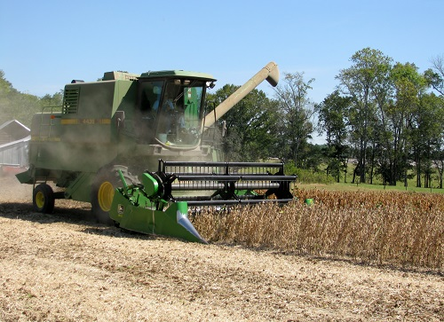
Soybean Weed Control
Start clean, use residuals, timely POST
Narrow rows (<30”)
Systems
Conventional
RR (glyphosate)
LL (glufosinate)
Xtend (dicamba)
Enlist (2,4-D choline)

Slide 4









2018 Georgia Soybean Varieties
Company | Varieties
AgriGold | ?
AG South Genetics | 747LL, 677LL, 738RR, 700R2X
Asgrow | 69X6, 72X7, 7535, 75X6
Bayer/BASF/Credenz | 7007LL, 7008LL, 6515LL
Meherrin | SH7418LL
Pioneer | 95Y70, P76T54R2, P72A21X
T.A. Seeds | 8059R2
Terral | ?
UniSouth Genetics | ?

Slide 5
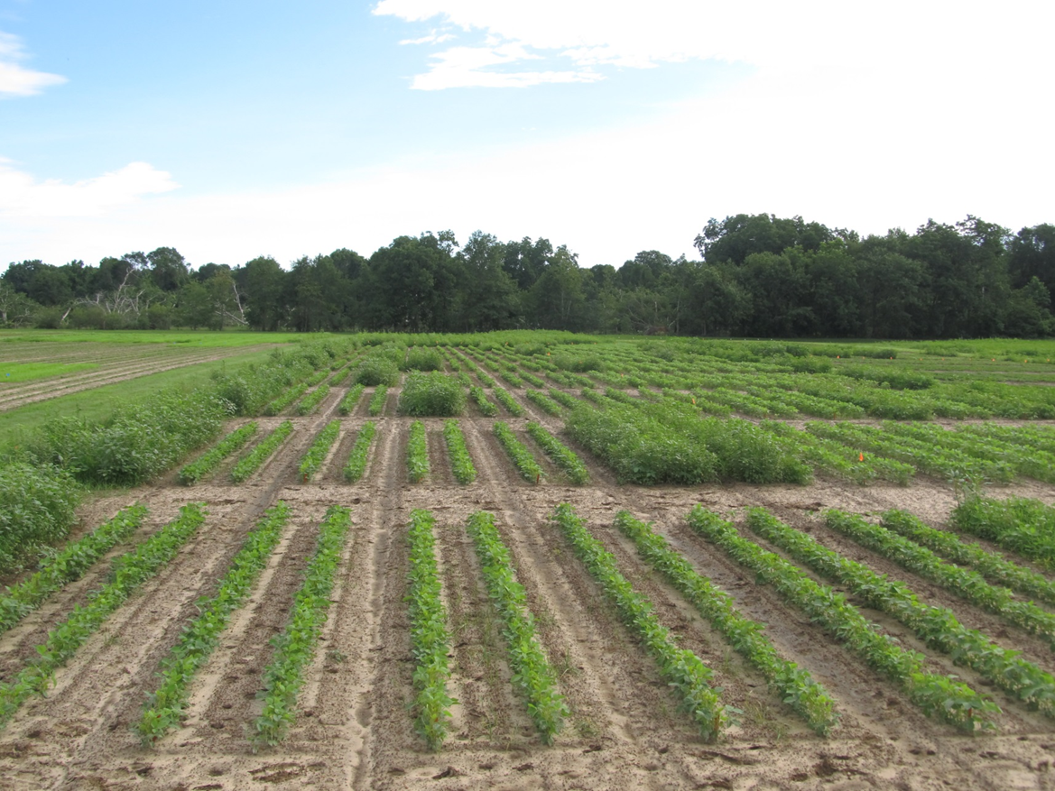
Started Clean + Activated Residual + Timely POST = HOMERUN!
SB-01-17
June 16
38 DAP

Slide 6


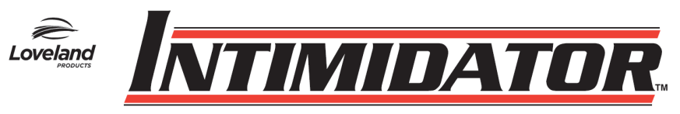
Old + Cheap + Still Good (i.e. metribuzin)
Not a PPO (Valor or Reflex)
Good on pigweed and sicklepod
Can be applied PPI
Dryland fields?
Issues (Be careful!!)
soil texture, OM, pH
Varieties
Rotations
Company support
Lack of incentive at dealer level
TriCor 75DF
Metribuzin 75DF

Slide 7
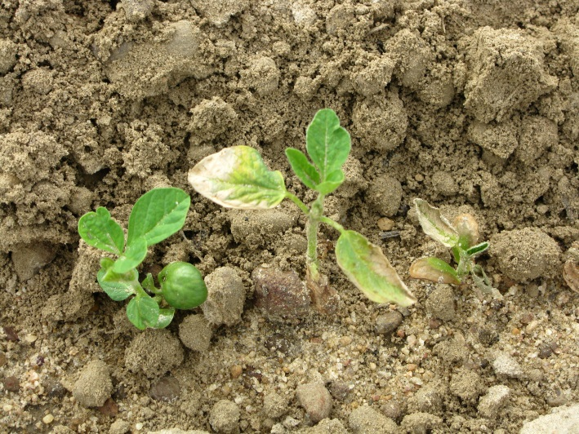
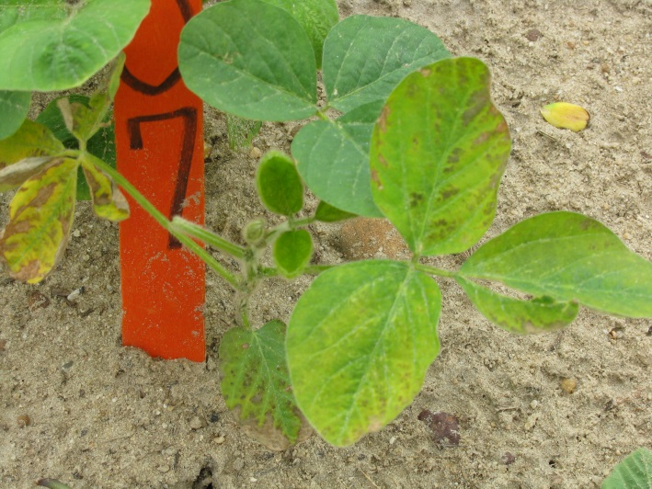
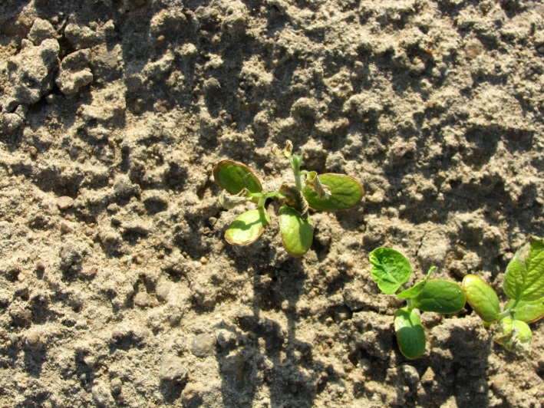
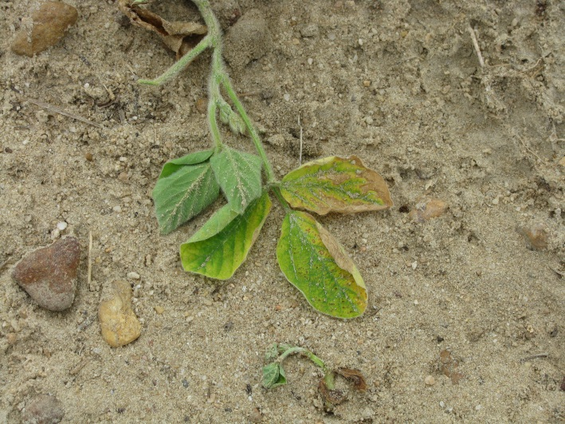
Metribuzin Injury

Slide 8
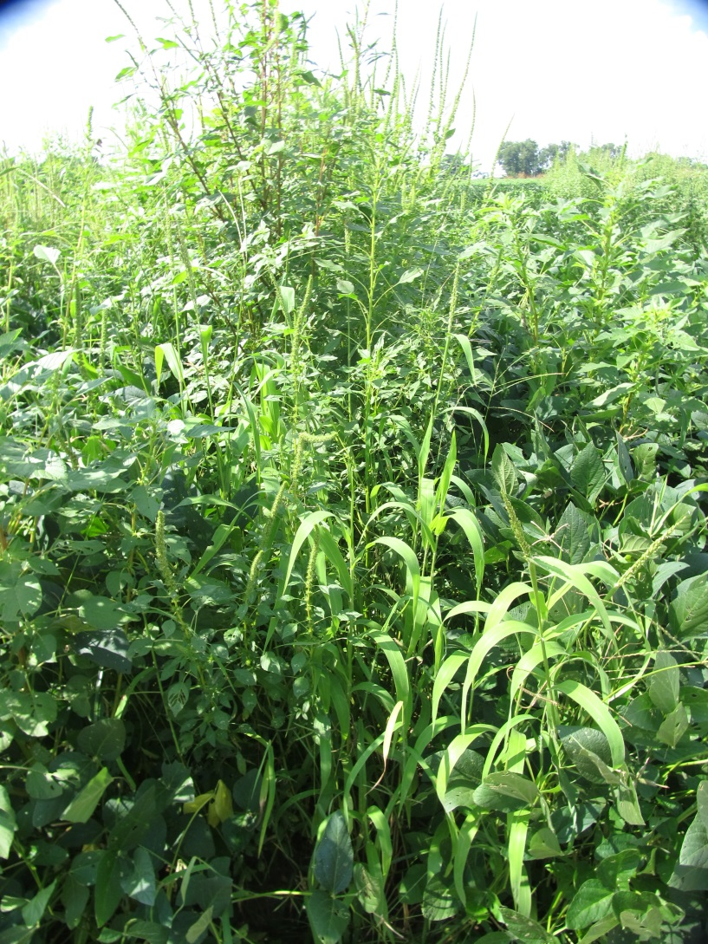
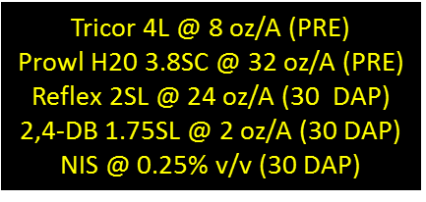
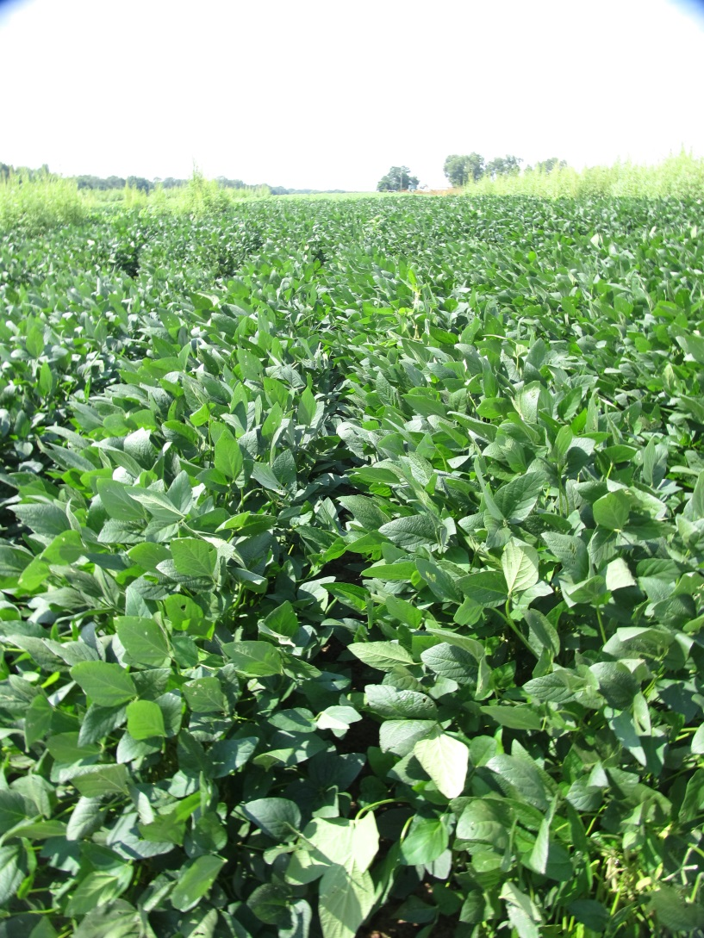
Soybean Weed Control – 2018 (Conventional System)
SB-07-18
July 26
73 DAP
NTC

Slide 9
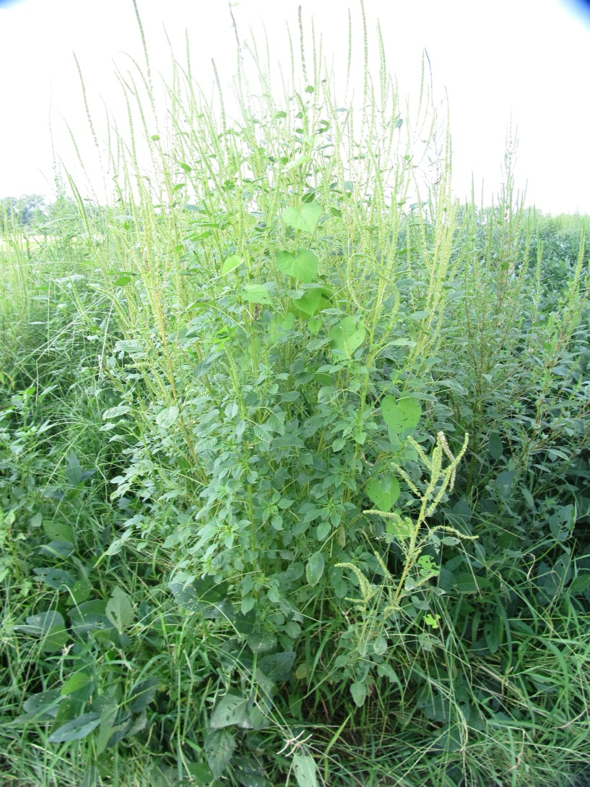
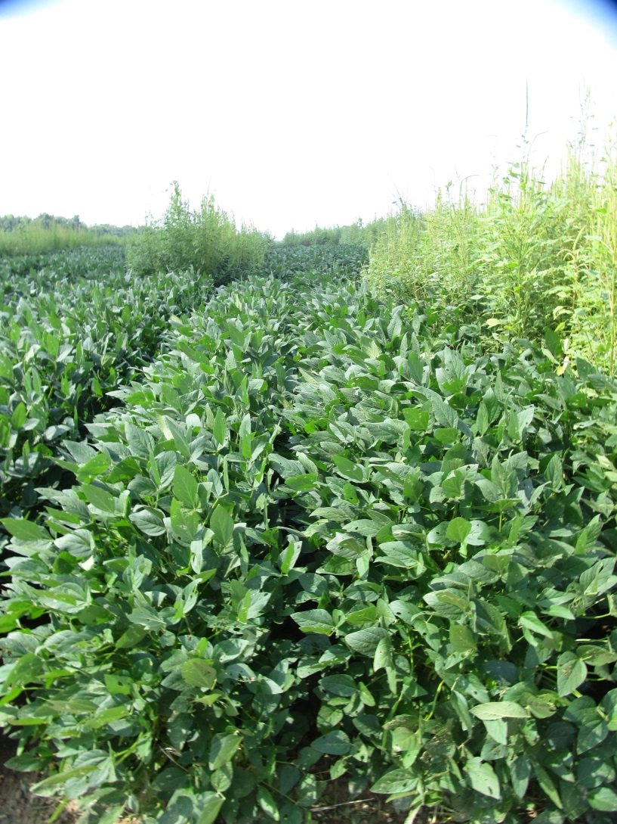
Soybean Weed Control – 2018 RR System
Metribuzin 75DG @ 5.3 oz/A (PRE)
Roundup Powermax 5.5SL @ 32 oz/A (31 DAP)
Reflex 2SL @ 24 oz/A (31 DAP)
SB-06-18
July 26
73 DAP
NTC

Slide 10


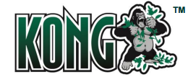


Liberty-Link® Soybeans
Liberty 2.34SL @ 32-43 oz/A or generics
VE-R1
2 applications (5 days apart)
(87 oz/A/year total)
Tank-mixes with POST grass herbicides may reduce grass control
Assure (10-21%); Fusilade (8-12%); Poast (25-41%); Select (4-22%)
Residuals still needed
15 GPA, medium-coarse droplet size, small weeds, 9 am - 6 pm

Slide 11
Spray Tip Classification by Droplet Size - Liberty
Category | Symbol | Color Code | Approximate VMD² (Microns)
Extremely Fine | XF | PURPLE | < 60
Very Fine | VF | RED | 61-105
Fine | F | ORANGE | 106-235
Medium | M | YELLOW | 236-340
Coarse | C | BLUE | 341-403
Very Coarse | VC | GREEN | 404-502
Extremely Coarse | XC | WHITE | 503-665
Ultra Coarse | UC | BLACK | >665
¹Estimated from sample reference graph in ASBAE/ANSI/ASAE Standard S572.1
²VMD = Volume median diameter

Slide 12
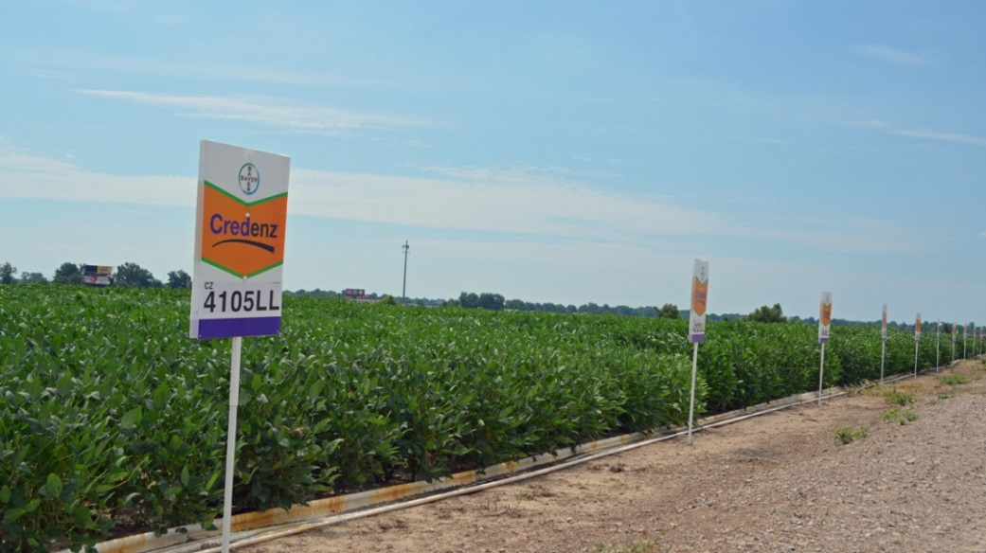
Liberty-Link Soybean Varieties
Getting better and better!
G13LL-7 and G13LL-44 developed by UGA Soybean Breeding Team
Group VII’s
AGS 747LL (G13LL-7)
AGSouth
Southern Harvest 7418LL (G13LL-44)
Meherrin
Others

Slide 13
Statewide Average Yield of UGA Developed LL Soybeans*
*Source: UGA OVT (6 locations/year, irrigated)

Slide 14
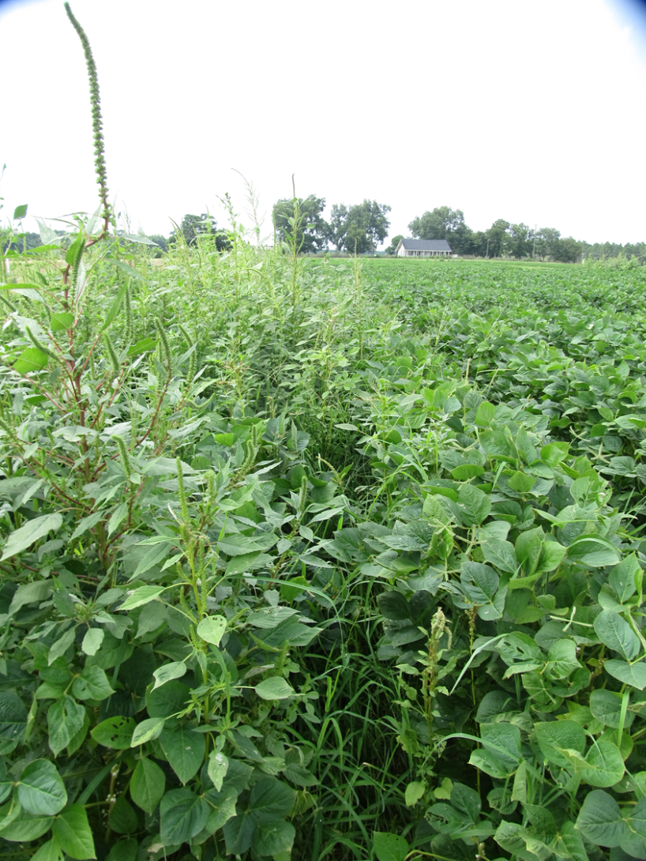
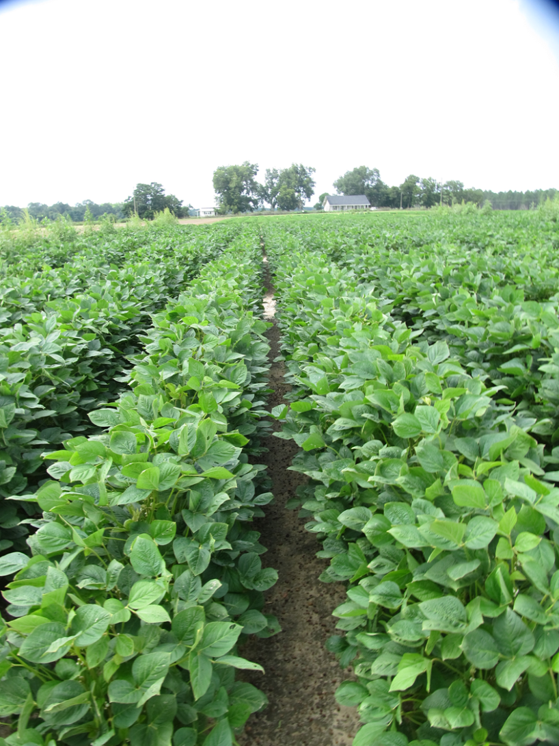
Soybean Weed Control – 2018 Liberty System
Surveil 48WG @ 2.8 oz/A (PRE)
Liberty 2.34SL @ 29 oz/A (23DAP)
Everprex 7.62EC @ 16 oz/A (23 DAP)
SB-05-18
July 30
54 DAP
NTC

Slide 15











2,4-D/Dicamba Technologies
2,4-D choline
dicamba

Slide 16
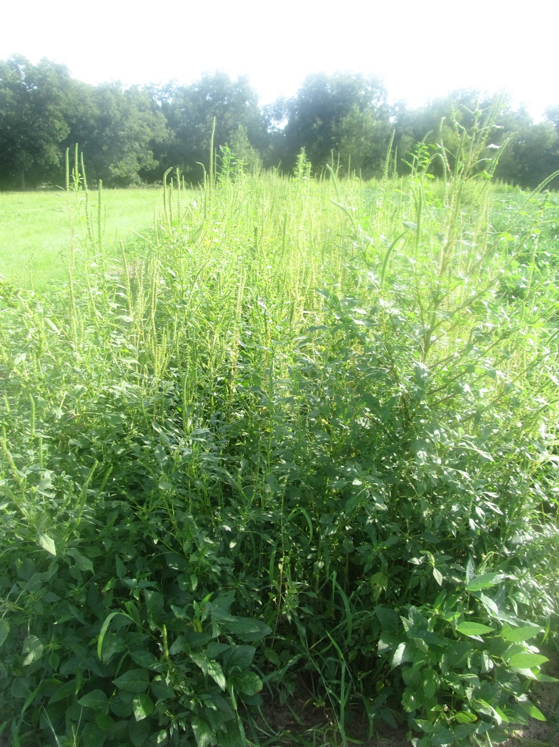
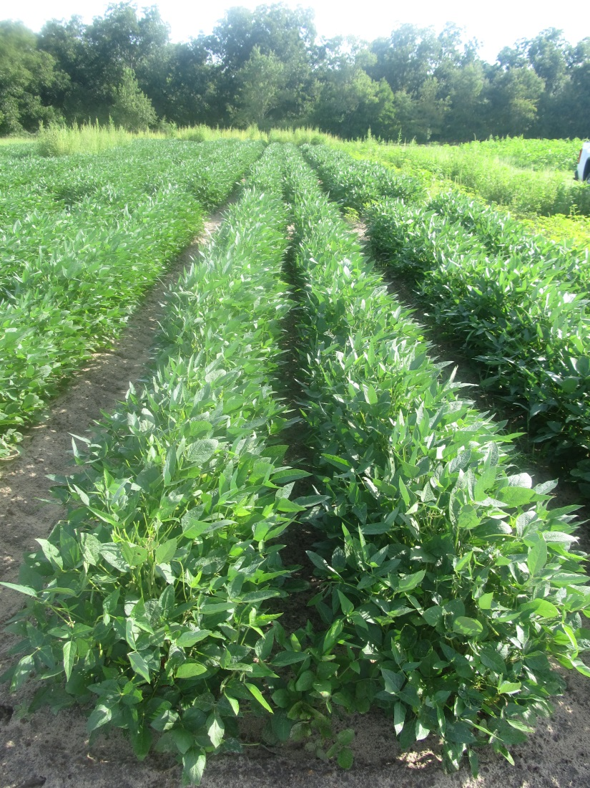
Enlist Soybeans (2016)
NTC
Surveil 48WG @ 2.83 oz/A (PRE)
Enlist Duo 3.33SL @ 75 oz/A (34 DAP)
Dual II Magnum 7.64EC @ 16 oz/A (34 DAP)
AMS @ 2.5% v/v (34 DAP)
SB-13-16
July 22
72 DAP

Slide 17
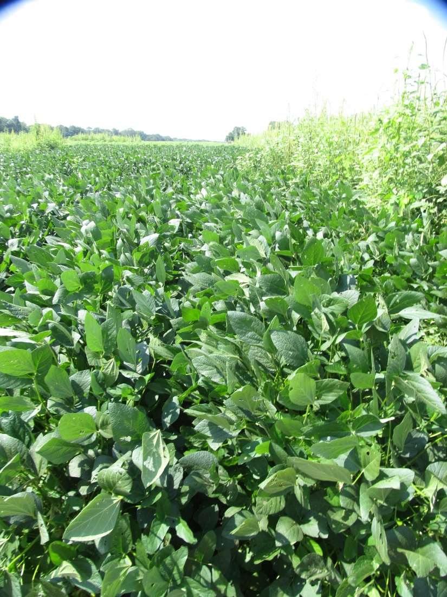
Soybean Weed Control – 2018 Xtend System
Tricor 4L @ 8 oz/A - PRE
Roundup PowerMax 5.5SL @ 32 oz/A – 30 DAP
Xtendimax + VG 2.9SL @ 22 oz/A – 30 DAP
Warrant 3ME @ 48 oz/A – 30 DAP
Intact @ 0.5% v/v – 30 DAP
SB-07-18
July 26
73 DAP
NTC

Slide 18
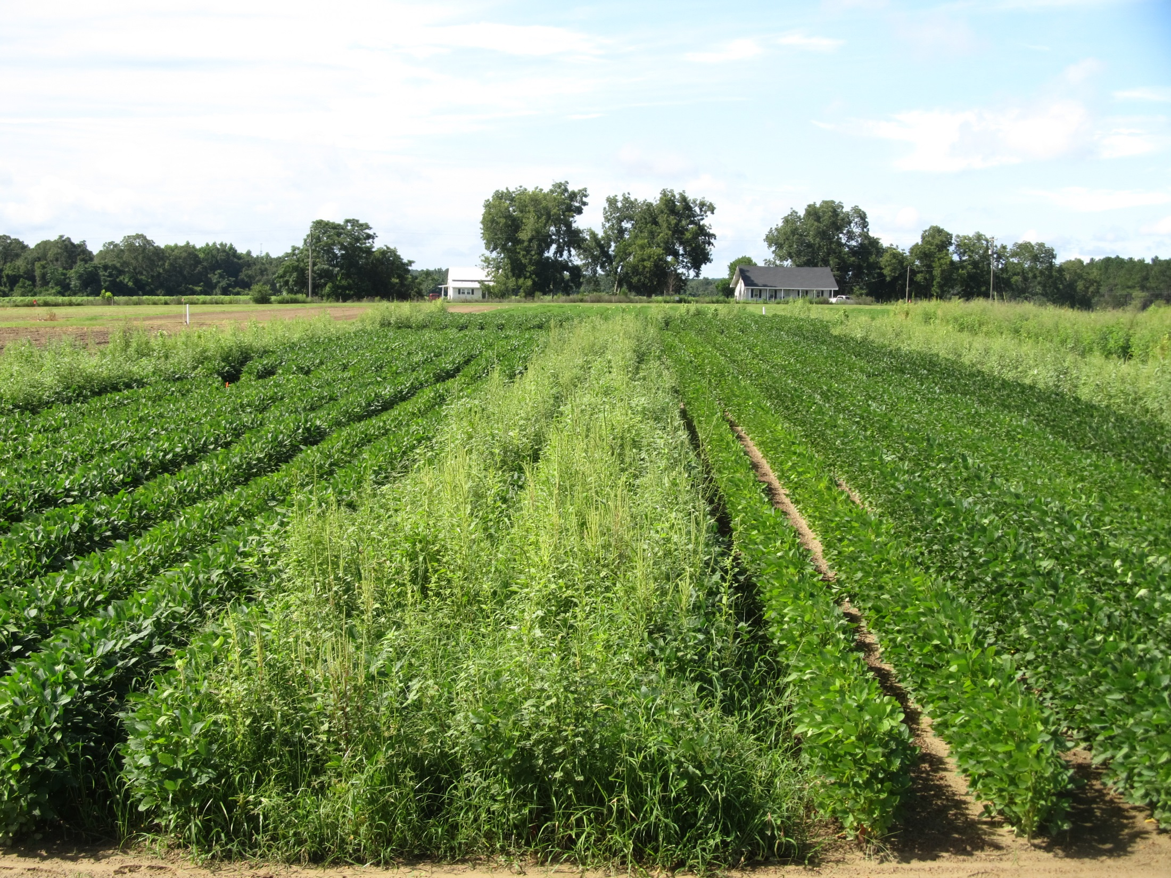


Soybean Weed Control - 2018
SB-01-18
August 3
SB-01-18
July 20

Slide 19
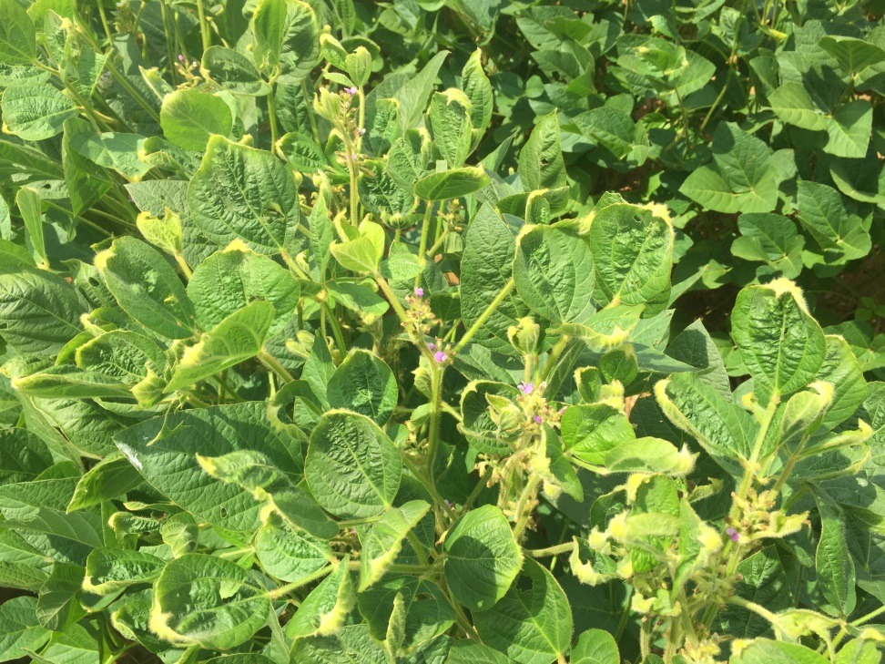
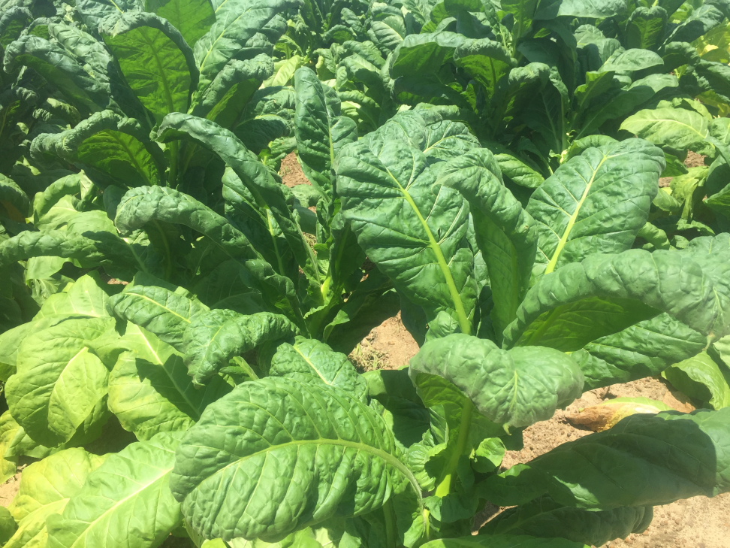
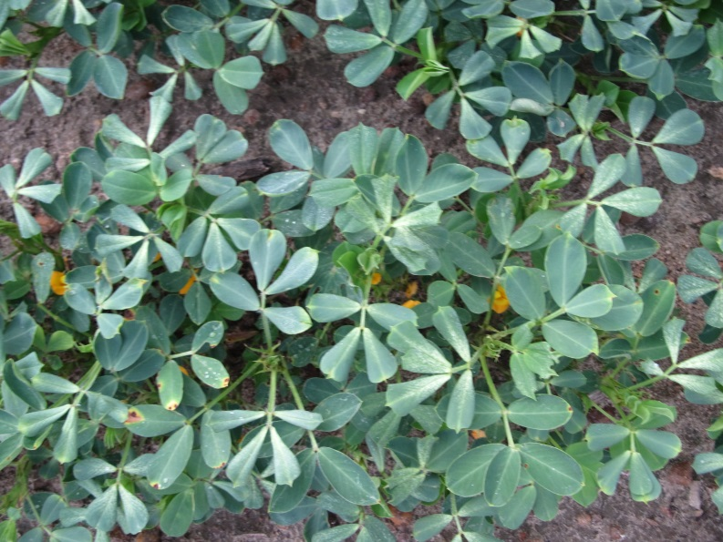
Off-Target Dicamba Problems

Slide 20
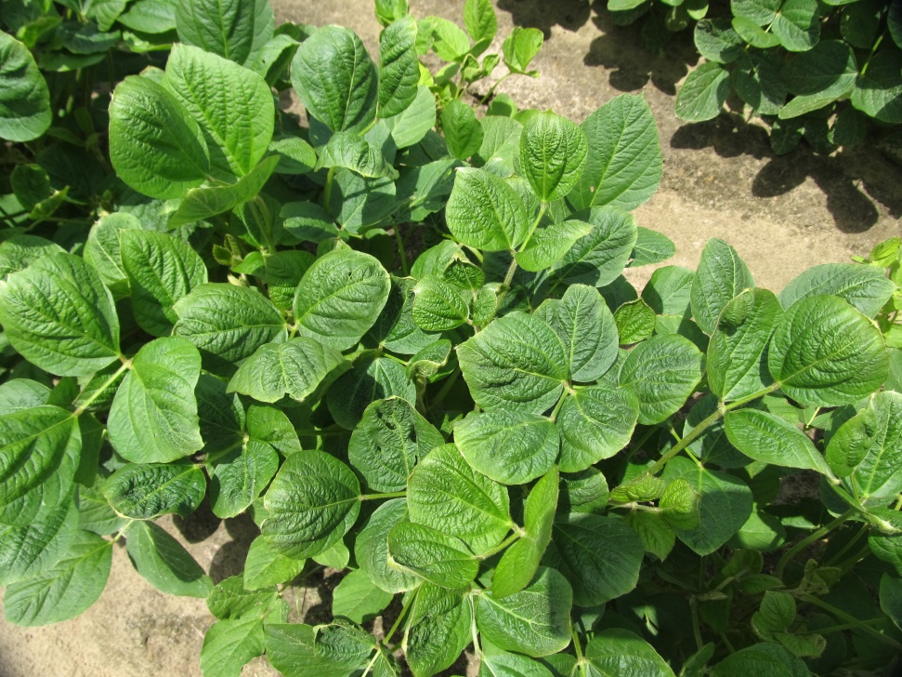
Dicamba Perspective – 2018
Only 4 “official” complaints to GA Dept. of Ag and no dicamba residues were detected (1-blueberry, 1-soybean, 2-non-DT cotton).
I am personally aware of 24 “incidents” that were handled between 2 parties involved (1-tobacco, 8-soybean, 9-peanut, 4-cotton, 1-crepe myrtle, 1-apple). More than last year for me.
Got to keep working on this!

Slide 21
Important Dicamba Label Updates for 2019 - Soybean
Xtendimax, Fexapan, Engenia formulations
Only certified applicators can purchase and apply
Records generated within 72 hours of application and kept for 2 years
Minimum of 15 GPA
POST applications no later than R1 or 45 DAP
Only 2 POST applications can be made (7 days apart)
Sensitive crops must be surveyed and documented
Sensitive crop/residential areas downwind – DO NOT APPLY
Applications between 1 hour after sunrise to 2 hours before sunset
110’ downwind buffer + 57’ omni-direction buffer around other sides of field in counties where endangered dicot species exist
Additional clean-out instructions/warnings
Spray mixture pH > 5.0

Slide 22
Endangered Species Information
Protecting Endangered Species from Pesticides
https://www.epa.gov/endangered-species
Bulletins Live! Two
https://www.epa.gov/endangered-species/bulletins-live-two-view-bulletins
U.S. Fish & Wildlife Service
https://www.fws.gov/endangered/

Slide 24
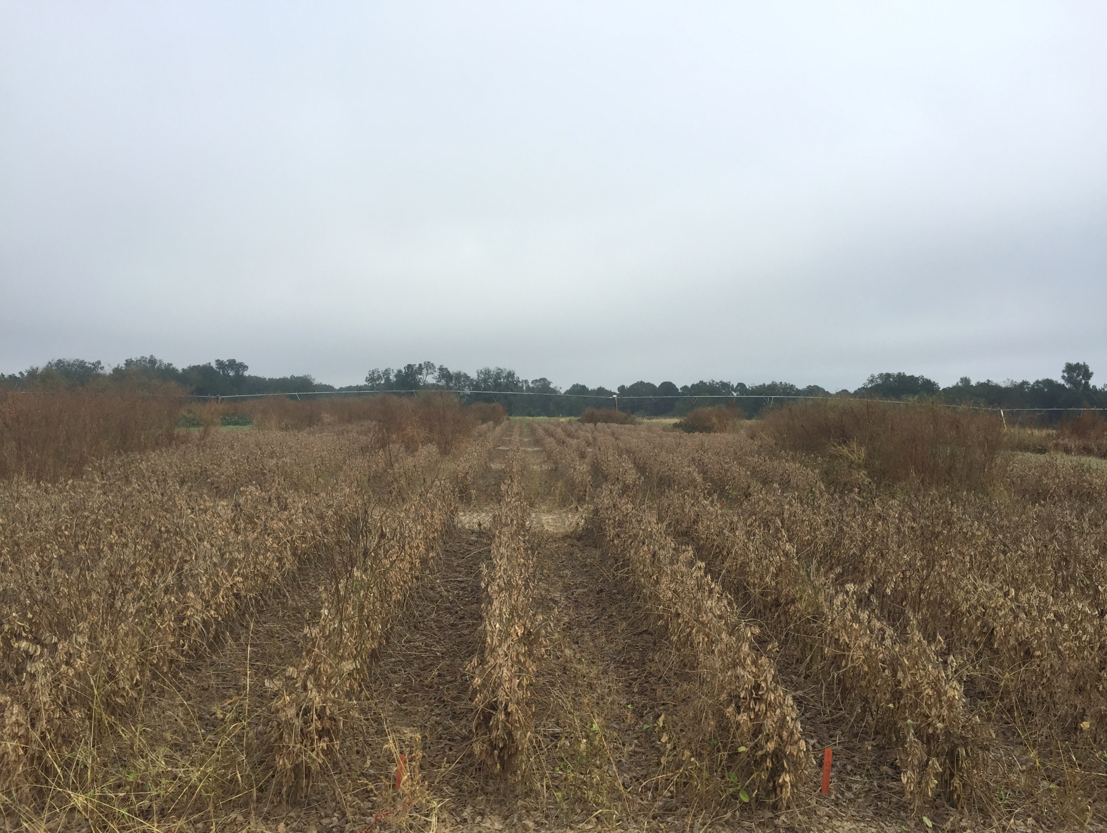

QUESTIONS?

