Slide 1
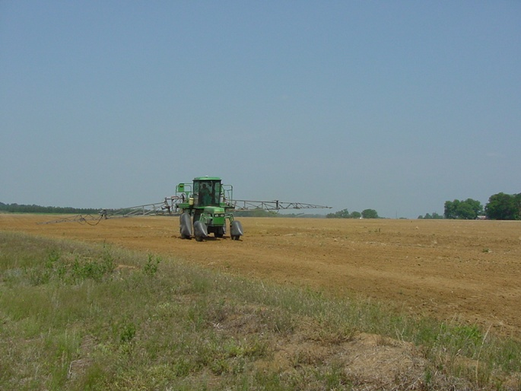

Weed Management Update Peanut, Field Corn, Soybean, Grain Sorghum, Canola (?)
Eric P. Prostko, Ph.D.
Professor and Extension Weed Specialist
Dept. Crop & Soil Sciences

Slide 2
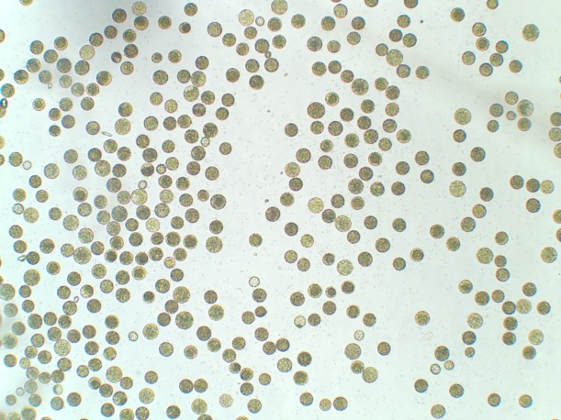
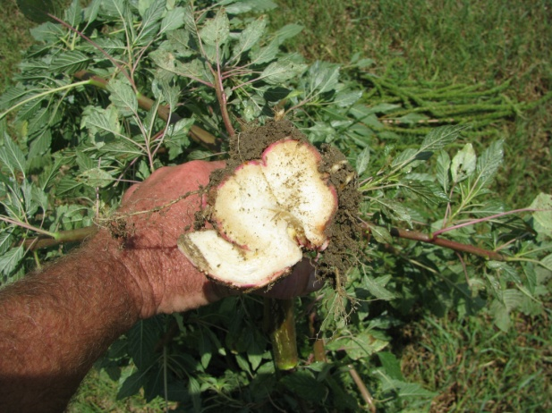
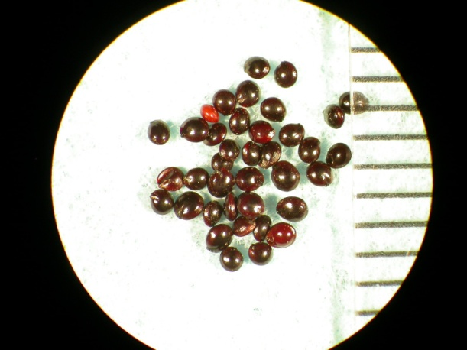
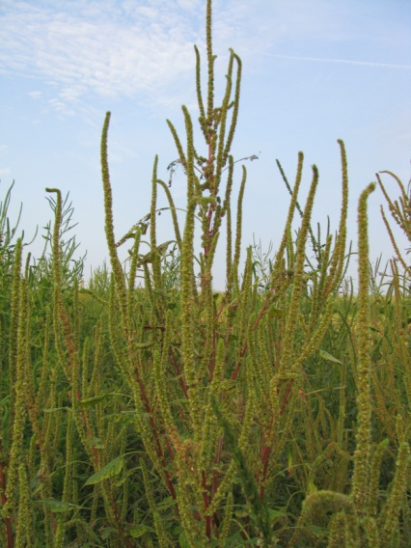
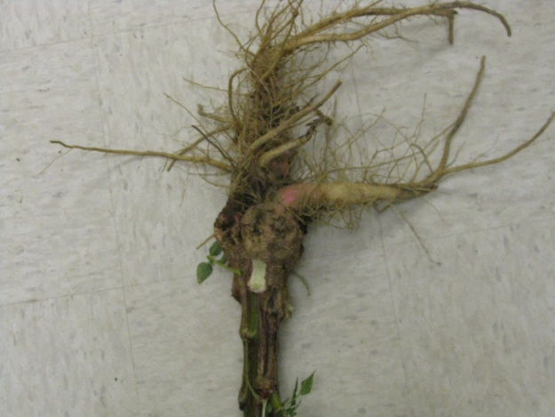
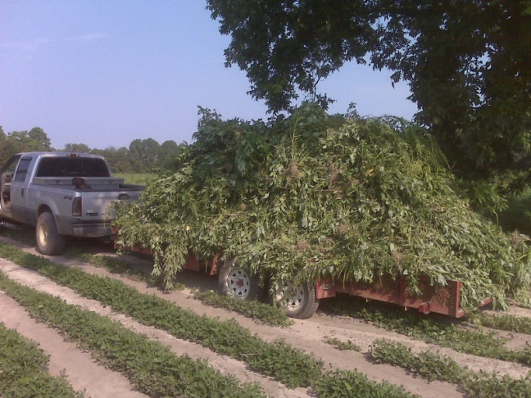
Current Weed Control Programs in GA Are Focused on 1 Weed!

Slide 3
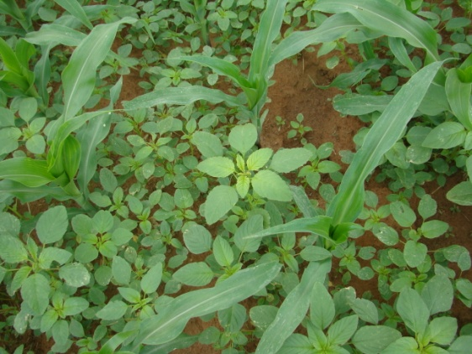
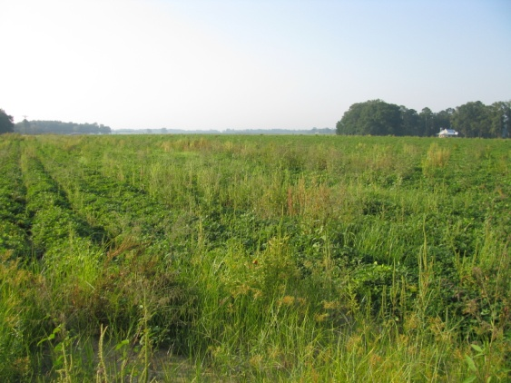
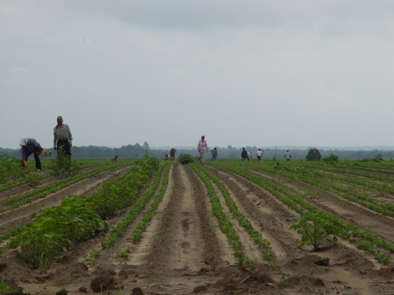

Herbicide-Resistant Palmer Amaranth in GA
ALS (2000)
Glyphosate (2005)
Atrazine (2009)
ALS + GLY (2009)
DNA + ALS + GLY (2010)
ALS + GLY + ATZ (2011)

Slide 4
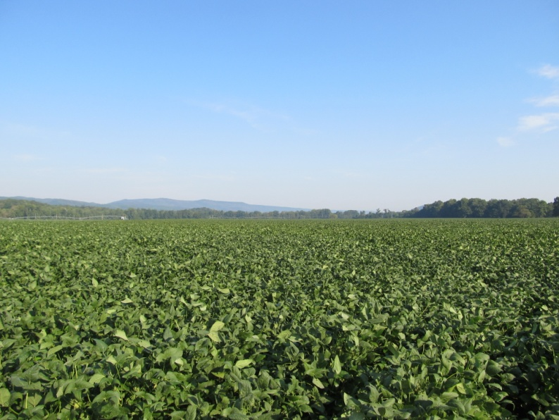
Pigweed Control is not impossible!!!!
Common Reasons for Failure:
1) did not start clean
2) did not use a residual
3) residual did not get activated
4) POST applications are too late
5) short arms and deep pockets

Slide 5
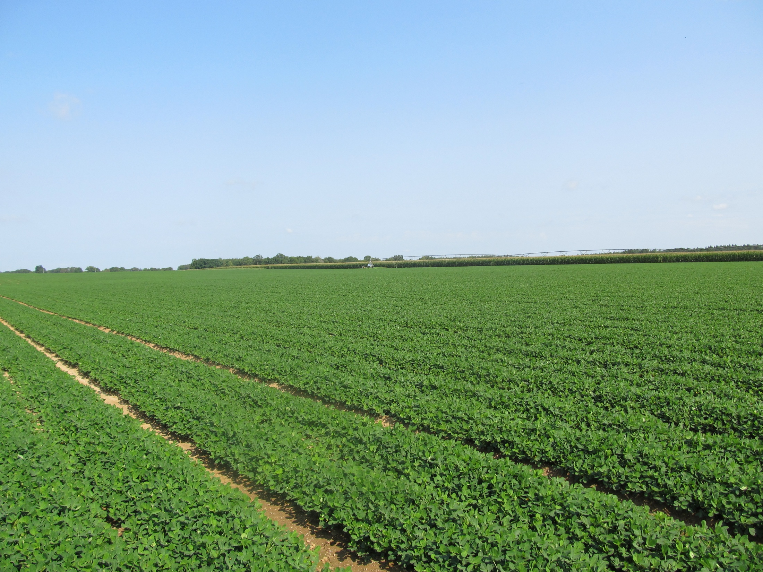
What one man can do, so can another!
Sumter County - June 28, 2011
(Prowl + Valor fb Cadre)

Slide 6
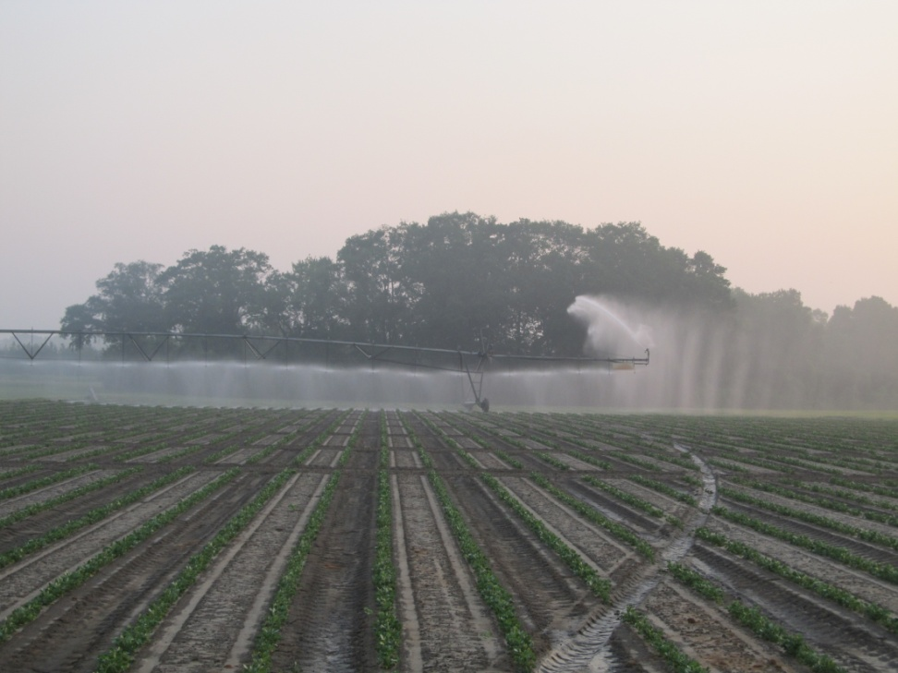
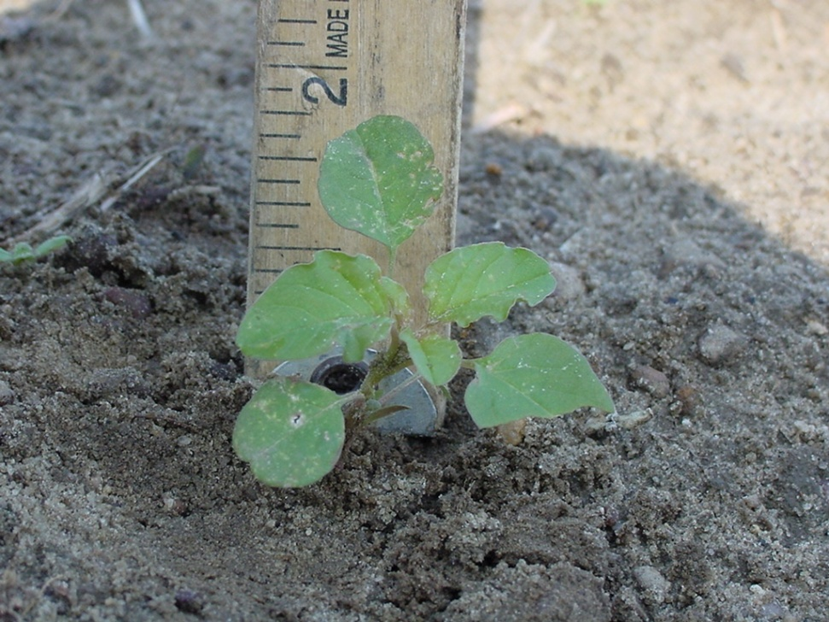
Our Biggest Challenges
Irrigation/Rainfall
Farm Size/Weed Size

Slide 7
Rainfall Totals Cordele, GA
inches
Month
Source: UGA Automated Weather

Slide 8
A Question For You
How many acres can be effectively and safely sprayed in 1 day?
How many total acres need to be sprayed?
What if it rains?
What if it is windy?

Slide 9
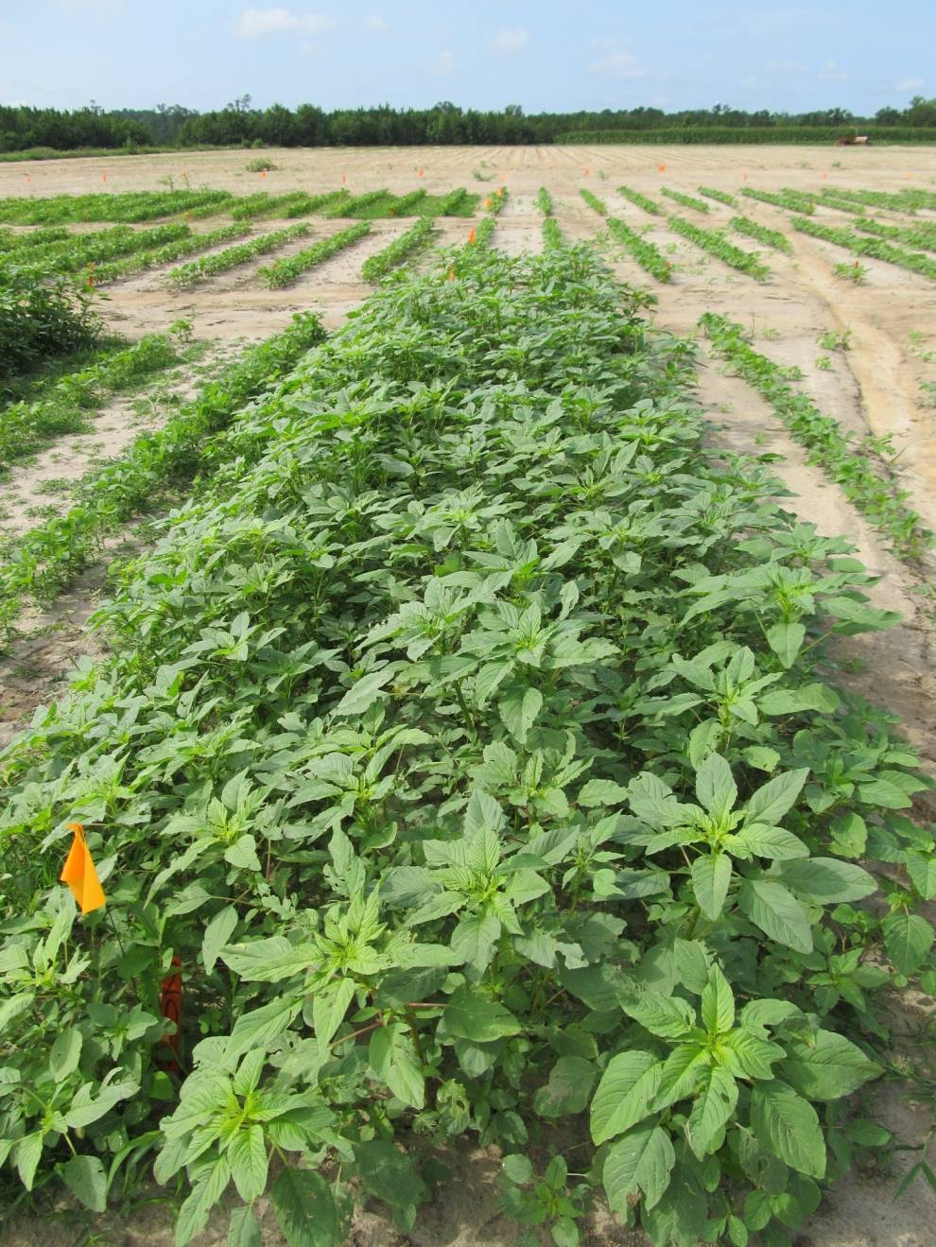
Palmer Amaranth Growth 22 days after starting clean
June 22, 2011
Attapulgus, GA

Slide 10
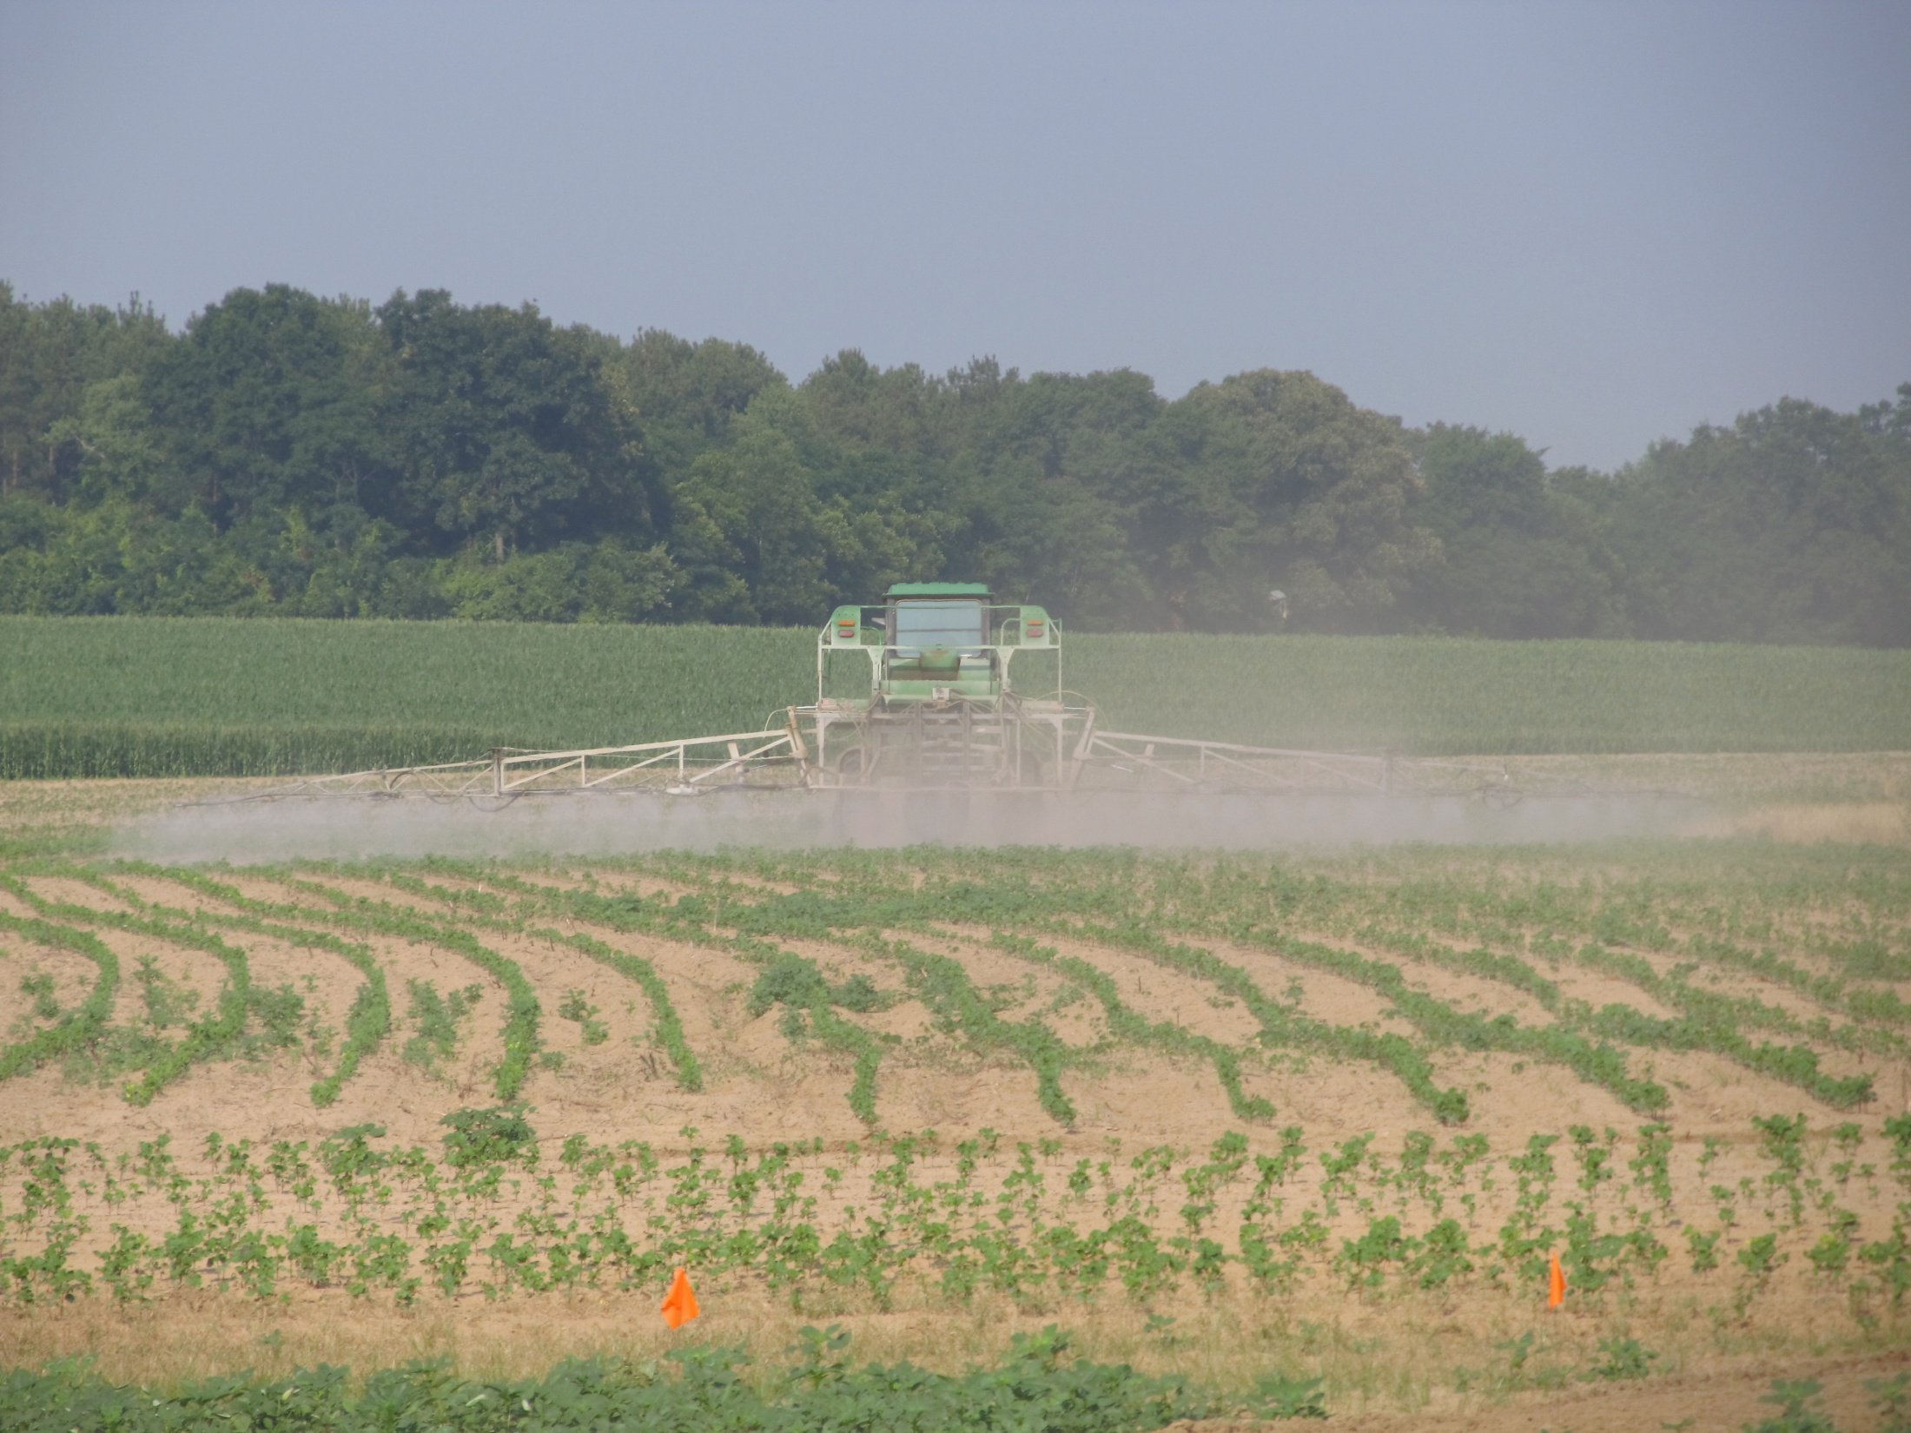
Activated Residual Herbicides are the key!
(Likely will need 2-4 depending upon the crop)
Cotton | Peanut | Corn | Sorghum | Soybean
Valor | Valor | Atrazine | Atrazine | Valor
Reflex | Dual Magnum | Dual Magnum | Dual Magnum | Envive
Dual Magnum | Warrant (?) | Warrant | Warrant | Reflex
Warrant |  |  |  | Prefix
Diuron |  |  |  | Dual Magnum
 |  |  |  | Warrant
 |  |  |  | Metribuzin Boundary TriCor Authority MTZ

Slide 11
PEANUTS

Slide 12
Cotton/Cadre Carryover Problems Worse in 2011?

Slide 13
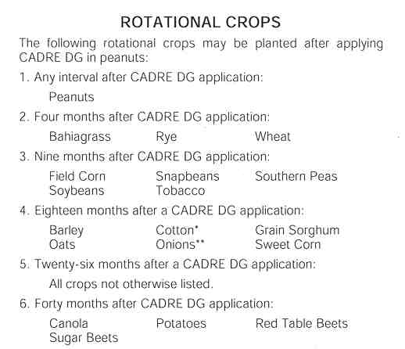

Cadre/Impose Rotational Restrictions

Slide 14
If growers cannot or will not use Cadre…...
weed control costs will probably be higher
purple nutsedge will not be controlled
Dual Magnum ($10-14/A) but not as effective. Generic metolachlors are cheaper but may not last as long ($5-6/A).
Strongarm + Valor
Other POST herbicides (Basagran, Blazer, Cobra, Storm) are effective but have some weaknesses and no residual

Slide 15
“Cadre-Free” Weed Control Programs
Program 1
Prowl or Sonalan – PPI/PRE
Valor (3 oz/A) + Strongarm (0.23 oz/A) – PRE
Cobra or Ultra Blazer + Dual Magnum – POST
Program 2
Prowl or Sonalan – PPI/PRE
Gramoxone + Storm + Dual Magnum – EPOST
Cobra or Ultra Blazer + Dual Magnum – POST
2,4-DB as needed in both programs for sicklepod. Will likely need 2 applications.

Slide 16
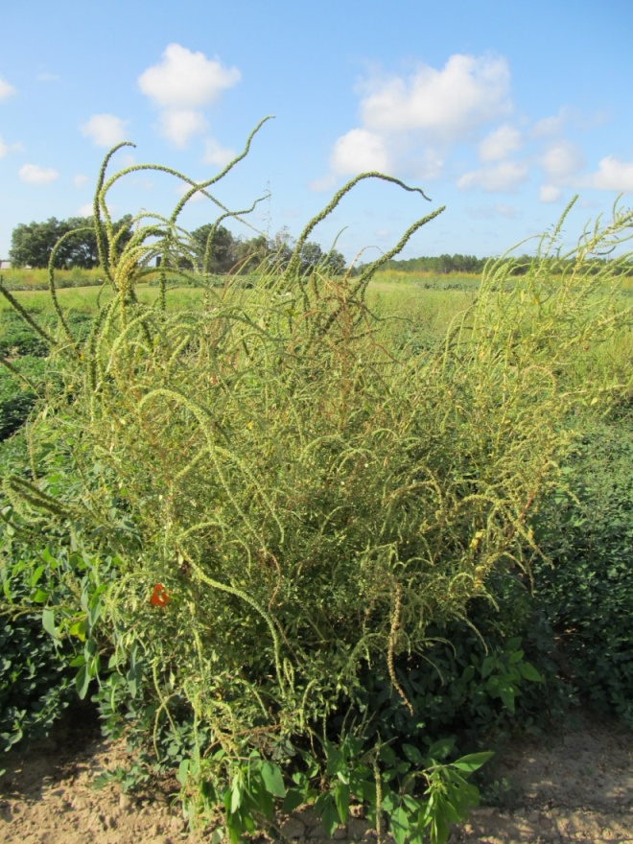
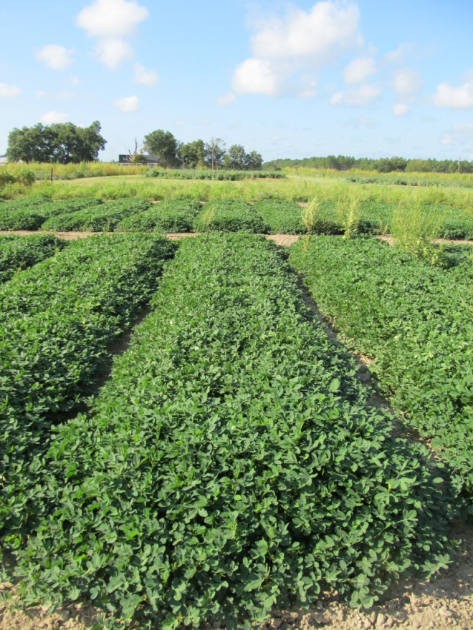
Palmer Amaranth Control in Peanut Valor Program
NTC
Prowl H₂0 3.8SC @ 32 oz/A (PRE)
Valor 51WG @ 3 oz/A (PRE)
Cadre 2AS @ 4 oz/A (POST)
COC @ 1% v/v (POST)
PE-26-11
August 25
108 DAP

Slide 17
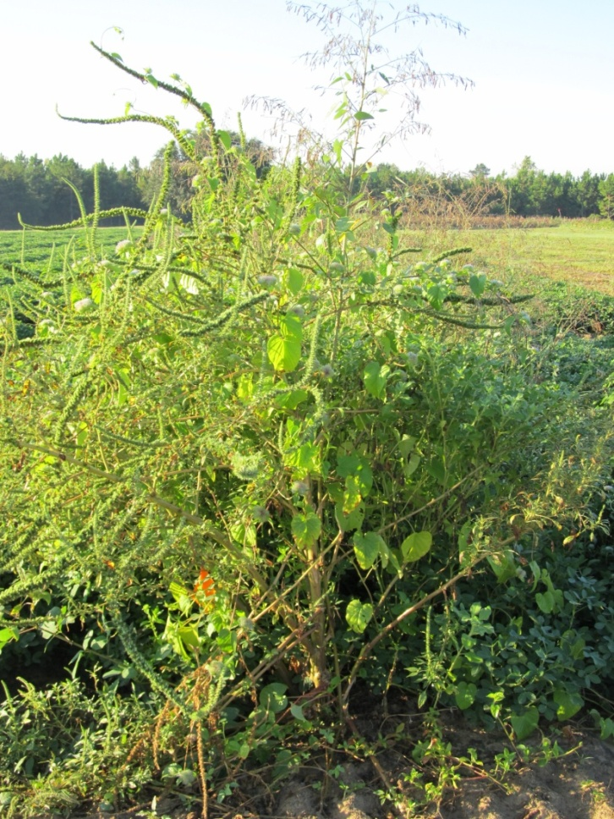
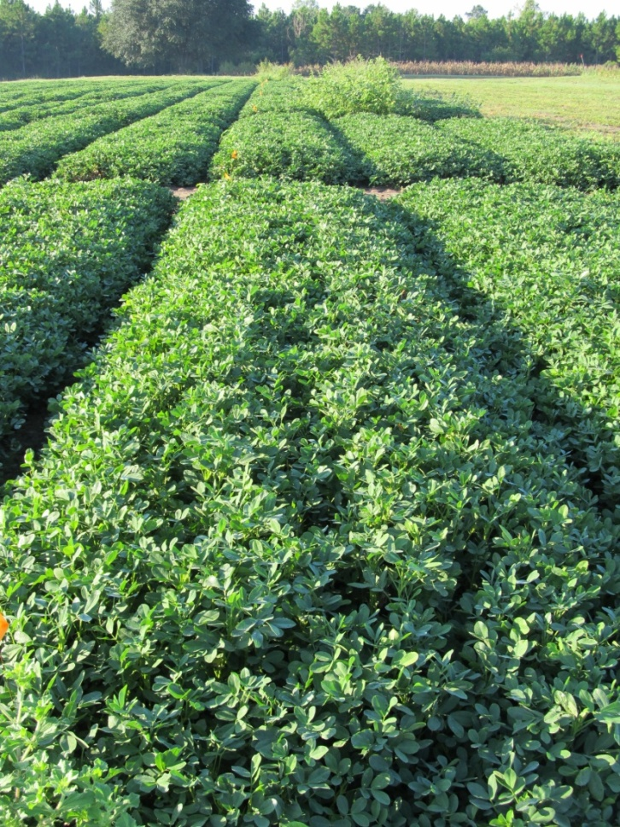
Palmer Amaranth Control in Peanut Dual (metolachlor) Program
NTC
Prowl H₂0 @ 34 oz/A (2 DAP)
Gramoxone Inteon @ 12 oz/A (21 DAP)
Storm @ 16 oz/A (21 DAP)
Dual Magnum @ 16 oz/A (21 DAP)
Cadre @ 4 oz/A (37 DAP)
Dual Magnum @ 16 oz/A (37 DAP)
PE16B-11
Sept 2
116 DAP

Slide 18
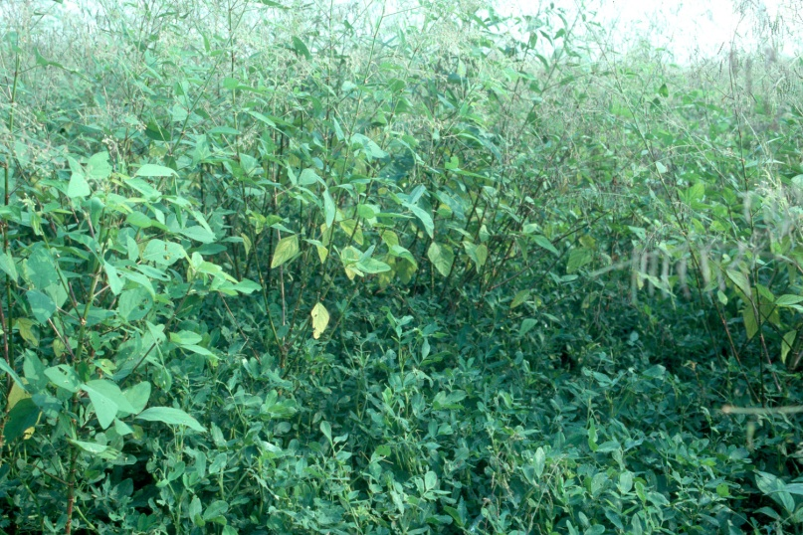

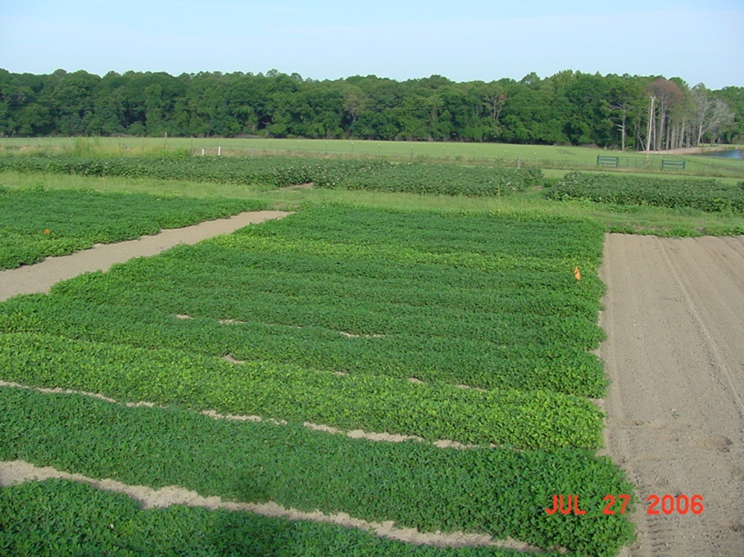
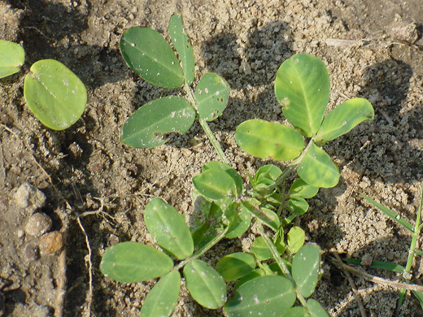
FL-07, GA Greener = No problems
GA-06G and Tifguard = 7-11% yield losses

Slide 19
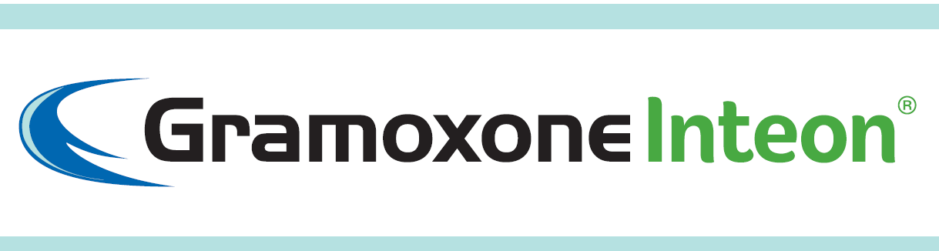
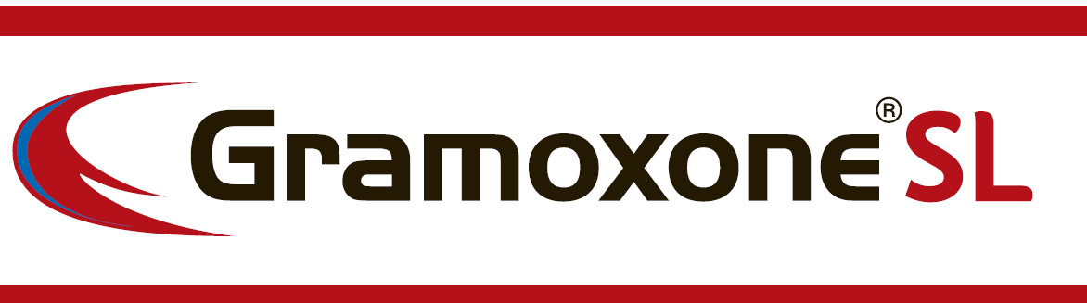
A New Formulation of Paraquat from Syngenta

Slide 20
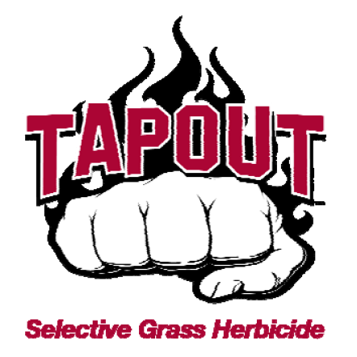
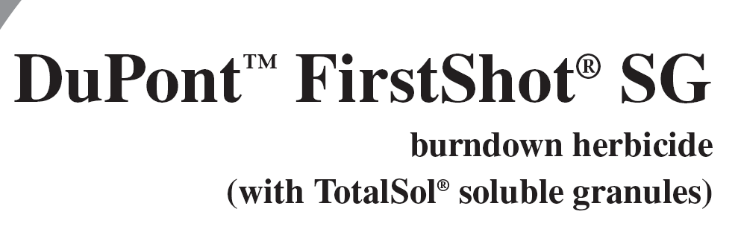
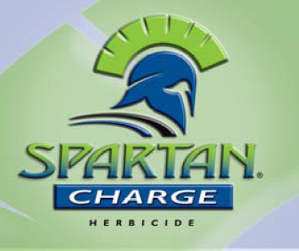
2012 Peanut Pest Control Rec Changes

Slide 21
Spartan Charge 3.5L
FMC
Sulfentrazone (Spartan) @ 3.15 lb/gal + carfentrazone (Aim) @ 0.35 lb/gal
PRE @ 3-4 oz/A
Tank-mix with Prowl or Dual
Not on sands with less than 1% OM
Rotation Restrictions: canola = 24 months; field corn = 4 months; cotton = 12 months**; small grains = 4 months; sorghum = 10 months; soybeans = anytime; sunflowers = anytime; tobacco = anytime.
Same MOA as Valor (PPO)
** some UGA research suggests that the crop rotation restriction for cotton should be 18 months.

Slide 22
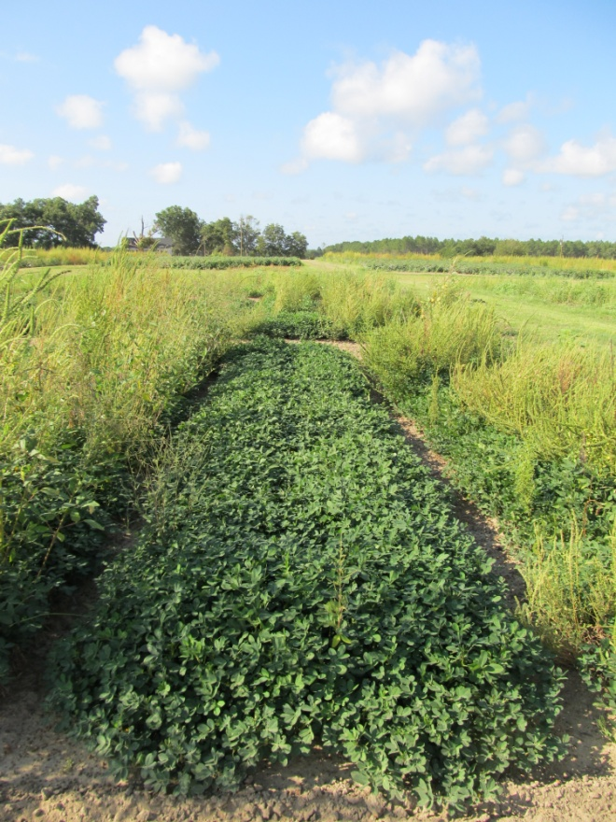
Palmer Amaranth Control in Peanut Valor vs. Spartan Charge
NTC
Prowl H₂0 3.8SC @ 32 oz/A (PRE)
Valor 51WG @ 3 oz/A (PRE)
Cadre 2AS @ 4 oz/A (POST)
COC @ 1% v/v (POST)
Prowl H₂0 3.8SC @ 32 oz/A (PRE)
Spartan Charge 3.5L @ 4 oz/A (PRE)
Cadre 2AS @ 4 oz/A (POST)
COC @ 1% v/v (POST)
PE-26-11
August 25
108 DAP

Slide 23
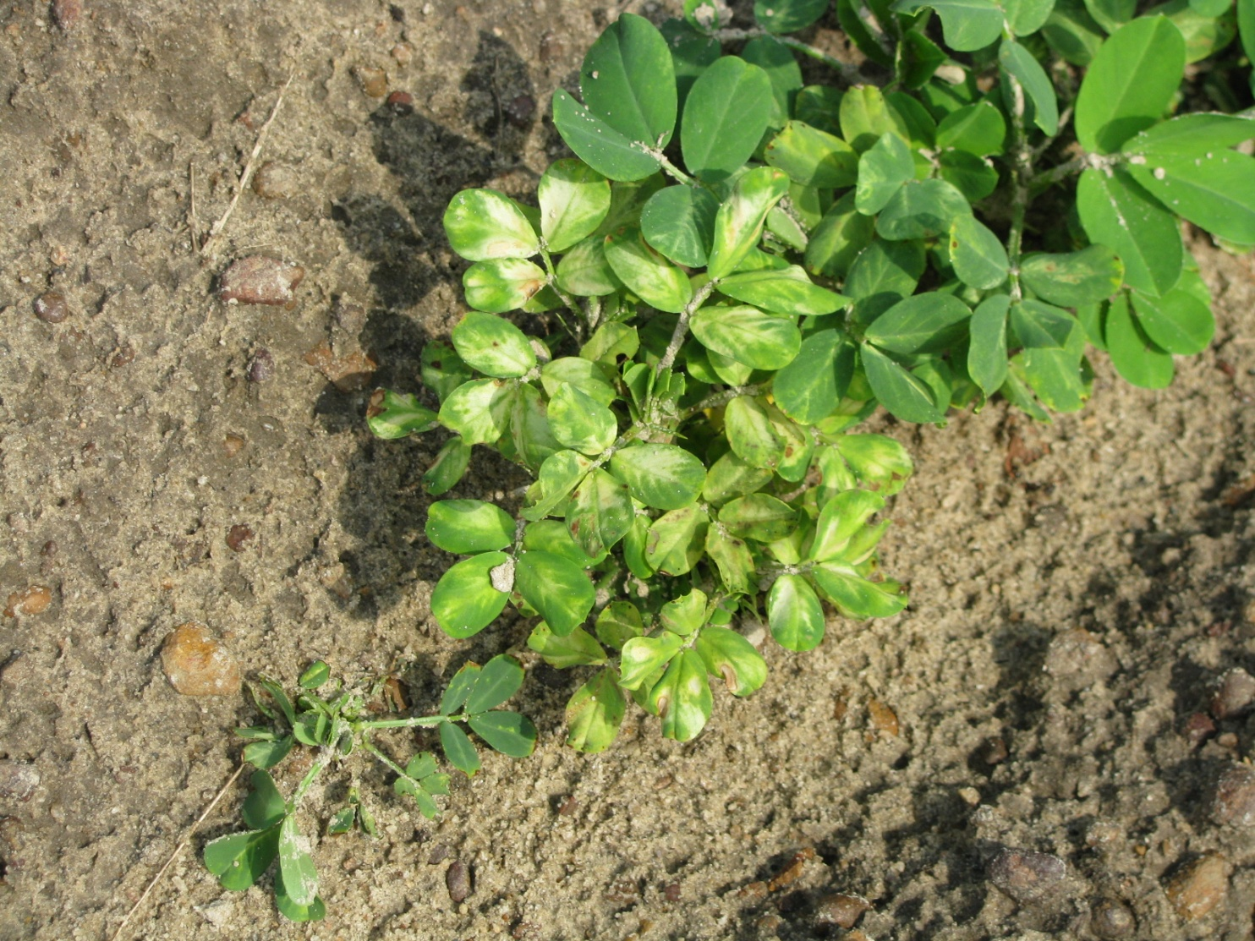
Sulfentrazone Injury on Peanut High rates, lighter soils

Slide 24



Potential New Herbicides?
Micro-encapsulated acetochlor
Valor + Pyroxasulfone
Pyroxasulfone

Slide 25
Field Corn
For most in GA …….
Atrazine +
Glyphosate (RR corn)
Ignite (LL corn)
Steadfast Q
Laudis or Capreno
If I was King, I would make you spray 1qt/A Atrazine PRE fb 1.5 qt/A + 1 of the above!

Slide 26
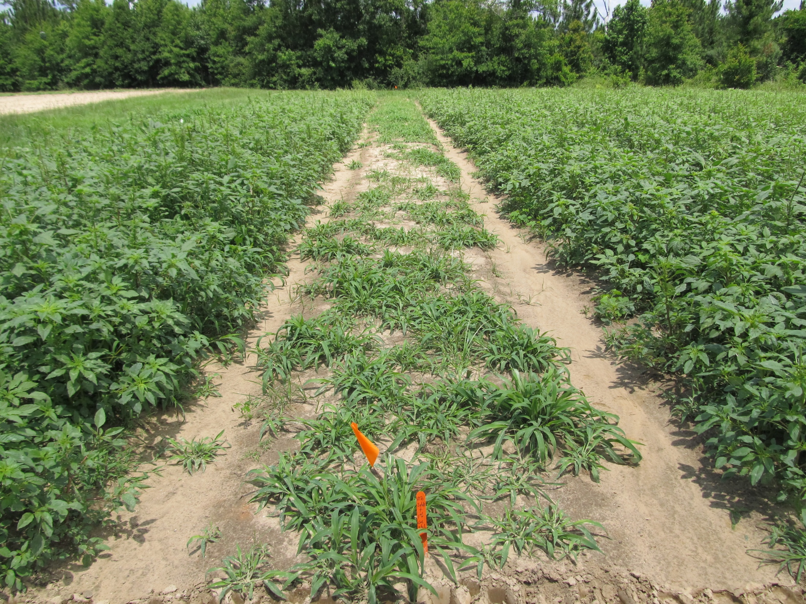
Atrazine 4L @ 2 qts/A + COC @ 1% v/v
Applied to 4”-9” Palmer Amaranth (6” average)
Photo 13 DAT

Slide 27
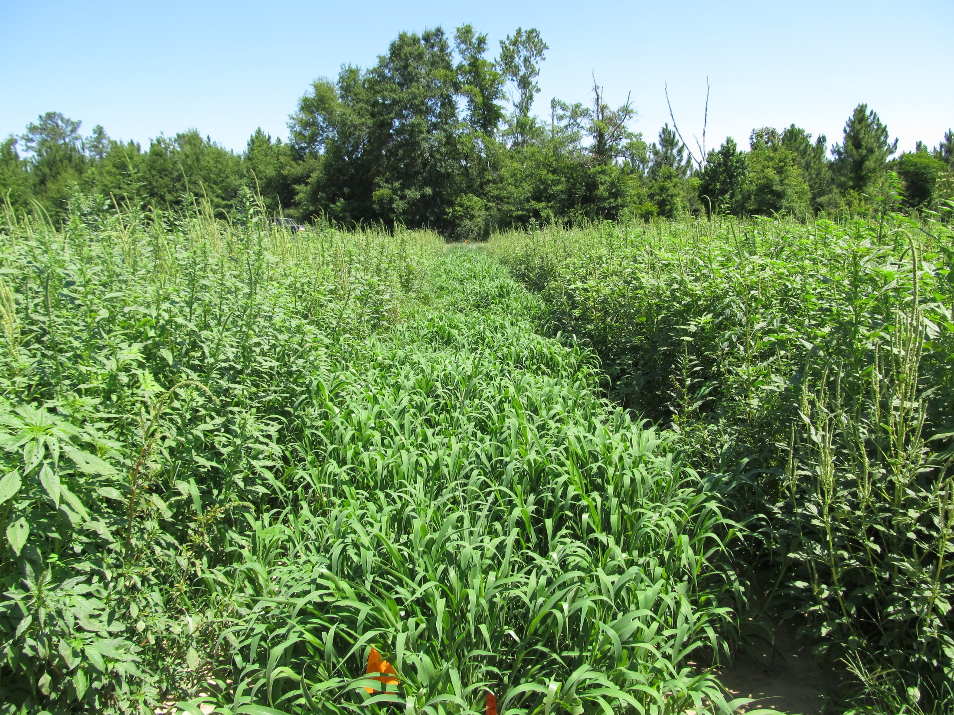
Atrazine 4L @ 2 qts/A + COC @ 1% v/v
Applied to 4”-9” Palmer Amaranth (6” average)
Photo 28 DAT

Slide 28

Future of Atrazine?
In April 2010, EPA stated that no additional testing is warranted to address the issue of atrazine and amphibian gonadal development.
On May 6, 2011, Save The Frogs petitioned the EPA to ban the use and production of atrazine.
Public comments were accepted until November 14, 2011
??

Slide 29
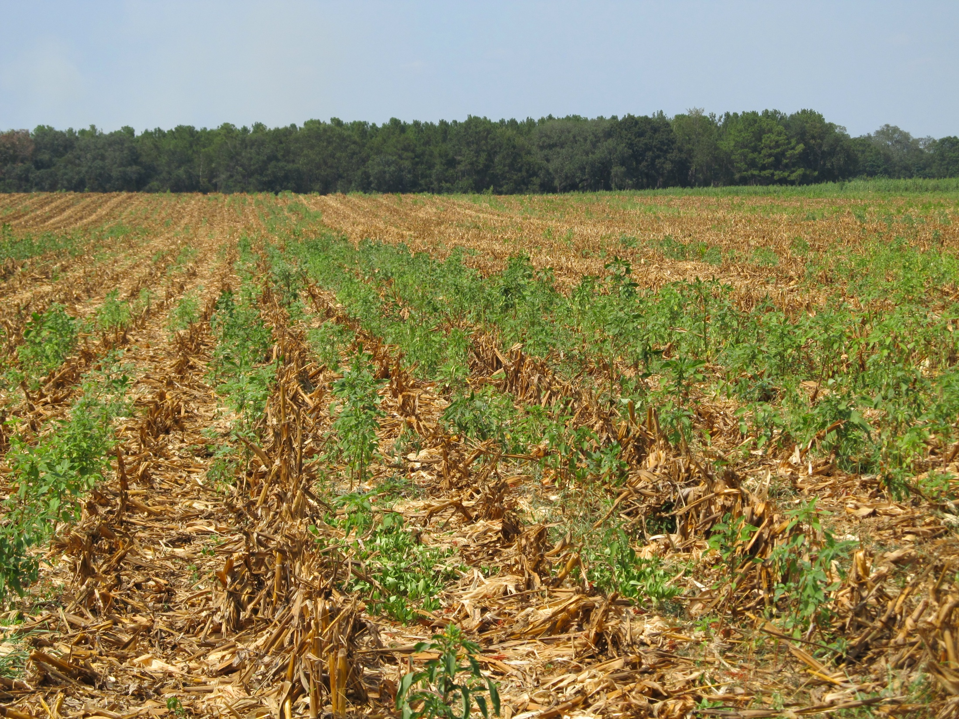
Post-Harvest Palmer Amaranth Populations Must be Managed!

Slide 30
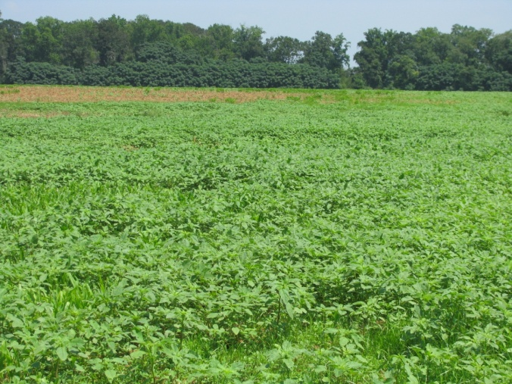
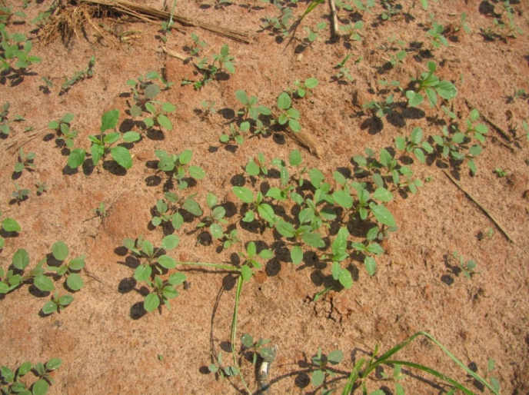
Post-Harvest (Corn) Pigweed Problems
Decreasing daylight hastens flower and seed production
Flowering (3-4 weeks)
Seed production (2-3 weeks)
Some germination at 41⁰F (8%)
Control Options
Mowing/Tillage (>6” weeds)
Herbicides (<6” weeds)
No small grain
Gramoxone + Dual Magnum or Warrant (?)
Small Grain planted soon
Gramoxone + 2,4-D or dicamba
When can we stop worrying about seed production?
Keeley et al. 1987. Weed Science 35:199-204
Steckel et al., 2004. Weed Science 52:217-221

Slide 31
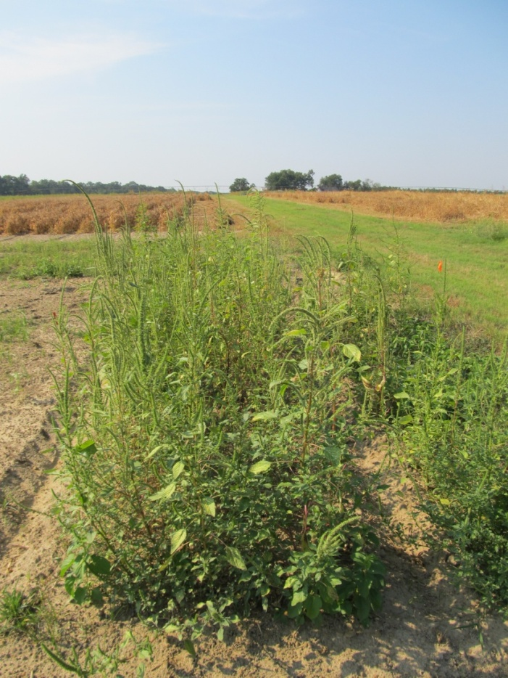
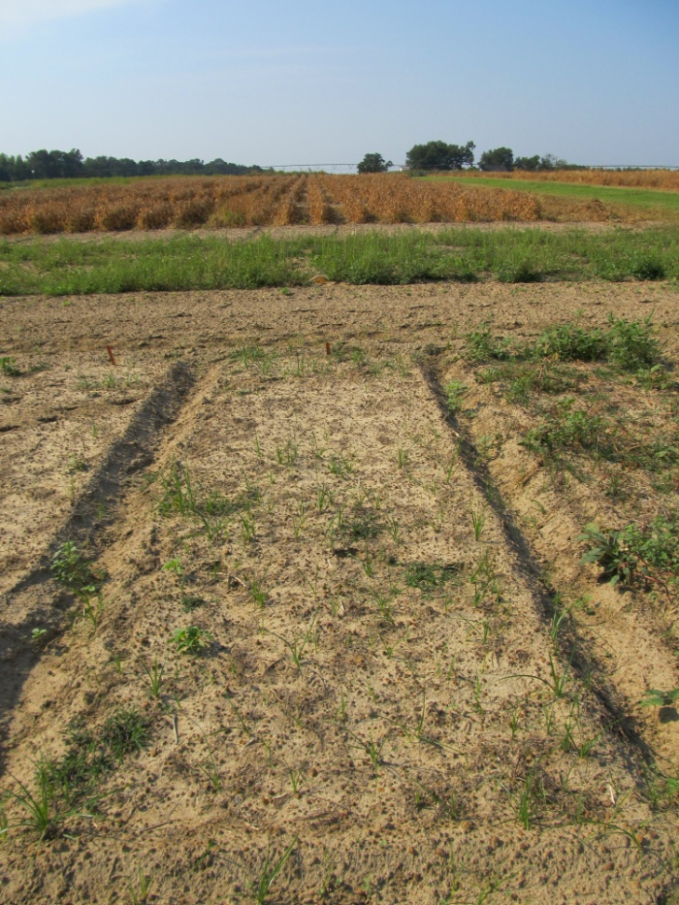
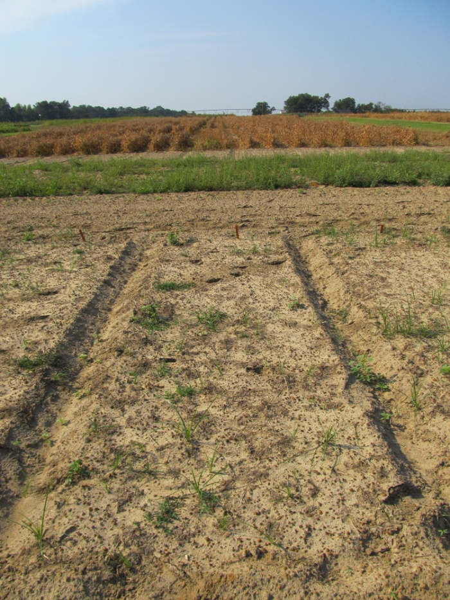
Post-Harvest Control of Palmer Amaranth (6” average: 2”-17” range at application)
NTC
Gramoxone Inteon 2SL @ 3 pt/A
2,4-D Amine 3.8SL @ 1 pt/A
Primary @ 1% v/v
Gramoxone Inteon 2SL @ 3 pt/A
Clarity 4SL @ 8 oz/A
Primary @ 1% v/v
CN-01B-11
September 15
30 DAT

Slide 32
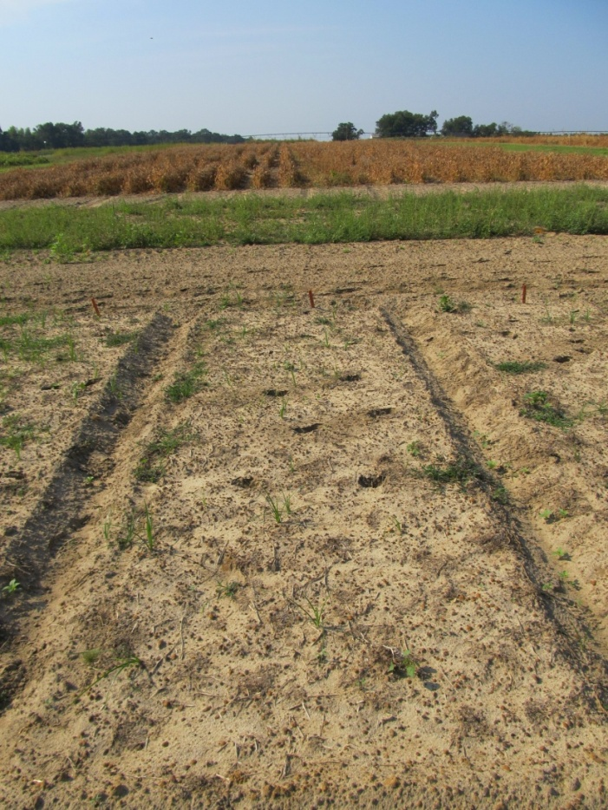
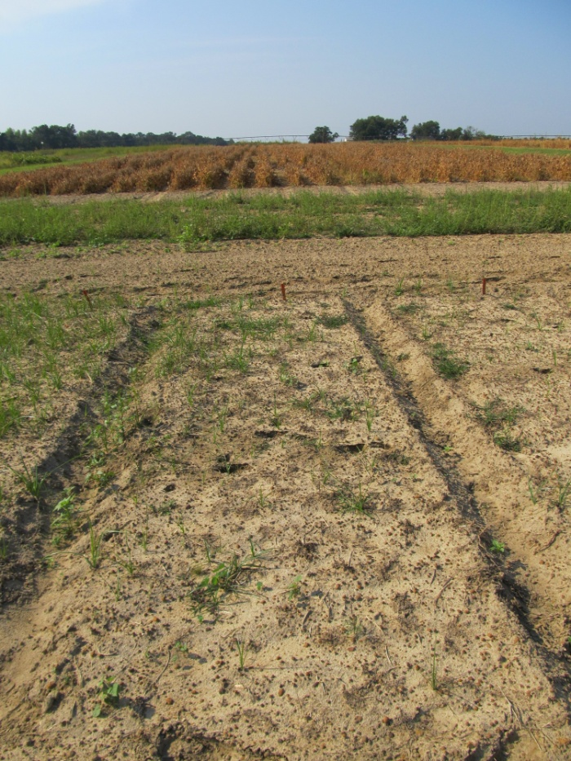
Post-Harvest Control of Palmer Amaranth (6” average: 2”-17” range at application)
NTC
Gramoxone Inteon 2SL @ 3 pt/A
Dual Magnum 7.62EC @ 16 oz/A
Primary @ 1% v/v
Gramoxone Inteon 2SL @ 3 pt/A
Warrant 3ME @ 48 oz/A
Primary @ 1% v/v
CN-01B-11
September 15
30 DAT

Slide 33

Capreno
Bayer CropScience
Thiencarbazone-methyl (0.57 lb/gal) (MOA = 2)
Tembotrione (2.88 lbs/gal) (MOA = 27)
Laudis
Isoxadifen (crop safener)
3.45 SC formulation
POST corn
OT Up until V1-V6; PDIR – V7
3 oz/A of Capreno
2.5 oz/A Laudis, normal rate is 3 oz/A
COC + AMS or UAN
OP/ALS Soil Interaction
Rotation Restrictions
Corn = 0 months; wheat = 4 months; cotton, soybean, sorghum = 10 months; peanut = 12 months; canola, tobacco = 18 months
Tank-Mixes
Atrazine, Ignite, Glyphosate

Slide 34
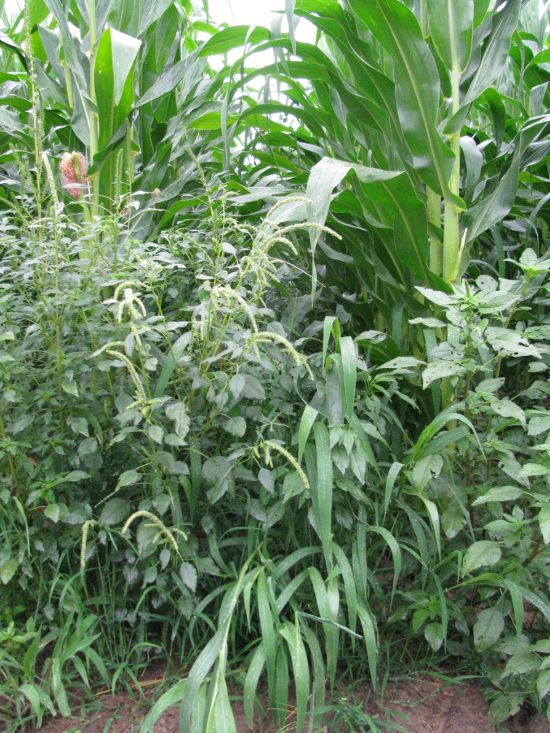
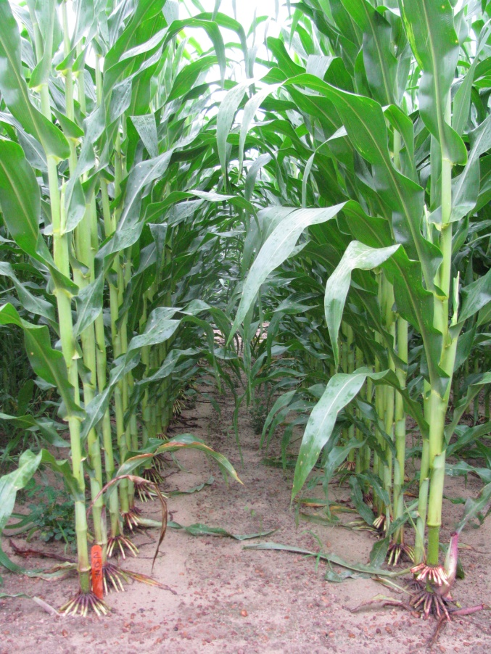
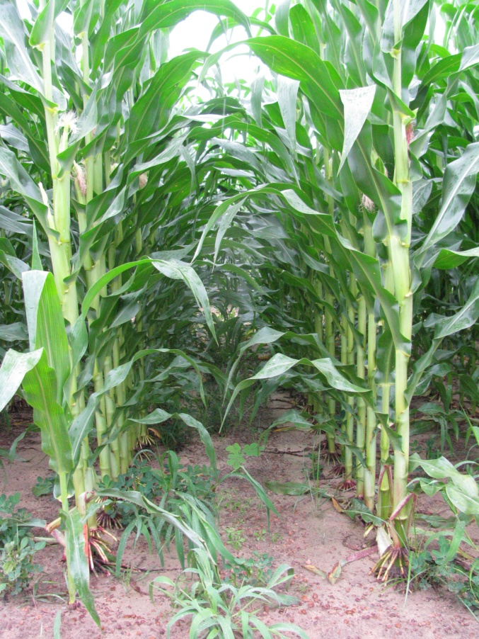
Capreno vs. Laudis (51 DAT)
NTC
Capreno 3.45SC @ 3 oz/A
MSO @ 1% v/v
AMS Xtra @ 2.5% v/v
Laudis 3.5SC @ 3 oz/A
MSO @ 1% v/v
AMS Xtra @ 2.5% v/v
CN-14-10
Applied 19 DAP

Slide 35
Sometime In The Near Future

Slide 36

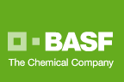
Zidua 85WG
Pyroxasulfone
Residual control of annual grasses and certain broadleaf weeds including pigweed
Same MOA as Dual or Warrant but used at lower rates
Use rate: 1-2 oz/A

Slide 37
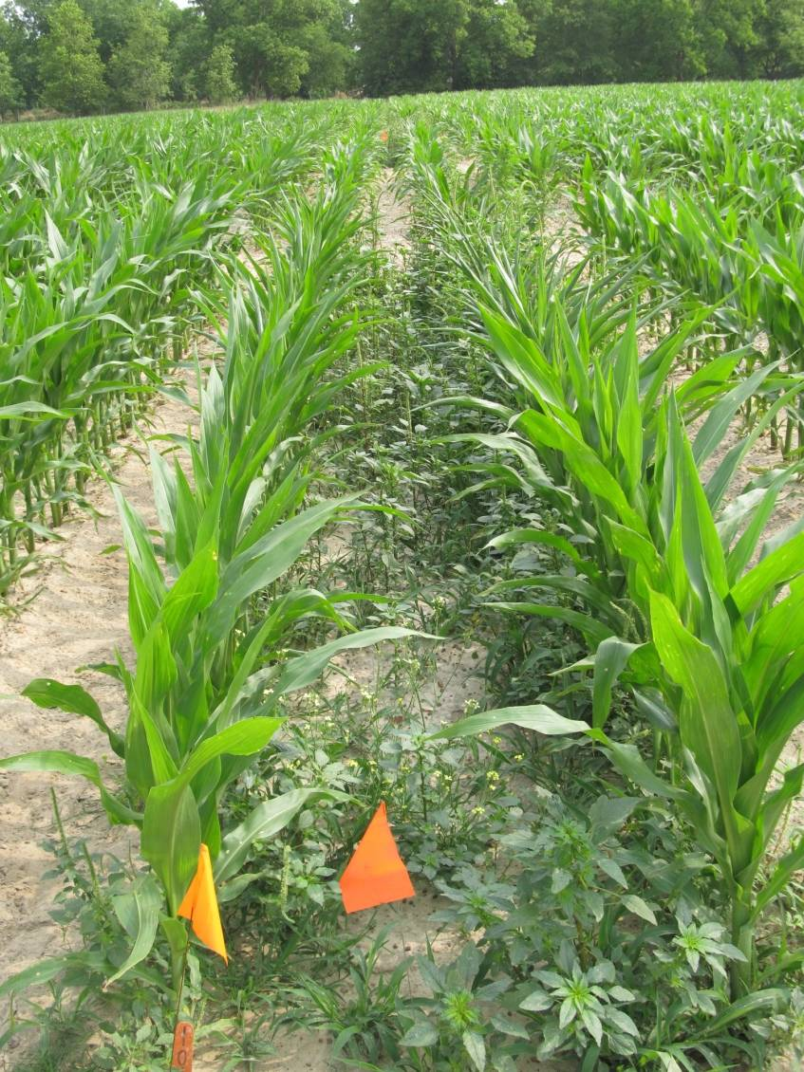
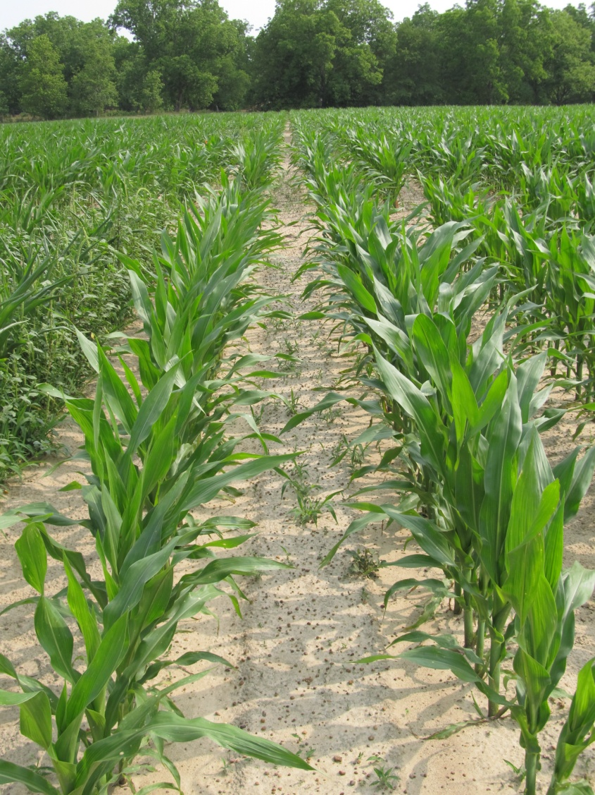
Weed Control in Field Corn with Zidua - 2011
NTC
Zidua 85WG @ 2 oz/A (PRE)
CN-11-11
May 11
47 DAT

Slide 38

Anthem 2.15L
Cadet (0.0632 lb/gal) + Pyroxasulfone (2.0868 lb/gal)
Residual control of annual grasses and certain broadleaf weeds including pigweed
Use rate: 3.5-7.0 oz/A (?)

Slide 39
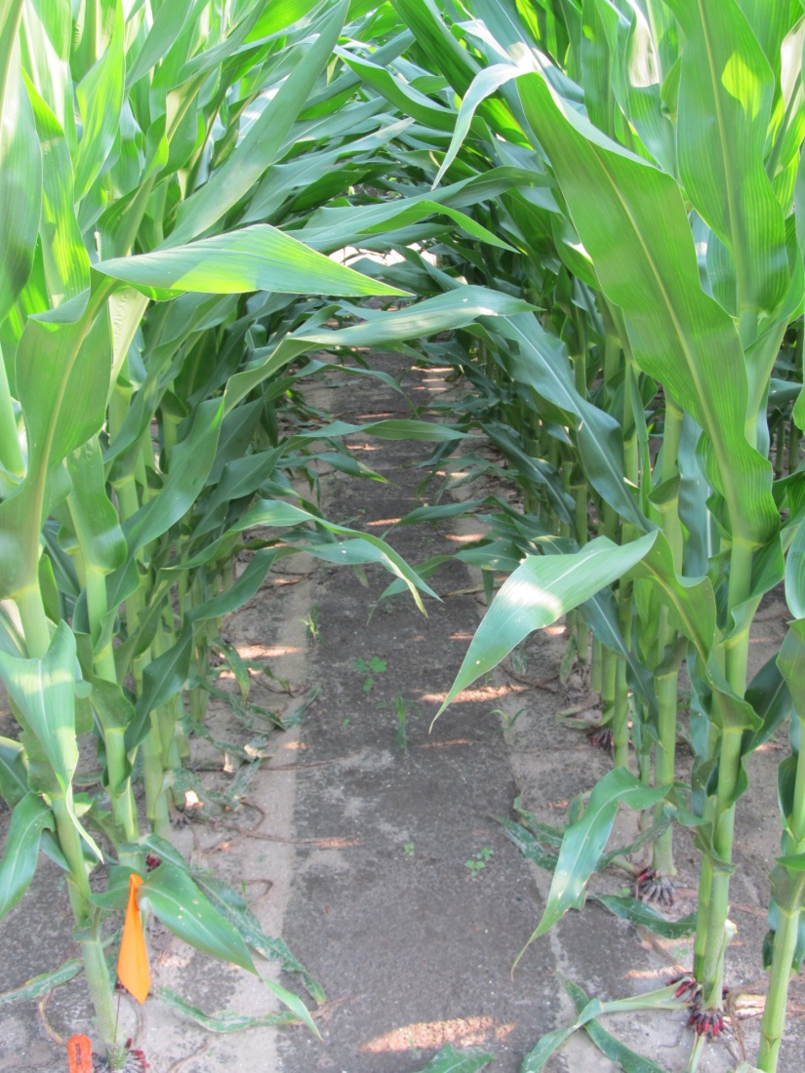
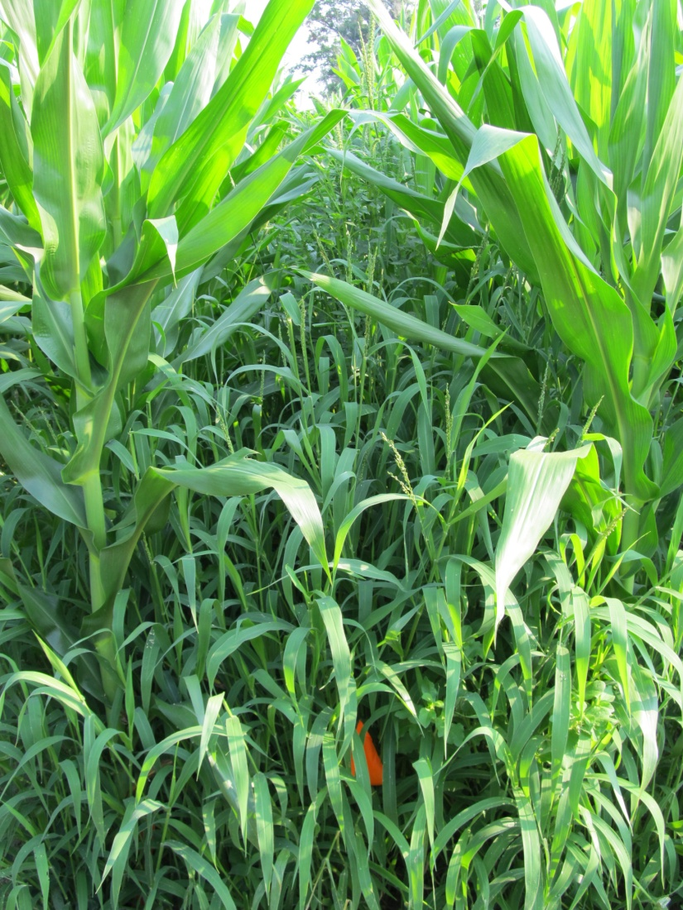
Weed Control in Field Corn with Anthem - 2011
Anthem 2.15SL @ 5 oz/A (EPOST)
Roundup W-Max 5.5SL @ 22 oz/A (EPOST)
Roundup W-Max 5.5SL @ 22 oz/A (MPOST)
NTC
CN-14-11
June 6
60 DAP

Slide 40


Corvus 2.63SC
3.33 oz/A
PRE or EPOST (V2)
Tank-Mixtures
Atrazine, Ignite, Glyphosate
No adjuvants needed
0.75 lbs/gal - thiencarbazone (MOA = 2)
1.88 lbs/gal - isoxaflutole (MOA = 27)
Balance Flexx
1.25 lbs/gal - cyprosulfamide (safener)
ALS/OP Interaction Problem
Rotations
Field corn = 0 months; soybean = 9 months; cotton = 10 months; peanut = 12 months; canola, sorghum, tobacco = 17 months

Slide 41
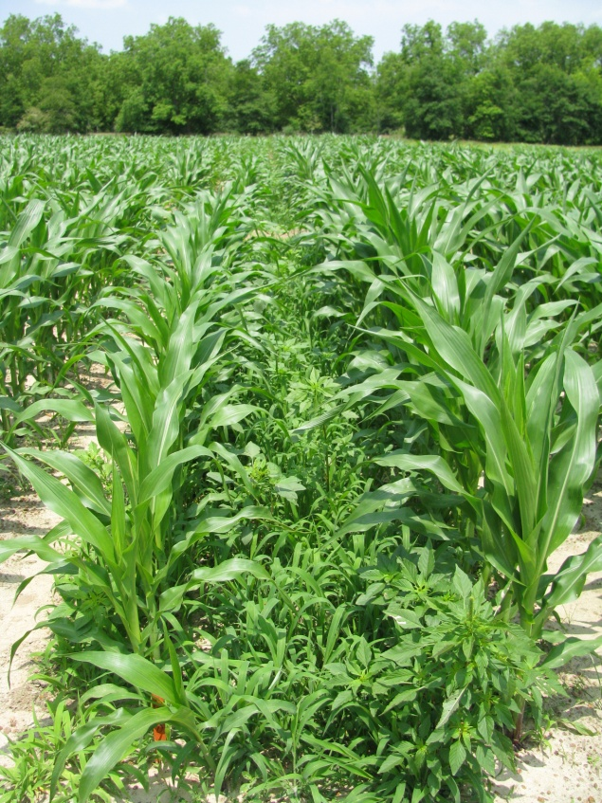


Weed Control in Field Corn with Corvus 2.6SC @ 3 oz/A - 2010
NTC
PRE (0 DAP)
EPOST (13 DAP)
CN-02-10
May 11, 2010
47 DAP

Slide 42


Enlist™ Herbicide Tolerant Corn
tolerance to 2,4-D and Assure
Colex-D™ technology
2,4-D choline
lower volatility
lower drift potential
enhanced handling/mixing characteristics
reduced odor
1 PRE application + 2 POST applications (V8 stage)
Enlist™ Duo
DMA-Glyphosate (1.71 lb ae/gal) + 2,4-D choline (1.63 lb ae/gal)
3.5 pt/A
2013 Product Launch

Slide 43
SOYBEANS

Slide 44

Herbicides for Pigweed Control in Soybeans
Residual Herbicides
Authority MTZ, Authority XL, Canopy/Cloak, Boundary, Valor, Valor XLT, Prefix, Dual Magnum/Generics, Tricor, Prowl, Intrro, Treflan, Envive, Warrant
Postemergence
Reflex/Dawn, Prefix, Cobra, Ultra Blazer, Flexstar GT, Harmony (ALS?), Ignite (LL soybeans)

Slide 45


Consider metribuzin on soybean?
Not a PPO
Not a PPO
Good on pigweed
Can be applied PPI
Issues
soil texture, OM, pH
Varieties
Rotations
Company support
Lack of incentive at dealer level
Cost/A
TriCor 75DF
Metribuzin 75DF
*Canopy price reduction for 2012

Slide 46


Palmer Amaranth Control in Soybeans - 2011
NTC
Boundary 6.5EC @ 1.5 pt/A
SB-13-2011
June 23, 2011
30 DAP

Slide 47

On the Horizon
Zidua
Anthem
Fierce
Enlist Soybean
Enhanced tolerance to 2,4-D
Stacked with glyphosate
2015?
Dicamba Resistant Soybeans
Monsanto/BASF
Stacked with glyphosate
2013?

Slide 48
Zidua 85WG
Pyroxasulfone
Residual control of annual grasses and certain broadleaf weeds including pigweed
Same MOA as Dual or Warrant but used at lower rates
Use rate: 1-2 oz/A

Slide 49

Palmer Amaranth Control in Soybeans - 2011
NTC
Zidua 85WG @ 2 oz/A
SB-13-2011
June 23, 2011
30 DAP

Slide 50

Fierce 76WDG
February 2012 (?)
Valor (33.5%) + Pyroxasulfone (42.5%)
preplant or preemergence
3 oz/A on coarse soils (Valor @ 2 oz/A + Pyrox @ 1.5 oz/A)

Slide 51


Palmer Amaranth Control with Fierce
NTC
Fierce 76WG @ 3 oz/A
SB-14-10 July 22, 2010 50 DAT

Slide 52

Anthem 2.15L
Cadet (0.0632 lb/gal) + Pyroxasulfone (2.0868 lb/gal)
Residual control of annual grasses and certain broadleaf weeds including pigweed
Use rate: 3.5-7.0 oz/A (?)

Slide 53


Weed Control in Soybeans with Anthem
SB-18-11
June 24
65 DAP
NTC
Anthem 2.15SL @ 8 oz/A – PRE
Roundup W-Max 5.5SL @ 22 oz/A - POST

Slide 54


Enlist™ Herbicide Tolerant Soybean
tolerance to 2,4-D + glyphosate + glufosinate (Ignite)
Colex-D™ technology
2,4-D choline
lower volatility
lower drift potential
enhanced handling/mixing characteristics
reduced odor
1 Burndown/PRE application + 2 POST applications (R2 stage)
Enlist™ Duo
DMA-Glyphosate (1.71 lb ae/gal) + 2,4-D choline (1.63 lb ae/gal)
3.5 pt/A
2015 Product Launch

Slide 55


Enlist Soybeans – 2010 (GA)
NTC
Ignite 280 2.34SL @ 22 oz/A
Weedar 64 4SL @ 17 oz/A
N-Pack AMS @ 2.5% v/v
Applied May 28 and June 18
SB-09-10
June 28

Slide 56


Slide 57

Grain Sorghum

Slide 58
GRAIN SORGHUM WEED CONTROL
Concep treated seed
Dual Magnum or Intrro/Micro-Tech or Warrant (PRE)
Atrazine (POST)
Paraquat (Hooded sprayer)

Slide 59


GR-Pigweed Control in Sorghum Macon County (2010) – 47 DAP
NTC
Concep Treated Seed
Dual Magnum 7.62EC @ 1 pt/A (PRE)
Atrazine 4L @ 1.5 qt/A + COC @ 1% v/v (16 DAP)
SG-01-10
JUNE 7

Slide 60



Reflex/Sorghum (10 month rotation restriction for a good reason!)

Slide 61

Canola
Howard F. Schwartz, Colorado State University, Bugwood.org

Slide 62


Canola in Georgia
~25,000 acres
Buyers
AgStrong
Bowersville (Hart Co.)
Moore’s
Resaca (Gordon Co.)
Needs
A PRE herbicide to control henbit and ryegrass
Howard F. Schwartz,
Colorado State University,
Bugwood.org

Slide 63



Canola Response to Dual Magnum 7.62EC - 31 DAT
NTC
3.6 oz/A
(low rate)
14.4 oz/A
(high rate)
** Dual Magnum is not yet labeled for use in canola grown in GA. Research is
underway to evaluate crop and weed response.

Slide 64




Future Concerns/Issues
Abuse of Ignite
Increased use of Dual Magnum and Warrant
Increased use of PPO herbicides
Valor and Reflex

Slide 65

Questions/Discussion?
www.gaweed.com
229-392-1034 (cell)

