Slide 1
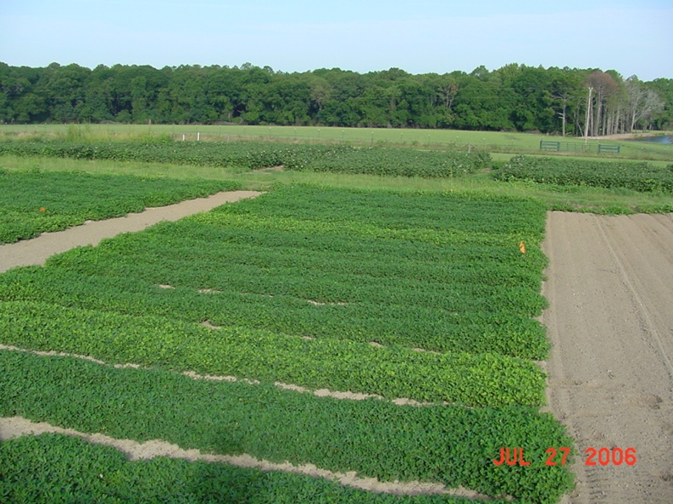
Peanut Response to Simulated Drift Rates of 2,4-D
R.M. Merchant*, E.P. Prostko, P.M. Eure,
and T.M. Webster
- 2012

Slide 2
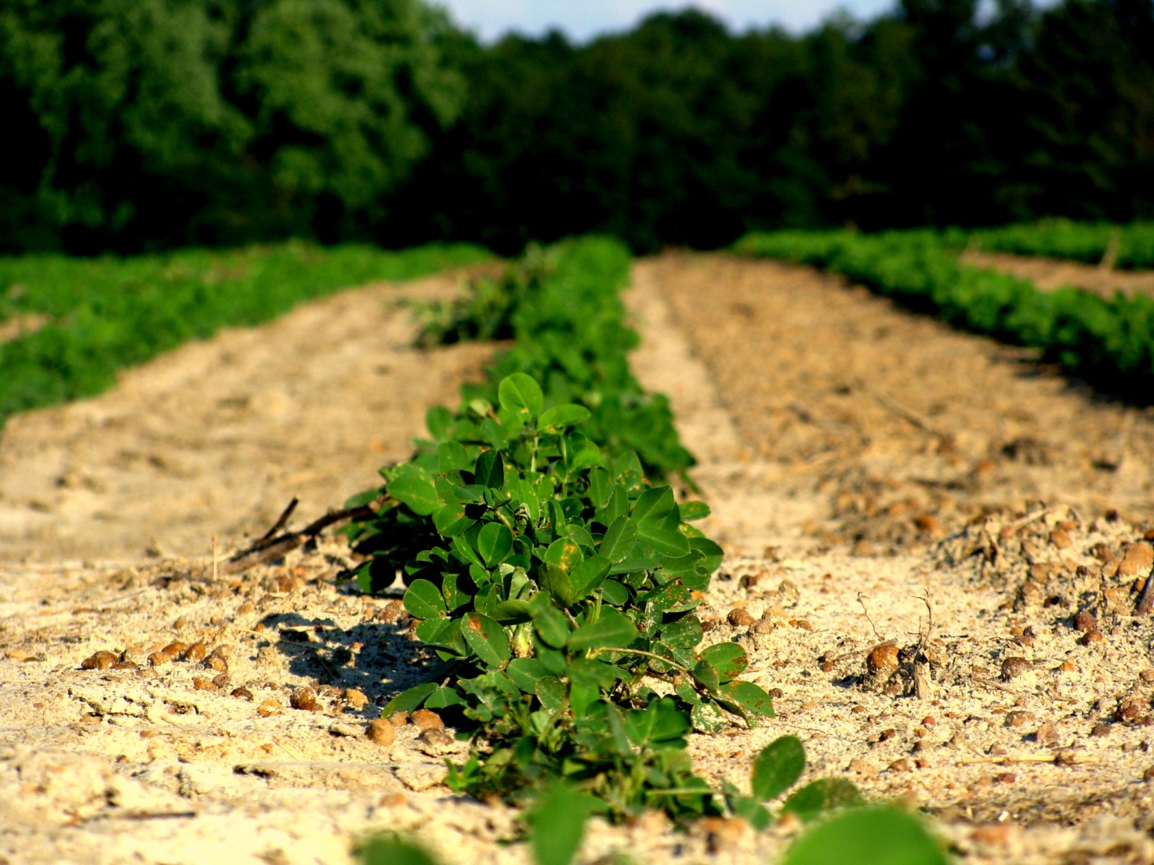
Introduction - I
In Georgia, peanuts were planted on nearly 202,000 ha in 2012

Slide 3
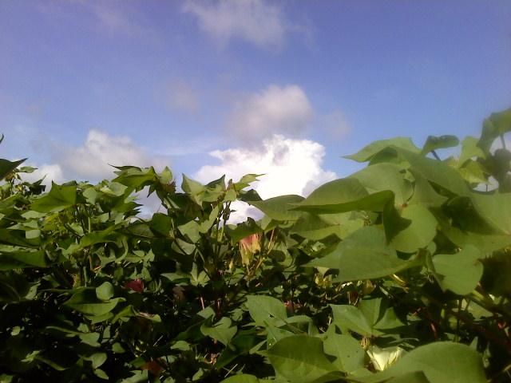
Introduction - II
Cotton and Soybeans are grown in close proximity to peanuts in Georgia

Slide 4
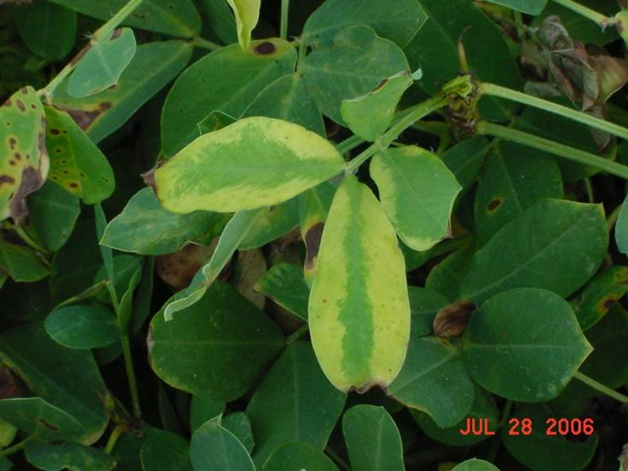
Introduction - III
Damage to peanut from commonly used cotton and soybean herbicides does occur
Glyphosate and glufosinate occur most often
Previous research has quantified the effects of these herbicides (Prostko et al. )
glyphosate
glufosinate

Slide 5
Introduction - IV
New technologies allow for POST topical application of 2,4-D or dicamba in cotton and soybean
Confusion of 2,4-D with 2,4-DB has consequences

Slide 6
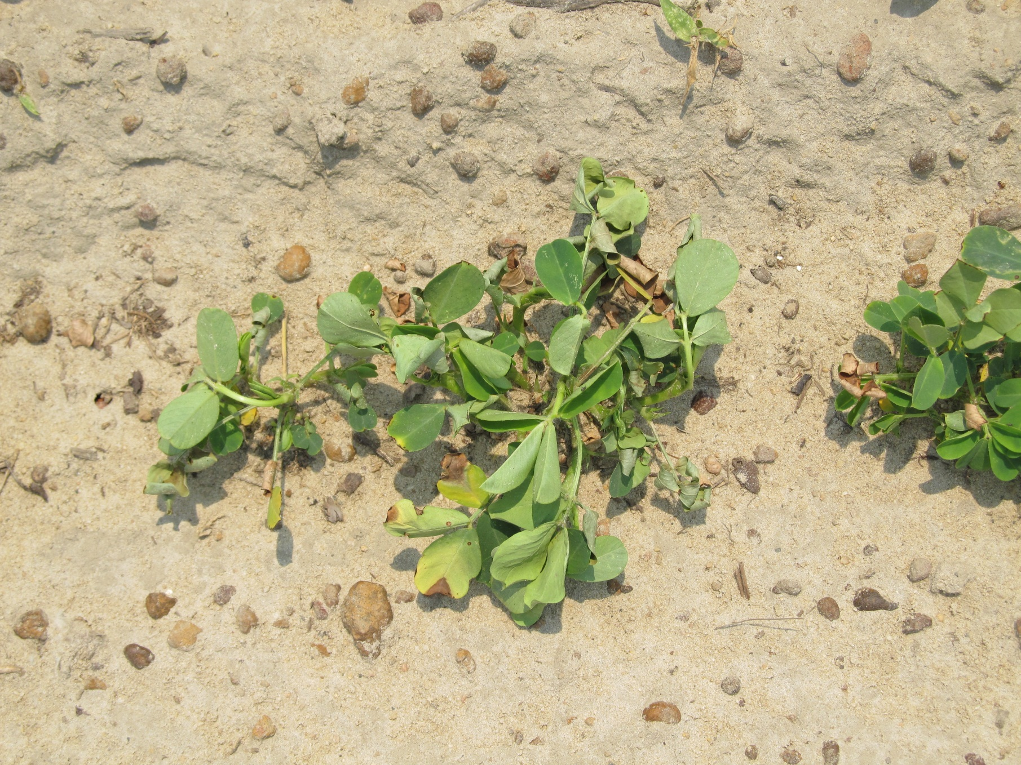
2,4-D symptomology of peanut – 30 DAP

Slide 7
Objective
To determine peanut yield response to simulated drift and tank contamination rates of 2,4-D amine

Slide 8
Materials and Methods - I
2 Field Trials
UGA Ponder Research Farm (Worth Co.)
Attapulgus Research/Extension Center (Decatur Co.)
‘GA-06G’
Split-plot, 4 replications
Whole Plot
30, 60, 90 DAP
Sub-plot
2,4-D amine rate
Weedar 64 Amine (3.8 lbs/gal)
105, 210, 420, 840, 1680 g ai/ha

Slide 9
Materials and Methods - II
CO₂-pressurized backpack sprayer
140 L/ha
Visual estimates of crop injury
0 -100%
Yield
100 pod/seed weights

Slide 10
Materials and Methods – III Peanut Growth Stages
Location | 30 DAP | 60 DAP | 90 DAP
Ponder | 10 cm tall - R1 | 20 cm tall 30 cm wide R3 | 38 cm tall Lapped R6
Attapulgus | 10 cm tall - R1 | 23 cm tall 35 cm wide R4 | 71 cm tall Lapped R6

Slide 11
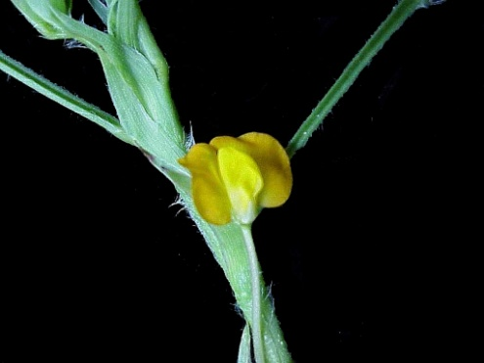
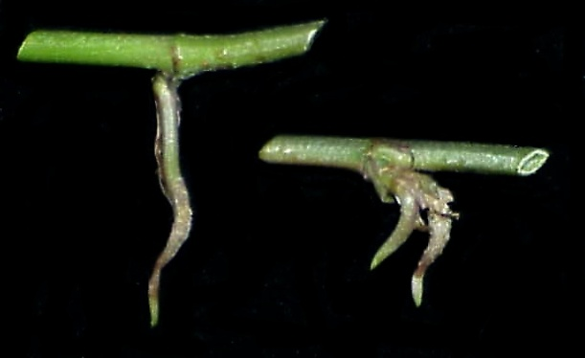
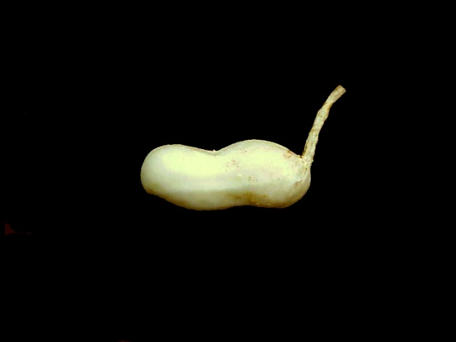
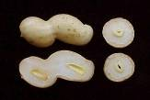
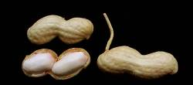
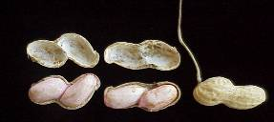
R1
R2
R3
Beginning bloom
Beginning peg
Beginning pod
R4
R5
R6
Full pod
Beginning seed
Full seed
R7
Reproductive Growth Stages of Peanut
Growth stages of peanut
K. J. Boote, Peanut Science 9:35-40
Beginning maturity

Slide 12
Statistical Analysis
Data combined over locations and subjected to ANOVA
Significant interaction between treatment and yield at 30 and 60 DAP
Regression analysis using Sigma Plot 11

Slide 13
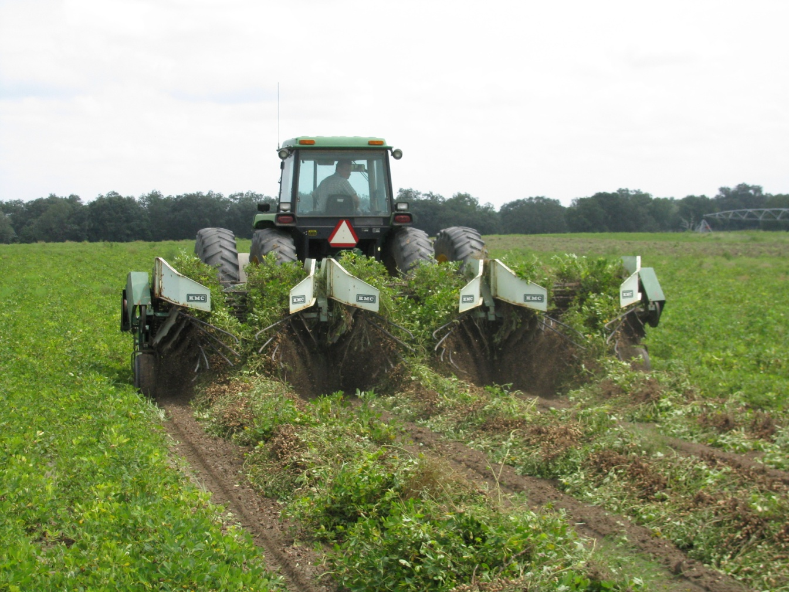
Results and Discussion

Slide 14
Yield Response – 30 DAP
y= 699760
1+e^{-(x-169/13.8)}
r²= 0.57
p= <0.0001
105 420 1680
Rate ( g ai/ha)

Slide 15
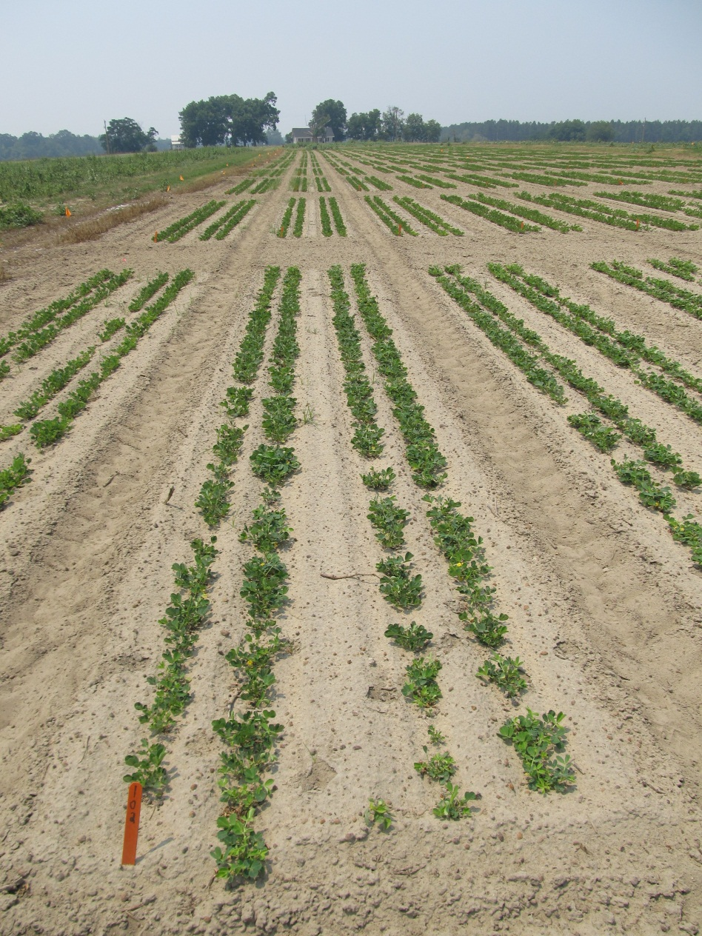
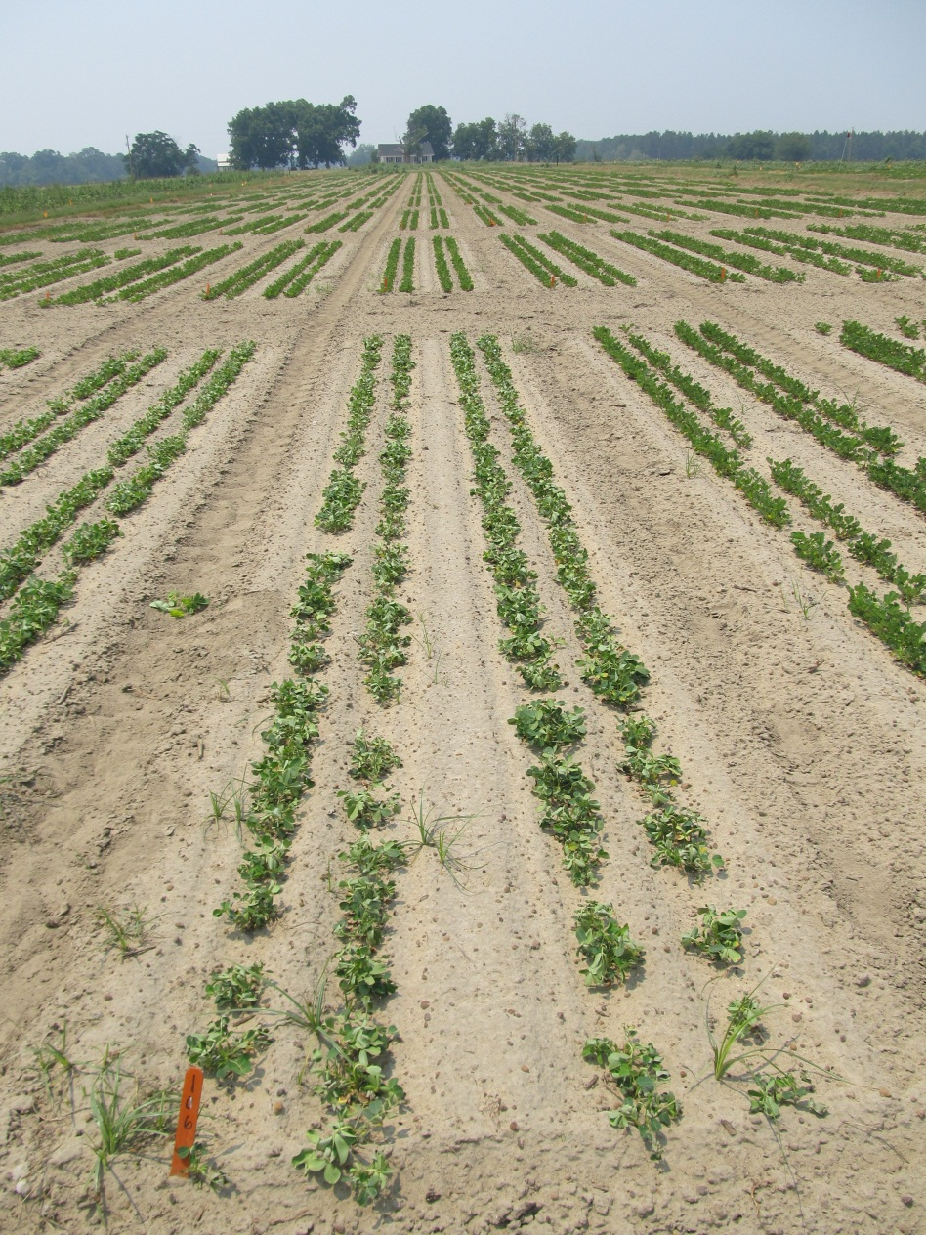
105 g ai/ha
1680 g ai/ha
1 week after treatment

Slide 16
Yield Response – 60 DAP
y= 9.86 + 0.82x
r²= 0.26
p= 0.003
105 420 1680
Rate ( g ai/ha)

Slide 17
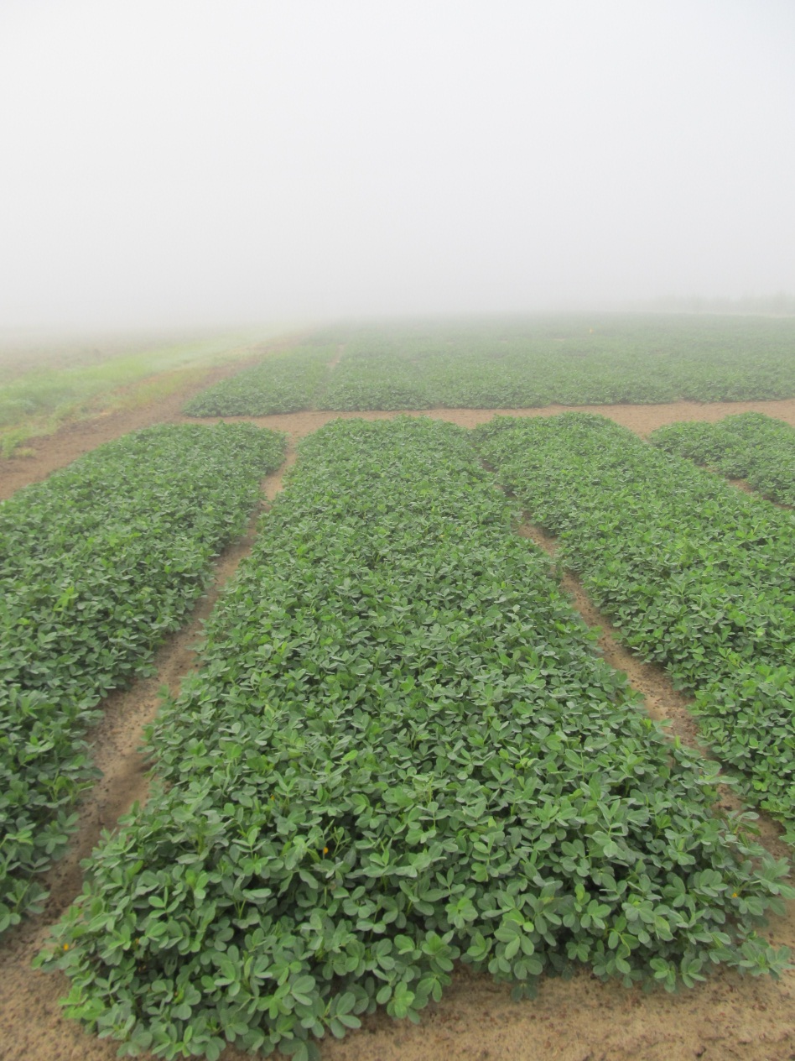
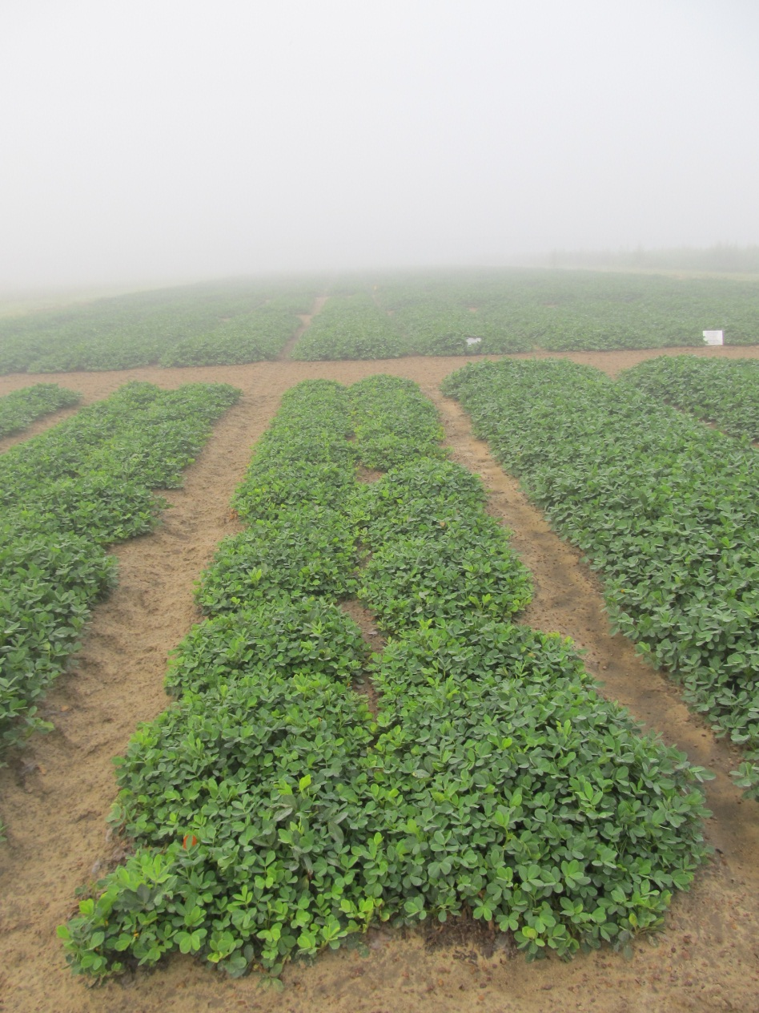
105 g ai/ha
1680 g ai/ha
1 week after treatment

Slide 18
Yield Response – 90 DAP
105 420 1680
Rate ( g ai/ha)

Slide 19
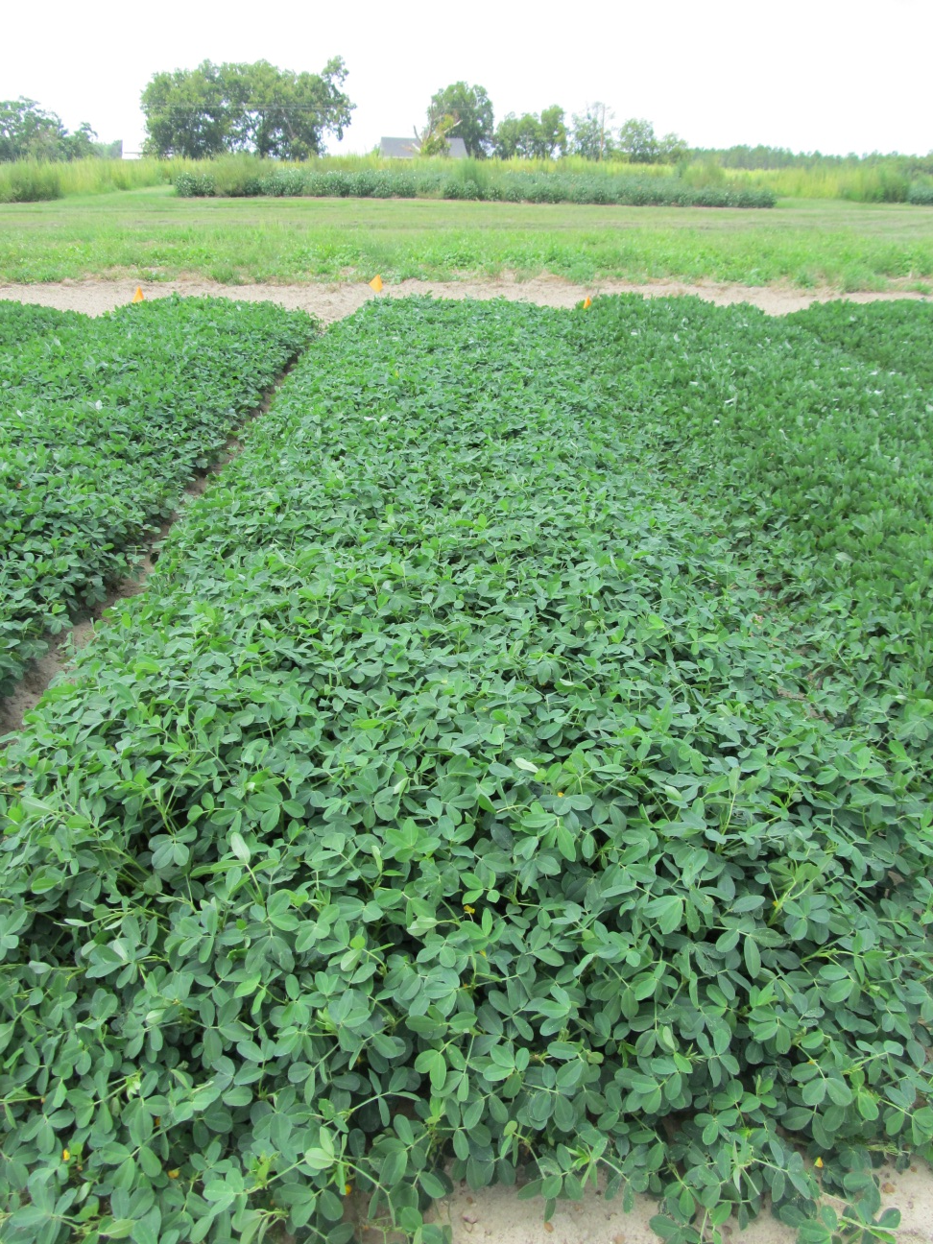
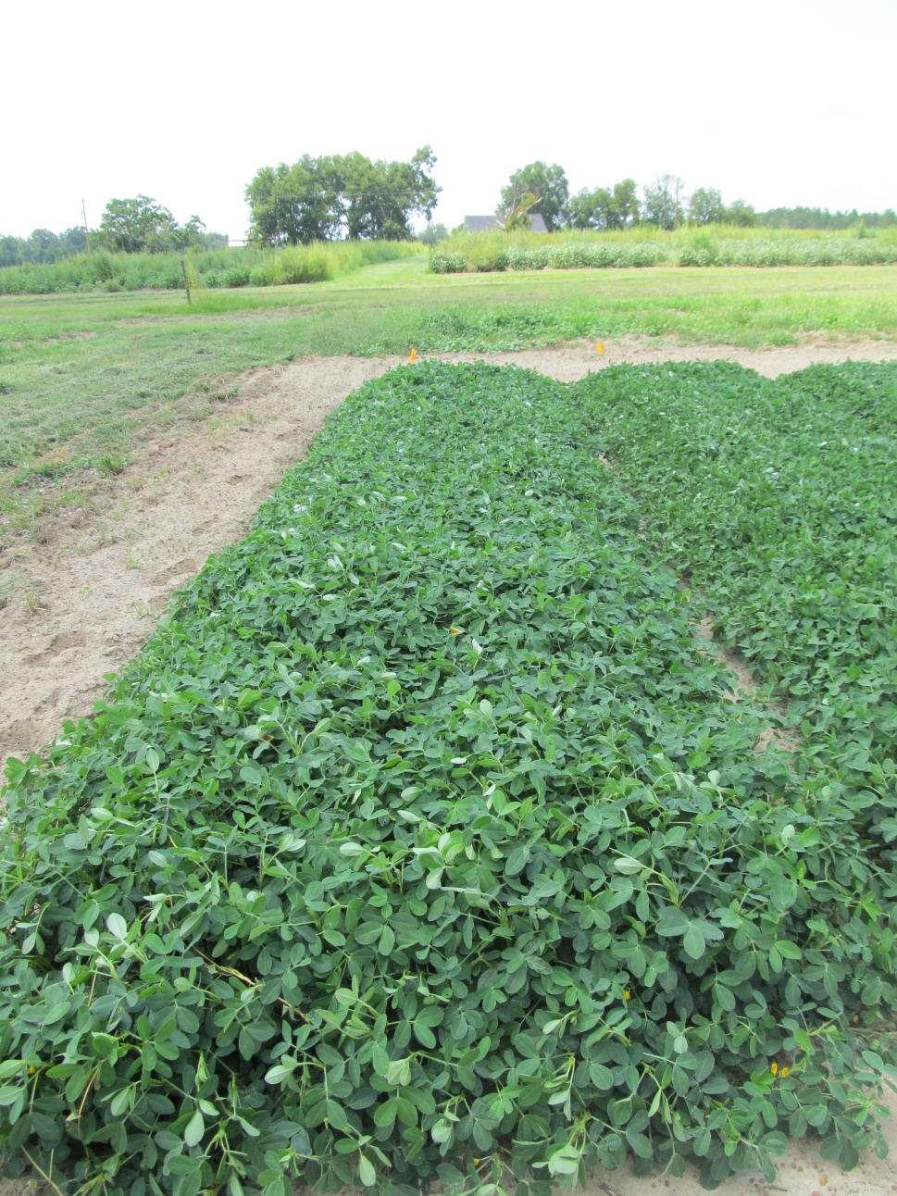
105 g ai/ha
1680 g ai/ha
1 week after treatment

Slide 20
Summary
105 420 1680
Rate ( g ai/ha)

Slide 21
Summary
Yield loss increased as rate increased when 2,4-D was applied 30 DAP and 60 DAP
There was no significant loss of yield when 2,4-D was applied 90 DAP at any rate

Slide 22
Conclusions
2,4-D was most injurious when applied at 60 DAP
There was no negative effect at 90 DAP
Growers must be cautious when applying 2,4-D

Slide 23
Future Research
Currently repeating tests at 2 locations in 2012
Earlier times of application
10, 20 DAP
Continue to screen current and future herbicides for off-target/contamination damage to peanut

Slide 24
Questions?

