Slide 1
Peanut Weed Control: Are We Out of Silver Bullets?
Eric P. Prostko, Ph.D.
Professor and Extension Weed Specialist
Department of Crop & Soil Sciences

Slide 2
Feral Hogs: My new #1 enemy!

Slide 3
ATTENTION ALL FERAL HOGS!
THIS WAY TO SCOTT MONFORT’S PEANUTS

Slide 5
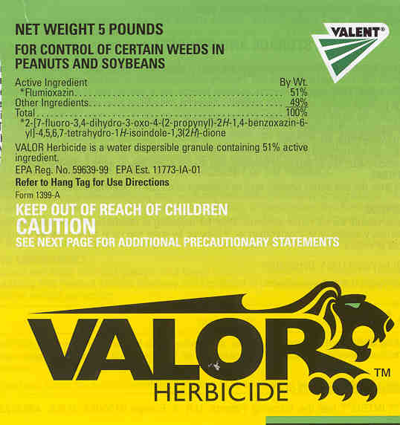
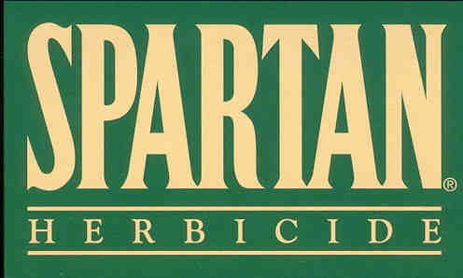
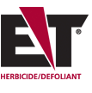
PPO-Resistance
Very popular herbicides
11 species worldwide
4 species in US
Palmer amaranth
AR, IL, TN (confirmed)
AL, MS, NC, SC (suspected)
tall waterhemp
IL, IN, IA, KS, MO, MN
common ragweed
DE, NC, OH
goosegrass
NC, VA

Slide 6
What and when was the last herbicide mode of action discovered?
HPPD inhibitors (WSSA MOA 27)
1980
Sanbird (pyrazolynate) – a rice herbicide
Sankyo (Japan)
Since then………..
Callisto (mesotrione) – 2001 (Syngenta)
Impact/Armezon (topramezone) – 2006 (AMVAC/BASF)
Laudis (tembotrione) - 2007 (Bayer)

Slide 7
What happened to herbicide discovery?
herbicide tolerant crops
industry consolidation
registration costs
It ain’t easy!

Slide 8
U.S. Planted Acres - 2017
NASS
June 30, 2017

Slide 9
For a minor crop, we have a great toolbox! (22 active ingredients)
Residuals
Dual Magnum
Outlook
Prowl
Pursuit
Sonalan
Spartan
Strongarm
Valor
Warrant
Zidua
Postemergence
2,4-DB
Aim
Basagran
Cadre
Classic
Cobra
ET
Fusilade
Gramoxone
Poast
Select
Storm
Ultra Blazer

Slide 10
Discovery and Development Costs of New Crop Protection Products
Source: P. McDougall
March 2016
For CropLife International

Slide 11
Number of Years Between Synthesis and 1st Sale
Source: P. McDougall
March 2016
For CropLife International

Slide 12
Number of Products (X 1000) Processed Leading to A Single Successful Launch
Source: P. McDougall
March 2016
For CropLife International

Slide 13
Peanut Silver Bullets Since the 1980’s
Poast – 1985
Premerge/Dinitro/Dynanap (dinoseb) was cancelled in 1986
Sonalan – 1988
Classic – 1988
Paraquat - 1988
Pursuit – 1991
Zorial/Solicam - 1993
Cadre – 1996
Prostko starts his Peanut Weed Science Career - 1997
Select - 1998
Strongarm - 2000
Valor - 2001
Spartan - 2004
Cobra - 2005
Fusilade - 2009
Warrant - 2014
Zidua - 2017

Slide 14
Zidua in Peanut
“As part of BASF’s internal top secret research program, I have been putting 0.5 oz of Zidua 85WG on my breakfast cereal for many years now. It cures everything from athletes foot to dandruff. It is also very good on Palmer pigweed!!”
Sandy Newell, BASF

Slide 15
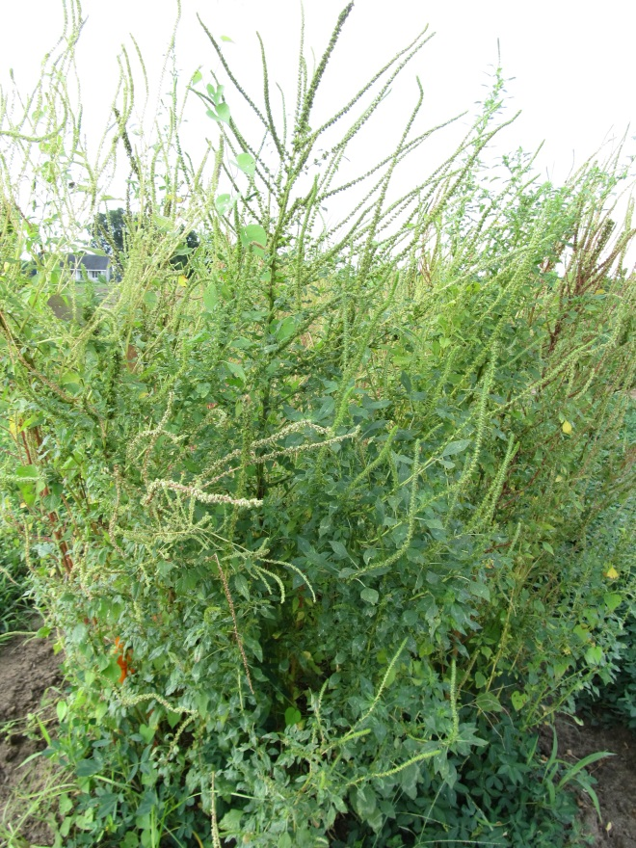
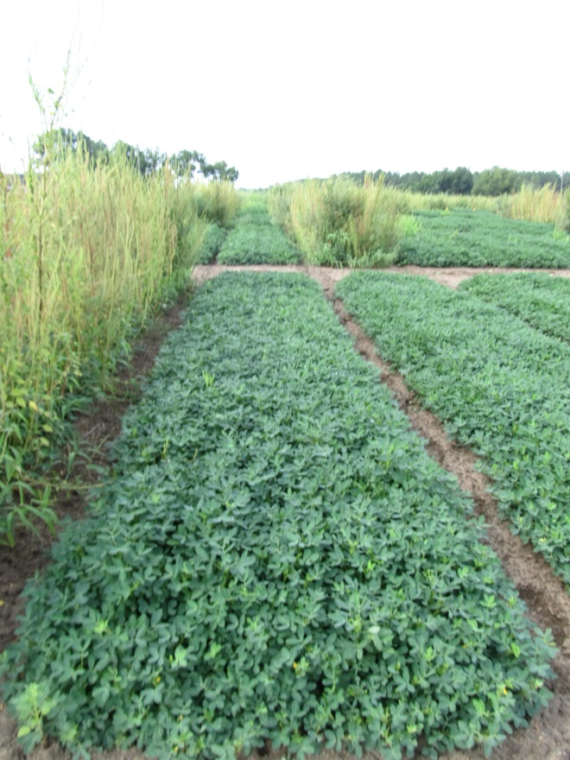
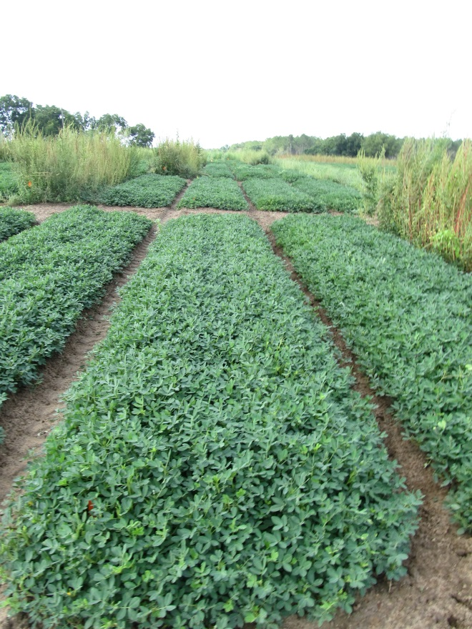
Zidua vs. Dual in Peanut - 2016
NTC
Prowl H₂O @ 32 oz/A – PRE
Gramoxone 2SL @ 12 oz/A – 14 DAP
Storm SL @ 16 oz/A – 14 DAP
Zidua 85WG @ 2.0 oz/A – 14 DAP
NIS @ 0.25% v/v – 14 DAP
Cadre 2AS @ 4 oz/A – 35 DAP
2,4-DB 1.75SL @ 18 oz/A – 35 DAP
Zidua 85WG @ 2.0 oz/A – 35 DAP
NIS @ 0.25% v/v – 35 DAP
Prowl H₂O @ 32 oz/A – PRE
Gramoxone 2SL @ 12 oz/A – 14 DAP
Storm SL @ 16 oz/A – 14 DAP
Dual Magnum 7.62EC @ 16 oz/A – 14 DAP
Cadre 2AS @ 4 oz/A – 35 DAP
2,4-DB 1.75SL @ 18 oz/A – 35 DAP
Dual Magnum 7.62EC @ 16 oz/A – 35 DAP
PE-08B-16
GA-14N
August 10, 2016
105 DAP

Slide 16
Future Silver Bullets?
Anthem Flex
FMC
Aim + Zidua
Brake
SePro
fluridone
WSSA MOA 12
PDS Inhibitor
Nothing else!!!!

Slide 17
Brake vs. Valor Programs* - 2017
Valor Program
Brake Program
NTC
Valor Program
Brake Program
NTC
Valor Program
Brake Program
PE-07-17
July 28
94 DAP
*Both programs also included Prowl (PRE) and Cadre + Dual Magnum + 2,4-DB (36 DAP)

Slide 18
Brake/Peanut Injury - 2017
PE-07-17
May 15
21 DAP

Slide 19
What about Zorial/Solicam?
Labeled in 1993
Fell off the map
WSSA MOA 12
Same as Brake
Were some issues with peanut varieties
No data on new peanut varieties
Grass crop rotational issues (24 months)
Cost/A
$37.50/1.5 lbs

Slide 20
The Future: What can you do?
other tactics
tillage, cover crops, row spacing, crop rotation (especially field corn)
use full labeled rates
hand-weeding
pray for a new mode of action!

Slide 21
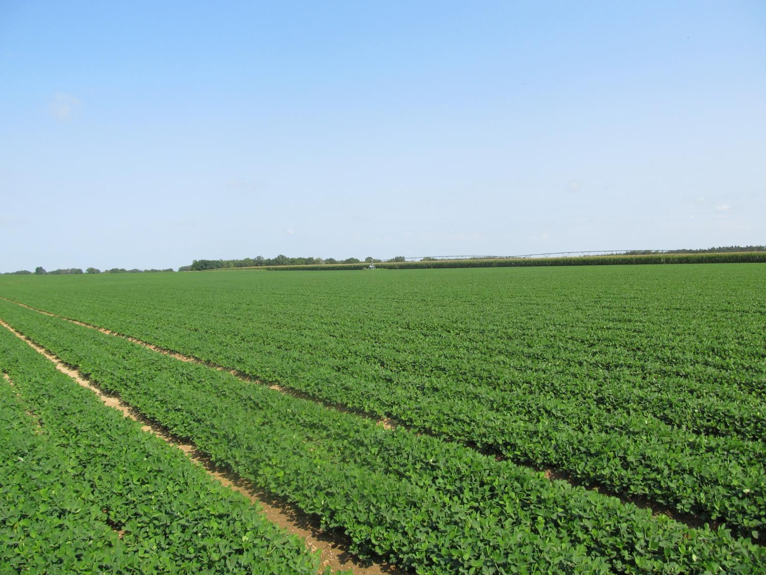
Questions?
eprostko@uga.edu
www.gaweed.com

