Slide 1


Peanut Response to Engenia™ and Enlist™ Duo
E.P. Prostko¹ and O.W. Carter²
¹Professor/Extension Weed Specialist
²Graduate Research Assistant
Dept. Crop & Soil Sciences

Slide 2
Georgia Planted Acres - 2017
NASS
June 30, 2017

Slide 3
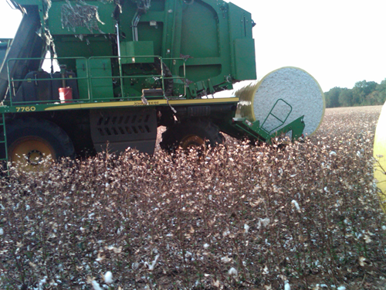


2016 Cotton - Southeast
~43% of SE cotton acreage was planted to Xtend varieties
46.2% of GA cotton acres
DP1538B2XF (21.28%)
DP1553B2XF (17.09%)
DP1646B2XF (7.79%)
2017 (GA) – July 11
Xtend (>75%)
Dr. J. Whitaker - UGA
Enlist (1.9% or 25,000 A)
Dr. J. Richburg - DAS

Slide 4



Peanuts/2,4-D/Dicamba
How much?
Vapor Drift
1/1000thX?
Particle Drift
1/10thX to 1/100thX
Tank-contamination (heel)
1/50thX to 1/400thX
When?
Stage of growth

Slide 5
Previous Research
Source | Year | Herbicide | Rates | Timing (DAP)
Peanut Sci. 38:61-85 | 2011 | dicamba | 1/16th to 1X | 30, 60, 90
MS Thesis R. Merchant UGA | 2013 | 2,4-D amine | 1/8th to 2X | 30, 60, 90
Weed Tech. 28:465-470 | 2014 | dicamba 2,4-D amine | 1/16th to 1X | 21, 42
Peanut Sci. 42:109-120 | 2015 | dicamba | 1/16th to 1X | 0, 10, 20, 30
APRES Proc. 47:145 | 2015 | glyphosate + dicamba | 1/16th to 1X | 30, 60, 90
WSSA Abstracts 57:207 | 2017 | 2,4-D dicamba | 0.05% to 15% of 1 pt/A rates | 4-5 leaf or bloom
Peanut Science (44:53-59) | 2017 | 2,4-D | 1/8th to 2X | 0, 10, 20, 30 DAP

Slide 6

Objectives
Effects of lower rates of Engenia™ (1/100thX)
dicamba-BAPMA
Effects of Enlist™ Duo
glyphosate + 2,4-D choline

Slide 7

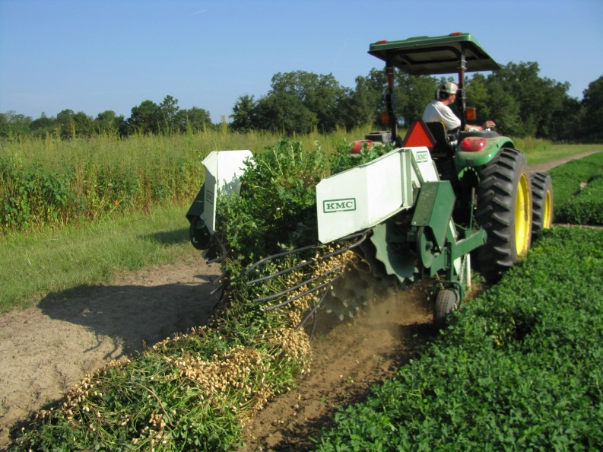
Materials and Methods
UGA Ponder Research Farm – 2016
Engenia™ Test
‘GA-06G’
1X, 1/10X, 100X
15, 30, 60, 90 DAP
Enlist™ Duo Test
‘GA-12Y’
1X, 1/10X, 1/100X
15, 30, 60, 90 DAP
factorial design
rate X timing
4 replications
15 GPA, 11002AIXR
weed-free

Slide 8
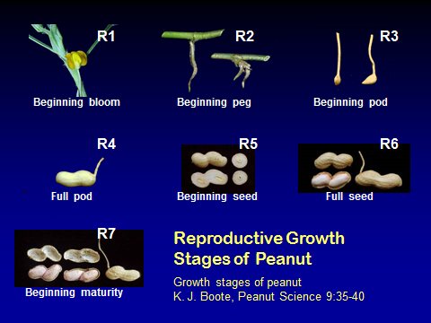
Peanut Stages of Growth
 | 15 DAP | 30 DAP | 60 DAP | 90 DAP
GA-06G | V4 | V6-V7 | R3-R4 | R6
GA-12Y | V4 | V6-V7 | R3-R4 | R6

Slide 9
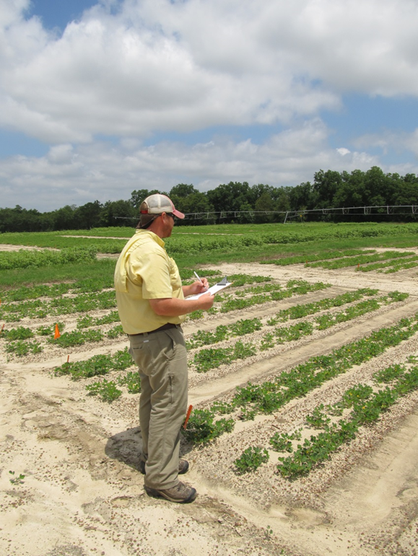
Data Collection/Analysis
Peanut Response
stunting
leaf burn
leaf roll
stand loss
Yield
ANOVA (P=0.10)

Slide 10
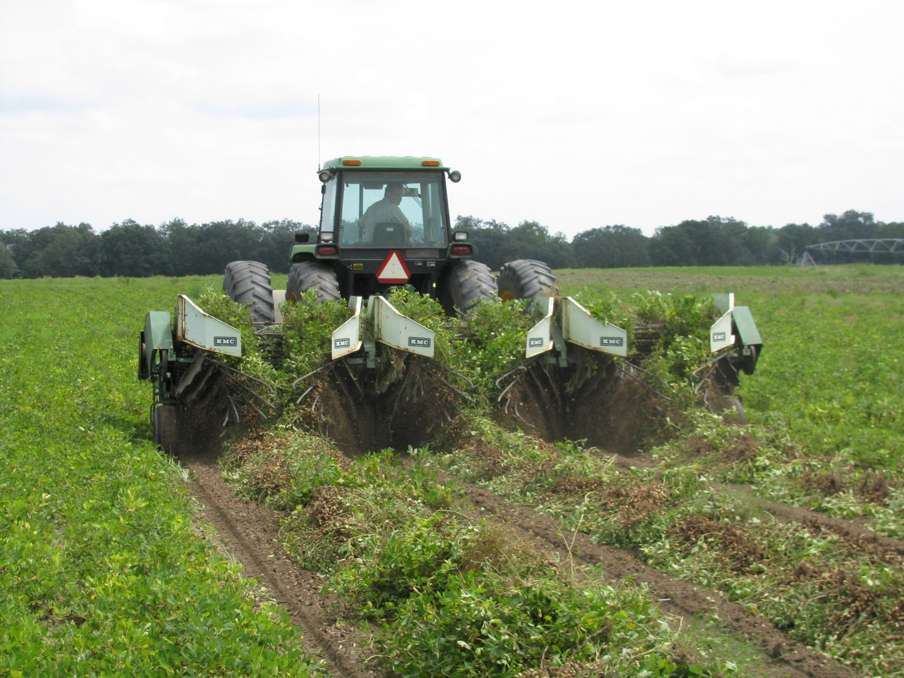
Results

Slide 11
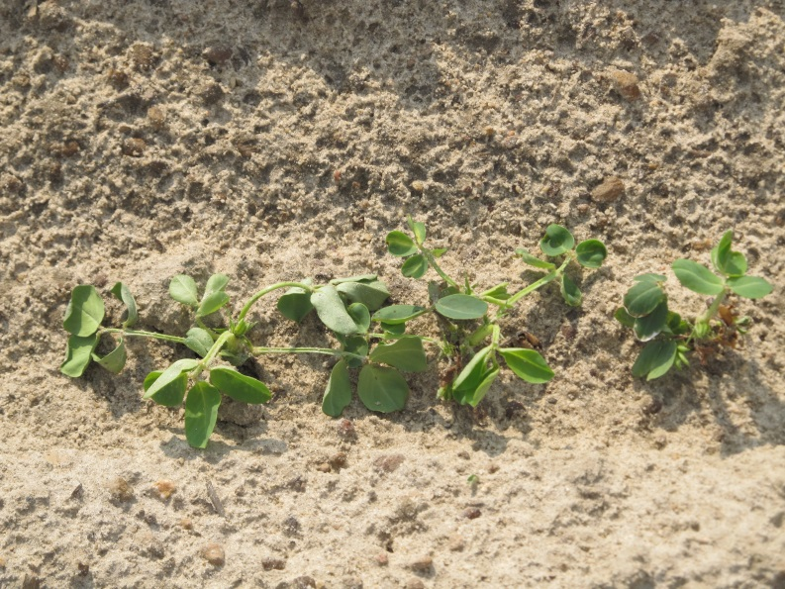
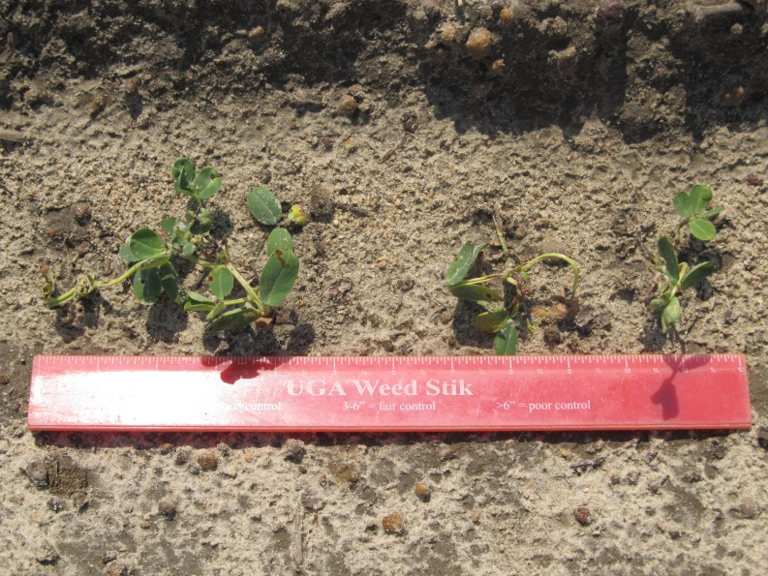
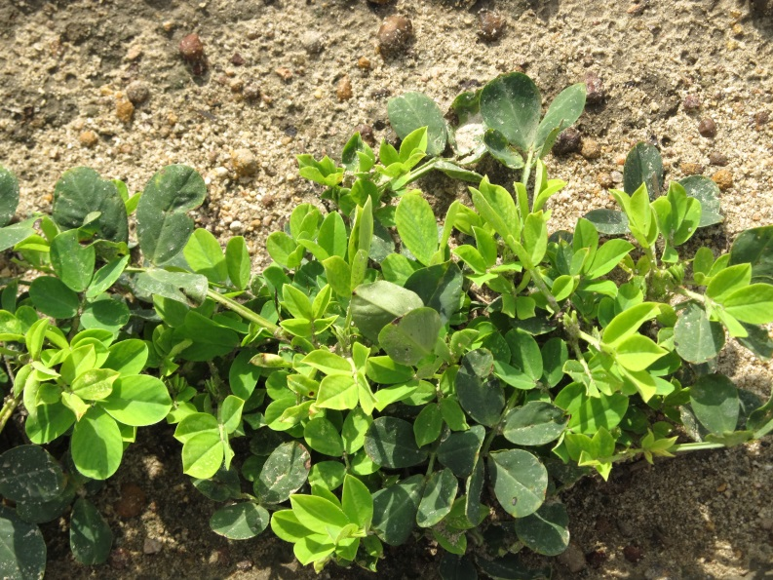
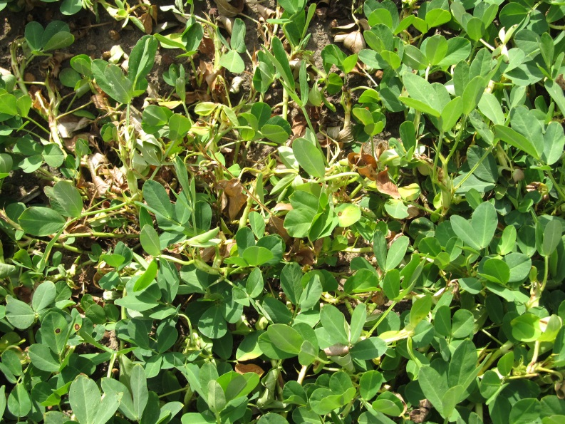
Engenia (dicamba) Injury Symptoms

Slide 12
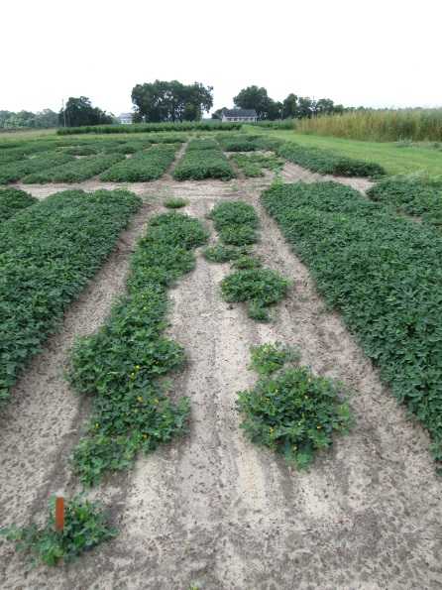
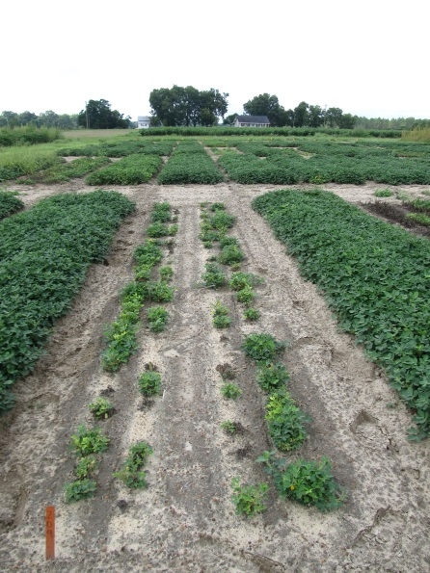
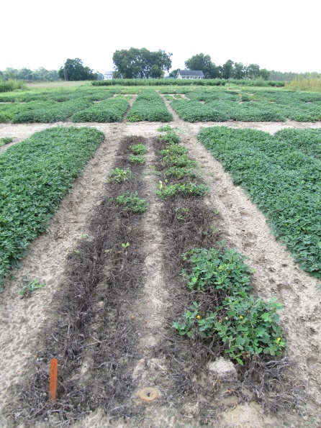
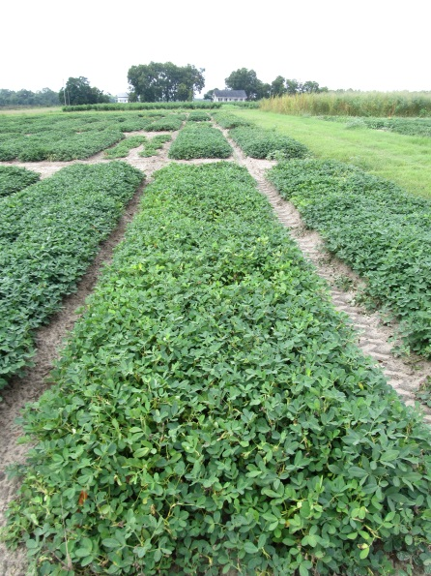
Peanut (GA-06G) Response to Engenia 5SL (dicamba) Applied at Various Times @ 12.8 oz/A
15 DAP
30 DAP
60 DAP
90 DAP
PE-04-16
August 12
107 DAP

Slide 13
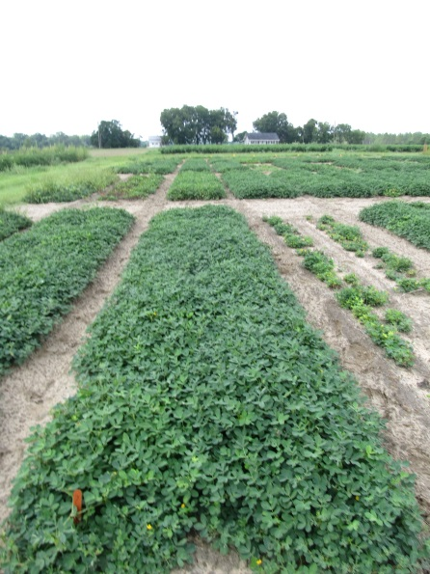
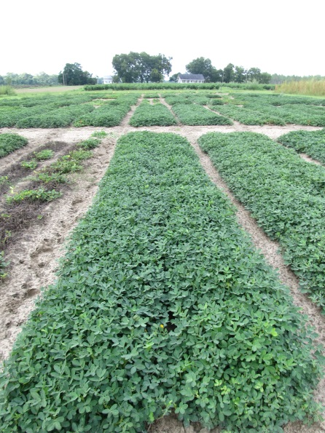
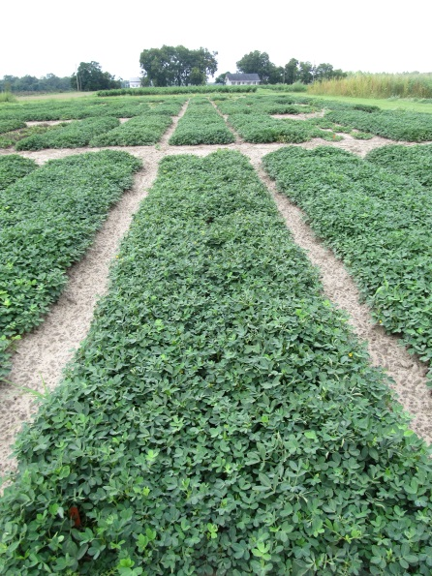
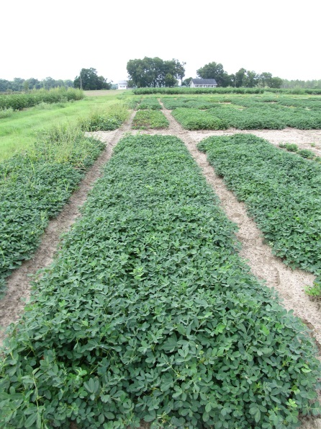
Peanut (GA-06G) Response to Engenia 5SL (dicamba) Applied at Various Times @ 1.28 oz/A
15 DAP
15 DAP
30 DAP
60 DAP
60 DAP
90 DAP
90 DAP
PE-04-16
August 12
107 DAP

Slide 14
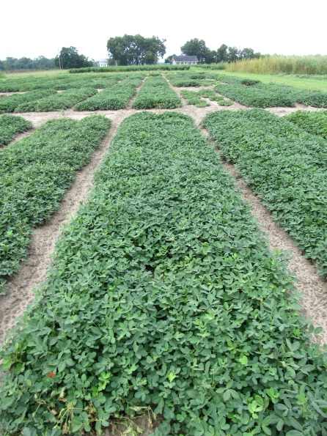
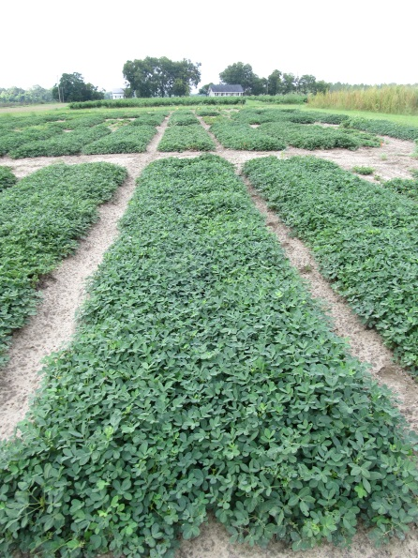
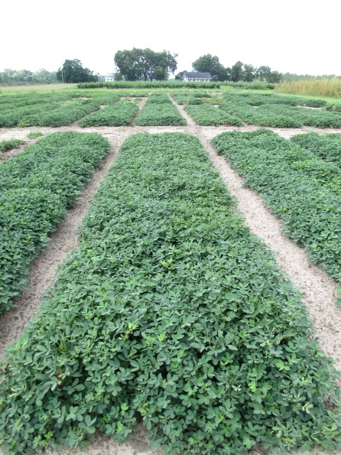
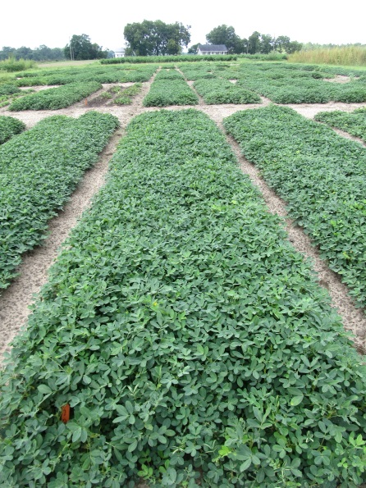
Peanut (GA-06G) Response to Engenia 5SL (dicamba) Applied at Various Times @ 0.128 oz/A
15 DAP
30 DAP
15 DAP
30 DAP
60 DAP
90 DAP
60 DAP
90 DAP
PE-04-16
August 12
107 DAP

Slide 15
Peanut (GA-06G) Yield Losses (%) Caused by Engenia 5SL - 2016
Rate/A | Time of Application (DAP¹)
 | 15 | 30 | 60 | 90
1X (12.8 oz/A) | 87 | 93 | 87 | 38
0.1X (1.28 oz/A) | 16 | 19 | 23 | 3
0.01X (0.128 oz/A) | 6 | 8 | 3 | 0
¹DAP = days after planting.
PE-04-16
LSD 0.10 = 7
CV = 23

Slide 16
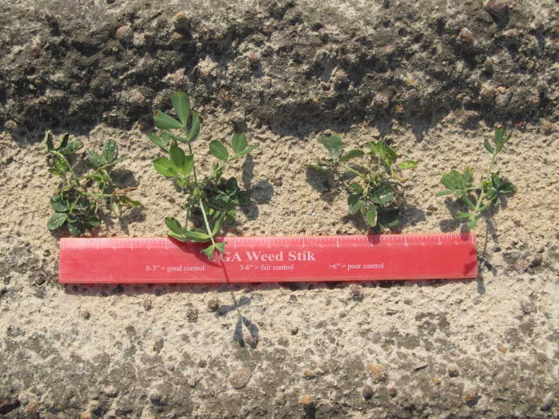
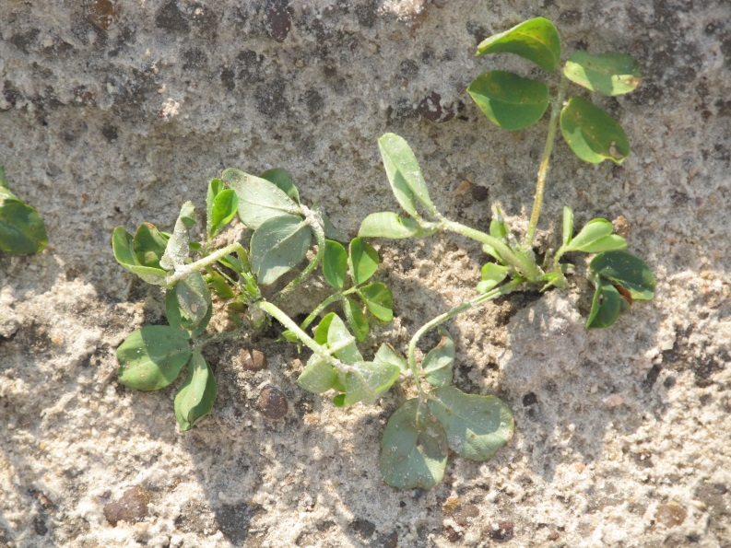
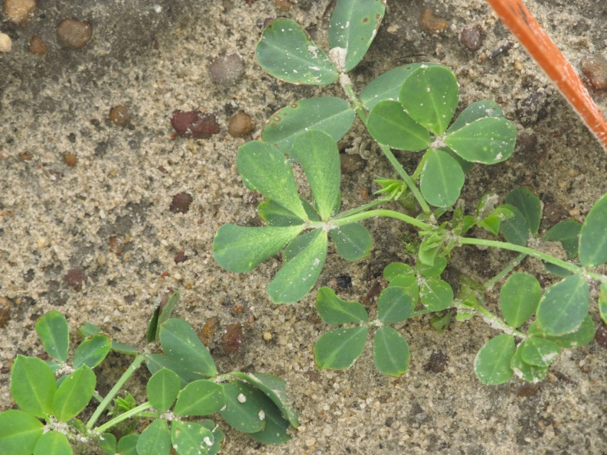
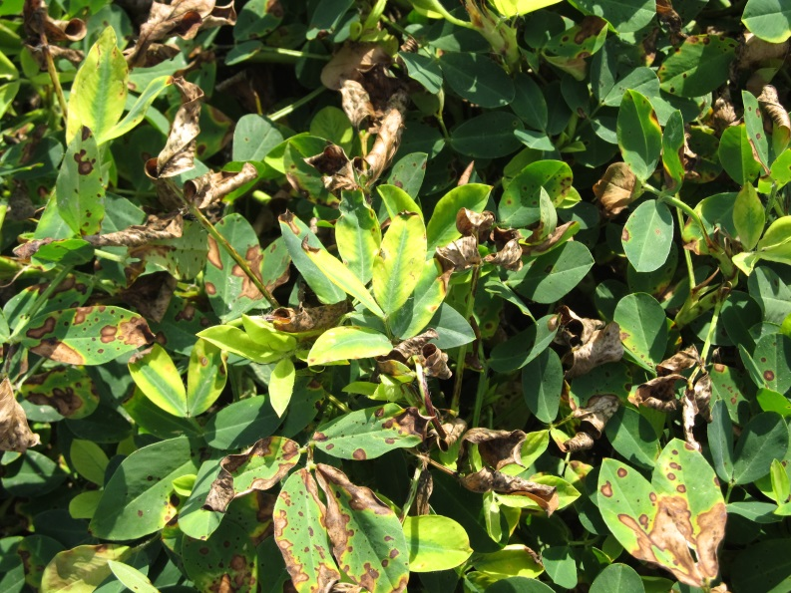
Enlist Duo Injury Symptoms

Slide 17


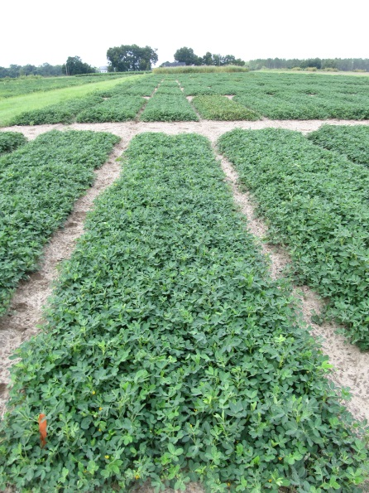
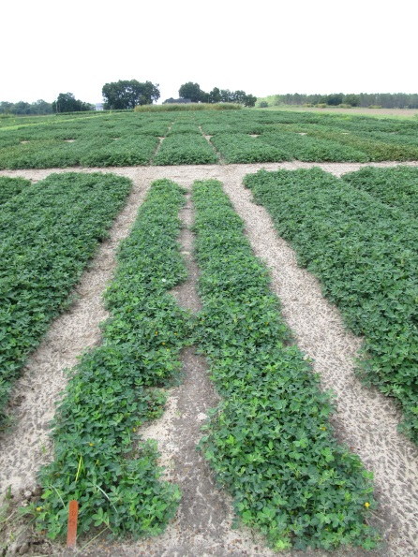


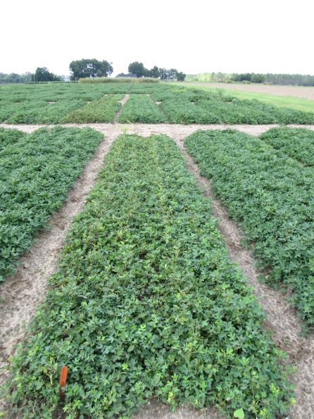
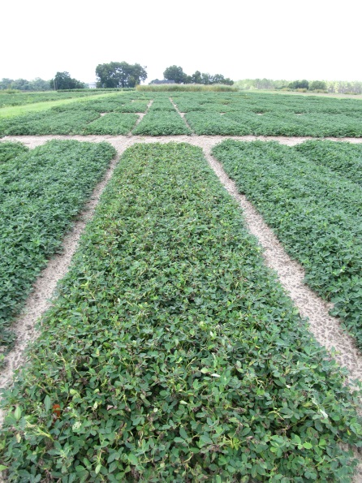
Peanut (GA-12Y) Response to Enlist Duo 3.3SL (glyphosate + 2,4-D choline) Applied at Various Times @ 56 oz/A
PE-05-16
August 12
107 DAP

Slide 18
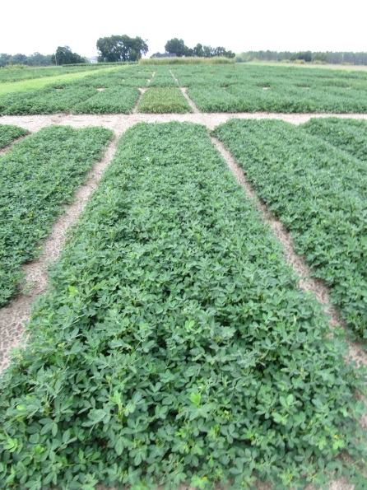
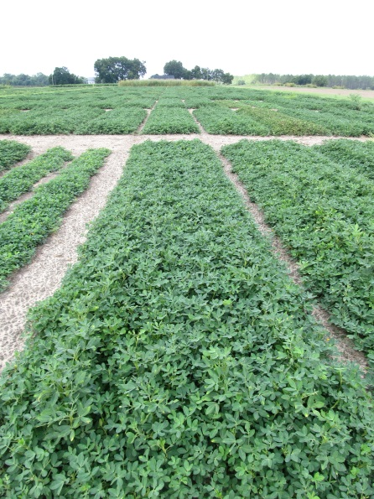
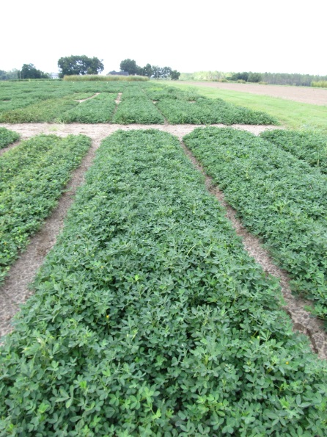
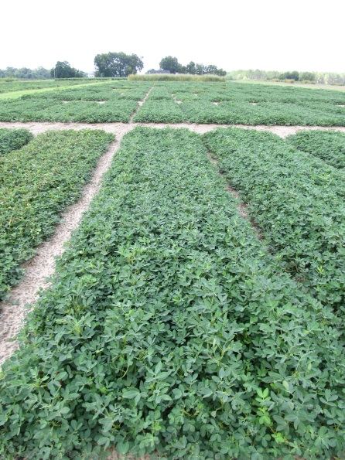
Peanut (GA-12Y) Response to Enlist Duo 3.3SL (glyphosate + 2,4-D choline) Applied at Various Times @ 5.6 oz/A
15 DAP
30 DAP
60 DAP
90 DAP
PE-05-16
August 12
107 DAP

Slide 19
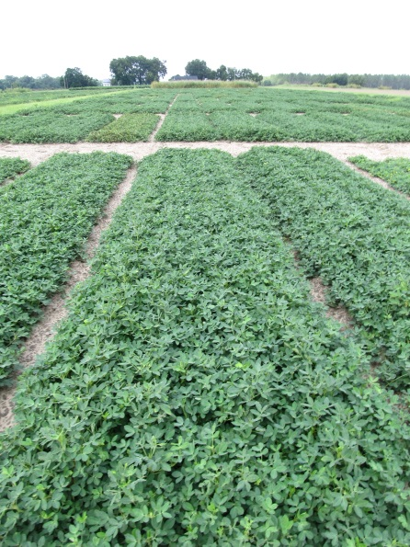
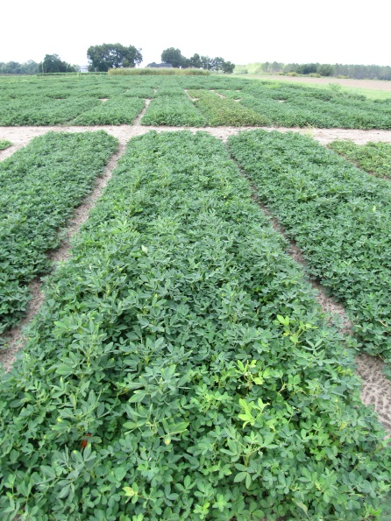
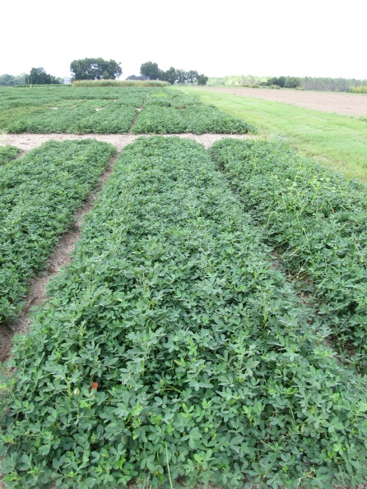
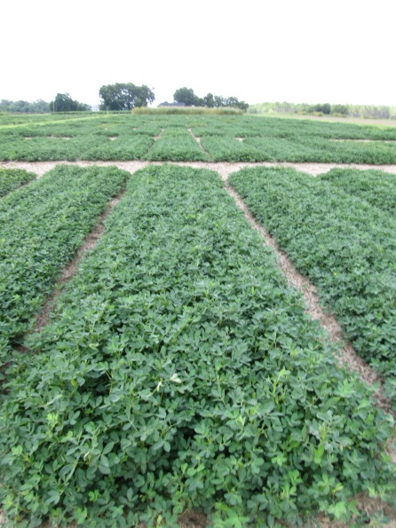
Peanut (GA-12Y) Response to Enlist Duo 3.3SL (glyphosate + 2,4-D choline) Applied at Various Times @ 0.56 oz/A
15 DAP
30 DAP
60 DAP
90 DAP
PE-05-16
August 12
107 DAP

Slide 20
Peanut (GA-12Y) Yield Losses (%) Caused by Enlist Duo 3.3SL - 2016
Rate/A² | Time of Application (DAP¹)
 | 15 | 30 | 60 | 90
1X (56 oz/A) | 45 | 61 | 64 | 56
0.1X (5.6 oz/A) | 12 | 11 | 7 | 3
0.01X (0.56 oz/A) | 12 | 5 | 5 | 5
¹DAP = days after planting.
²56 oz/A = 0.7 lb ae 2,4-D + 0.74 lb ae glyphosate; 5.6 oz/A =
0.07 lb ae 2,4-D + 0.074 lb ae of glyphosate; 0.56 oz/A= 0.007 lb ae
2,4-D + 0.0074 lb ae glyphosate.
PE-05-16
LSD 0.10 = 8
CV = 38

Slide 21
Peanut Yield Loss Caused By Simulated Drift Rates (1X) - 2016
Engenia = 12.8 oz/A
Enlist Duo = 56 oz/A

Slide 22
Peanut Yield Loss Caused By Simulated Drift Rates (1/10X) - 2016
Engenia = 1.28 oz/A
Enlist Duo = 5.6 oz/A

Slide 23
Peanut Yield Loss Caused By Simulated Drift Rates (1/100X) - 2016
Engenia = 0.128 oz/A
Enlist Duo = 0.56 oz/A

Slide 24
Summary - I
Timing X Rate interaction for both (yield loss)
Engenia
Within Time
1X > 0.1X > 0.01X (15, 30, 60 DAP)
1X > 0.1X = 0.01X (90 DAP)
Within Rate
15 DAP = 30 DAP = 60 DAP > 90 DAP (1X and 0.1X)
≤ 8% yield loss at any timing (0.01X)

Slide 25
Summary - II
Enlist Duo
Within Time
1X > 0.1X = 0.01X (15, 30, 60, 90 DAP)
Within Rate
15 DAP < 30 DAP = 60 DAP = 90 DAP (1X)
15 DAP = 30 DAP = 60 DAP; 30 DAP = 60 DAP = 90 DAP; 15 DAP > 90 DAP (0.1X)
15 DAP = 30 DAP = 60 DAP = 90 DAP (0.01X)
≤ 12% yield loss at any timing (0.01X)

Slide 26

Future Research
repeated studies in 2016
glyphosate + dicamba
glufosinate + dicamba or 2,4-D
multiple events
seed germination studies
residue analysis
hull and nut

Slide 27
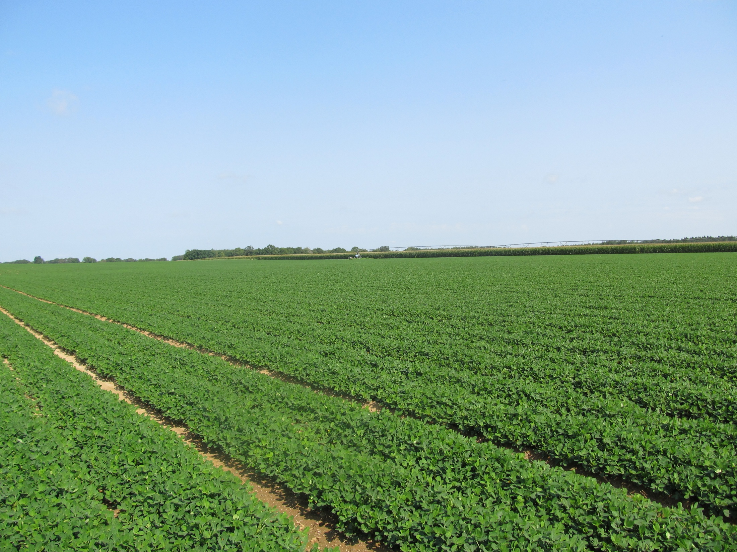
Questions?
eprostko@uga.edu
www.gaweed.com

