Slide 1

Impact of Dual Magnum on Peanut Yields in Georgia
Eric P. Prostko and Timothy L. Grey
Department of Crop & Soil Sciences

Slide 2


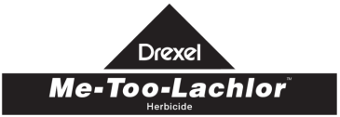
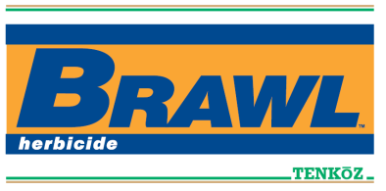
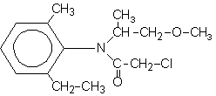
Brief History of Metolachlor
Synthesized by Ciba-Geigy in 1972
50/50% mixture of R + S isomers
Registered for corn in 1977
Registered for peanut in 1980 (February)
S-metolachlor registered for use in 1997 (Novartis)
12/88% mix of R + S isomers
Patent expiration
EPA Reduced Risk Pesticide Program
Novartis stopped selling “old” metolachlor in 1999, phased out completely by 2001.
Novartis + AstraZeneca became Syngenta in 2000
Generic companies started producing “old” metolachlor in 2003 (i.e. 50/50 mix of R + S isomer).

Slide 3
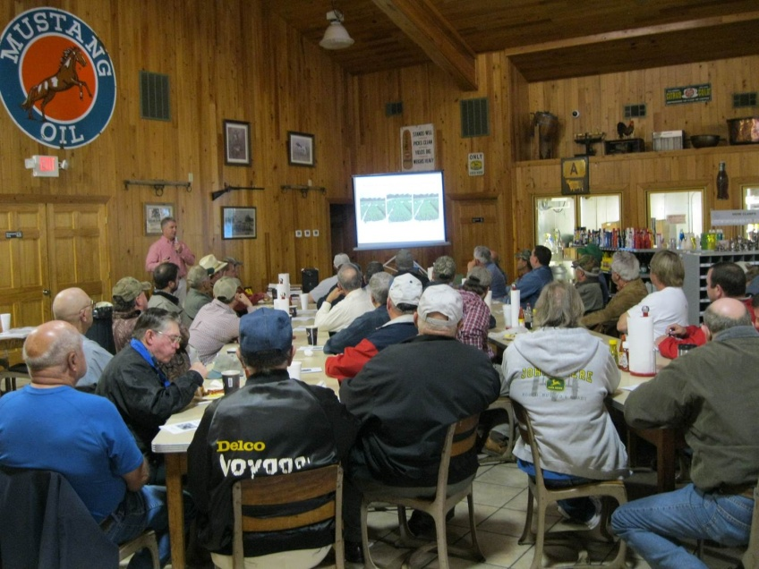
Some Grower Perceptions
Under the right conditions (wet and cold) Dual can cause ……..
J-rooting
Delayed emergence
Stand loss
Yield loss

Slide 4
Early Metolachlor/Peanut Research Results
Author (s) | Year | Journal | Results
Cardina and Swann | 1988 | Peanut Sci. 15:57-60 | Emergence and growth delayed from PPI applications when rainfall or irrigation followed application. No effect on yield at labeled rates. 3X rate reduced yield (11-15%)
Wehtje et al. | 1988 | Peanut Sci. 15:53-56 | Across all years, a 2-fold safety factor existed between maximum labeled rate and injury rate.
Johnson et al. | 1993 | Peanut Sci. 20:17-20 | Split applications of metolachlor (PPI + VE) had no effect on yield.
Johnson et al. | 1994 | Peanut Sci. 21:126-129 | PPI, VE, and PPI + VE applications had no effect on yield.

Slide 5

Materials and Methods
2010-2012
Replicated, small-plot research techniques
10 weed-free trials
Attapulgus, Plains, Tifton (Ty Ty)
GA-06G

Slide 6
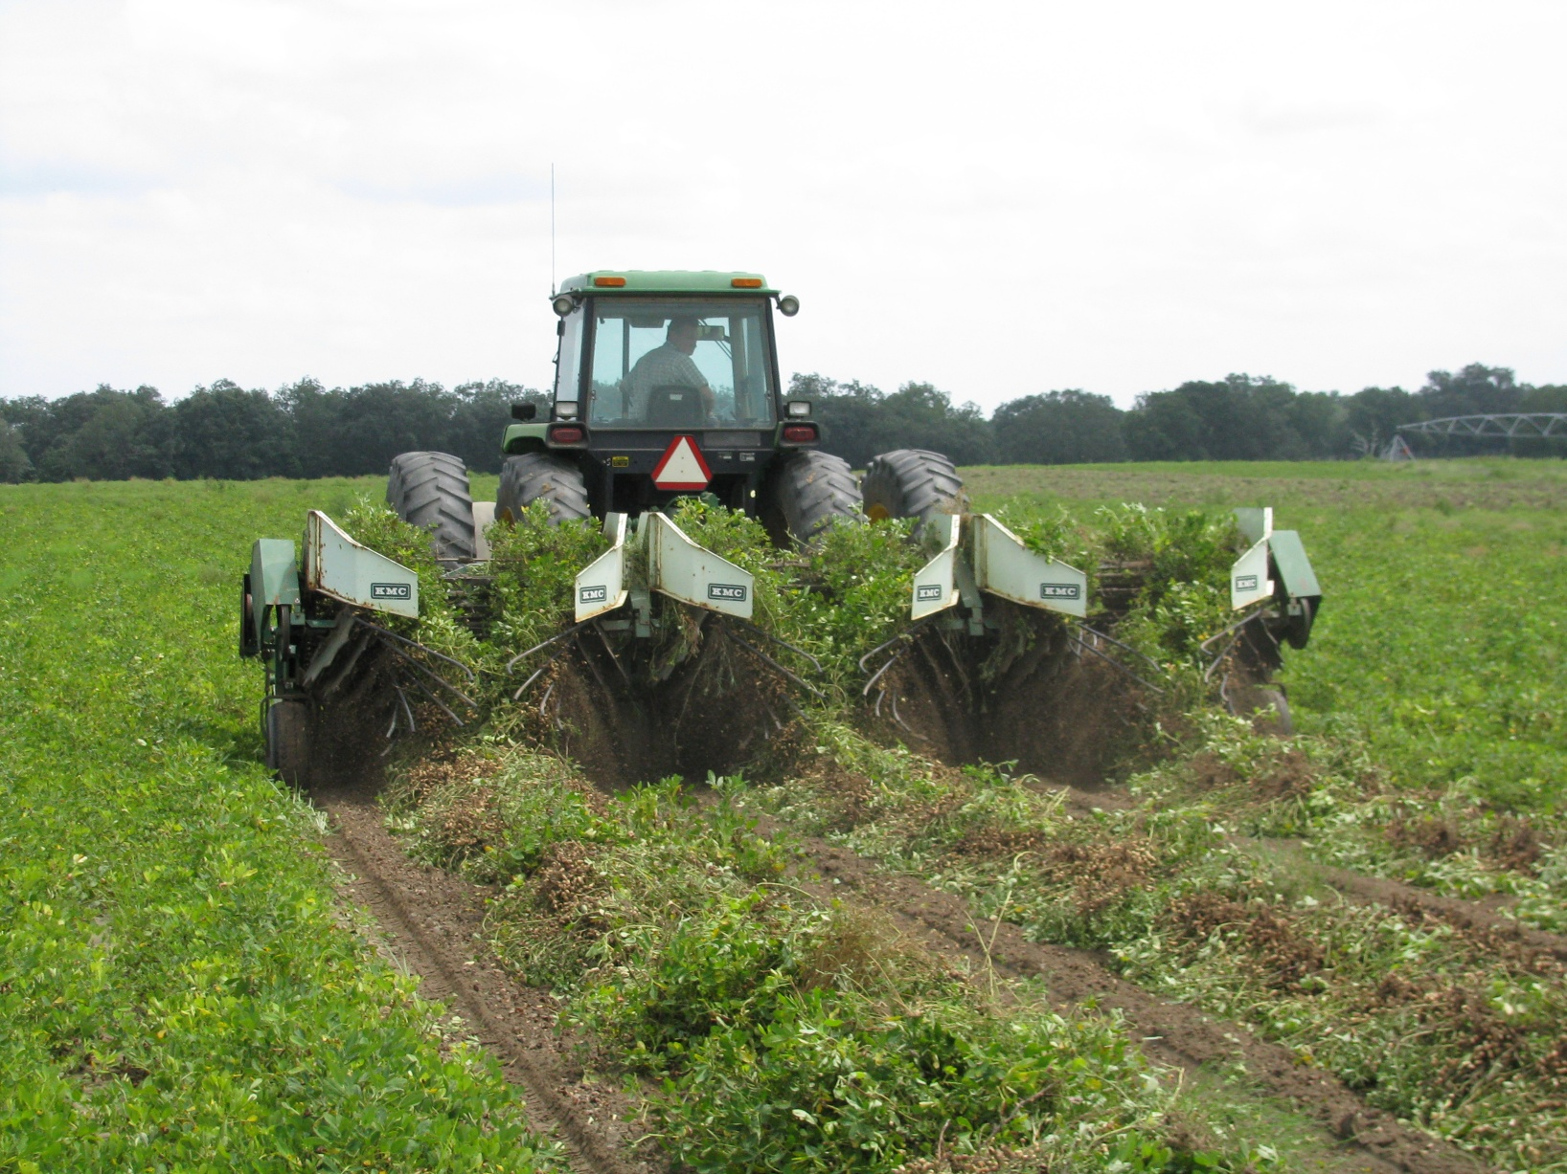
Results

Slide 7
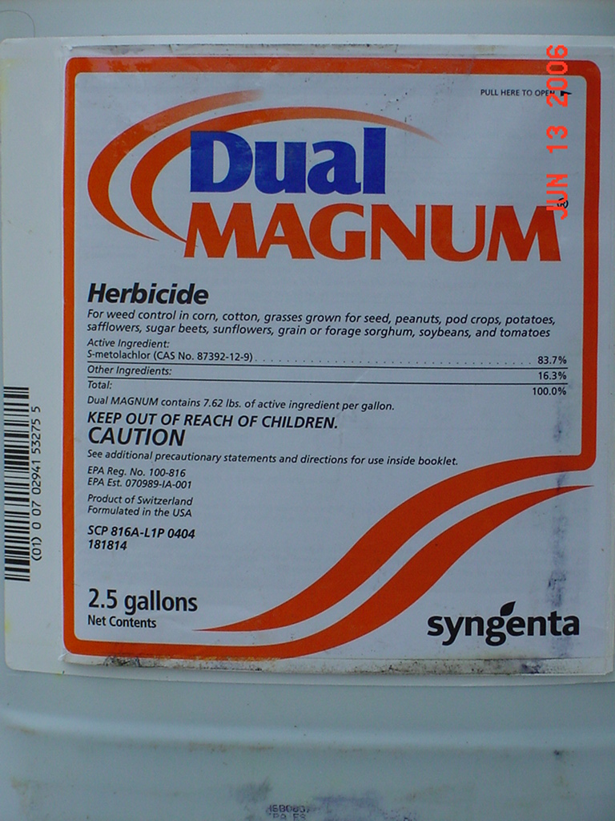
Dual Magnum Alone

Slide 8
Influence of PPI Dual Magnum on Peanut Yield (lbs/A) – 2011
LSD (0.10)
Tifton = 295
Plains = NS

Slide 9
Influence of PPI Dual Magnum on Peanut Yield (lbs/A) – 2012
LSD (0.10)
Tifton = NS
Plains = NS

Slide 10
Influence of PRE Dual Magnum on Peanut Yield (lbs/A) - 2011
LSD (0.10)
Tifton = 295
Plains = NS

Slide 11
Influence of PRE Dual Magnum on Peanut Yield (lbs/A) - 2012
LSD (0.10)
Tifton = NS
Plains = NS

Slide 12
Influence of PRE Dual Magnum on Peanut Yield (lbs/A) – 2012**
LSD (0.10)
Tifton = NS
Plains = NS
**Averaged over 3 planting dates

Slide 13
Influence of EPOST (13-18 DAP) Dual Magnum on Peanut Yield (lbs/A) - 2011
LSD (0.10)
Tifton = 295
Plains = NS

Slide 14
Influence of EPOST (13-15 DAP) Dual Magnum on Peanut Yield (lbs/A) - 2012
LSD (0.10)
Tifton = NS
Plains = NS

Slide 15
Influence of POST (25-26 DAP) Dual Magnum on Peanut Yield (lbs/A) - 2011
-8.1%
LSD (0.10)
Tifton = 295
Plains = NS

Slide 16
Influence of POST (30-34 DAP) Dual Magnum on Peanut Yield (lbs/A) - 2011
LSD (0.10)
Tifton = NS
Plains = NS

Slide 17


Cadre + Dual Magnum

Slide 18
Peanut Yield (lbs/A) Response to Cadre + Dual Magnum + 2,4-DB (2010).
Cadre (C) = 4 oz/A
Dual Magnum (DM) @ 16 oz/A
2,4-DB (DB) @ 18 oz/A
Applied 31 DAP
Weed-free
Tifton
PE-19-10
LSD (0.10) = NS

Slide 19
Influence of POST (25-26 DAP) Cadre + Dual Magnum on Peanut Yield (lbs/A) - 2011
LSD (0.10)
Tifton = 295
Plains = NS
Cadre @ 4 oz/A + Dual Magnum @ 1.33 pt/A

Slide 20
Influence of POST (30-34 DAP) Cadre + Dual Magnum on Peanut Yield (lbs/A) - 2012
LSD (0.10)
Tifton = NS
Plains = NS
Cadre @ 4 oz/A + Dual Magnum @ 1.33 pt/A

Slide 21


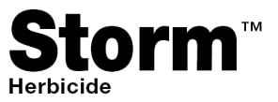
Gramoxone + Storm + Dual Magnum

Slide 22
Influence of EPOST (13-18 DAP) Gramoxone (G) + Storm (S) + Dual Magnum (DM) on Peanut Yield (lbs/A) - 2011
-9.6%
LSD (0.10)
Tifton = 295
Plains = NS
G @ 12 oz/A + S @ 16 oz/A + DM @ 1.33 pt/A

Slide 23
Influence of EPOST (13-15 DAP) Gramoxone (G) + Storm (S) + Dual Magnum (DM) on Peanut Yield (lbs/A) - 2012
LSD (0.10)
Tifton = NS
Plains = NS
G @ 12 oz/A + S @ 16 oz/A + DM @ 1.33 pt/A

Slide 24
Peanut Yield Response to Gramoxone (G) + Storm (S) + Dual Magnum (DM) – 2012**
PE-01-12
Attapulgus
LSD 0.10 = NS
CV = 15.52
**Averaged over 3 timings (11, 21, 32 DAP)

Slide 25
A Comparison of Weed-Free Peanut Yields Between NTC and Gramoxone (12 oz/A) + Storm (16 oz/A) + Dual Magnum (16-21 oz/A) Treatments in Georgia, 2011-2012.
G + S + DM
(lbs/A)
PEA01-11
PEA01-12
PE-20-11
PE-01-12
PE-17-12
NTC (lbs/A)
n = 25

Slide 26
Gramoxone + Storm + Dual Magnum (EPOST) fb Cadre + Dual Magnum (POST)

Slide 27
Peanut Yield Response to Gramoxone (G) + Storm (S) + Dual Magnum (DM) fb Cadre (C) + Dual Magnum – 2012**
-7.1%
LSD (0.10)
Tifton = 355
Plains = NS
**G @ 12 oz/A + S @ 16 oz/A + DM @ 16 oz/A fb C @ 4 oz/A + DM @ 16 oz/A

Slide 28
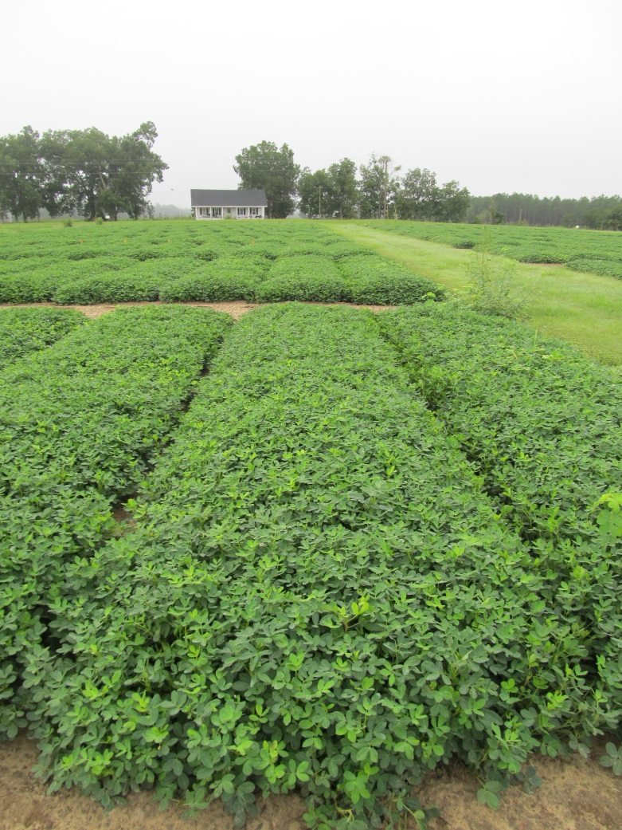
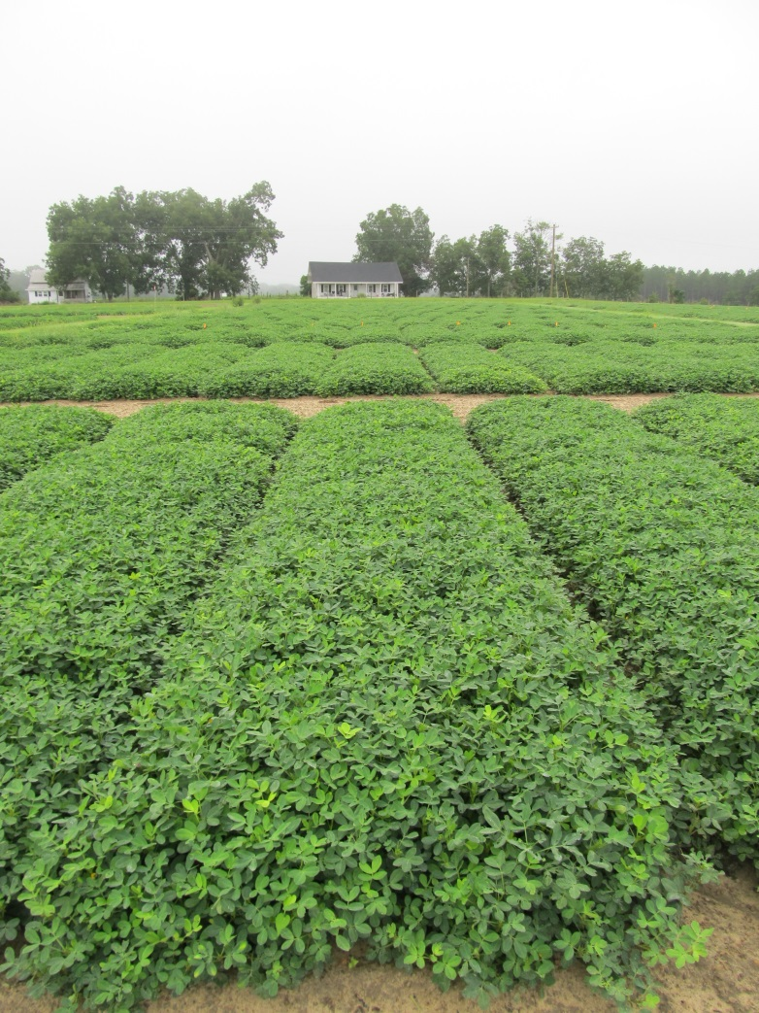
Peanut Response to Gramoxone + Storm + Dual Magnum fb Cadre + Dual Magnum - 2012
NTC
Gramoxone SL @ 12 oz/A (13 DAP)
Storm @ 16 oz/A (13 DAP)
Dual Magnum @ 16 oz/A (13 DAP)
Cadre @ 4 oz/A (34 DAP)
Dual Magnum @ 16 oz/A (34 DAP)
PE-06-12
August 22
118 DAP

Slide 29
A Comparison of Weed-Free Peanut Yields Between NTC and Gramoxone (12 oz/A) + Storm (16 oz/A) + Dual Magnum (16 oz/A) fb Cadre (4 oz/A) + Dual Magnum (16 oz/A) Treatments in Georgia, 2012.
G + S + DM fb C + DM
(lbs/A)
PE-06-12
PEA03-12
NTC (lbs/A)
n = 8

Slide 30
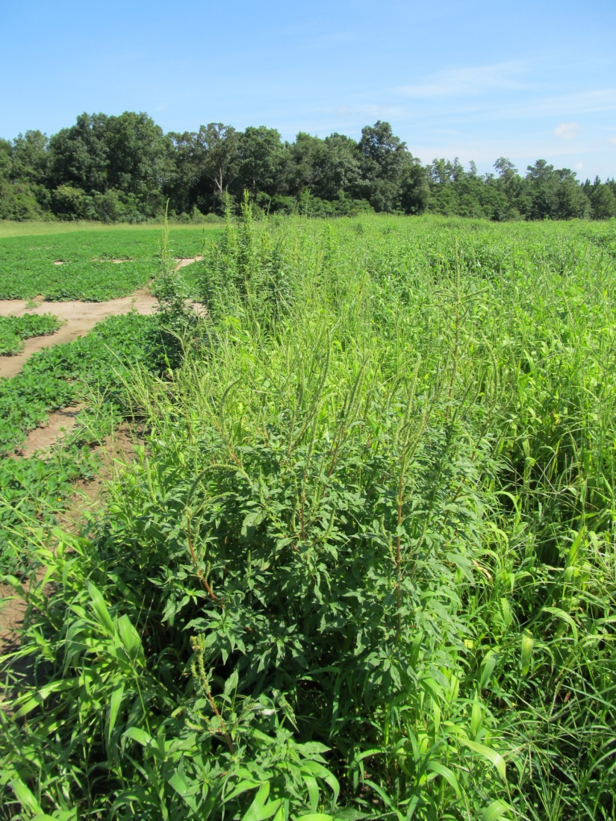
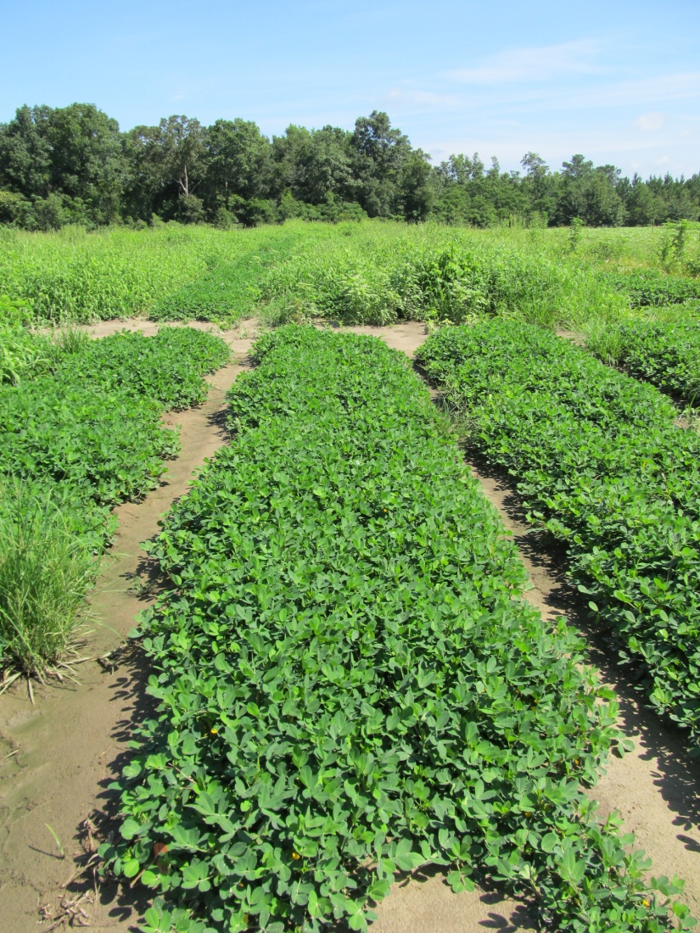
Palmer Amaranth Control in Peanut – 2012 (Gramoxone/Dual Magnum Based Program)
NTC
Prowl H₂O @ 34 oz/A (PRE)
Gramoxone SL @ 12 oz/A (21 DAP)
Storm @ 16 oz/A (21 DAP)
Dual Magnum @ 16 oz/A (21 DAP)
Cadre @ 4 oz/A (39 DAP)
Dual Magnum @ 16 oz/A (39 DAP)
PE-18-12
July 18
75 DAP

Slide 31
Summary
Dual Alone (PPI, PRE, EPOST)
4/4 trials = No effect on yield
Dual Alone (POST)
1/4 trials = -8.1% yield loss
Cadre + Dual (POST)
5/5 trials = No effect on yield
Gramoxone + Storm + Dual (EPOST)
1/5 trials = -9.6% yield loss
Gramoxone + Storm + Dual fb Cadre + Dual
1/2 trials = -7.1% yield loss

Slide 32

Questions?
www.gaweed.com

