Slide 1
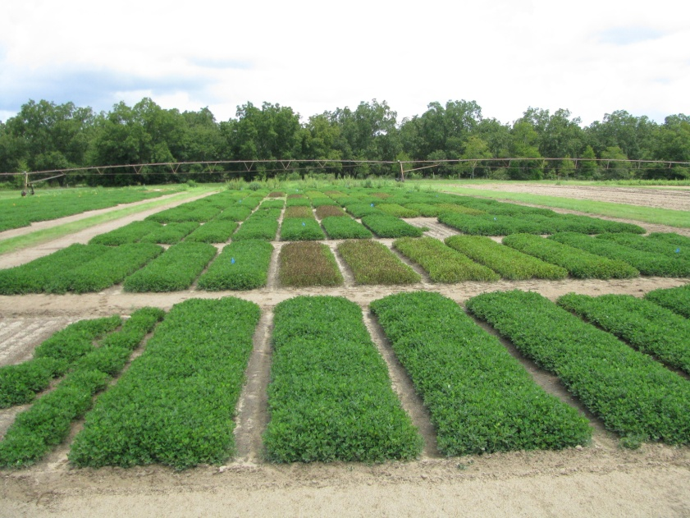



Peanut Response to Ignite (glufosinate) in Georgia - 2010
E.P. Prostko*, T.L. Grey, and T.M. Webster
- 2011

Slide 2


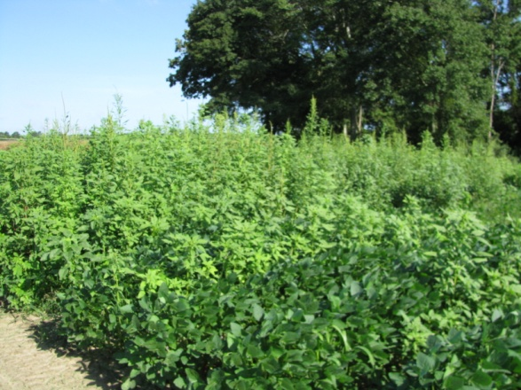
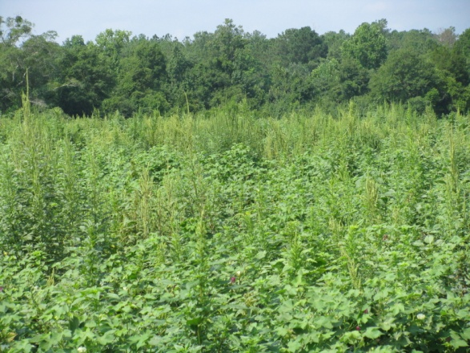
Ignite (glufosinate) has become very popular in Georgia due to HR-Palmer amaranth.

Slide 3
Ignite Sales in Georgia
+174%
gallons

Slide 4
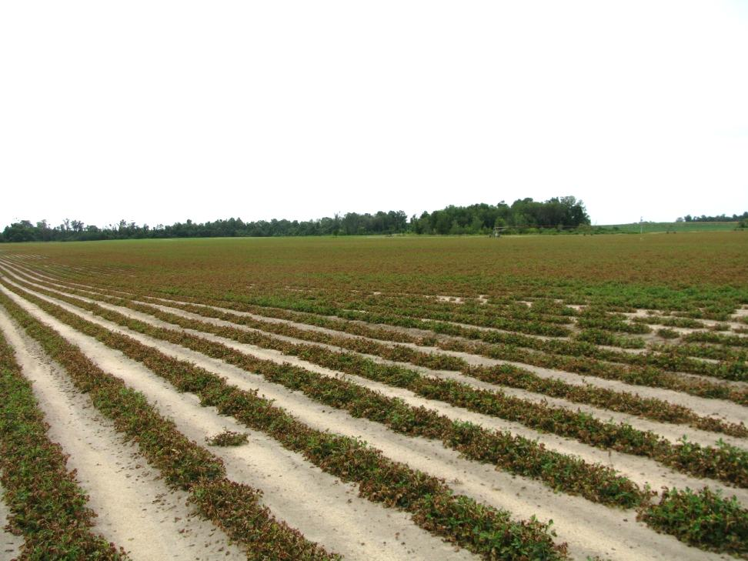
Potential Problems with Ignite
Drift
Sprayer contamination
How sensitive are peanuts?
Pulaski County Peanut Field – 2009
Misapplication of Ignite

Slide 5
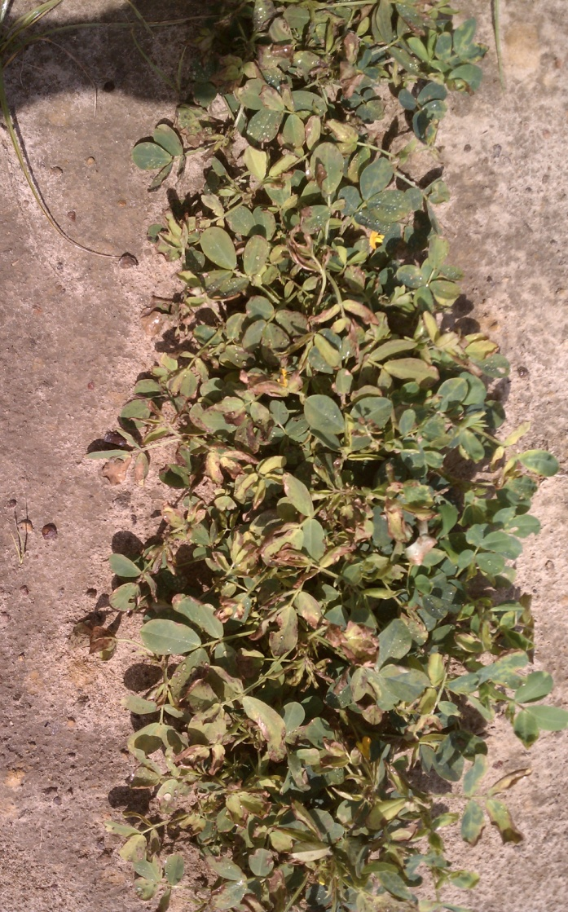
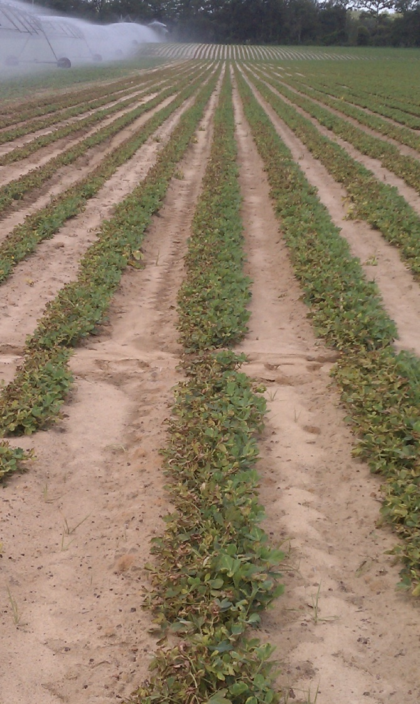
Ignite @ 32 oz/A + Staple 1.5 oz/A Drift
Seminole County, GA (June 2011)

Slide 6
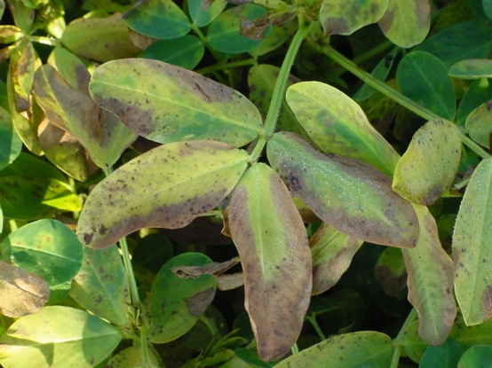
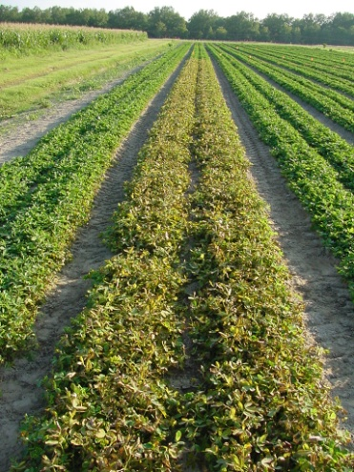
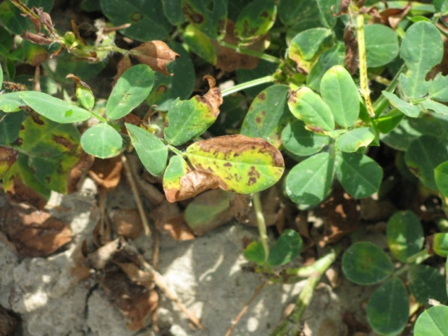
Objective
To determine the response of peanut to Ignite (glufosinate) applied at different rates and timings.
Similar research was also conducted in FL, SC, and TX

Slide 7
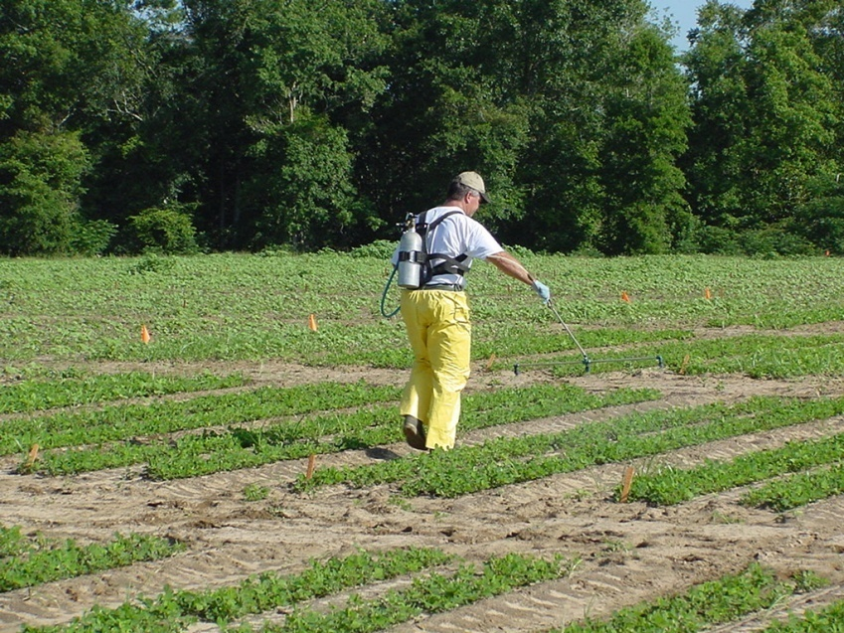
Materials and Methods - I
Small plot techniques
Split-plot design
  Whole plot = timing (3)
    30, 60, 90 DAP
  Sub-plot = rate (6)
    0,2,4,8,16,32 oz/A – Ignite 2.34SL
Locations (2)
  Ponder Farm, Plains
4 replications
weed-free
irrigated

Slide 8
Materials and Methods - II
Locations
 | Ponder | Plains
Planting Date | May 11 | May 26
Variety | GA-06G | GA-06G
30 DAP | June 11 | June 29
60 DAP | July 12 | July 27
90 DAP | August 12 | August 18
Soil pH | 6.0 | 6.1
OM (%) | 1.34 | 1
Sand (%) | 92 | 71
Silt (%) | 6 | 13
Clay (%) | 4 | 16

Slide 9
Materials and Methods – III
Peanut Growth Stages
Location | 30 DAP | 60 DAP | 90 DAP
Ponder | 4” tall 7” wide R1 | 8” tall Lapped R5 | 15” tall Lapped R6
Plains | 4” tall 6” wide R1 | 6” tall 18” wide R3 | 14” tall Lapped R5

Slide 10
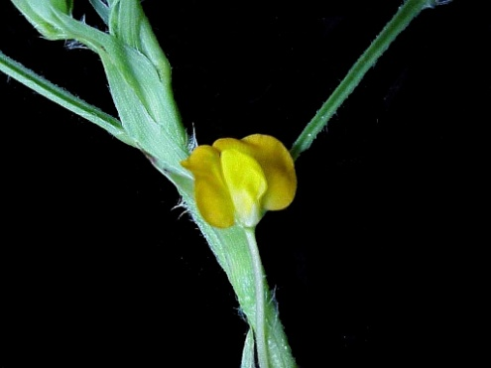
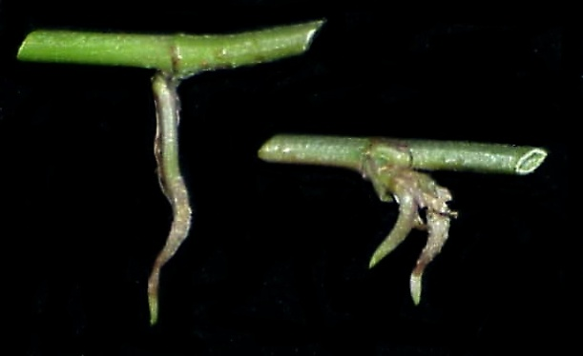
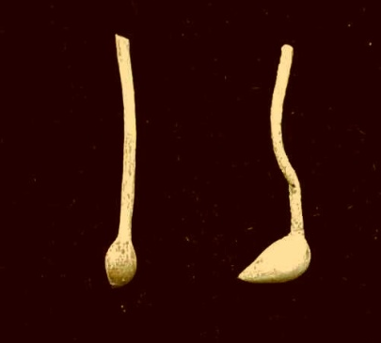
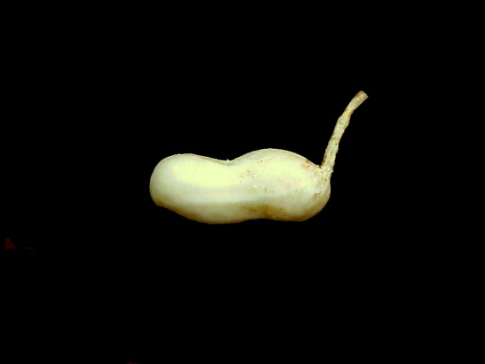
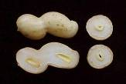
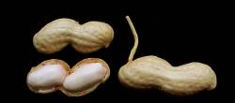
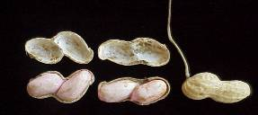
R1
R2
R3
Beginning bloom
Beginning peg
Beginning pod
R4
R5
R6
Full pod
Beginning seed
Full seed
R7
Reproductive Growth Stages of Peanut
Growth stages of peanut
K. J. Boote, Peanut Science 9:35-40
Beginning maturity

Slide 11
Statistical Analysis
PROC MIXED Procedure
Location - Random effect
  No interaction
  Data combined over location
Timing X rate interaction
Linear regression for each timing
NTC Average Yields
  Ponder Farm: 6329-6476 lb/A
  Plains: 4776-5344 lb/A

Slide 12
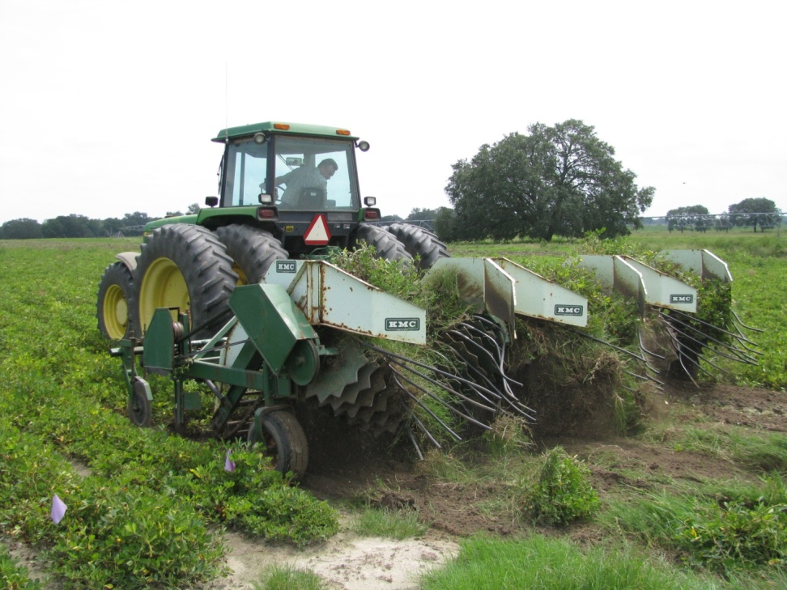
Results

Slide 13
Peanut Yield Loss (%) From Ignite Applied at 30 DAP – Ponder Farm + Plains
%
Ignite 2.34SL Rate (oz/A)
GA-06G

Slide 14
Peanut Yield Loss (%) From Ignite Applied at 60 DAP – Ponder Farm + Plains
%
Ignite 2.34SL Rate (oz/A)
GA-06G

Slide 15
Peanut Yield Loss (%) From Ignite Applied at 90 DAP – Ponder Farm + Plains
%
Ignite 2.34SL Rate (oz/A)
GA-06G

Slide 16
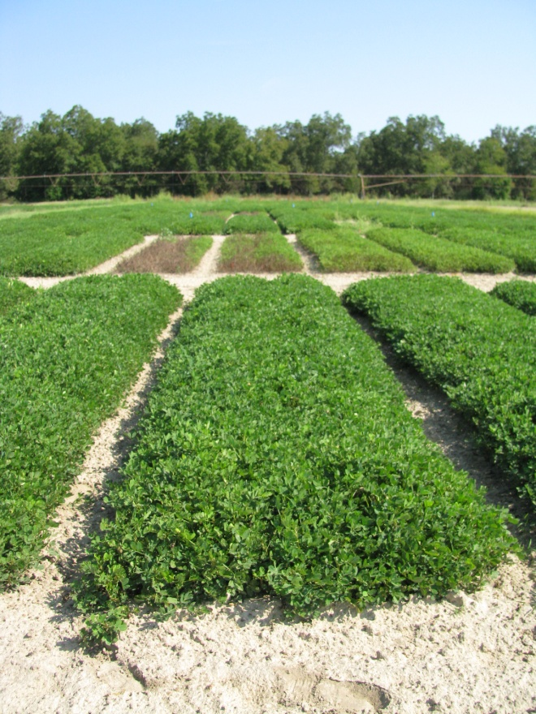
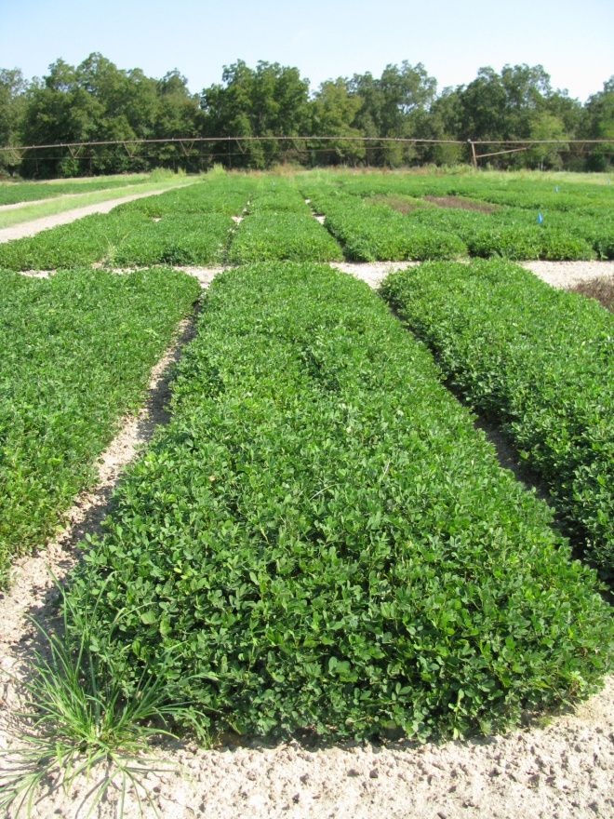
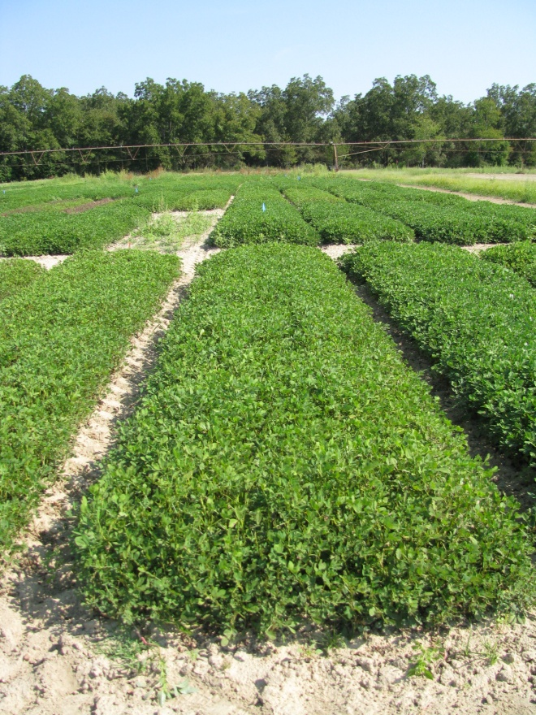
Peanut Response to Ignite @ 2 oz/A
Applied 30 DAP
Applied 60 DAP
Applied 90 DAP
PE-01-10
September 17
129 DAP

Slide 17
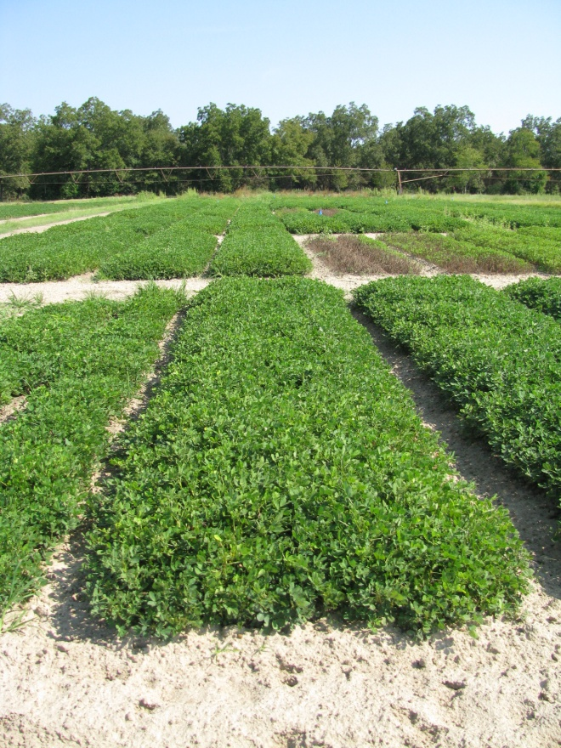
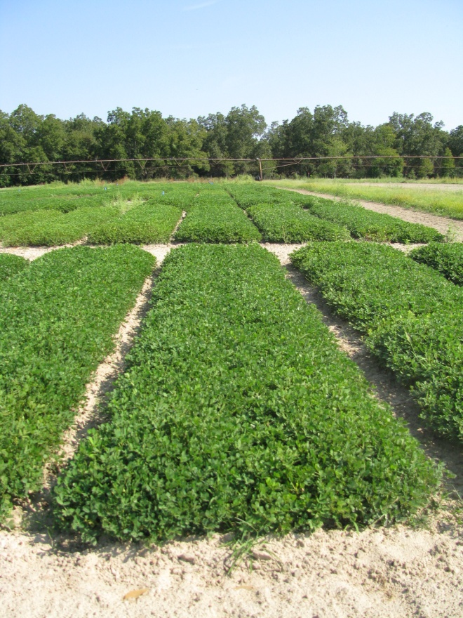
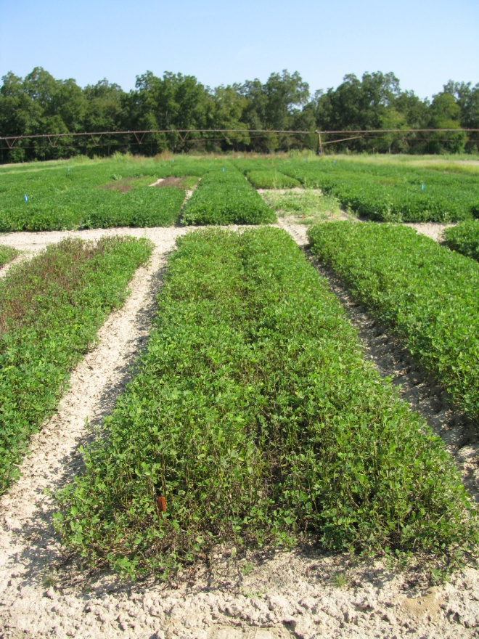
Peanut Response to Ignite @ 8 oz/A
Applied 30 DAP
Applied 60 DAP
Applied 90 DAP
PE-01-10
September 17
129 DAP

Slide 18
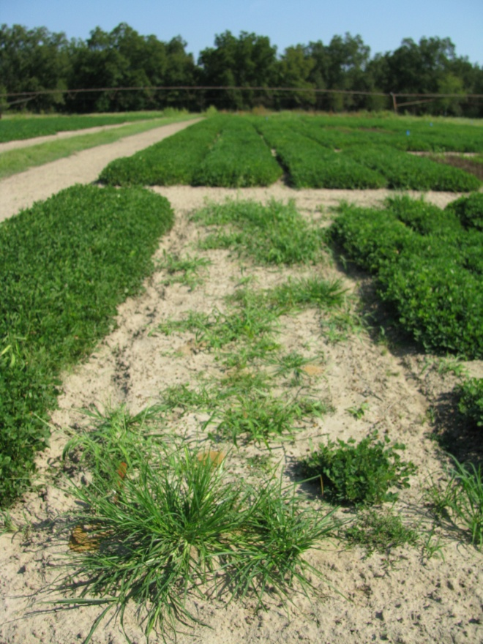
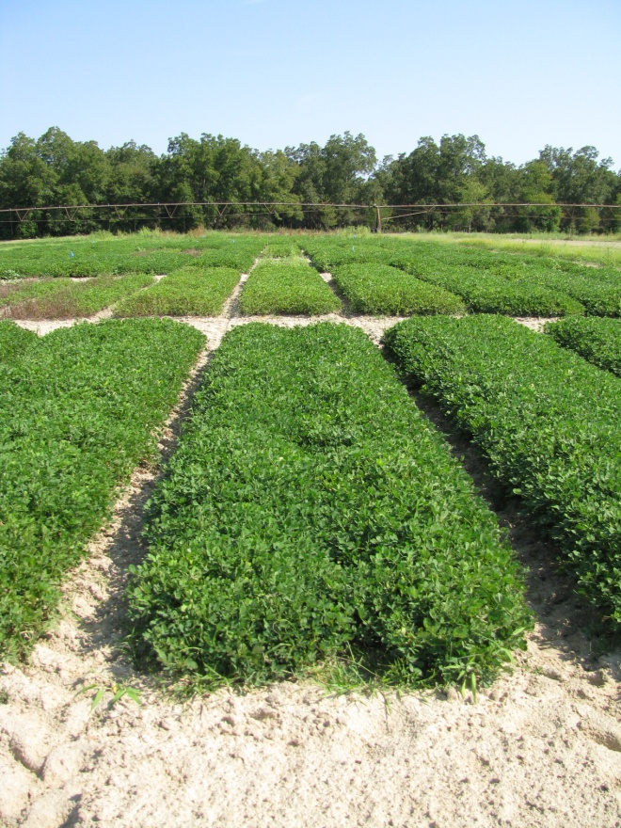
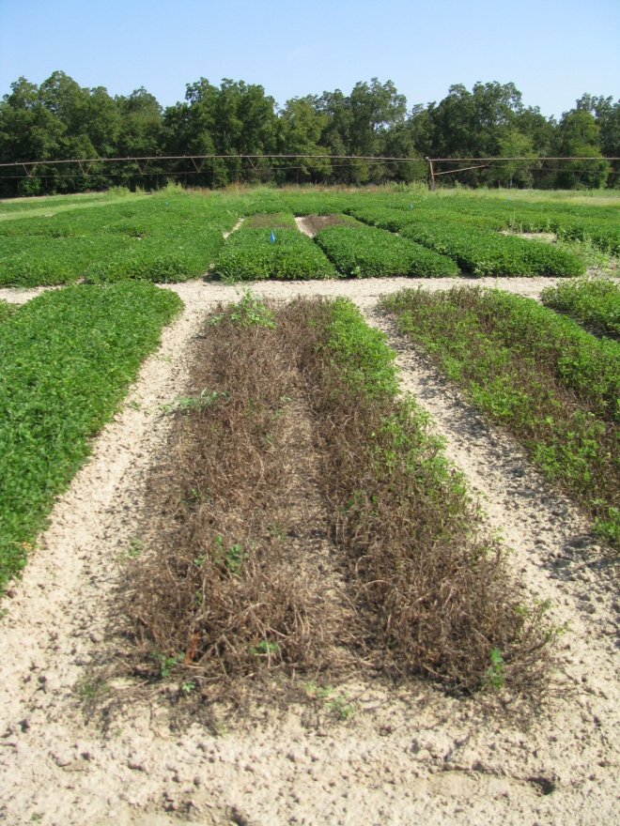
Peanut Response to Ignite @ 32 oz/A
Applied 30 DAP
Applied 60 DAP
Applied 90 DAP
PE-01-10 (Ponder Farm)
September 17
129 DAP

Slide 19
Estimated Peanut Yields Losses (%) from Ignite 2.34SL
Rate/A (ozs) | Time (DAP)
 | 30 | 60 | 90
0 | 0 | 0 | 0
2 | 6.4 | 6.8 | 19.3
4 | 13.2 | 10.0 | 23.7
6 | 19.9 | 13.2 | 28.0
8 | 26.7 | 16.5 | 32.3
10 | 33.5 | 19.7 | 36.6
12 | 40.3 | 22.9 | 40.9
16 | 53.8 | 29.3 | 49.5
32 | 100 | 55.0 | 84.0
GA-06G
2 locations (Ponder, Plains)
2010

Slide 20
Was there any correlation between visual estimates of peanut injury and yield loss?

Slide 21
Peanut Injury vs. Yield Loss
Ignite Applied 30 DAP
Yield Loss (%)
Visual Estimates of Injury (%)

Slide 22
Peanut Injury vs. Yield Loss
Ignite Applied 60 DAP
Yield Loss (%)
Visual Estimates of Injury (%)

Slide 23
Peanut Injury vs. Yield Loss
Ignite Applied 90 DAP
Yield Loss (%)
Visual Estimates of Injury (%

Slide 24
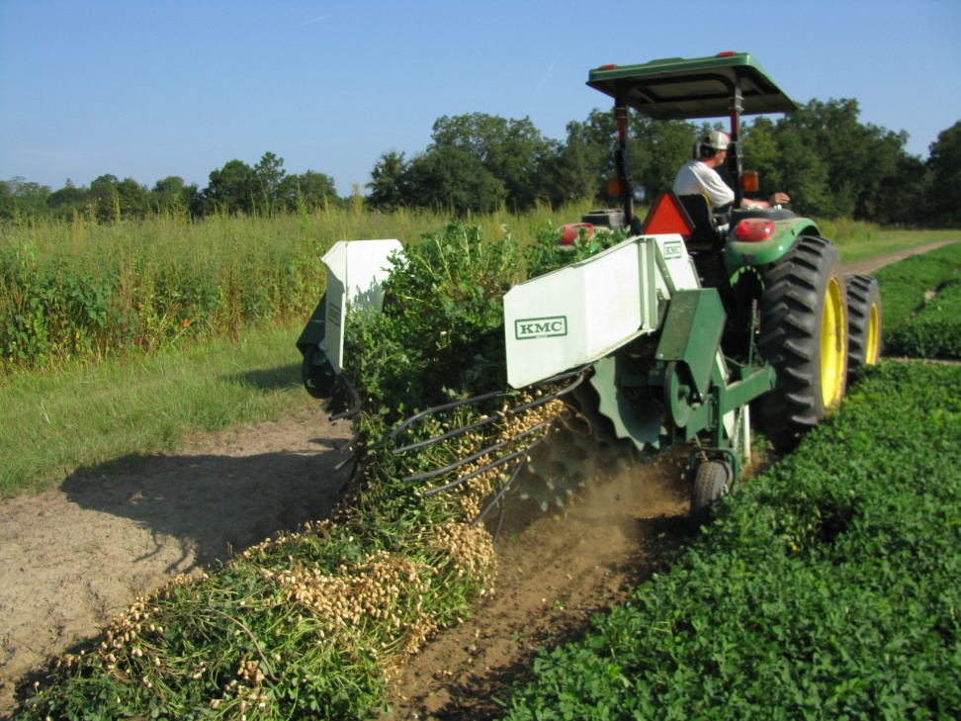
Summary - I
Peanuts were more sensitive to Ignite at 30 and 90 DAP when compared to 60 DAP??
As little as 2 oz/A of Ignite has the potential to reduce peanut yields by 6-19%.

Slide 25
Summary - II
Strong linear correlation (R² > 0.84) between crop injury estimates and yield loss for 30 and 90 DAP.
Ignite drift and sprayer contamination must be avoided!

Slide 26
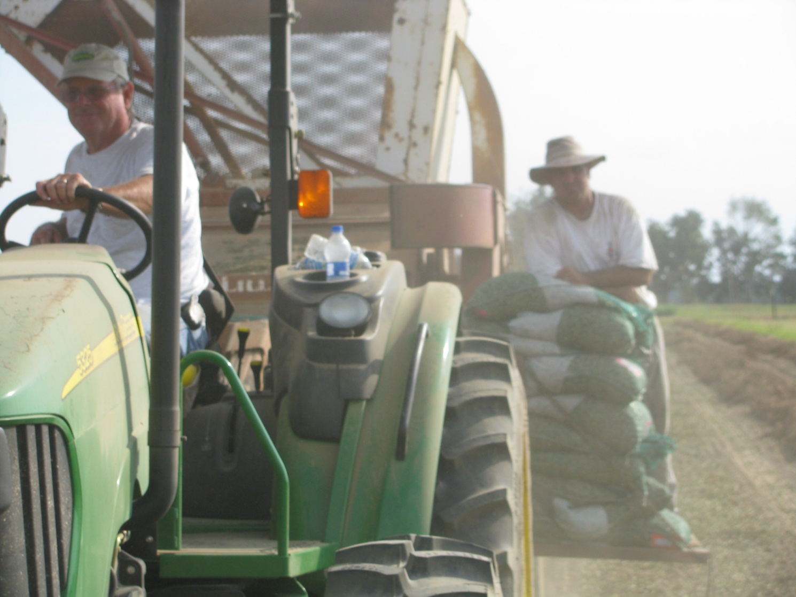
Questions?
www.gaweed.com

