Slide 1
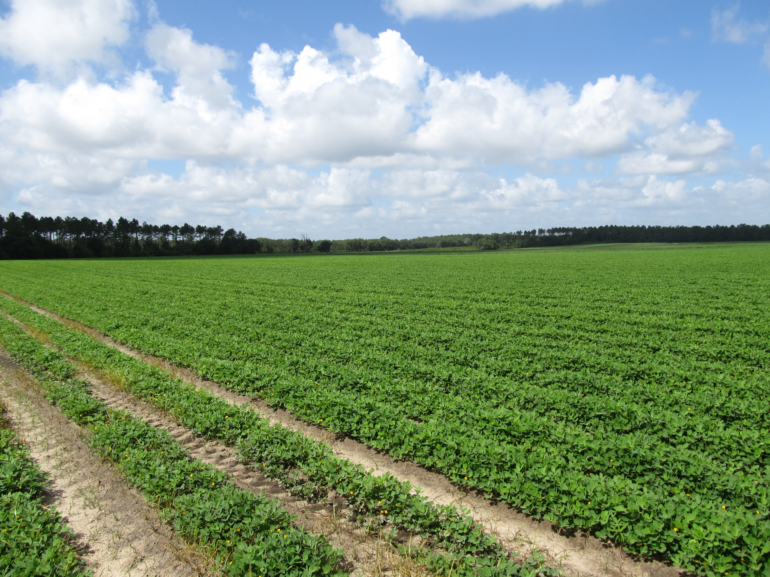
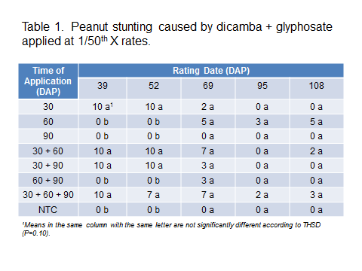
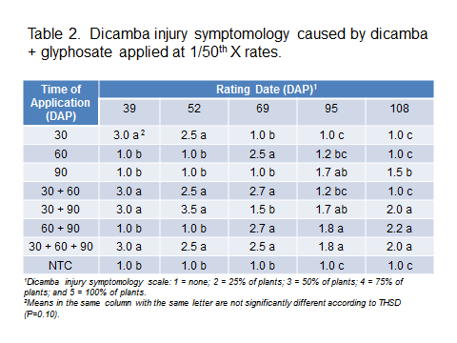
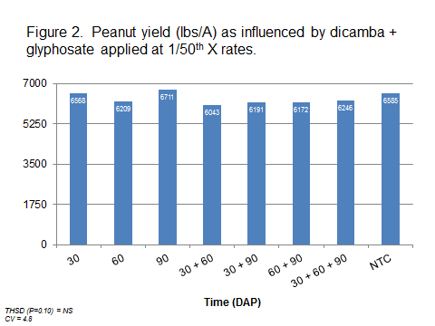
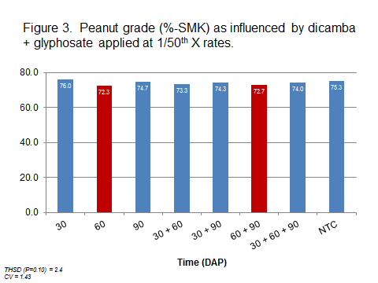
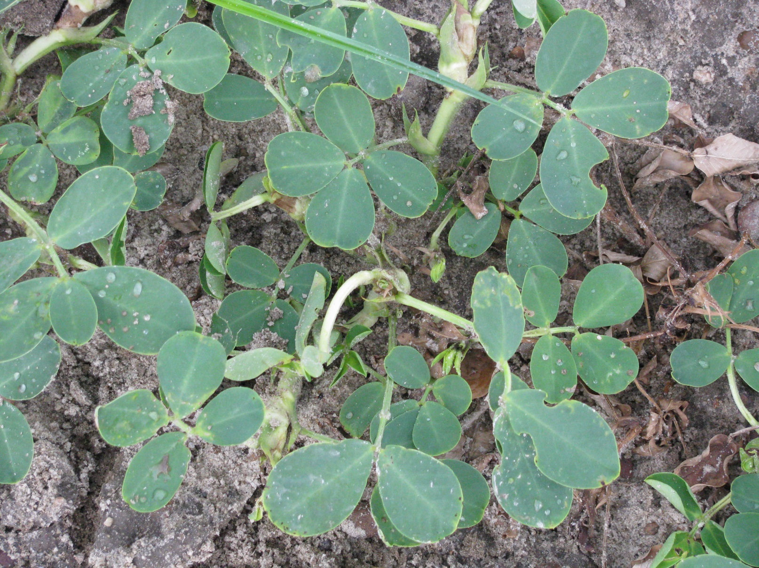
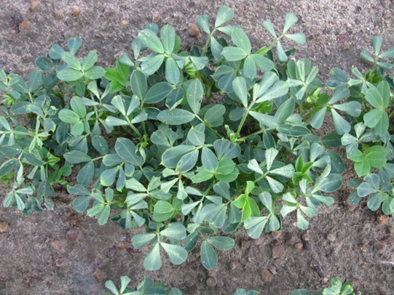
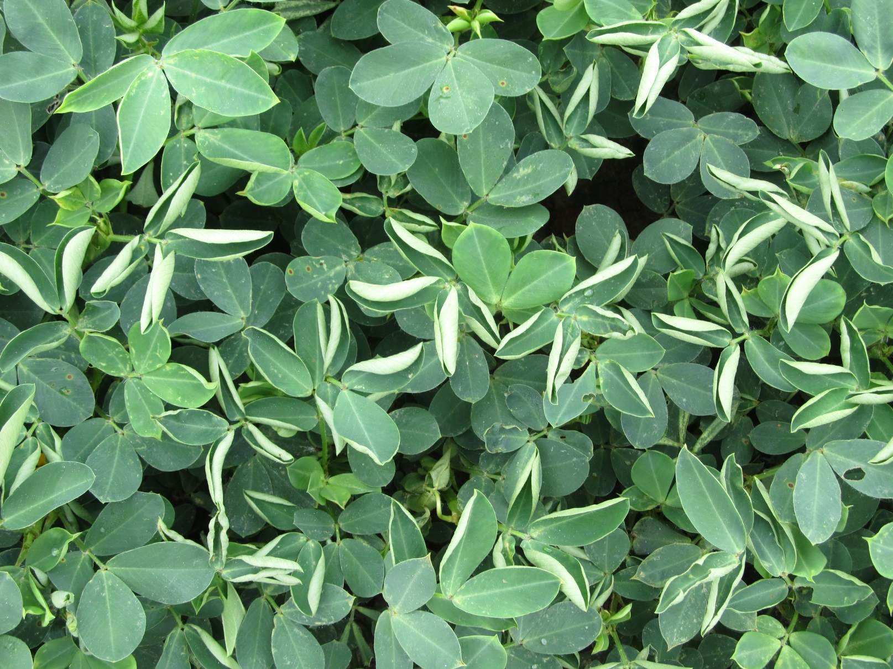
PEANUT RESPONSE TO MULTIPLE SIMULATED OFF-TARGET
EVENTS OF DICAMBA + GLYPHOSATE
Eric P. Prostko
Dept. Crop & Soil Sciences
The University of Georgia
INTRODUCTION
Cotton and peanuts are the major row crops grown in Georgia. Since both crops are grown in close proximity, off-target movement of pesticides is a concern.
In 2017 and 2018, XtendFlex® (dicamba-tolerant) varieties were planted on 65% and 81% of the total cotton acreage in Georgia. Previous research has demonstrated that peanuts have adequate tolerance to single exposure events of low rates of dicamba or glyphosate. However, limited research has been conducted on multiple exposure events with combinations. Therefore, the objective of this research was to evaluate the response of peanuts to multiple low rate applications of dicamba + glyphosate tank-mixtures.
MATERIALS AND METHODS
A small-plot, replicated field trial was conducted in 2018 at the UGA Ponder Research Farm near Ty Ty, Georgia. ‘GA-06G’ peanut were planted in twin rows on April 30. In a randomized complete block design with 4 replications, dicamba (Xtendimax® with VaporGrip®) + glyphosate (Roundup PowerMax®) were applied at 1/50th X rates at various timings including the following: 30 days after planting (DAP), 60 DAP, 90 DAP, 30 + 60 DAP, 30 + 90 DAP, 60 + 90 DAP, and 30 + 60 + 90 DAP. 1X rates of Xtendimax® 2.9SL and Roundup PowerMax® 5.5SL are 22 oz/A and 32 oz/A, respectively. Peanut stages of growth at the time of application were as follows: 30 DAP = V6; 60 DAP = R3-R4 (beginning pod to full pod); and 90 DAP = R6 (full seed).
All treatments were applied using a CO₂-powered, backpack sprayer calibrated to deliver 15 GPA @ 45 PSI and 3.5 MPH using 11002AIXR nozzles. The plot area was maintained weed-free using a combination of hand-weeding and labeled herbicides (bentazon, diclosulam, imazapic, paraquat, pendimethalin, s-metolachlor, and 2,4-DB).
Data collected included visual estimates of peanut stunting, dicamba symptomology, yield, and grade. All data were subjected to ANOVA and means separated using Tukey’s HSD Test (P=0.10).
RESULTS AND DISCUSSION
1) At 1/50th X rates, typical dicamba injury symptoms were observable (Figure 1). Foliar glyphosate symptoms were not observed.
2) Peanut stunting was ≤ 10% (Table 1).
3) Dicamba symptomology was less obvious as the season progressed (Table 2). At 108 DAP, only peanuts that received 90 DAP applications were exhibiting dicamba injury symptoms.
4) Peanut yields were not significantly reduced by any timing of dicamba + glyphosate (Figure 2). However, peanut grade was reduced (2.6-3.0%) with dicamba + glyphosate applied 60 and 60 + 90 DAP (Figure 3).
5) Additional data is being collected for seed germination, seed size, pod abnormalities, and chemical residues (hull + nut) associated with potential dicamba + glyphosate exposure.
Figure 1. Dicamba injury on peanut (stem epinasty, leaf strapping, leaf rolling)

