Slide 1
On-Farm Evaluations of Auxin Nozzles For Peanut Pest Management
E.P. Prostko¹, M.R. Abney, R.C. Kemerait, G.C. Rains
J.L. Jacobs, C.T. Powell, W.G. Tyson
¹Department of Crop & Soil Sciences

Slide 2
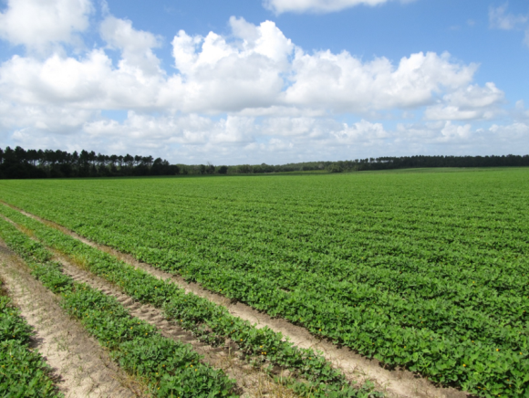
Peanut and Cotton In Georgia
640,000 acres harvested in 2018
47.6% of US Total (#1)
1,350,000 acres harvested in 2018
13.0% of US Total (#2)
Source: USDA/NASS, Crop Production (11/01/2018)

Slide 3
XtendFlex® and Enlist™ Cotton Varieties in Georgia
Source: USDA/AMS Annual Cotton Variety Reports (mp_cn833)

Slide 4
Research Questions?
Can coarse droplet producing “auxin” nozzles be used for pest mgt. in peanut?
herbicides, fungicides, insecticides, fertilzers
UGA small plot weed science research has been very positive but what about other disciplines and on-farm?

Slide 5
Objective:
Compare the field performance of auxin nozzles to flat fan nozzles in commercial peanut fields.

Slide 6
Methodology
3 commercial peanut fields
Plot size
Sprayer width X field length
3-4 replications
2 nozzle types
All agri-chemicals
ANOVA
Tukey’s HSD (P=0.10)

Slide 7
2018 Nozzle Tests Farmer Cooperators
Bulloch County
Greg Sikes
Miller County
Kim Henley
Pierce County
Jim Waters

Slide 8
2018 Nozzle Tests
XR-11006-VP
Bulloch Co.
Pierce Co
TTI-11006-VP-C
(Pierce Co.)
TADF06-D
(Bulloch Co.)

Slide 9
Miller County Nozzle Test - 2018
XRC-11005
TTI60-11005

Slide 10
Bulloch County Nozzle Test - 2018
JD 4630
15 GPA
25 PSI
12.6 MPH
90’ boom
15” nozzle spacing
32”-34” boom height
72 nozzles
600 gal tank

Slide 11
Miller County Nozzle - 2018
JD4030
110’ boom
20” nozzle
10 MPH
24 PSI
10 GPA
66 NOZZLES
800 GAL TANK

Slide 12
Pierce County Nozzle Test - 2018
JD 4730
BOOM LENGTH = 100’
NOZZLE SPACING = 15”
79 NOZZLES
800 GALLON TANK
SPEED = 11.6 MPH
GPA = 16
PSI = 21-23
BOOM HEIGHT = 28"

Slide 13
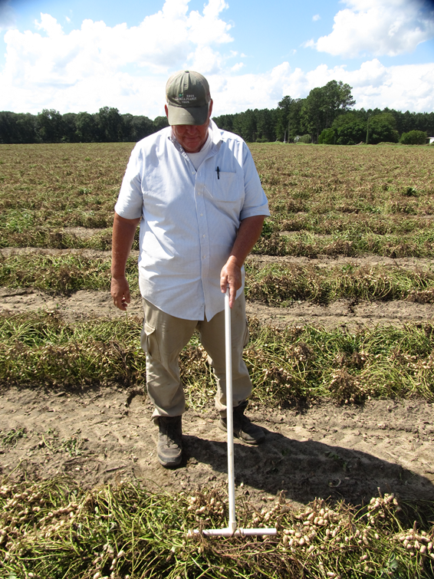
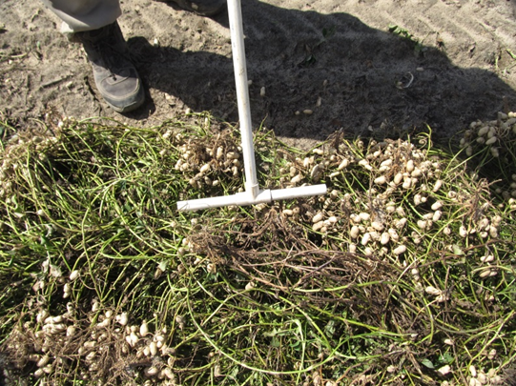
Disease Evaluations

Slide 14
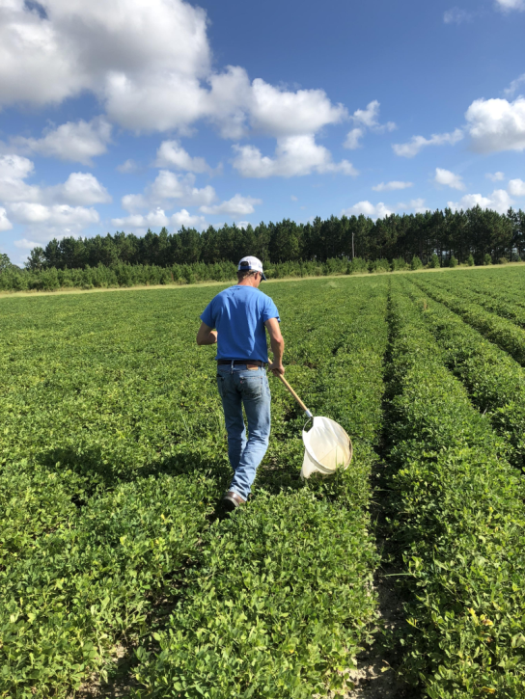
Insect Evaluations
Bulloch Co.
October 2

Slide 15
Yield Data
Miller Co.
October 3
6 rows (18’) X 1000’ (0.413 acres/rep) – Bulloch/Miller
6 rows (18’) X Field Length (0.680-0.735 acres/rep) - Pierce

Slide 16
2018 Peanut Nozzle Tests
County | Rotation | Variety | Planting | Digging | Harvest
Bulloch | corn-cotton-cotton-peanut | GA-06G | May 11 | Oct. 9 | Oct. 17
Miller | peanut-corn-peanut | GA-06G | May 3-4 | Sept. 24 | Oct. 3
Pierce | tobacco-cotton-peanut | GA-06G | June 8 | Oct. 17 | Oct. 31

Slide 17
2018 Nozzle Tests Pesticides/Fertilizers Applied
County | Herbicide | Fungicide | Insecticide | Other
Bulloch | Valor Strongarm Acumen Gramoxone Storm Dual Magnum 2,4-DB | Alto Bravo Elatus Folicur | Bifenthrin Dimilin | Boron PegPower
Miller | Cadre Dual Magnum 2,4-DB | Bravo Elatus Folicur Priaxor Propulse | Acephate Beseige | FullBor Micropak PegPower
Pierce | Valor Dual Magnum Cadre 2,4-DB | Chlorothalonil Convoy Tebuzole | Dimilin | Boron

Slide 18
Bulloch County Nozzle - 2018
Following agi-chemicals were applied with either XR11006 or TADF06-D nozzle:
May 11 = Valor + Strongarm + Acumen
June 14 = Gramoxone + Dual Magnum + Storm + 2,4-DB
June 19 = Alto + Folicur
July 9 = Elatus
July 25 = Elatus + PegPower + Boron
August 15 = Bravo + Folicur + PegPower + Boron + Dimilin
August 27 = Elatus + Bifenthrin
JD 4630
15 GPA
25 PSI
12.6 MPH
90’ boom length
15” nozzle spacing
32”-34” boom ht

Slide 19
Results
Bulloch Co.
October 17

Slide 20
Pierce County Nozzle Test September 19, 2018
XR11006-VP

Slide 21
Pierce County Nozzle Test September 19, 2018
TTI-11006VP-C

Slide 22
Bulloch County Nozzle Test - 2018
Nozzle Type | Disease |  | Insects - 10/2/18 #/10 sweeps |  |  | Yield (lbs/A)
 | Early Leaf Spot (1-10) 9/18/18 | White Mold (%) 10/12/18 | Soybean Looper | 3-CAH | Garden Flea Hopper
XR11006 | 1.0 | 4.8 | 0.5 | 27.3 | 18.3 | 6628
TADF06-D | 1.0 | 8.4 | 0.5 | 31.3 | 19.5 | 6810
P-Value THSD (0.10) | 1.0 NS | 0.1866 NS | 1.00 NS | 0.1558 NS | 0.8920 NS | 0.3060 NS

Slide 23
Miller County Nozzle Test - 2018
Nozzle Type | Diseases |  | Insects – 9/11/18 #/10 sweeps |  | Yield (lbs/A)
 | Early Leaf Spot (1-10) 9/11/18 | White Mold (%) 9/26/18 | 3-CAH | Garden Fleahopper
XR11005 | 2.8 | 3.7 | 3.7 | 34.0 | 5784
TTI60-11005 | 3.0 | 3.9 | 9.0 | 47.0 | 5880
P-Value THSD (0.10) | 0.5799 NS | 0.8995 NS | 0.0153 1.95 | 0.6035 NS | 0.4634 NS

Slide 24
Pierce County Nozzle Test - 2018
Nozzle Type | Diseases |  | Insects – 9/19/18 #/10 sweeps |  |  |  | Yield (lbs/A)
 | Late Leaf Spot (1-10) 9/18/18 | White Mold (%) 10/18/18 | Velvet Bean CP | Soybean Looper | 3-CAH | Garden Flea Hopper
XR11006 | 3.2 | 15.5 | 0.7 | 2.0 | 5.0 | 8.3 | 5160
TTI-11006 | 3.8 | 11.8 | 0.3 | 0.0 | 3.3 | 9.0 | 5297
P-Value THSD (0.10) | 0.1835 NS | 0.5458 NS | 0.4226 NS | 0.1835 NS | 0.4226 NS | 0.8675 NS | 0.3990 NS

Slide 25
Summary
No differences in weed, insect, disease control observed except for 3-CAH in Miller Co.
No differences in peanut yield
Growers liked auxin nozzles and plan to expand use in 2019
Pierce Co.
October 31

Slide 26
Nozzle Tests – Final Thoughts
TTI60 will likely not be registered for dicamba
Growers who historically have less than ideal pest control should not take a chance on coverage
Timing is important!
More work with TTI

Slide 27
Questions/Comments?

