Slide 1

Evaluation of A New TwinJet Nozzle for Weed Control in Peanut
Eric P. Prostko¹, Brock A. Ward¹, Glenn C. Rains³,O. Wen Carter²
¹Department of Crop & Soil Sciences
²Miller County Extension Agent
³Department of Entomology

Slide 2
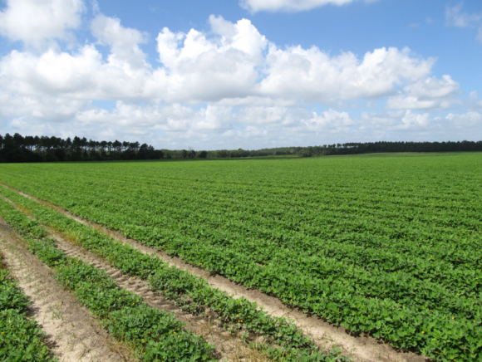
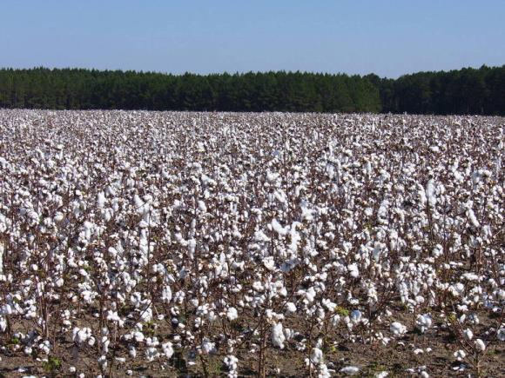
Peanut and Cotton In Georgia
825,000 acres harvested in 2017
46% of US Total (#1)
1,270,000 acres harvested in 2017
11% of US Total (#2)
Source: USDA/NASS, Crop Production (01/12/2018)

Slide 3


New Technologies
2,4-D and dicamba resistant crops
  Cotton 2017 (GA):
    Xtend (65%)
    Enlist (2%)
Application Requirements
Nozzle Requirements

Slide 4
Spray Tip Classification by Droplet Size
Category | Symbol | Color Code | Approximate VMD² (Microns)
Extremely Fine | XF | PURPLE | < 60
Very Fine | VF | RED | 61-105
Fine | F | ORANGE | 106-235
Medium | M | YELLOW | 236-340
Coarse | C | BLUE | 341-403
Very Coarse | VC | GREEN | 404-502
Extremely Coarse | XC | WHITE | 503-665
Ultra Coarse | UC | BLACK | >665
¹Estimated from sample reference graph in ASBAE/ANSI/ASAE Standard S572.1
²VMD = Volume median diameter

Slide 5
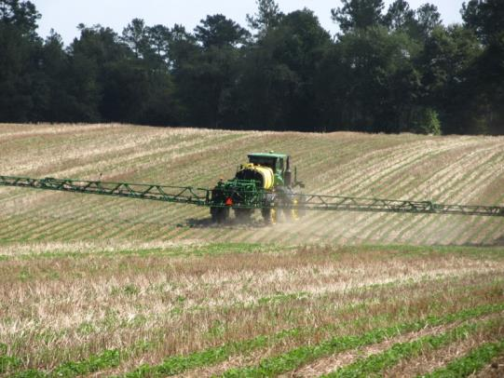
Research Questions?
Can coarse droplet producing nozzles be used for weed control in peanut?
  acifluorfen, bentazon, lactofen, paraquat
UGA small plot research has been very positive but what about on-farm?

Slide 6
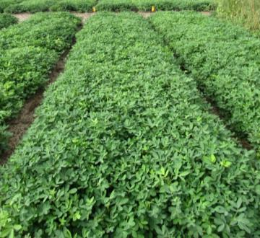
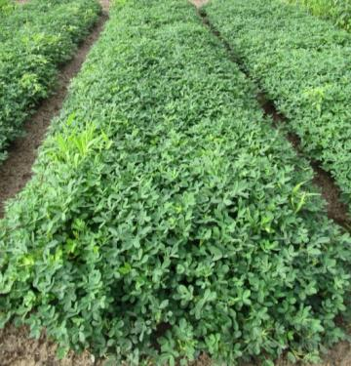
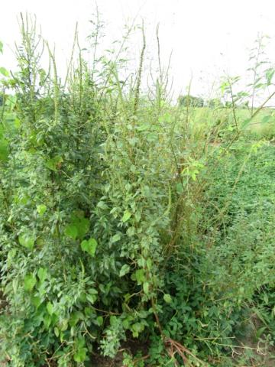
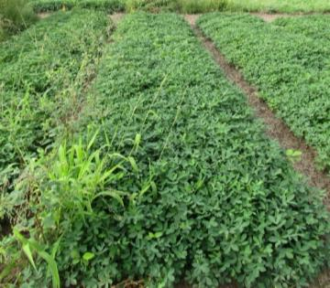
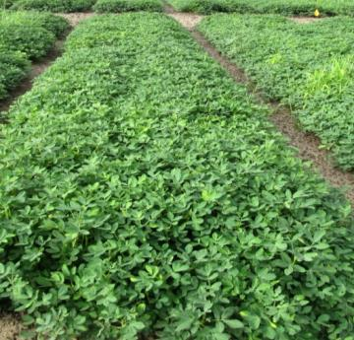
2016 Nozzle Research
Prowl + Valor + Strongarm (PRE) fb Cadre + Dual Magnum + 2,4-DB (45 DAP)
11002DG
11002AIXR
TTI02
TADF02-D
NTC
PE-12-16
August 10
107 DAP

Slide 7
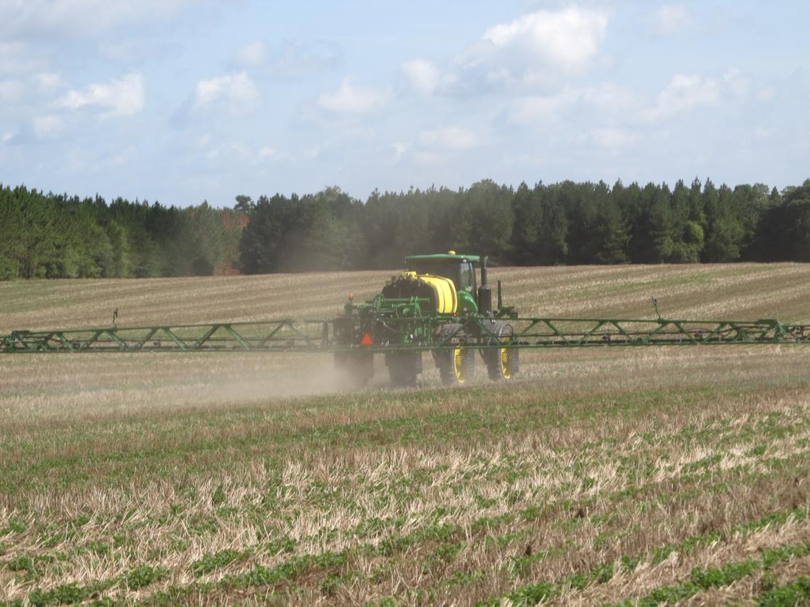
The New Norm

Slide 8
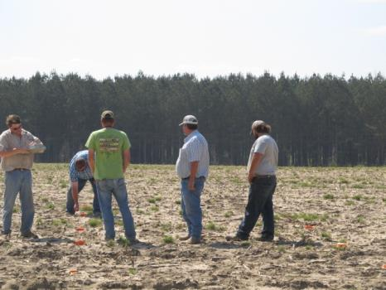
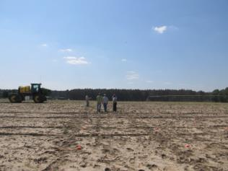
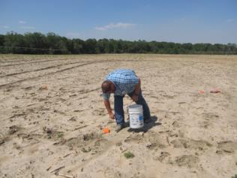
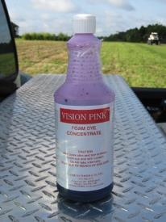
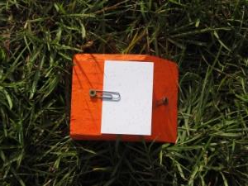
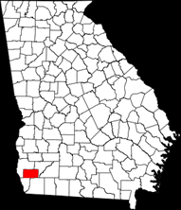
Materials and Methods
April 10, 2017
Miller County
  Kim Henley Farm
JD R4030
  110’ boom
  20” nozzle spacing
Tractor Speed
  9.8 MPH
Boom Height
  36”
15 GPA (water + dye)
XRC-11005VP + TTI60-11005VP spray tips
  40 PSI
  66 nozzles
3 reps
  10 kromekote cards (2” X 3”)/rep
  10’ X 10’ apart
Dropletscan (WRK of Arkansas, LLC)
Kim Henley

Slide 9
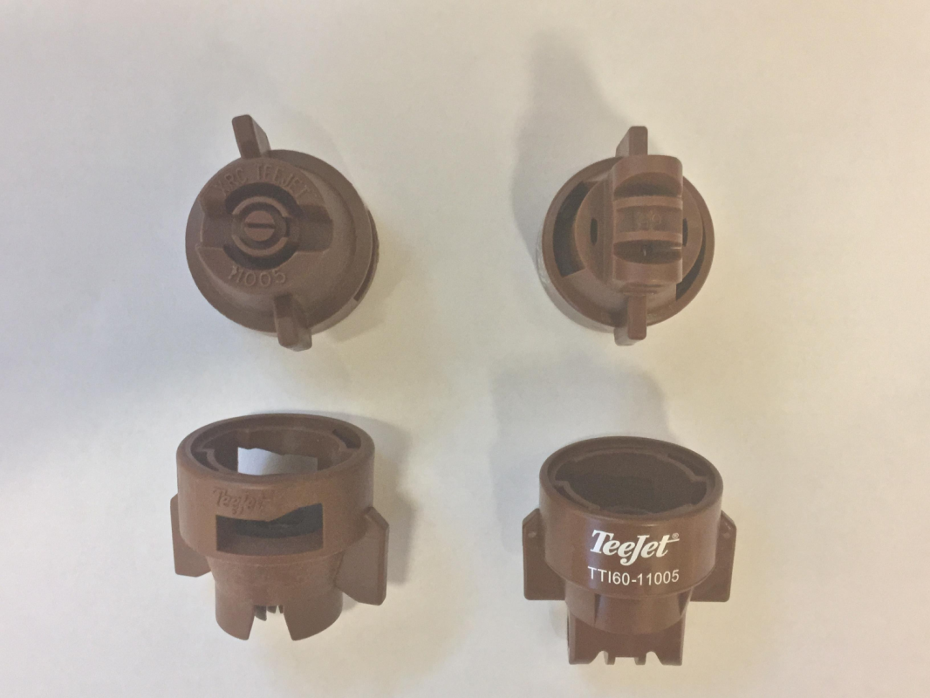
2017 Nozzle Test – Miller Co.
XRC-11005
TTI60-11005

Slide 10
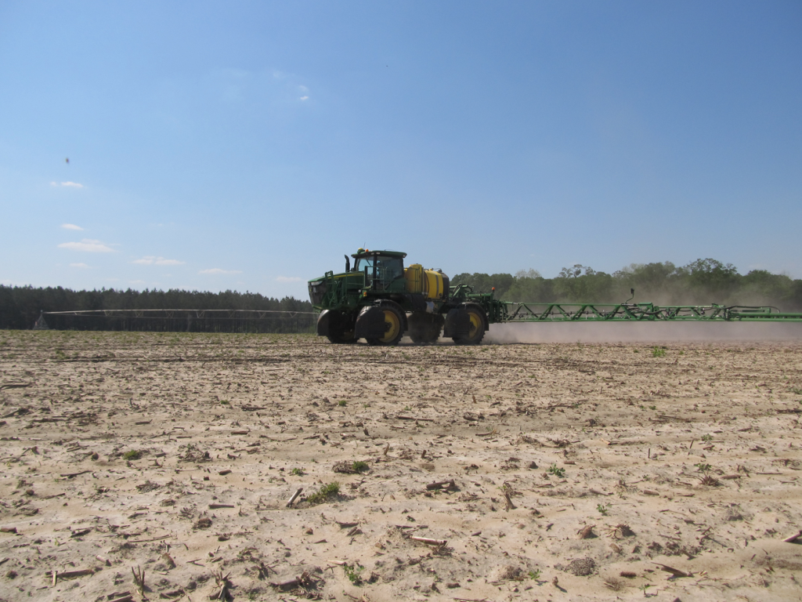
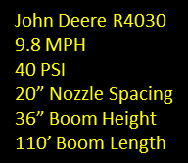
Miller County – April 10, 2017

Slide 11
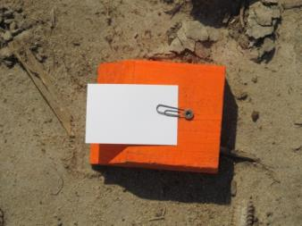
Miller County Nozzle Test - 2017
4-6 MPH (SE to NW wind)
R3
R2
10 feet
R1
tractor
10 feet
North

Slide 12
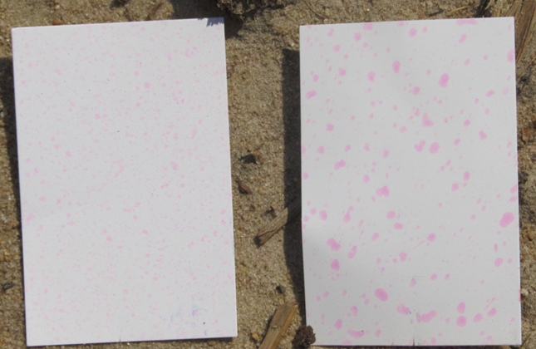
Coverage/Droplet Size as Influenced by Nozzle Type
JD R4030, 9.8 MPH, 40 PSI, 15 GPA, 20” spacing, 36” boom height, 110’ boom
XRC-11005
TTI60-11005
NZ-01-17
April 10, 2017
Miller County

Slide 13
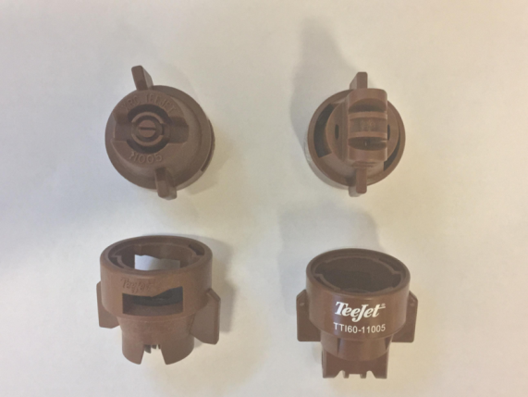
Coverage and Droplet Size as Influenced by Nozzle Type
JD R4030, 9.8 MPH, 40 PSI, 15 GPA, 20” spacing, 36” boom height, 110’ boom
Nozzle Type | Coverage (%)** | Droplet Size (VMD₅₀)**
XRC-11005 | 6.63 | 301.96 (M)
TTI60-11005 | 8.40 | 514.26 (XC)
LSD (0.10) CV | 1.56 8.72 | 19.51 2.0
NZ-01-17
April 10, 2017
Miller County
**Average of 30 Kromekote Cards

Slide 14
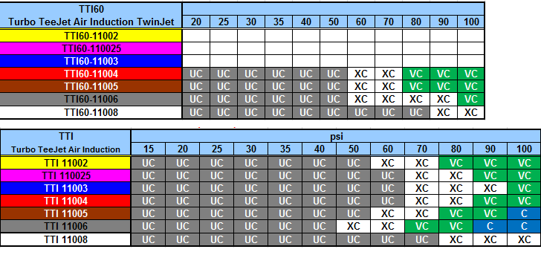
Droplet Size Comparison

Slide 15
Grower and County Extension Agent (CEA) Farm-Scale Observations with TTI60 Nozzle
105 acre peanut field planted on 5/22/2017
All peanut herbicides, except Valor, were applied by grower with JD-R4030 sprayer using either the XRC-11005VP or TTI60-11005VP nozzle tips.
  Prowl (5/21/2017)
  Cadre + Dual Magnum + Bravo (6/15/2017)
General Comments/Observations:
  Grower and CEA were very pleased with performance.
  Would like to be able to use TTI60 for everything?
  6179 lb/A peanut yield (4380 lb/A state average)

Slide 16
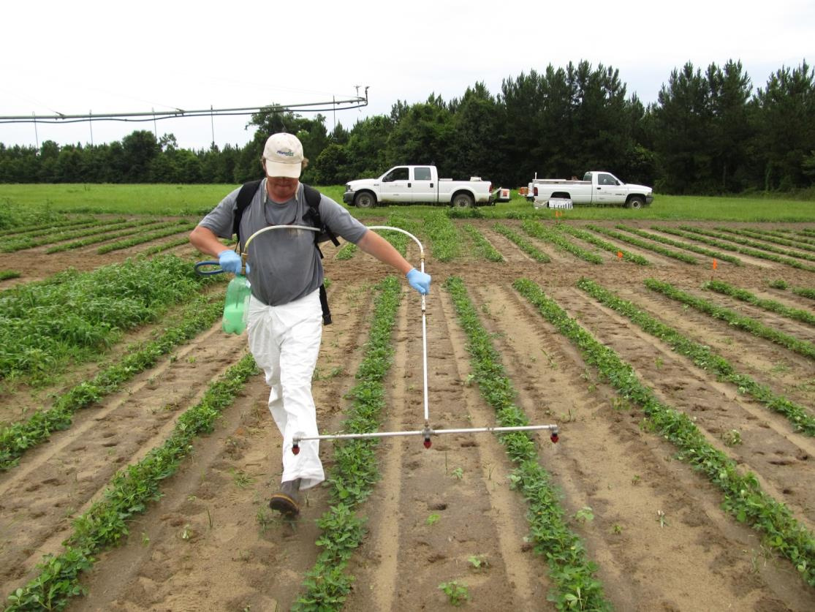
Small Plot Study - 2017

Slide 17
Materials and Methods
Non-Crop Study - 2017
Ponder Research Farm – Ty Ty, GA
3 X 4 factorial in RCB design
3 nozzle types:
  DG11002, TTI60-11002, TADF02-D
4 herbicide treatments:
1. Gramoxone (12 oz) + Storm (16 oz) + Dual Magnum (16 oz)
2. Cadre (4 oz) + 2,4-DB (18 oz) + Dual Magnum (16 oz)
3. Cobra (12.5 oz) + 2,4-DB (18 oz) + Dual Magnum (16 oz)
4. Arrow (8 oz) + COC (1% v/v)
4 replications
Application equipment: CO₂-powered backpack sprayer, 15 GPA, 38 PSI, 3.5 MPH, 20” spacing, 20” boom height, 7:30 AM.

Slide 18
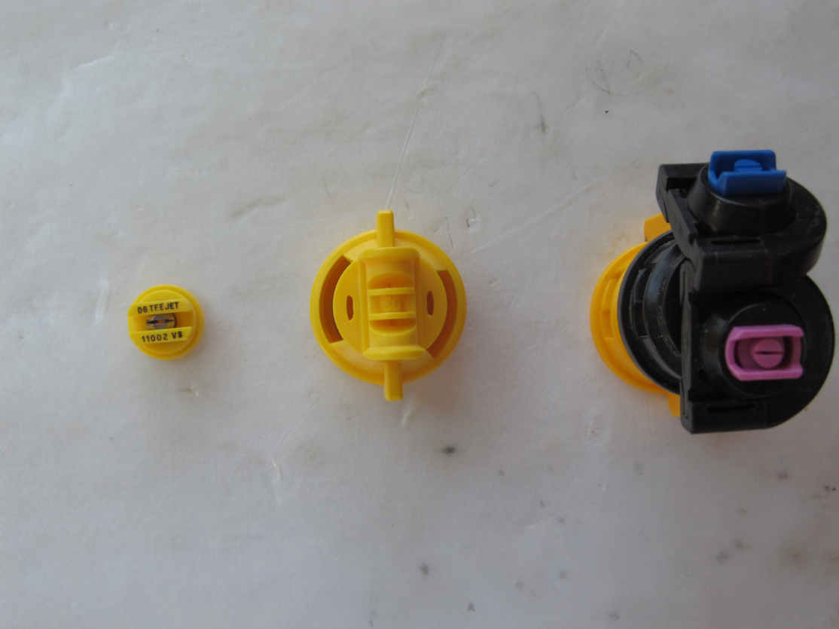
2017 Small Plot Nozzle Test
(DG11002, TTI60-11002, TADF02-D)

Slide 19
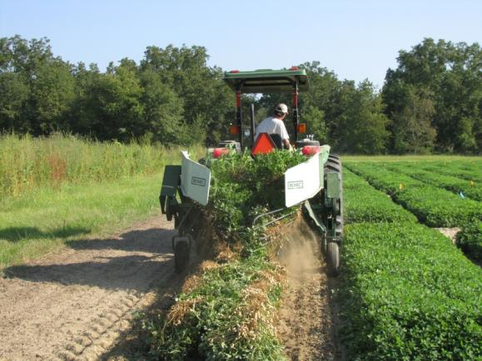
Results – 14 DAT
No interactions between nozzle type and treatment were observed (P > 0.25).
Only main effects are presented.

Slide 20
Nozzle Type and Herbicide Treatment Effects on Palmer Amaranth Control (14 DAT)

Slide 21
Nozzle Type and Herbicide Treatment Effects on Annual Grass Control (14 DAT)

Slide 22
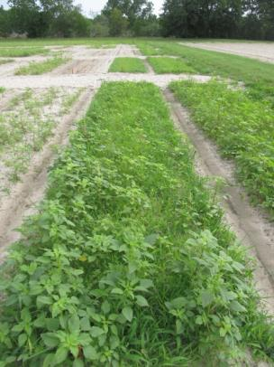
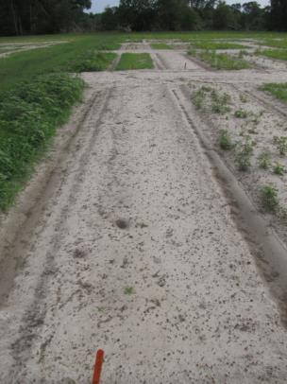
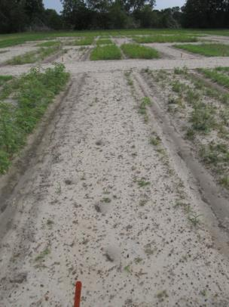
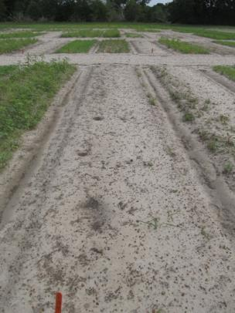
Gramoxone + Storm + Dual Magnum – 14 DAT
NTC
DG11002
TADF02-D
TTI60-11002

Slide 23
Summary
When applied with commercial sprayer (JD R4030):
  TTI60-11005VP better coverage and larger droplets (514 microns, XC) than XRC-11005VP (302 microns, M)
  Grower would like to be able to use TTI60 for every pesticide application?
    Entomologists and plant pathologists need to get off their tails!
Small Plot Results:
  No interaction between nozzle type and treatment.
  When averaged over herbicide treatments:
    nozzle type had no effect on Palmer amaranth control.
    TADF02-D provided 4% less grass control than DG11002

Slide 24
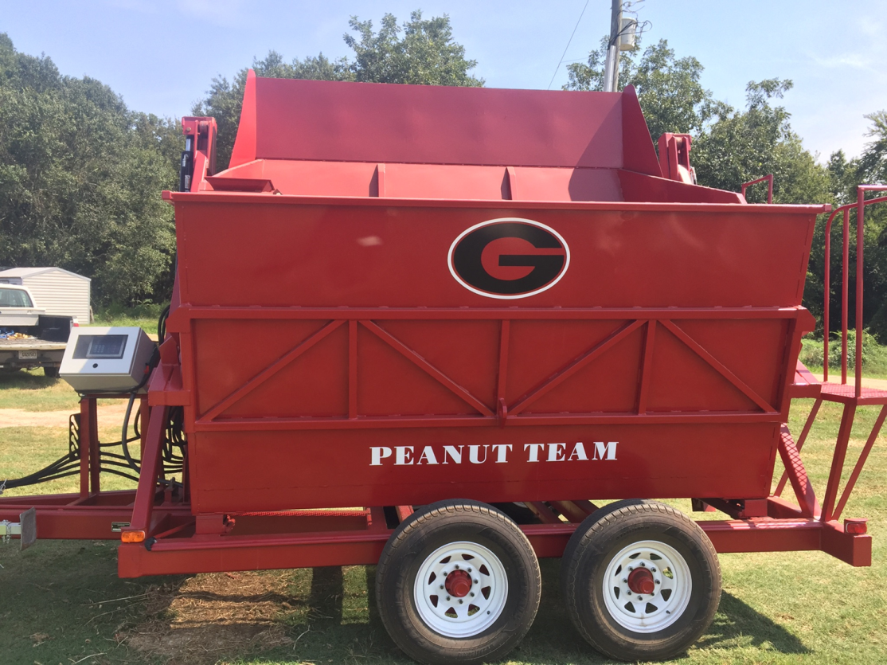
Future Yield Data

Slide 25
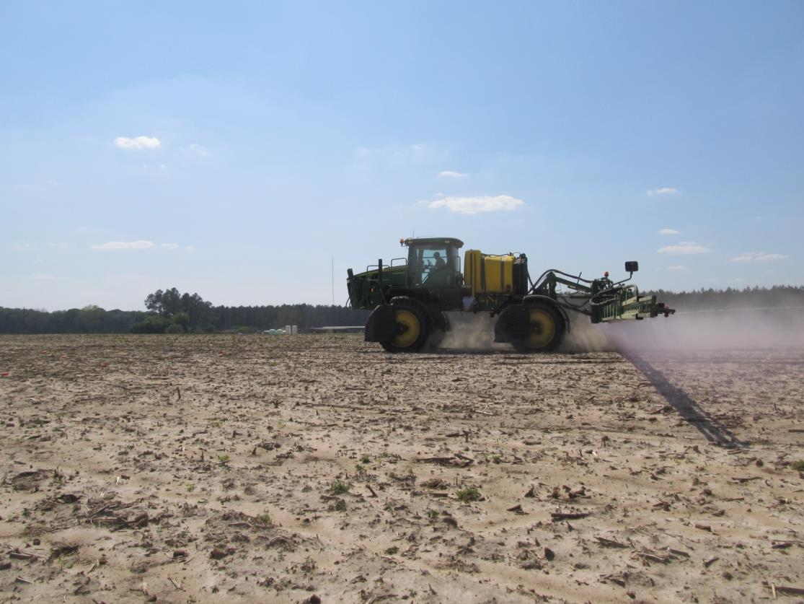

Questions/Comments?

