Slide 1
Peanut Weed Control Update - 2019
Eric P. Prostko, Ph.D.
Professor and Extension Weed Specialist
Department of Crop & Soil Sciences

Slide 2
Georgia Rainfall Totals (inches) April 1 – September 1
Source: UGA Weather Network

Slide 3
Is this glyphosate?
5900+ lbs/A

Slide 4
Which treatment do you prefer?
PE-13-18
LSD (P= 0.10) = 481
THSD (P = 0.10) = 974

Slide 5
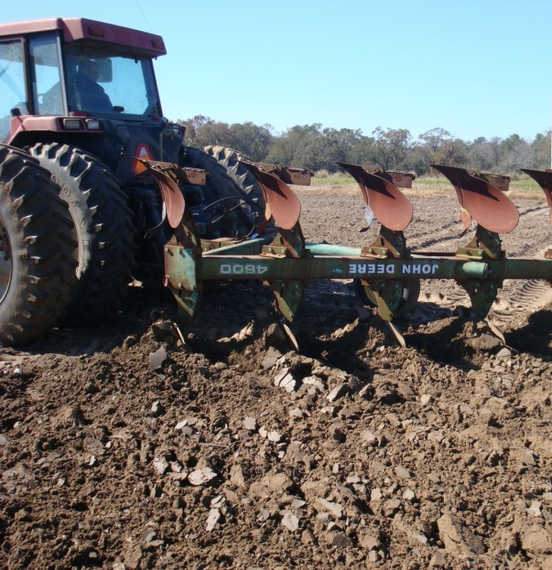
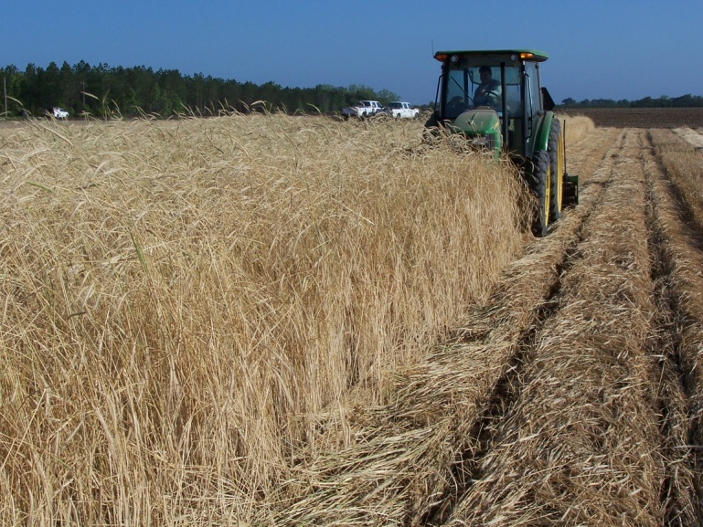
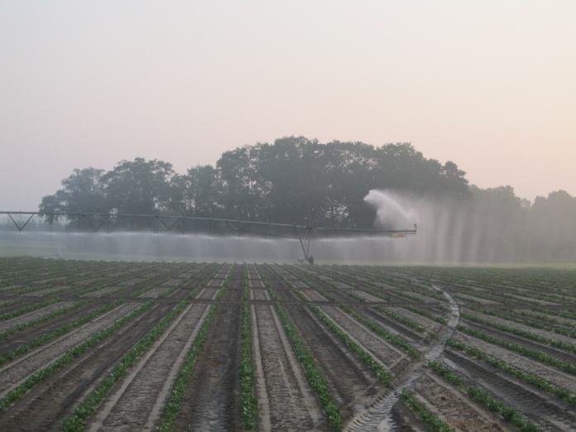
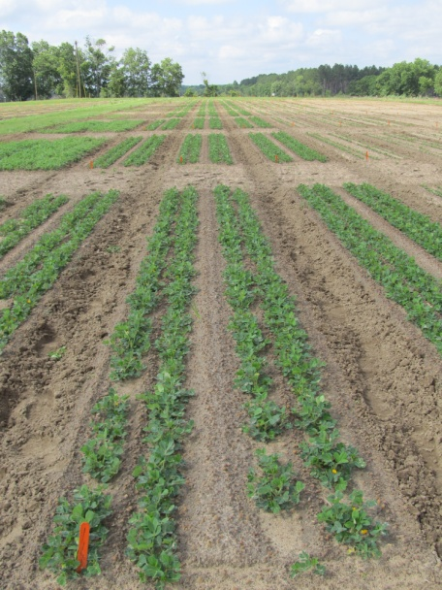
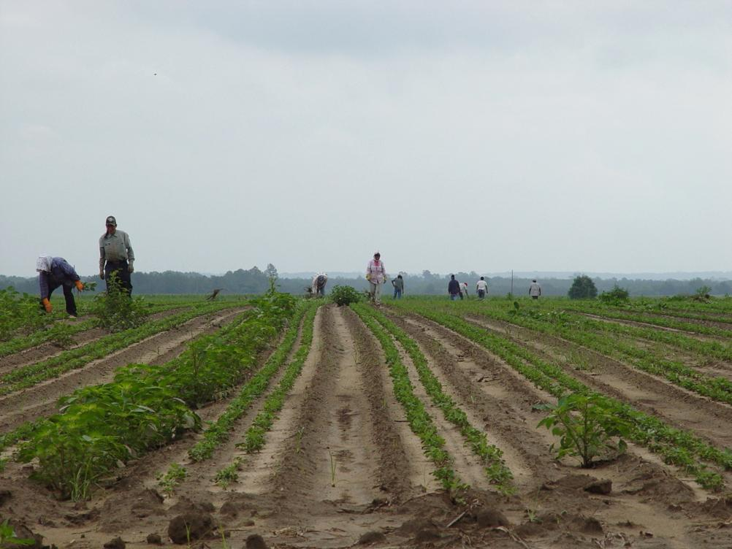
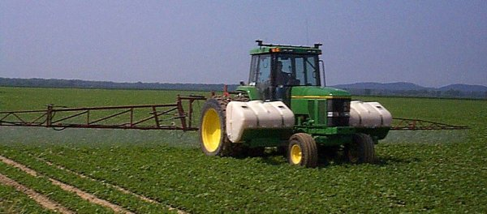
Peanut Weed Control Integrated Program Approach
Tillage
Irrigation
Rye Cover Crop
Hand-Weeding
Twin Rows
Herbicides

Slide 6
The Peanut Herbicide Toolbox 23 Active ingredients
PPI/PRE
Sonalan
Prowl/Pendimax
Dual Magnum/Generics
Outlook/Propel
Pursuit
Spartan Charge
Solicam
Strongarm
Valor
Zidua
POST
Aim (Harvest Aid)
Gramoxone Inteon/Firestorm/Parazone
Basagran
Ultra Blazer
Cadre/Impose
Classic
Cobra
ET (harvest aid)
Fusilade
Poast/Poast Plus
Pursuit
Select/Arrow/Trigger
Storm
2,4-DB

Slide 7
Peanut Weed Control – 2018 Valor/Cadre Program
Prowl H₂0 3.8Sc @ 32 oz/A (PRE)
Valor SX 51WG @ 3.0 oz/A (PRE)
Strongarm 84WG @ 0.45 oz/A (PRE)
Cadre 2AS @ 4 oz/A (38 DAP)
Dual Magnum 7.62EC @ 16 oz/A (38 DAP)
PE-15-18
July 17
71 DAP
NTC

Slide 8
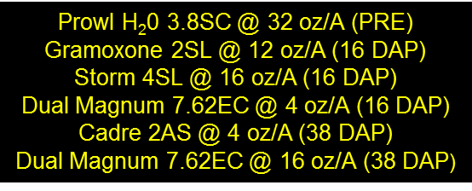
Peanut Weed Control – 2018 Gramoxone/Cadre Program
PE-15-18
July 17
71 DAP
NTC

Slide 9
What do the top Georgia peanut growers do? 2017 Georgia Peanut Achievement Club Winners
15 growers
6249 lb/A average yield
GA State Avg. = 4380 lb/A
100% - irrigated
67% - bottom plow
86% - twin rows
Herbicides
53% - Sonalan
93% - Valor
20%- Dual
73% - Cadre
53% - 2,4-DB
47% - Prowl
40% - Strongarm
9.1 MPH and 12.2 GPA (avg.)

Slide 10
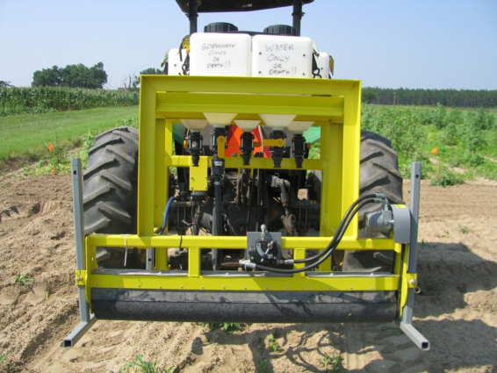
Weed Wiper Randolph County – August 20, 2018
Treated 8/8/18

Slide 11
Other Topics of Interest
Future
Anthem Flex (pyroxasulfone + carfentrazone)
Brake (fluridone)
Valor Formulations
Valor/Dual Magnum Combos in High Moisture
Auxin Nozzles
Dicamba
Tropical spiderwort /Benghal Dayflower

Slide 12
Anthem Flex in Peanut
FMC
Anthem Flex 4SE
carfentrazone (0.267 lb/gal)
pyroxasulfone (3.733 lbs/gal)
Testing since 2012
POST only!
Increase in crop injury mostly due to carfentrazone
3 oz/A + NIS
0.0063 lb ai/A – carfentrazone
Aim 2EC @ 0.4 oz/A
0.0875 lbs ai/A – pyroxasulfone
Zidua 85WG @ 1.65 oz/A

Slide 13
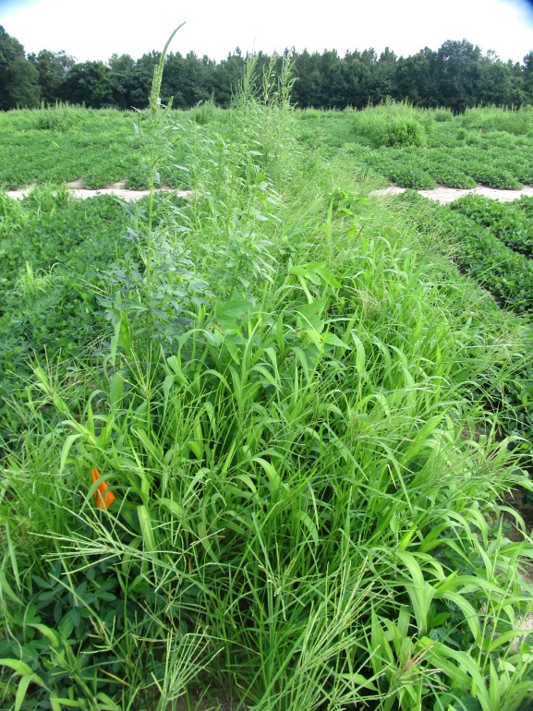
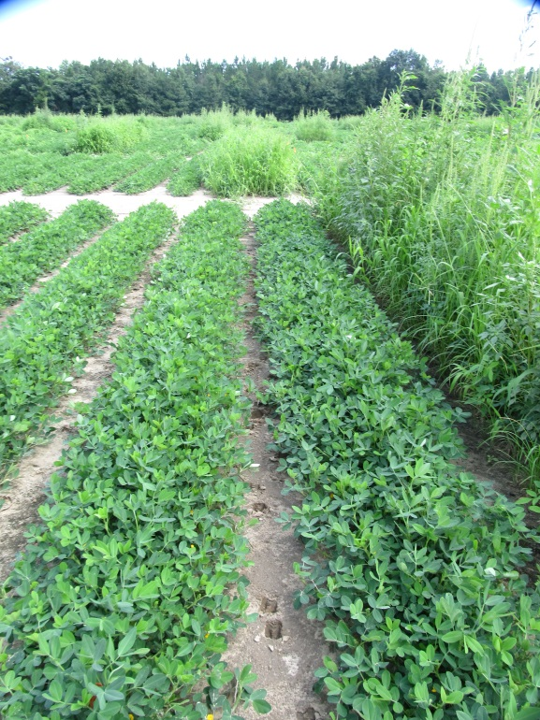
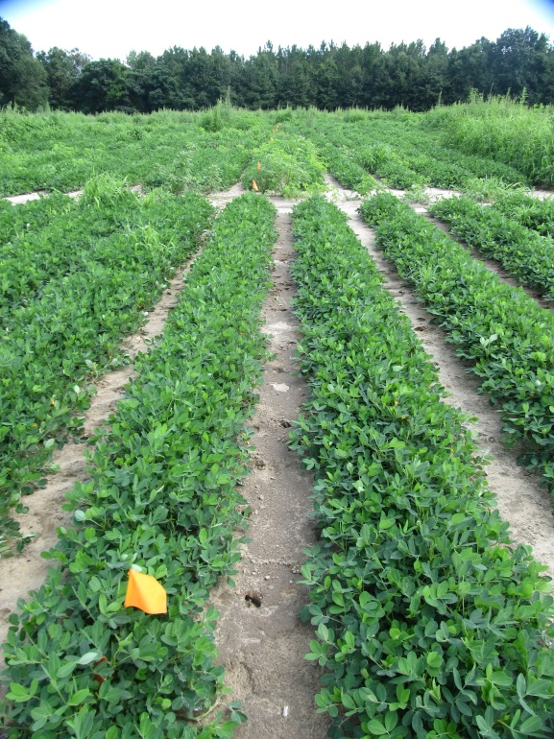
Weed Control in Peanut with Anthem Flex - 2018
NTC
Prowl H₂0 @ 32 oz/A – PRE
Gramoxone @ 12 oz/A - 16 DAP
Storm @ 16 oz/A - 16 DAP
Dual Magnum @ 16 oz/A -16 DAP
Cadre @ 4 oz/A - 38 DAP
Dual Magnum @ 16 oz/A - 38 DAP
Prowl H₂0 @ 32 oz/A – PRE
Gramoxone @ 12 oz/A - 16 DAP
Storm @ 16 oz/A - 16 DAP
Anthem Flex @ 3 oz/A -16 DAP
Induce @ 0.25% v/v
Cadre @ 4 oz/A - 38 DAP
Anthem Flex @ 3 oz/A - 38 DAP
Induce @ 0.25% v/v
PE-15-18
July 17
71 DAP

Slide 14
Gramoxone + Storm + Anthem Flex
PE-02-15
May 19
1 DAT

Slide 15
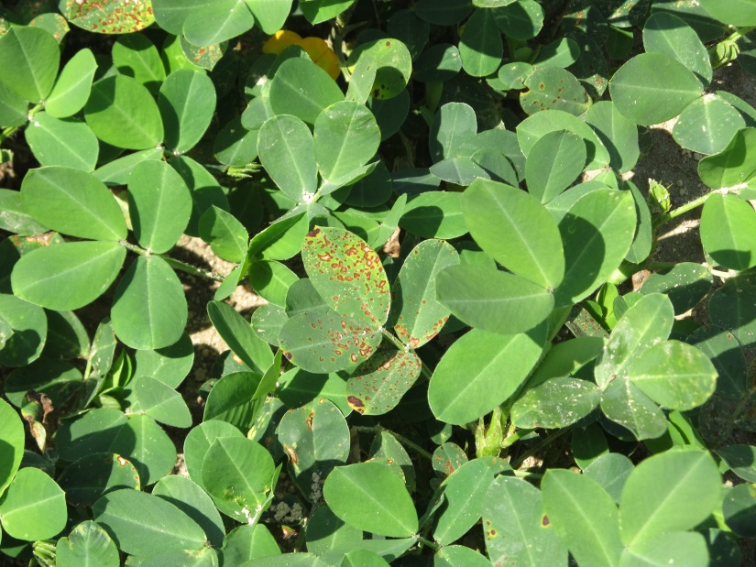
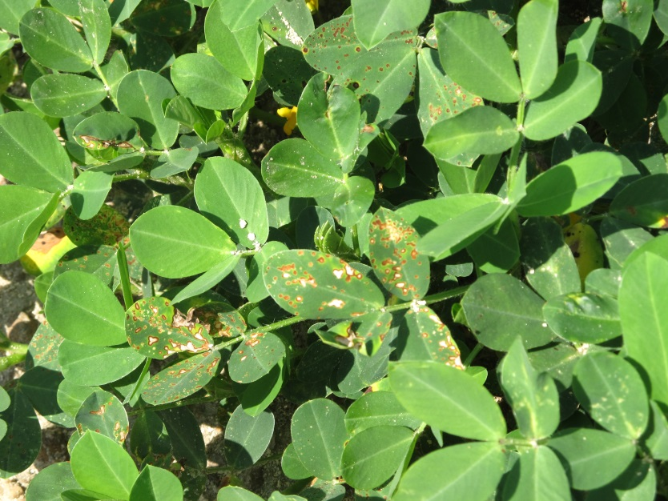
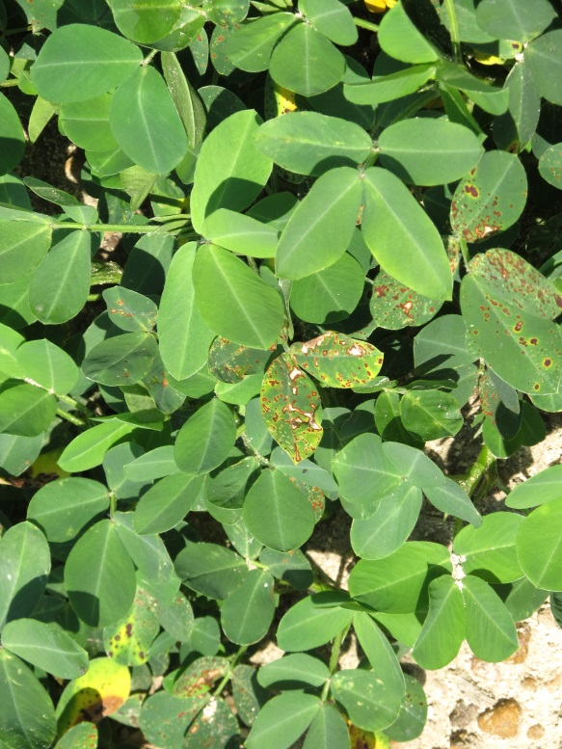
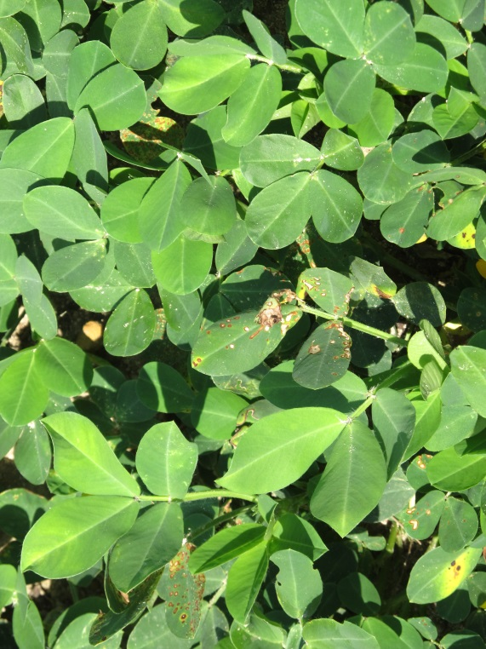
Anthem Flex Injury from POST Applications
PE-12B-14
June 19

Slide 16
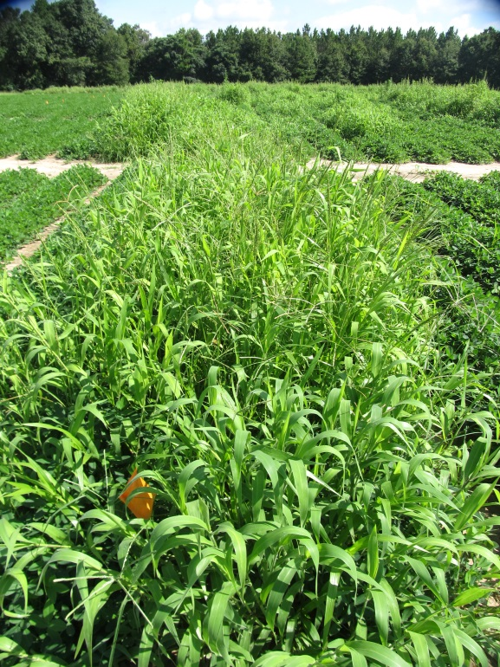
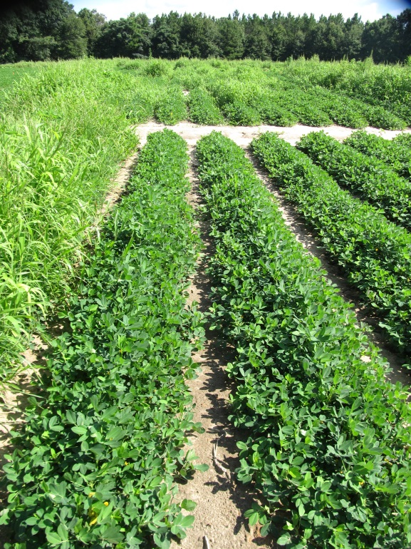
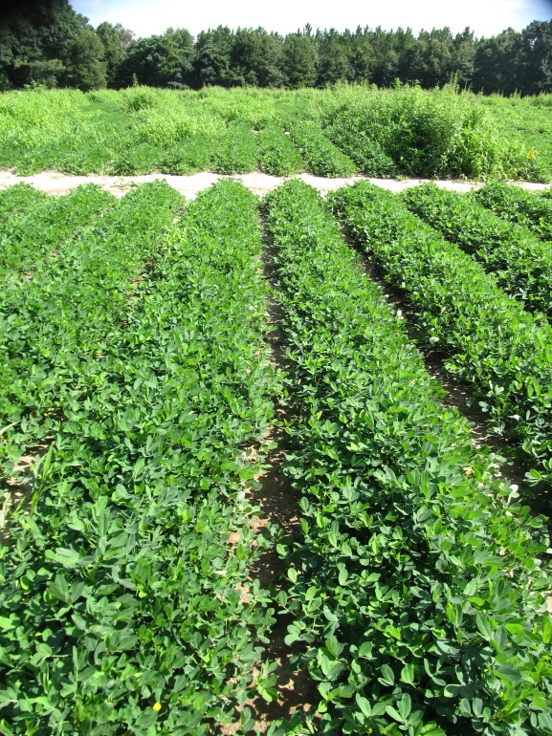
Brake (fluridone) vs. Valor - 2018
NTC
Prowl H₂0 @ 32 oz/A (PRE)
Valor SX @ 3 oz/A (PRE)
Cadre @ 4 oz/A (POST)
Dual Magnum @ 16 oz/A (POST)
2,4-DB @ 16 oz/A (POST)
Prowl H₂0 @ 32 oz/A (PRE)
Brake 1.2L @ 16 oz/A (PRE)
Cadre @ 4 oz/A (POST)
Dual Magnum @ 16 oz/A (POST)
2,4-DB @ 16 oz/A (POST)
PE-12-18
July 17
5 weeks after POST

Slide 17
Flumioxazin Formulations

Slide 18
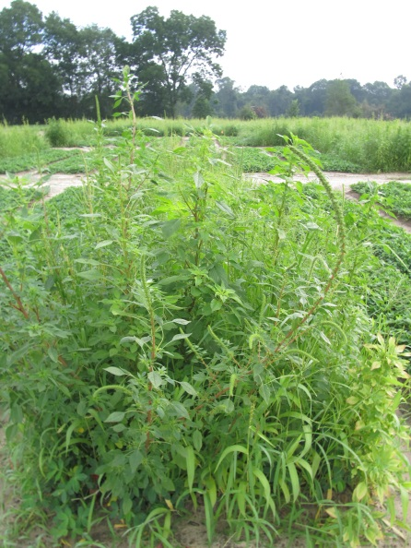
Flumioxazin Formulation Test – 2017 3 oz/A
PE-20A-17
June 28
65 DAP
*All treatments included Prowl H₂O (PRE) fb Cadre + Dual Magnum + 2,4-DB (32 DAP)

Slide 19
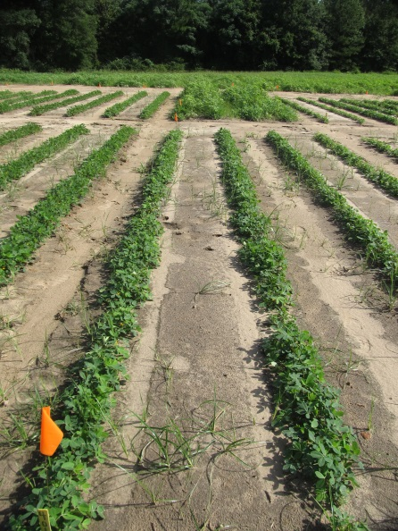
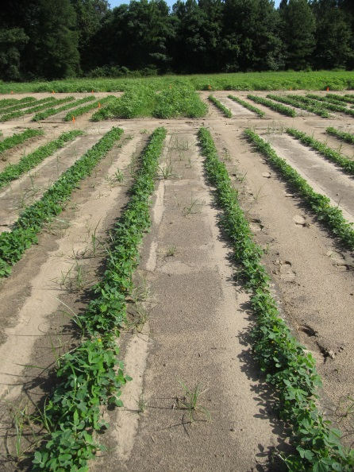
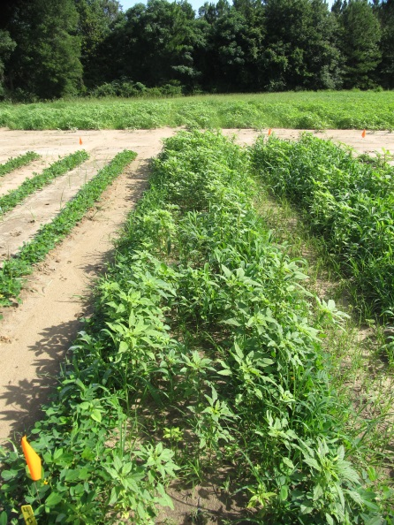
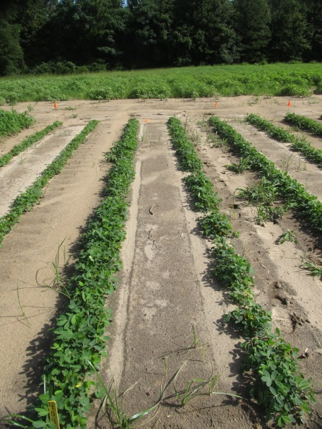
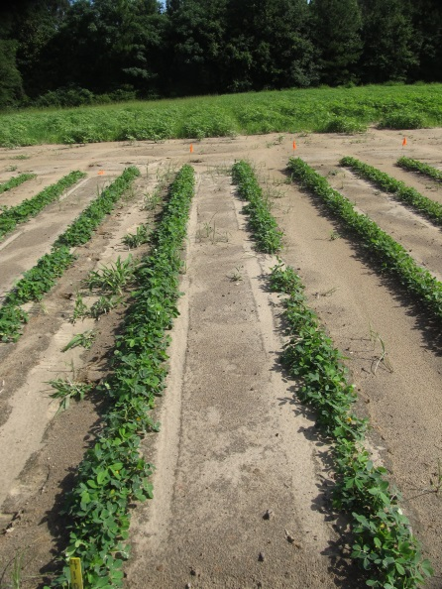
Valor Formulation Test - 2018 (3 oz/A + Prowl H₂0 @ 32 oz/A)
Valor SX
Red Eagle
NTC
Panther SC
Valor EZ
PE-06-18
June 18
42 DAP
13.55” (R + I)

Slide 20
Brief History of Metolachlor
Synthesized by Ciba-Geigy in 1972
50/50% mixture of R + S isomers
Registered for corn in 1977
Registered for peanut in 1980 (February)
S-metolachlor registered for use in 1997 (Novartis)
12/88% mix of R + S isomers
Patent expiration
EPA Reduced Risk Pesticide Program
Novartis stopped selling “old” metolachlor in 1999, phased out completely by 2001.
Novartis + AstraZeneca became Syngenta in 2000
Generic companies started producing “old” metolachlor in 2003 (i.e. 50/50 mix of R + S isomer).

Slide 21
Early Metolachlor/Peanut Research Results
Author (s) | Year | Journal | Results
Cardina and Swann | 1988 | Peanut Sci. 15:57-60 | Emergence and growth delayed from PPI applications when rainfall or irrigation followed application. No effect on yield at labeled rates. 3X rate reduced yield (11-15%)
Wehtje et al. | 1988 | Peanut Sci. 15:53-56 | Across all years, a 2-fold safety factor existed between maximum labeled rate and injury rate.
Johnson et al. | 1993 | Peanut Sci. 20:17-20 | Split applications of metolachlor (PPI + VE) had no effect on yield.
Johnson et al. | 1994 | Peanut Sci. 21:126-129 | PPI, VE, and PPI + VE applications had no effect on yield.
What about high moisture conditions and tank-mixes with Valor?

Slide 22
Valor/Dual High Moisture Test - 2018
11.315" OF TOTAL IRRIGATION/RAINFALL IN FIRST 30 DAYS AFTER APPLICATION

Slide 23
Peanut Response to Valor + Dual Magnum - 2018
11.315" OF TOTAL IRRIGATION/RAINFALL IN FIRST 30 DAYS AFTER APPLICATION
PE-09-18
July 24
83 DAT
NTC
Valor @ 3 oz/A + Dual Magnum @ 16 oz/A
PRE

Slide 24
J-Rooting
PE-09-18
May 21
21 DAP

Slide 25
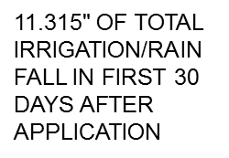
Valor/Dual Magnum High Moisture Results - 2018
No interactions between Valor and Dual Magnum
No effect on J-rooting
Valor and Dual reduced early season peanut biomass (stunting)
Valor @ 3 or 6 oz/A had no effect on yield
Dual Magnum reduced peanut yields under these high moisture conditions.
16 oz/A = 4.2% loss
21 oz/A = 5.4% loss
42 oz/A = 10.8% loss

Slide 26
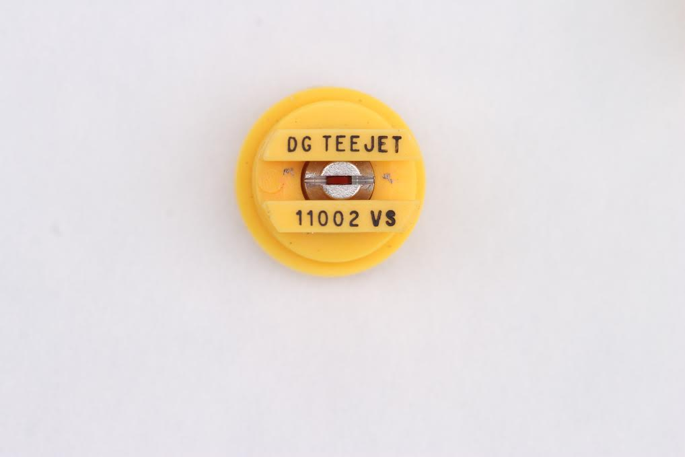
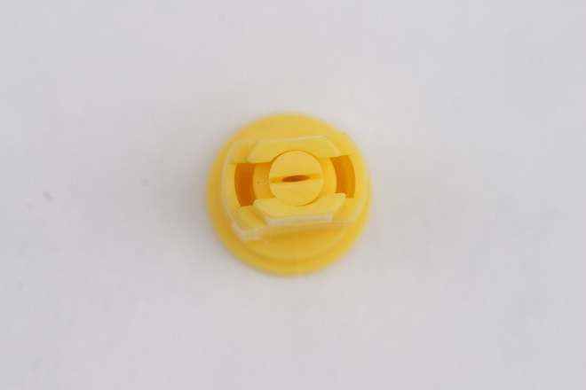
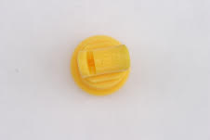
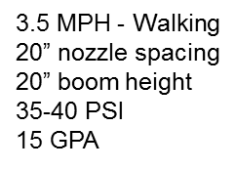
VMD for common nozzle types
11002DG
VMD₅₀ = 322 (M)
AIXR 11002
VMD₅₀ = 402 (C)
TTI 02
VMD₅₀ = 524 (XC)

Slide 27
Objective:
Compare the field performance of auxin nozzles to flat fan nozzles in commercial peanut fields.

Slide 28
Methodology
3 commercial peanut fields
Plot size
Sprayer width X field length
3-4 replications
2 nozzle types
All agri-chemicals
ANOVA
Tukey’s HSD (P=0.10)

Slide 29
Bulloch County Nozzle Test - 2018
03/23/2017
JD 4630
15 GPA
25 PSI
12.6 MPH
90’ boom length
15” nozzle spacing
32”-34” boom height

Slide 30
Miller County Nozzle - 2018
JD4030
110 ft boom
20” nozzle
10 MPH
25 PSI
10 GPA

Slide 31
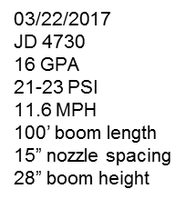
Pierce County Nozzle Test - 2018

Slide 32
2018 Nozzle Tests Pesticides/Fertilizers Applied
County | Herbicide | Fungicide | Insecticide | Other
Bulloch | Valor Strongarm Acumen Gramoxone Storm Dual Magnum 2,4-DB | Alto Bravo Elatus Folicur | Bifenthrin Dimilin | Boron PegPower
Miller | Cadre Dual Magnum 2,4-DB | Bravo Elatus Folicur Priaxor Propulse | Acephate Beseige | FullBor Micropak PegPower
Pierce | Valor Dual Magnum Cadre 2,4-DB | Chlorothalonil Convoy Tebuzole | Dimilin | Boron

Slide 33
Yield Data
Miller Co.
October 3
6 rows (18’) X 1000’ (0.413 acres/rep) – Bulloch/Miller
6 rows (18’) X Field Length (0.680-0.735 acres/rep) - Pierce

Slide 34
Pierce County Nozzle Test September 19, 2018
XR11006-VP

Slide 35
Pierce County Nozzle Test September 19, 2018
TTI-11006VP-C

Slide 36
Nozzle Tests - Summary
No differences in weed, insect, disease control observed except for 3-CAH in Miller Co.
No differences in peanut yield
Growers liked auxin nozzles and plan to expand use in 2019
Pierce Co.
October 31

Slide 37
Nozzle Tests Thoughts
TTI60 will likely not be registered for dicamba
Growers who historically have less than ideal pest control should not take a chance on coverage
Timing is important!

Slide 38
Off-Target Dicamba/Peanuts

Slide 39
Dicamba/Peanuts – I (Epinasty)

Slide 40
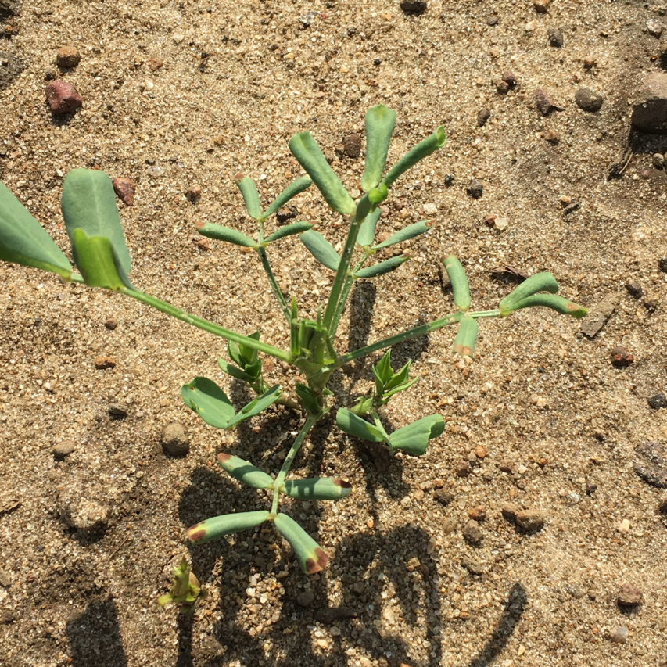
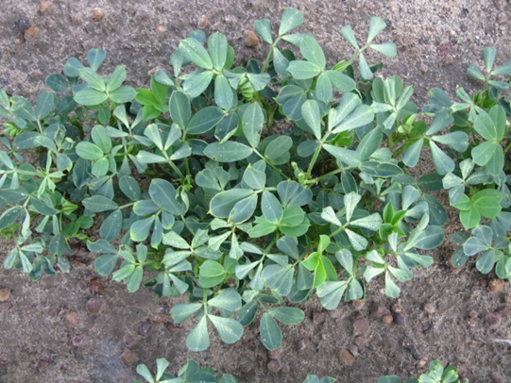
Dicamba/Peanuts – II (leaf strapping)

Slide 41
Dicamba/Peanuts – III (leaf roll)

Slide 42
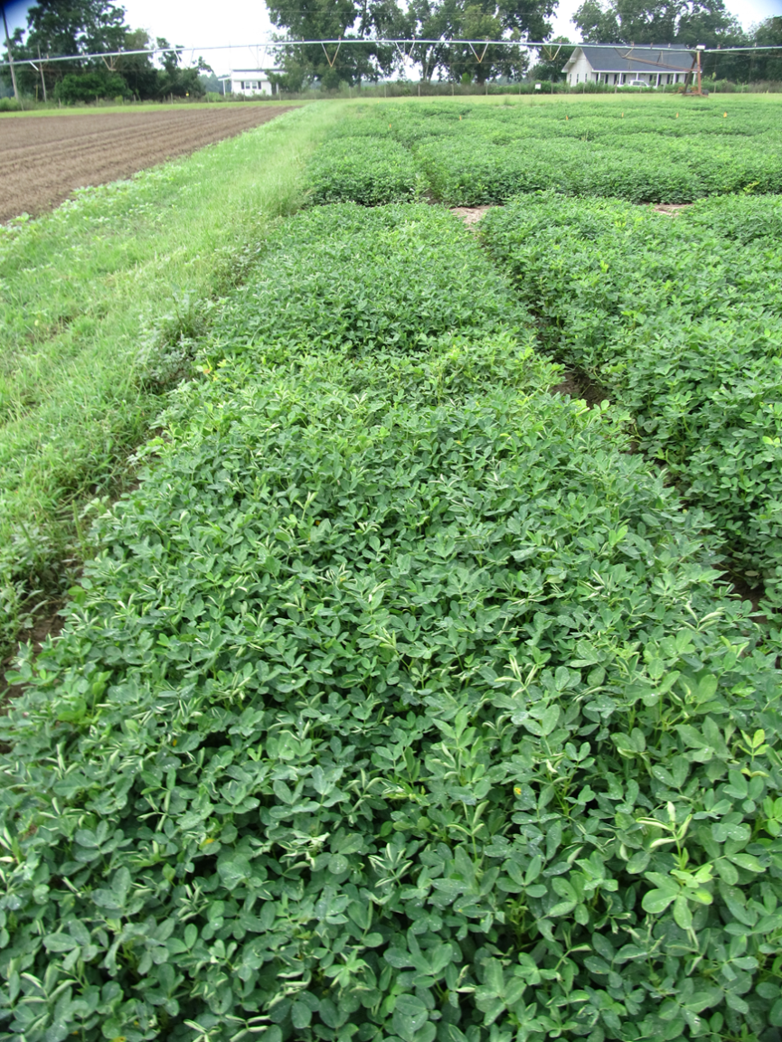
Peanut Response to Xtendimax + Glyphosate (1/50th X) - 2018 Applied 30 + 60 + 90 DAP
PE-03-18
August 16
108 DAP

Slide 43
Peanut yield (lbs/A) as influenced by dicamba + glyphosate applied at 1/50th X rates.
Time (DAP)
THSD (P=0.10) = NS
CV = 4.8

Slide 44
Peanuts/Dicamba Summary
No tolerance is currently established
Peanut injury dependent upon rate and time of event
Drift rates or volatility rates (1/50thX and lower) will cause symptomology but should not reduce yields
Pay attention!

Slide 45
Pay Attention to Detail!

Slide 46
Tropical Spiderwort (a.k.a. Benghal Dayflower) Control in Peanut
Tillage (moldboard plow)
Twin Rows (+8%)
2 applications of Dual Magnum
PRE or EPOST or POST?
Gramoxone, Cadre, Strongarm, Basagran – POST

Slide 47
Questions/Comments

