Slide 1

2,4-D and Dicamba Resistant Soybeans in the Southeast
Eric P. Prostko
Professor and Extension Weed Specialist
Dept. Crop & Soil Sciences
2016 Soybean Expo

Slide 2

Public Service Announcement
UGA weed scientists are not actively promoting the use of 2,4-D or dicamba resistant crop technologies over any other technology or herbicide.
If GA growers decide to use these technologies, UGA weed scientists and extension agents will provide the best possible educational programs and technical support to ensure safe and effective use.

Slide 3

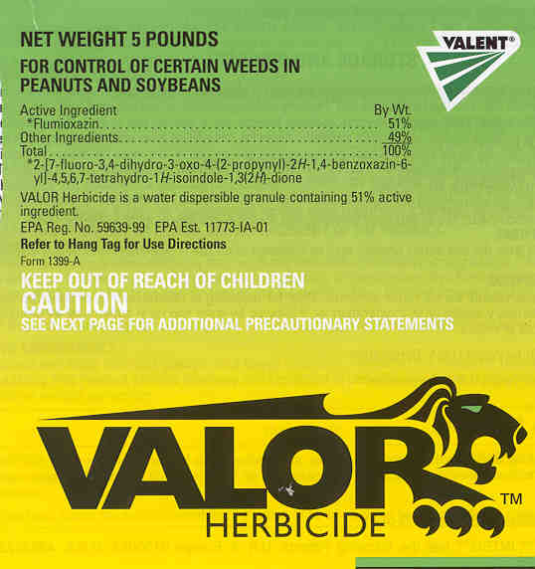


Do we have to have this new technology?
PPO’s still working?
Reflex, Valor
When will Liberty crash and burn?
Dryland production
Residual activation

Slide 4
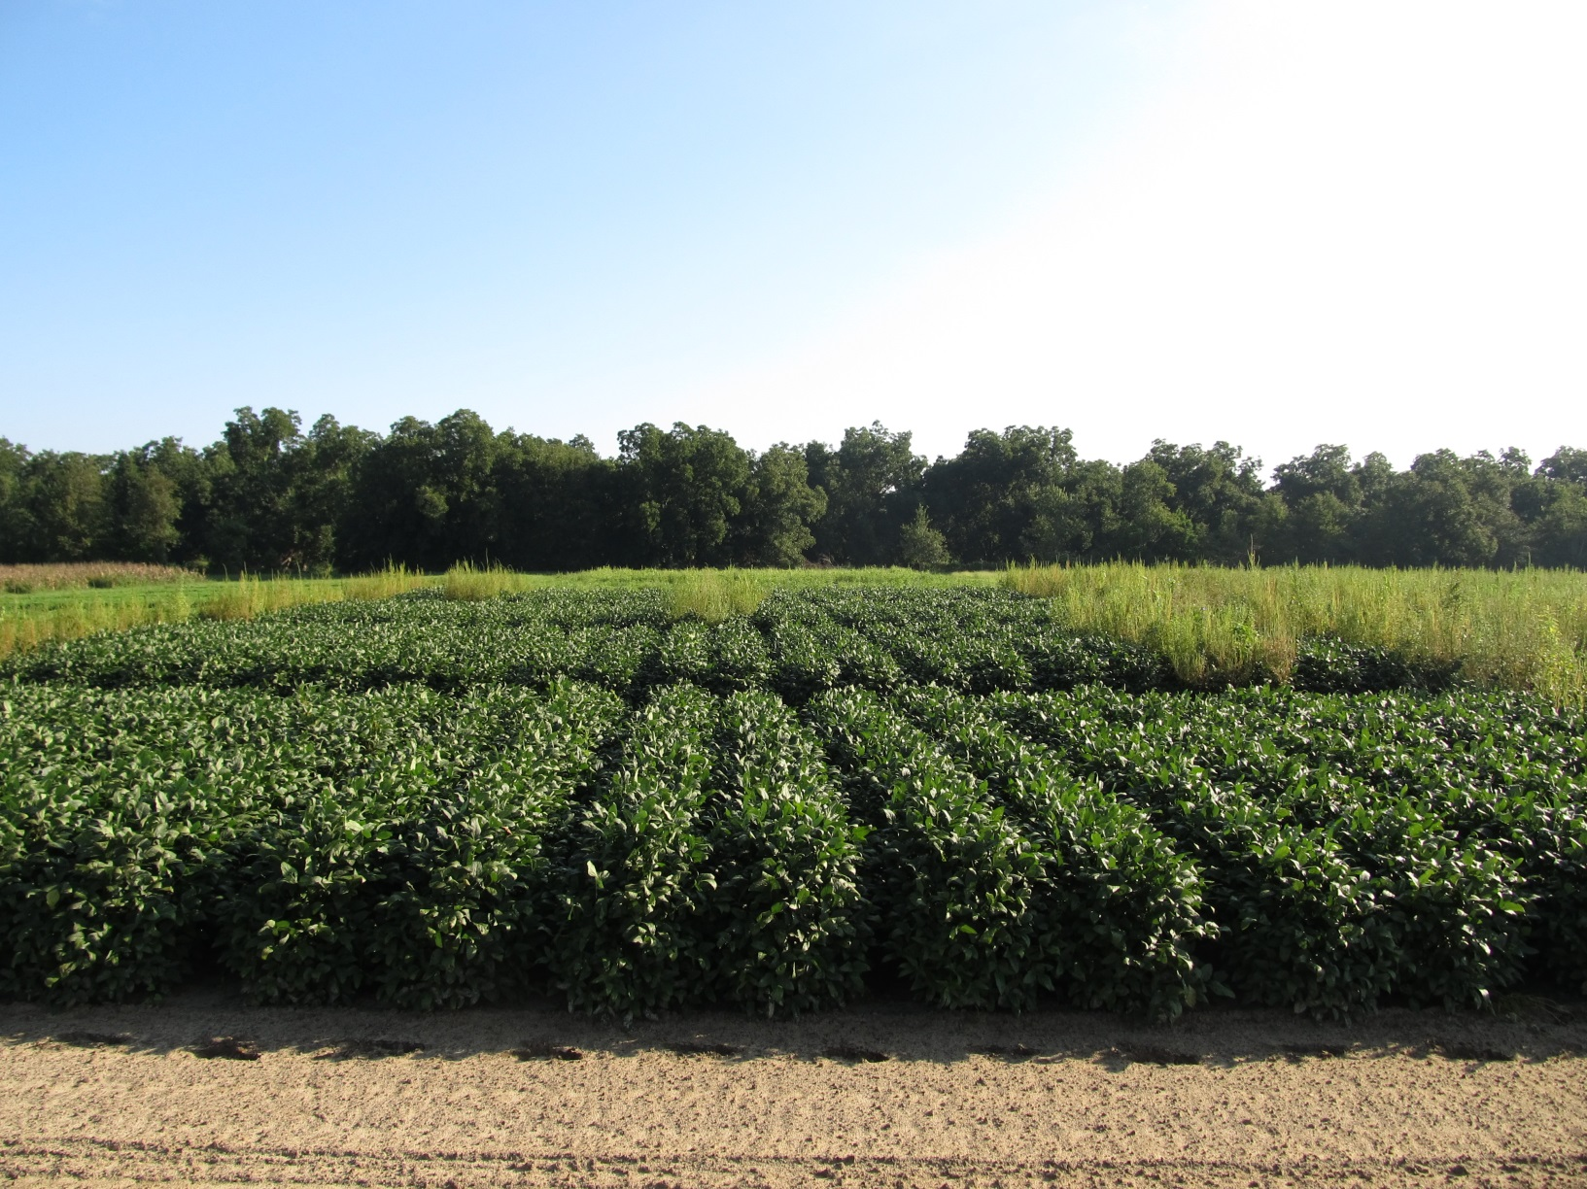
Soybean Weed Control August 13, 2015 (99 DAP)
Started clean
Dual Magnum (PRE)
0.5” irrigation (1 DAT)
Roundup WM + Reflex or Prefix + Classic or FirstRate (23 DAP)
NTC
NTC
NTC
SB-01-15

Slide 5










2,4-D/Dicamba Technologies
2,4-D
dicamba

Slide 6
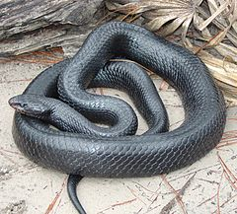
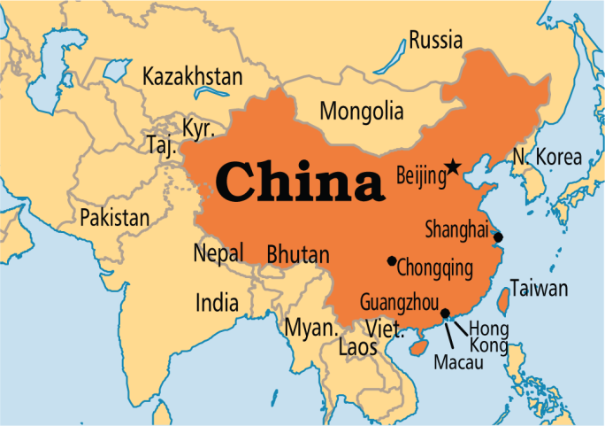
What was/is causing the delay?
Endangered Species Act
GA has 63 species
China
Leading importer of soybean and cotton

Slide 7

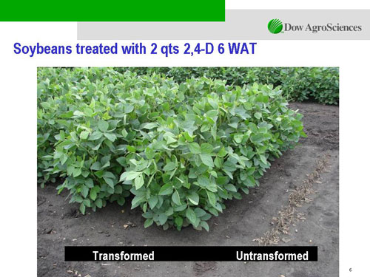

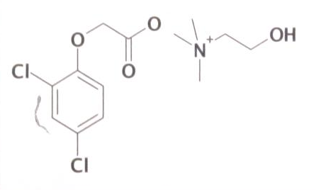
Enlist™ Herbicide Tolerant Soybean
tolerance to 2,4-D + glyphosate + glufosinate (Liberty)
Trait was deregulated in September 2014 and herbicide in October 2014
Colex-D™ technology
2,4-D choline
lower volatility
lower drift potential
enhanced handling/mixing characteristics
reduced odor
1 Burndown/PRE application + 2 POST applications (R2 stage)
Enlist™ Duo
DMA-Glyphosate (1.7 lb ae/gal) + 2,4-D choline (1.6 lb ae/gal) – (3.5-4.75 pt/A)
2015 Product Launch
IA, IL, IN, OH, SD, WI (first)
AR, KS, LA, MN, MO, MS, NE, ND, OK, TN, (next)
2,4-D choline

Slide 8
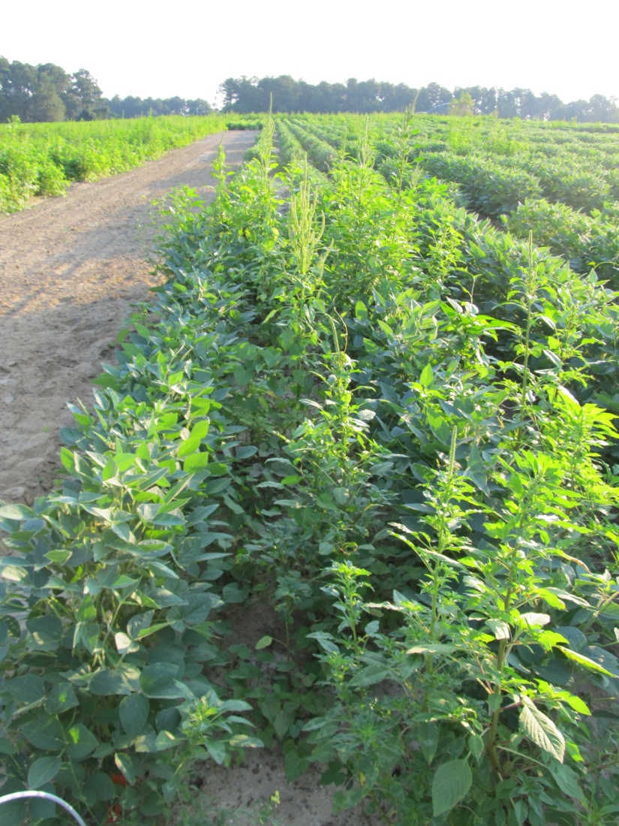
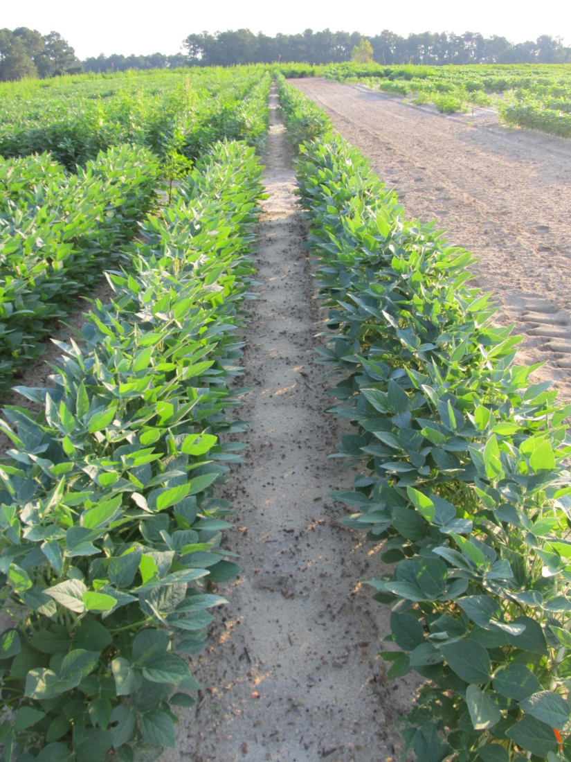
Enlist Soybeans - 2012
NTC
Valor SX 51WG - PRE (May 4)
Enlist Duo - MPOST (June 1)
N-PAK AMS - MPOST (June 1)
SB-09-12
Planted May 3
Photo: June 29

Slide 9

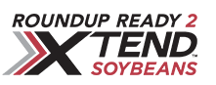

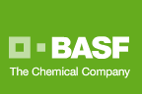

Dicamba-Tolerant (DT) Soybeans
Monsanto/BASF
Roundup Ready XTEND Crop System
Roundup Ready 2 XTEND- soybeans
Glyphosate + dicamba resistance
Herbicides
XtendiMax (with Vapor Grip)
Reduced volatility dicamba
12.8 oz/A (0.5 lb ae/A dicamba)
Roundup Xtend (with Vapor Grip)
Reduced volatility dicamba + glyphosate
48 oz/A (1 lb ae glyphosate + 0.5 lb ae dicamba)
Engenia™ (BASF)
dicamba–BAPMA
12.8 oz/A (0.5 lb ae/A)
PRE or POST (R1)
RESIDUAL STILL NEEDED!!!!!!!!!!!!!!!!!!!!!!!

Slide 10
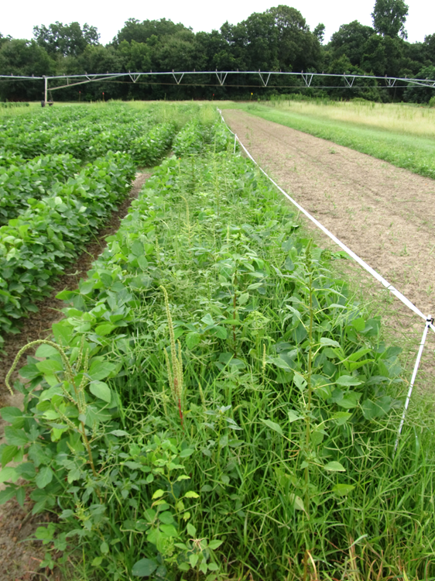
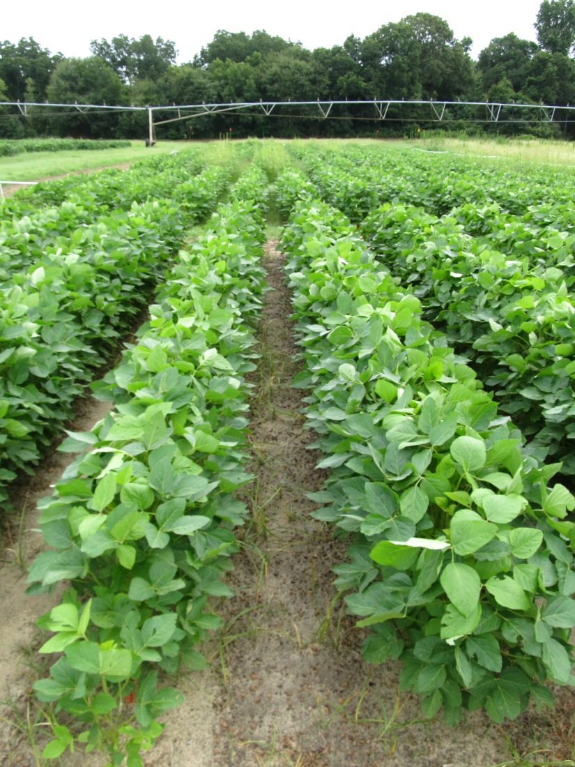
Roundup Xtend - 2014
NTC
Valor – PRE
Roundup Xtend - POST
SB-10-14
July 21
D after
POST

Slide 11

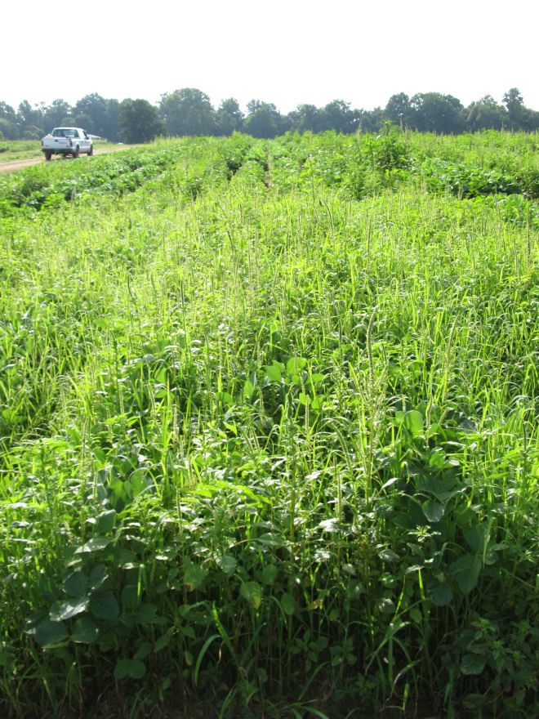
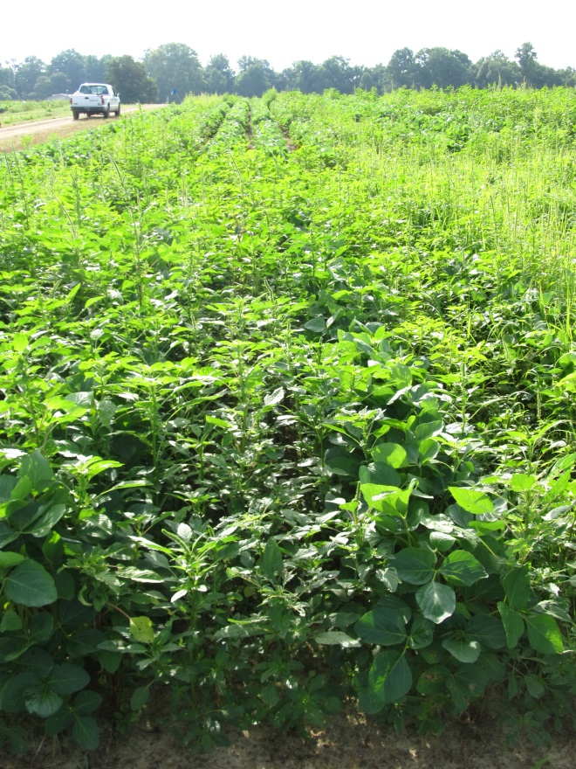
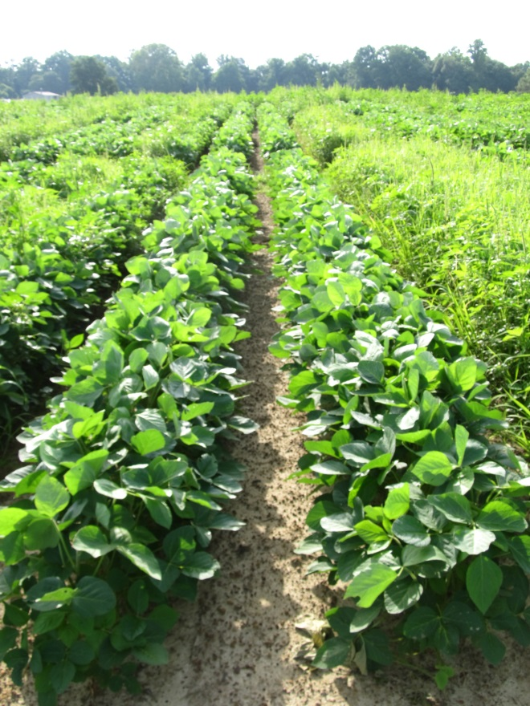
Engenia Program – DT Soybeans 2014 (EPOST Applied 13 DAP)
NTC
Roundup P-Max +
Induce
EPOST
Prowl H₂0 – PRE
Zidua + Roundup P-Max
+ ENGENIA + Induce
EPOST
New-2014, July 14
27 d after EPOST

Slide 12
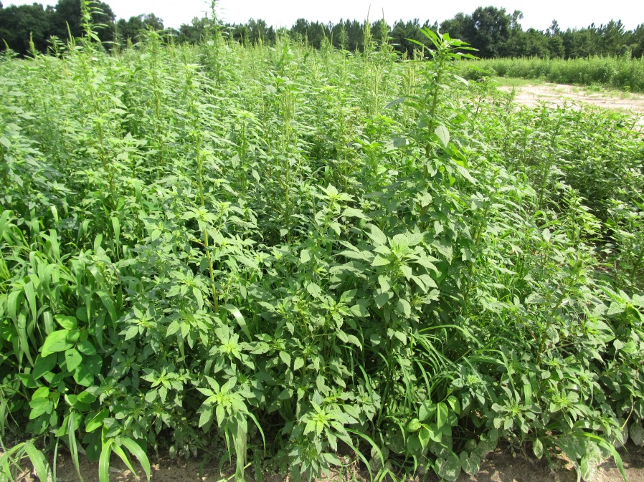
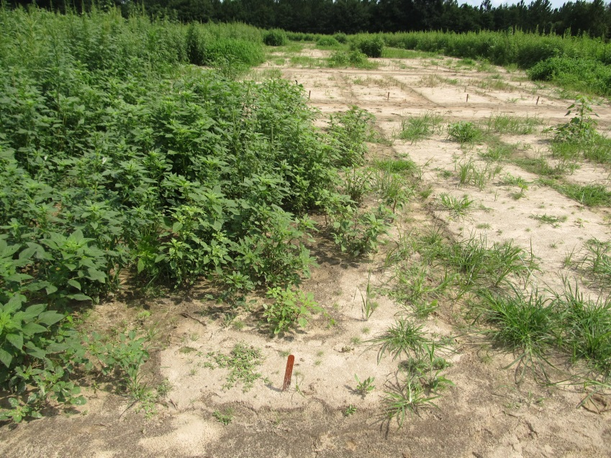
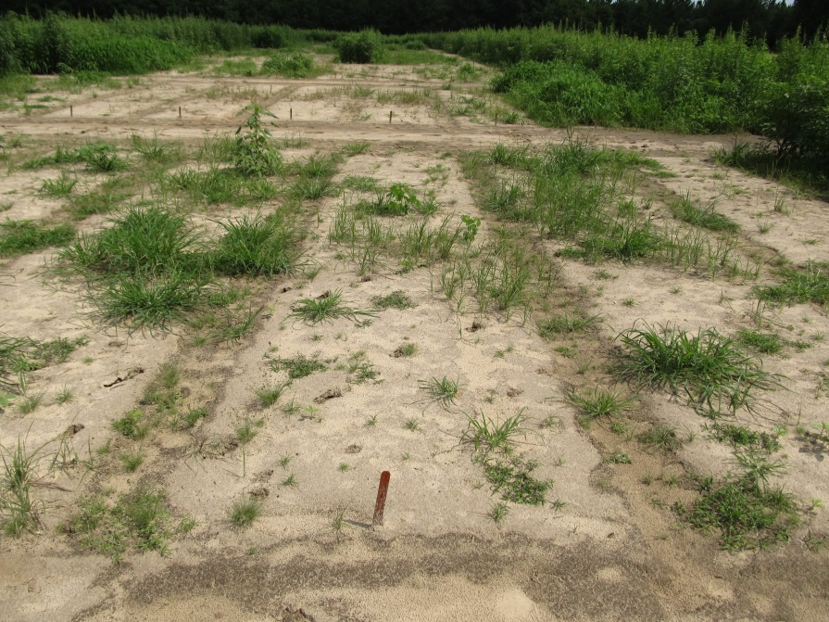
How good are dicamba and 2,4-D on Palmer Amaranth?
NTC
Roundup PM @ 22 oz/A
Clarity @ 16 oz/A
Roundup PM @ 22 oz/A
Cobra @ 16 oz/A
COC @ 1% v/v
SB-10-15
July 7
35 DAT
AMAPA – 1-8” tall
15 GPA
TTI02 tips

Slide 13
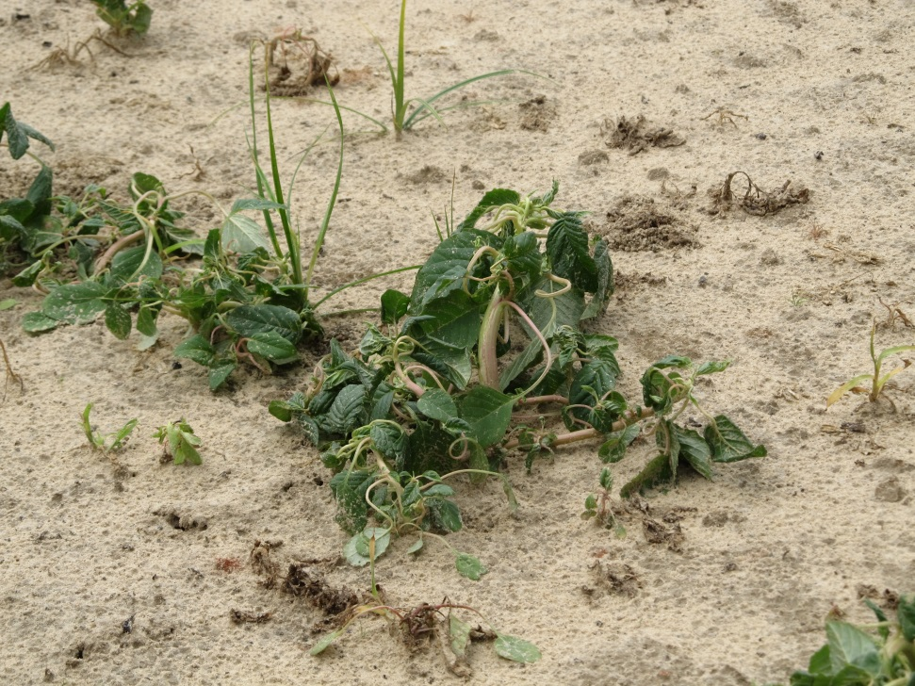
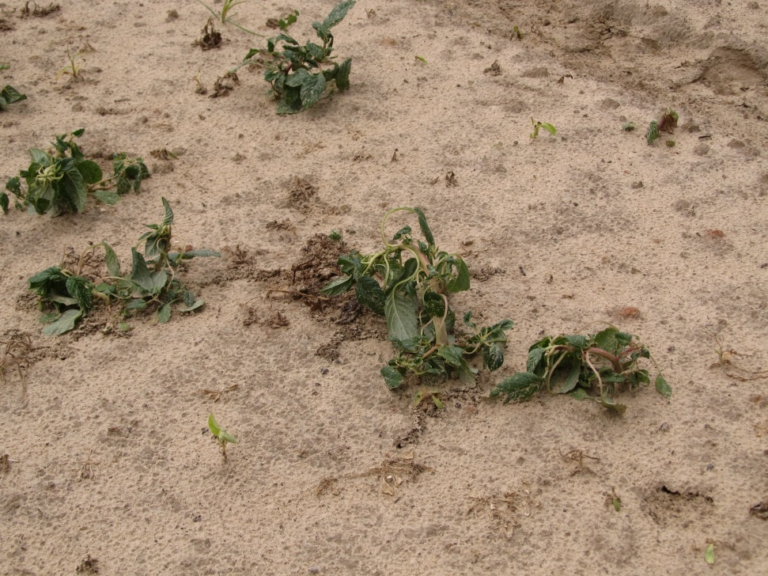
Dicamba/2,4-D Symptomology

Slide 14
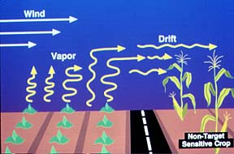
Formulation Improvements
Volatility has always been a big issue/concern with auxin herbicides.
Newer formulations of 2,4-D and dicamba are significantly less volatile than older formulations.
OLDER FORMULATIONS WILL NOT BE LABELED FOR USE IN AUXIN SYSTEMS!!!!!
Less volatility (i.e. vapor drift) does not mean less physical drift!!!!

Slide 15
Cotton Injury (%) From 2,4-D Volatiles for 48 hours Under Plastic Tunnels (21-28 DAT)
*83% reduction
*93% reduction
Source: Sosnoskie et al. 2015. Weed Technology 29:177-184 (UGA)

Slide 16
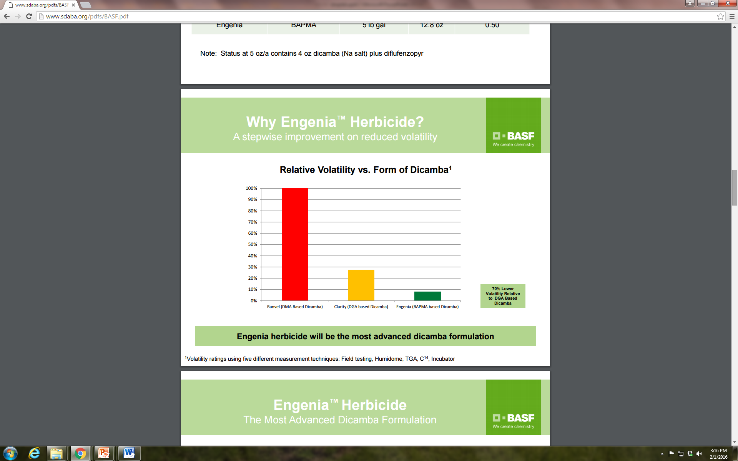

Slide 17

Less drift potential and less volatility does not mean 0 drift or volatility!!!

Slide 18
2,4-D and Dicamba Crops (Don’t Get Messed Up!)
Crop | Glyphosate | Glufosinate | 2,4-D | Dicamba
2,4-D field corn | YES | YES/NO | YES | YES¹
2,4-D soybean | YES | YES | YES | NO
2,4-D cotton | YES | YES | YES | NO
Dicamba cotton | YES | YES | NO | YES
Dicamba soybean | YES | NO | NO | YES
¹Dicamba is already registered for use in field corn (up to a certain point). Not sure
at this point if new formulations will be specifically labeled.

Slide 19
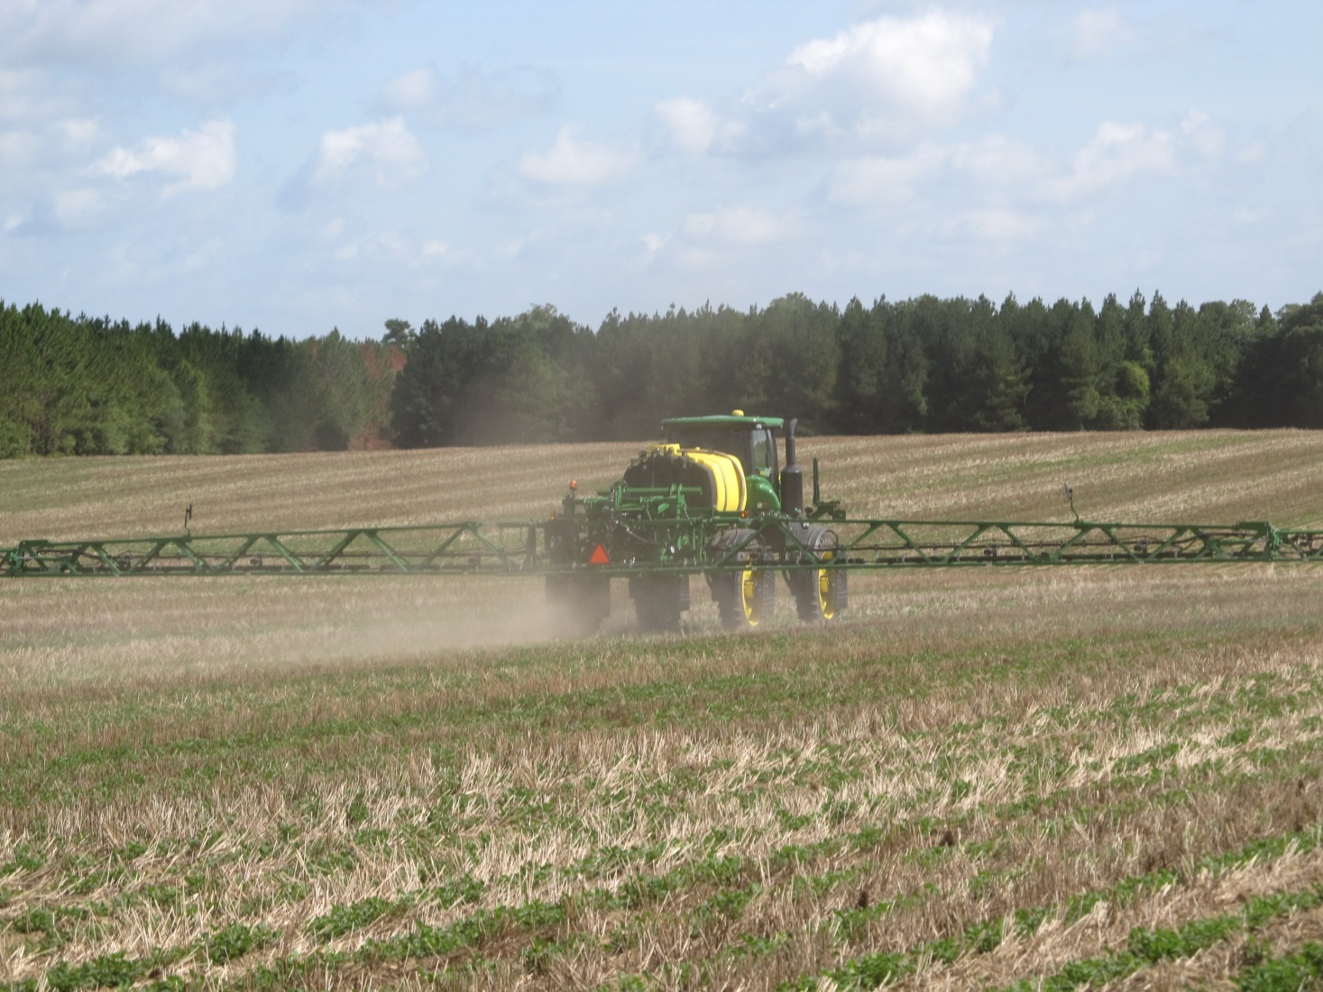
Droplet Size

Slide 20
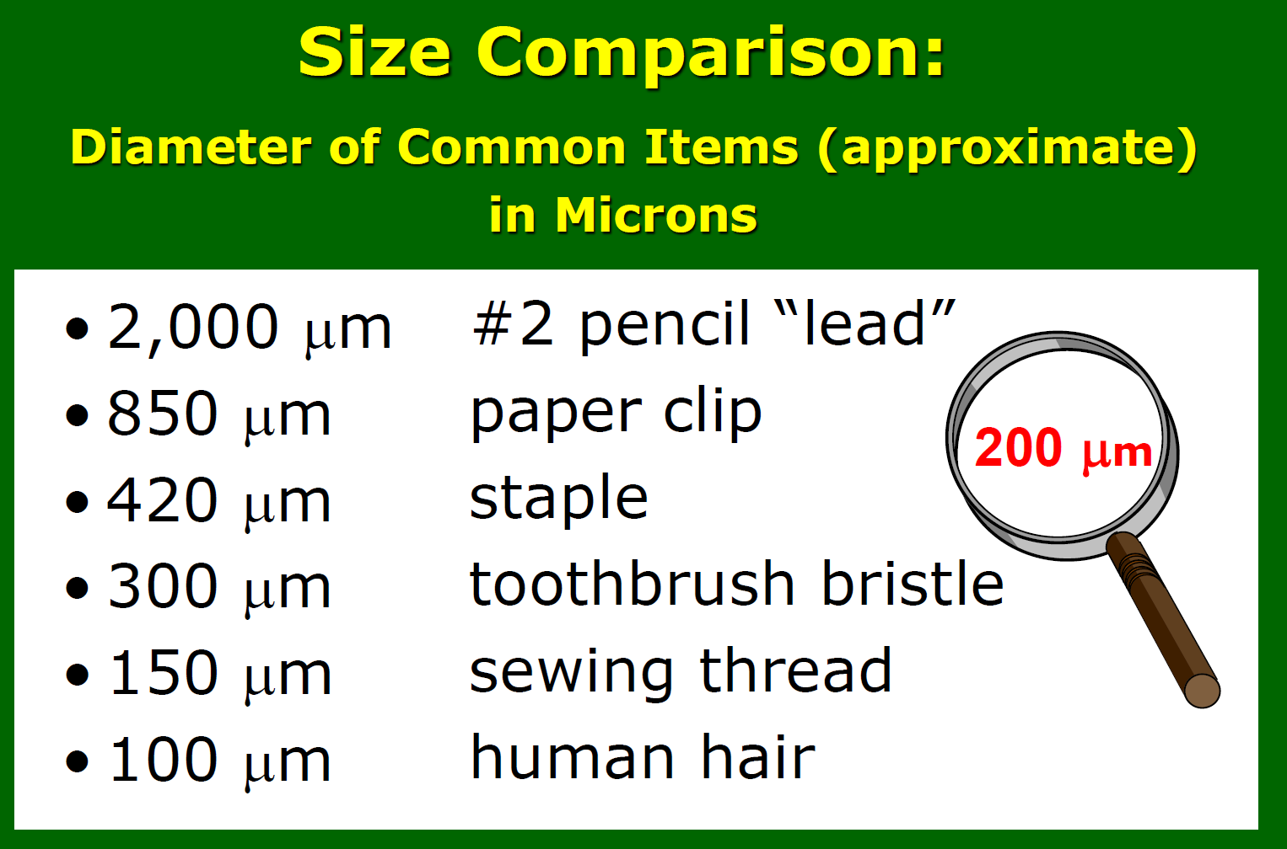
Micron
micron (µm) is a unit of measure equivalent to 1/25,000 of an inch.

Slide 21
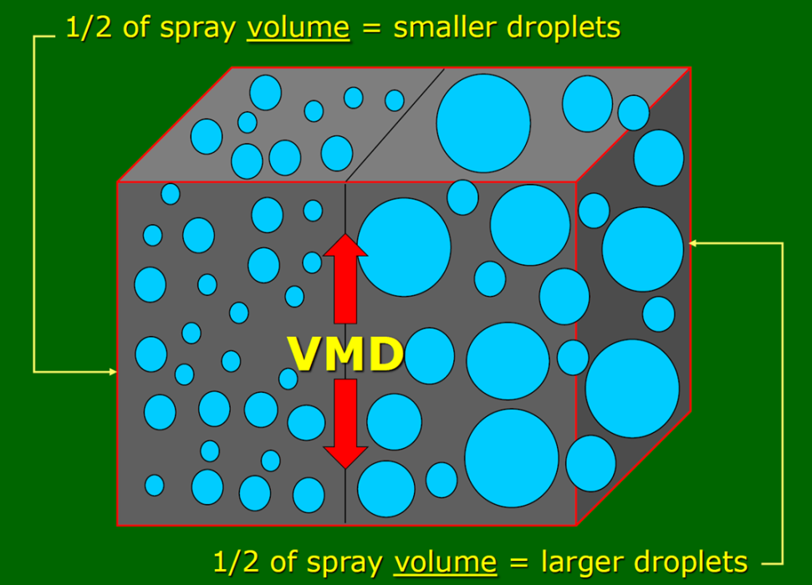
Volume Median Diameter (VMD)
value where 50% of the total volume or mass of liquid sprayed is made up of droplets larger than this value, and 50% is made up of droplets smaller than this value.
D_{v0.5}
Measured in microns

Slide 22
Table 1. Spray Droplet Size Classification¹.
Category | Symbol | Color Code | Approximate VMD₅₀² (Microns)
Extremely Fine | XF | PURPLE | <50
Very Fine | VF | RED | 51-136
Fine | F | ORANGE | 137-177
Medium | M | YELLOW | 178-218
Coarse | C | BLUE | 219-349
Very Coarse | VC | GREEN | 350-428
Extremely Coarse | XC | WHITE | 429-622
Ultra Coarse | UC | BLACK | >622
¹Estimated from sample reference graph in ASBAE/ANSI/ASAE Standard S572.1
²VMD = Volume median diameter

Slide 23
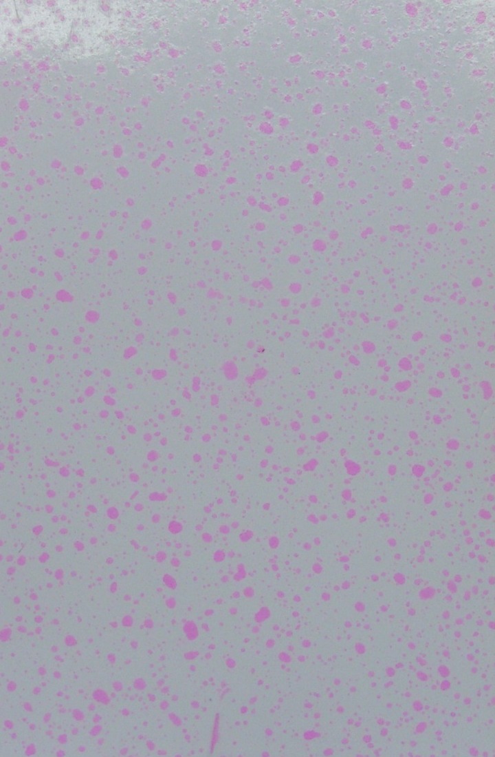
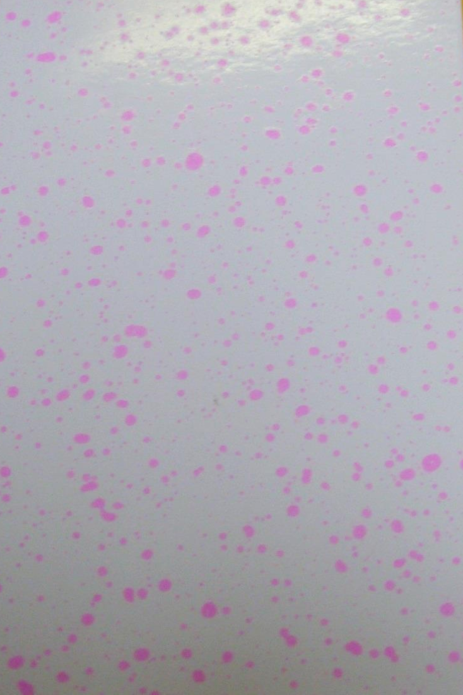
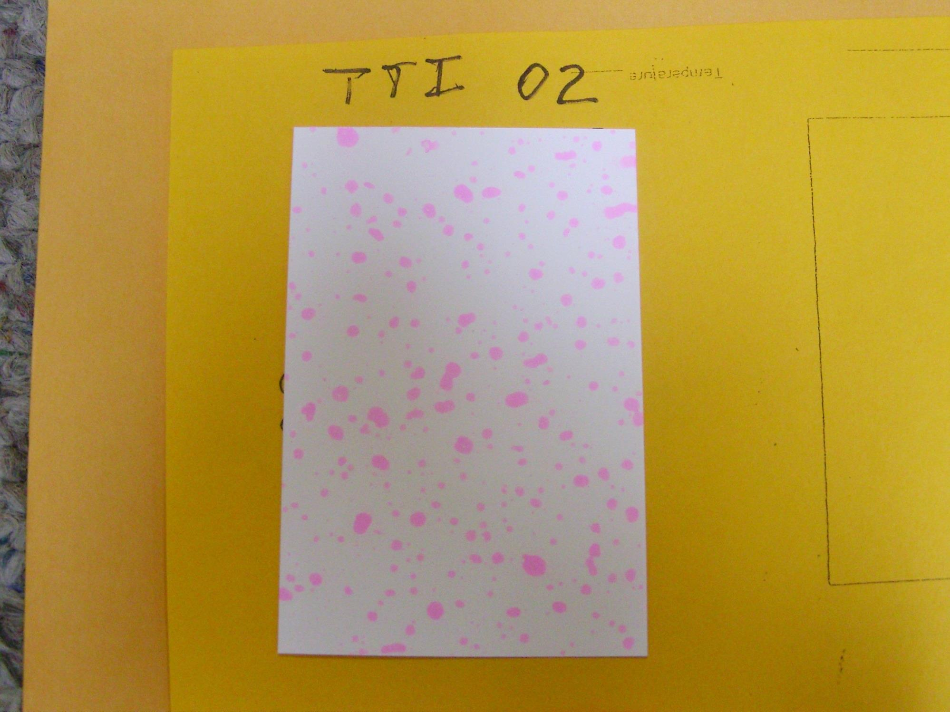
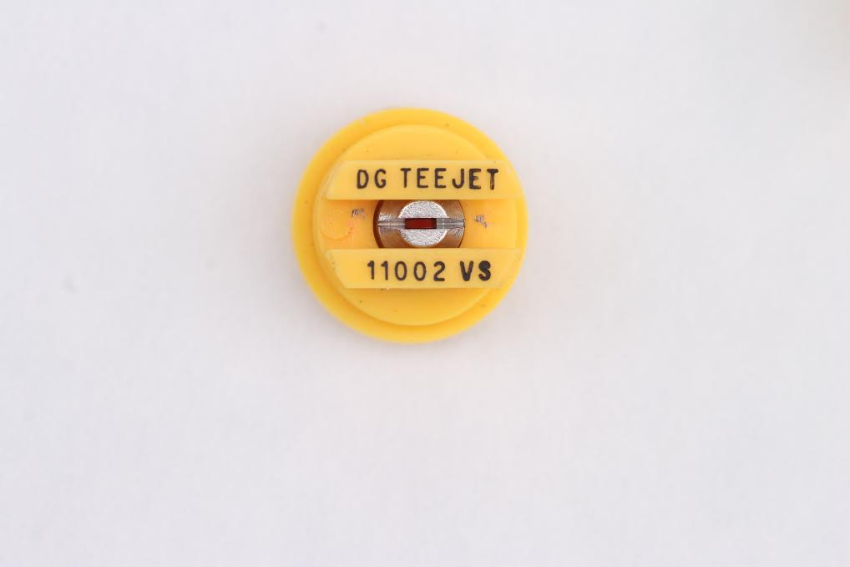
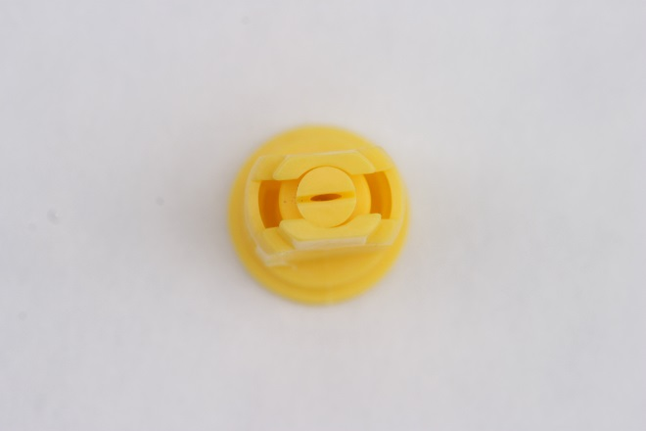
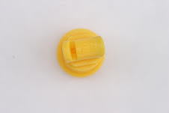
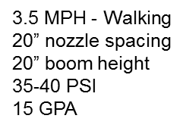
VMD₅₀ for Common Nozzle Types
?
11002DG
VMD₅₀ = 322 (C)
AIXR 11002
VMD₅₀ = 402 (VC)
TTI 02
VMD₅₀ = 524 (XC)

Slide 24
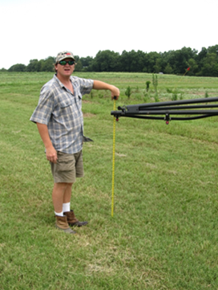


Boom Height Auto-Boom

Slide 25
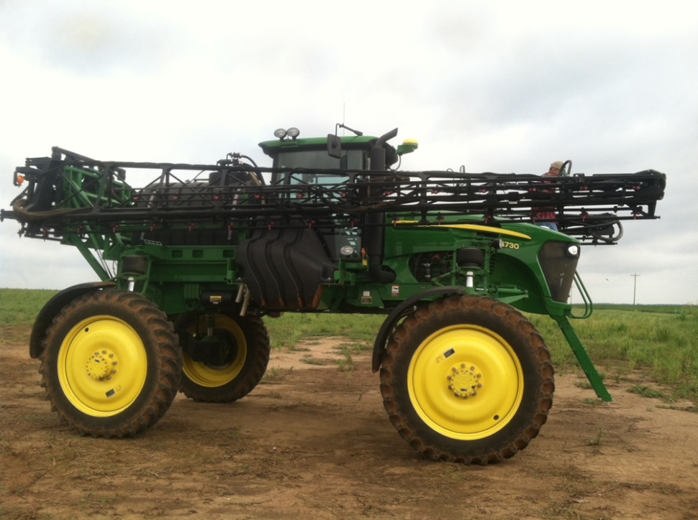
Sprayer Cleanout Is it possible in this rig?

Slide 26

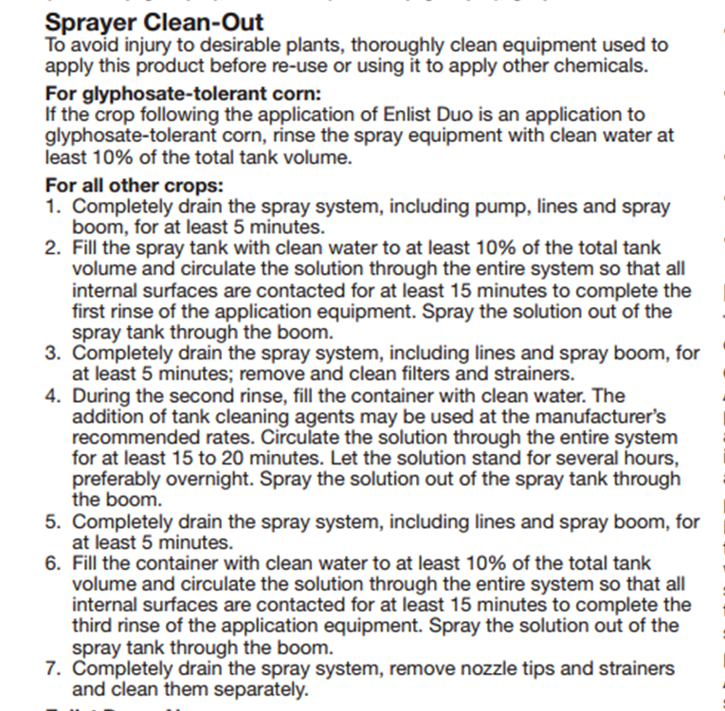
Enlist™ Duo Label Sprayer Cleanout

Slide 27
What happened in 2015 and what will happen in 2016?
Question | 2,4-D | Dicamba
Herbicide Trait Deregulated | Yes | Yes
Herbicide Registered | Yes (not in SE) | No
China Import Approval | No | Yes (2/2/2016)
Were there any commercial acres of 2,4-D or dicamba soybean planted in SE in 2015? | No | No
Were there any commercial soybean acres treated with 2,4-D or dicamba in 2015? | No | No
What is the cost of Enlist Duo or Roundup Xtend or Xtendimax or Engenia? | ?? | ??
How much for a 50 lb bag of seed? | ?? | +$5/bag
Realistic first commercial use in SE? | 2017?? | Seed but no herbicide in 2016

Slide 28
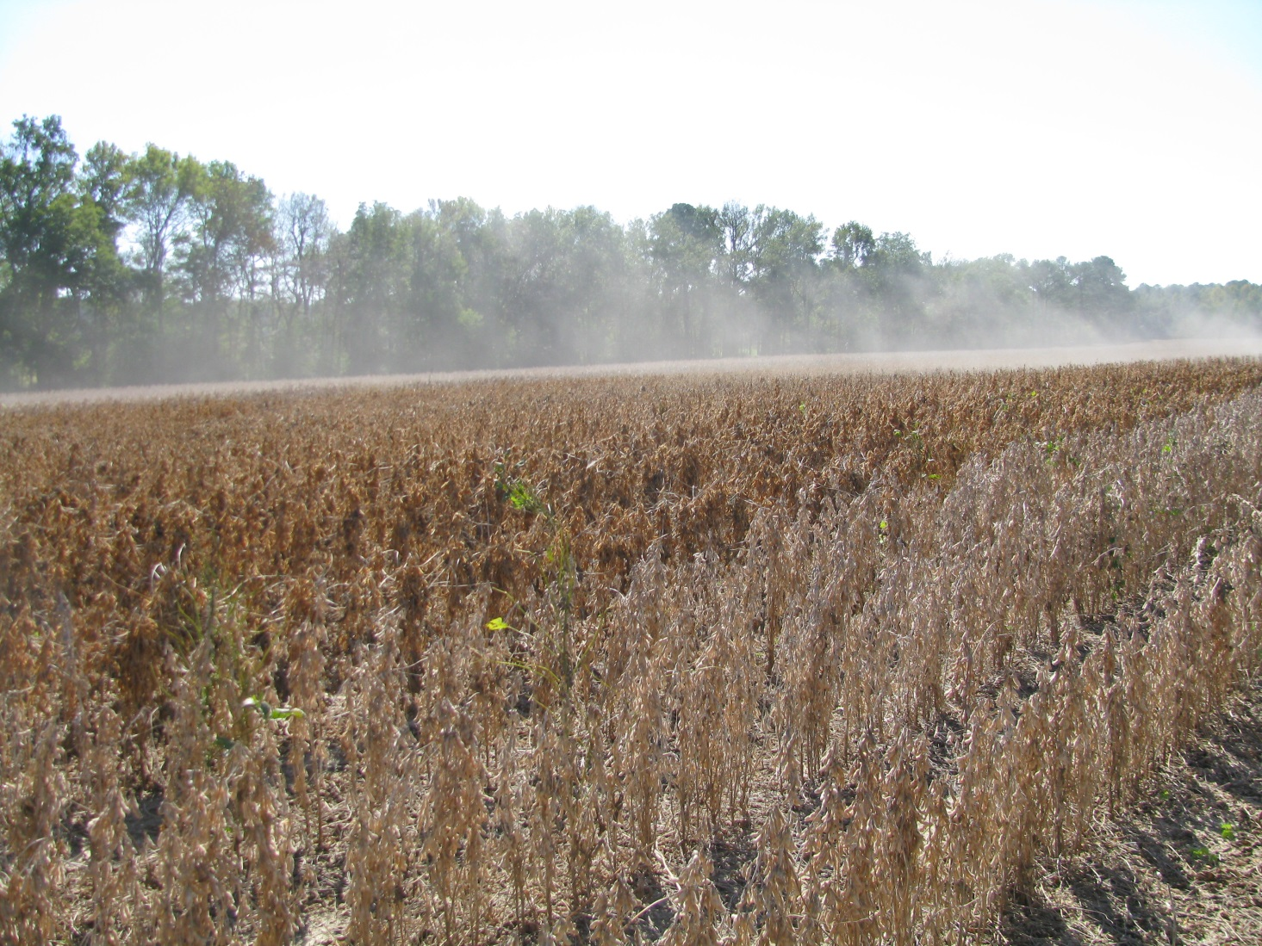
Variety Performance?????

Slide 29
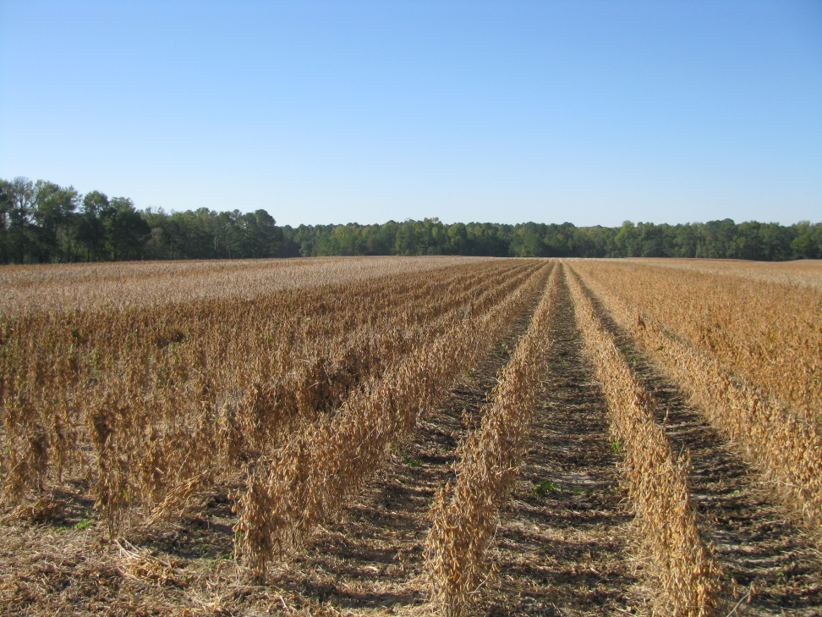
2,4-D and Dicamba Tolerant Crops
Start clean!
Still need a residual! Maybe 2???
Still need to be timely (3-4” tall weeds)!
GA growers must significantly improve in the areas of drift and sprayer contamination management

Slide 30

Read The Labels!!!!!!!

Slide 31

2016 Auxin Trainings “Using Pesticides Wisely”
Required by GA Dept. of Ag
Feb 22: Turner/Bacon
Feb 23: Dooly/Dodge
Feb 23: Brooks/Mitchell
Feb 29: Early/Terrell
Feb 29: Toombs-Tattnall/Screven
Mar 1: Washington/Emanuel
Mar 1: Gordon/Madison
One-on-One follow ups with UGA County Extension Agent (voluntary)

Slide 32
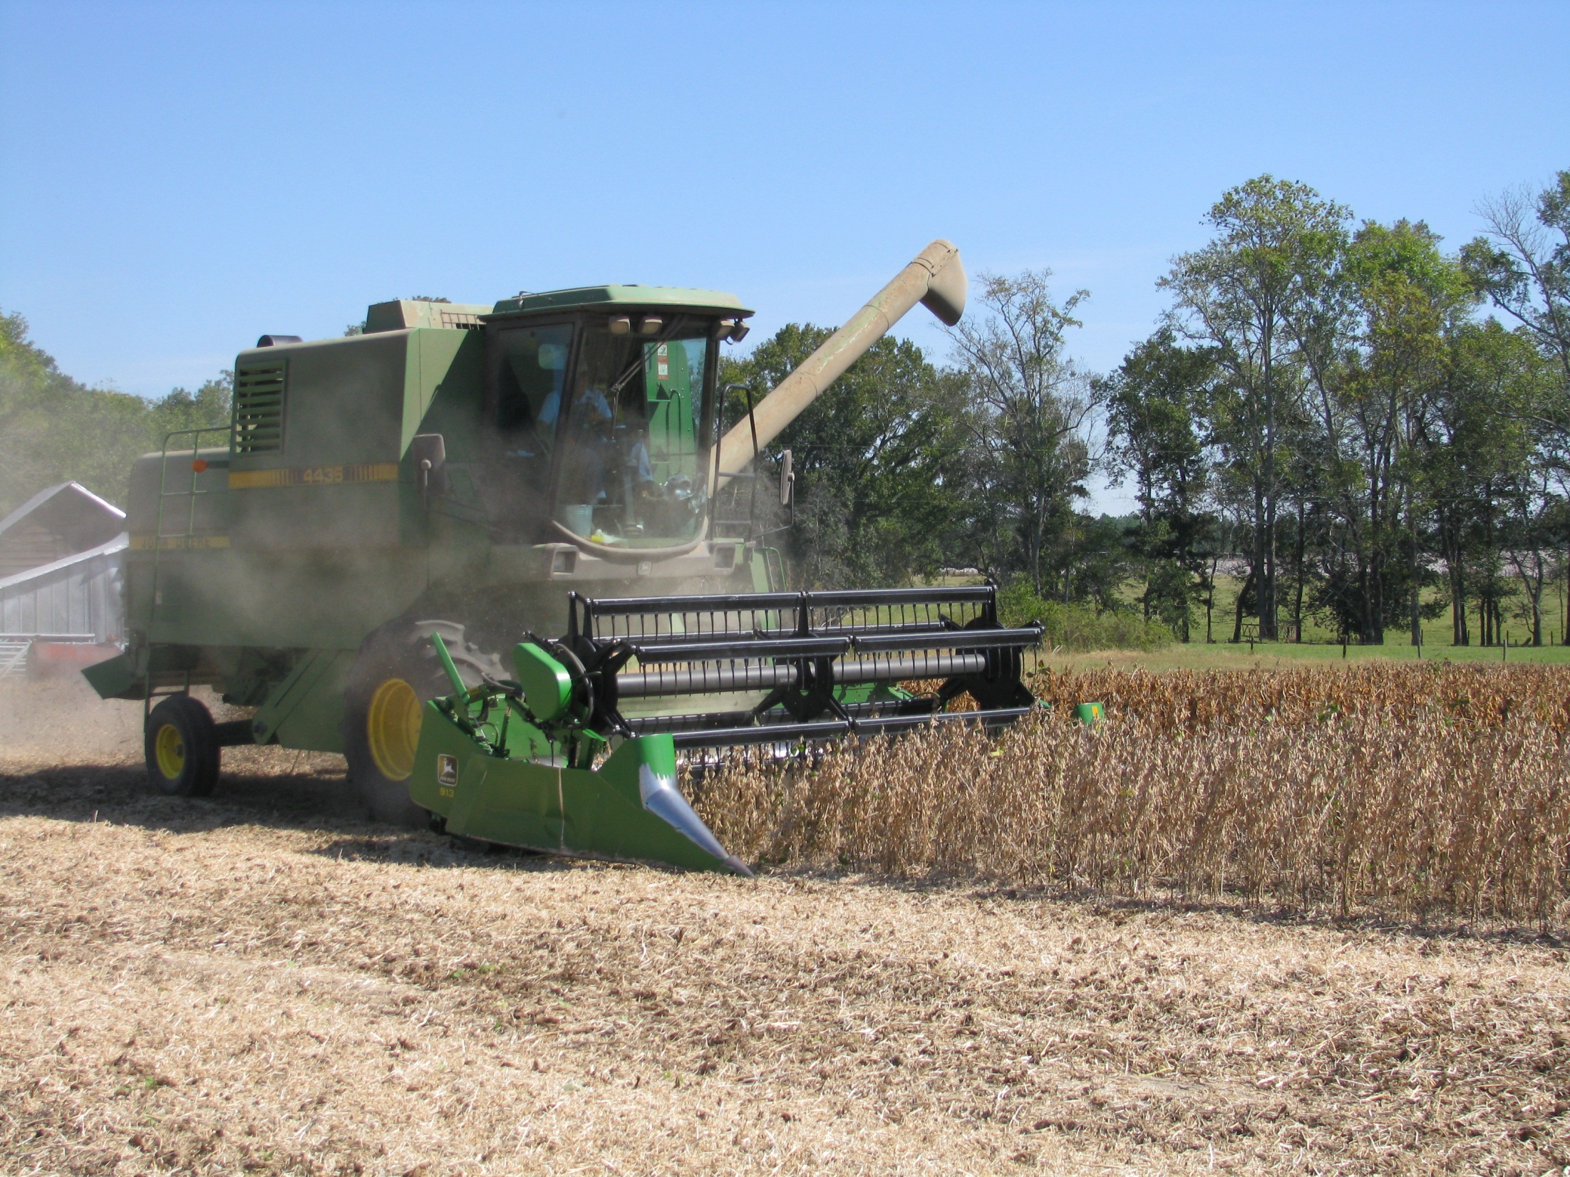

QUESTIONS?
eprostko@uga.edu
www.gaweed.com

