Slide 1
Herbicide-Resistant Weeds
November 2013

Slide 2
Herbicide Resistance Definition
inherited ability of a weed or crop biotype to
survive a herbicide application to which the
original population was susceptible.
Biotype = a group of plants within a species that has
biological traits that are not common to the population
as a whole.

Slide 3
Herbicide Resistance Types
Single Herbicide Resistance
Resistant to only one herbicide
Herbicide A
MOA #1
Cross Herbicide Resistance
Resistant to two or more herbicide families with same mechanism of action
Single resistance mechanism
Herbicide A
MOA #1
Herbicide B
MOA #1
Multiple Herbicide Resistance
Resistant to two or more herbicides with different mechanisms of action
May be the result of two or more different resistance mechanisms
Herbicide A
MOA #1
Herbicide C
MOA #2
Notes:
Some weeds are only resistant to one herbicide, known as single herbicide resistance, while other weeds may be resistant to more than one herbicide, either through cross resistance or multiple resistance.
<mouse click> Cross resistance occurs when a weed is resistant to two or more herbicides due to a single herbicide resistance mechanism.
<mouse click> Multiple resistance occurs when a weed is resistant to several herbicides with different mechanisms of action. This type of resistance may be the result of two or more different resistant mechanisms within the same plant.
We will now look at cross and multiple resistance in more detail using two examples from the field.
<mouse click>

Slide 4
Herbicide Resistance Around the World
404 Unigue Cases (species X site of action)
220 species
130 dicots
90 monocots
Top 3 Modes of Action
ALS Inhibitors
PS II Inhibitors
ACCase Inhibitors
Source: Heap, I. The International Survey of Herbicide Resistant Weeds. Online. Internet.
November 15, 2013 .

Slide 5
Herbicide Resistant Weeds Top 3 Countries
Cases (#)
International Survey of Herbicide Resistant Weeds, November 15, 2013

Slide 6
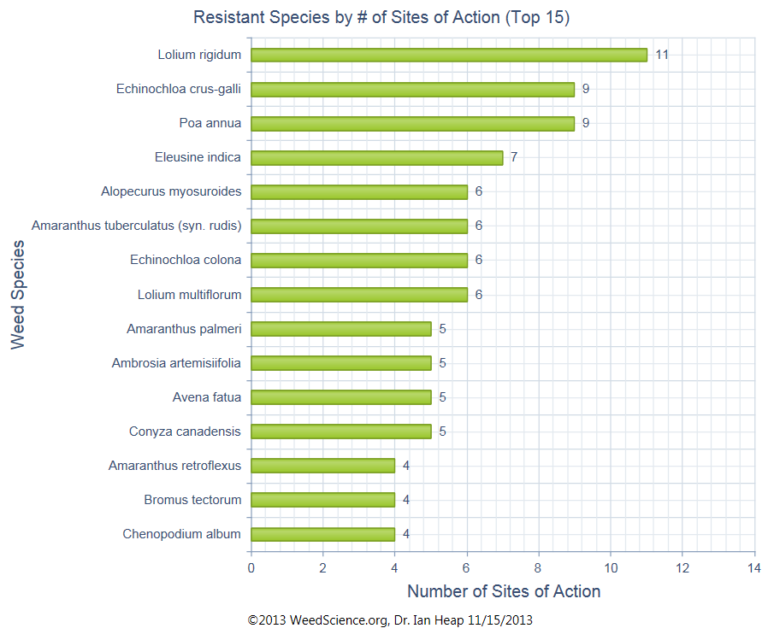
Herbicide Resistant Weeds Important Species - Worldwide

Slide 7
Herbicide Resistance in Georgia
Weed | Year | MOA
Goosegrass | 1992 | DNA
Prickly Sida | 1993 | ALS
Italian Ryegrass | 1995 | ACCase
Palmer Amaranth | 2000 | ALS
Palmer Amaranth | 2005 | Glycine
Palmer Amaranth | 2008 | ALS + Glycine
Palmer Amaranth | 2008 | PS II
Italian Ryegrass | 2009 | ALS + ACCase
Rigid Ryegrass | 2009 | ALS
Source: International Survey Of Herbicide Resistant Weeds, October 2013.

Slide 8
Herbicide Resistance
How does it occur?

Slide 9
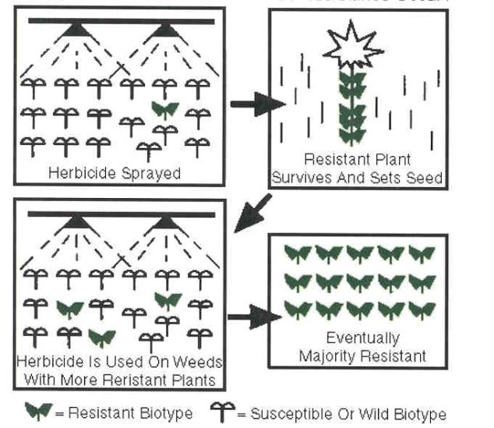
Herbicide Resistant Weeds Selection Pressure
Source: J.L. Gunsolus. Herbicide Resistant Weeds. 1998.
North Central Region Extension Publication 468.

Slide 10
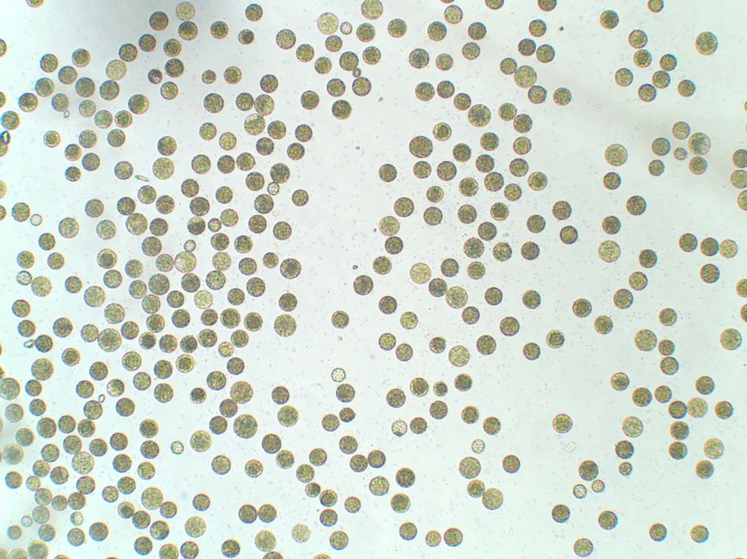
Herbicide Resistant Weeds Pollen Drift
Off-site movement (wind, gravity, insects) of resistance trait through pollen
Pollen from resistant male fertilizes susceptible female to produce resistant progeny
UGA researchers have documented GR-trait movement of at least 900’ (Palmer amaranth).
Palmer Amaranth Pollen
Source: Dr. Lynn Sosnoskie

Slide 11
In-Field Palmer Amaranth Pollen Movement – Macon Co. 2006-2007

Slide 12

Why Are Plants Resistant to Herbicides? Mechanisms
altered site of action
most common
enhanced metabolism
sequestration
Gene amplification

Slide 13
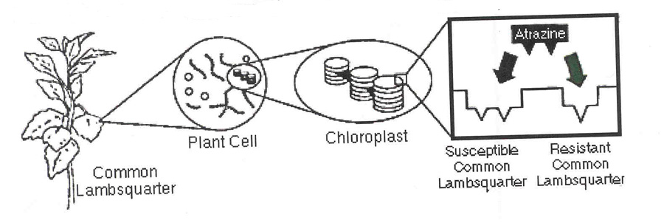
Altered Site of Action
Source: J.L. Gunsolus. Herbicide Resistant Weeds. 1998.
North Central Region Extension Publication 468.

Slide 14
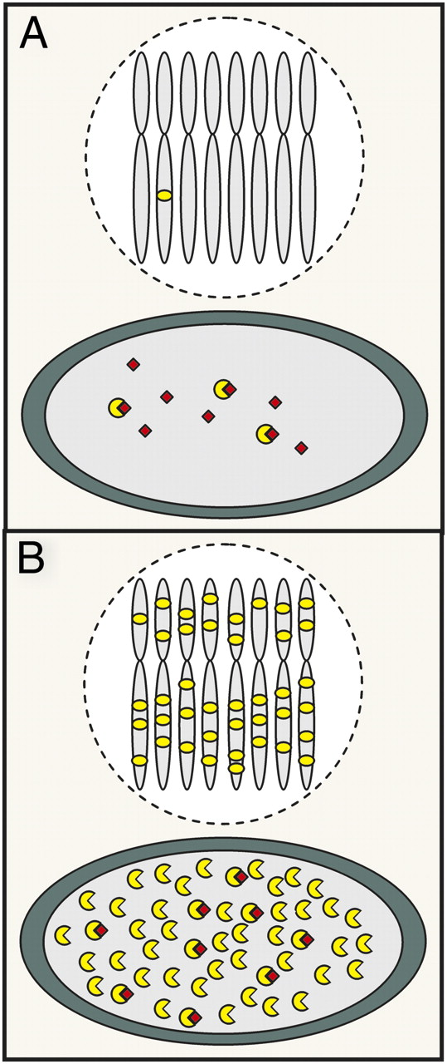
Glyphosate resistance resulting from gene amplification.
Susceptible
Resistant
Powles S B PNAS 2010;107:955-956
©2010 by National Academy of Sciences
Notes:
Glyphosate resistance resulting from gene amplification. In a susceptible individual (A), the normal number of EPSPS gene copies (yellow dots on chromosomes) produce EPSPS (yellow) in leaf chloroplasts that is targeted and overwhelmed by the normal usage rate of glyphosate (red), and the plant dies. In a resistant individual (B) with amplified EPSPS gene copies present on multiple chromosomes, there is increased EPSPS, and the normal glyphosate rate cannot inhibit all of the available EPSPS.

Slide 15
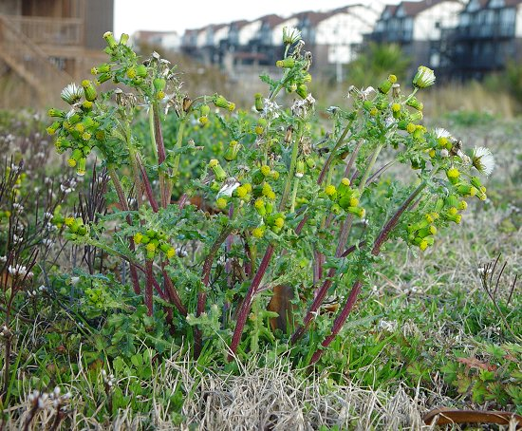
The Beginning of Weed Resistance
1968 (Washington)
nursery crops
common groundsel
atrazine
simazine
Photo: The Missouri Flora Web-Site

Slide 16
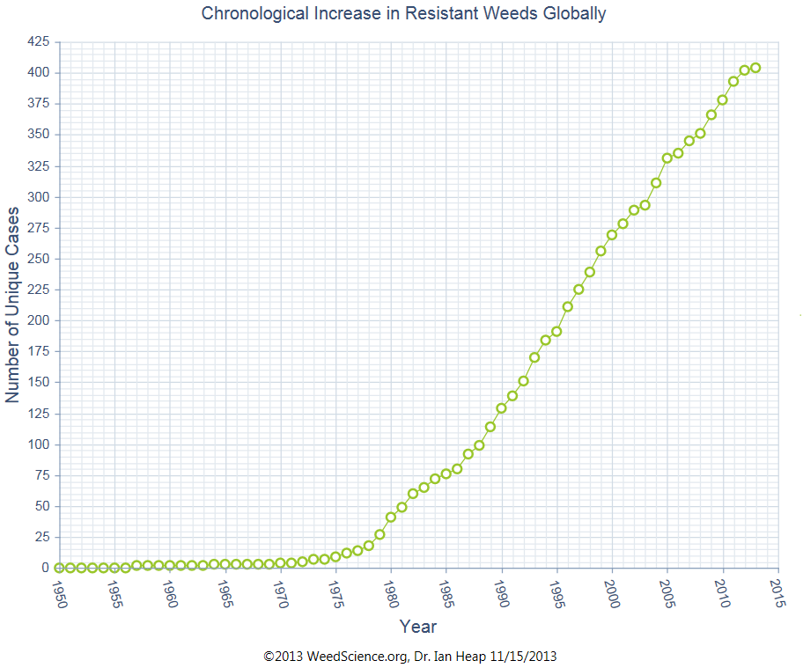

Slide 17
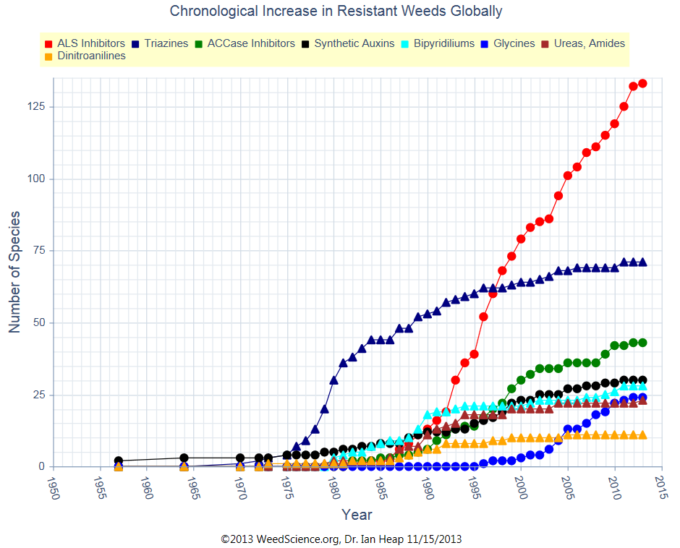
Herbicide Resistant Weeds By Mode of Action

Slide 18
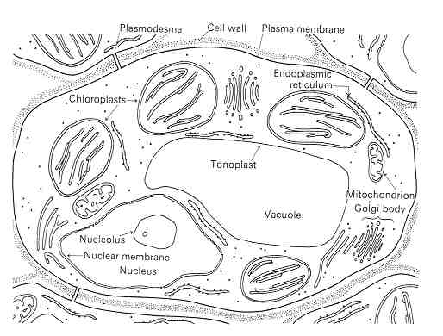
What does ALS mean?
Acetolactate synthase (ALS)
Acetohydroxyacid synthase (AHAS)
chloroplast enzyme needed to form certain amino acids
Valine, leucine, isoleucine
Herbicide families
Imidazolinone, sulfonanalide, benzoates, sulfonylurea

Slide 19
ALS-Resistance Around the World
133 species have developed ALS-resistance world-wide
Insensitive ALS enzyme
26 species in U.S.
Why?
very popular
low use rates
environment friendly
single sites of action
major MOA development in late 1980’s early 1990’s

Slide 20
Commonly Used ALS Herbicides
Accent
Ally/Cimarron
Beyond
Cadre
Classic
Envoke
Express
Finesse
FirstRate
Harmony Extra
Maverick Pro
Osprey
Permit/Sandea
Powerflex
Pursuit
Python
Staple
Steadfast Q
Strongarm

Slide 21
GA Confirmed ALS-Resistant Palmer Sites

Slide 22
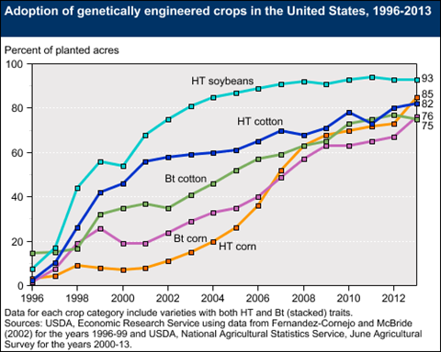

Slide 23



Glyphosate Resistance Around the World 24 species
rigid ryegrass (1996)
goosegrass (1997)
Horseweed (2000)
Italian ryegrass (2001)
Buckhorn Plainain (2003)
Hairy fleabane (2003)
Ragweed parthenium (2004)
Common ragweed (2004)
Giant ragweed (2004)
Johnsongrass (2005)
Common waterhemp (2005)
Palmer amaranth (2005)
Sourgrass (2005)
Kochia (2007)
Junglerice (2007)
Gramilla mansa (2008)
Liverseedgrass (2008)
Perennial ryegrass (2008)
Sumatran fleabane (2009)
Annual bluegrass (2010)
Australina fingergrass (2010)
Tropical sprangletop (2010)
Ripgut brome (2011)
Spiny amaranth (2012)

Slide 24
Glyphosate-Resistant Palmer Amaranth in GA*
2004 – 1 county
2005 – 2 counties
2006 – 7 counties
2007 – 11 counties
2008 – 18 counties
2009 – 13 counties
2010 – 16 counties
2011 – 8 counties
Total = 76 counties
*Greenhouse screening has been conducted on each site.

Slide 25
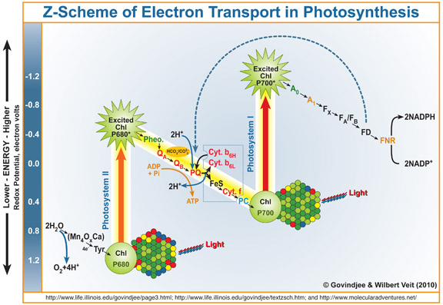
PS-II Resistance
Photosystem (PS) II
Photosynthesis electron transfer disruption
71 species worldwide
26 species in US
Atrazine, simazine

Slide 26
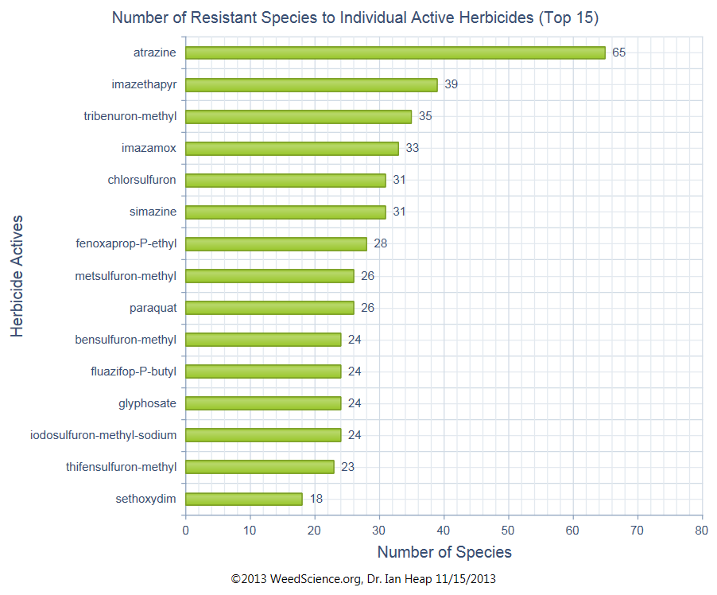

Slide 27
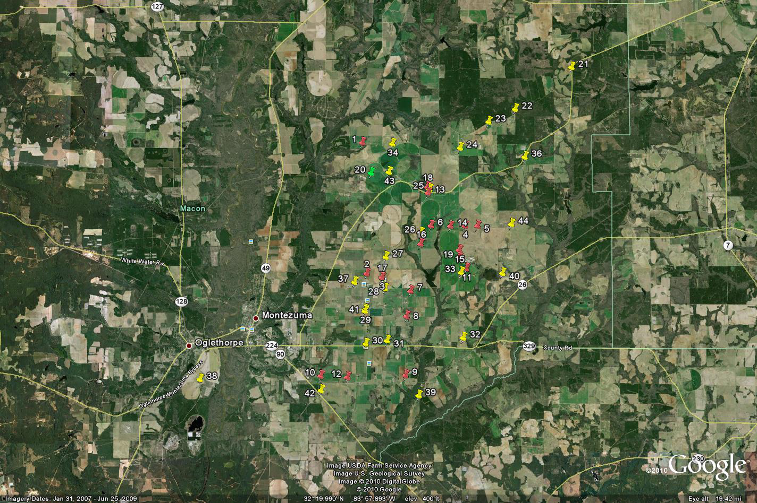
2007, 2008, 2010 Macon County Triazine-Resistance Survey
ALS + GLY + ATZ

Slide 28
Herbicide Resistance Should Only Be Suspected When .……...
other causes of herbicide failure have been ruled out.
the same herbicide or herbicides with the same mode of action have been used year after year.
one weed that is normally controlled is not controlled while other weeds are.
healthy weeds are mixed with controlled weeds (same species)
a patch of uncontrolled weed is spreading.

Slide 29
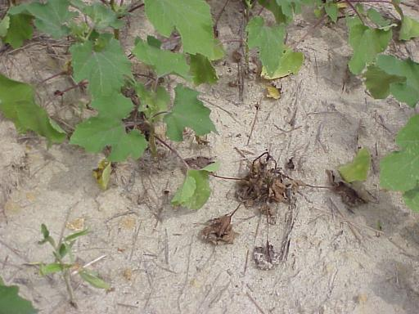
MSMA Resistant Cocklebur in NC
(Dr. Alan York – NCSU))

Slide 30
Causes of Herbicide Failures
weed size**
moisture
temperature
humidity
rate
application method
calibration
others
All possible reasons for poor performance should be investigated
before considering the possibility of resistance!!!

Slide 31
Herbicide Resistant Weeds Strategies for Control/Prevention
proactive vs. reactive
utilize other weed control tactics
tillage, cultivation, row patterns, cover crops, etc.
rotate herbicides with different MOA
rotate crops
scout fields
prevent seed production
weed seed bank management
clean tillage and harvesting equipment

Slide 32
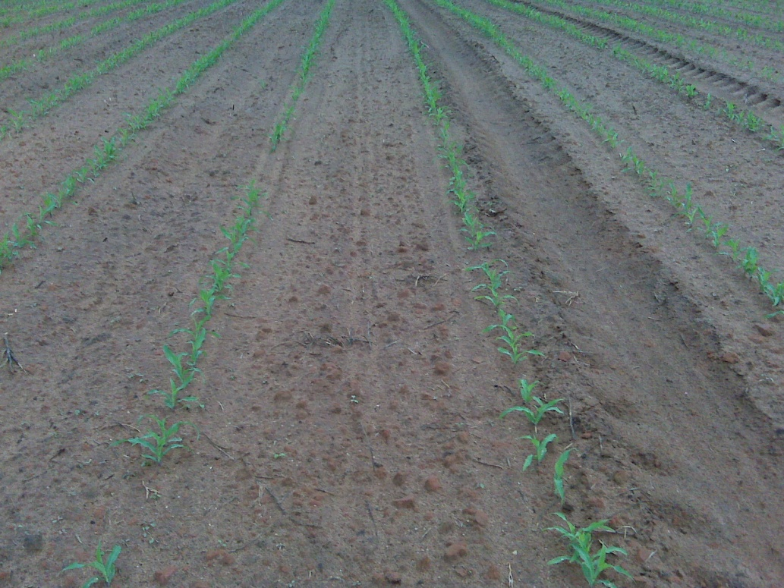
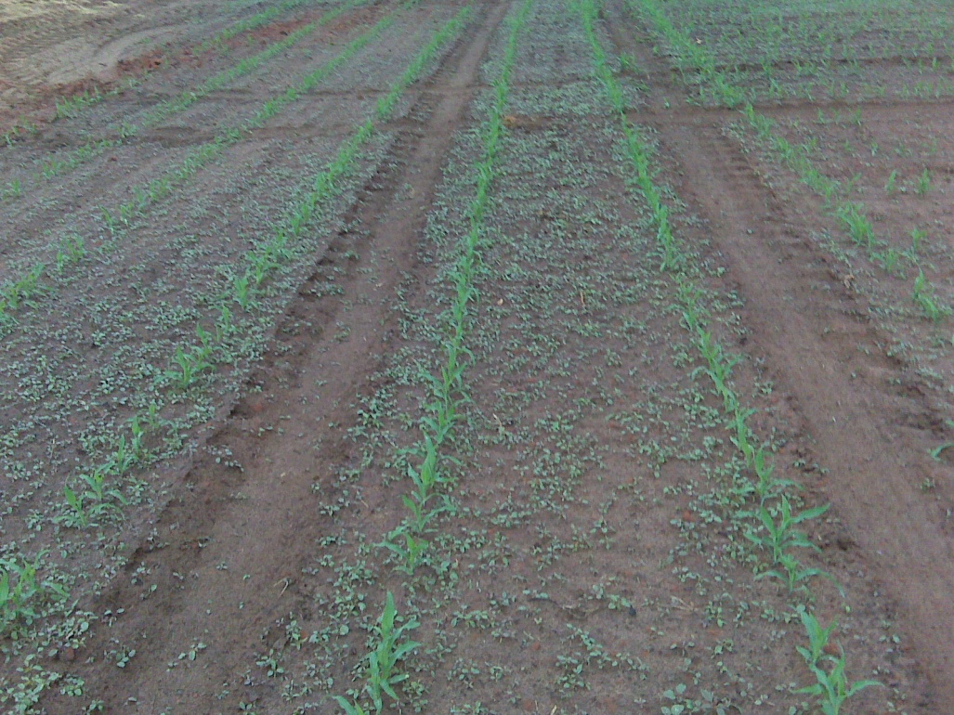
Tillage and Pigweed
Bottom Plow
Chisel Plow
Source: David Hall (Farmer) and Wade Green, Twiggs Co. CEC, April 22, 2010

Slide 33
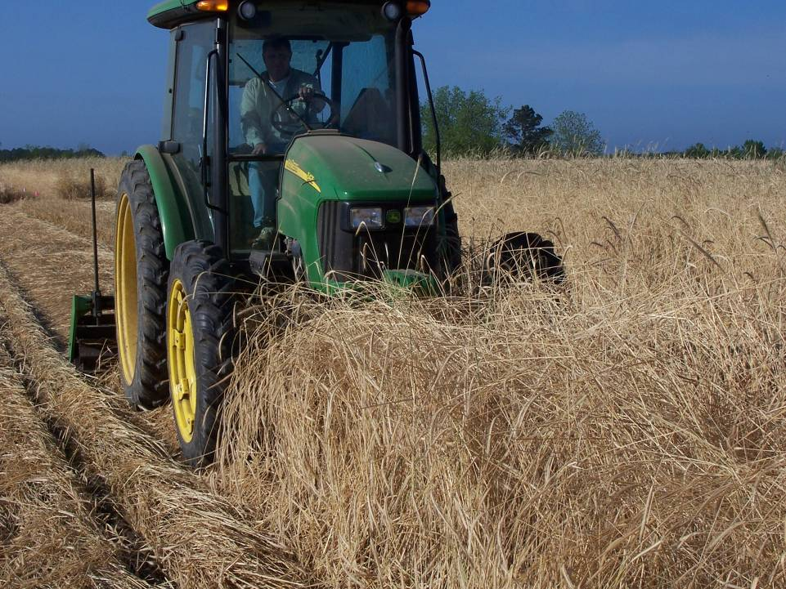

Slide 34
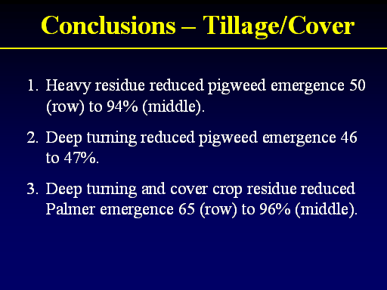
UGA Weed Science Research

Slide 35
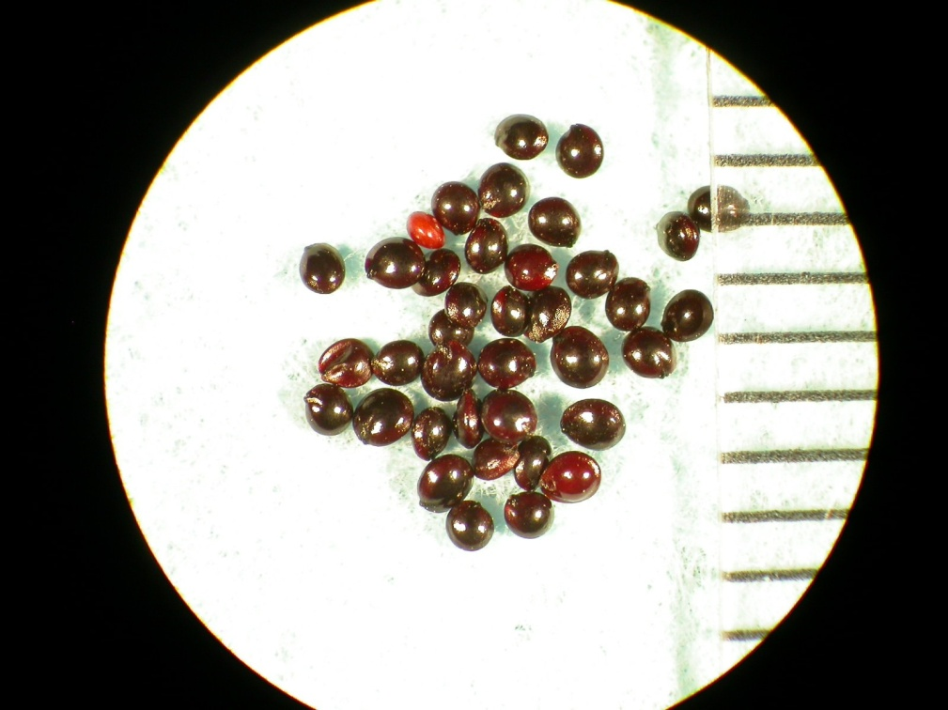
Weed Seed Bank Management
How many are produced?
How many will survive?
seed predation
seed decay
seed dormancy
seed size
depth of emergence
How will changes in practices influence weed seed bank?
Palmer Amaranth Seed

Slide 36
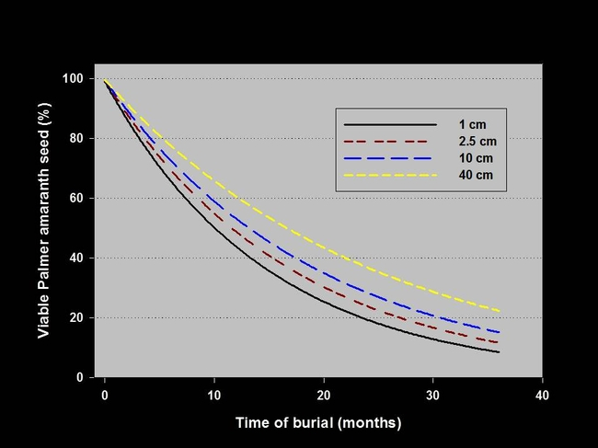
The influence of burial duration and depth on the viability of Palmer amaranth seeds in Georgia (2007-2011).
Sosnoskie, L.M., T.M. Webster and A.S. Culpepper. 2013. Glyphosate resistance does not affect Palmer amaranth (Amaranthus palmeri) seedbank longevity. Weed Science. 61:283-288.

Slide 37
How long does resistance last in absence of further selection pressure?
Andrews and Morrison (1997) - Canada
DNA resistant green foxtail
% of resistant seeds after 7 years
initial resistance was at least 90%
Source: Weed Technology (1997): 11:369-372.

Slide 38
Does the use of reduced rates influence the rate of herbicide resistance development ?
yes!!
a bad idea!!!!
Herbicides should be used at recommended rates that ensure high weed mortality to minimize the likelihood of minor herbicide resistance traits leading to rapid herbicide resistance evolution
Manalil et al., 2011. Weed Science 59:210-217

Slide 39
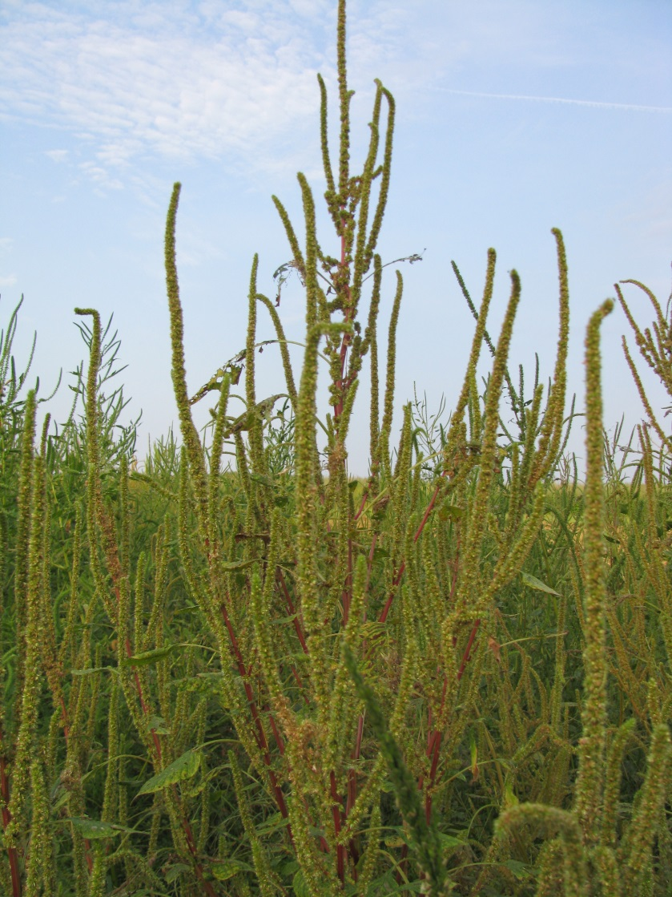
Why Palmer Amaranth?
38 species of Amaranthus in U.S.
27 species found in SE
grows faster than other pigweeds (1-2” per day!!)
more competitive than other pigweeds
prolific seed producer
Up to 1,000,000 seeds/plant
9-12 WAE
2 generations/year
herbicide tolerance
reduced tillage

Slide 40
More Information About Herbicide Resistance
Herbicide Resistance Action Committee (HRAC)
http://www.hracglobal.com/
International Survey of Resistant Weeds
http://www.weedscience.org/summary/home.aspx

