Slide 1


New Peanut Cultivar Response to Paraquat Applications
Eric P. Prostko, Ph.D.
Professor and Extension Weed Specialist
Department of Crop & Soil Sciences

Slide 2
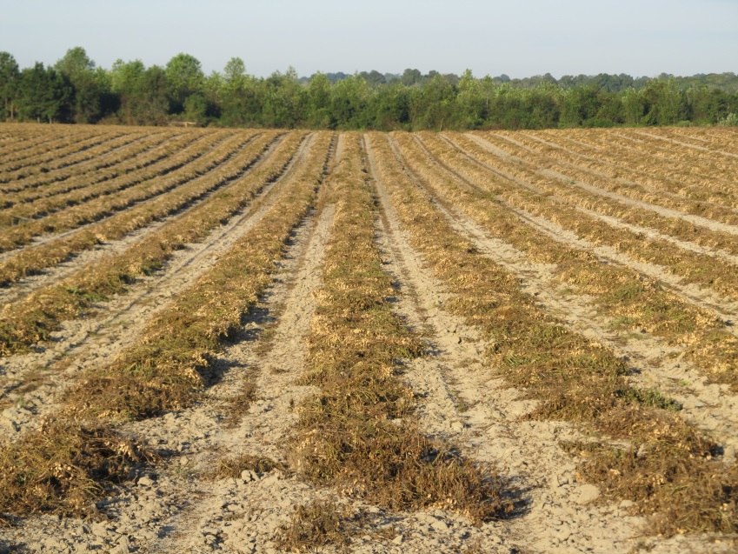


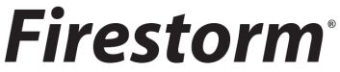
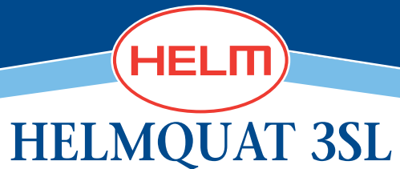
Paraquat in Peanut
Labeled in 1988
Replacement for dinoseb
significant foliar injury
Cultivars changing all the time

Slide 3
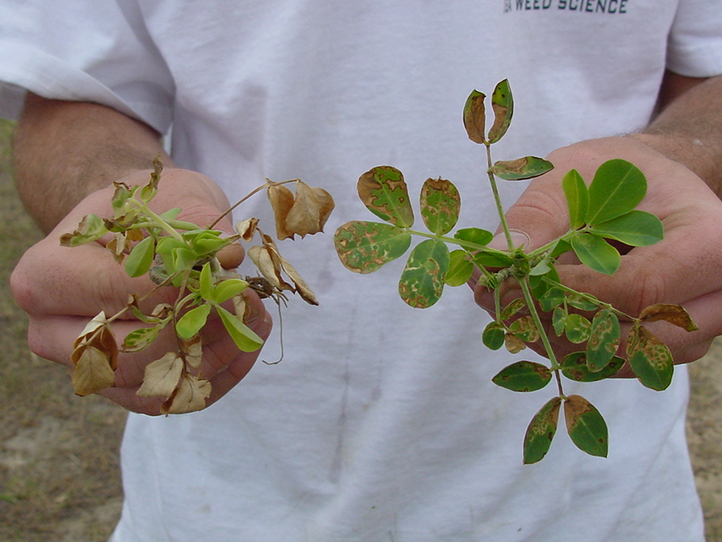
Treatments applied 6 DAC; Photo at 3 DAT
GA-02C
GI @ 8 oz/A +
NIS @ 0.25% v/v
GI @ 12 oz/A + Basagran @ 8 oz/A +
NIS @ 0.25% v/v

Slide 4

Acreage Planted in Seed Certification Program in SE in 2013 to Produce 2014 Seed Supply

Slide 5
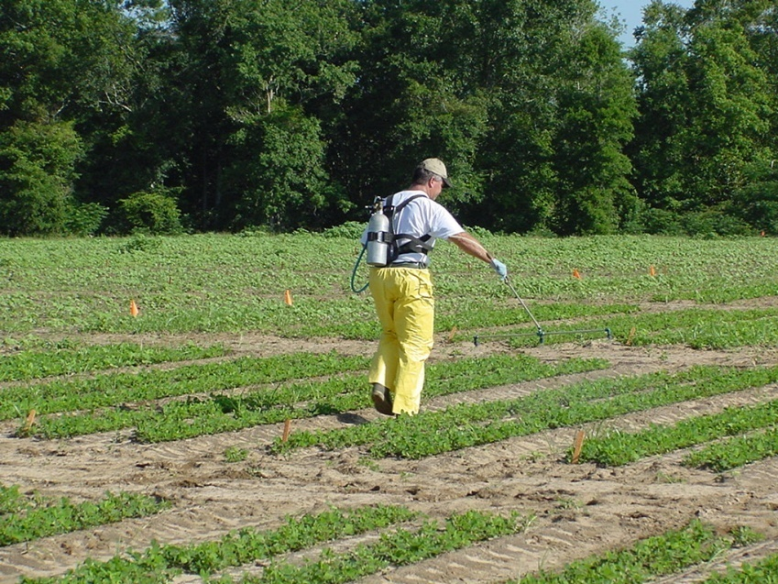

Materials and Methods - I
Tests 1 and 2
GA-06B, GA-09B
3 timings (15, 22, 31 DAP)
Gramoxone, Gramoxone + Storm, Gramoxone + Storm + Dual Magnum
Tifton
Tests 3 and 4
GA-06G
Tifton, Attapulgus
Gramoxone, Storm, Dual Magnum, Cadre
Small-plots
4 replications
weed-free
irrigated

Slide 6
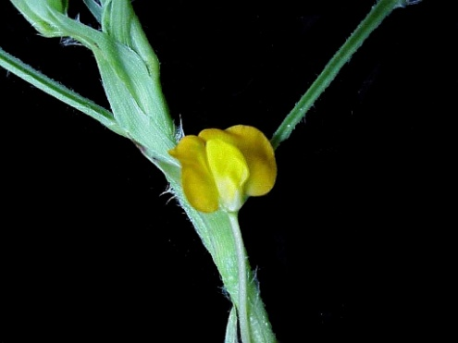
Materials and Methods - II Stages of Growth
Tests 1 & 2
Cultivar | 15 DAP | 22 DAP | 31 DAP
GA-06G | V4 3 in | V6 4 in | V7 4 in
GA-09B | V4 3 in | V6 4 in | V7 4 in
Tests 3 & 4
Location | EPOST | POST
Tifton | 13 DAP V3 2 in | 35 DAP R1 4 in
Attapulgus | 18 DAP V5 3 in | 39 DAP R1 9 in
R1
Beginning bloom

Slide 7
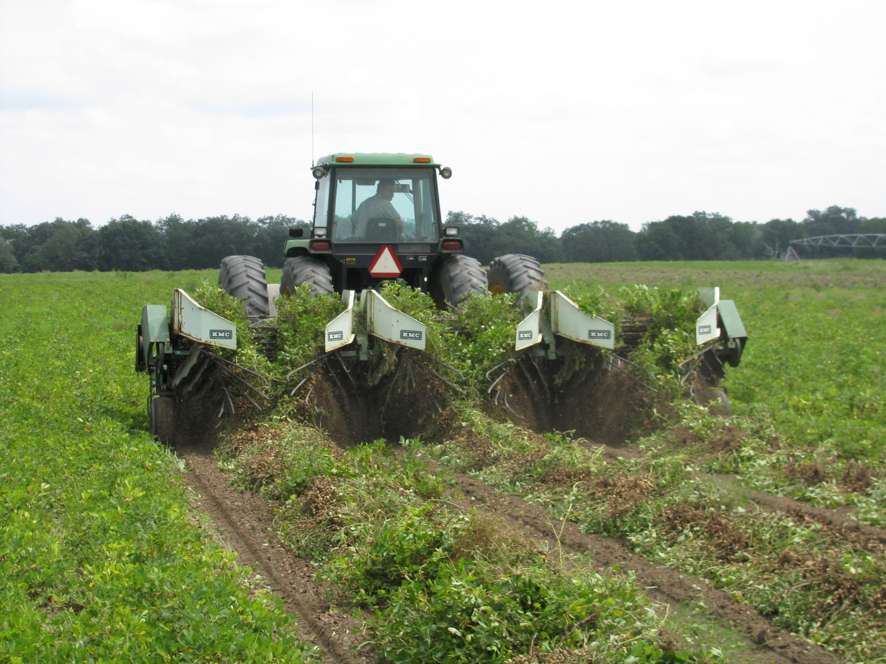
Results

Slide 8
Peanut Cultivar Response to Gramoxone Application Timings - 2013
Timing (DAP) | Yield (lb/A)
 | GA-06G | GA-09B
15 | 6183 | 5818
22 | 6452 | 5856
31 | 6206 | 5723
P-value | 0.4216 | 0.8705
Averaged over 4 herbicide treatments.
UGA Ponder Farm (Tifton)
Tests 1 & 2
PE-02-13
PE-02B-13

Slide 9
Peanut Cultivar Response to Gramoxone Treatments - 2013
Herbicide | Rate/A | Yield (lb/A)
 |  | GA-06G | GA-09B
None | -- | 6291 | 5701
Gramoxone 2SL Adept | 8 oz 0.25% v/v | 6218 | 5720
Gramoxone 2SL Storm 4SL Adept | 12 oz 16 oz 0.25% v/v | 6328 | 5813
Gramoxone 2SL Storm 4SL Dual Magnum 7.62EC | 12 oz 16 oz 16 oz | 6284 | 5962
P-value |  | 0.9310 | 0.8837
Averaged over 3 application timings (15, 22, and 31 DAP).
UGA Ponder Farm (Tifton)
Tests 1& 2
PE-02-13
PE-02B-13

Slide 10
GA-06 Response to Gramoxone Treatments - 2013
Herbicide | Rate/A | Timing | Yield (lb/A)
 |  |  | Tifton | Attapulgus
None | -- | -- | 6857 | 7306
Gramoxone 2SL Storm 4SL Dual Magnum 7.62EC | 12 oz 16 oz 16 oz | EPOST | 6906 | 6962
Cadre 2AS Dual Magnum 7.62EC | 4 oz 16 oz | POST | 6754 | 7525
Gramoxone 2SL Storm 4SL Dual Magnum 7.62EC Cadre 2AS Dual Magnum 7.62EC | 12 oz 16 oz 16 oz 4 oz 16 oz | EPOST POST | 6617 | 7124
P-value | -- | -- | 0.7934 | 0.8831
Tests 3 & 4
PE-12-13
PE-13-13

Slide 11
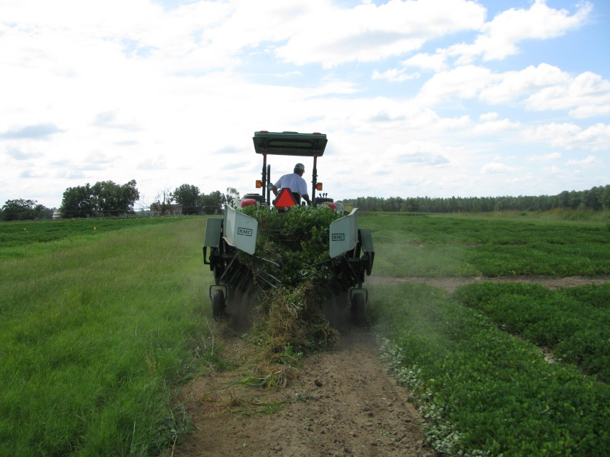
Is there a better way to evaluate yield response?
Frequently herbicide tolerance trials are NS
Large LSD values?

Slide 12
A Comparison of Irrigated Weed-Free Peanut Yields Between NTC and Gramoxone (12 oz/A) + Storm (16 oz/A) + Dual Magnum (16-21 oz/A) Treatments in Georgia, 2011-2013.
G + S + DM
(lbs/A)
PEA01-11 (GA-06G)
PEA01-12 (GA-06G)
PE-20-11 (GA-06G)
PE-01-12 (GA-06G)
PE-17-12 (GA-06G)
PE-02-13 (GA-06G)
PE-02B-13 (GA-09B)
PE-12-13 (GA-06G)
PE-13-13 (GA-06G)
6000 = 5801 (97%)
7000 = 6590 (94%)
NTC (lbs/A)
n = 50

Slide 13
NTC Peanut Yield Variability (lb/A)

Slide 14
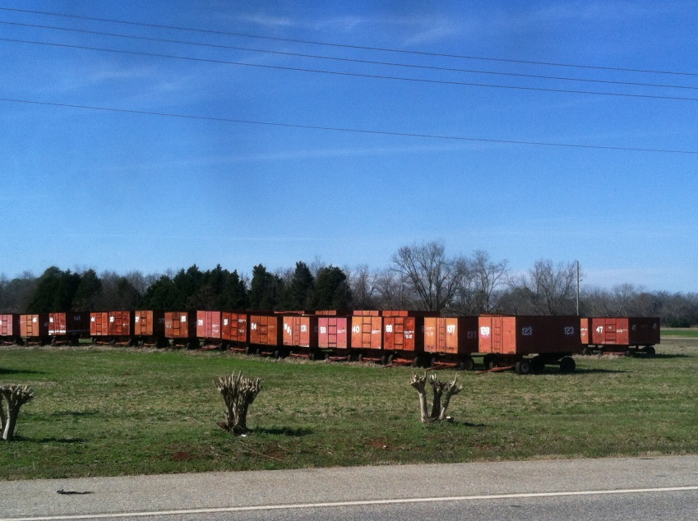
Summary/Conclusions
Leaf burn and crop stunting were observed
Peanut yields were not reduced by any herbicide treatment
New cultivars (GA-06G, GA-09B) are tolerant to common paraquat treatments.
Dryland vs. Irrigated????

Slide 15
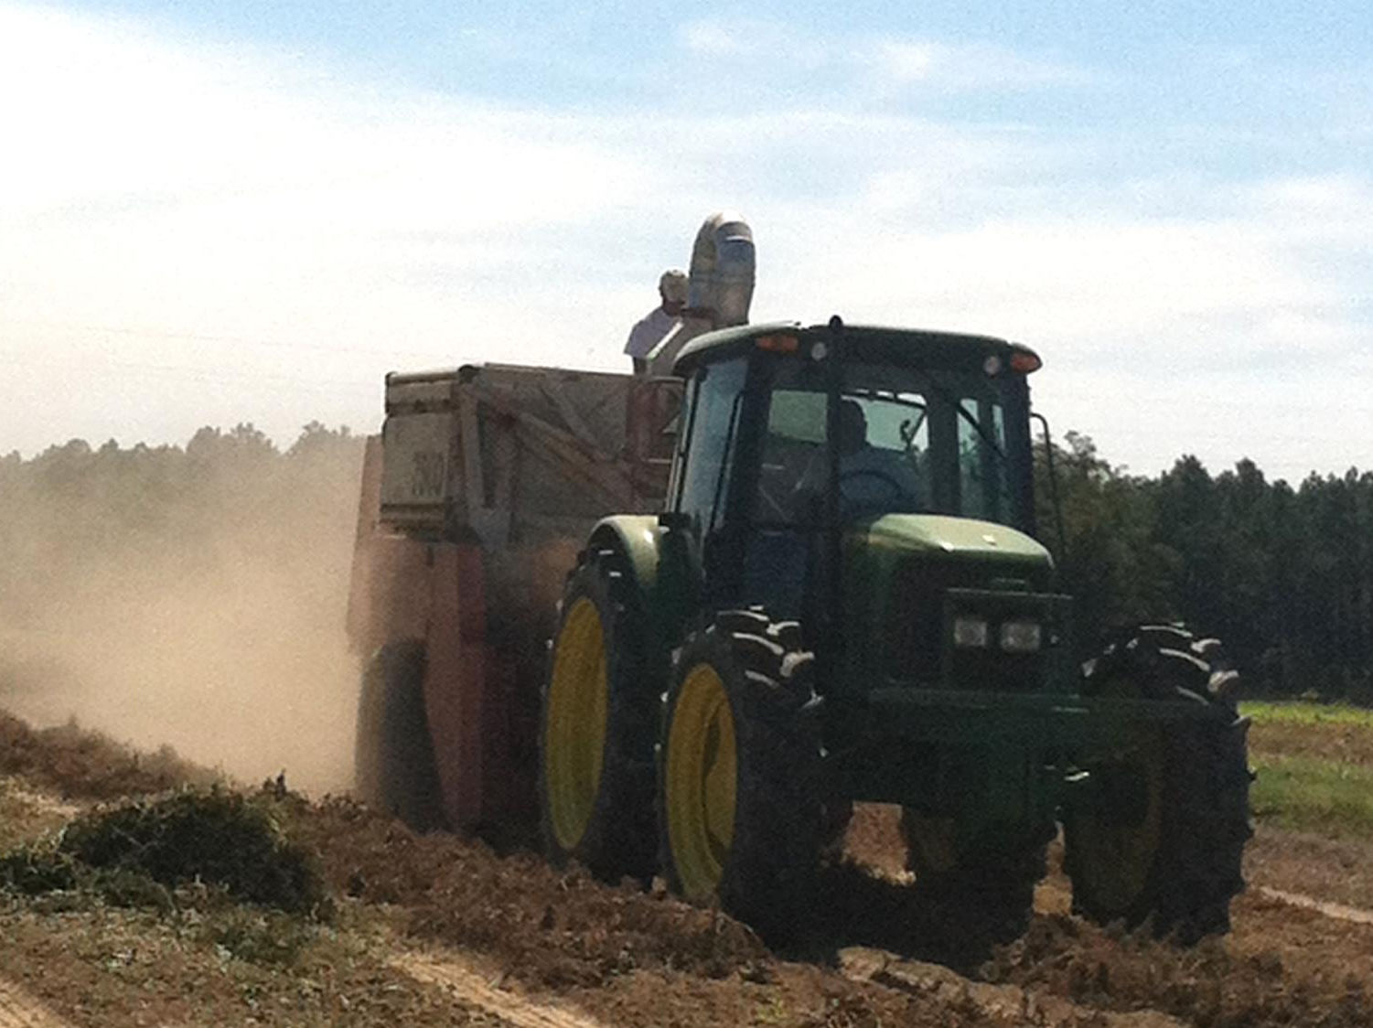

Questions?
eprostko@uga.edu
www.ugaweed.com

