Slide 1
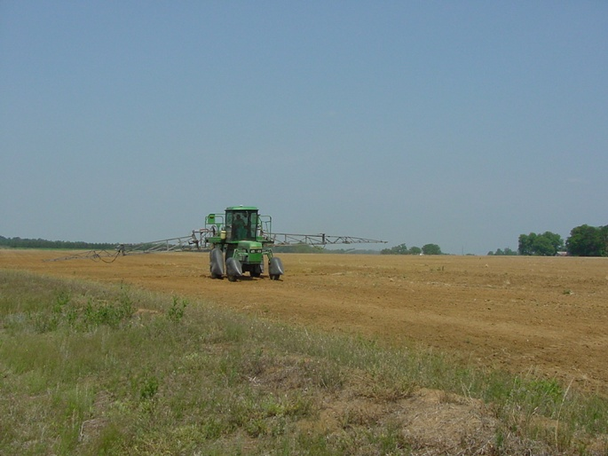

Whole-Farm Weed Management Practices For Palmer Amaranth Control
Eric P. Prostko, Ph.D.
Professor and Extension Weed Specialist
Dept. Crop & Soil Sciences

Slide 2
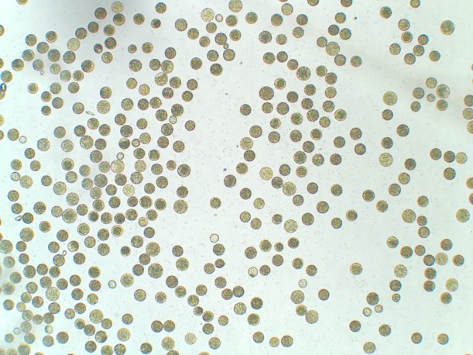
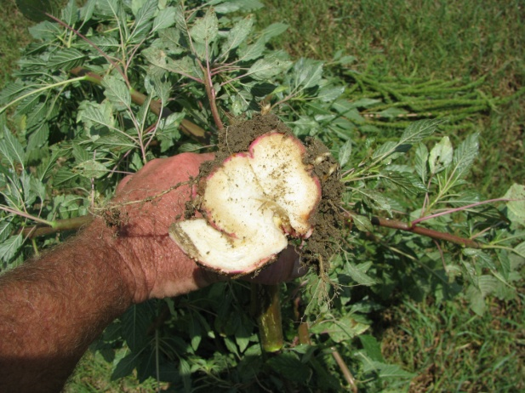
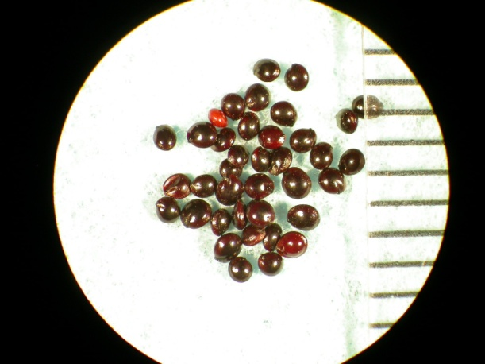
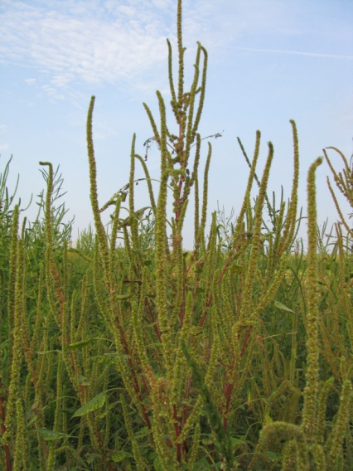
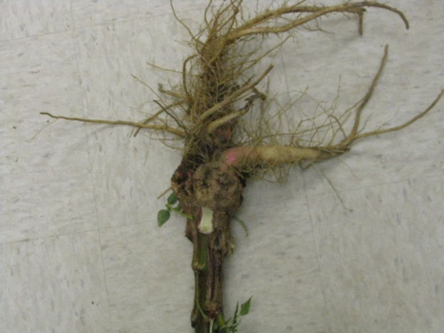
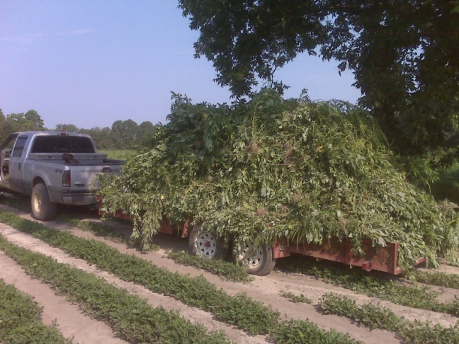
Current Weed Control Programs in GA Are Focused on 1 Weed!

Slide 3
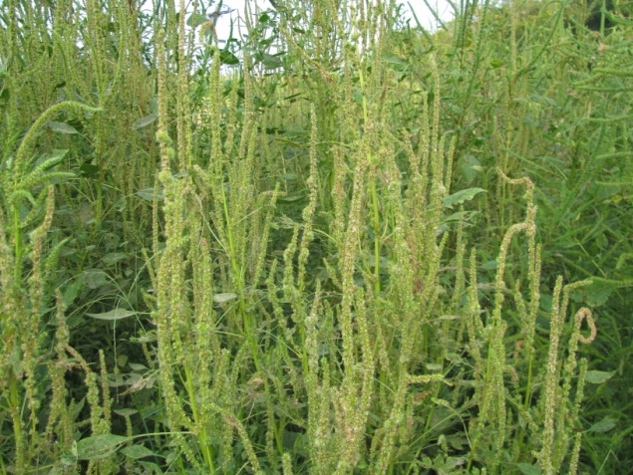
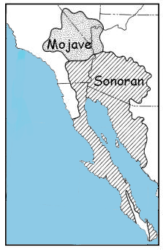
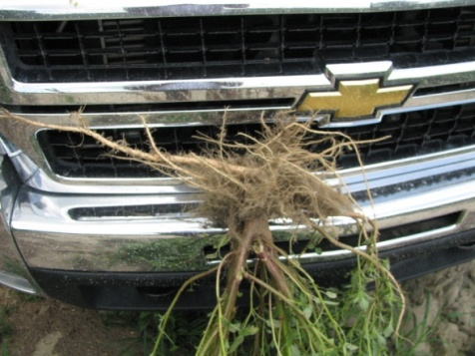
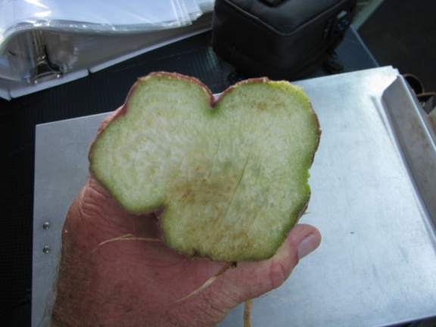
Important Things We Know About Palmer Amaranth
Well-adapted to Georgia!
Native to Sonoran desert
Separate male and female plants
Lots of seed!!!!
400,000 – 500,000/female plant
Seed do not last long in soil
20% germ after 30 months
Seed do not emerge from deep depths (≥ 3-4”)
Seed need light to germinate
Resistance trait moves in pollen
At least 1000 feet!!

Slide 4
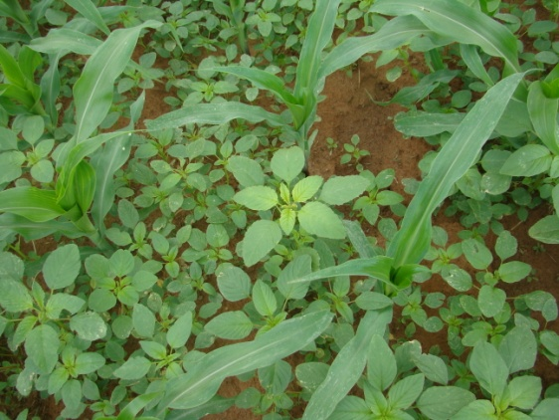
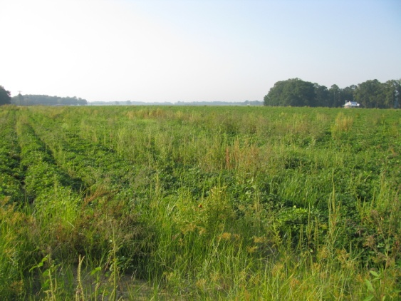
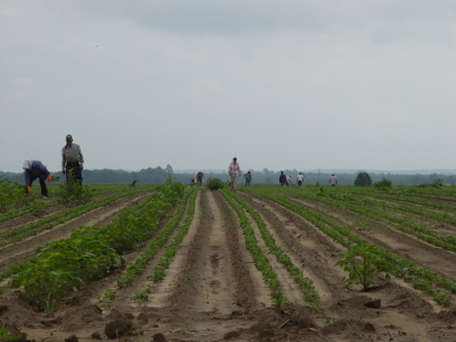

Herbicide-Resistant Palmer Amaranth in GA
ALS (2000)
Glyphosate (2005)
Atrazine (2009)
ALS + GLY (2009)
DNA + ALS + GLY (2010)
ALS + GLY + ATZ (2011)

Slide 5
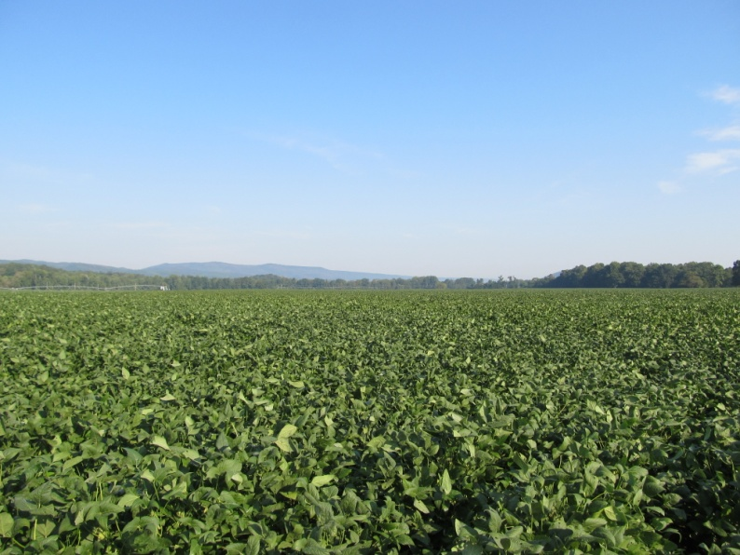
Pigweed Control is not impossible!!!!
Common Reasons for Failure:
1) did not start clean
2) did not use a residual
3) residual did not get activated
4) POST applications are too late
5) short arms and deep pockets

Slide 6
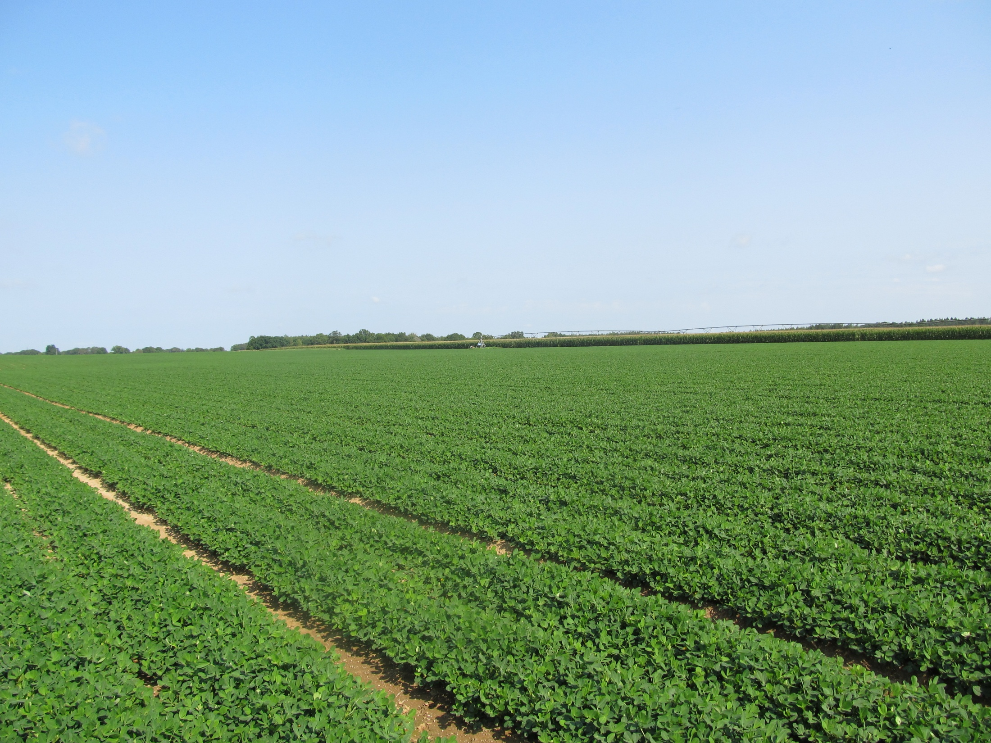
What one man can do, so can another!
Sumter County - June 28, 2011
(Prowl + Valor fb Cadre)

Slide 7
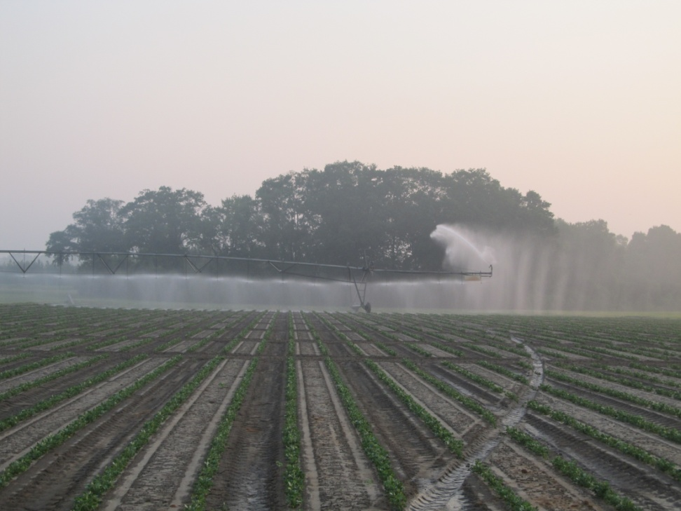
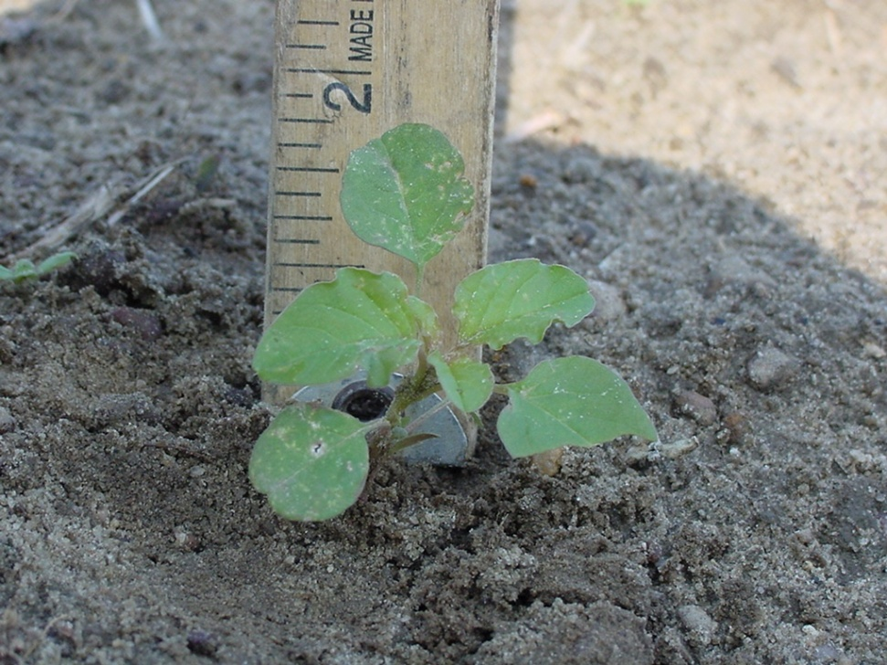
Our Biggest Challenges
Irrigation/Rainfall
Farm Size/Weed Size

Slide 8
Rainfall Totals Midville, GA
inches
Month
Source: UGA Automated Weather

Slide 9
A Question For You
How many acres can you effectively and safely spray in 1 day?
How many total acres need to be sprayed?
What if it rains?
What if it is windy?

Slide 10
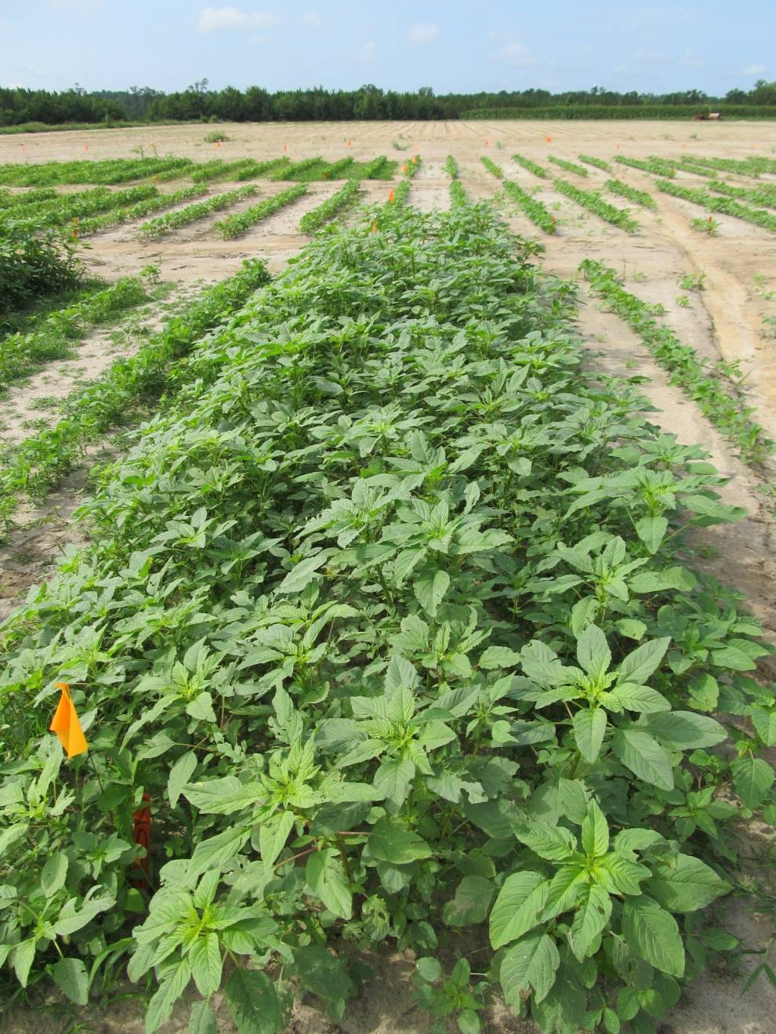
Palmer Amaranth Growth 22 days after starting clean
June 22, 2011
Attapulgus, GA

Slide 11
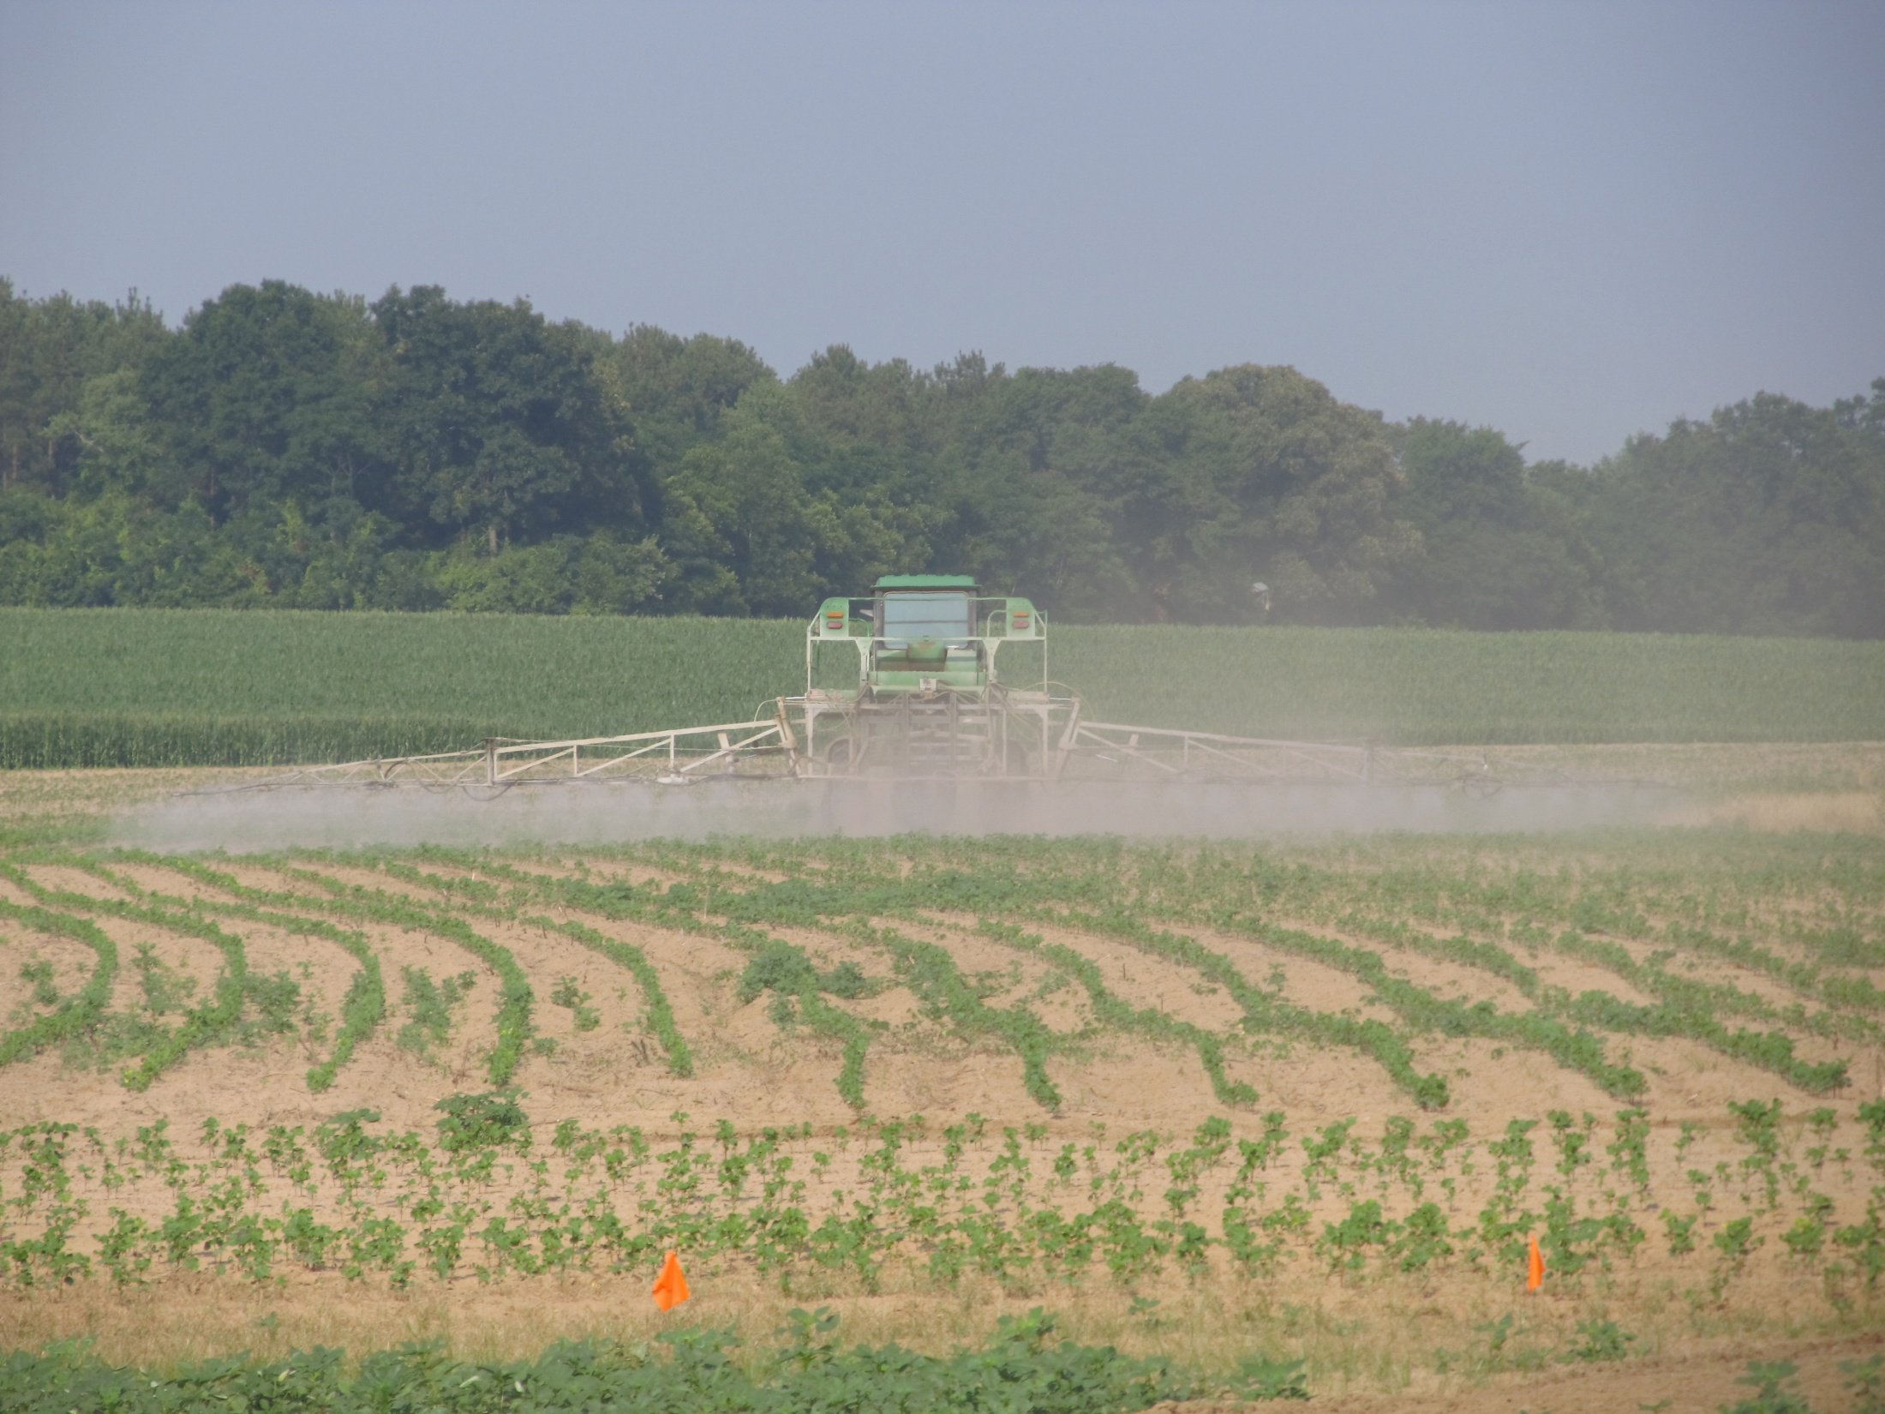
Activated Residual Herbicides are the key!
(Likely will need 2-4 depending upon the crop)
Cotton | Peanut | Corn | Sorghum | Soybean
Valor | Valor | Atrazine | Atrazine | Valor
Reflex | Dual Magnum | Dual Magnum | Dual Magnum | Envive
Dual Magnum | Warrant (?) | Warrant | Warrant | Reflex
Warrant |  |  |  | Prefix
Diuron |  |  |  | Dual Magnum
 |  |  |  | Warrant
 |  |  |  | Metribuzin Boundary TriCor Authority MTZ

Slide 12

Top 10 Reasons Why I Like Corn in a GA Crop Rotation! (unless you are a dairyman with long-term ryegrass/field corn/sorghum rotation)
Atrazine
Atrazine
Atrazine
Atrazine
Atrazine
Atrazine
Atrazine
Atrazine
Atrazine
Atrazine

Slide 13
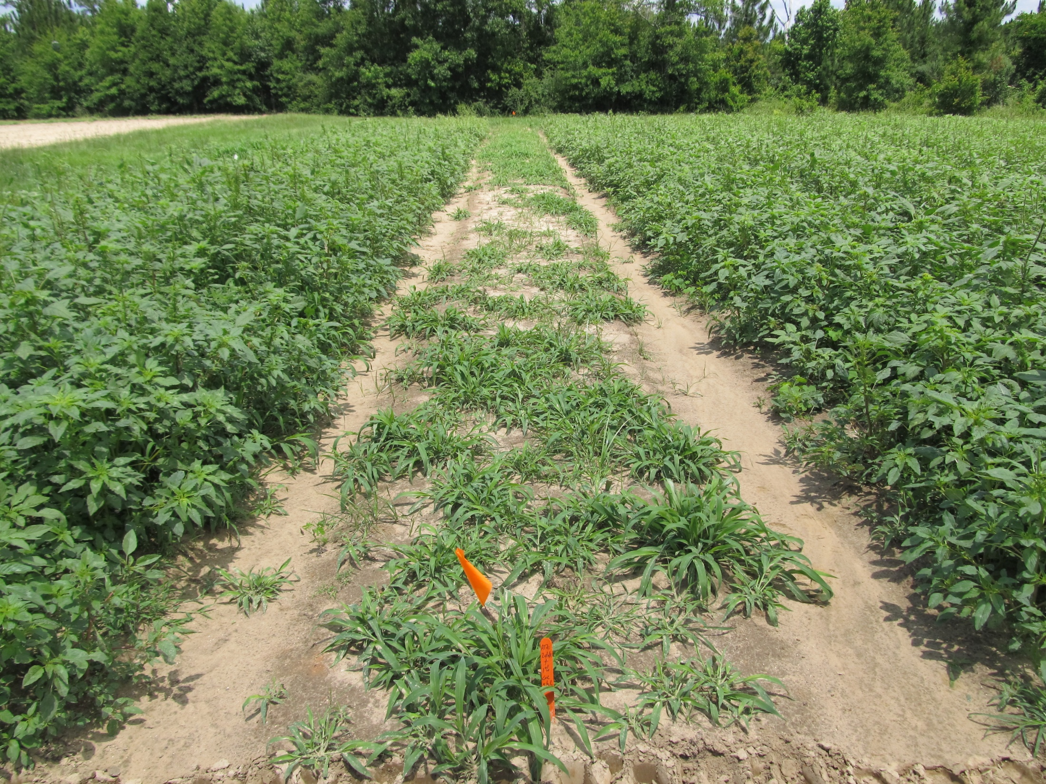
Atrazine 4L @ 2 qts/A + COC @ 1% v/v
Applied to 4”-9” Palmer Amaranth (6” average)
Photo 13 DAT

Slide 14
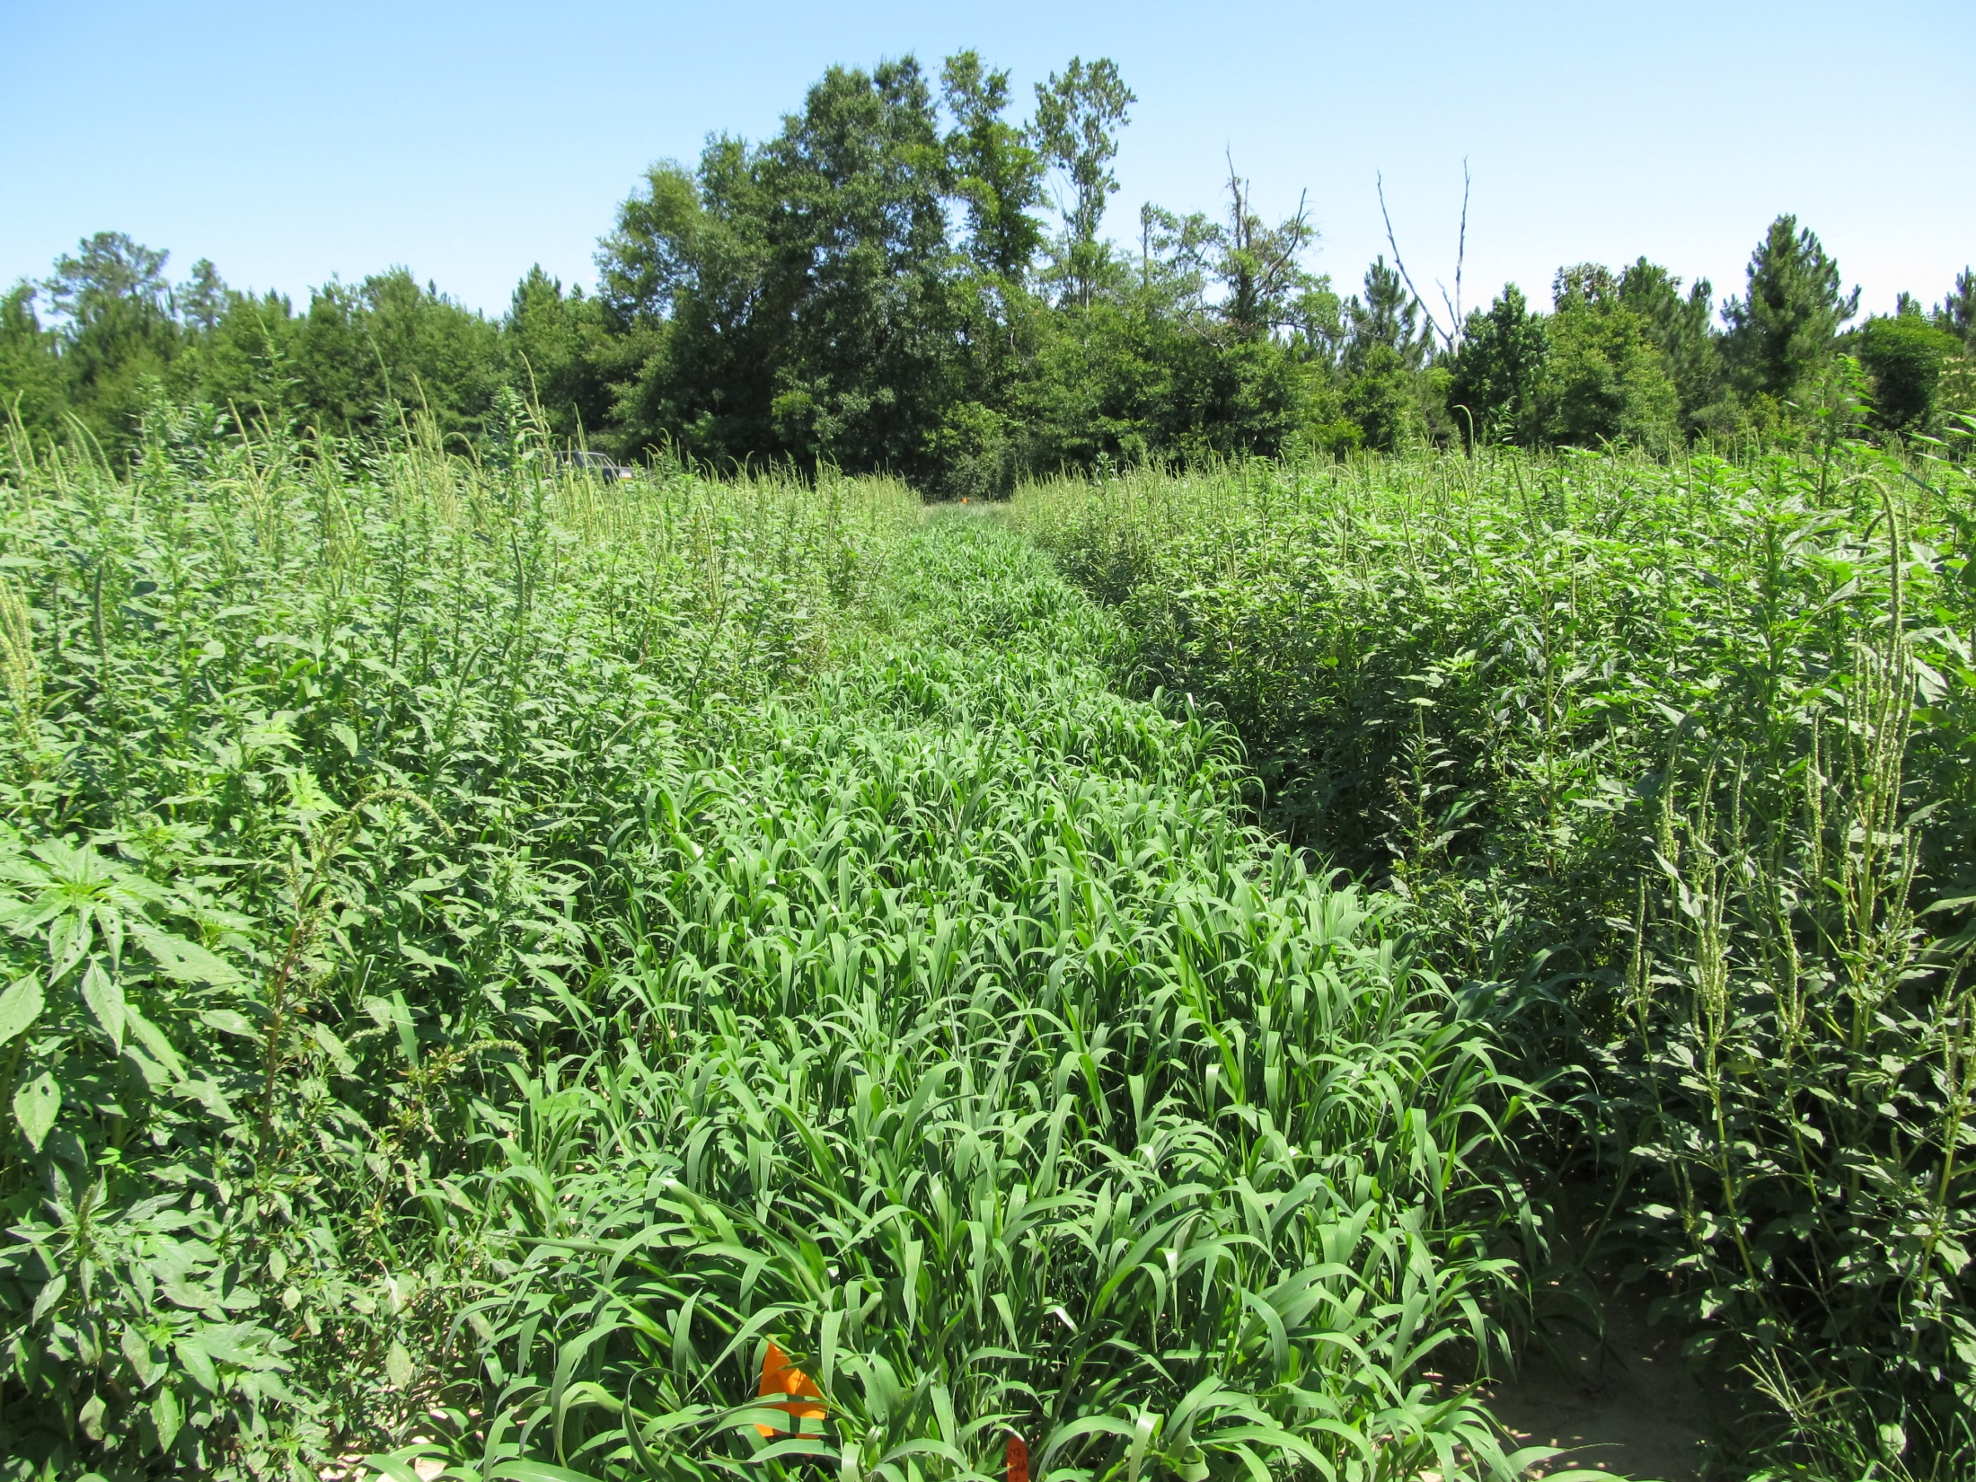
Atrazine 4L @ 2 qts/A + COC @ 1% v/v
Applied to 4”-9” Palmer Amaranth (6” average)
Photo 28 DAT

Slide 15

Future of Atrazine?
In April 2010, EPA stated that no additional testing is warranted to address the issue of atrazine and amphibian gonadal development.
On May 6, 2011, Save The Frogs petitioned the EPA to ban the use and production of atrazine.
Public comments were accepted until November 14, 2011
??

Slide 16
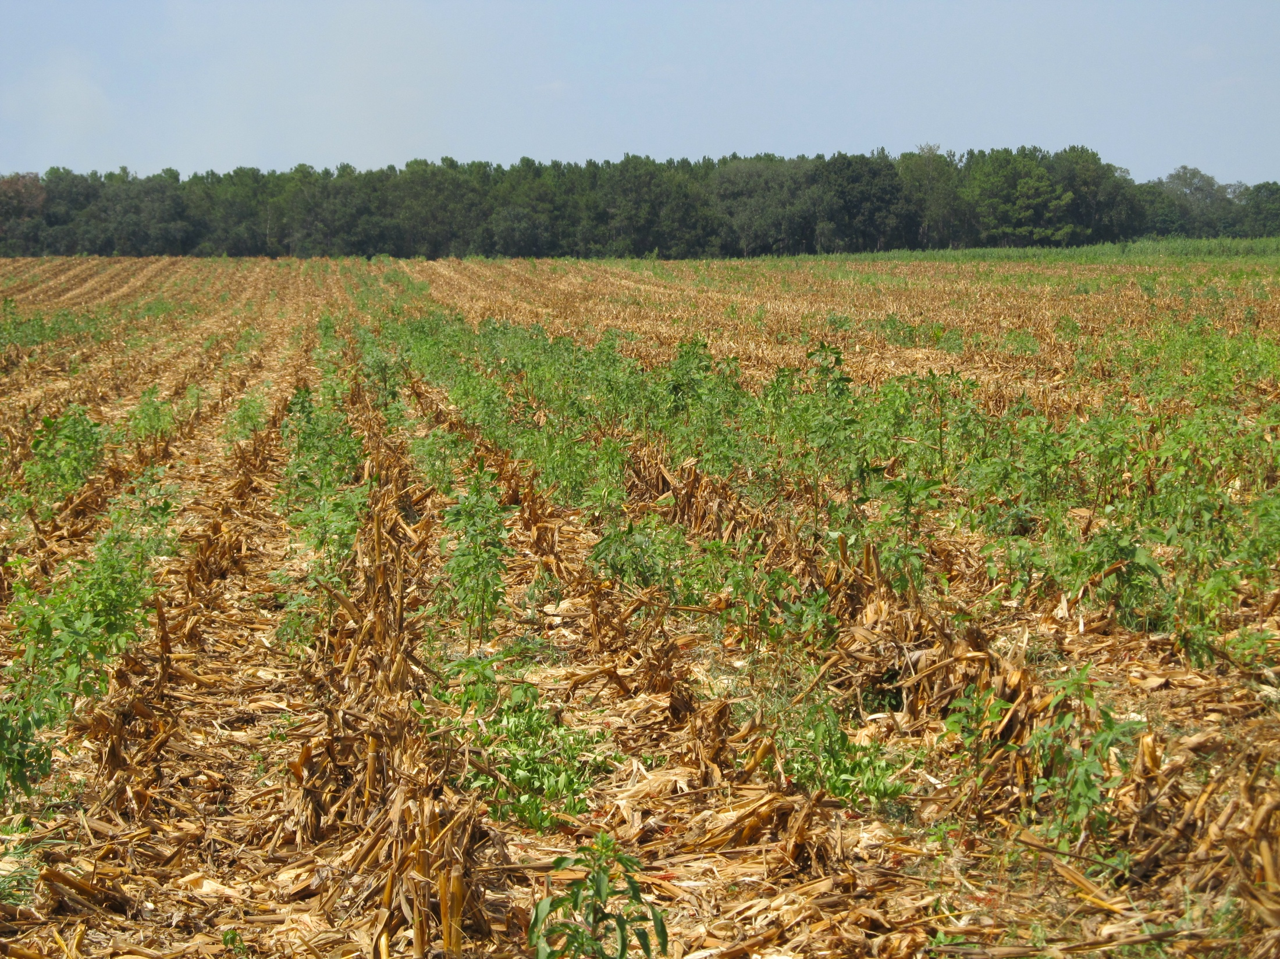
Post-Harvest Palmer Amaranth Populations Must be Managed!

Slide 17
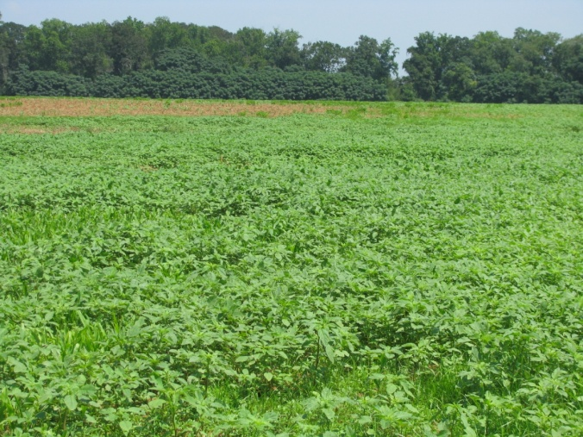
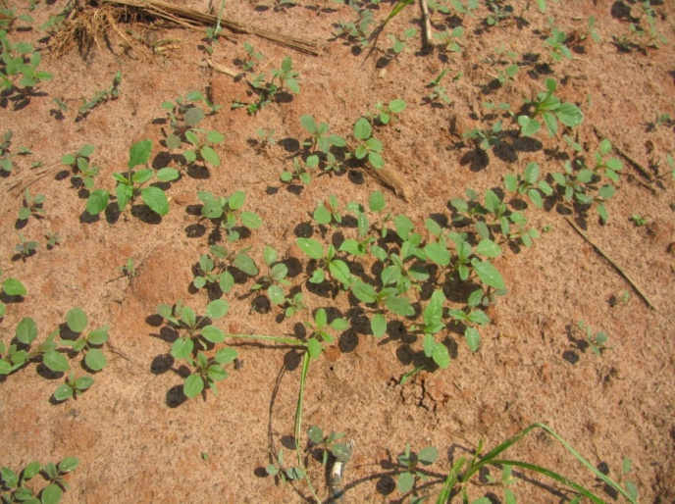
Post-Harvest (Corn) Pigweed Problems
Decreasing daylight hastens flower and seed production
Flowering (3-4 weeks)
Seed production (2-3 weeks)
Some germination at 41⁰F (8%)
Control Options
Mowing/Tillage (>6” weeds)
Herbicides (<6” weeds)
No small grain
Gramoxone + Dual Magnum or Warrant (?)
Small Grain planted soon
Gramoxone + 2,4-D or dicamba
When can we stop worrying about seed production?
Keeley et al. 1987. Weed Science 35:199-204
Steckel et al., 2004. Weed Science 52:217-221

Slide 18
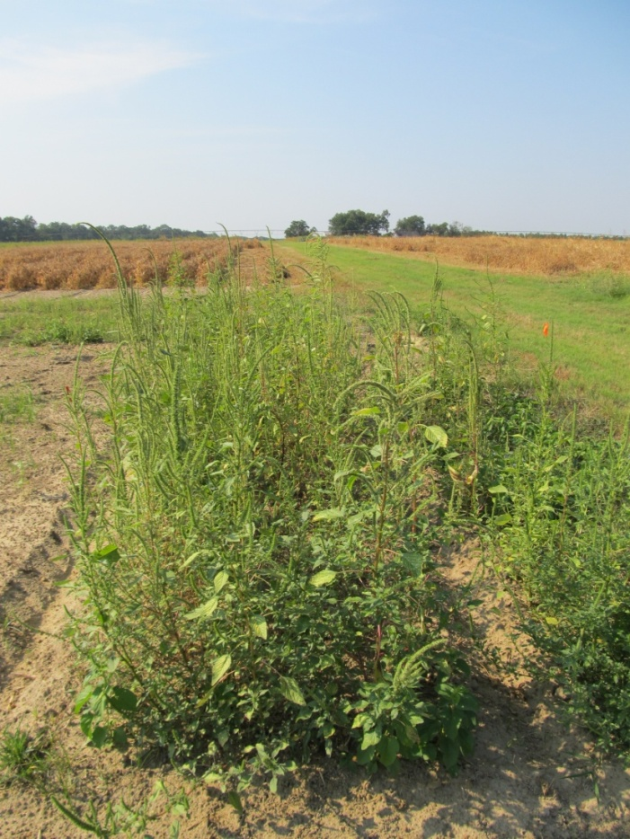
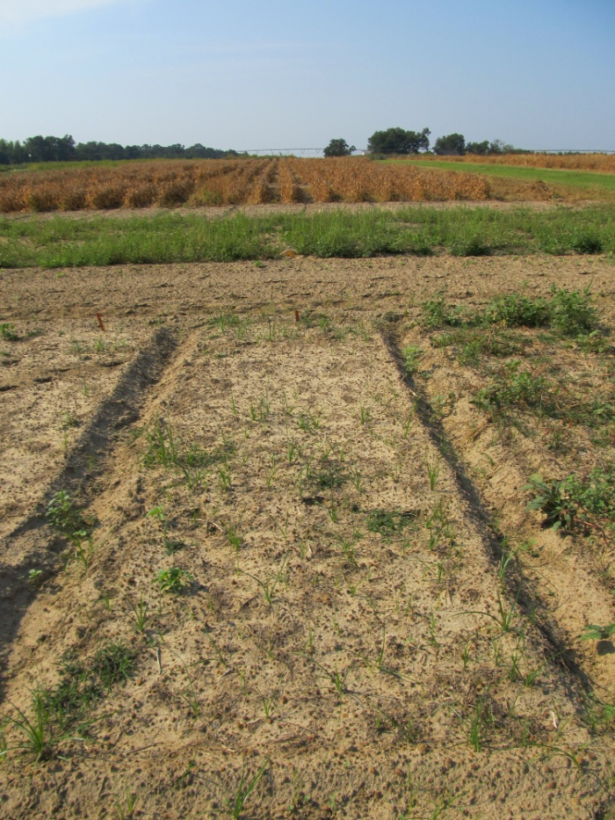
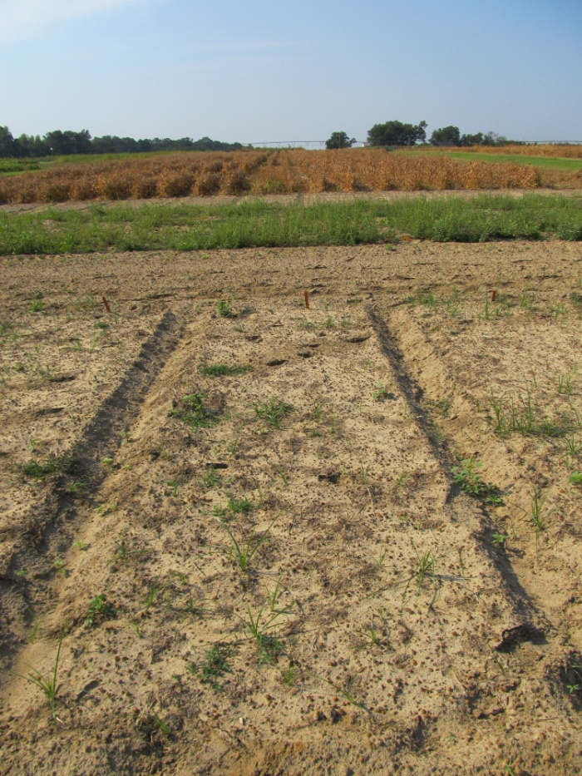
Post-Harvest Control of Palmer Amaranth (6” average: 2”-17” range at application)
NTC
Gramoxone Inteon 2SL @ 3 pt/A
2,4-D Amine 3.8SL @ 1 pt/A
Primary @ 1% v/v
Gramoxone Inteon 2SL @ 3 pt/A
Clarity 4SL @ 8 oz/A
Primary @ 1% v/v
CN-01B-11
September 15
30 DAT

Slide 19
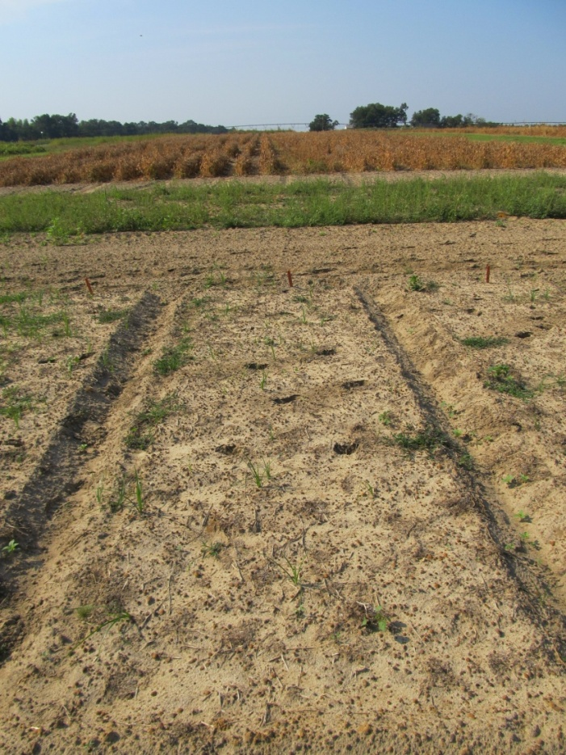
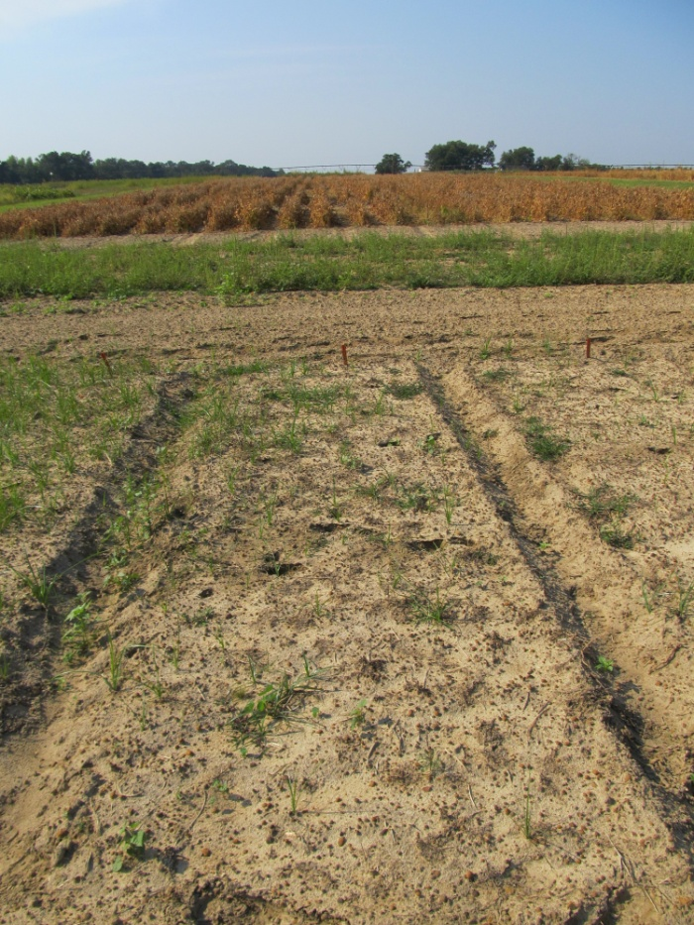
Post-Harvest Control of Palmer Amaranth (6” average: 2”-17” range at application)
NTC
Gramoxone Inteon 2SL @ 3 pt/A
Dual Magnum 7.62EC @ 16 oz/A
Primary @ 1% v/v
Gramoxone Inteon 2SL @ 3 pt/A
Warrant 3ME @ 48 oz/A
Primary @ 1% v/v
CN-01B-11
September 15
30 DAT

Slide 20
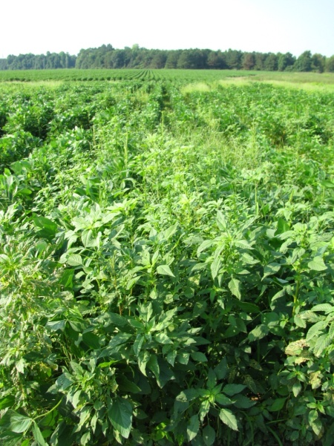
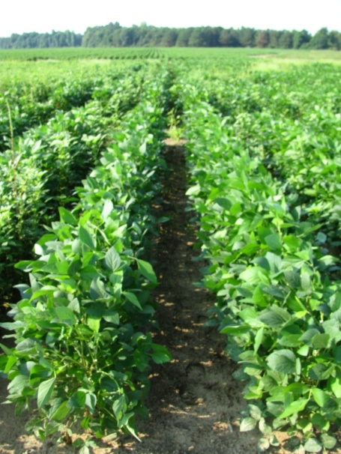
Palmer Amaranth Control Tactics For Every Row Crop
Starting Clean
Tillage
Extreme Cover Crops
Residual Herbicides
Irrigation
Incorporation (dryland)
Timely POST’s
Post-Harvest (Corn)
Others
Hand-Weeding
Non-Selective Applicators (only for peanuts)

Slide 21
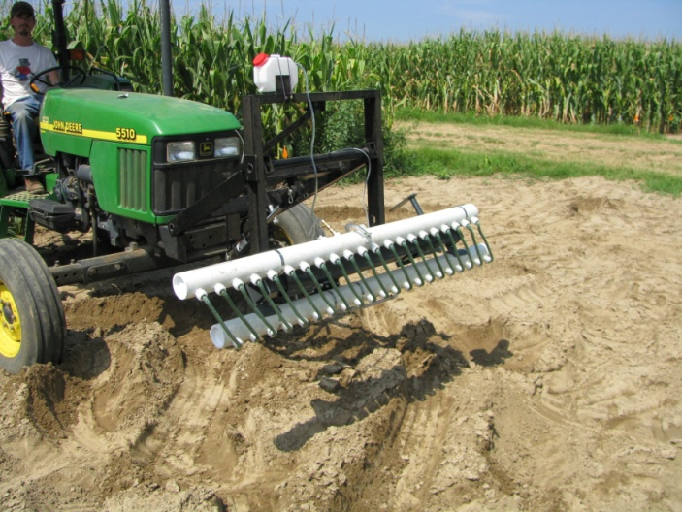
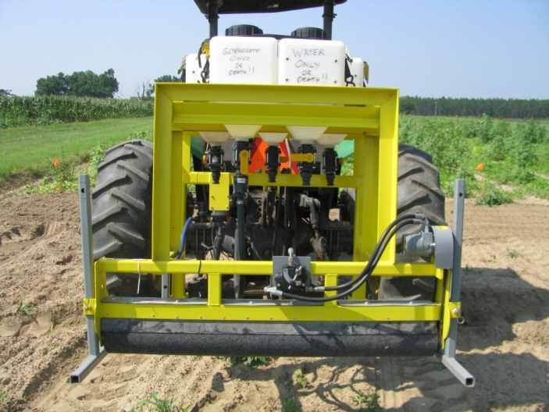
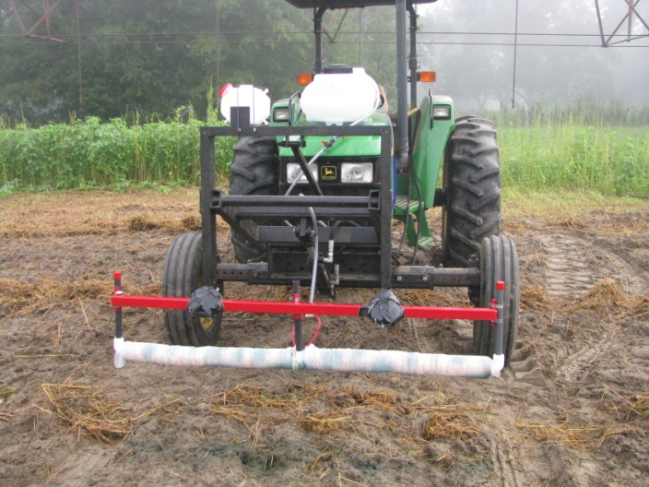
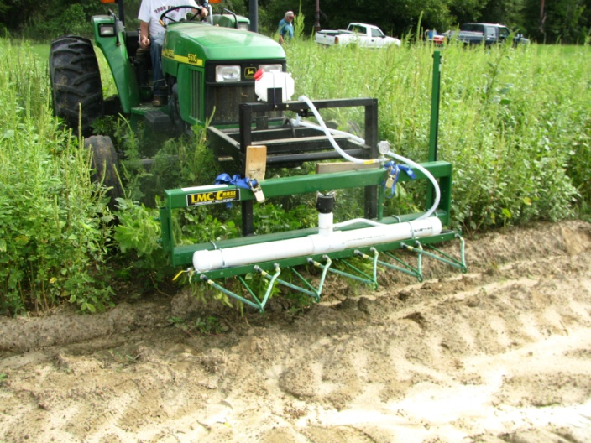
Non-Selective Applicators

Slide 22
The Influence of Wipe Percentage on the Control of Palmer Amaranth with Gramoxone Inteon (50% solution) in the Grassworks WeedWiper
Control (%)
Wipe Percentage (%)
Data from 8 Field trials (2009-2011)

Slide 23
Future Concerns
Abuse of Ignite
Increased use of Dual Magnum and Warrant
Increased use of PPO herbicides
Valor and Reflex

Slide 24
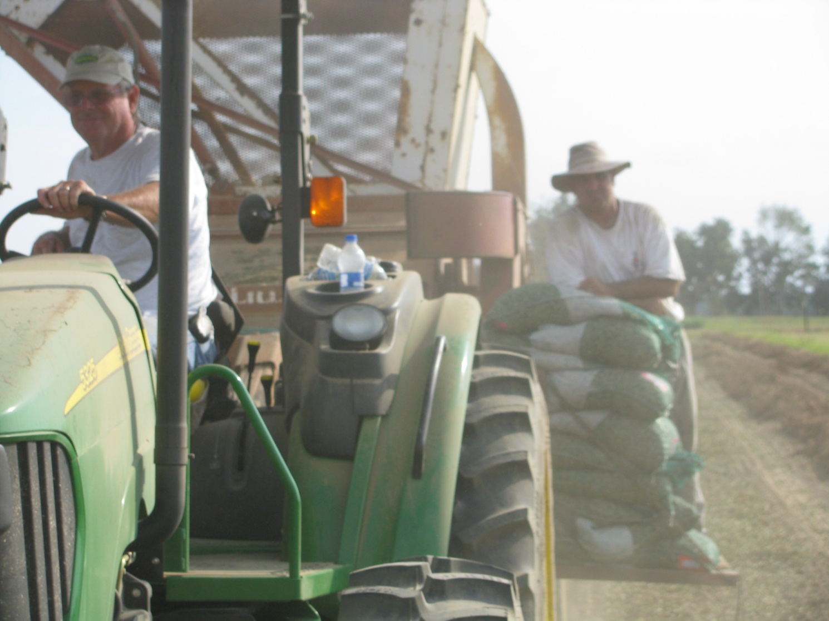
Questions/Discussion?
www.gaweed.com

