Slide 1

Peanut Weed Control for
New Agents
Eric P. Prostko, Ph.D.
Professor and Extension Weed Specialist
Department of Crop & Soil Sciences

Slide 2
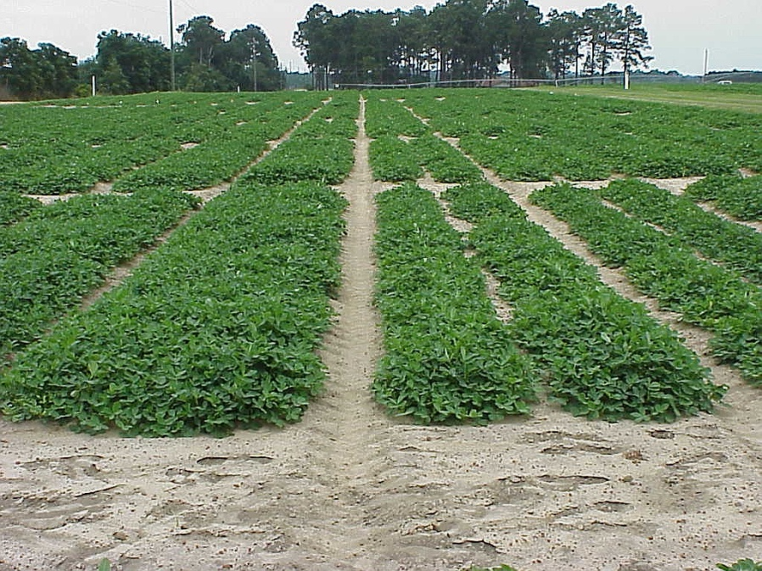
Peanut Weed Control Tactics
Cultural Practices
  Planting Date
  Row spacing
Tillage
Cover Crops
Herbicides
Cultivation
Mowing
Hand-Weeding
Twin Row
Single Row

Slide 3
Sicklepod Control (%) in Conventional Tillage Peanut as Influenced by Row Pattern
Source: Brecke et al. 2006.
Weed Technology
20:368-376.

Slide 4
The Peanut Weed Control Toolbox
21 Active ingredients
PPI/PRE
Sonalan
Prowl/Pendimax
Dual Magnum/Generics
Outlook/Propel
Pursuit
Spartan Charge
Solicam
Strongarm
Valor
POST
Aim (Harvest Aid)
Gramoxone Inteon/Firestorm/Parazone
Basagran
Ultra Blazer
Cadre/Impose
Classic
Cobra
ET
Fusilade
Poast/Poast Plus
Pursuit
Select/Arrow/Trigger
Storm
2,4-DB

Slide 5
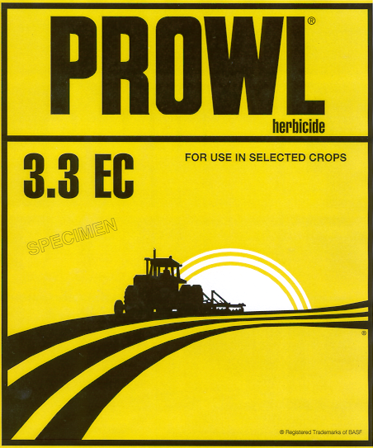


The foundation of weed management in peanuts is the yellow/DNA herbicides!
Sonalan, Prowl, Pendimax, Prowl H₂O
inexpensive
  (< $8/A)
Texas panicum
Florida pusley
must be incorporated by tillage or irrigation
Flip a coin or personal preference

Slide 6
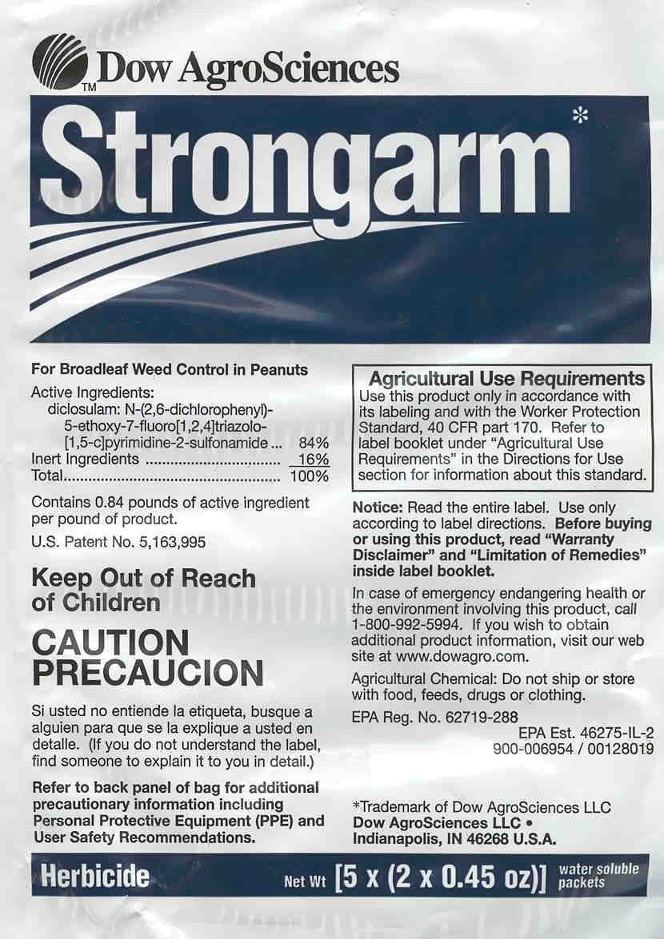
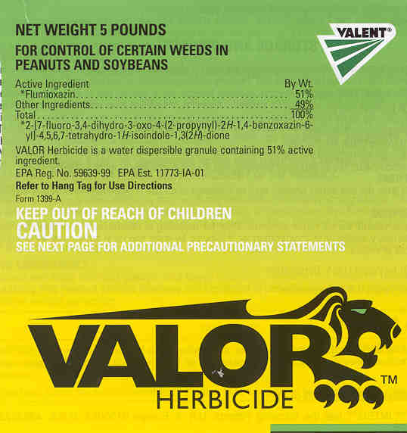

Slide 7
 | Strongarm 84WG (0.45 oz/A) | Valor SX 51WG (3 oz/A)
price/A | $16.75 | $11.06
crop injury potential | + | -
sprayer cleanup | + | -
rotational crops | - | +
Florida beggarweed | - | +
annual morningglory | + | -
sicklepod | - | -
bristly starbur | + | -
ALS-resistant pigweed | - | +
eclipta | + | +
common cocklebur | + | -
tropic croton | - | +
tropical spiderwort | + | -
wild poinsettia | + | -
hophornbeam copperleaf | + | +
nutsedge spp. | + | -

Slide 8
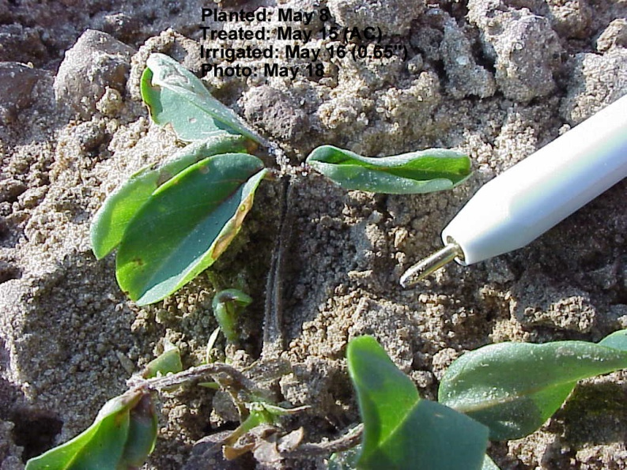
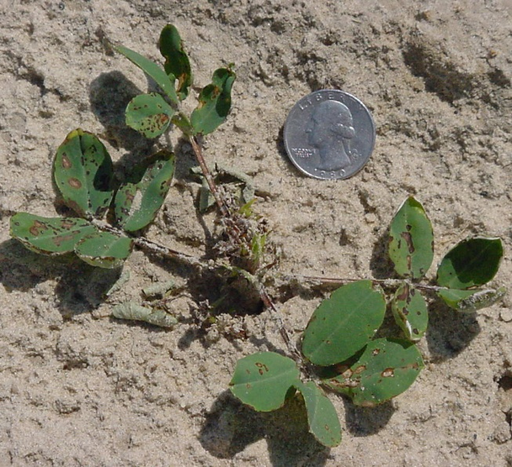
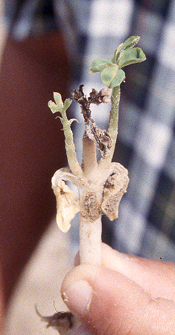
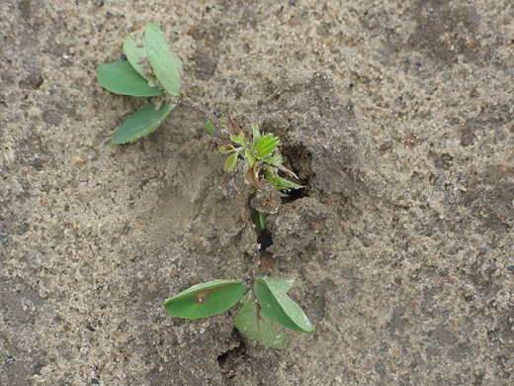
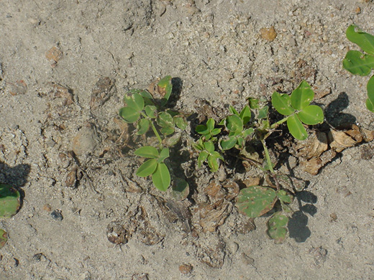
Valor Injury in Peanut

Slide 9
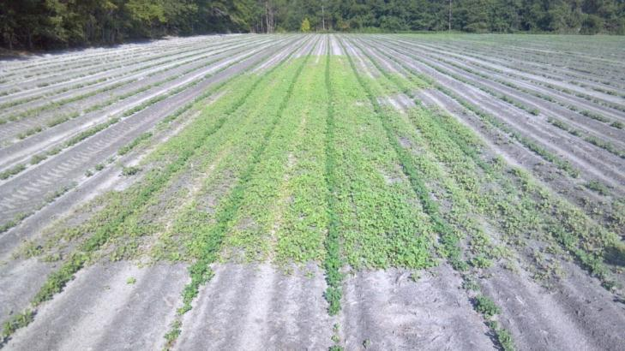
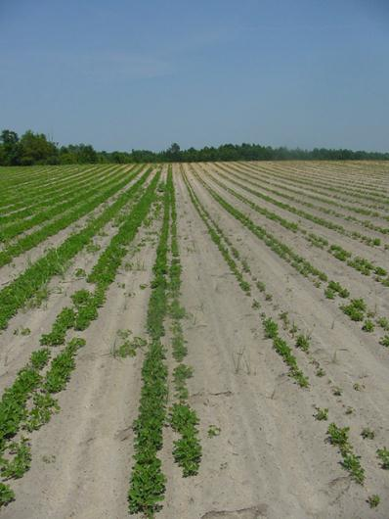
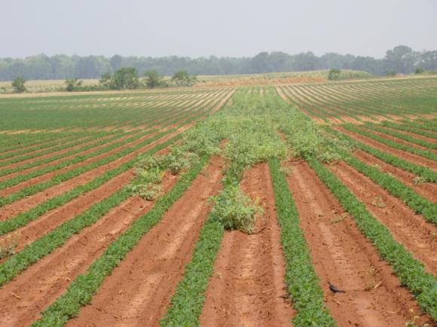

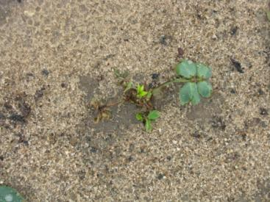
Valor
Great Weed Control vs. Crop Injury

Slide 10
Valor in Peanuts - The Bottom Line
Plant at least 1.5” deep and apply within 2 days of planting
Injury will occur if heavy rainfall occurs from cracking until ~2 WAC
peanut yield should not be reduced if stand is not lost
hose and nozzle clean-out very important!!!!!
  dedicated sprayer for Valor only?
except this or do not use it!!!

Slide 11
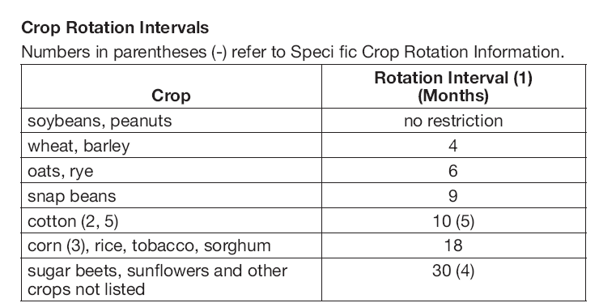
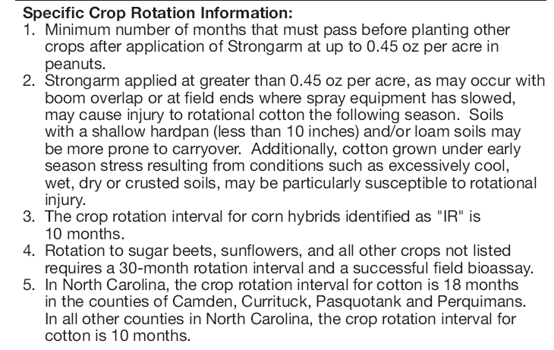
Strongarm Rotation Restrictions
Clearfield canola is not resistant!

Slide 12


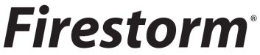
Paraquat in Peanut
less than $4.00/A
if not using Valor or Strongarm
apply early
  alone = before 14 DAC
  tank-mixes = before 28 DAC
tank-mixes with Basagran, Storm, 2,4-D, Dual
Tips
  15 GPA
  flat-fan nozzles
  slower tractor speeds
Gramoxone Inteon (2 lb/gal) or Firestorm (3 lb/gal) or Parazone (3lb/gal)

Slide 13
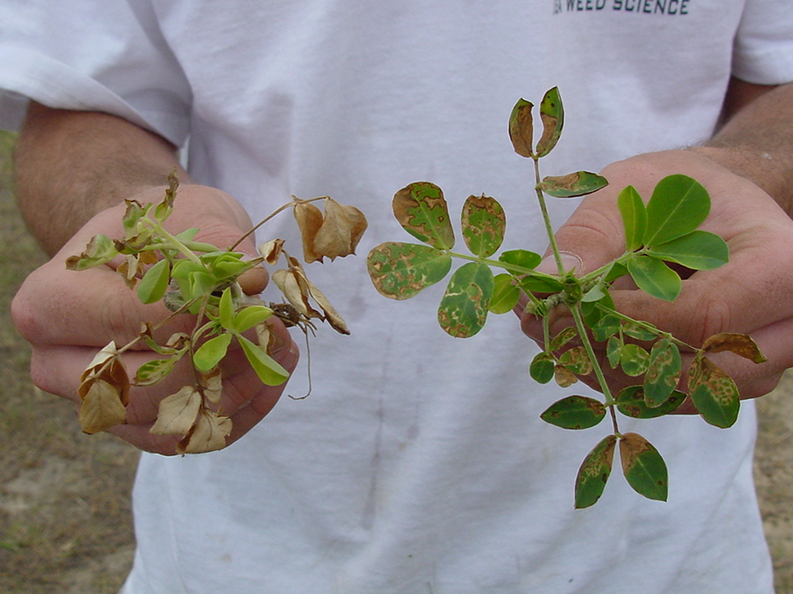
Treatments applied 6 DAC; Photo at 3 DAT
GA-02C
GI @ 8 oz/A +
NIS @ 0.25% v/v
GI @ 12 oz/A + Basagran @ 8 oz/A +
NIS @ 0.25% v/v

Slide 14
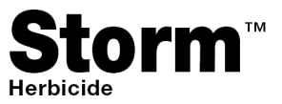
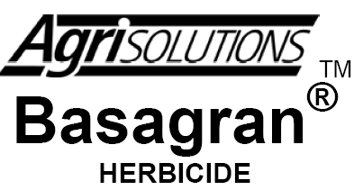
Why do we use Storm or Basagran with paraquat?
Improves control of smallflower mg and tropic croton
Reduces peanut injury but does not really influence yield (cosmetic)
Reduces control of sicklepod, beggarweed, Texas panicum

Slide 15

Cadre: The glyphosate of peanuts?
Yellow and purple nutsedge
Sicklepod, pigweeds, morningglory, cocklebur
Does not control common ragweed, tropic croton, eclipta, spurges, and hophornbeam copperleaf
Is it worth the rotational crop risk??
ALS-resistance???
Cadre @ 4 oz/A = $10.94
Impose @ 4 oz/A = $8.59

Slide 16
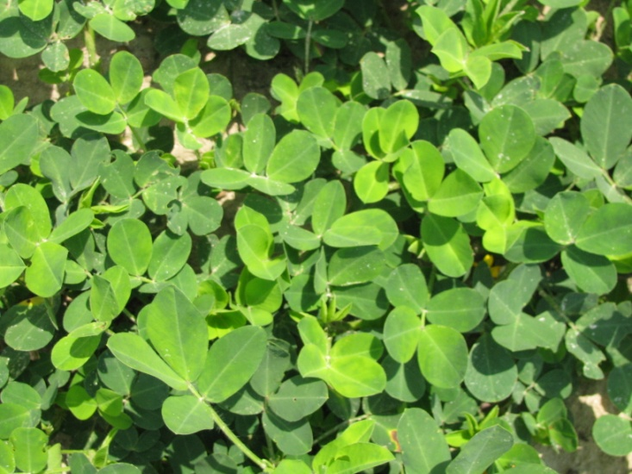
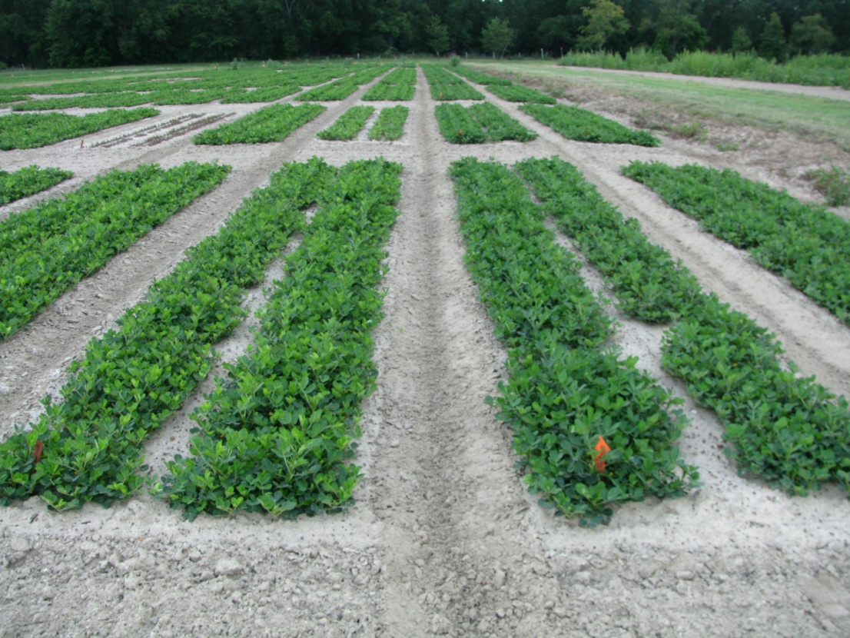
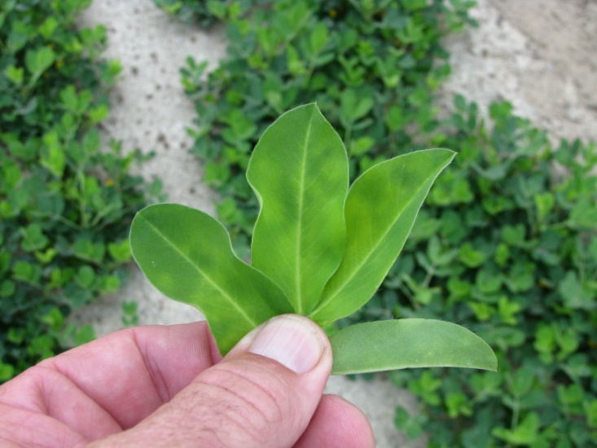
Cadre “Yellow Flash” – 3 DAT
TREATED
NTC
June 25, 2010
GA-06G

Slide 17
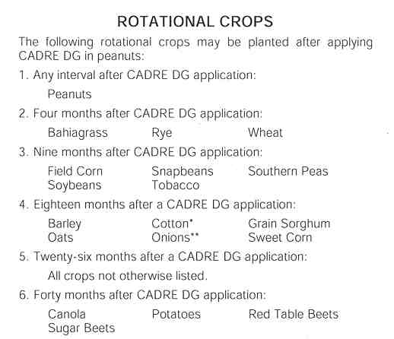
Cadre/Impose Rotational Restrictions

Slide 18
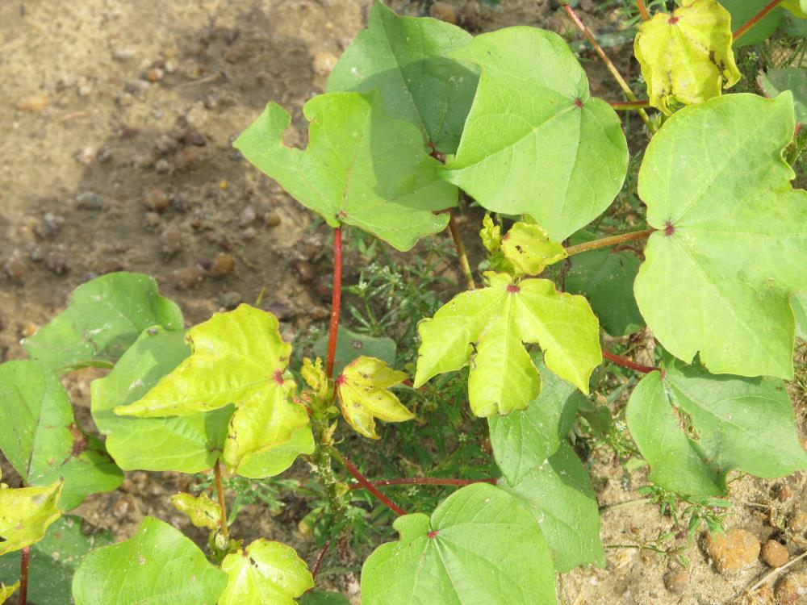
Cadre/Cotton

Slide 19
If growers cannot or will not use Cadre…...
weed control costs will probably be higher
purple nutsedge will not be controlled
Dual Magnum ($10-14/A) but not as effective. Generic metolachlors are cheaper but may not last as long ($5-6/A).
Strongarm or Valor
Other POST herbicides (Basagran, Blazer, Cobra, Storm) are effective but have some weaknesses and no residual

Slide 20
“Cadre-Free” Weed Control Programs
Program 1
  Prowl or Sonolan – PPI/PRE
  Valor (3 oz/A) + Strongarm (0.23 oz/A) – PRE
  Cobra + Dual Magnum – POST
Program 2
  Prowl or Sonolan – PPI/PRE
  Gramoxone + Storm + Dual Magnum – EPOST
  Cobra + Dual Magnum – POST
2,4-DB as needed in both programs for sicklepod supression

Slide 21
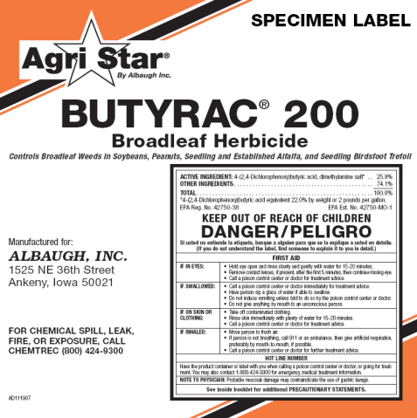
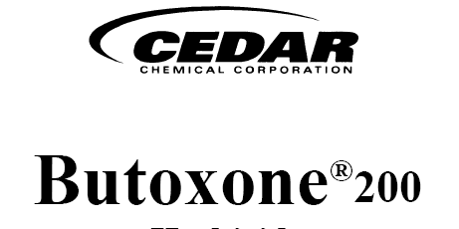
2,4-DB
Around for along time
Annual mg, cocklebur, sicklepod
Usually applied with paraquat or with fungicides
Also frequently tank-mixed with Cadre, Cobra, or Ultra Blazer
Very inexpensive (<$3.00/A)
1.75 or 2.0 lb/gal formulations

Slide 22
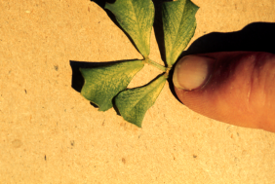
2,4-DB Injury

Slide 23
How much 2,4-DB?
Product | Manufacturer | Rate/A (oz) | Time of Application | Total # Applications /Year | PHI (days)
2,4-DB 175 | Winfield/AgriSolutions | 14.4-17.6 | 2-12 WAPª | 2 | 45
2,4-DB 175 | ACETO | 16.0-28.0 | No later than late bloom (90-100 DAP^{b}) | 2 | 60
2,4-DB 200 | Winfield/AgriSolutions | 12.8-16.0 | 2-12 WAP | 2 | 60
2,4-DB 200 | ACETO | 14.4-25.6 | No later than late bloom (90-100 DAP^{b}) | 2 | 60
AgriStar Butyrac 175 | Albaugh/AgriStar | 14.4-17.6 | 2-12 WAP | 2 | 45
AgriStar Butyrac 200 | Albaugh/AgriStar | 12.8-16.0 | 2-12 WAP | 2 | 45
ªWAP = weeks after planting; ^{b}DAP = days after planting

Slide 24
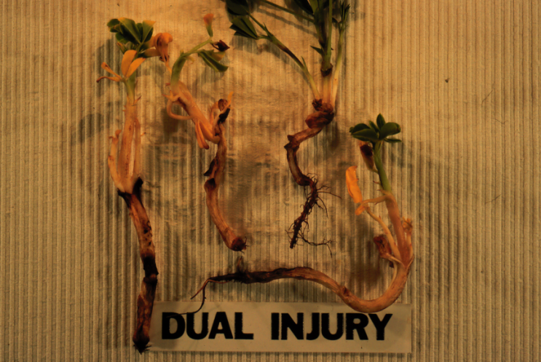

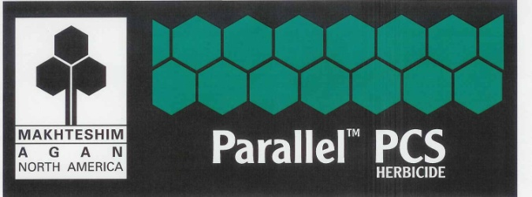
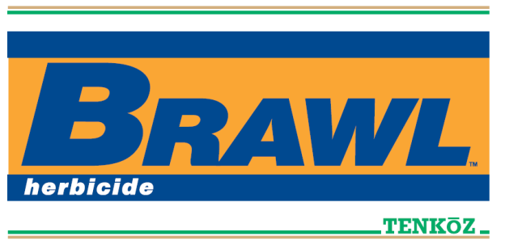
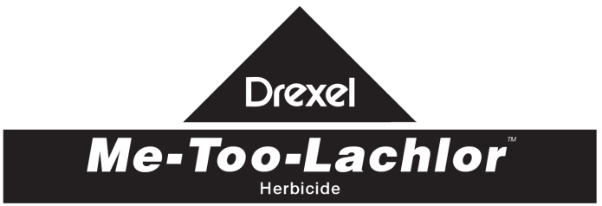
What about Dual Magnum?
Weed-free trials conducted in 2010-2012
22/23 comparisons (96%)
  no negative yield effects
  PPI, PRE, EPOST, POST, Cadre + Dual

Slide 25
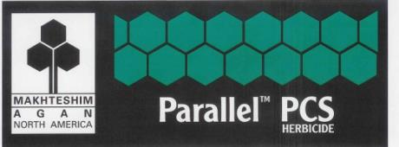

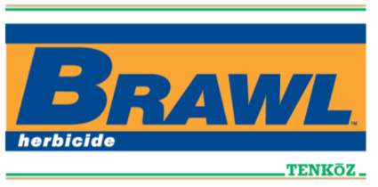
Dual Magnum vs. Generics
Research Summary
UGA Weed Science Research (11 data sets)
  44 individual rating dates (average of 3-4 replications/date)
  Palmer amaranth and tropical spiderwort data
  Dual Magnum better than Generics (16/44 = 36.3%)
  Generics better than Dual Magnum (1/44 = 2.3%)
  Dual Magnum = Generics (27/44 = 61.4%)

Slide 26


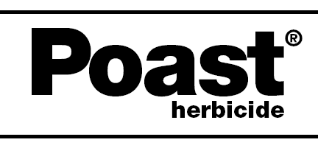
Postemergence Grass Control

Slide 27
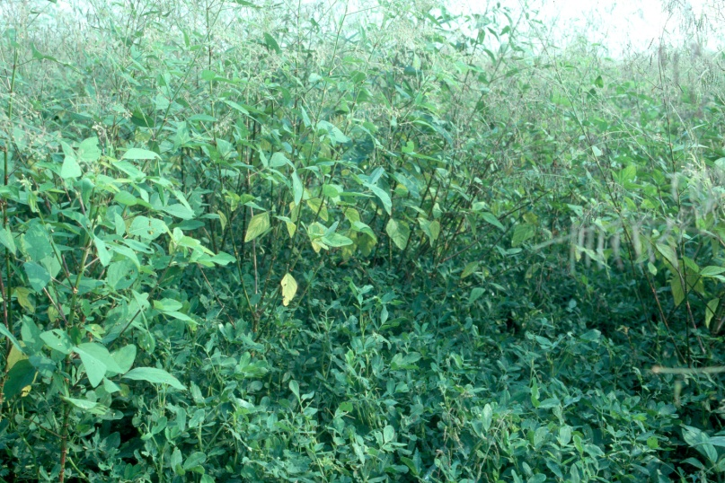

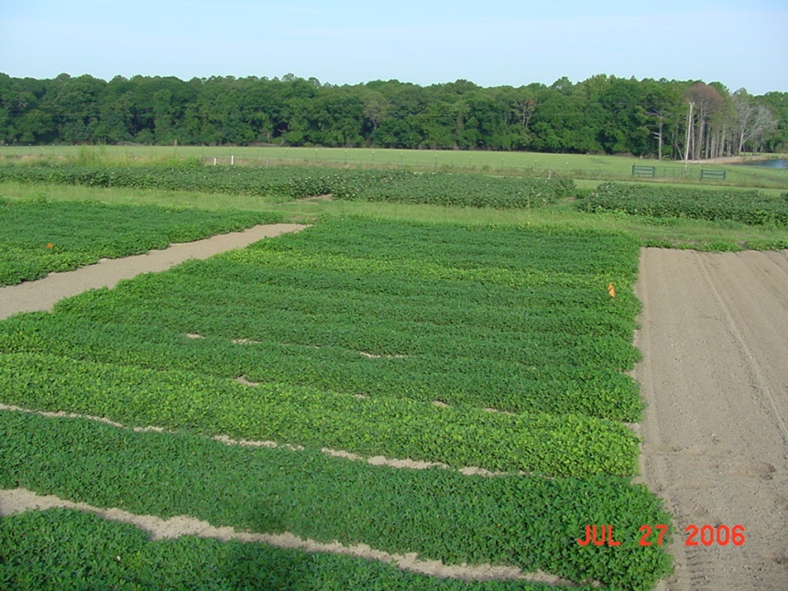
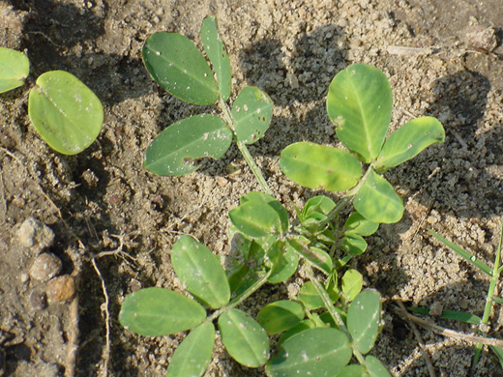
FL-07, GA Greener, GA-07W = No problems
GA-06G and Tifguard = 7-11% yield losses

Slide 28
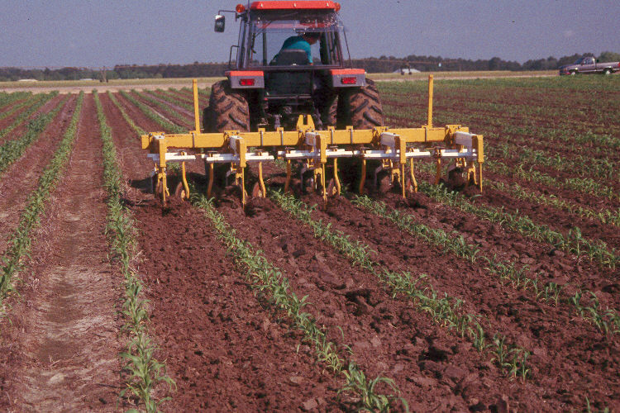
Cultivation
(no weeds are steel-resistant!!!)
Time
Diesel fuel prices
Strip-tillage
Twin rows
White mold

Slide 29
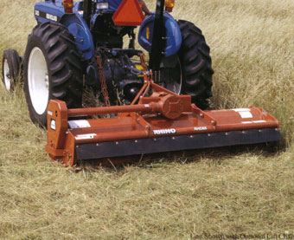
Mowing
Weed/peanut height differential
Digging and harvest aid
Flail mower better than rotary mower
diesel fuel prices
Time???

Slide 30
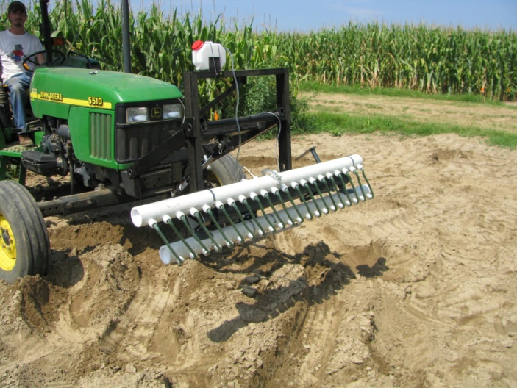
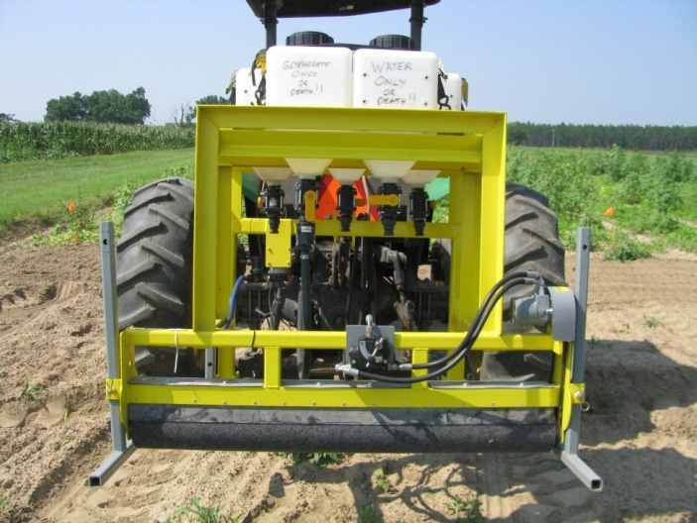
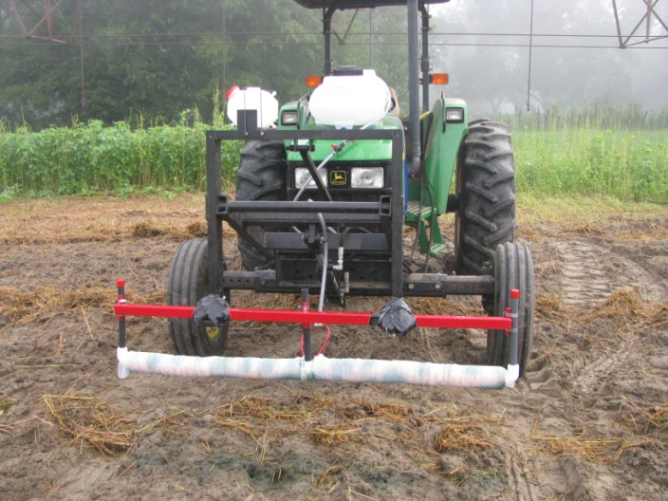
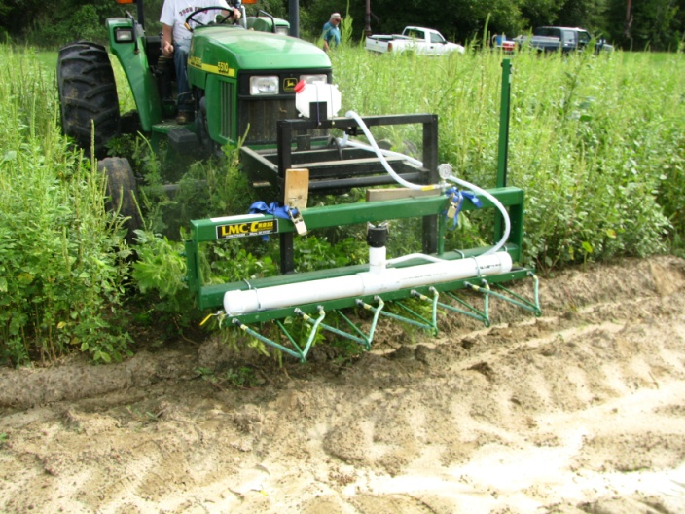
Non-Selective Applicators

Slide 31
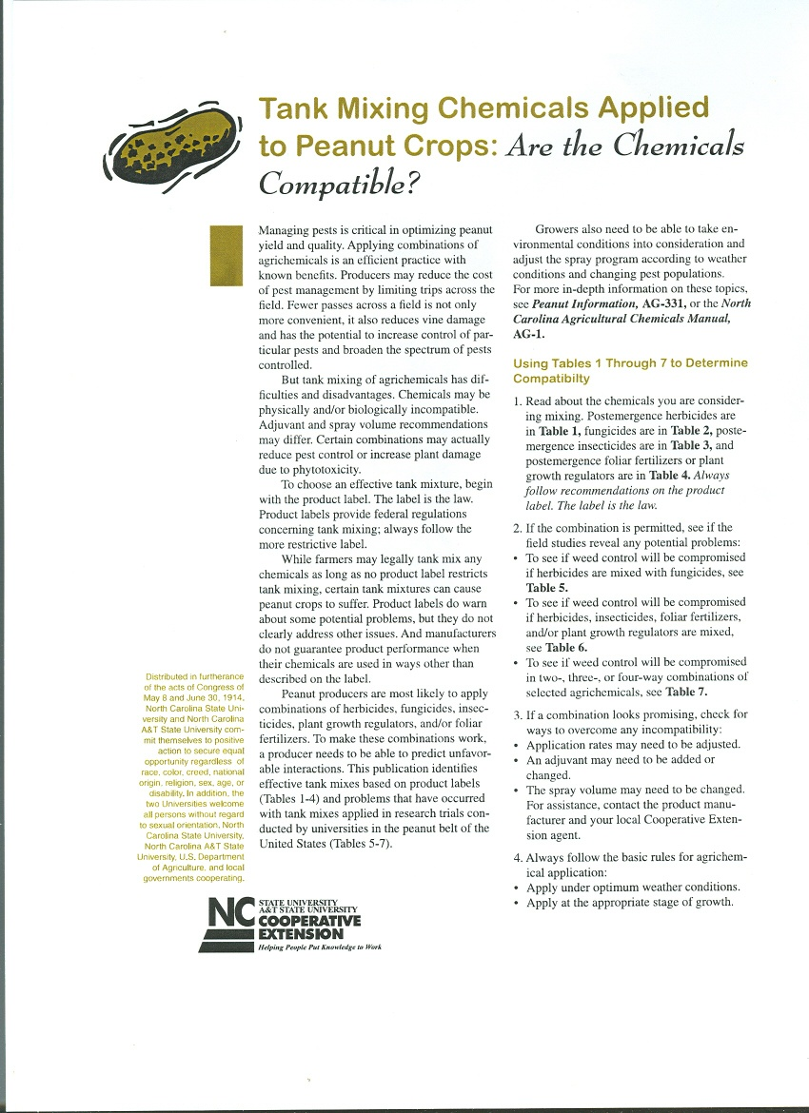
Herbicide/Fungicide Tank-Mixes
Possible combinations are endless
  > 24,000
Avoid 3-way mixes if possible
Regional Publication
  AGW-653
  NCSU
  http://www.peanut.ncsu.edu/PDFFiles/004993/Tank_Mixing_Chemicals_Applied_to_Peanut_Crops.pdf

Slide 32
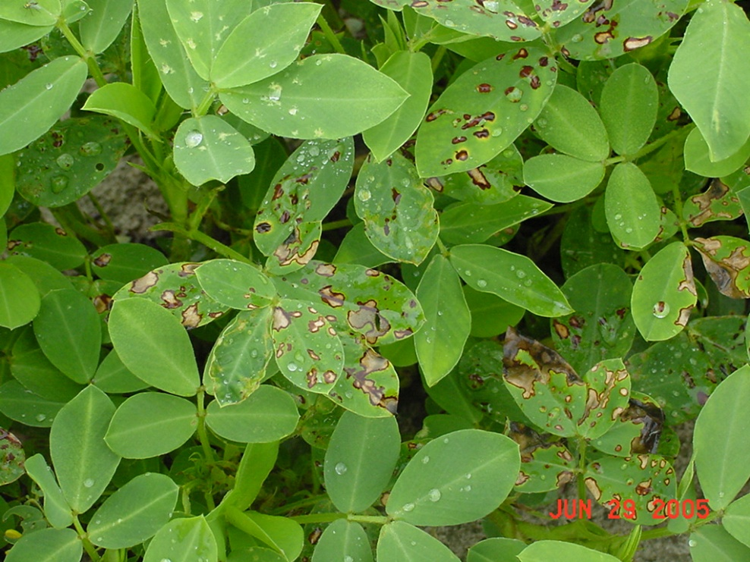
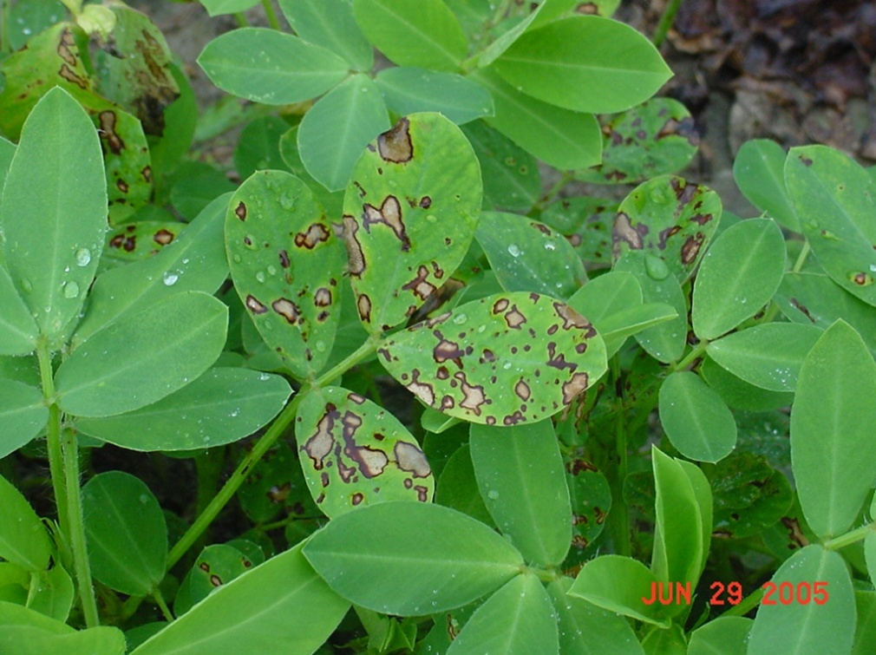
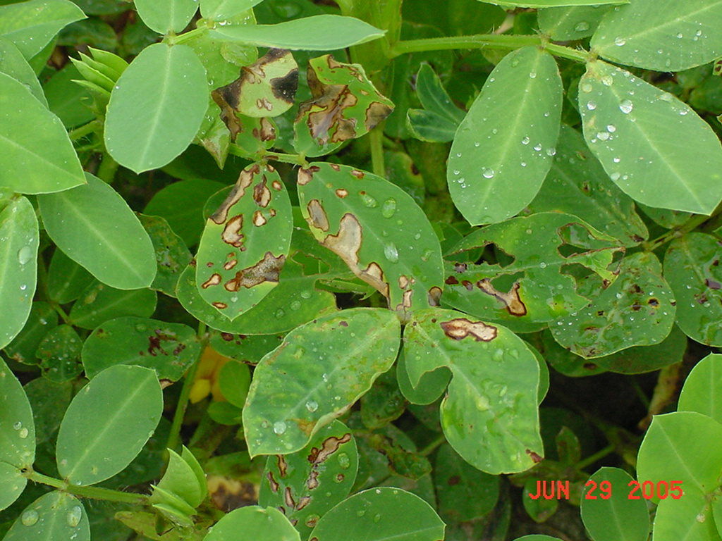
Cadre @ 1.44 ozs/A
Headline @ 9 ozs/A
Dual Magnum @ 1.33 pts/A
AMS @ 1 lb/A
COC @ 1 qt/A

Slide 33
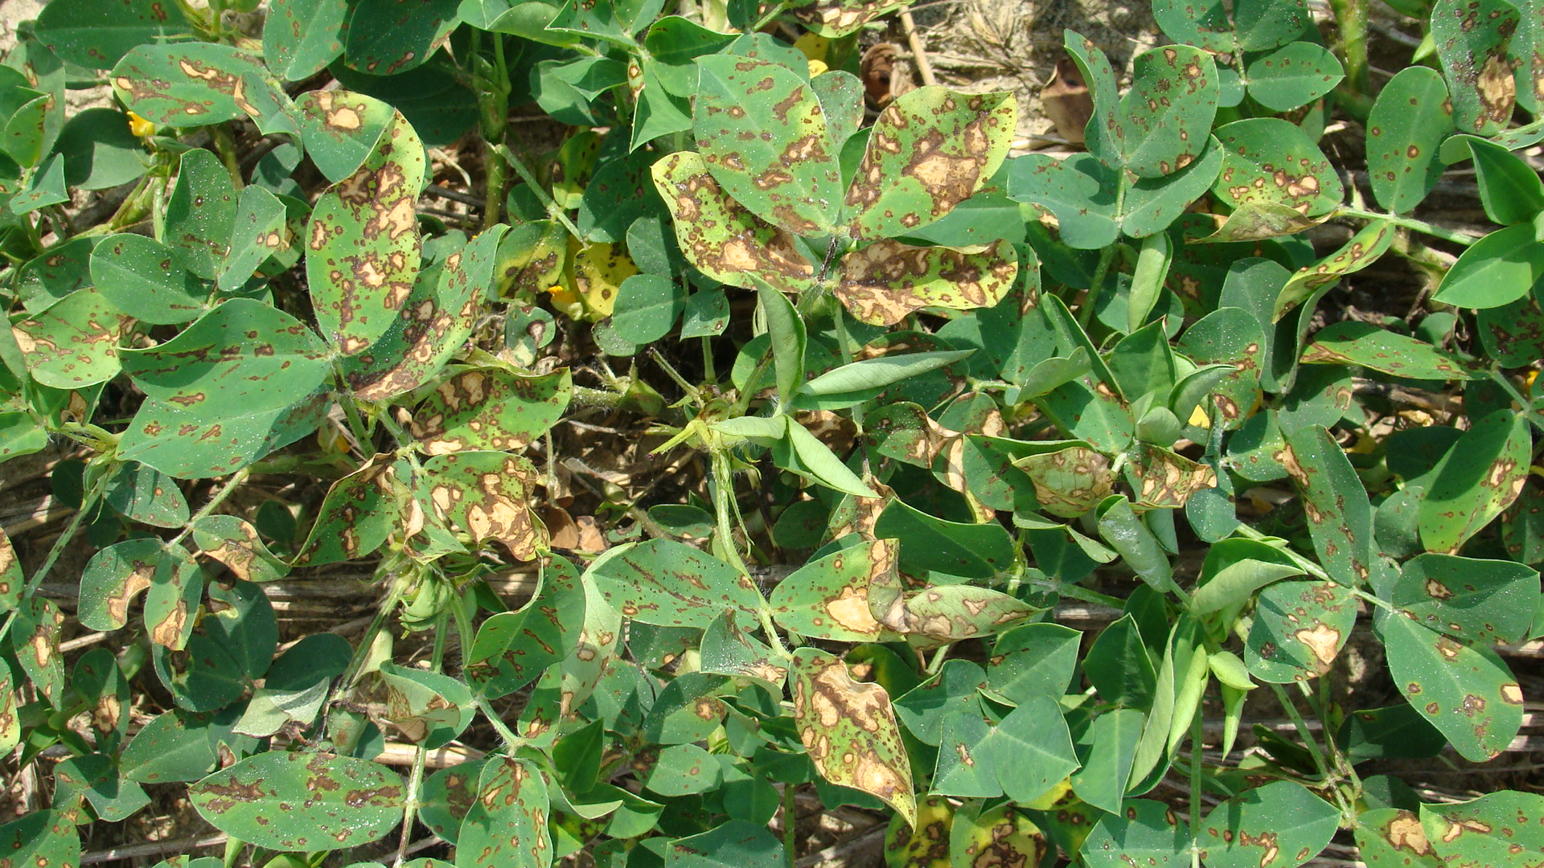
Headline + Cadre + Strongarm + 2,4-DB + Dyne-Amic

Slide 34
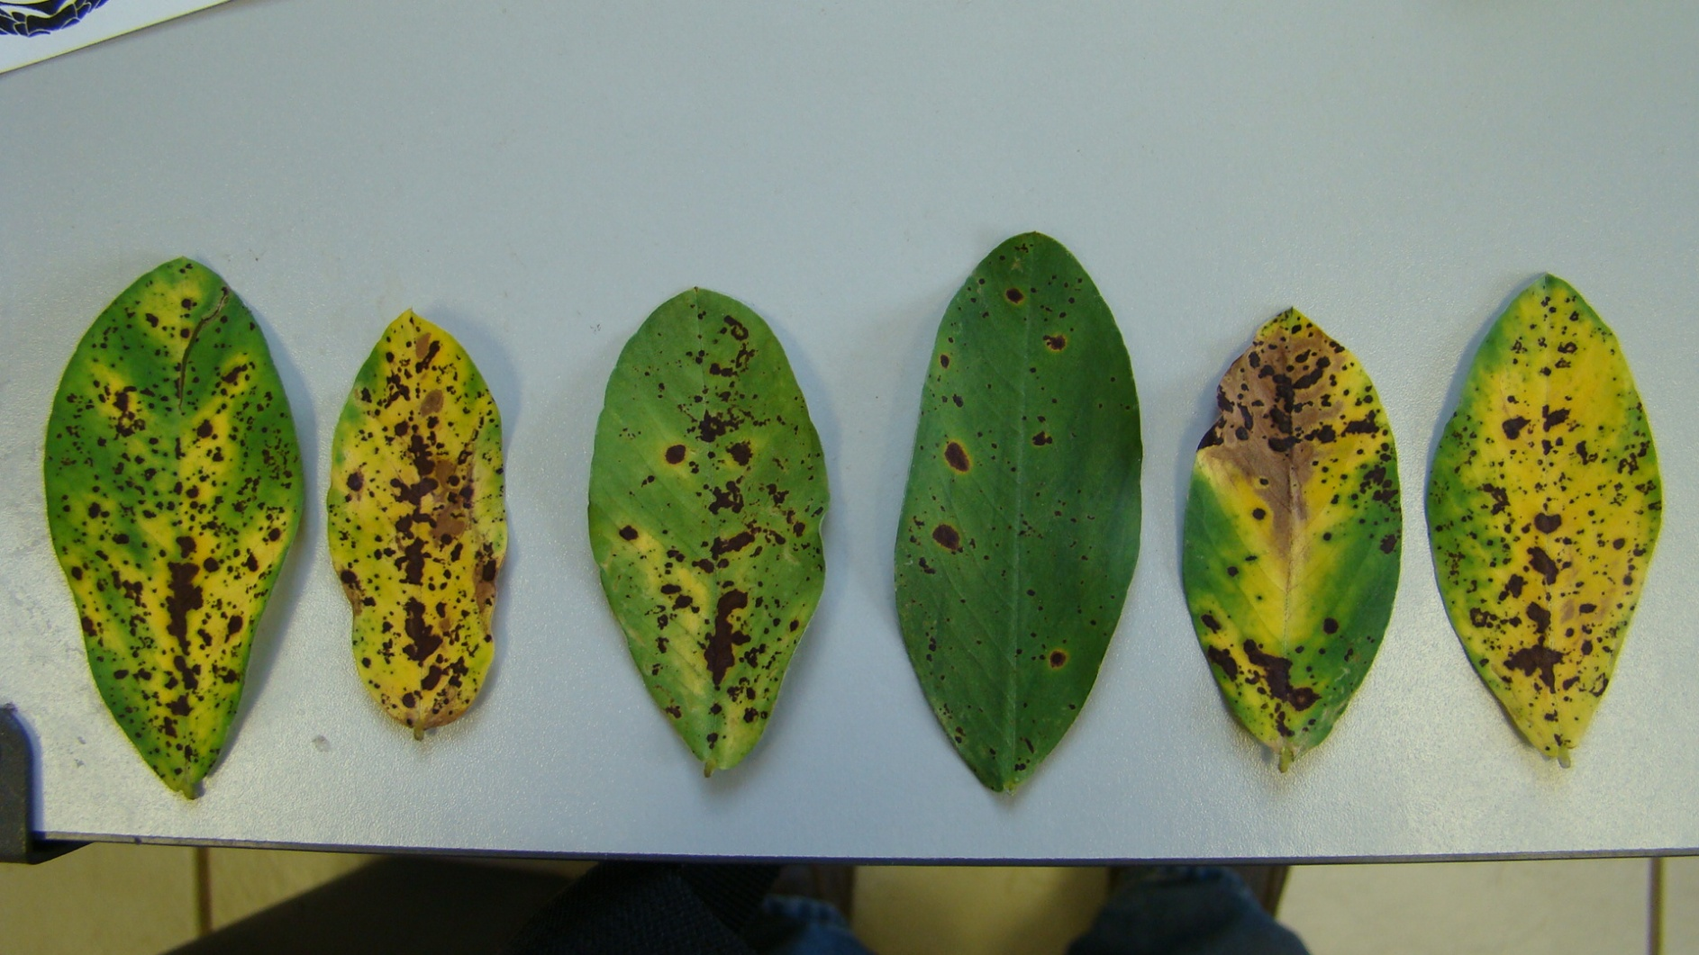
Cadre (4 oz/A) + 2,4-DB (24 oz/A) + Stratego (7 oz/A) + Peg Power (16 oz/A) + Hook (0.25% v/v)

Slide 35
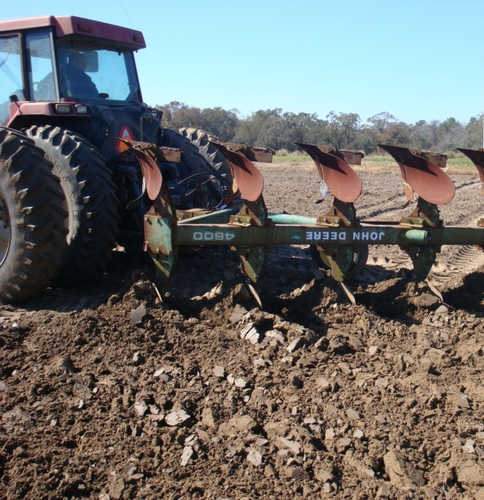





Palmer Amaranth Control
Integrated Program Approach
Tillage
Irrigation
Rye Cover Crop
Hand-Weeding
Twin Rows
Herbicides

Slide 36


Peanut Weed Control - 2013
Prowl/Valor/Strongarm/Cadre/Dual Magnum
NTC
Prowl H₂0 @ 34 oz/A (PRE)
Valor @ 3 oz/A (PRE)
Strongarm @ 0.23 oz/A (PRE)
Cadre @ 4 oz/A (POST)
Dual Magnum @ 16 oz/A (POST)
PE-01-13
June 25
57 DAP

Slide 37

Peanut Weed Control - 2013
Prowl/Gramoxone/Storm/Cadre/Dual Magnum
NTC
Prowl H₂0 @ 34 oz/A (PRE)
Gramoxone @ 12 oz/A (EPOST)
Storm @ 16 oz/A (EPOST)
Dual Magnum @ 16 oz/A (EPOST)
Cadre @ 4 oz/A (POST)
Dual Magnum @ 16 oz/A (POST)
PE-01-13
June 25
57 DAP

Slide 38


What do the top growers do?
2012 Georgia Peanut Achievement Club Winners
10 growers
6204 lbs/A average yield
10/10- irrigated
8/10 – bottom plow
10/10 – twin rows
Herbicides
  9/10 – Sonalan
  10/10 – Valor
  3/10 – Dual
  9/10 – Cadre
  2/10 – 2,4-DB
  1/10 – Prowl
  2/10 - Strongarm

Slide 39

Questions/Comments?
eprostko@uga.edu
229-392-1034 (cell)
www.gaweed.com

