Slide 1
Basic Field Corn Weed Management For New Extension Agents - 2013
Eric P. Prostko, Ph.D.
Professor and Extension Weed Specialist
Dept. Crop & Soil Sciences

Slide 2
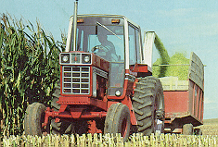
Cultural Practices
Planting Date
Row Spacing
Fertility
Irrigation
give the crop a competitive edge against weeds

Slide 3
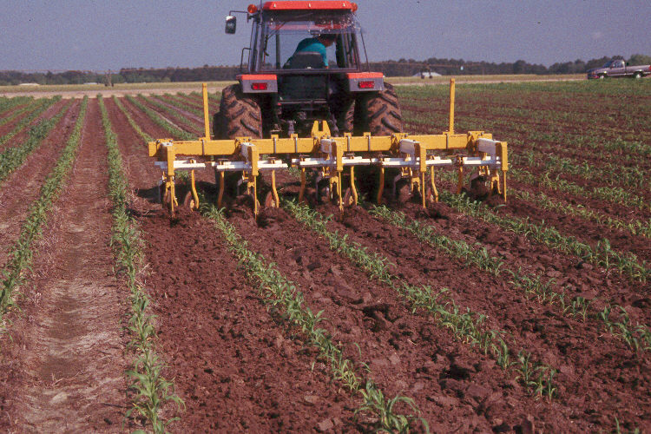
Mechanical Cultivation
Time
Diesel fuel prices
Strip-tillage
no weeds are steel-resistant!!!

Slide 4
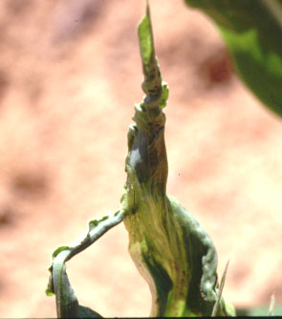
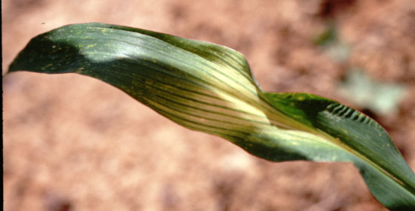
Insecticide/Herbicide Interactions
Insecticides
Organophosphates (OP’S)
Counter, Lorsban, Thimet
Herbicides
Steadfast Q
Capreno
Halex GT
Sandea
Why?
overload the plant’s ability to metabolize chemicals

Slide 5
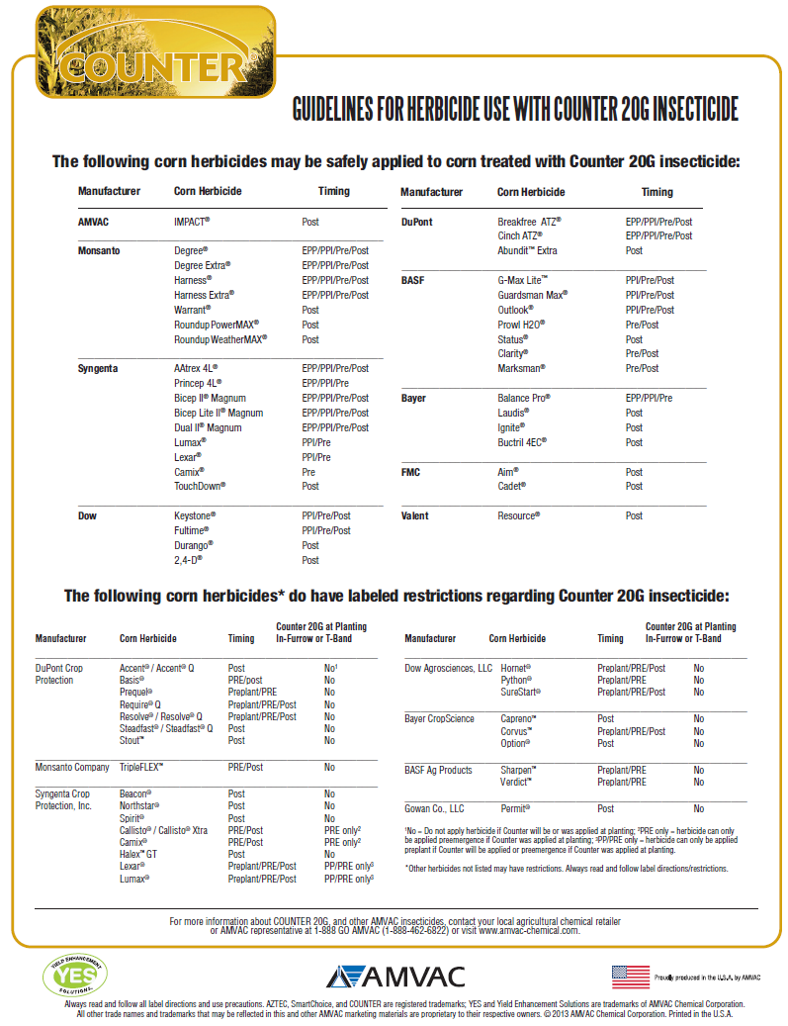

Slide 6
Field Corn (DKC 66-97) Yield Response to Counter fb Steadfast - 2012
LSD 0.10 = 26
Bu/A
Treatment
CN-06-12

Slide 7
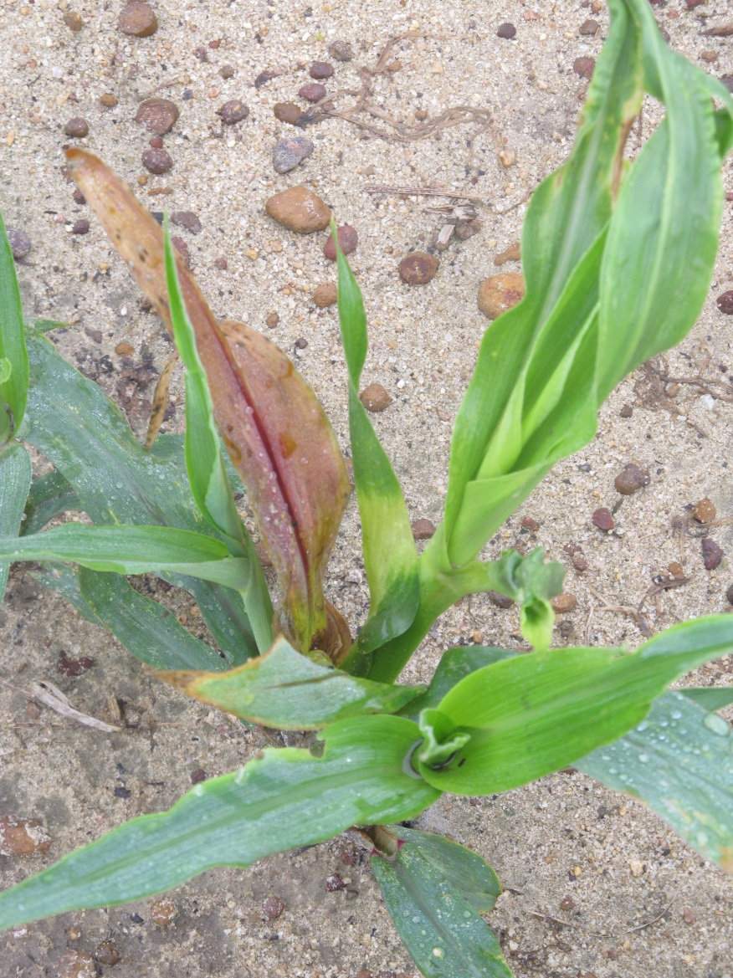
Corn Hybrid/Herbicide Interactions
some corn hybrids are sensitive to certain herbicides
Companies screen for tolerance to …….
Amides (Dual)
Benzoic Acid/phenoxy – (dicamba)
HPPD (Calliso/Balance)
SU (Steadfast)
DuPont Q Products
Steadfast Q, Resolve Q
Isoxadifen (safener)

Slide 8
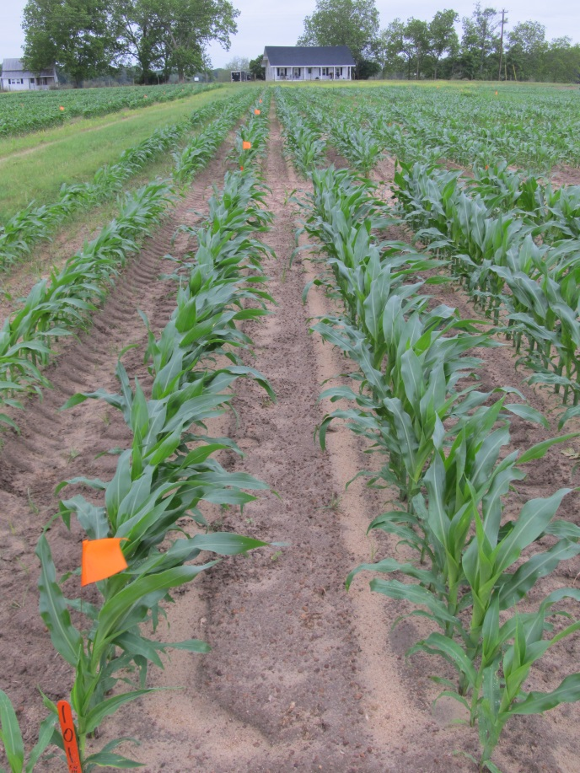
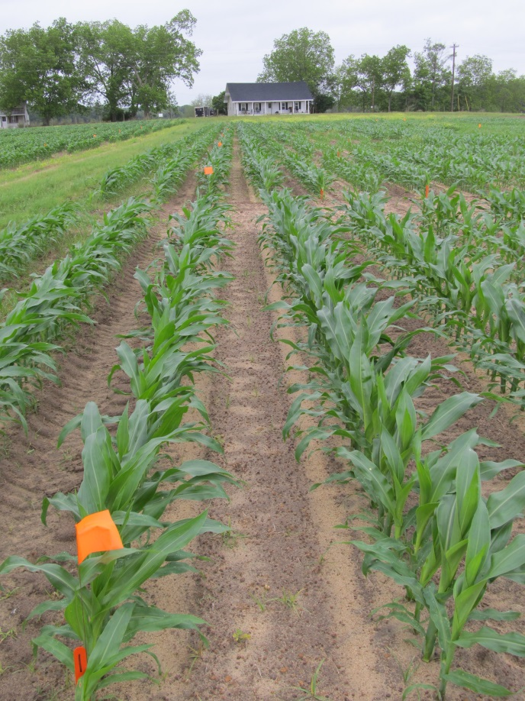
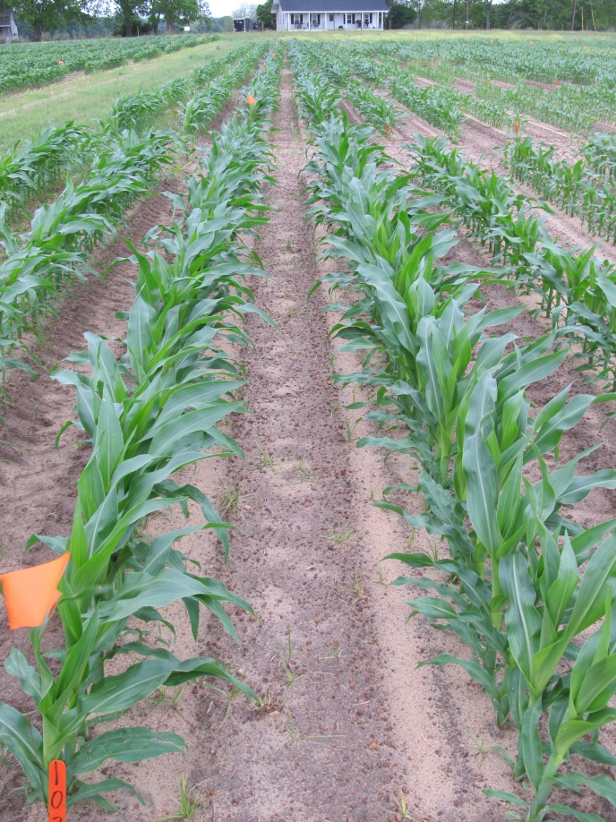
DKC-6469 Response to Steadfast Q
Roundup WeatherMax @ 22 oz/A Aatrex @ 64 oz/A
Roundup WeatherMax @ 22 oz/A
Steadfast Q @ 1.5 oz/A Aatrex @ 64 oz/A
Roundup WeatherMax @ 22 oz/A
Steadfast Q @ 3.0 oz/A Aatrex @ 64 oz/A
CN-18-13
May 3
16 DAT

Slide 9
‘DKC 64-69’ Yield Response to POST Applications of Steadfast Q (RUWM @ 22 oz/A, ATZ @ 64 oz/A, STDQ @ 1.5 or 3 oz/A)
Bu/A
P = 0.5017
CV = 1.75
Applied 28 DAP
V4, 6” tall corn

Slide 10


Hybrid/Herbicide Interactions
Check Pioneer and Dekalb Web-sites in spring for new listing of hybrid/herbicide interactions.

Slide 11
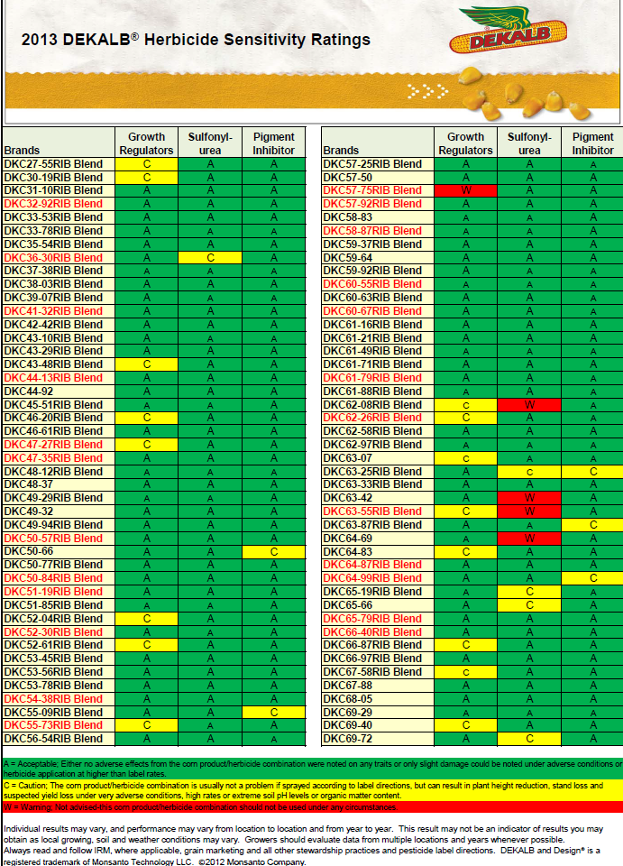
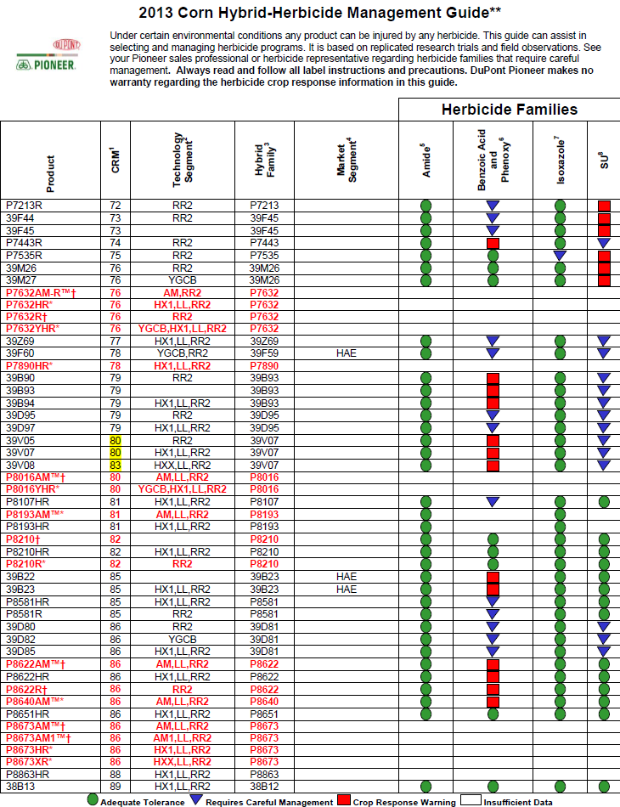

Slide 12
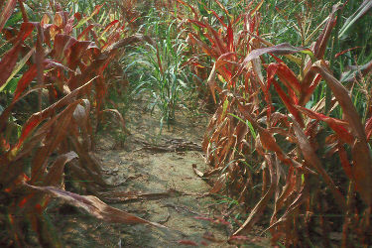
Weed/Disease Interactions
Maize Dwarf Mosaic Virus (MDMV)
Maize Chlorotic Dwarf Virus (MCDV)
johnsongrass
aphid/leafhoppers
hybrid tolerance

Slide 13
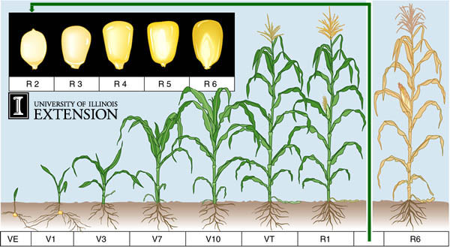
Corn Stages of Growth
All leaves and ear shoots are initiated at V3 stage and completed by V5

Slide 14
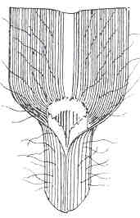
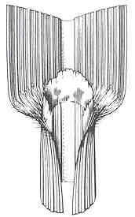
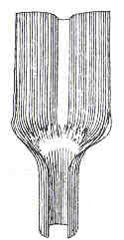
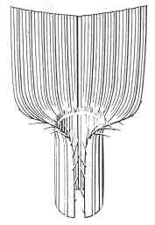
Know Your Grasses
large crabgrass
johnsongrass
fall panicum
broadleaf
signalgrass
Source: SWSS Weed ID Guide

Slide 15
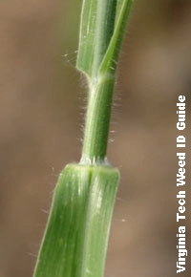
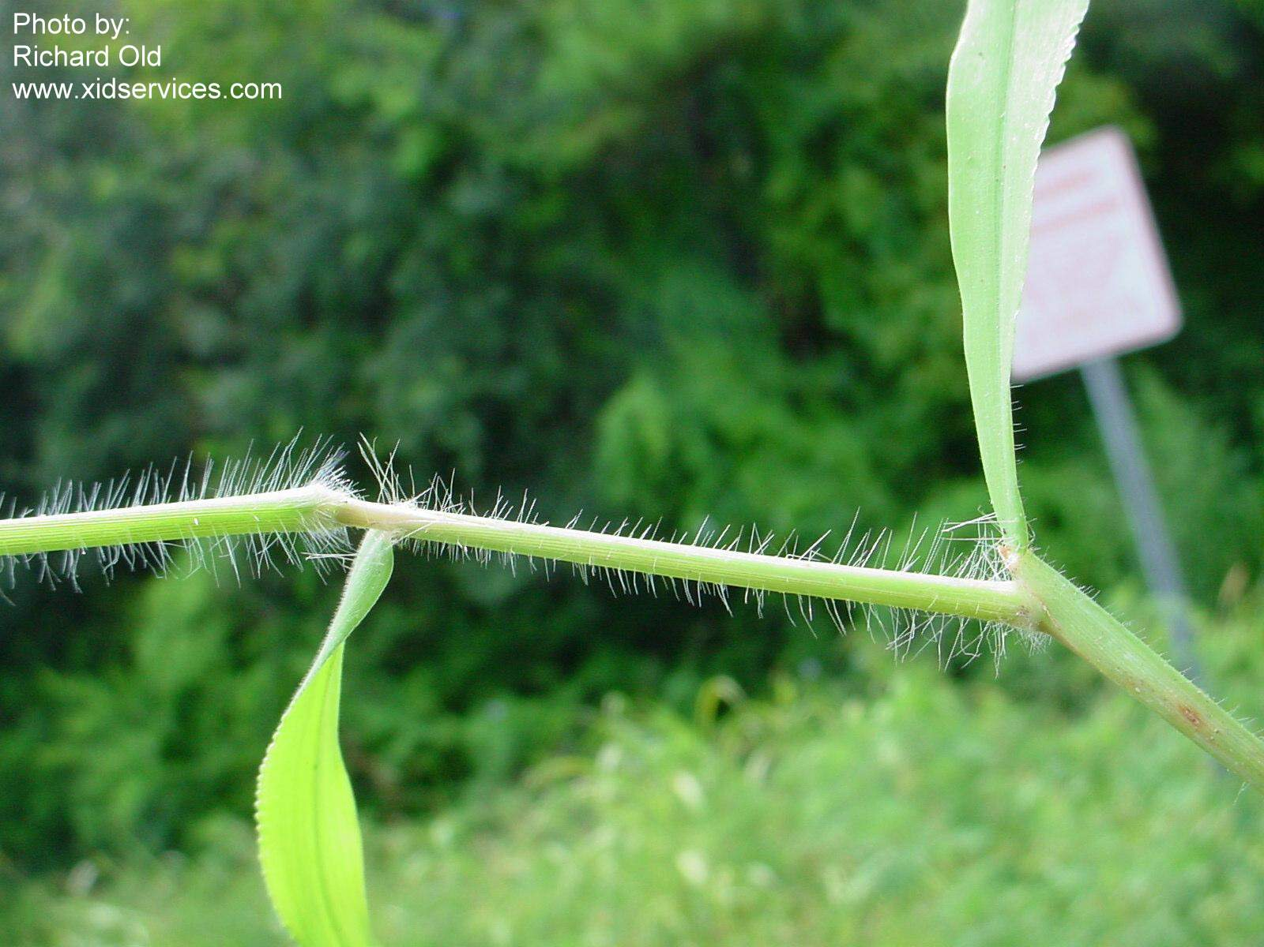
Texas Panicum vs. Crabgrass
Fringe of
hairs
membranous
WSSA
Southern crabgrass
Texas panicum

Slide 16


Oldies But Goodies
Atrazine
Prowl (pendimethalin)

Slide 17

Atrazine Use in Field Corn
Since 1958
foundation
inexpensive
excellent crop tolerance
PPI, PRE, POST (12”)
broad-spectrum
up to 2.5 lb ai/A/year
easily tank-mixed
weak on T. panicum
does not last full season in SE
Rainfall
soil type
Enhanced degradation

Slide 18
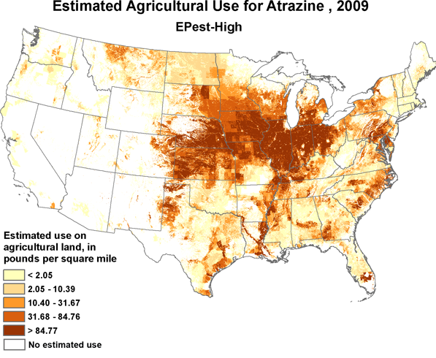
Atrazine Issues
Resistance
Enhanced degradation
Environmental Concerns?
www.atrazinefacts.com
Source: USGS Pesticide National Synthesis Project

Slide 19
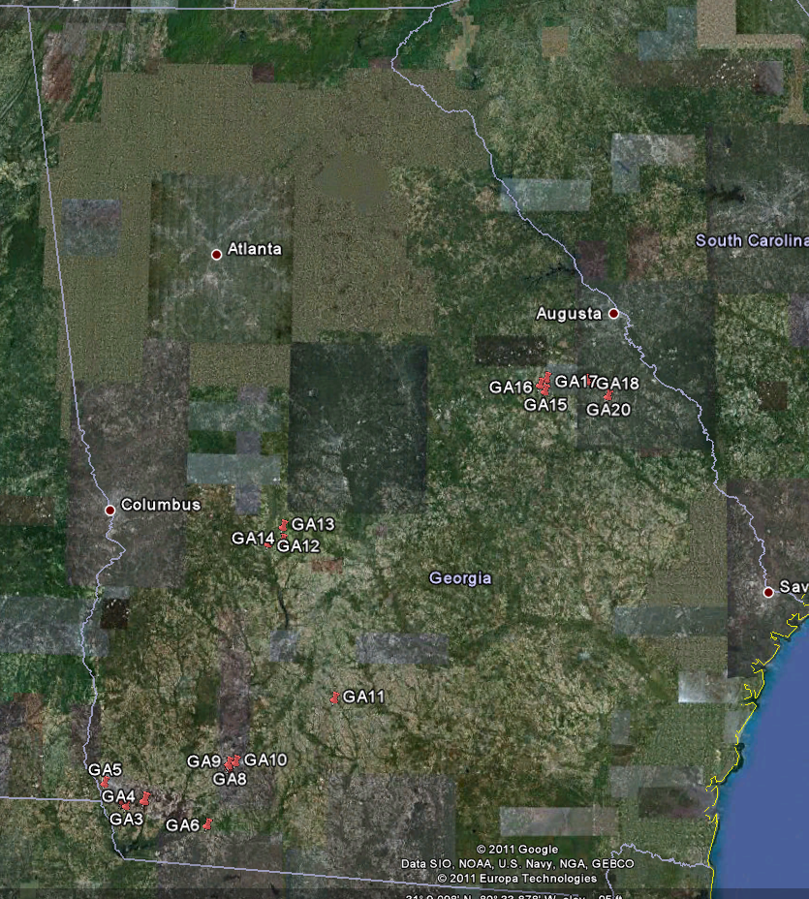
2011 Enhanced Atrazine Degradation Project
20 soil samples collected from Georgia corn fields in August
Burke Co.
Decatur Co.
Jefferson Co.
Mitchell Co.
Macon Co.
Seminole Co.
Worth Co. (control) #11
UGA-Ponder Farm
No atrazine for 12+ years

Slide 20
Atrazine Half Lives (T_{1/2}) from Georgia Soil Samples - 2011
T_{1/2}(days)
Sample

Slide 21
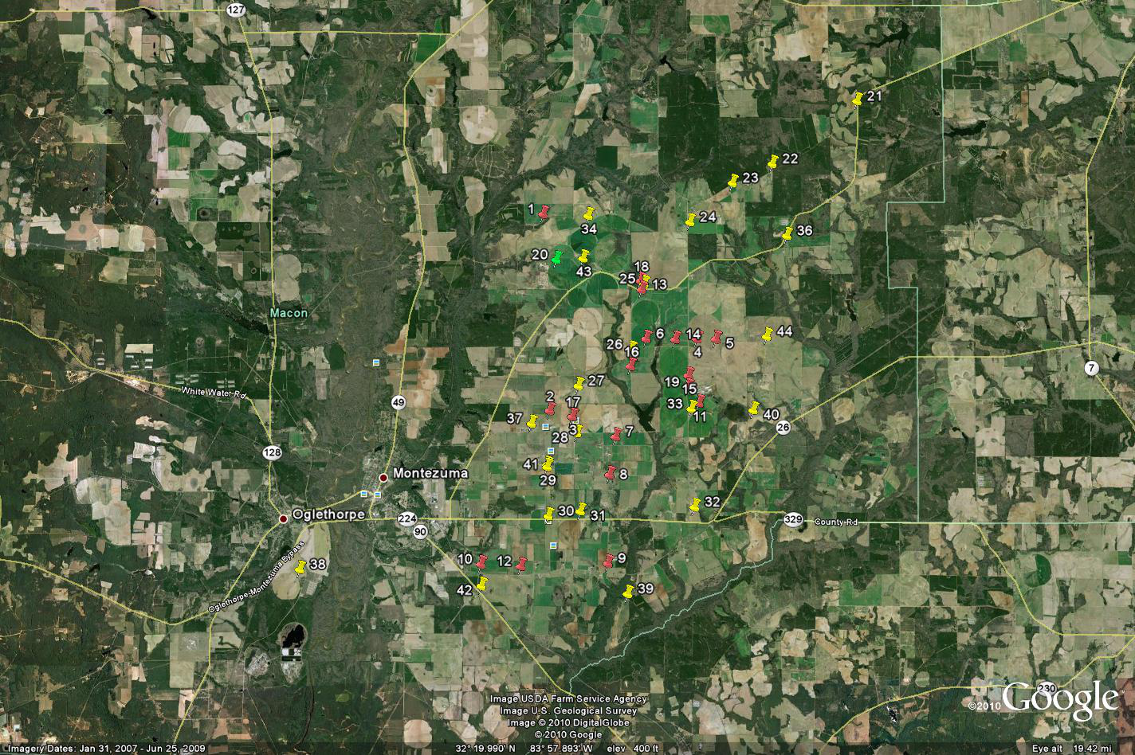
2007, 2008, 2010 Macon County Triazine-Resistance Survey

Slide 22


Prowl Use in Field Corn
since 1975
pendimethalin
DNA or “yellow”
inexpensive but….
do not apply PRE
early-post (EPOST)
up to 30” tall or V8
crop injury concerns
Planting depth (1.5”)
Furrow closure

Slide 23
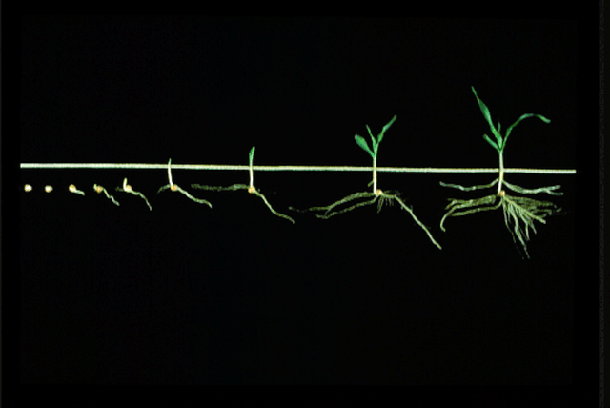
Optimum Prowl/Pendimax Timing Field Corn
Prowl will not control emerged grasses!!!

Slide 24
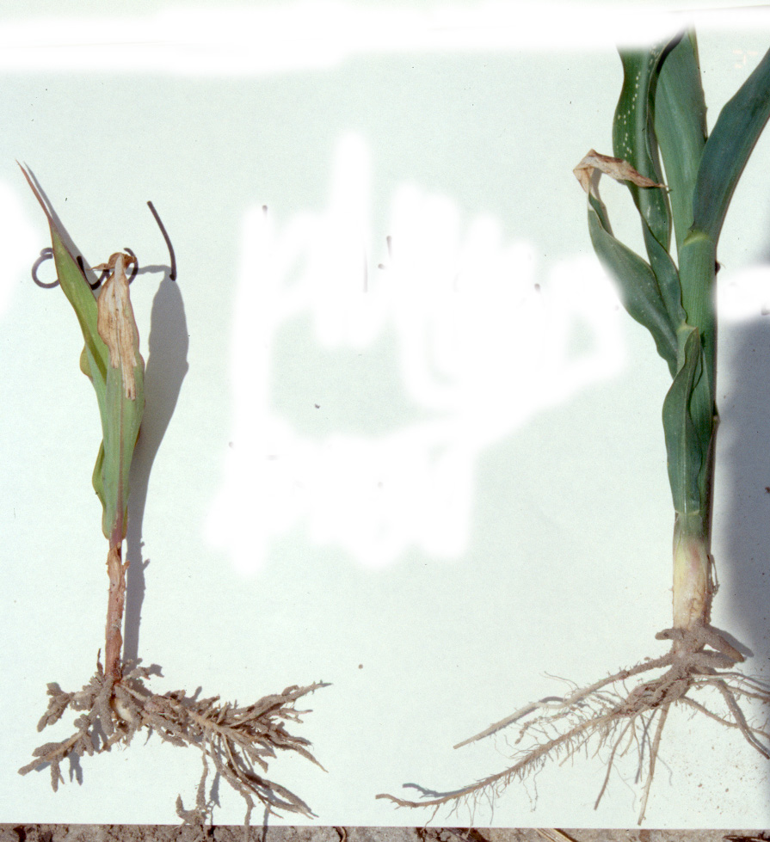
Prowl Injury In Field Corn
Prowl
Control

Slide 25
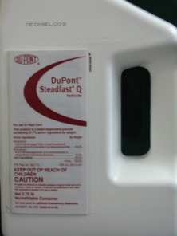


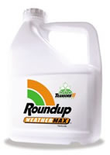
Current GA Field Corn Weed Control
For most in GA …….
Atrazine +
Glyphosate (RR corn)
Liberty (LL corn)
Steadfast Q
Laudis or Capreno
Halex GT (glyphosate + Callisto + Dual)
If I was King, I would make every GA grower use 1 qt/A Atrazine PRE fb 1.5 qt/A + 1 of the above!

Slide 26
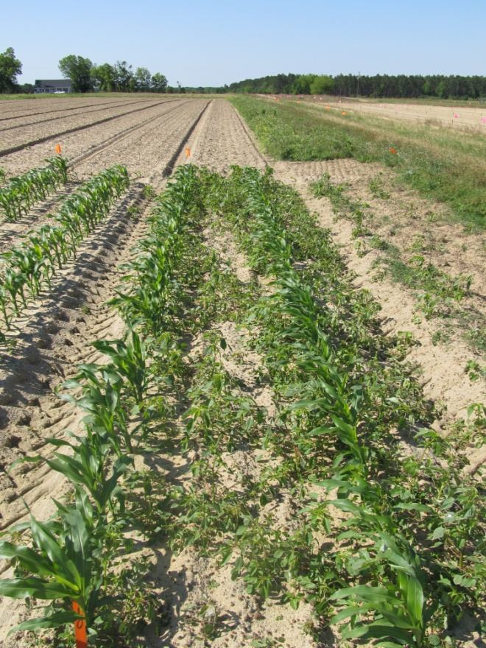
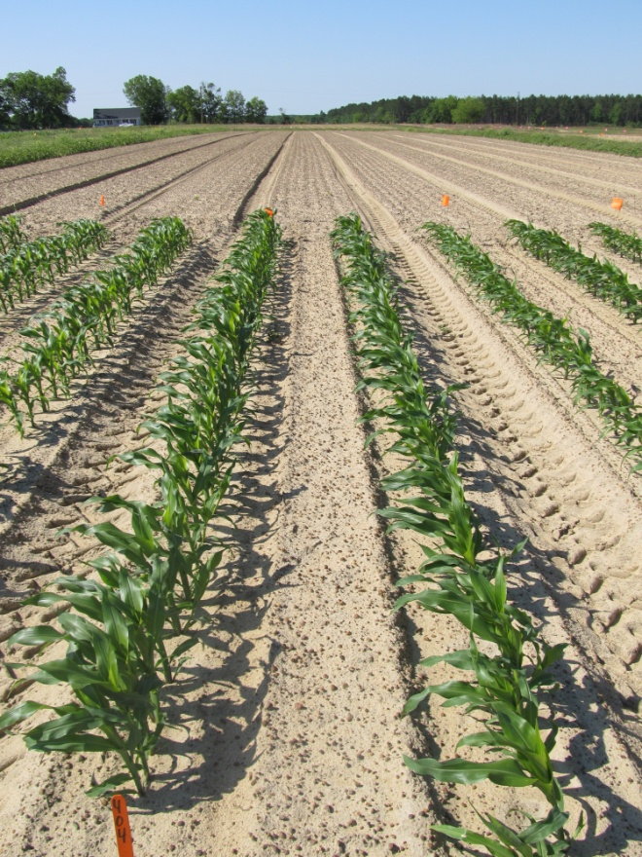
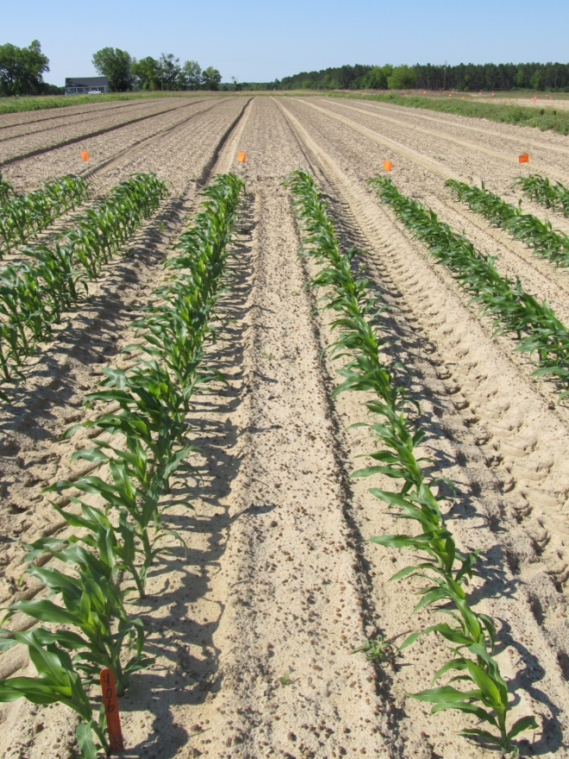
The Power of a PRE Herbicide
NTC
Dual II Magnum 7.64EC
1 pt/A
(PRE)
Atrazine 4L
1 qt/A
(PRE)
CN-13-12
April 24
28 DAT

Slide 27
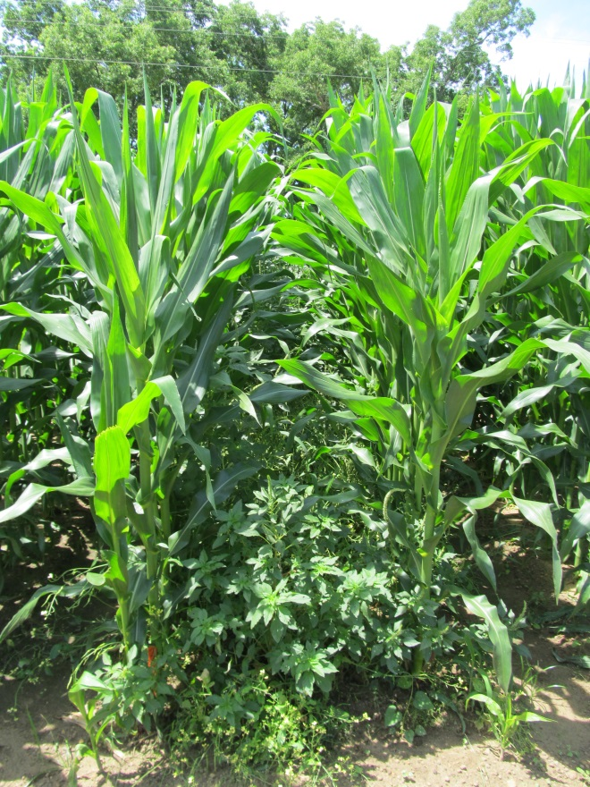
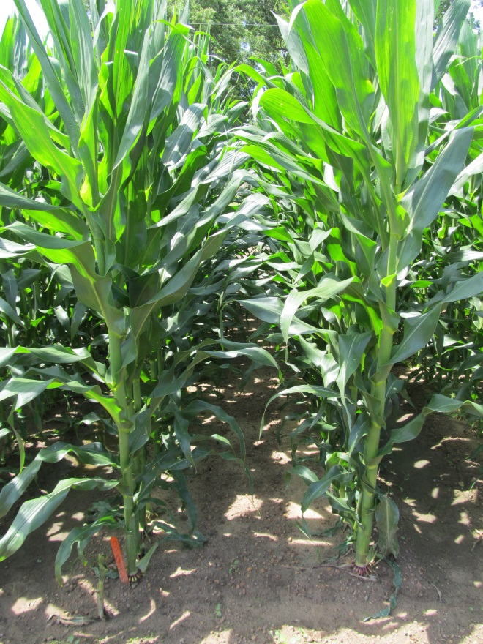
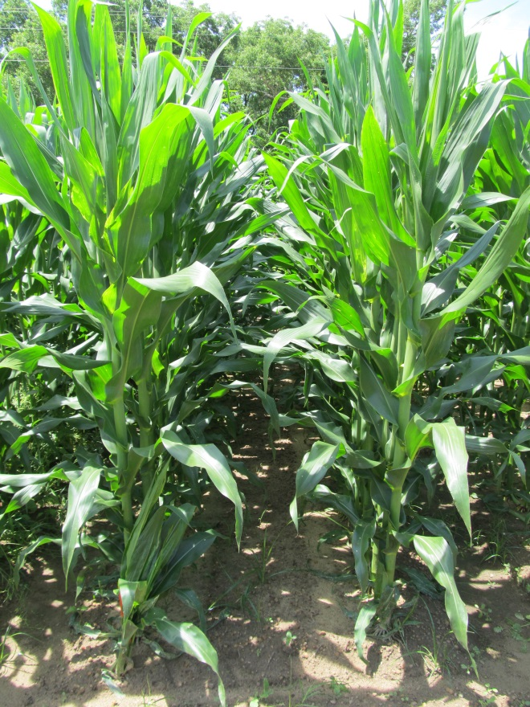
Weed Control in Field Corn – 2013
NTC
Aatrex 4L @ 32 oz/A (PRE)
Roundup W-Max @ 22 oz/A (POST)
Aatrex 4L @ 48 oz/A (POST)
Aatrex 4L @ 32 oz/A (PRE)
Liberty 2.34 SL @ 29 oz/A (POST)
Aatrex 4L @ 48 oz/A (POST)
CN-15-13
May 28
69 DAP

Slide 28
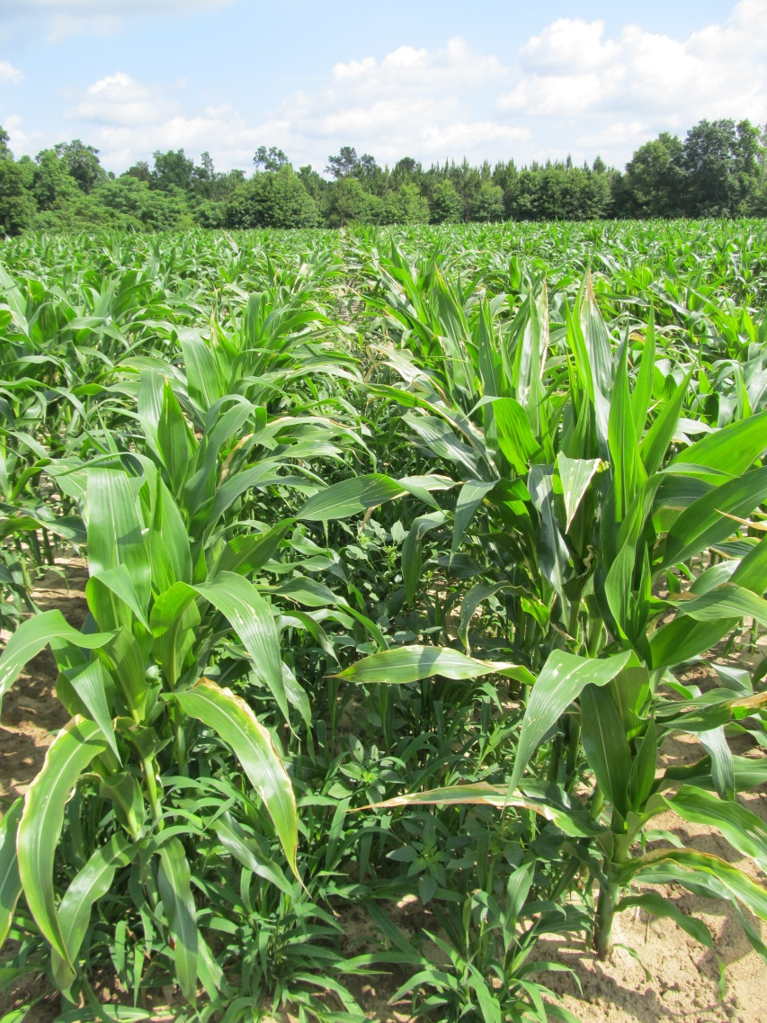
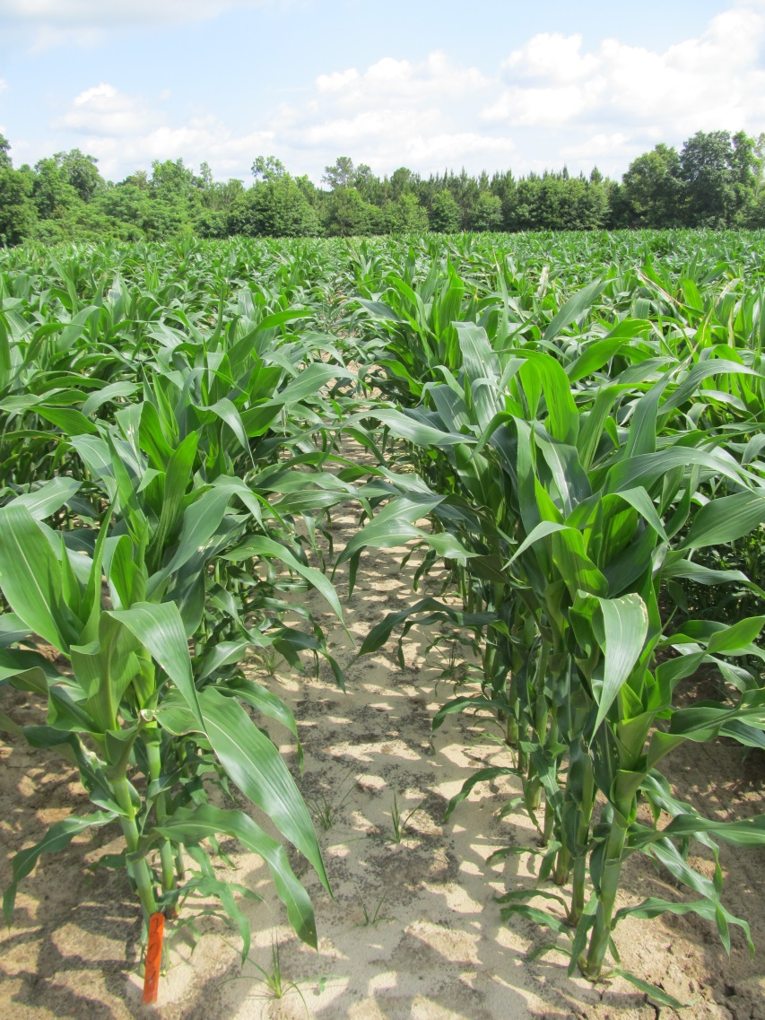
Weed Control in Field Corn with Steadfast Q - 2013
NTC
Steadfast Q @ 1.5 oz/A
Aatrex @ 64 oz/A
COC @ 1% v/v
CN-13-13
May 23
30 DAT

Slide 29
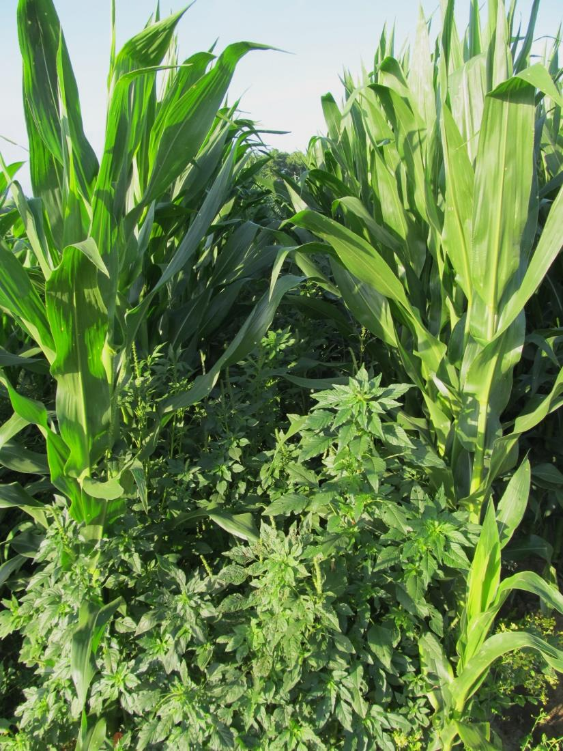
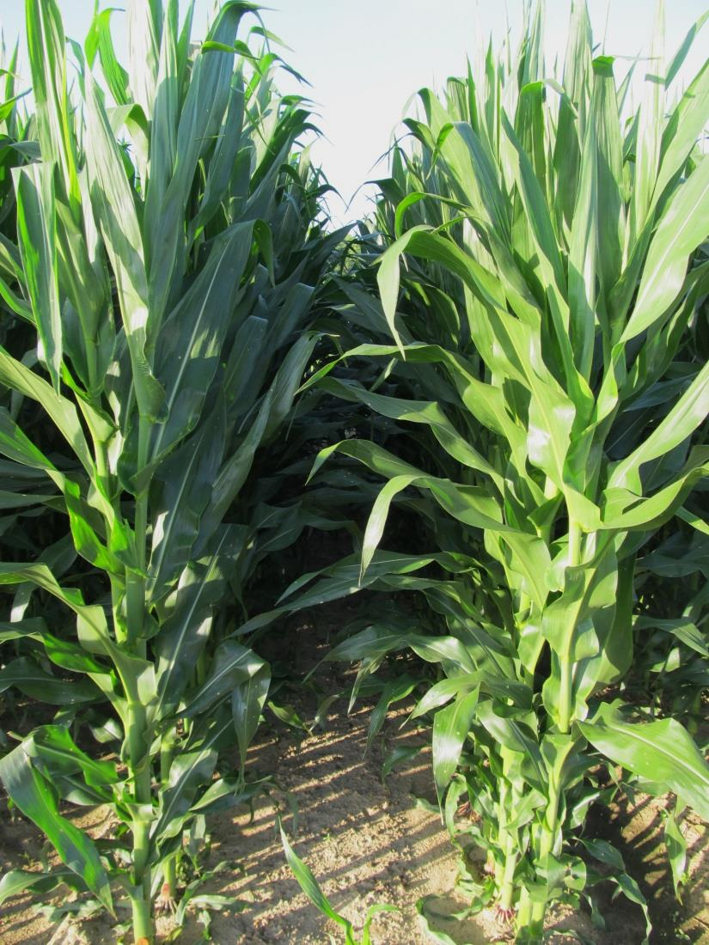
Weed Control in Field Corn with Halex GT – 2013
NTC
Halex GT @ 58 oz/A
Aatrex @ 32 oz/A
NIS @ 0.25% v/v
AMS Xtra @ 2.5% v/v
Applied April 9 (20 DAP)
CN-09-13
MAY 31

Slide 30
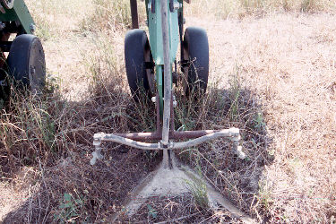
Post-Directed Options for Field Corn
Evik
Gramoxone/Firestorm (paraquat)
Lorox/Linex
Aim
tropical spiderwort
pigweeds
Morningglory (Ipomoea sp.)

Slide 31
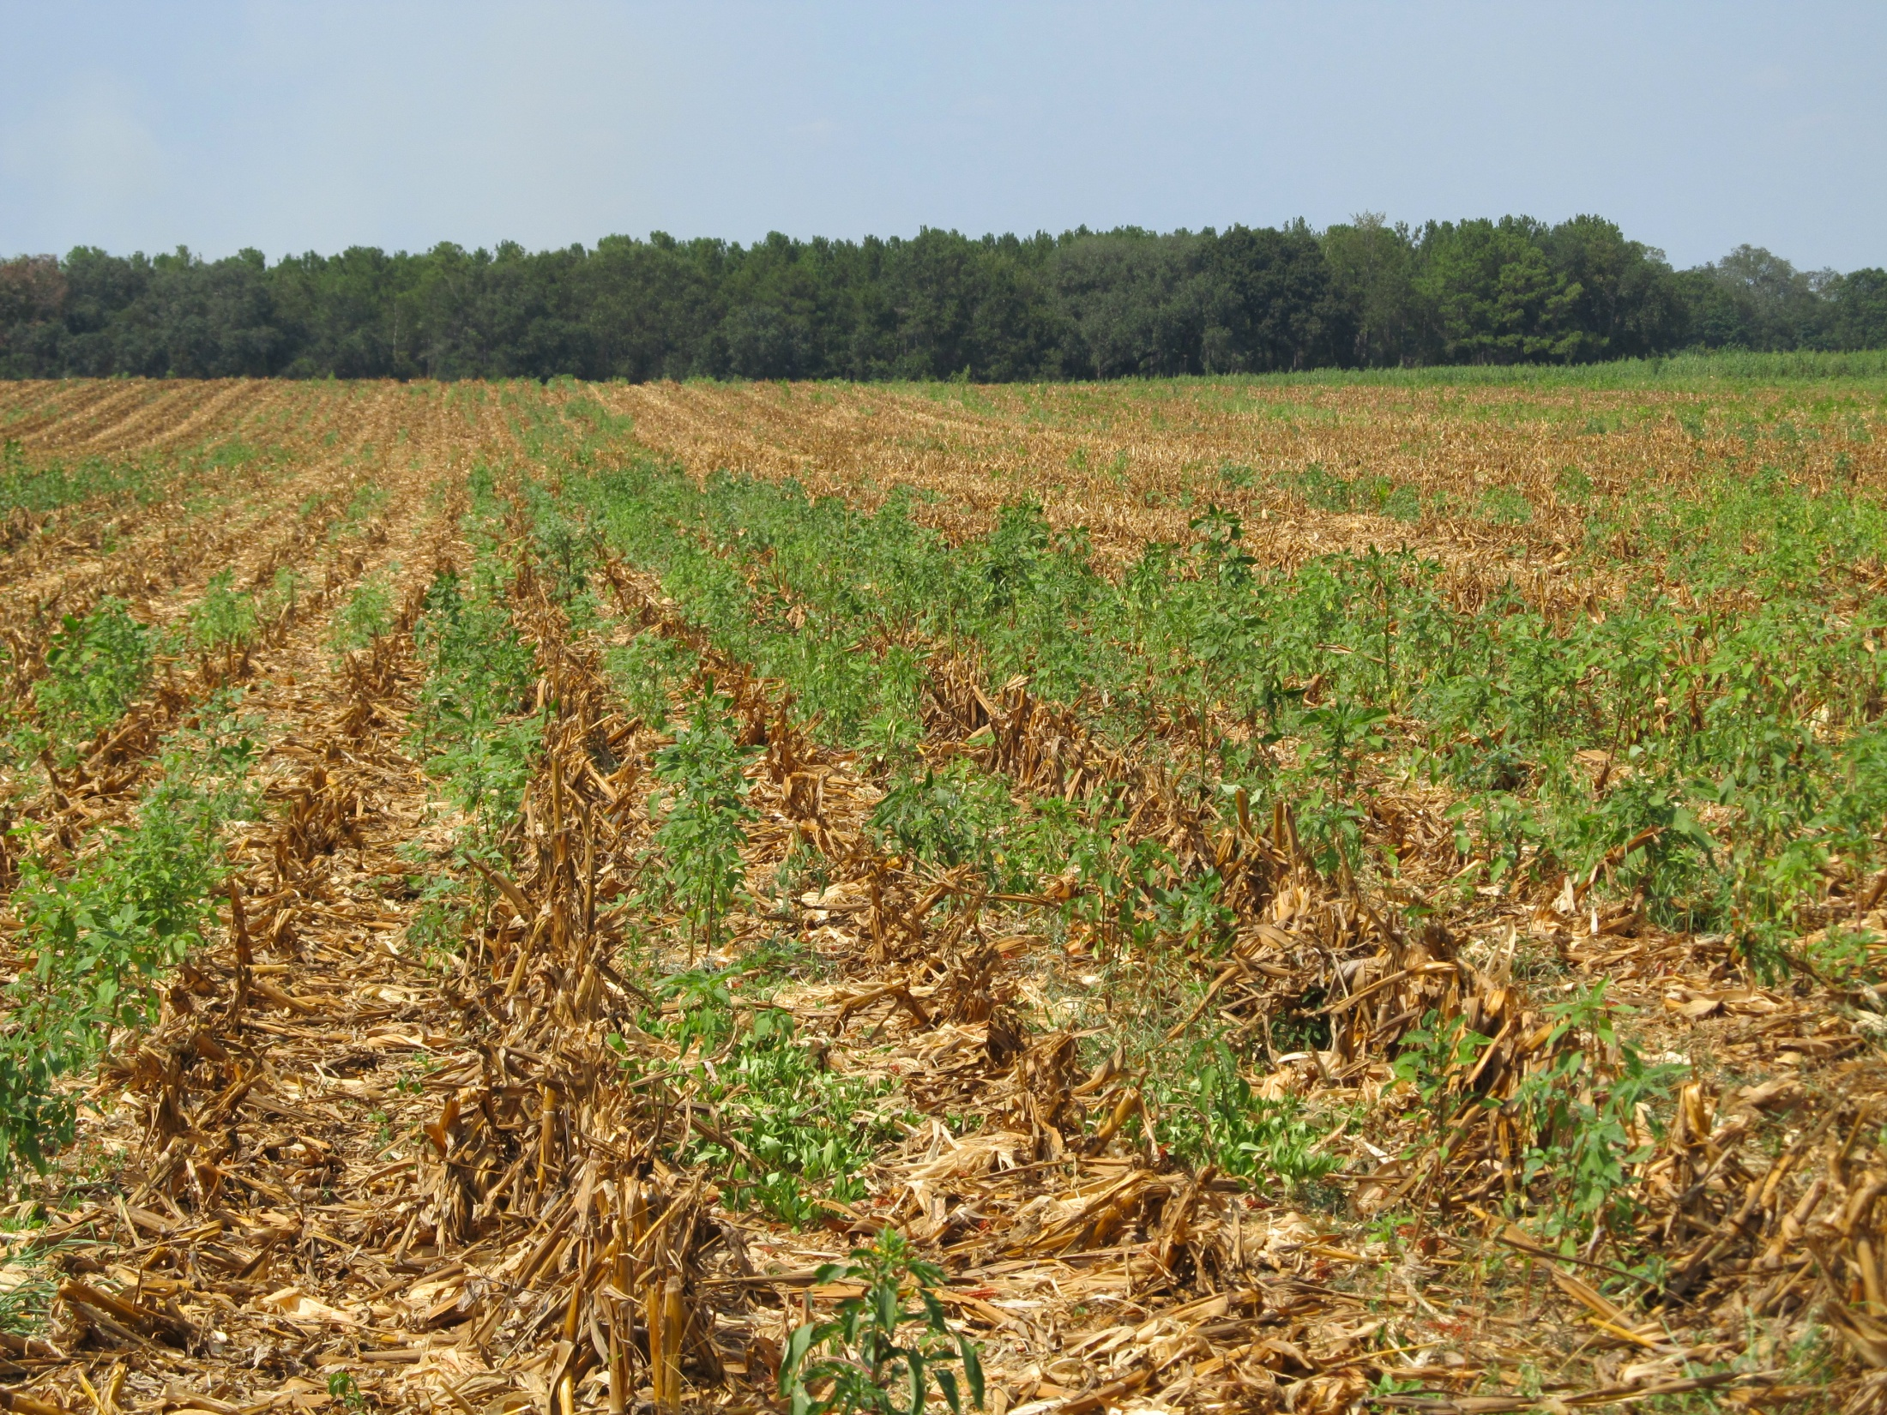
Post-Harvest Palmer Amaranth Populations Must be Managed!

Slide 32
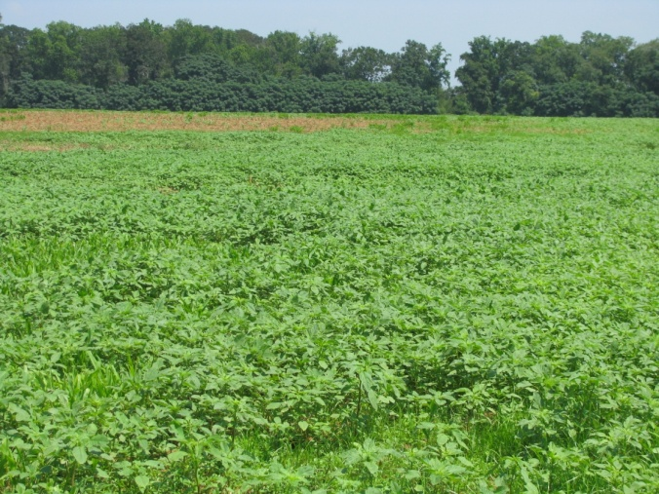
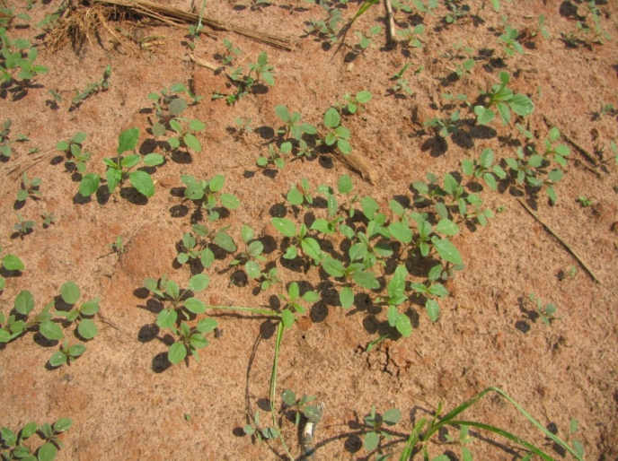
Post-Harvest (Corn) Pigweed Problems
Decreasing daylight hastens flower and seed production
Flowering (3-4 weeks)
Seed production (2-3 weeks)
Some germination at 41⁰F (8%)
Control Options
Mowing/Tillage (>6” weeds)
Herbicides (<6” weeds)
No small grain
Gramoxone + Dual Magnum or Warrant (?)
Small Grain planted soon
Gramoxone + 2,4-D or dicamba
When can we stop worrying about seed production?
Keeley et al. 1987. Weed Science 35:199-204
Steckel et al., 2004. Weed Science 52:217-221

Slide 33
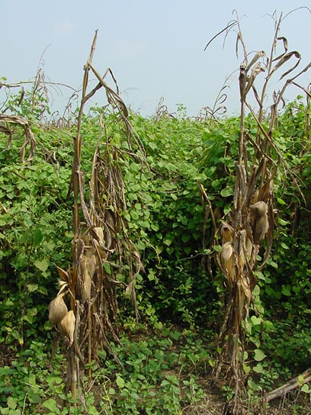
Morningglory Control in Corn
as much atrazine as possible
1.0 lb/A – PRE fb 1.5 lb/A – POST
small grain rotations
2,4-D, Clarity, Status, Aim, ET
Liberty-Link® Corn Systems
split applications of glyphosate (RR corn)
* 1st application + atrazine
Evik (PDIR)
Harvest Aids
Aim
Early-harvest

Slide 34
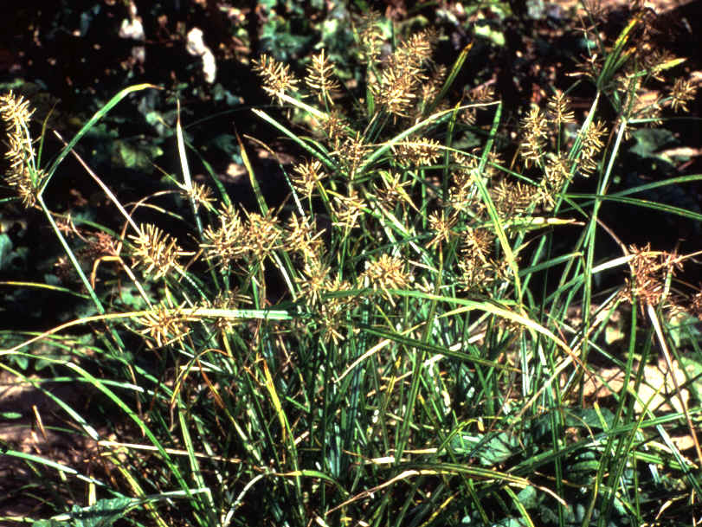
Nutsedge Control
not very competitive
800 plants/100 row feet only reduce yields by 2%
Eradicane or Sutan - PPI
Dual II Magnum or generic – PRE
Glyphosate – RR corn
Split applications
Basagran
Sandea

Slide 35
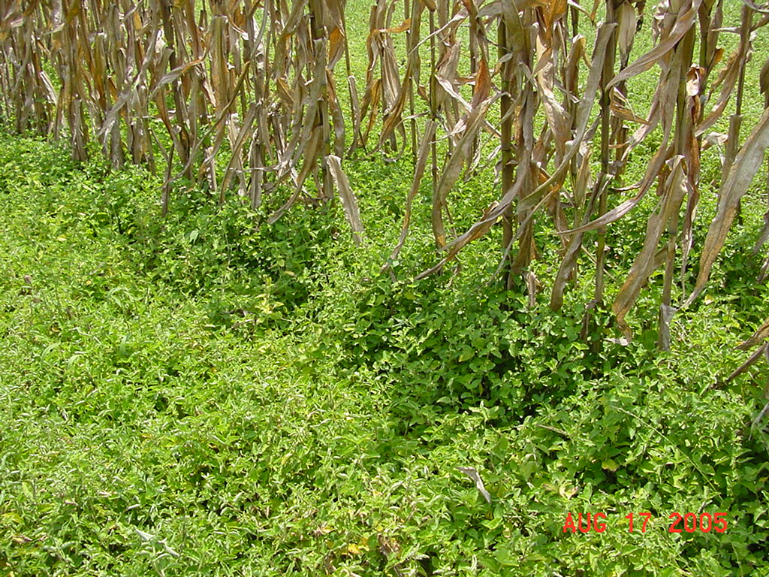
TSW Control in Field Corn
Depends on planting date
2,4-D or Aim – POST
Sequence or Expert in RR corn
Aim/Gramoxone/Evik + Dual Magnum – layby
Post-harvest may be more important than in-crop
Tillage
2 applications of 2,4-D, Gramoxone, or Aim

Slide 36
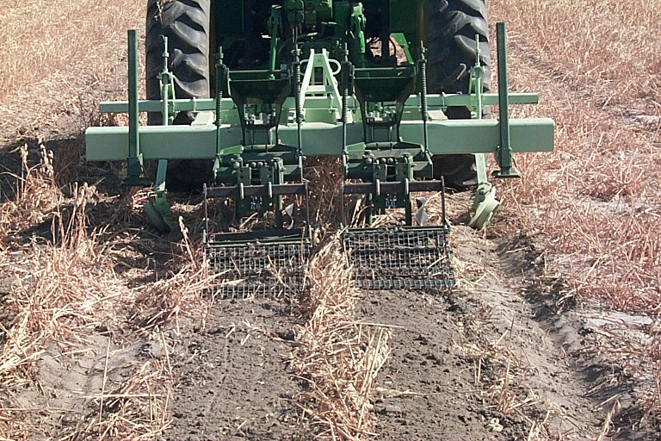
Reduced Tillage Systems

Slide 37
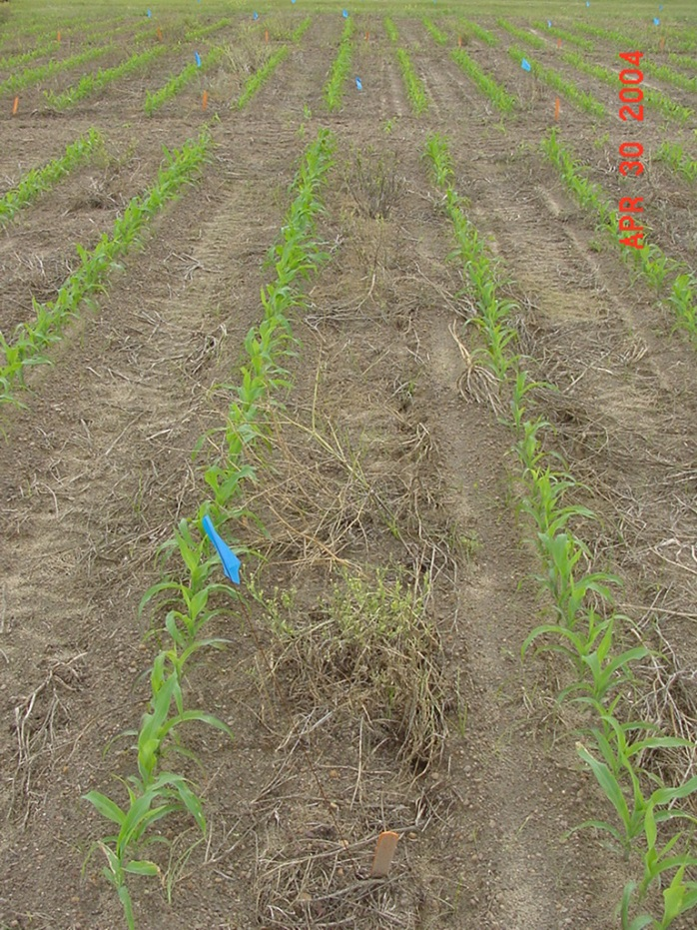
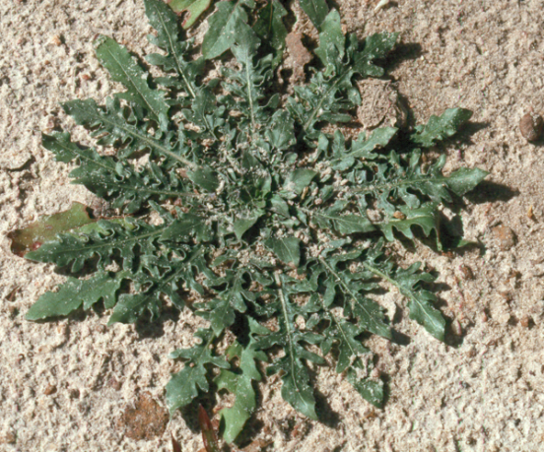
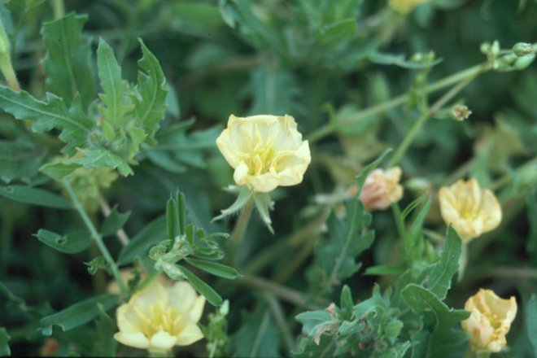
Burndown Control Options
glyphosate
Paraquat
Liberty (glufosinate)
tank-mixes with?
2,4-D, dicamba
atrazine
Leadoff
Aim, ET
Need a clean seed-bed at planting

Slide 38
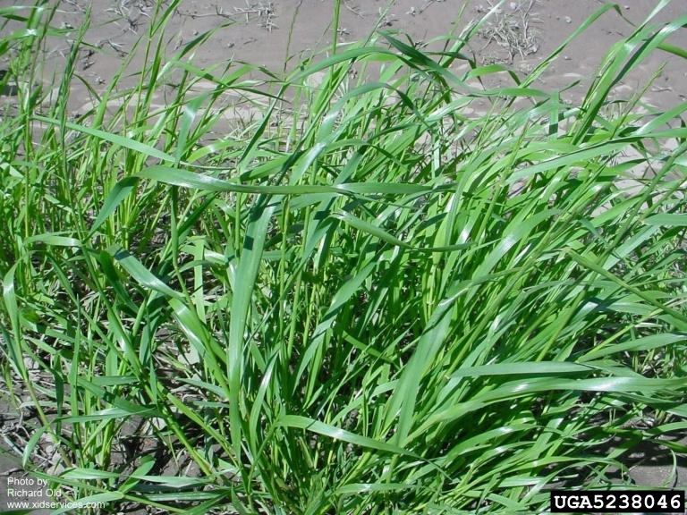
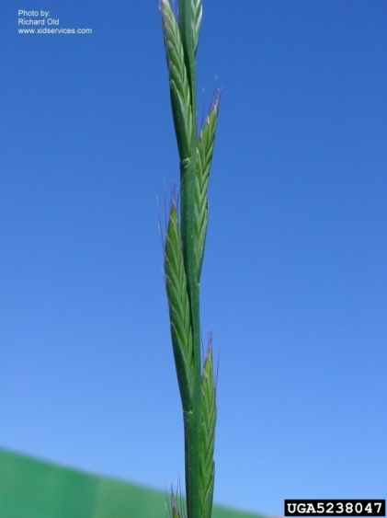
Ryegrass Control
Glyphosate-resistant or not?
Fall (mid-October – Mid-November)
Tillage (double disk) or
Dual Magnum @ 1.33 pt/A
Mid-January – Mid-February
2” - 6” tall
Select Max @ 12-16 oz/A or
Clethodim 2EC @ 6-8 oz/A
Corn – 30 days
Nighttime temps > 47⁰ F
March 1-20
Gramoxone 2SL @ 3-4 pt/A
May need 2 applications (10-14 days apart)
+ atrazine @ 1 qt/A (corn)
Source: Drs. Jason Bond and Tom Eubank, MS State University

Slide 39
Where to go for more information?
UGA Weed Science Web-Site
www.gaweed.com
UGA Pest Control Handbook
UGA Corn Production Guide
Call me at any time!!!
229-392-1034

