Slide 1
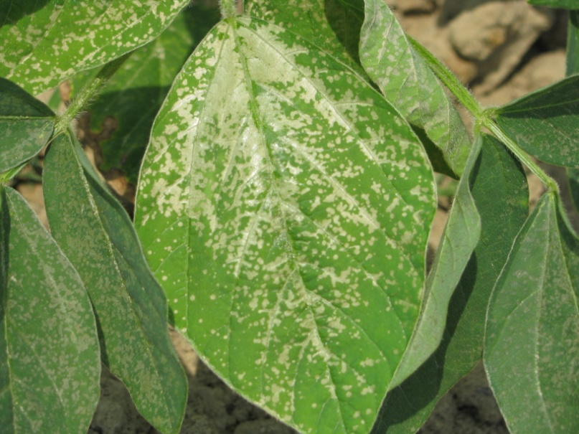

Herbicide Drift Symptomology
Eric P. Prostko, Ph.D.
Professor and Extension Weed Specialist
Department of Crop & Soil Sciences

Slide 2
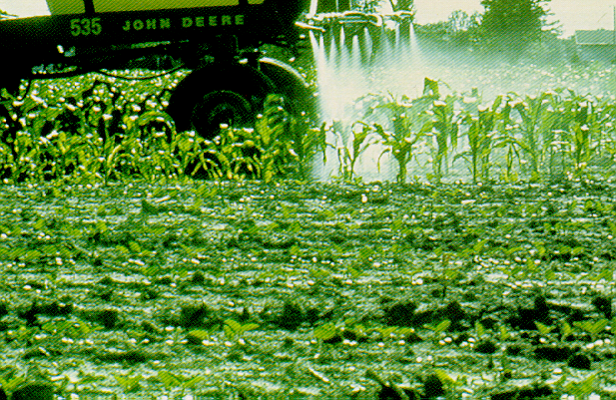
What is pesticide drift??
the movement of the pesticide away from the target area.
physical drift
vapor drift

Slide 3
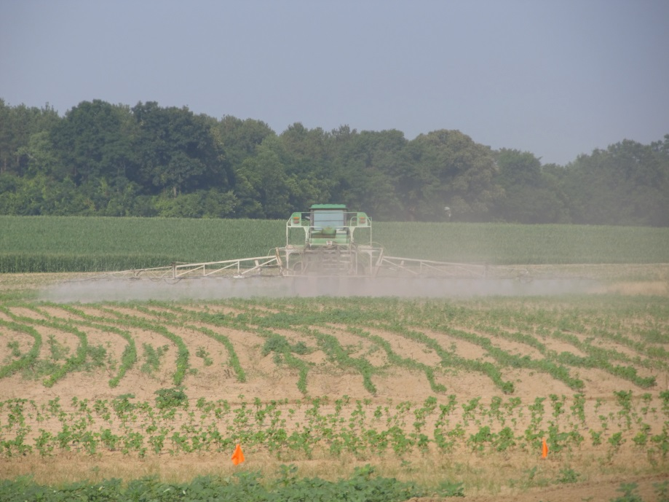
Common Causes of Drift (My Opinion)
Too windy
Boom heights too high
Tractor (Warp) speeds
Nozzle selection

Slide 5
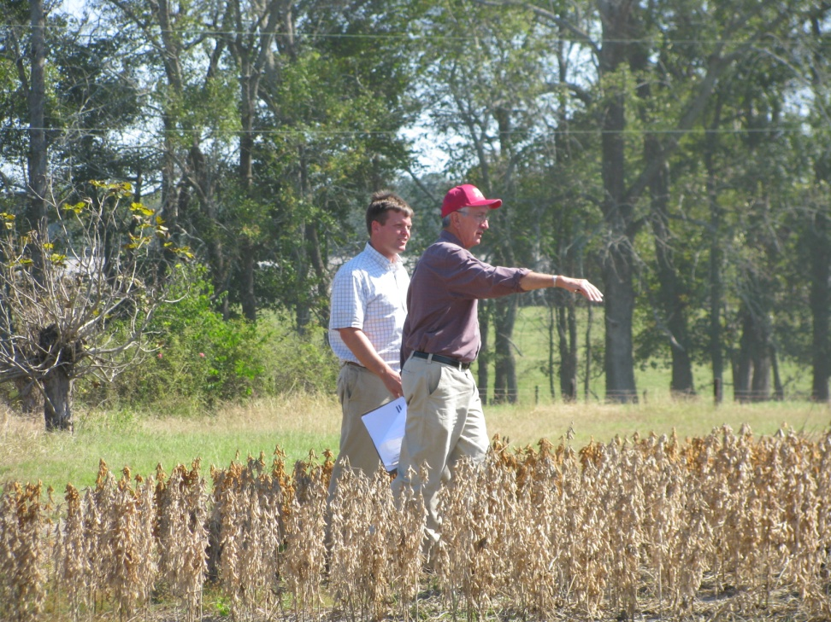
My Approach
Obvious or not?
Patterns
Crop history
Things you can easily prove or rule out
pH
Fertility
nematodes

Slide 6
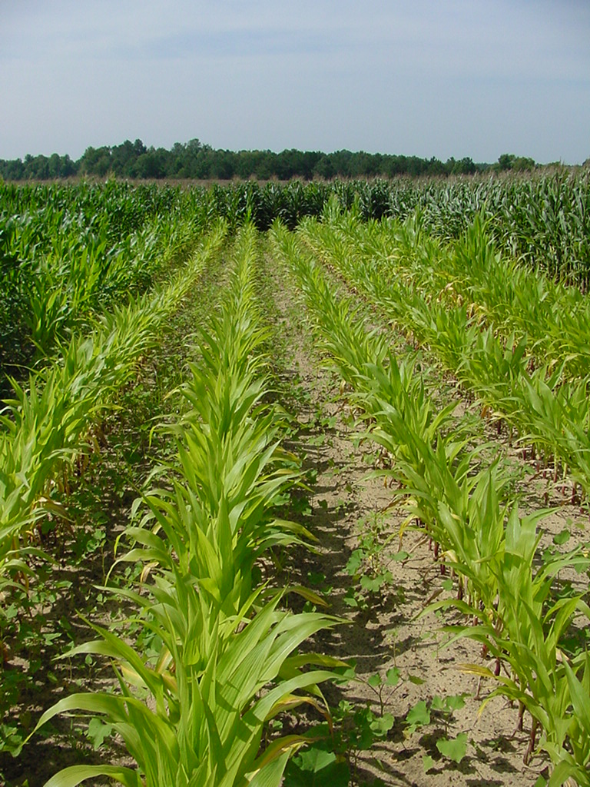
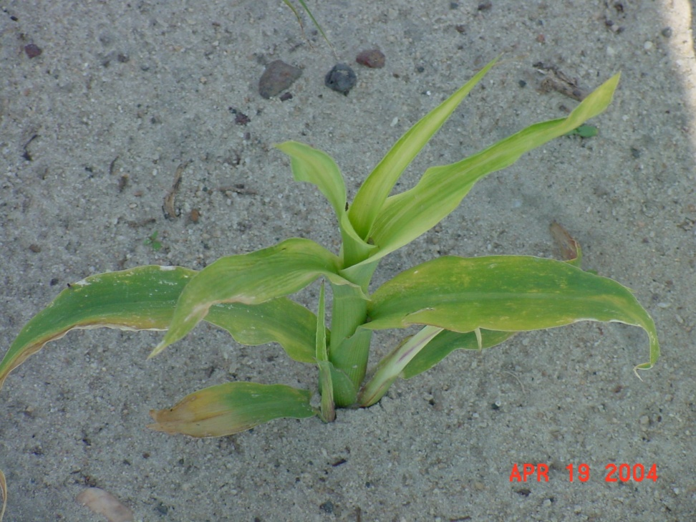
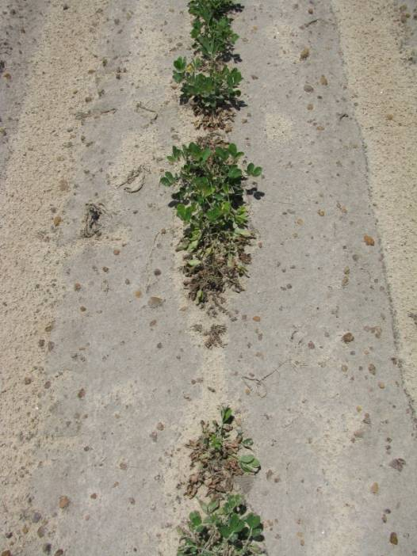
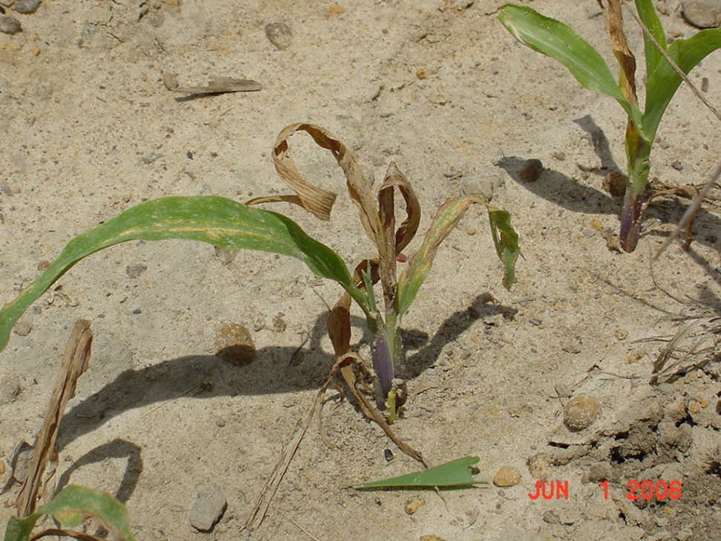
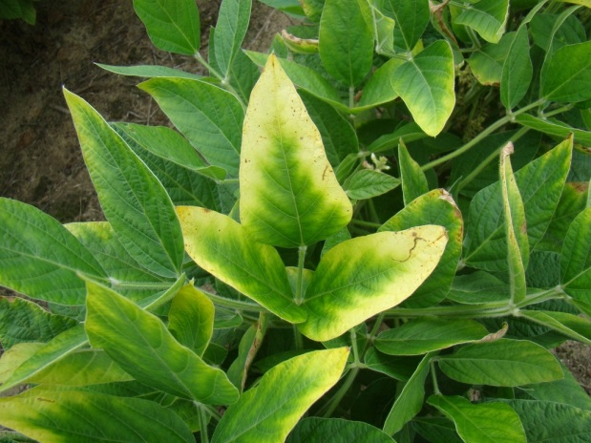
Herbicide Injury or Something Else?

Slide 7
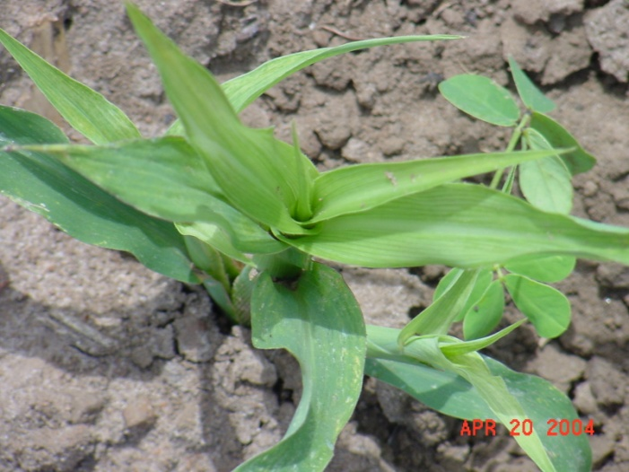
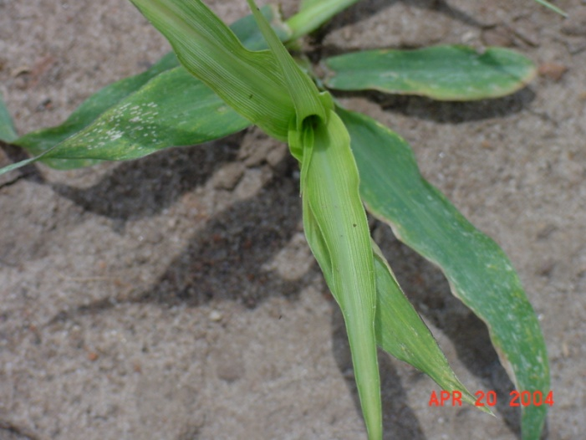
Herbicide Injury??

Slide 8
Herbicide Injury or Fertilizer Injury?
Phosphite Fertilizer

Slide 9
Roundup Drift?

Slide 10
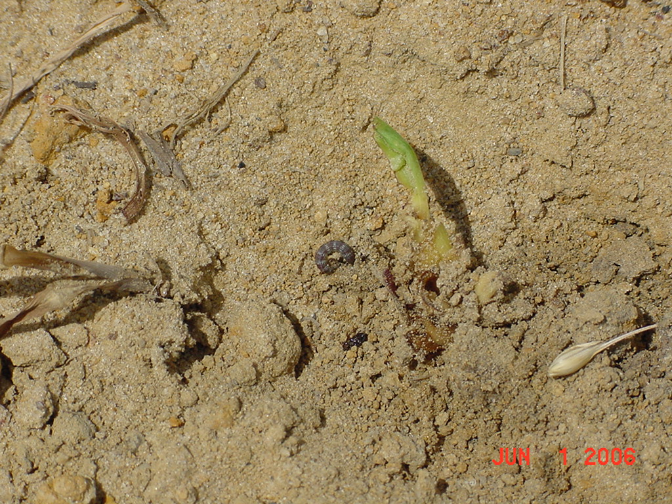
Roundup Drift or LCB??

Slide 11
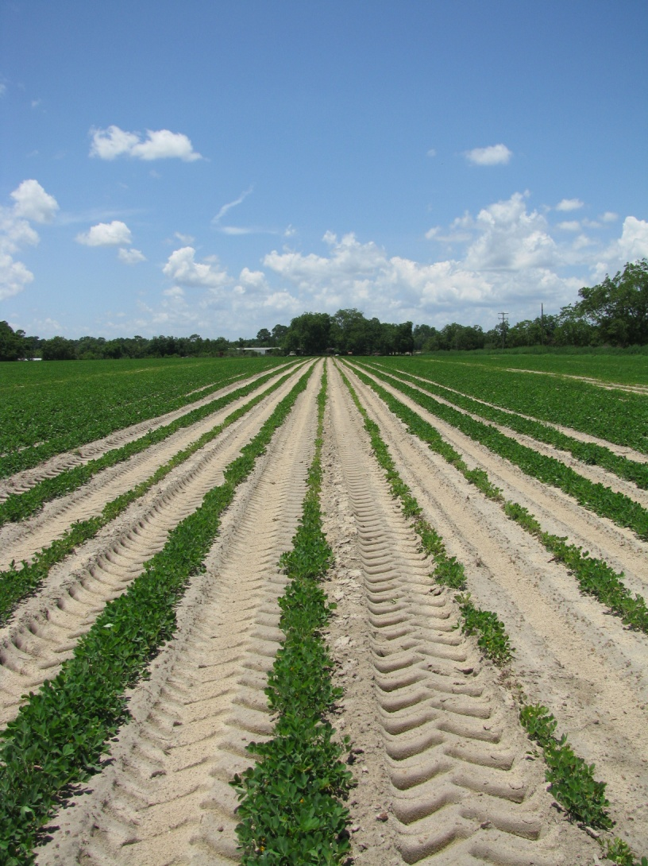
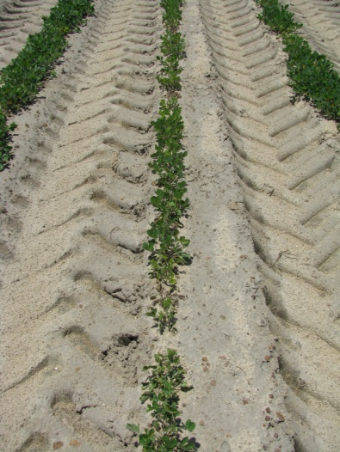
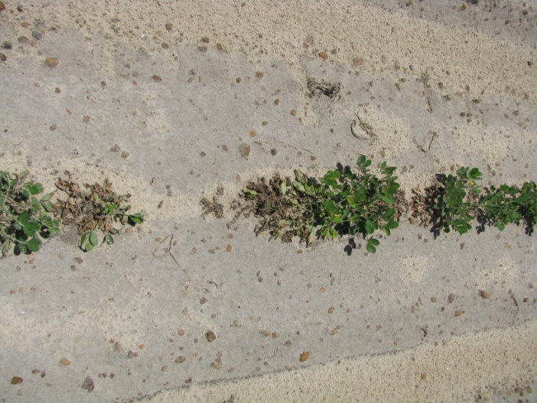
Herbicide Injury?

Slide 12
Herbicide Injury or Soil pH/Zn?
July 2007
pH = 5.04
Zn = 14-17 lbs/a

Slide 13
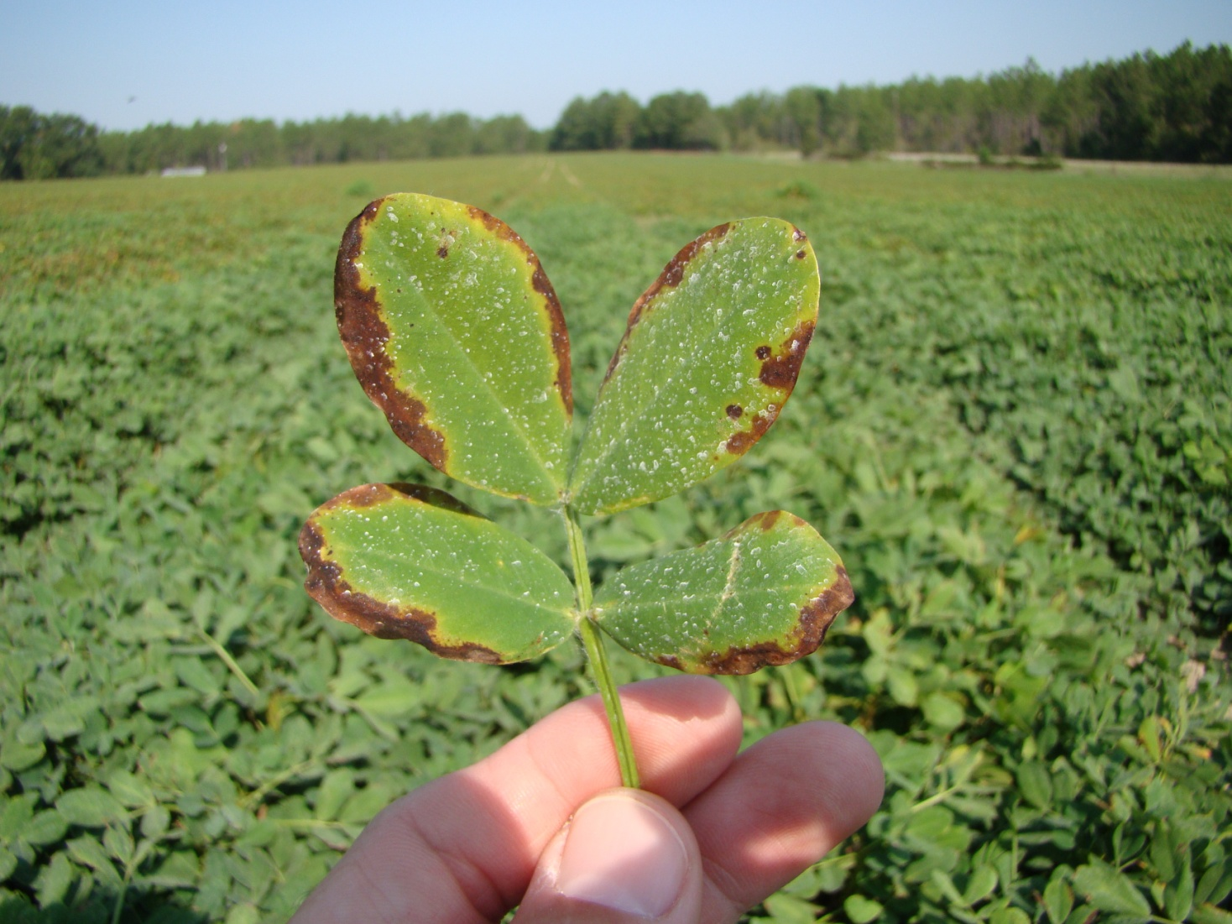
Herbicide Injury or Soil Fertility

Slide 14
Herbicide Injury or Soil Fertility
Old Pasture, no fertilizer was applied, medium soil test K (40 lbs/A)
but K deficient (was 0.34% should be 1.7-3.0%) leaf sample

Slide 15
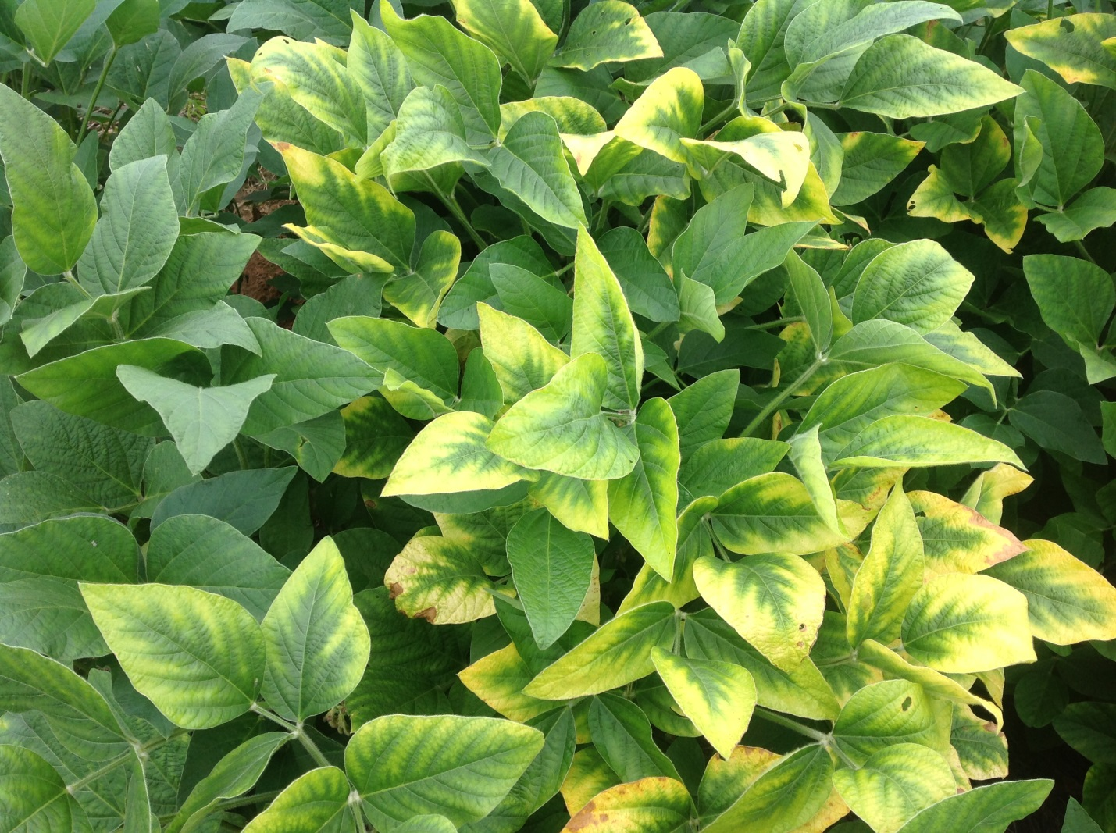
Drift or Potassium?

Slide 16
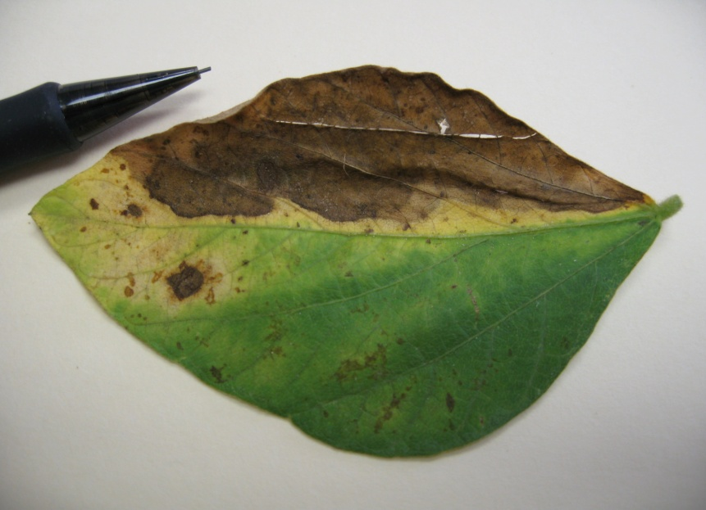
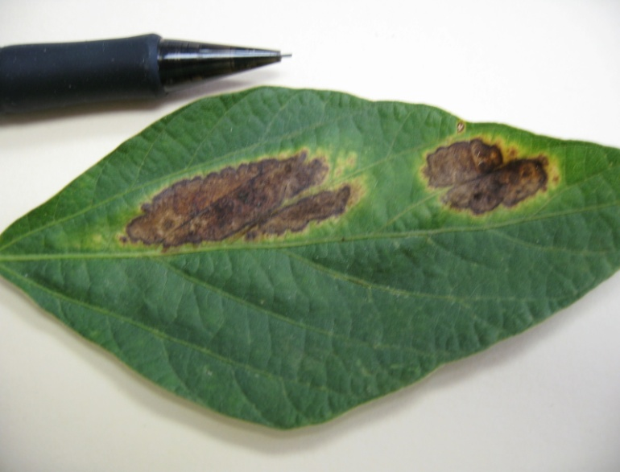
Herbicide Injury??
Johnson County
August 2010

Slide 17
Herbicide Injury or Disease?
Anthracnose
Johnson County
August 2010

Slide 18


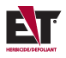

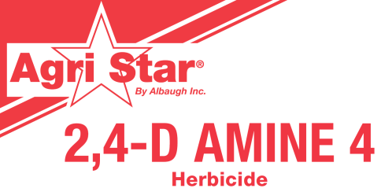
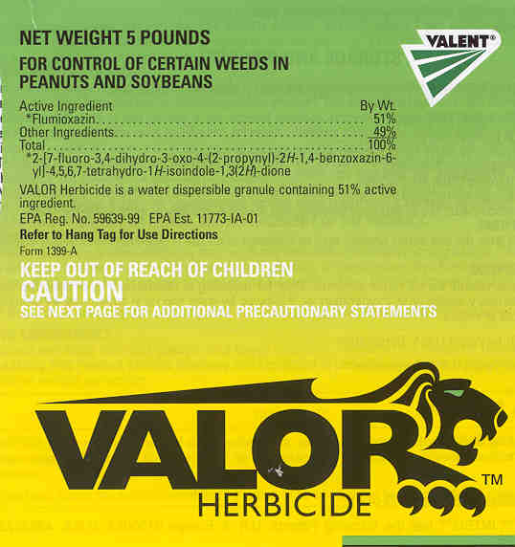

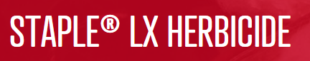
Most Common Drift Problems

Slide 19
Glyphosate

Slide 20
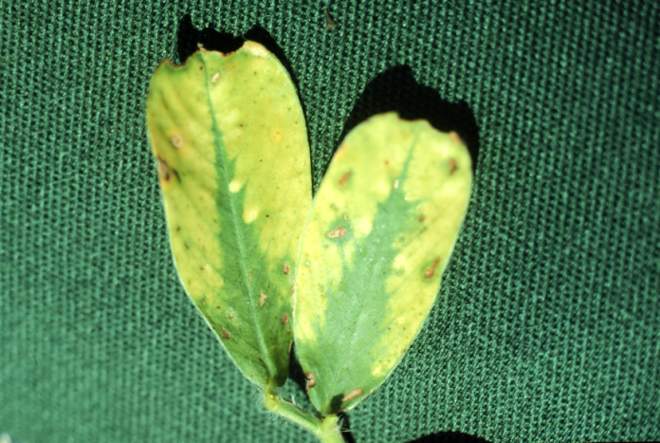
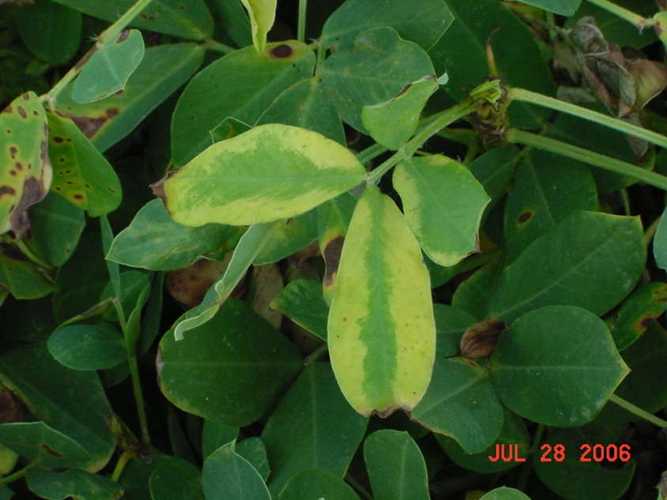
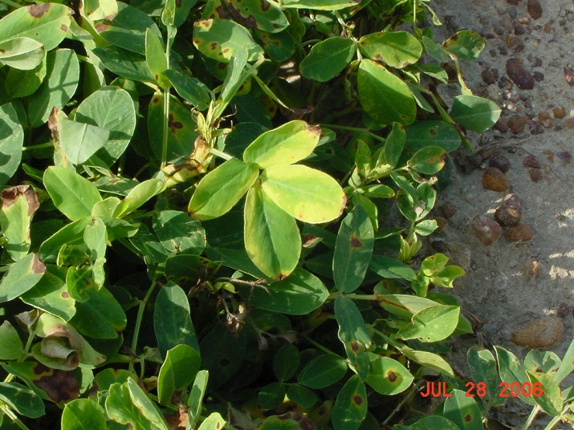
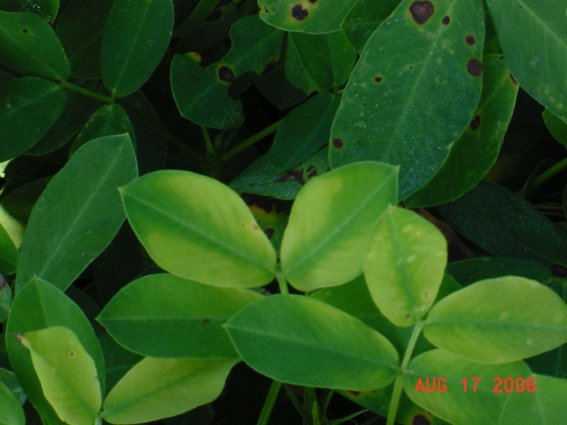

Slide 21
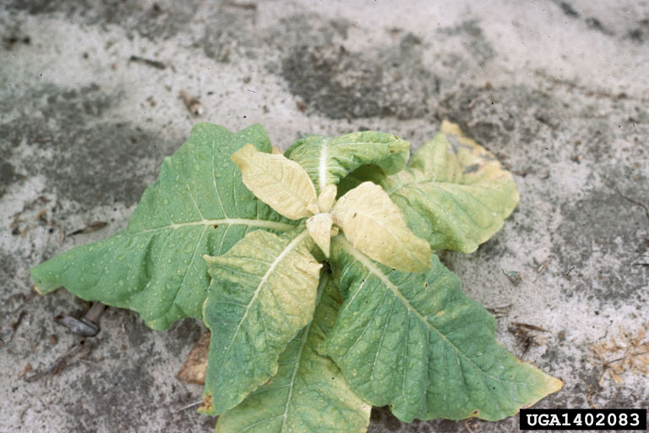

Slide 22
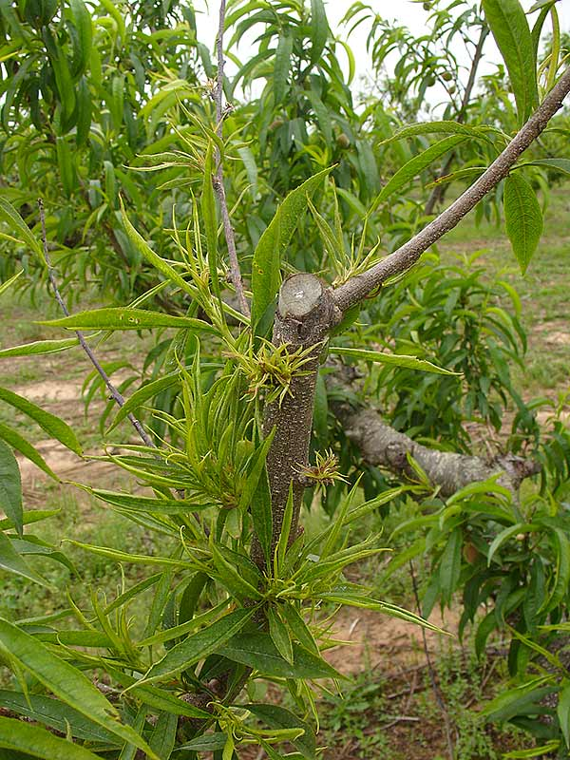
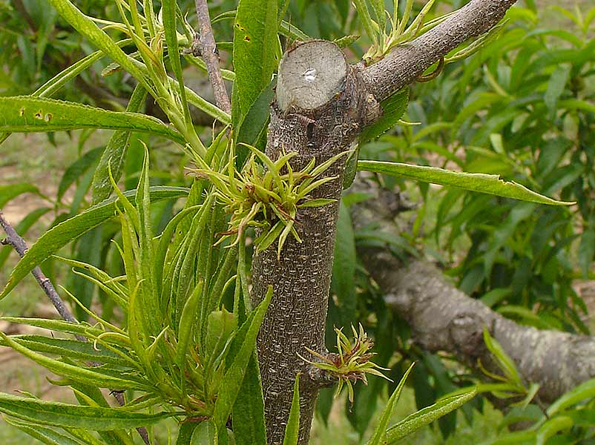
Peach - NCSU

Slide 23
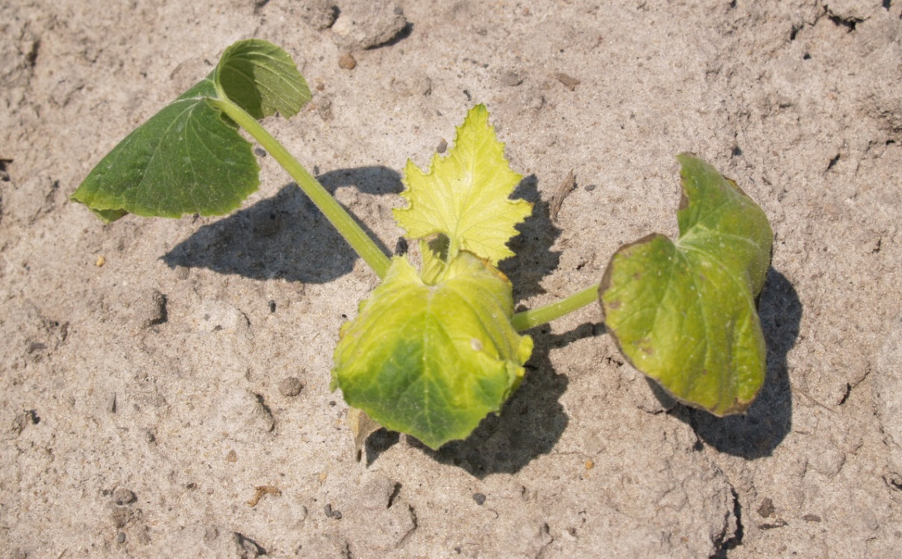
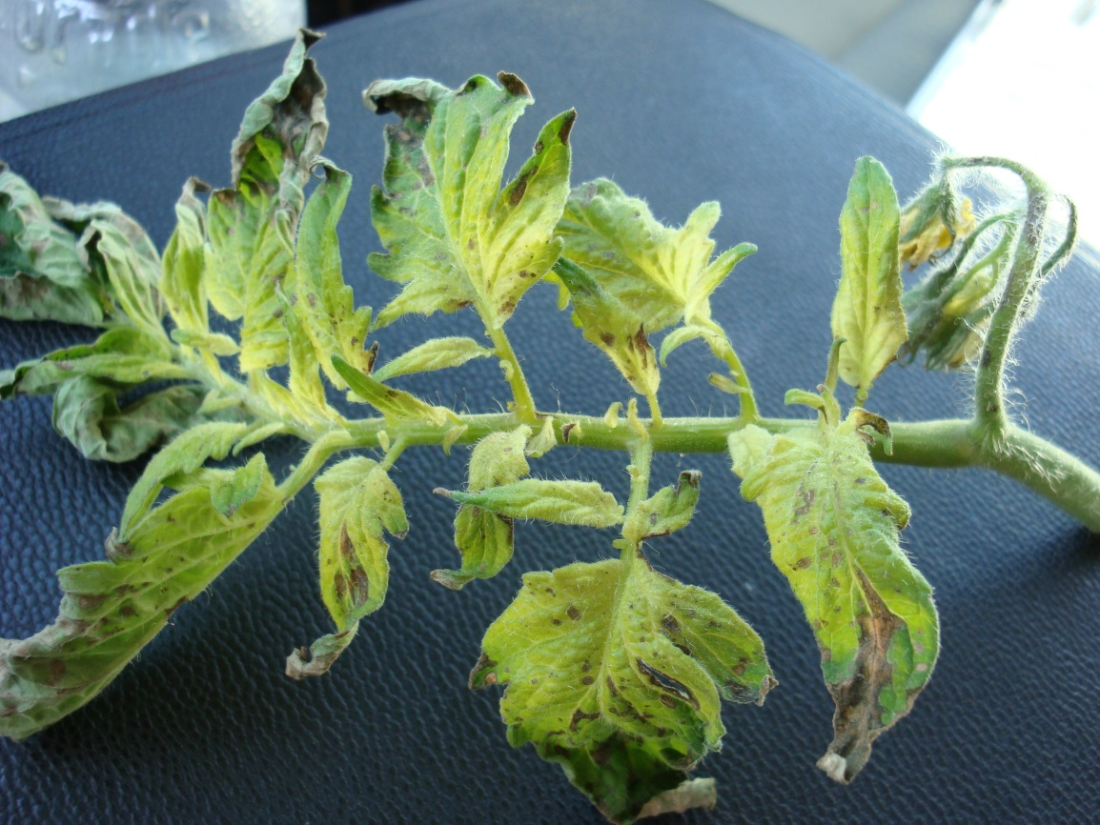
Vegetable Sensitivity to Glyphosate

Slide 24
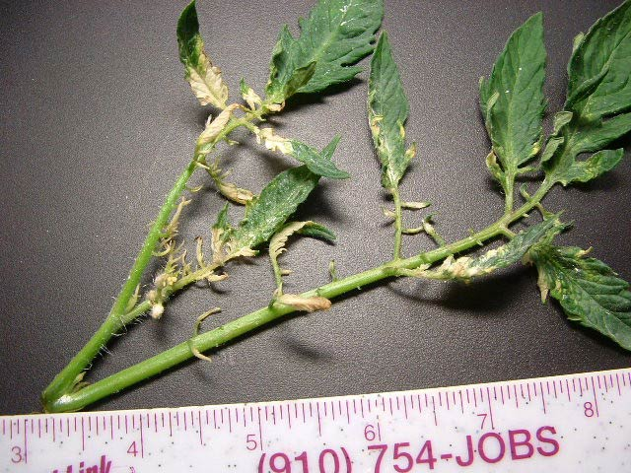
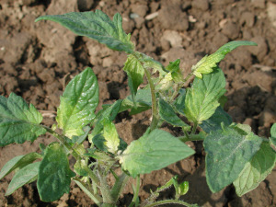
Tomato – NCSU/Ontario Ministry of Ag

Slide 25
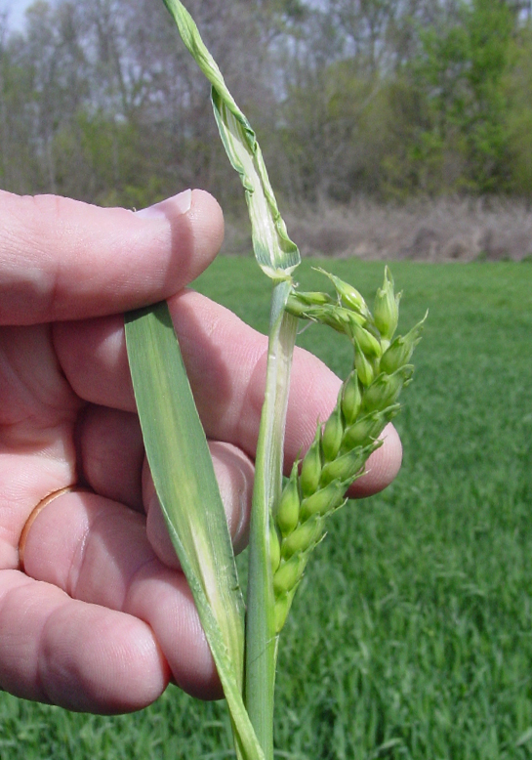
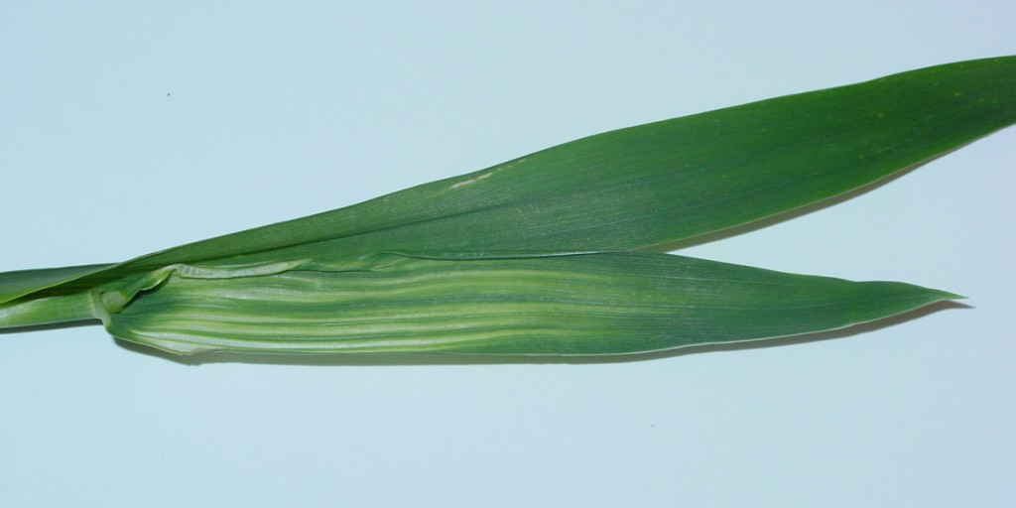
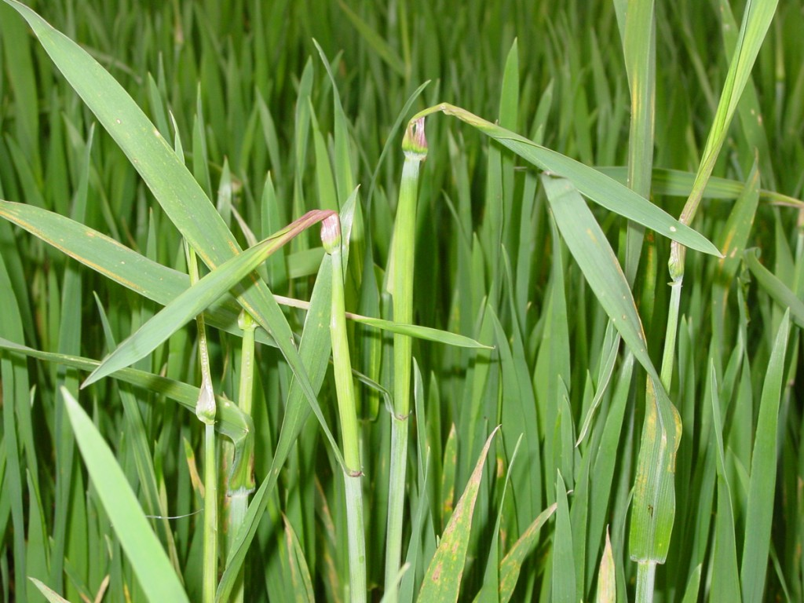
Erick Larson - MSU

Slide 26
Liberty (glufosinate)

Slide 27
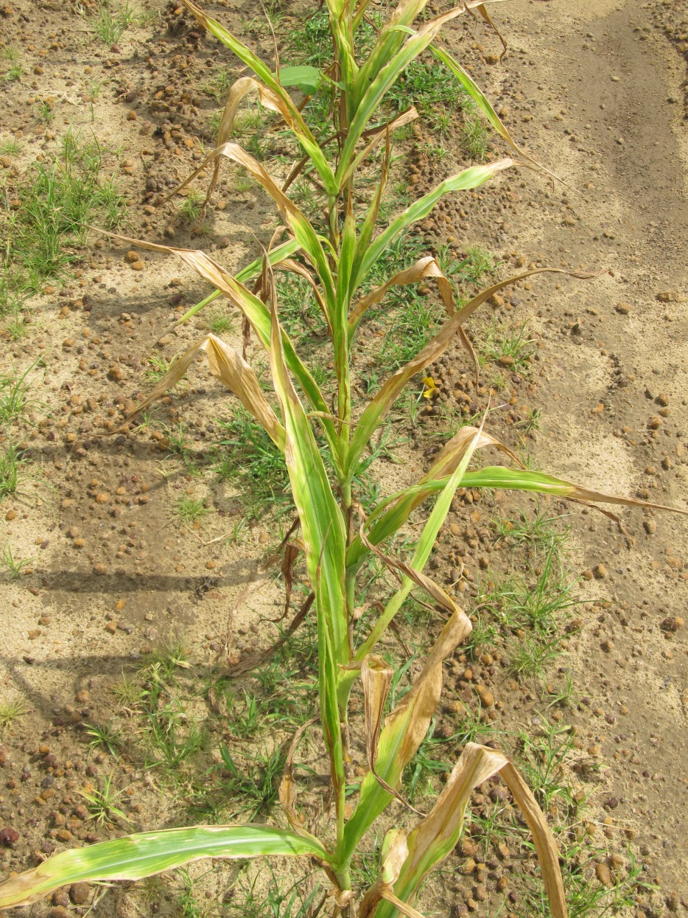
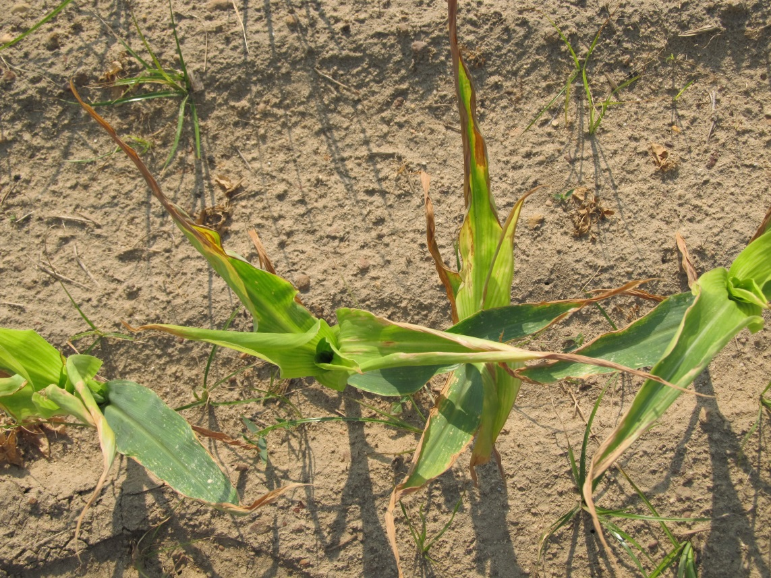

Slide 28
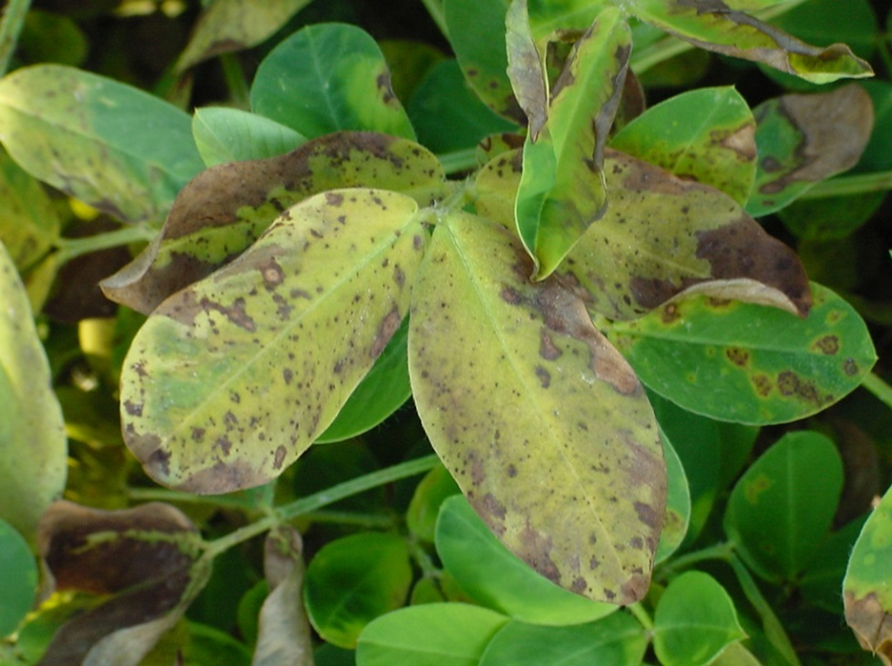
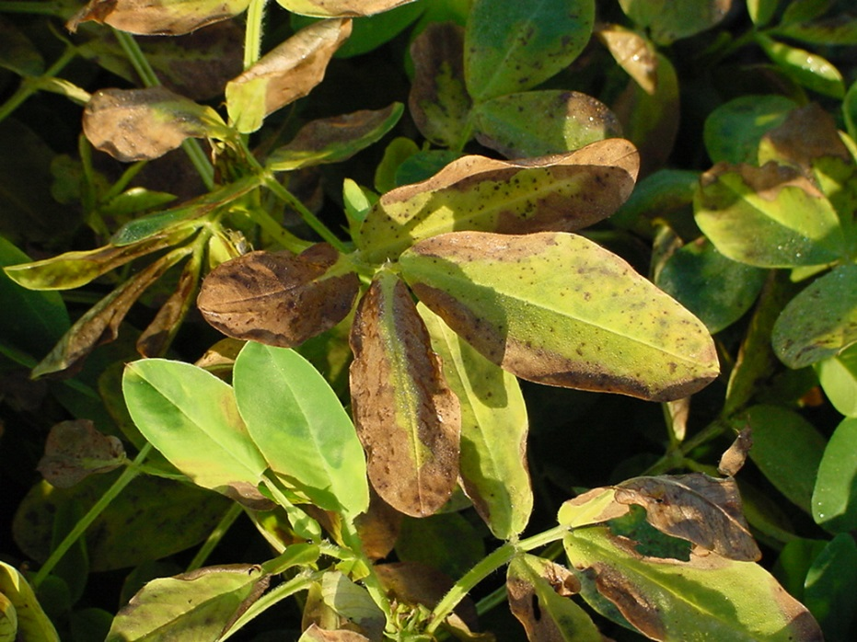
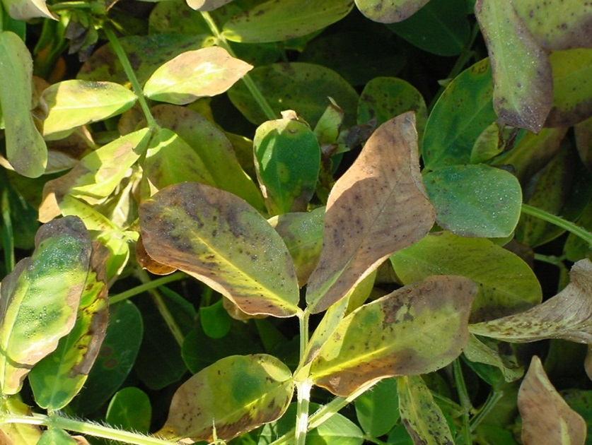

Slide 29
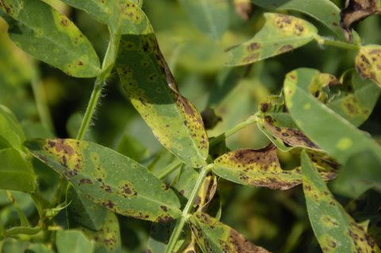

Slide 30
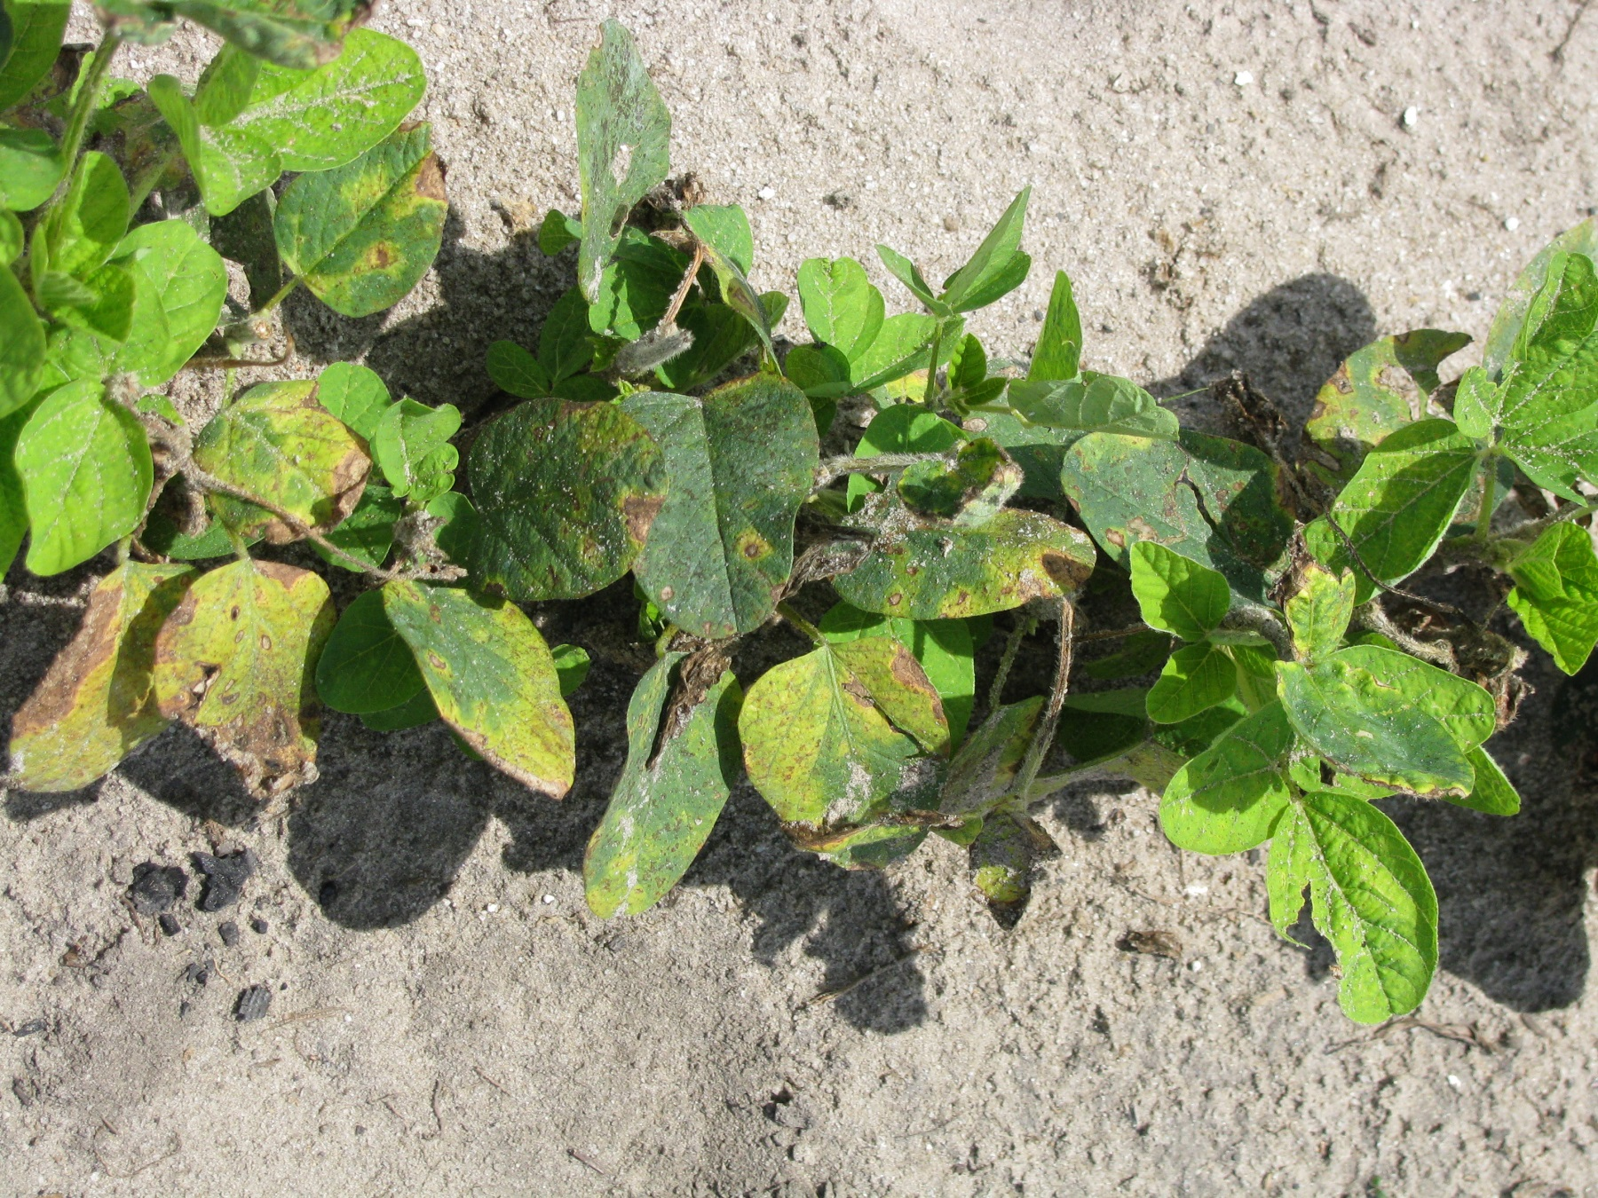

Slide 31
Paraquat

Slide 32
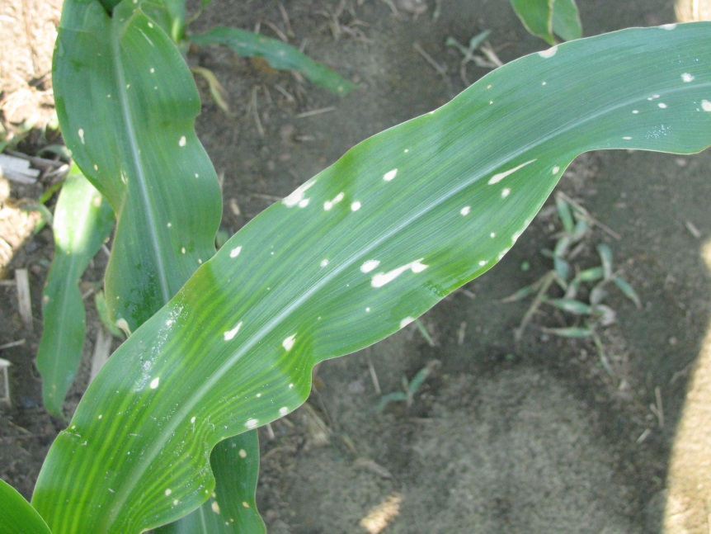
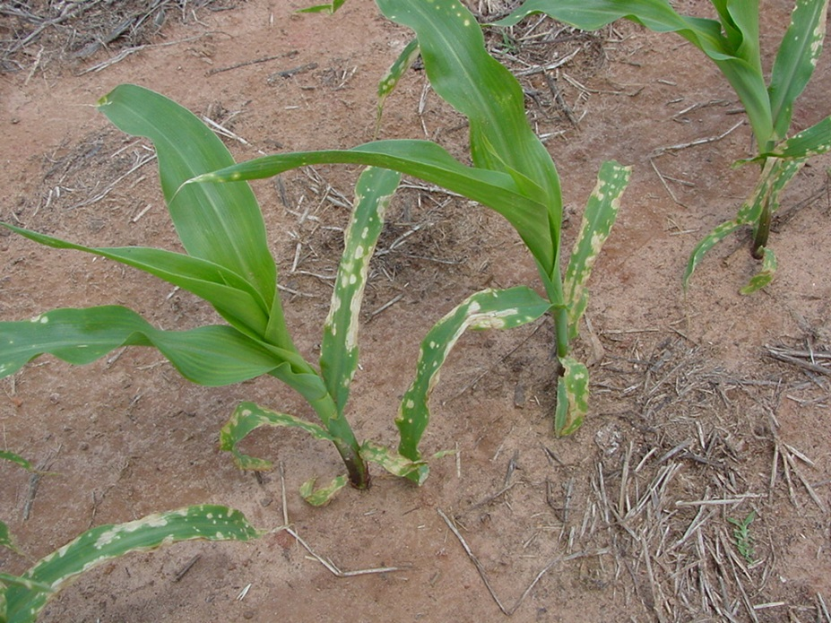
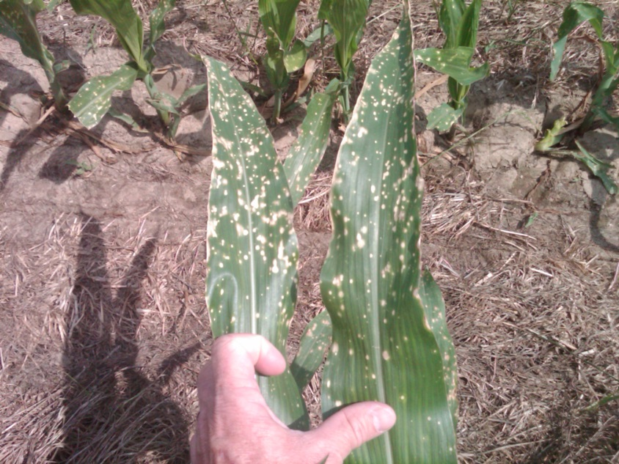

Slide 33
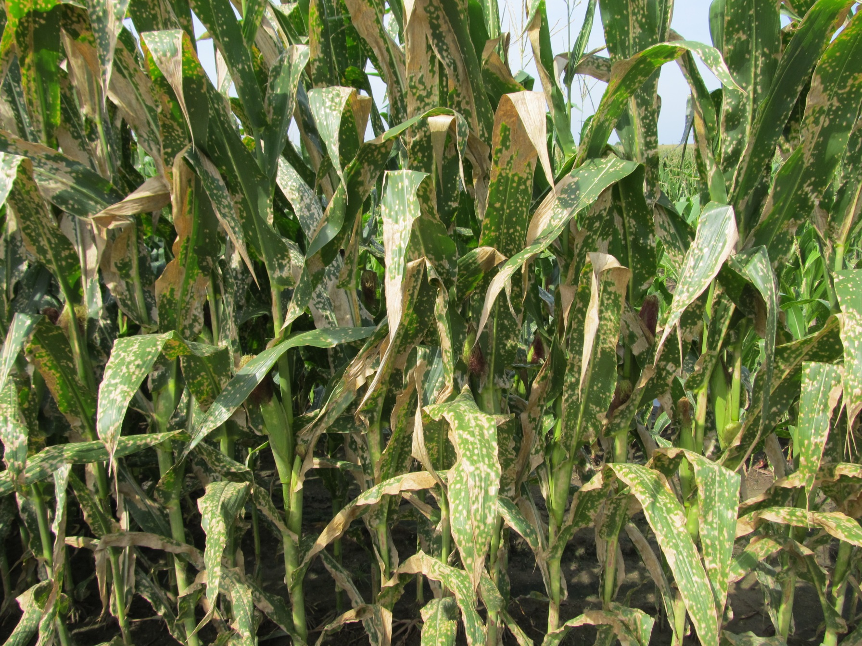

Slide 34
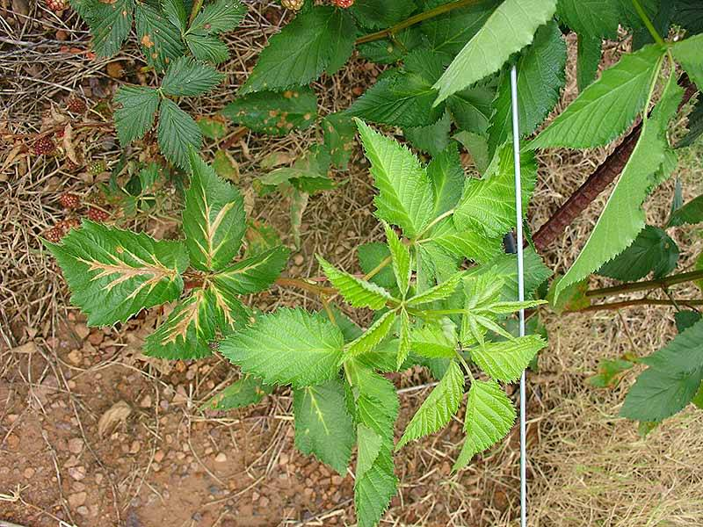
Blackberry - NCSU

Slide 35
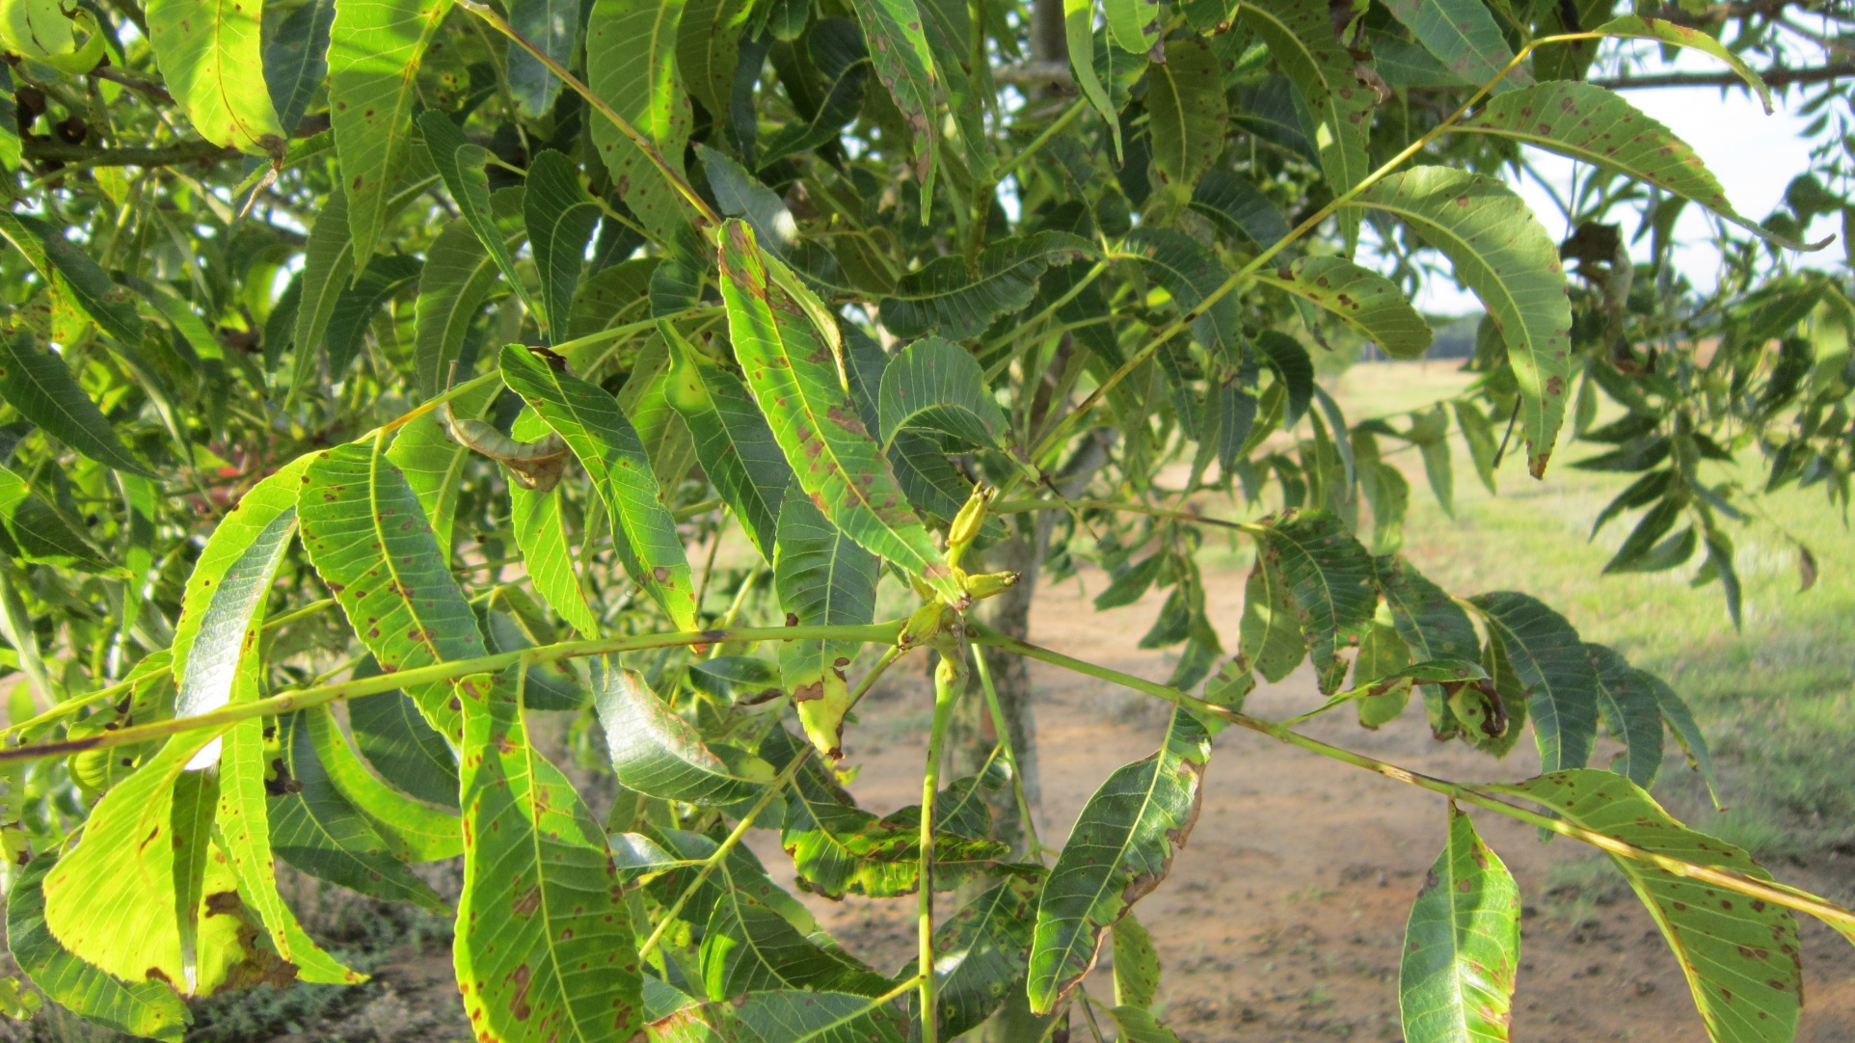
Pecan – Lenny Wells (UGA)

Slide 36



Slide 37
Growth Regulators (2,4-D, dicamba, triclopyr, picloram, etc.)

Slide 38

dicamba

Slide 39


2,4-D

Slide 40

picloram

Slide 41


dicamba

Slide 42


dicamba

Slide 43

2,4-D (P. Dotray, Texas Tech)

Slide 44



Slide 45


Slide 46

Oak Tree - Bill Vencill - UGA

Slide 47




Vegetables sensitivity to Phenoxys is high

Slide 48


Slide 49


Slide 50


Slide 51
Aim (carfentrazone)

Slide 52

Strawberry – Univ. of California

Slide 53
Valor (flumioxazin)

Slide 55
Staple (pyrithiobac)

Slide 56


Slide 57


Slide 58


Slide 59

Halex GT/Callisto (mesotrione)
Halex GT

Slide 60

mesotrione

Slide 61

Command (clomazone)

Slide 62

What is our role in a drift complaint?
UGA
Identification
Effects/outcome
Education
GDA
Samples
Enforcement
Litigation???

Slide 63

Questions?
www.gaweed.com

