Slide 1
Peanut Response to Foliar Applied Pyroxasulfone Tank-Mixtures
P.M. Eure*, E.P. Prostko, and R.M. Merchant
Department of Crop & Soil Sciences
Notes:
Why pyrox? Lower use rate compared to metolachlor. Less injury over the top compared to Prowl or Sonolan. Better Texas panicum control than S-metolchlor (MAYBE RATE DEPENDENT)?
Isoxazoline

Slide 2
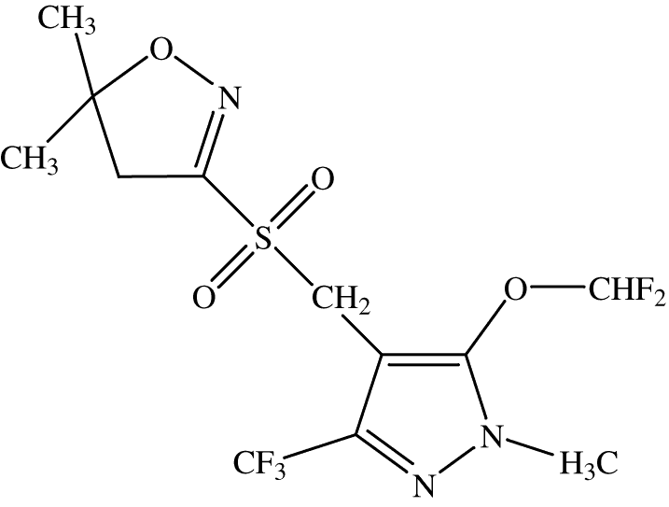
Introduction
Inhibitor of VLCFA synthesis
Low use rates
Developed for use in corn, soybean, sunflower, and wheat
Notes:
Why pyrox? Lower use rate compared to metolachlor. Less injury over the top compared to Prowl or Sonolan. Better Texas panicum control than S-metolchlor (MAYBE RATE DEPENDENT)?
Isoxazoline

Slide 3
Current and Future Pyroxasulfone Products
BASF – (pyroxasulfone)
FMC - (pyroxasulfone + fluthiacet)
Valent - (pyroxasulfone + flumioxazin)
Notes:
Mentions KIH owns the rights…. Allows BASF, FMC, and Valent to distribute or include the AI in formulations

Slide 4
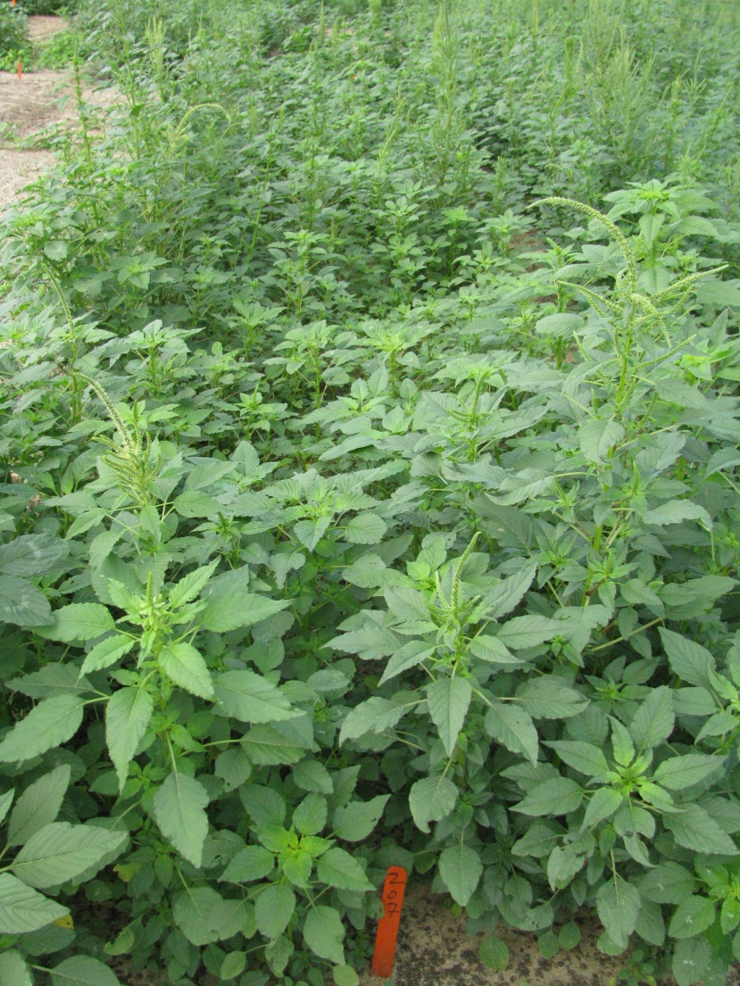
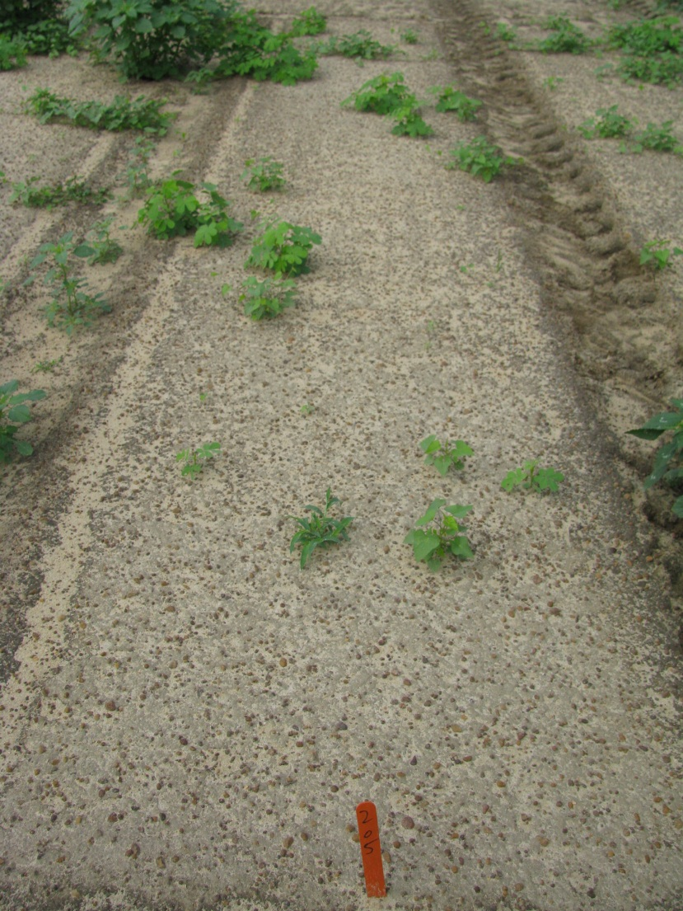
Weed Control with Pyroxasulfone
Non-treated control
Pyroxasulfone 85 WG @ 1.5 oz/A*
* 5 WAT
Notes:
Pyroxasulfone does exhibit excellent residual control of troublesome weeds such as Palmer amaranth, Texas panicum, and large crabgrass.
Texas panicum control is rate dependent.

Slide 5
Previous Research
Peanut Tolerance (Prostko et al. 2011)
PRE
Significant stunting at 1 of 2 locations
POST
Excellent tolerance when applied 44-51 days after planting
No reduction in peanut yield
E.P. Prostko, T.L. Grey, T.M. Webster, and R.C. Kemerait (2011) Peanut Tolerance to Pyroxasulfone. Peanut Science: July 2011, Vol. 38, No. 2, pp. 111-114.
Notes:
Peanut tolerance work in GA

Slide 6
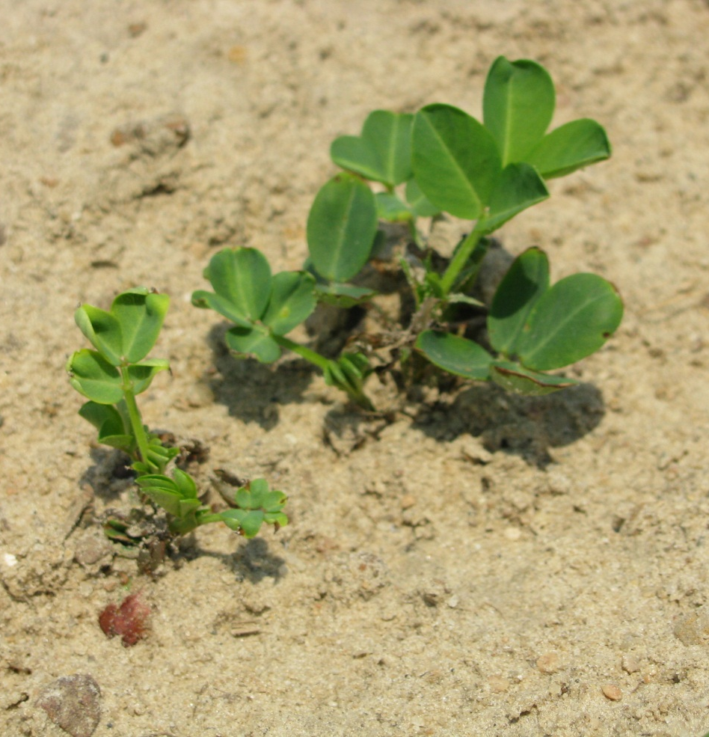
Pyroxasulfone 85WG Applied 10 DAP
4 oz/A
8 oz/A
P.M. Eure, E.P. Prostko, A.S. Culpepper, W.K. Vencill, and R.M. Merchant (2012) Cotton and Peanut Response to Pyroxasulfone, Southern Weed Science Society PROC: 65:101.
Notes:
Data reported at SWSS 2012.
At the 4 oz/A rate… chlorosis and some stunting
At the 8 oz/A rate…. Chlorosis and eventually necrosis followed by stunting

Slide 7
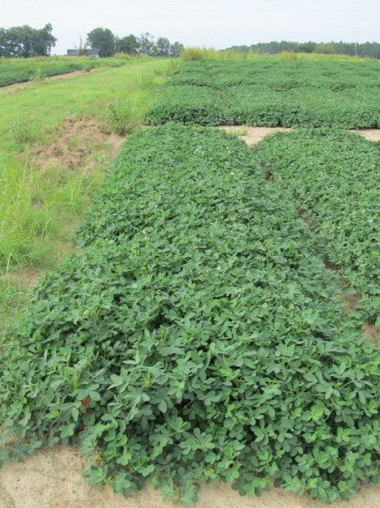
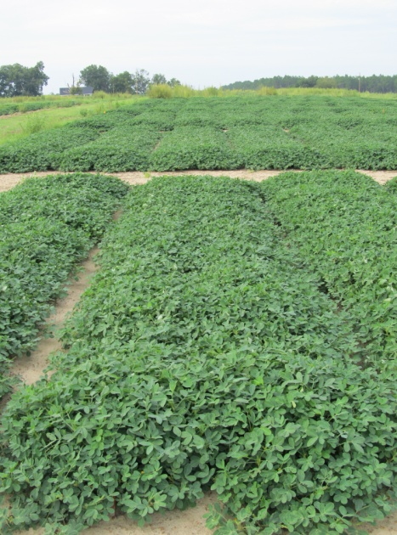
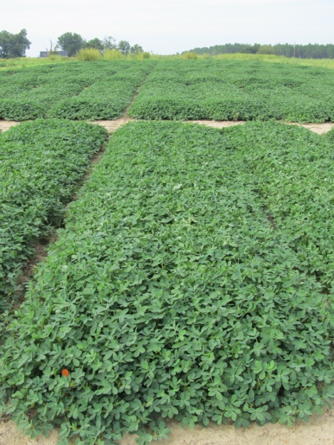
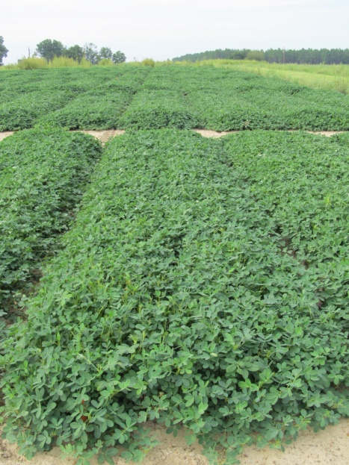
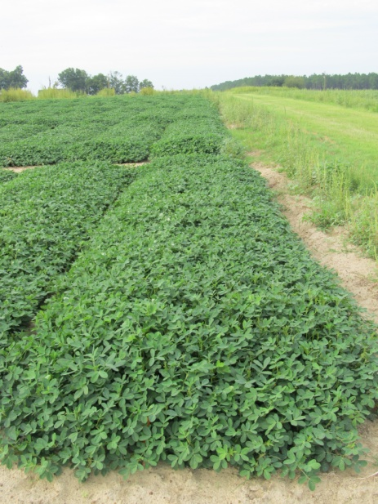
Peanut Response to Pyroxasulfone 85WG @ 8 oz/A + NIS @ 0.25% v/v
NTC
10 DAP
30 DAP
99 DAP
60 DAP
90 DAP
Notes:
In a set of experiments we evaluated pyroxasulfone application timing (10, 30, 60, and 90 DAP) and rate (4 and 8 oz).
Pyroxasulfone applied 11 DAP at 4 and 8 oz/A caused 10 and 27% stunting, respectively
Application of pyroxasulfone at 30, 60, and 90 DAP at 4 or 8 oz/A did not result in significant injury (<2%)
Yield was not influenced by pyroxasulfone rate or application timing

Slide 8
Objective
Evaluate peanut response to pyroxasulfone applied POST with and without tank-mix partners

Slide 9
Materials and Methods-I
Location: UGA Ponder Research Farm
2009
2010
Soil type: Tifton loamy sand
Notes:
Two studies conducted at Ty Ty Georgia

Slide 10
Materials and Methods-II
Factorial design (2 x 6 )
Pyroxasulfone 85WG (2)
0 or 4 oz/A
Foliar herbicide system (6)
No foliar herbicide
Paraquat 2SL (8 oz/A)
Paraquat 2SL (12 oz/A) + Bentazon 4SL (8 oz/A)
Paraquat 2SL (12 oz/A) + Bentazon/Acifluorfen 4SL (24 oz/A)
Imazapic 2AS (4 oz/A)
Lactofen 2SC (12.5 oz/A)
All herbicide treatments included 0.25% v/v NIS

Slide 11
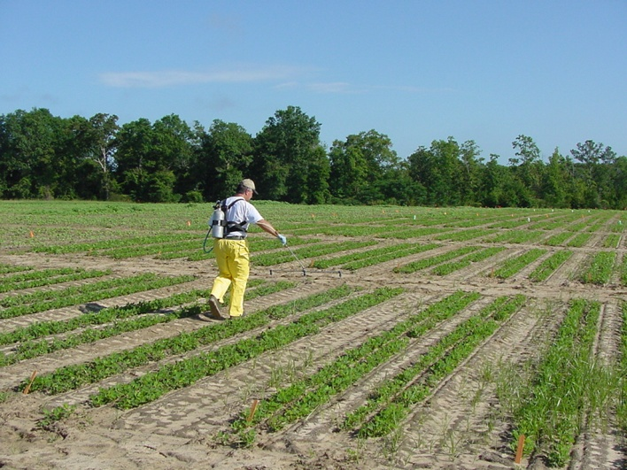
Materials and Methods-III
Application method:
CO₂-pressurized backpack sprayer
15 GPA
DG 11002XR spray tips
Cultivar: ‘GA-06G’
Plots maintained weed-
free
Notes:
Prowl H2O + Strongarm + Valor
GA06G = 70% of peanut acres in Georgia.

Slide 12
Materials and Methods-IV
Data recorded
Peanut stunting
Yield
Adjusted to 10% moisture
Data subjected to ANOVA and means separated using Fisher’s Protected LSD Test (P ≤ 0.10) when appropriate

Slide 13
Results - Statistics
No interaction between year, pyroxasulfone rate, and foliar herbicide system
Main effects will be discussed:
Pyroxasulfone rate
Foliar herbicide system

Slide 14
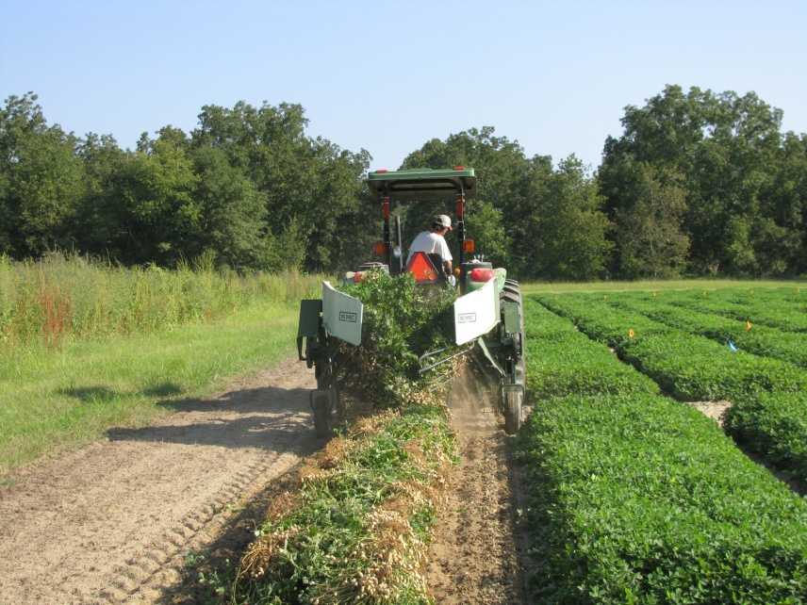
2009
Notes:
Planted on May 28th and treatments made on June 9th. 11 DAYS

Slide 15
Peanut Stunting
*Data pooled over foliar herbicide systems

Slide 16
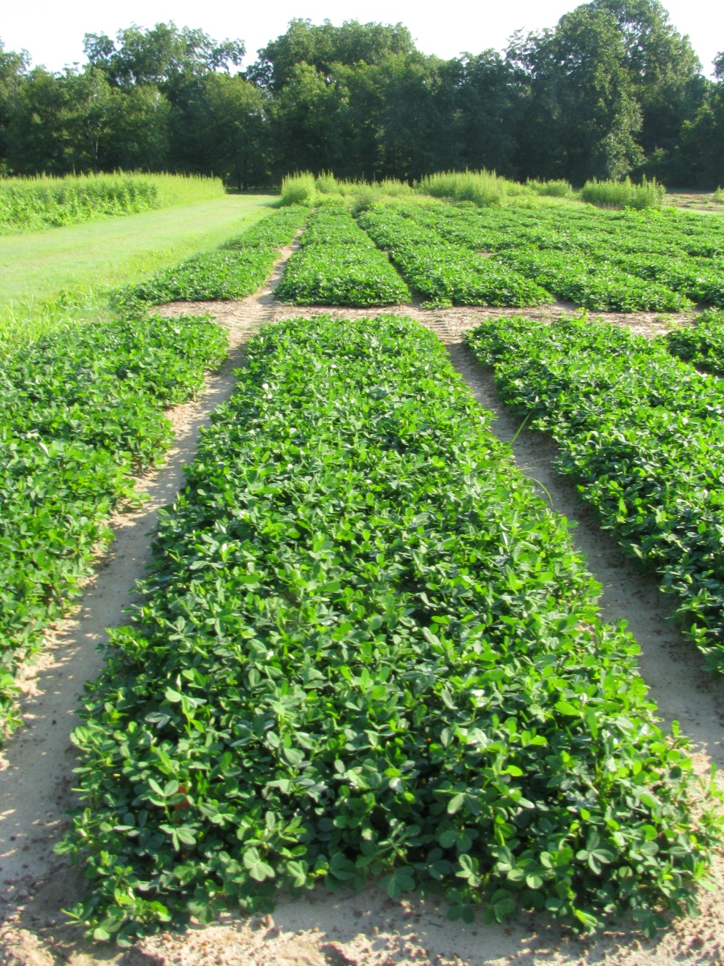
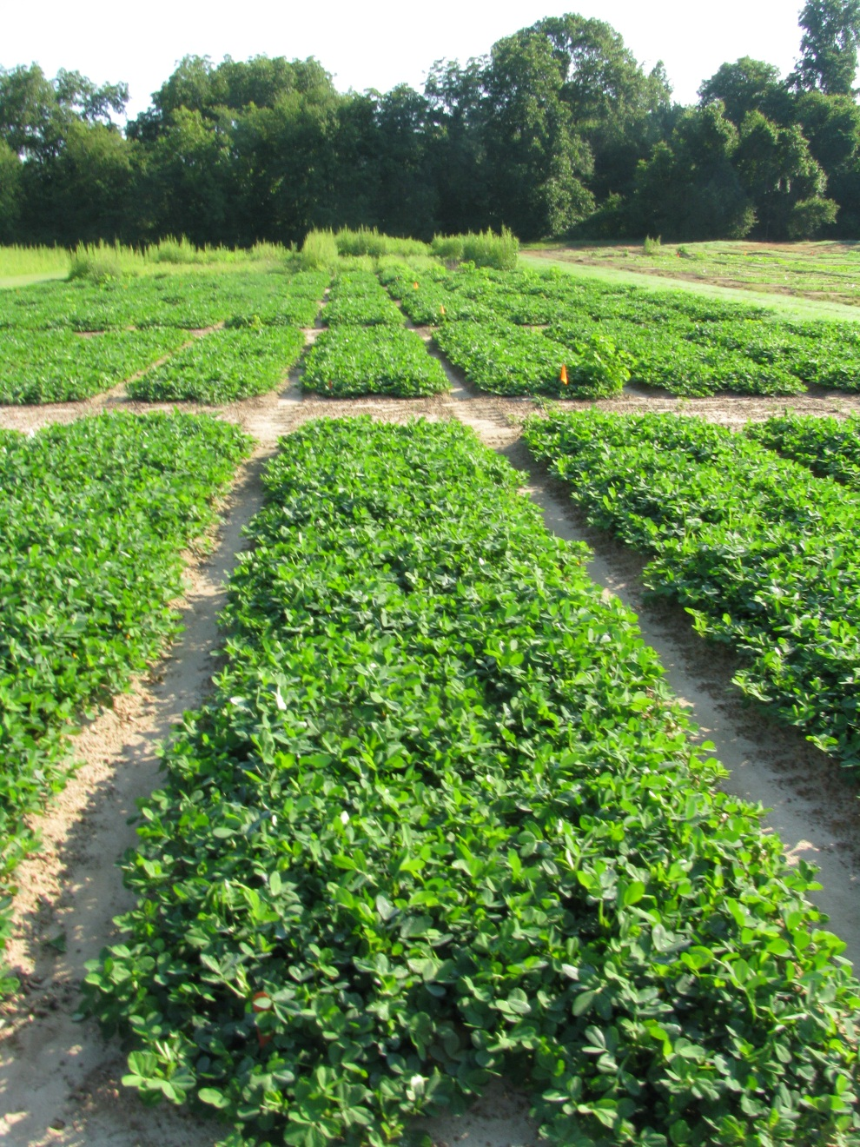
Paraquat 2SL @ 8 oz/A
Pyroxasulfone 85WG @ 4 oz/A
+ Paraquat 2SL @ 8 oz/A
42 DAT

Slide 17
Peanut Stunting
No Foliar Herbicide | Paraquat | Paraquat + Bentazon | Paraquat + Bentazon/ Acifluorfen | Imazapic | Lactofen
*Data pooled over pyroxasulfone rates

Slide 18
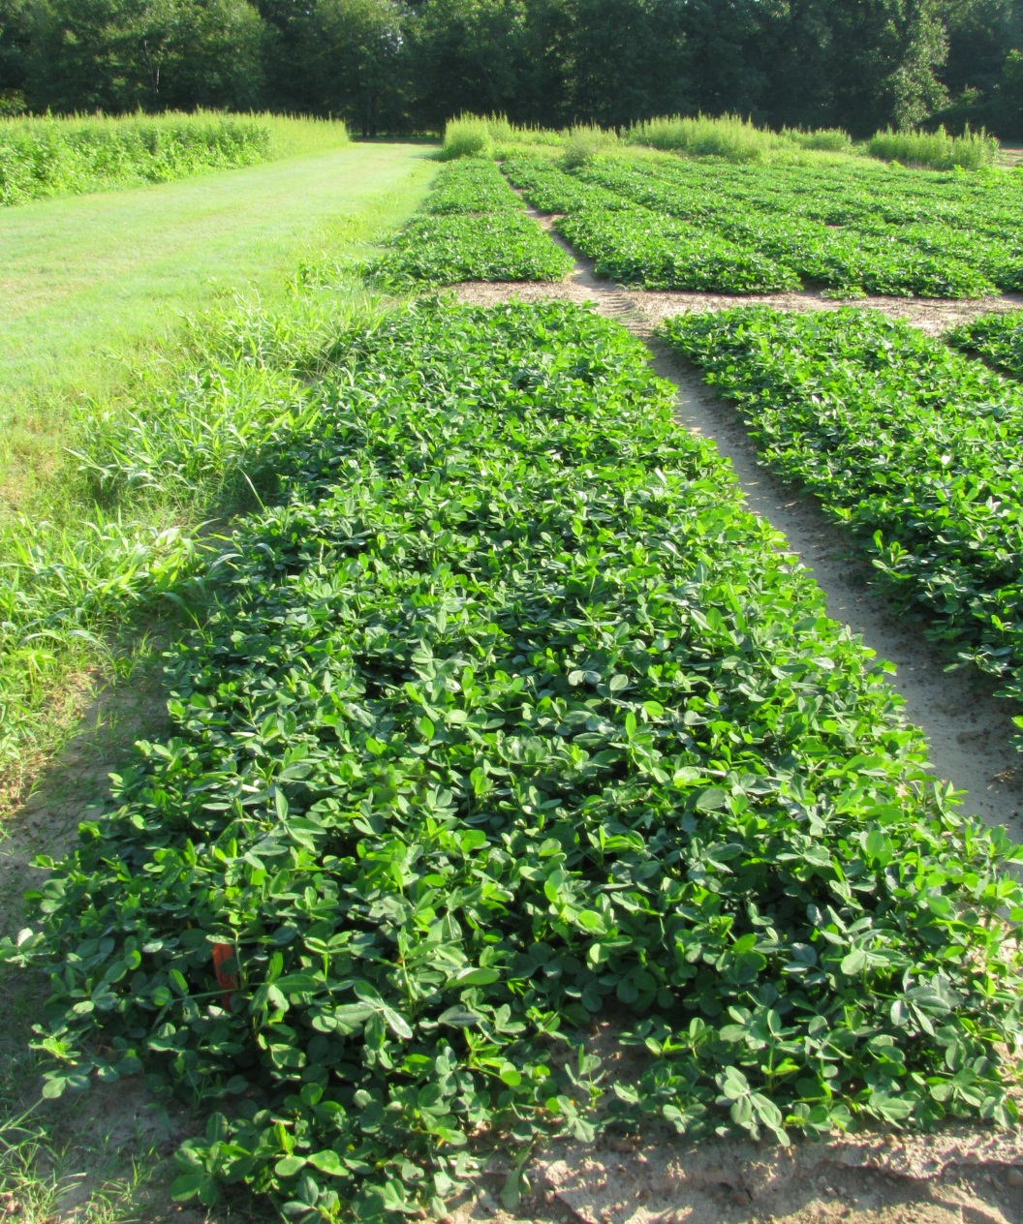
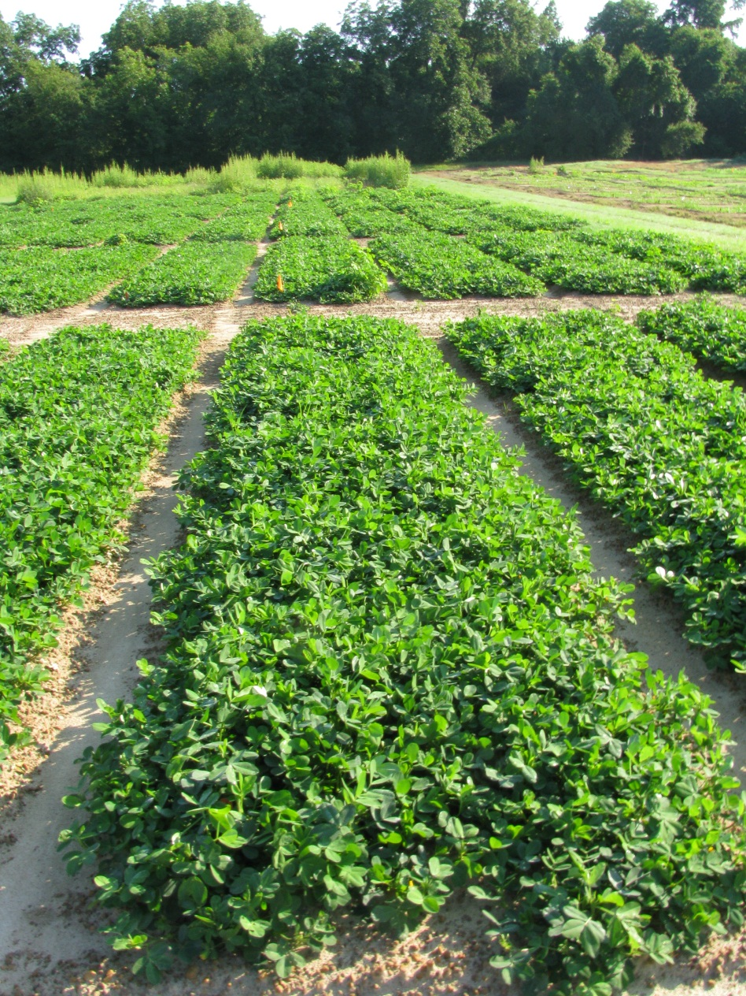
NTC
Pyroxasulfone 85WG @ 4 oz/A
+ Paraquat 2SL @ 12 oz/A
+ Bentazon 4SL @ 8 oz/A
42 DAT

Slide 19
Peanut Yield
P=0.42
*Data pooled over foliar herbicide systems

Slide 20
Peanut Yield
No Foliar Herbicide | Paraquat | Paraquat + Bentazon | Paraquat + Bentazon/ Acifluorfen | Imazapic | Lactofen
*Data pooled pyroxasulfone rates
P=0.21

Slide 21
2010
Notes:
Peanuts planted on May 11th and treatments made on June 2nd. 22 DAYS

Slide 22
Peanut Stunting
*Data pooled over foliar herbicide systems

Slide 23
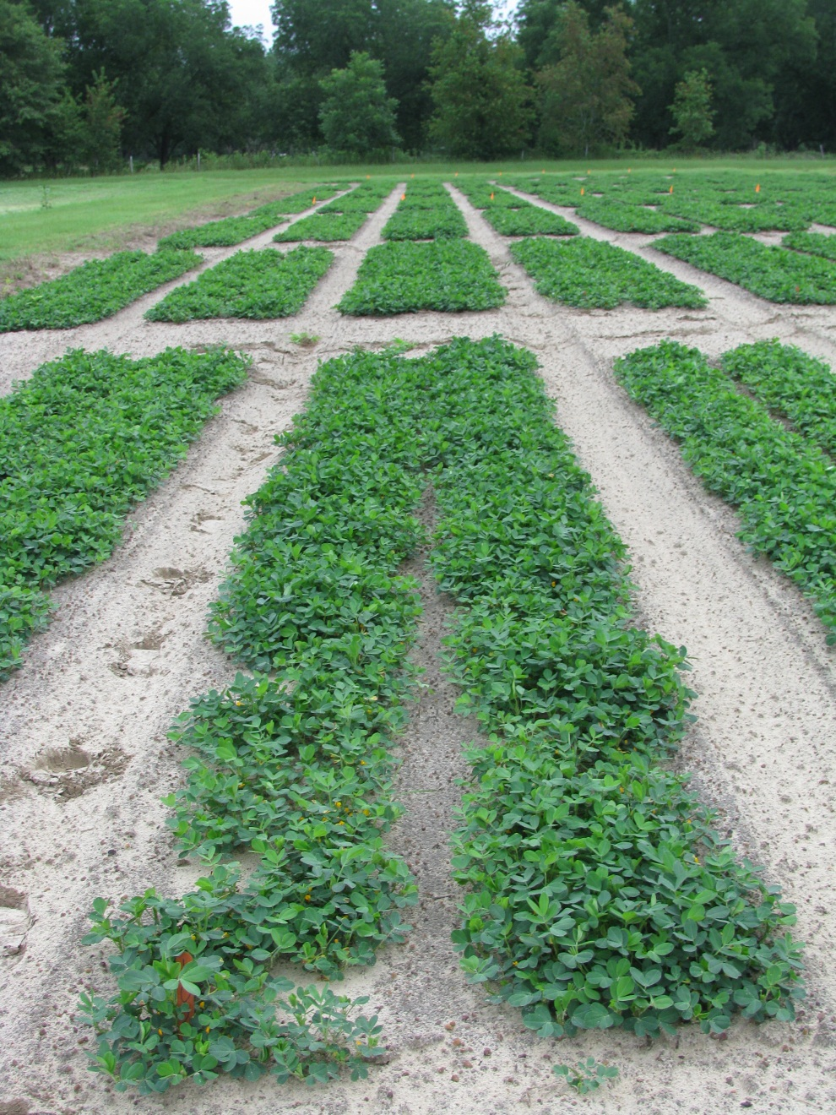
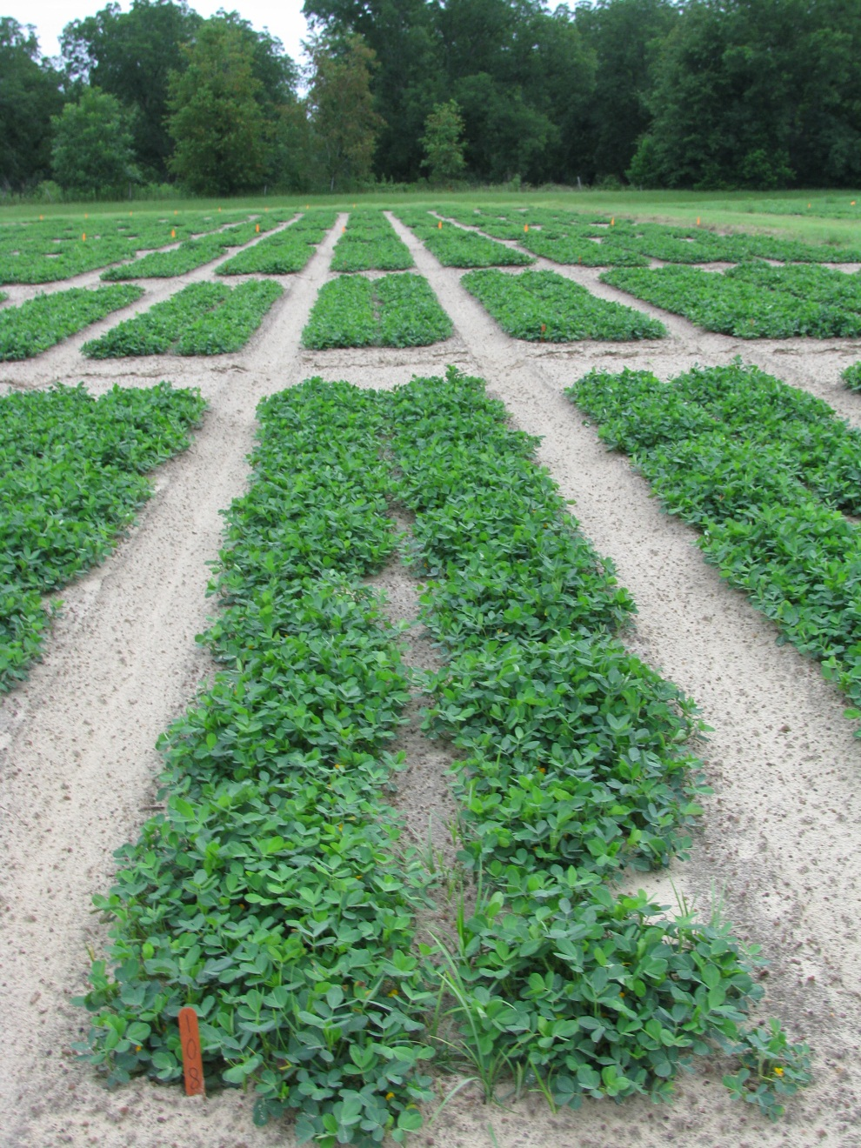
Paraquat 2SL @ 8 oz/A
Pyroxasulfone 85WG @ 4 oz/A
+ Paraquat 2SL @ 8 oz/A
29 DAT

Slide 24
Peanut Stunting
No Foliar Herbicide | Paraquat | Paraquat + Bentazon | Paraquat + Bentazon/ Acifluorfen | Imazapic | Lactofen
*Data pooled pyroxasulfone rates
Notes:
Maximum injury from paraquat?
Recovery period?

Slide 25
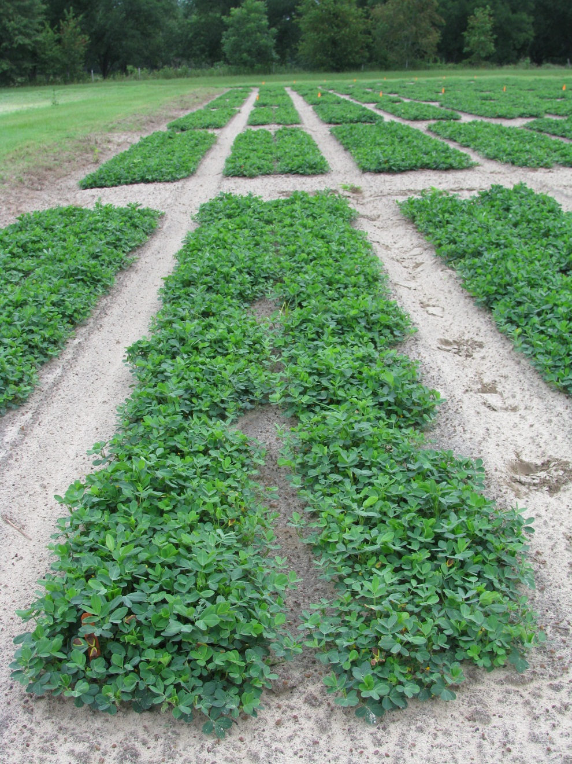
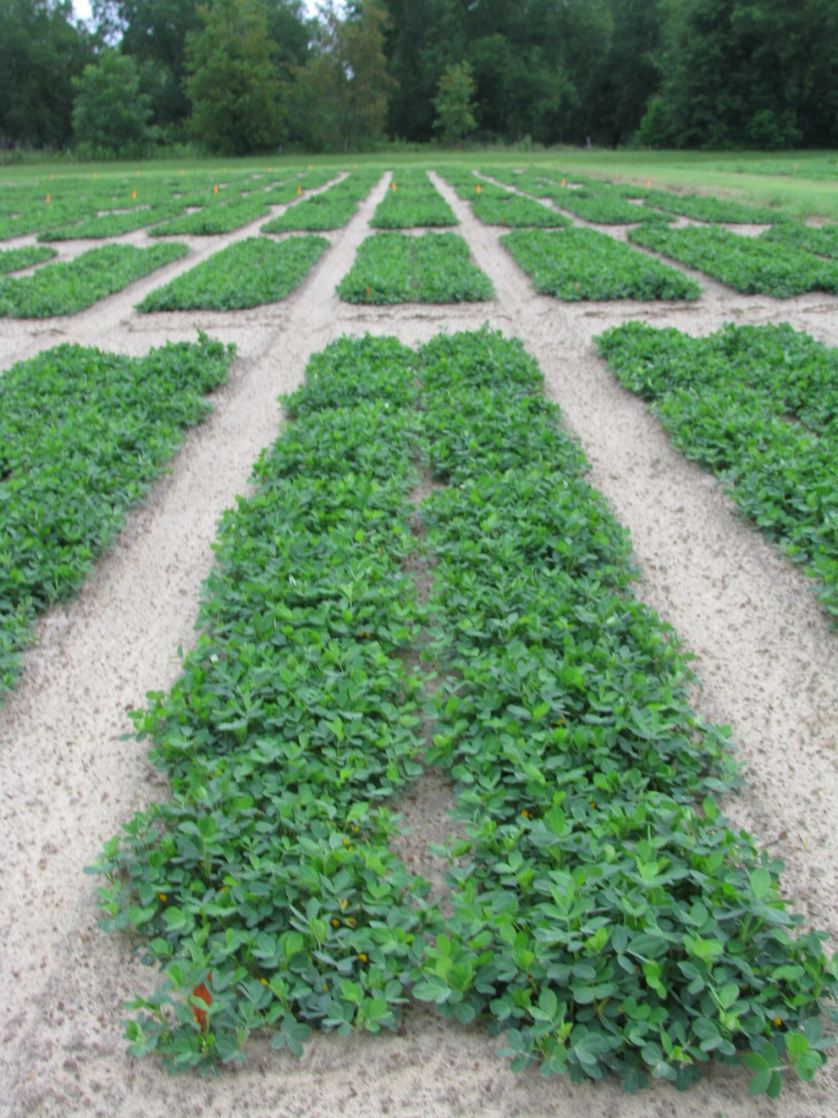
NTC
Pyroxasulfone 85WG @ 4 oz/A
+ Paraquat 2SL @ 12 oz/A
+ Bentazon 4SL @ 8 oz/A
29 DAT

Slide 26
Peanut Yield
P=0.33
*Data pooled over foliar herbicide systems

Slide 27
Peanut Yield
No Foliar Herbicide | Paraquat | Paraquat + Bentazon | Paraquat + Bentazon/ Acifluorfen | Imazapic | Lactofen
P=0.57
*Data pooled pyroxasulfone rates

Slide 28
Summary
Peanut stunting
2009: Pyroxasulfone did not influence peanut stunting
2010: Addition of pyroxasulfone to tank-mixtures increased peanut stunting 8% (6 DAT)
Complete recovery (29 DAT)
Peanut yield
No interaction between pyroxasulfone and foliar systems
No main effect of pyroxasulfone or foliar system on yield
Notes:
Stunting: 2009: no problem (22 days between planting and treatment @ V4 w/ height of 2”)
2010: additional stunting (13 days between planting and treatment @ V4-V5 w/ height of 4”)
Difference between seasons?
Yield: No problem. Should mention that we used 4oz/A and the projected use rate is 1-2 oz/A

Slide 29
Future Research
Evaluate peanut cultivar response to PRE applied pyroxasulfone
Peanut tolerance to split applications
EPOST + POST
Tank-mixes of pyroxasulfone with other herbicides
Weed management systems
Evaluate pyroxasulfone efficacy on various weed species

Slide 30
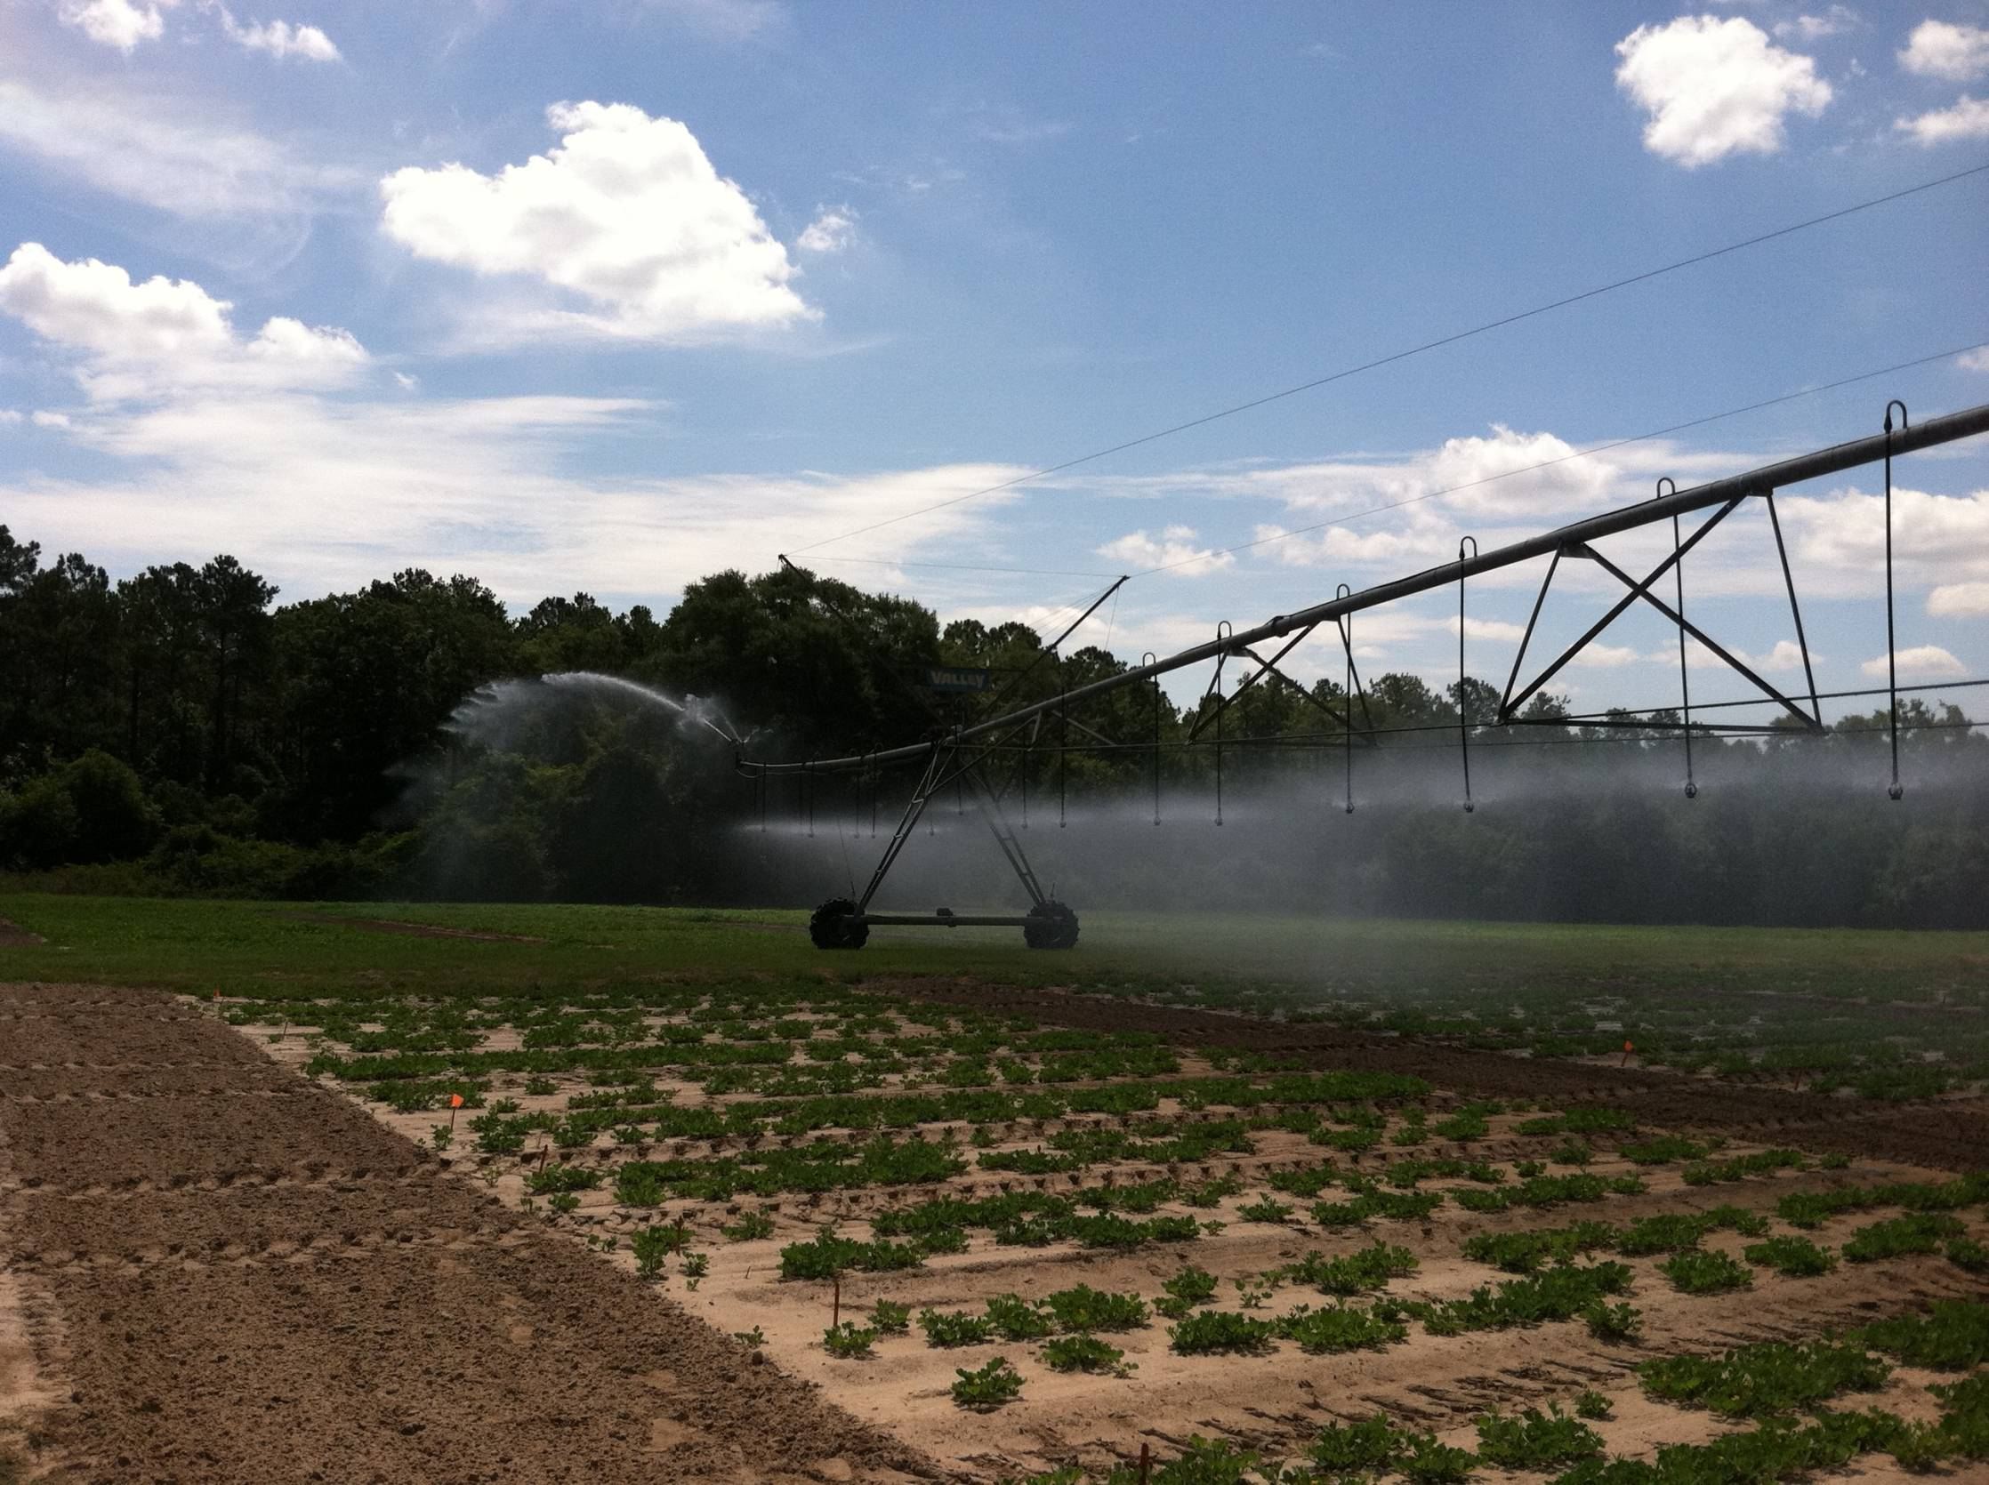
Questions or Comments?

