Slide 1
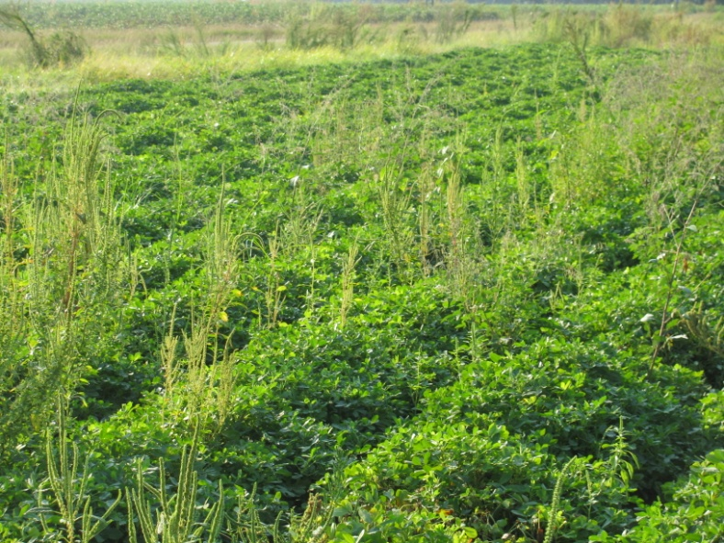
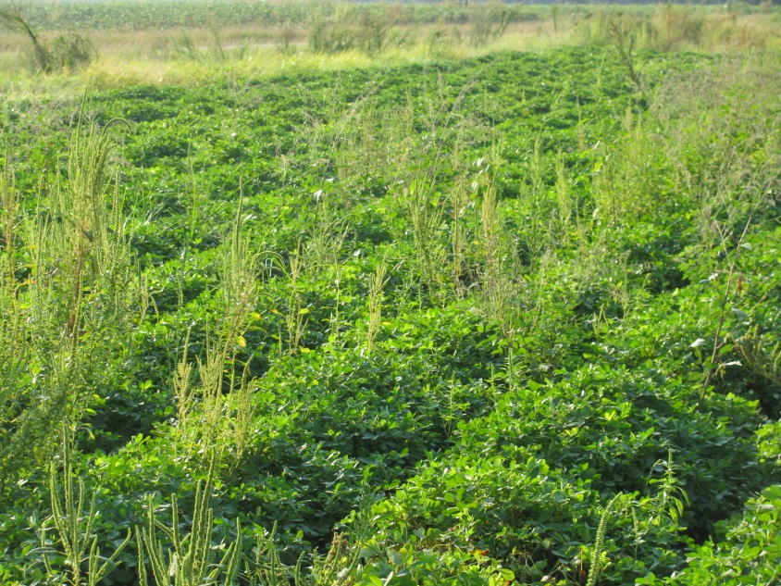

Strategies for Palmer Amaranth (Pigweed) Management in Peanut
Eric P. Prostko
Professor and Extension Weed Specialist Department of Crop & Soil Sciences
Farm Bureau - 2010

Slide 2
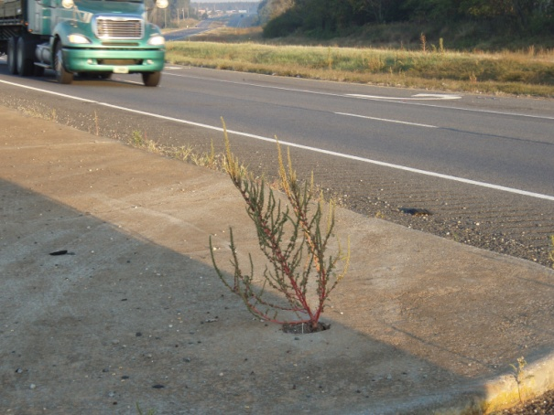
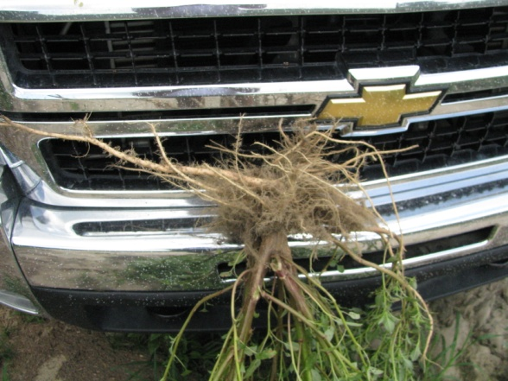
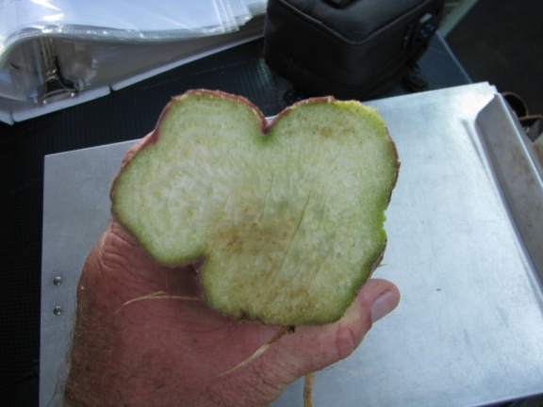
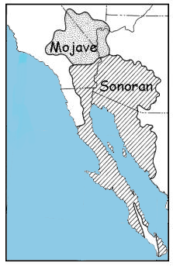
Important Things to Know About Palmer Amaranth
A well-adapted plant!
  Native to Sonoran desert
Separate male and female plants
Lots of seed!!!!
Seed do not last long in soil
  20% germ after 30 months
Seed do not emerge from deep depths (≥ 4”)
Seed need light to germinate
Resistance trait moves in pollen
  At least 1000 feet

Slide 3
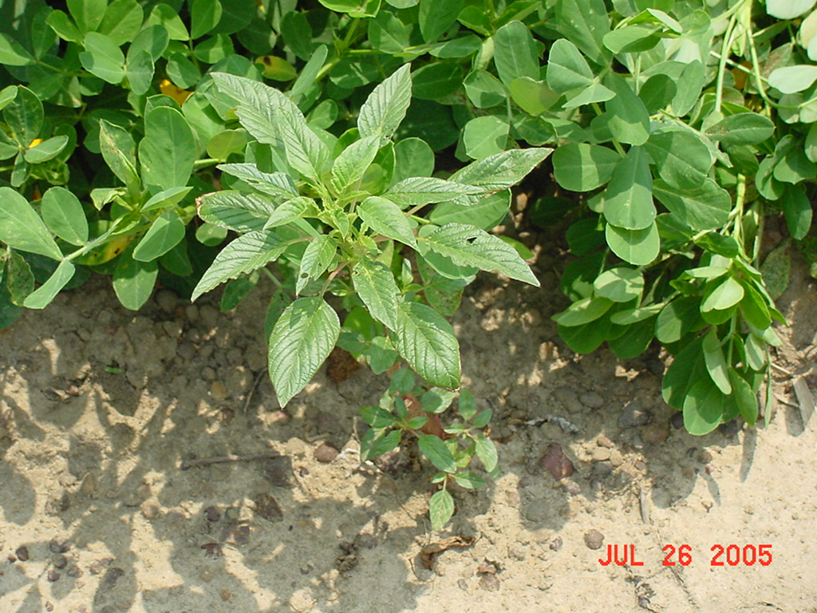
Palmer Amaranth
Competitive and Prolific!!!!
1 Palmer amaranth plant per meter (3.2 ft) of row can reduce peanut yield by 28%.
1 Female Palmer amaranth plant can produce 400,000-500,000 seed
Source: Burke et al., 2007. Weed Technology 21:367-371

Slide 4
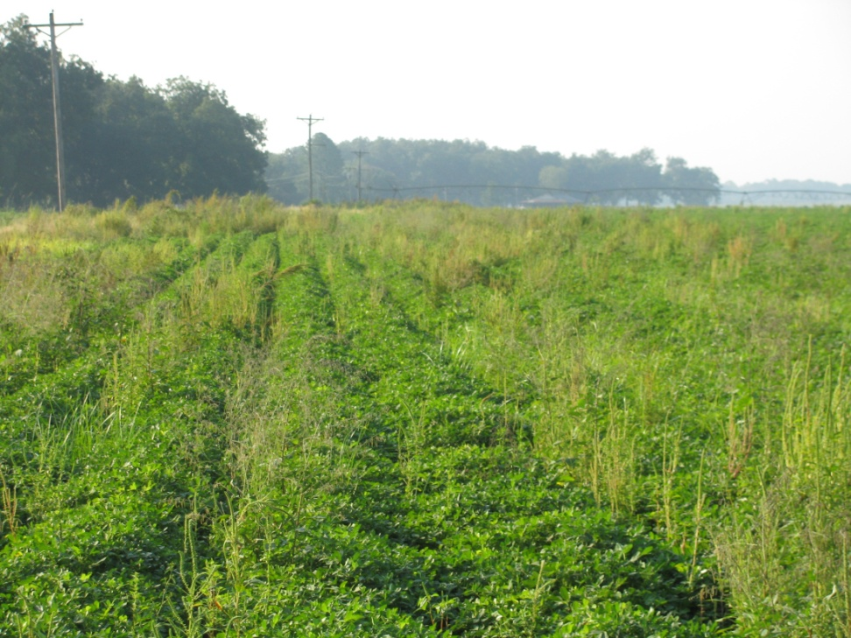
Palmer Amaranth Control Tactics
Start Clean!!!!!
Tillage
Extreme Cover Crops
Residual Herbicides
  Irrigation
  May need more than 1
Timely POST’s
Others
  Hand-Weeding
  Non-Selective Applicators

Slide 5
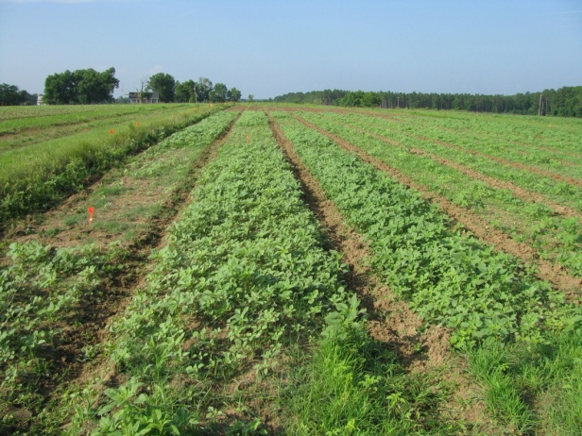
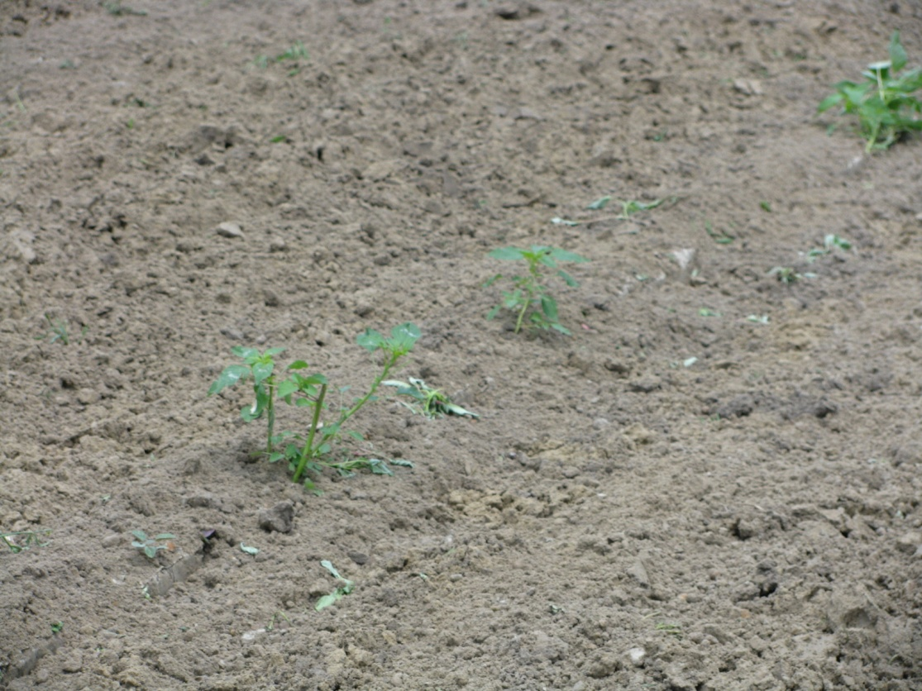
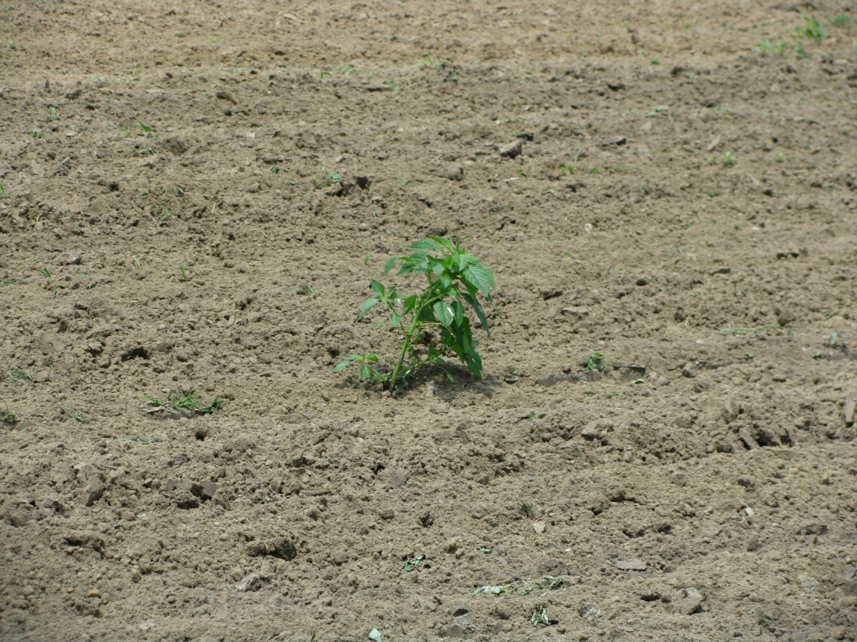
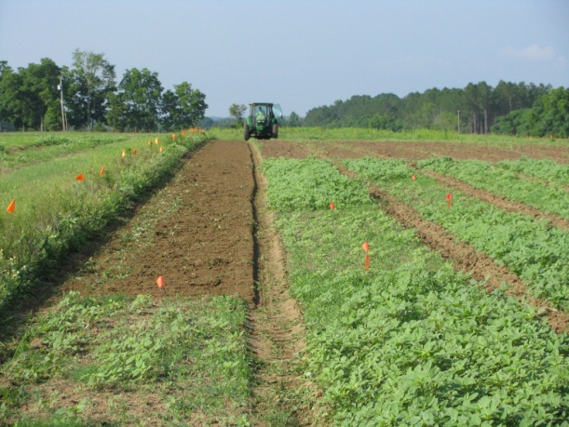
Many pigweed problems are due to weeds already up at planting!

Slide 6
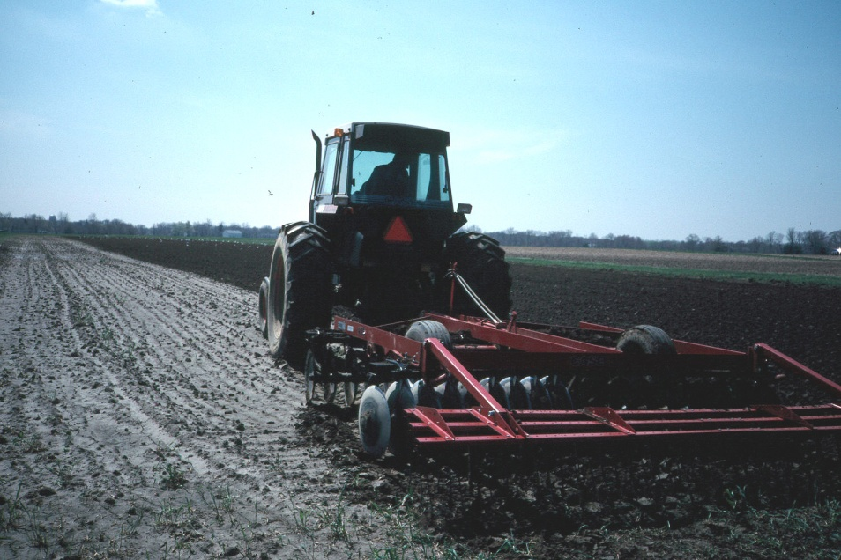
Dryland Production Systems
A Difficult Challenge!
Growers need to think about mechanical herbicide incorporation
Will help but not a guarantee
Success will depend upon……
  operator
  implement
  soil conditions
Prowl/Sonalan + Dual Magnum?

Slide 7
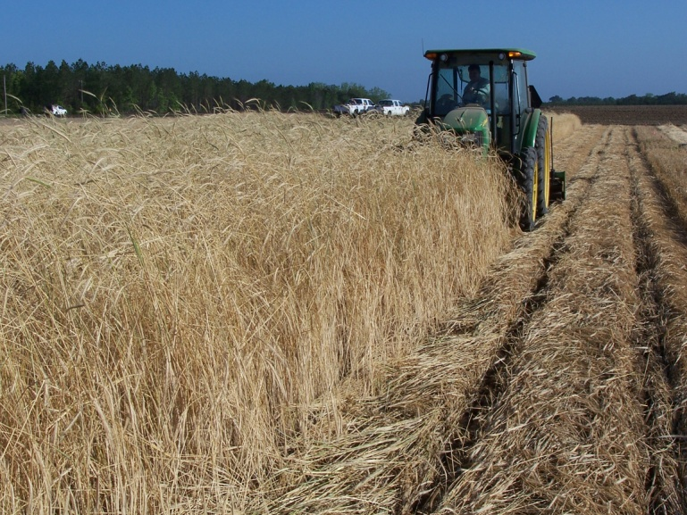
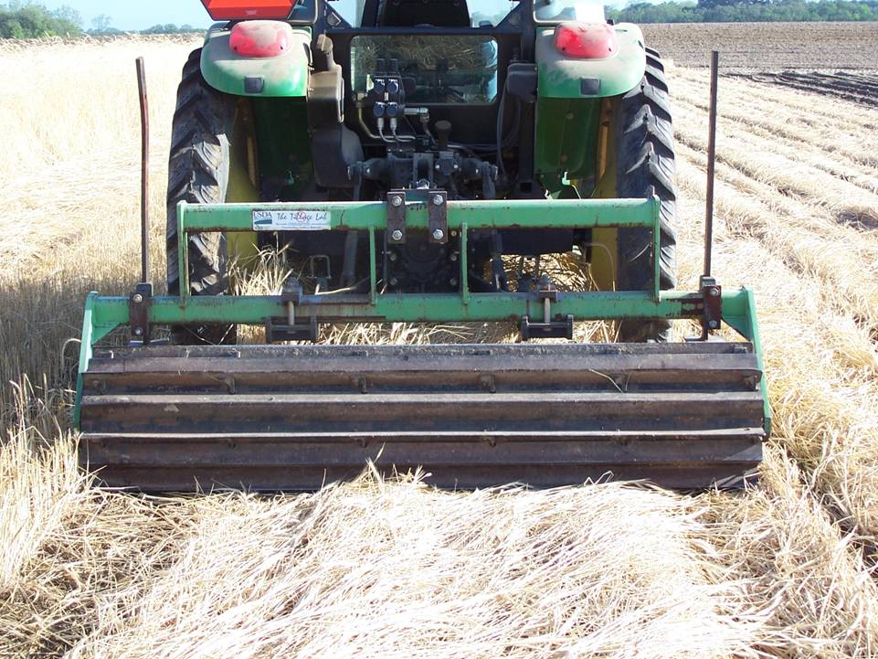
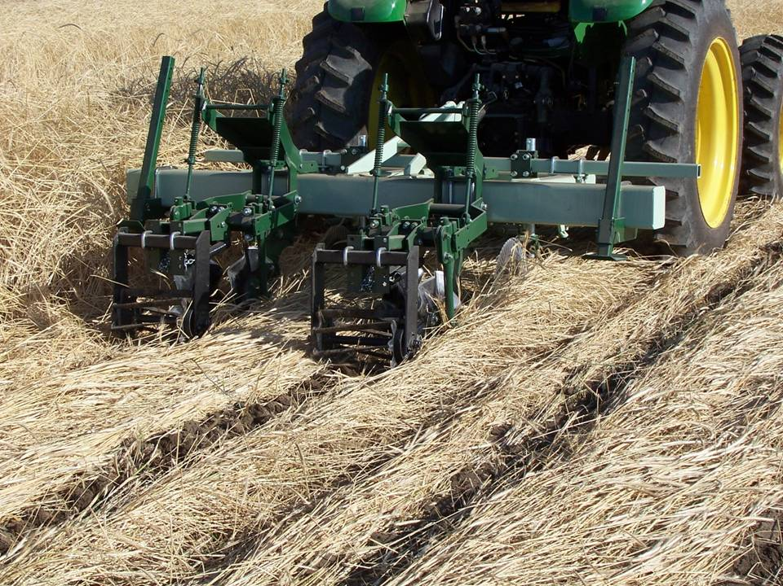
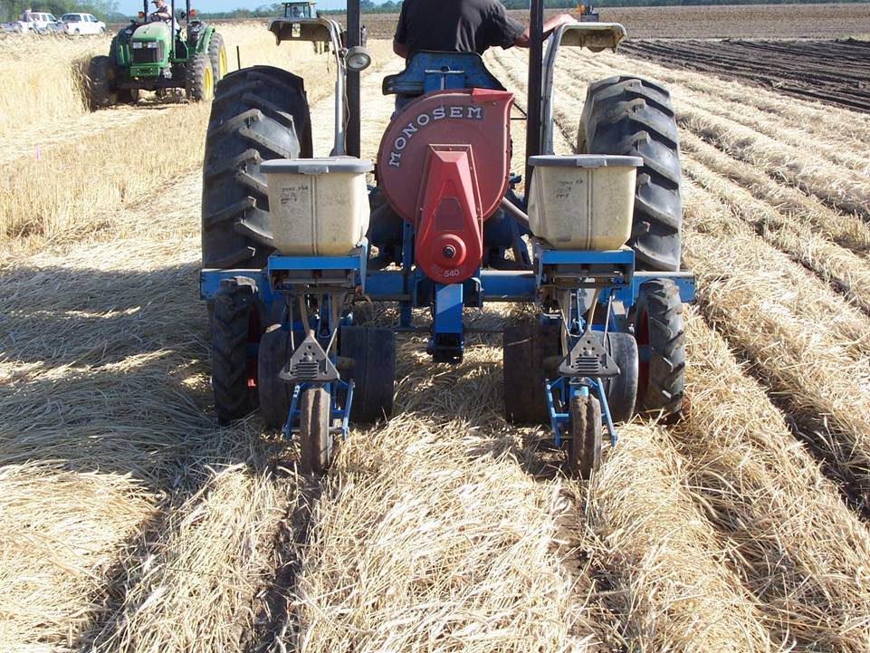
Extreme Cover Crops
1
2
3
4

Slide 8
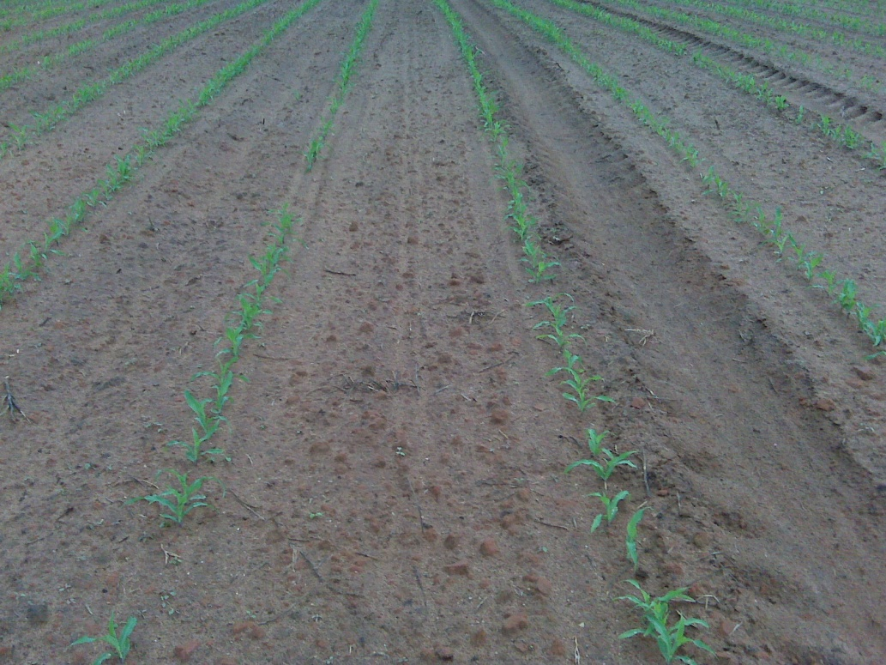
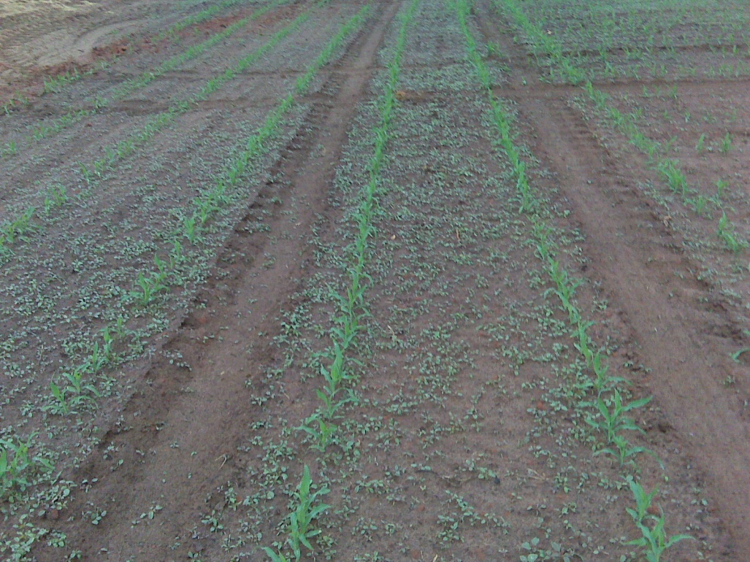
Tillage and Pigweed
Bottom Plow
Chisel Plow
Source: Twiggs Co., April 22, 2010

Slide 9
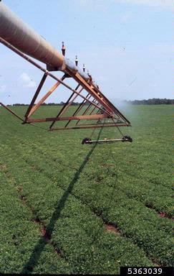
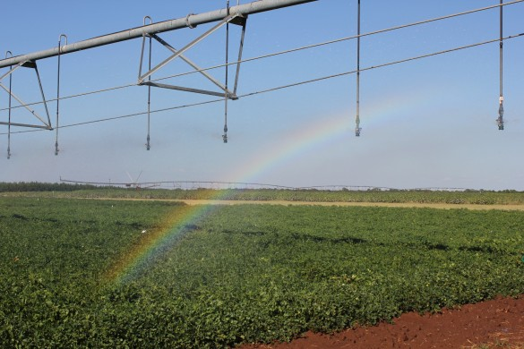
Irrigation
Joy Carter
GPC

Slide 10
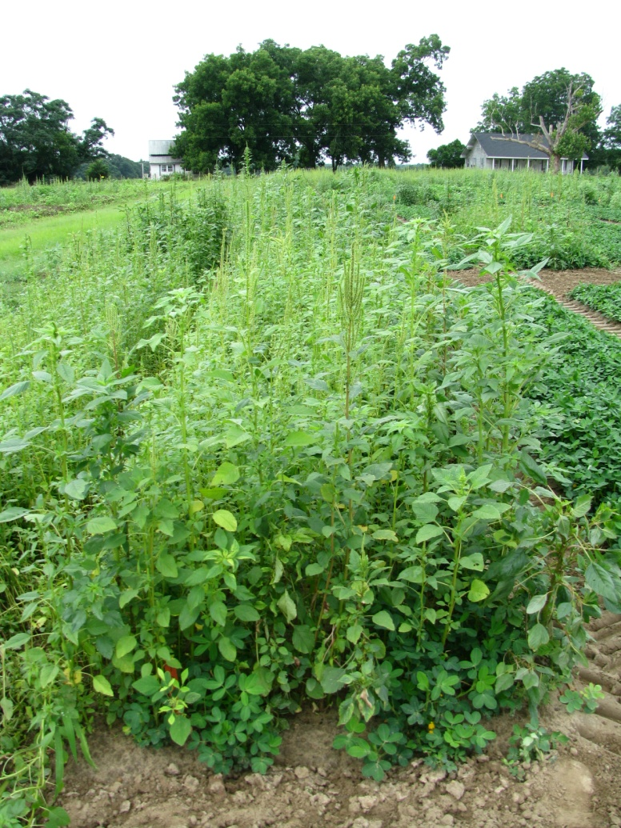
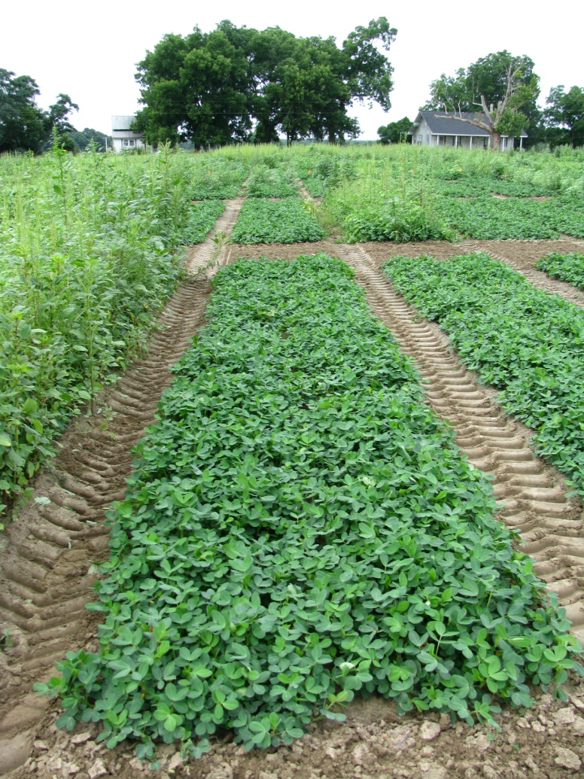
Palmer Amaranth Control - 2010
NTC
Prowl H₂0 3.8ASC @ 34 oz/A (PRE)
Valor SX 51WG @ 3 oz/A (PRE)
Cadre 2AS @ 4 oz/A (June 14)
COC @ 1% v/v (June 14)
PE-03-10
June 29

Slide 11
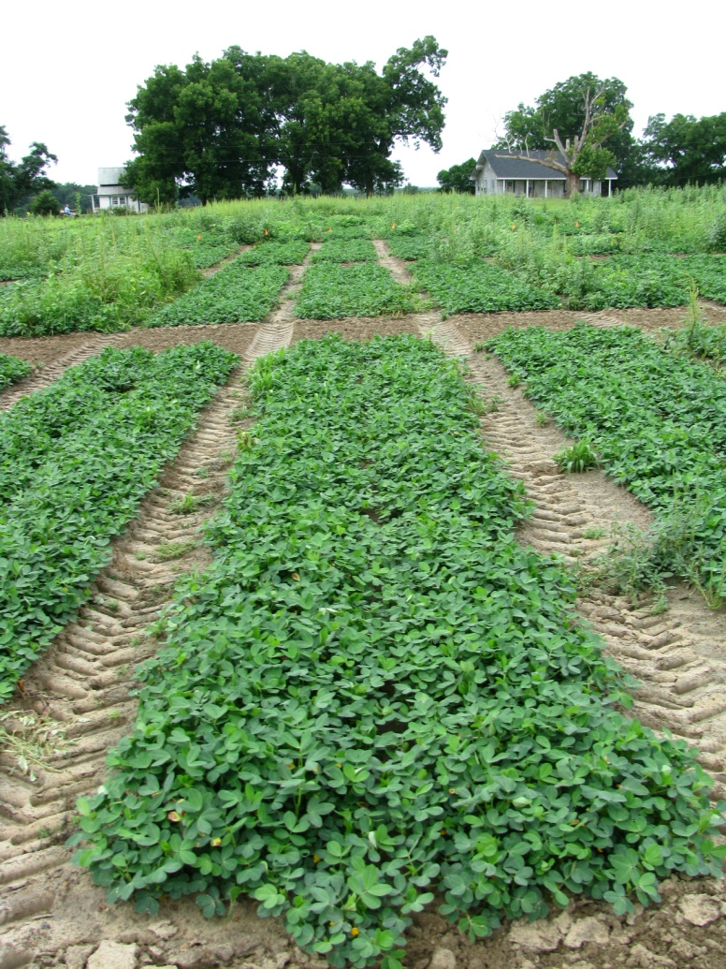
Palmer Amaranth Control - 2010
NTC
Gramoxone Inteon 2SL @ 12 oz/A (June 2)
Storm 4SL @ 16 oz/A (June 2)
Dual Magnum 7.62EC @ 16 oz/A (June 2)
Cadre 2AS @ 4 oz/A (June 14)
Dual Magnum 7.62EC @ 16 oz/A (June 14)
PE-03-10
June 29

Slide 12
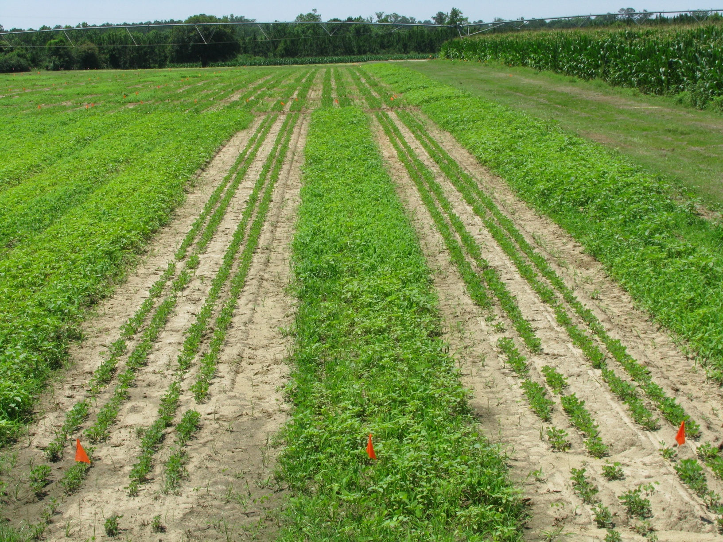
Gramoxone Inteon @ 12 oz/A + Storm @ 16 oz/A + Dual Magnum @ 1 pt/A + 2,4-DB @ 1 pt/A (Left)
NTC (Middle)
Gramoxone Inteon @ 12 oz/A + Storm @ 16 oz/A + Dual Magnum @ 1 pt/A (Right)
May 8, 2010
13 DAT

Slide 13
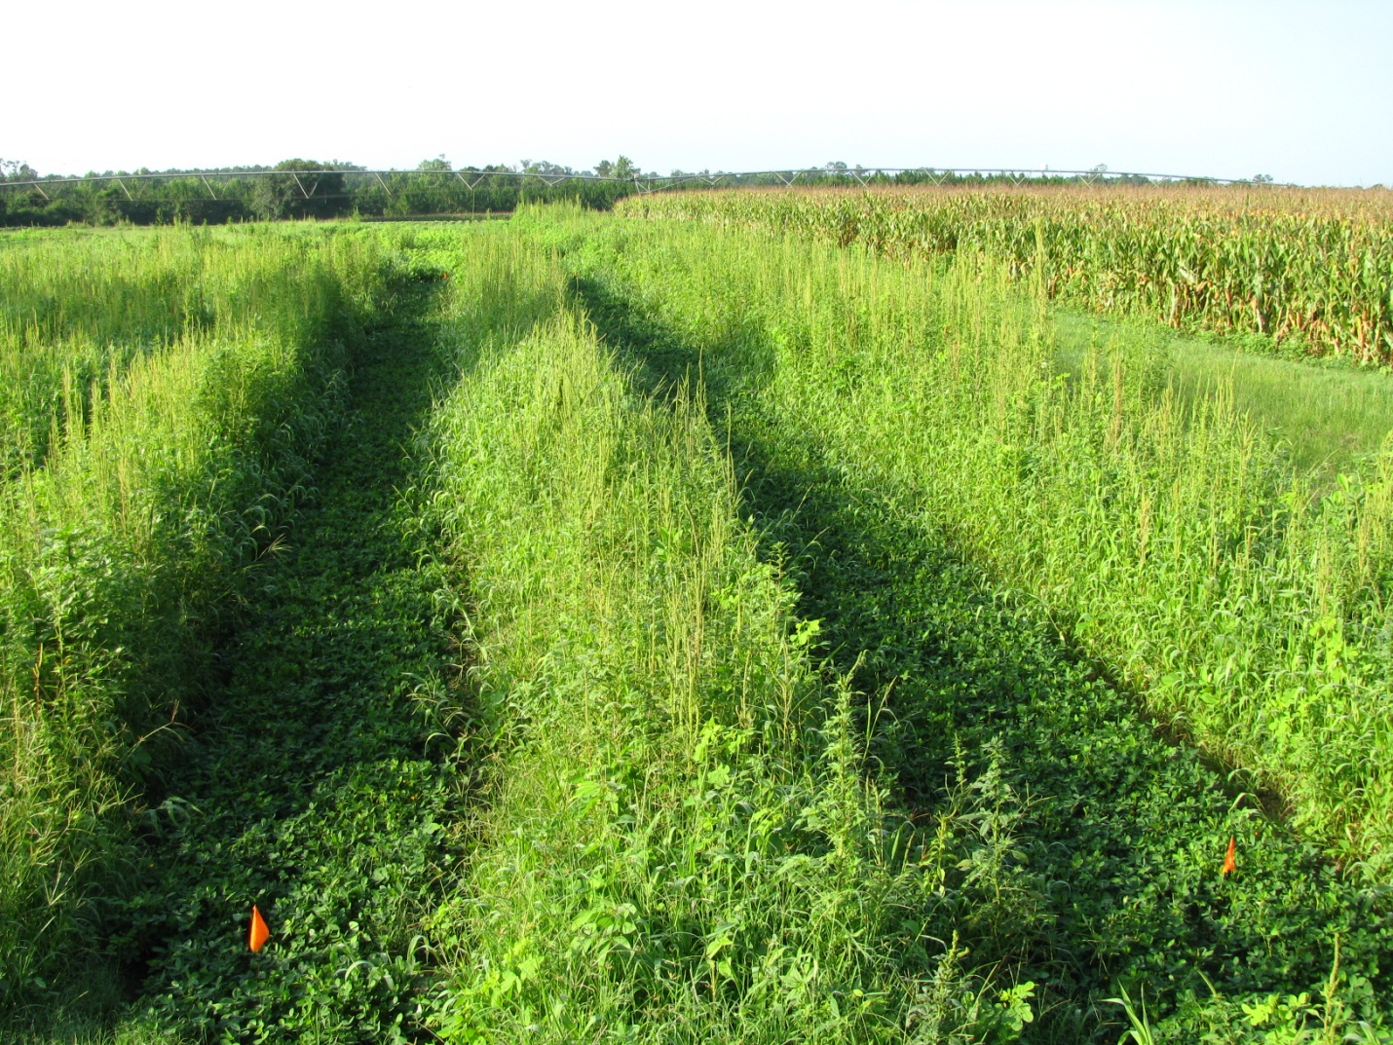
Gramoxone Inteon @ 12 oz/A + Storm @ 16 oz/A + Dual Magnum @ 1 pt/A + 2,4-DB @ 1 pt/A (Left)
NTC (Middle)
Gramoxone Inteon @ 12 oz/A + Storm @ 16 oz/A + Dual Magnum @ 1 pt/A (Right)
May 26, 2010
Cadre @ 4 oz/A + Dual Magnum @ 16 oz/A (June 16)
July 20, 2010
34 DAT (Cadre)

Slide 14
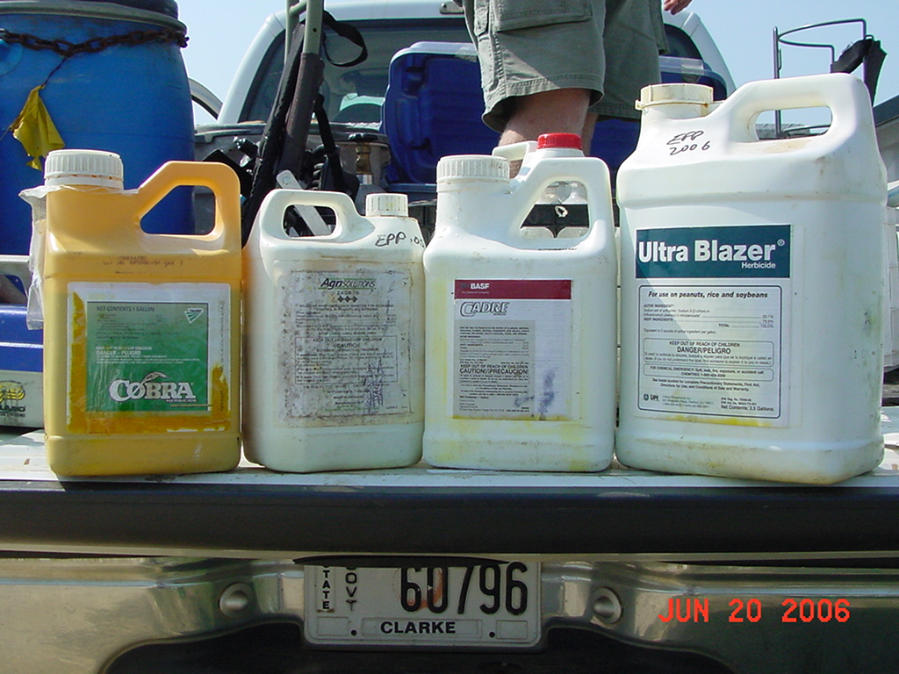
POST Control Options
2,4-DB

Slide 15
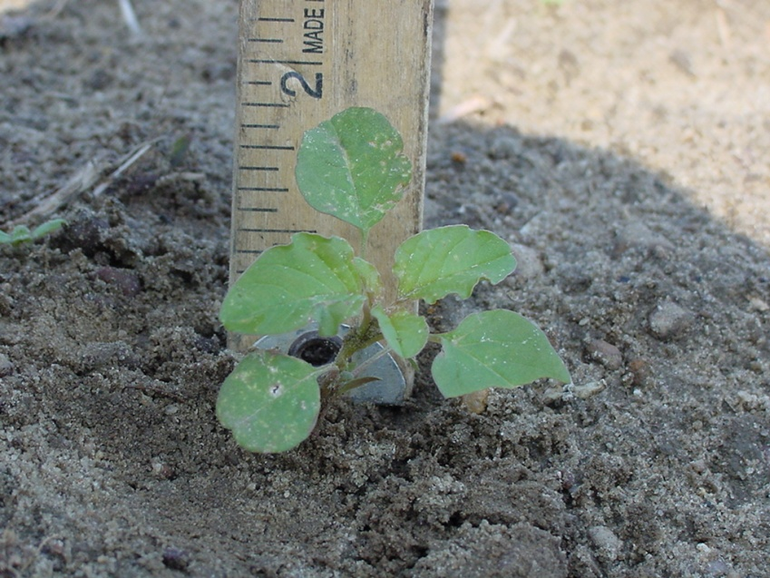
Timing is Critical for POST’s!!!

Slide 16
ALS-Resistant Palmer Amaranth in GA
2005 Survey
First discovered in 2000
ALS Herbicides – Peanut
  Cadre
  Classic
  Pursuit
  Strongarm

Slide 17


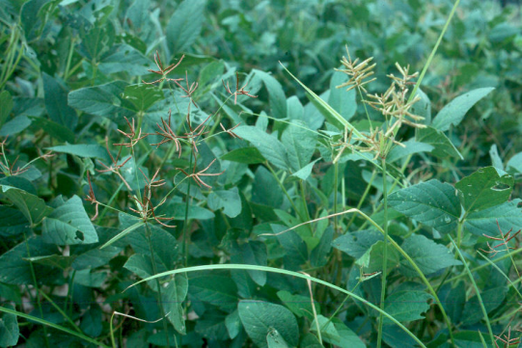
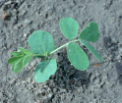
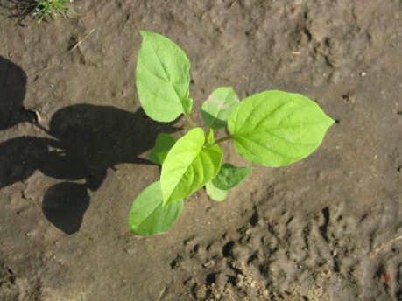
Where does Cadre fit now?
nutsedges
  Only control for purple
sicklepod
morningglory

Slide 18
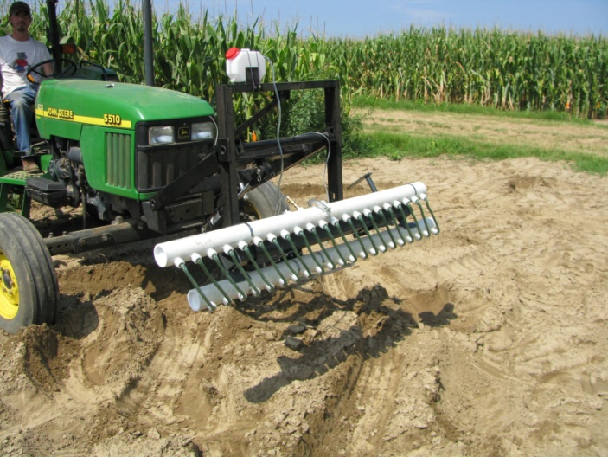
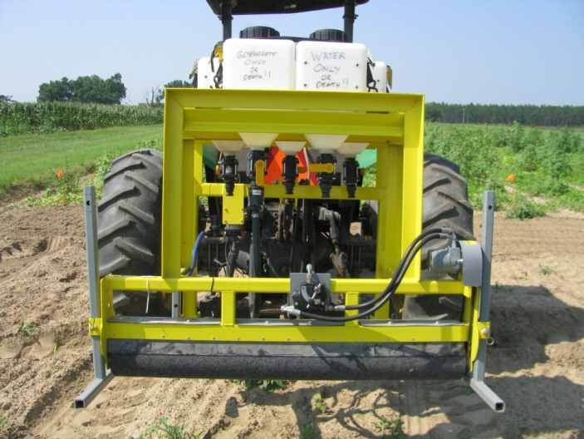
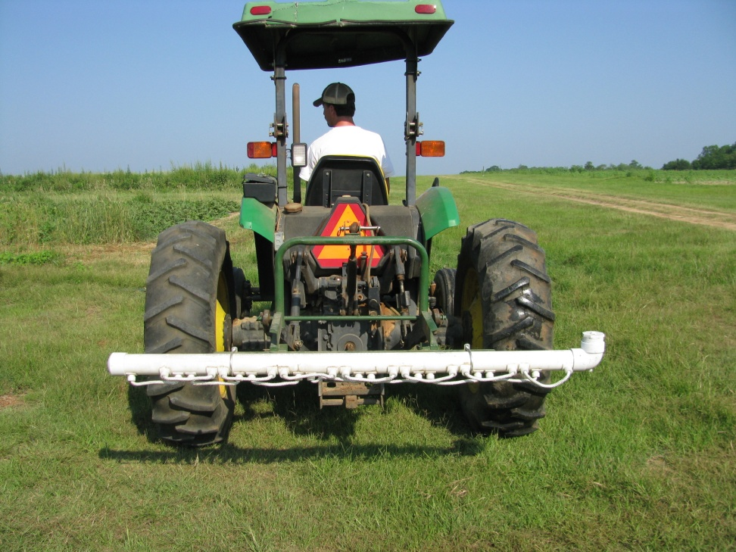
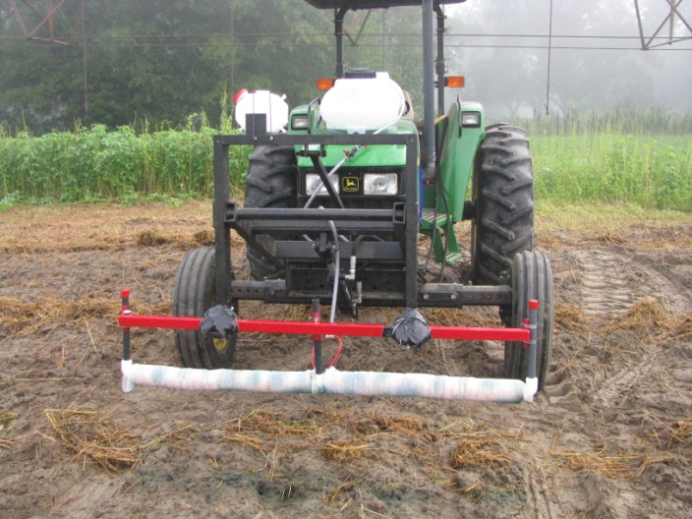
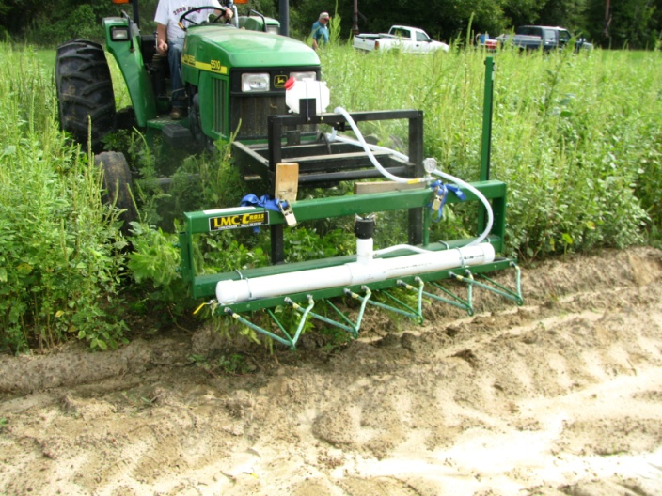
Non-Selective Applicators

Slide 19
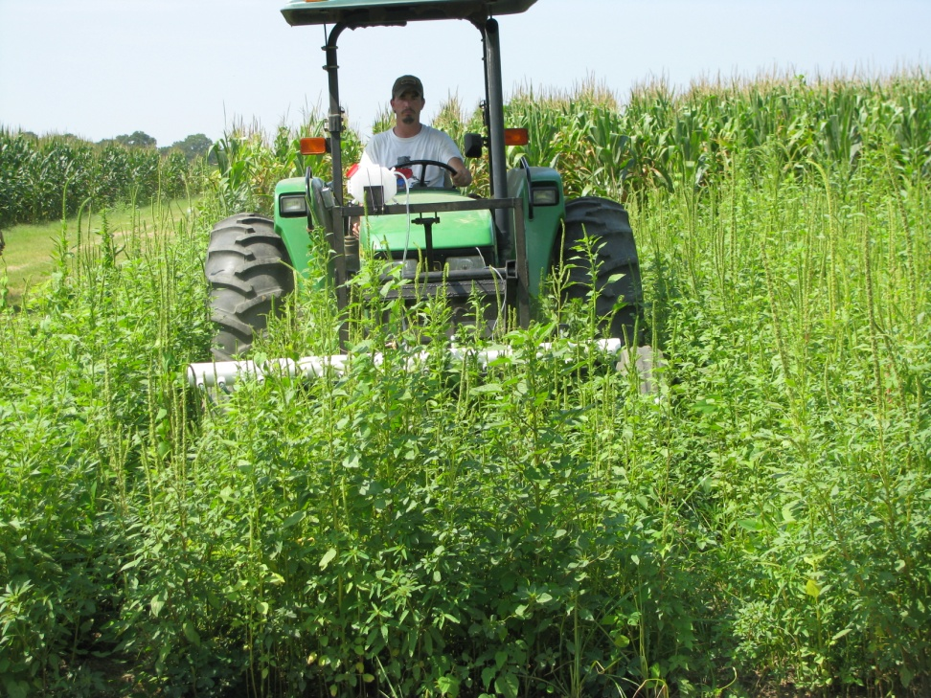
What are the benefits of NSA’s?
Improved harvest efficiency
Improved fungicide deposition
Reduction in weed seed
Cheaper than hand-weeding?
REVENGE!!!!!

Slide 20
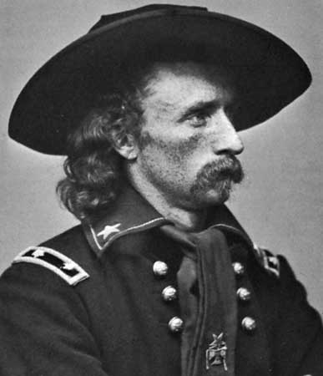
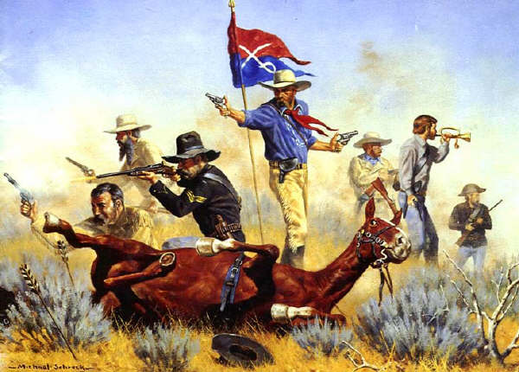
Non-Selective Applicators or
(Custer’s Last Stand)

Slide 21
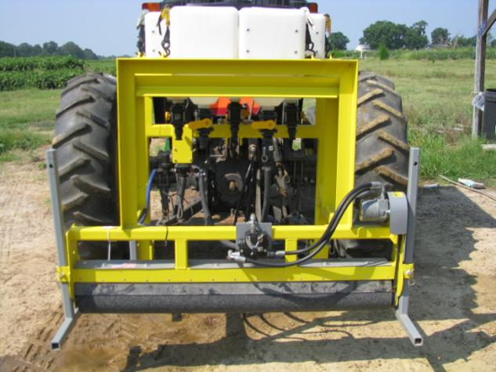

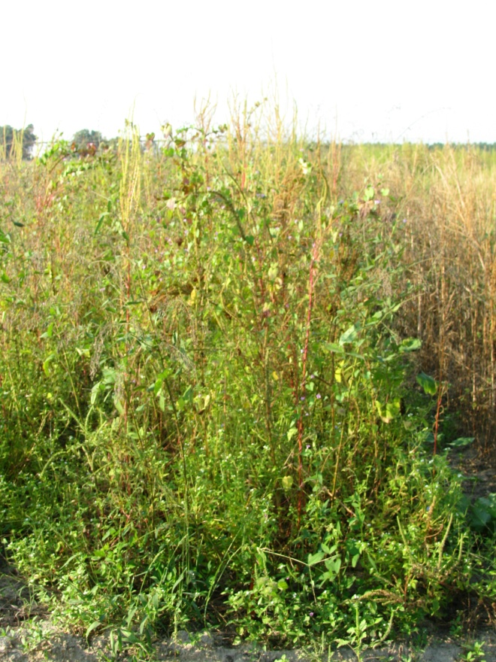
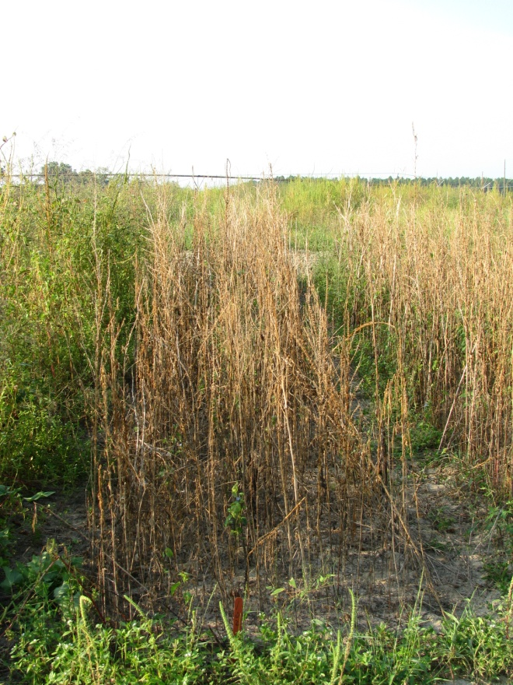
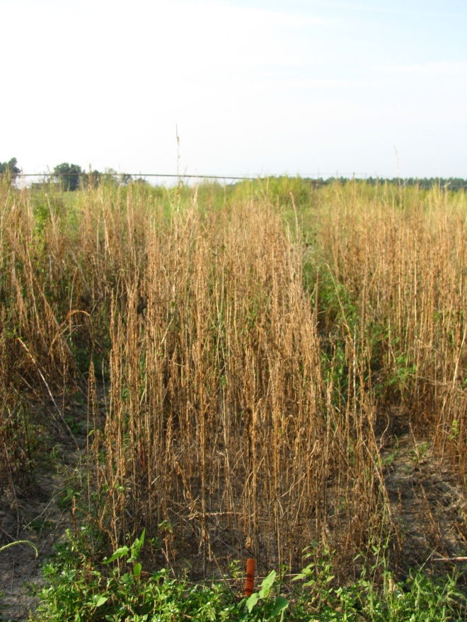
WeedWiper vs. TopCrop Sponge
50% Solution of Gramoxone Inteon
3.1 MPH, 20” Applicator Height
AMAPA = 36-86” tall, 66” avg.
NTC
WeedWiper
TopCrop
PIG-07-10
9/21/10
29 DAT

Slide 22
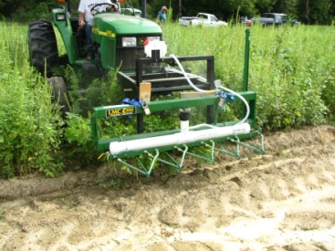
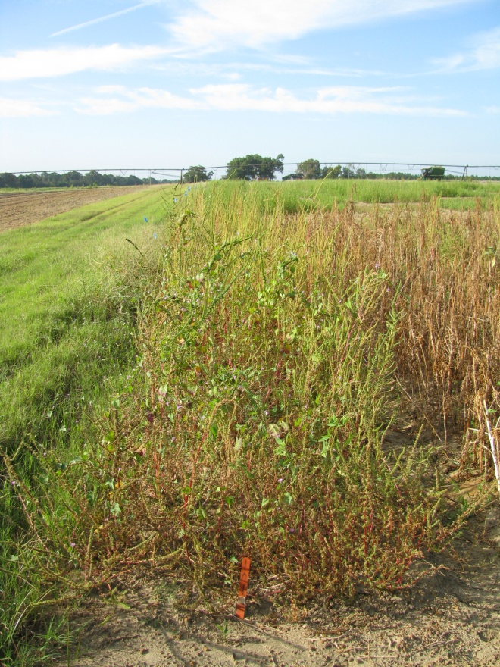
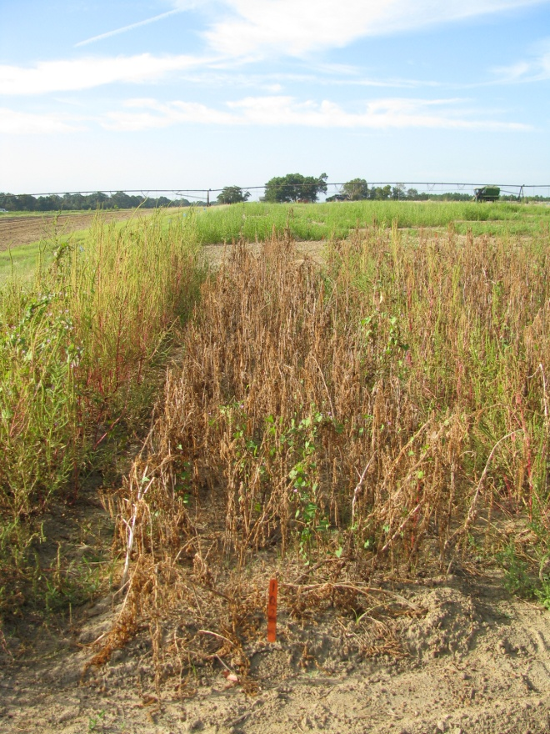
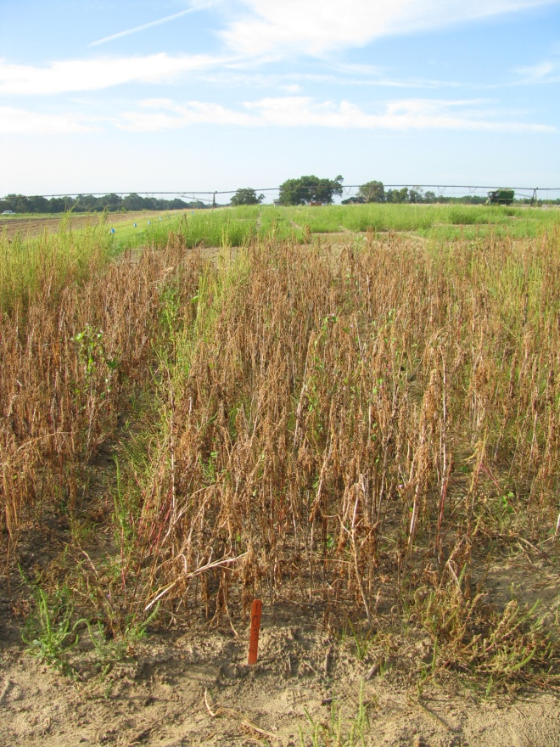
WeedWiper vs. LMC-Cross Wick
50% Solution of Gramoxone Inteon
3.1 MPH, 15” Applicator Height
AMAPA = 16-62” tall, 34” avg.
NTC
WeedWiper
LMC-Cross
PIG-06-10
9/24/10
28 DAT

Slide 23
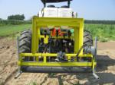
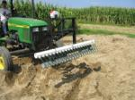
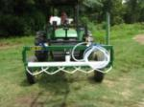

Applicator Costs
20’ Weed Wiper + gauge wheels + 40 gallon tank = $6800
20’ Wickmaster = $5500
6-Row (18’) LMC-Cross Wick Bar = $6225
15’, front mount, pump fed, TopCrop Weed Wiper = $1995

Slide 24


Section 24C SLN
Granted July 27, 2010
Peanuts (GA)
Palmer amaranth
Florida beggarweed

Slide 25


Post-Harvest (Corn) Management
Decreasing daylight hastens flower and seed production
  Flowering (3-4 weeks)
  Seed production (2-3 weeks)
  Some germination at 41⁰F (8%)
Control Options
  Mowing
  Tillage
  Herbicides
    Gramoxone + 2,4-D or dicamba
    Residuals i.e. Dual Magnum?
When can we stop worrying about seed production?
Keeley et al. 1987. Weed Science 35:199-204
Steckel et al., 2004. Weed Science 52:217-221

Slide 26
Palmer Amaranth Control Tactics
Start Clean!!!!!
Irrigation
Tillage
Extreme Cover Crops
Residual Herbicides
Timely POST’s
Others
  Hand-Weeding
  Non-Selective Applicators

Slide 27

Questions?
www.gaweed.com

