Slide 1
2013
Field Corn/Grain Sorghum
Weed Management Update
Eric P. Prostko, Ph.D.
Professor and Extension Weed Specialist
Dept. Crop & Soil Sciences

Slide 2

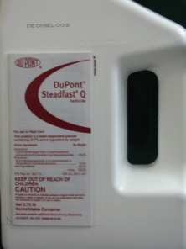


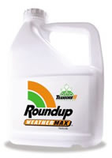
Field Corn
For most in GA …….
  Atrazine +
    Glyphosate (RR corn)
    Liberty (LL corn)
    Steadfast Q
    Laudis or Capreno
    Halex GT (glyphosate + Callisto + Dual)
If I was King, I would make you spray 1 qt/A Atrazine PRE fb 1.5 qt/A + 1 of the above!

Slide 3
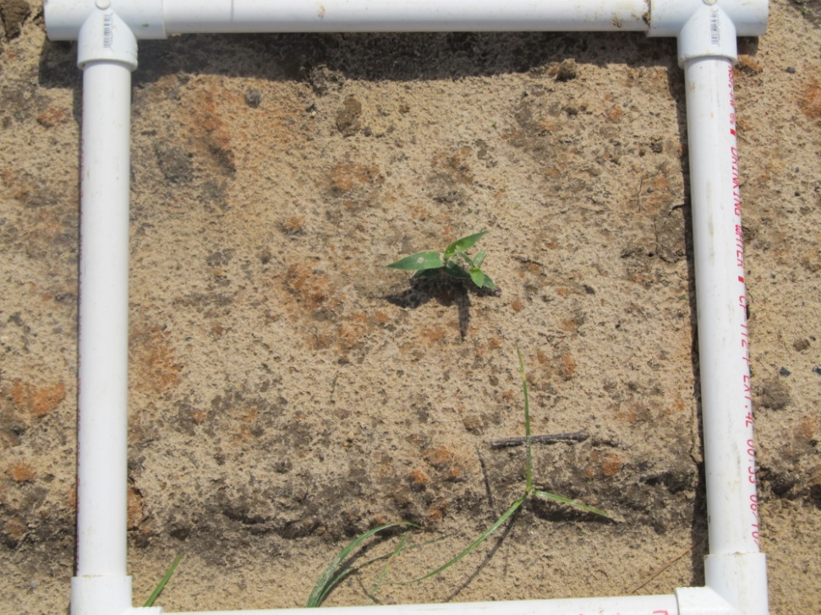
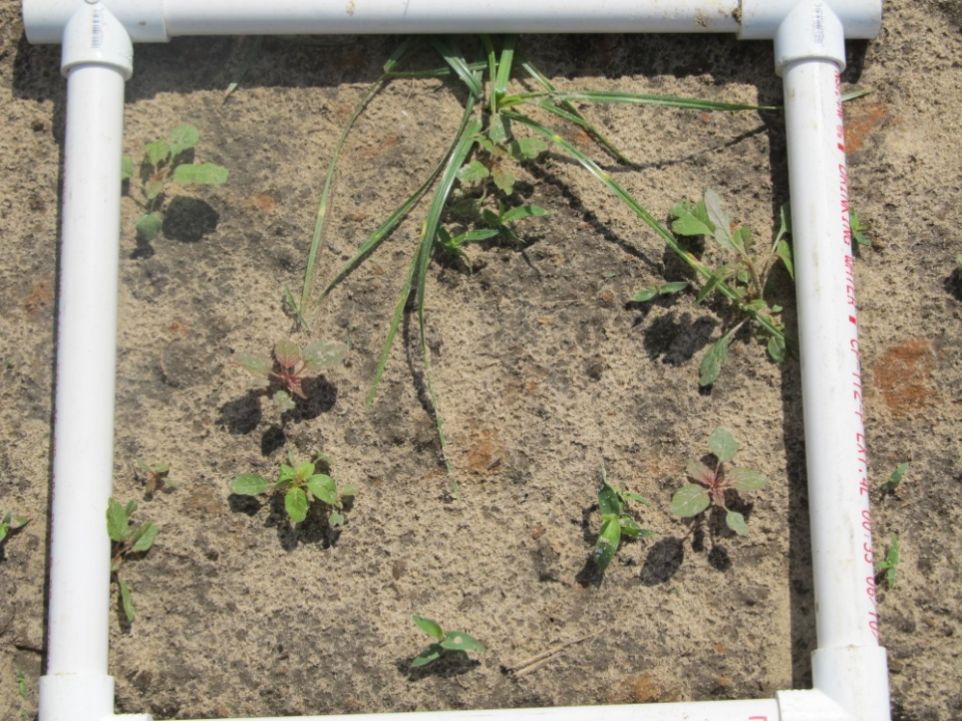
Benefits of Atrazine (1 qt/A) Applied PRE – 18 DAT
0 Pigweed/ft²
8 Pigweed/ft²
(348,480/A)

Slide 4
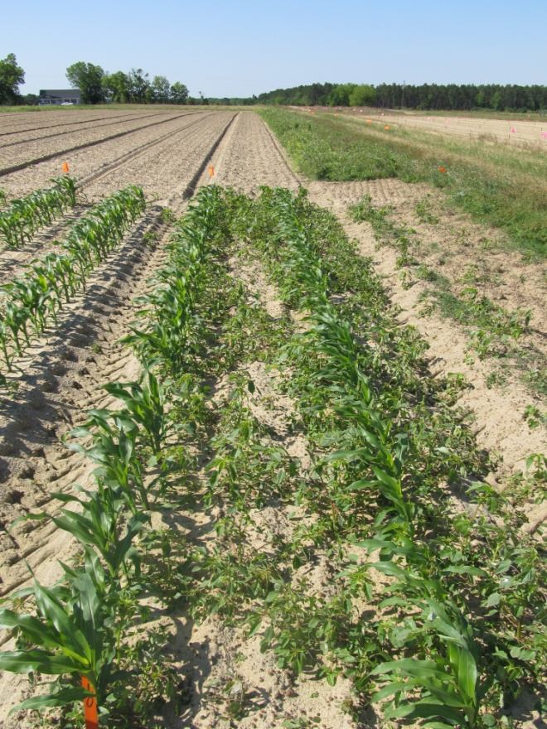
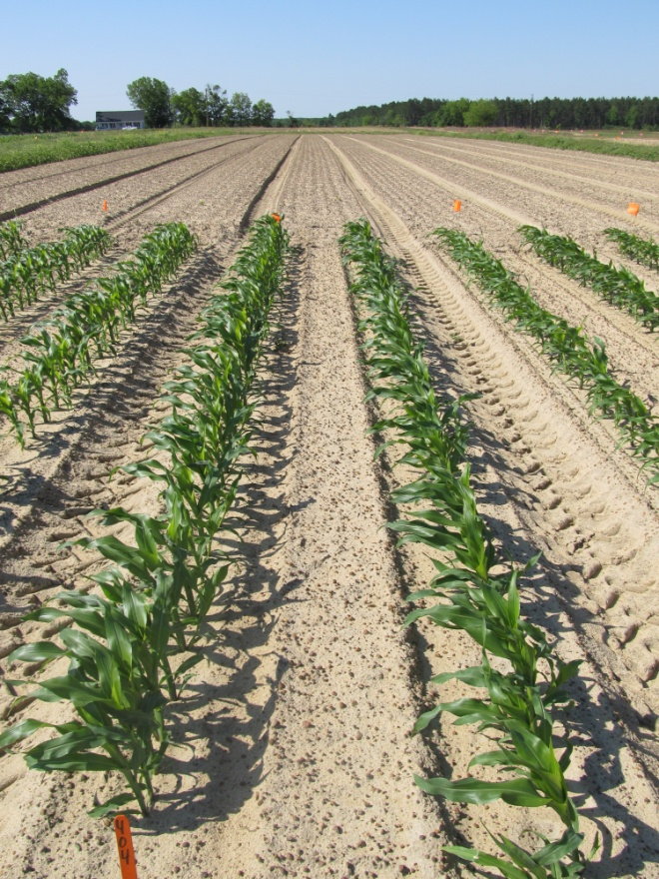
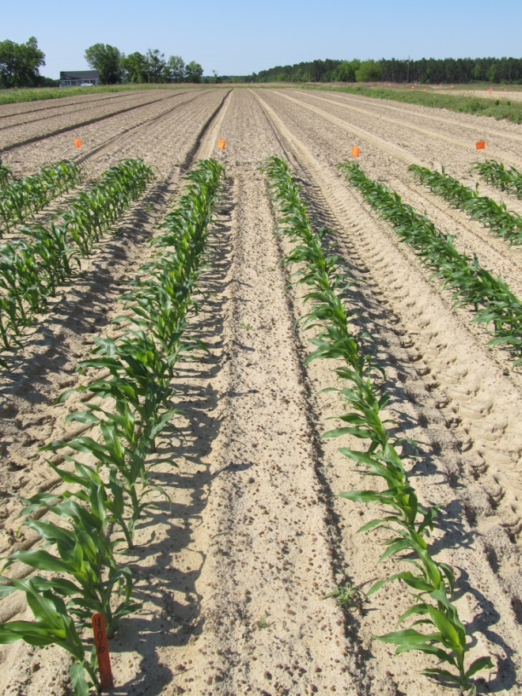
The Power of a PRE Herbicide
NTC
Dual II Magnum 7.64EC
1 pt/A
(PRE)
Atrazine 4L
1 qt/A
(PRE)
CN-13-12
April 24
28 DAT

Slide 5
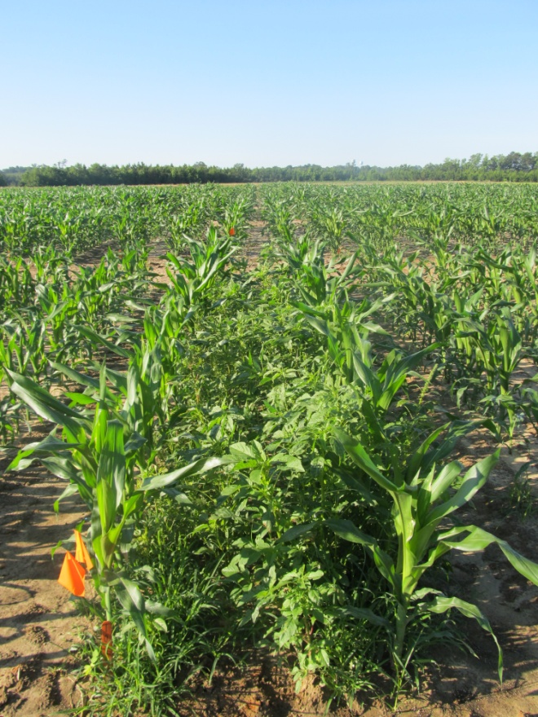
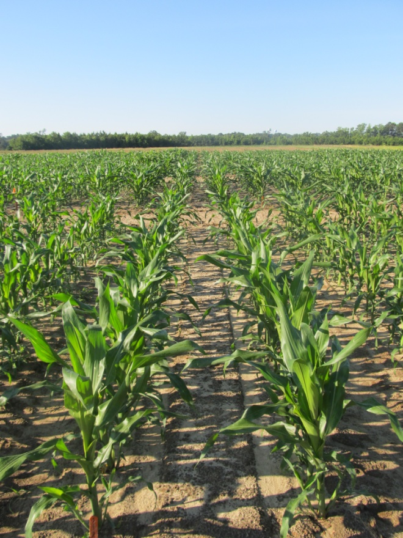
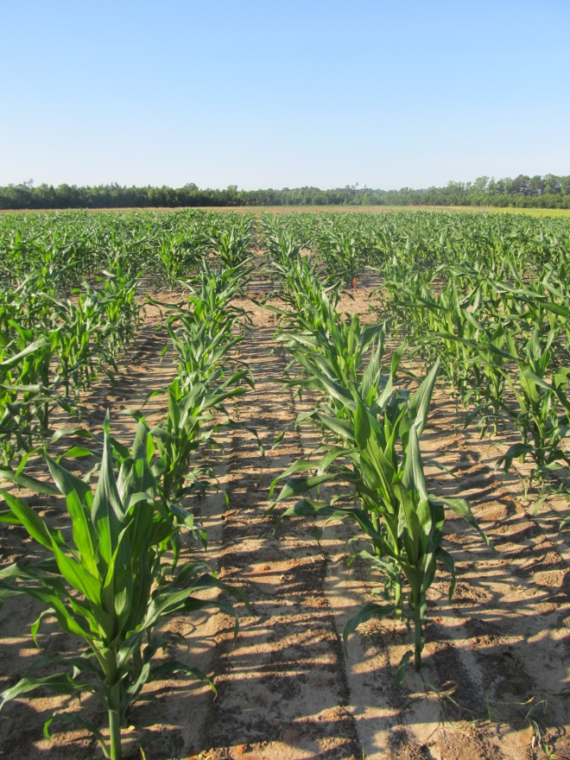
Field Corn Weed Control - 2012
NTC
Atrazine @ 32 oz/A (PRE)
fb
Roundup WM @ 22 oz/A (29 DAP)
Atrazine @ 48 oz/A (29 DAP)
Atrazine @ 32 oz/A (PRE)
fb
Liberty @ 29 oz/A (29 DAP)
Atrazine @ 48 oz/A (29 DAP)
AMS XTRA @ 2.5% v/v (29 DAP)
CN-11-12
May 11
39 DAP

Slide 6
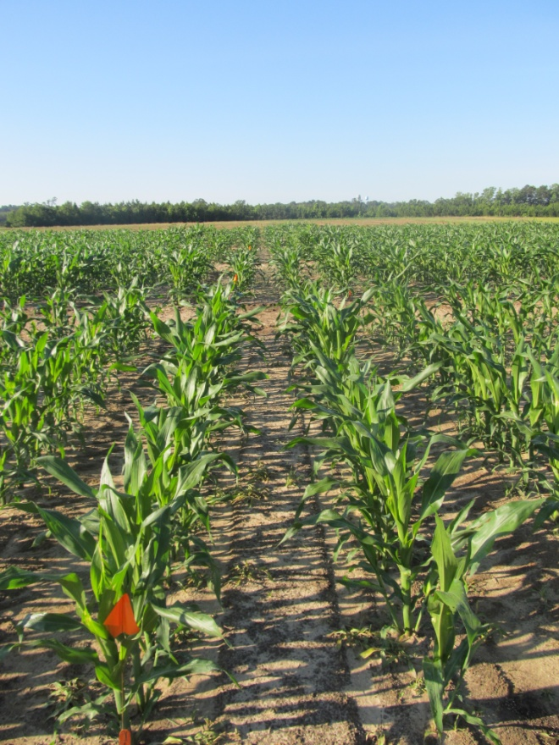
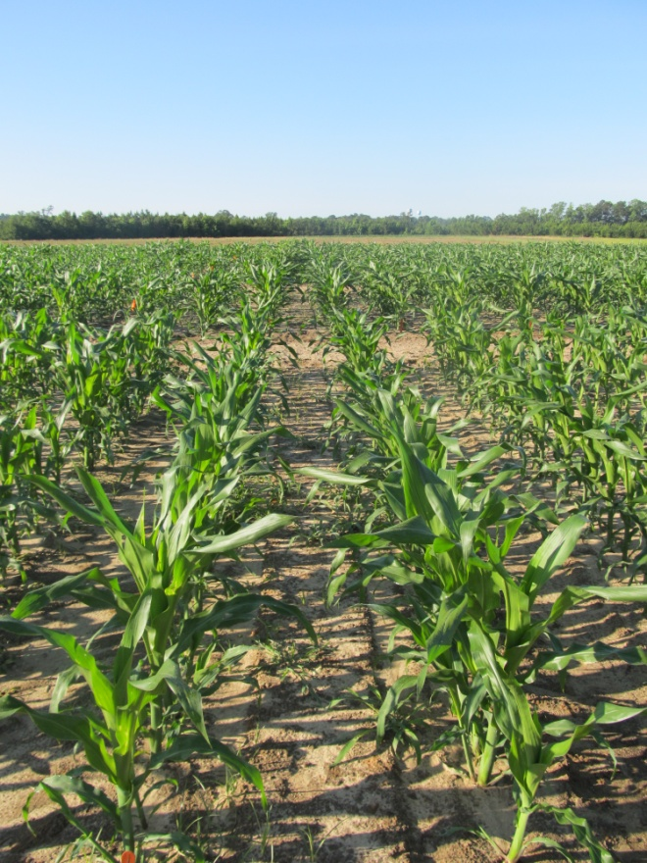
Field Corn Weed Control - 2012
NTC
Atrazine @ 32 oz/A (PRE)
fb
Steadfast Q @ 1.5 oz/A (29 DAP)
Atrazine @ 48 oz/A (29 DAP)
COC @ 1% v/v (29 DAP)
Atrazine @ 32 oz/A (PRE)
fb
Halex GT @ 3.6 pt/A (29 DAP)
Atrazine @ 48 oz/A (29 DAP)
COC @ 1.0% v/v (29 DAP)
CN-11-12
May 11
39 DAP

Slide 7
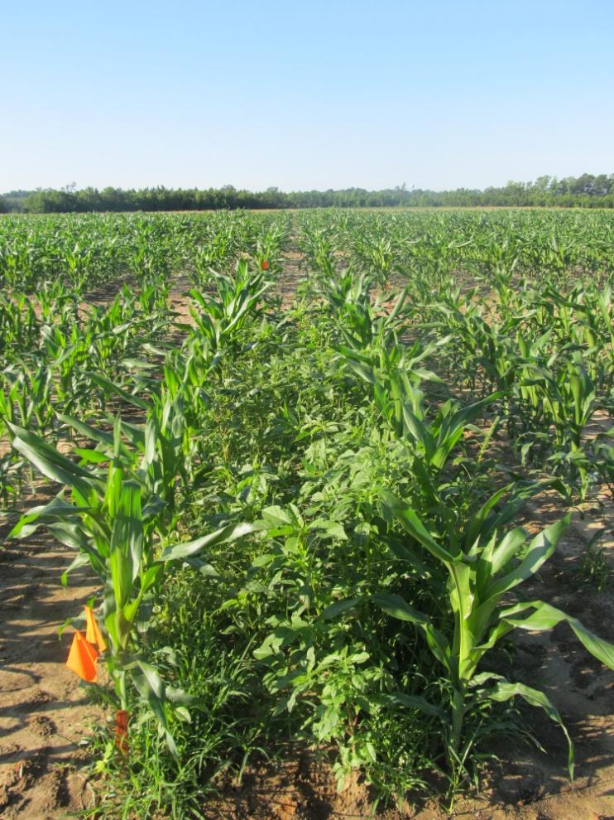
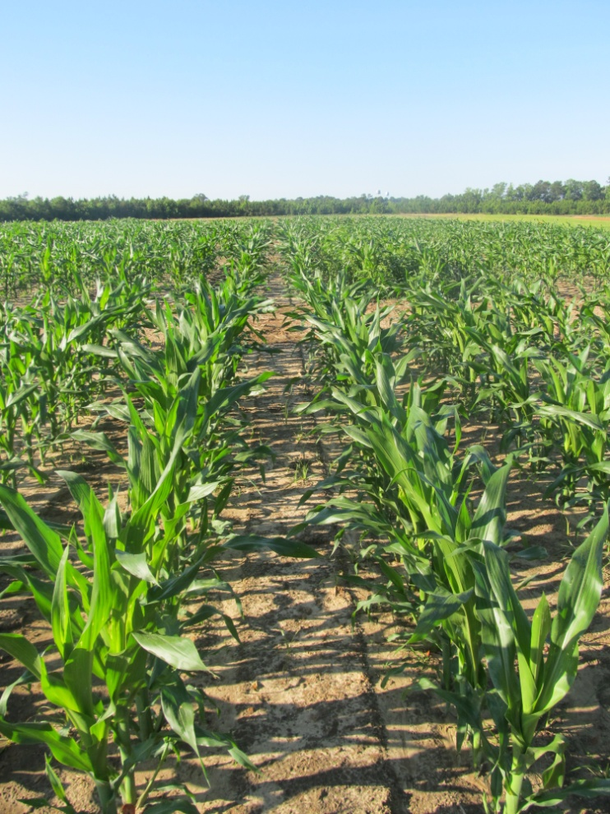
Field Corn Weed Control - 2012
NTC
Capreno @ 3 oz/A (22 DAP)
Atrazine @ 48 oz/A (22 DAP)
COC @ 1% v/v (22 DAP)
AMX XTRA @ 2.5% v/v (22 DAP)
CN-11-12
May 11
39 DAP

Slide 8
Corn Yield As Influenced By POST Herbicide Treatment - 2012
LSD 0.10 = 24
CV = 10
Bu/A
Treatment
CN-12-12
Ponder Farm

Slide 9
Capreno
Bayer CropScience
Thiencarbazone-methyl (0.57 lb/gal) (MOA = 2)
Tembotrione (2.88 lbs/gal) (MOA = 27)
  Laudis
Isoxadifen (crop safener)
3.45 SC formulation
POST corn
  OT Up until V1-V6; PDIR – V7
3 oz/A of Capreno
  2.5 oz/A Laudis, normal rate is 3 oz/A
COC + AMS or UAN
OP/ALS Soil Interaction
Rotation Restrictions
  Corn = 0 months; wheat = 4 months; cotton, soybean, sorghum = 10 months; peanut = 12 months; canola, tobacco = 18 months
Tank-Mixes
  Atrazine, Ignite, Glyphosate

Slide 10
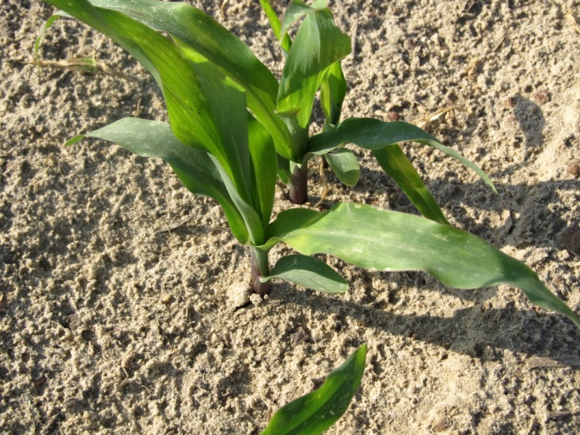
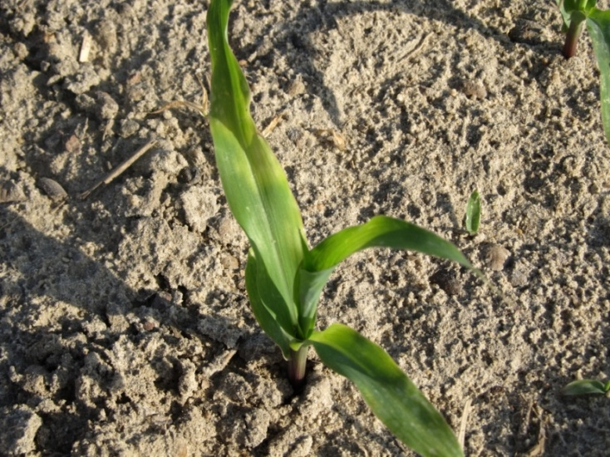
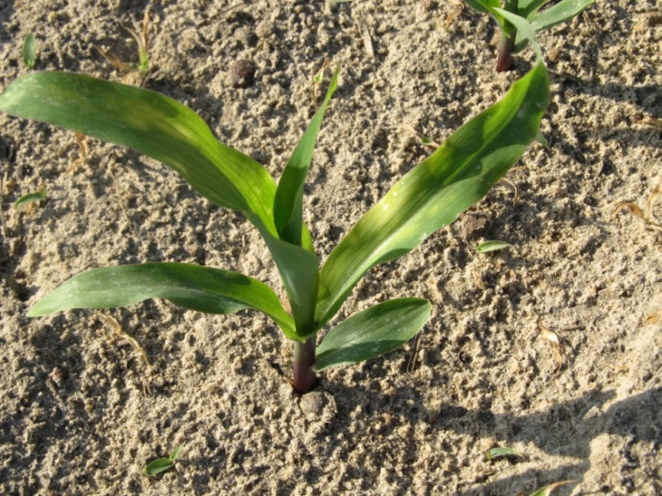
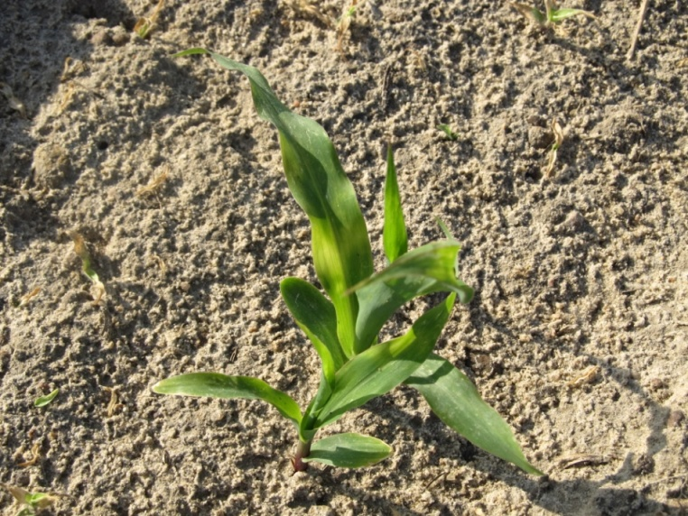
POST Capreno Injury - 5 DAT
Did it matter?
CN-08-12
April 11

Slide 11
Corn Yield As Influenced By POST Applied Halex GT and Capreno - 2012
Bu/A
LSD (0.10) = 30
CV = 16
LSD (0.10) = 30
CV = 14
LSD (0.10) = 27
CV = 15
LSD (0.10) = 24
CV = 10
Trial

Slide 12

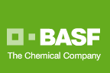
Zidua 85WG
PPI, PRE, EPOST (V4)
Pyroxasulfone (KIH-485)
Residual control of annual grasses and certain broadleaf weeds including pigweed
Same MOA as Dual or Warrant but used at lower rates. May also be better on FL beggarweed ?
Use rates: 1.0-2.75 oz/A
  $6.50/oz?
Registered June 2012

Slide 13
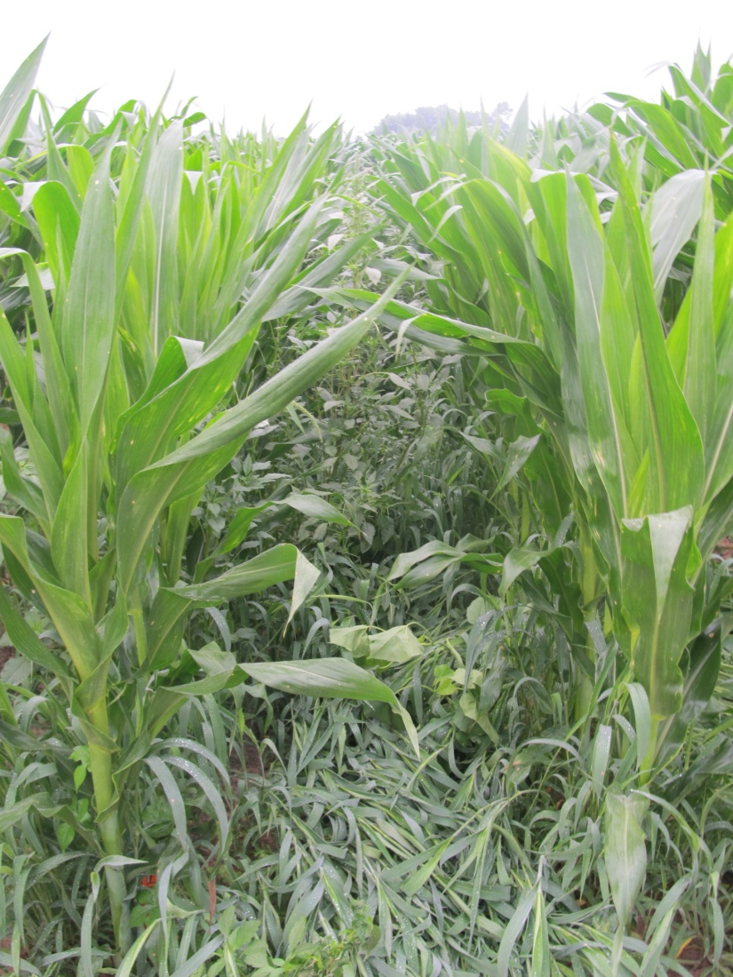
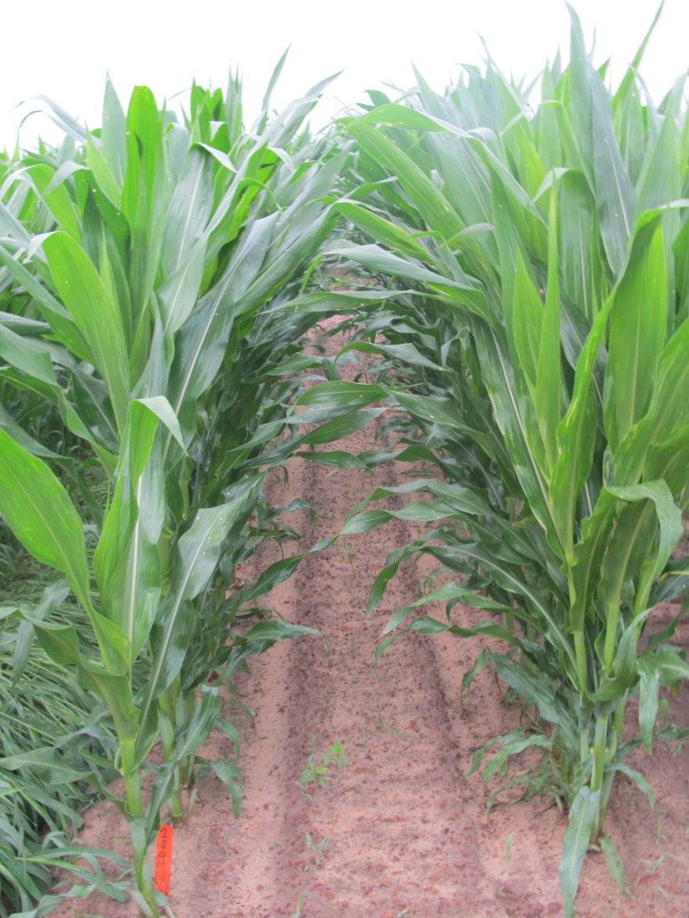
Weed Control in Field Corn with Zidua Programs - 2012
NTC
Zidua 85WG @ 2 oz/A (PRE)
Status 56WG @ 5 oz/A (POST)
Roundup WM 5.5SL @ 22 oz/A (POST)
NIS @ 0.25% v/v (POST)
AMS XTRA @ 2.5% v/v (POST)
CN-08-12
May 16
29 Days after POST

Slide 14
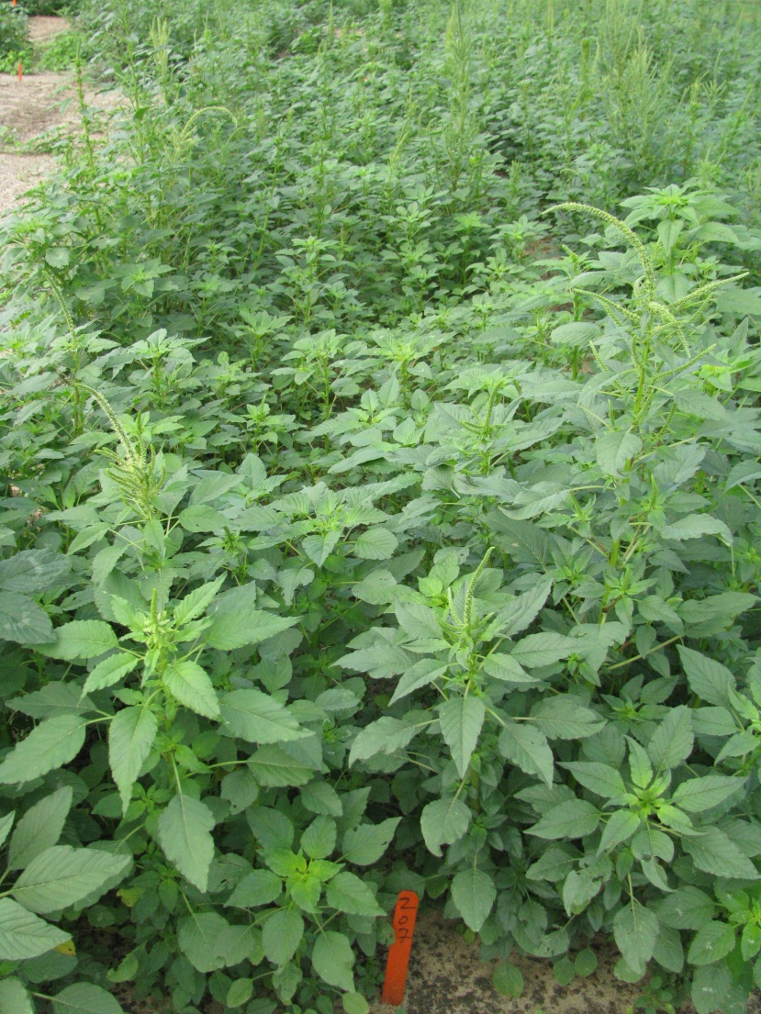
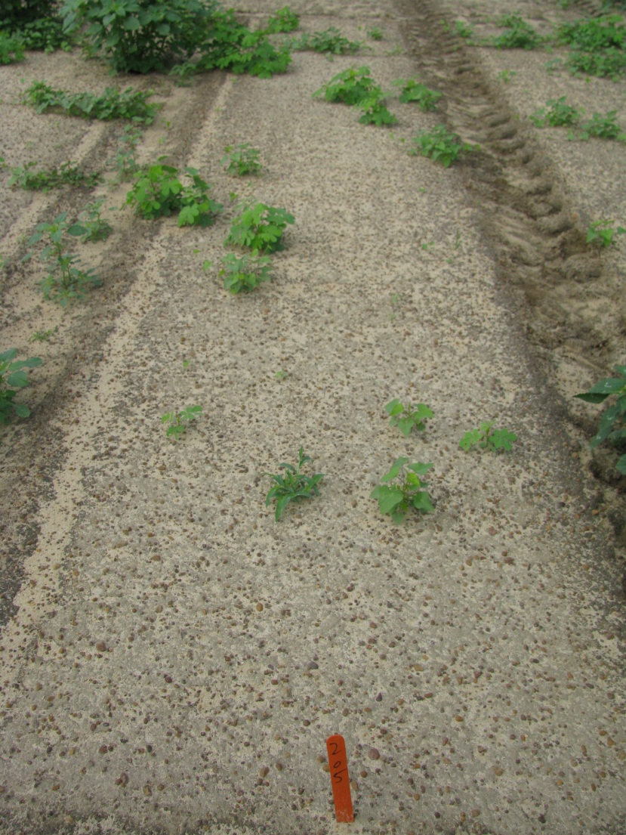

Residual Weed Control with Zidua – 5 WAT
NTC
Zidua 85 WG
@ 1.5 oz/A
NC-05-11
Notes:
Pyroxasulfone does exhibit excellent residual control of troublesome weeds such as Palmer amaranth, Texas panicum, and large crabgrass.
Texas panicum control is rate dependent.

Slide 15


Anthem 2.15SE
  Cadet (0.0632 lb/gal) + Zidua (pyroxasulfone) (2.0868 lb/gal)
  Residual control of annual grasses and certain broadleaf weeds including pigweed
  Use rate: 3.5-8.0 oz/A (?)
Anthem ATZ 4.5SE
  Cadet (0.014 lb/gal) + Zidua (pyroxasulfone) (0.475 lb/gal) + Atrazine (4.011 lb/gal)
  1.75-2.5 pt/A
Registered on ??

Slide 16
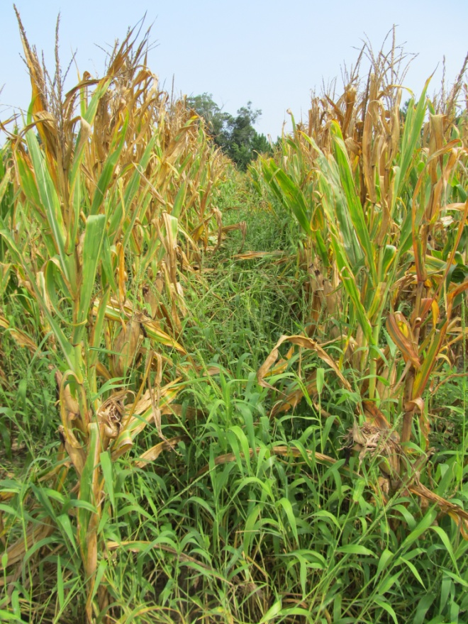
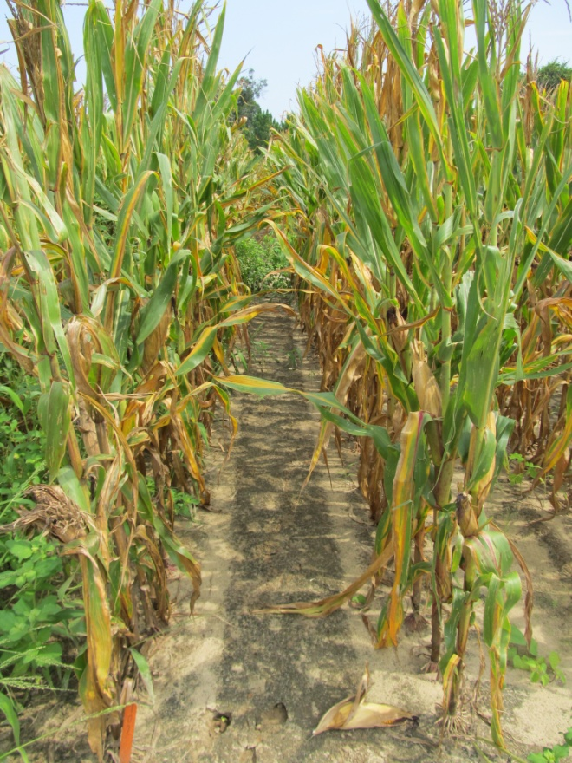

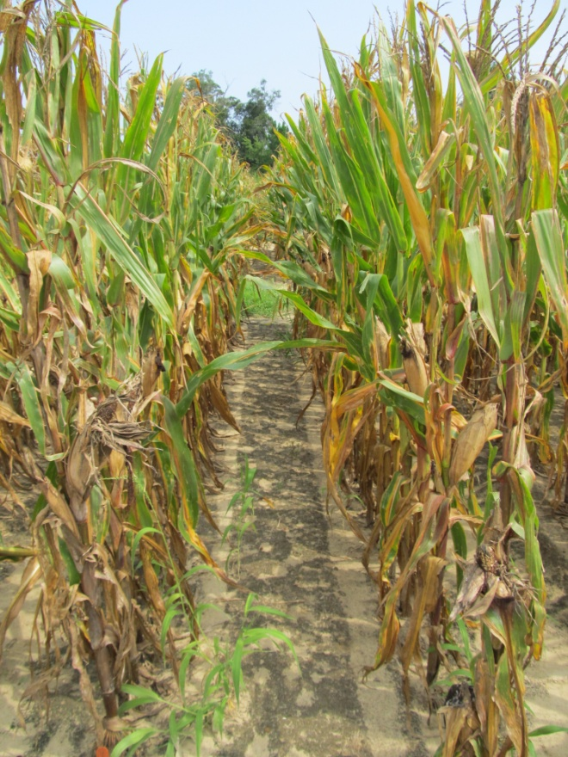
Weed Control in Field Corn with Anthem/Anthem ATZ - 2012
NTC
Anthem 2.15SE @ 8 oz/A (PRE)
fb
Roundup WM 5.5SL @ 22 oz/A (29 DAP)
Anthem ATZ 4.5SE @ 2 pt/A +
Roundup WM 5.5SL @ 22 oz/A
(18 DAP)
CN-12-12
July 26
115 DAP

Slide 17
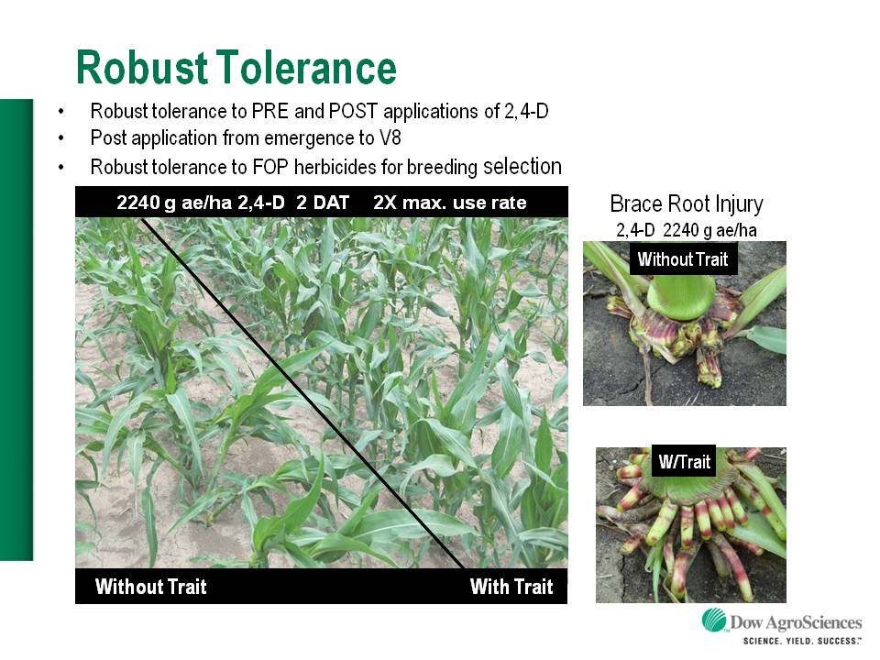

Enlist™ Herbicide Tolerant Corn
tolerance to 2,4-D and Assure
Colex-D™ technology
  2,4-D choline
  lower volatility
  lower drift potential
  enhanced handling/mixing characteristics
  reduced odor
1 PRE application + 2 POST applications (V8 stage)
Enlist™ Duo
  DMA-Glyphosate (1.71 lb ae/gal) + 2,4-D choline (1.63 lb ae/gal)
  3.5 pt/A
2013 Product Launch (Mid-West)

Slide 18
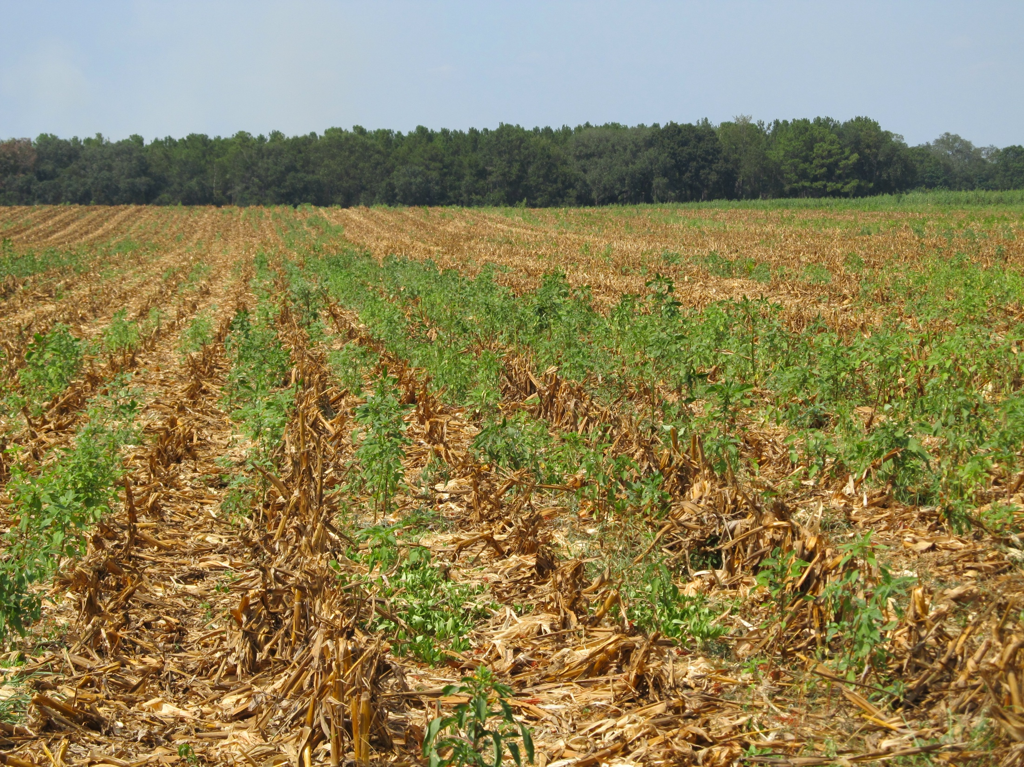
Post-Harvest Palmer Amaranth Populations Must be Managed!

Slide 19
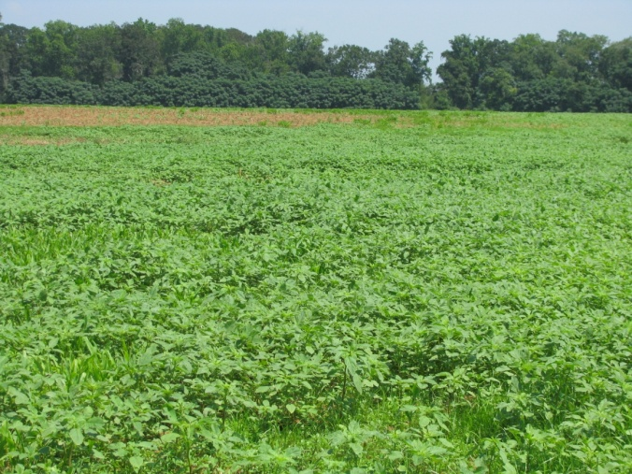
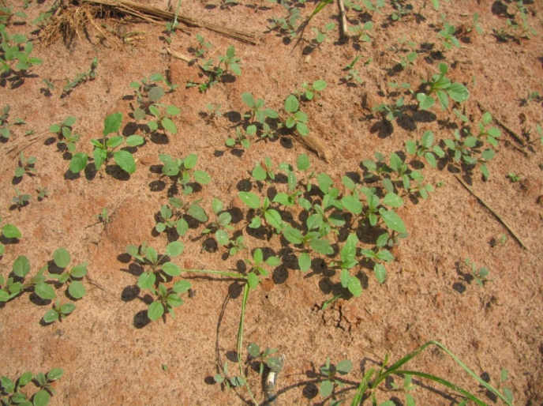
Post-Harvest (Corn) Pigweed Problems
Decreasing daylight hastens flower and seed production
  Flowering (3-4 weeks)
  Seed production (2-3 weeks)
  Some germination at 41⁰F (8%)
Control Options
  Mowing/Tillage (>6” weeds)
  Herbicides (<6” weeds)
    No small grain
      Gramoxone + Dual Magnum or Warrant (?)
    Small Grain planted soon
      Gramoxone + 2,4-D or dicamba
When can we stop worrying about seed production?
Keeley et al. 1987. Weed Science 35:199-204
Steckel et al., 2004. Weed Science 52:217-221

Slide 20
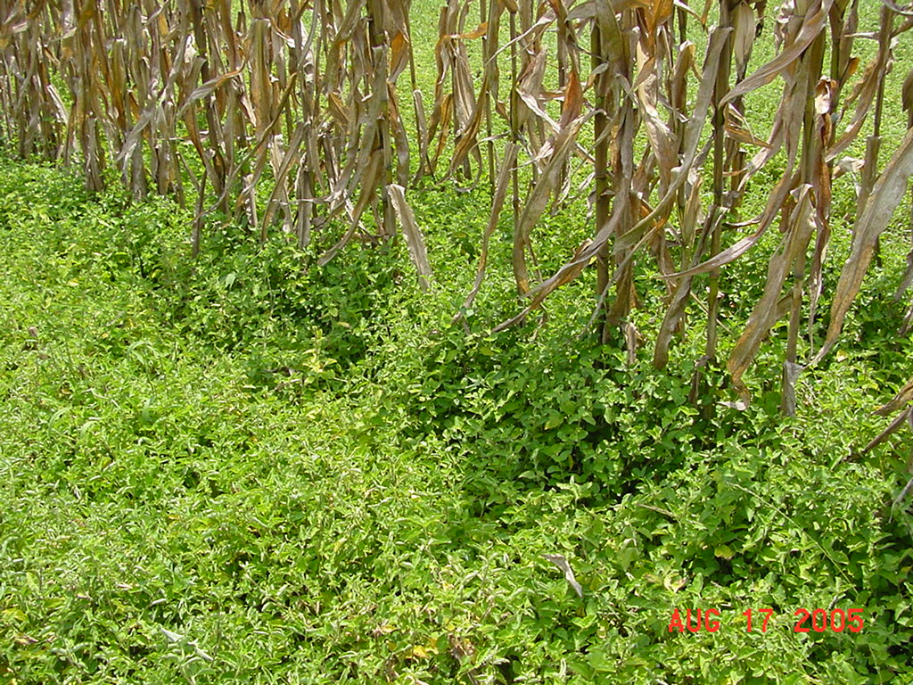

Slide 21
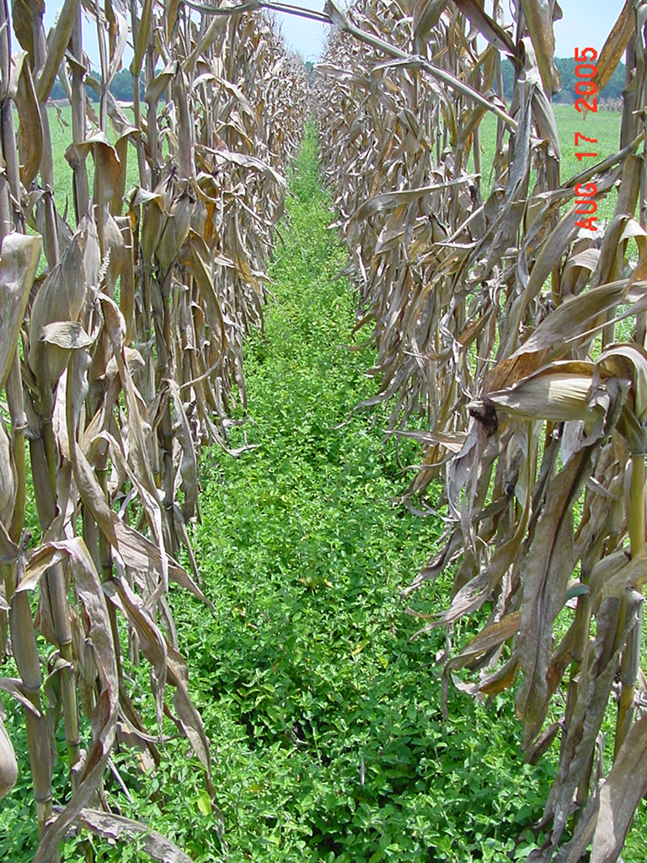
TSW Control in Field Corn
Depends on planting date
2,4-D or Aim – POST
Sequence + Atrazine or Expert in RR corn
Aim/Gramoxone/Evik + Dual Magnum – layby
Post-harvest may be more important than in-crop
  Tillage
  2 applications of 2,4-D, Gramoxone, or Aim

Slide 22
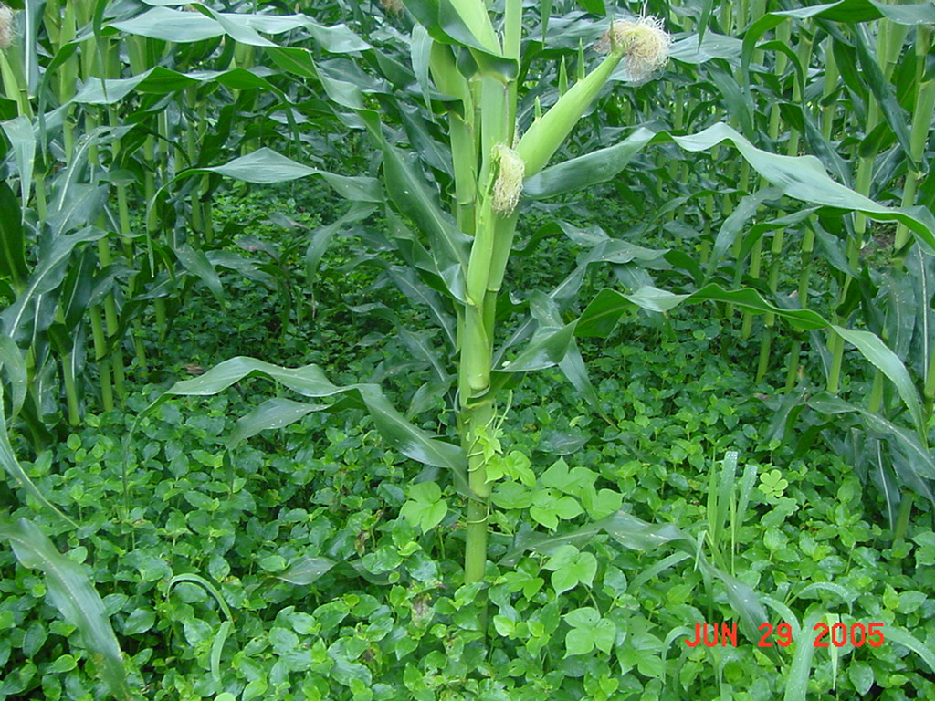
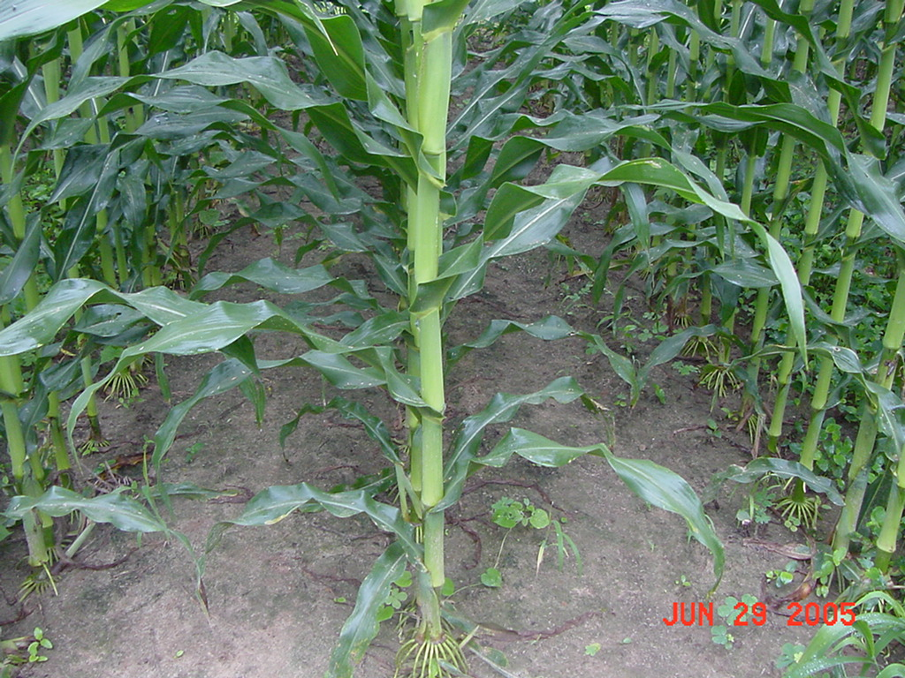
Tropical Spiderwort Control in Field Corn - 2005
Untreated
(166 bu/A)
Aim 2EC @ 1.5 ozs/A
Dual Magnum 7.62EC @ 1.33 pt/A
Herbimax @ 1% v/v
(168 bu/A)
34 DAT

Slide 23
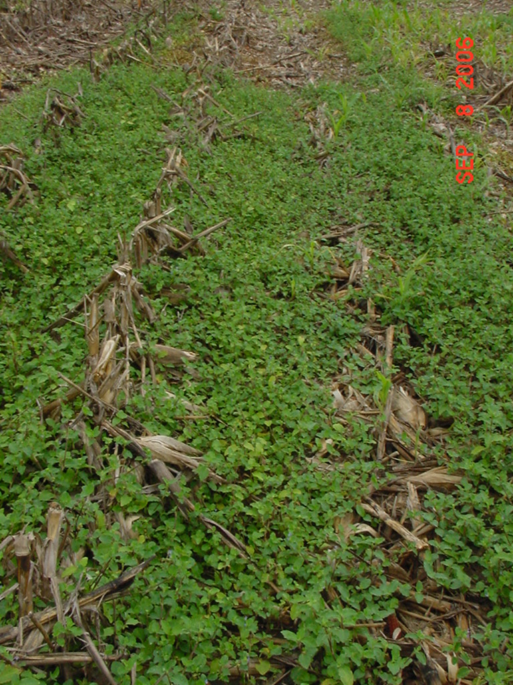
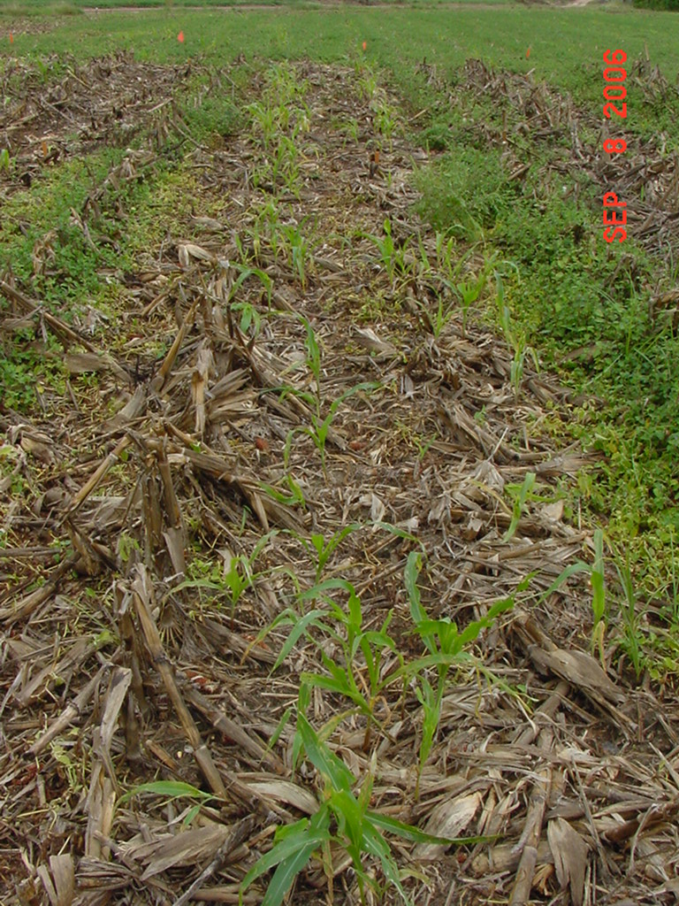
Post-Harvest Control of Tropical Spiderwort
Untreated
2,4-D @ 1.5 pt/A
POST1 + POST 2
($14.41/A)
POST1: 8-10” tall COMBE
POST2: 2 weeks later
Photo 1 week after POST2

Slide 24
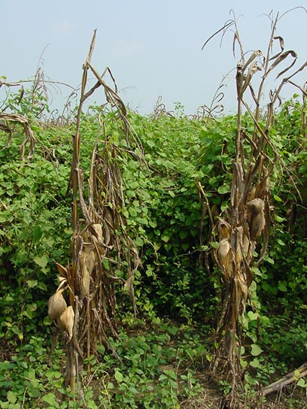
Morningglory Control in Corn
as much atrazine as possible
1.0 lb/A – PRE fb 1.5 lb/A – POST
  small grain rotations
2,4-D, Clarity, Status, Aim, ET
Liberty-Link® Corn Systems
split applications of glyphosate (RR corn)
  * 1st application + atrazine
Harvest Aids
  Aim
Early harvest

Slide 25
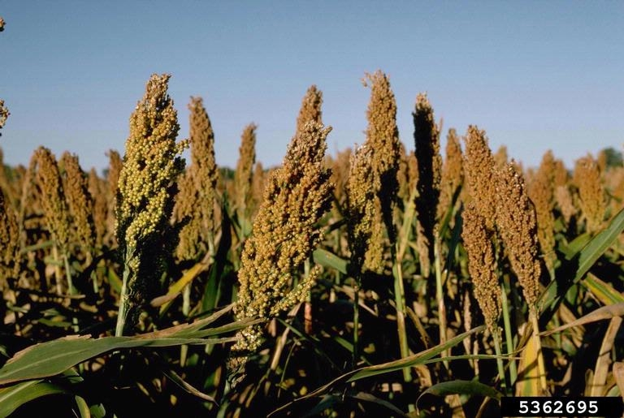
Grain Sorghum

Slide 26
GRAIN SORGHUM WEED CONTROL
Start clean!
Concep treated seed
Dual Magnum or Intrro/Micro-Tech or Warrant (PRE)
Atrazine (POST)
Paraquat (Hooded sprayer)

Slide 27
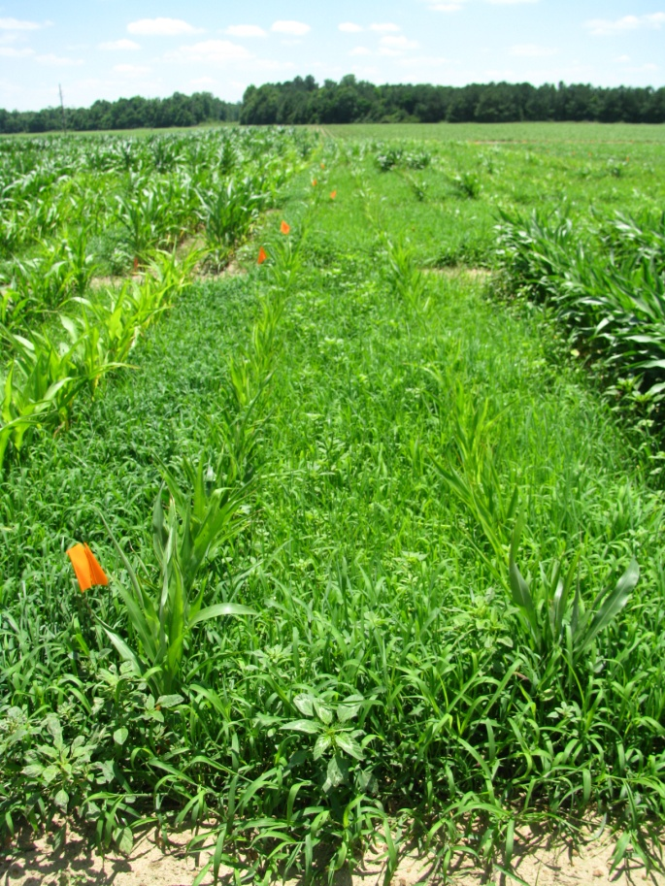
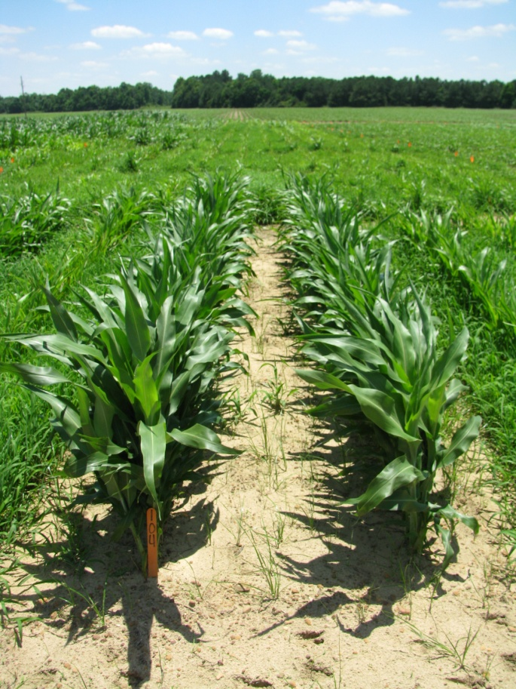
GR-Pigweed Control in Sorghum
Macon County (2010) – 47 DAP
NTC
Concep Treated Seed
Dual Magnum 7.62EC @ 1 pt/A (PRE)
Atrazine 4L @ 1.5 qt/A + COC @ 1% v/v (16 DAP)
SG-01-10
JUNE 7

Slide 28
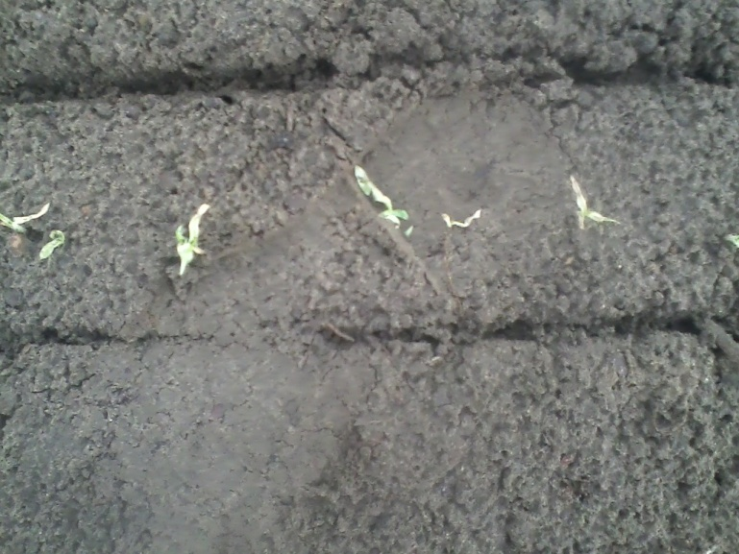
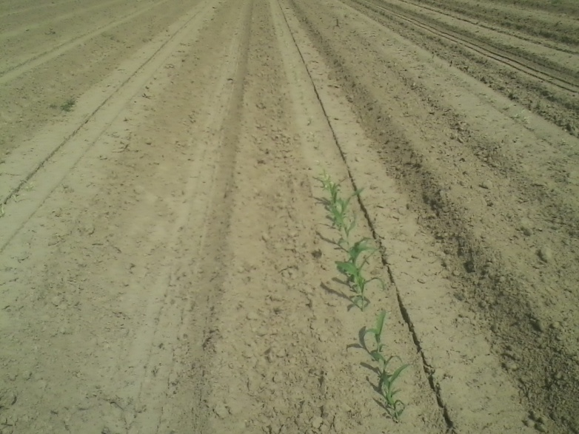
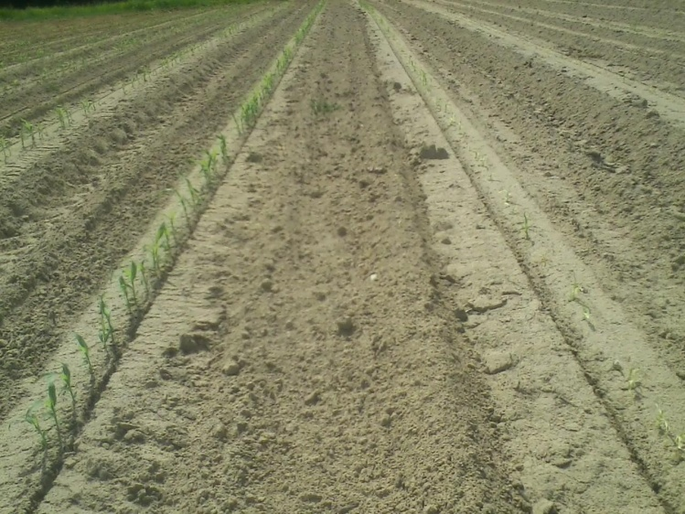
Reflex/Sorghum (10 month rotation restriction for a good reason!)

Slide 29
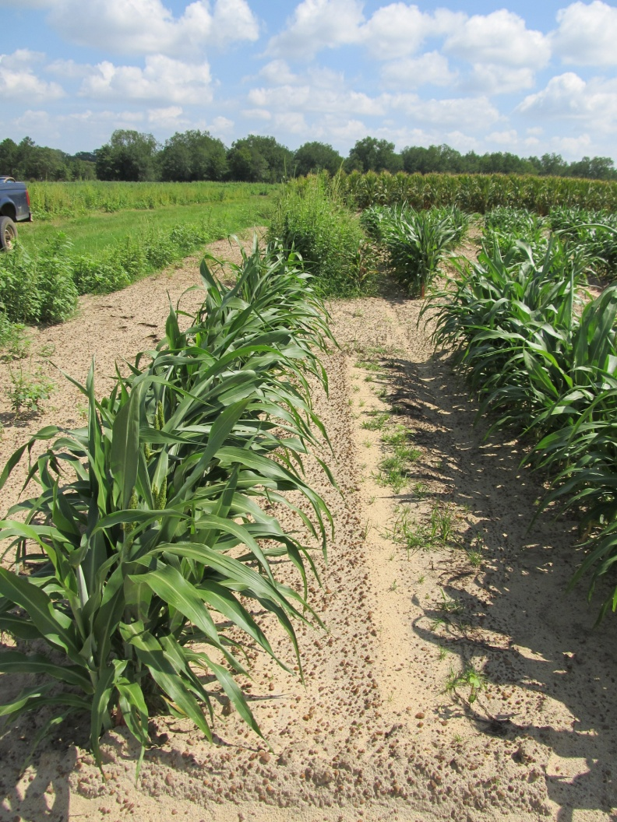
Inzen™ Z Grain Sorghum
Kansas State Univ.
DuPont
Resistance to POST applications of ALS herbicides
Non-GMO
  ALS-resistant shattercane
Dual/Cinch PRE a must in my opinion
  Concep treated seed
Stewardship!!!
Inzen™ Cultivar (left row)
Conventional Cultivar (right row - dead)
Ponder Farm 2012

Slide 30
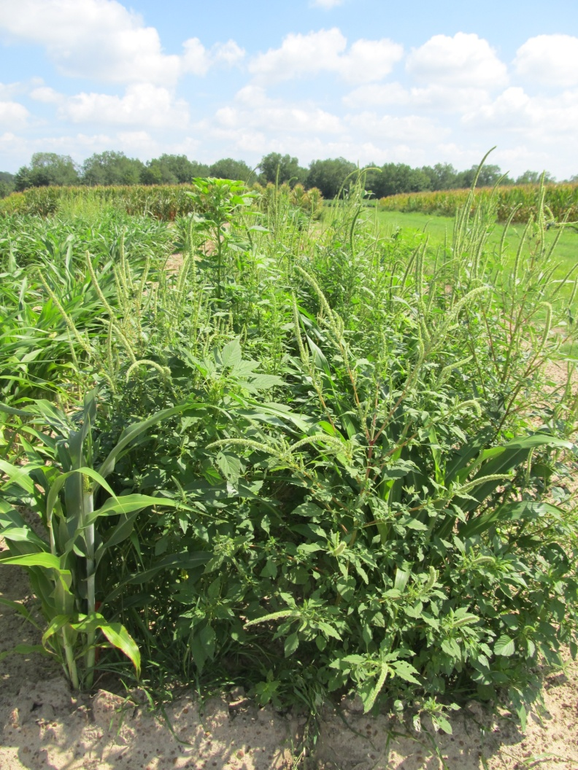
Inzen™ Z Grain Sorghum – 2012
(Inzen – left row; Conventional – right row)
Accent 75DG @ 0.5 oz ai/A
Rimsulfuron 25SG @ 0.25 oz ai/A
Atrazine 4L @ 32 oz/A
COC @ 1% v/v
28-0-0 @ 2 qt/A (3.33% v/v)
NTC
SG-01-12
July 9
36 DAT

Slide 31

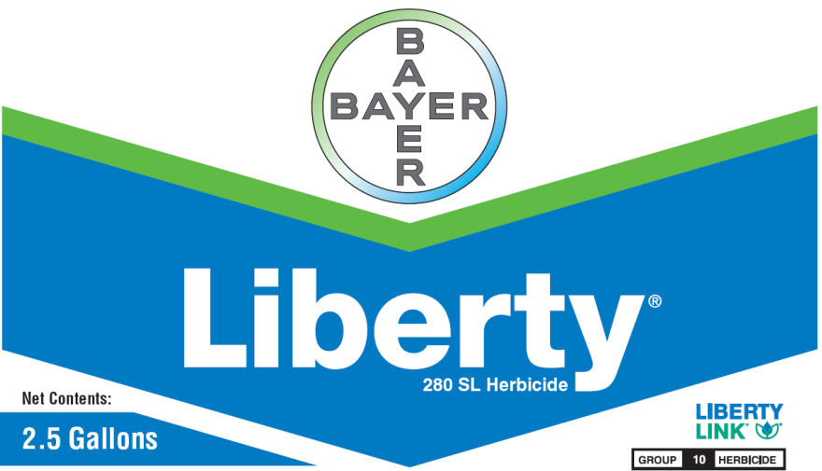

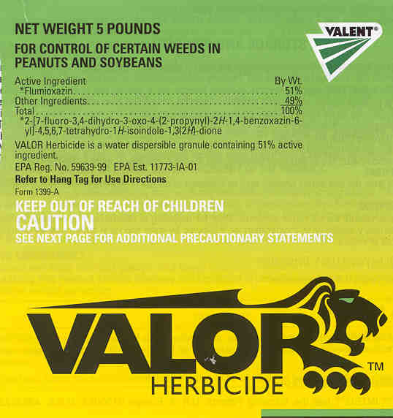

Popular Herbicides That We Must Protect From Resistance

Slide 32
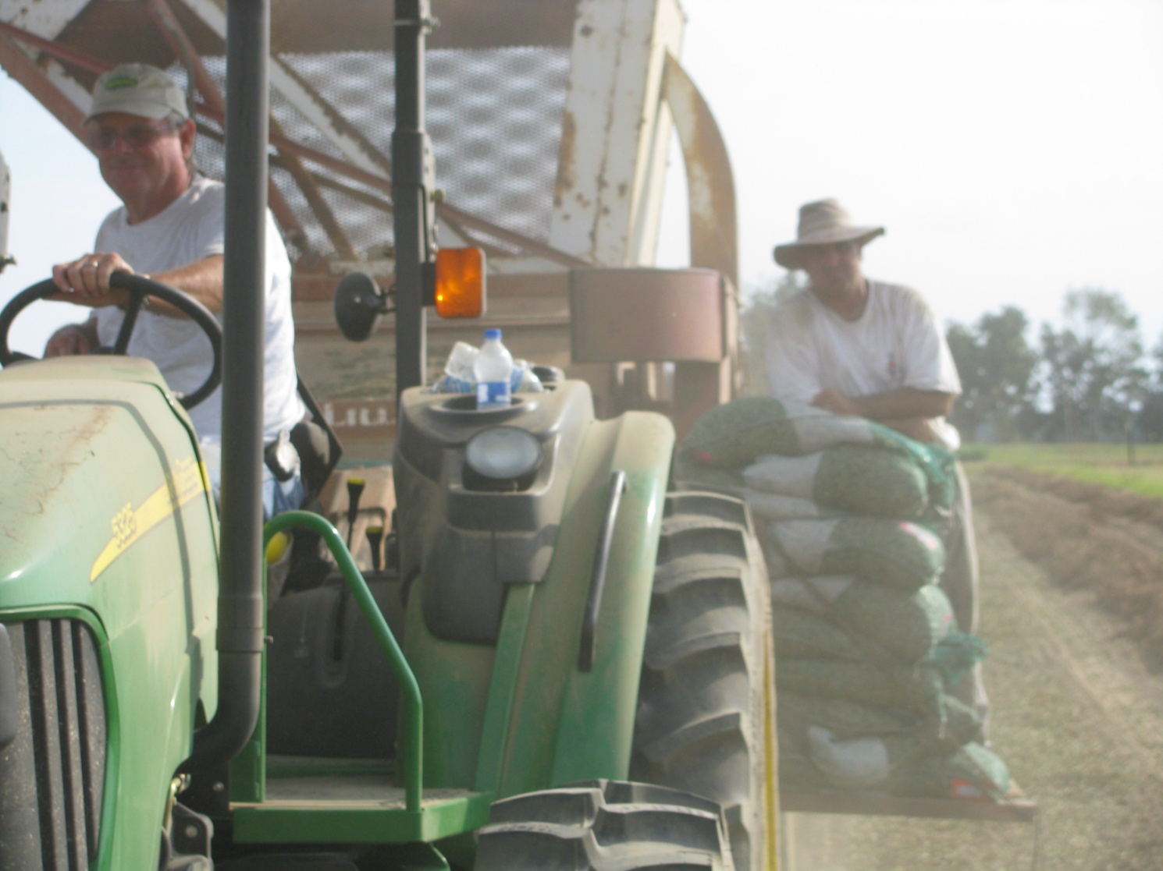
Questions/Discussion?
www.gaweed.com

