Slide 1
Weed Control in Field Corn and Forage Sorghum June 20, 2019
Eric P. Prostko, Ph.D.
Professor/Extension Weed Specialist
Dept. Crop & Soil Sciences

Slide 2
Field Corn Weed Contrl Questions for you?
What technologies have you planted?
RR, LL, Conventional, Enlist (2,4-D)?
Have you used Counter INFR?
Is atrazine still working for you?
What will be planted after the field corn?

Slide 3
Pigweed Should Not Be a Problem!!!!
moisture activated residual?
atrazine resistance
timing/coverage
weeds too big
corn too big
environmental
hot and dry #1 enemy POST’s

Slide 4
A general plan of attack?
MUST START CLEAN!
Use 1 qt/A of Atrazine 4L PRE (or Dual II Magnum, or Warrant, or Outlook)
Follow up with a timely POST program that includes an additional 1.5 qt/A of Atrazine 4L
Lots of options depending upon how you answered previous questions?

Slide 5
Starting Clean
If you are getting ready to plant and get to the field and have pigweed > 6” tall …………
Park the sprayer
Go get your mower, disk, and/or bottom plow

Slide 6
To PRE or Not to PRE?

Slide 7
Dual, Outlook, Warrant, Zidua????

Slide 8
Field Corn Weed Control – 2019 Roundup + Atrazine + Prowl H₂0 (~$18/A)
NTC
Roundup PowerMax @ 32 oz/A
Atrazine @ 64 oz/A
Prowl H₂0 @ 32 oz/A
Applied 23 DAP (V5/8” tall)
CN-07-19
May 13
19 DAT

Slide 9
Field Corn Weed Control – 2019 Roundup + Laudis + Atrazine (~$18/A)
NTC
Roundup PowerMax @ 32 oz/A
Laudis @ 3 oz/A
Atrazine @ 64 oz/A
Applied 23 DAP (V5/8” tall)
CN-07-19
May 13
19 DAT

Slide 10
Field Corn Weed Control – 2019 Halex GT + Atrazine + NIS (~$24/A)
NTC
Halex GT @ 58 oz/A
Atrazine @ 64 oz/A
NIS @ 0.25% v/v
Applied 23 DAP (V5/8” tall)
CN-07-19
May 13
19 DAT

Slide 11
Field Corn Weed Control – 2019 Liberty + Atrazine (~$18/A)
NTC
Liberty @ 32 oz/A
Atrazine @ 64 oz/A
Applied 22 DAP (V4/8” tall)
CN-04-19
May 13
19 DAT

Slide 12
Field Corn Weed Control – 2019 Roundup + Impact Z (~$14/A)
NTC
Roundup PowerMax @ 32 oz/A
Impact Z @ 8 oz/A
Applied 22 DAP (V4/8” tall)
CN-04-19
May 13
19 DAT

Slide 13
Field Corn Weed Control – 2019 Roundup + Engenia + Prowl H₂0 (~$18/A)
NTC
Roundup W-Max @ 32 oz/A
Engenia @ 6.4 oz/A
Prowl H₂O @ 32 oz/A
Applied 21 DAP (V4/7” tall)
CN-08-19
May 10
18 DAT

Slide 14
Field Corn Weed Control – 2019 Roundup + Status + Prowl H₂0 (~$31/A)
NTC
Roundup W-Max @ 32 oz/A
Status @ 5.0 oz/A
Prowl H₂O @ 32 oz/A
Applied 21 DAP (V4/7” tall)
CN-08-19
May 10
18 DAT

Slide 15
Field Corn Injury – Status (dicamba)
CN-04-16
Agrigold 6659
7 DAT (April 25, 2016)
Roundup P-Max @ 32 oz/A + Status @ 5 oz/A
Applied 27 DAP
V4-V5; 7” tall
No yield effect

Slide 16
Field Corn Weed Control – 2019 Atrazine (PRE) fb Roundup + Acuron (POST) ($31/A)
NTC
Atrazine @ 32 oz/A (PRE)
fb
Roundup W-Max @ 32 oz/A
Acuron @ 48 oz/A
Applied 28 DAP (V6/12” tall)
CN-09-19
May 10
10 days after POST

Slide 17
Corn Herbicide Rotation Restrictions for Corn, Sorghum, Soybean, Ryegrasss
Herbicide | Corn | Sorghum | Soybeans | Ryegrass
Atrazine | 0 | 0 | NY (10 weeks) | NY
Acuron | 0 | 10 months | 10 months | 18 months
Dicamba (Xtendimax, Engenia) | 0 | 14-28 days | 14-28 days (RR/CV/LL/Enlist) 0 days (Xtend) | 14-28 days
Halex GT | 0 | 0 (Concep treated) | 10 months (MGI beans?) | 10 months
Impact Z | 0 | 9 months | 9 months | 18 months
Laudis | 0 | 10 months | 8 months | 18 months
Liberty | 0 | 180 days???? | 0 | 180 days
Prowl H₂0 | 0???? | 10 months | 0 | 10 months
Status | 7 days | 30 days (1” water) | 30 days (1” water) | 120 days

Slide 18
Public Enemy #1 in Field Corn

Slide 19
Lay-By Rig for Morningglory
Ponder Farm
May 9, 2019

Slide 20
Roundup Powermax II @ 32 oz/A + Evik 80DF @ 2 lbs/A – 36 DAT (June 15, 2018)
NTC
7 row middles
Treated
NTC
16 GPA
30 PSI
3.7 MPH
V7-V8
24” tall
FloodJet
TK-VS2
NTC
TREATED

Slide 21
2019 Lay-By Test - I UGA Ponder Farm
Roundup Powermax II @ 32 oz/A
Tricor 4L @ 5 oz/A
NTC
June 11
33 DAT

Slide 22
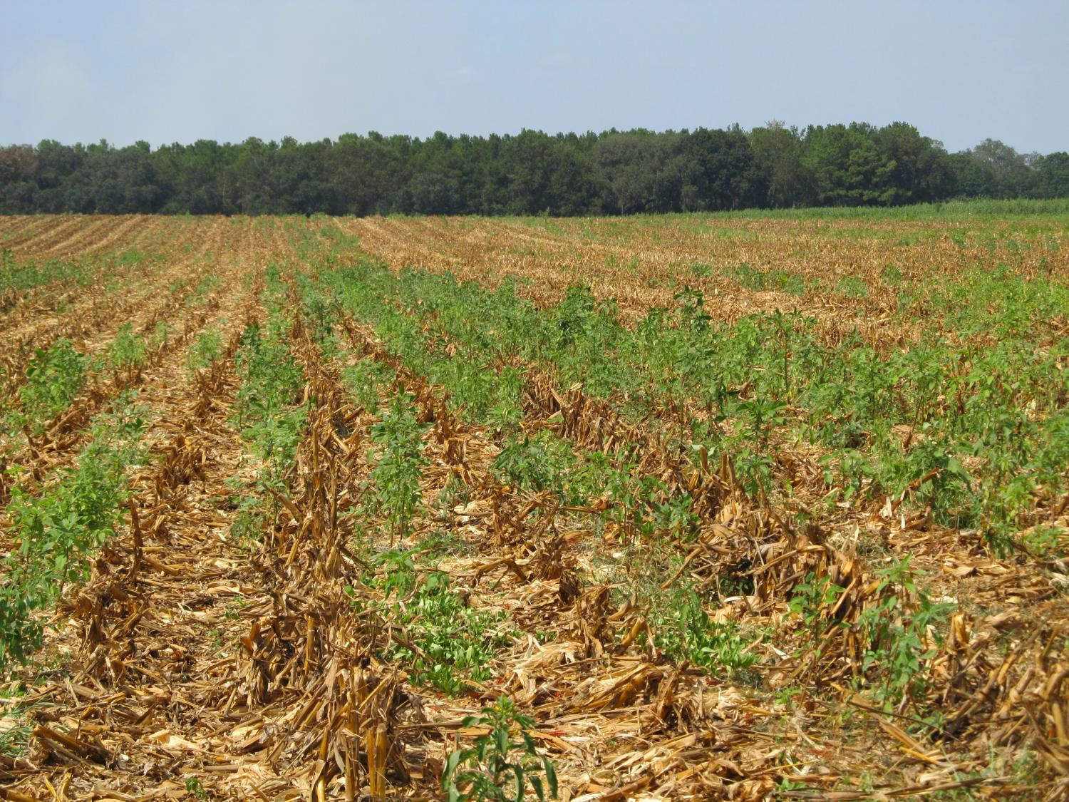
Post-Harvest Palmer Amaranth Populations Must be Managed!

Slide 23
Palmer Amaranth Burndown - 2019 (AMAPA 1-6” tall)
NTC
Gramoxone 3SL @ 32 oz/A
Tricor 4L @ 8 oz/A
Induce @ 0.25% v/v
NC-01-19
May 30
10 DAT

Slide 24
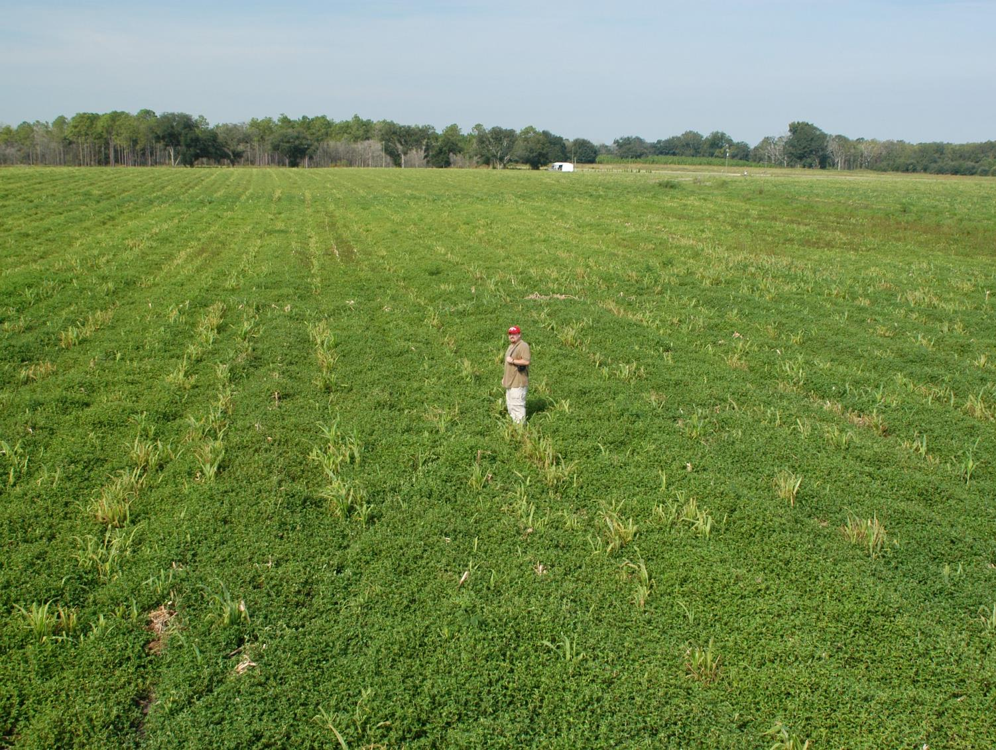
Tropical Spiderwort/Benghal Dayflower (TSW/BD) After Corn Harvest
(need tillage and/or 2 apps of Gramoxone or 2,4-D or Aim)

Slide 25
Post-Harvest Control of TSW/BD with 2 Applications (14 d apart) of Gramoxone (paraquat)
1 week after POST2

Slide 26
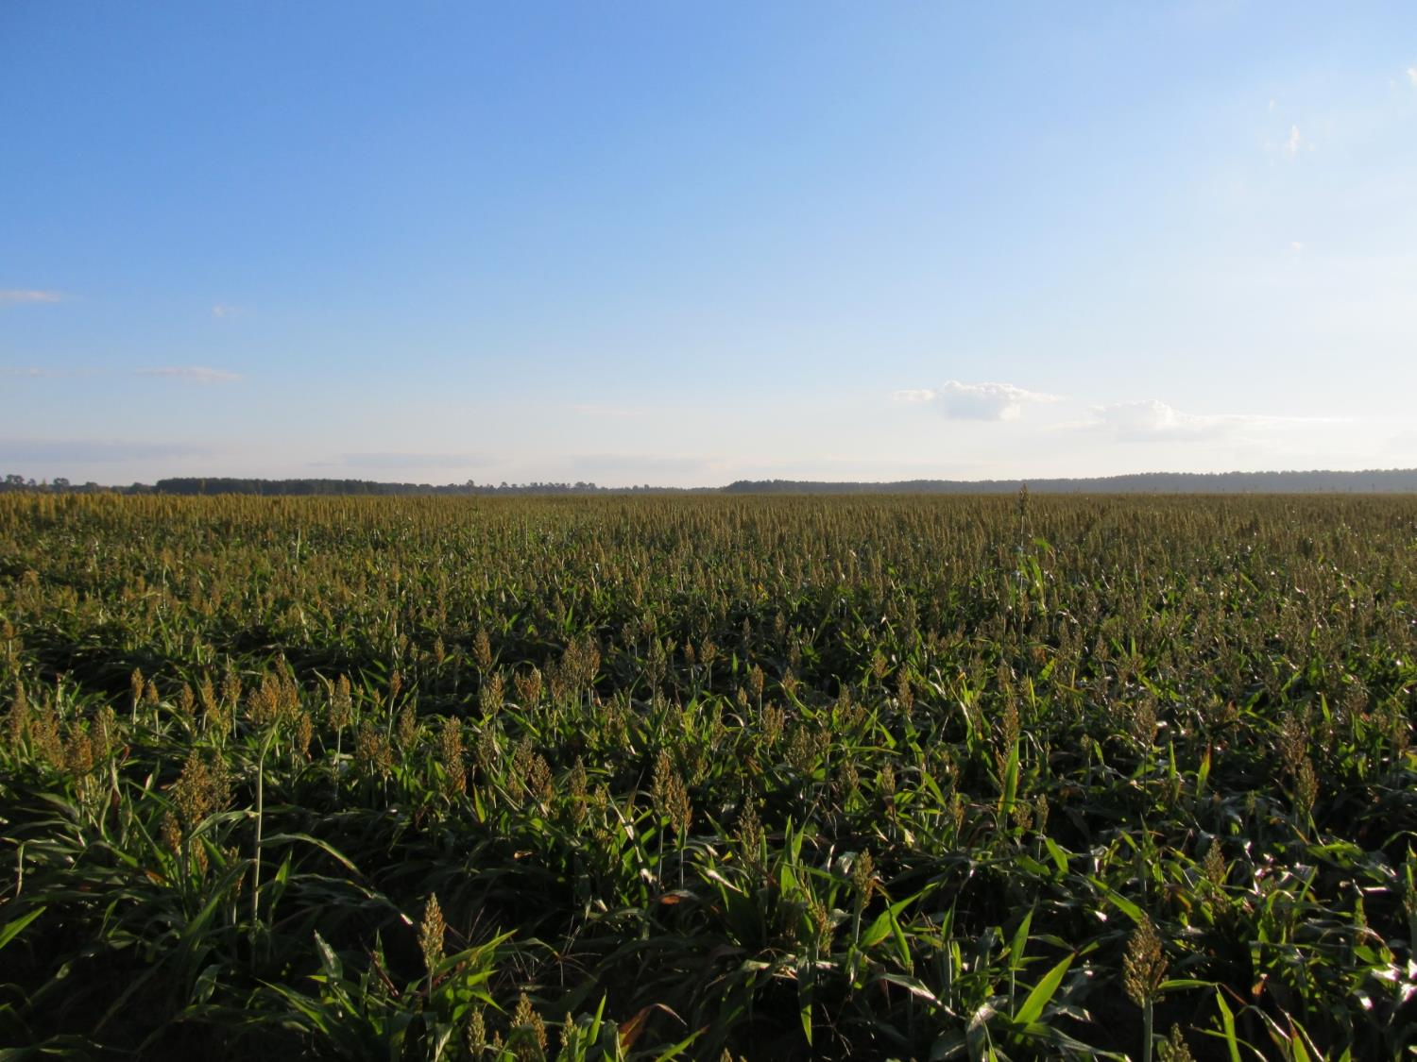
FORAGE SORGHUM WEED CONTROL UPDATE
Eric P. Prostko, Ph.D.
Professor/Extension Weed Specialist
Dept. Crop & Soil Sciences

Slide 27
FORAGE SORGHUM WEED CONTROL
Start clean!
Concep treated seed
Dual Magnum or Warrant (PRE)
Atrazine 4L @ 1.5 QT/A (EPOST)
Add Huskie if you have ATZ resistance
Paraquat (Hooded sprayer)
Mechanical Cultivation

Slide 28
Grain Sorghum Weed Control - 2018
Dual Magnum 7.62EC
24 oz/A (PRE)
NTC
GS-01-18
July 20
86 DAP

Slide 29
Weed Control in Grain Sorghum - 2015
NTC
Warrant @ 48 oz/A – PRE
Atrazine @ 48 oz/A – 23 DAP
COC @ 1% v/v – 23 DAP
SG-01-15
May 26
49 DAP

Slide 30
A New Product to Consider?
Huskie 2.06EC
Bayer CropScience
Buctril (1.75 lbs/gal) + pyrasulfotole (0.31 lbs/gal)
MOA = 6 + 27
Postemergence (13-16 oz/A)
3-leaf to 12” tall sorghum
Broadleaf weeds, good on pigweed
Tank-mix with atrazine (16 oz/A)

Slide 31
Weed Control in Grain Sorghum - 2015
NTC
Dual II Magnum @ 16 oz/A – PRE
Huskie @ 13 oz/A – 23 DAP
Atrazine @ 16 oz/A – 23 DAP
AMS Xtra @ 2.5% v/v – 23 DAP
NIS @ 0.25% v/v – 23 DAP
SG-01-15
May 26
49 DAP

Slide 32
Huskie Injury on Sorghum

Slide 33
Other Sorghum Options
Sandea/Permit – nutsedge
Auxin Herbicides
2,4-D
Dicamba
Rate
Weed size
Injury
Off-target movement
Newer formulations are better (less volatile)

Slide 34
Questions/Comments?

