Slide 1
2011 Corn Weed Control Update
Eric P. Prostko
Extension Weed Specialist
Dept. Crop & Soil Sciences

Slide 2
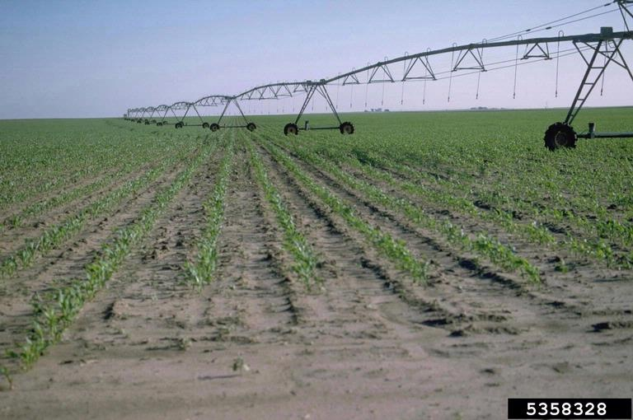
Topics for Discussion
Atrazine Review
RR Corn Control (replant)
Steadfast Q
LL Corn
Palmer Amaranth
New (er) Products

Slide 3
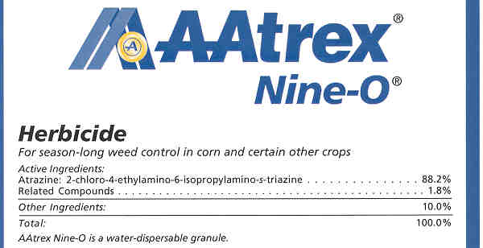
Atrazine Evaluation Update
October 2009 – EPA calls for New Evaluation
Scientific Advisory Panel (SAP) Meetings
  Human Health Effects
  February, April, September (2010)
  At September meeting, results of NCI Agricultural Health Study were not available
  Additional SAP meeting sometime in 2011
  Then, SAP review of atrazine effects on amphibians and aquatic ecosystems
Registration review in 2013?

Slide 4
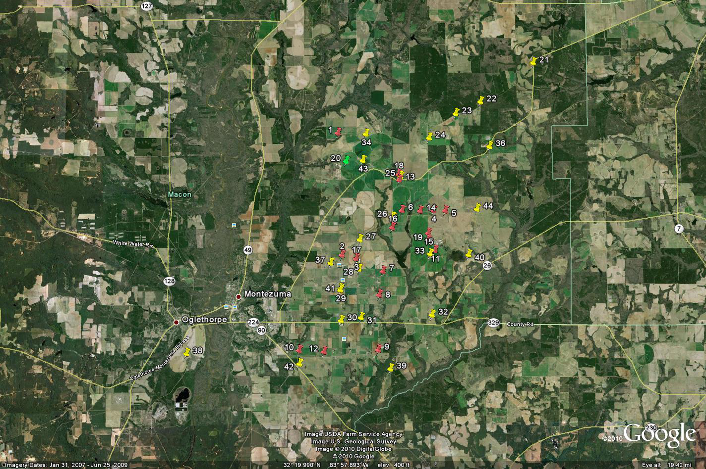
2007, 2008, 2010 Macon County
Triazine-Resistance Survey

Slide 5
Macon County Resistance Survey
Location | Atrazine | Glyphosate | Staple | Cadre
1 | Y | ? | ? | ?
3 | Y | ? | ? | ?
4 | Y | ? | ? | ?
5 | Y | ? | ? | ?
6 | Y | ? | ? | ?
7 | N | ? | ? | ?
8 | Y | ? | ? | ?
9 | N | ? | ? | ?
10 | N | ? | ? | ?
11 | N | ? | ? | ?
12 | N | ? | ? | ?
13 | N | ? | ? | ?
14 | Y | ? | ? | ?
15 | Y | ? | ? | ?
16 | N | ? | ? | ?
17 | Y | ? | ? | ?
18 | N | ? | ? | ?
19 | Y | ? | ? | ?
20 | Y | ? | ? | ?
21 | N | Y | Y | N
22
23 | Y | Y | Y | Y
24 | Y | N | Y | Y
25 | N | Y | Y | N

Slide 6
Macon County Resistance Survey
Location | Atrazine | Glyphosate | Staple | Cadre
26
27
28
29
30 | Y | Y | Y | Y
31 | N | Y | Y | Y
32
33 | N | ? | N | Y
34 | Y | Y | Y | N
35
36 | N | Y | Y | Y
37
38
39
40
41 | N | Y | N | N
42
43

Slide 7
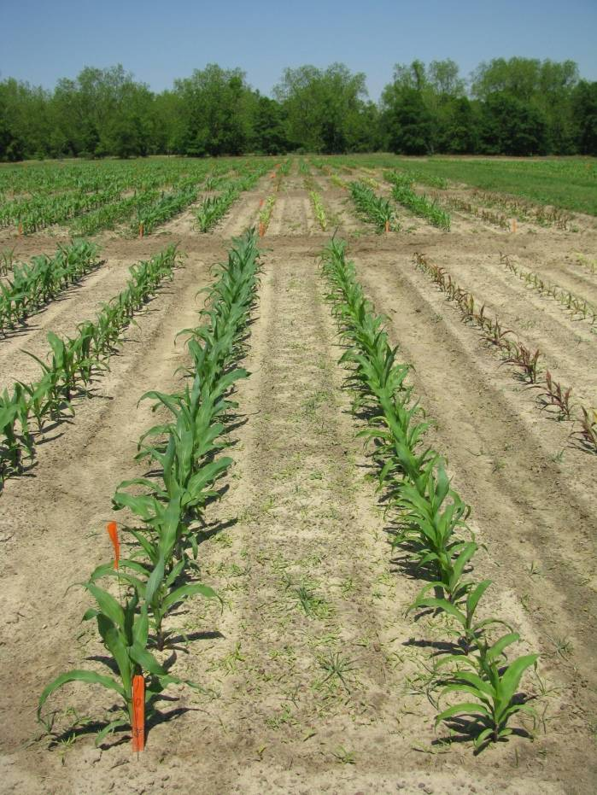
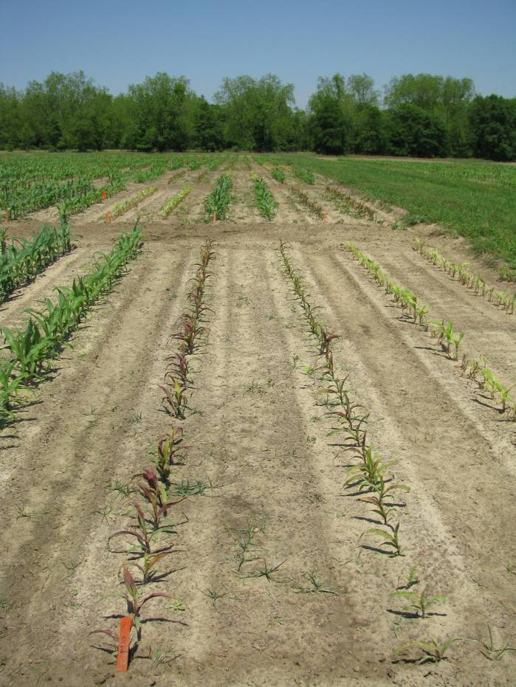
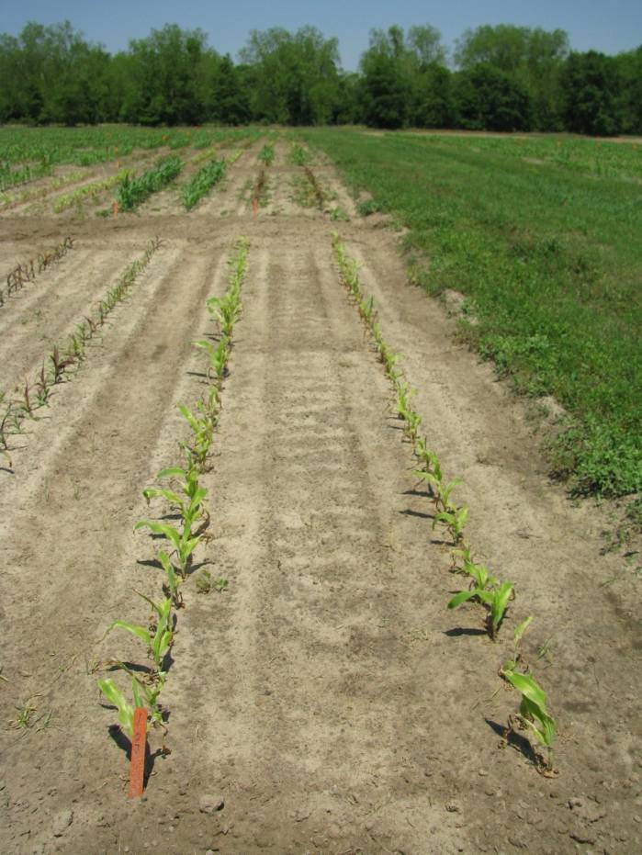
RR Corn Control (Pioneer 33M57)
7 DAT - 2010
NTC
SelectMax 0.97EC @ 6 oz/A
Induce @ 0.25% v/v
AMS X-TRA @ 2.5% v/v
Gramoxone Inteon 2SL @ 40 oz/A
Atrazine 4L @ 32 oz/A
Agridex @ 1% v/v

Slide 8
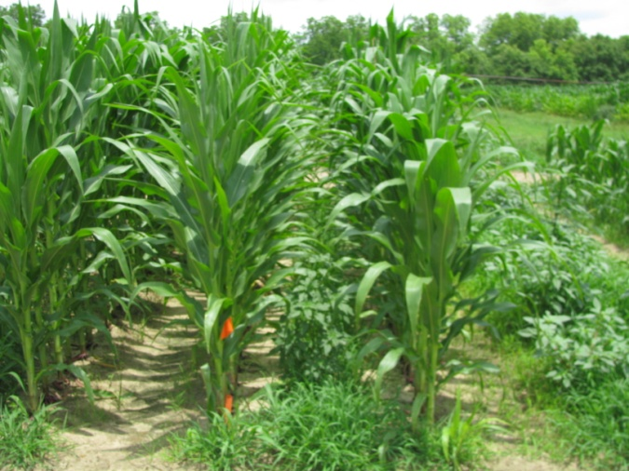
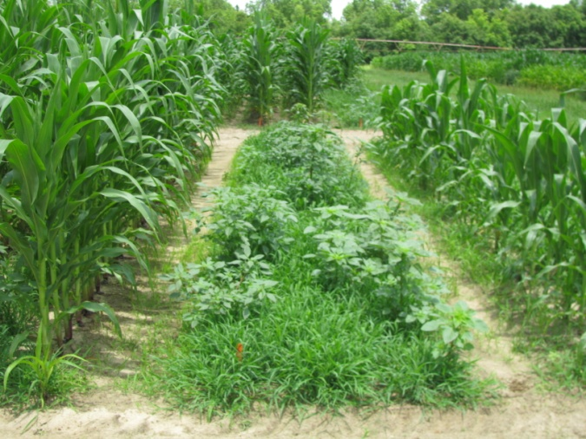
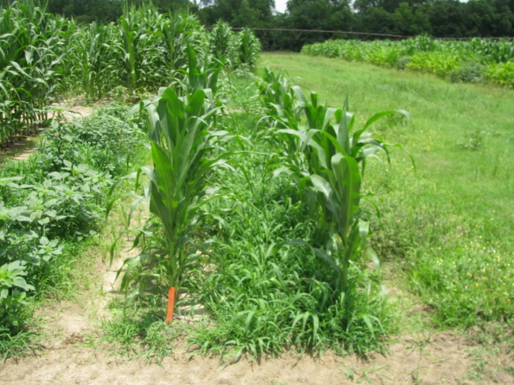
RR Corn Control (Pioneer 33M57)
40 DAT -2010
NTC
(123 Bu/A)
SelectMax 0.97EC @ 6 oz/A
Induce @ 0.25% v/v
AMS X-TRA @ 2.5% v/v
(0 Bu/A)
Gramoxone Inteon 2SL @ 40 oz/A
Atrazine 4L @ 32 oz/A
Agridex @ 1% v/v
(27 Bu/A)

Slide 9
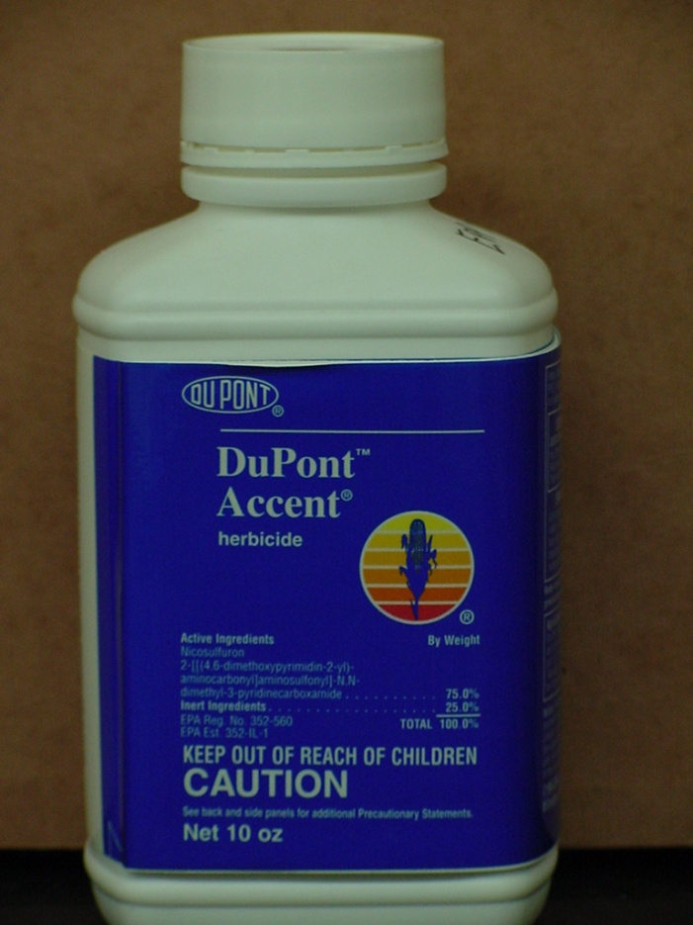
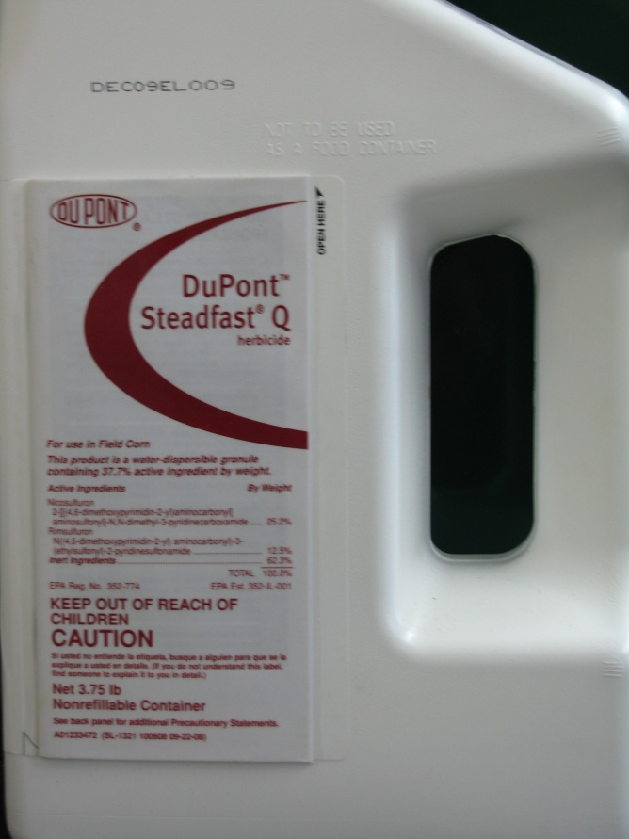
Q Products
Steadfast Q 37.7DG
1.5 oz/A
Accent (0.024 lb ai/A) i.e. 0.5 oz/A
Resolve (0.012 lb ai/A)
Isoxadifen (safener)
Accent 75DG
0.67 oz/A
(0.031 lb ai/A)

Slide 10
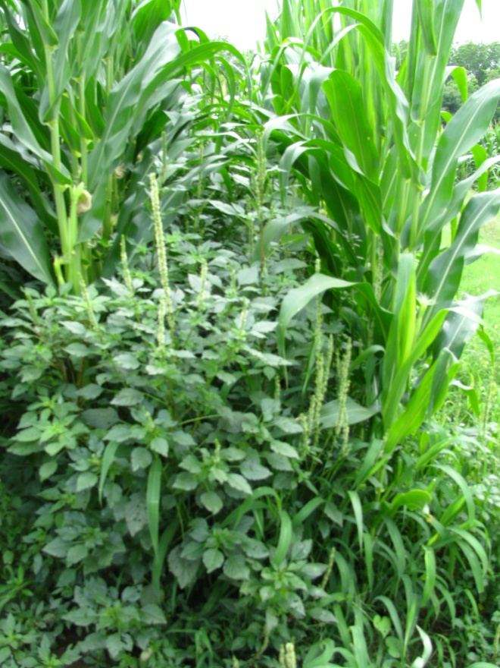
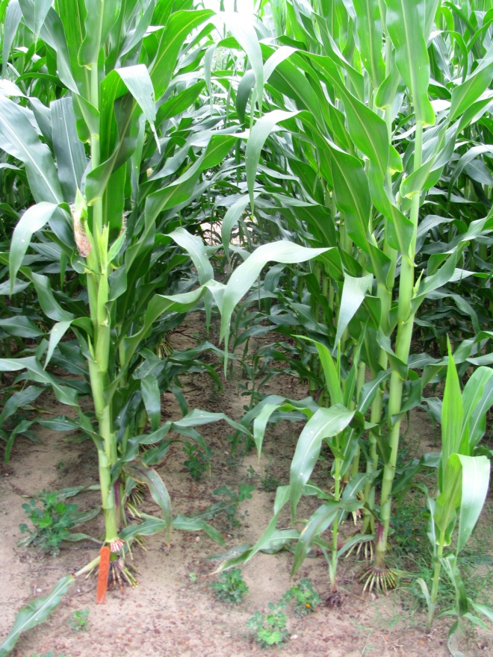
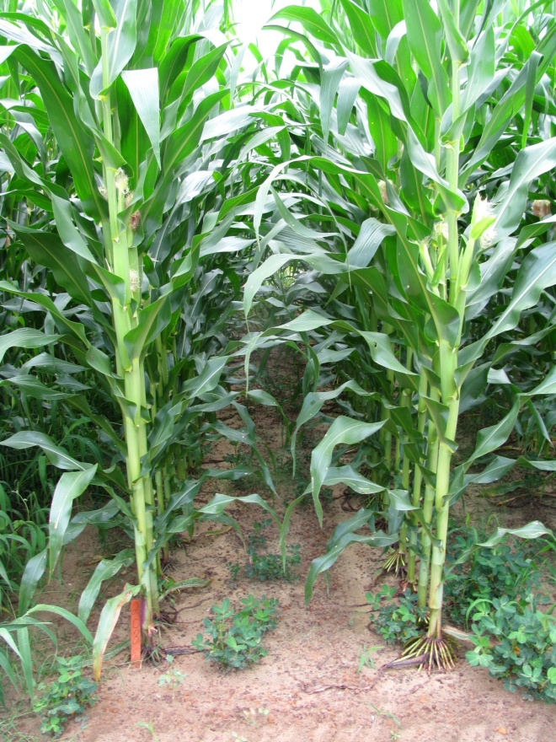
Accent vs. Steadfast Q - 2010
NTC
Accent 75 WDG @ 0.67 oz/A
Atrazine 4L @ 48 oz/A
Primary @ 1% v/v
Steadfast Q 37.7WDG @ 1.5 oz/A
Atrazine 4L @ 48 oz/A
Primary @ 1% v/v
CN-04-10
June 4
53 DAT

Slide 11


What about Liberty-Link Corn?
(different mode of action compared to glyphosate)
Glufosinate
  Ignite 2.34SL (22 oz/A)
  44 oz/A year (total)
up to 24” or V7 (OT) or 24”-36” (drops)
Tank-mix with atrazine
good on morningglory, Texas millet, sicklepod, small Palmer (3” or less)

Slide 12
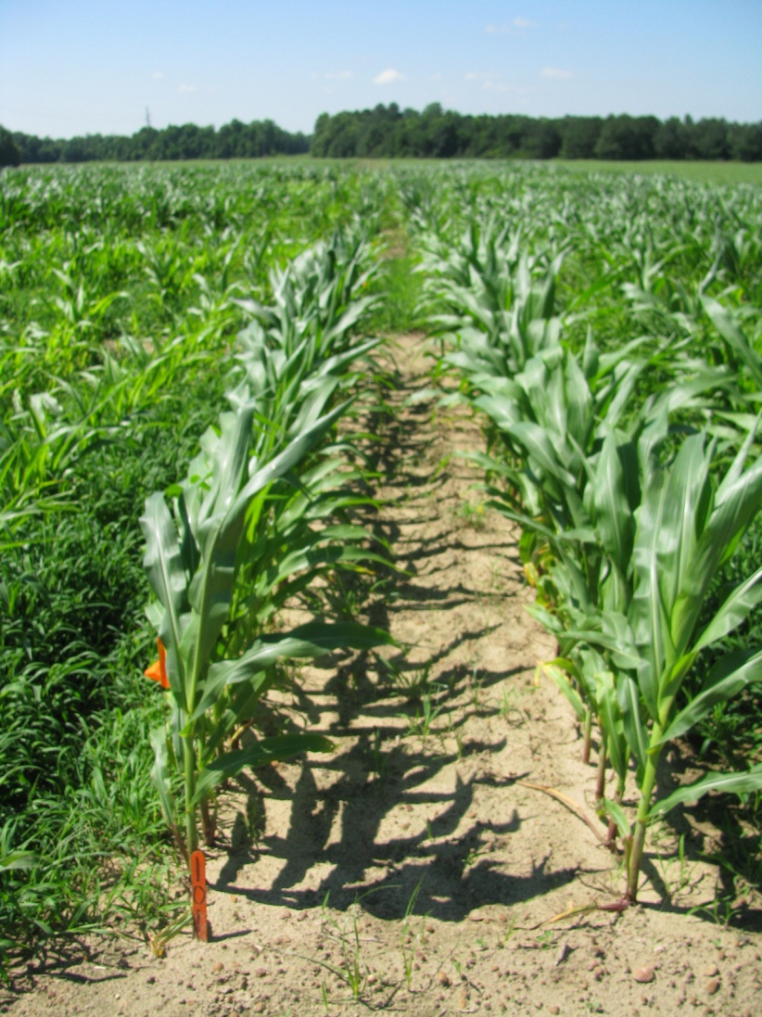
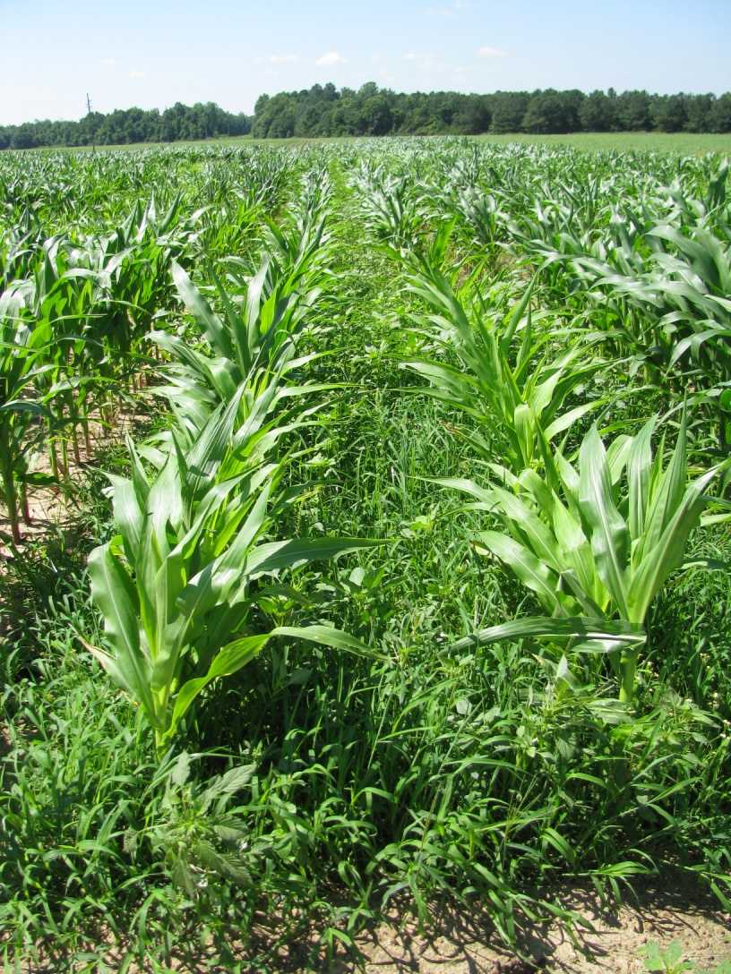
Weed Control in LL-Field Corn - 2010
Macon County - 47 DAP
Ignite 280 2.34SL @ 22 oz/A
Atrazine 4L @ 1 qt/A
N-Pak AMS @ 2.5% v/v
Applied 24 DAP
NTC

Slide 13

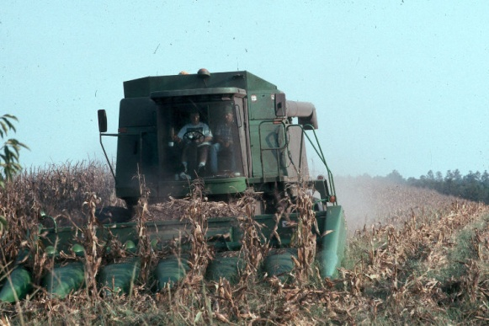
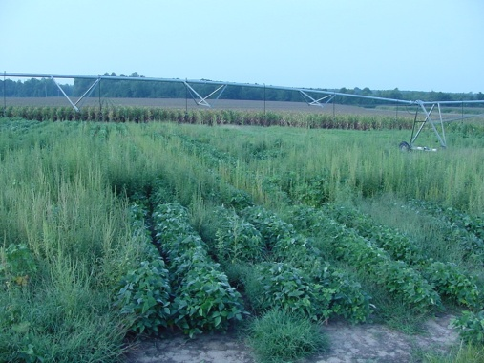
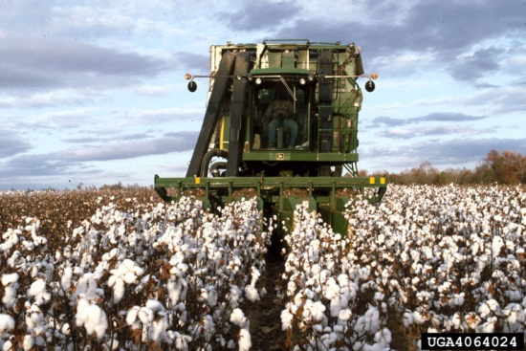
Concerns About LL Crops
Residual Important
  1 may not be enough
Abuse of Ignite
  LL cotton, corn, soybeans
  may jeopardize future technologies (DHT, Dicamba)
Current Resistant Weeds
  Goosegrass (Malaysia)

Slide 14

GR-Amaranthus sp.
Amaranthus palmeri
Illinois
Missouri
Kentucky
N Carolina
Tennessee
Amaranthus rudis
Arkansas
S Carolina
4 Counties in Mid-South
Mississippi
Georgia
Alabama
Louisiana
Larry Steckel (UT)
September 2010

Slide 15
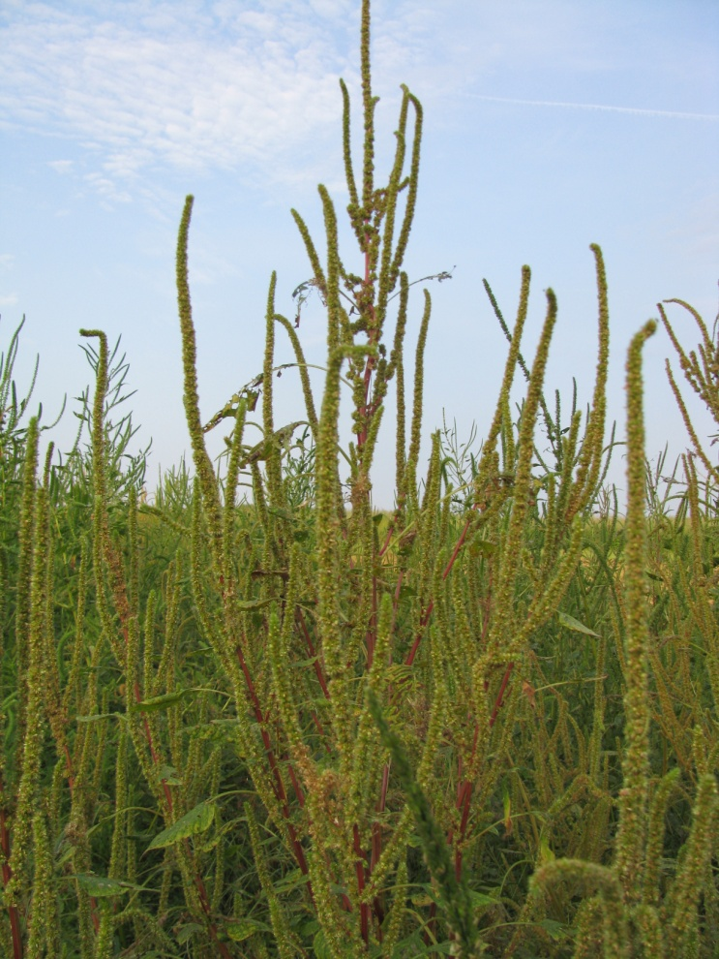
Palmer Amaranth Control Tactics – Field Corn
Start Clean!!!!!
Irrigation
Tillage
Extreme Cover Crops
Residual Herbicides
  More than 1
Timely POST’s
Post-Harvest

Slide 16
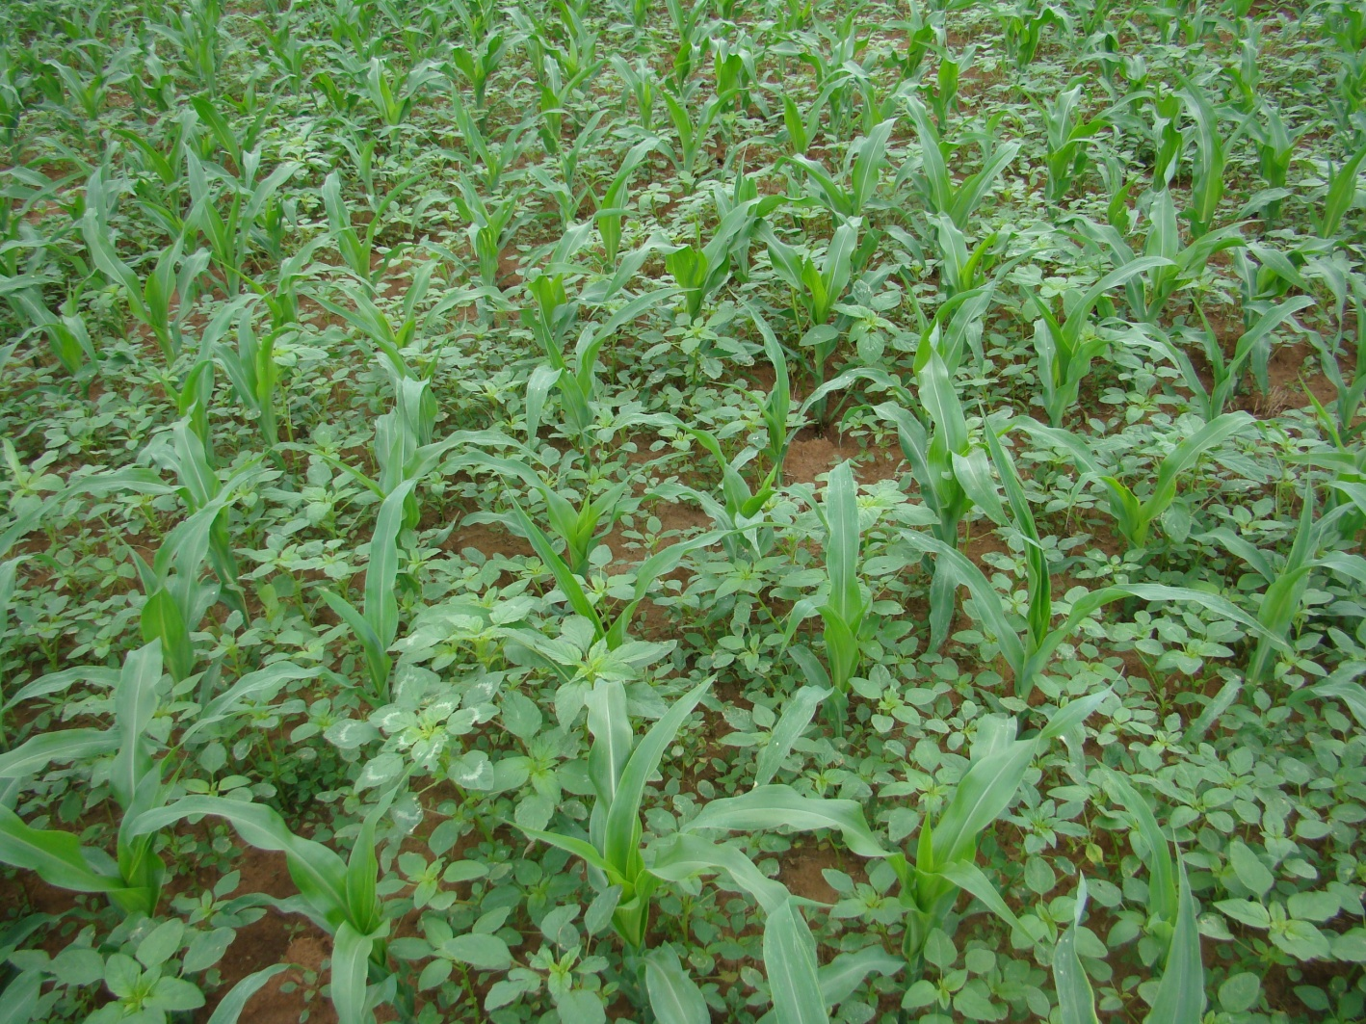
Palmer Control in Field Corn
Residuals
  Atrazine
  Dual Magnum/Generics
  Micro-Tech
RR corn
  Glyphosate + atrazine + Prowl
  Expert
  Halex GT ( + atrazine?)
LL Corn
  Ignite + atrazine + Prowl(?)
Conventional
  Steadfast Q + atrazine (ALS?)
  Laudis + atrazine
  Callisto + atrazine

Slide 17
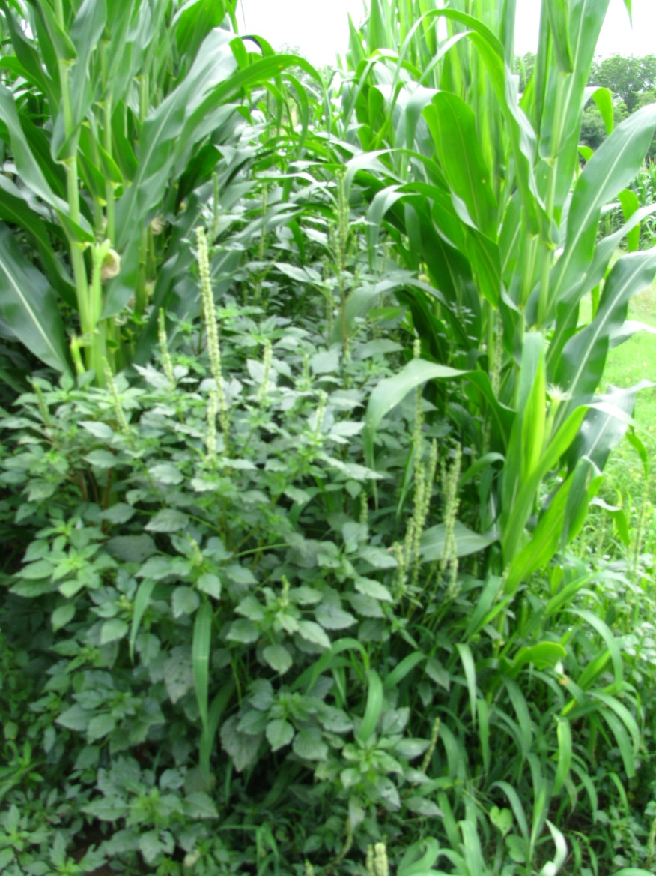
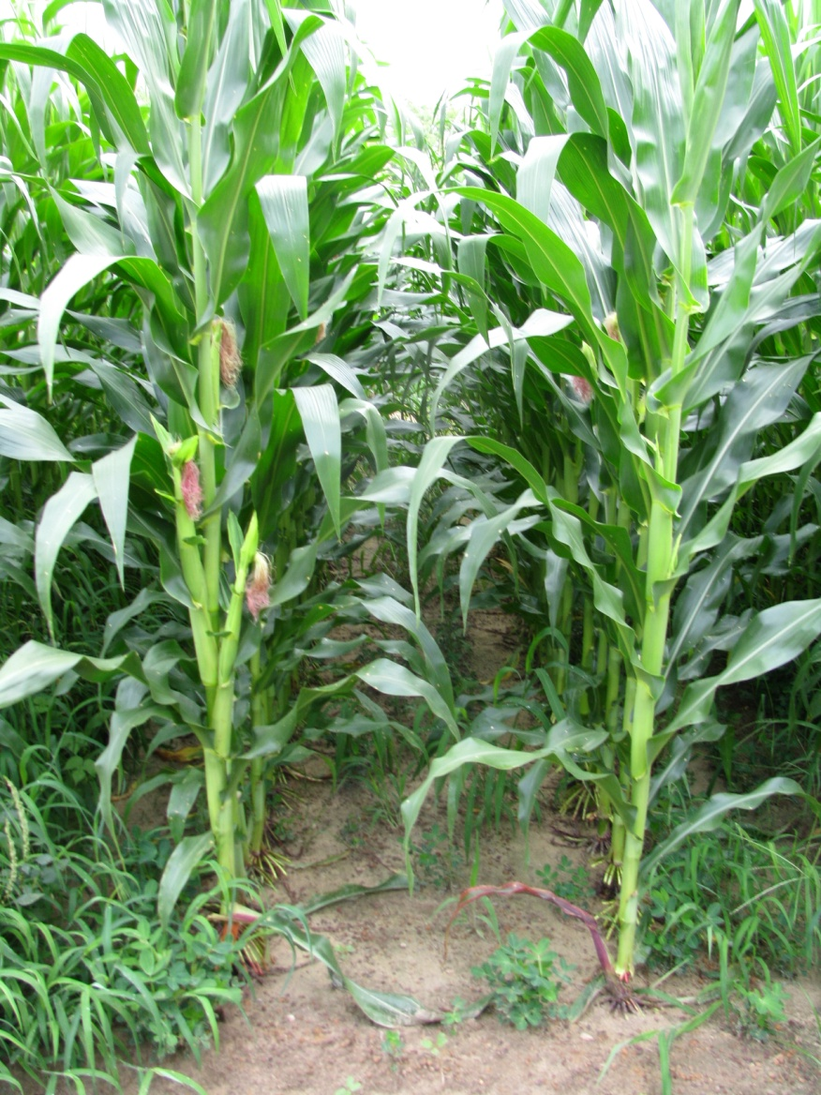
Roundup + Atrazine + Prowl - 2010
NTC
RUWM 5.5SL @ 22 oz/A
Atrazine 4L @ 1.5 qt/A
Prowl H₂0 @ 1 qt/A
CN-04-10
June 4
53 DAT

Slide 18
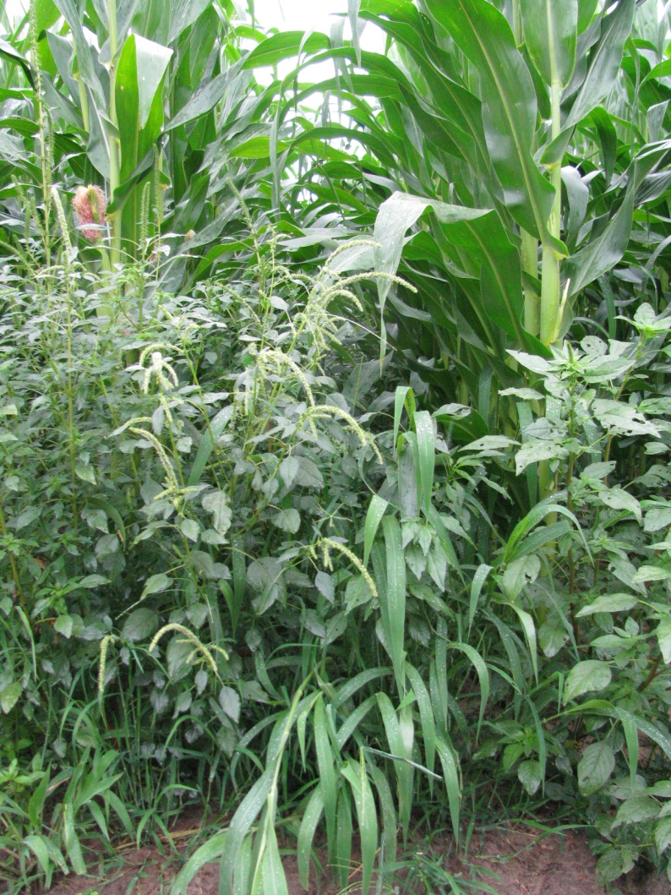
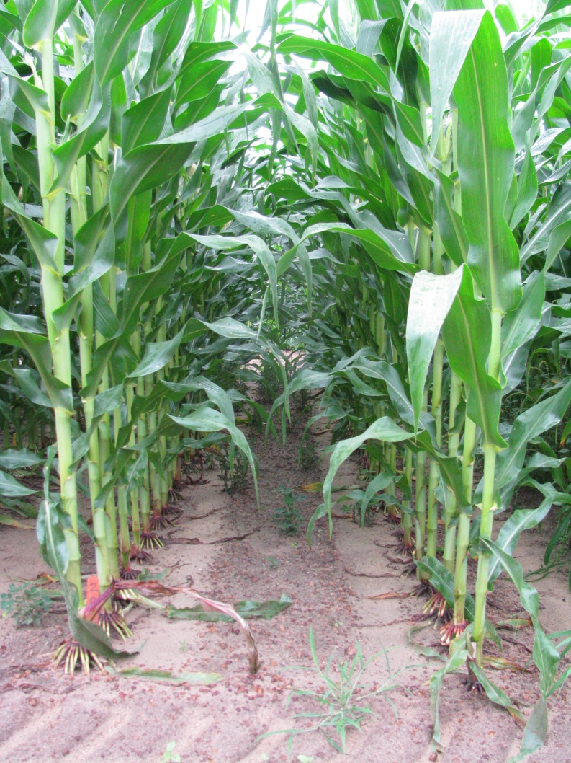
Halex GT - 2010
NTC
Halex GT 4.39SC @ 3.6 pt/A
80/20 @ 0.25% v/v
AMS X-TRA @ 2.5% v/v
CN-14-10
June 3, 2010
51 DAT

Slide 19
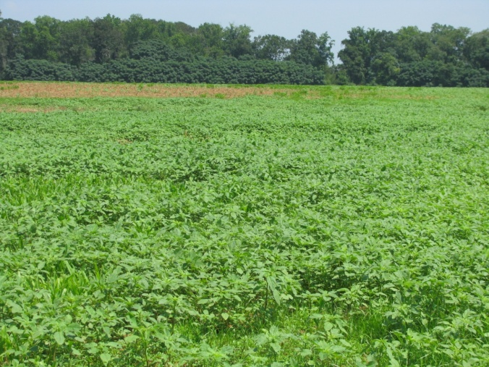
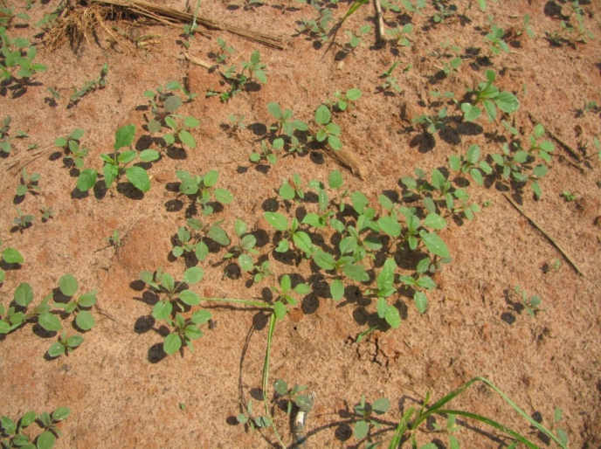
Post-Harvest AMAPA Problems
Decreasing daylight hastens flower and seed production
  Flowering (3-4 weeks)
  Seed production (2-3 weeks)
  Some germination at 41⁰F (8%)
Control Options
  Mowing
  Tillage
  Herbicides
    paraquat + 2,4-D amine or dicamba
    Residuals i.e Dual Magnum?
When can we stop worrying about seed production?
Keeley et al. 1987. Weed Science 35:199-204
Steckel et al., 2004. Weed Science 52:217-221

Slide 20
When can we stop worrying about Palmer seed production?
Year | First Frost Date (FFD) | FFD-35
2005 | Dec 20 | Nov 15
2006 | Nov 20 | Oct 16
2007 | Nov 8 | Oct 4
2008 | Nov 19 | Oct 15
2009 | Dec 21 | Nov 16
2010 | Dec 2 | Oct 27
Source: UGA Automated Environmental Monitoring Network
Tifton Campus Conference Center

Slide 21


Other Herbicides We Might Need to More Seriously Consider in GA Field Corn?

Slide 22
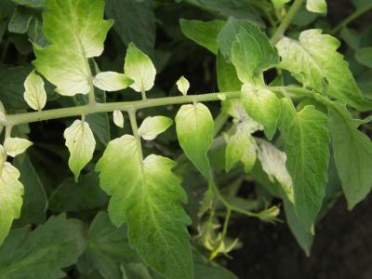
Callisto 4SC
Syngenta
POST
3 oz/A + COC + UAN or AMS ($12-13/A)
Up to 30” tall or 8-leaf corn
Palmer amaranth up to 5”
Tank-mix with atrazine
  Callisto Xtra
also good on horsenettle
Interaction with OP’s
Weak on PANTE and CASOB
Good option for atrazine, ALS and GR-Palmer
Unique mode of action
  “Bleacher”

Slide 23
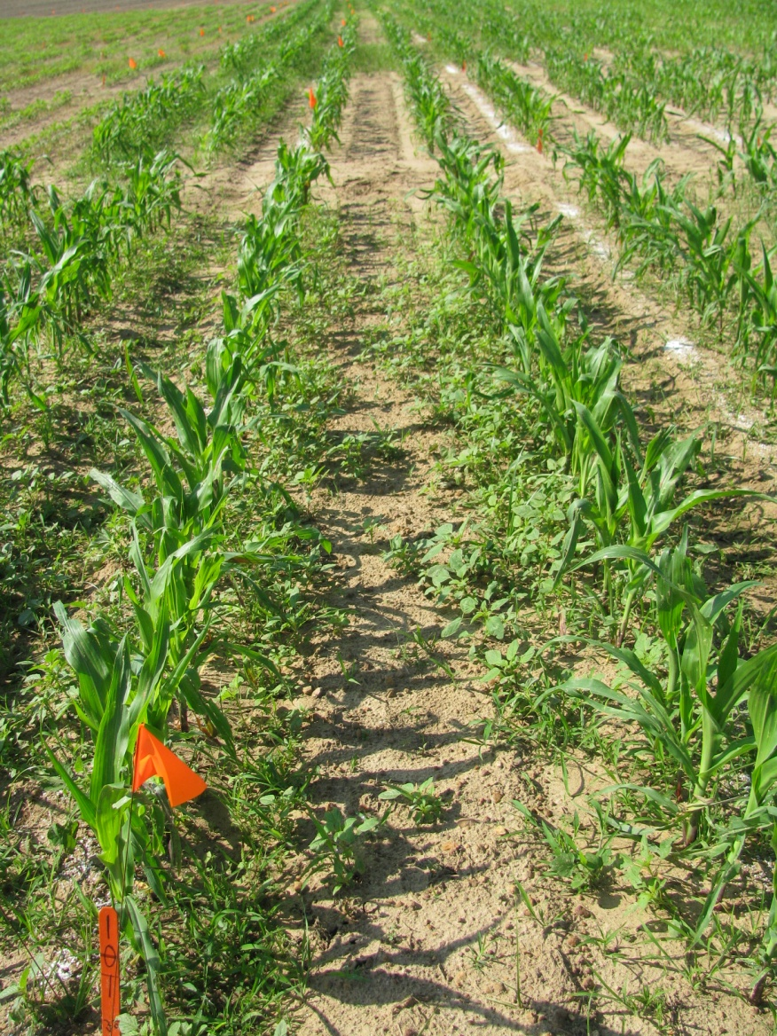
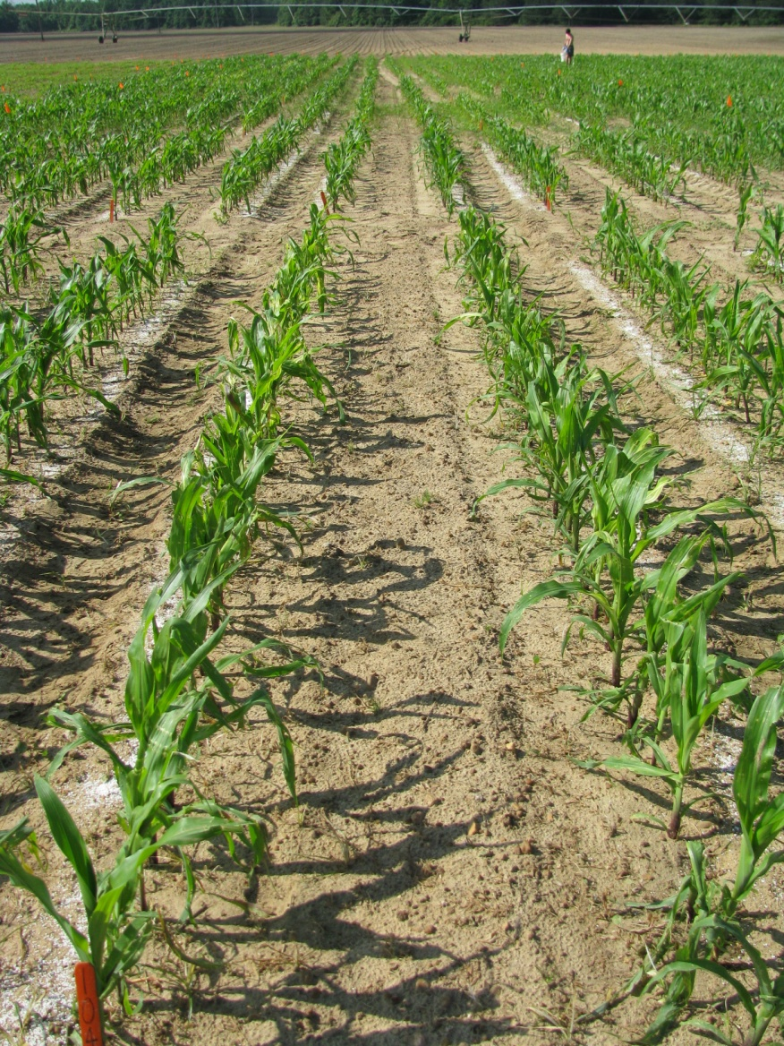
Callisto
7 DAT
NTC
Callisto 4SC @ 4 oz/A
Agrioil @ 1% v/v
AMS @ 1.28 lb/A
CN-01-09

Slide 24
Laudis 3.5SC
Bayer
Tembotrione + isoxadifen (safener)
“Bleacher”
POST
  3 oz/A
  Emergence to V8 stage
Requires use of MSO and nitrogen
Good for pigweed management
Also has crabgrass and BL signalgrass listed on label
No OP interaction
Is it as good as Accent/Steadfast Q on Texas millet?

Slide 25

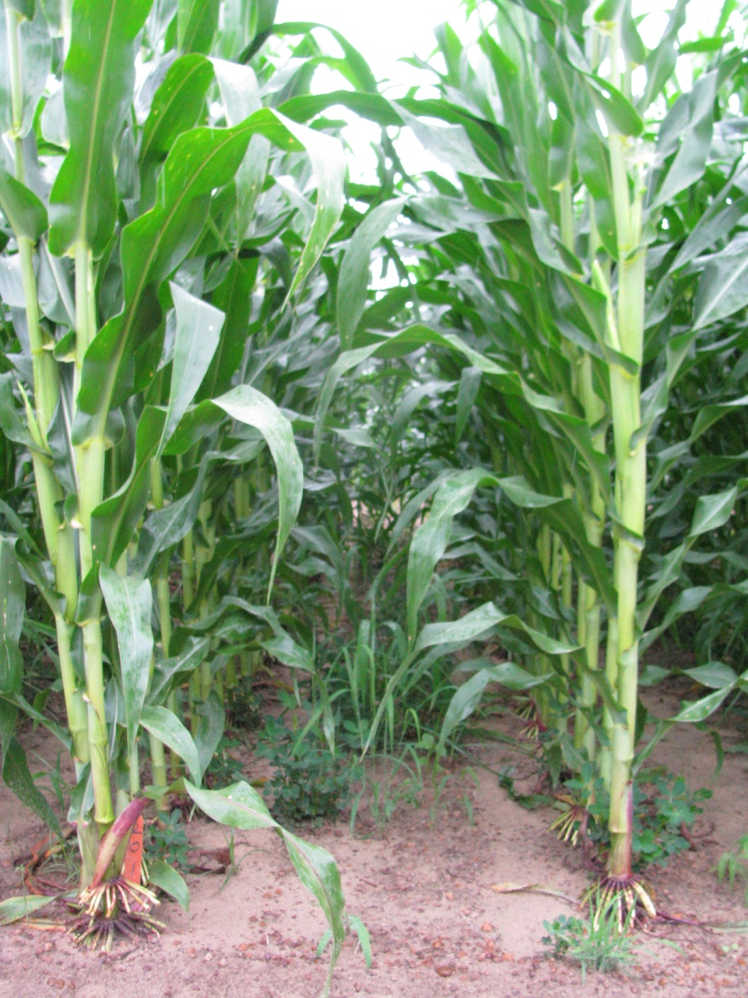
Laudis – 2010
51 DAT
NTC
Laudis 3.5SC @ 3 oz/A
Atrazine 4L @ 16 oz/A
MSO @ 1% v/v
AMS @ 2.5% v/v
CN-14-10

Slide 26
Status 56WG
BASF
dicamba + diflufenzopyr + isoxadifen
“Super” Banvel + safener
POST
5-10 oz/A ($2.20/oz)
broadleaf weed control only
no residual

Slide 27
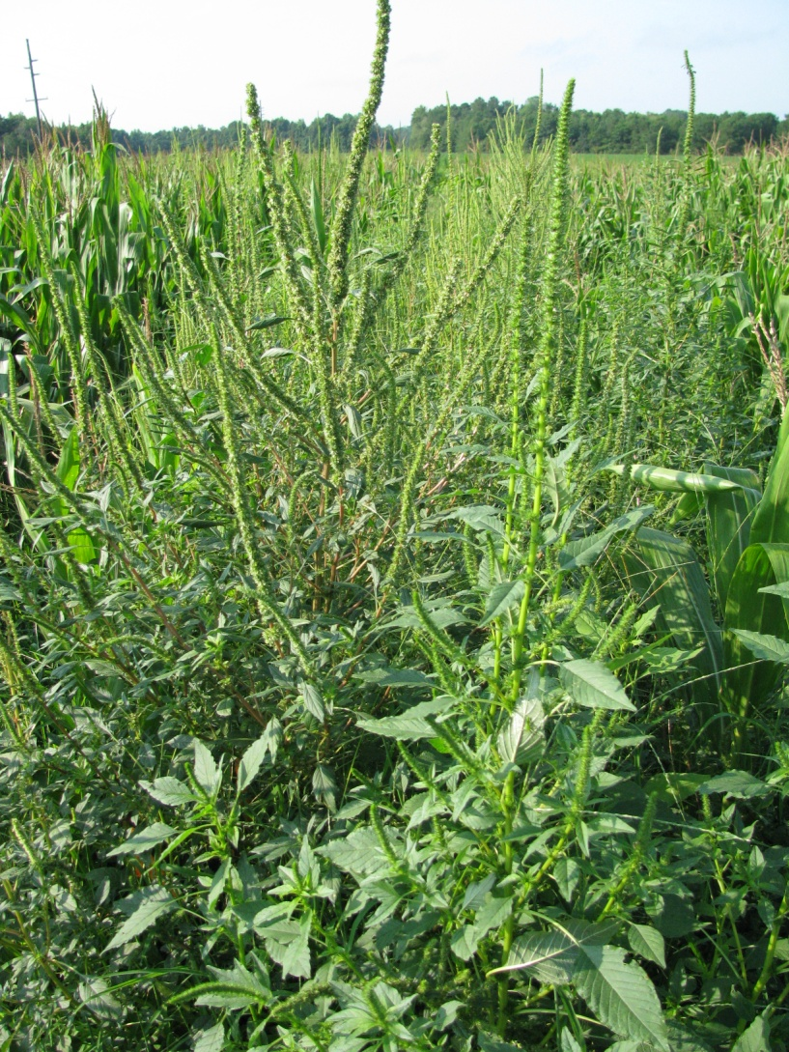
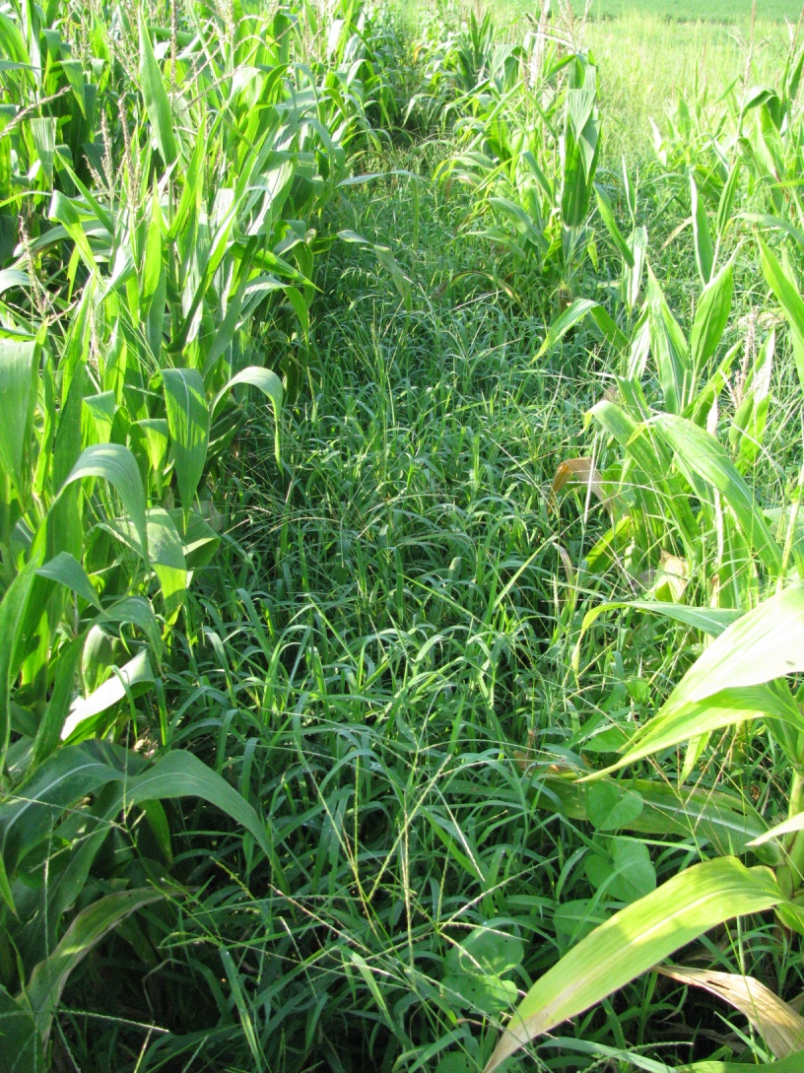
GR-Palmer Amaranth Control in Field Corn with Status
(70 DAT)
NTC
Status 56WG @ 5 oz/A
NIS @ 0.25% v/v
AMS @ 3 lb/A
EPOST (21 DAP)
CN-01-08

Slide 28

On the Horizon
DHT Corn
  DowAgroScience Herbicide Tolerance
  Enhanced tolerance to 2,4-D and “fops”
  Stacked with glyphosate
  2013?
Herbicides
  Zidua (pyroxasulfone) - BASF
  Capreno (Laudis + thiencarbazone + isoxadifen) - Bayer

Slide 29
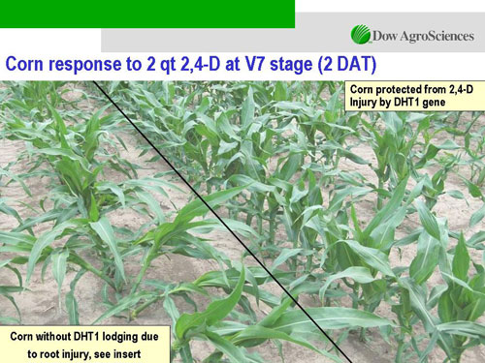
DHT Corn

Slide 30
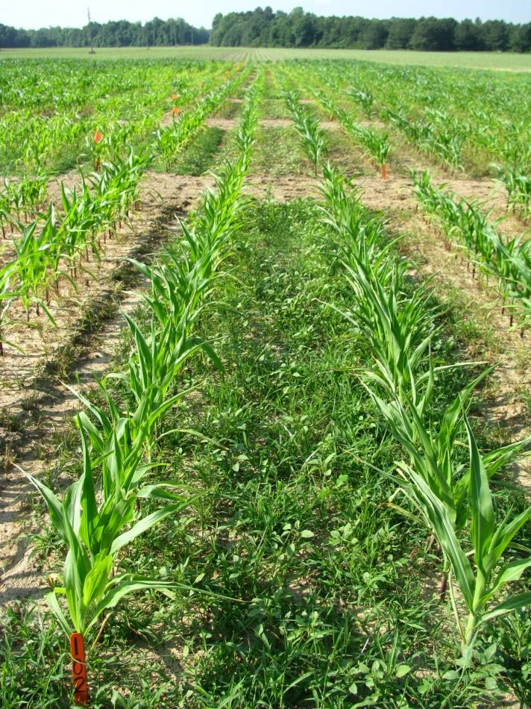
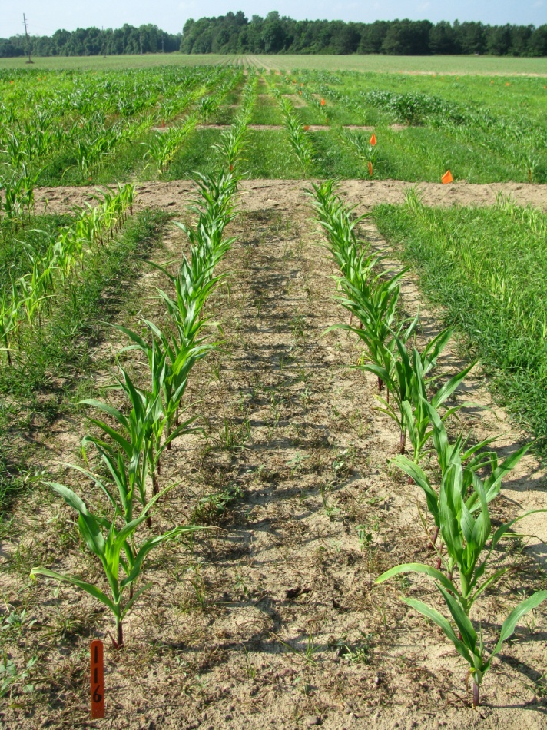
DHT Systems– 2010
Palmer Amaranth (GR) + Crabgrass
NTC
Durango DMA 4SL @ 16 oz/A
Weedar 64 3.8SL @ 17 oz/A
N-PAK AMS @ 2.5% v/v
CN-10-10
9 DAT

Slide 31
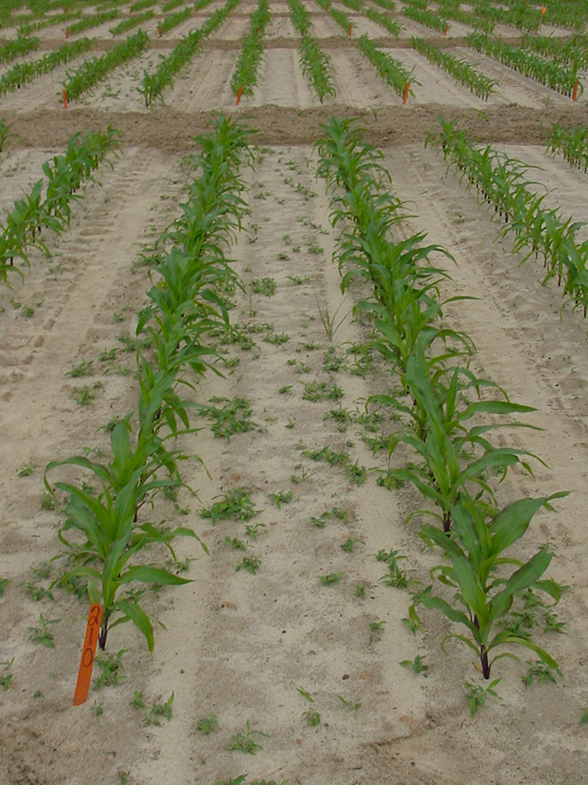
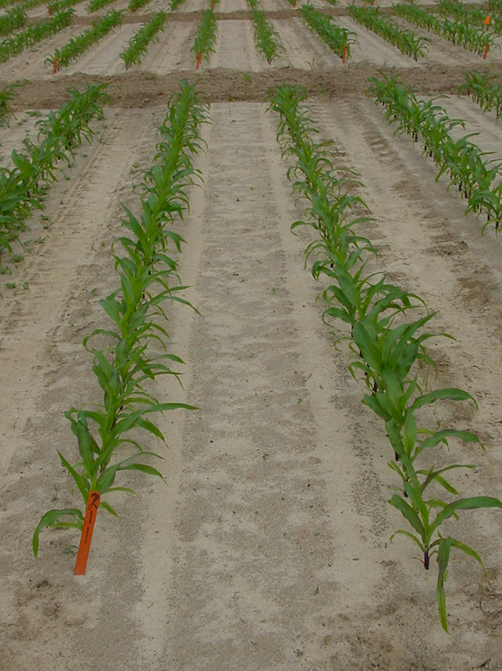
Weed Control in Georgia Field Corn with Zidua Applied PRE (Photo @ 32 DAT)
NTC
Zidua 85WG @ 1.67 oz/A
Atrazine 4L @ 1.5 qt/A
(0.09 lb ai/A)
CN-02-08

Slide 32

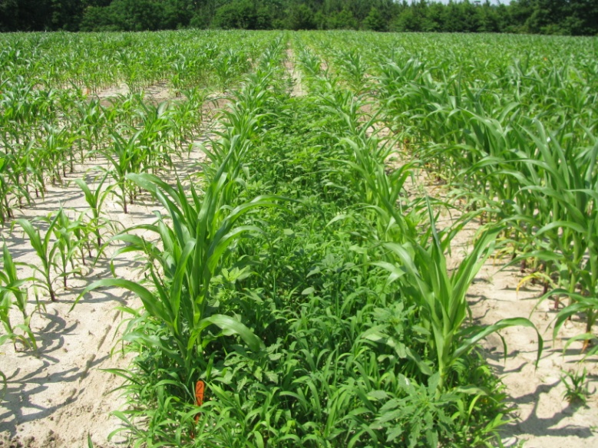
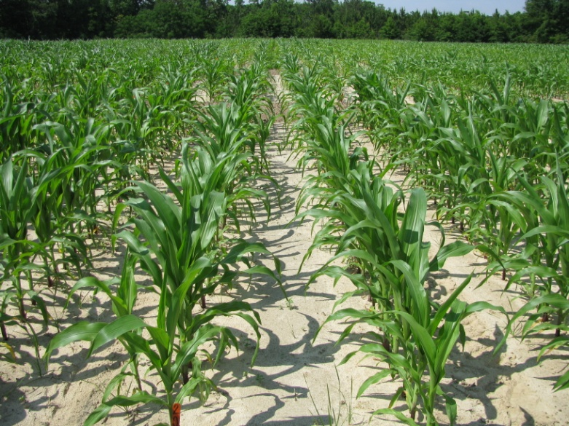
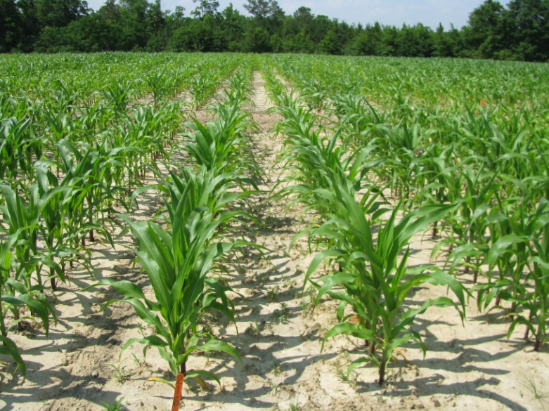
Capreno (3 oz/A) + COC (1% v/v) + 28% UAN (2.5% v/v)
NTC
EPOST (14 DAP)
MPOST (23 DAP)
CN-13-10
May 13
43 DAP

Slide 33

For More Weed Science Info
www.gaweed.com

