Slide 1
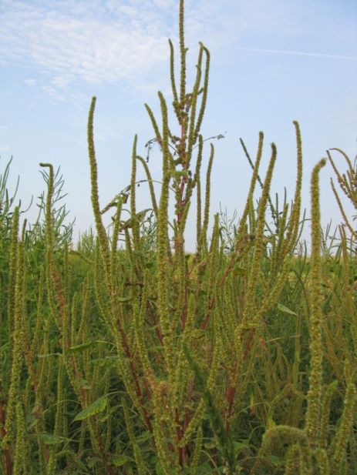

Developing An Herbicide-Resistant Weed Management Plan
Eric P. Prostko, Ph.D.
Professor and Extension Weed Specialist
Dept. Crop & Soil Sciences

Slide 2
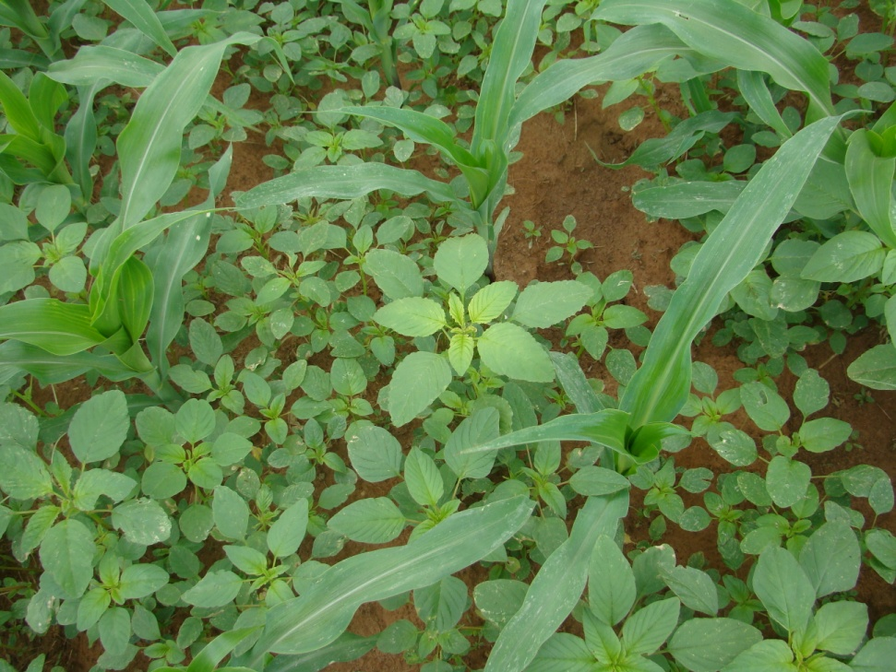
Evolution of Herbicide Resistant Weeds
Repeated applications of herbicides with same site of action (i.e. selection pressure)
Annual weeds that……
occur in high populations
are widely distributed
are prolific seed producers
have efficient gene (seed or pollen) dissemination

Slide 3
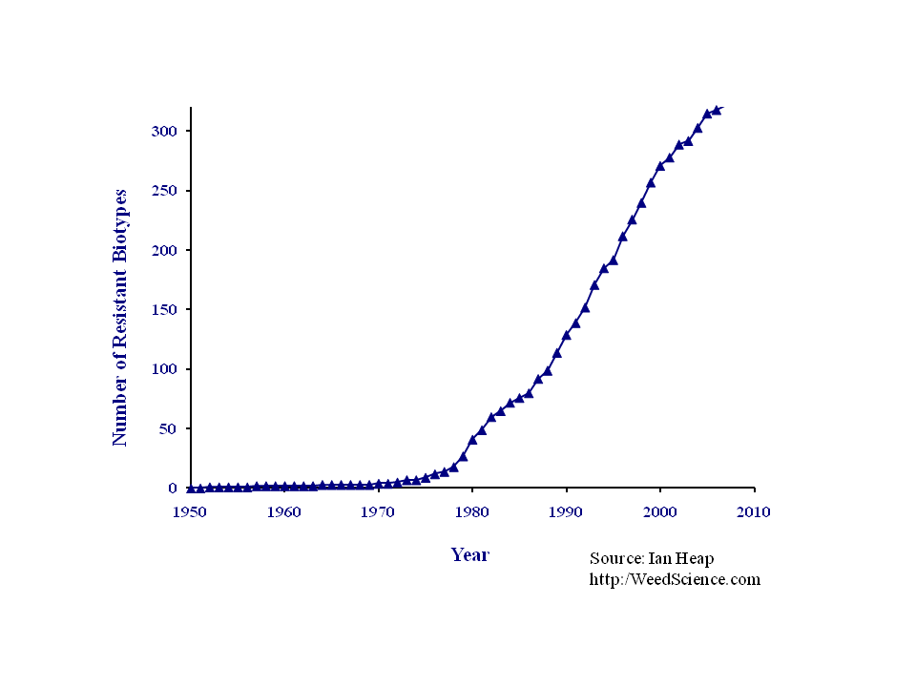
Herbicide-resistance is not a new phenomenon! Its been happening since 1968!
Source: International Survey of Herbicide Resistant Weeds (http://www.weedscience.org/In.asp)

Slide 4
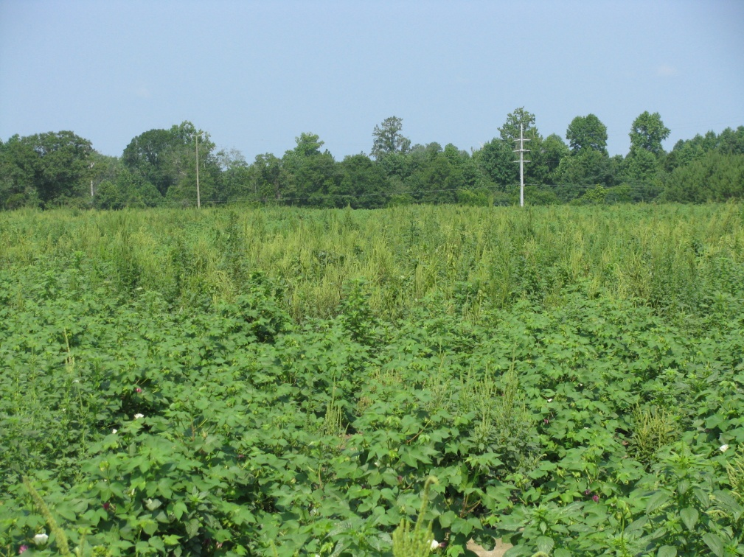
Hindrances to Resistance Management
Economics
Reluctance to Change
Denial
Belief that chemical companies will develop “new” products

Slide 5
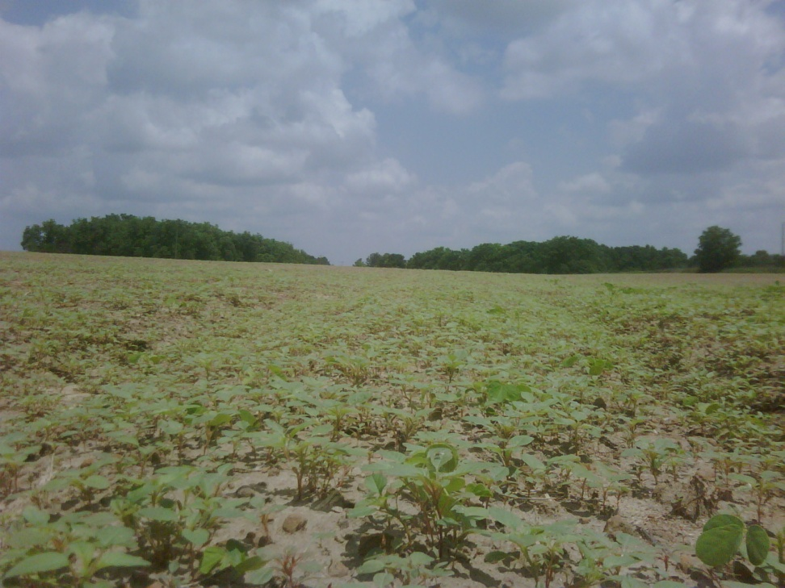
Herbicide Resistant Weed Management Plan
Other Control Tactics
Know Modes of Action
Rotating MOA
Tank-mixtures
Residuals
Escape Rogueing
Post-harvest
Future Resistance Concerns

Slide 6
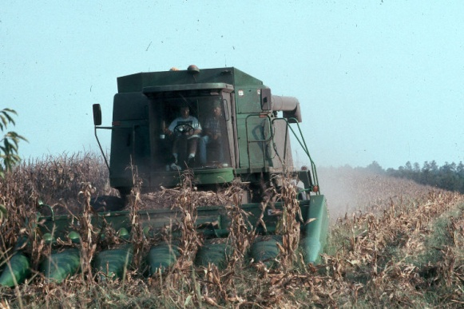
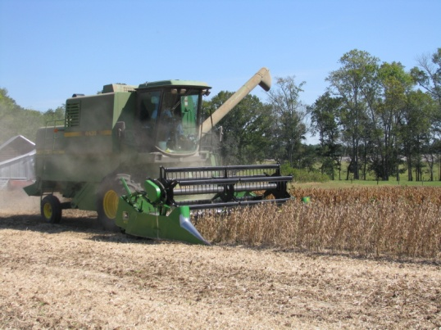
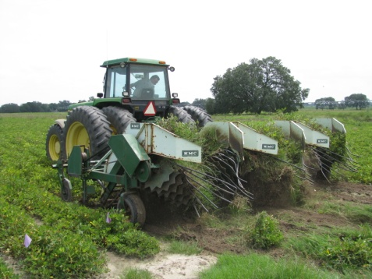
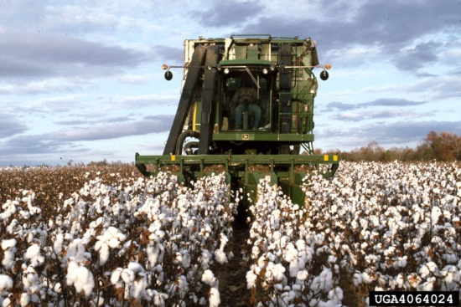
Crop Rotation
Yield Loss (%) from 1 AMAPA/row meter

Slide 7
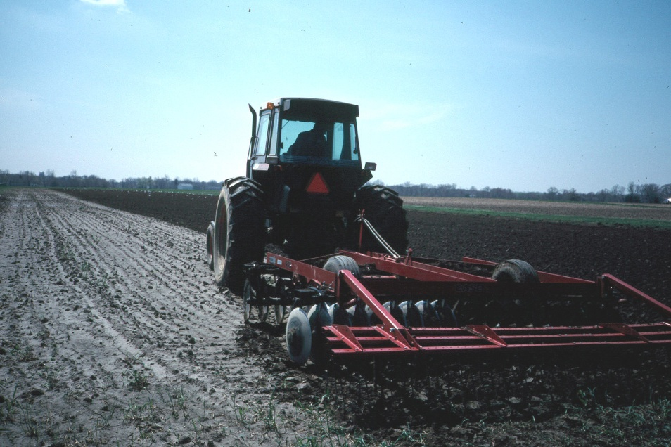
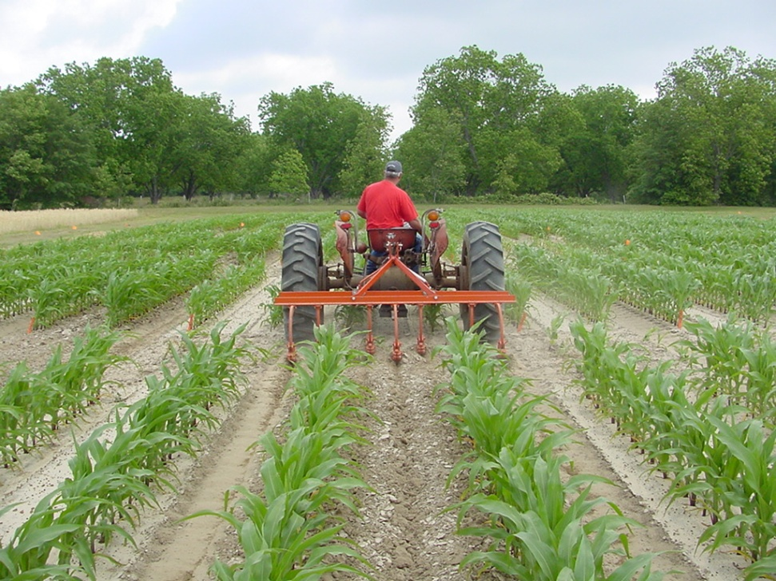
Tillage and/or Cultivation

Slide 8
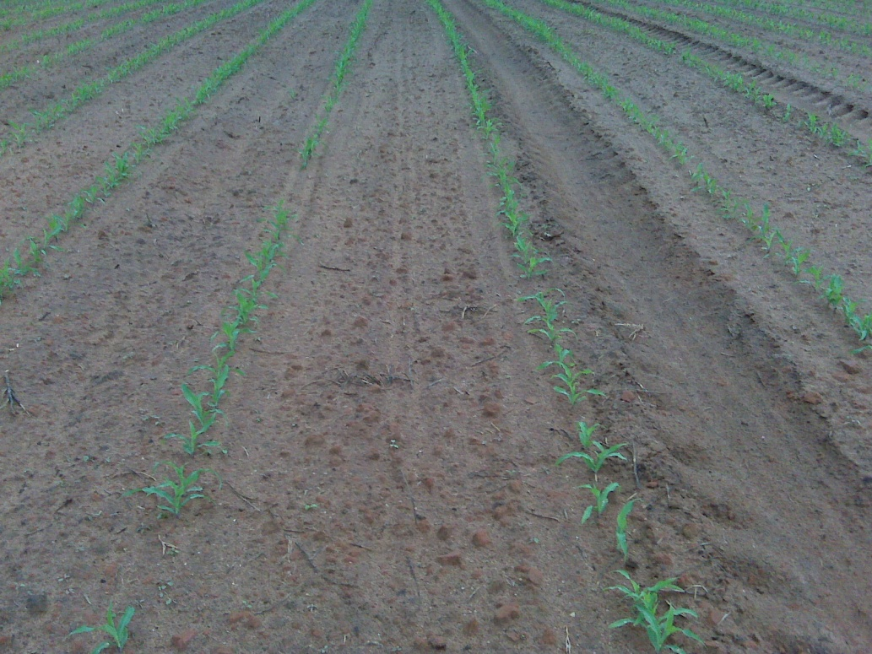
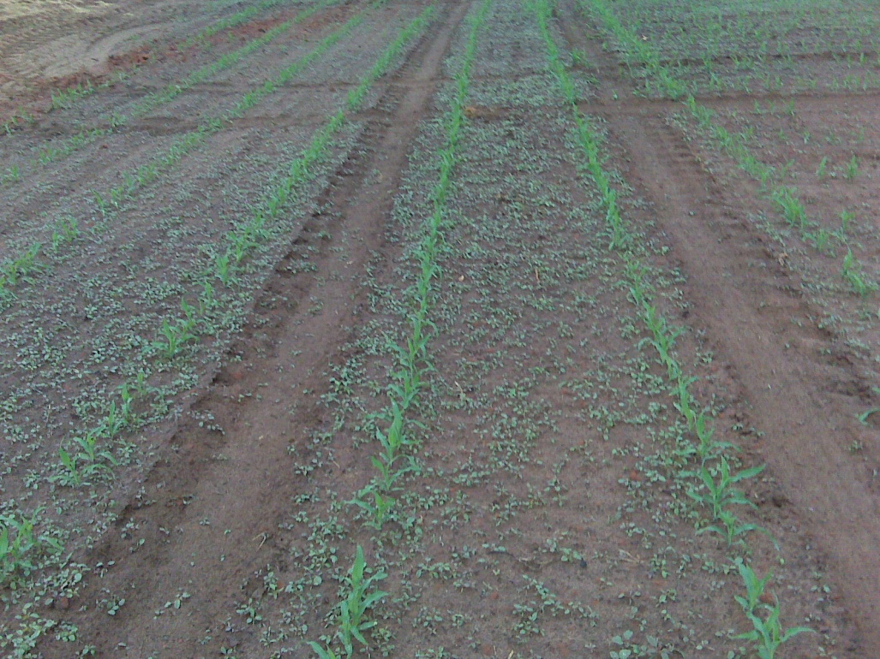
Tillage and Pigweed
Bottom Plow
Chisel Plow
Source: Twiggs Co., April 22, 2010

Slide 9
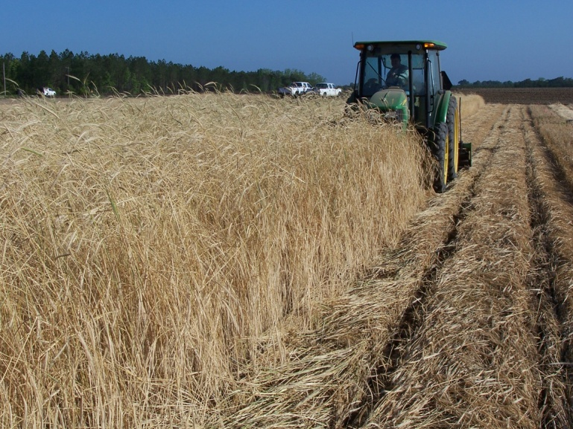
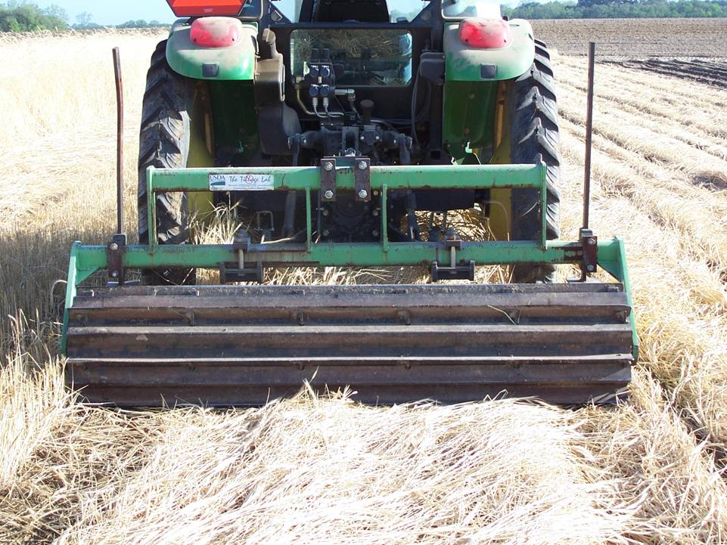
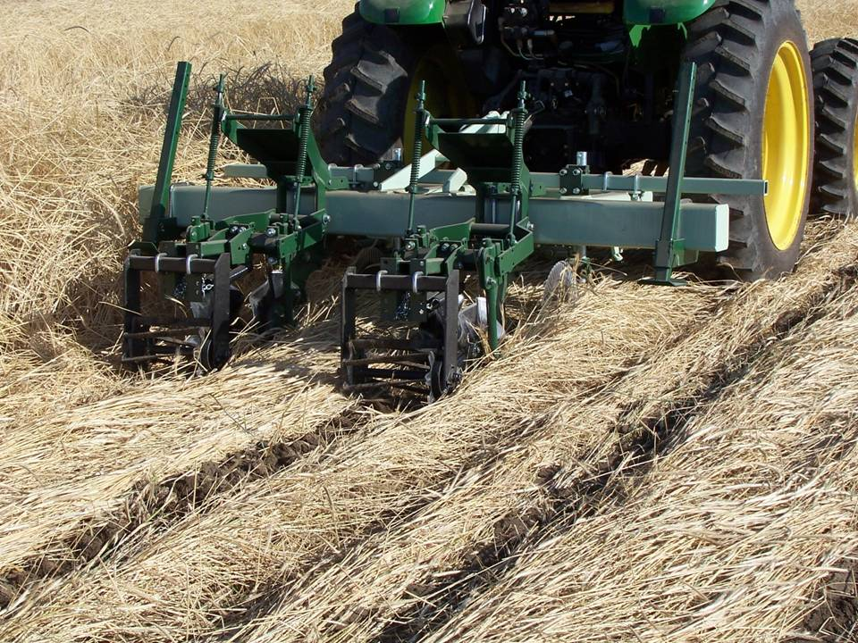
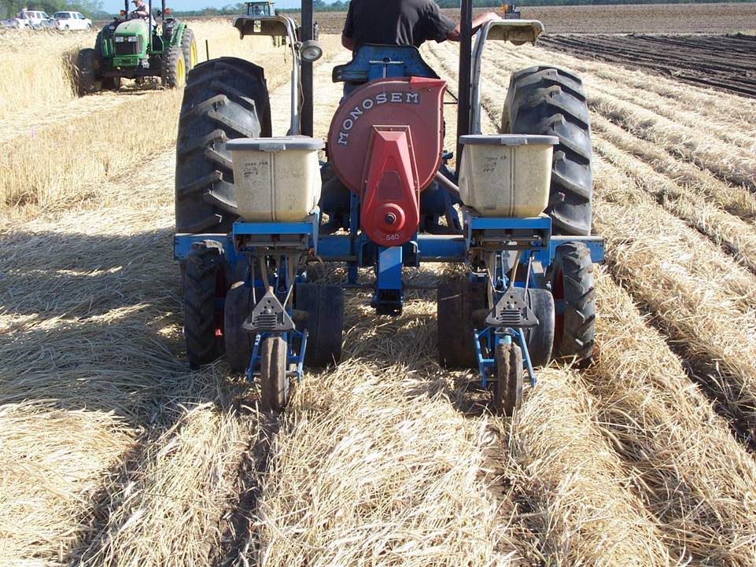
Extreme Cover Crops
1
2
3
4

Slide 10
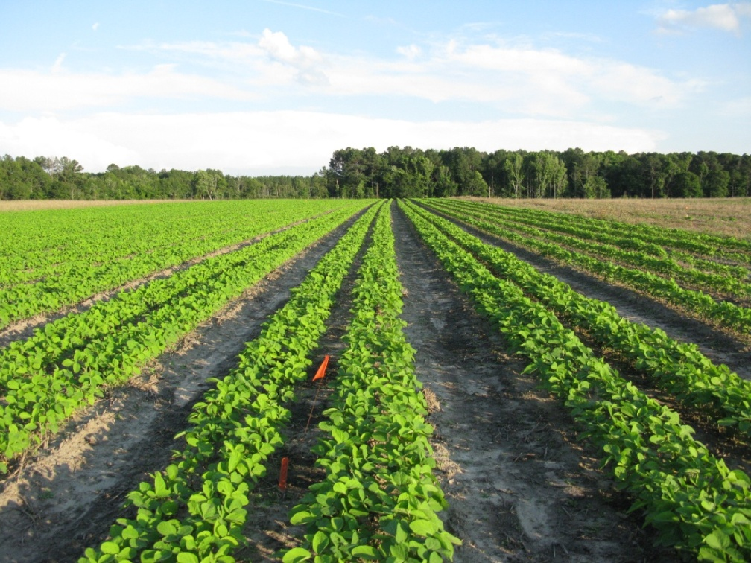
Row Spacing
Washington County 2009

Slide 11
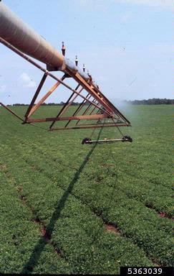
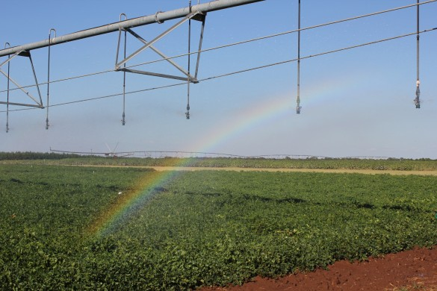
Irrigation
Joy Carter
GPC

Slide 12
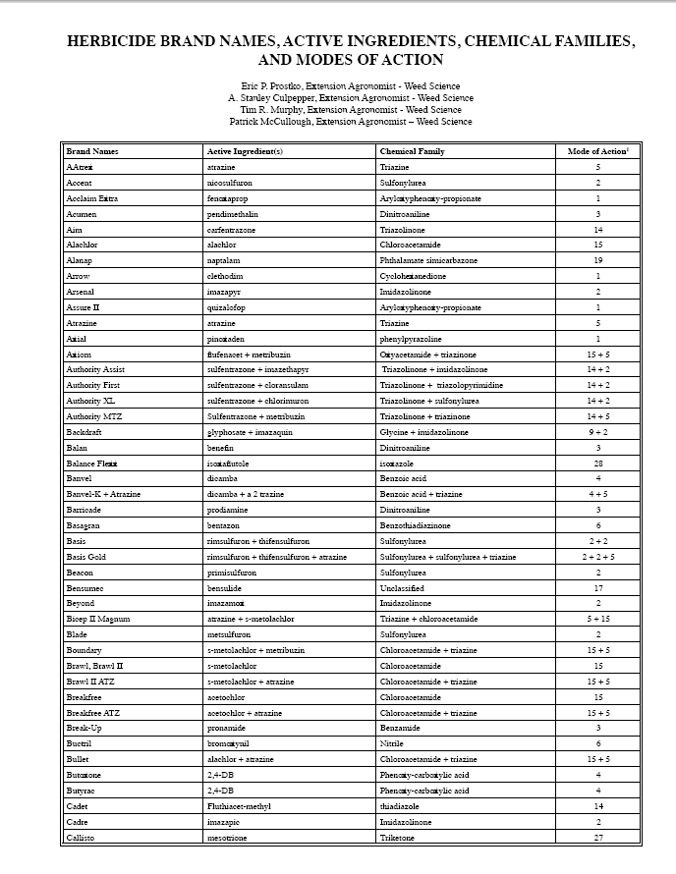
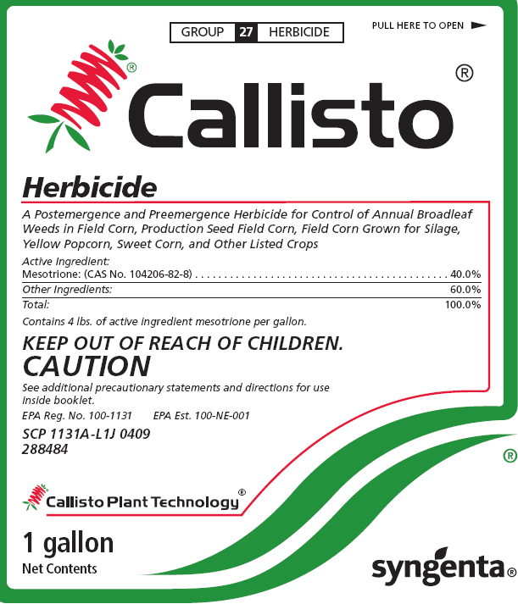
Modes of Action

Slide 13
A long-term resistance plan?
Crop | PPI/PRE | POST1 | POST2 | MOA’s
Peanut (No ALS) | DNA + Valor | Cadre | 2,4-DB | 4
Peanut (ALS) | DNA | Paraquat Basagran + Dual | Ultra Blazer + Dual | 5
RR-Cotton | Reflex | Glyphosate + Staple | Direx + MSMA | 5
RR-corn | Micro-Tech | Glyphosate + atrazine | -- | 3
RR-soybean | Boundary | Glyphosate + FirstRate | -- | 4
LL-soybean | Dual Magnum | Ignite + Reflex |  | 3

Slide 14
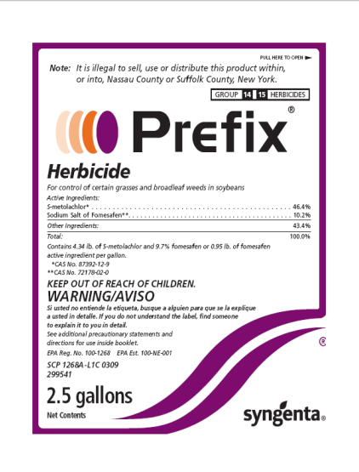




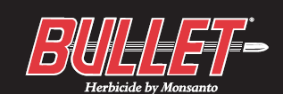
Tank Mixtures/Pre-Mixtures
For herbicide mixtures to be the most effective in delaying the evolution of herbicide resistance they must have (ideally) …..
Different sites of action
Similar efficacy and persistence
Different propensities for selecting for resistance
ALS/ACCase – high
Auxins/GS - low

Slide 15
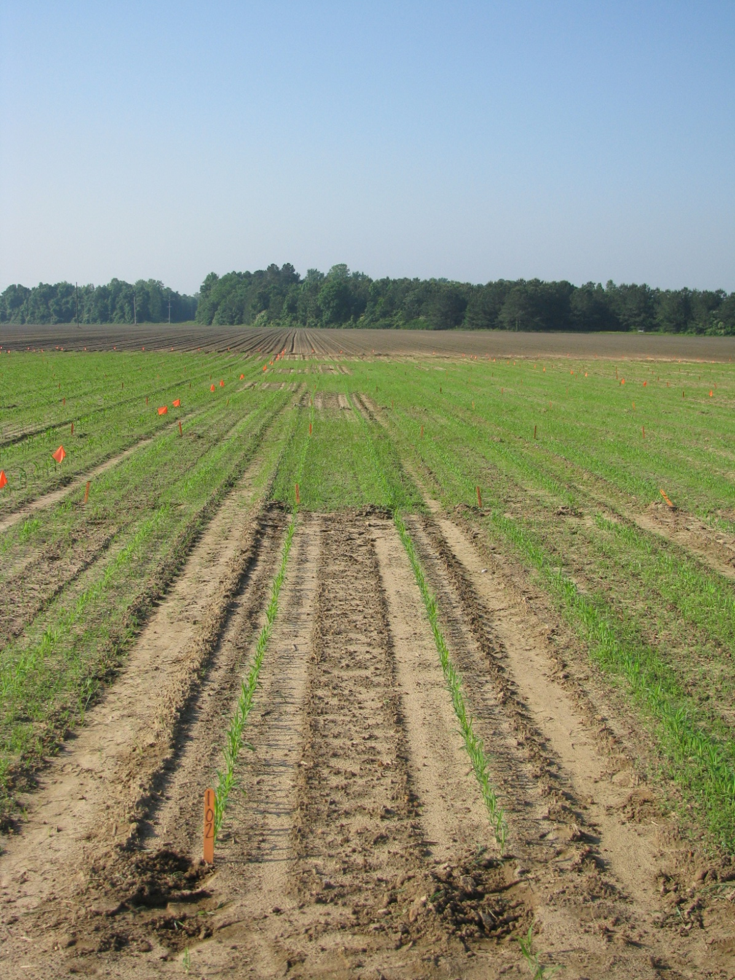
Residual Herbicides
Dual Magnum @ 1 pt/A (16 DAT)
Key to future survival
Should be used on every acre!!!
1 may not be enough!

Slide 16
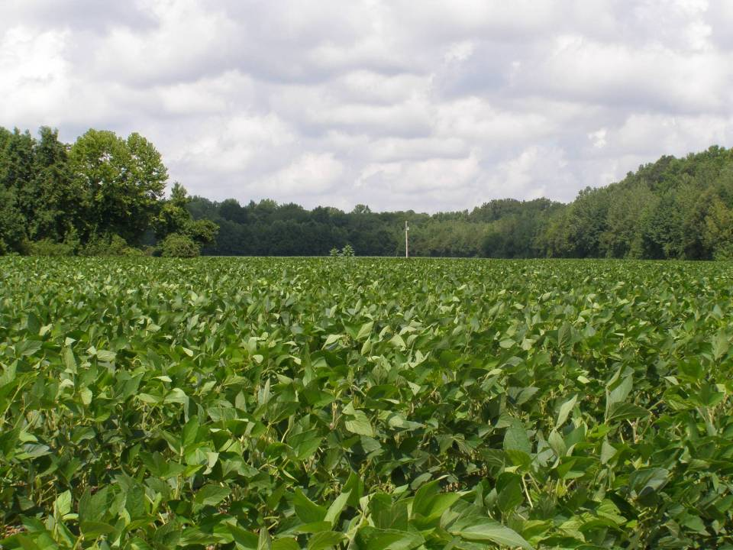
Is this weed resistant?
Want to risk it?
Alan York
NCSU
ACY 2008
Notes:
16

Slide 17
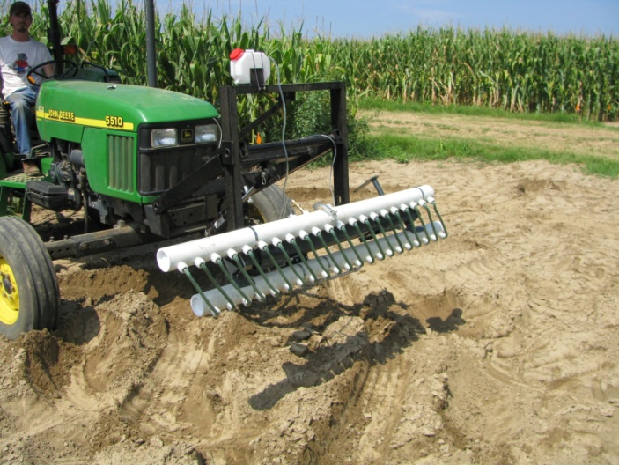
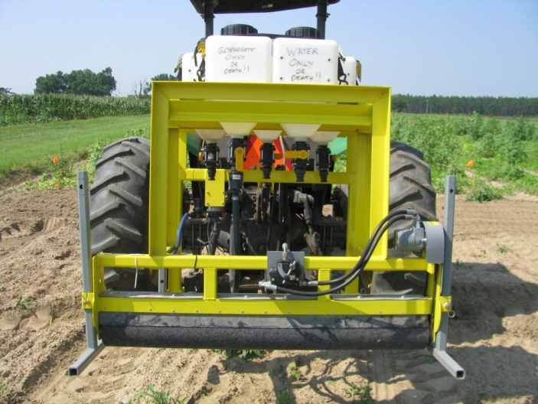
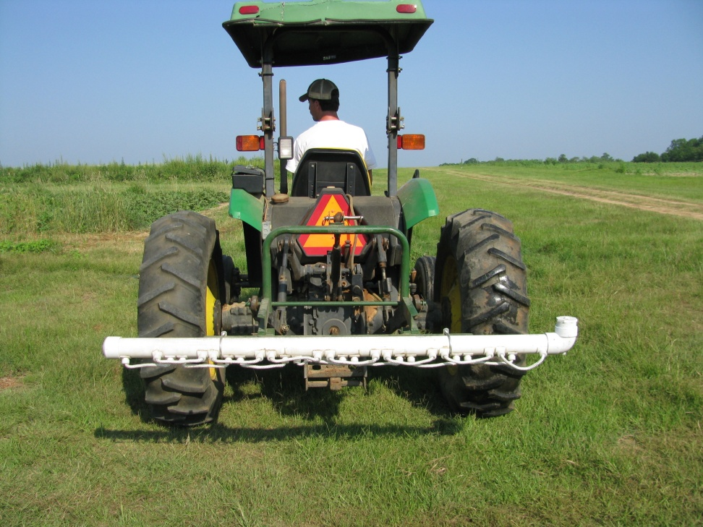
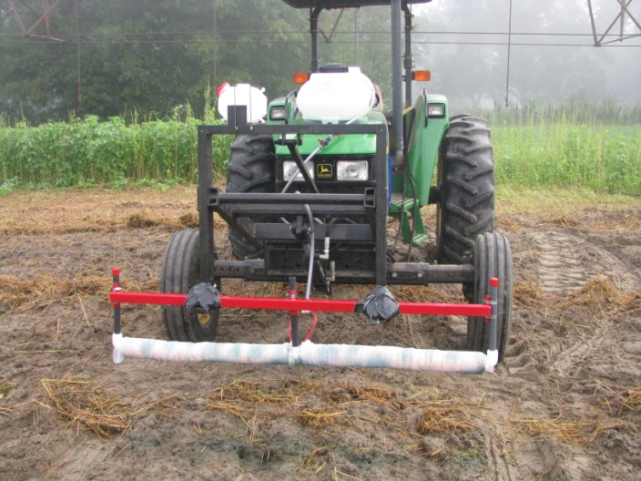
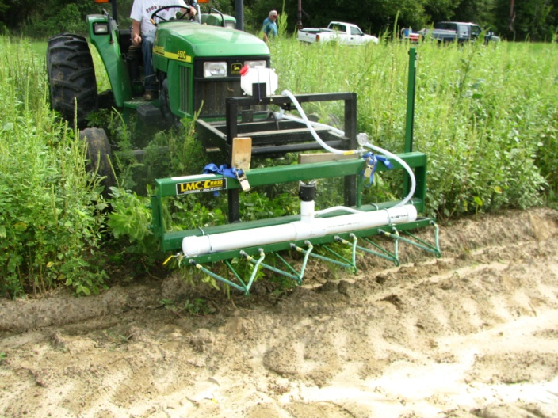
Non-Selective Applicators

Slide 18
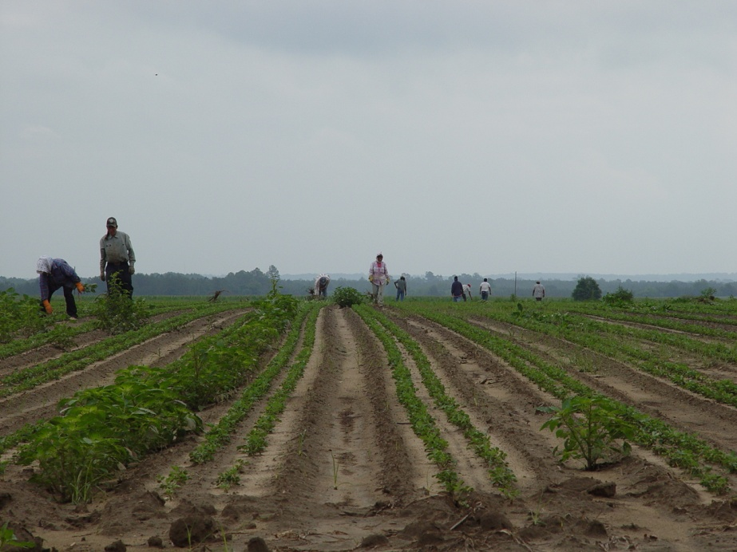
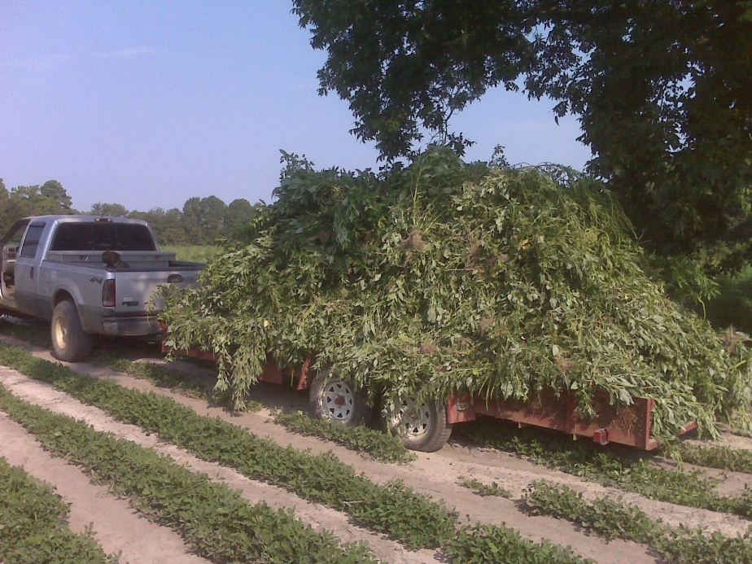
Hand-Weeding

Slide 19
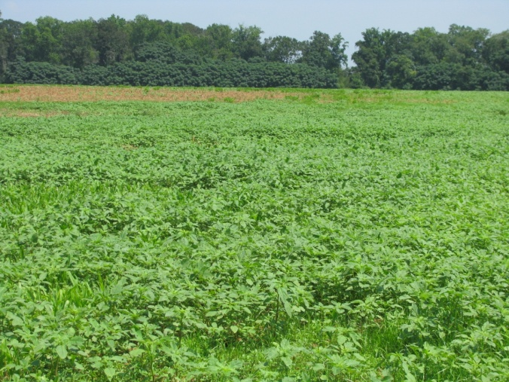
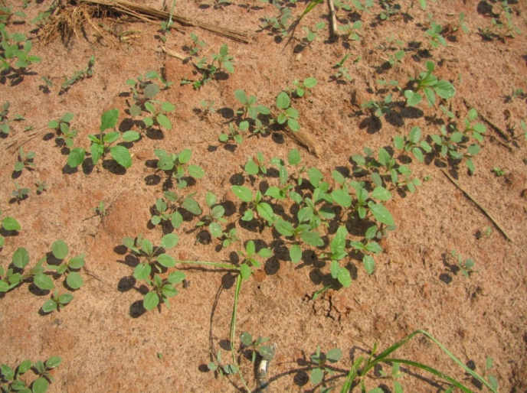
Post-Harvest Pigweed Problems
Decreasing daylight hastens flower and seed production
Flowering (3-4 weeks)
Seed production (2-3 weeks)
Some germination at 41⁰F (8%)
Control Options
Mowing
Tillage
Herbicides
Gramoxone + 2,4-D or dicamba
Residuals i.e. Dual Magnum?
When can we stop worrying about seed production?
Keeley et al. 1987. Weed Science 35:199-204
Steckel et al., 2004. Weed Science 52:217-221

Slide 20


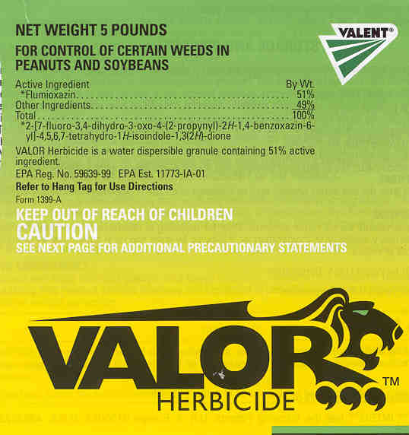

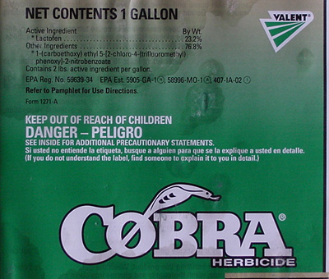


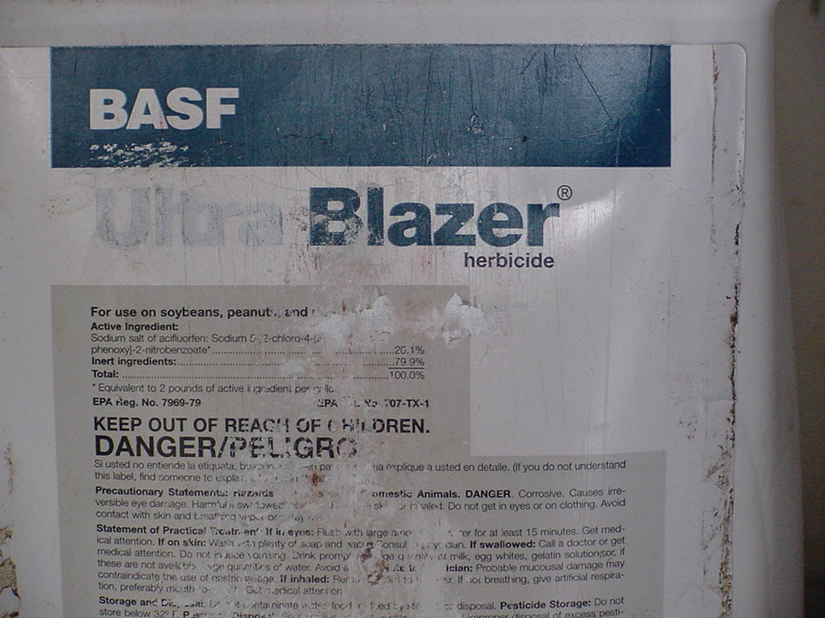




PPO Herbicides
Resistance has already been reported in other areas!!!
Amaranthus quitensis
2005 (Bolivia)
Common waterhemp
2001 (Kansas)
2002 (Illinois)
2005 (Missouri)
2009 (Iowa)
Common ragweed
2005 (Delaware)
2006 (Ohio)
Wild poinsettia
2004 (Brazil)

Slide 21
Is this already happening?
Crop | PPLNT | PRE | POST or PDIR | Harvest Aid
Soybean | Valor | Reflex | Cobra | Aim
Cotton | Valor | Reflex | Valor | Aim/ET
Corn | Valor | Sharpen | ET | Aim
Peanut | Valor | Valor | Ultra Blazer | Aim
In a 4 year rotation, we could use 16 PPO’s!!!!

Slide 22
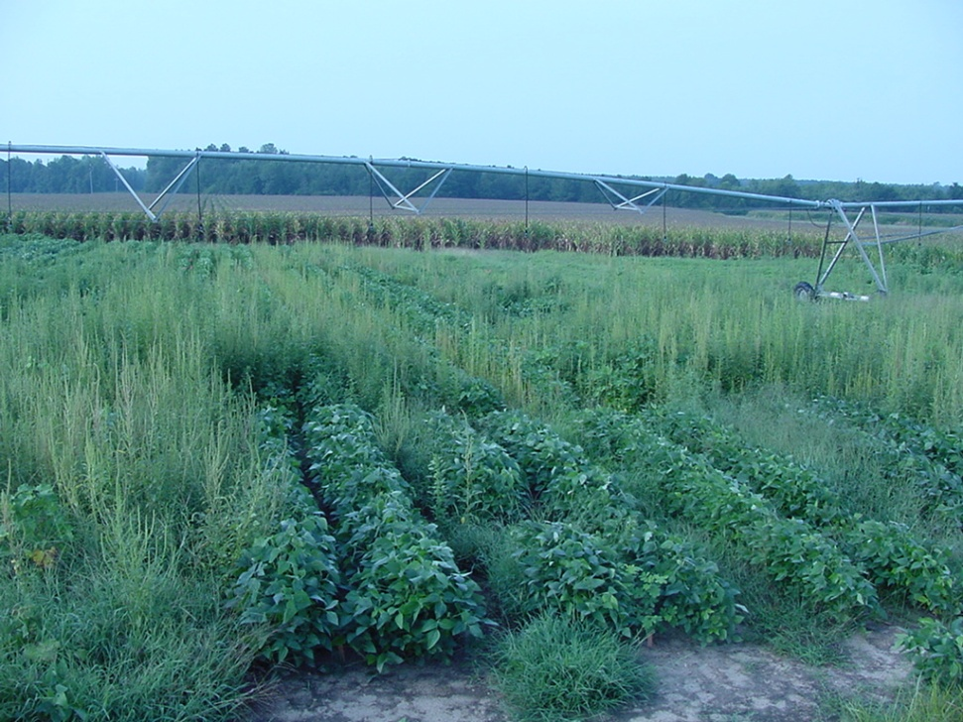


Ignite and LL Crops
Abuse of Ignite
LL cotton, corn, soybeans
may jeopardize future technologies (DHT, Dicamba)
Current resistances
Italian ryegrass (Oregon)
Goosegrass (Malaysia)

Slide 23
Herbicide Resistant Weed Management Plan
Other Control Tactics
Know Modes of Action
Rotating MOA
Tank-mixtures
Residuals
Escape Rogueing
Post-harvest
Future Resistance Concerns

Slide 24
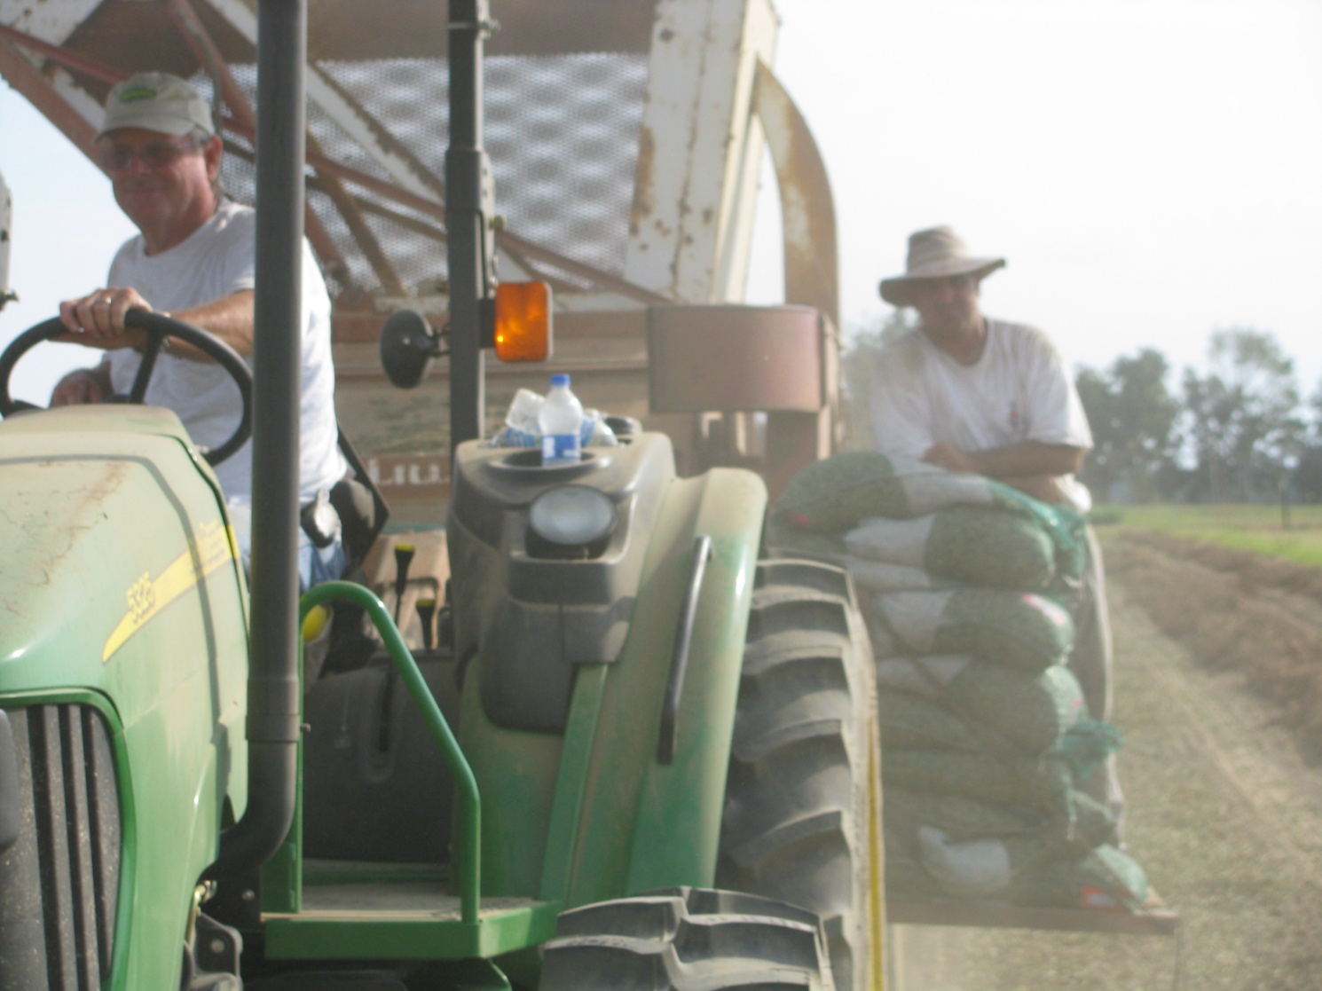
Questions?
www.gaweed.com

