Slide 1

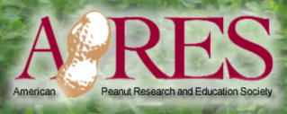
Peanut Response To Metribuzin
L.C. Hand* and E.P. Prostko
Department of Crop & Soil Sciences

Slide 2
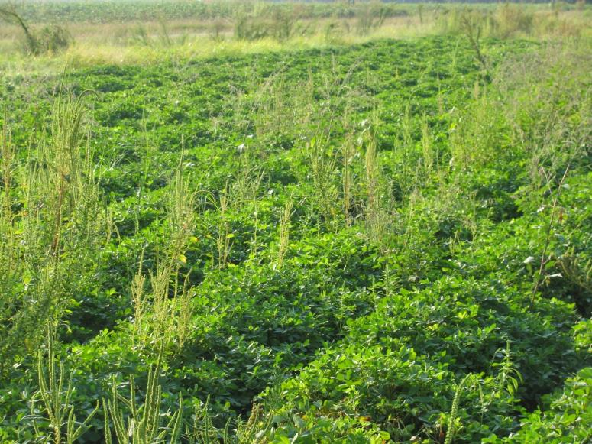
Introduction
Herbicide-resistant Palmer amaranth is one of the most troublesome weeds in agronomic crops in GA (Webster, ed. 2012; Webster, ed. 2013)

Slide 3
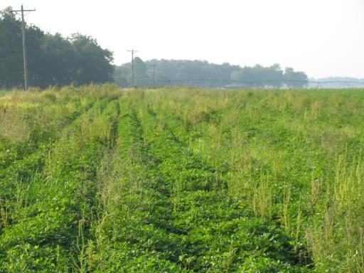
Palmer Amaranth Biology
Wide germination window (Keeley et al. 1987)
March-October
Greatest germination from June-August
Prolific seed production
Over 446,000 seed per plant in non-crop (Webster and Grey 2015)
Over 60,000 seed per plant when planted on August 1 (Keeley et al. 1987)

Slide 4
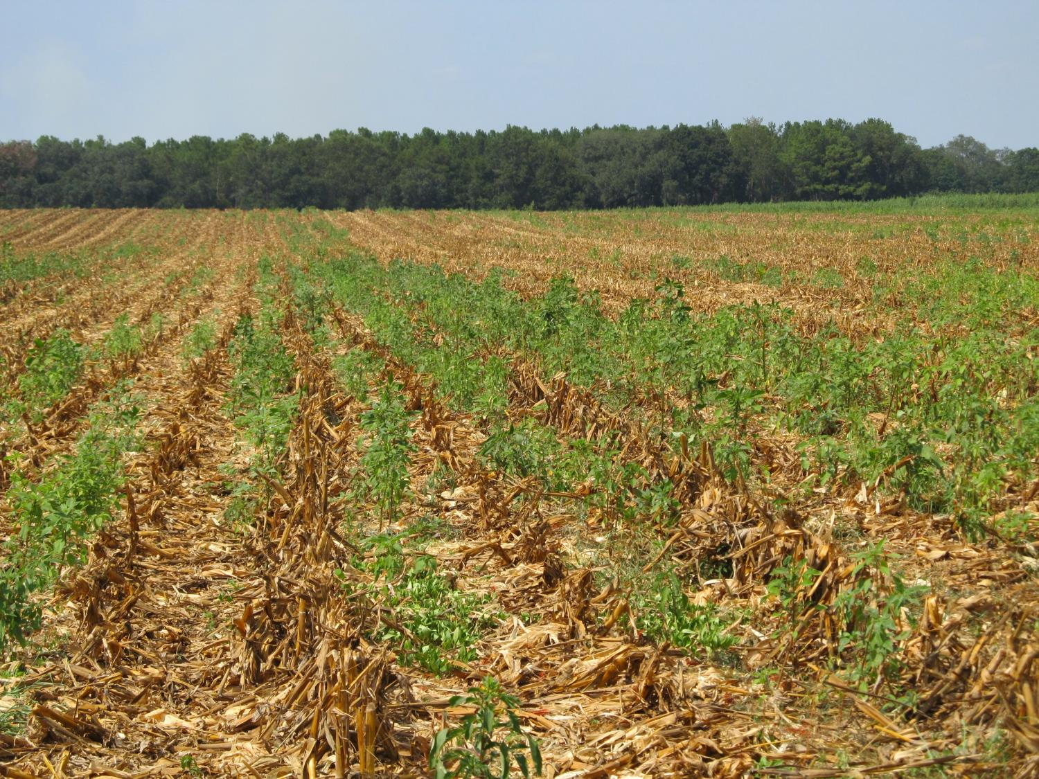
Field Corn: Post-Harvest Palmer Amaranth Populations Must be Managed!

Slide 5
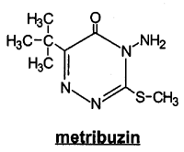

Post-Harvest Control Option
Metribuzin
Good POST and residual control of Palmer amaranth (Crow et al. 2015; Grey et al. 2014)
Takes pressure off of PPOs
Can help reduce Palmer amaranth contributions to weed seed-bank
~30-60 day half-life (Shaner, ed. 2014)
Microbial degradation and highly water soluble (Shaner, ed. 2014)

Slide 6
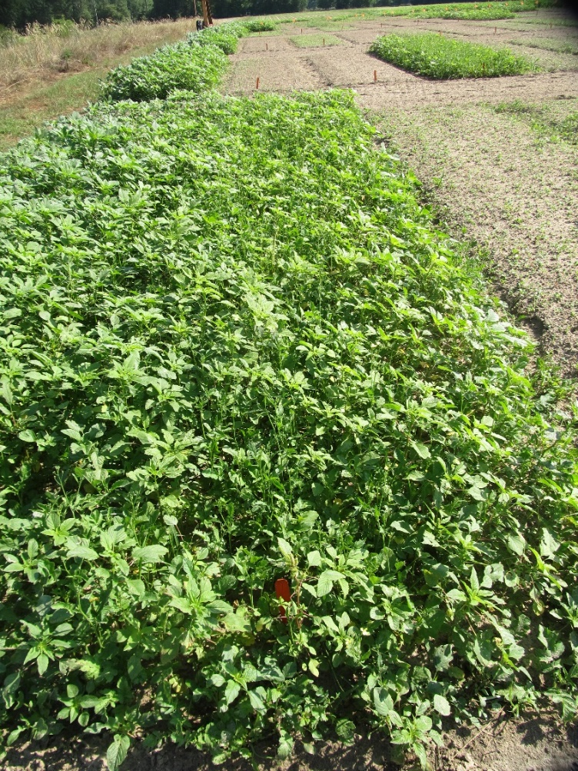
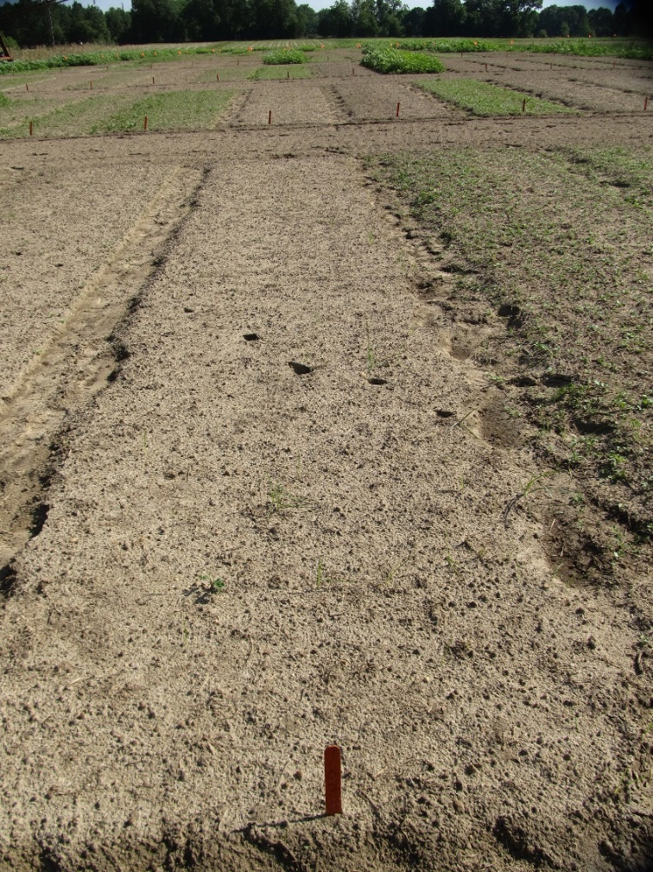
Palmer Amaranth Burndown - 2019 (AMAPA 1-6” tall)
NTC
Gramoxone 3SL @ 840 g ai ha⁻¹
Tricor 4L @ 280 g ai ha⁻¹
Induce @ 0.25% v/v
NC-01-19
May 20
10 DAT

Slide 7
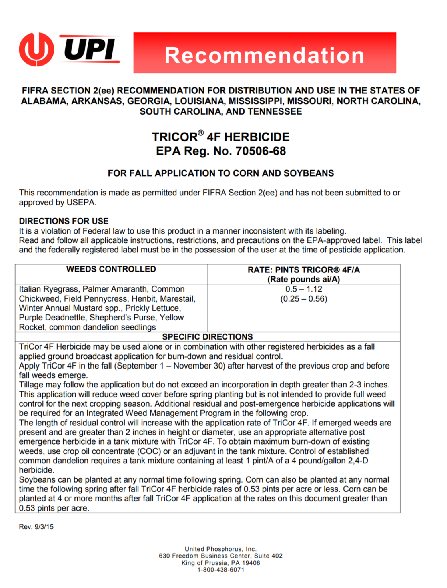
Issues
UPL (formerly UPI) released a Section 2(ee) recommendation for fall applications of metribuzin.
Plantback intervals are listed for corn and soybean only.
Notes:
UPL distributed a section 2ee label recommending…

Slide 8
Issues
Notes:
However, some of our most important crops in Georgia (including peanuts) are not listed in the crop rotation section of the label, resulting in an 18 month plantback interval. With a targeted application date of late July – early August for post-harvest app in corn, that prevents us from planting peanuts for 18 months after application.

Slide 9
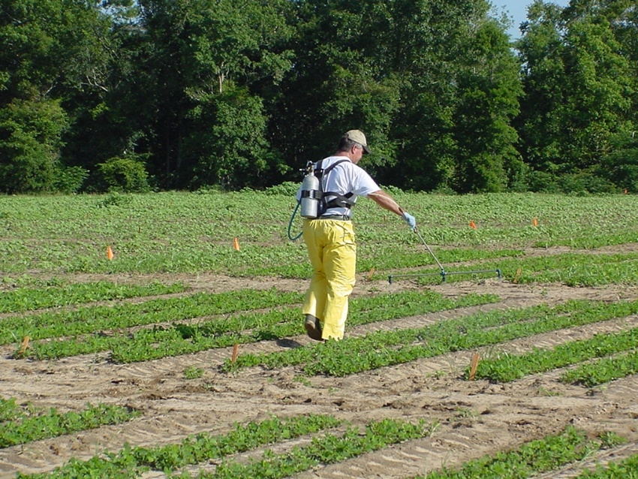
Objective
Evaluate the response of peanut to various rates of metribuzin applied preemergence.
Data will assist in reducing the plant-back interval on the Tricor® 4F label.

Slide 10
Hypothesis
Based on a targeted application rate of 280 g ai ha⁻¹ and an estimated half-life of ~30-60 days, we hypothesize that rates of 70 g ai ha⁻¹ or less (~two half-lives) should not negatively affect peanut growth and development.

Slide 11
Materials and Methods
Trials conducted in 2017 and 2018 in Ty Ty, GA
‘GA-06G’ peanut were planted in late April both years (twin-row).

Slide 12
Materials and Methods
Metribuzin was applied preemergence (two days after planting):
0, 35*, 70, 140, 280, 420, and 560 g ai ha⁻¹
*35 g ai ha⁻¹ rate not included in 2018 due to planting errors
Treatments applied using a CO₂-pressurized backpack sprayer
140 L ha⁻¹
AIXR 11002 nozzles
Plots were kept weed-free using labeled herbicides and hand-weeding
Randomized Complete Block Design
Four replications

Slide 13
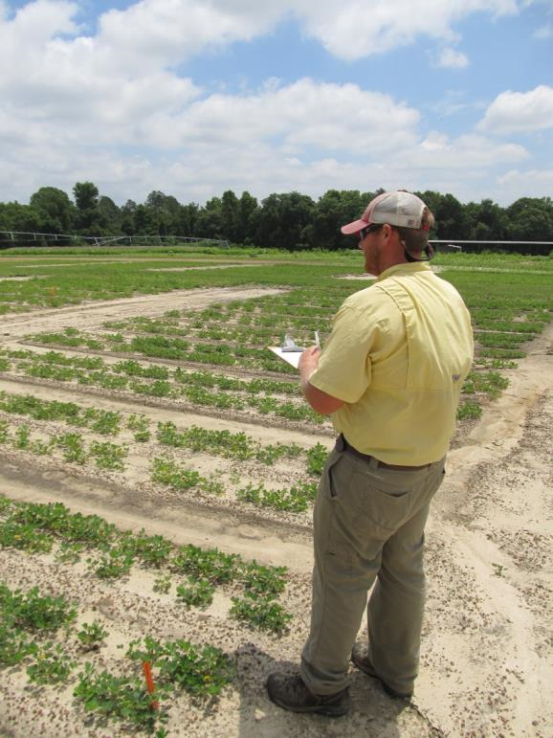
Data Collected
Visual Estimates of Crop Injury
0 to 100%
Peanut Plant Stand Reductions
Peanut Yield Loss (%)

Slide 14

Data Analysis
Data were subjected to nonlinear regression using log-logistic analysis to describe a dose-response relationship
Seefeldt et al. 1995
C = Lower limit
D = Upper limit
b = slope
I₅₀= dose giving 50% response
Parameter estimates were obtained using PROC GLM in SAS 9.4 and graphed in SigmaPlot 14.0
y $=C+ \frac{D−C}{1+{\left(\frac{X}{I50}\right)}^{b}}$

Slide 15
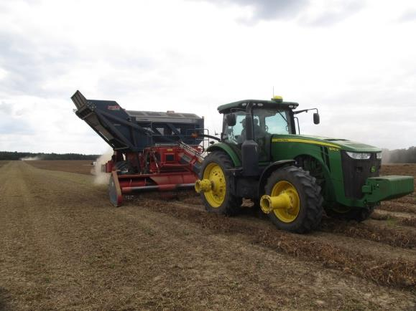
Data Presented
Early and late season injury
2017
2018
Stand reduction
2017
2018
Yield
2017 and 2018 combined

Slide 16
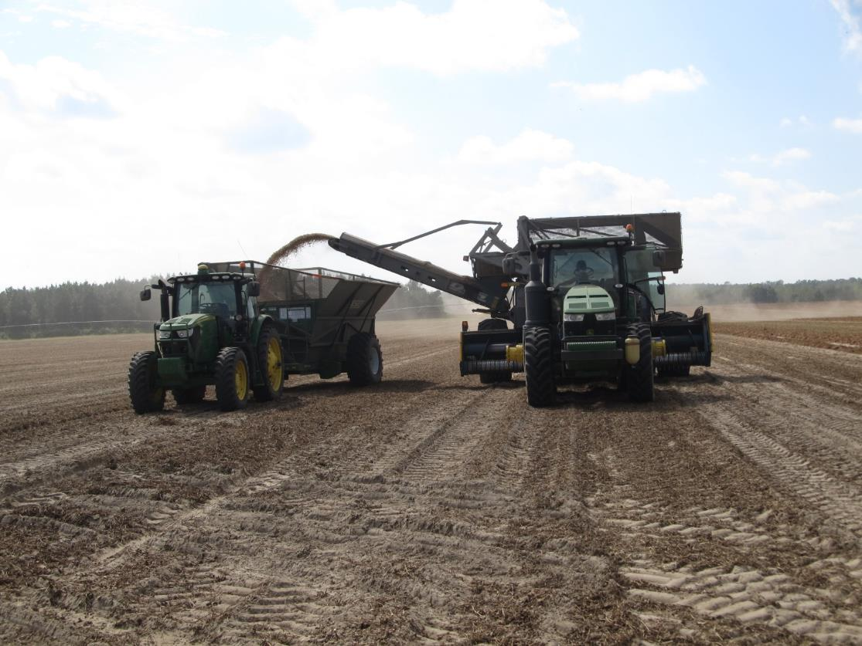
Results

Slide 17
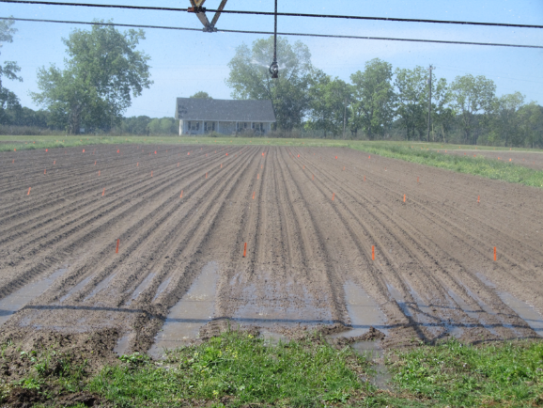
Rainfall/Irrigation
2017
Time (DAP) | Rain (cm) | Irrigation (cm) | Total (cm)
0-7 | 0.3 | 1.3 | 1.6
8-14 | 3.7 | 1.3 | 5.0
15-21 | 0.3 | 1.3 | 1.6
22-30 | 2.3 | 2.6 | 4.9
Total | 6.6 | 6.5 | 13.1
2018
Time (DAP) | Rain (cm) | Irrigation (cm) | Total (cm)
0-7 | 0 | 1.3 | 1.3
8-14 | 0 | 1.3 | 1.3
15-21 | 3.7 | 0 | 3.7
22-30 | 9.6 | 0 | 9.6
Total | 13.3 | 2.6 | 15.9

Slide 18
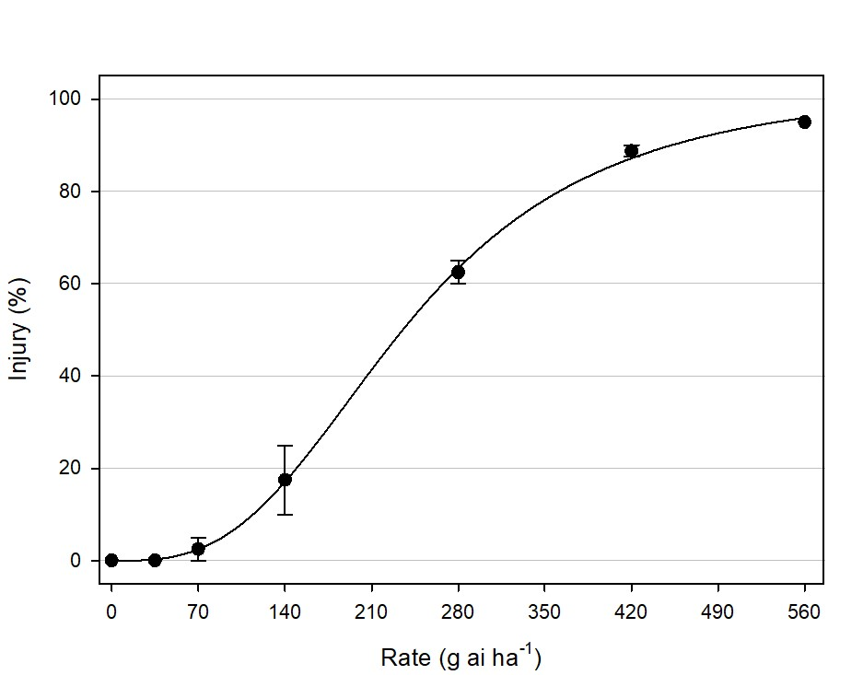
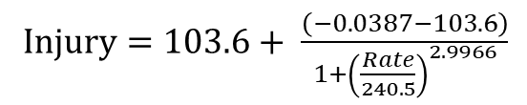
Early Season Injury – 2017
Injury $=103.6+ \frac{\left(−0.0387−103.6\right)}{1+{\left(\frac{Rate}{240.5}\right)}^{2.9966}}$
R² = 0.98
I₅₀ = 240.5
29 DAP
Notes:
280-560 = 60-95%
140 – 17%

Slide 19
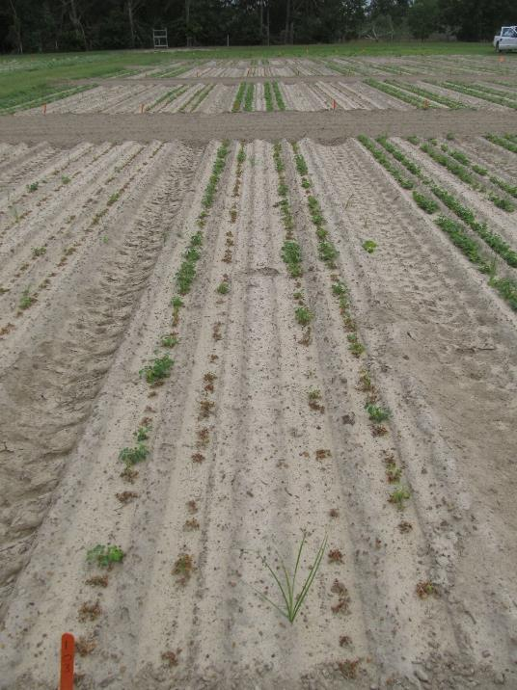
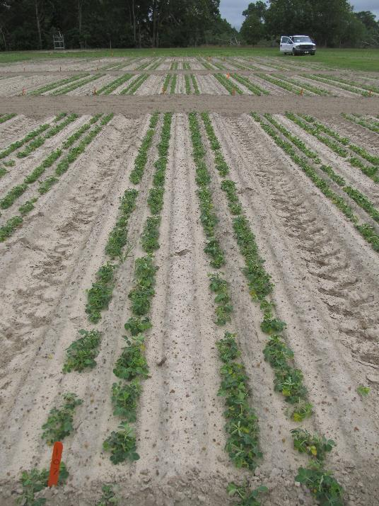
Early Season Injury - 2017
280 g ai ha⁻¹
0 g ai ha⁻¹

Slide 20
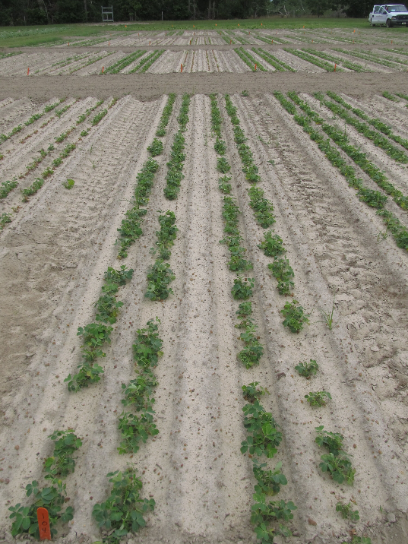
Early Season Injury - 2017
140 g ai ha⁻¹
0 g ai ha⁻¹

Slide 21
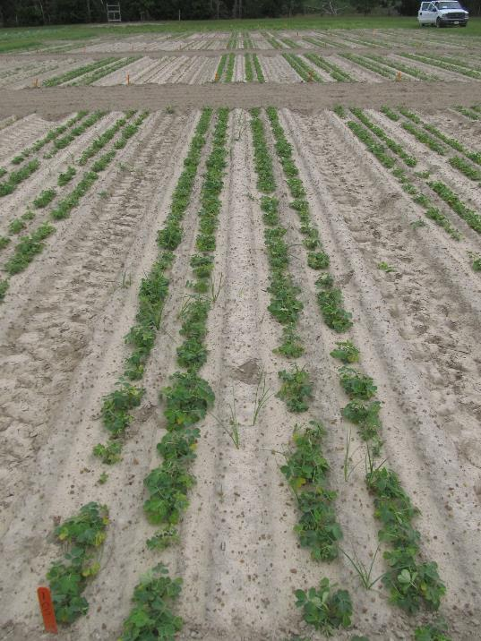
Early Season Injury - 2017
70 g ai ha⁻¹
0 g ai ha⁻¹

Slide 22
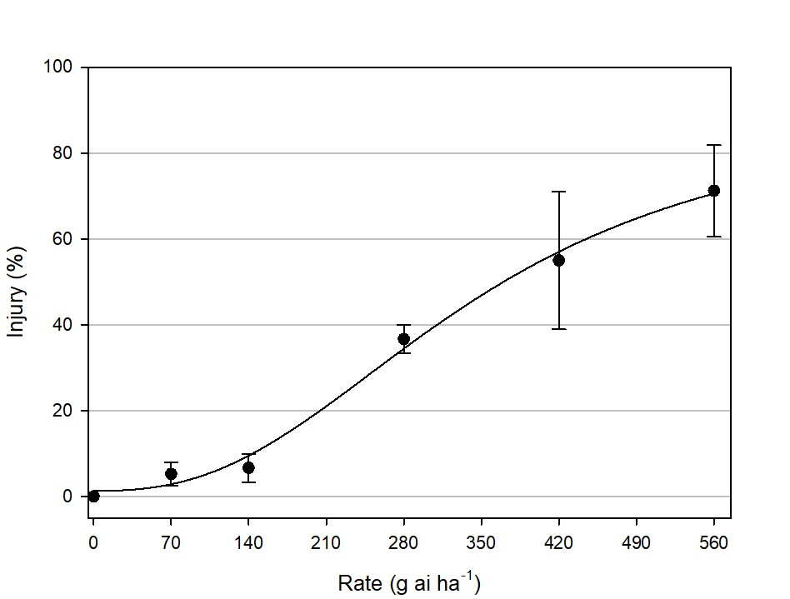
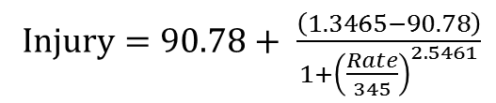
Early Season Injury - 2018
Injury $=90.78+ \frac{\left(1.3465−90.78\right)}{1+{\left(\frac{Rate}{345}\right)}^{2.5461}}$
R² = 0.83
I₅₀ = 345.0
52 DAP
Notes:
280-560 = 35-70%
140 = 10%

Slide 23
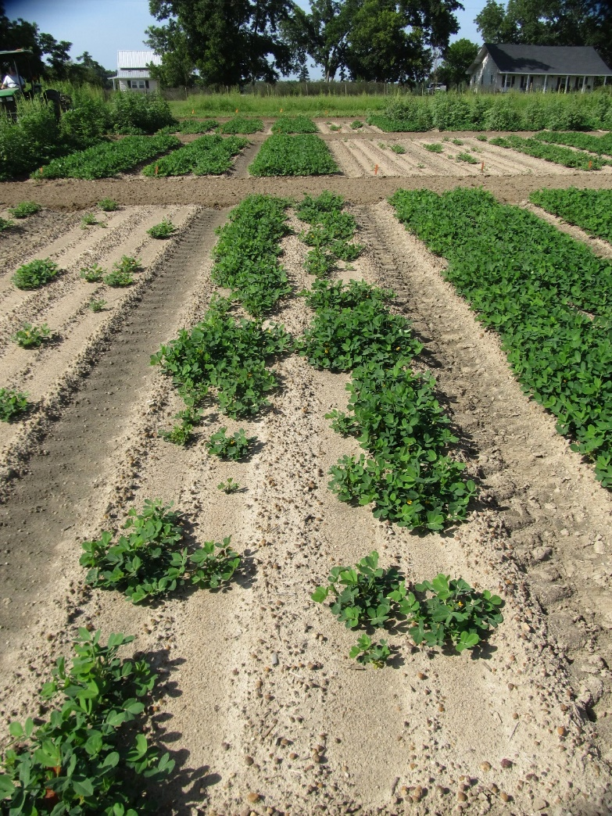
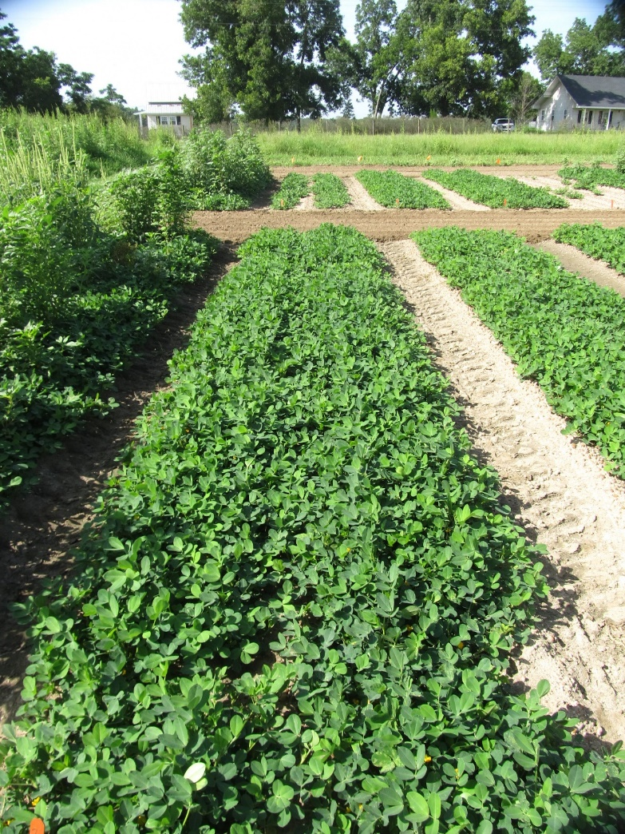
Early Season Injury - 2018
280 g ai ha⁻¹
0 g ai ha⁻¹

Slide 24
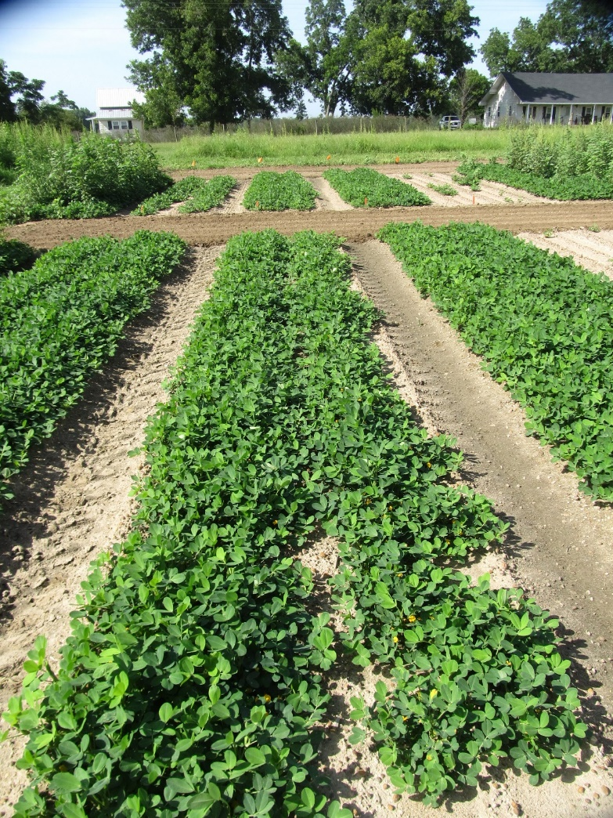
Early Season Injury - 2018
140 g ai ha⁻¹
0 g ai ha⁻¹

Slide 25
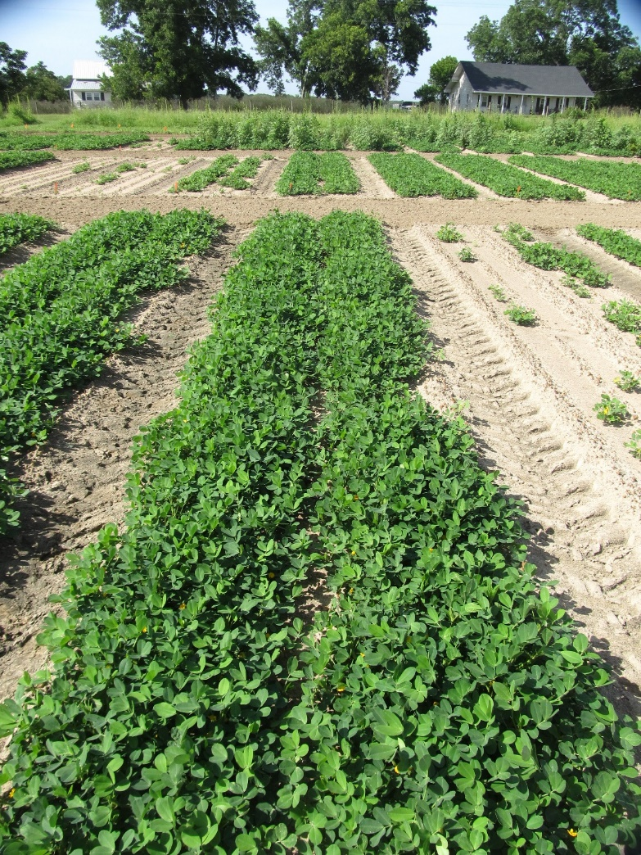
Early Season Injury - 2018
70 g ai ha⁻¹
0 g ai ha⁻¹

Slide 26
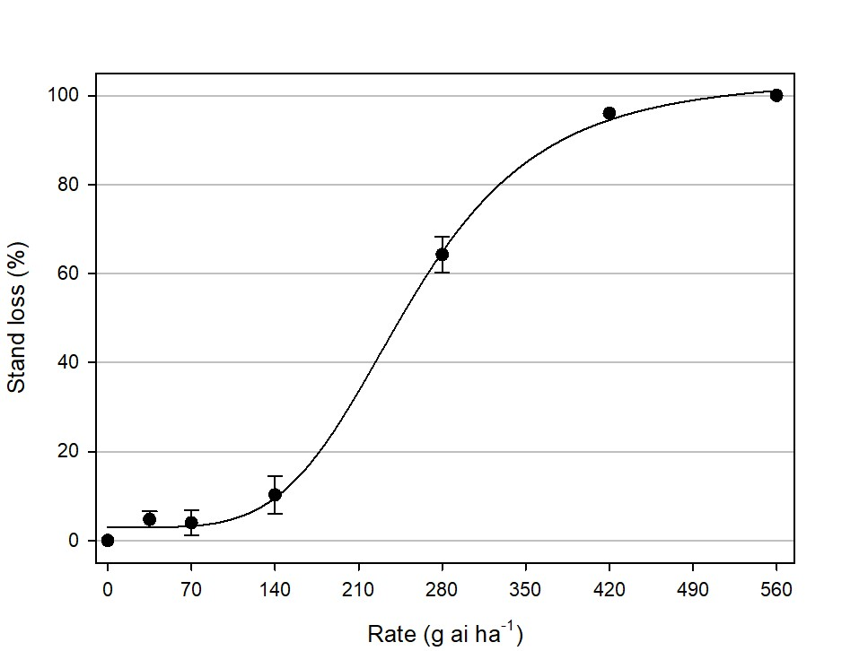
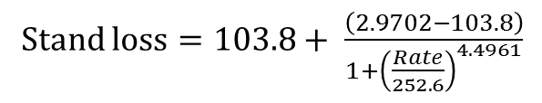
Peanut Stand Loss - 2017
Stand loss $=103.8+ \frac{\left(2.9702−103.8\right)}{1+{\left(\frac{Rate}{252.6}\right)}^{4.4961}}$
R² = 0.99
I₅₀ = 252.6
31 DAP
Notes:
280-560 = 65-100%
140 = 10%

Slide 27
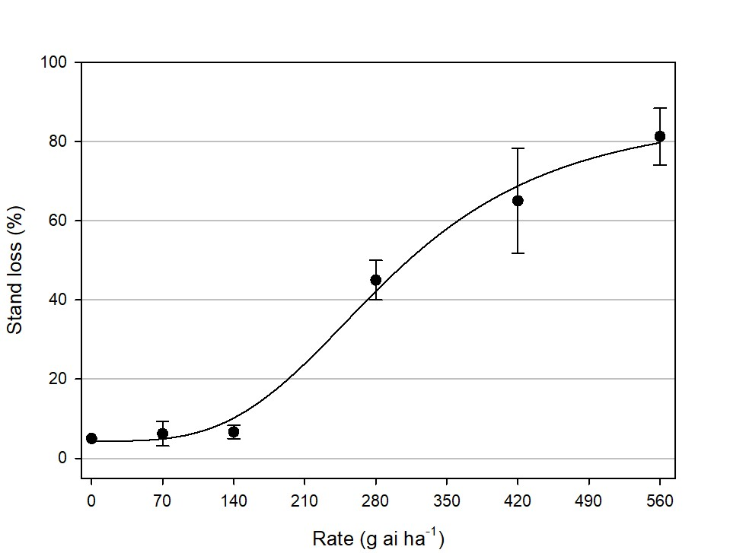
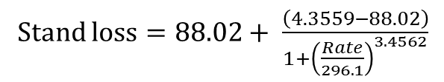
Peanut Stand Loss - 2018
Stand loss $=88.02+ \frac{\left(4.3559−88.02\right)}{1+{\left(\frac{Rate}{296.1}\right)}^{3.4562}}$
R² = 0.91
I₅₀ = 296.1
52 DAP
Notes:
280-560 = 42-80%
140 = 10%

Slide 28
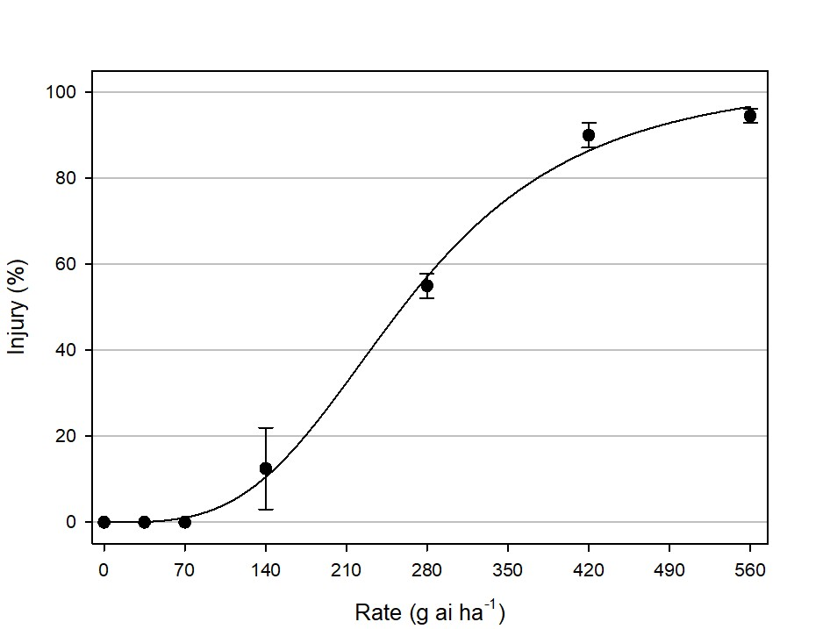
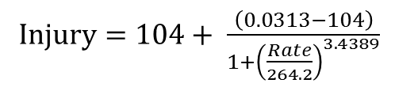
Late Season Injury - 2017
Injury $=104+ \frac{\left(0.0313−104\right)}{1+{\left(\frac{Rate}{264.2}\right)}^{3.4389}}$
R² = 0.97
I₅₀ = 264.2
98 DAP
Notes:
280-560 = 55-97%
140 = 11%

Slide 29
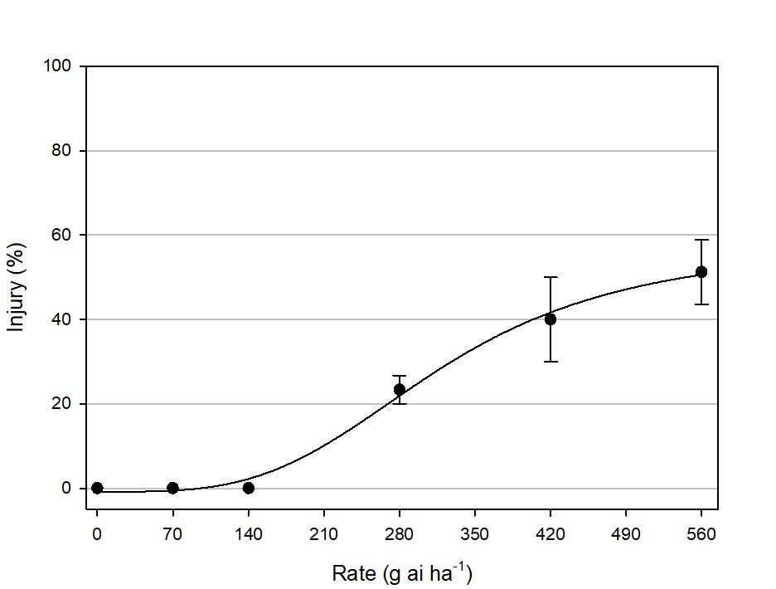
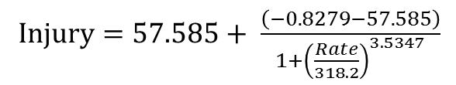
Late Season Injury - 2018
Injury $=57.585+ \frac{\left(−0.8279−57.585\right)}{1+{\left(\frac{Rate}{318.2}\right)}^{3.5347}}$
R² = 0.87
I₅₀ = 318.2
85 DAP
Notes:
280-560 = 22-51%
140 = 2%

Slide 30
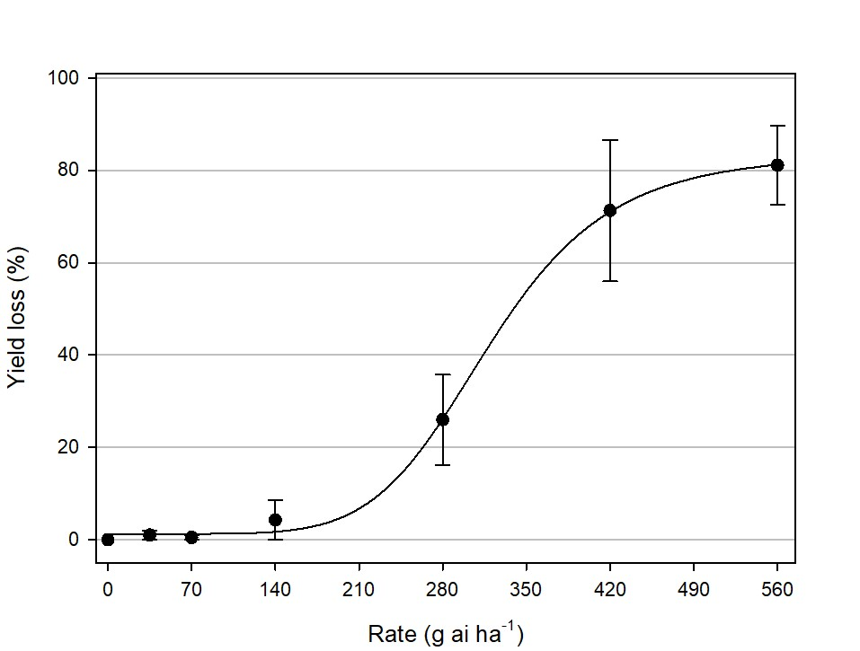
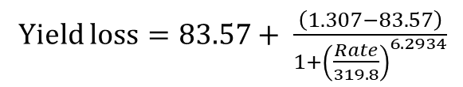
Peanut Yield Loss – 2017 & 2018
Yield loss $=83.57+ \frac{\left(1.307−83.57\right)}{1+{\left(\frac{Rate}{319.8}\right)}^{6.2934}}$
R² = 0.74
I₅₀ = 319.8
5,368 kg ha⁻¹
Notes:
280-560 = 25-80%
140 = 2%

Slide 31
Summary/Conclusions
Rates from 280-560 g ai ha⁻¹ caused unacceptable injury and stand loss, resulting in 25-80% yield loss.
The 140 g ai ha⁻¹ rate resulted in a maximum of 17% visual injury and 10% stand loss, resulting in minimal yield loss (2%).
Comparable injury levels, stand loss, and yield loss were observed at the 0, 35, and 70 g ai ha⁻¹ rates.
We conclude that metribuzin can be used as a post-harvest burndown treatment in corn with minimal injury, stand loss, and yield loss to a subsequent peanut crop.

Slide 32
Hypothesis
Based on a targeted application rate of 280 g ai ha⁻¹ and an estimated half-life of ~30-60 days, we hypothesize that rates of 70 g ai ha⁻¹ or less (~two half-lives) should not negatively affect peanut growth and development.
FAIL TO REJECT

Slide 33

Future Research
Study repeated
PPI applications
A more accurate representation of carryover issues??
On-farm evaluations
Burndown after corn harvest at multiple rates, plant peanut the next season and evaluate crop tolerance

Slide 34
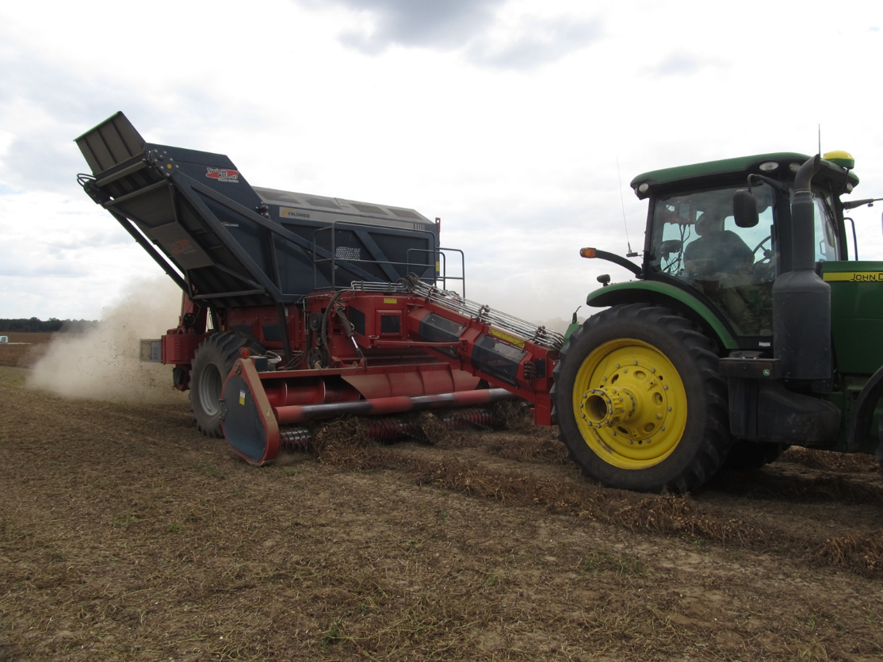
Questions/Comments?

