Slide 1
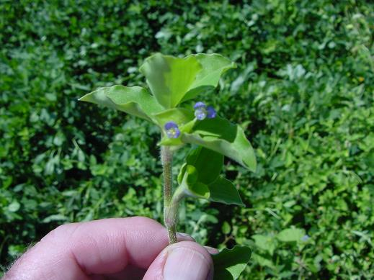
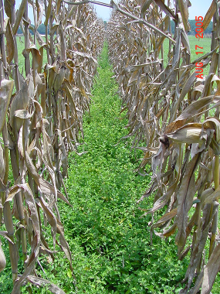

Benghal Dayflower (aka Tropical Spiderwort) in Georgia: A Review
Eric P. Prostko
Extension Weed Specialist
Dept. Crop & Soil Sciences
The University of Georgia

Slide 2
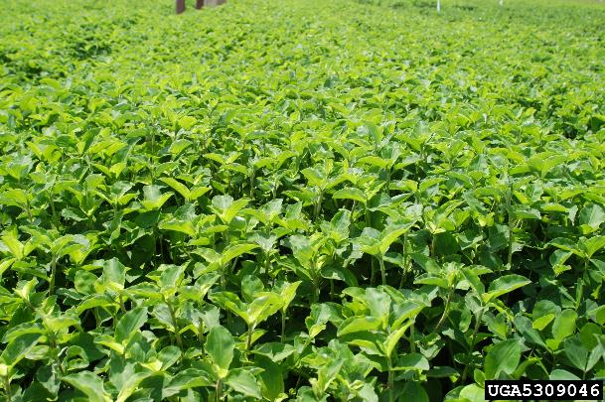
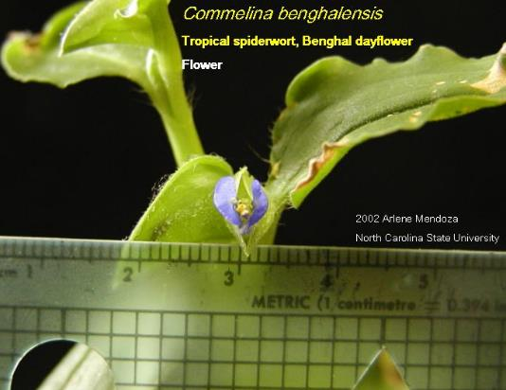
Benghal Dayflower/Tropical Spiderwort Commelina benghalensis
noxious and invasive
tropical Asia/Africa native
annual or perennial
seeds and rhizomes
above and below ground flowers
A “monsoon” weed
rapid germination and completion of lifecycle when soil moisture is plentiful
8,000-12,000 seeds/plant
Seed to seed in 42 days

Slide 3
Rainfall Departures From Normal (2020-2024) April 1- October 1
Source: UGA Automated Weather

Slide 4
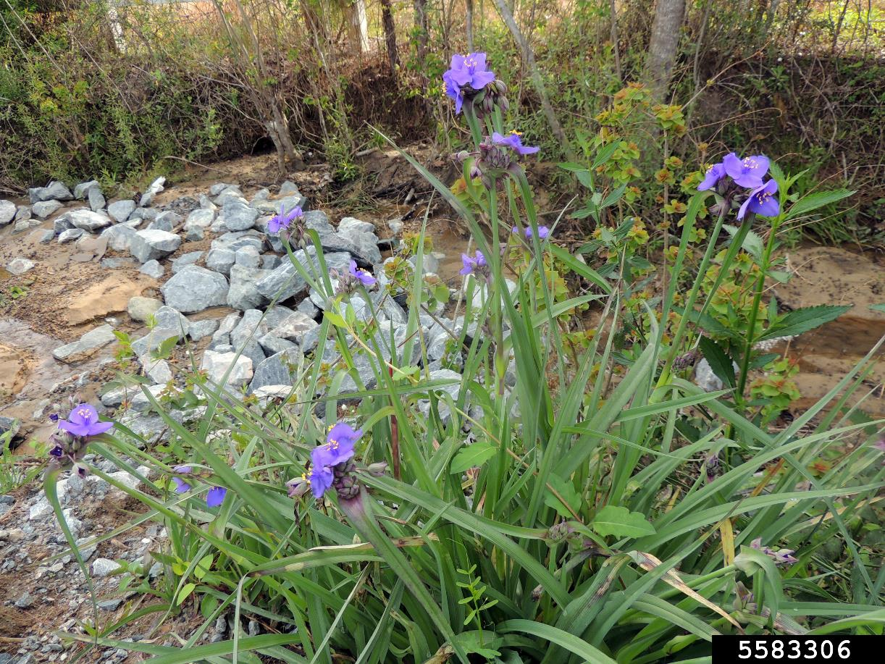
The Other Spiderwort Tradescantia spp.

Slide 5
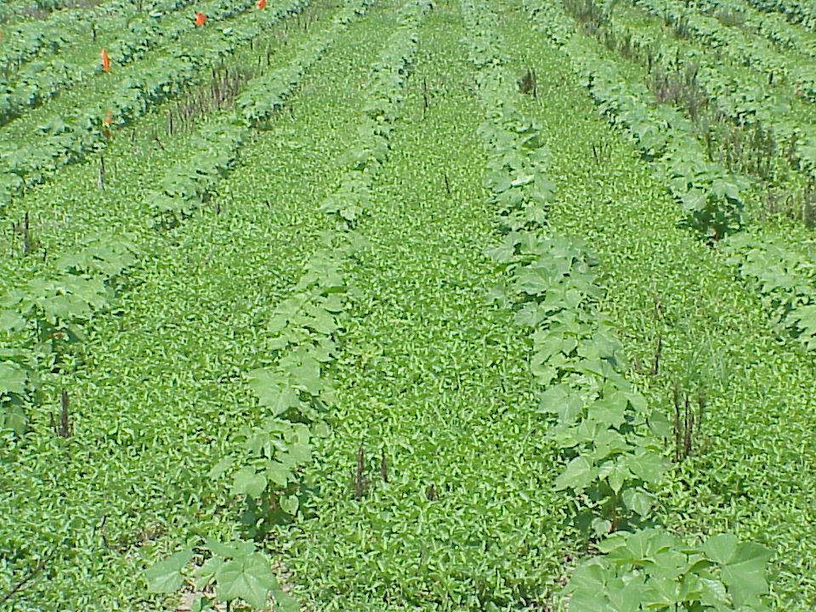
Benghal Dayflower in Cotton

Slide 6
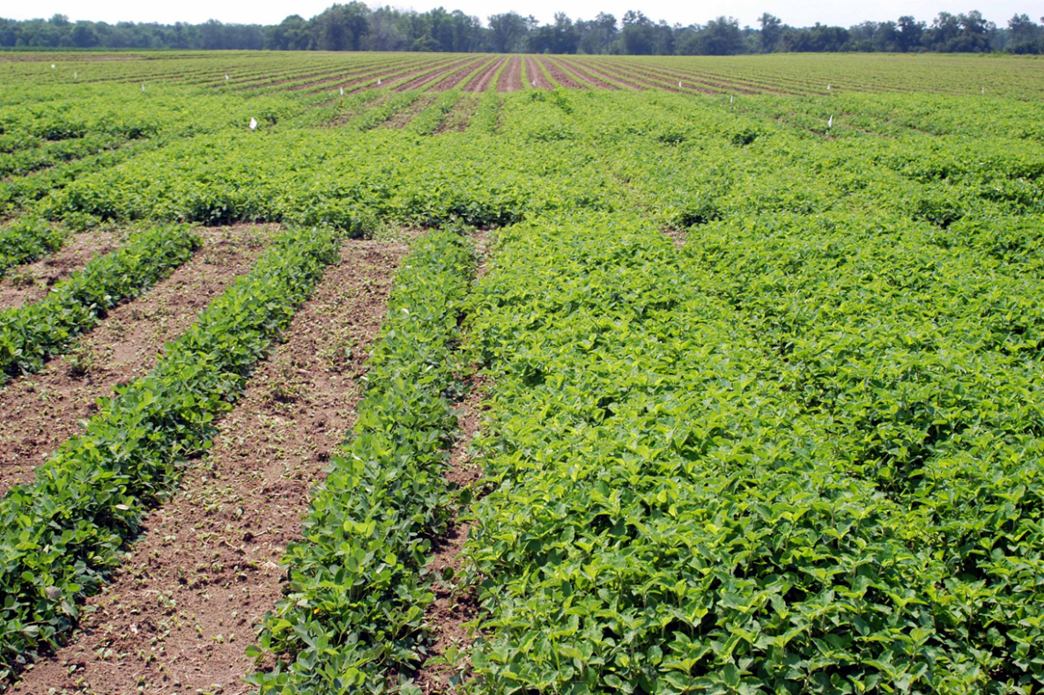
Benghal Dayflower in Peanut

Slide 7
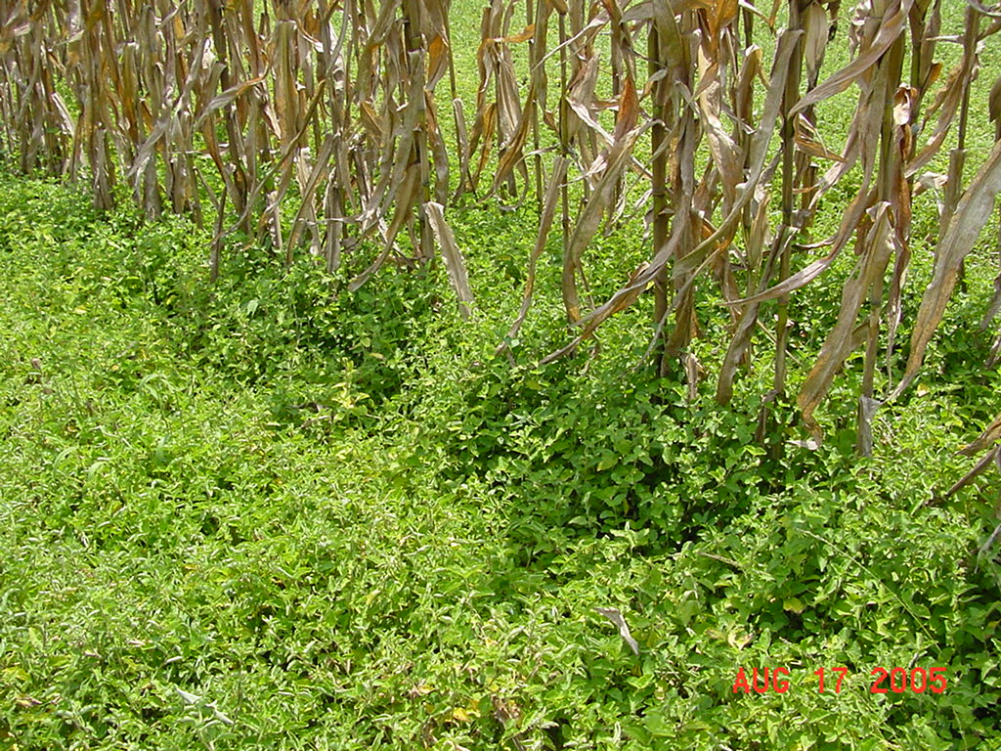
Benghal Dayflower in Field Corn

Slide 8
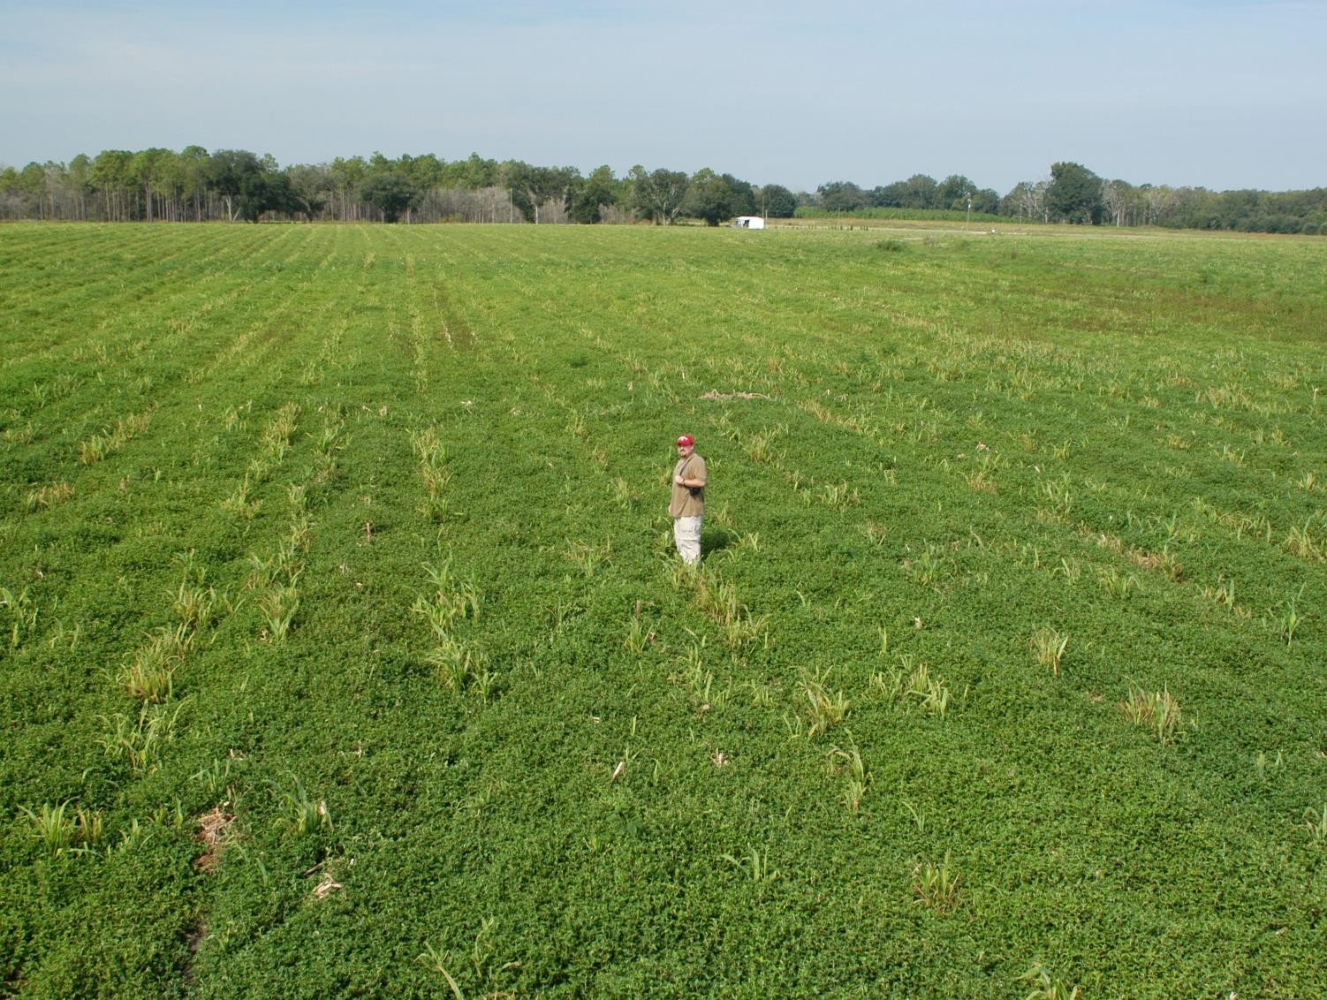
Benghal Dayflower Following Corn Harvest
Dr. Ted Webster
USDA/ARS
1969-2016

Slide 9
Common Dayflowers and Look A-Likes in Georgia Commelinaceae Plant Family (41 Genera, 650 species)
Commelina spp. (6)
Benghal dayflower
C. benghalensis
Asiatic dayflower
C. communis
Spreading dayflower
C. diffusa
Slender dayflower
C. erecta
Carolina dayflower
C. caroliniana
Virginia dayflower
C. virginica
Murdannia spp. (3)
Marsh dayflower
M. keisak
Doveweed
M. nudiflora
Asiatic dewflower
M. spirata
Source: Dr. Richard Carter
Valdosta State University

Slide 10
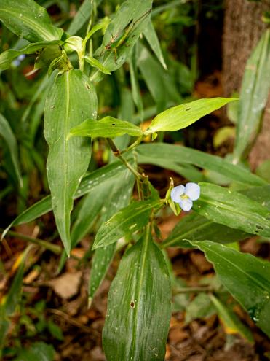
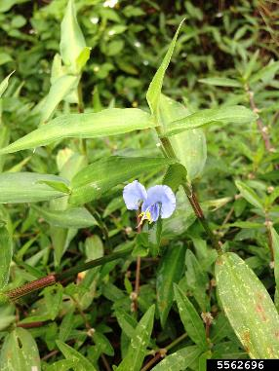
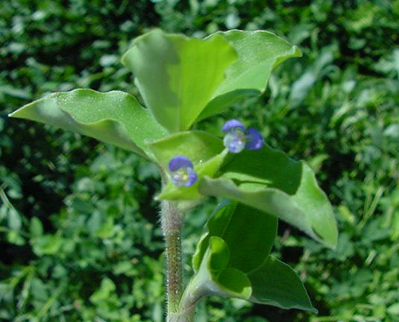
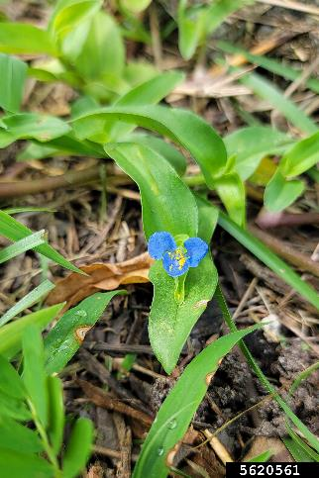
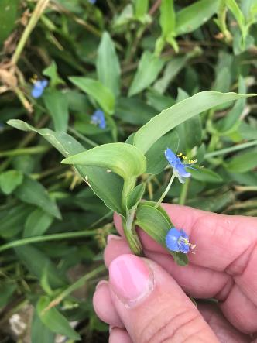
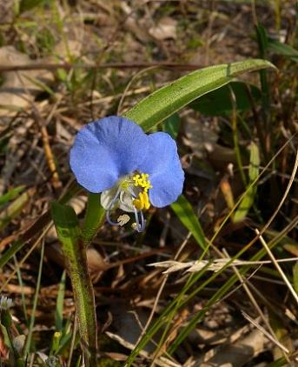
Commelina spp.
Virginia Dayflower
Asiatic Dayflower
Benghal Dayflower
Source: Stephanie Brundage
Spreading Dayflower
Carolina Dayflower
Slender Dayflower
Source: https://www.illinoiswildflowers.info/
prairie/plantx/sl_dayflower.htm
Source: https://www.inaturalist.org/observations
/61568115

Slide 11
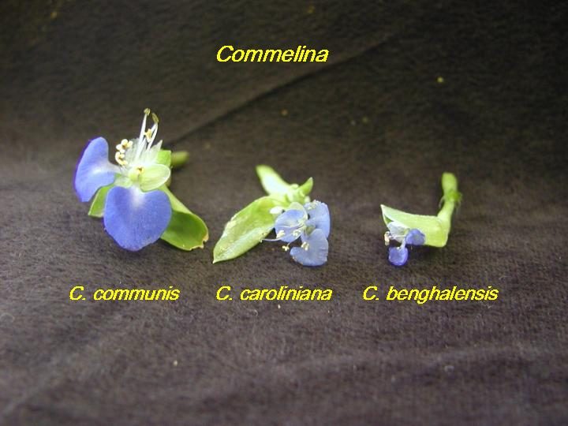
Scale:
much smaller
1-cm
Asiatic
Dayflower:
2 Very Blue,
1 White
Spreading
Dayflower:
3 Blue
Tropical Spiderwort:
2 Blue,
1 White
Mendoza, NCSU, 2002
Mike Burton, IFAS

Slide 12
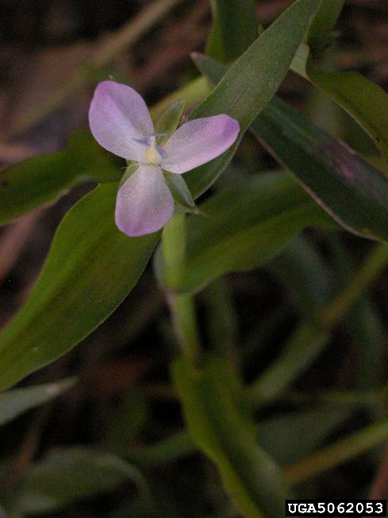
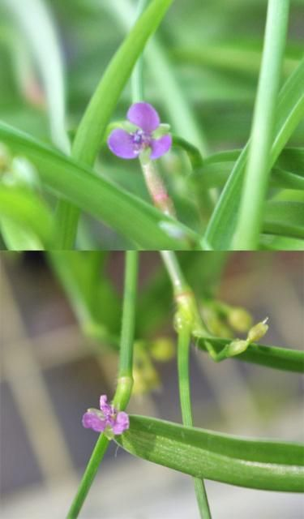
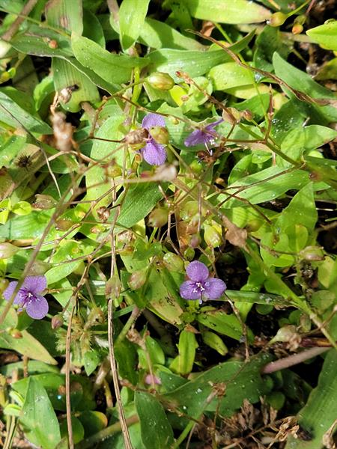
Murdannia spp.
marsh dayflower
doveweed
Asiatic dewflower
(Source: J. Horn)
(Source: A. Chandler, UF/IFAS)

Slide 13
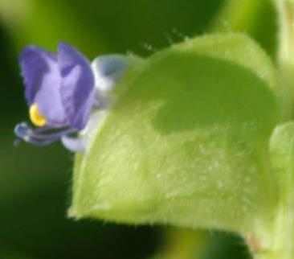
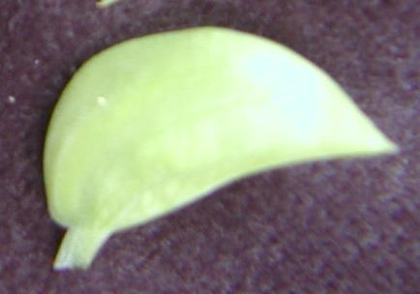
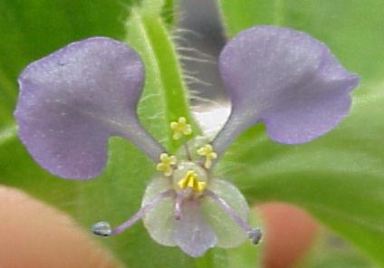
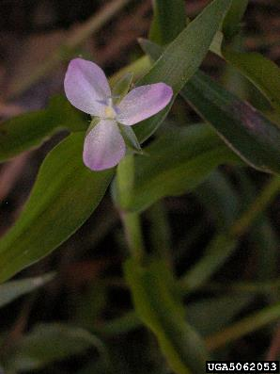
Commelina spp. vs. Murdannia spp.
Commelina spp.
spathe (leaf-like bract)
Encloses flowers/fruit
flowers with 3 petals
2 large/1 small
Murdannia spp.
No spathe
Flowers with 3 petals
same size
Benghal dayflower
Marsh dayflower

Slide 14
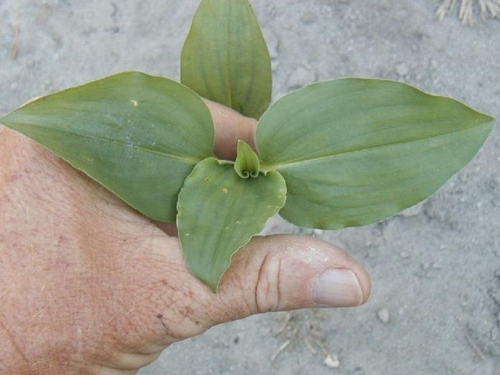
Benghal Dayflower
Leaf Length: Leaf Width ~ 1.5
(Less than 3:1)
Mike Burton, IFAS

Slide 15
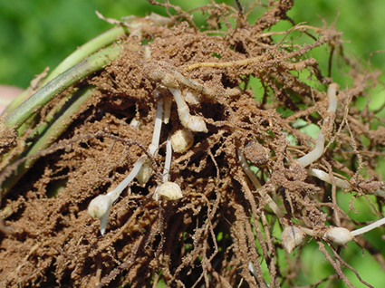
Underground Flowers

Slide 16
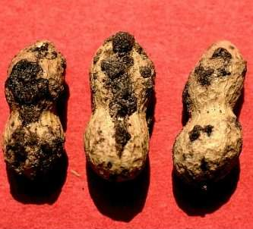
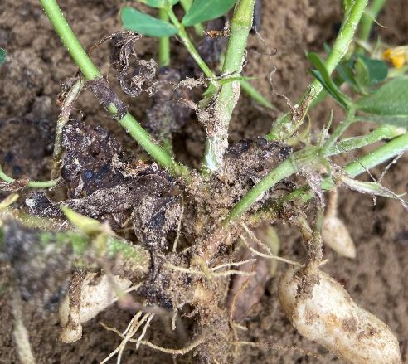
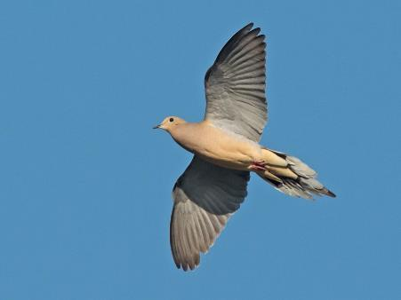
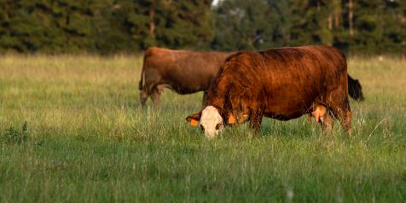
Other Fun Facts
host for reniform, southern/peanut root knot nematodes
host for southern stem rot (white mold)
seed is spread by doves and other birds
has some value as forage but……

Slide 17
Forage Quality of Benghal Dayflower/Tropical Spiderwort
Forage | CP-% | TDN-% | RFQ
bermudagrass¹ | 12.1 | 59 | 116 (good)
perennial peanut¹ | 15.1 | 66 | 133 (good)
Benghal dayflower/tropical spiderwort² | 10.5 | 61 | 102 (fair)
¹Winners of 2005 Tri-State Hay Contest
²Sampled on October 6, 2006; 12” tall and flowering

Slide 18
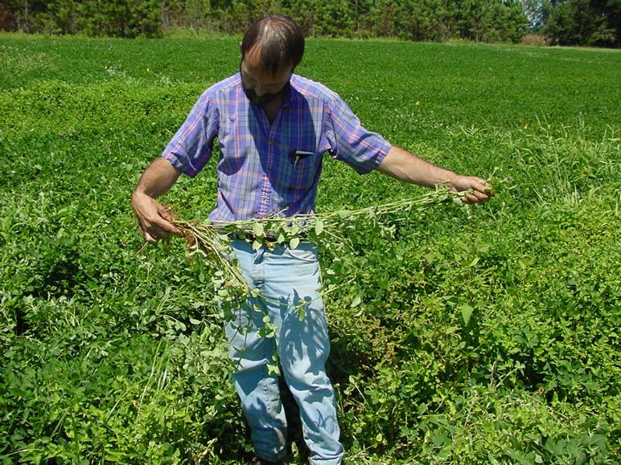
Some Important Research Data
Planting Date
Twin Rows
Tillage
Burrial Depth
T. Flanders, Retired Grady/Berrien CEA

Slide 19
Table 1. Benghal Dayflower Density (in NTC) As Influenced by Planting Date (~30 DAP)
*2.7X increase
Plants/m²
Source: Daramola et al. 2024. Implications of planting date on Benghal dayflower (Commelina benghalensis L.) and sicklepod (Senna
obtusifolia L.) management in peanut. Weed Technology 38(e66):1-9.

Slide 20
Figure 2. Tropical Spiderwort/Benghal Dayflower Control in Peanut As Influenced by Row Pattern
Source: Yoder et al. 2003. Peanut weed management under varying row patterns and tillage regimes. WSSA Abstracts 43:81.

Slide 21
Figure 3. Tropical Spiderwort/Benghal Dayflower Emergence As Influenced by Burial Depth
Source: Sabila et al. 2012. Evaluation of factors that influence Benghal dayflower (Commelina benghalensis) seed germination and emergence.
Weed Science 60:75-80.

Slide 22
Figure 4 . Tillage Effects on Tropical Spiderwort/Bengal Dayflower Density
Source: Brecke et al. 2005. Impact of tillage and herbicides on Tropical Spiderwort. Proceedings of Tropical Spiderwort Symposium, Tifton, GA.
November 29, 2005.(http://gaweed.com/tsw2005/index.html)

Slide 23
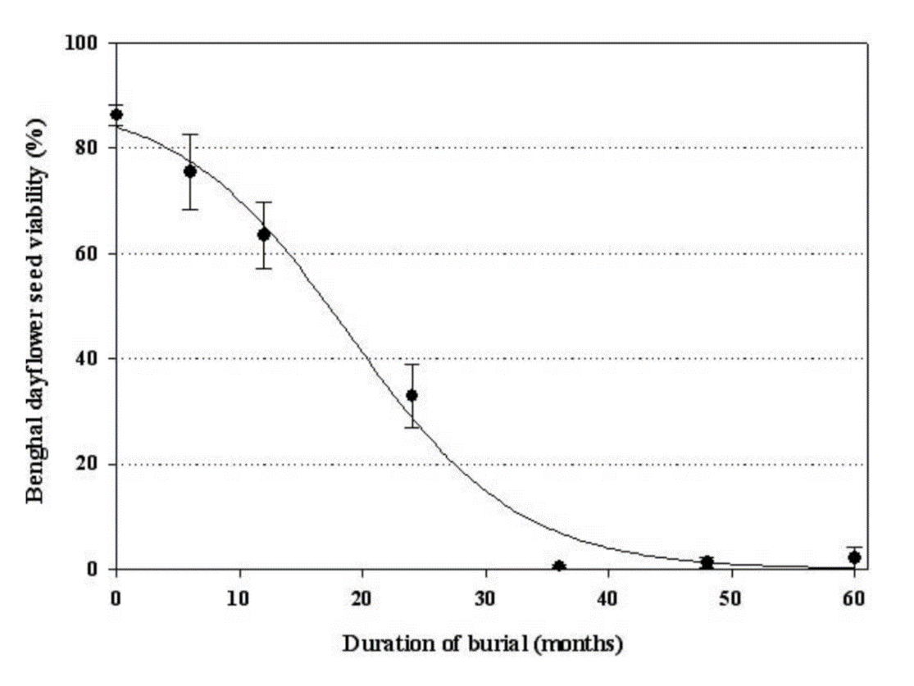
Figure 5. The Influence of Burial Duration (8” depth) on Tropical Spiderwort/Benghal Dayflower Seed Viability
3 years
Source: Riar et al. 2012. Benghal dayflower (Commelina benghalensis ) seed viability in soil. Weed Science 60:589-592.

Slide 24
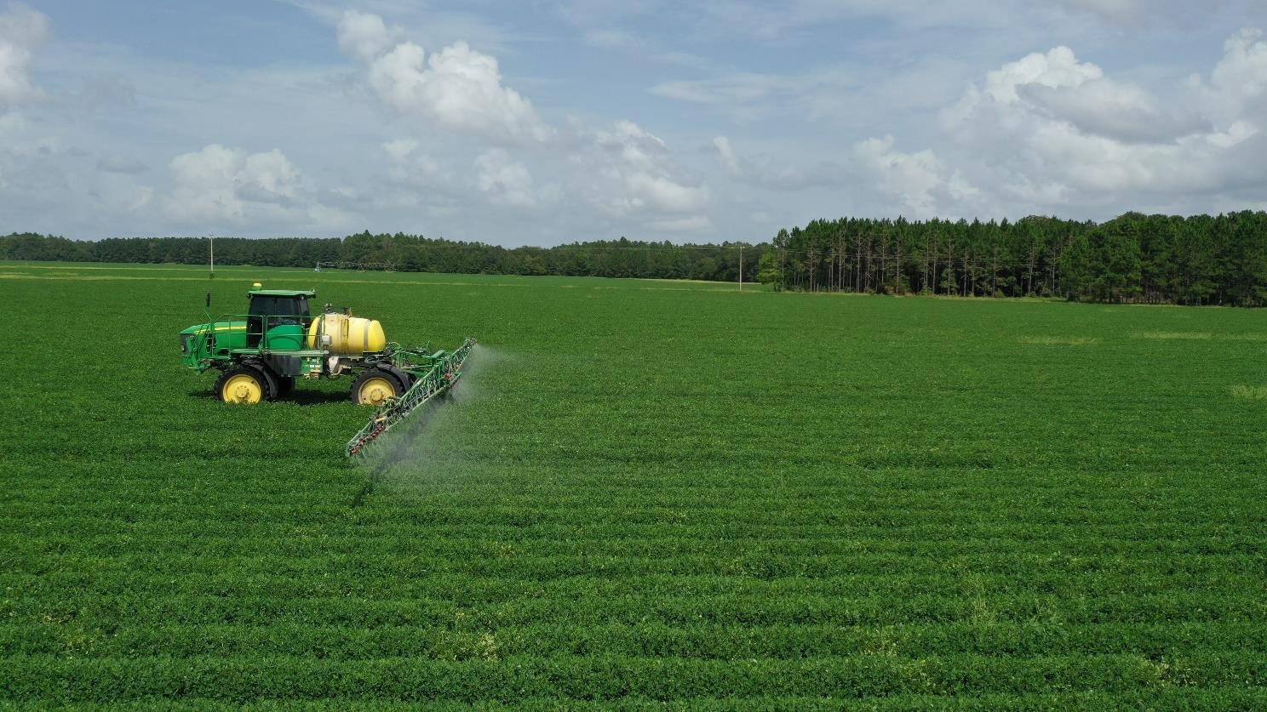
Control

Slide 25
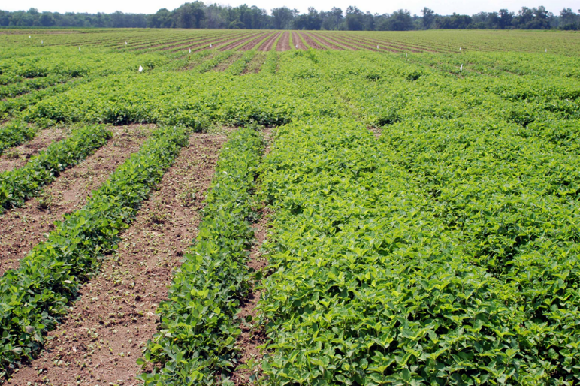
BD/TS in Peanut
Plow (i.e. bury seed): 3-5 years (not every year)
Planting Date (May vs. June)
Twin Rows
Group 15’s (Dual Magnum, Warrant, Outlook, Zidua, Anthem Flex)
Paraquat
Cadre?
Strongarm
Basagran

Slide 26
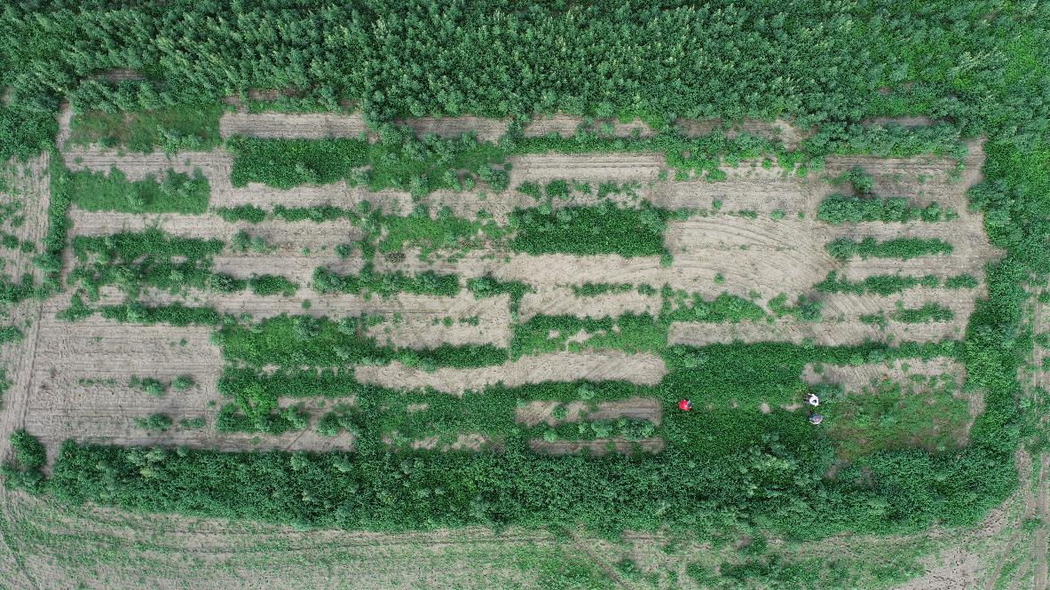
Benghal Dayflower/Tropical Spiderwort – 2022 Gramoxone + Storm + Group 15’s
Gramoxone + Storm + Outlook (EPOST)
Gramoxone + Storm + Anthem Flex
+ Induce (EPOST)
Gramoxone + Storm + Warrant (EPOST)
Gramoxone + Storm + Zidua
+ Induce (EPOST)
Gramoxone + Storm + Dual Magnum (EPOST)
TSW-01-22
Sumter Co.
EPOST: July 26
PIC: August 30 (35 DAT)
Storm or Basagran

Slide 27
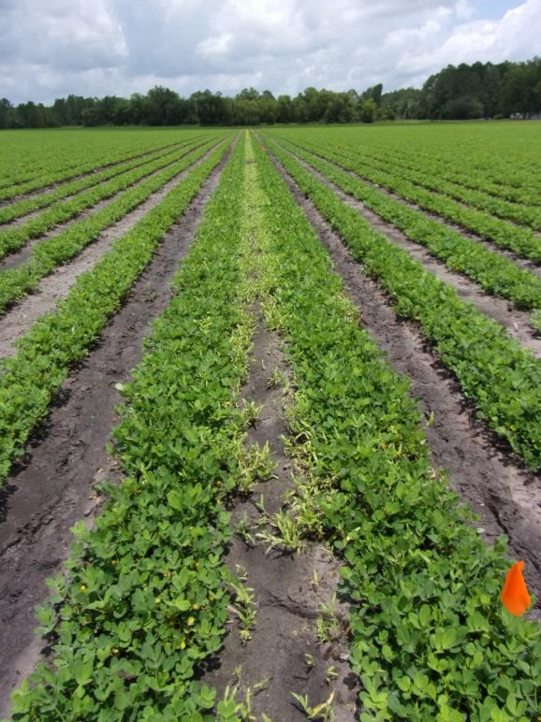
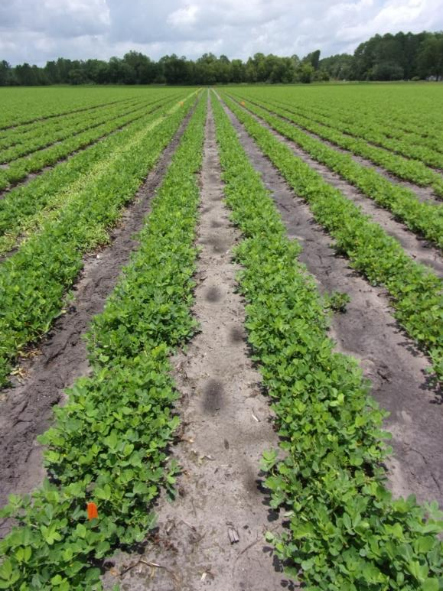
Spreading Dayflower in Peanut - 2023
PE-112-23
Berrien Co.
June 20 - 18 DAT
NTC
Strongarm 84WG @ 0.45 oz/A
Dual Magnum 7.62EC @ 16 oz/A

Slide 28
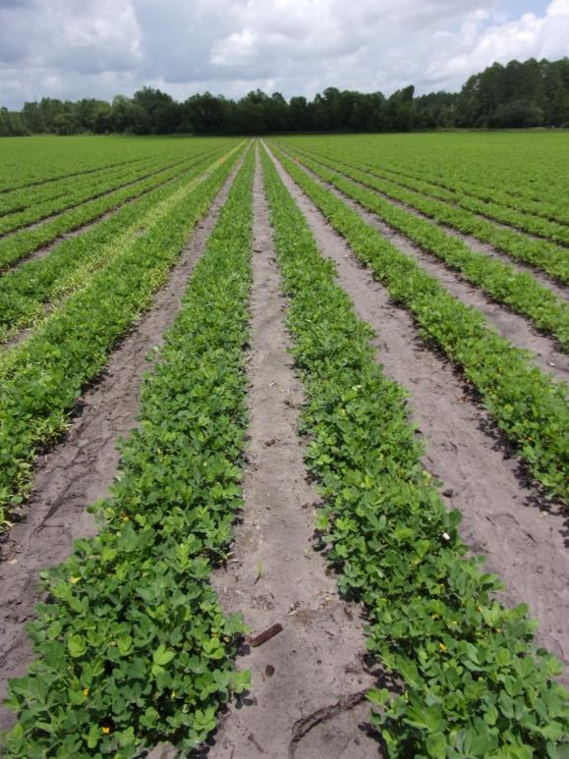
Spreading Dayflower in Peanut - 2023
NTC
Broadloom 4LC @ 32 oz/A
Dual Magnum 7.62EC @ 16 oz/A
PE-112-23
Berrien Co.
June 20 - 18 DAT

Slide 29
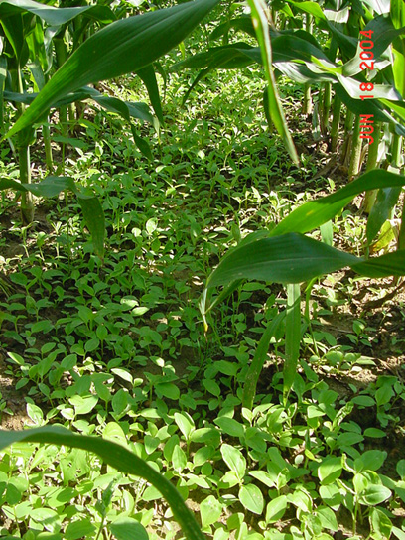
BD/TSW Control in Field Corn
Residuals
Dual Magnum, Outlook, Warrant, Zidua, Anthem Maxx
POST
2,4-D (crop injury issues)
Basagran
Halex GT/Callisto
Lay-By/Hood
Aim
Evik
Gramoxone
Post-Harvest
Gramoxone, 2,4-D, Aim, Reviton (?)

Slide 30
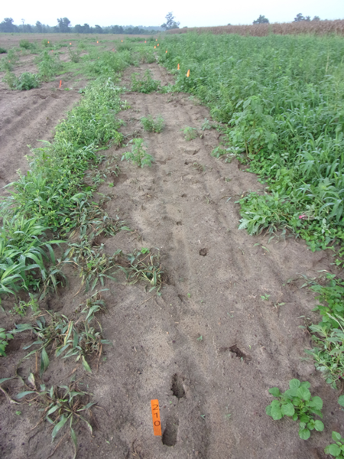
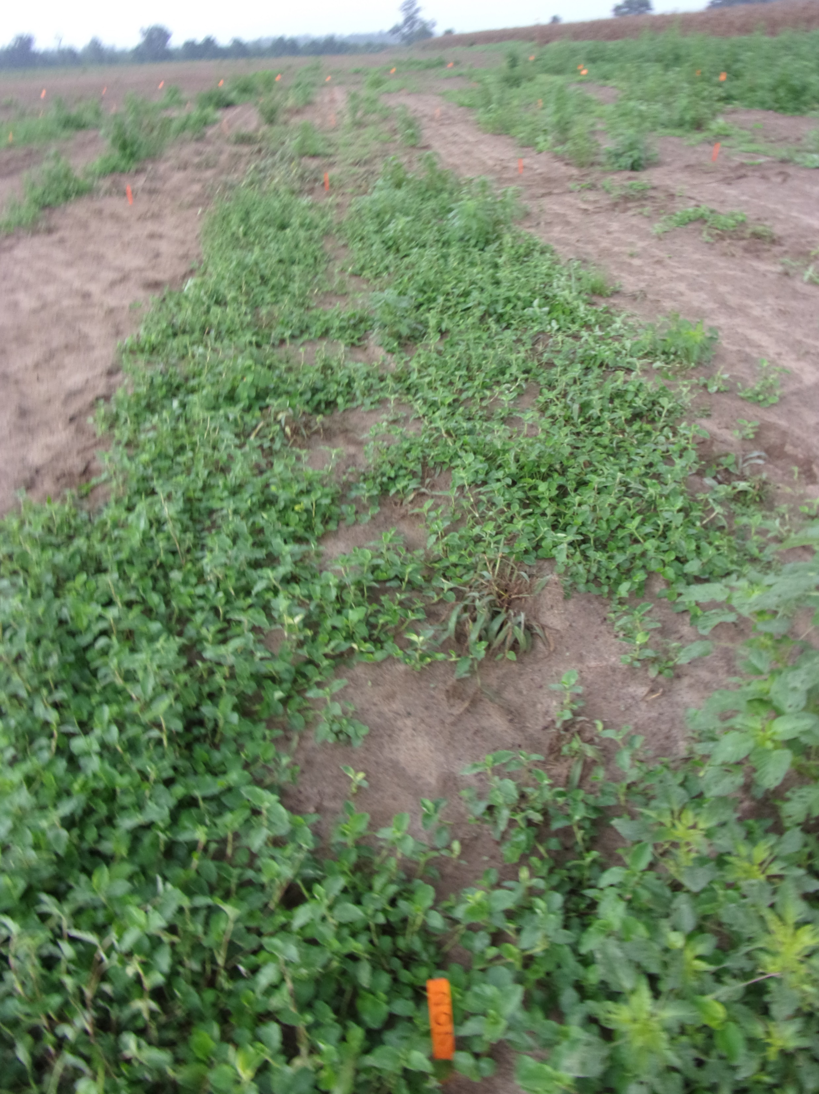
Benghal Dayflower/Tropical Spiderwort – HPPD’s
Callisto 4SC @ 3 oz/A
Agridex @ 1% v/v
TSW-01-22
August 17
22 DAT

Slide 31
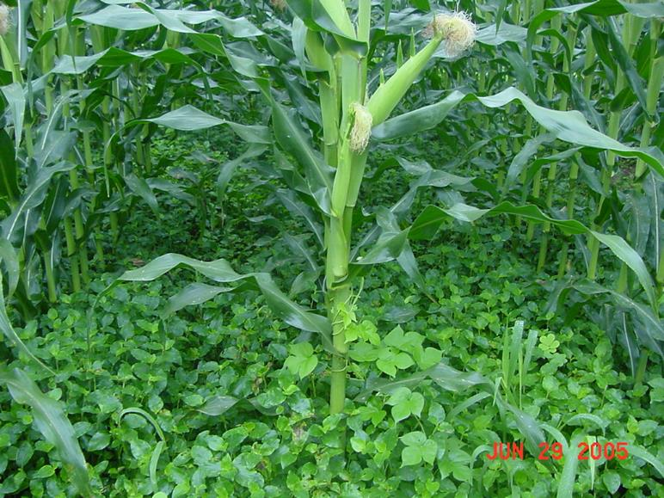
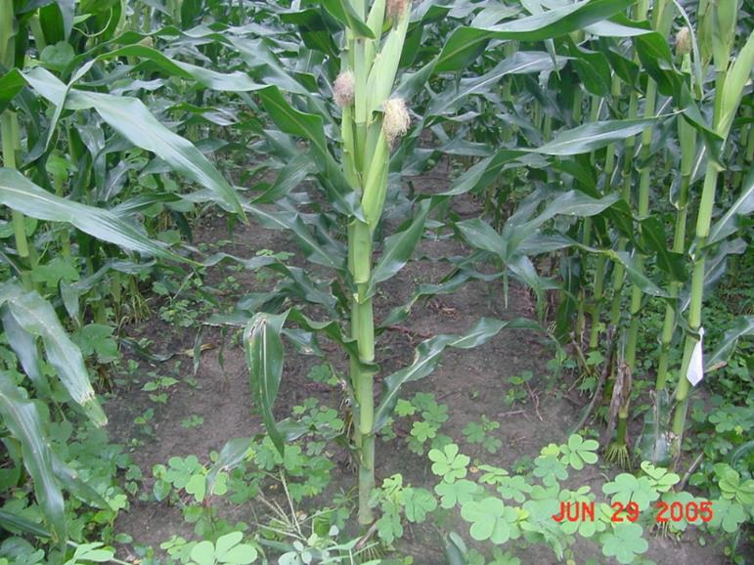
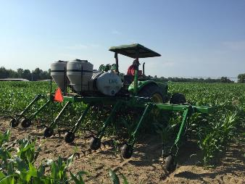
BD/TS Control in Field Corn
Untreated
Gramoxone Max 3SC @ 16 oz/A
Dual Magnum 7.62EC @ 1.33 pt/A
Herbimax @ 1% v/v
Lay-By
CN-09-05
12 DAT

Slide 32
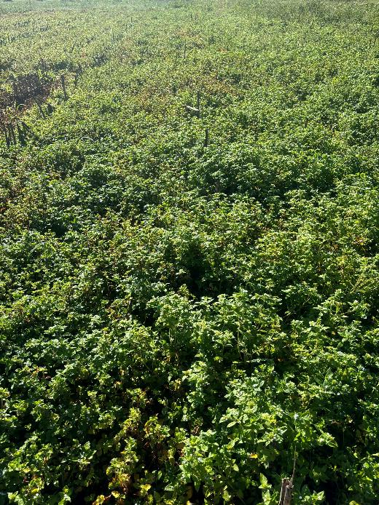
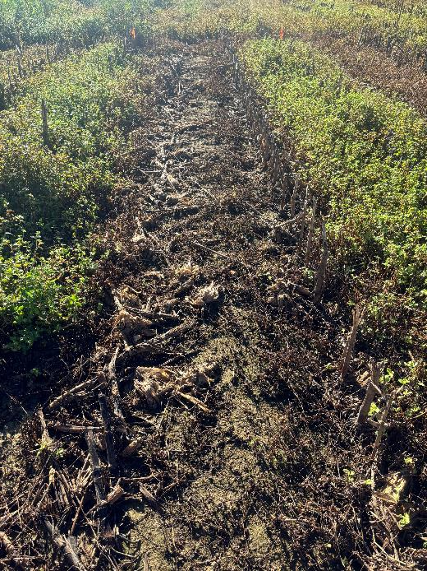
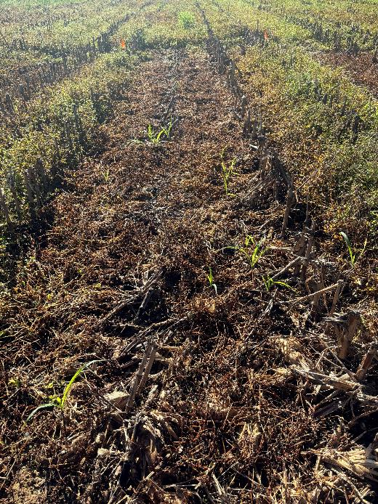
Post-Harvest Tropical Spiderwort Control – 2024 COMBE: 12-16” tall; flowering; POST1 = 09/10/24; POST2= 09/17/24
NTC
Gramoxone 3SL @ 32 oz/A
Induce @ 0.25% v/v
POST1 + POST2
Roundup P-MAX3 5.88 SL @ 32 oz/A
Enlist One 3.8SL @ 24 oz/A
POST1 + POST2
PH-01A-24
October 2
15 DAT (POST2)

Slide 33
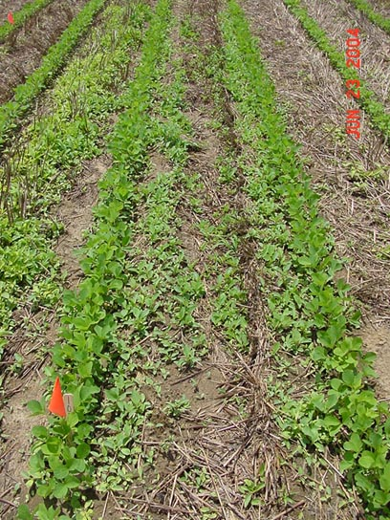
BD/TSW Control in Soybeans
Residuals
Dual Magnum, Outlook, Warrant, Zidua, Anthem Maxx
POST
Basagran, Classic, FirstRate, Enlist Duo/One, Pursuit
Lay-By/Hood
Gramoxone, Aim

Slide 34
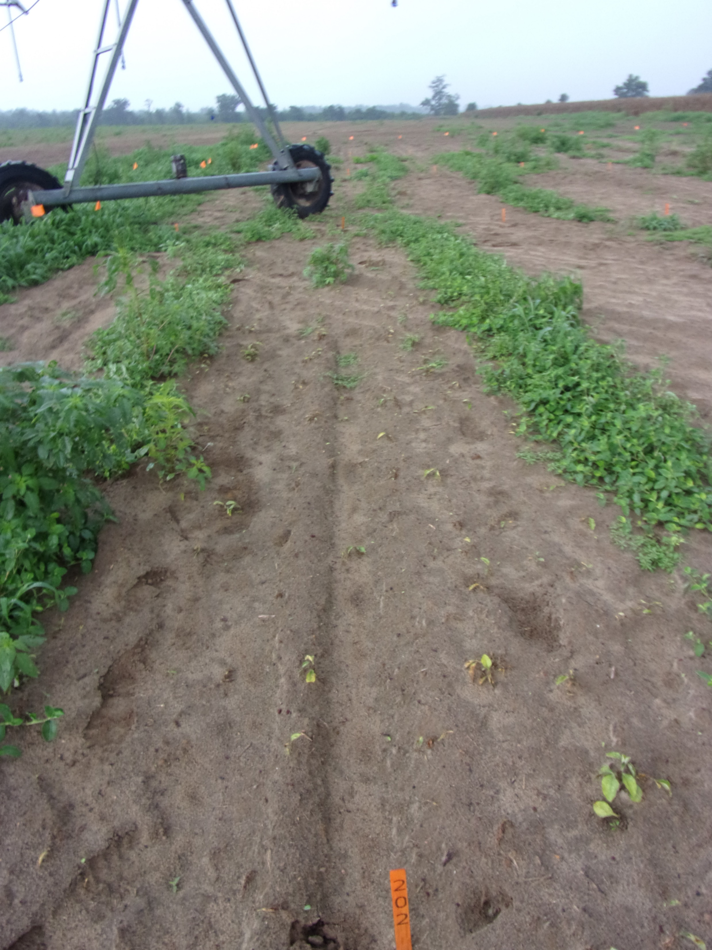
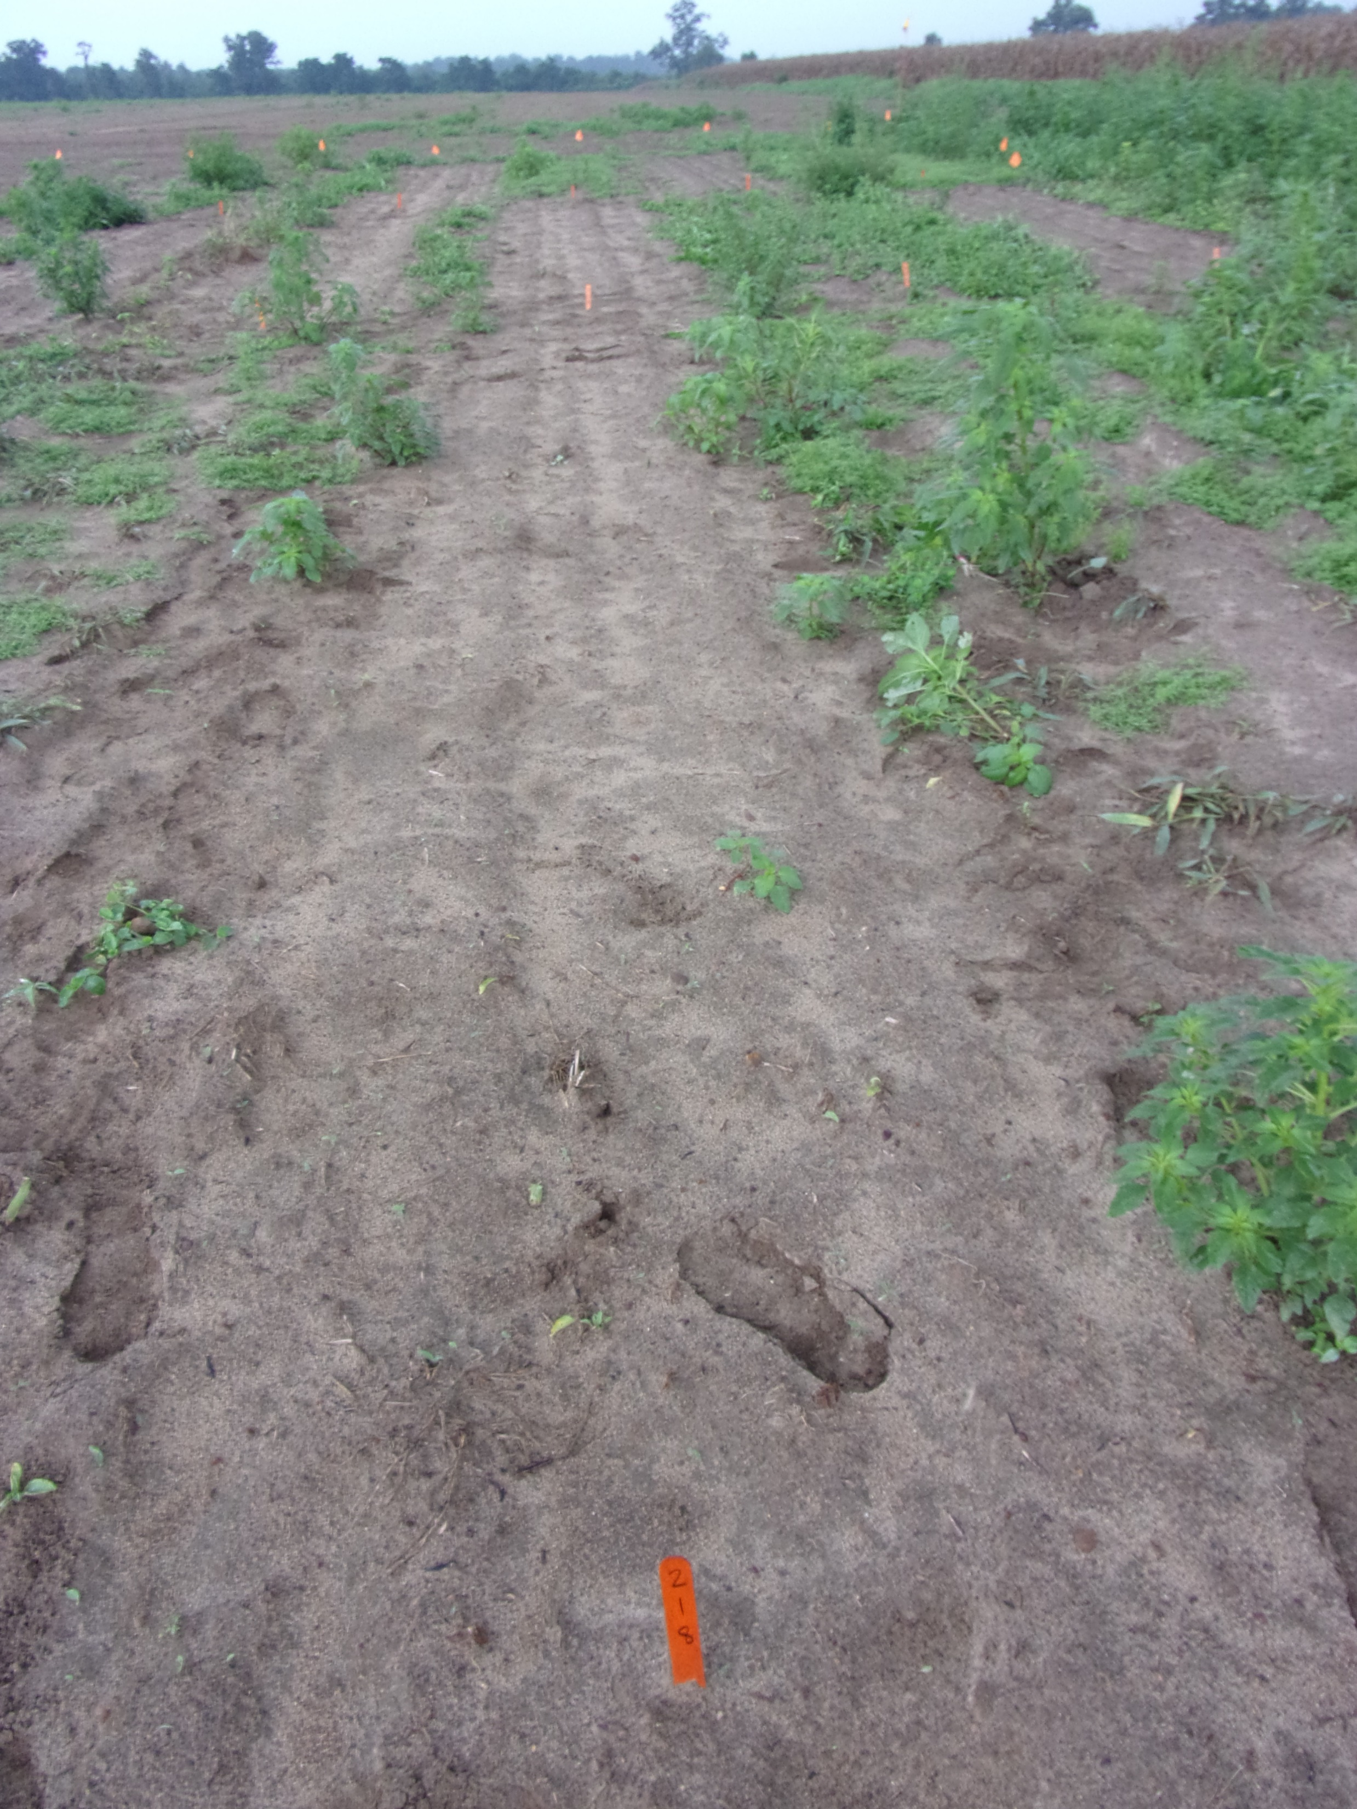
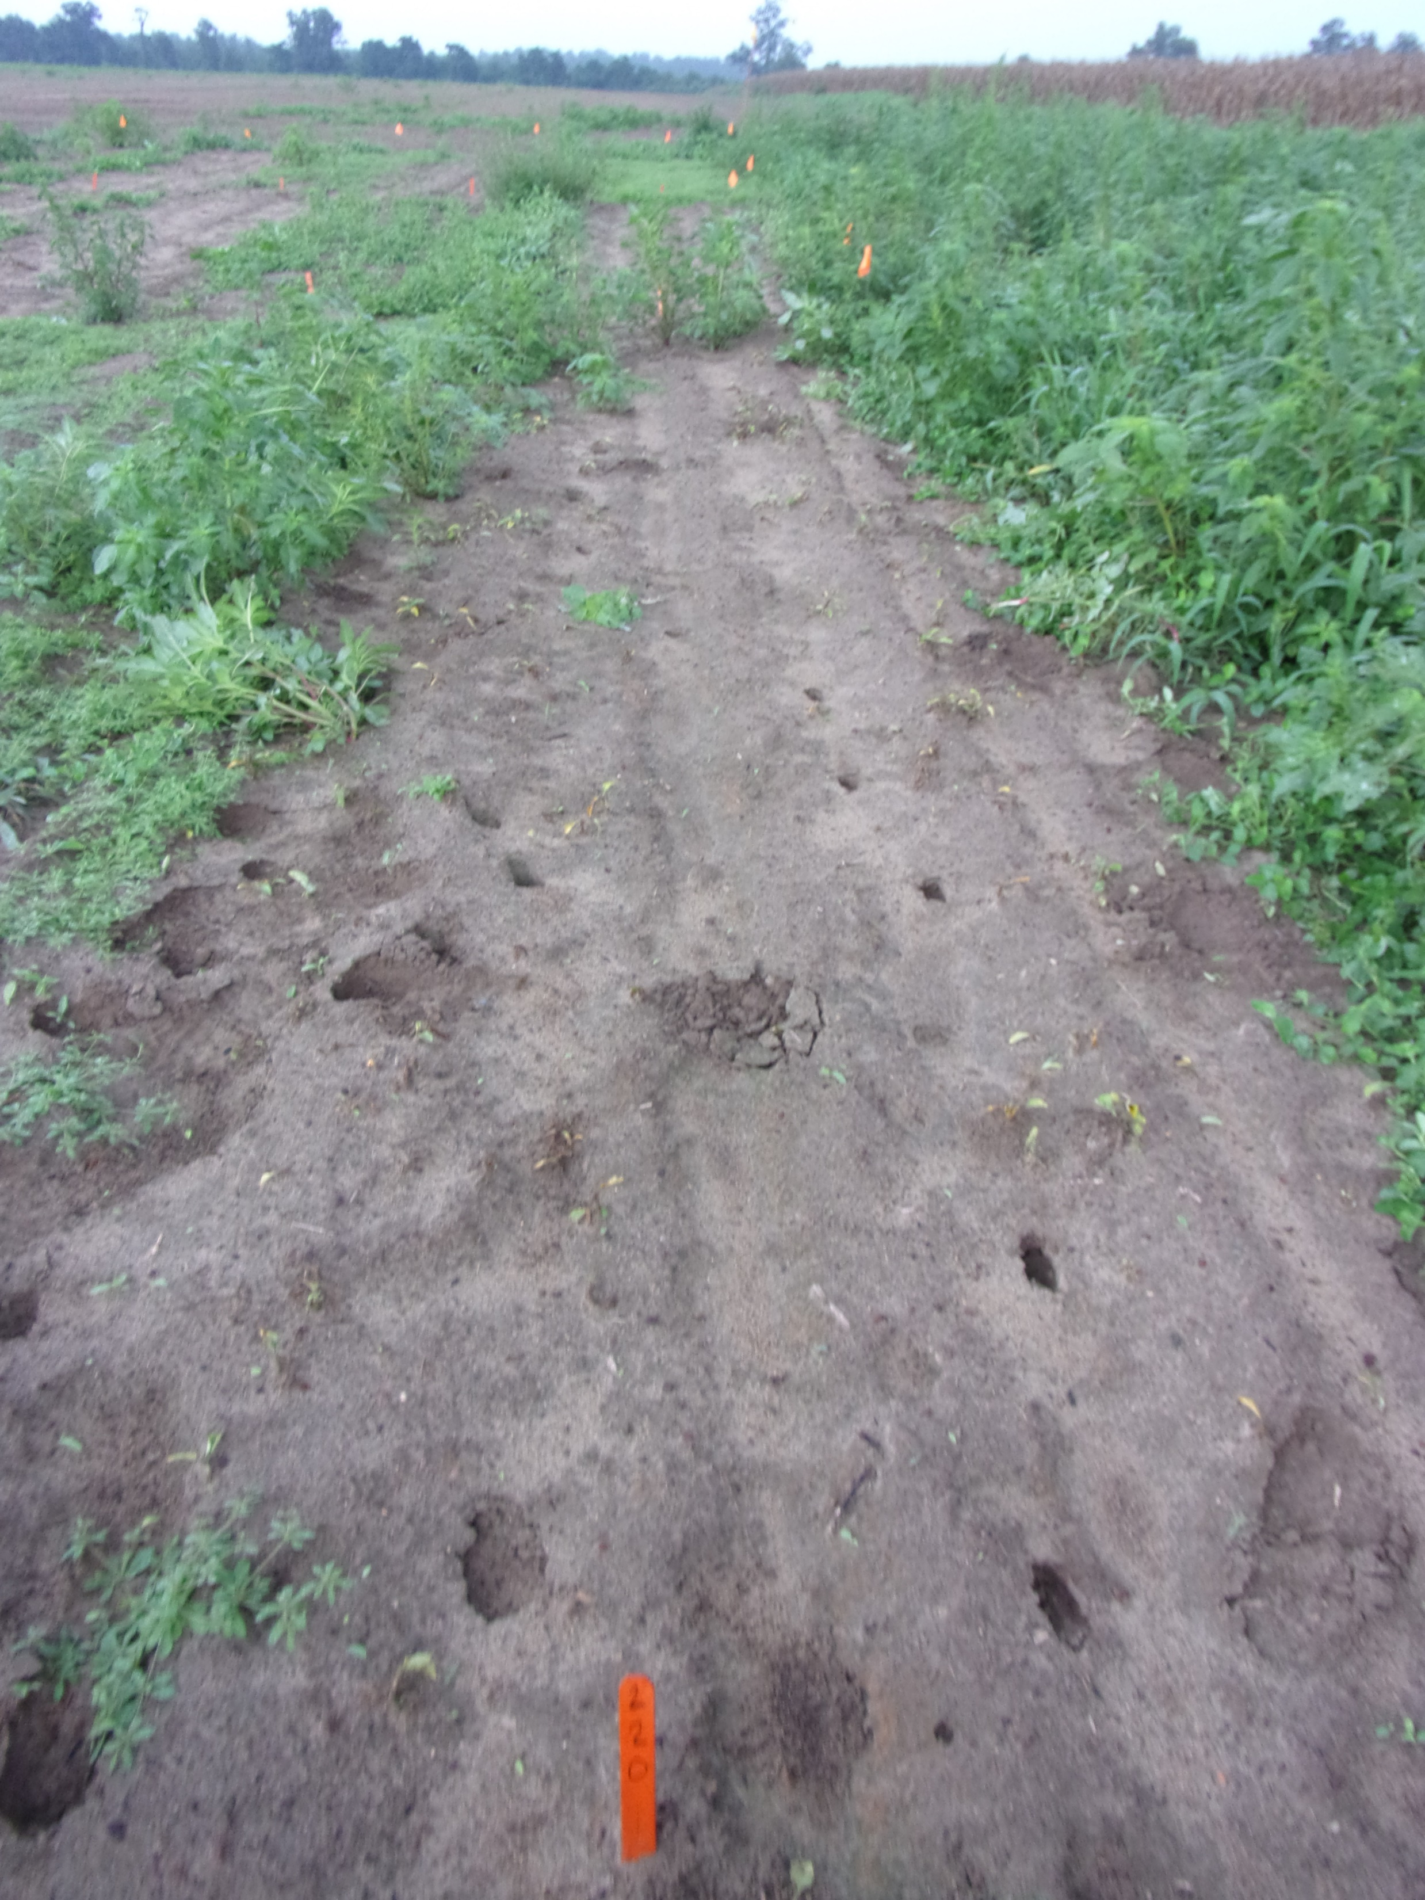
Benghal Dayflower/Tropical Spiderwort - 2022
Roundup PowerMax3 5.88SL @ 25 oz/A
Pursuit 2SL @ 4 oz/A
Roundup PowerMax3 5.88SL @ 25 oz/A
Classic 25DG @ 0.5 oz/A
Roundup PowerMax3 5.88SL @ 25 oz/A
FirstRate 84WG @ 0.3 oz/A
TSW-01-22
August 17
22 DAT

Slide 35

BDF/TS in Cotton

Slide 36

BDF in Cotton

Slide 37

Benghal Dayflower Summary
“monsoon” weed
Late emerging
~60+% after June 1
Does not like tillage!
Burial depth important
5”/3 years
Lots of seed
Above/below ground flowers
Residual’s
Group 15’s
Post-Harvest
seed to seed in ~42 days

