Slide 1
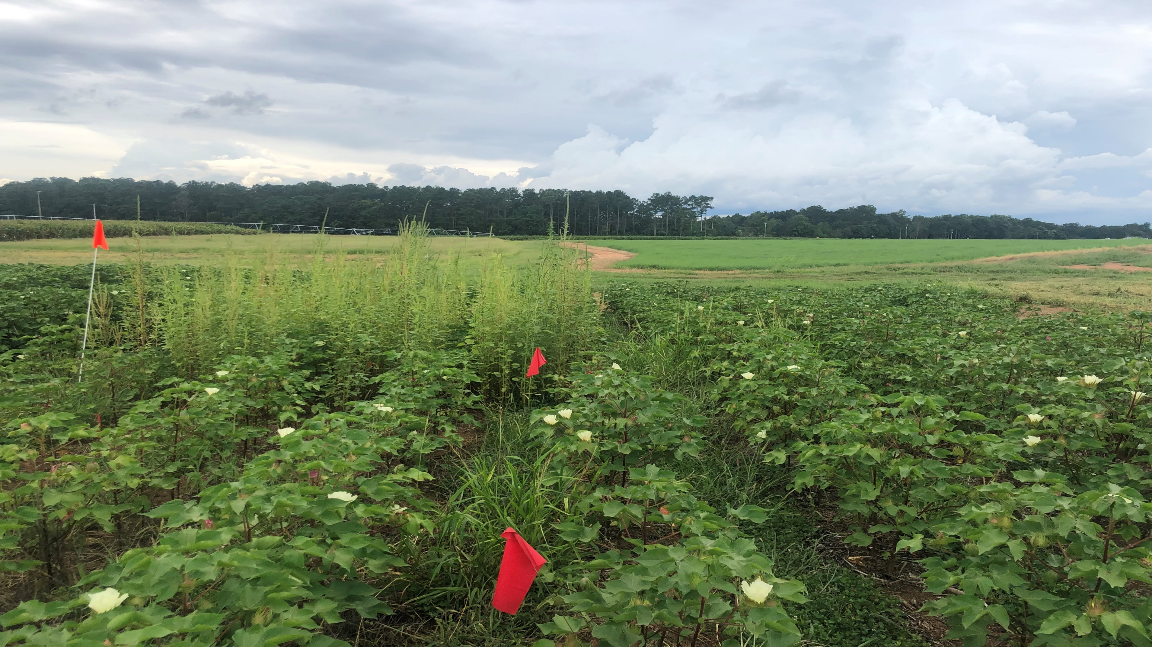
Undercover farming: Assessment of cover crop and integrated weed management for Georgia row-crops
H. C. Lindell, M. C. Bocz, T. L. Grey, E. P. Prostko, A. S. Culpepper, F. Meeks, N. T. Basinger

Slide 2
Outline
Living Mulch Affect on Palmer Amaranth Attributes in Cotton
Cereal Grain Covercrop in Peanuts

Slide 3
Cover crop and living mulch systems with herbicide on Palmer Amaranth (Amaranthus palmeri S. Wats.) population dynamics

Slide 4
Cotton and Cover Crops
“Herbicides provide great control
But…
Herbicide reliance herbicide resistance to multiple mechanisms of action”
Palmer amaranth is currently resistant to 5 MOA
Cover crops
alter soil environment + decrease light to soil surface
Physical barrier + weed suppression
Reduce exposure to herbicide (Wiggins et al. 2017, Hand et al. 2021)
Herbicide more effective (Wallace et al. 2019)
Low overall adoption <15%
Example of living mulch between cotton strips
Annual: terminated before cash crop
Perennial (living mulch): grows synchronously with cash crop
Nitrogen release; cost saver (Hill et al. 2017)
Potential tradeoffs

Slide 5
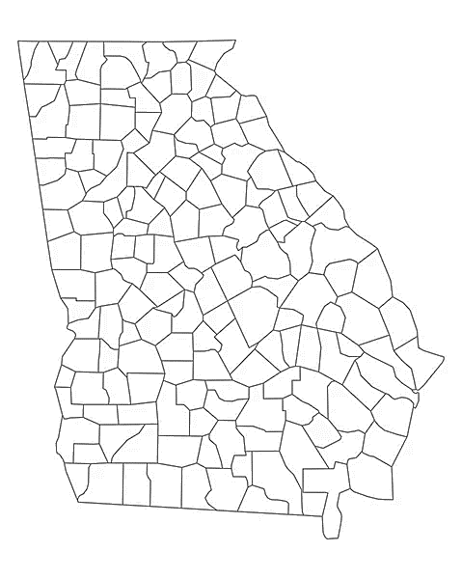
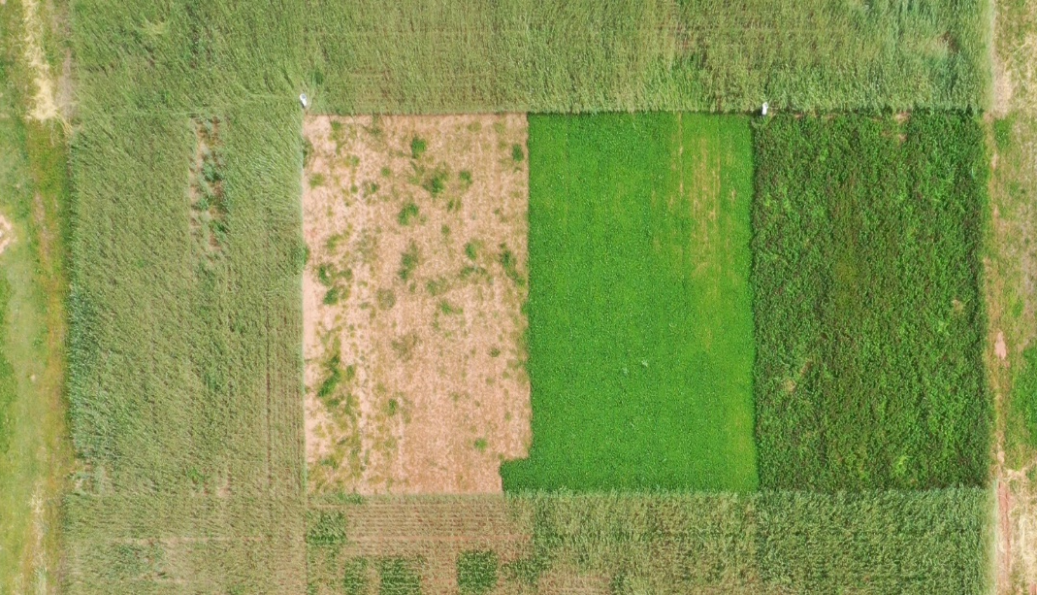
Materials and Methods
Watkinsville, GA: 2020, 2021, 2022, 2023
Cover crops and living mulch (two annuals, one perennial, & bare ground):
Cereal rye (Secale cereale L.) at 100 lb ac
Crimson clover (Trifolium incarnatum L.) at 20 lb ac
White clover (Trifolium repens L. ‘Durana®’) at 20 lb ac
Bare ground
DG 3615 Cotton (38,000 seed/acre)
Irrigated based on UGA check book method (Porter, 2021)
Plots 36 ft by 54 ft
Randomized complete block design
annuals
perennial
12 cotton rows: 4 harvested for yield, 4 used in Palmer amaranth subplots
CR
BG
LM
CC

Slide 6
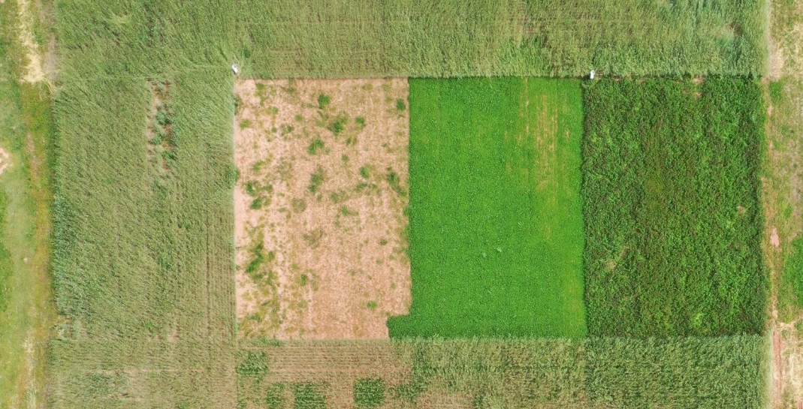
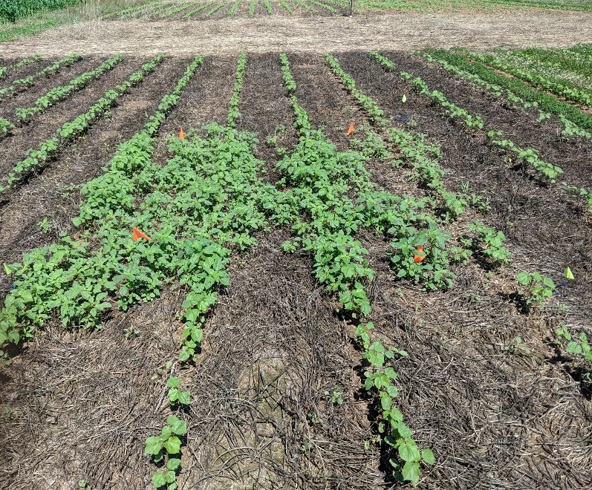
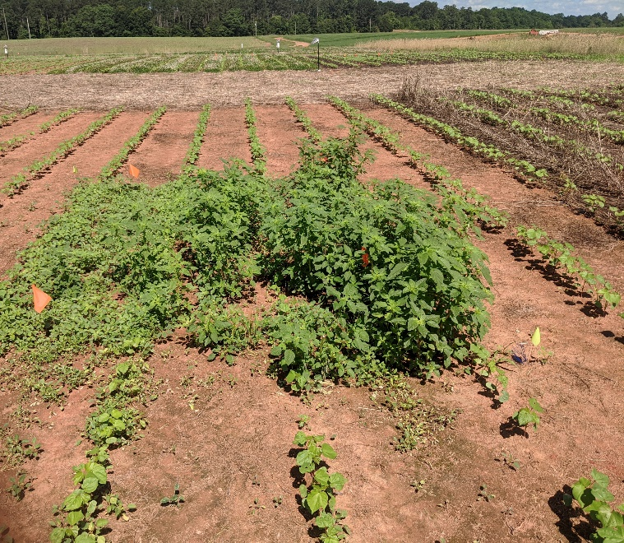
Materials and Methods
No previous Palmer amaranth population
(2020) 25,000 seed m⁻² (Palmer amaranth) placed in 9 m⁻² subplots
20 soil cores (annually) for seed bank density
Seeds collected from end-of-season added back to each plot
Watksinville, GA: 2020, 2021, 2022
Cover crops and living mulch (two annuals, one perennial, & bare ground):
Cereal rye (Secale cereale L.) at 112 kg ha⁻¹
Crimson clover (Trifolium incarnatum L.) at 22 kg ha⁻¹
White clover (Trifolium repens L. ‘Durana®’) at 22 kg ha⁻¹
Bare ground
DG 3615 Cotton (93,898 seed/ha)
Irrigated based on UGA check book method (Porter, 2021)
Randomized complete block design
Annuals
CR
BG
LM
CC

Slide 7
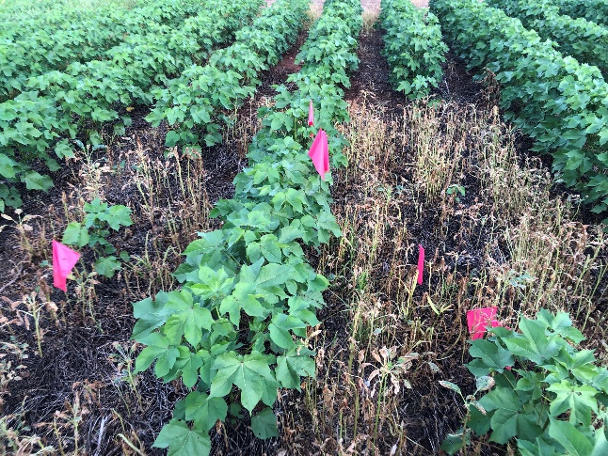
Herbicide Management
Burndown application for CR, CC, and BG
Strip width spray of 20 cm for LM
Herbicide management based on seedling emergence
NO residuals
Herbicide | Rate | WAP
 |  | 2022 | 2023
glufosinate-ammonium | 32 oz/ac | 3 | 3
glufosinate-ammonium | 32 oz/ac | 7 | 7
glyphosate + carfentrazone-ethyl | 32 oz/ac and 2 oz/ac | 11 | NA

Slide 8
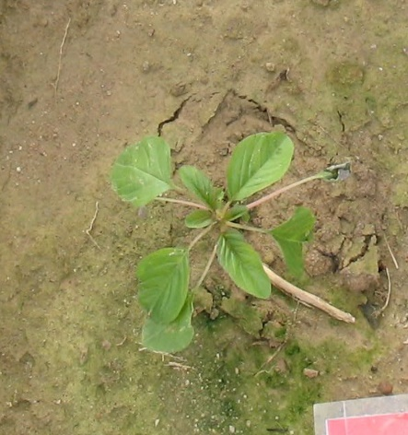
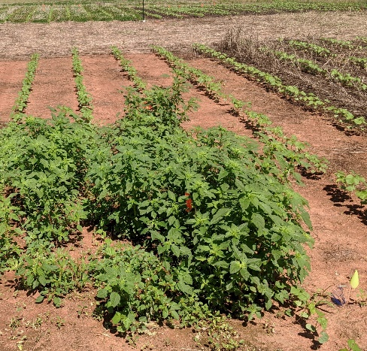
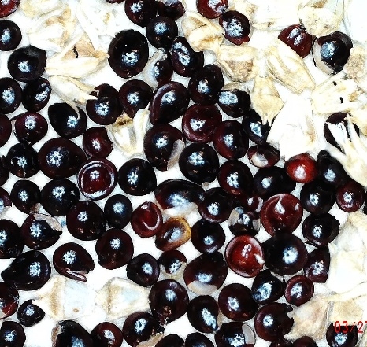
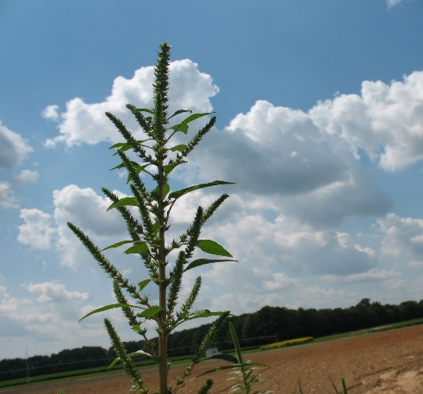
B. Seedlings
C. Adult plants
2. Seedling survival = $\frac{C}{B}$
3. Fecundity = $\frac{D}{C}$
1. Seedling recruitment = $\frac{B}{A}$
Palmer amaranth lifecycle
Seed production
Seed survival
A. Seed bank
D. Seeds
Notes:
Importance of understanding life history to identify vulnerabilities -> important part of IWM
-Slowly explain life history stages and transitions
–important to identify how both stages and transitions are affected
-Biological sketch of an organisms life

Slide 9
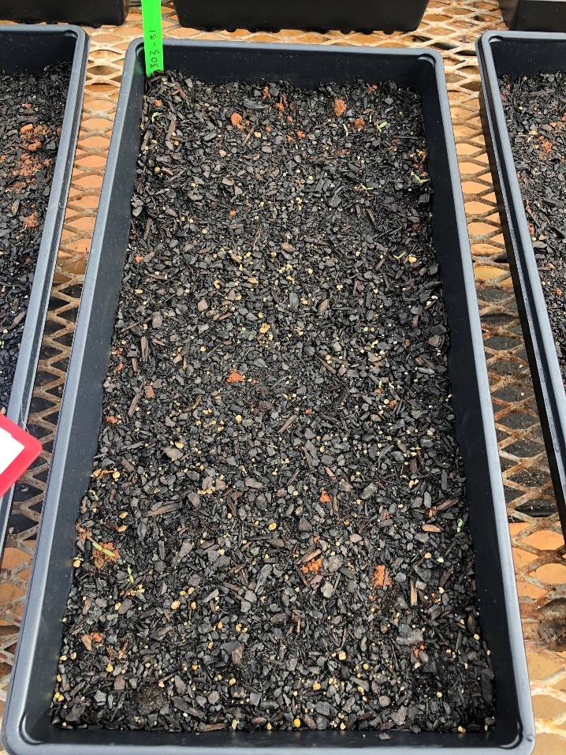
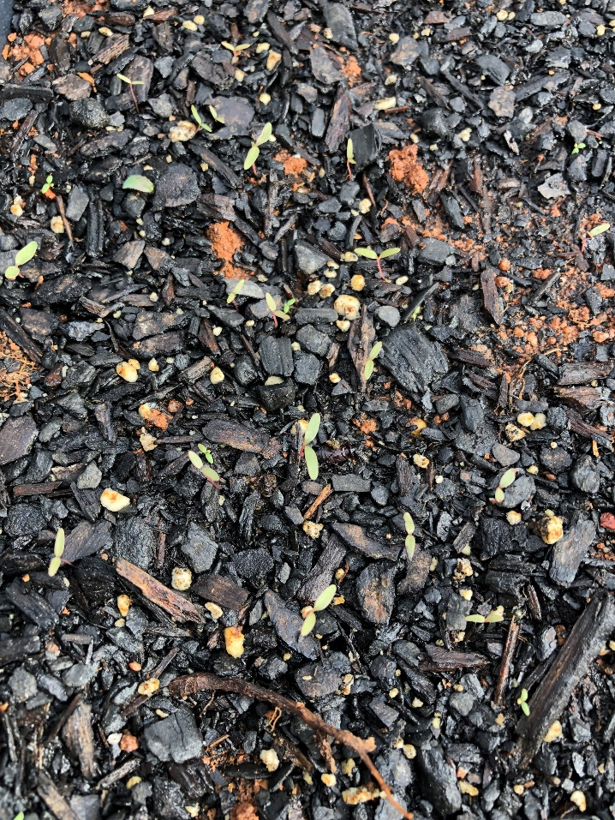
Seedbank
Cover crop | Germinated seedlings m⁻²
 | 2020 | 2021 | 2022 | 2023
BG | 3229a | 3846a | 5152a | 1380b
CC | 3796a | 5424a | 8407a | 4191b
CR | 3871a | 2194a | 4783a | 1208b
LM | 2416a | 3525a | 3550a | 12475a

Slide 10
B. Seedlings
C. Adult plants
2. Seedling survival = $\frac{C}{B}$
3. Fecundity = $\frac{D}{C}$
1. Seedling recruitment = $\frac{B}{A}$
Palmer amaranth lifecycle
Seed production
Seed survival
A. Seed bank
D. Seeds
Notes:
Importance of understanding life history to identify vulnerabilities -> important part of IWM
-Slowly explain life history stages and transitions
–important to identify how both stages and transitions are affected
-Biological sketch of an organisms life

Slide 11
Palmer Amaranth: EOS Number of plants
covercrop only
Post herbicide applications

Slide 12
Palmer Amaranth: EOS Biomass
covercrop only
Post herbicide applications

Slide 13
B. Seedlings
C. Adult plants
2. Seedling survival = $\frac{C}{B}$
3. Fecundity = $\frac{D}{C}$
1. Seedling recruitment = $\frac{B}{A}$
Palmer amaranth lifecycle
Seed production
Seed survival
A. Seed bank
D. Seeds
Notes:
Importance of understanding life history to identify vulnerabilities -> important part of IWM
-Slowly explain life history stages and transitions
–important to identify how both stages and transitions are affected
-Biological sketch of an organisms life

Slide 14
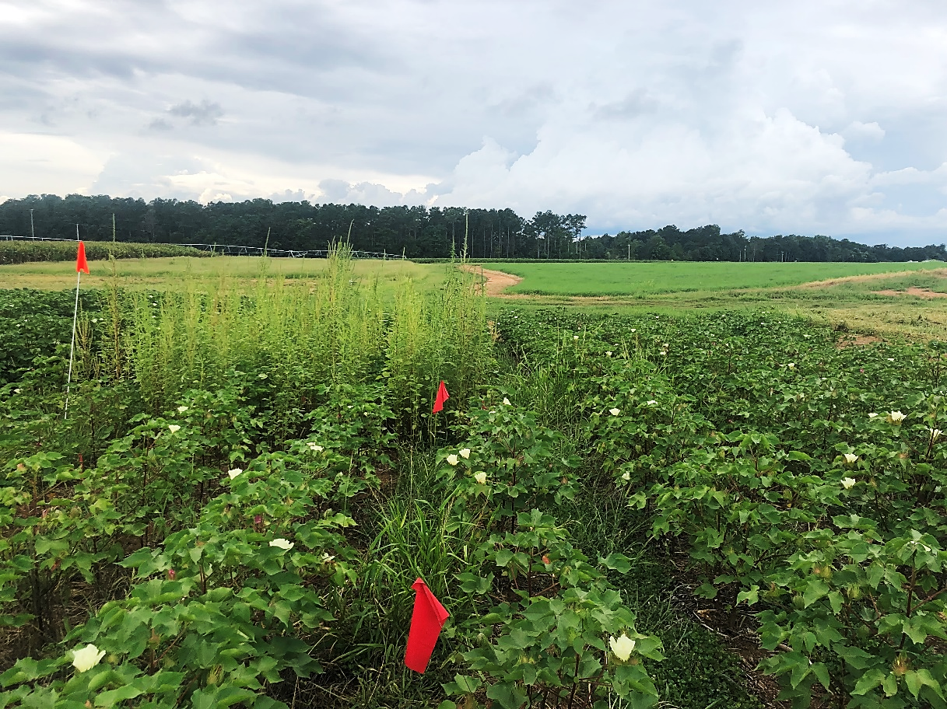
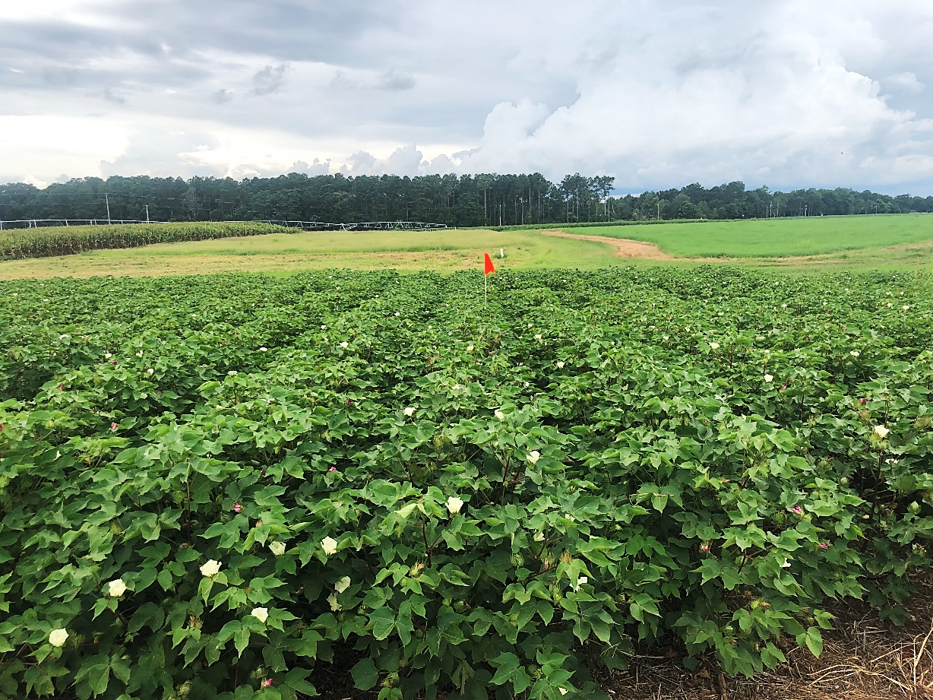
2022 Plots
Living mulch + strip width application
Cereal rye + broadcast application

Slide 15
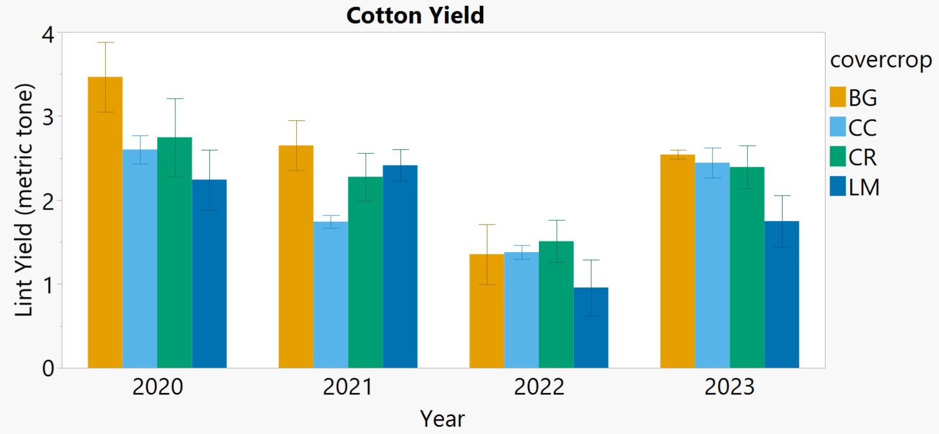
No significant difference between cover crop treatments

Slide 16
Take Home
Without herbicides, cereal rye and living mulch effectively reduced palmer amaranth plant number
Herbicides with covercrops reduced palmer amaranth plant number and biomass in cereal rye, crimson clover, and bare ground scenarios
Covercrop did not affect cotton yield for years 1, 2, 3, and 4

Slide 17
Evaluating planting arrangement, herbicide persistence, and weed management using cereal rye cover crop in Georgia peanut

Slide 18
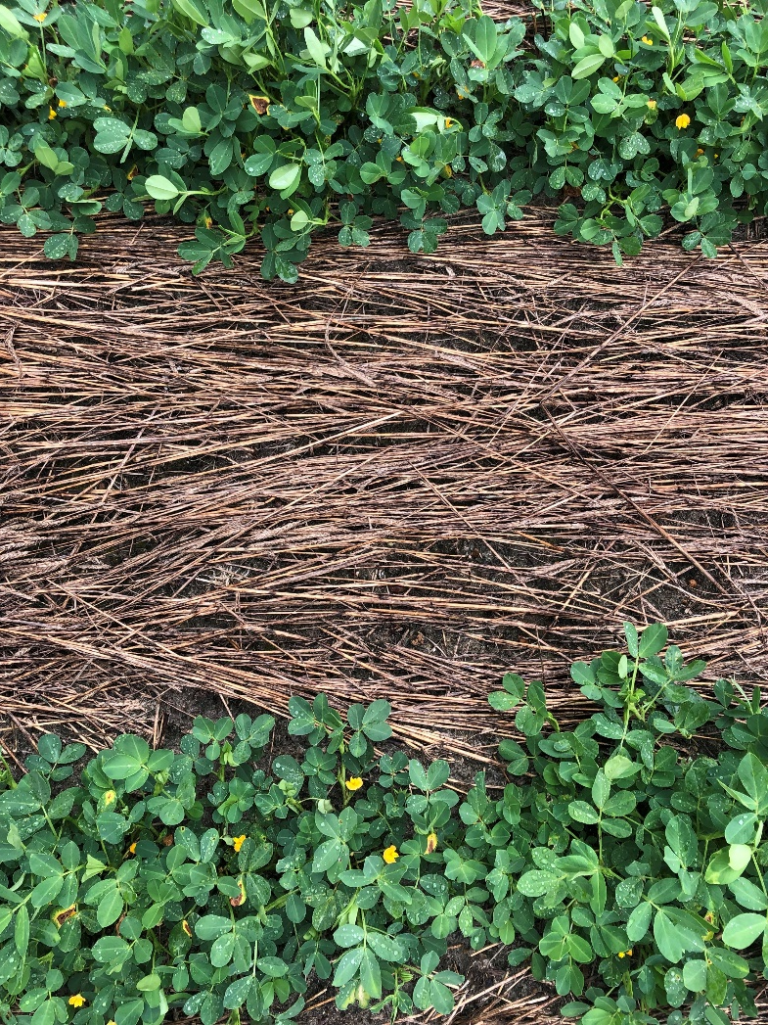
Peanuts and Cover Crops
Georgia makes up >52% peanut production
11 recorded cases of herbicide resistant weeds in Georgia (Heap 2023)
Cover crops affect herbicide efficacy, alter weed control, and create a risk for peanut injury from carryover (Perkins 2020)
Evaluations of the potential risk/benefits of cover crops in peanut production is crucial

Slide 19
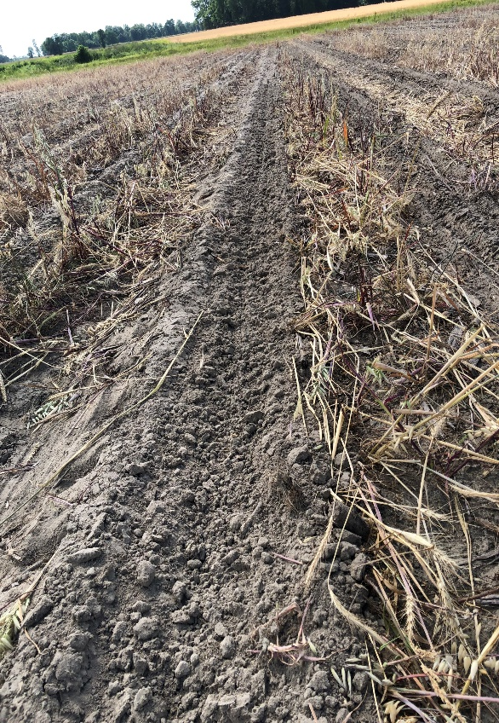
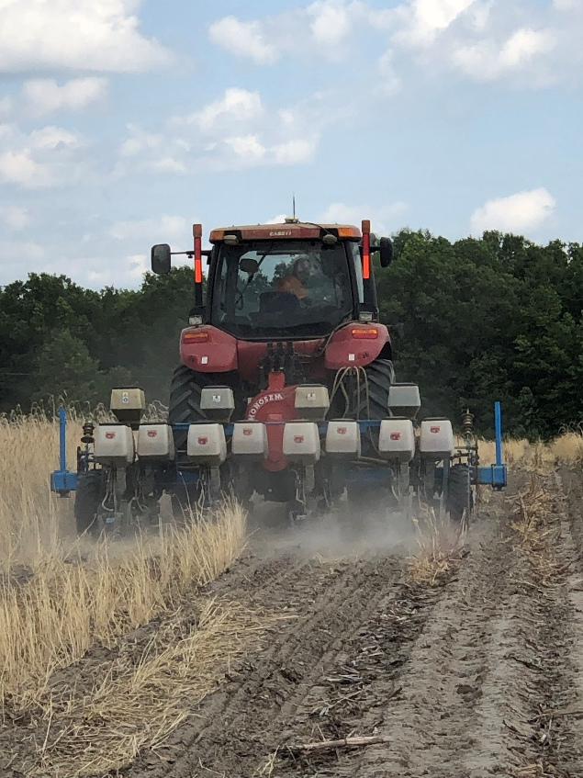
Materials and Methods
Trial locations for:
2023: Midville and Tifton, GA
Variety: Georgia-06G
High yielding and TSWV resistant runner cultivar
Plot size 12 ft by 30 ft
Seeds planted at 88,000 seeds acre⁻¹

Slide 20
Materials and Methods
Table 1. Proposed treatment structure.
Cover crop | Planting | PRE | POST
No Cover crop | Single | None | None
 |  | Paraquat+Prowl+ Valor+Strongarm | Cadre +Warrant+2,4DB
 |  | Paraquat+Prowl+ Strongarm+Brake | Cadre +Warrant+2,4DB
 | Twin | None | None
 |  | Paraquat+Prowl+ Valor+Strongarm | Cadre +Warrant+2,4DB
 |  | Paraquat+Prowl+ Strongarm+Brake | Cadre +Warrant+2,4DB
Cereal Grain | Single | None | None
 |  | Paraquat+Prowl+ Valor+Strongarm | Cadre +Warrant+2,4DB
 |  | Paraquat+Prowl+ Strongarm+Brake | Cadre +Warrant+2,4DB
 | Twin | None | None
 |  | Paraquat+Prowl+ Valor+Strongarm | Cadre +Warrant+2,4DB
 |  | Paraquat+Prowl+ Strongarm+Brake | Cadre +Warrant+2,4DB
50 lbs/A 100% cereal rye drilled in Tifton (37,082 lb/ac biomass), and a cereal grain mix (70% cereal rye; 20% oat; 10% wheat) broadcast at 70 lb/A in Midville (103,195 lb/ac biomass)
Midville planted 5/8; PREs applied 5/9; POSTs applied 6/6
Tifton planted 5/8; PREs applied 5/9; POSTs applied 6/8

Slide 21
Weed Biomass: Herbicide Effect

Slide 22
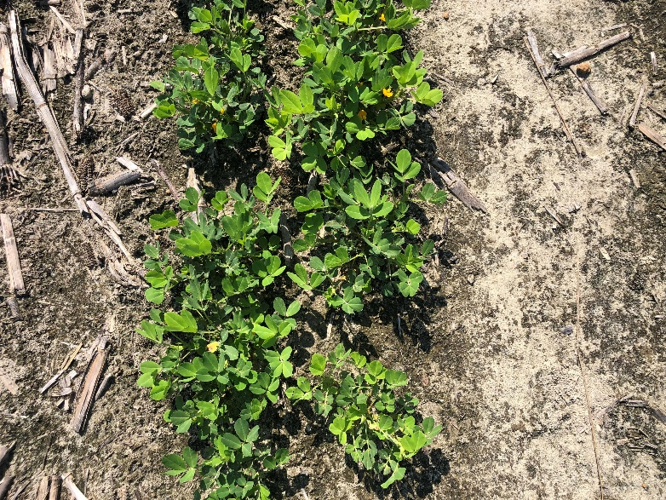
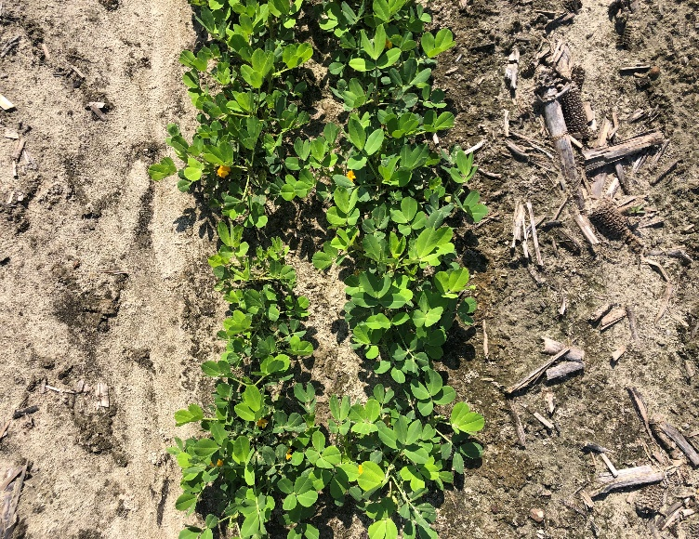
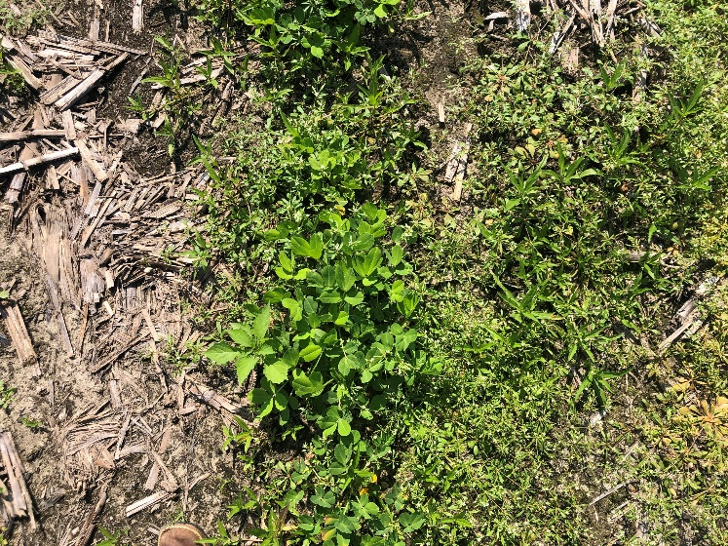
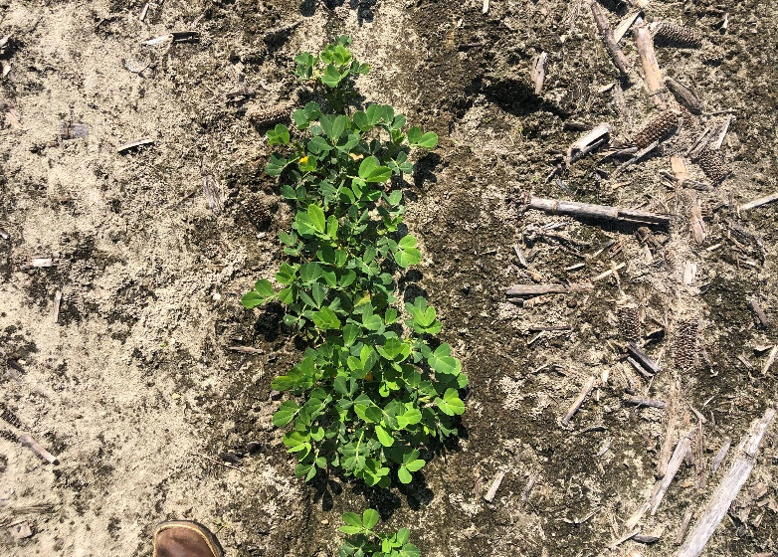
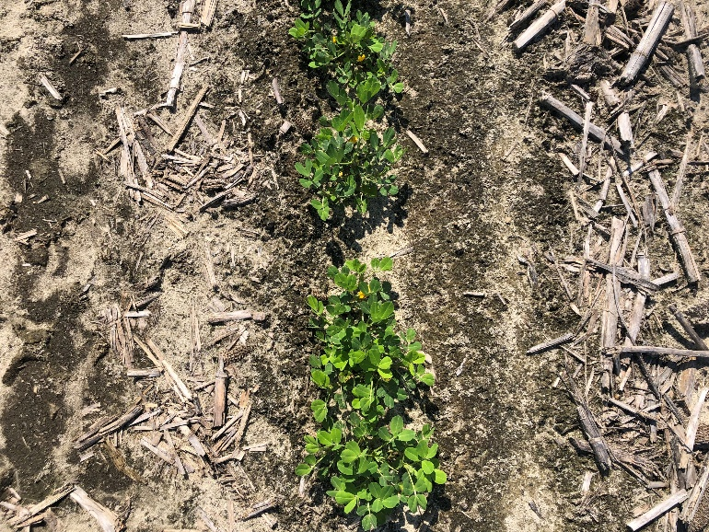
Strongarm @ 0.225 oz/a + Valor SX @ 3 oz/a + Gramoxone 3SL @ 20.8 oz/a + Prowl 32 oz/a
Strongarm @ 0.225 oz/a + Brake @ 12 oz/a Gramoxone 3SL @ 20.8 oz/a + Prowl 32 oz/a
Nontreated
Twin-row
Single-row
Midville 6/26/2023 – 7 WAP/WAT

Slide 23
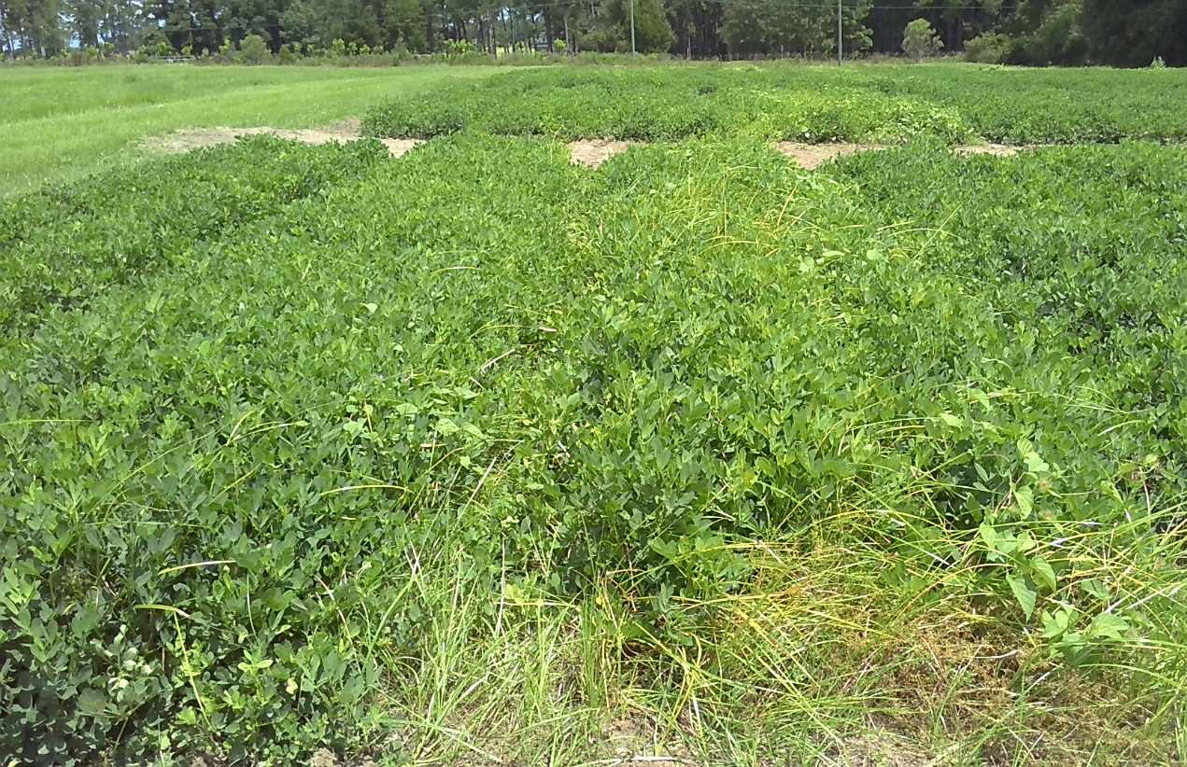
Tifton, GA – August 10
12 WAP
Single-row + nontreated
Twin-row + nontreated
Weed biomass at the end of the season is 68% higher in single-row peanuts compared to twin-row

Slide 24
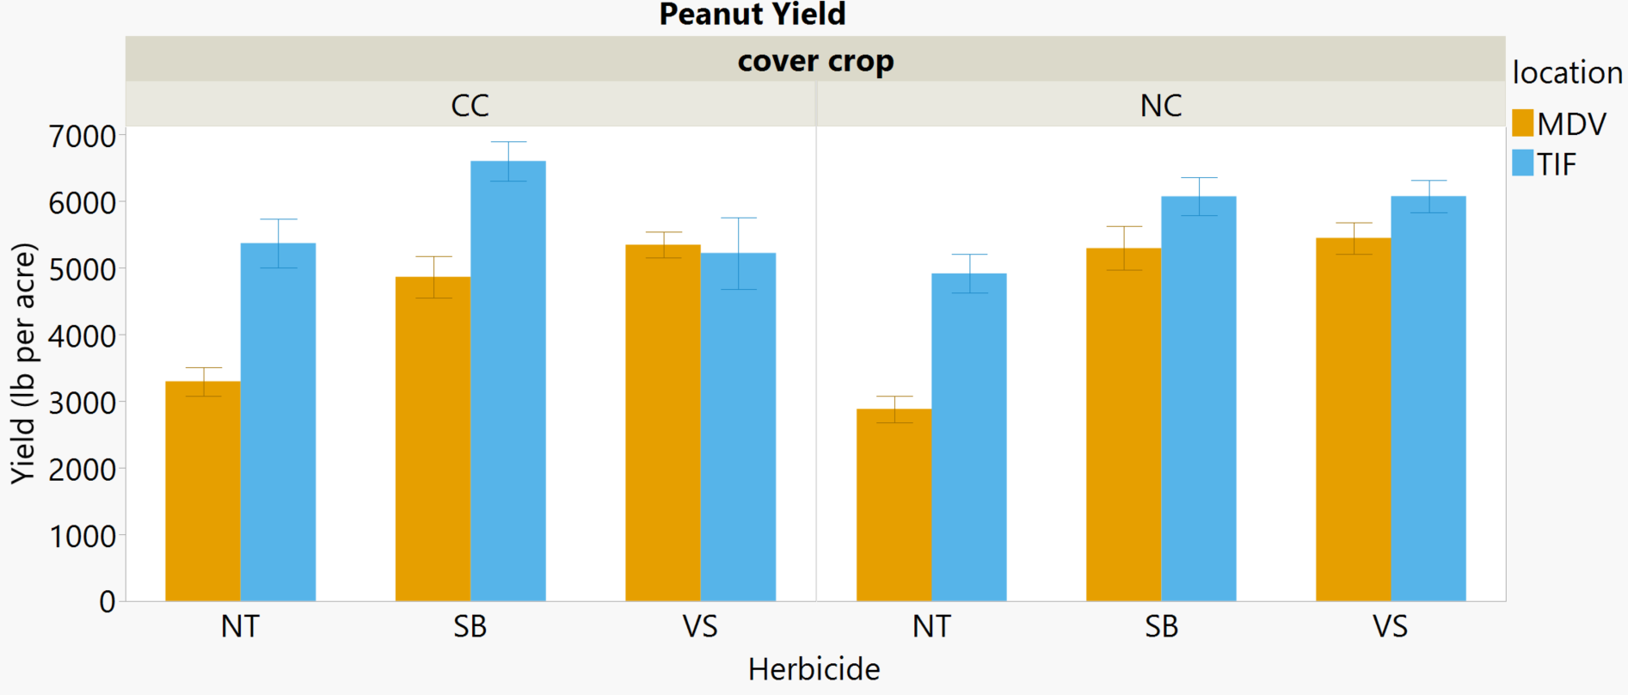
*A
AB
AB
AB
a
AB
a
a
a
B
b
b
NT = nontreated
SB = Strongarm @ 0.225 oz/a + Brake @ 12 oz/a
VS = Strongarm @ 0.225 oz/a + Valor SX @ 3 oz/a
Yield was not affected by planting arrangement

Slide 25
Take Home
Multiple tank mix herbicides reduce weed biomass compared to nontreated, regardless of cover crop or planting arrangement
At Midville, where late emerging weeds occurred, herbicide use increased peanut yield
Twin-row reduced biomass from early emerging weeds at Tifton, GA by 68%
Yield was affected by herbicide and covercrop at Tifton

Slide 26
Acknowledgments
Research was funded by:
Cotton Incorporated
Georgia Peanut Commission
UGA Research Stations :
Jones Farm
Southeast Georgia Research and Education Center (SEGREC)
J. Phil Campbell Research and Education Center (JPCREC)
Agricultural Specialists:
Chris Bocz, John D. Hale, Sidney Cromer, and Ray Boyd
Undergraduate help

Slide 27
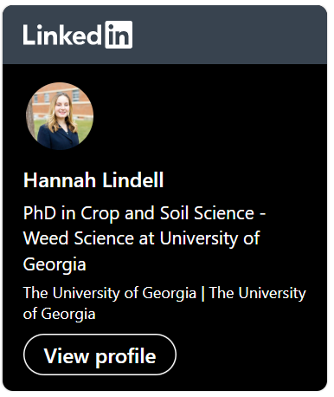
Thank you for listening
For any further questions, please contact me at
hcl00025@uga.edu
@lind_han9

