Slide 1
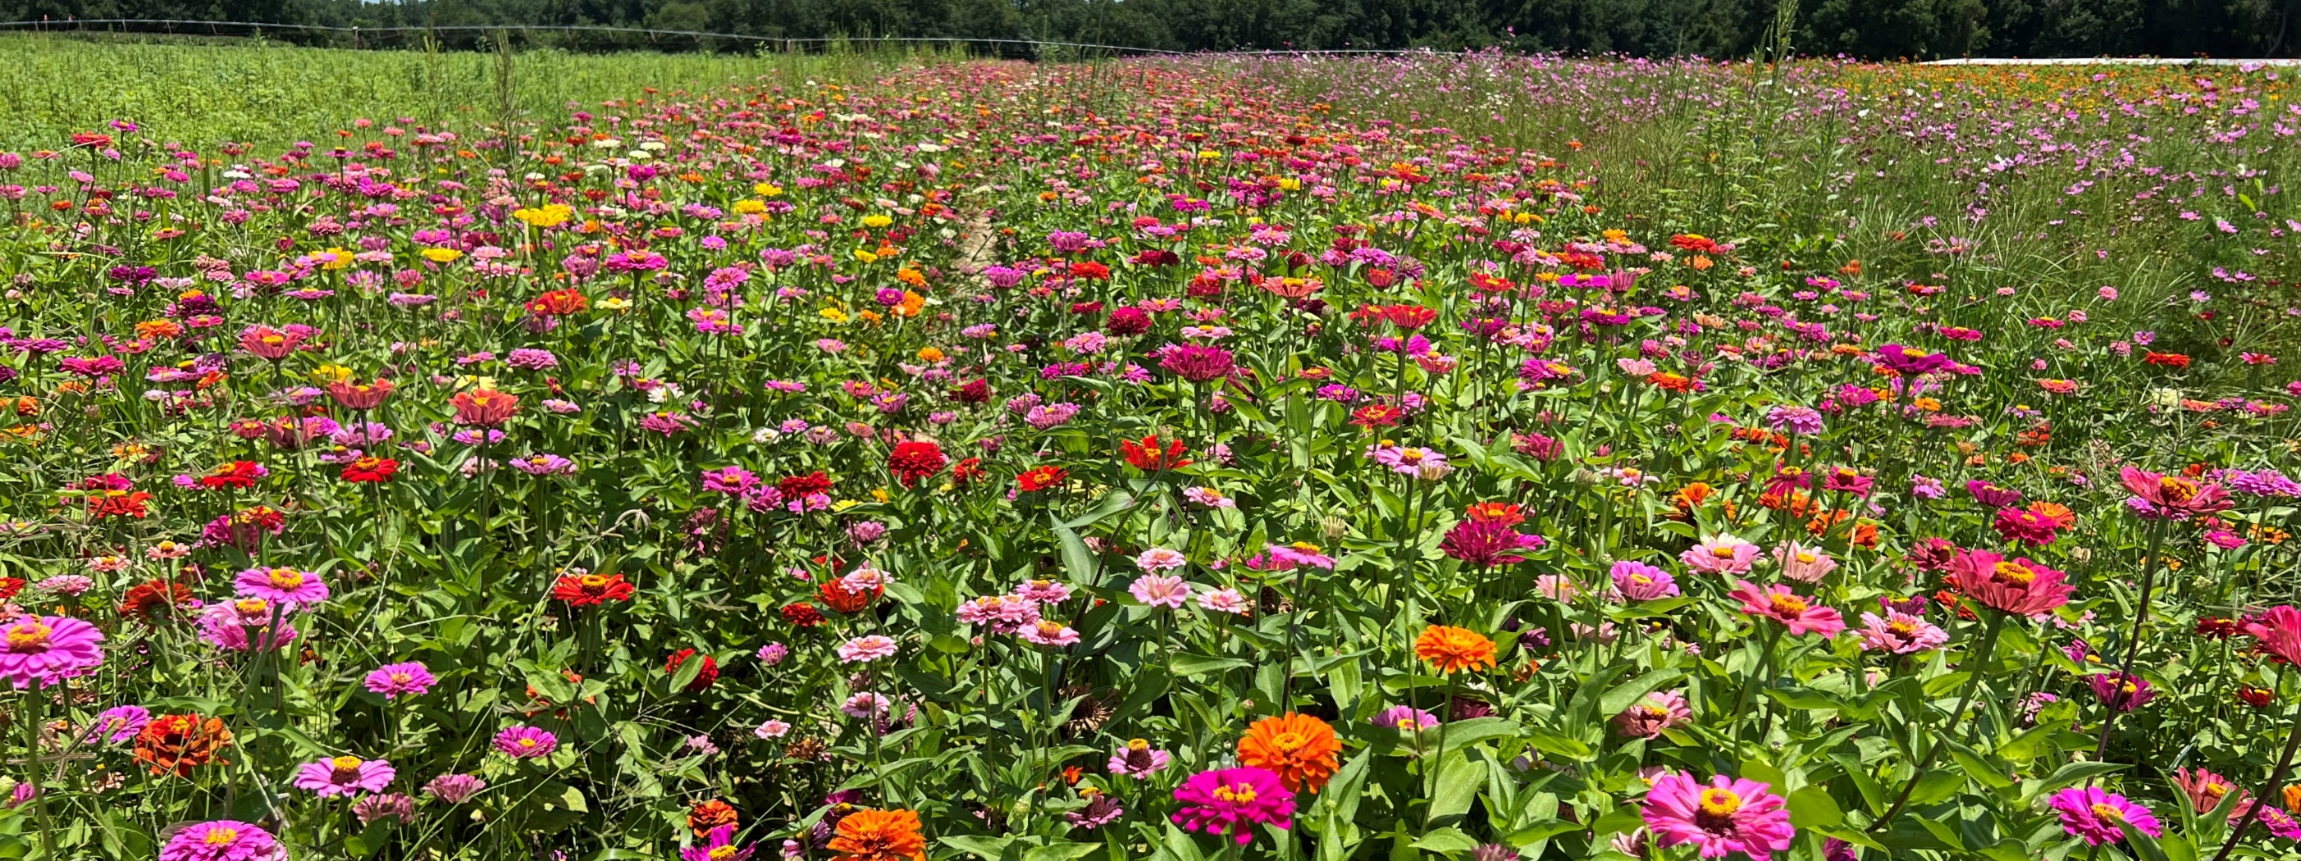
Sustainability Objectives
Taylor Randell Singleton
Extension Sustainability Specialist

Slide 2
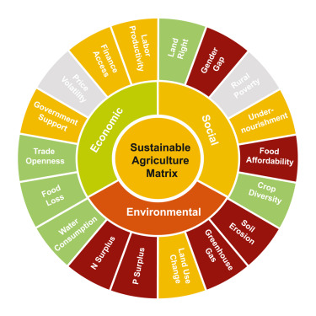
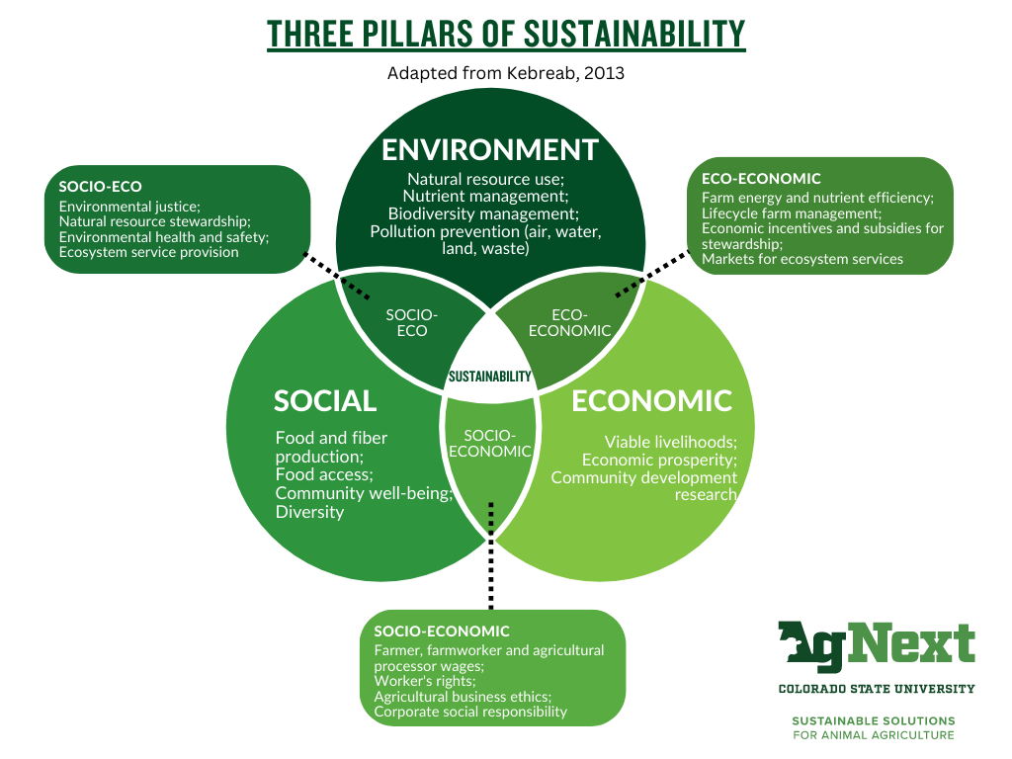
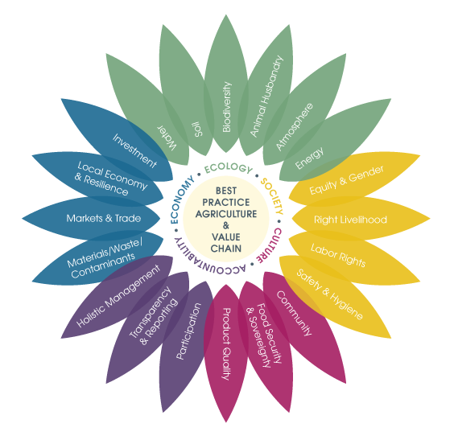
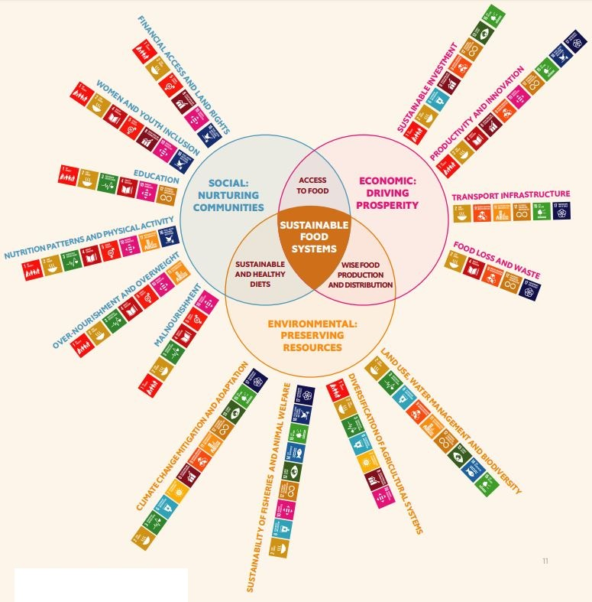
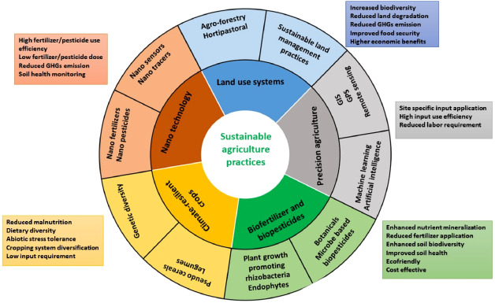
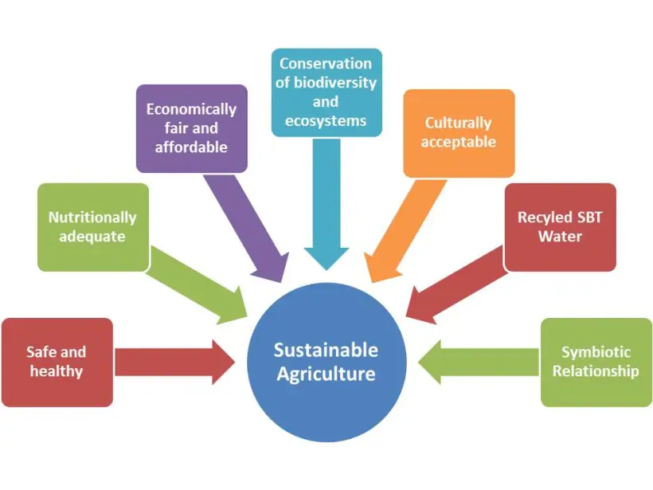
Sustainability
Notes:
Now I’d like to transition into why I believe I could be a good fit for this position, but first I would like to talk a minute about what “sustainability” means to me, As defined by the US EPA, to pursue sustainability is to create and maintain the conditions under which humans and nature can exist in productive harmony to support present and future generations. This is a great definition, but what exactly does this mean if you view this from an agriculture lens? Well, to me this means…..

Slide 3
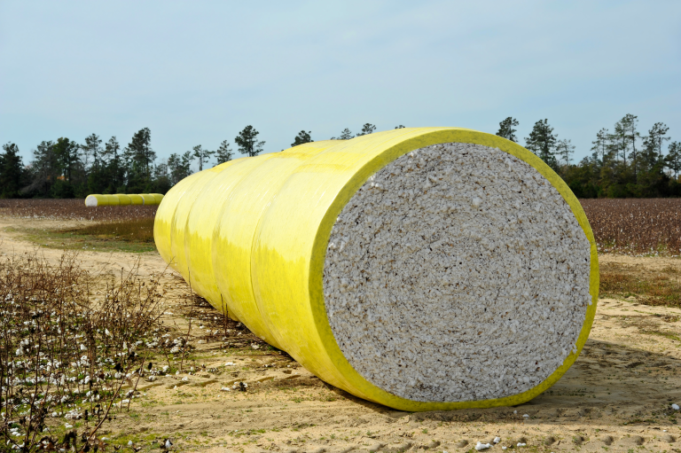
Sustainability
In my mind, this means:
To pursue sustainability is to understand and anticipate how farms, cropping systems, and production practices will need to change in the years to come, and prepare for these changes ahead of time
Sustainability is to ensure:
Economical feasibility
Flexibility and adaptability
Environmental soundness

Slide 4
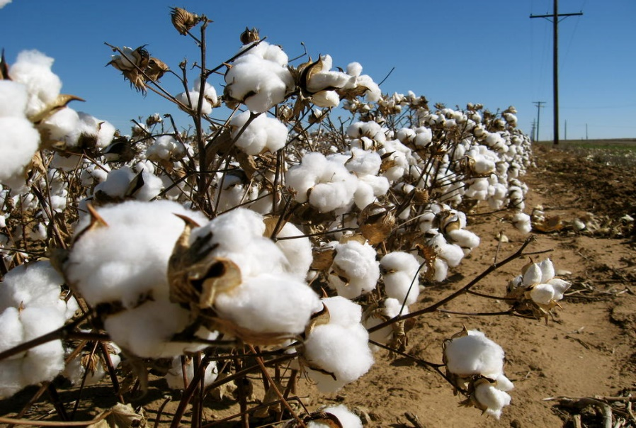
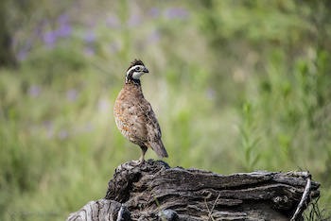
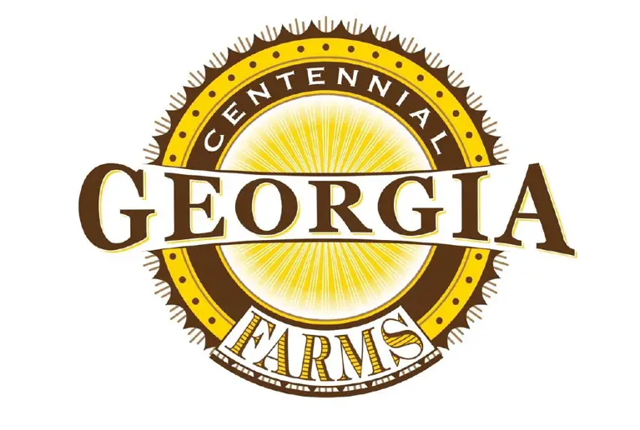
Georgia Agriculture Sustainability
Productive Farmland & Profitable Products
Healthy Land/Water for Habitat & Other Ecological Services
Generational Farms Continue to Steward the Land

Slide 5
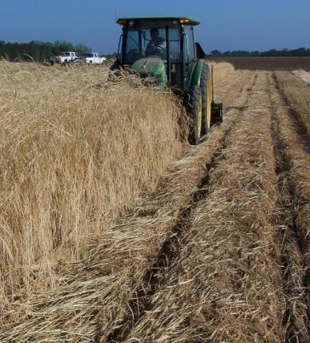
Ag Sustainability
Incredible opportunity to support this need for GA agriculture
Interdisciplinary, whole-farm approach
Sustainable cropping systems
Agronomic + specialty crops
Emphasis in pesticide stewardship
Understand practices that support the farm and the environment:
Cultural/Mechanical/Chemical

Slide 6
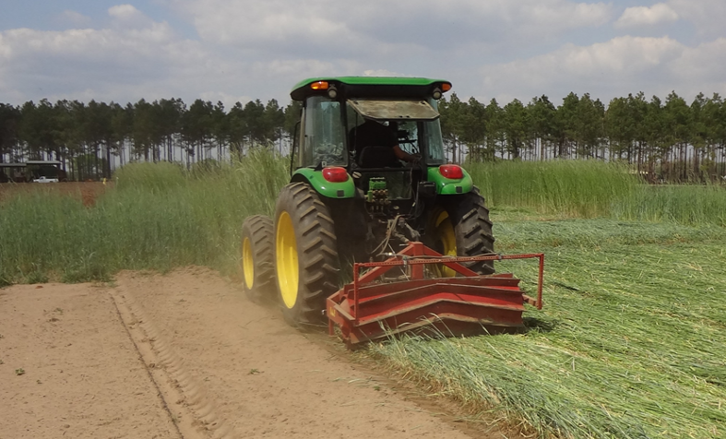
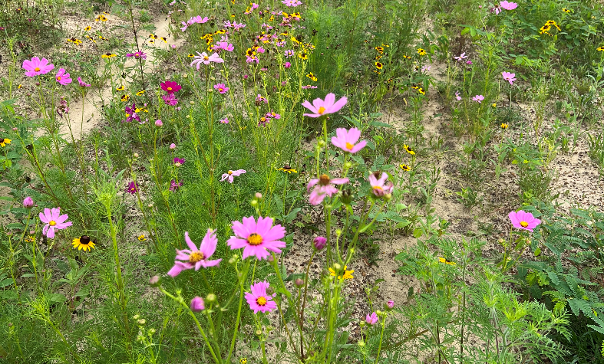
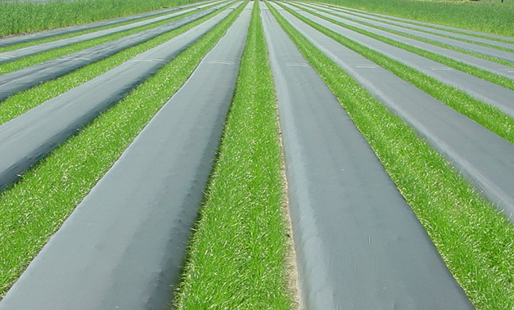
Traditional Sustainability
Foundational concepts:
Cover crops
Erosion mitigation
Pollinator protection/habitat
Protecting natural resources (minimize inputs where applicable)
Advance sustainable cropping systems + farm health
Notes:
When I think about traditional agricultural sustainability, I think of the foundational concepts including the use of cover crops and conservation tillage practices, erosion mitigation and soil health, pollinator health and protection, and climate-smart practices on the farm….just to name a few. Knowledge is growing, technology is rapidly changing, and new challenges emerge everyday, therefore any practice that advances sustainable cropping systems while promoting farm-health should be investigated.

Slide 7
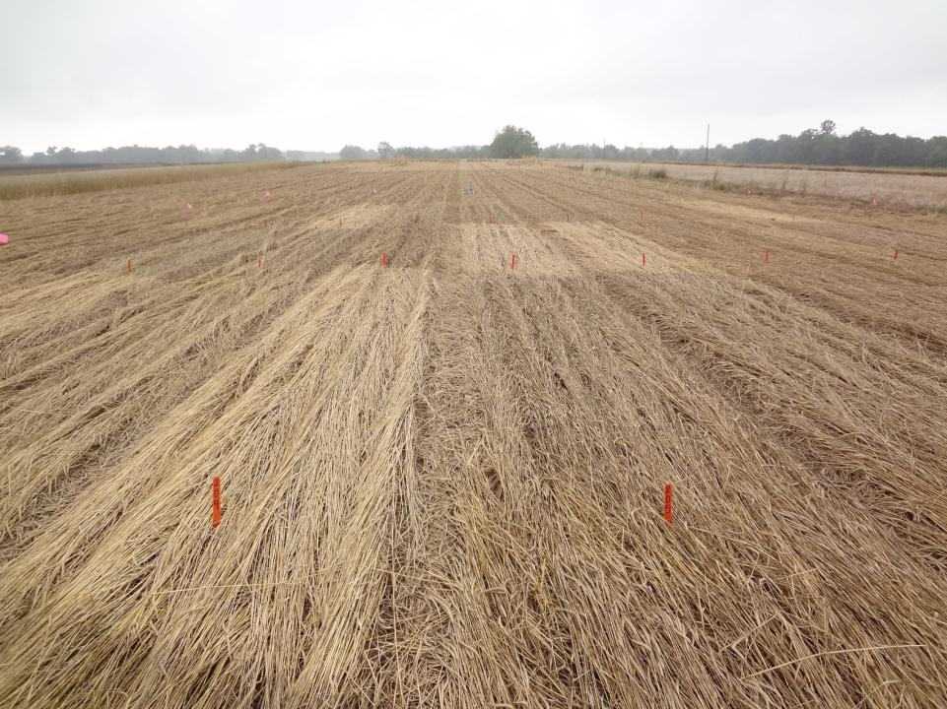
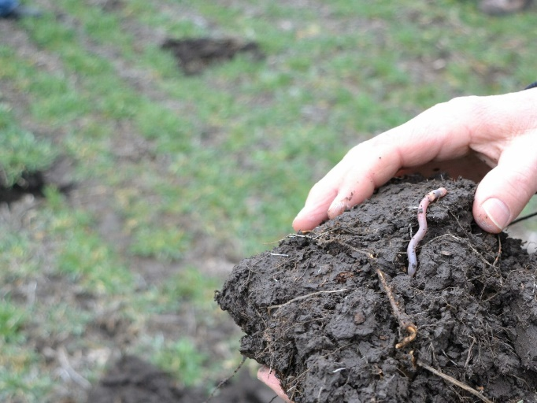
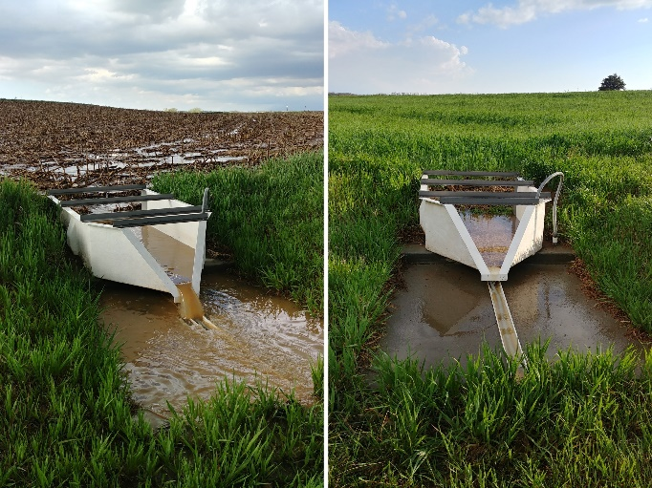
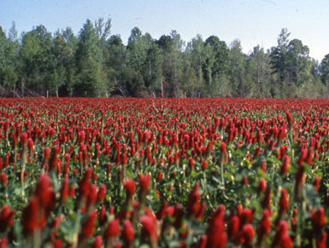
Cover Crops
Numerous environmental/economic benefits:
Weed Suppression
Soil Health/Quality
Water Quality
Soil Fertility
MANY options depending on your goals
Location, equipment, resources, cropping systems, etc.
Acres vary in GA….not a fit for everyone BUT need to understand barriers
Notes:
When I think about traditional agricultural sustainability, I think of the foundational concepts including the use of cover crops and conservation tillage practices, erosion mitigation and soil health, pollinator health and protection, and climate-smart practices on the farm….just to name a few. Knowledge is growing, technology is rapidly changing, and new challenges emerge everyday, therefore any practice that advances sustainable cropping systems while promoting farm-health should be investigated.

Slide 8
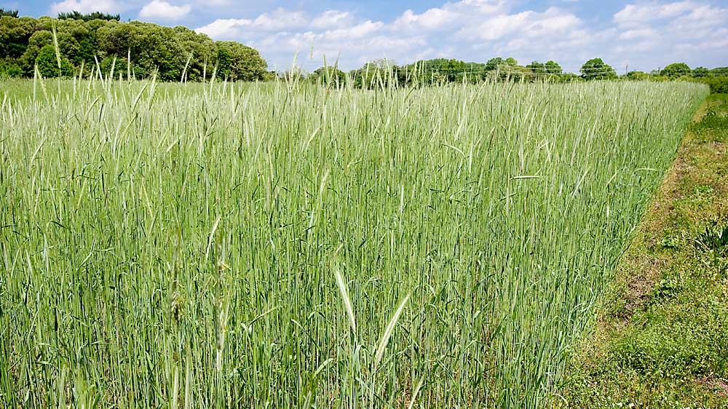
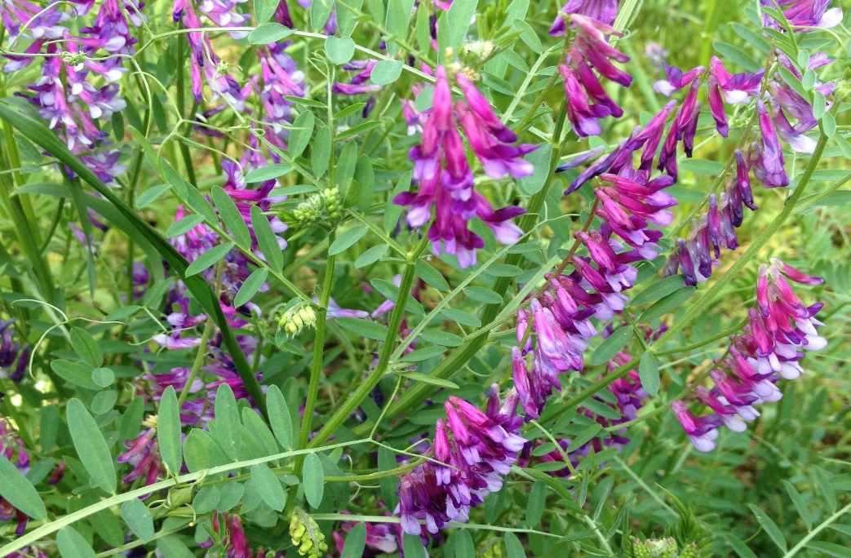
Cover Crops
What species to plant?
Benefits/value of each
When to plant/terminate?
Pros/Cons
Value of cover crops to farm:
Economic/Environmental
Pesticide stewardship??
Mitigation points for pesticide use
Notes:
When I think about traditional agricultural sustainability, I think of the foundational concepts including the use of cover crops and conservation tillage practices, erosion mitigation and soil health, pollinator health and protection, and climate-smart practices on the farm….just to name a few. Knowledge is growing, technology is rapidly changing, and new challenges emerge everyday, therefore any practice that advances sustainable cropping systems while promoting farm-health should be investigated.

Slide 9
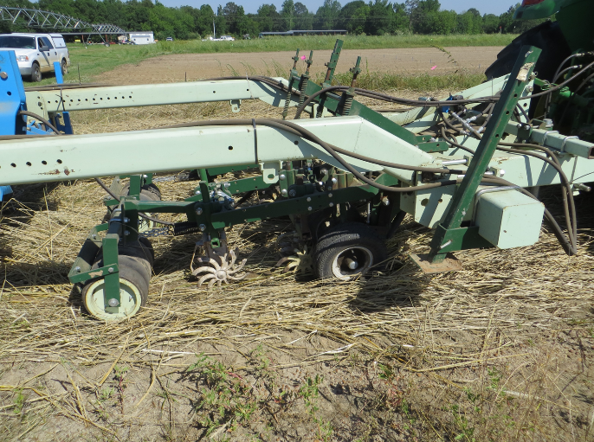
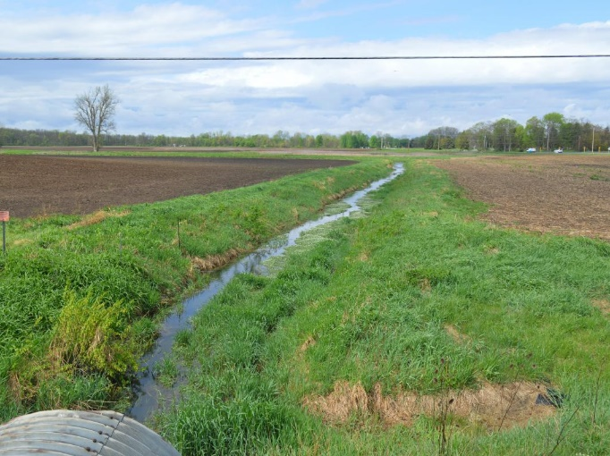
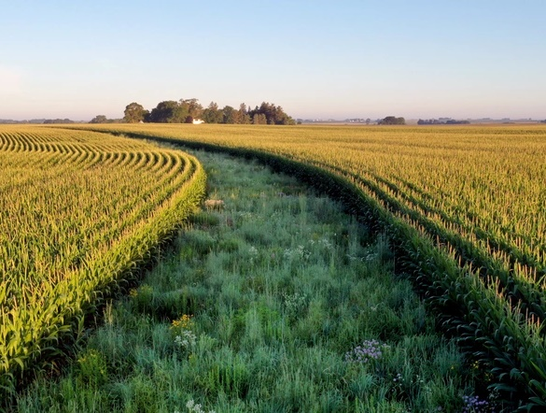
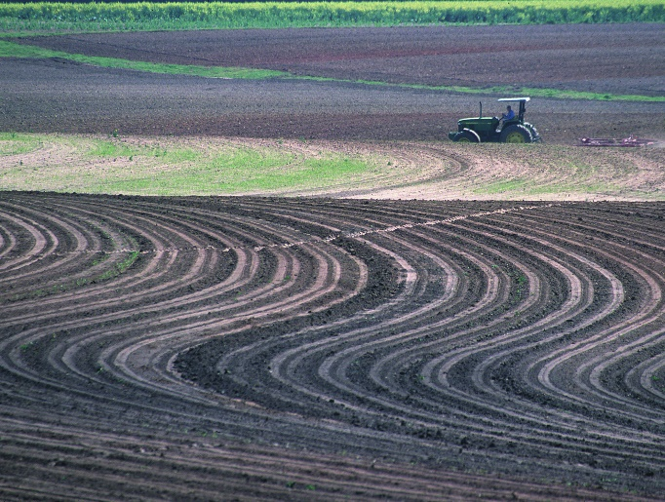
Erosion/Runoff Mitigation
Numerous environmental/ecological benefits:
Conservation Tillage
Grassed Waterways
Filter/Prairie Strips
Terrace/Contours
Landscape, equipment, resources, cropping system, etc.
Support overall health of the land and the farm
Need to understand barriers to implementation
Notes:
When I think about traditional agricultural sustainability, I think of the foundational concepts including the use of cover crops and conservation tillage practices, erosion mitigation and soil health, pollinator health and protection, and climate-smart practices on the farm….just to name a few. Knowledge is growing, technology is rapidly changing, and new challenges emerge everyday, therefore any practice that advances sustainable cropping systems while promoting farm-health should be investigated.

Slide 10
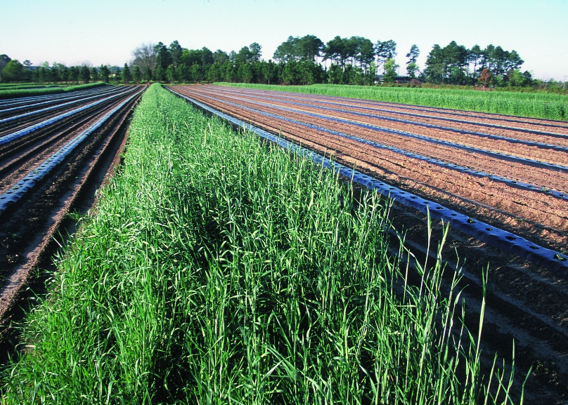
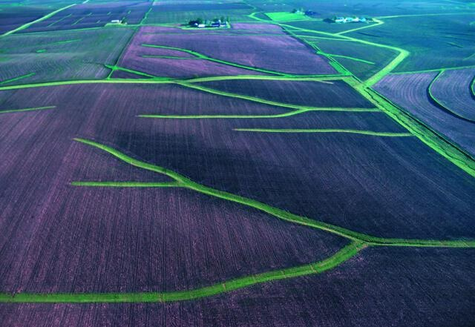
Erosion/Runoff Mitigation
What practices are suitable?
Service needed
Landscape/Topography
How to install?
Equipment
Resources
Creative ways to implement in GA?
Public perception
Environmental stewardship
POINTS on pesticide mitigation menu
Notes:
When I think about traditional agricultural sustainability, I think of the foundational concepts including the use of cover crops and conservation tillage practices, erosion mitigation and soil health, pollinator health and protection, and climate-smart practices on the farm….just to name a few. Knowledge is growing, technology is rapidly changing, and new challenges emerge everyday, therefore any practice that advances sustainable cropping systems while promoting farm-health should be investigated.

Slide 11
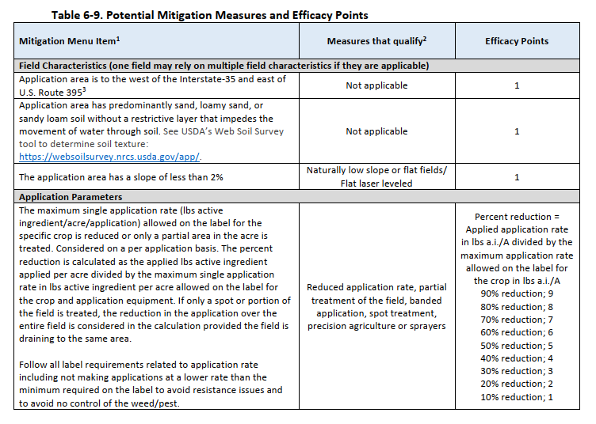
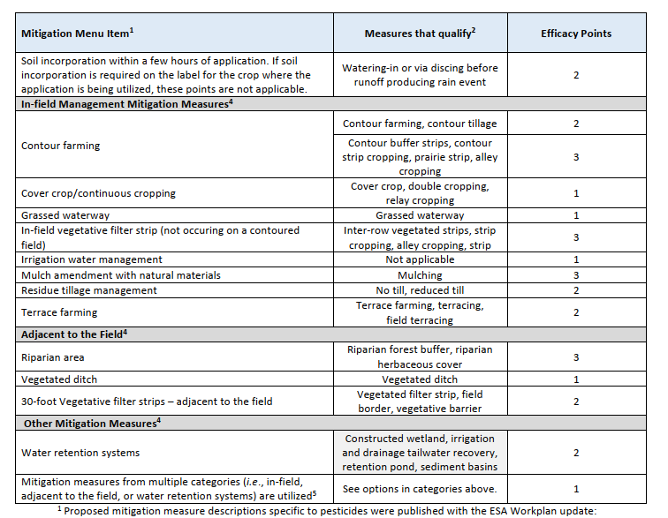
Proposed “Mitigation Menu”
Notes:
When I think about traditional agricultural sustainability, I think of the foundational concepts including the use of cover crops and conservation tillage practices, erosion mitigation and soil health, pollinator health and protection, and climate-smart practices on the farm….just to name a few. Knowledge is growing, technology is rapidly changing, and new challenges emerge everyday, therefore any practice that advances sustainable cropping systems while promoting farm-health should be investigated.

Slide 12
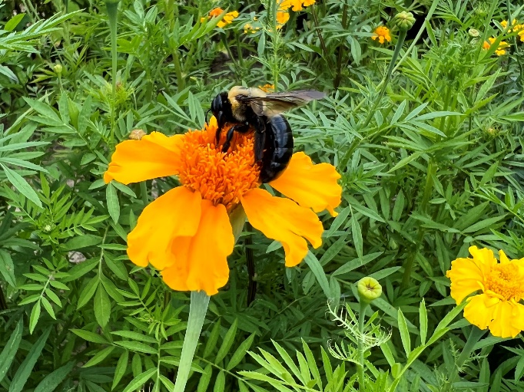
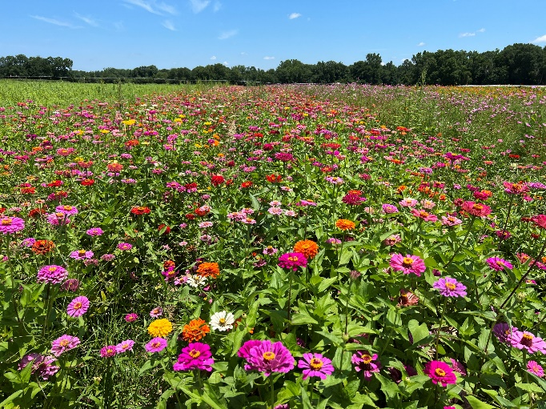
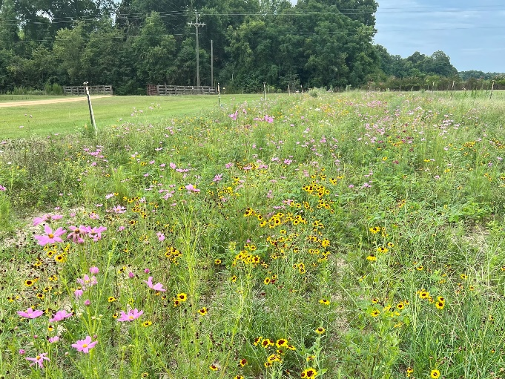
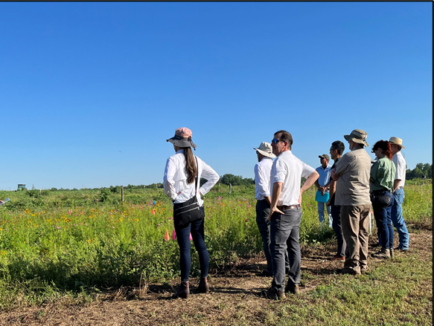
Pollinator Protection/Habitat
Numerous environmental/ecological benefits:
Establish Habitat
Maintain Habitat
Support Pollinators
Value to System
Lots of challenges = Need to understand how to implement
IF WE DON’T SUPPORT WILDLIFE HABITAT, WE CANNOT MAKE ADVANCES IN FIGHT TO PERSERVE PESTICIDE USE !!!!
Notes:
When I think about traditional agricultural sustainability, I think of the foundational concepts including the use of cover crops and conservation tillage practices, erosion mitigation and soil health, pollinator health and protection, and climate-smart practices on the farm….just to name a few. Knowledge is growing, technology is rapidly changing, and new challenges emerge everyday, therefore any practice that advances sustainable cropping systems while promoting farm-health should be investigated.

Slide 13
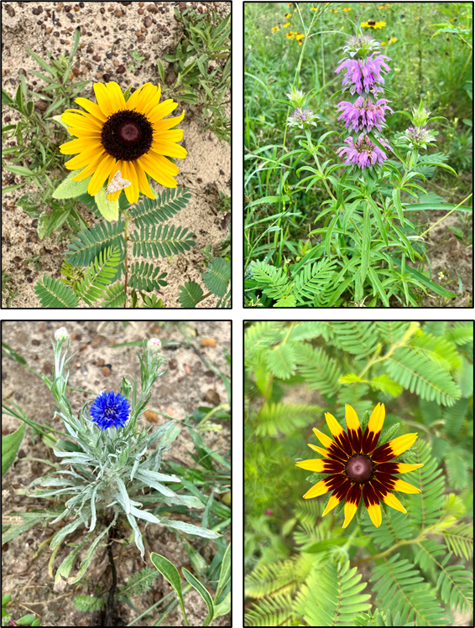
Pollinator Protection/Habitat
2024 = year 3 of research
Lots to learn…..
How to establish on farm?
Mix of species
Technique/Timing
Weed control
Cost-share programs?
How to maintain year after year?
Combine with practices from Mitigation menu??
Notes:
When I think about traditional agricultural sustainability, I think of the foundational concepts including the use of cover crops and conservation tillage practices, erosion mitigation and soil health, pollinator health and protection, and climate-smart practices on the farm….just to name a few. Knowledge is growing, technology is rapidly changing, and new challenges emerge everyday, therefore any practice that advances sustainable cropping systems while promoting farm-health should be investigated.

Slide 14
Overall Farm Sustainability
Erosion/Runoff Mitigation
Cover Crops/
Reduced Tillage
Pollinator Habitat
Pesticide Sustainability
Navigating Regulatory Challenges
Minimize Labor Needs
Minimize Inputs
……..etc.
Notes:
Climate smart practices
Ability to absorb adverse impacts from weather, fluctuating markets/prices

Slide 15
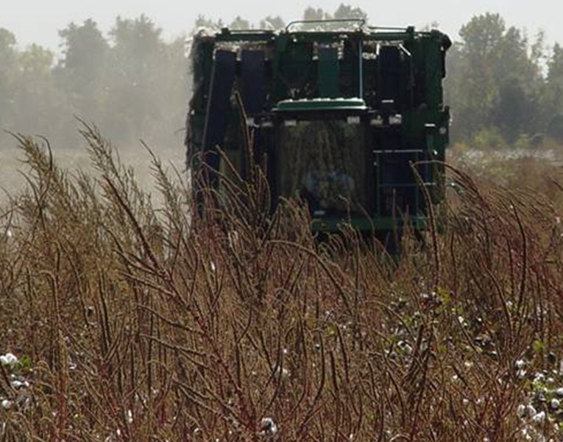
Pesticide Stewardship
Agriculture sustainability currently relies heavily on pesticide use:
Economical and environmental standpoint
Without the ability to use pesticides:
Crop yield loss from weed competition?
Burndown cover crops before strip-tillage?
Attractive product for the consumer?
Capitalize farm investments?
Notes:
While understanding and continuing to investigate traditional sustainability concepts are critical and will be an essential component of this position….I believe that true agriculture and cropping system sustainability currently relies heavily on pesticide use, both both an economical and environmental standpoint. Consider these scenarios…without the ability to use pesticides, what would crop yield loss be from weed competition, such as Palmer amaranth? How would we continue to use conservational tillage if we couldn’t burndown our cover crop? How could we continue to produce an attractive final product for consumers without the ability to protect it from insects and disease? How can we capitalize on our in-field investments, such as fertilizer and irrigation, if there is minimal final product to market?

Slide 16
To Preserve Pesticide Use…
Practices that support the farm and maintain environmental quality:
Protect utility of pesticide product (i.e. resistance mgmt.)
Environmentally focused practices
Navigate regulatory challenges
Notes:
Climate smart practices
Ability to absorb adverse impacts from weather, fluctuating markets/prices

Slide 17
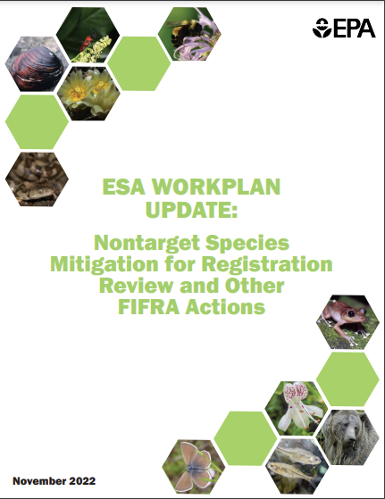
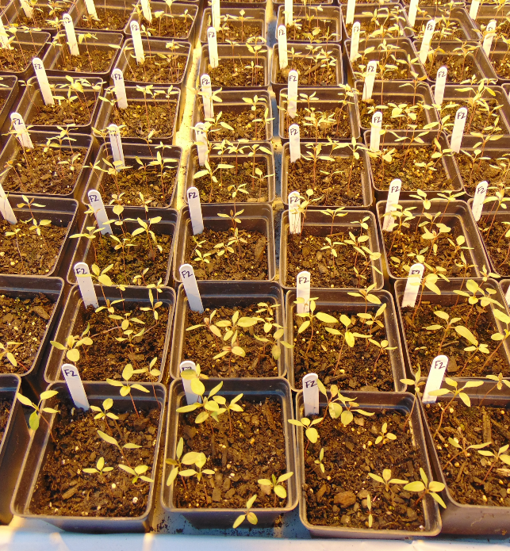
Challenging Times Ahead
Pesticides (sustainability) face enormous hurdles
Regulatory restrictions (ESA, FIFRA, etc.)
Pesticide resistance
On-farm impacts today – adapt on the GO!
Notes:
Right now, pesticides and subsequent farm sustainability face enormous hurdles from multiple factors….most imperative being regulatory restrictions for pesticide registration and reregistration under FIFRA and the ESA that have led to on-farm impacts happening right now, forcing growers to adapt on the go.

Slide 18
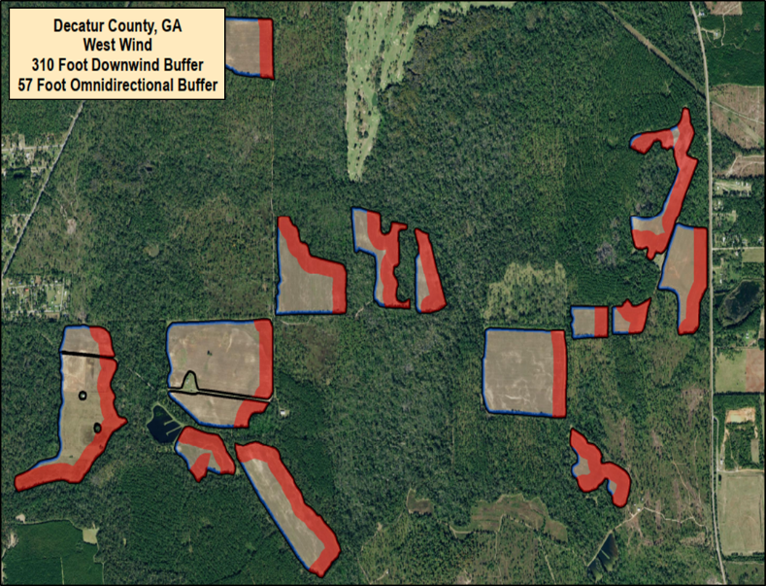
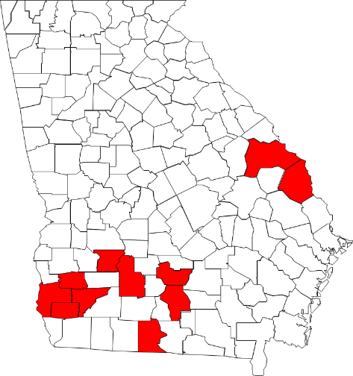
Challenging Times Ahead
GA impacts thus far:
Pesticide-use buffers
Product restrictions in the state
Widespread resistance
GA impacts soon:
Mitigation Measures Menu
No dicamba on 49.6% of field
Navigating regulatory challenges will influence sustainability!
Notes:
So far in Georgia, we have seen pesticide-use buffers and product use restrictions around the state, and I believe there is a need for sound scientific research to support these regulatory decisions to ensure that Georgia agriculture has access to the pesticide products they need to remain sustainable.

Slide 19
Counties with Threatened and Endangered Species
140 out of 159 counties have threatened/ endangered species
Plants:
30 species
Invertebrates:
23 species
Reptiles/ Amphibians:
8 species
Birds:
5 species
Counties with threatened/ endangered species highlighted in red.
Fish:
7 species
Mammals:
4 species
Total: 78 species
Source: U.S. Fish & Wildlife Service Environmental Conservation Online System (ECOS). https://ecos.fws.gov/ecp/
*Remember, it’s the species AND its habitat
Notes:
Here’s a very brief background of the status of Georgia counties with threatened and endangered species, and what we are up against on a state level. In the state of GA, 137 out of the 159 counties have a threatened and or endangered species, and these counties are highlighted in red. These species vary from over 30 species of plants to 22 different species of invertebrates…for a total of 75 listed species in the state….

Slide 20
Please fill out my survey!!!
“Sustainability” can go a lot of different directions….
Help me understand what is important to you and your growers
You don’t have to put your name on it (but you can if you want)
Leave on table/put in box….THANK YOU!!!!
Notes:
Once this mapping effort is complete, we plan to work with the GDA and EPA to seek to allow Enlist duo use in all appropriate counties and sites in Georgia. But this is just the beginning….currently atrazine and glyphosate are undergoing reregistration and use of these products and how that overlaps with endangered species is being evaluated by the EPA. Restrictions that will be placed on these two herbicides due to their impact on endangered species is likely to affect all agronomic crops in most counties in GA. The EPA legally must comply with its ESA obligations, therefore there are 1,200 pesticide active ingredients that will require an ESA review in the future, and GA agriculture MUST navigate this process successfully in order to remain economically and environmentally sustainable.
This work with enlist duo was very reactive, we had a LOT of figuring out to do quickly when these restrictions were put into place….we must find a way to ensure that restrictions like this don’t happen again, and ensure that we take a proactive approach to generating information to support preventing restrictions like these, and this is an area that I believe the UGA Extension sustainability specialists will be instrumental in.

Slide 21
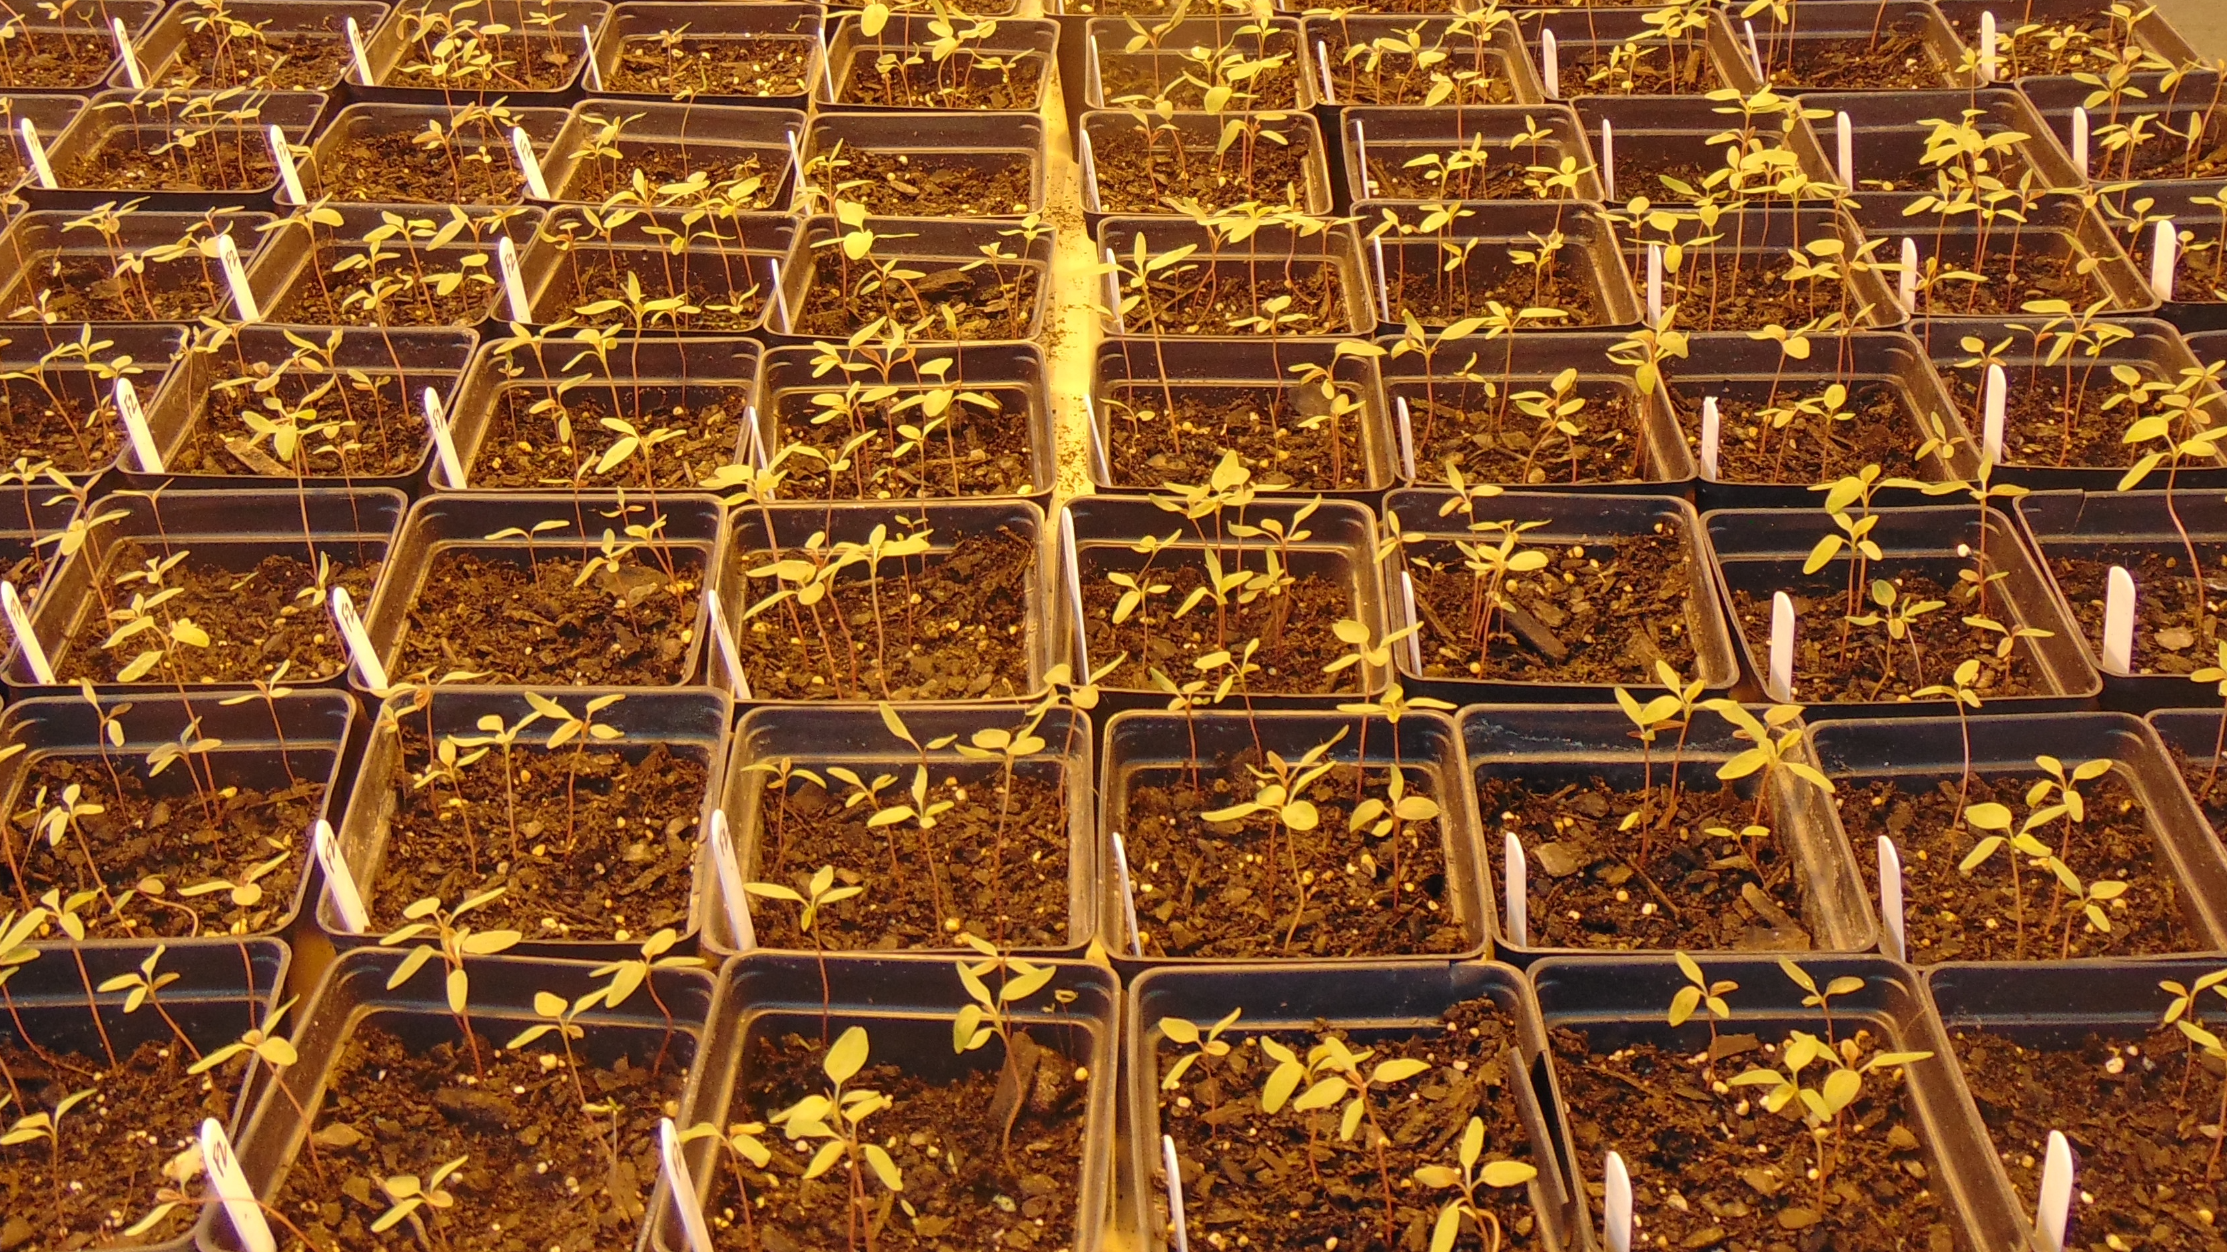
Thank you!
Questions/Comments/
Thoughts???
trandell@uga.edu

