Slide 1
2024 Soybean Weed Control Update
Eric P. Prostko
Professor and Extension Weed Specialist
Dept. Crop & Soil Sciences

Slide 2
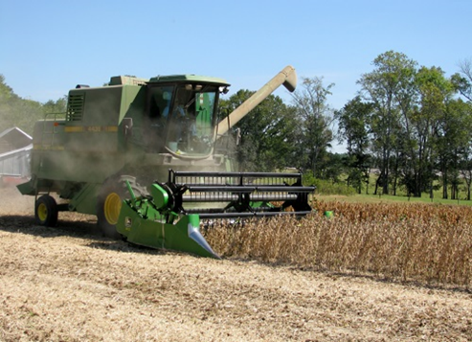
Soybean Weed Control Simplified
Start clean
Narrow rows (< 30”)
PRE
Metribuzin + Group 15 or Prowl
tolerant variety
Irrigation or rainfall
POST + Residual (weeds <3” tall)
Post = Reflex or Prefix or Warrant Ultra or Liberty or Dicamba (Engenia/Tavium/ Xtendimax) or Enlist One (2,4-D choline) or Enlist Duo (glyphosate + 2,4-D choline)
Residual = Anthem Flexx/Max or Dual or Warrant or Outlook or Zidua
Check tank-mix sites first

Slide 3
Metribuzin Products
Manufacturer | Trade Name | Active Ingredients
FMC | Authority MTZ | sulfentrazone + metribuzin
Syngenta | Boundary | s-metolachlor + metribuzin
Corteva | Canopy Canopy Blend | chlorimuron (10.7%) + metribuzin (64.3%) chlorimuron (8.3%) + metribuzin (50%)
NuFarm | Cloak | chlorimuron (10.7%) + metribuzin (64.3%)
Valent | Fierce MTZ | flumioxazin + pyroxasulfone + metribuzin
Loveland | Intimidator | s-metolachlor + fomesafen + metribuzin
NuFarm | Panther MTZ | flumioxazin + metribuzin
NuFarm | Panther Pro | flumioxazin + imazethapyr + metribuzin
Valent | Mauler | metribuzin
Syngenta | tendovo | metribuzin + s-metolachlor + chloransulam
UPL | TriCor | metribuzin
Corteva | Trivence | flumioxazin + chlorimuron + metribuzin

Slide 4
Metribuzin Tolerant Soybean Cultivars

Slide 5
Soybean Weed Control - 2023
SB-05-23
June 6
48 DAT
NTC
Tricor 4F @ 8 oz/A + Zidua 4.17SC @ 2.5 oz/A
(metribuzin + pyroxasulfone)

Slide 6
Valor in GA Soybeans?
Effective, legal and labeled but…….
Valor fb Reflex/Prefix/Warrant Ultra is a good weed control program but a bad resistance mgt plan!
Unless you hand-weed escapes!
Weed control in cotton and peanut without Valor/Reflex?

Slide 7
But would be OK with ……
PRE
Valor or
Envive (Valor + Classic + Harmony) or
Surveil (Valor + FirstRate) or
Fierce (Valor + Zidua)
POST
Roundup + Xtendimax/ Engenia + residual (Xtend System) or
Liberty + residual (Liberty-Link or XtendFlex System) or
Liberty + Enlist One + residual (Enlist System)

Slide 8
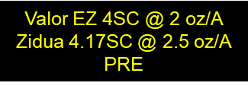
Soybean Weed Control - 2023
SB-05-23
June 6
48 DAT
NTC

Slide 9
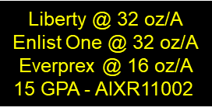
Enlist Soybeans - 2023
SB-04-23
June 6
29 DAT
NTC

Slide 10
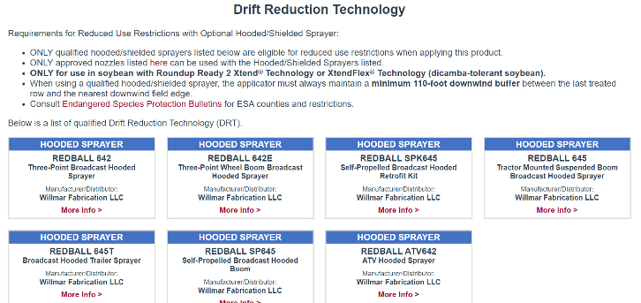
Dicamba Soybeans Hooded Sprayers
**Reduction in downwind buffer
from 240 ft to 110 ft

Slide 11
“Old School” Conventional Systems

Slide 12
Weed Control in Conventional Soybeans
All depends upon the development and spread of PPO resistance (WSSA/HRAC MOA #14)!

Slide 13
Conventional Soybeans
PPO resistant weeds = SOL (really!)
Metribuzin – PRE
Prowl or Group 15’s
Reflex, Cobra, Ultra Blazer, Prefix, Warrant Ultra
Classic or FirstRate (sicklepod + MG)
STS® (1993) - single gene (non-GMO)
Bolt™ (2015) - 2 genes (non-GMO)

Slide 14
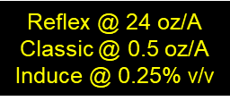
Conventional Soybeans - 2023
SB-04-23
June 6
29 DAT
NTC

Slide 15
New Stuff?
ZALO™ 2.57SL
AMVAC
glufosinate (2.34 lbs/gal) + quizalofop (0.23 lbs/gal)
i.e. Liberty + Assure II
32 oz/A = 0.585 lbs/A glufosinate + 0.0575 lbs/A quizalofop
Liberty 2.34SL @ 32 oz/A + Assure II 0.88EC @ 8.4 oz/A
Soybean, cotton, LL-canola
ProLease™ Technology formulation?
degradation/separation/compatibility issues

Slide 16
Weed Control in Soybeans - 2023
Zalo 2.57SL @ 29 oz/A
(glufosinate + quizalofop)
Prime Oil @ 1% v/v
AMS @ 3 lbs/A
SB-06-23
May 30
23 DAT
NTC

Slide 17
Liberty Ultra 1.76SL
BASF
Glu-L Technology
L-isomer (more active)
25% reduction in rate
24 oz/A vs. 32 oz/A

Slide 18
tolerant to glyphosate, glufosinate, isoxaflutole (Alite™ 27)
Alite™ 27
NOT labeled for use GA
PPI or PRE
1.5-2.0 oz/A
No UGA-OVT variety data
I have conducted no research?

Slide 19
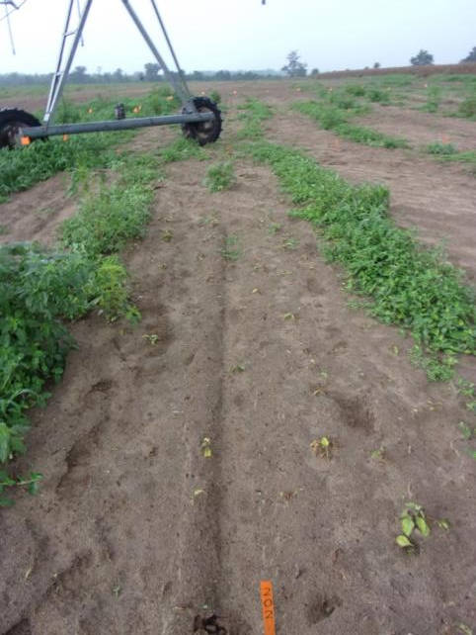
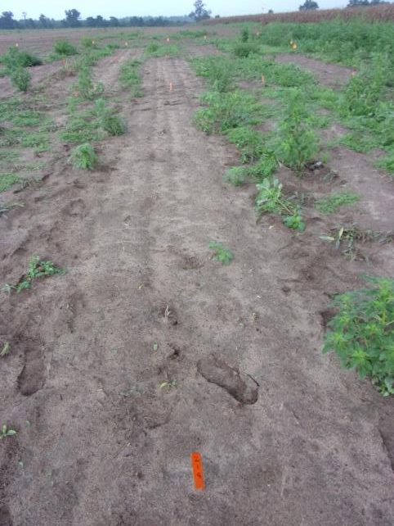
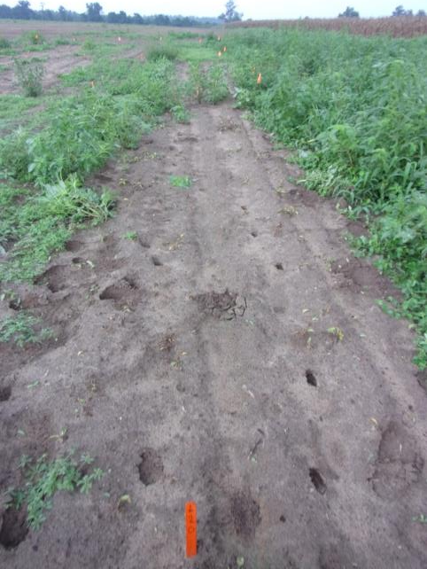
Tropical Spiderwort - 2022
Roundup PowerMax3 5.88SL @ 25 oz/A
Pursuit 2SL @ 4 oz/A
Roundup PowerMax3 5.88SL @ 25 oz/A
Classic 25DG @ 0.5 oz/A
Roundup PowerMax3 5.88SL @ 25 oz/A
FirstRate 84WG @ 0.3 oz/A
TSW-01-22
August 17
22 DAT

Slide 20
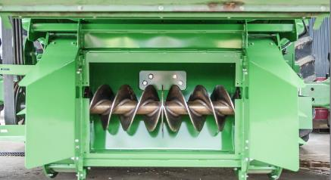
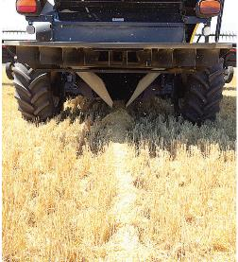
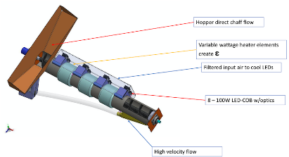
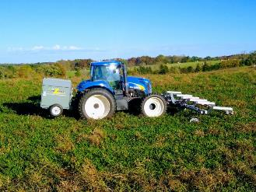
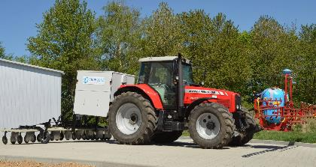
Other Options??? (Seedbank Mgt.)
Seed Mills
Integrated Harrington Seed Destructor
~$55,000
Redekop Seed Control
~$70,000
Chaff Lining
$5000-$6,000
Blue LED Light
Weed Seed Destroyer
heat + blue light
$30,000
Weed Zapper
$69,000-$89,000
Crop Zone
Electrophysical weeder + Volt.fuel
Cost???????

Slide 21
Double-Cropped Soybean Behind Field Corn
What herbicides are safe?
Roundup, Liberty, Group 15’s, Atrazine (?)
What about the HPPD herbicides?
Callisto = 10 months
Impact = 9 months
Laudis = 8 months
Shieldex = 9 months
What about south Georgia?
Irrigation, sandier soils, low OM
less carryover potential (?)

Slide 22
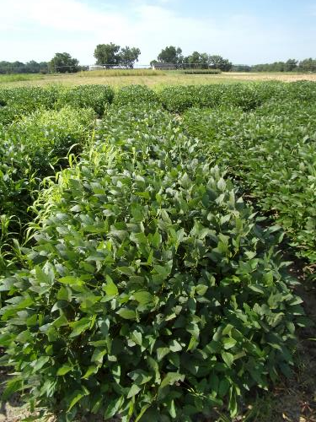
HPPD/Soybean Test - 2023 Planted 92 DAT
SB-03-23
September 7
67 DAP

Slide 23
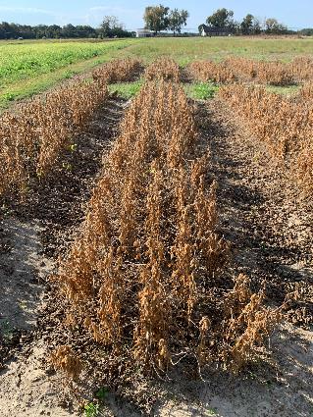
HPPD/Soybean Test - 2023 Planted 92 DAT
SB-03-23
October 31

Slide 24
Soybean Yield Response to HPPD Herbicides Applied 92 DBP* - 2023
LSD 0.10 = 9.8
-30%
-68%
SB-03-23
Asgrow AG66XF2
PD: July 3
7.5” rows

Slide 25
Questions/Comments

Slide 26
Weed Control in Grain Sorghum – 2024
Eric P. Prostko Extension Weed Specialist
Seth McAllister, Terrell Co. (October 2022)

Slide 27
Grain Sorghum Weed Control
Start clean!
Concep treated seed
Dual Magnum or Outlook or Warrant (PRE)
Atrazine 4L @ 1.5 QT/A (EPOST)
Add Huskie if you have ATZ resistance
Paraquat (Hooded sprayer)
Mechanical Cultivation

Slide 28
A New (er) Product to Consider?
Huskie 2.06EC
Bayer CropScience
Buctril (1.75 lbs/gal) + pyrasulfotole (0.31 lbs/gal)
MOA = 6 + 27
Postemergence (13-16 oz/A)
3-leaf to 12” tall sorghum
Broadleaf weeds, good on pigweed
Tank-mix with atrazine (16 oz/A)
Huskie FX = Huskie + Starane

Slide 29
Grain Sorghum Weed Control - 2021
Warrant @ 48 oz/A
Atrazine @ 16 oz/A
Huskie @ 16 oz/A
Induce @ 0.25% v/v
AMS @ 5% v/v
Applied 19 DAP
NTC
GS-04-21
July 16
58 DAP

Slide 30
Huskie Injury on Sorghum

Slide 31
Texas Panicum in Grain Sorghum
Terrell Co.
08/05/22

Slide 32
New Grain Sorghum Weed Control Technologies (Non-GMO)
Igrowth®
Alta/UPL
ImiFlex (imazamox)
PRE/POST
DoubleTeam™
S&W/Sorghum Partners/ADAMA
FirstAct (quizalofop)
POST
Inzen™
Pioneer/Corteva
Zest (nicosulfuron)
POST

Slide 33
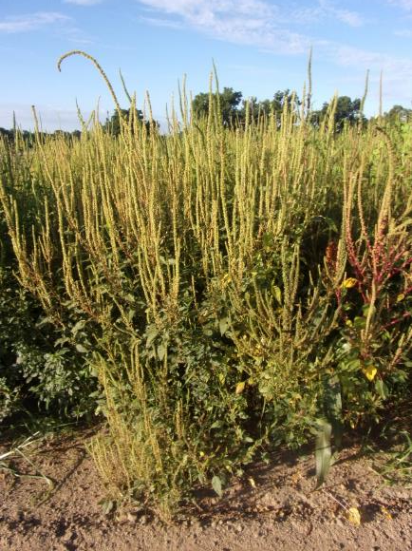
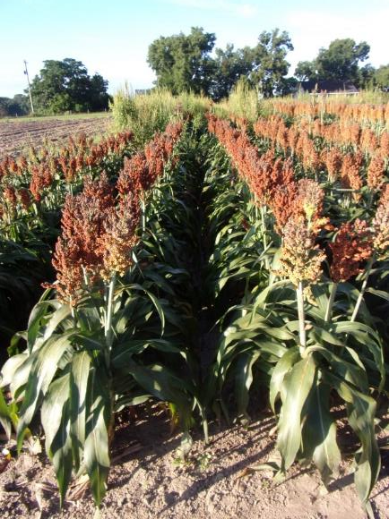
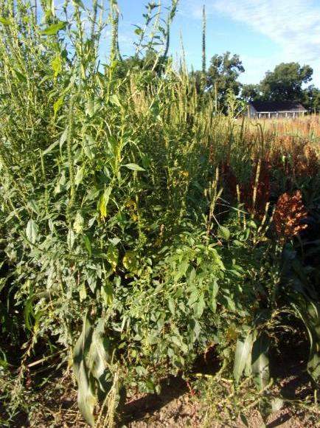
Grain Sorghum Weed Control – 2022 I-Growth
NTC
Mocassin II Plus 7.64EC @ 21 oz/A (PRE)
fb
Imiflex 1AS @ 6 oz/A
Agridex @ 1% v/v
POST (V7, 9-10” tall, 22 DAP)
Imiflex 1AS @ 4 oz/A
Agridex @ 1% v/v
EPOST (V3, 4” tall, 14 DAP)
GS-01-22
August 1
69 DAT (POST)/77 DAT (EPOST)

Slide 34
Igrowth Grain Sorghum Hybrids

Slide 35
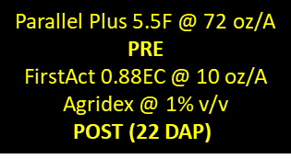
DoubleTeam Sorghum - 2022
NTC
GS-01-22
August 1
69 DAT (POST)

Slide 36
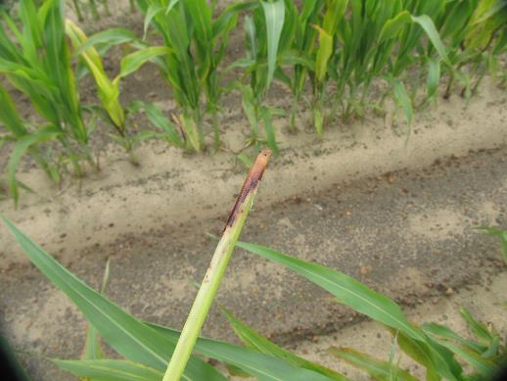
DoubleTeam™ System – First Act Off-Types
GS-02-21
June 23
9 DAT

Slide 37
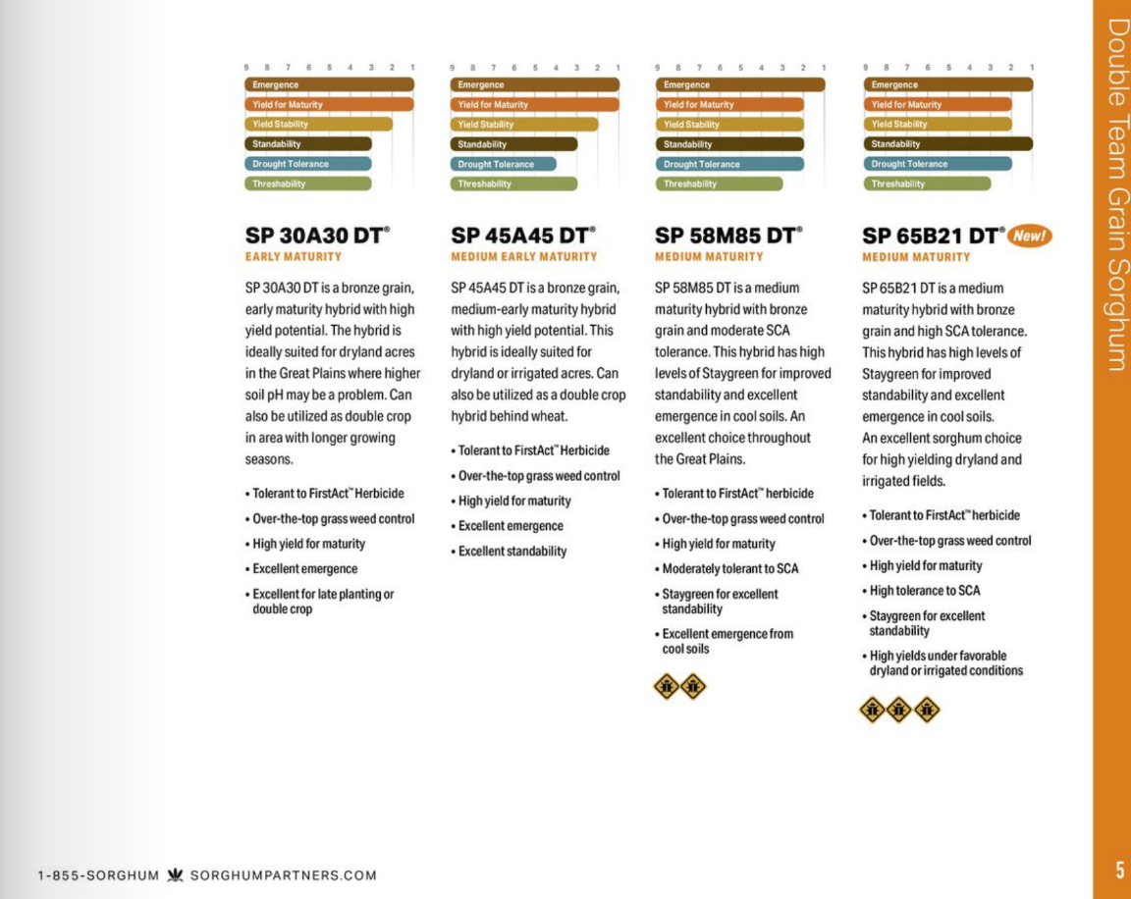
DoubleTeam Sorghum Hybrids
Disease/lodging issues in 2023?

Slide 38
Inzen Grain Sorghum - 2022
NTC
Everprex 7.62EC @ 16 oz/A (PRE) fb
Zest 75DG @ 0.67 oz/A +
Aatrex 4L @ 48 oz/A + Agridex @ 1% v/v
(POST)
GS-01-22
August 1
69 DAT (POST)

Slide 39
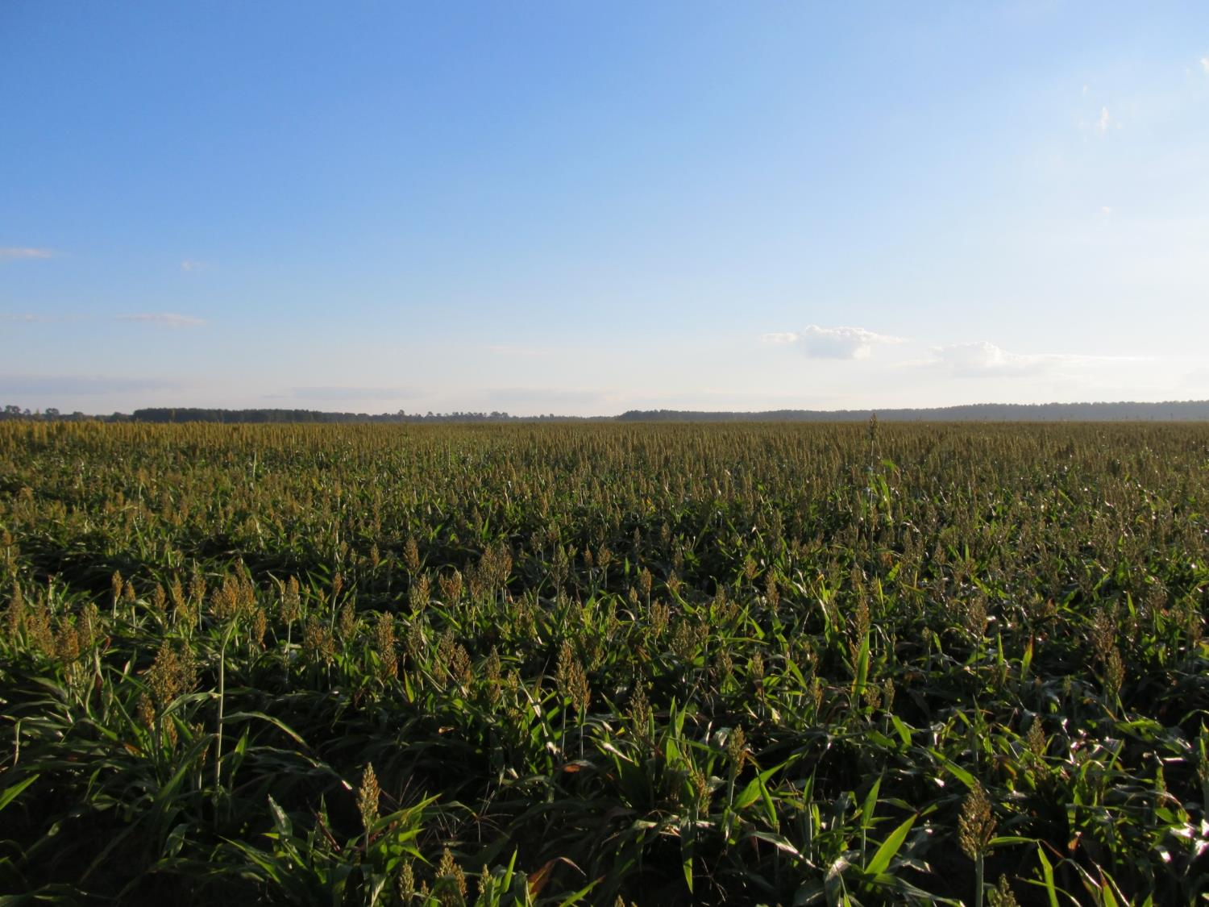
Questions/Comments?
eprostko@uga.edu
gaweed.com

