Slide 1
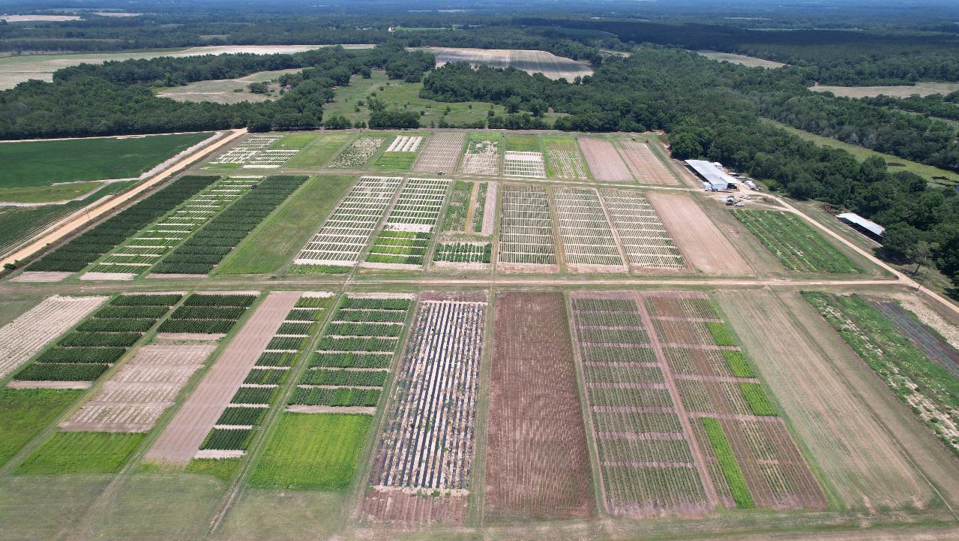
Brake (fluridone) Application Timing in Peanut & Peanut Response to Milestone (aminopyralid) Nicholas Shay/Dr. Eric Prostko UGA Weed Science Update for County Extension Agents December 6, 2023

Slide 2
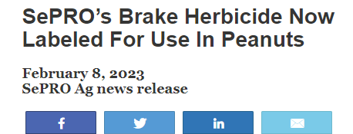
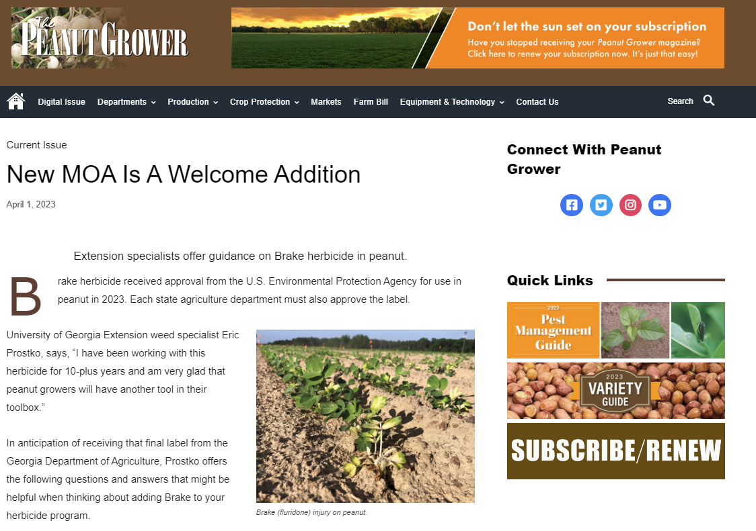
Introduction:
Brake® registration 2023
Notes:
The development of new herbicides for peanut is needed but also infrequent. Good news for peanut producers is that fluridone sold under the trade name Brake was registered for use in peanuts.

Slide 3
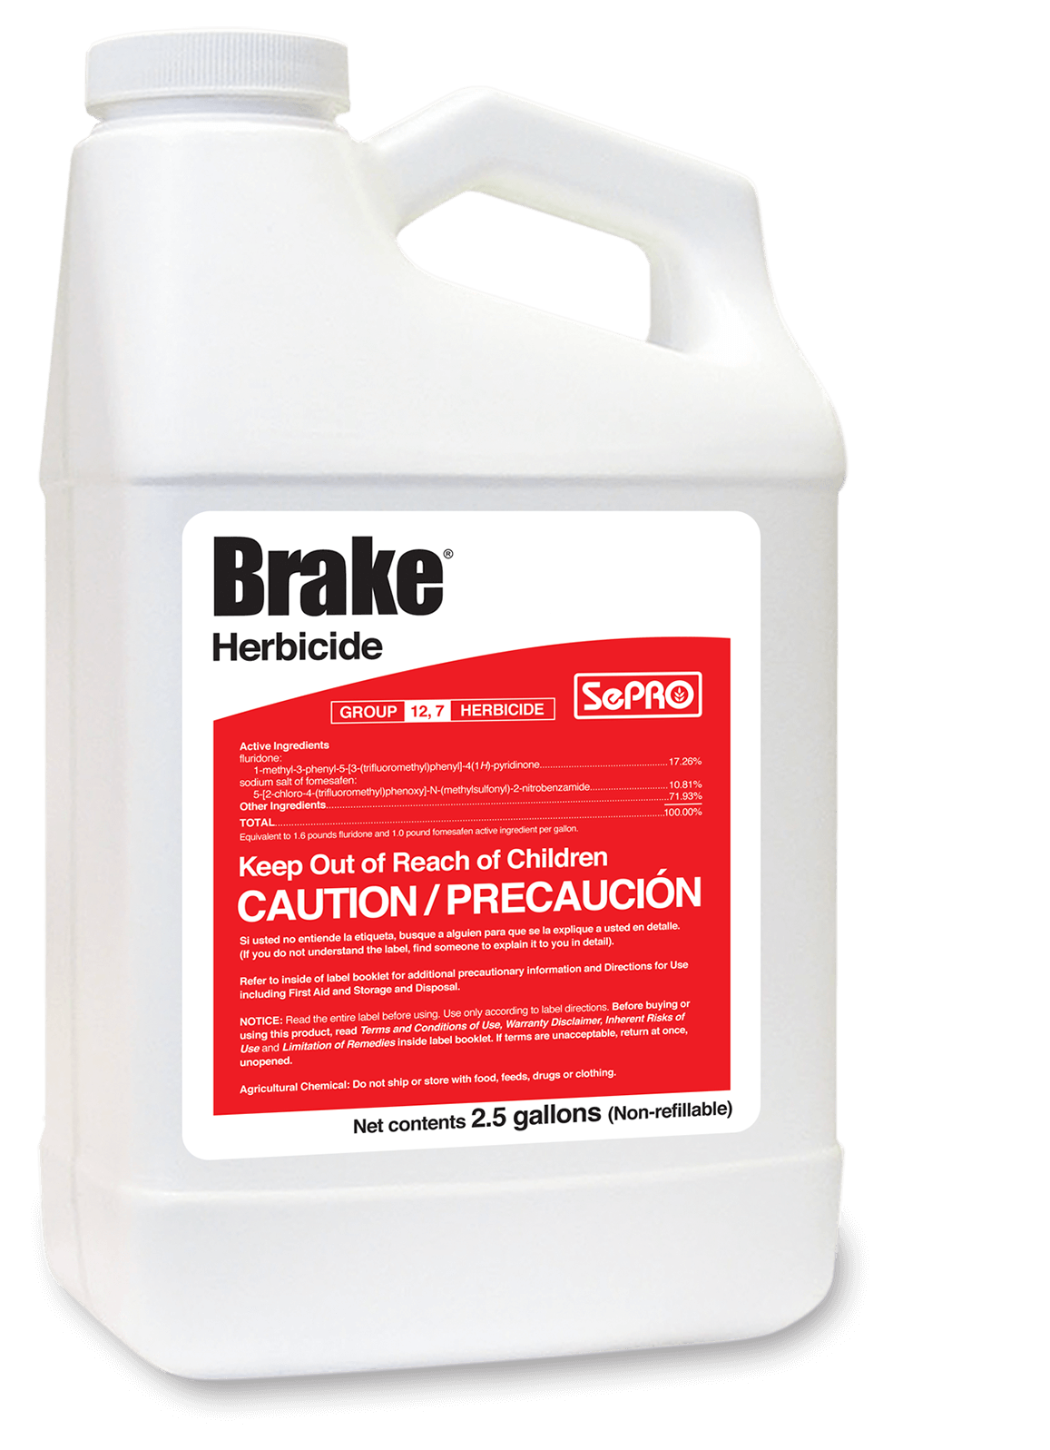
Introduction:
Brake®
Fluridone
WSSA Group # 12
Phytoene Desaturase Inhibitor
Application method: PRE
“Apply behind the planter (i.e. at planting) or within 36 hours after planting.”

Slide 4
Objective
Evaluate peanut response to delayed timings of Brake.

Slide 5
Methods:
Experimental Design
Experimental Period: 2022 – 2023
Location: Ponder Farm; Ty Ty, GA
Dothan/Tifton sand
Peanut variety:
GA-06G
RCB design; 4 replications
Treatments:
NTC
Brake® 1.2SL @ 12 oz/A
Timing: 1, 3, 5, 7 DAP
Data analyzed in SAS 9.4 (Cary, NC)
PROC GLIMMIX
Tukey-HSD (P = 0.10)
Pairwise comparison
Notes:
202,622 seeds / ha

Slide 6
Brake Timing - 2022
1 DAP
3 DAP
5 DAP
7 DAP*
PE-16B-22
GA-06G
*7 DAP: GROUND CRACKING; SOME GREEN PLANT TISSUE EXPOSED (20-25%); 1" GREEN ABOVE SOIL SURFACE; ROOT=2";
HYPOCOTYL=1.25'; EPICOTYL=0.5

Slide 7
Brake Timing Study - 2023
1 DAP (~20 HAP)
3 DAP
5 DAP
7 DAP*
PE-09-23
GA-06G
*7 DAP: 50% GROUND CRACKING; 2/20 PLANTS WERE 0.25" ABOVE GROUND; ROOT=2"; HYPOCOTYL=1"; EPICOTYL=0.25";
COTYLEDONS SPLIT; 90+% BELOW GROUND.

Slide 8
Results

Slide 9
Results:
Peanut stand 13 DAP following Brake @ 1, 3, 5, 7 DAP (2022-2023)
P = 0.68
*Columns with letter separation are significantly different at (P < 0.1)

Slide 10
Results:
Peanut stunting 13 DAP following Brake @ 1, 3, 5, 7 DAP (2022-2023)
P = 0.01
*Columns with letter separation are significantly different at (P < 0.1)

Slide 11
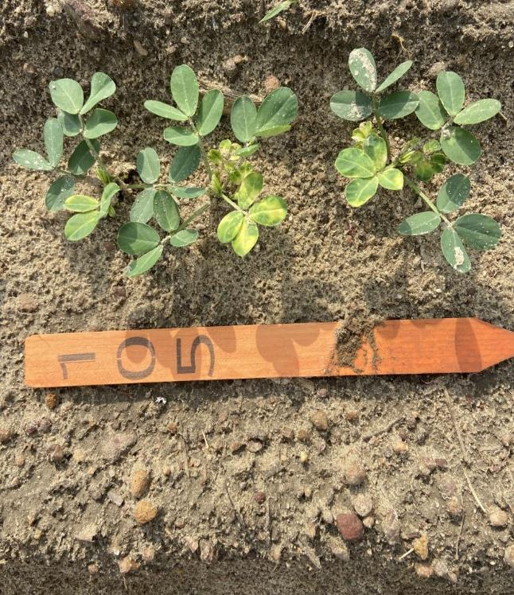
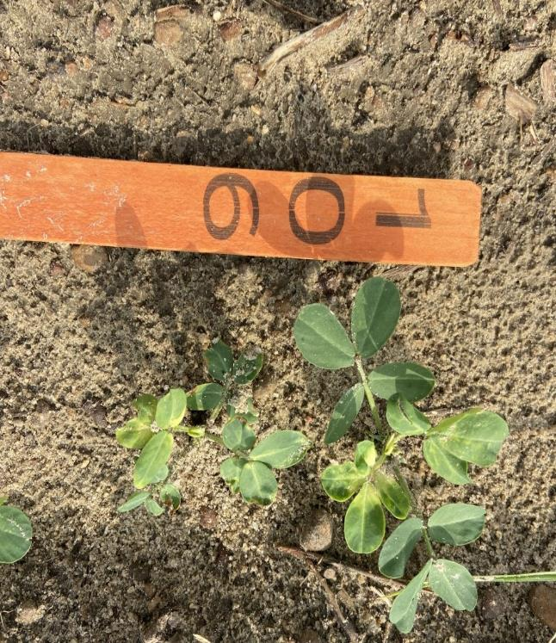
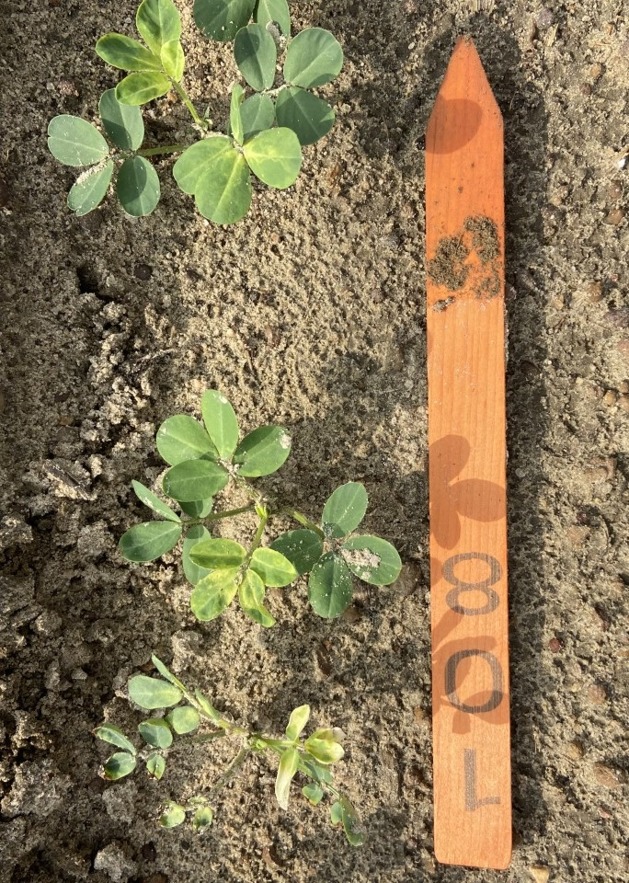
Results:
Brake
1 DAP
3 DAP
7 DAP
13 DAP; May 15, 2023

Slide 12
Results:
Peanut height 30 DAP following Brake @ 1, 3, 5, 7 DAP (2022-2023)
P = 0.62
*Columns with letter separation are significantly different at (P < 0.1)

Slide 13
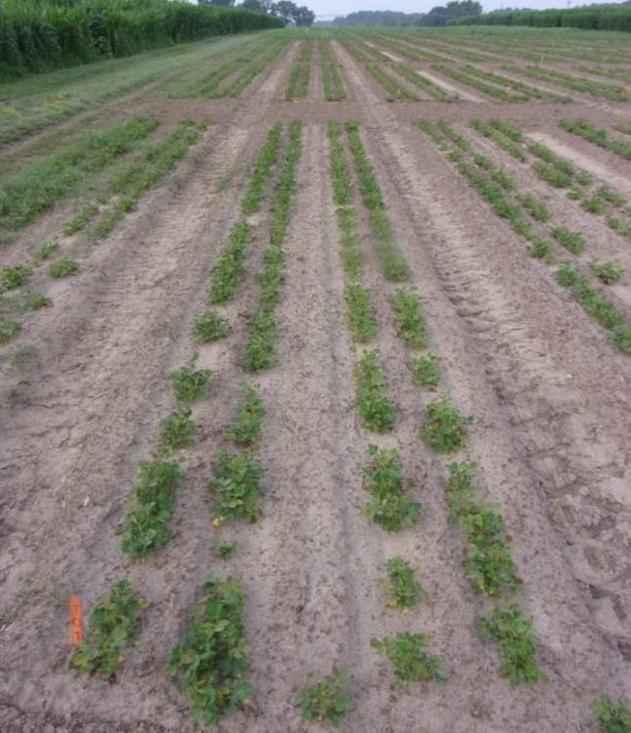
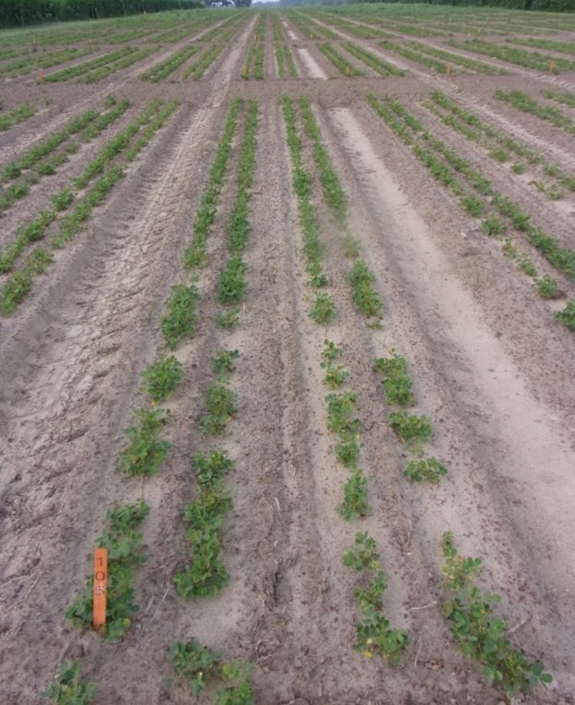
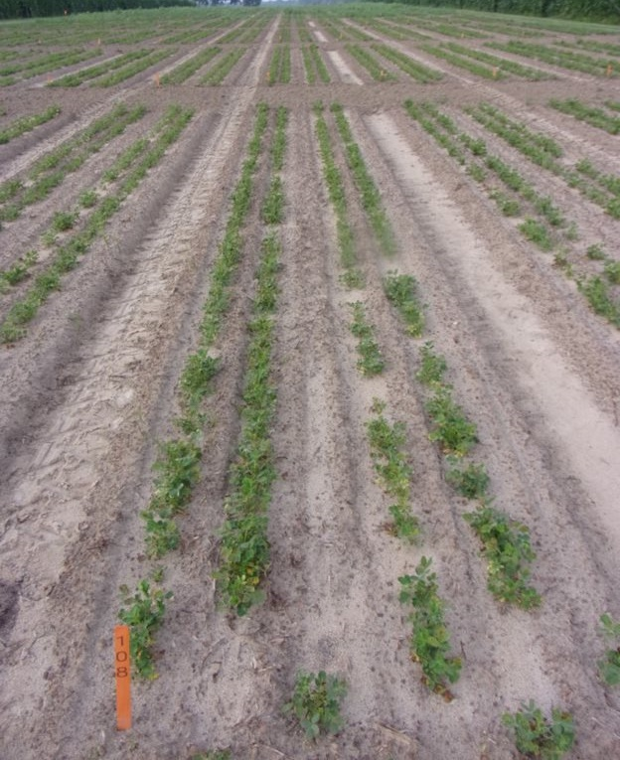
Results:
Brake
NTC
1 DAP
7 DAP
30 DAP; May 31, 2023

Slide 14
Results:
Peanut yield following Brake at 1, 3, 5, 7 DAP (2022-2023)
P = 0.74
*Columns with letter separation are significantly different at (P < 0.1)

Slide 15
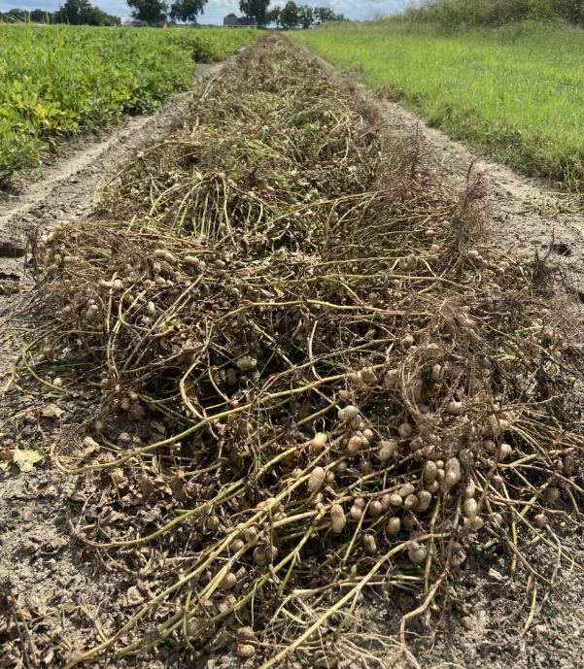
Summary/Conclusions:
No effect on peanut density
Increased visual injury with delayed applications
No effect on peanut plant height
No effect on yield.
Overall Takeaways:
1) Peanuts were tolerant of applications of Brake up to 7 DAP without negatively impacting yield.
2) Increase window of application? READ/FOLLOW THE LABEL
Repeating study in 2024!

Slide 16
Peanut Response to Milestone (aminopyralid)

Slide 17
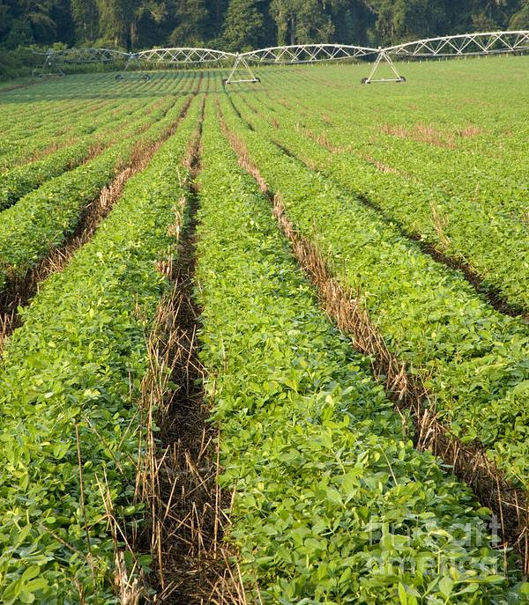
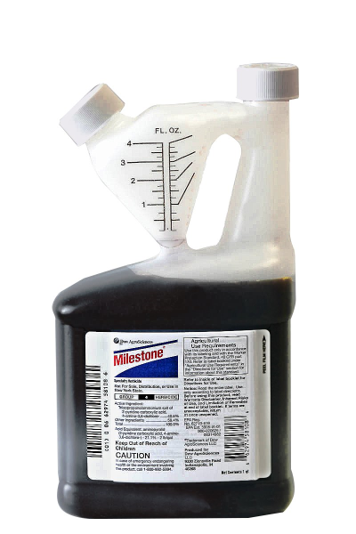
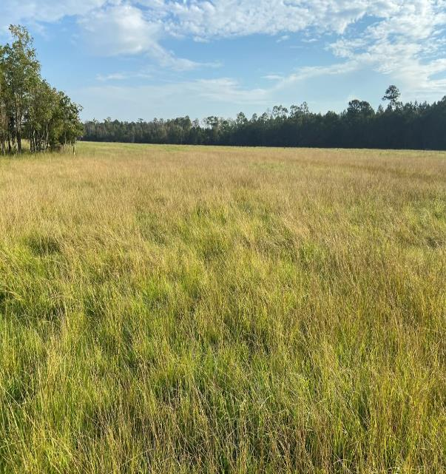
Introduction:
MILESTONE®
Aminopyralid
WSSA Group 4 – Auxin
Family: Pyridine Carboxylate
Trade names: Milestone, GrazonNext, Chaparral DF
Pre/Postemergence
Mostly foliar applications
Horsenettle, Tropical Soda Apple
Uses: pastures, right-of-way, rangelands, CRP
Advantages: soil residual activity
Restrictions:
Animal/manure management
Hay distribution 18 months
Crop rotations 1 (corn); 2-3 (BL crops) years
6-74 day ½ life
Notes:
DOW AGRISCIENCES - Aminopyralid – WSSA Group 4 - pyridine carboxylic acid - pre and postemergence in pastures systems with tolerance to both cool and warm season grasses.
Controls annual, biennial, and perennial broadleaf species
Offers soil residual activity
Low use rates = 3 – 7 oz ac
Restrictions:
Do not distribute hay/straw off of farm prior to 18 months
Manure must be > 3 days post consumed treated forage
Avoid non-target uses (drift) within 50 feet of application to susceptible crops
Label recommendations:
Crop Rotation: Do not rotate to any crop from rangeland, permanent pasture, or CRP acres within one year following treatment. Cereals and corn can be planted one year after treatment. Broadleaf crops are sensitive to aminopyralid residues in the soil and prediction of crop safety by field bioassay (see instructions below) is the BEST way to determine planting options. Broadleaf crops such as canola, flax, and alfalfa can require at least 2 to 3 years depending on the crop and environmental conditions. More sensitive crops such as soybeans, tobacco, peanuts, potatoes, and peas may require a longer plant-back interval and should not be planted until a field bioassay shows that the level of aminopyralid present in the soil will not adversely affect that broadleaf crop.

Slide 18
Objective
Evaluate peanut responses to applications of Milestone (aminopyralid).

Slide 19
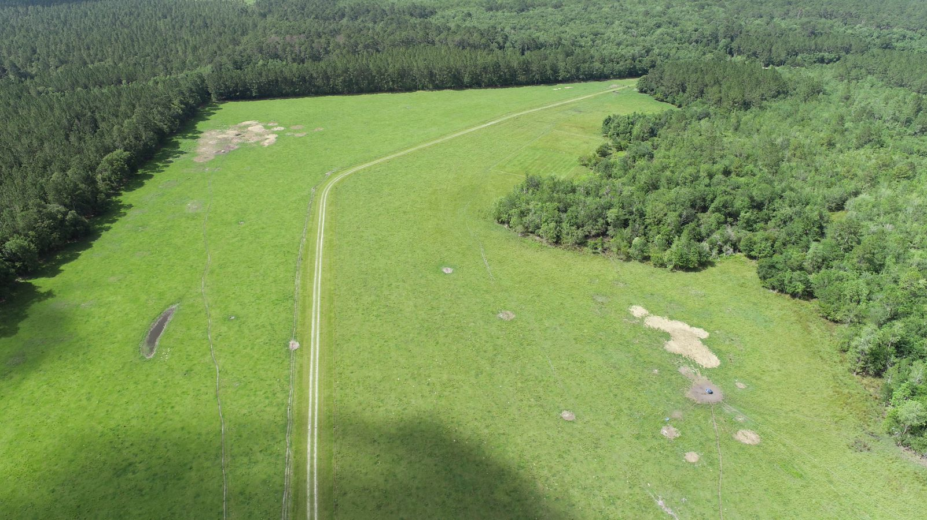
Methods:
Experimental Design
Experimental Period: 2023-2024
Location: Ponder Farm, Ty Ty, GA
RCB design: 3 replications
5x4 factorial arrangement
20 treatments
60 plots
2 m x 7.62 m plots
Treatments:
Milestone 3LC
1x rate: 7 oz/A
NTC, 1x, 1/5X, 1/10X, 1/100X
Timing: PRE, 30, 60 - DAP
In-season data collection:
Plant density / 5ft
% stunting
% leaf curl
% necrosis
% epinasty
Plant height & width
Yield

Slide 20
Results:
Peanut visual injury ratings 2 WAT from Milestone in TyTy, Georgia, 2023.
*Columns with letter separation are significantly different at (P < 0.1)
P = 0.03

Slide 21
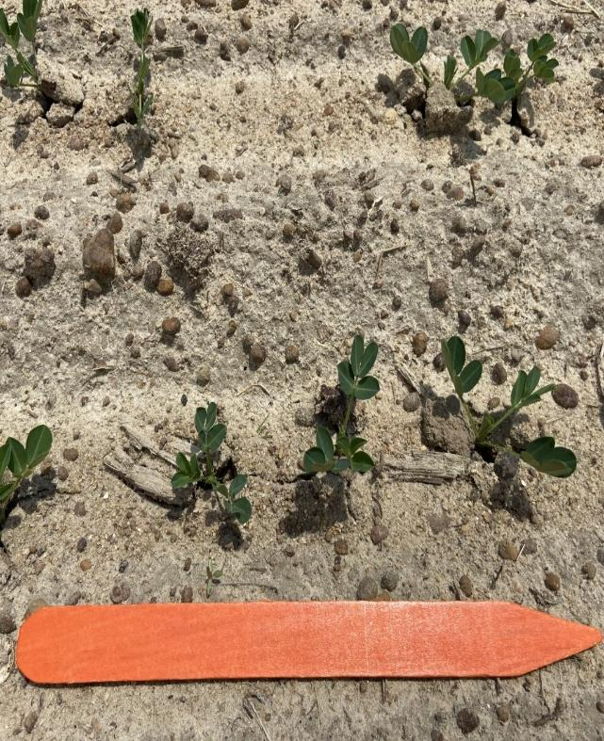
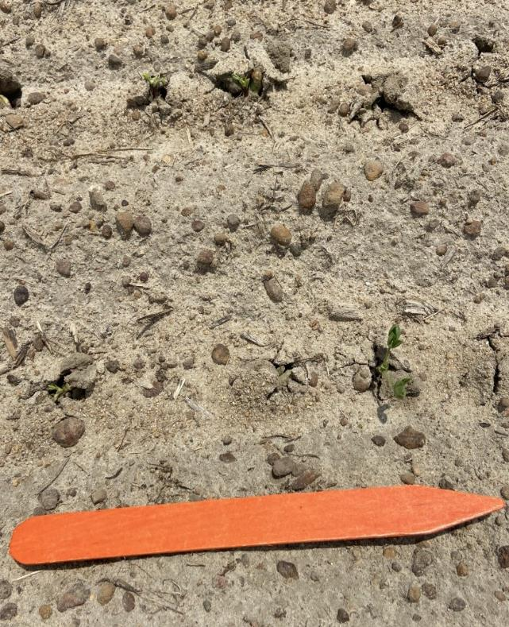
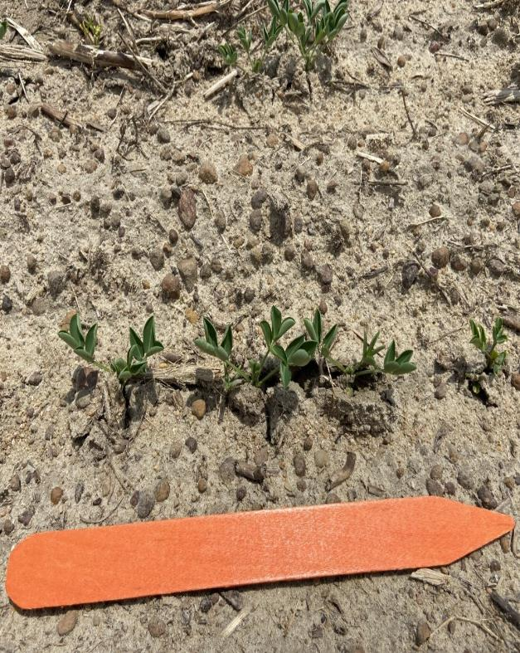
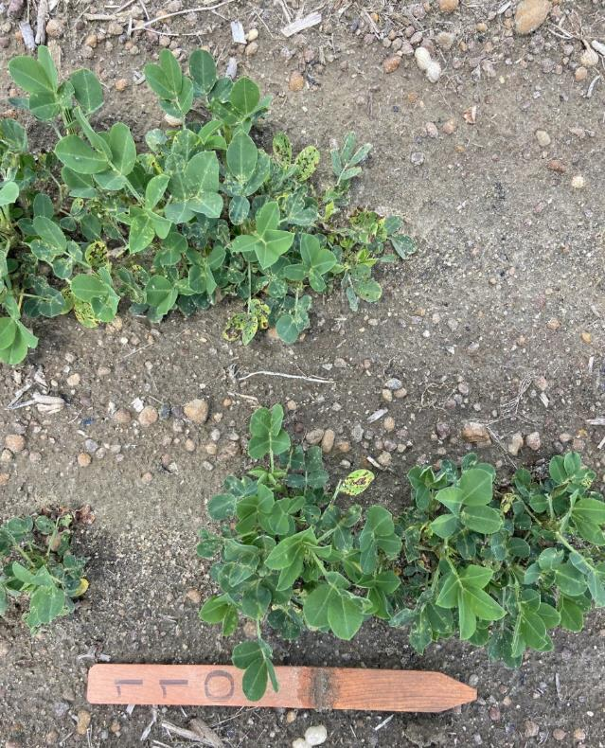
Results:
Visual peanut injury from PRE treatment
NTC
1X
1/100X
14 DAT; May 9, 2023

Slide 22
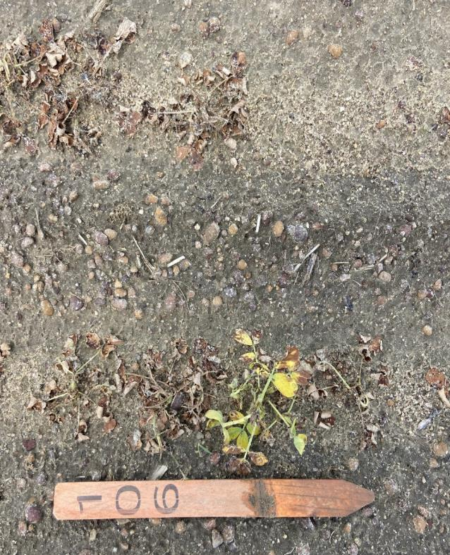
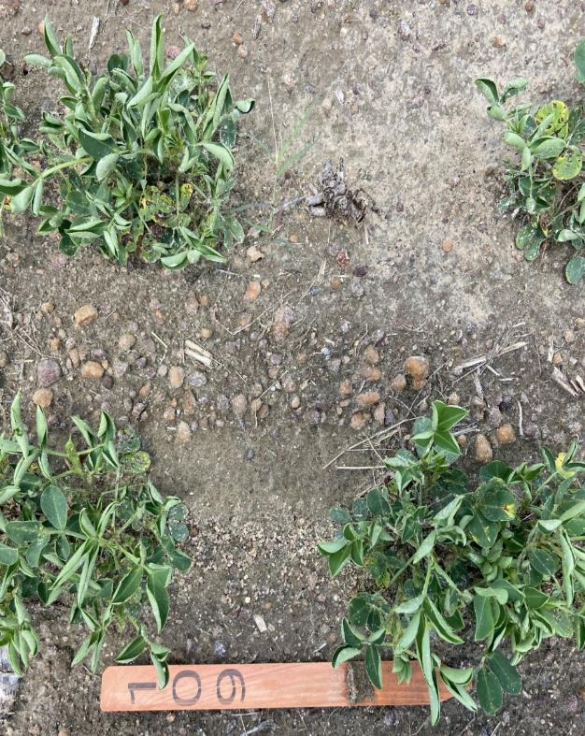
Results:
Visual peanut injury from 30 DAP
NTC
1X
1/100X
14 DAT, 30DAP; June 7, 2023

Slide 23
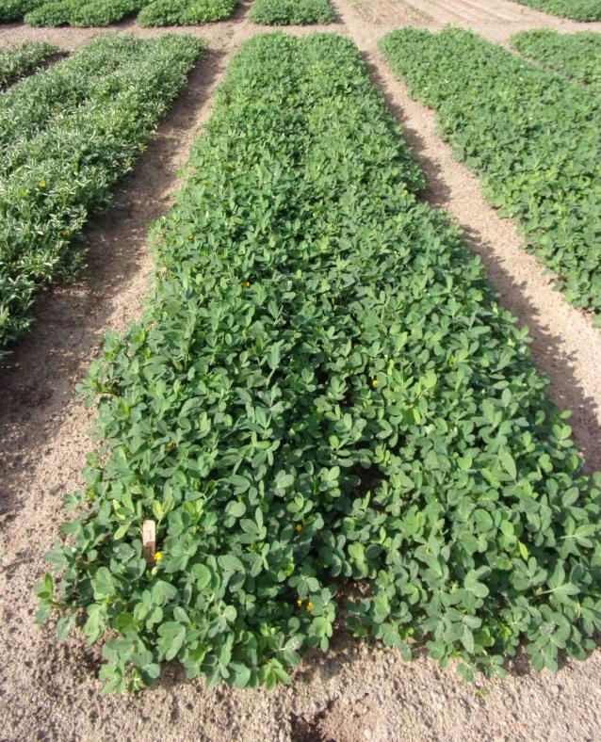
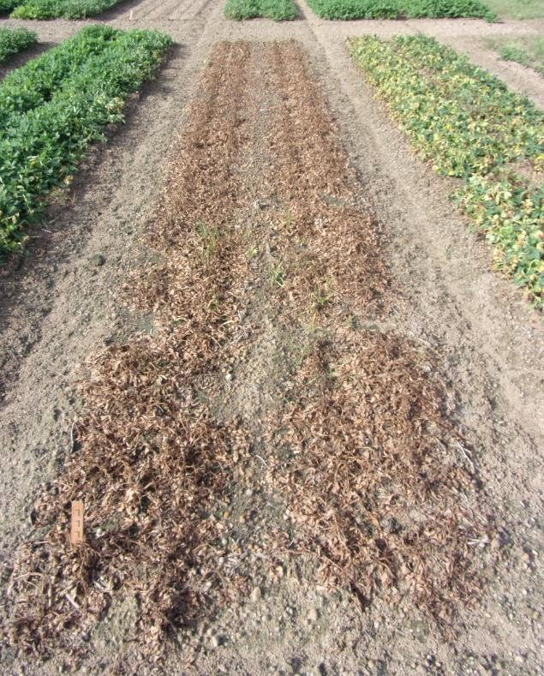
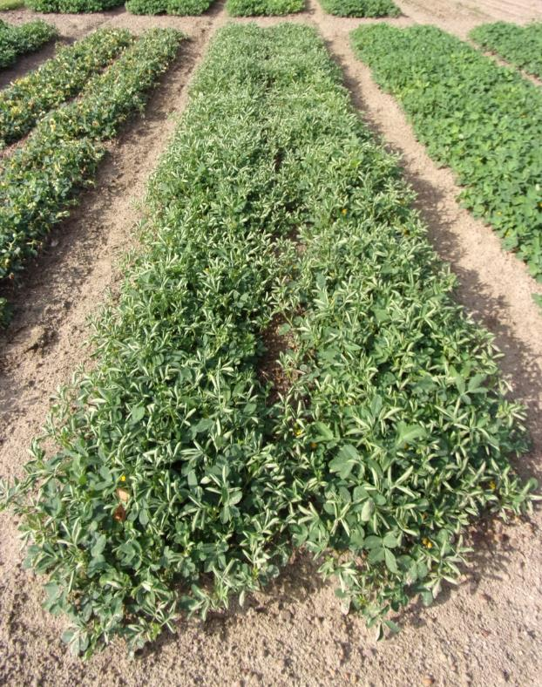
Results:
Visual peanut injury from 60 DAP
NTC
1X
1/100X
14 DAT, 60 DAP; July 5, 2023

Slide 24
Results:
Peanut plant height at 98 DAP from Milestone in TyTy, Georgia, 2023.
a
e
c
d
b
*Columns with letter separation are significantly different at (P < 0.1)
P < 0.001

Slide 25
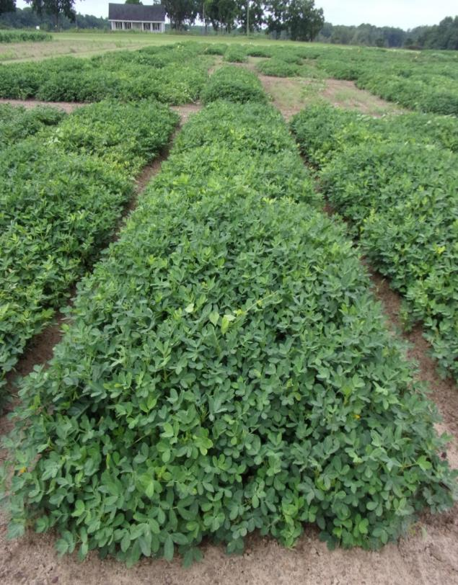
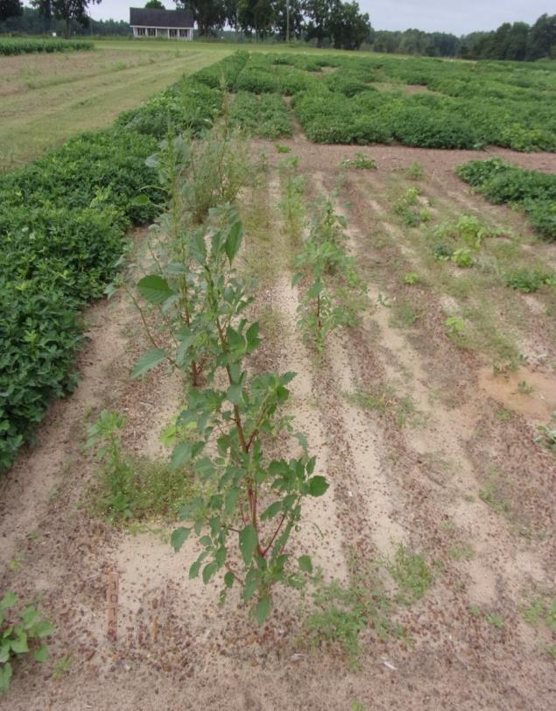
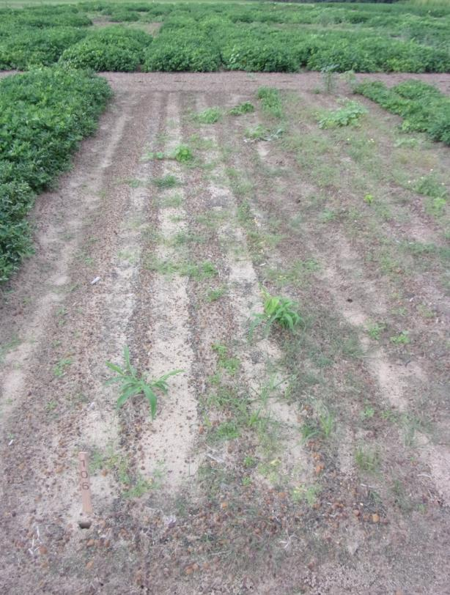
Results:
Peanut plant height at 98 DAP in TyTy, Georgia, 2023.
NTC
PRE; 1X
30 DAP; 1X
Aug. 11, 2023

Slide 26
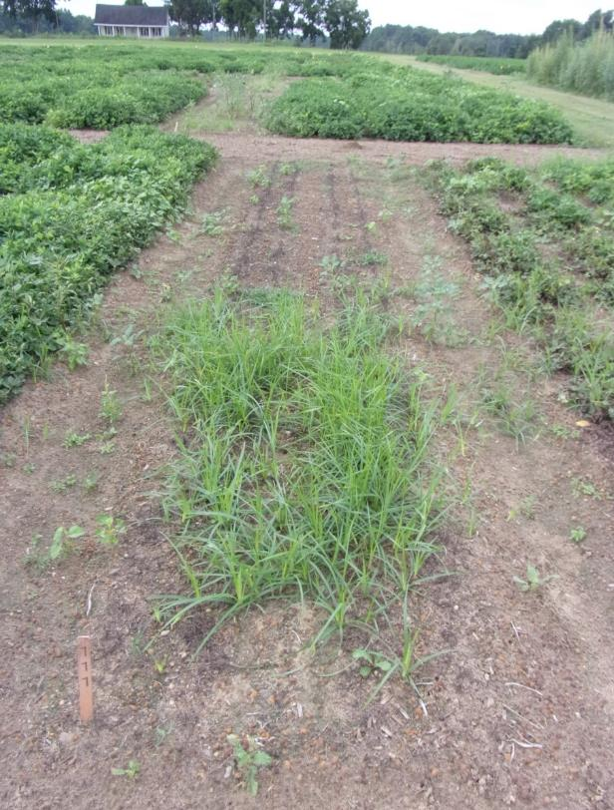
Results:
Peanut plant height at 98 DAP in TyTy, Georgia, 2023.
NTC
PRE; 1X
60 DAP; 1X
Aug. 11, 2023

Slide 27
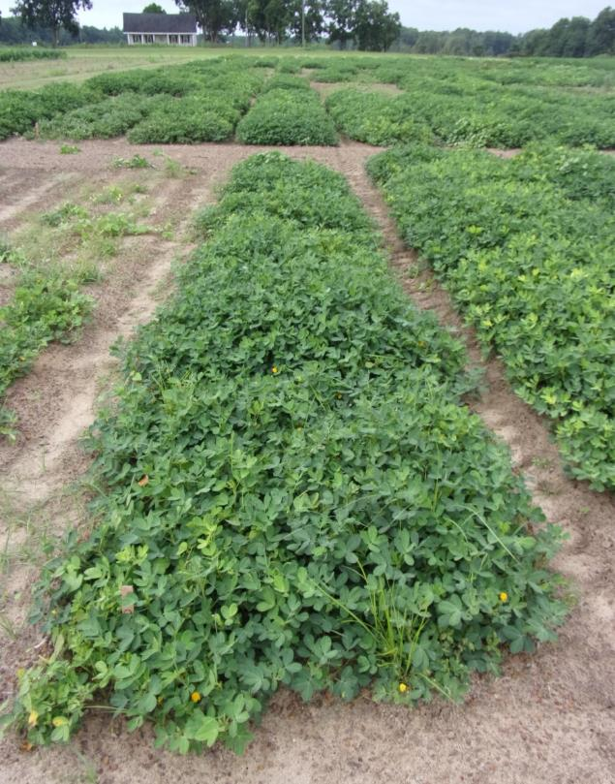
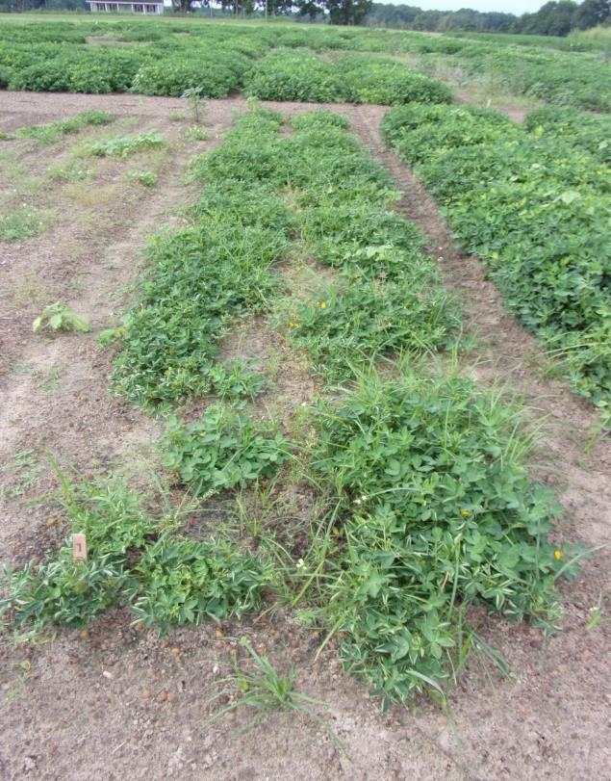
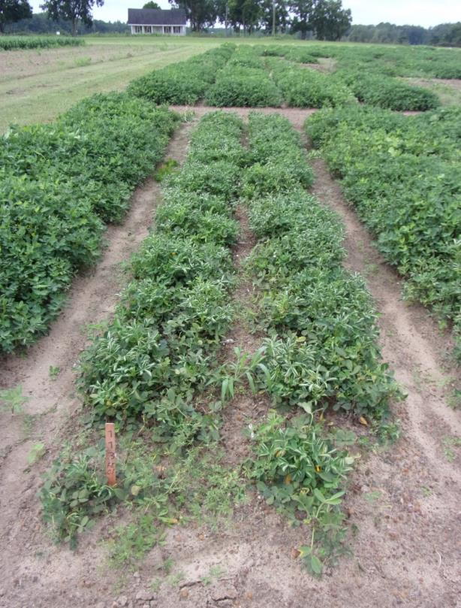
Results:
Peanut plant height at 98 DAP in TyTy, Georgia, 2023.
PRE; 1/5X
30 DAP; 1/10X
60 DAP; 1/10X
Aug. 11, 2023

Slide 28
Results:
Peanut yield response to Milestone in TyTy, Georgia, 2023.
a
b
c
d
d
*Columns with letter separation are significantly different at (P < 0.1)
P < 0.001

Slide 29
Summary/Conclusions
Stunting:
1X rate: Significant injury (70 – 99%) all timings
60 > PRE > 30
1/5X rate (27-43%)
1/10X rate (18-37%)
1/100X rate (<15%)
Height:
All heights were significantly reduced from NTC
1X: 100%
1/5X: 71%
1/10X: 53%
1/100X: 12%
Yield:
All trt significantly reduced yield from NTC
1X: 100%
1/5X: 93%
1/10X: 73%
1/100X: 16%
6+ ½ lives (~444 days)
Repeat study in 2024!

Slide 30
Current Milestone Label: Real Deal!
Crop Rotation: Do not rotate to any crop from rangeland, permanent pasture, or CRP acres within one year following treatment. Cereals and corn can be planted one year after treatment. Broadleaf crops are sensitive to aminopyralid residues in the soil and prediction of crop safety by field bioassay (see instructions below) is the BEST way to determine planting options. Broadleaf crops such as canola, flax, and alfalfa can require at least 2 to 3 years depending on the crop and environmental conditions. More sensitive crops such as soybeans, tobacco, peanuts, potatoes, and peas may require a longer plant-back interval and should not be planted until a field bioassay shows that the level of aminopyralid present in the soil will not adversely affect that broadleaf crop.

Slide 31
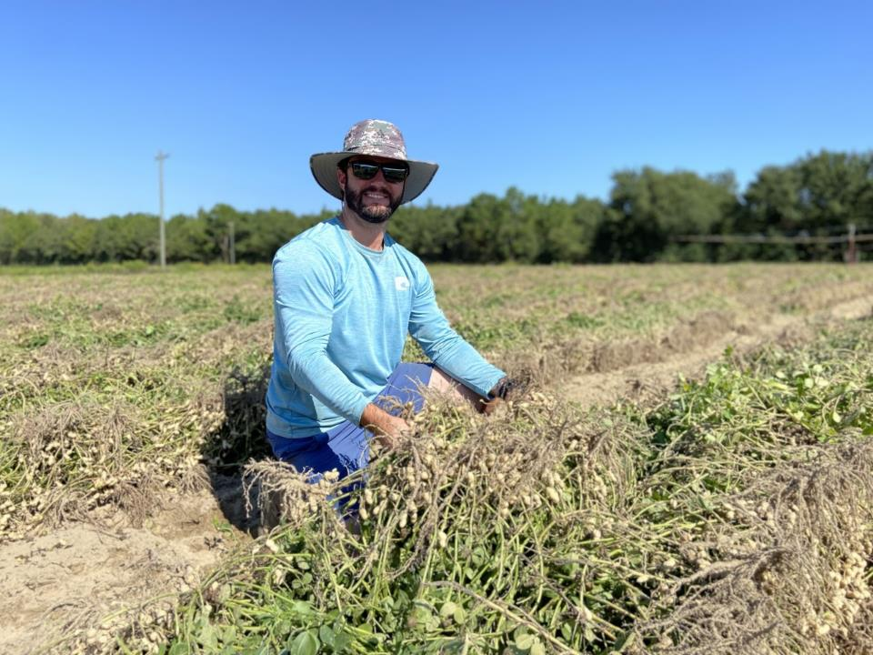
Thank you. Questions?
nicholas.shay@uga.edu

