Slide 1
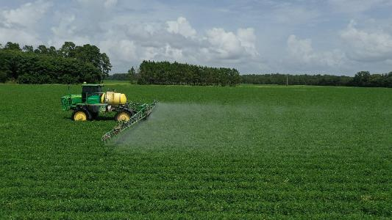
2023 Common Problems Survey of Southern Row Crop Extension Weed Specialists
Eric P. Prostko
Professor/Extension Weed Specialist
Dept. Crop & Soil Sciences
University of Georgia
SWSS/WSSA Joint Annual Meeting – 2024
San Antonio, TX

Slide 2
Special Thanks to……
Alabama – Steve Li/David Russell
Arkansas – Tom Barber/Tommy Butts
Florida – Pratep Devkota
Georgia – Stanley Culpepper
Kentucky – Travis Legleiter
Louisiana – Dan Stephenson/Connor Webster
Missouri – Kevin Bradley
Mississippi – Jason Bond
North Carolina – Charlie Cahoon/Wes Everman
Oklahoma – Todd Baughman
South Carolina – Mike Marshall
Tennessee – Larry Steckel
Texas – Peter Dotray/Scott Nolte
Virginia – Mike Flessner/Vijay Singh

Slide 3
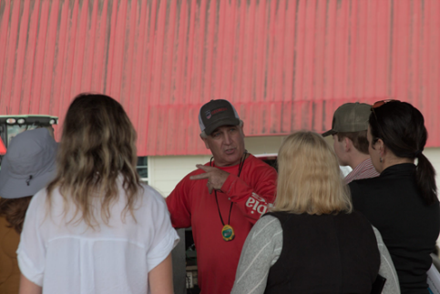
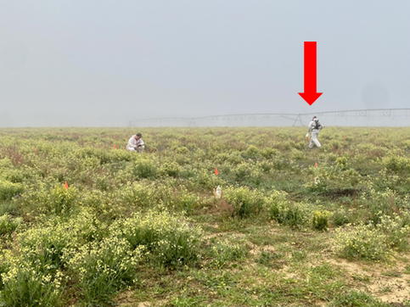
Current Day Extension Weed Specialist at UGA (95% Extension/5% Service)
Traditional
County Agent #1 Client
Grower Meetings
Newsletters, fact sheets, popular press articles
Trouble-shooting
Telephone
Modern
Applied Research (40-70 field trials)
Grad students/J-articles
Web-Page/Blog
E-mail/I-Phone (texts)
Pay for almost everything (grants)

Slide 4
2023 Common Problems Survey
April 2023
21 Southern Row Crop Extension Weed Specialists (14 States)
Asked to rank these specific 5 problems
Scale: 1 = most common to 5 = least common
off-target movement, sprayer contamination, mixing/jug errors, herbicide carryover look-alikes, true herbicide carryover

Slide 5
2023 Survey of Southern Row Crop Extension Weed Specialists Common Problems (1 = most common, 5 = least common)
N = 21
April 2023

Slide 6
Off-Target Movement
#1 for 57%

Slide 7
Off-Target Movement glyphosate + metsulfuron
Washington Co.
May 2023

Slide 8
Off-Target Movement glyphosate + carfentrazone
Miller Co.
August 2023
0.089 ppm glyphosate

Slide 9
Sprayer Contamination

Slide 10
Laurens Co. - 2023
Valor (flumioxazin) Sprayer Contamination
Photos: R. Joyce

Slide 11
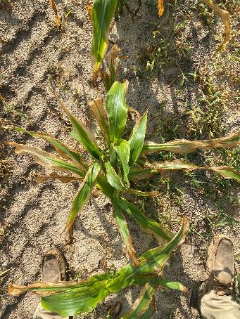
Tattnall Co. - 2023
Stine 9818-32N
Possible linuron sprayer contamination
Linex 4L @ 24 oz/A applied to V3-V4 (12”) tall field corn (P1197VYHR) caused a 22-32% yield reduction.
Richburg et al. 2020. Weed Technology 34:277-283.
2.3 ppm of linuron was detected in tissue sample
Photos: D. Bowen (May 2023)

Slide 12
Mixing/Jug Errors

Slide 13
Glyphosate/Peanut
*6.8 ppm
glyphosate
Detected
Jeff Davis Co.
July 2023

Slide 14
Jugs and Jugs?

Slide 15
Jugs and Jugs? (~$1 million mistake)

Slide 16
Herbicide Carryover Look-Alikes

Slide 17
Pierce Co. - 2023
pH = 5.0; P was very high; K, Mg, Ca were all low

Slide 18
Macon Co. - March 2023
Nematodes
Root-knot = 100-140
100 is threshold
Stubby = 170-200
40 is threshold
Lesion = 50-210
200 or more is threshold
K. Brown (GreenPoint AG)

Slide 19
True Herbicide Carryover
#5 for 57%

Slide 20
Imazethapyr (Newpath) Carryover to Provisia or Conventional Rice
Source: C. Webster – LSU (Oct 2023)

Slide 21
Imazapic (Cadre) Carryover to Cotton

Slide 22
Picloram (Grazon P+D) Carryover to Peanut

Slide 23
Specialists with Same Rankings
Li/Bradley
Barber/Legleiter/Bond
Prostko/Stephenson
Cahoon/Baughman

Slide 24
Generally, all of these problems are self-inflicted and could be minimized!
Off-Target Movement
nozzles, pressure, MPH, GPA, boom height, DRA’s, formulation, situational awareness
Sprayer Contamination
proper cleaning (label), hose type (rubber or polyethylene), separate sprayers
Mixing/Jug Errors
Non-labeled jugs, head in tank, color coded jugs/labels?, no assumptions
Carryover Look-Alikes
soil test, nematode test, grid-sampling is not absolute
True Herbicide Carryover
follow labeled crop rotation restrictions, local experts/experience, sprayer calibration, overlap

Slide 25
Special Thanks to……
Alabama – Steve Li/David Russell
Arkansas – Tom Barber/Tommy Butts
Florida – Pratep Devkota
Georgia – Stanley Culpepper
Kentucky – Travis Legleiter
Louisiana – Dan Stephenson/Connor Webster
Missouri – Kevin Bradley
Mississippi – Jason Bond
North Carolina – Charlie Cahoon/Wes Everman
Oklahoma – Todd Baughman
South Carolina – Mike Marshall
Tennessee – Larry Steckel
Texas – Peter Dotray/Scott Nolte
Virginia – Mike Flessner/Vijay Singh

Slide 26
Questions/Comments
eprostko@uga.edu
www.gaweed.com
229-392-1034 (cell)

