Slide 1
2023 Soybean Weed Control Update
Eric P. Prostko
Professor and Extension Weed Specialist
Dept. Crop & Soil Sciences

Slide 2
Dicamba Drift or Aminopyralid Carryover? Pierce Co - 2022
Original
Replant

Slide 3
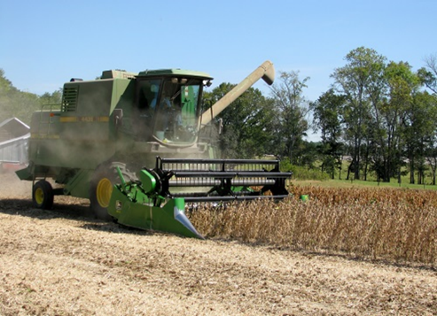
Soybean Weed Control Simplified
Start clean
Narrow rows (< 30”)
PRE
Metribuzin + Group 15 or Prowl
tolerant variety
Irrigation or rainfall
POST + Residual (weeds <3” tall)
Post = Reflex or Prefix or Warrant Ultra or Liberty or Dicamba (Engenia/Tavium/ Xtendimax) or Enlist One (2,4-D choline) or Enlist Duo (glyphosate + 2,4-D choline)
Residual = Anthem Flexx/Max or Dual or Warrant or Outlook or Zidua
Check tank-mix sites first

Slide 4
Metribuzin Products
Manufacturer | Trade Name | Active Ingredients
FMC | Authority MTZ | sulfentrazone + metribuzin
Syngenta | Boundary | s-metolachlor + metribuzin
Corteva | Canopy Canopy Blend | chlorimuron (10.7%) + metribuzin (64.3%) chlorimuron (8.3%) + metribuzin (50%)
NuFarm | Cloak | chlorimuron (10.7%) + metribuzin (64.3%)
Valent | Fierce MTZ | flumioxazin + pyroxasulfone + metribuzin
Loveland | Intimidator | s-metolachlor + fomesafen + metribuzin
NuFarm | Panther MTZ | flumioxazin + metribuzin
NuFarm | Panther Pro | flumioxazin + imazethapyr + metribuzin
Valent | Mauler | metribuzin
UPL | TriCor | metribuzin
Corteva | Trivence | flumioxazin + chlorimuron + metribuzin

Slide 5
Metribuzin in Soybeans - 2022
NTC
(~40-50 AMAPA/ft²)
Tricor 4F
8 oz/A
PRE
SB-01-22
April 26
12 DAT

Slide 6
Valor in GA Soybeans?
Effective, legal and labeled but…….
Valor fb Reflex/Prefix/Warrant Ultra is a good weed control program but a bad resistance mgt plan!
Unless you hand-weed escapes!
Weed control in cotton and peanut without Valor/Reflex?

Slide 7
PPO-Resistance in US
40 reported cases worldwide
26 reported cases in US
first identified in US in 2002
tall waterhemp (Illinois)
6 weed species (US)
tall waterhemp, Palmer amaranth, redroot pigweed, common ragweed, goosegrass, annual bluegrass
1 recently confirmed case in GA
Source: Heap, I. The International Herbicide-Resistant Weed Database. Online. Monday. October 17, 2022 . Available www.weedscience.org Copyright © 1993- 2022 WeedScience.org All rights reserved.

Slide 8
But would be OK with ……
PRE
Valor or
Envive (Valor + Classic + Harmony) or
Surveil (Valor + FirstRate) or
Fierce (Valor + Zidua)
POST
Roundup + Xtendimax/ Engenia + residual (Xtend System) or
Liberty + residual (Liberty-Link or XtendFlex System) or
Liberty + Enlist One + residual (Enlist System)

Slide 9
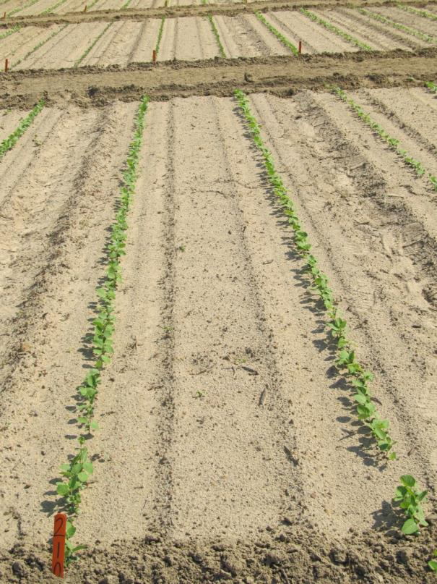
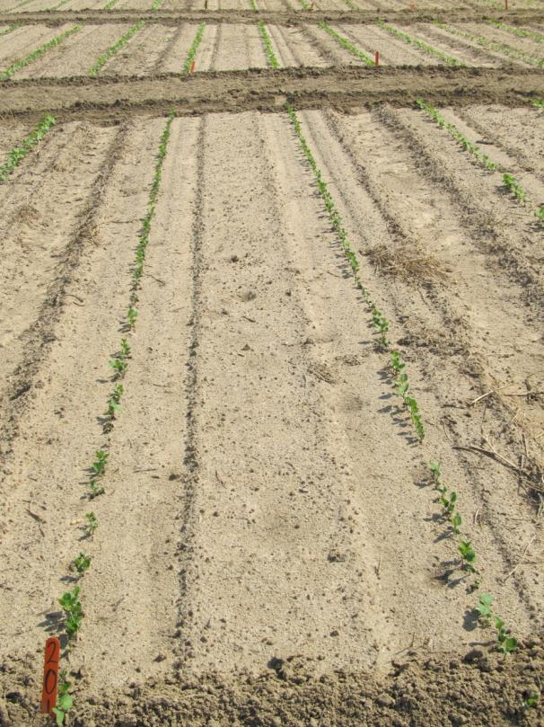
Soybean Injury Caused by Envive 41.3WG @ 3.5 oz/A 10 DAP
NTC
Envive
SB-21-11

Slide 10
“Old School” Conventional Systems

Slide 11
Weed Control in Conventional Soybeans
All depends upon the development and spread of PPO resistance (WSSA/HRAC MOA #14)!

Slide 12
Conventional Soybeans
PPO resistant weeds = SOL (really!)
Metribuzin – PRE
Prowl or Group 15’s
Reflex, Cobra, Ultra Blazer, Prefix, Warrant Ultra
Classic or FirstRate (sicklepod + MG)
STS® (1993) - single gene (non-GMO)
Bolt™ (2015) - 2 genes (non-GMO)

Slide 13
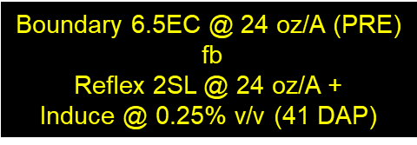
Soybean Weed Control Without New Technology - 2022
SB-01-22
August 1
110 DAP

Slide 14
Anthem Max, Dual, Warrant, Zidua, Outlook, Prowl????

Slide 15
Group 15’s - Residuals
NTC
Dual II Magnum 7.62EC
16 oz/A (PRE)
CN-04-21
April 18
21 DAT

Slide 16
PPO Injury on Soybean

Slide 17
Classic 25DG @ 0.67 oz/A + NIS Injury on Non-STS Soybeans
WT-01-21
July 19
6 DAT

Slide 18
tolerant to glyphosate, glufosinate, isoxaflutole (Alite™ 27)
Alite™ 27
NOT labeled for use GA
PPI or PRE
1.5-2.0 oz/A
No UGA-OVT variety data
I have conducted no research?

Slide 19
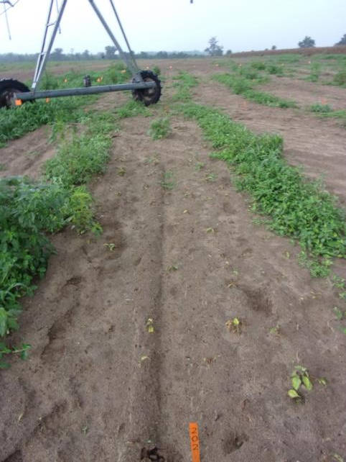
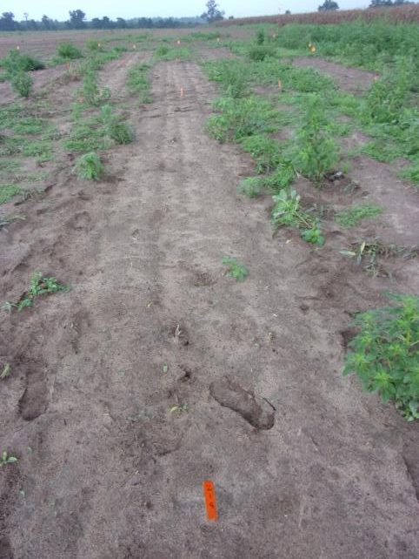
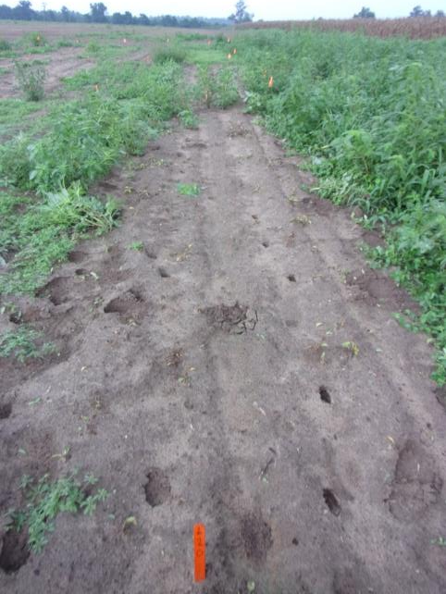
Tropical Spiderwort - 2022
Roundup PowerMax3 5.88SL @ 25 oz/A
Pursuit 2SL @ 4 oz/A
Roundup PowerMax3 5.88SL @ 25 oz/A
Classic 25DG @ 0.5 oz/A
Roundup PowerMax3 5.88SL @ 25 oz/A
FirstRate 84WG @ 0.3 oz/A
TSW-01-22
August 17
22 DAT

Slide 20
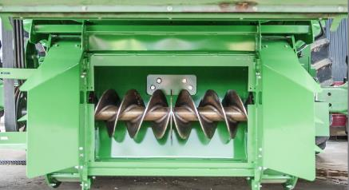
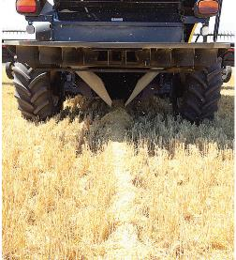
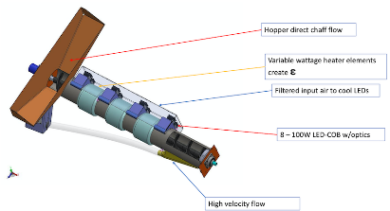
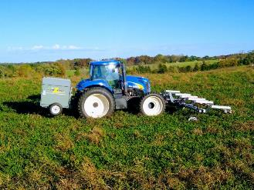
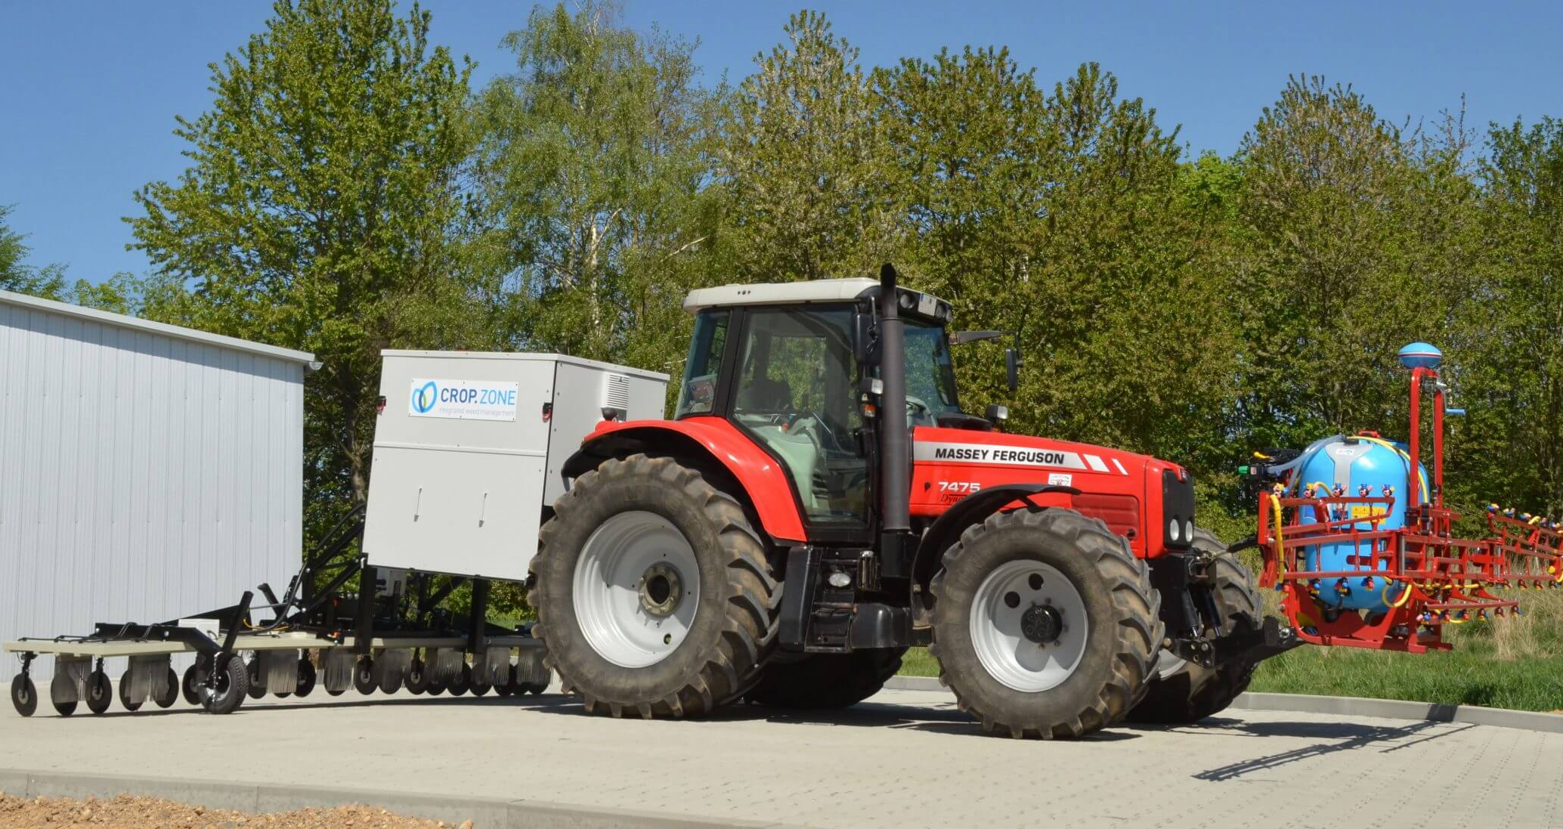
Other Options??? (Seedbank Mgt.)
Seed Mills
Integrated Harrington Seed Destructor
~$55,000
Redekop Seed Control
~$70,000
Chaff Lining
$5000-$6,000
Blue LED Light
Weed Seed Destroyer
heat + blue light
$30,000
Weed Zapper
$69,000-$89,000
Crop Zone
Electrophysical weeder + Volt.fuel
Cost???????

Slide 21
Questions/Comments

Slide 22
Weed Control in Grain Sorghum – 2023
Eric P. Prostko Extension Weed Specialist
Seth McAllister, Terrell Co. (October 2022)

Slide 23
Grain Sorghum Weed Control
Start clean!
Concep treated seed
Dual Magnum or Outlook or Warrant (PRE)
Atrazine 4L @ 1.5 QT/A (EPOST)
Add Huskie if you have ATZ resistance
Paraquat (Hooded sprayer)
Mechanical Cultivation

Slide 24
A New (er) Product to Consider?
Huskie 2.06EC
Bayer CropScience
Buctril (1.75 lbs/gal) + pyrasulfotole (0.31 lbs/gal)
MOA = 6 + 27
Postemergence (13-16 oz/A)
3-leaf to 12” tall sorghum
Broadleaf weeds, good on pigweed
Tank-mix with atrazine (16 oz/A)
Huskie FX = Huskie + Starane

Slide 25
Grain Sorghum Weed Control - 2021
Warrant @ 48 oz/A
Atrazine @ 16 oz/A
Huskie @ 16 oz/A
Induce @ 0.25% v/v
AMS @ 5% v/v
Applied 19 DAP
NTC
GS-04-21
July 16
58 DAP

Slide 26
Huskie Injury on Sorghum

Slide 27
Texas Panicum in Grain Sorghum
Terrell Co.
08/05/22

Slide 28
New Grain Sorghum Weed Control Technologies (Non-GMO)
Igrowth™
Alta/UPL
ImiFlex (imazamox)
PRE/POST
DoubleTeam™
S&W Seed Partners/ADAMA
FirstAct (quizalofop)
POST
Maybe cultivars???
S&W Seeds
SP58M85DT/SP45A45DT
SP31C06DT (cream colored)
Inzen™
Pioneer/Corteva
Zest (nicosulfuron)
POST

Slide 29
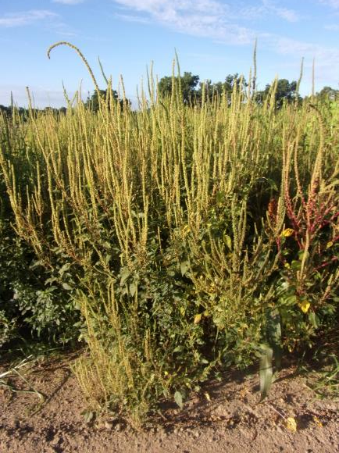
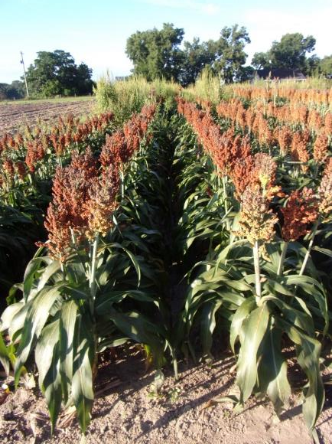
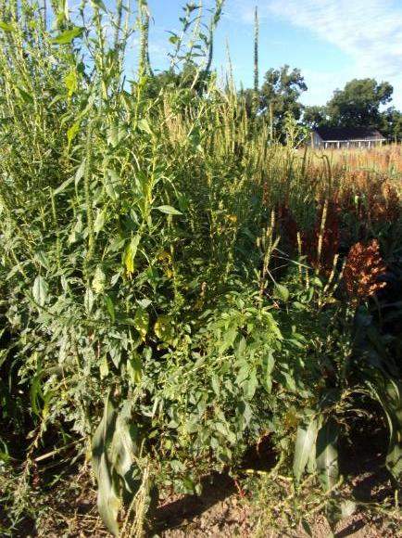
Grain Sorghum Weed Control – 2022 I-Growth
NTC
Mocassin II Plus 7.64EC @ 21 oz/A (PRE)
fb
Imiflex 1AS @ 6 oz/A
Agridex @ 1% v/v
POST (V7, 9-10” tall, 22 DAP)
Imiflex 1AS @ 4 oz/A
Agridex @ 1% v/v
EPOST (V3, 4” tall, 14 DAP)
GS-01-22
August 1
69 DAT (POST)/77 DAT (EPOST)

Slide 30
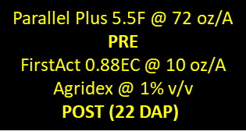
DoubleTeam Sorghum - 2022
NTC
GS-01-22
August 1
69 DAT (POST)

Slide 31
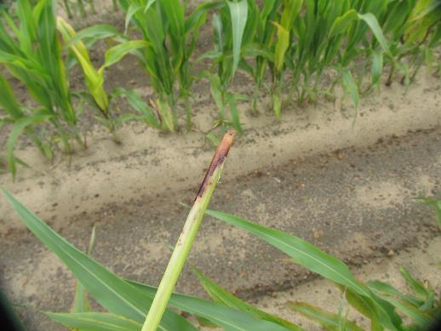
DoubleTeam™ System – First Act Off-Types
GS-02-21
June 23
9 DAT

Slide 32
Inzen Grain Sorghum - 2022
NTC
Everprex 7.62EC @ 16 oz/A (PRE) fb
Zest 75DG @ 0.67 oz/A +
Aatrex 4L @ 48 oz/A + Agridex @ 1% v/v
(POST)
GS-01-22
August 1
69 DAT (POST)

Slide 33
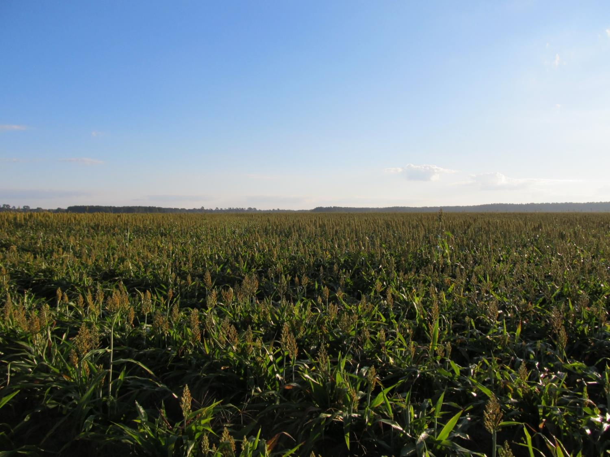
Questions/Comments?
eprostko@uga.edu
gaweed.com

