Slide 1
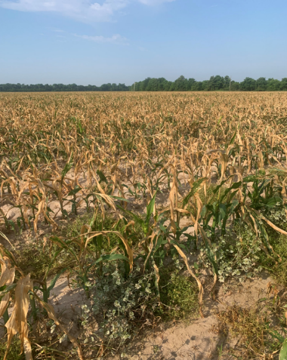
Preventing Preventable Problems on the Farm
Impact Core @ 24 oz/A + Dual Magnum @ 16 oz/A + Atrazine @ 48 oz/A + RUPM3 @ 32 oz/A + Class Act @ 0.25% v/v
Eric P. Prostko
Professor/Extension Weed Specialist
Dept. Crop & Soil Sciences
University of Georgia

Slide 2
Why do I have this type of data?
Peanut response to ….
2,4-D
Dicamba
Glyphosate
Glyphosate + Dicamba
Glufosinate
Diuron
Picloram
Imazapyr
Triclopyr
Aminopyralid
In 2023
Glyphosate injury on peanut

Slide 3
Problems

Slide 4
Valor/Sprayer Cleanout/Field Corn

Slide 5
Valor/Sprayer Cleanout

Slide 6
Imazapyr in Field Corn

Slide 7
Oops!

Slide 8
Liberty (glufosinate) in Lay-By?
DKC-6869
DKC-6208

Slide 9
Jugs and Jugs?

Slide 10
Jugs and Jugs? (~$1 million mistake)

Slide 11
Dicamba (Ugh!)

Slide 12
Tank-Mix Blues! Cadre @ 3.5 oz/A + 2,4-DB @ 16 oz/A + Dual Magnum @ 20 oz/A + Domark @ 4 oz/A + Praiz @ 24 oz/A + Class Act NG @ 8 oz/A

Slide 13
Mixing Sequence Was: 1) Gramoxone; 2) Storm; 3) Zidua SC Should have been: 1) Zidua SC; 2) Storm; 3) Gramoxone

Slide 14
Why does this happen?
Plant on Time
Spray on Time
Harvest on Time
Pay the Banker On Time
Weather/Wind
Equipment
People

Slide 15
Did you know ………
GA farmers (%) needing an annual operating loan
County1 - 60%
County2 - 95%
County3 - 80%
County4 - 80%
County5 - 80%
County6 - 80%
County7 - 90%
Operating Loans ($$)??
$500,000
$2,000,000
$5,000,000+

Slide 16
How do we fix this?
Phone a friend
Mix what you need
No label = NO MIX!
Head in Tank??
Label/Container Colors
Plumbing
Records
Label
Nix the Mix?
Weather/Wind/Common Sense

Slide 17
Phone A Friend
County Agent/Specialist
Consultant
Dealer
Priest/Rabbi/Imam

Slide 18
Mixing/Loading Area
Or This?
This?

Slide 19
NO LABEL = NO MIX!!!!

Slide 20
Head In Tank

Slide 21
Valor/Sprayer Cleanout
J. Cochran
Worth Co.
06/16/22

Slide 22
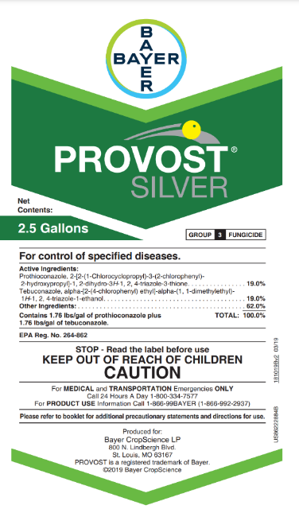
Pesticide Containers Label/Container Color?

Slide 23
Or This?
“Works good when you stand a bunch of white jugs up on water truck side by side.”
Kerry Hodges, Screven Co. (GA) Farmer, 10/11/2022

Slide 24
Plumbing (multiple tanks on 1 tractor)

Slide 25
Records

Slide 26
Label Read/Reform?
29 pages long
All sections in same place?
i.e. crop rotation restrictions on page X

Slide 27
Nix the Mix? (When You Can)
Solving all pest/fertility problems in 1 application
More products = More problems
Mixing order is important
Impossible to get enough good data for all scenarios
TOD, temperature, humidity, leaf wetness, plant health, etc.
Reflex, Zidua, B-Moly, Glyphosate, Brandt Smart Trio (N + S + B + Mn + Zn)

Slide 28
Weather/Wind/Common Sense
paraquat drift on field corn

Slide 29
Questions/Comments
eprostko@uga.edu

