Slide 1
2023 Peanut Weed Control Update
Eric P. Prostko
Extension Weed Specialist
Dept. Crop & Soil Sciences

Slide 2
Peanut Weed Control - 2022
Start clean
Twin rows
Strong PRE’s
Timely POST’s
Hand-Weeding
PE-07-22
July 6
70 DAP

Slide 3
Peanut Tillage Systems
Conventional Tillage (Macon Co.)
Strip-Tillage (Worth Co.)
June 2022

Slide 4
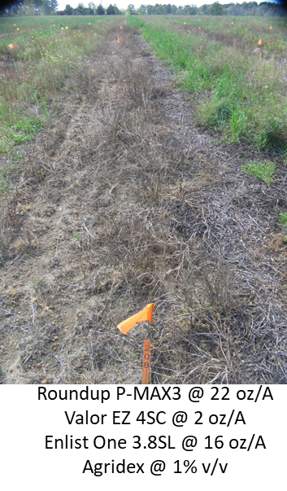
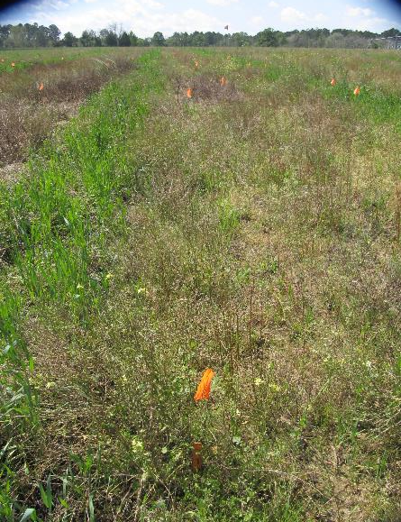
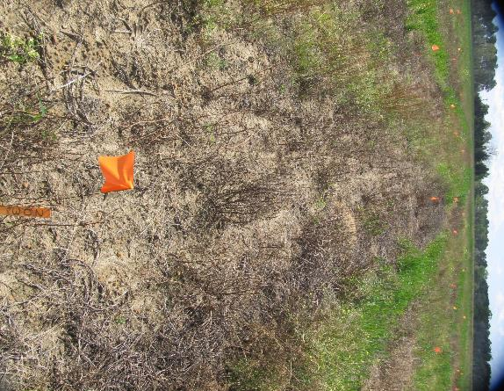
Preplant Burndowns - 2022
NTC
Gramoxone 2SL @ 48 oz/A
Valor EZ 4SC @ 2 oz/A
2,4-D 3.8SL @ 16 oz/A
Agridex @ 1% v/v
2,4-D 3.8SL @ 16 oz/A
BN-01-22 (Tift Co.)
March 25
30 DAT (Rep 2)

Slide 5
Cutleaf Evening Primrose Control
Gramoxone 3SL @ 8 oz/A + Basagran 4SL @ 8 oz/A + 2,4-DB 2SL @ 12 oz/A + NIS @ 0.25% v/v
10 DAT
Wayne Nixon (NC Consultant)
“You saved the man’s crop. Many thanks!”
Personal Text
06/09/22

Slide 6
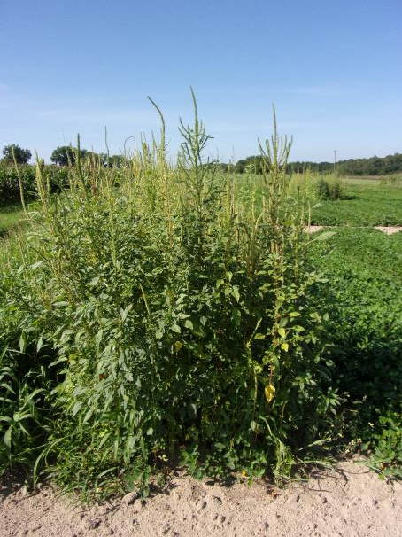
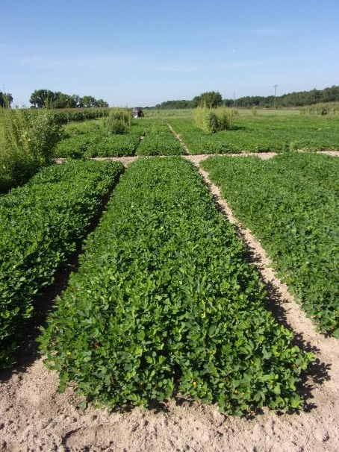
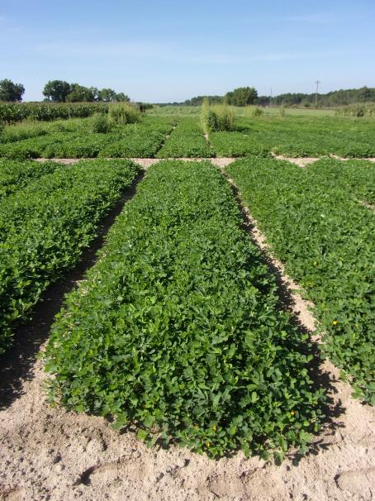
Peanut Weed Control – 2022 Sonalan vs. Prowl
6096 lbs/A
6220 lbs/A
NTC
Sonalan HFP 4EC @ 32 oz/A
Valor EZ 4SC @ 3 oz/A
Strongarm 84WG @ 0.225 oz/A
PRE (1 DAP)
Cadre 2AS @ 4 oz/A
2,4-DB 2SL @ 16 oz/A
Dual Magnum 7.62EC @ 16 oz/A
POST (27 DAP)
Prowl H₂0 3.8SC @ 32 oz/A
Valor EZ 4SC @ 3 oz/A
Strongarm 84WG @ 0.225 oz/A
PRE (1 DAP)
Cadre 2AS @ 4 oz/A
2,4-DB 2SL @ 16 oz/A
Dual Magnum 7.62EC @ 16 oz/A
POST (27 DAP)
PE-12-22
July 5
69 DAP

Slide 7
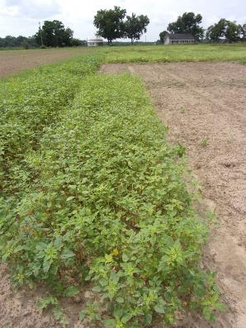
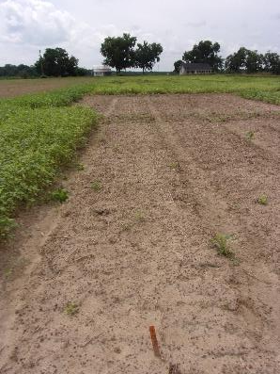
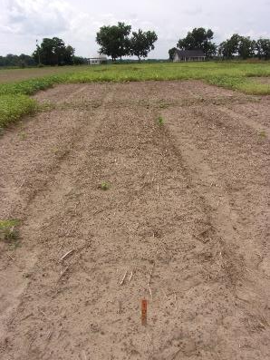
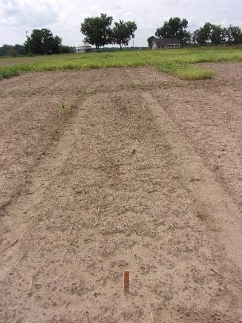
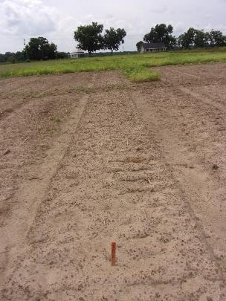
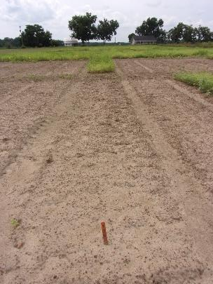
Flumioxazin Formulation Test – 2022 3 oz/A
Valor EZ2 4SC
PE-23-22
September 7
29 DAT

Slide 8
How long does Valor last?
Georgia Rainfall (inches)*
Dates | Ty Ty |  | Midville
 | 2022 | 1981- 2010 | 2022 | 1981- 2010
March 15-Apr 15 | 4.92 | 4.69 | 4.73 | 3.99
Apr 15-May 15 | 1.25 | 2.47 | 2.43 | 2.63
May 15-June 15 | 3.57 | 3.85 | 3.32 | 4.03
June 15-July 15 | 6.09 | 4.92 | 3.90 | 4.50
July 15-Aug 15 | 5.69 | 4.56 | 4.57 | 4.72
*University of Georgia Weather Network

Slide 9
Palmer Amaranth Control with Flumioxazin Formulations (3 oz/A)
Control (%)
PE-23-22
Time (DAT)

Slide 10
Valor Timing

Slide 11
Peanut Yield as Influenced By Valor 50WG (3 oz/A) Timing
“True Crack”
lbs/A
2” tall
3 lf
PE-16-01
GA Green
Time (DAP)
LSD 0.10 = 602
CV = 14.32

Slide 12
Peanut Emergence - 2022
1 DAP
3 DAP
5 DAP
7 DAP
PE-16B-22
GA-06G

Slide 13
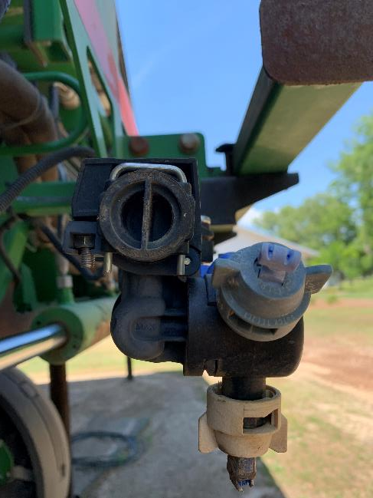
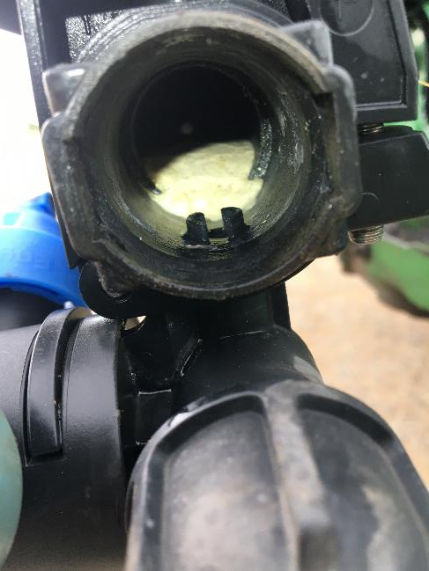
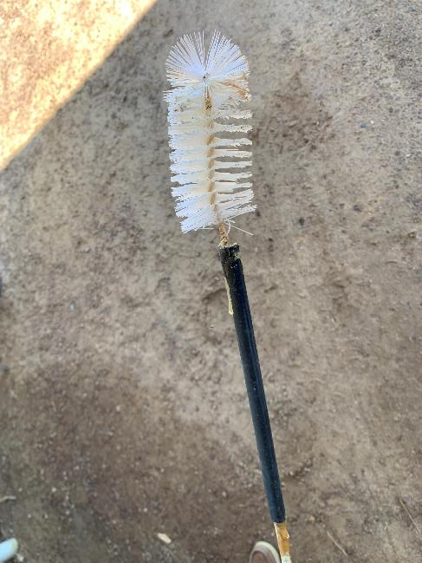
Valor Cleanout
Worth Co.
06/16/22

Slide 14
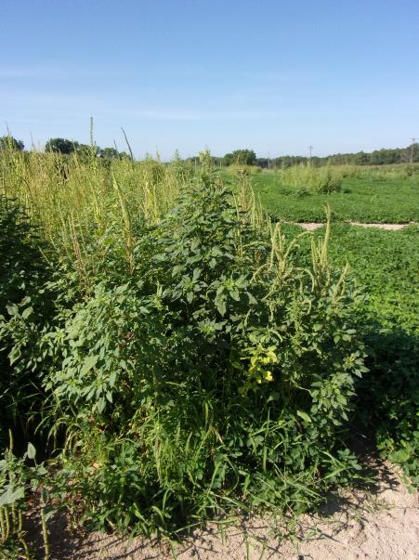
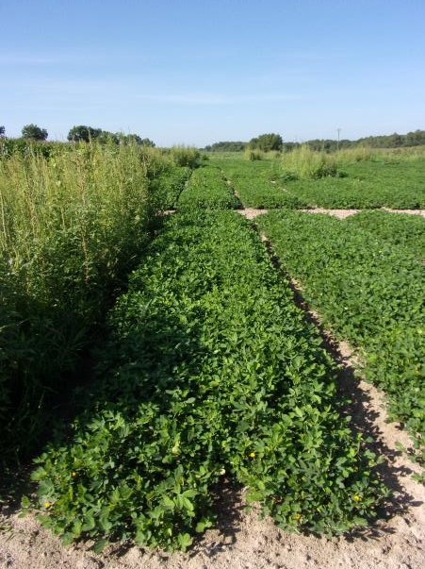
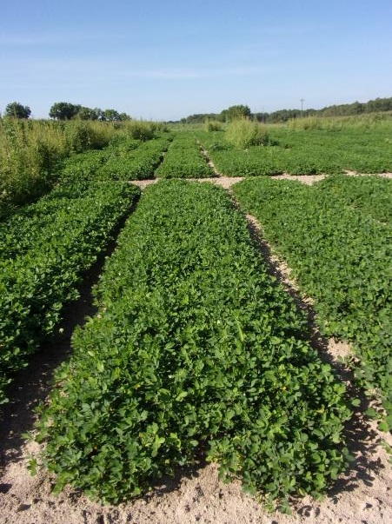
Peanut Weed Control - 2022
NTC
Gramoxone 2SL @ 12 oz/A
Storm 4SL @ 16 oz/A
Anthem Flex 4SE @ 3 oz/A
Induce @ 1% v/v
EPOST (13 DAP)
Cadre 2AS @ 4 oz/A
2,4-DB 2SL @ 16 oz/A
Induce @ 0.25% v/v
POST (34 DAP)
Gramoxone 2SL @ 12 oz/A
Storm 4SL @ 16 oz/A
Dual Magnum 7.62EC @ 16 oz/A
EPOST (13 DAP)
Cadre 2AS @ 4 oz/A
2,4-DB 2SL @ 16 oz/A
Induce @ 0.25% v/v
POST (34 DAP)
PE-11-22
July 5
69 DAP

Slide 15
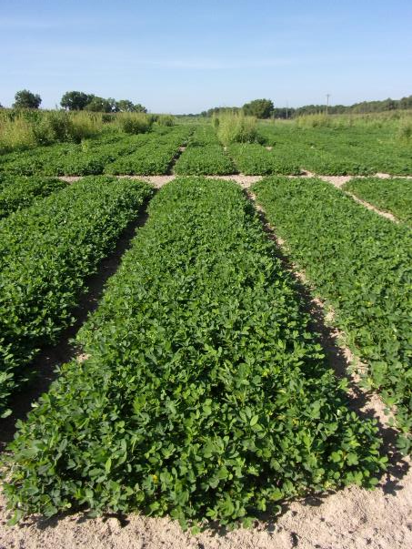
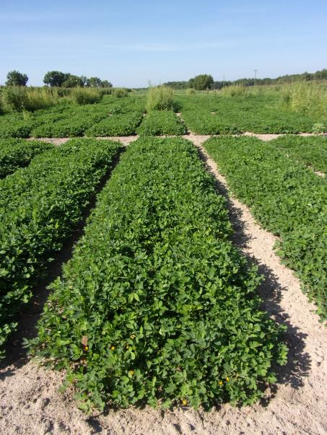
Peanut Weed Control - 2022
NTC
Gramoxone 2SL @ 12 oz/A
Storm 4SL @ 16 oz/A
Warrant 3ME @ 48 oz/A
Induce @ 1% v/v
EPOST (13 DAP)
Cadre 2AS @ 4 oz/A
2,4-DB 2SL @ 16 oz/A
Induce @ 0.25% v/v
POST (34 DAP)
Gramoxone 2SL @ 12 oz/A
Storm 4SL @ 16 oz/A
Outlook 6EC @ 12.8 oz/A
EPOST (13 DAP)
Cadre 2AS @ 4 oz/A
2,4-DB 2SL @ 16 oz/A
Induce @ 0.25% v/v
POST (34 DAP)
PE-11-22
July 5
69 DAP

Slide 16
Cadre (4 oz/A) + 2,4-DB (16 oz/A) + ……….. (15 GPA, AIXR11002 nozzles, Applied 6:45 am)
Anthem Flex (3 oz/A) + Induce (0.25%)
Dual Magnum (16 oz/A)
Warrant (48 oz/A) + Induce (0.25%)
Outlook (12.8 oz/A)
PE-11-22
June 6
6 DAT

Slide 17
Tropical Spiderwort/Benghal Dayflower
Plow (i.e. bury seed)
Twin Rows
Group 15’s (Dual Magnum, Warrant, Outlook, Zidua, Anthem Flex)
Paraquat
Cadre?
Strongarm?
Manage after field corn harvest.

Slide 18
Tropical Spiderwort – 2022 Gramoxone + Storm + Group 15’s
Gramoxone + Storm + Outlook (EPOST)
Gramoxone + Storm + Anthem Flex
+ Induce (EPOST)
Gramoxone + Storm + Warrant (EPOST)
Gramoxone + Storm + Zidua
+ Induce (EPOST)
Gramoxone + Storm + Dual Magnum (EPOST)
TSW-01-22
Sumter Co.
EPOST: July 26
PIC: August 30 (35 DAT)

Slide 19
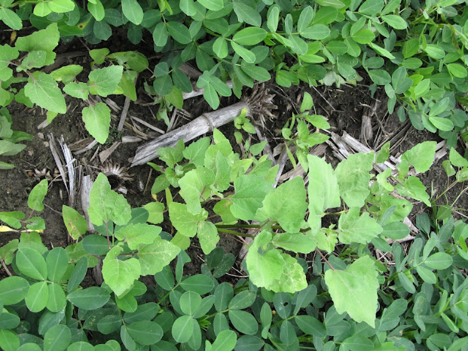
Herbicides for Common Cocklebur Control in Peanut
PRE and/or POST
Cadre
Pursuit
Strongarm
POST Only
2,4-DB
Basagran
Cobra
Storm
Ultra Blazer

Slide 20
Morningglory in Peanut
B. Starr
S. Monfort
June 2022

Slide 21
Cadre 2AS @ 4 oz/A + Zidua 4.17SC @ 2.5 oz/A + Strongarm 84WG @ 0.30 oz/A + Cobra 2EC @ 12.5 oz/A + 2,4-DB 2SL @ 16 oz/A + Induce @ 0.25%
Applied:
06/17/22
51 DAP
R2-R3 stage
6:55 am
15 GPA
AIXR nozzles
PE-13-22
June 21
4 DAT

Slide 22
Cadre 2AS @ 4 oz/A + Zidua 4.17SC @ 2.5 oz/A + Strongarm 84WG @ 0.30 oz/A + Cobra 2EC @ 12.5 oz/A + 2,4-DB 2SL @ 16 oz/A + Induce @ 0.25%
Applied:
06/17/22
51 DAP
R2-R3 stage
6:55 am
15 GPA
AIXR nozzles
PE-13-22
June 27
10 DAT

Slide 23
Cadre 2AS @ 4 oz/A + Zidua 4.17SC @ 2.5 oz/A + Strongarm 84WG @ 0.30 oz/A + Cobra 2EC @ 12.5 oz/A + 2,4-DB 2SL @ 16 oz/A + Induce @ 0.25%
Applied:
06/17/22
51 DAP
R2-R3 stage
6:55 am
15 GPA
AIXR nozzles
06/17/22
Before
08/02/22
47 Days After
PE-13-22

Slide 24
Cadre 2AS @ 4 oz/A + Zidua 4.17SC @ 2.5 oz/A + Strongarm 84WG @ 0.30 oz/A + Cobra 2EC @ 12.5 oz/A + 2,4-DB 2SL @ 16 oz/A + Induce @ 0.25%
Applied:
06/17/22
51 DAP
R2-R3 stage
6:55 am
15 GPA
AIXR nozzles
06/17/22
Before
08/02/22
47 Days After
PE-13-22

Slide 25
History of Classic® Use in Peanut
First registered for use in 1988
DuPont-Corteva-AMVAC
Late-season control of Florida beggarweed
60 DAE until 45 DBH
Peanut Response
TSWV
height/chlorosis
cultivar tolerance
Southern Runner
GA-06G
Tifguard

Slide 26
UGA Current Classic®/Cultivar Use Recommendations
NO
GA-06G
Tifguard
YES
Florida-07
GA Greener
GA-07W
GA-09B
GA-20VHO
GA-18RU
AUNPL-17
TIFNV HIGH O/L
FLORUN 331
GA-12Y
65 or 75 DAP – OK
94 DAP – 8% yield loss
Only 1 year of data
GA-16HO

Slide 27
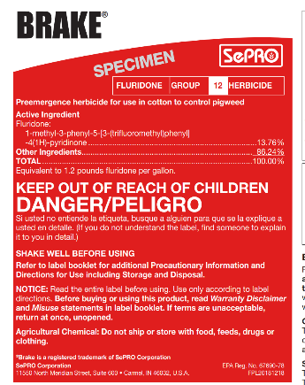
Future Products
Brake 1.2SL
SePRO
fluridone
WSSA/HRAC Group 12
PRE
2023?
Vulcarus 4.17SL
BASF
trifludimoxazin
WSSA/HRAC Group14
PRE
2025??

Slide 28
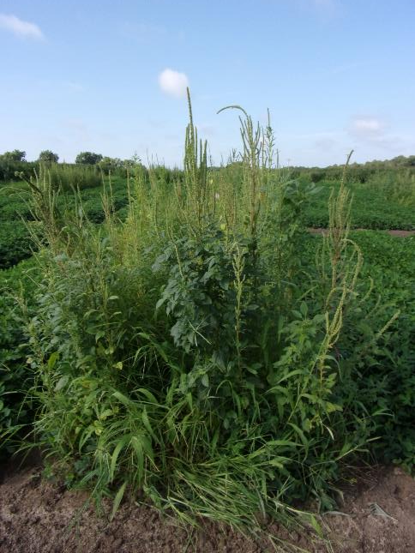
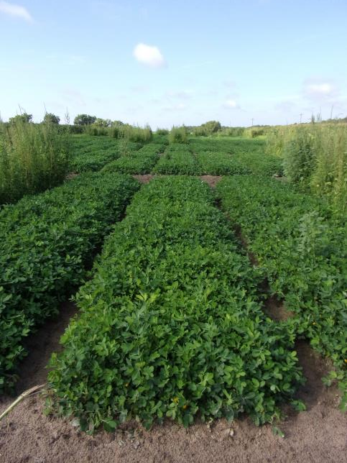
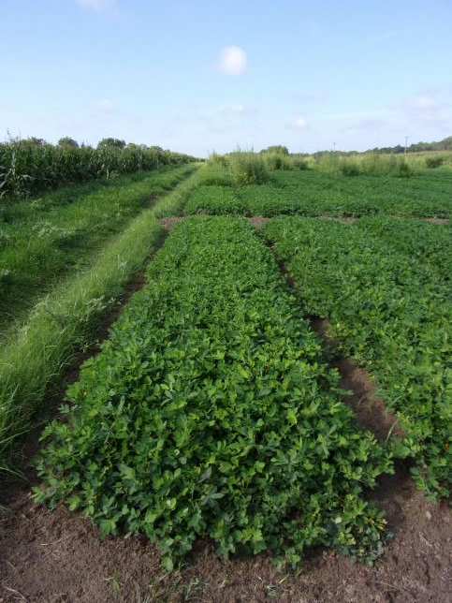
Peanut Weed Control – 2022 Valor + Strongarm vs. Brake + Strongarm
NTC
Prowl H₂0 3.8SC @ 32 oz/A
Valor EZ 4SC @ 3 oz/A
Strongarm 84WG @ 0.225 oz/A
PRE (1 DAP)
Cadre 2AS @ 4 oz/A
2,4-DB 2SL @ 16 oz/A
Dual Magnum 7.62EC @ 16 oz/A
POST (27 DAP)
Prowl H₂0 3.8SC @ 32 oz/A
Brake 1.2SL @ 12 oz/A
Strongarm 84WG @ 0.225 oz/A
PRE (1 DAP)
Cadre 2AS @ 4 oz/A
2,4-DB 2SL @ 16 oz/A
Dual Magnum 7.62EC @ 16 oz/A
POST (27 DAP)
PE-04-22
July 6
70 DAP
Rep 2

Slide 29
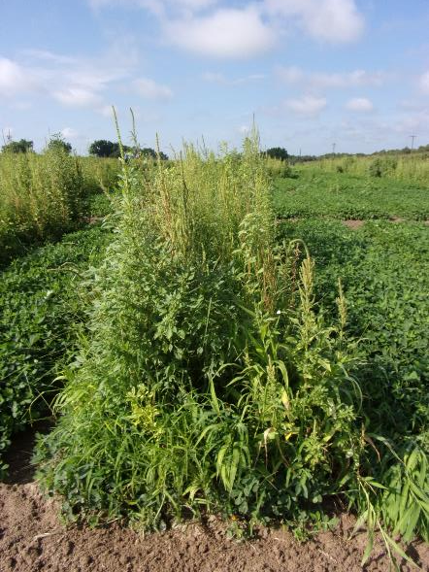
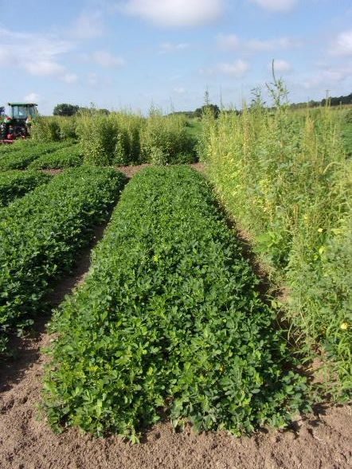
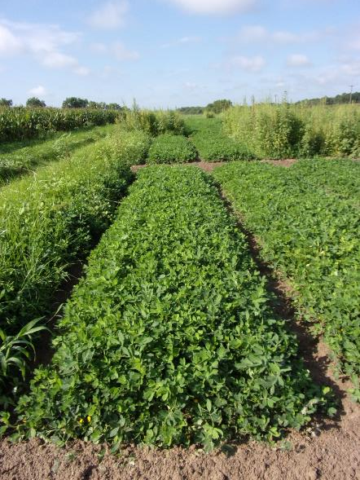
Peanut Weed Control – 2022 Valor + Strongarm vs. Vulcarus + Strongarm
NTC
Prowl H₂0 3.8SC @ 32 oz/A
Valor EZ 4SC @ 3 oz/A
Strongarm 84WG @ 0.225 oz/A
PRE (1 DAP)
Cadre 2AS @ 4 oz/A
2,4-DB 2SL @ 16 oz/A
Dual Magnum 7.62EC @ 16 oz/A
POST (27 DAP)
Prowl H₂0 3.8SC @ 32 oz/A
Vulcarus 4.17SC @ 1.03 oz/A
Strongarm 84WG @ 0.225 oz/A
PRE (1 DAP)
Cadre 2AS @ 4 oz/A
2,4-DB 2SL @ 16 oz/A
Dual Magnum 7.62EC @ 16 oz/A
POST (27 DAP)
PE-07-22
July 6
70 DAP
Rep 2

Slide 30
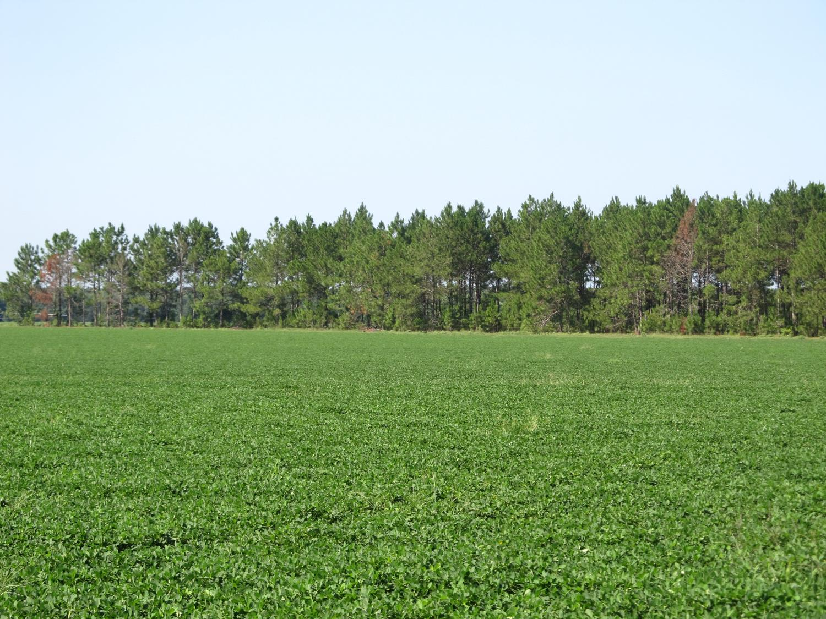
Peanut Field Surrounded by Pine Trees - Bulloch Co. (August 2020)

Slide 31
Arsenal/Peanut Injury

Slide 32
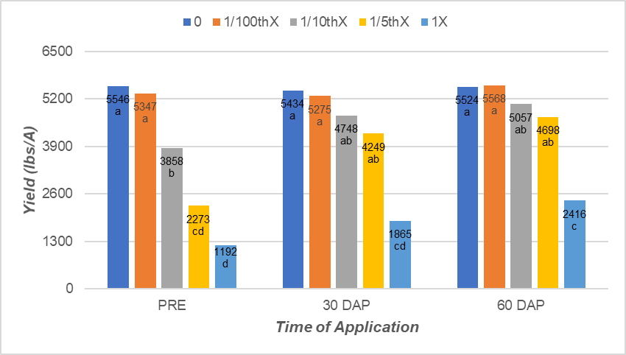
Arsenal/Peanut Yield (2020-2022)
Arsenal® Powerline™ 2SL 1X = 24 oz/A

Slide 33
Cadre (imazapic/AC-263,222) vs. Pursuit (imazethapyr) vs. Arsenal (imazapyr) Structurally not that different but……..
(Arsenal)
(Cadre)
(Pursuit)
Source: The Imidazolinone Herbicides, Shaner and O’Connor, 1991

Slide 34
Garlon/Peanut/Injury

Slide 35
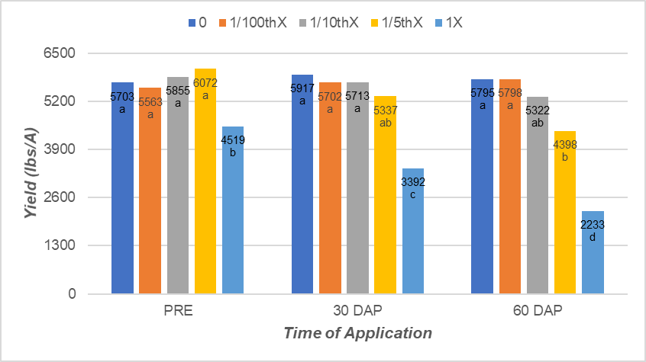
Garlon/Peanut Yield (2020-2022)
Garlon® 3AS 1X = 32 oz/A

Slide 36
What do the top Georgia peanut growers do? 2022 Georgia Peanut Achievement Club Winners (2021 Crop)
15 growers
110 to 1443 acres (range)
6059 lb/A average yield
5289-6814 lbs/A (range)
GA State Avg. = 4450 lb/A
87% - irrigated
67% - bottom plow
93% - twin rows
Herbicides
80% - Sonalan
100% - Valor
53% - Dual
80% - Cadre
73% - 2,4-DB
27% - Prowl
33% - Strongarm

Slide 37
Questions/Comments

