Slide 1
2023 Field Corn Weed Control Update
Eric P. Prostko
Extension Weed Specialist
Dept. Crop & Soil Sciences

Slide 2
Field Corn Weed Control Questions for you?
What technologies are you planting?
RR, LL, Conventional, Enlist (2,4-D)?
Do you need Counter?
Is atrazine still working for you on pigweed?
Lets assume it does not
What will be planted after the field corn?

Slide 3
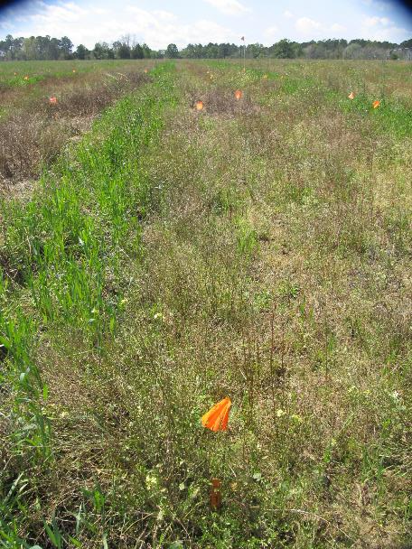
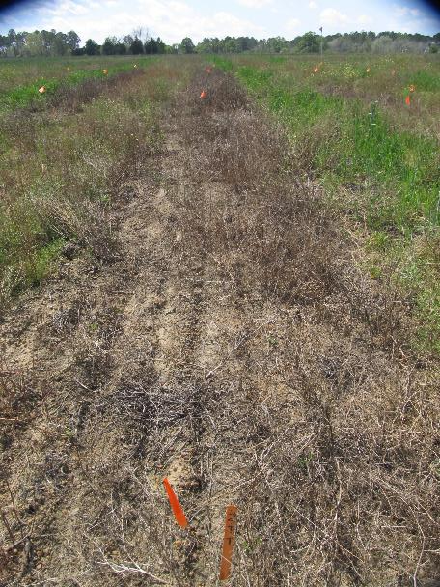
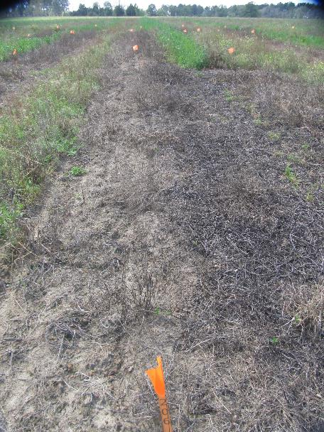
Preplant Burndowns - 2022
NTC
Roundup P-MAX3 @ 22 oz/A
Aatrex 4L @ 32 oz/A
Agridex @ 1% v/v
Gramoxone 2SL @ 48 oz/A
Aatrex 4L @ 32 oz/A
Agridex @ 1% v/v
BN-01-22 (Tift Co.)
March 25
30 DAT (Rep 2)

Slide 4
Glyphosate Rates
Glyphosate Formulation (lbs ai/gal) | Rate/A (oz) for 1.0 lb ai/A
3.6 | 35.6
3.64 | 35.2
3.97 | 32.2
4.0 | 32.0
5.07 | 25.2
5.4 | 23.7
5.5 | 23.3
5.83 | 22.0
5.88 | 21.8

Slide 5
PRE’s in Field Corn?
NTC
Dual II Magnum 7.64EC
16 oz/A (PRE)
CN-04-21
April 18
21 DAT

Slide 6
PRE* Herbicide Effects on Field Corn Yield
CN-01-22
LSD 0.10 = 6.53
CV = 1.44
*Averaged over 6 POST treatments.

Slide 7
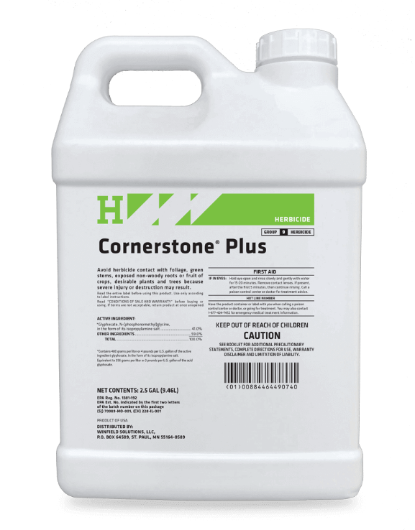
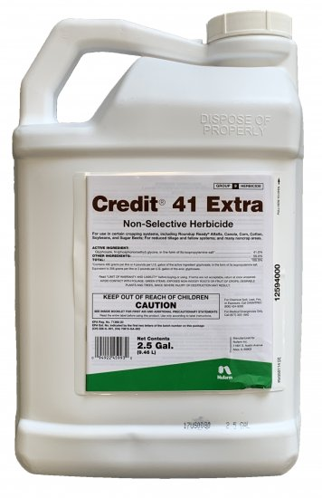
Field Corn Weed Control – 2022 With Roundup

Slide 8
Field Corn Weed Control - 2022
Roundup P-Max3 @ 22 oz/A
Aatrex 4L @ 64 oz/A
Prowl H₂0 3.8SC @ 32 OZ/A
Applied 24 DAP
NTC
CN-07-22
May 2
35 DAP
11 DAT

Slide 9
Field Corn Weed Control - 2022
Shieldex 3.33SC @ 1.0 oz/A
Aatrex 4L @ 32 oz/A
Roundup P-Max3 5.88SL @ 22 oz/A
Applied 23 DAP
NTC
CN-04-22
May 4
14 DAT

Slide 10
Shieldex @ 1.0 oz/A + Roundup P-Max3 @ 22 oz/A + Aatrex @ 32 oz/A + Grounded @ 16 oz/A
CN-02-22
May 4
14 DAT

Slide 11
Field Corn Weed Control - 2022
Empyros 3.82L @ 32 oz/A
Aatrex 4L @ 32 oz/A
Roundup P-Max3 5.88SL @ 22 oz/A
Applied 23 DAP
NTC
CN-04-22
May 4
14 DAT

Slide 12
Tolpyralate Herbicides for Field Corn
Trade Name | Company | Active Ingredients (lbs/gal)
 |  | s-metolachlor | atrazine | tolpyralate | nicosulfuron
Katagon™ | Helm | -- | -- | 1.0 | 1.0
Shieldex® | Summit Agro | -- | -- | 3.33 | --
Empyros™** | Helena | 3.72 | -- | 0.10 | --
Empyros™ Triad** | Helena | 1.75 | 1.75 | 0.043 | --
Empyros™ Triad Flex** | Helena | 2.47 | 0.93 | 0.048 | --
**All Empyros formulations include a corn safener (benoxacor)

Slide 13
Field Corn Weed Control - 2022
Laudis 3.5SC @ 3 oz/A
Roundup P-Max3 5.88SL @ 22 oz/A
Aatrex 4L@ 32 oz/A
Grounded @ 16 oz/A
Applied 23 DAP
NTC
CN-02-22
May 4
14 DAT

Slide 14
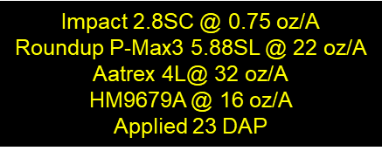
Field Corn Weed Control - 2022
NTC
CN-02-22
May 4
14 DAT

Slide 15
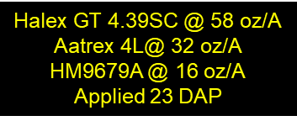
Field Corn Weed Control - 2022
NTC
CN-02-22
May 4
14 DAT

Slide 16
Field Corn Weed Control - 2022
Acuron GT 4.295ZC @ 60 oz/A
AAtrex 4L @ 32 oz/A
Induce @ 0.25% v/v
POST (23 DAP)
NTC
CN-06-22
June 8
72 DAP

Slide 17
Comparison of Acuron, Acuron Flexi, Acuron GT, and Halex GT
Trade Name | Active Ingredients (lbs/gal) (WSSA/HRAC MOA)
 | glyphosate (9) | mesotrione (27) | bicyclopyrone (27) | S-metolachlor (15) | atrazine (5)
Acuron | - | 0.240 | 0.060 | 2.14 | 1.0
Acuron Flexi | - | 0.320 | 0.080 | 2.86 | -
Acuron GT | 2.00 | 0.200 | 0.095 | 2.00 | -
Halex GT | 2.09 | 0.209 | - | 2.09 | -

Slide 18
Field Corn Weed Control – 2022 NO Roundup

Slide 19
Field Corn Weed Control - 2022
Impact 2.8SC @ 1.25 oz/A
Aatrex 4L @ 32 oz/A
Prowl H₂0 3.8SC @ 32 oz/A
Agridex @ 1% v/v
Applied 23 DAT
NTC
CN-06-22
May 5
15 DAT

Slide 20
Field Corn Weed Control - 2022
Revulin Q 51.2DG @ 3.5 oz/A
Aatrex 4L @ 64 oz/A
Prowl H₂0 3.8SC @ 32 oz/A
Agridex @ 1% v/v
Applied 24 DAP
NTC
CN-01-22
May 5
38 DAP

Slide 21
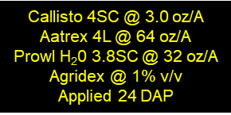
Field Corn Weed Control - 2022
NTC
CN-01-22
May 5
38 DAP

Slide 22
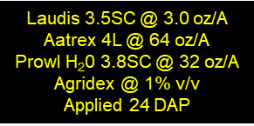
Field Corn Weed Control - 2022
NTC
CN-01-22
May 5
38 DAP

Slide 23
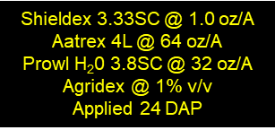
Field Corn Weed Control - 2022
NTC
CN-01-22
May 5
38 DAP

Slide 24
New(er) Products Being Tested Not in UGA Pest Control Handbook (yet?)
AMVAC
Sinate (glufosinate + topramezone)
Impact Core (topramezone + acetochlor)
Corteva
Kyro (encapsulated acetochlor + topramezone + clopyralid)
Resicore (mesotrione + acetochlor + clopyralid)
Resicore XL (mesotrione + encapsulated acetochlor + clopyralid)
Syngenta
Acuron GT (bicyclopyrone + s-metolachlor + mesotrione + glyphosate)
Acuron XR (bicyclopyrone + s-metolachlor + mesotrione + atrazine)
Helm
Katagon (tolpyralate + nicosulfuron)
Helmet Maxx (metolachlor + atrazine + mesotrione)
Helena
Empyros (tolpyralate + s-metolachlor)
Empyos Triad (tolpyralate + s-metolachlor + atrazine)
Empyros Triad Flex (tolpyralate + s-metolachlor + atrazine)
Valent
Maverick (mesotrione + pyroxasulfone + clopyralid)
Summit Agro
Restraint (tolpyralate + acetochlor + dichlormid)

Slide 25
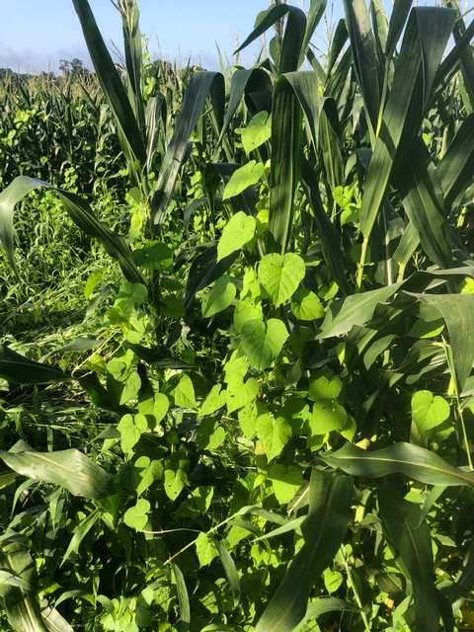
MG in Field Corn

Slide 26
Field Corn Lay-By (16 GPA, 30 PSI, 3.7 MPH, Floodjet TK-VS2)

Slide 27
Tropical Spiderwort/Benghal Dayflower
Bury seed!
Residuals-Group 15’s
Dual Magnum, Outlook, Warrant, Zidua, Anthem Max
POST – 2,4-D
Directed
Aim, Paraquat, Evik
Post-Harvest
2,4-D, Aim, Paraquat

Slide 28
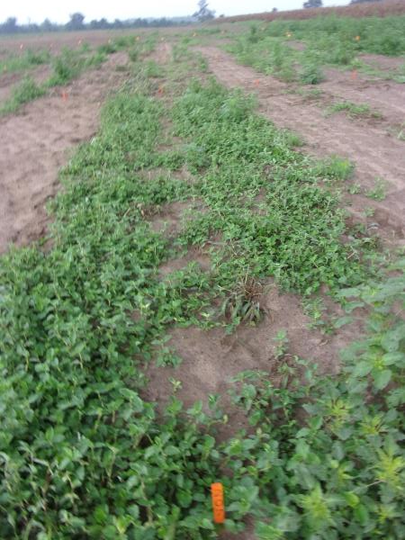
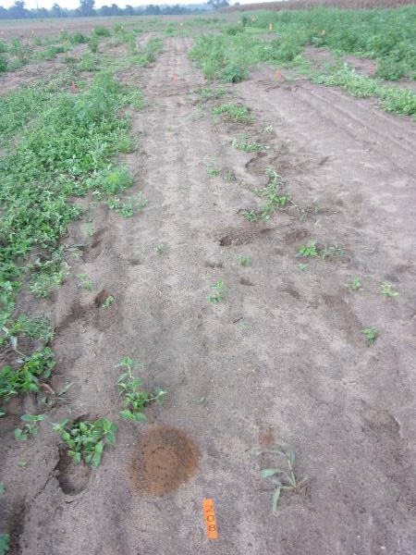
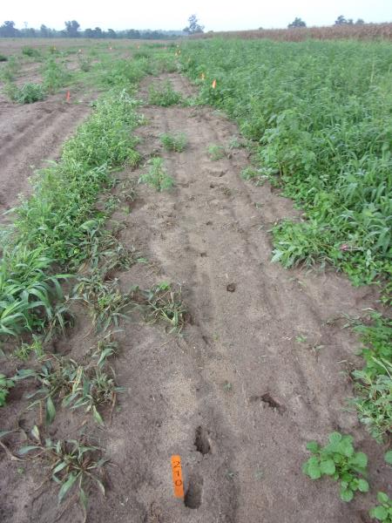
Tropical Spiderwort - HPPD’s - 2022
Laudis 3.5SC @ 3 oz/A
Agridex @ 1% v/v
Impact 2.87SC @ 1.25 oz/A
Agridex @ 1% v/v
Callisto 4SC @ 3 oz/A
Agridex @ 1% v/v
TSW-01-22
August 17
22 DAT

Slide 29
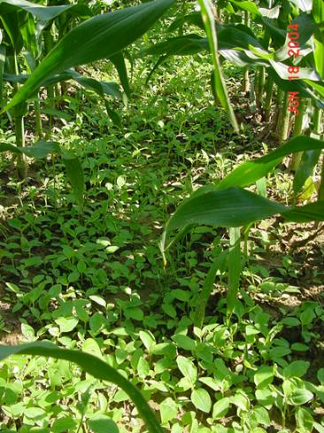
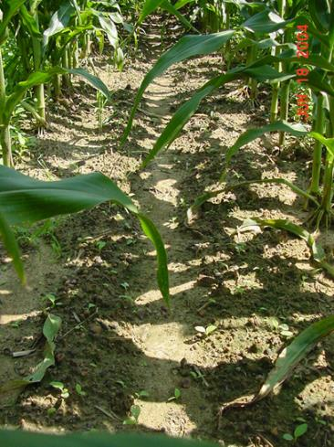
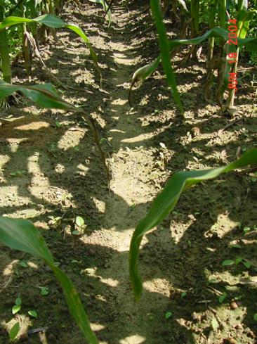
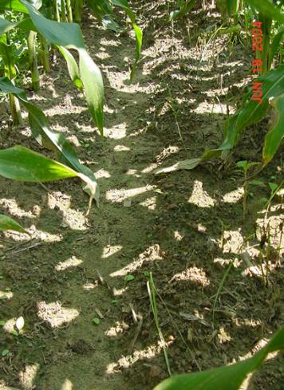
Tropical Spiderwort Control in Field Corn Control with Lay-Bys (8 DAT)
Untreated
Aim 2EC @ 1.5 ozs/A
Agrioil @ 1% v/v
Gramoxone 3SC @ 1 pt/A
80/20 @ 0.25% v/v
Evik 80WP @ 2 lb/A
80/20 @ 0.5% v/v
CN-11-04
COMBE:1-6”; 2-7 LF

Slide 30
Post-Harvest Control of TSW/BD with 2 Applications (14 d apart) of Gramoxone (paraquat)
CN-01-06
COMBE: 8-10”, flowering
1 week after POST2

Slide 31
Post-Harvest Weed Control Gramoxone 2L @ 3 pts/A + Tricor 4L @ 8 oz/A + NIS @ 0.25% v/v
09/24/21
Day of application

Slide 32
Post-Harvest Weed Control Gramoxone 2L @ 3 pts/A + Tricor 4L @ 8 oz/A + NIS @ 0.25% v/v
10/22/21
28 DAT

Slide 33
Field Corn Weed Control - Summary
Start Clean
Use a PRE
Timely POST (V3-V5)
need something else with Roundup + ATZ
Lay-By for MG
Post-Harvest
pigweed
dayflower

Slide 34
Questions/Comments?
eprostko@uga.edu
www.gaweed.com

