Slide 1
Preparing for Brake® (fluridone) in Peanut – 2023 2022 UGA Weed Science Update Chad Abbott & Eric P. Prostko Dec. 7, 2022

Slide 2
UGA History with Brake®
SePRO Ag
WSSA #12, PDS-inhibitor herbicide
Bleaching / Necrosis / Plant Death
Requires water for activation
Small seeded broadleaves & grasses
Section 18 for Brake in Peanut
AL, MS, AR
Full Registration for Peanut Belt coming
Cotton: PRE @ 16 fl oz/A
Too injurious on light soils for Peanut
Soil OM dependent – Midsouth can tolerate
$170/gal ~ $21.25/A

Slide 3
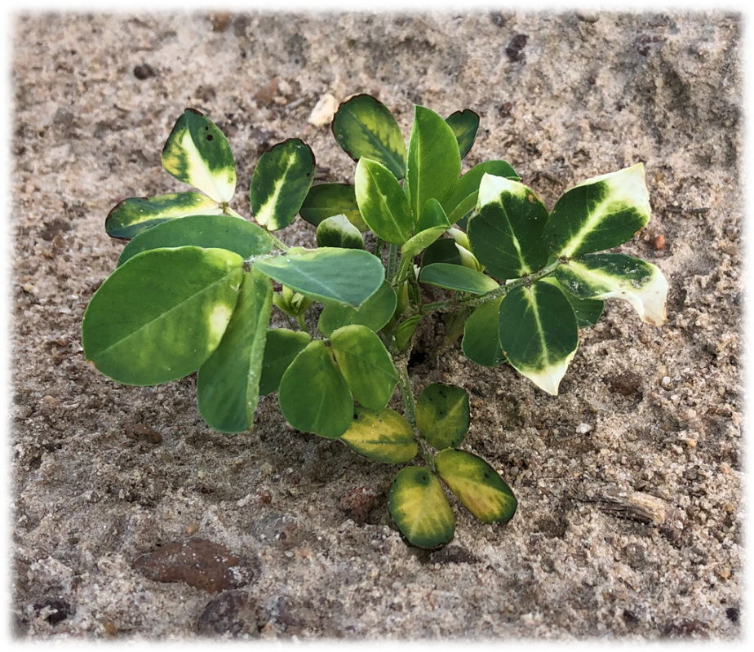
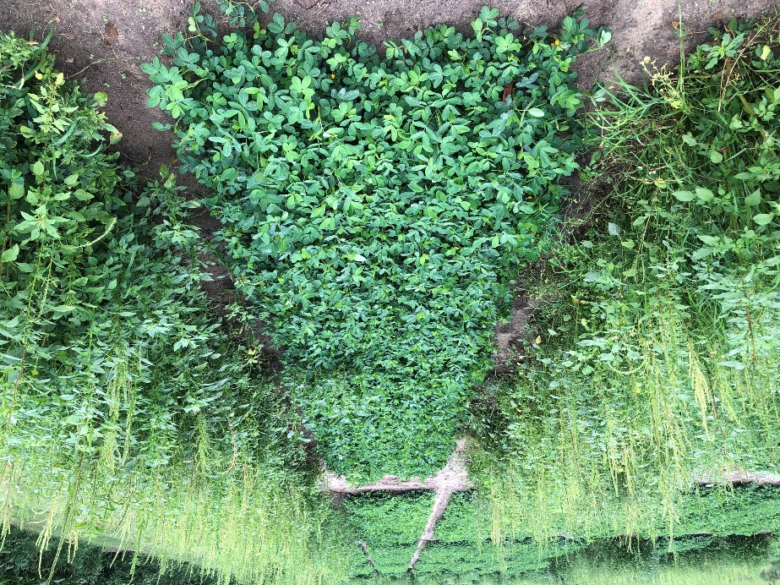
UGA History with Brake®
19 Total Field Trials – 2013
Ponder Farm, Ty Ty, GA
Ph.D. Work 2020 – 2022
8 Peanut Cultivars
Weed control trials
2022 – 2024
Application timings – Nick Shay
1, 3, 5, 7 DAP
1 X Rate

Slide 4
Cultivar Studies
Study 1: 2019 -2021
Cultivars:
GA-18RU
GA-06G
GA-16HO
Rates:
0 (NTC) oz/A
16 (1X) oz/A
32 (2X) oz/A
64 (4X) oz/A
Study 2: 2021 – 2022
Cultivars:
AUNPL-17
FlORUN-331
TIFNV-HOL
GA-20VHO
Rates:
0 (NTC) oz/A
12 (1X) oz/A
24 (2X) oz/A
Study 3: 2022
Cultivar:
GA-12Y
Rates:
0 (NTC) oz/A
12 (1X) oz/A
24 (2X) oz/A
48 (4X) oz/A

Slide 5
Cultivar Studies
Study 1: 2019 -2021
Cultivars:
GA-18RU
GA-06G
GA-16HO
Rates:
0 (NTC) oz/A
16 (1X) oz/A
32 (2X) oz/A
64 (4X) oz/A
Study 2: 2021 – 2022
Cultivars:
AUNPL-17
FlORUN-331
TIFNV-HOL
GA-20VHO
Rates:
0 (NTC) oz/A
12 (1X) oz/A
24 (2X) oz/A
Study 3: 2022
Cultivar:
GA-12Y
Rates:
0 (NTC) oz/A
12 (1X) oz/A
24 (2X) oz/A
48 (4X) oz/A

Slide 6
Cultivar Studies
Study 1: 2019 -2021
Cultivars:
GA-18RU
GA-06G
GA-16HO
Rates:
0 (NTC) oz/A
16 (1X) oz/A
32 (2X) oz/A
64 (4X) oz/A
Study 2: 2021 – 2022
Cultivars:
AUNPL-17
FlORUN-331
TIFNV-HOL
GA-20VHO
Rates:
0 (NTC) oz/A
12 (1X) oz/A
24 (2X) oz/A
Study 3: 2022
Cultivar:
GA-12Y
Rates:
0 (NTC) oz/A
12 (1X) oz/A
24 (2X) oz/A
48 (4X) oz/A

Slide 7
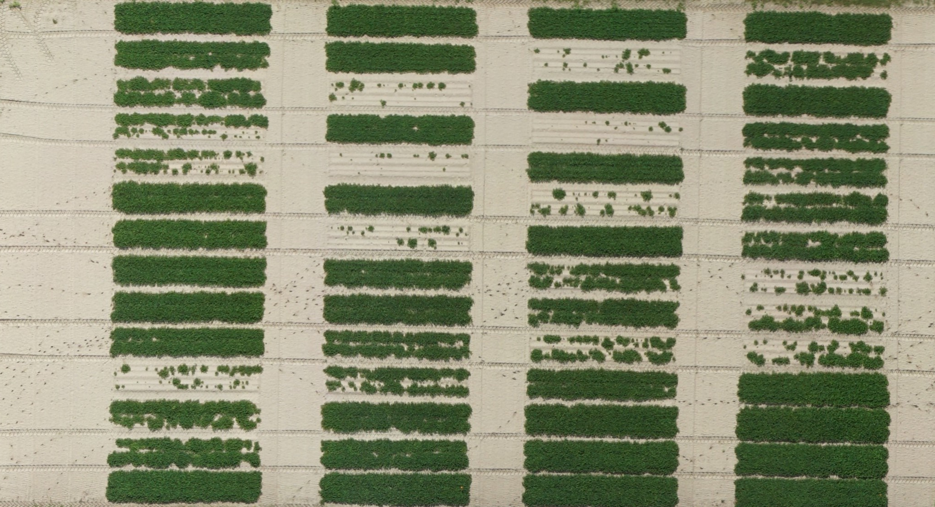
Cultivar Study 1 - 2019
1 = NTC
2 = 16 oz/A
3 = 32 oz/A
4 = 64 oz/A
GA-16HO
GA-16HO
GA-18RU
GA-06G
GA-16HO
GA-18RU
GA-06G
GA-16HO
GA-18RU
GA-06G
GA-16HO
GA-18RU
GA-06G
4
3
2
1
GA-06G

Slide 8
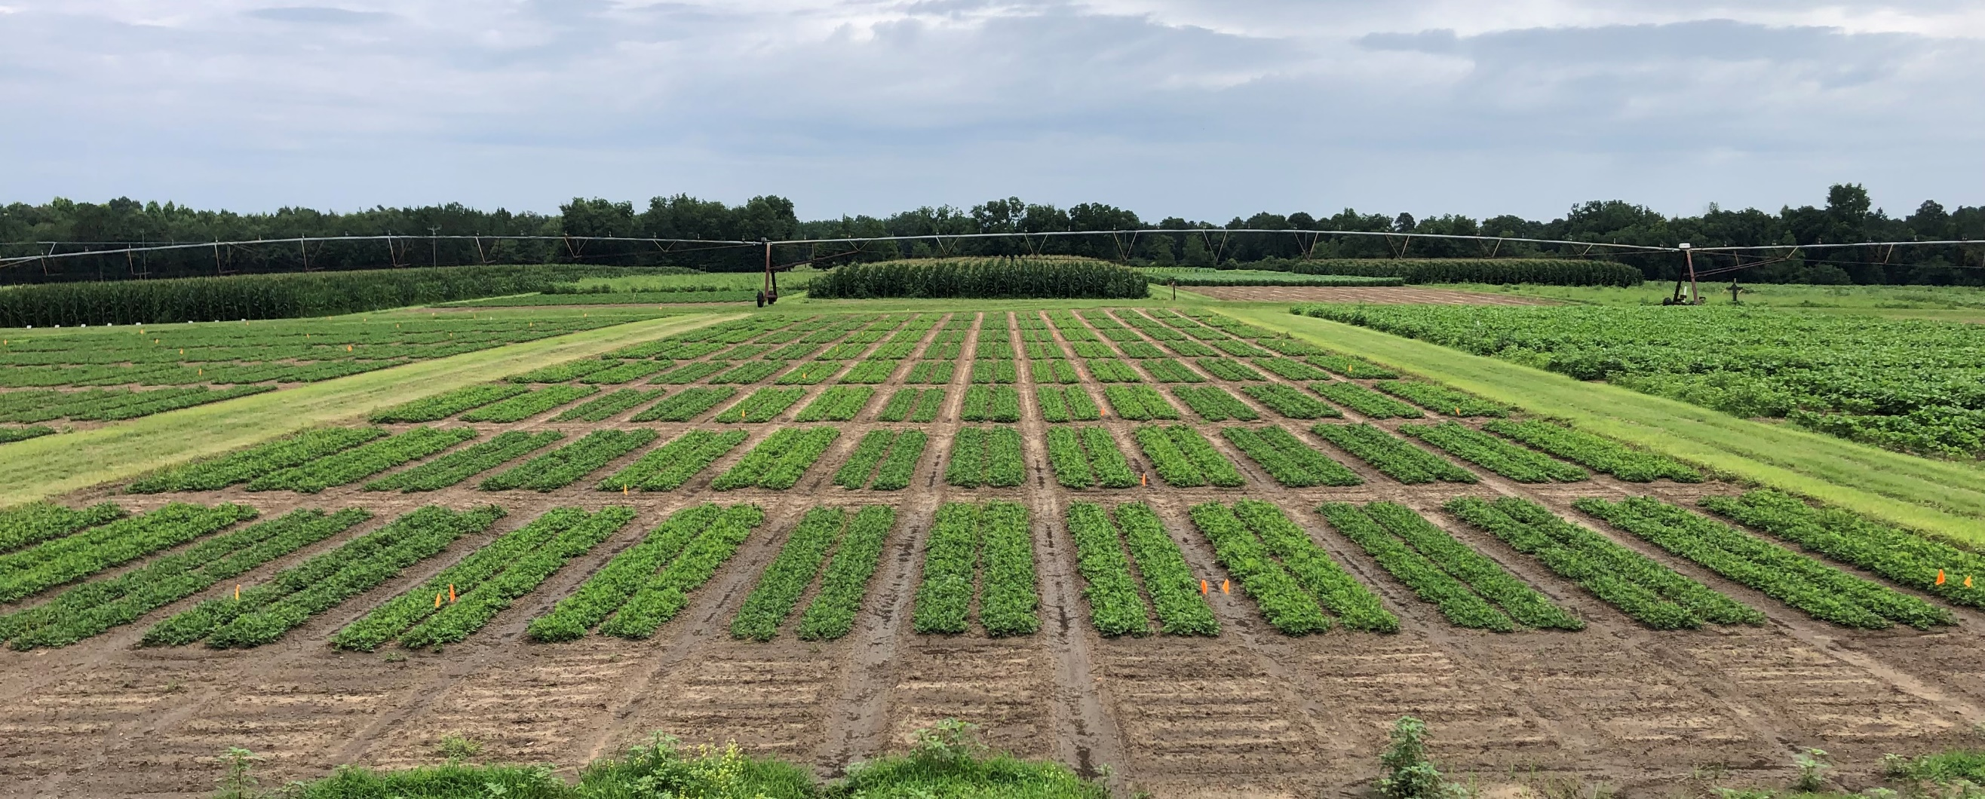
Cultivar Study 2 - 2021
FloRun 331
TifNV-Hi-OL
GA-20VHO
AU-NPL17

Slide 9
Weather Variability – Variable Injury
 | 2019 | 2020 | 2021
Planting Date | May 1 | April 28 | May 8
sand-silt-clay-OM (%) | 92-6-2-0.62 | 94-4-2-0.93 | 94-4-2-0.93
Daily Avg. Max Air Temp (F)¹ | 89 | 83 | 85
Daily Avg. Min Air Temp (F)¹ | 65 | 61 | 61
Average 2” Soil Temp (F)¹ | 85 | 79 | 82
Total Rainfall (in)¹ | 2 | 4.4 | 2.9
Total Irrigation (in)¹ | 1.6 | 1.3 | 2.4
Total Rainfall/ Irrigation – 14 DAP | 2.9 in of 3.6 in (83% of total I/R in first 30 DAP BY 14 DAP) | 2.2 in of 5.7 in (39% of total I/R in first 30 DAP by 14 DAP) | 1.5 in of 5.3 in (28% of total I/R in first 30 DAP by 14 DAP)
Notes:
Before we get into the charts, I would like to go over this table briefly to help with contextualizing the variation we experienced between 2019 and 2020 and briefly look at our weather in 2021.
CLICK MOUSE I would like to point out Brake is strongly absorbed to soil OM, therefore adsorption/desorption coefficients correlate well with soil OM content, which we have very little of.
CLICK MOUSE In 2019, our daily average max and minimum air temperatures are vastly warmer than our 2020 weather in the first 30 days after planting. Our Soil temperatures were also much warmer in 2019 than in 2020. Breaking it down further, if you look at the differences in total rainfall, there was over twice as much rainfall in 2020 than in the previous year, but there was not much difference in irrigation totals,
CLICK MOUSE but when you consolidate the rainfall/irrigation data to the first two weeks when peanuts are trying to crack and emerge from the soil, 83% of the total irrigation and rainfall occurred within 14 dap in 2019. In 2020, there was significantly less irrigation/rainfall when looking at the first two weeks after planting.
Looking at our 2021 weather, we experienced similar conditions to 2020 within the first 30 DAP. But the rest of the results are focused on 2019 and 2020.

Slide 10
Weather Variability – Variable Injury
 | 2019 | 2020 | 2021
Planting Date | May 1 | April 28 | May 8
sand-silt-clay-OM (%) | 92-6-2-0.62 | 94-4-2-0.93 | 94-4-2-0.93
Daily Avg. Max Air Temp (F)¹ | 89 | 83 | 85
Daily Avg. Min Air Temp (F)¹ | 65 | 61 | 61
Average 2” Soil Temp (F)¹ | 85 | 79 | 82
Total Rainfall (in)¹ | 2 | 4.4 | 2.9
Total Irrigation (in)¹ | 1.6 | 1.3 | 2.4
Total Rainfall/ Irrigation – 14 DAP | 2.9 in of 3.6 in (83% of total I/R in first 30 DAP BY 14 DAP) | 2.2 in of 5.7 in (39% of total I/R in first 30 DAP by 14 DAP) | 1.5 in of 5.3 in (28% of total I/R in first 30 DAP by 14 DAP)
Notes:
Before we get into the charts, I would like to go over this table briefly to help with contextualizing the variation we experienced between 2019 and 2020 and briefly look at our weather in 2021.
CLICK MOUSE I would like to point out Brake is strongly absorbed to soil OM, therefore adsorption/desorption coefficients correlate well with soil OM content, which we have very little of.
CLICK MOUSE In 2019, our daily average max and minimum air temperatures are vastly warmer than our 2020 weather in the first 30 days after planting. Our Soil temperatures were also much warmer in 2019 than in 2020. Breaking it down further, if you look at the differences in total rainfall, there was over twice as much rainfall in 2020 than in the previous year, but there was not much difference in irrigation totals,
CLICK MOUSE but when you consolidate the rainfall/irrigation data to the first two weeks when peanuts are trying to crack and emerge from the soil, 83% of the total irrigation and rainfall occurred within 14 dap in 2019. In 2020, there was significantly less irrigation/rainfall when looking at the first two weeks after planting.
Looking at our 2021 weather, we experienced similar conditions to 2020 within the first 30 DAP. But the rest of the results are focused on 2019 and 2020.

Slide 11
Weather Variability – Variable Injury
 | 2019 | 2020 | 2021
Planting Date | May 1 | April 28 | May 8
sand-silt-clay-OM (%) | 92-6-2-0.62 | 94-4-2-0.93 | 94-4-2-0.93
Daily Avg. Max Air Temp (F)¹ | 89 | 83 | 85
Daily Avg. Min Air Temp (F)¹ | 65 | 61 | 61
Average 2” Soil Temp (F)¹ | 85 | 79 | 82
Total Rainfall (in)¹ | 2 | 4.4 | 2.9
Total Irrigation (in)¹ | 1.6 | 1.3 | 2.4
Total Rainfall/ Irrigation – 14 DAP | 2.9 in of 3.6 in (83% of total I/R in first 30 DAP BY 14 DAP) | 2.2 in of 5.7 in (39% of total I/R in first 30 DAP by 14 DAP) | 1.5 in of 5.3 in (28% of total I/R in first 30 DAP by 14 DAP)
Notes:
Before we get into the charts, I would like to go over this table briefly to help with contextualizing the variation we experienced between 2019 and 2020 and briefly look at our weather in 2021.
CLICK MOUSE I would like to point out Brake is strongly absorbed to soil OM, therefore adsorption/desorption coefficients correlate well with soil OM content, which we have very little of.
CLICK MOUSE In 2019, our daily average max and minimum air temperatures are vastly warmer than our 2020 weather in the first 30 days after planting. Our Soil temperatures were also much warmer in 2019 than in 2020. Breaking it down further, if you look at the differences in total rainfall, there was over twice as much rainfall in 2020 than in the previous year, but there was not much difference in irrigation totals,
CLICK MOUSE but when you consolidate the rainfall/irrigation data to the first two weeks when peanuts are trying to crack and emerge from the soil, 83% of the total irrigation and rainfall occurred within 14 dap in 2019. In 2020, there was significantly less irrigation/rainfall when looking at the first two weeks after planting.
Looking at our 2021 weather, we experienced similar conditions to 2020 within the first 30 DAP. But the rest of the results are focused on 2019 and 2020.

Slide 12
Weather Variability – Variable Injury
 | 2019 | 2020 | 2021
Planting Date | May 1 | April 28 | May 8
sand-silt-clay-OM (%) | 92-6-2-0.62 | 94-4-2-0.93 | 94-4-2-0.93
Daily Avg. Max Air Temp (F)¹ | 89 | 83 | 85
Daily Avg. Min Air Temp (F)¹ | 65 | 61 | 61
Average 2” Soil Temp (F)¹ | 85 | 79 | 82
Total Rainfall (in)¹ | 2 | 4.4 | 2.9
Total Irrigation (in)¹ | 1.6 | 1.3 | 2.4
Total Rainfall/ Irrigation – 14 DAP | 2.9 in of 3.6 in (83% of total I/R in first 30 DAP BY 14 DAP) | 2.2 in of 5.7 in (39% of total I/R in first 30 DAP by 14 DAP) | 1.5 in of 5.3 in (28% of total I/R in first 30 DAP by 14 DAP)
Notes:
Before we get into the charts, I would like to go over this table briefly to help with contextualizing the variation we experienced between 2019 and 2020 and briefly look at our weather in 2021.
CLICK MOUSE I would like to point out Brake is strongly absorbed to soil OM, therefore adsorption/desorption coefficients correlate well with soil OM content, which we have very little of.
CLICK MOUSE In 2019, our daily average max and minimum air temperatures are vastly warmer than our 2020 weather in the first 30 days after planting. Our Soil temperatures were also much warmer in 2019 than in 2020. Breaking it down further, if you look at the differences in total rainfall, there was over twice as much rainfall in 2020 than in the previous year, but there was not much difference in irrigation totals,
CLICK MOUSE but when you consolidate the rainfall/irrigation data to the first two weeks when peanuts are trying to crack and emerge from the soil, 83% of the total irrigation and rainfall occurred within 14 dap in 2019. In 2020, there was significantly less irrigation/rainfall when looking at the first two weeks after planting.
Looking at our 2021 weather, we experienced similar conditions to 2020 within the first 30 DAP. But the rest of the results are focused on 2019 and 2020.

Slide 13
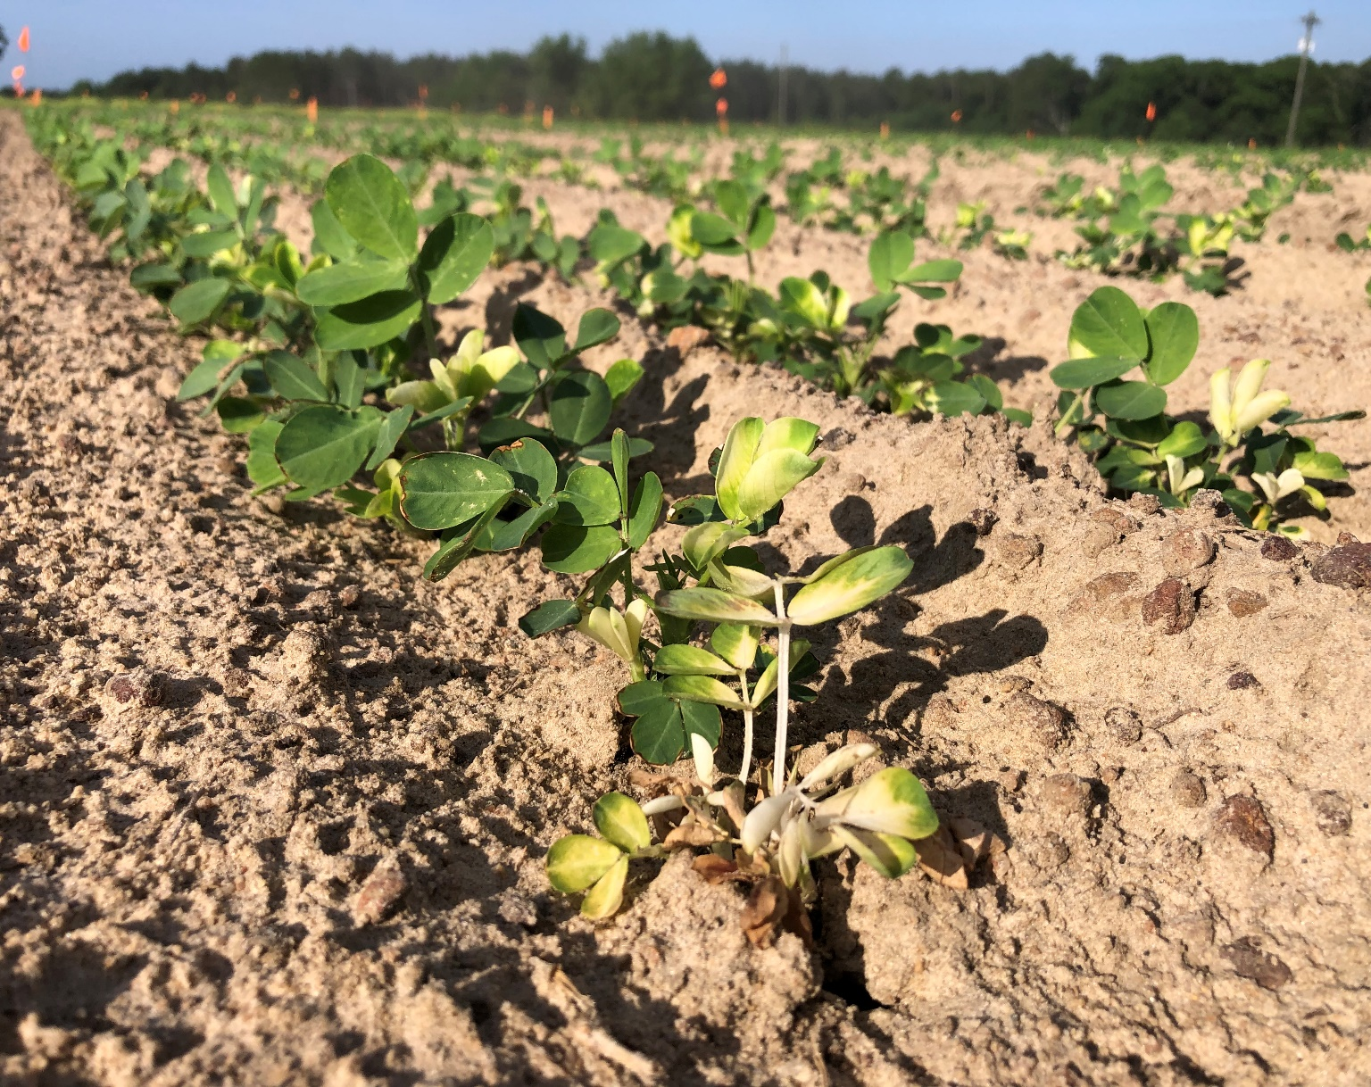
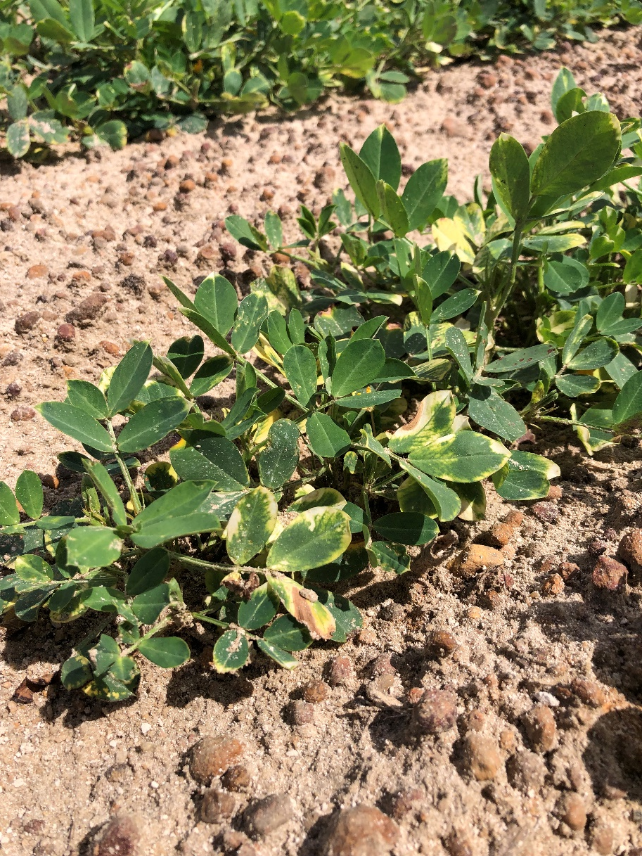
Brake® Symptomology
GA-16HO; 20 DAP; 64 oz/A
GA-16HO; 40 DAP; 64 oz/A

Slide 14
Cultivar Trial - Results & Summary
Study 1: 2019 -2021
Cultivars:
GA-18RU A
GA-06G B
GA-16HO B
Rates:
0 (NTC) A
16 (1X) AB
32 (2X) B
64 (4X) C
Study 2: 2021 – 2022
Cultivars:
AUNPL-17 A
FlORUN-331 B
TIFNV-HOL B
GA-20VHO B
Rates:
0 (NTC) A
12 (1X) A
24 (2X) A
Study 3: 2022
Cultivars:
GA-12Y
Rate:
0 (NTC) A
12 (1X) A
24 (2X) A
48 (4X) A
P = 0.1

Slide 15
Culitvar Trial - Results & Summary
Study 1: 2019 -2021
Cultivars:
GA-18RU A
GA-06G B
GA-16HO B
Rates:
0 (NTC) A
16 (1X) AB
32 (2X) B
64 (4X) C
Study 2: 2021 – 2022
Cultivars:
AUNPL-17 A
FlORUN-331 B
TIFNV-HOL B
GA-20VHO B
Rates:
0 (NTC) A
12 (1X) A
24 (2X) A
Study 3: 2022
Cultivars:
GA-12Y
Rate:
0 (NTC) A
12 (1X) A
24 (2X) A
48 (4X) A
P = 0.1

Slide 16
Cultivar Trial - Results & Summary
Study 1: 2019 -2021
Cultivars:
GA-18RU A
GA-06G B
GA-16HO B
Rates:
0 (NTC) A
16 (1X) AB
32 (2X) B
64 (4X) C
Study 2: 2021 – 2022
Cultivars:
AUNPL-17 A
FlORUN-331 B
TIFNV-HOL B
GA-20VHO B
Rates:
0 (NTC) A
12 (1X) A
24 (2X) A
Study 3: 2022
Cultivars:
GA-12Y
Rate:
0 (NTC) A
12 (1X) A
24 (2X) A
48 (4X) A
P = 0.1

Slide 17
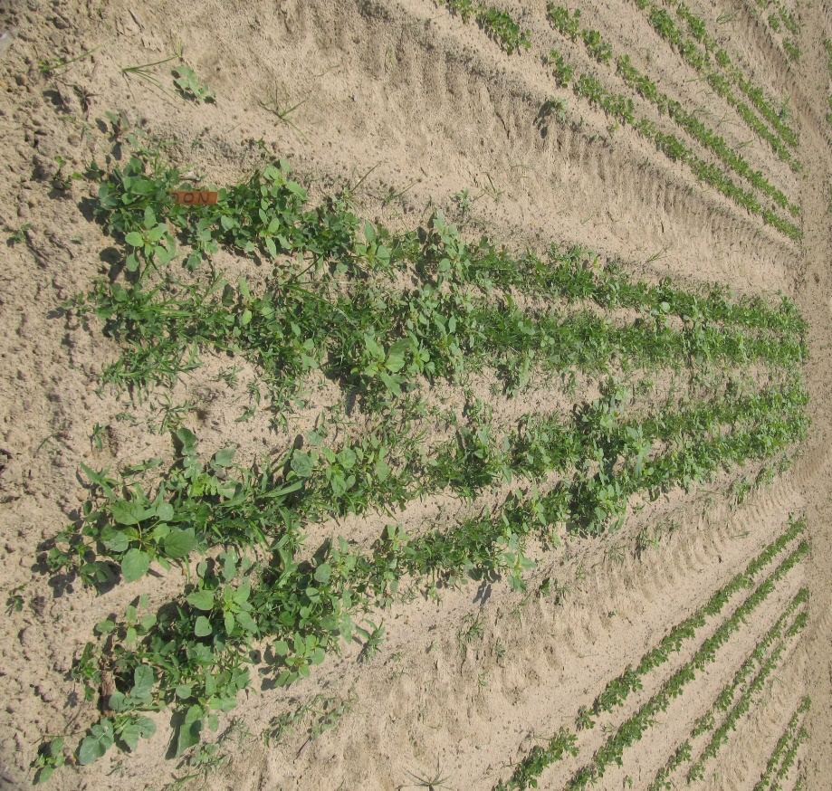
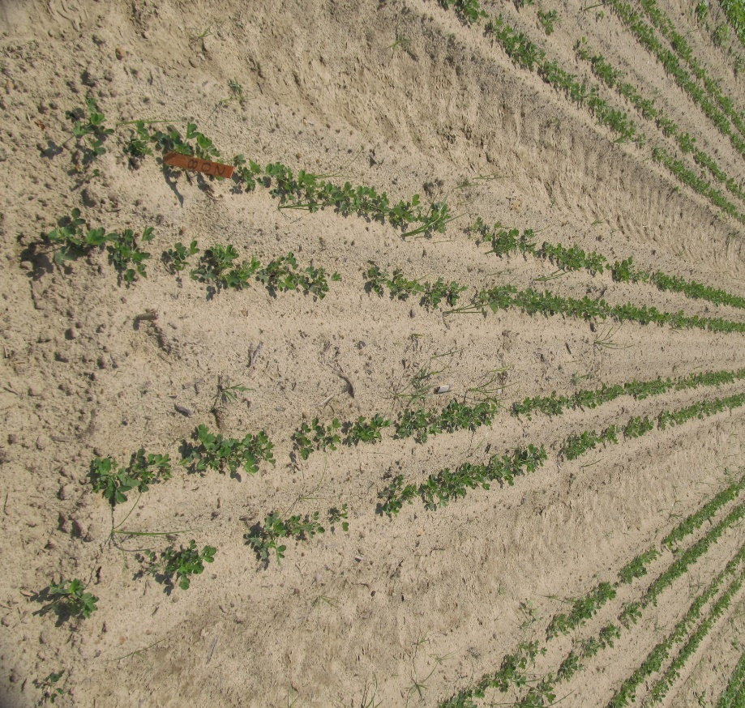
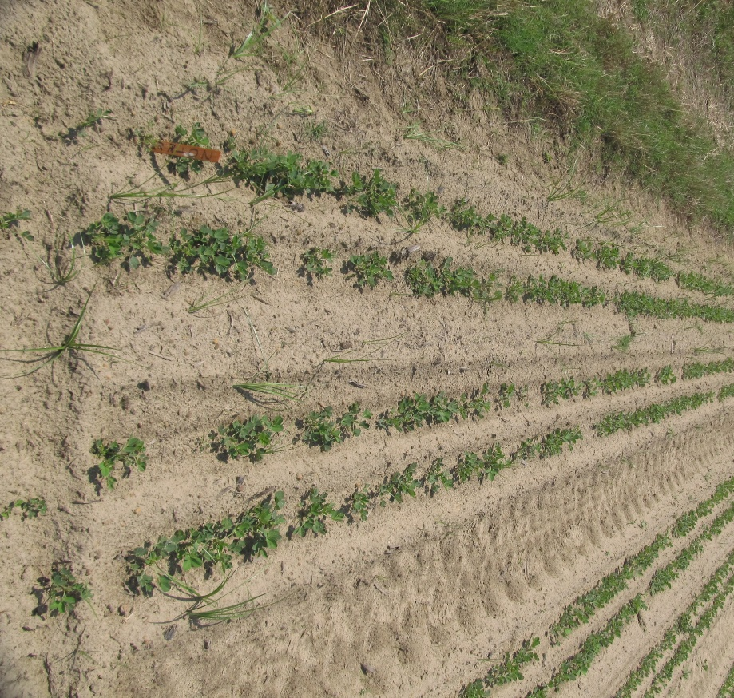
Peanut Weed Control - 2022
Valor + Strongarm vs. Brake + Strongarm
NTC
PRE (1 DAP)
Prowl H₂0 3.8SC @ 32 oz/A
Valor EZ 4SC @ 3 oz/A
Strongarm 84WG @ 0.225 oz/A
PRE (1 DAP)
Prowl H₂0 3.8SC @ 32 oz/A
Brake 1.2SL @ 12 oz/A
Strongarm 84WG @ 0.225 oz/A
PE-04-22
May 18
20 DAT
Rep 2

Slide 18
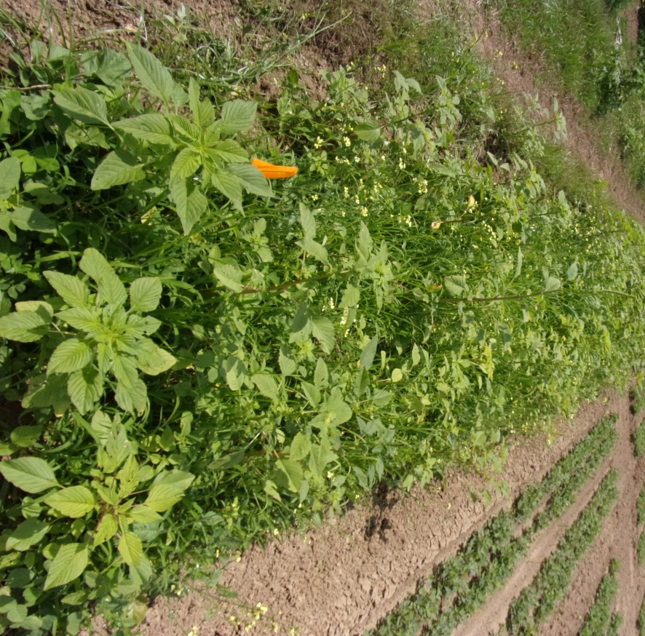
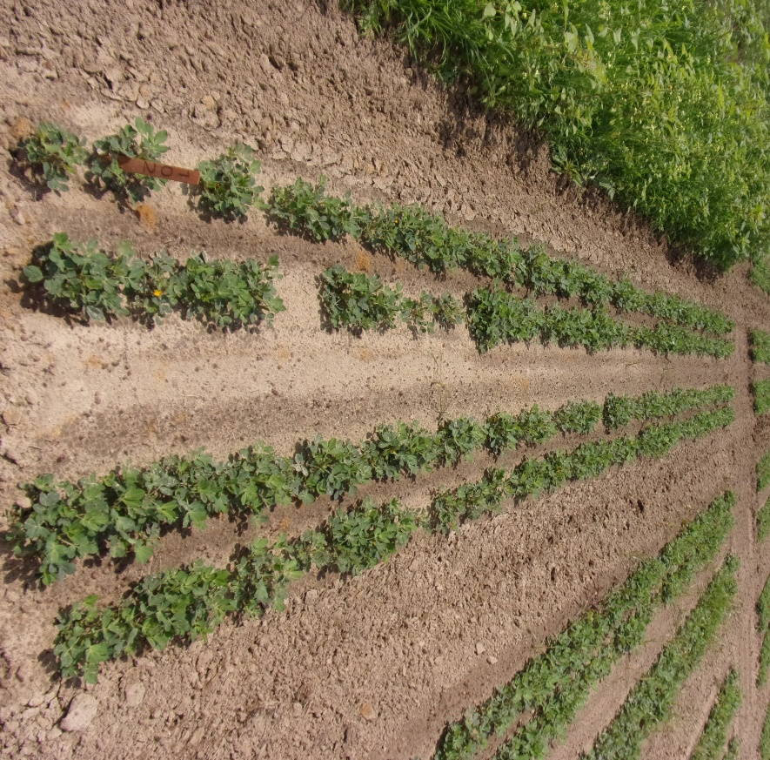
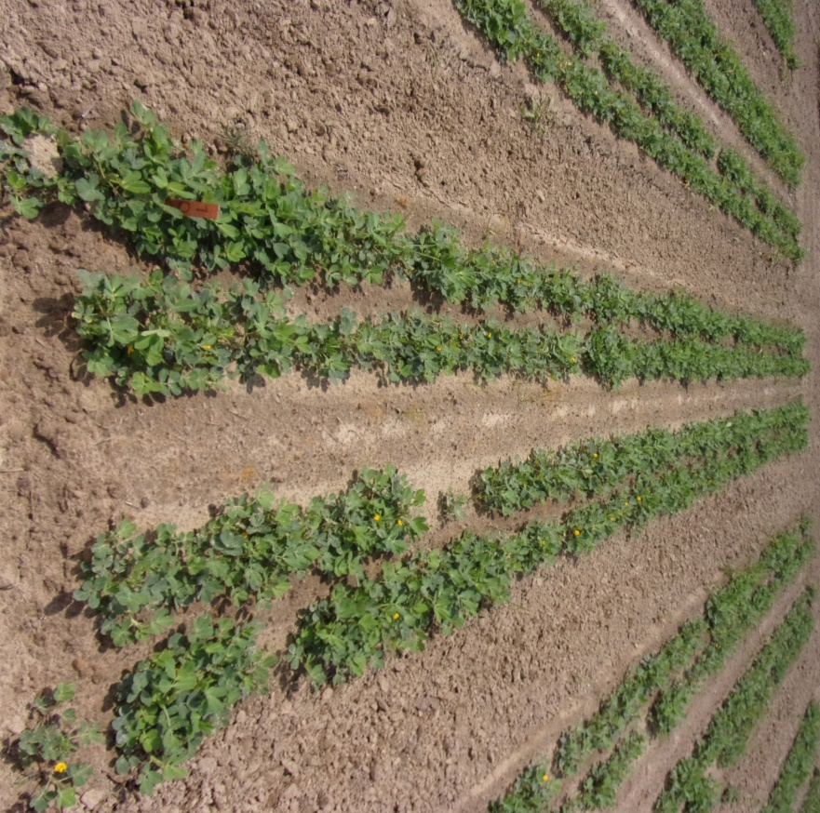
Peanut Weed Control - 2022
Valor + Strongarm vs. Brake + Strongarm
NTC
PRE (1 DAP)
Prowl + Valor + Strongarm
POST (27 DAP)
Cadre 2AS @ 4 oz/A
2,4-DB 2SL @ 16 oz/A
Dual Magnum 7.62EC @ 16 oz/A
PRE (1 DAP)
Prowl + Brake + Strongarm
POST (27 DAP)
Cadre 2AS @ 4 oz/A
2,4-DB 2SL @ 16 oz/A
Dual Magnum 7.62EC @ 16 oz/A
PE-04-22
June 2
36 DAP
Rep 1

Slide 19
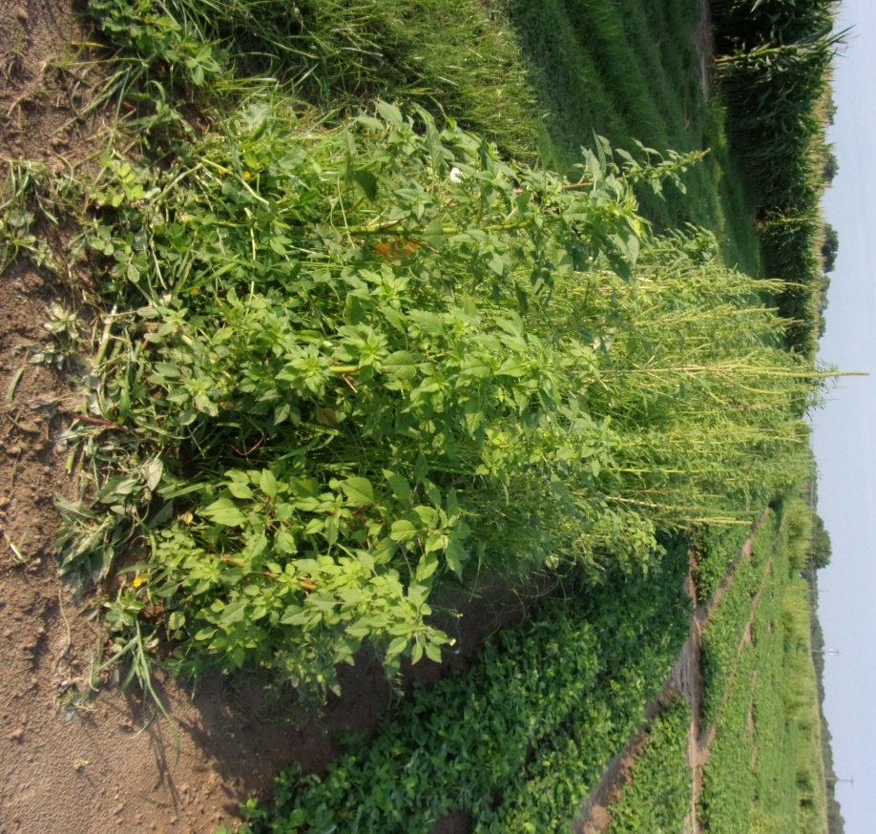
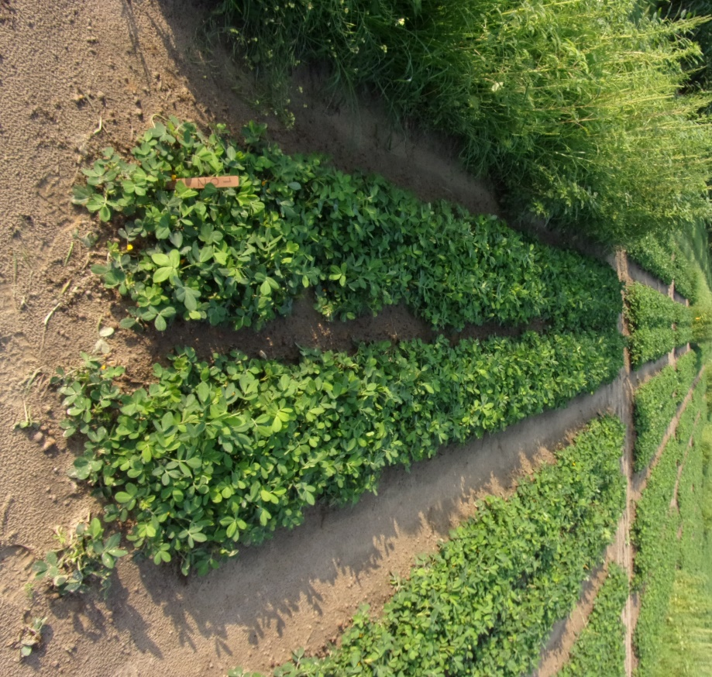
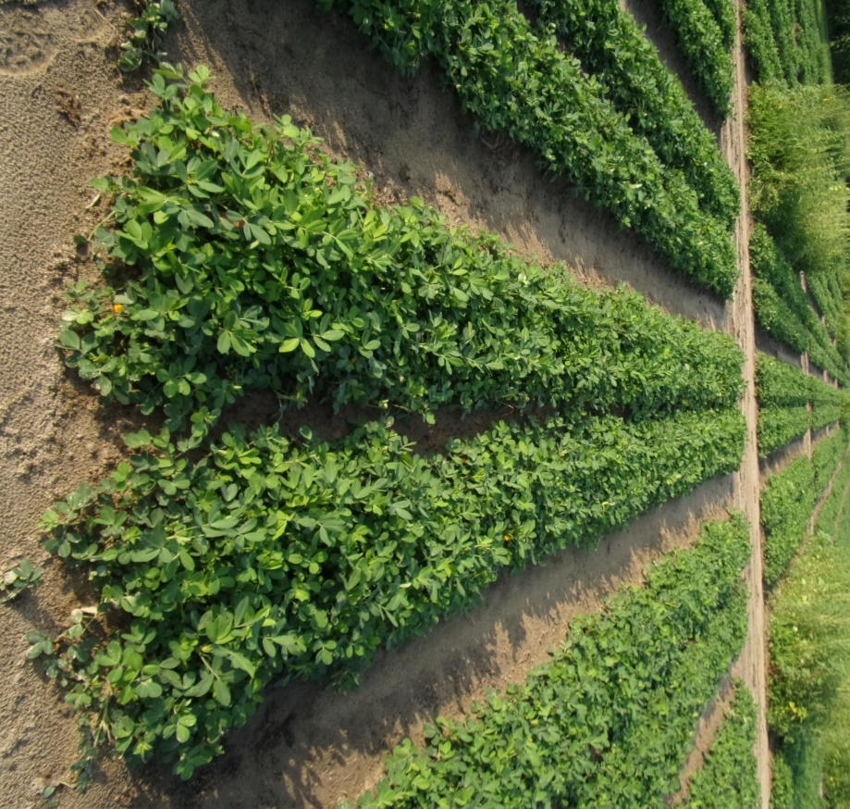
Peanut Weed Control - 2022
Valor + Strongarm vs. Brake + Strongarm
NTC
PRE (1 DAP)
Prowl + Valor + Strongarm
POST (27 DAP)
Cadre 2AS @ 4 oz/A
2,4-DB 2SL @ 16 oz/A
Dual Magnum 7.62EC @ 16 oz/A
PRE (1 DAP)
Prowl + Brake + Strongarm
POST (27 DAP)
Cadre 2AS @ 4 oz/A
2,4-DB 2SL @ 16 oz/A
Dual Magnum 7.62EC @ 16 oz/A
PE-04-22
June 16
50 DAP
Rep 1

Slide 20
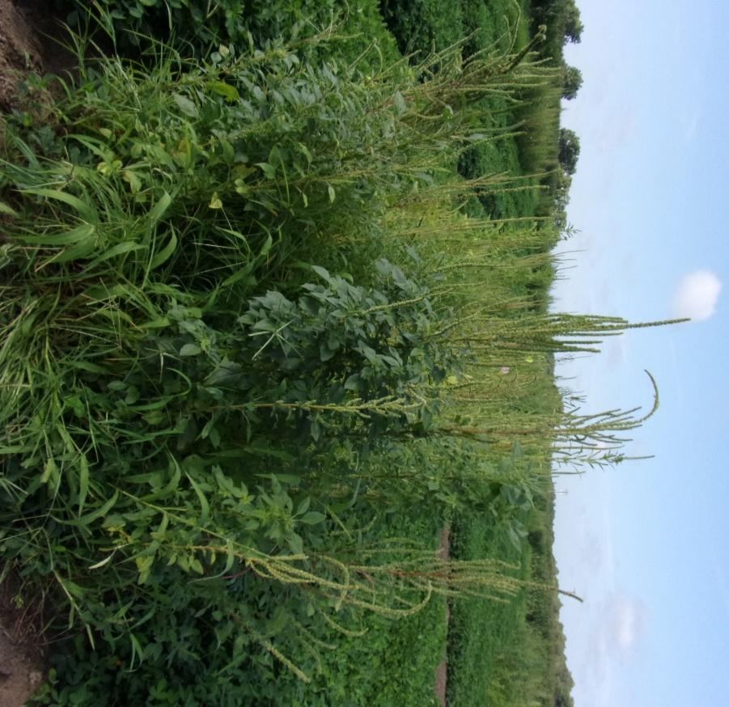
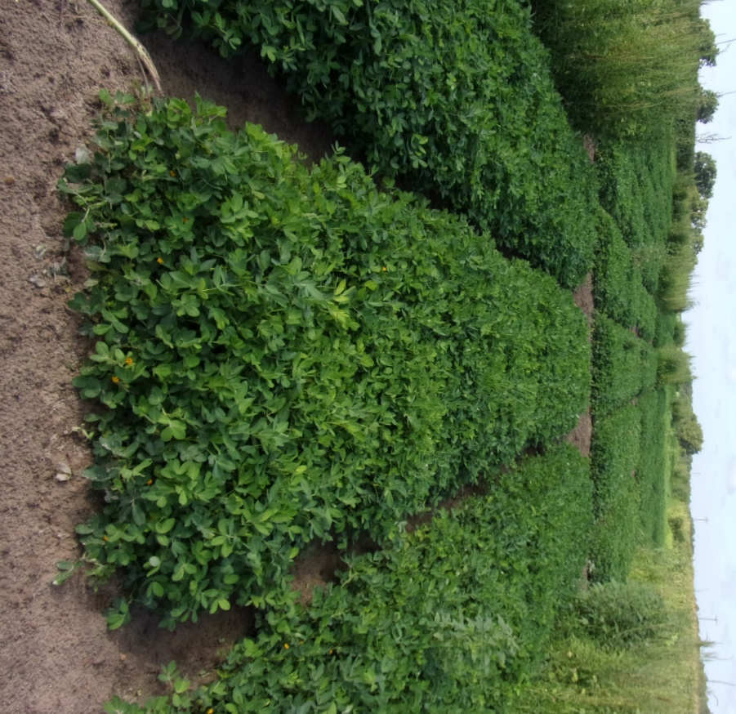
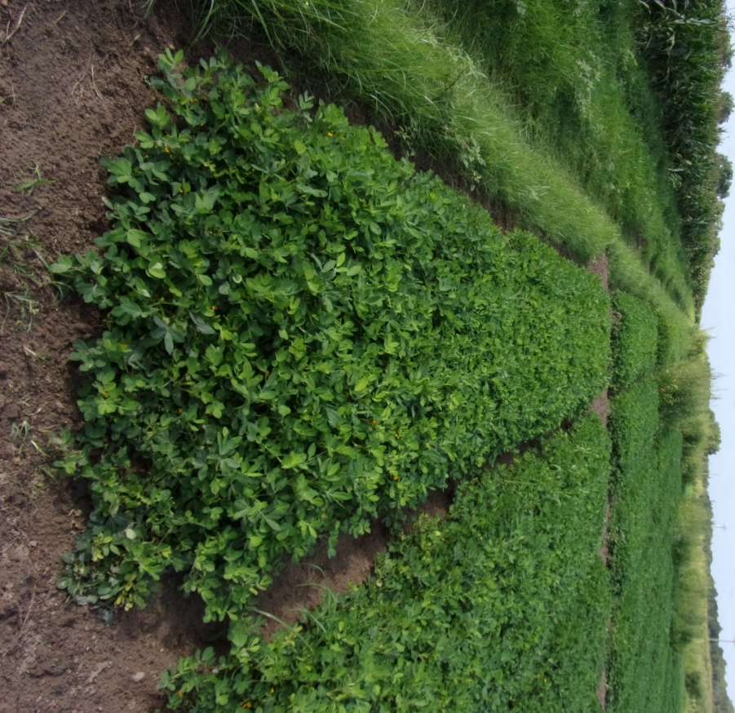
Peanut Weed Control - 2022
Valor + Strongarm vs. Brake + Strongarm
NTC
PRE (1 DAP)
Prowl + Valor + Strongarm
POST (27 DAP)
Cadre 2AS @ 4 oz/A
2,4-DB 2SL @ 16 oz/A
Dual Magnum 7.62EC @ 16 oz/A
PRE (1 DAP)
Prowl + Brake + Strongarm
POST (27 DAP)
Cadre 2AS @ 4 oz/A
2,4-DB 2SL @ 16 oz/A
Dual Magnum 7.62EC @ 16 oz/A
PE-04-22
July 6
70 DAP
Rep 2

Slide 21
Weed Control Summary
Stunting: Brake < Valor ~ 50 DAP
Brake w/ Prowl + SA = Valor w/ Prowl + SA
> 80% Weed Control
Additional MOA in Chemical Tool Box
Used with Cotton program
Advise 12 oz/A rate, confident 2X rate is safe
Less $$ than Cotton

Slide 22
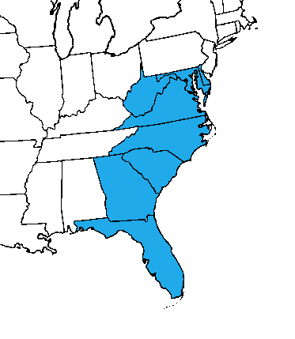
SePRO Update
Brake Registration for 2023 on track with EPA
Continued Collaboration with UGA
Peanut / Cotton / Permanent Crop Research
Looking to continue University / Extension trials
Call me for On-farm Questions or Problems
Technical Development Manager
Located in Tifton
Territory from Florida to Virginia

Slide 23
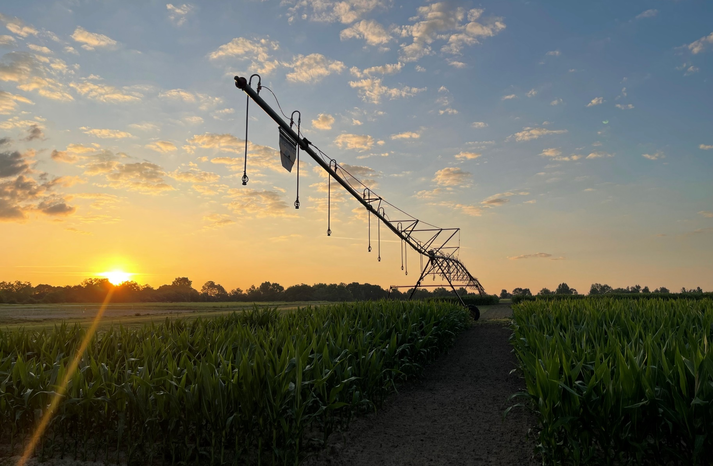
Thank You! Questions?

