Slide 1
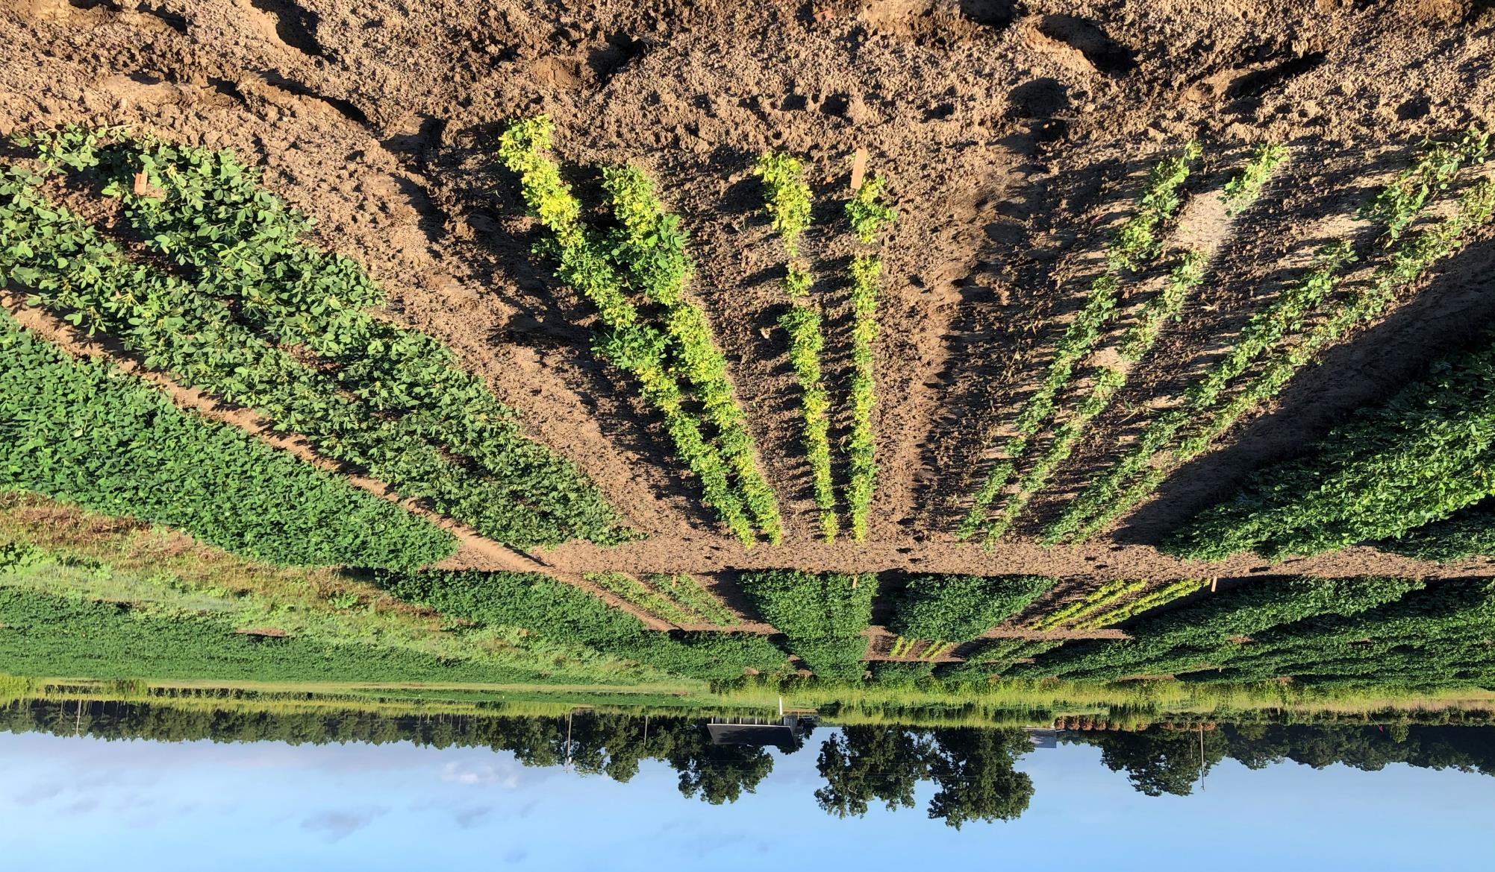
Peanut Response to Forestry Herbicides: Imazapyr and Triclopyr
Chad Abbott
Dr. Eric Prostko

Slide 2
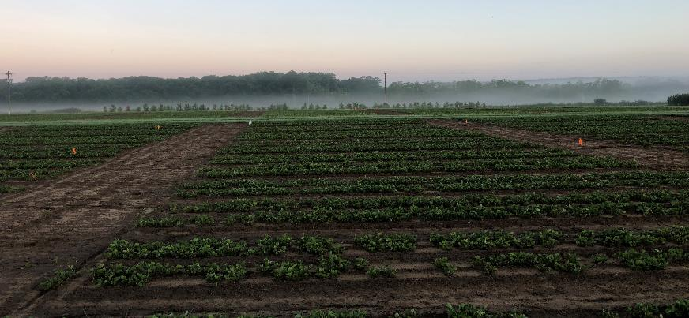
Georgia Pines
Peanuts
4,451,542 ha in pine production
1,677,539 ha in natural
2,805,099 ha in planted
67% in loblolly/shortleaf
33% in longleaf/slash
Lumber, pulp, telephone poles, straw, toiletries, cleaning products
35,180 ha Evergreen Forest in Mitchell County, GA
Source: Brandeis, Thomas J.; McCollum, Joe; Hartsell, Andy; Brandeis, Consuelo; Rose, Anita K.; Oswalt, Sonja N.; Vogt, James T. (JT); Marcano-Vega, Humfredo. 2016. Georgia's Forests, 2014. Resource Bulletin SRS-209. Asheville, NC: U.S. Department of Agriculture Forest Service, Southern Research Station. 78 p.
335,889 ha planted
Averaged 5040 kg/ha
18,871 ha peanut in Mitchell County, GA
1.86 ha Evergreen Forest : 1 ha Peanut
Sources: NASS 2021; https://quickstats.nass.usda.gov/results/18D9DF74-F8EE-3E43-BF25-4B2E6F24E512
Notes:
Its typically the intensively managed pine production acres is where herbicides maybe sprayed. The takeaway from this slide to is illustrate the expansiveness of pine tree production across Georgia, and to highlight the frequency at which you will find a peanut field within close proximity managed pines.

Slide 3
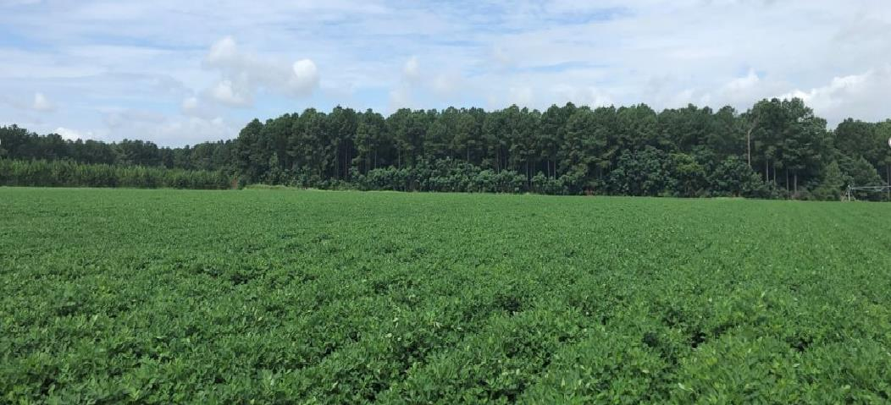
Accidental Drift and Extension Calls
Peanut Field Surrounded by Pine Trees – Bulloch Co​
(July 2020)​
Aerial applications:
Site prep; HWC; CRP
Poured/Drifted into irrigation ponds
Notes:
Herbicides labeled for pines effectively changed the way pine silviculture is performed. Prior to herbicides, it was expensive mechanical removal or fire which is limited to tree size.
In order to promote successful pine competition, herbicides (Garlon and Arsenal) release pines by effectively controlling grasses, broadleaf species, and other tree species;
Chemical site preparation using herbicides prior to planting; occurring August to October (imazapyr @28-32oz/a/ triclopyr @ 1-1.5pts/a);
Herbaceous Weed Control (HWC) applications occur between March or April at 4 to 6 oz/ac;
Woody Release occurs 1 to 5 years while stand is precommercial, August through October imazapyr @12-14oz/a;
Mid-rotation Brush Control occurs the first year after a thinning when pines are 15-18 yrs old, can be delayed up to 5 yrs after thinning occurs applications during August-Oct.
These herbicides can also be used on unimproved Bermuda grass, for example, shoulders of the road. These applications would most likely not be the reason for a drift event, but just another example of the many uses and applications of these two herbicides and their potential to find their way onto a peanut field.

Slide 4
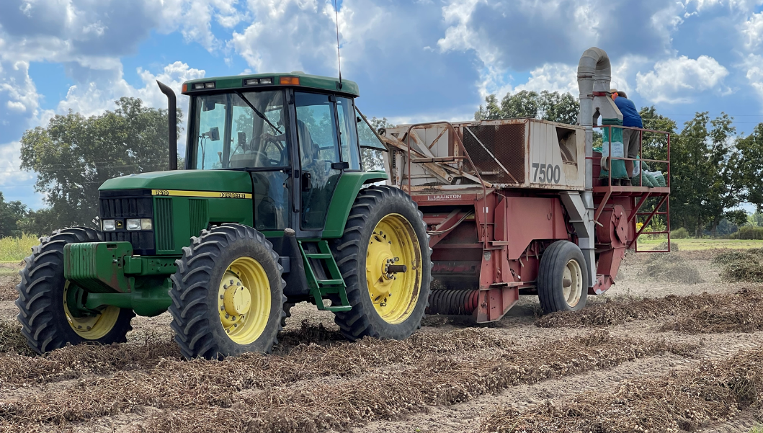
Statement of Objective
The objective of this research was to determine the effects of PRE and POST applications of imazapyr and triclopyr on peanut.
Hypothesis
Our hypothesis is that imazapyr and triclopyr will impact peanut growth and yield depending on rate and time of application (PRE or POST).

Slide 5
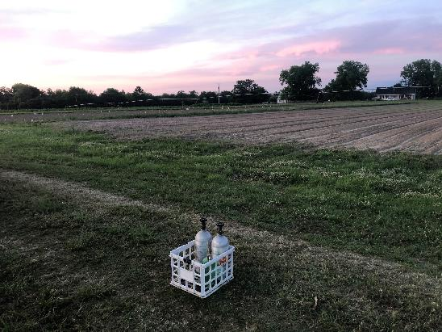
Materials and Methods
2020 – 2021 in Ty Ty, GA
Two different studies
Treatments arranged in CRD, 4 replications
3 (Time) X 4 (Rate) Factorial
Plots planted in twin-row configuration on 1.83 m x 7.62 m beds
Maintained Weed-Free
Peanut Variety:
GA-06G
Herbicide Rates and Timings:
PRE (1 DAP), 28 DAP, 58 DAP
Imazapyr: 0, 4.2 (1/100th X), 42 (1/10th X), 420 g ai ha⁻¹ (1X)
Arsenal Powerline 2AS
Triclopyr: 0, 8.4 (1/100th X), 84 (1/10th X), 840 g ai ha⁻¹ (1X)
Garlon 3A
Standard small plot application techniques

Slide 6
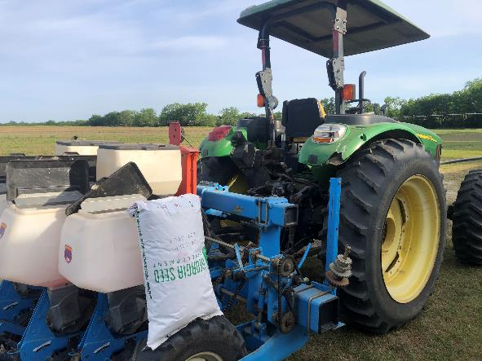
Materials and Methods
Peanut plant density: 17 days after planting (DAP)
Peanut stunting/chlorosis: 61-63 DAP
Plant height and widths: 64 DAP
Yield and percent yield loss
Data subjected to ANOVA using PROC GLIMMIX, SAS 9.4; means separated using Tukey-Kramer HSD (P=0.05)
No interaction between years
Imazapyr: No Rate * Timing: Main Effect of Rate; Timing NS
Triclopyr: Rate * Timing
Notes:
Data was collected throughout the growing season, but for this presentation I will be reporting peanut density, showing the qualitative results of peanut stunting from both studies and chlorosis from imazapyr. I will be showing the height and width data from both studies along with yield and associated yield losses. Yields were adjusted for foreign material and moisture.
There was a rate by timing interaction with triclopyr, therefore data is reported as herbicide rates at timings.
Timing had no effect with Imazapyr herbicide. Therefore results are reporting the main effect of herbicide rate.

Slide 7
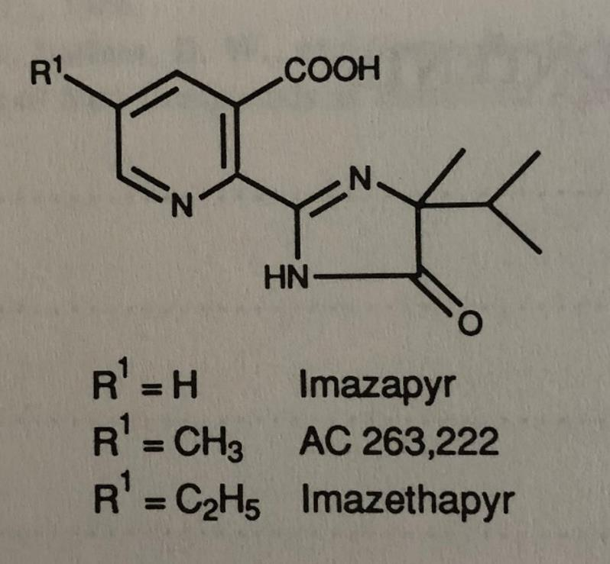
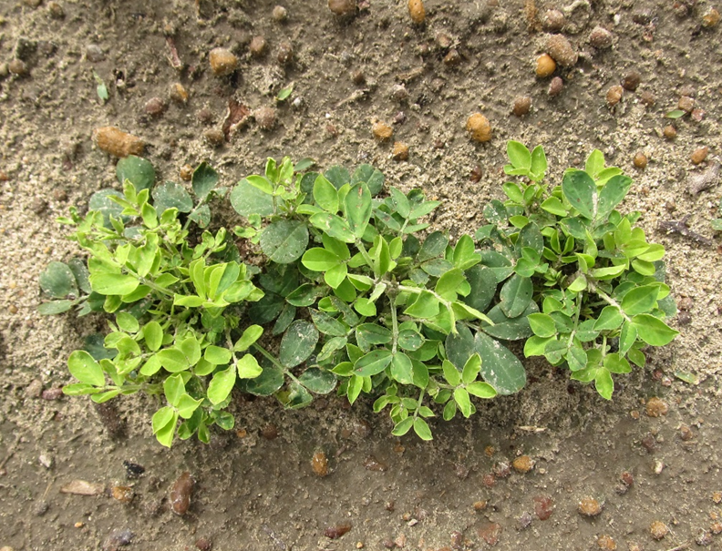
Cadre (imazapic/AC-263,222) vs. Pursuit (imazethapyr) vs. Arsenal (imazapyr). Structurally not that different but……..
1X Rate: 28 DAP
June – 26; 60 DAP
Notes:
On this slide before we get into the results of imazapyr and triclopyr, I would like to highlight the very slight differences in imidiazilinone herbicides at the R1 binding site. Two of the 3 compounds presented have excellent peanut tolerance and prolific use within row crop situations, however, as you can see with the picture on the right of the stunted and chlorotic peanut plants on the right, the single Hydrogen at the R1 binding site of imazapyr herbicides shows that one substitution can make all the difference in tolerance and significant crop injury or susceptibility.

Slide 8
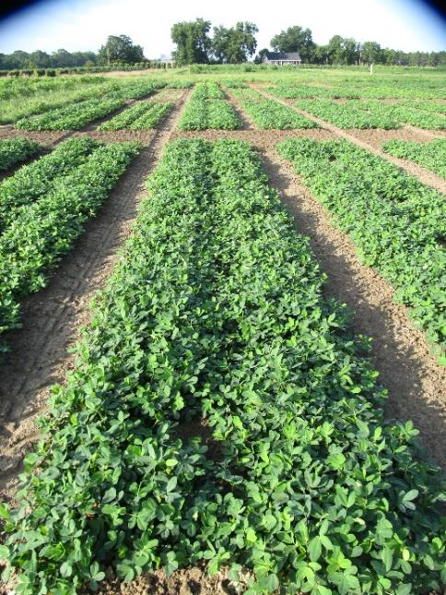
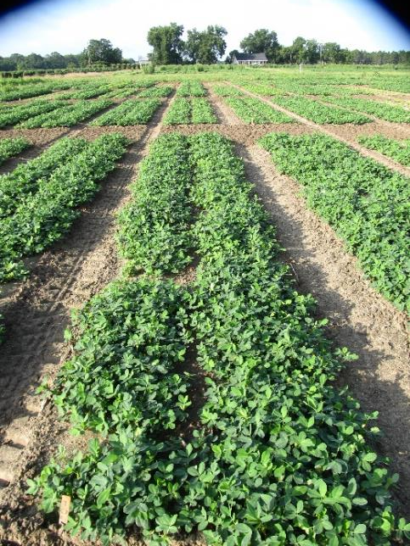
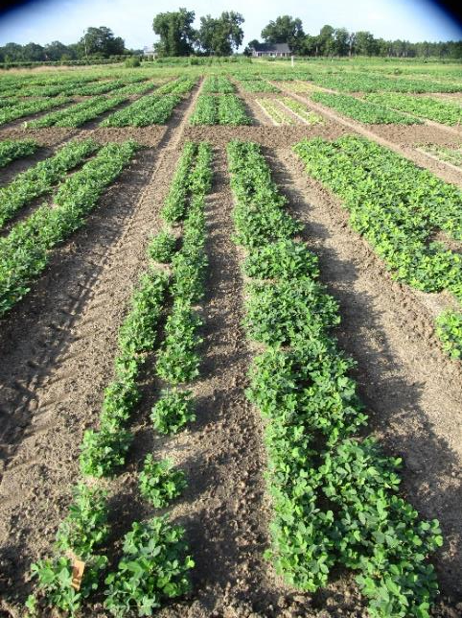
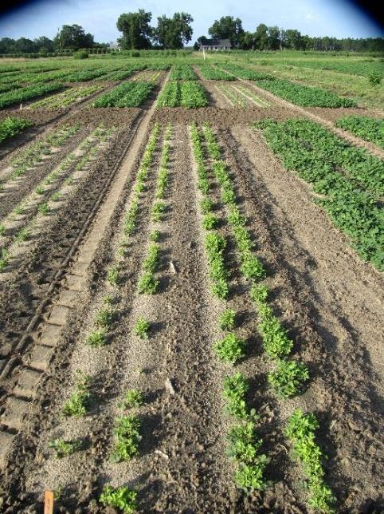
Peanut Response to Imazapyr – Applied 28 DAP
0
1/100th X
1/10th X
1 X
July – 2; 66 DAP
Notes:
For the next few slides, I want to discuss with you the timing and rates which highlight the most significant reduction in plant canopy development and respectively had the lowest yields. These series of pictures show the visual development or lack there of when Arsenal is sprayed over the top. The 1/10th and 1X rates had significant effects in peanut canopy development throughout the growing season.

Slide 9
Imazapyr Plant Density: 17 DAP
P=0.0812
Notes:
For the next few slides, I want to discuss with you the timing and rates which highlight the most significant reduction in plant canopy development and respectively had the lowest yields. These series of pictures show the visual development or lack there of when Arsenal is sprayed over the top. The 1/10th and 1X rates had significant effects in peanut canopy development throughout the growing season.

Slide 10
Imazapyr Stunting and Chlorosis: 61 DAP
P<.0001

Slide 11
Imazapyr Plant Measurements: 64 DAP
P<.0001

Slide 12
Imazapyr Yield
15%
67%
P<.0001
Notes:
Yield Loss 0 4 15.3 67.3
Worst case scenario.. In order to plant after 1X rate.. Er on side of caution..

Slide 13
Imazapyr Summary
Plant density was not impacted by any rate
1/10th and 1X rate regardless of timing caused:
Significant stunting and chlorosis (1X rate)
Significant reductions in plant canopy
Significant Yield loss
Drift Rates ≤1/100th X should not cause significant yield loss
Half-life various: 25 -142 days in soil, 2 – 3 days in shallow ponds

Slide 14
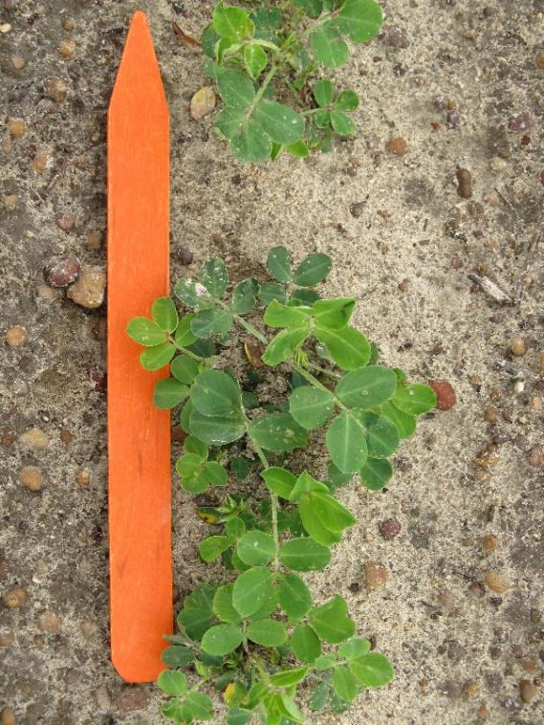
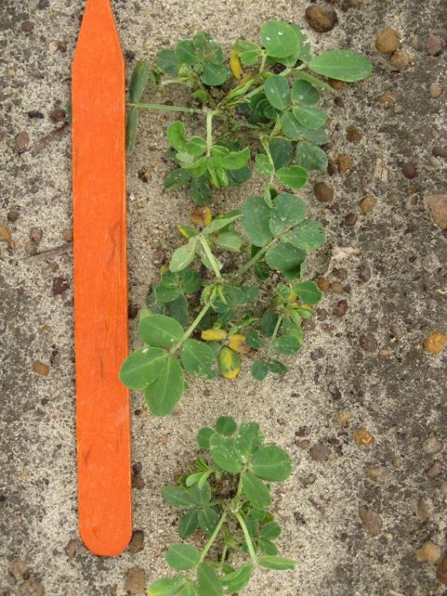
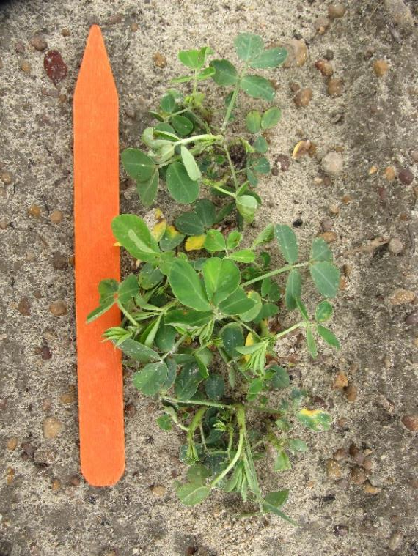
Peanut Response to Triclopyr Applied @ 28 DAP – 1 DAT
1/100thX
1/10thX
1X
May – 26
Notes:
As I mentioned earlier, that garlon has a synthetic auxin mode of action, so epinasty injury is something that we noticed very early on soon after we sprayed the 1x rate over the top. I also want to highlight the chlorosis that is exhibited when peanuts were exposed to the 1/10thX rate. We did not notice much of any epinasty or chlorosis when we sprayed the 1/100thX rate over the top.

Slide 15
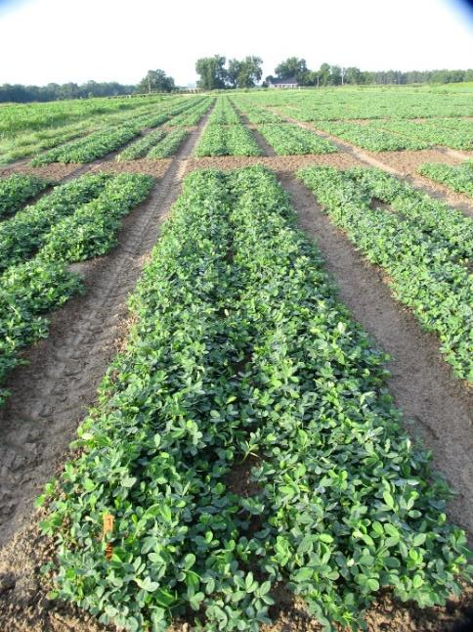
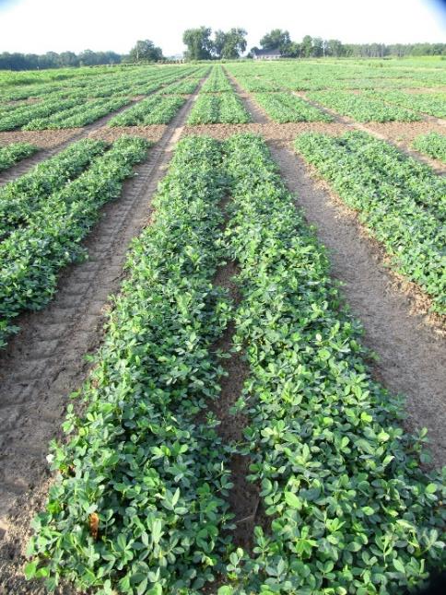
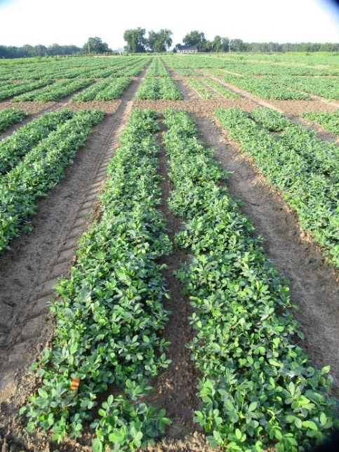
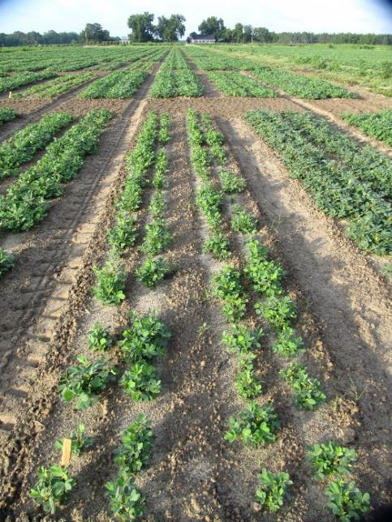
Peanut Response to Triclopyr – Applied 28 DAP
0
1/100th X
1/10th X
1 X
July – 2; 66 DAP
Notes:
For the next few slides, I want to discuss with you the timing and rates which highlight the most significant reduction in plant canopy development and respectively had the lowest yields. These series of pictures show the visual development or lack there of when Arsenal is sprayed over the top. The 1/10th and 1X rates had significant effects in peanut canopy development throughout the growing season.

Slide 16
Triclopyr Plant Density: 17 DAP
P<.0001

Slide 17
Triclopyr Plant Stunting: 63 DAP
P<.0001

Slide 18
Triclopyr Plant Heights: 64 DAP
P<.0001

Slide 19
Triclopyr Plant Widths: 64 DAP
P<.0001

Slide 20
Triclopyr Yield
15%
45%
57%
P<.0001

Slide 21
Triclopyr Summary
1X rate = Yield loss 15 – 57% depending on timing
1X rate at 28 DAP = greatest injury to plant canopy
1X rate at 58 DAP = greatest yield loss
Drift rates ≤1/10th X should not cause significant yield loss
Less injurious than Imazapyr
Half-life various: 10 - 46 days in soil, ~10 hours in shallow ponds @ 25 ̊C

Slide 22
Hypothesis
Our hypothesis is that imazapyr and triclopyr will impact peanut growth and yield depending on rate and time from PRE or POST applications.
Fail to Reject
Other Relevant Research
Carter, O. W., Prostko, E. P. 2020. The Effect of Picloram Plus 2,4-Dichlorphenoxyacetic Acid on Peanut Growth and Yield. Peanut Science. 47:111-114
“Peanut fields unintentionally exposed to picloram + 2,4-D rates ≤ 1/100thX can exhibit typical injury symptoms but most likely will not experience yield losses.
Future Research
Continue research in 2022
Implement a 1/5th X Rate for regression analysis (2021 and 2022)

Slide 23
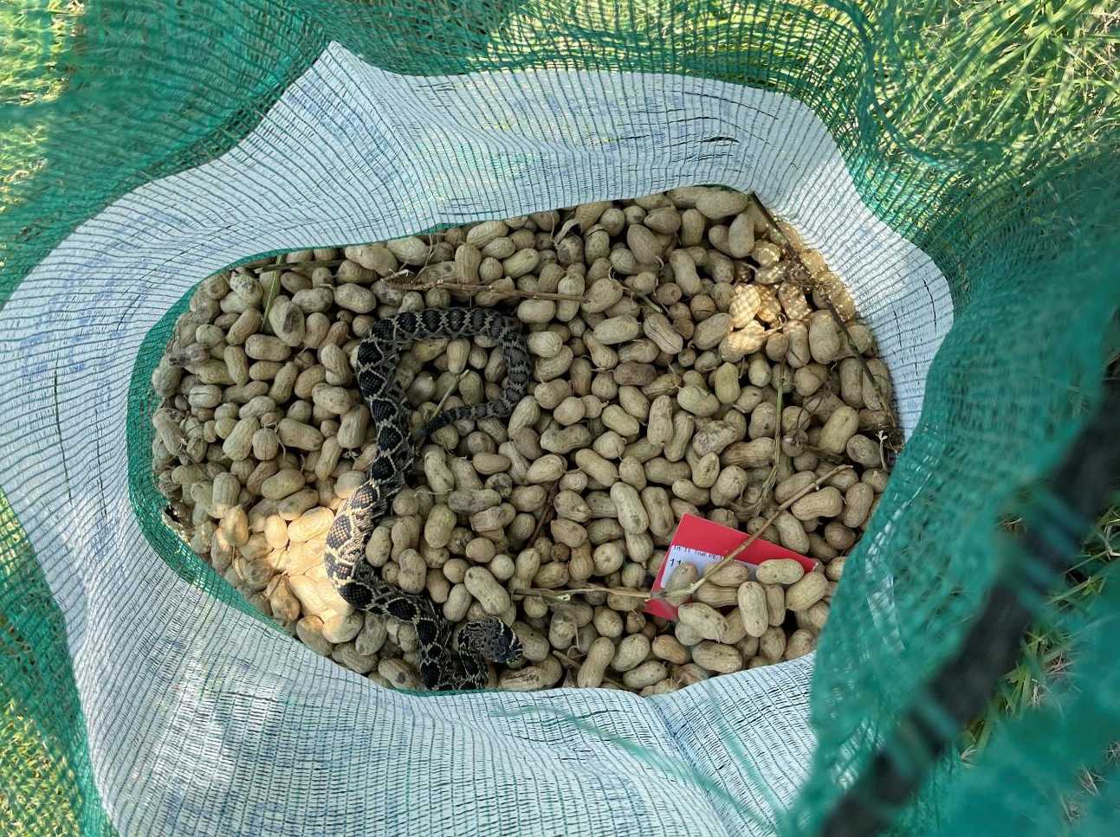
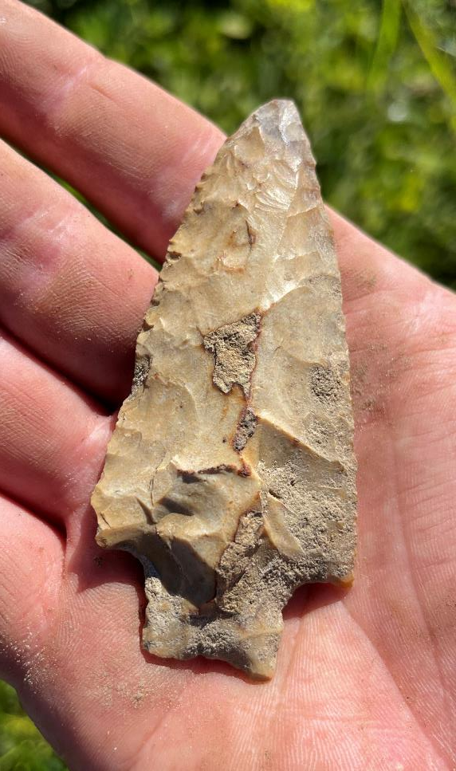
Thank You!
Questions?
ccabbott@uga.edu

