Slide 1
Weed Control in Conventional Soybeans: “Back to the Future”
Eric P. Prostko
Extension Weed Specialist
Dept. Crop & Soil Sciences

Slide 2
Weed Control in Conventional Soybeans
All depends upon the development and spread of PPO resistance (WSSA MOA #14)!

Slide 3
PPO-Resistance in US
First identified in US in 2002
tall waterhemp (Illinois)
24 reported cases
4 weed species
tall waterhemp, Palmer amaranth, common ragweed, goosegrass
1 recently confirmed case in GA
Source: Heap, I. The International Herbicide-Resistant Weed Database. Online. Friday, December 3, 2021 . Available www.weedscience.org Copyright © 1993- 2021 WeedScience.org All rights reserved.

Slide 4
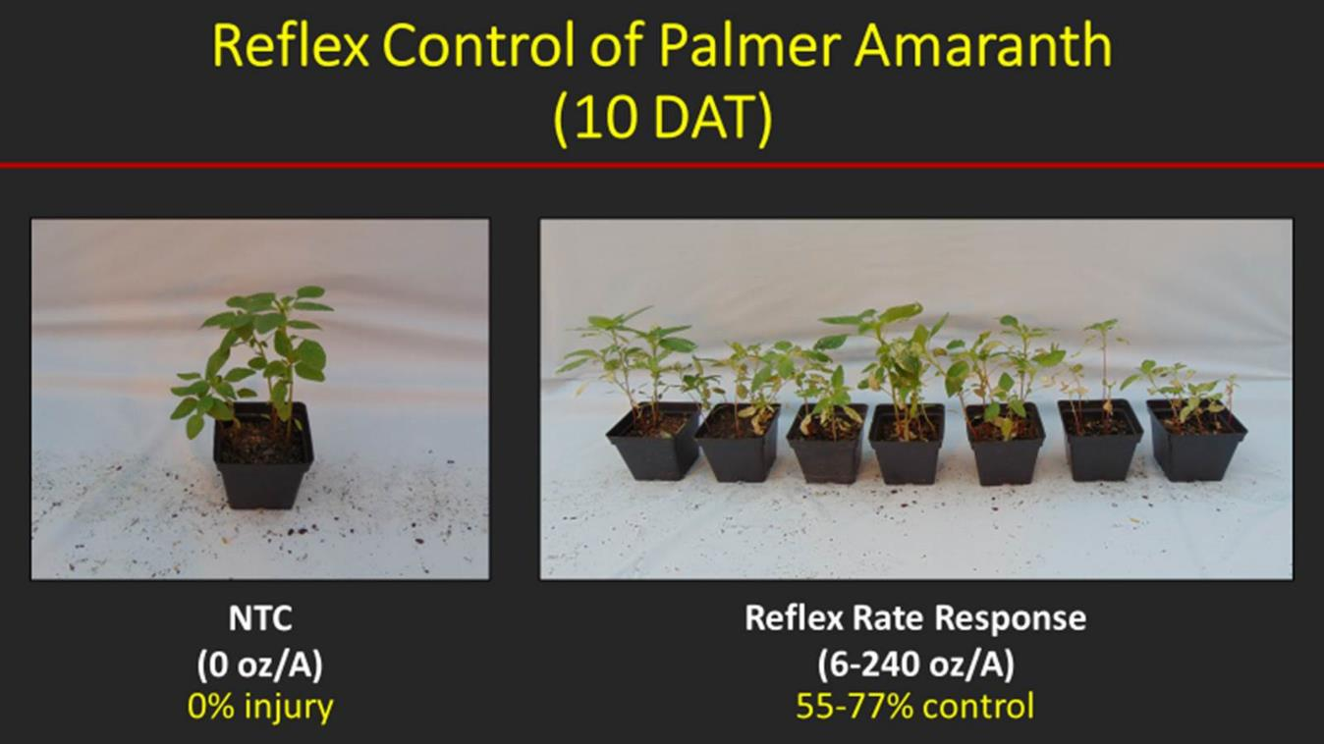
PPO-Resistance in GA
240 oz/A
Source: Randell and Culpepper, 2021

Slide 5
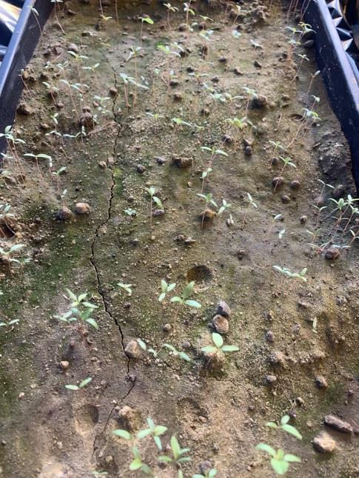
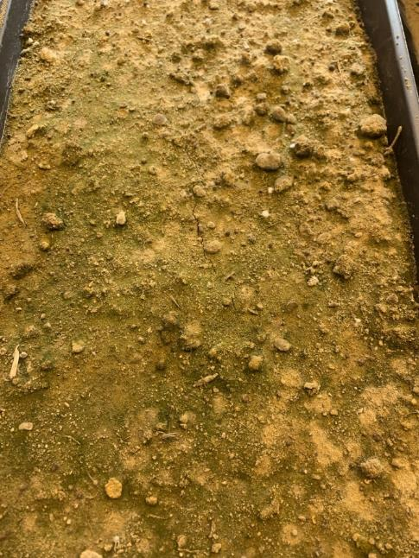
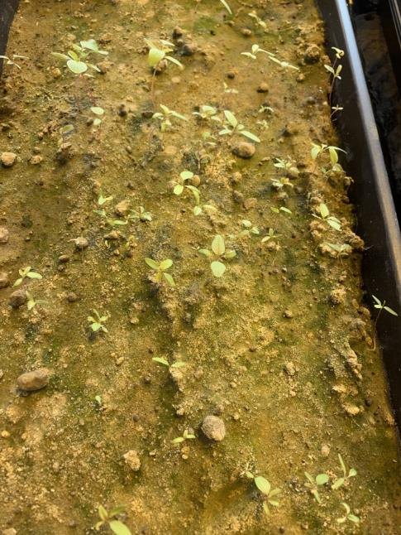
Palmer Amaranth Response to Valor PRE.
UGA Tifton Greenhouse - 2021
Non-treated control
Valor PRE
Susceptible Population
Valor PRE
PPO POST Resistant Population

Slide 6
Valor in GA Soybeans?
Effective, legal and labeled but…….
Valor fb Reflex/Prefix/Warrant Ultra is a good weed control program but a bad resistance mgt plan!
Unless you hand-weed escapes!
Weed control in cotton and peanut without Valor/Reflex?

Slide 7
“Old School”
What were you doing before 1996?
What weeds were causing you problems before 1996?

Slide 8
Top Herbicides Used in Georgia Soybeans (1995) (330,000 acres planted)
Acres (%)
Source: NASS – Agricultural Chemical Usage – Field Crops and Potatoes (03/25/96)

Slide 9
Top 10 Troublesome Weeds in Georgia Soybeans (1995)
sicklepod
annual MG
pigweed
coffee senna
cocklebur
Johnsongrass
crabgrass
Texas panicum
FL beggarweed
yellow nutsedge
Source: Proceeding SWSS (1995) 48:299

Slide 10
Conventional Soybeans Herbicides
PPO resistant weeds = SOL (really!)
Metribuzin – PRE
Prowl or Group 15’s
Reflex, Cobra, Ultra Blazer, Prefix, Warrant Ultra
Classic or FirstRate (sicklepod + MG)
STS® (1993) - single gene (non-GMO)
Bolt™ (2015) - 2 genes (non-GMO)

Slide 11
NON-GMO Soybean Cultivars with STS and Metribuzin Tolerance????
GoSoy 48C17S
Root-knot susceptible
Virtue 4520S, 4921S, V4720S
Root-knot susceptible

Slide 12
Metribuzin Products
Manufacturer | Trade Name | Active Ingredients
FMC | Authority MTZ | sulfentrazone + metribuzin
Syngenta | Boundary | s-metolachlor + metribuzin
Corteva | Canopy Canopy Blend | chlorimuron (10.7%) + metribuzin (64.3%) chlorimuron (8.3%) + metribuzin (50%)
NuFarm | Cloak | chlorimuron (10.7%) + metribuzin (64.3%)
Valent | Fierce MTZ | flumioxazin + pyroxasulfone + metribuzin
Loveland | Intimidator | s-metolachlor + fomesafen + metribuzin
NuFarm | Panther MTZ | flumioxazin + metribuzin
NuFarm | Panther Pro | flumioxazin + imazethapyr + metribuzin
Valent | Mauler | metribuzin
UPL | TriCor | metribuzin
Corteva | Trivence | flumioxazin + chlorimuron + metribuzin

Slide 13
Anthem Max, Dual, Warrant, Zidua, Outlook, Prowl????

Slide 14
Soybean Weed Control - 2021
Metribuzin @ 0.25 lb ai/A + WSSA Group 15
(PRE)
NTC
SB-01-21
May 18
29 DAP

Slide 15
Soybean Weed Control - 2021
NTC
Reflex 2SL @ 24 oz/A
Classic 25DG @ 0.5 oz/A
2,4-DB 2SL @ 2 oz/A
Induce @ 0.25% v/v
Applied 17 DAP
SB-04-21
July 19
53 DAP

Slide 16
Reflex @ 24 oz/A + Classic @ 0.5 oz/A + 2,4-DB @ 2 oz/A - Applied 17 DAP (V2)
SB-04-21
June 16
30 DAP

Slide 17
Classic 25DG @ 0.67 oz/A + NIS Injury on Non-STS Soybeans
WT-01-21
July 19
6 DAT

Slide 18
PPO Injury on Soybean

Slide 19
Envive Rates/Crop Injury
Corteva
41.3% WG
Classic – 9.2%
Valor – 29.2%
Harmony – 2.9%
Rate range of 2.5-4.0 oz/A
I prefer 2.5 oz/A
Similar injury situation occurs with Valor XLT
Valor XLT = Valor (30%) + Classic (10.3%)
Most likely cause is Classic
STS/Bolt technologies??

Slide 20
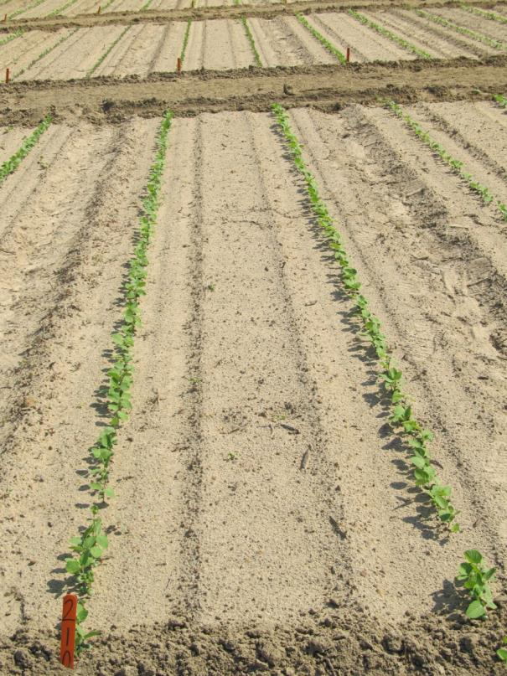
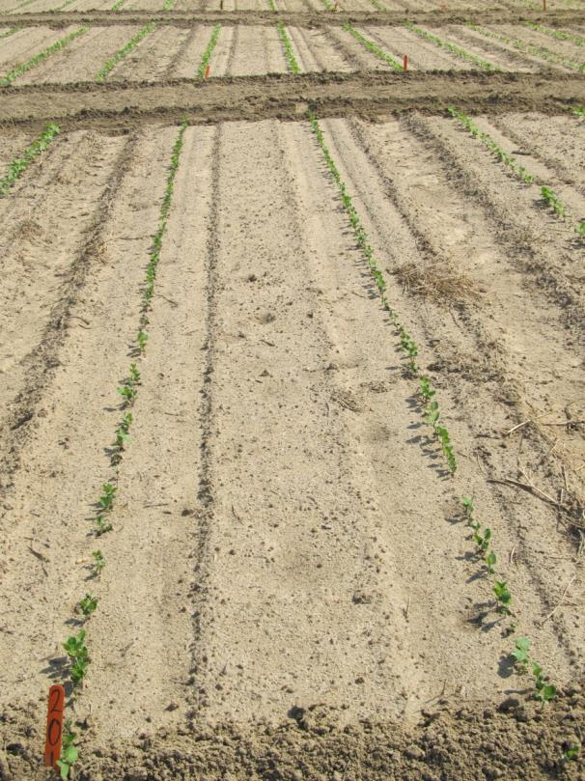
Soybean Injury Caused by Envive 41.3WG @ 3.5 oz/A 10 DAP
NTC
Envive
SB-21-11

Slide 21
Surveil 48WDG
Corteva
Valor (36%) + FirstRate (12%)
2.8 to 4.2 oz/A
PRE within 3 days of planting
Better residual control of annual mg than Valor alone?
2.8 oz/A
2 oz/A Valor 51WG
0.4 oz/A FirstRate 84WG
NTC
Surveil 48WG
2.8 oz/A (PRE)
75 DAT

Slide 22
Sonic 70WG
Corteva
Spartan (62.1%) + FirstRate (7.9%)
PPI or PRE
Cotton rotations??
NTC
Sonic 70WG
3 oz/A (PRE)
SB-08-13
June 16
39 DAT

Slide 23
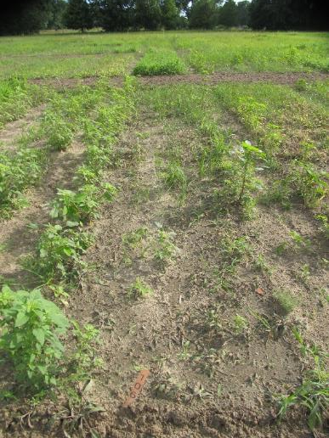
Conventional Soybeans POST Grass Control
NTC
PE-42-21
June 16
29 DAT
4’-5” weeds at application

Slide 24
Narrow Rows and Weed Control - Soybeans
“A review of row spacing experiments in which an initial weed management practice had been accomplished revealed that in 64% of the cases (72 of 113 site-years), less late-season weed density and/or biomass, or greater late-season weed control, was achieved in narrow-row (< 30”) compared to wide-row soybean production systems.”
Bradley, K. W. 2006. A review of the effects of row spacing on weed management in corn and soybean. Online. Crop Management doi:10.1094/CM-2006-0227-02-RV.

Slide 25
On-Time
Works 100% of the time
Excellent crop safety
any GPA or nozzle
tank-mix with anything
no rotational restrictions
FREE
Obstacles
Farm size
Weather
breakdowns
Beach Vacations
???

Slide 26
Conventional Soybean Weed Control – Summary (assuming no PPO resistance)
start clean
narrow rows (<30”)
metribuzin + Group 15 or Prowl - PRE
timely POST’s
Reflex, Prefix, Warrant Ultra, Cobra, Ultra Blazer, Classic, FirstRate
hand-weed escapes

Slide 27
Questions/Comments eprostko@uga.edu www.gaweed.com

