Slide 1

2022 Soybean Weed Control Update
Eric P. Prostko
Professor and Extension Weed Specialist
Dept. Crop & Soil Sciences

Slide 2
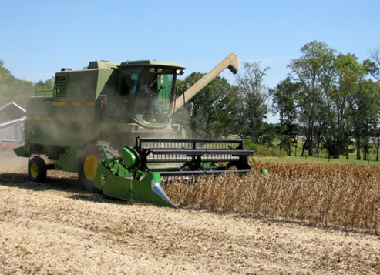
Soybean Weed Control Simplified
Start clean
Narrow rows (< 30”)
PRE
Metribuzin + Group 15 or Prowl
tolerant variety
Irrigation or rainfall
POST + Residual (weeds <3” tall)
Post = Reflex or Prefix or Warrant Ultra or Liberty or Dicamba (Engenia/Tavium/ Xtendimax) or Enlist One (2,4-D choline) or Enlist Duo (glyphosate + 2,4-D choline)
Residual = Anthem Flexx/Max or Dual or Warrant or Outlook or Zidua
Check tank-mix sites first

Slide 3
Metribuzin Products
Manufacturer | Trade Name | Active Ingredients
FMC | Authority MTZ | sulfentrazone + metribuzin
Syngenta | Boundary | s-metolachlor + metribuzin
Corteva | Canopy Canopy Blend | chlorimuron (10.7%) + metribuzin (64.3%) chlorimuron (8.3%) + metribuzin (50%)
NuFarm | Cloak | chlorimuron (10.7%) + metribuzin (64.3%)
Valent | Fierce MTZ | flumioxazin + pyroxasulfone + metribuzin
Loveland | Intimidator | s-metolachlor + fomesafen + metribuzin
NuFarm | Panther MTZ | flumioxazin + metribuzin
NuFarm | Panther Pro | flumioxazin + imazethapyr + metribuzin
Valent | Mauler | metribuzin
UPL | TriCor | metribuzin
Corteva | Trivence | flumioxazin + chlorimuron + metribuzin

Slide 4
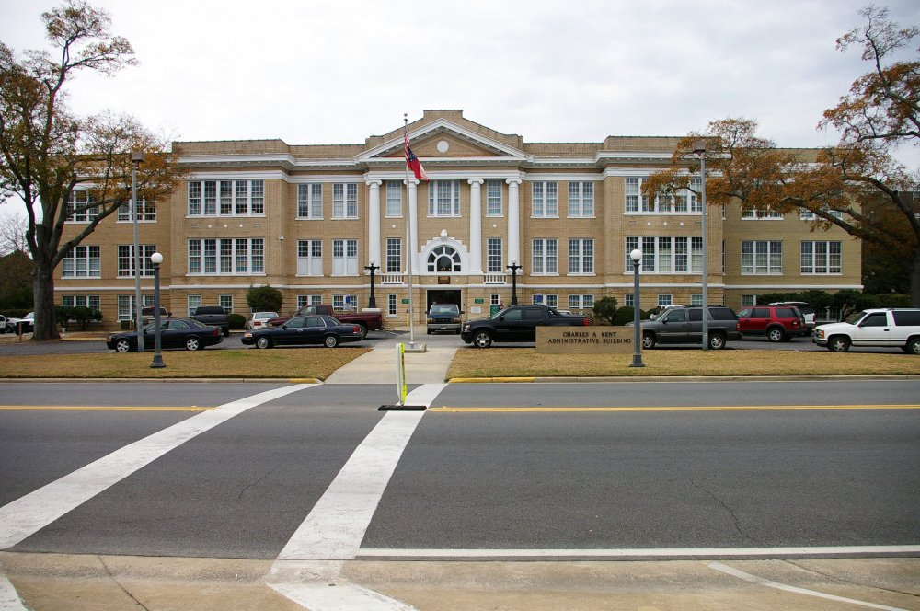
“Old School”

Slide 5




Conventional Soybeans
PPO resistant weeds = SOL (really!)
Metribuzin – PRE
Prowl or Group 15’s
Reflex, Cobra, Ultra Blazer, Prefix, Warrant Ultra
Classic or FirstRate (sicklepod + MG)
STS® (1993) - single gene (non-GMO)
Bolt™ (2015) - 2 genes (non-GMO)

Slide 6
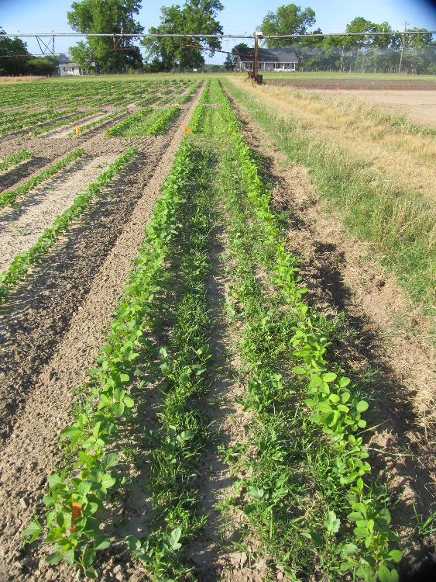
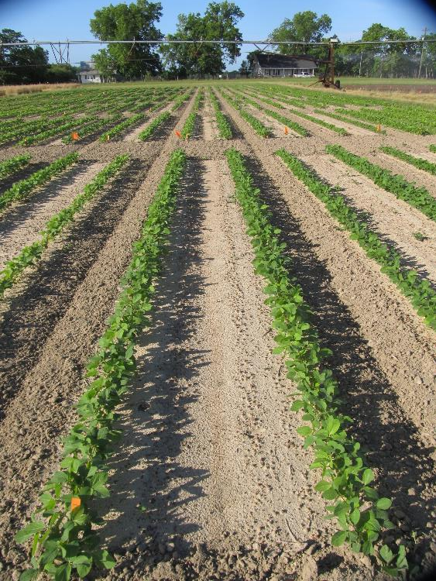
Soybean Weed Control - 2021
Metribuzin @ 0.25 lb ai/A + WSSA Group 15
(PRE)
NTC
SB-01-21
May 18
29 DAP

Slide 7
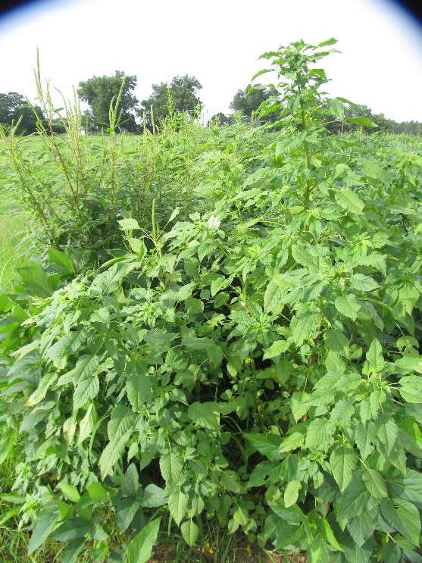
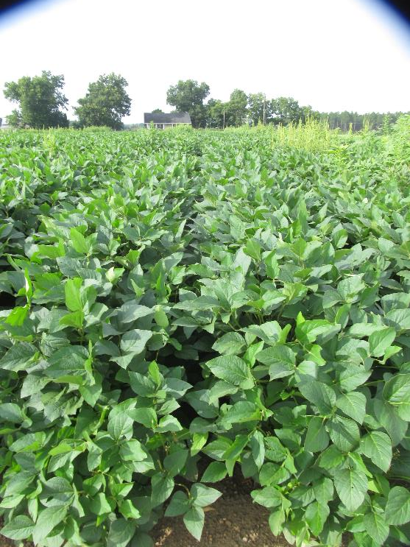
Soybean Weed Control - 2021
NTC
Reflex 2SL @ 24 oz/A
Classic 25DG @ 0.5 oz/A
2,4-DB 2SL @ 2 oz/A
Induce @ 0.25% v/v
Applied 17 DAP
SB-04-21
July 19
53 DAP

Slide 8
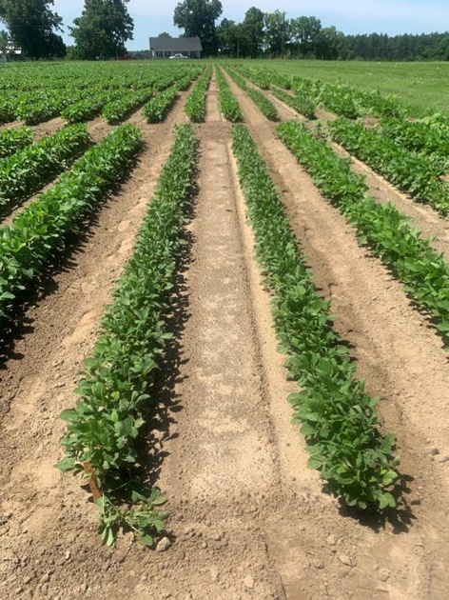
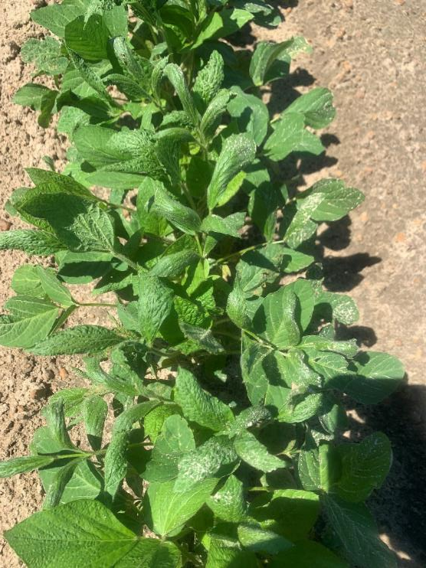
Reflex @ 24 oz/A + Classic @ 0.5 oz/A + 2,4-DB @ 2 oz/A - Applied 17 DAP (V2)
SB-04-21
June 16
30 DAP

Slide 9
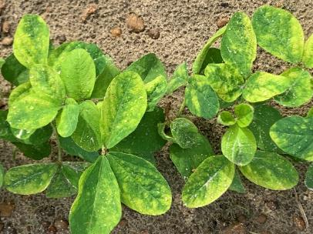
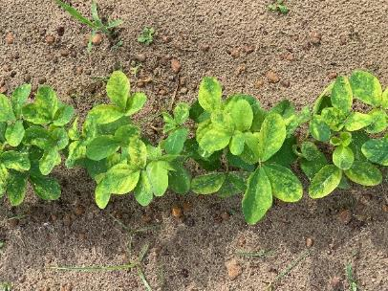
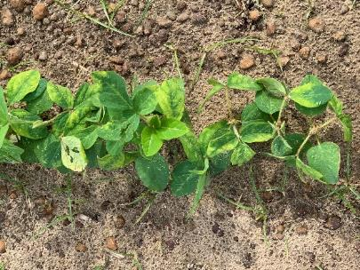
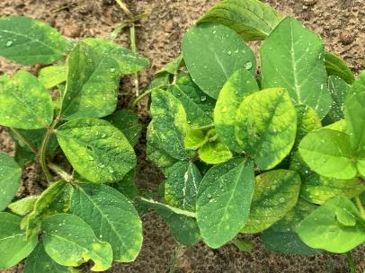
Classic 25DG @ 0.67 oz/A + NIS Injury on Non-STS Soybeans
WT-01-21
July 19
6 DAT

Slide 10
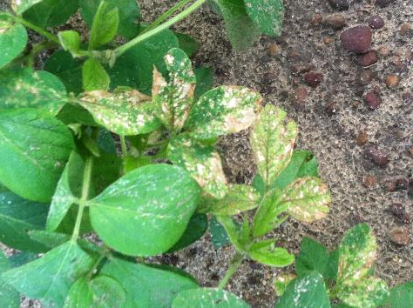
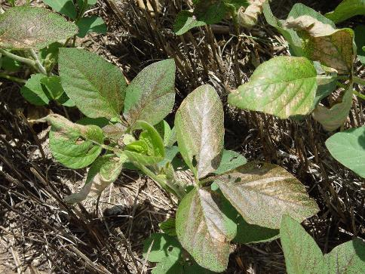
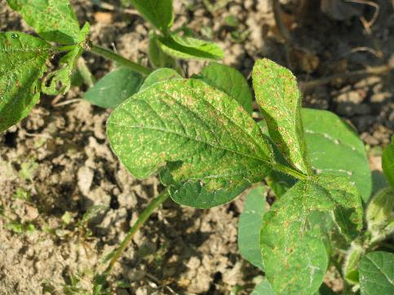
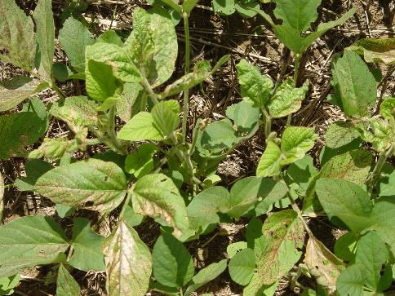
PPO Injury on Soybean

Slide 11


Valor in GA Soybeans?
Effective, legal and labeled but…….
Are you worried about PPO resistance?
13 species worldwide
4 species in US
1 species in GA
Weed control in cotton and peanut without Valor?
Valor fb Reflex/Prefix is a good weed control program but a bad resistance mgt plan!

Slide 12






Liberty-Link® Soybeans
Liberty 2.34SL @ 32-43 oz/A or generics
VE-R1 (beginning bloom)
2 applications (5 days apart)
(87 oz/A/year total)
Tank-mixes with POST grass herbicides may reduce grass control
Assure (10-21%); Fusilade (8-12%); Poast (25-41%); Select (4-22%)
Residuals still needed
15 GPA, medium-coarse droplet size, small weeds, 9 am - 6 pm

Slide 13

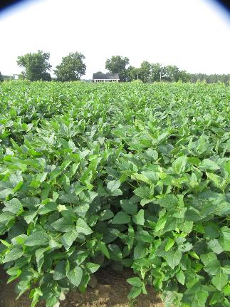
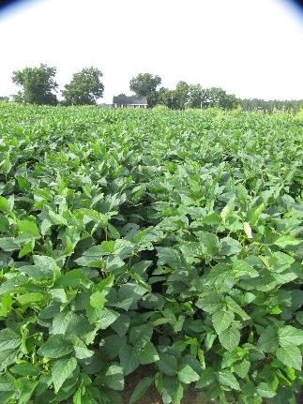
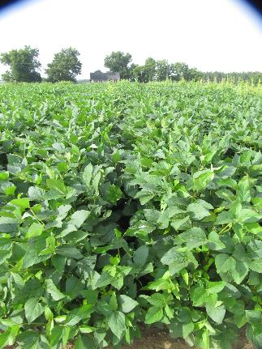
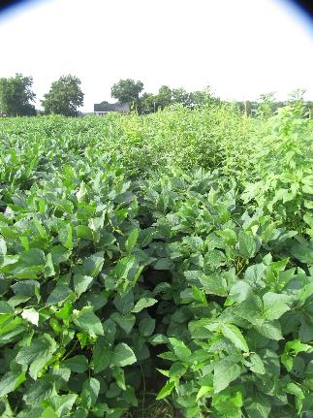
Soybean Weed Control - 2021
NTC
Liberty + Zidua
Liberty + Outlook
Applied 17 DAP
Liberty @ 32 oz/A
Zidua 4.17SL @ 2.5 oz/A
Outlook @ 12.8 oz/A
Dual Magnum @ 16 oz/A
Warrant @ 48 oz/A
Roundup P-Max @ 32 oz/A
Liberty + Dual
Magnum
Liberty + Warrant
Roundup P-Max
SB-04-21
July 19
53 DAP

Slide 14

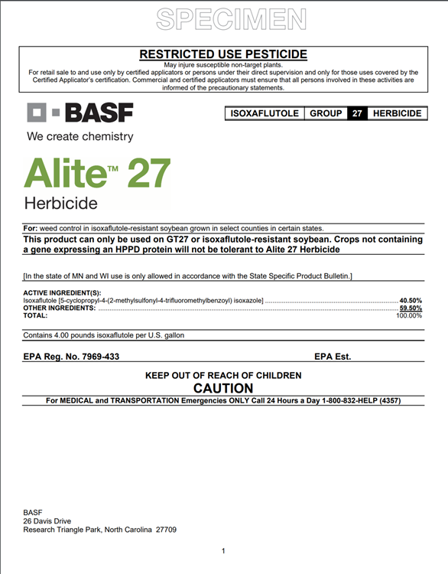
tolerant to glyphosate, glufosinate, isoxaflutole (Alite™ 27)
Alite™ 27
Only labeled for use in these GA counties: Atkinson, Berrien, Clinch, Echols, Evans, Lanier, Lowndes
PPI or PRE
1.5-2.0 oz/A
No UGA-OVT variety data

Slide 15
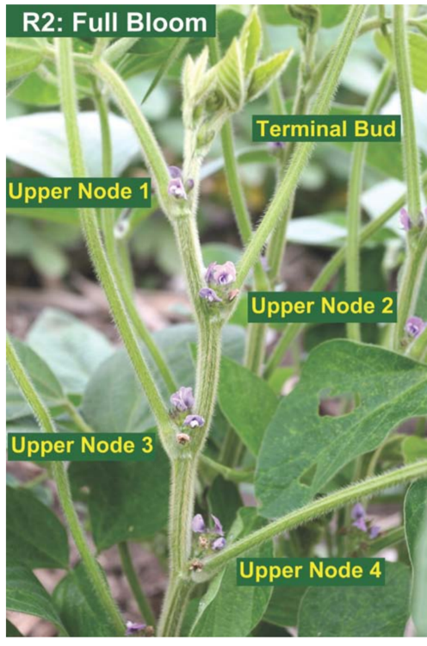

Enlist™ Soybeans
China approval in Jan 2019
Enlist One®
2,4-D choline
Enlist Duo®
2,4-D choline + glyphosate
POST up to R2 (full bloom)
2 apps (12 days)
Enlist One can be tank-mixed with glufosinate (Liberty)
Check label/web-sites for restrictions (nozzles, wind speed, buffers, etc.)
Varieties for GA????

Slide 16

Enlist™ Soybean Varieties UGA-OVT
2020 Tests (6 varieties)
DM48E73 (+), DM59E01 (+), DM51E01 (=), AGS48E19 (+), AGS51E19 (-), MS4800E (+), MS5110E (-)
2021 Tests (4 varieties)
~20% of US market in 2020
~35% of US market in 2021
+/- = equal or above or below Maturity Group statewide average yield

Slide 17
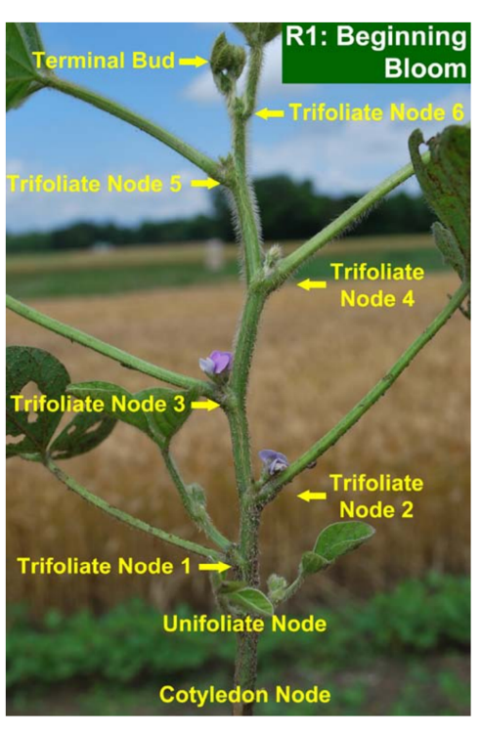
Xtend®/XtendFlex® Soybeans
Xtendimax® 2.9SL, Engenia® 5SL
Dicamba
POST up to R1 (beginning bloom) or June 30
2 apps (7 days)
Add a residual
Tavium® 3.38SC
dicamba (1.12 ae) + s-metolachlor (2.26 lb)
56.5 oz/A
POST up to V4 or June 30
1 PPLNT/PRE + 1 POST
tank-mixes
Check Xtendimax label/web-sites for tank-mixes and restrictions (nozzles, wind speed, buffers, etc.)
Engenia information
Photo: Dr. Shaun Casteel, Purdue Univ.

Slide 18

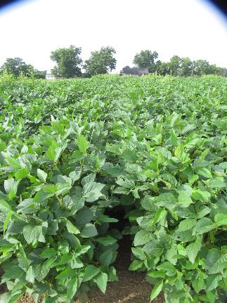
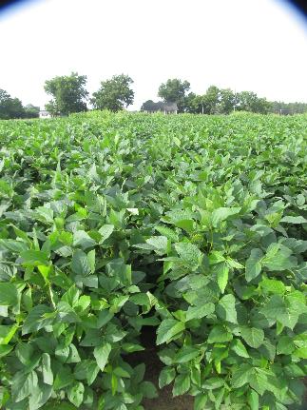
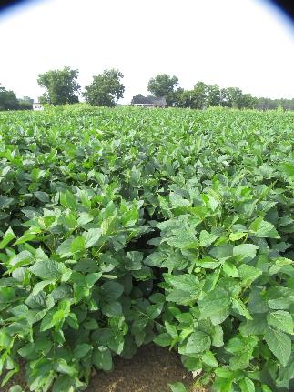
Soybean Weed Control - 2021
Engenia + Zidua +
Roundup P-Max
Applied 17 DAP
Engenia @ 12.8 oz/A
Zidua 4.17SL @ 2.5 oz/A
Tavium @ 56.5 oz/A
Xtendimax @ 22 oz/A
Warrant @ 48 oz/A
Roundup P-Max @ 32 oz/A
+
Sentris @ 8 oz/A
Induce @ 0.25% v/v
Tavium +
Roundup P-Max
Xtendimax + Warrant
+ Roundup P-Max
SB-04-21
July 19
53 DAP

Slide 19
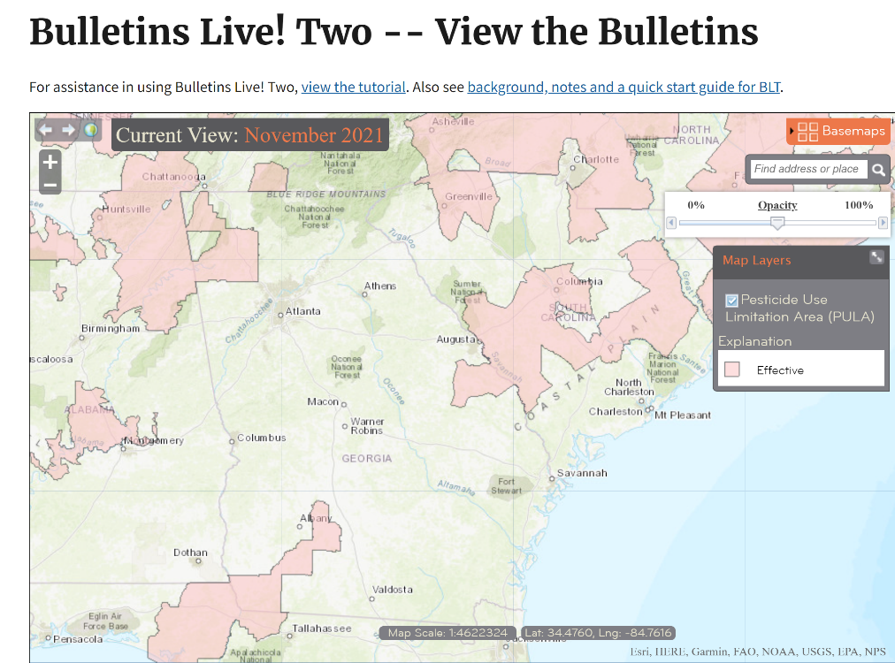
GA Endangered Species Concerns for DT Soybeans
310’ downwind buffer
57’ omni buffer
South
Burke
Seminole
Decatur
Mitchell
Worth
North
Floyd
Bartow
Gordon
Walker

Slide 20
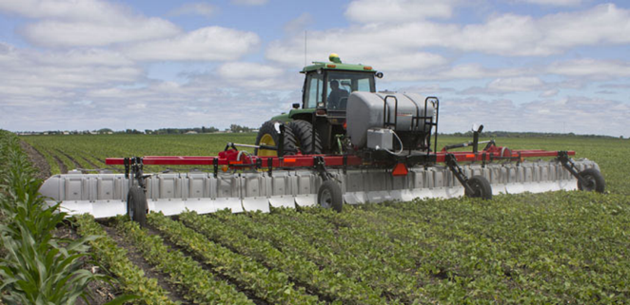
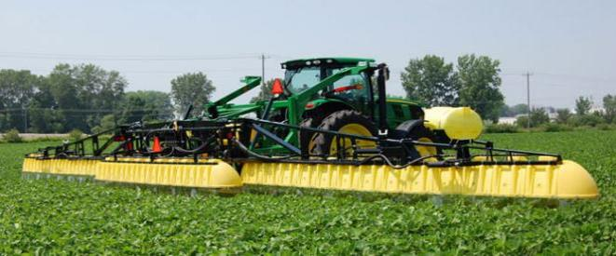
Hooded Sprayer Reduces Downwind Dicamba Buffer Requirement (240’ to 110’ and 310’ to 240’)
642E
Redball
642
642E
645
645T
ATV642
SP645
SPK645
645

Slide 21
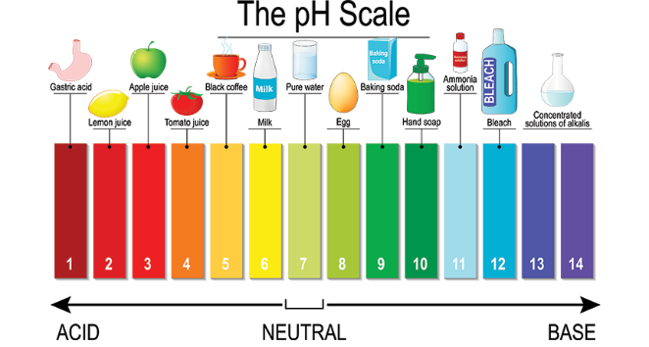
Dicamba Soybeans DRA, VRA, pH Buffers
Drift Reduction Adjuvant (DRA)
Volatility Reduction Adjuvant (VRA)
VaporGrip® Xtra Agent
potassium hydroxide/ethanoic acid
pH Buffering Adjuvant
Sentris™(BASF)
potassium carbonate
Glyphosate + Engenia + Sentris Issues??
- gas pressure buildup/foaming
- mixing order issues

Slide 22
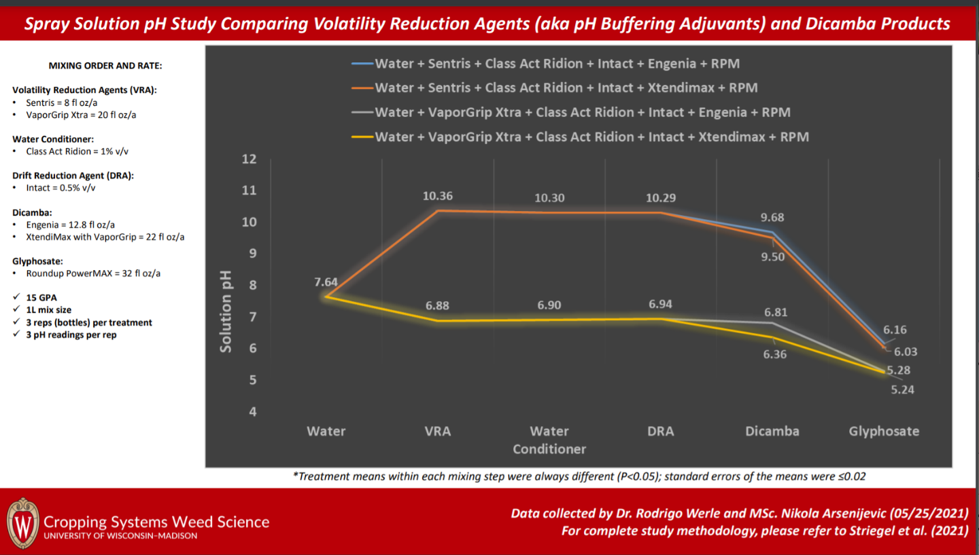
What happens to pH?

Slide 23
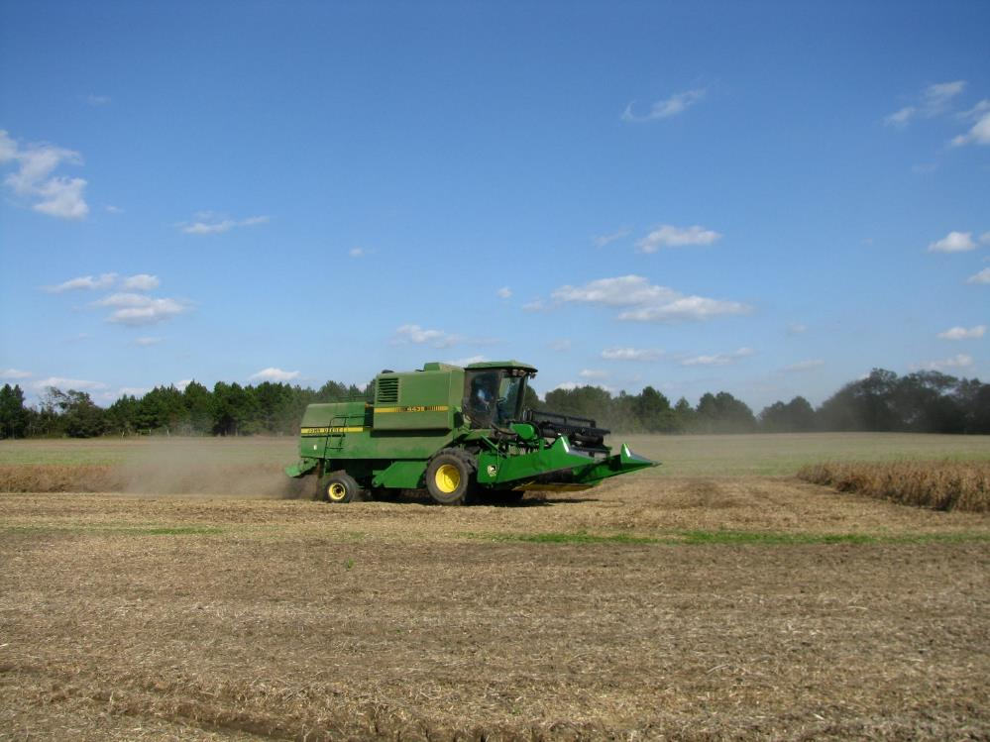
Questions/Comments

Slide 24
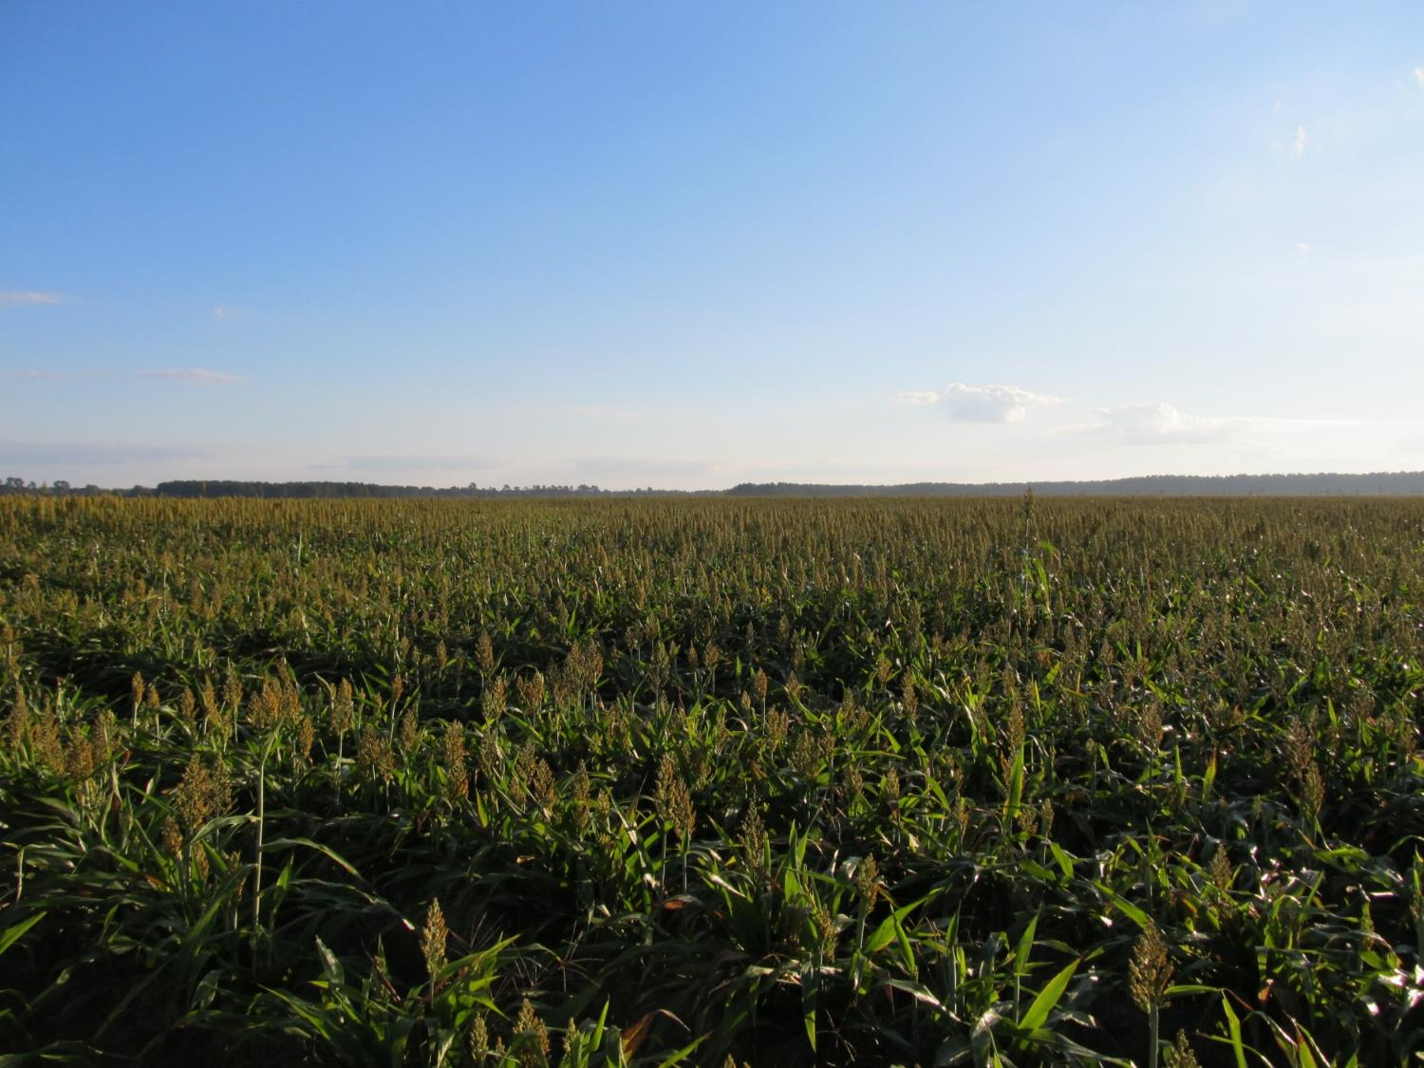

GRAIN SORGHUM WEED CONTROL UPDATE - 2022
Eric P. Prostko, Ph.D.
Professor/Extension Weed Specialist
Dept. Crop & Soil Sciences

Slide 25
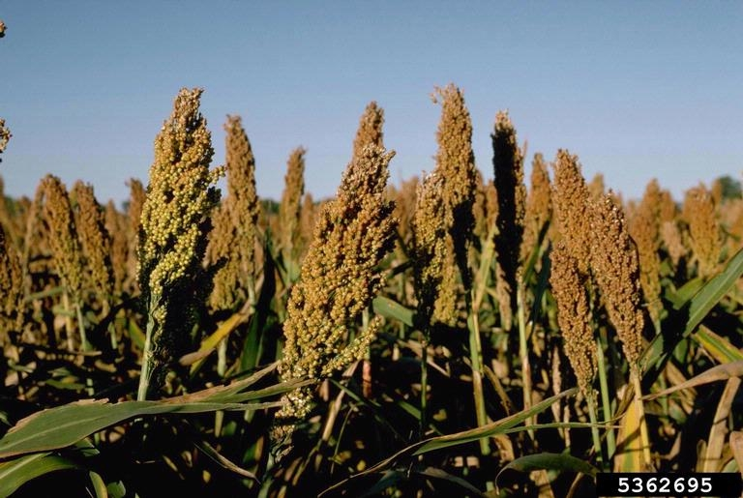
Grain Sorghum Weed Control
Start clean!
Concep treated seed
Dual Magnum or Outlook or Warrant (PRE)
Atrazine 4L @ 1.5 QT/A (EPOST)
Add Huskie if you have ATZ resistance
Paraquat (Hooded sprayer)
Mechanical Cultivation

Slide 26
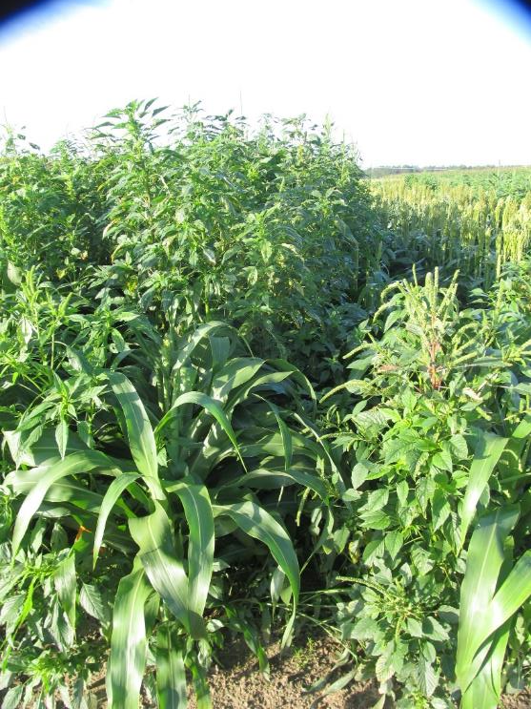
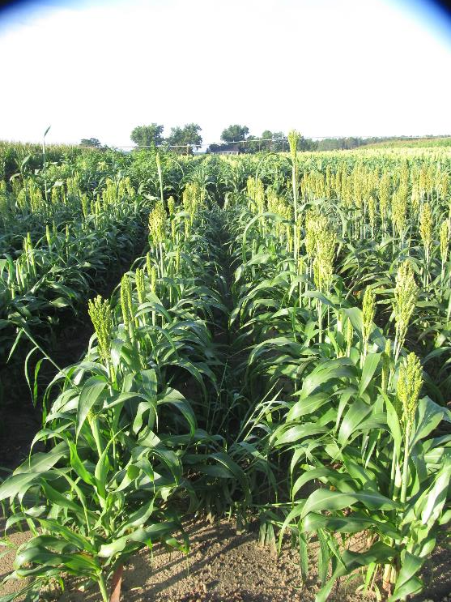
Conventional Sorghum Weed Control System - 2021
Mocassin II Plus @ 16 oz/A (PRE)
Atrazine 4L @ 48 oz/A (26 DAP)
Prowl H₂O @ 32 oz/A (26 DAP)
Agridex @ 1% v/v (26 DAP)
NTC
GS-02-21
July 16
58 DAP

Slide 27

A New (er) Product to Consider?
Huskie 2.06EC
Bayer CropScience
Buctril (1.75 lbs/gal) + pyrasulfotole (0.31 lbs/gal)
MOA = 6 + 27
Postemergence (13-16 oz/A)
3-leaf to 12” tall sorghum
Broadleaf weeds, good on pigweed
Tank-mix with atrazine (16 oz/A)
Huskie FX = Huskie + Starane

Slide 28
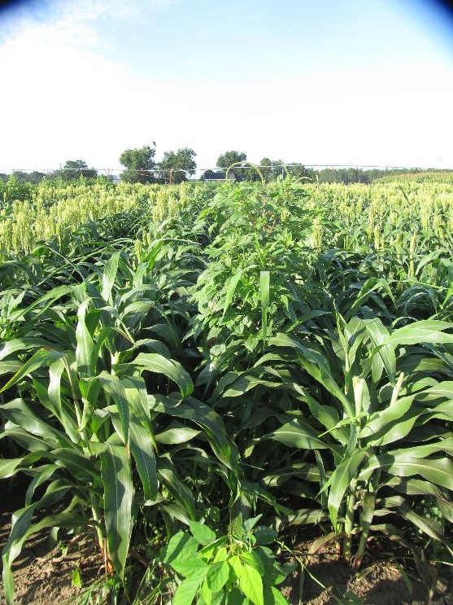
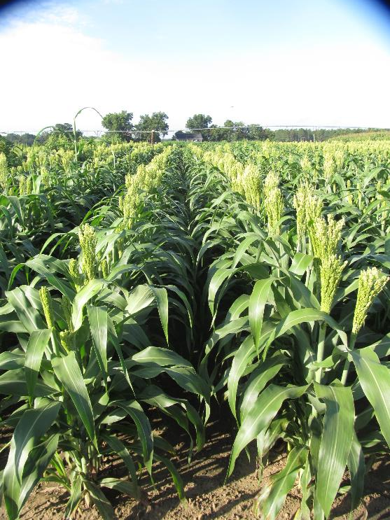

Grain Sorghum Weed Control - 2021
Warrant @ 48 oz/A
Atrazine @ 16 oz/A
Huskie @ 16 oz/A
Induce @ 0.25% v/v
AMS @ 5% v/v
Applied 19 DAP
NTC
GS-04-21
July 16
58 DAP

Slide 29
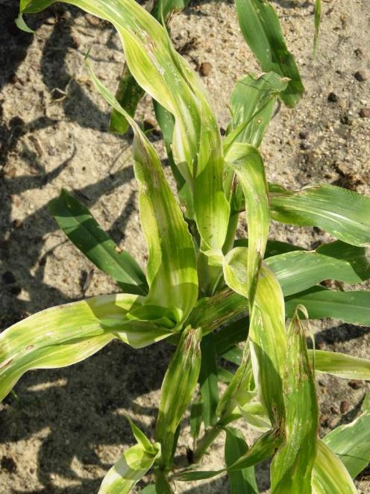
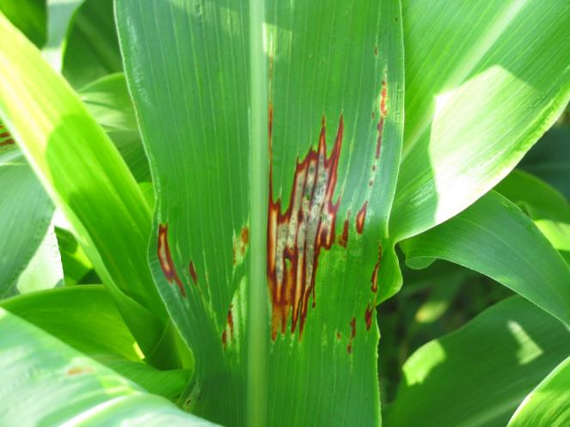

Huskie Injury on Sorghum

Slide 30
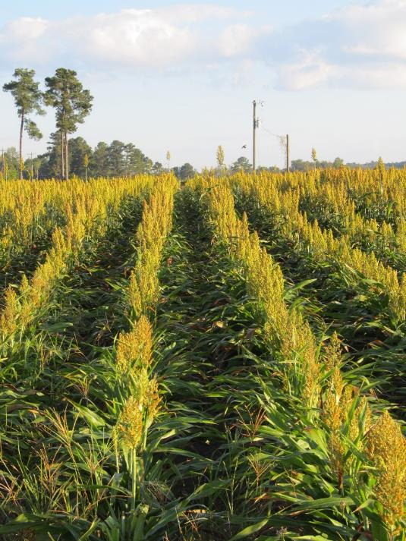
New Grain Sorghum Weed Control Technologies (Non-GMO)
Igrowth™
Alta/UPL
ImiFlex (imazamox)
PRE/POST
DoubleTeam™
S&W Seed Partners/ADAMA
FirstAct (quizalofop)
POST
Maybe cultivars???
S&W Seeds
SP58M85DT/SP45A45DT
Inzen™
Pioneer/Corteva
Zest (nicosulfuron)
POST

Slide 31

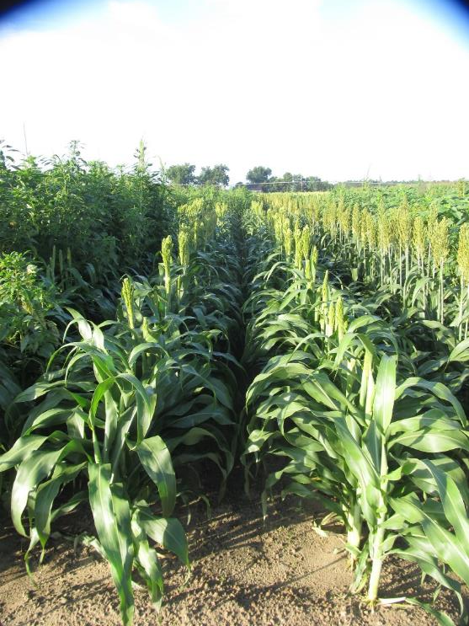
Igrowth™ System - 2021
NTC
Mocassin II Plus @ 16 oz/A (PRE)
ImiFlex 1SL @ 6 oz/A (14 DAP)
Agridex @ 1% v/v (14 DAP
GS-02-21
July 16
58 DAP

Slide 32

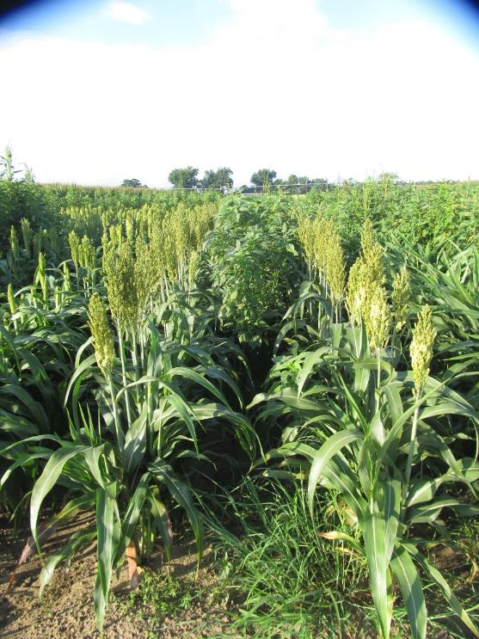
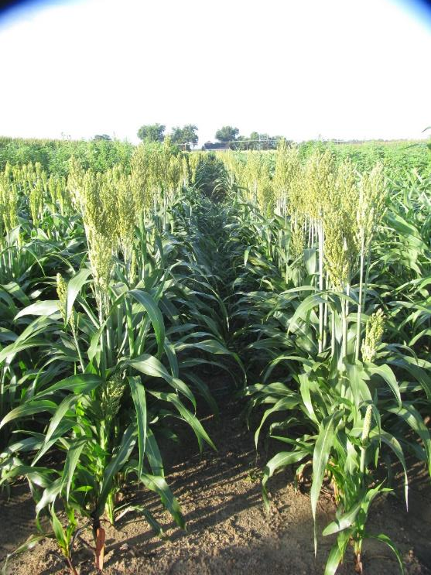
DoubleTeam™ System - 2021
NTC
Dual II Magnum 7.64EC @ 16 oz/A (PRE)
FirstAct 0.88EC @ 10 oz/A
Agridex @ 1% v/v
Applied 26 DAP
GS-02-21
July 16
58 DAP

Slide 33
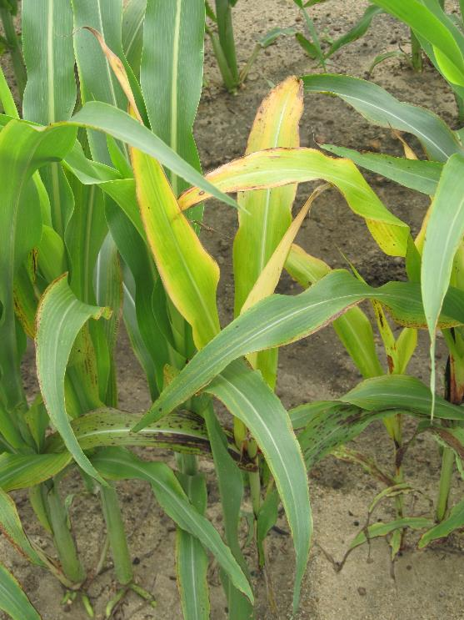
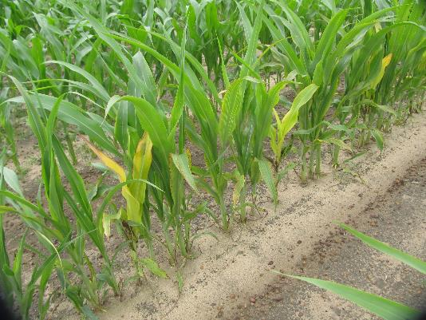
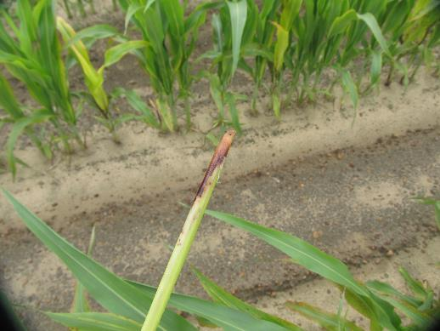
DoubleTeam™ System – First Act Off-Types
GS-02-21
June 23
9 DAT

Slide 34

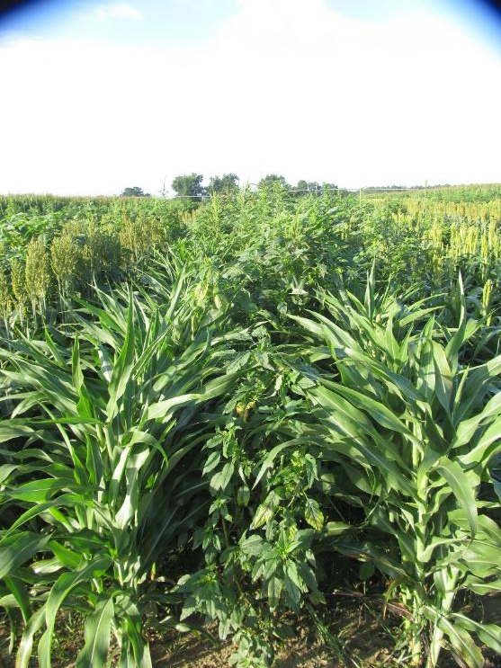
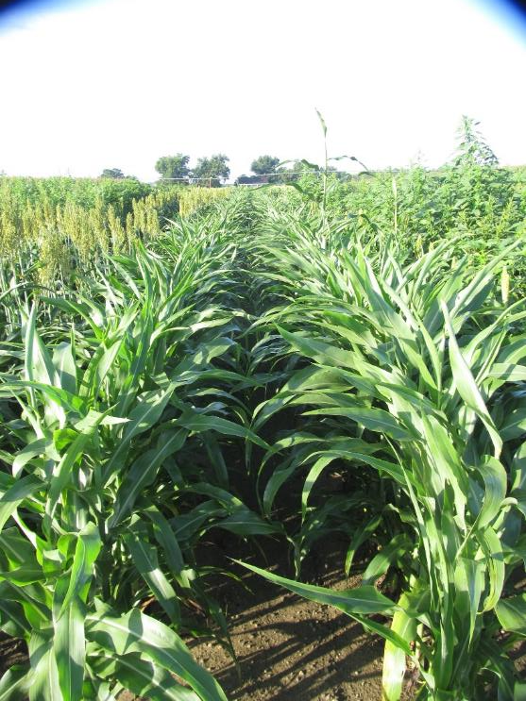
Inzen™ System - 2021
NTC
Everprex 7.62EC @ 16 oz/A (PRE)
Zest 75WG @ 0.67 oz/A
Agridex @ 1% v/v
AMSOL @ 2.5% v/v
Applied 26 DAP
GS-02-21
July 16
58 DAP

Slide 35
Questions/Comments?
eprostko@uga.edu
gaweed.com

