Slide 1
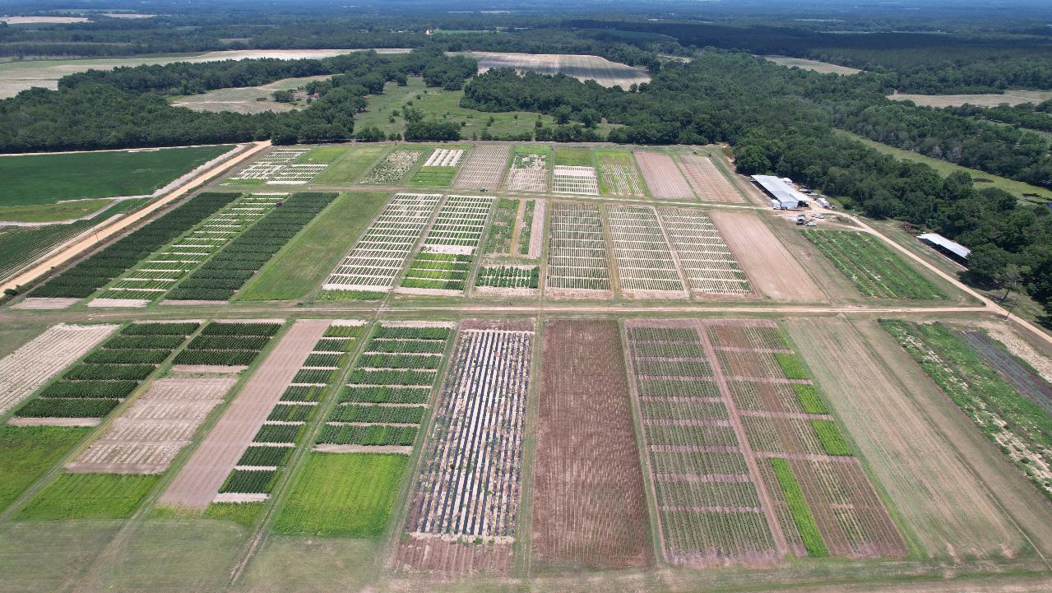
New Weed Science Research Projects Nicholas Shay and Dr. Eric Prostko UGA Agent Training 2022
Notes:
First time addressing everyone as a whole. I am grateful to for the opportunity to take part in confronting the many challenges we face here in Georgia, and my hope is that I can provide some insight over the next three years that is useful that you can utilize to equip your producers with techniques, tools, and knowledge for optimizing their crop production.

Slide 2
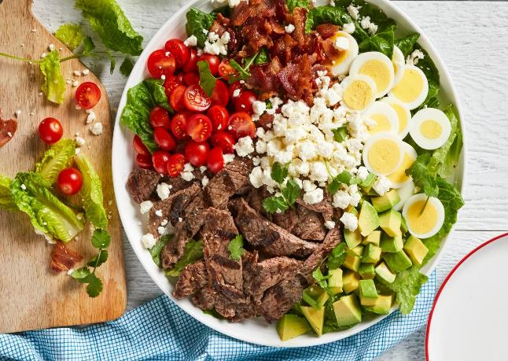
Project(s) Overview
Sorghum (Sorghum bicolor)
Pink Purslane (Portulaca pilosa)
Peanut (Arachis hypogaea)
Corn (Zea mays)
Soybean (Glycine max)
Notes:
Fried chicken = hope to bring a nutritious blend of experiments, like a salad, to improve our Georgia farming communities.
Like a salad with many ingredients, the experiments that I would like to share with you today are diverse.
Transition: Dive into the details…..

Slide 3
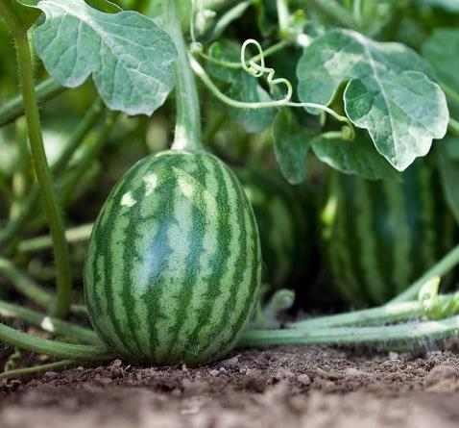
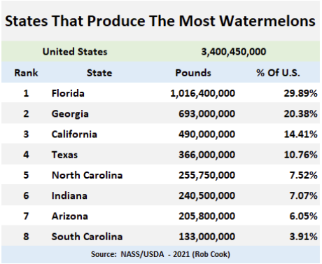
Watermelon Production & Management
$103,742,000 (NASS/USDA 2021)
Notes:
Watermelon is a high-value crop here in the state of Georgia with an estimated…

Slide 4
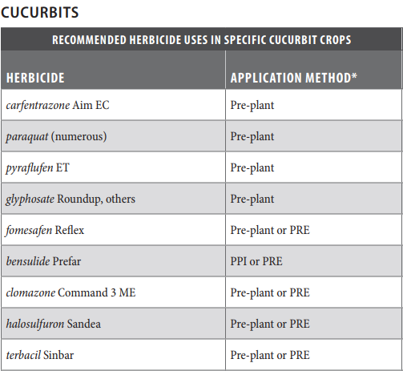
Watermelon Production & Management
(UGA Pest Management Handbook – Veggies, 2021)
$103,742,000 (NASS/USDA 2021)
Notes:
Herbicides that provide residual control of pigweed, morningglory, wild radish, and nutsedge.

Slide 5
Watermelon Production & Management
$103,742,000 (NASS/USDA 2021)
Notes:
however that residual activity can be problematic to successive rotational crops with plant back restrictions 18 months fomesafen and 24 months for Terbacil.

Slide 6
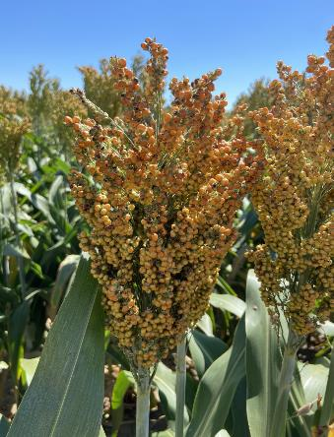
Impact of Residuals on Sorghum (Sorghum bicolor)
10 mos.
24 mos.
Notes:
however that residual activity can be problematic to successive rotational crops
Both herbicides can significantly impact grain yield of sorghum
Current label plant back restrictions =10 months fomesafen and 24 months for Terbacil

Slide 7
Sorghum Production Systems
Sorghum production in GA:
GA - 41,000 acres
Farm gate value $16 million (UGA Farmgate Report 2019)
Objective:
Simulating sorghum planting behind watermelon production
Sorghum tolerance following fomesafen & terbacil applications 100 DAA

Slide 8
Sorghum Response to Fomesafen
Sorghum: Preliminary Results
2019
PRE applications of Terbacil & Fomesafen:
Did not reduce plant stand, and biomass (14 DAA)
Did not reduce plant stand, and height (21 DAA)
Yield:
Range: 58 – 77 bu ac⁻¹ or 3,657 – 4,781 lbs ac⁻¹
Trt differences (P = 0.03) but none from NTC
2020 – 2022
PRE applications of Terbacil & Fomesafen:
Did not reduce plant stand, and biomass (14 DAA)
Did not reduce plant stand, and height (21 DAA)
Necrosis was observed 139 DAA – transient by Sep.
Yield:
Range: 41 – 53 bu ac⁻¹ or 2,519 – 3,254 lbs ac⁻¹
No Trt differences (P > 0.1)

Slide 9
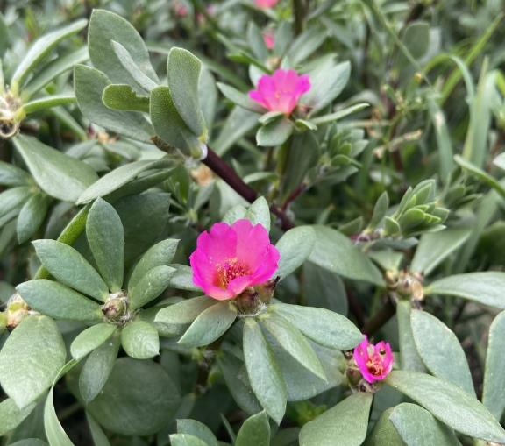
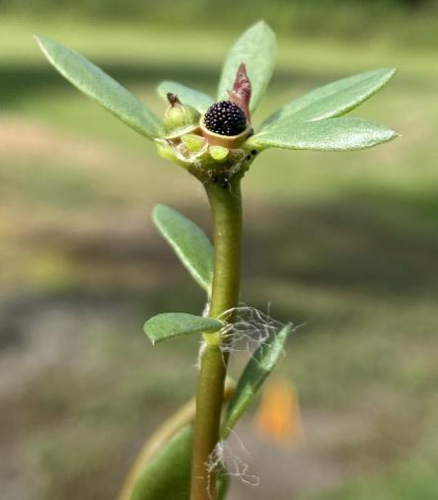
TITLE
Controlling Pink Purslane (Portulaca pilosa)
Increased frequency
Disturbed gravelly and sandy field edges
Occurrence:
Southwest
Southeast (Railroad)
Summer annual / weak-perennial
212,000 – 292,000 seeds plant⁻¹
Germination ~ 10 days
6 – 8 weeks – flowering / mature capsules
Non-dormant seed
Management difficulties:
Succulent vegetative structures
Densely populated hairs
Continuous seed production
Notes:
Purslane has spread to many regions across the US persisting in the arid southwest to more subtropical and tropical climates in the southeast. Illustrating its ability to tolerate diverse growing conditions.
212,000 seeds per plant – nearly 100% germ within 10 days. Fully opened bright pink flowers 6-8 weeks after germination with mature seed capsules roughly 7 to 10 days after flowering.
Continuous germination throughout the year

Slide 10
TITLE
Controlling Pink Purslane (Portulaca pilosa)
Limited research for desired control in southeastern U.S.
Objective:
Investigating herbicidal options for controlling pink purslane in the coastal plain region of Georgia

Slide 11
TITLE
Controlling Pink Purslane (Portulaca pilosa)
Greenhouse POST Treatments
NTC
Roundup PowerMaxx3: 22.0 oz ac⁻¹
Gramoxone: 32.0 oz ac⁻¹
Liberty: 32.0 oz ac⁻¹
Engenia: 12.8 oz ac⁻¹
Enlist One: 32.0 oz ac⁻¹
Diuron: 24.0 oz ac⁻¹
Aatrex: 48.0 oz ac⁻¹
Ultra Blazer: 24.0 oz ac⁻¹
Storm: 24.0 oz ac⁻¹
2,4-DB: 16.0 oz ac⁻¹
Strongarm: 0.30 oz ac⁻¹
Cobra: 12.5 oz ac⁻¹
Impact: 1.25 oz ac⁻¹
Callisto: 3.0 oz ac⁻¹
Laudis: 3.0 oz ac⁻¹
Shieldex: 1.0 oz ac⁻¹
Gramoxone 12.0 + Storm 16.0 oz ac⁻¹
Reflex: 24.0 oz ac⁻¹
AIM: 1.0 oz ac⁻¹
Cadre: 4.0 oz ac⁻¹
ª Treatments followed by letter indicate efficacious herbicides selected from greenhouse experiment for in-field research.
Notes:
POST emergence treatments

Slide 12
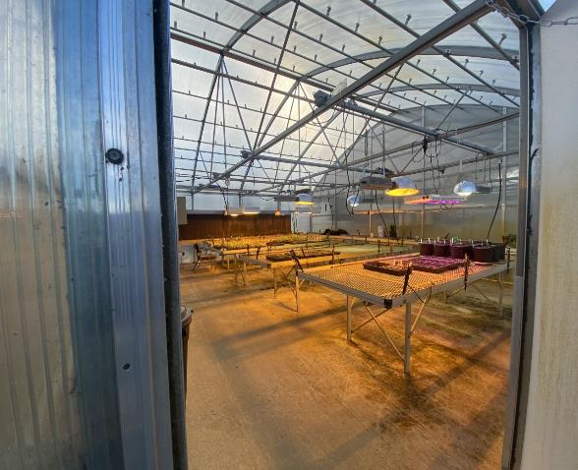
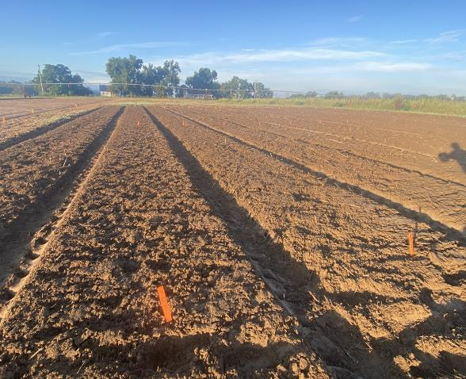
TITLE
Controlling Pink Purslane (Portulaca pilosa)

Slide 13
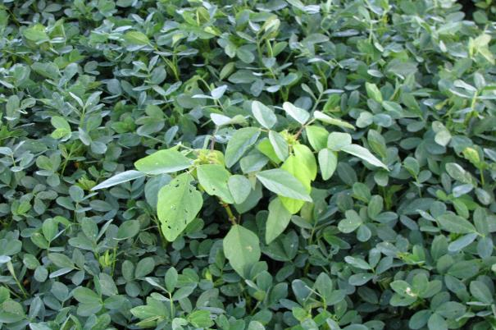
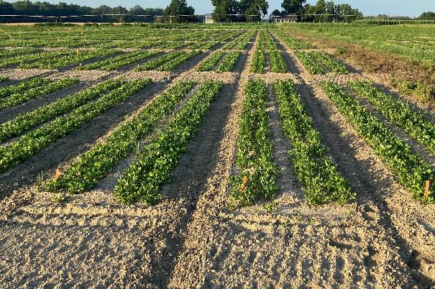
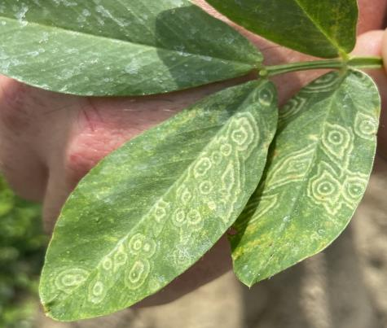
Investigating New Peanut Cultivar Responses to Postemergence Applications of Chlorimuron
Rescue herbicide
Chlorimuron TSWV
Disease management
Cultivar resistance
Lack of understanding on new cultivars
Objective:
Evaluate impact of chlorimuron on the incidence of TSWV and yield on AUNPL-17, FLORUN 331, GA-12Y, GA-16HO, GA-18RU, GA-20VHO, & TIFNV HIGH O/L
Notes:
Trade name = CLASSIC - WSSA Group 2 herbicide in the Sulfonylurea family
Chlorimuron is used as a late-season rescue option for controlling FL beggarweed; good crop safety
Not only do we have to have a solid understanding of chemistries and their ability to control problematic weeds, but often times we must also consider antagonistic relationships and how these chemistries can influence disease pressure. So now we are not only weed scientists, but also disease specialists.
Preventative measures utilized consistently in peanut production focus on both chemical and cultural practices, however, the largest single factor affecting disease progress is cultivar resistance.

Slide 14
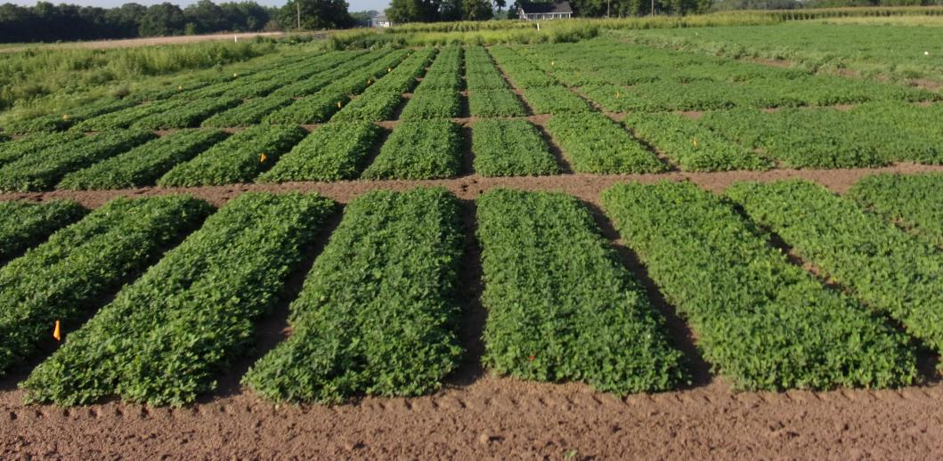
Response to Chlorimuron
TSWV:
No interaction between variety & herbicide (P = 0.38)
Avg. over variety, classic timing @ 90 DAP TSWV (P < 0.1)
Avg. over herbicide, some variety differences:⁺
FLORUN 331 – 29.7%_{a}
GA-18RU – 19.6%_{b}
TIFNV HIGH O/L – 18.8%_{b}
GA-20VHO – 10.4%_{c}
AUNPL-17 – 8.6%_{c}
Yield:
No interaction between variety & herbicide (P = 0.30)
Avg. over variety, no yield difference at any timing (P = 0.12)
No yield difference regardless of TSWV (P > 0.1)
GA-18RU
TIFNV HIGH O/L
AUNPL-17
GA-20VHO
FLORUN 331
⁺ Varieties with different letter indicated statistical difference at (P = 0.05).

Slide 15
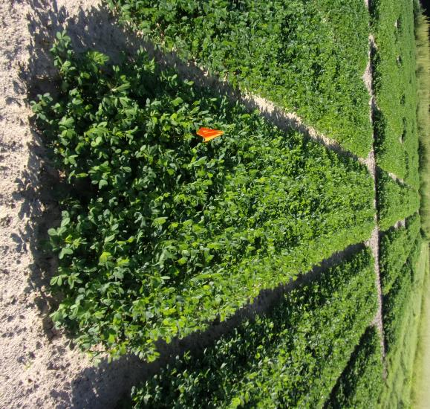
Response to Chlorimuron
GA-12Y
Plant height:
No trt. Influence (P = 0.43)
TSWV:
No trt. Influence (P = 0.16)
Yield:
Trt differences (P = 0.05)
77_{a} = 6772 lb ac⁻¹
0_{ab} = 6573 lb ac⁻¹
65_{ab} = 6432 lb ac⁻¹
90_{b} = 5943 lb ac⁻¹
GA-16HO
Plant height:
65 & 77 DAP (P = 0.01)
TSWV:
No trt. influence (P = 0.13)
Yield:
No yield difference (P = 0.30)
4833 – 5835 lbs ac⁻¹

Slide 16
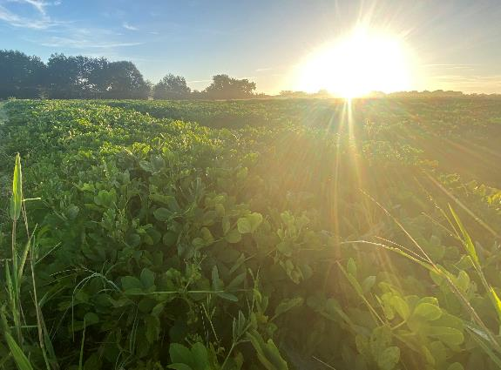
Peanut Response to Delayed Timing Applications of Fluridone and Trifludimoxazin
Limited herbicide options
Herbicide resistance
Newly developed herbicides
Repurpose herbicides
Objective:
Test peanut response to delayed timing applications of fluridone & Trifludimoxazin
Application timing: 1,3,5, & 7 DAP
Notes:
Cultivar: GA06G
Treatments:
NTC
Fluridone: 1x rate
Trifludimoxazin: 1x rate
Application timing: 1, 3, 5, 7 DAP

Slide 17
Peanut (GA-06G) Yield Response to Brake and Vulcarus Applied 1,3,5,7 DAP
P = 0.8992
P = 0.1462

Slide 18
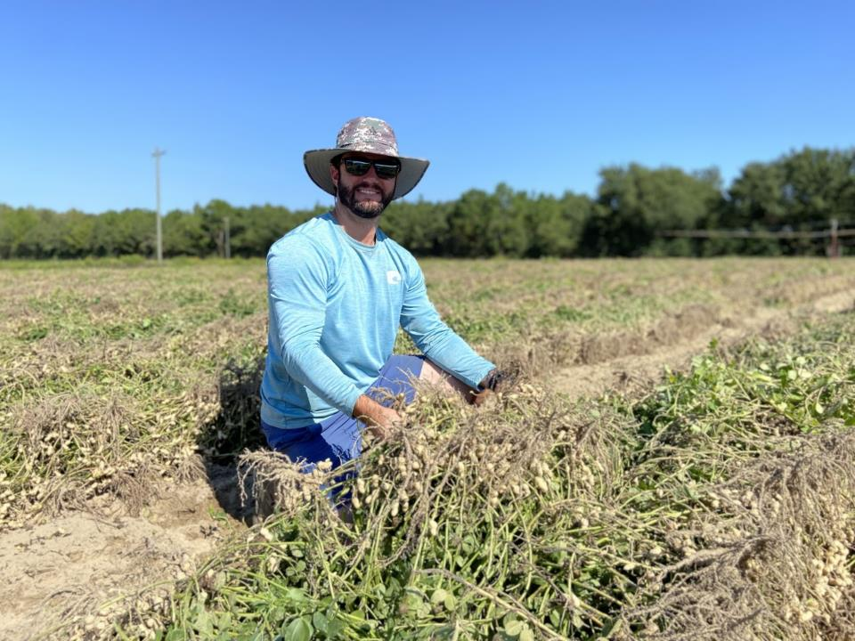
Thank you. Questions?
nicholas.shay@uga.edu

