Slide 1
Peanut Weed Control Update - 2022
Eric P. Prostko
Extension Weed Specialist
Department of Crop & Soil Sciences

Slide 2
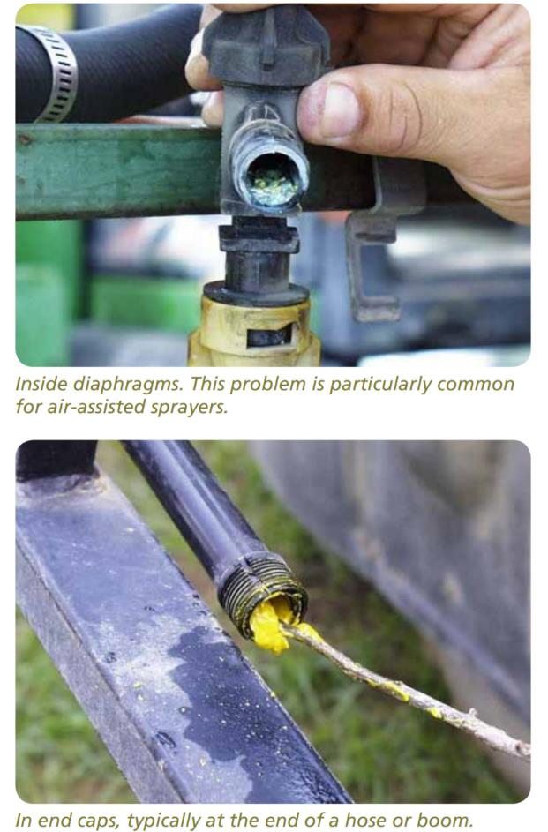
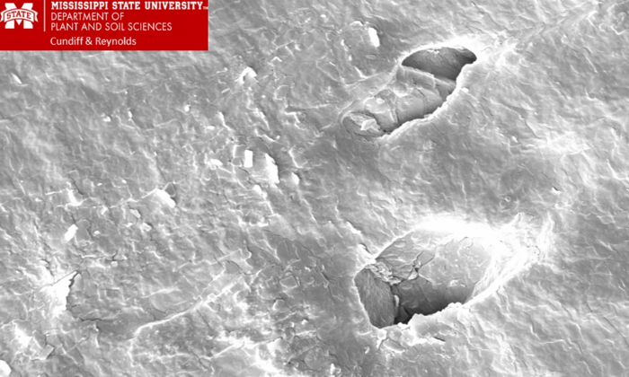
Valor (Flumioxazin) in Sprayers
*Even new rubber hoses have cracks
1) Flumioxazin is not very water soluble!
Only 1.8 ppm
2) For comparison:
dicamba acid = 4500 ppm
glyphosate acid = 15,700 ppm
glufosinate = 1,370,000 ppm
3) Tank-cleaners or ammonia raise pH and
increase Valor breakdown
* ½ life at pH 9 is only 15-22 minutes
Source: Sumitomo Technical Update

Slide 3
Wild radish????
Turner Co.
June 24, 2021

Slide 4
On-Time
Works 100% of the time
Excellent crop safety
any GPA or nozzle
tank-mix with anything
no rotational restrictions
FREE
Obstacles
Farm size
Weather
breakdowns
Beach Vacations
???

Slide 5
Peanut Weed Control – 2021 How does this happen?
PE-09-21
June 15
36 DAP
205/206/207

Slide 6
Peanut Weed Control – 2021 How does this happen?
PE-09-21
June 29
50 DAP
205/206/207

Slide 7
Peanut Weed Control – 2021 How does this happen?
PE-09-21
July 14
65 DAP
205/206/207

Slide 8
Peanut Weed Control – 2021 How does this happen?
Started clean
Twin Rows (36”-9”)
Strong residual program activated with irrigation
Prowl or Sonalan or Dual or Warrant or Outlook + Valor + Strongarm (0.225 oz/A)
On-Time (25 DAP) POST application with additional residual
Cadre + 2,4-DB + Residual (Anthem Flex or Dual Magnum or Outlook or Warrant or Zidua)
PE-09-21
August 5
87 DAP
205/206/207

Slide 9
Aim 2EC + COC Peanut Harvest Aid - 5 DAT

Slide 10
Flail Mower and Peanut - 2021
August 10, 2021
GA-16HO
92 DAP

Slide 11
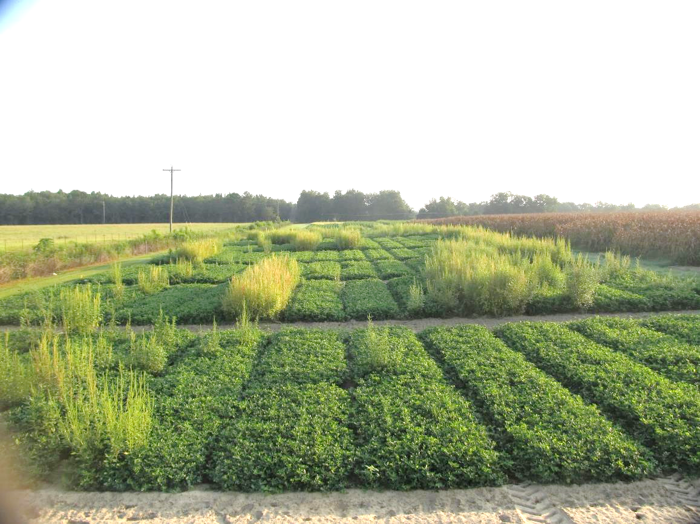
Flail Mower and Peanut – 2021 Before
August 10, 2021
GA-16HO
92 DAP

Slide 12
Flail Mower and Peanut – 2021 After (2 passes in opposite directions, ~2 MPH)
August 10, 2021
GA-16HO
92 DAP

Slide 13
History of Classic® Use in Peanut
First registered for use in 1988
DuPont-Corteva-AMVAC
Late-season control of Florida beggarweed
60 DAE until 45 DBH
Peanut Response
height/chlorosis
cultivar tolerance
Southern Runner
GA-06G
Tifguard

Slide 14
Influence of Classic® Timing on Peanut Yield - 2021*
*Averaged over 5 cultivars (GA-18RU, GA-20VHO, AUNPL-17, TIFNV HIGH O/L, FLORUN 331)
P=0.4778

Slide 15
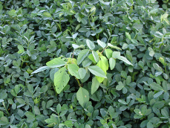
UGA Current Classic®/Cultivar Use Recommendations
NO
GA-06G
Tifguard
YES
Florida-07
GA Greener
GA-07W
GA-09B
GA-20VHO
GA-18RU
AUNPL-17
TIFNV HIGH O/L
FLORUN 331

Slide 16
Tropical Spiderwort/Benghal Dayflower
Plow (i.e. bury seed)
Twin Rows
Group 15’s (Dual Magnum, Warrant, Outlook, Zidua, Anthem Flex)
Paraquat
Cadre?
Strongarm?
Manage after field corn harvest.

Slide 17
Georgia Rainfall Totals – 2021 April 15-October 15

Slide 18
Figure 1. Tropical Spiderwort/Benghal Dayflower Control in Peanut As Influenced by Row Pattern
Source: Yoder et al. 2003. Peanut weed management under varying row patterns and tillage regimes. WSSA Abstracts 43:81.

Slide 19
Figure 2. Tropical Spiderwort/Benghal Dayflower Emergence As Influenced by Burial Depth
Source: Sabila et al. 2012. Evaluation of factors that influence Benghal dayflower (Commelina benghalensis) seed germination and emergence.
Weed Science 60:75-80.

Slide 20
Figure 3. Tillage Effects on Tropical Spiderwort/Bengal Dayflower Density
Source: Brecke et al. 2005. Impact of tillage and herbicides on Tropical Spiderwort. Proceedings of Tropical Spiderwort Symposium, Tifton, GA.
November 29, 2005.(http://gaweed.com/tsw2005/index.html)

Slide 21
Figure 4. The Influence of Burial Duration (8” depth) on Tropical Spiderwort/Benghal Dayflower Seed Viability
Source: Riar et al. 2012. Benghal dayflower (Commelina benghalensis ) seed viability in soil. Weed Science 60:589-592.

Slide 22
TSW Control in Peanut with Paraquat + Dual Magnum (Applied 17 DAP)
32 DAT

Slide 23
What do the top Georgia peanut growers do? 2020 Georgia Peanut Achievement Club Winners
14 growers
167 to 1482 acres (range)
5805 lb/A average yield
4452-6632 lbs/A (range)
GA State Avg. = 4120 lb/A
100% - irrigated
79% - bottom plow
100% - twin rows
Herbicides
57% - Sonalan
93% - Valor
50% - Dual
93% - Cadre
57% - 2,4-DB
43% - Prowl
14% - Strongarm
7% - Zidua

Slide 24
Paraquat Label Changes Coming
EPA Interim Decision – July 2021
Limit aerial applications to a maximum of 350 acres per applicator per 24-hr period for all uses except cotton desiccation;
Require a residential area drift buffer for all aerial applications (50’-75’);
Prohibit use of human flaggers;
Prohibit pressurized handgun and backpack sprayer application methods;
Limit the maximum application rate for alfalfa to one pound of paraquat cation per acre;
Require enclosed cabs if area treated in 24-hour period is more than 80 acres;
Require enclosed cabs or PF10 respirators if area treated in 24-hour period is 80 acres or less;
Require a 7-day restricted entry interval (REI) for cotton desiccation;
Require a 48-hour REI for all crops and uses except cotton desiccation; and
Require mandatory spray drift management label language.

Slide 25
Paraquat/Parkinson’s Disease??
Parkinson's disease (PD) is a neurodegenerative disorder that affects predominately dopamine-producing (“dopaminergic”) neurons in a specific area of the brain called substantia nigra.
1 million people in US have PD
60,000 people in US diagnosed with PD every year
Men are 1.5X more likely to develop PD than women
Causes: Genetics X Environment (head injuries, residence, occupation, metal exposure, TCE/PCB exposure, pesticides?) X Lifestyle
300+ lawsuits filed against paraquat
Tanner et al. 2011. Rotenone, Paraquat, and Parkinson’s Disease. Environmental Health Perspectives 119(6):866-872.
“Our findings, considered together with earlier results, suggest that paraquat use plays a role in human PD.”
Costello et al. 2009. Parkinson’s Disease and Residential Exposure to Maneb and Paraquat from Agricultural Applications in the Central Valley of California. American Journal of Epidemiology 169:919-926.
“This study provides evidence that exposure to a combination of maneb and paraquat increases PD risk, particularly in younger subjects and/or when exposure occurs at younger ages.”
Tanner et al. 2009. Occupation and Risk of Parkinsonism. Archives of Neurology 66(9):1106-1113.
“2,4-D, paraquat, and permethrin were associated with more than a 3-fold increased risk of disease, although precision was poor for paraquat and permethrin.”

Slide 26
Paraquat/Parkinson’s Disease??
Cell Death and Differentiation (2010) 17:1115-1125
“The epidemiological and clinical evidence that PQ may favor the onset of PD is inconclusive”.
“In the case of PQ, the link between experiments in rodents and potential human adverse effects is weak.”
PLoS ONE (2016) 11(10):e0164094
“Paraquat administered maximum tolerated doses did not induce any neuro-pathogenic effects.”
2019 EPA-OPP Review (June 26, 2019)
Data from 28 human, 217 animal, and 244 in vitro studies
“Weight of evidence was insufficient to link paraquat exposure from pesticide use of US registered products to PD in humans.”
Journal of Toxicology and Environmental Health (2019) 22(5-6):172-302
Data indicates a positive association between exposure to PQ and PD occurrence, but the weight of evidence does not enable one to assume an indisputable cause/effect relationship.”
Environmental Research (2020) 191:110186***
Hazard ratio for ever-use of paraquat was elevated but not statistically significant.”
Journal of Occupational Medicine and Toxicology (2021) 16-21
“No evidence of increased risk of PD or increased mortality from other causes among PQ production workers whose exposure to PQ on a daily basis was at least comparable to that of PQ sprayer or mixer/loader.”
Neurotoxicology (2021) 86:80-184
“A consensus exists in the scientific community that the available evidence does not warrant a claim that paraquat causes Parkinson’s disease.”
Handbook of Neurotoxicity (2021) 1-19
“Weight of evidence is sufficient to conclude a generic association between PQ exposure and PD exists, but is not sufficient to conclude that this is a causal relationship.”

Slide 27
Wear Your PPE!

Slide 28
Questions/Comments

