Slide 1
Weed Control in Field Corn 2022
Eric P. Prostko, Ph.D.
Professor/Extension Weed Specialist
Dept. Crop & Soil Sciences
eprostko@uga.edu

Slide 2
Field Corn Yield Loss (%) Caused by Uncontrolled Weeds in UGA Weed Science Research Trials (2007-2021). Treated vs. Non-treated
200 Bu/A X 0.33 X $4.00 = $264/A
What about harvest?
What about next year?

Slide 3
Field Corn Weed Control Questions for you?
What technologies are you planting?
RR, LL, Conventional, Enlist (2,4-D)?
Do you need Counter?
Is atrazine still working for you on pigweed?
Lets assume it does not
What will be planted after the field corn?

Slide 4
A general plan of attack?
MUST START CLEAN!
Use 1 qt/A of Atrazine 4L PRE (or Dual II Magnum, or Warrant, or Outlook)
Zidua/Anthem Max (POST)
Follow up with a timely POST program (V3-V5 stage) that includes an additional 1.5 qt/A of Atrazine 4L
Roundup + Atrazine probably not good enough anymore!
Roundup Cost$/Supply
Lots of options depending upon how you answered previous questions?
Liberty, Laudis, Impact/Armezon, Halex GT, Callisto, Revulin Q, Shieldex, Acuron, Acuron GT, dicamba, 2,4-D

Slide 5
Anthem Max, Dual, Warrant, Zidua, Outlook????

Slide 6
Herbicide Timing Effects on Spray Coverage - 2020
JD 4630
90’ boom length
20” nozzle spacing
10 GPA
32 PSI
11 MPH
8003EVS
Roundup + Atrazine + Quest + Grounded
CN-06-20
Miller Co.
30 DAP
April 16

Slide 7
Herbicide Timing Effects on Spray Coverage in Field Corn - 2020
V4: 9-10” tall
20 DAP
V6: 14-16” tall
30 DAP
CN-06-20
JD 4630, 90’ Boom
20” Nozzle Spacing
10 GPA, 32 PSI
11 MPH
8003EVS Nozzles
2”
6”

Slide 8
Field Corn Weed Control - 2021
NTC
Roundup PowerMax3 @ 25 oz/A
Atrazine @ 64 oz/A
Prowl H₂0 @ 32 oz/A
Applied 18 DAP
CN-02-21
May 3
17 DAT

Slide 9
Field Corn Weed Control - 2021
Liberty @ 32 oz/A
Atrazine @ 64 oz/A
Prowl H₂0 @ 32 oz/A
Applied 18 DAP
NTC
CN-02-21
May 3
17 DAT

Slide 10
Field Corn Weed Control - 2021
NTC
Roundup PowerMax3 @ 25 oz/A
Laudis @ 3 oz/A
Atrazine @ 64 oz/A
Prowl H₂0 @ 32 oz/A
Applied 18 DAP
CN-02-21
May 3
17 DAT

Slide 11
Field Corn Weed Control - 2021
NTC
Halex GT @ 58 oz/A
Atrazine @ 64 oz/A
Prowl H₂0 @ 32 oz/A
Induce @ 0.25% v/v
Applied 18 DAP
CN-02-21
May 3
17 DAT

Slide 12
Annual Grass Control in Field Corn - 2021
CN-02-21
May 10
42 DAP
Applied 18 DAP
LSD 0.10 = 12

Slide 13
Field Corn Weed Control - 2021
Acuron GT @ 60 oz/A
Atrazine @ 32 oz/A
Induce @ 0.25% v/v
Applied 23 DAP
CN-11-21
May 14
53 DAP

Slide 14
Field Corn Weed Control - 2021
NTC
Acuron 3.44SC @ 80 oz/A
(Applied PRE)
CN-08-21
May 13
51 DAP

Slide 15
Comparison of Acuron, Acuron Flexi, Acuron GT, and Halex GT
Trade Name | Active Ingredients (lbs/gal) (WSSA MOA)
 | glyphosate (9) | mesotrione (27) | bicyclopyrone (27) | S-metolachlor (15) | atrazine (5)
Acuron | - | 0.240 | 0.060 | 2.14 | 1.0
Acuron Flexi | - | 0.320 | 0.080 | 2.86 | -
Acuron GT | 2.00 | 0.200 | 0.095 | 2.00 | -
Halex GT | 2.09 | 0.209 | - | 2.09 | -

Slide 16
Field Corn Weed Control - 2021
Impact 2.8L @ 0.75 oz/A
Roundup P-Max3 5.88SL @ 21 oz/A
Atrazine 4L @ 32 oz/A
Applied 18 DAP
NTC
CN-06-21
May 13
45 DAP

Slide 17
Field Corn Weed Control - 2021
Shieldex @ 1 oz/A
Atrazine @ 32 oz/A
Agridex @ 1% v/v
AMSOL @ 2% v/v
Applied 21 DAP
NTC
CN-09-21
April 29
16 DAT

Slide 18
Field Corn Weed Control - 2021
Roundup P-Max3 @ 21 oz/A
Revulin Q @ 3.5 oz/A
Atrazine @ 32 oz/A
Applied 23 DAP
CN-08-21
May 14
53 DAP
NTC

Slide 19
What about dicamba?
Clarity = dicamba
Status = dicamba + diflufenzopyr + isoxadifen (safener)
Diflexx = dicamba + cyprosulfamide (safener)
Newer, lower volatility, dicamba formulations are not labeled
Engenia
Xtendimax

Slide 20
Field Corn Weed Control – 2019 Roundup + Status + Prowl H₂0 (~$31/A)
NTC
Roundup W-Max @ 32 oz/A
Status @ 5.0 oz/A
Prowl H₂O @ 32 oz/A
Applied 21 DAP (V4/7” tall)
CN-08-19
May 10
18 DAT

Slide 21
Field Corn Injury – Status (dicamba)
CN-04-16
Agrigold 6659
7 DAT (April 25, 2016)
Roundup P-Max @ 32 oz/A + Status @ 5 oz/A
Applied 27 DAP
V4-V5; 7” tall
No yield effect

Slide 22
Roundup W-Max @ 32 oz/A + dicamba @ 0.25 lb ae/A + Prowl H₂0 @ 32 oz/A (Applied 9 DAP, V1/2” tall field corn)
CN-08-19
April 16
6 DAT

Slide 23
Roundup W-Max @ 32 oz/A + dicamba @ 0.25 lb ae/A + Prowl H₂0 @ 32 oz/A (Applied 21 DAP, V4/7” tall field corn)
CN-08-19
April 24
2 DAT

Slide 24
Field Corn Yield (DKC-6208) As Influenced By Herbicide Treatment
LSD (0.10) = 13.2
CV = 7.3
Bu/A
CN-08-19, Averaged over 3 timings (V1, V4, and V6), WEEDY

Slide 25
New(er) Products Being Tested
AMVAC
Sinate (glufosinate + topramezone)
Impact Core (topramezone + acetochlor)
Corteva
Resicore (mesotrione + acetochlor + clopyralid)
Syngenta
Acuron GT (bicyclopyrone + s-metolachlor + mesotrione + glyphosate)
Acuron XR (bicyclopyrone + s-metolachlor + mesotrione + atrazine)
Helm
Katagon (tolpyralate + nicosulfuron)
Helmet Maxx (metolachlor + atrazine + mesotrione)
Helena
Empyros (tolpyralate + s-metolachlor)
Empyos Triad (tolpyralate + s-metolachlor + atrazine) (not in SE)
Empyros Triad Flex (tolpyralate + s-metolachlor + atrazine) (not in SE)
Valent
Maverick (mesotrione + pyroxasulfone + clopyralid)
Summit Agro
Restraint (tolpyralate + acetochlor + dichlormid)

Slide 26
Morningglory Control in Field Corn?????

Slide 27
Field Corn Lay-By (16 GPA, 30 PSI, 3.7 MPH, Floodjet TK-VS2)

Slide 28
Post-Harvest Weed Control Gramoxone 2L @ 3 pts/A + Tricor 4L @ 8 oz/A + NIS @ 0.25% v/v
09/24/21
Day of application

Slide 29
Post-Harvest Weed Control Gramoxone 2L @ 3 pts/A + Tricor 4L @ 8 oz/A + NIS @ 0.25% v/v
10/22/21
28 DAT

Slide 30
Post-Harvest Weed Control Gramoxone 2L @ 3 pts/A + Tricor 4L @ 8 oz/A + NIS @ 0.25% v/v
11/03/21
40 DAT

Slide 31
Tropical Spiderwort/Benghal Dayflower
Bury seed!
Residuals-Group 15’s
Dual Magnum, Outlook, Warrant, Zidua, Anthem Max
POST – 2,4-D
Directed
Aim, Paraquat, Evik
Post-Harvest
2,4-D, Aim, Paraquat

Slide 32
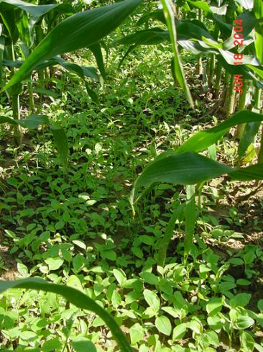
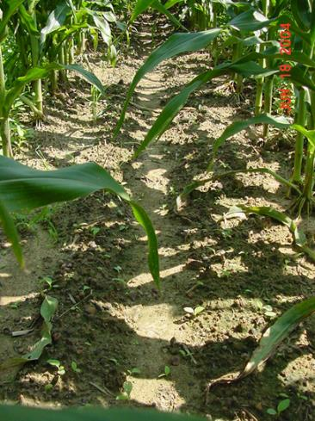
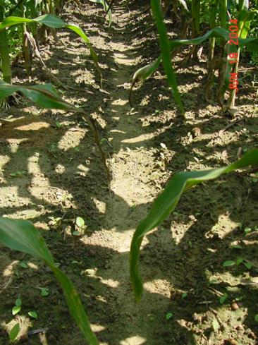
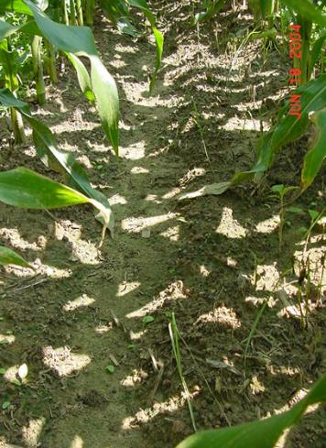
Tropical Spiderwort Control in Field Corn Control with Lay-Bys (8 DAT)
Untreated
Aim 2EC @ 1.5 ozs/A
Agrioil @ 1% v/v
Gramoxone 3SC @ 1 pt/A
80/20 @ 0.25% v/v
Evik 80WP @ 2 lb/A
80/20 @ 0.5% v/v
CN-11-04
COMBE:1-6”; 2-7 LF

Slide 33
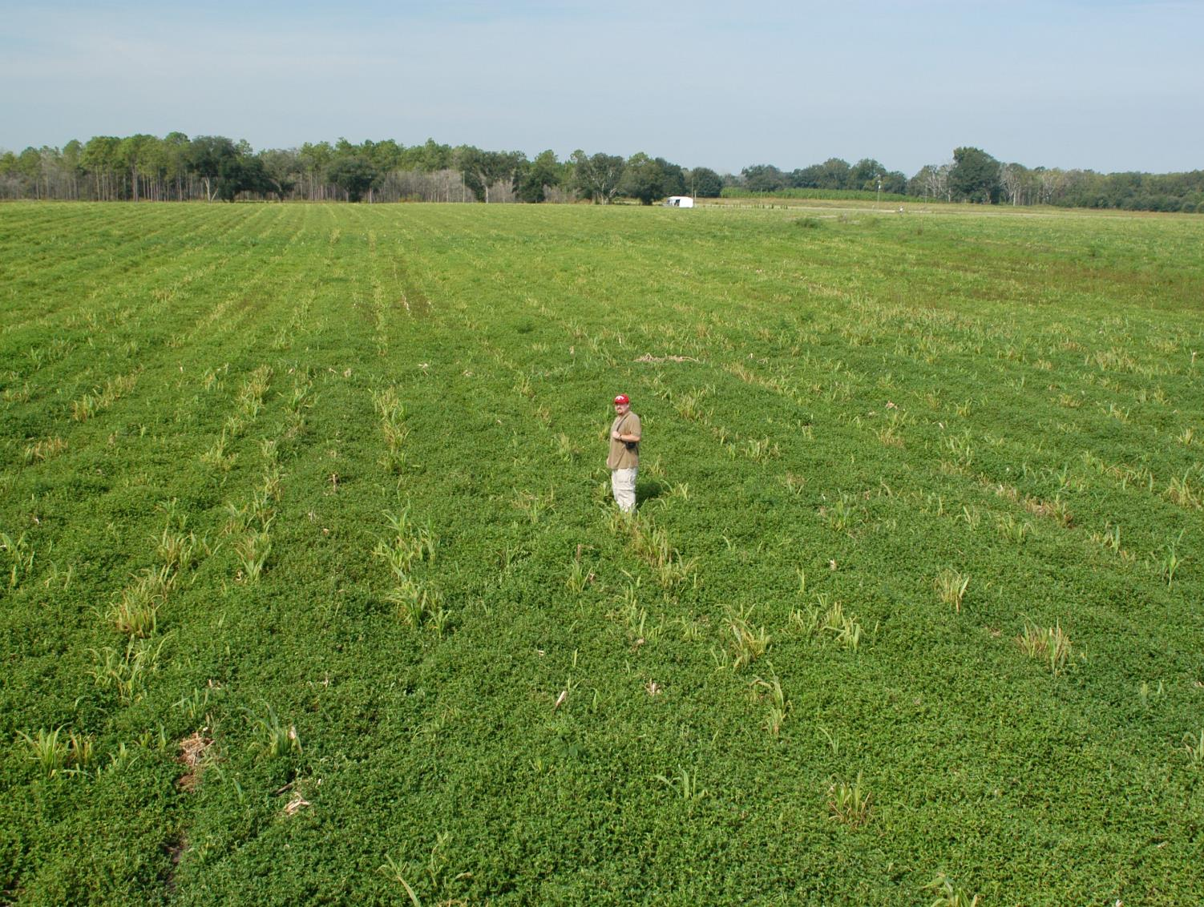
Tropical Spiderwort/Benghal Dayflower (TSW/BD) After Corn Harvest
(need tillage and/or 2 apps of Gramoxone or 2,4-D or Aim)

Slide 34
Post-Harvest Control of TSW/BD with 2 Applications (14 d apart) of Gramoxone (paraquat)
CN-01-06
COMBE: 8-10”, flowering
1 week after POST2

Slide 35
Field Corn Weed Control - Summary
Start Clean
Use a PRE
Timely POST (V3-V5)
need something else with Roundup + ATZ
Lay-By for MG
Post-Harvest
pigweed
dayflower

Slide 36
Questions/Comments?
eprostko@uga.edu
www.gaweed.com

