Slide 1
2021 Georgia Pesticide Application Equipment & Technology Survey
Simer Virk & Eric Prostko
Dept. Crop & Soil Sciences
University of Georgia
Tifton, GA 31793

Slide 2
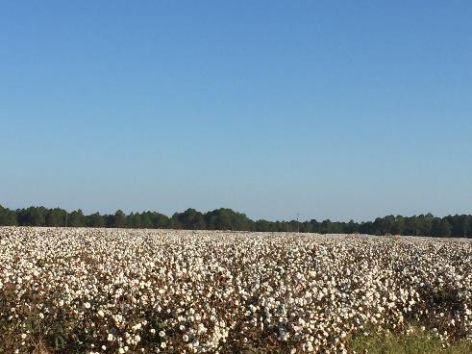
2021 Georgia Row Crop Production Acres Planted (X 1000)
Source: USDA/NASS – Crop Production (09/10/2021)
*Acres harvested

Slide 3
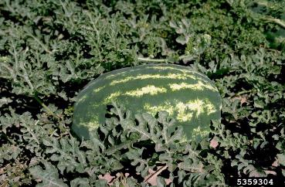
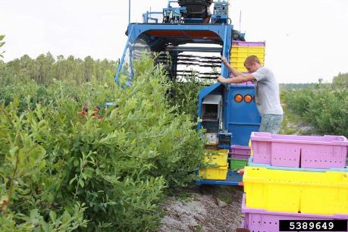
2019 Georgia Specialty Crop Production Acres (X 1000)
Source: USDA/NASS

Slide 4
Methodology
In 2021, PDF and online surveys (Qualtrics) were sent to Georgia county extension agents (159 counties).
Survey goal was at least 5 growers/county
Agents e-mailed and texted on-line links to growers and distributed hard copies at other face-to-face meetings.
186 respondents in 65 counties
~50/50 split between on-line and printed surveys were received

Slide 5
Total number of survey respondents = 186
Number of counties represented = 65
Responses by County
 | ≤5
 | 6-10
 | ≥11

Slide 6
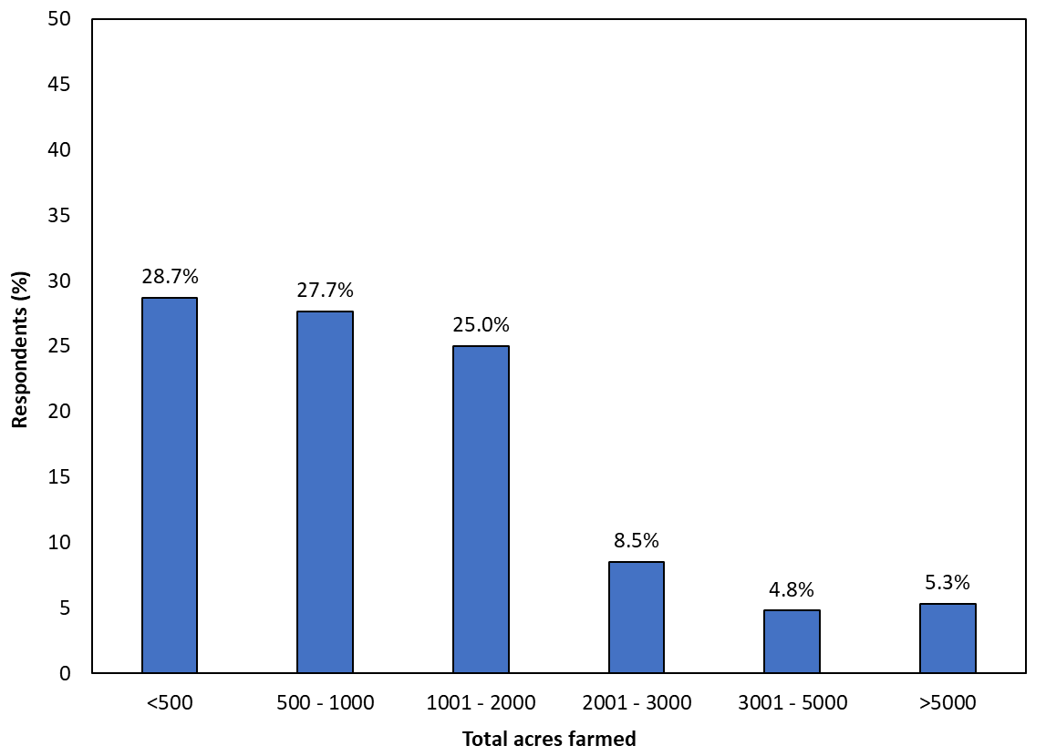
Q2: How many total acres (on average) do you farm every year? [n = 186]

Slide 7
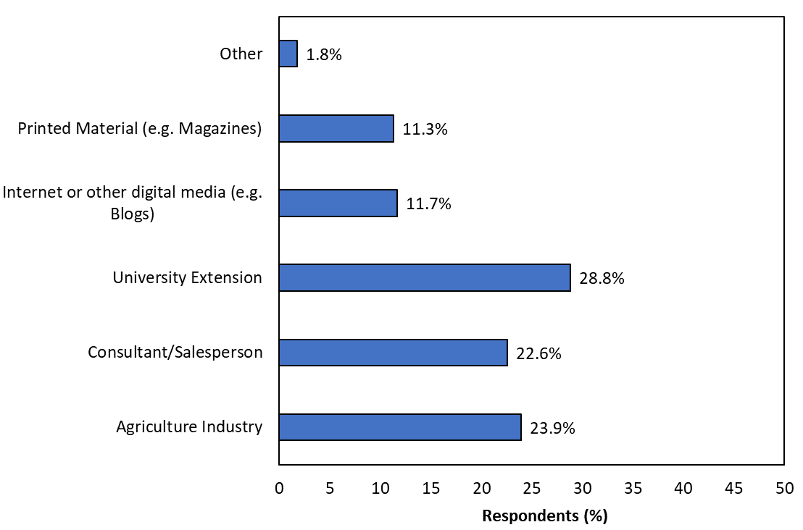
Q3: Where do you receive your information about spray application equipment or technology? (select all that apply) [n = 186]

Slide 8
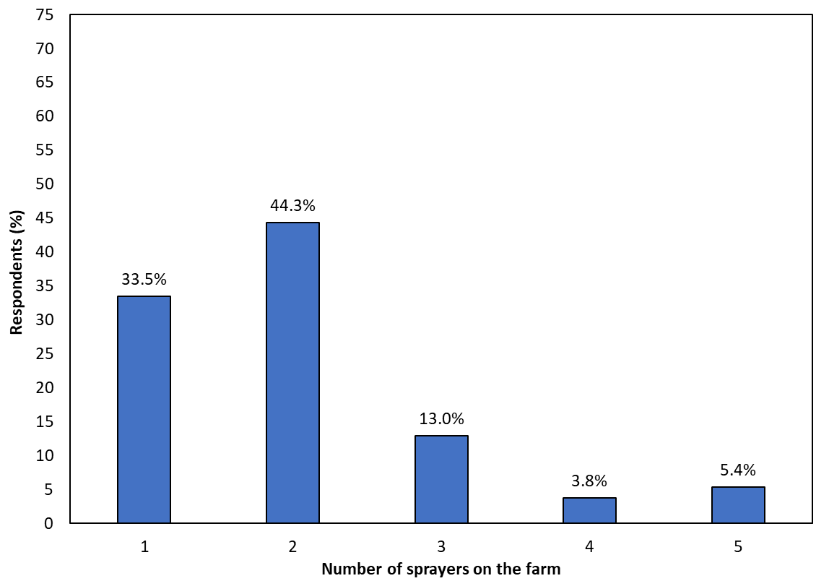
Q4: How many sprayers do you have on your farm that you regularly use for pesticide applications? [n = 185]

Slide 9
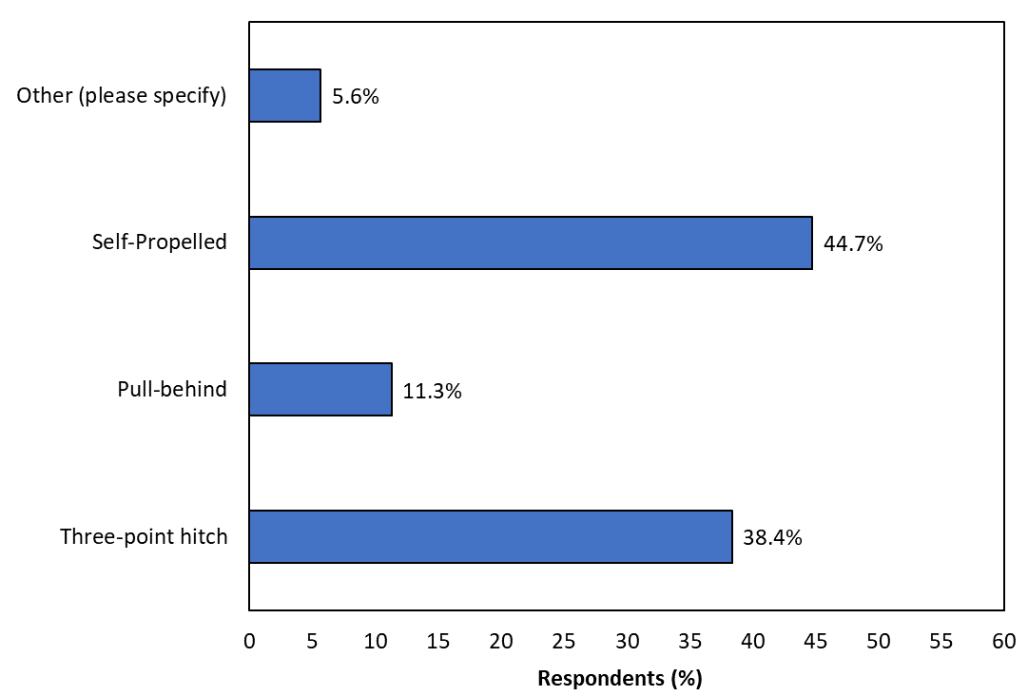
Q5: What type of sprayer(s) do you regularly use for pesticide applications? (select all that apply) [n = 186]

Slide 10
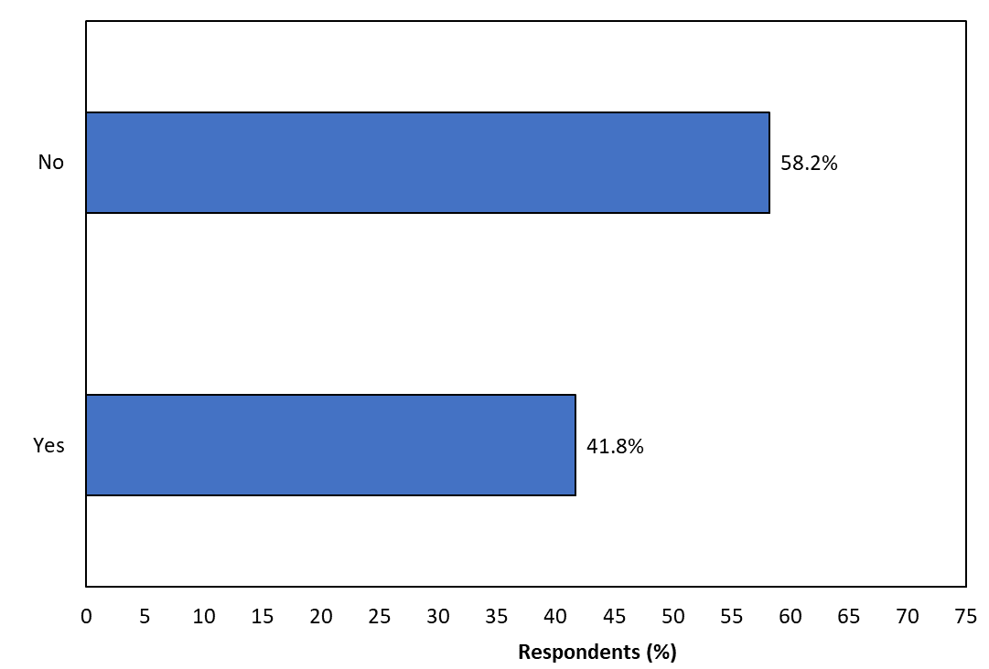
Q6: Do you use a separate sprayer for applying dicamba, 2,4-D or 2,4-DB? [n = 182]

Slide 11
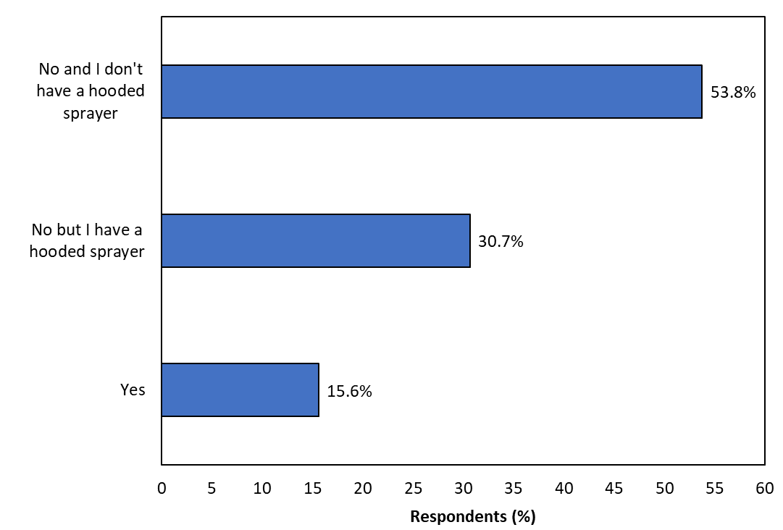
Q7: Do you use a hooded sprayer for any restrictive pesticide applications? (e.g. for applying dicamba or 2.4-D etc.) [n = 186]

Slide 12
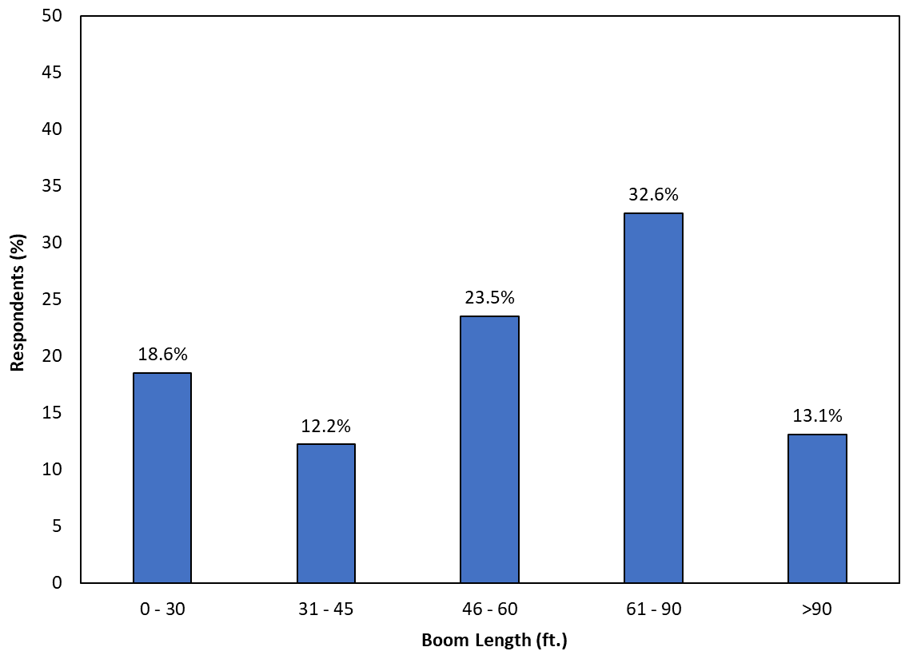
Q8: What is the boom length on your sprayer? (select all that apply) [n = 181]

Slide 13
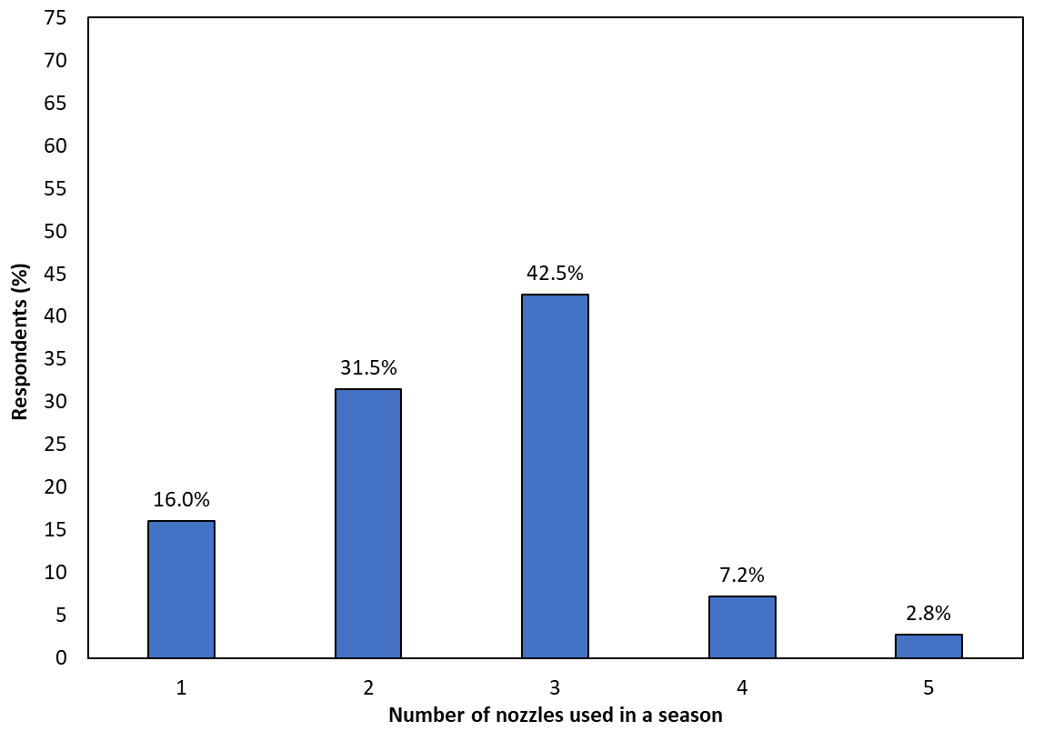
Q9: How many different nozzles do you typically use in a growing season on your sprayer? [n = 181]

Slide 14
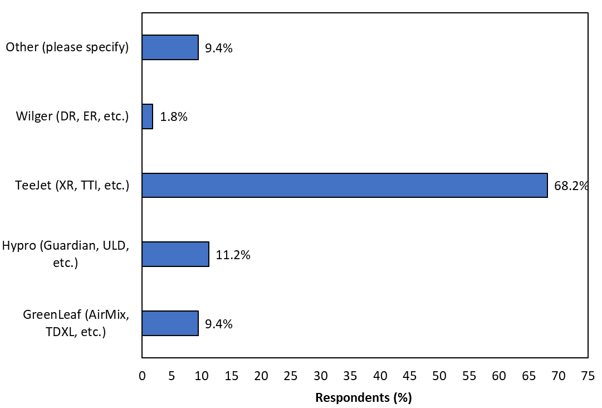
Q10: What type of nozzles do you use for pesticide applications on your farm? Select all that apply. [n = 181]

Slide 15
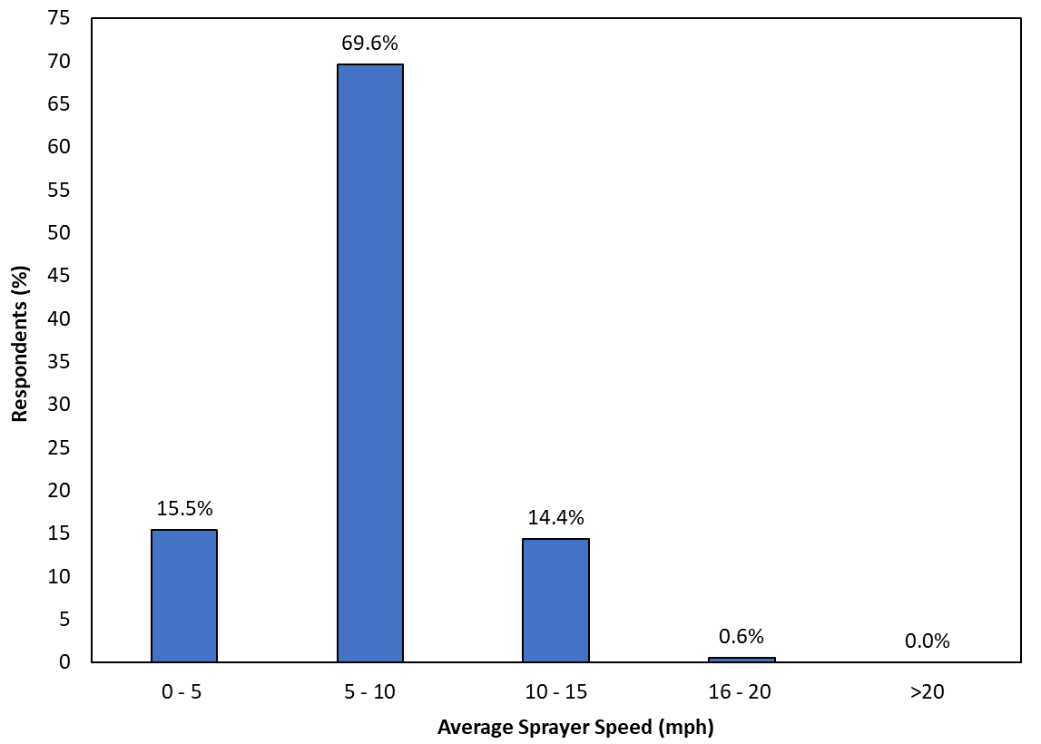
Q11: What is your average sprayer speed during pesticide applications? [n = 181]

Slide 16
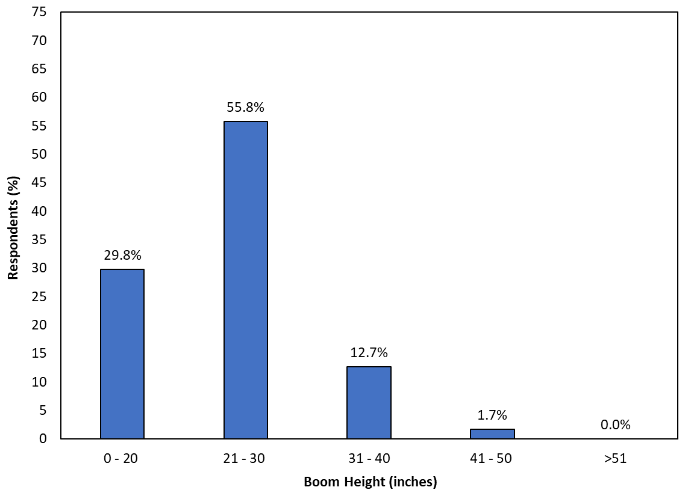
Q12: What is your target boom height during pesticide applications? [n = 181]

Slide 17
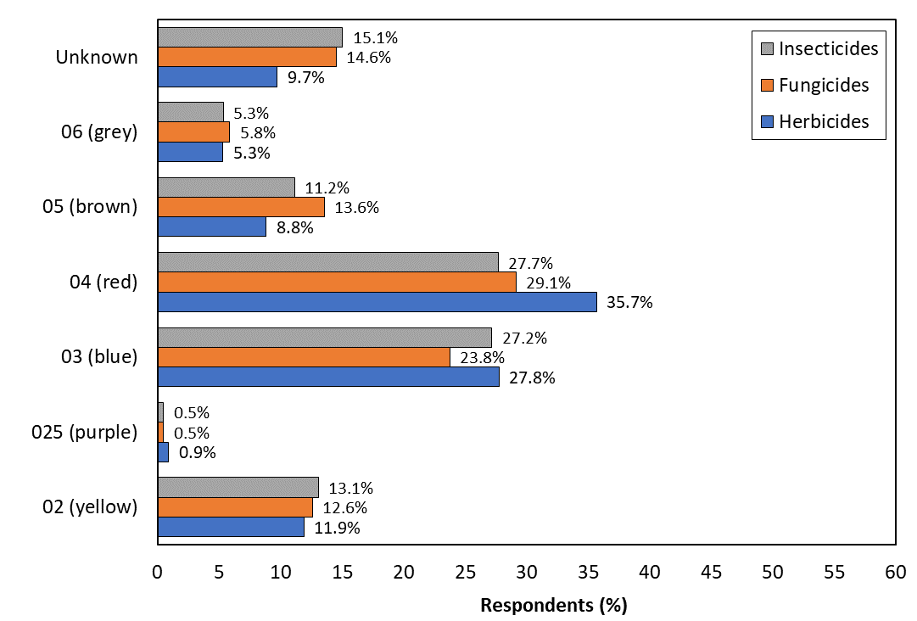
Q13: What nozzle size (or color) do you typically use for pesticide applications? (select all that apply). If unknown, please select “unknown”. [n = 173]

Slide 18
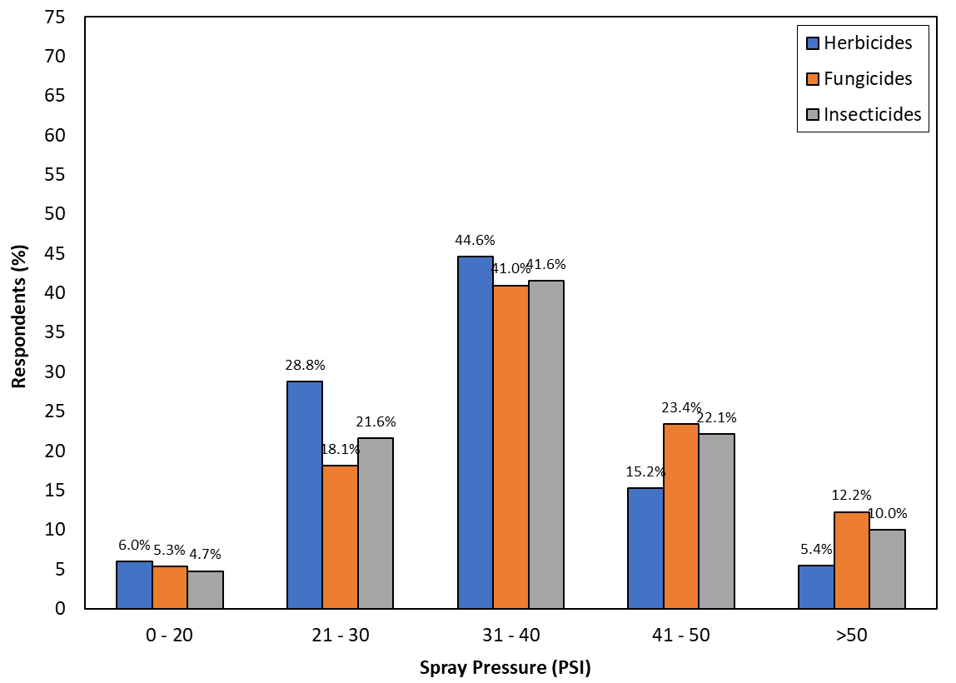
Q14: What pressure do you typically use for pesticide applications? If unknown, please select “unknown”. [n = 173]

Slide 19
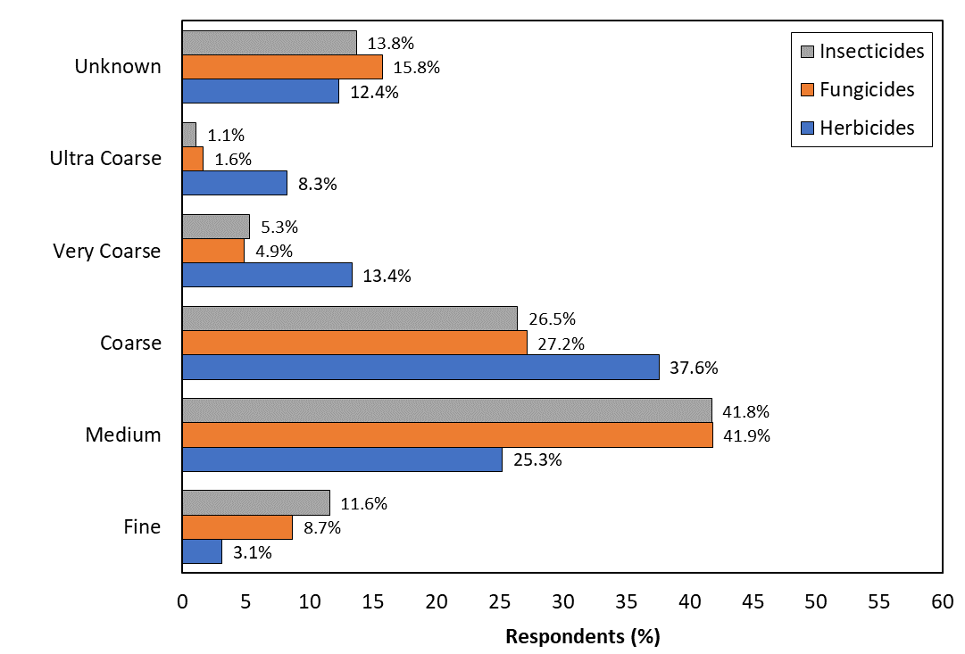
Q15: What droplet size do you typically use for pesticide applications? If unknown, please select “unknown”. [n = 171]

Slide 20
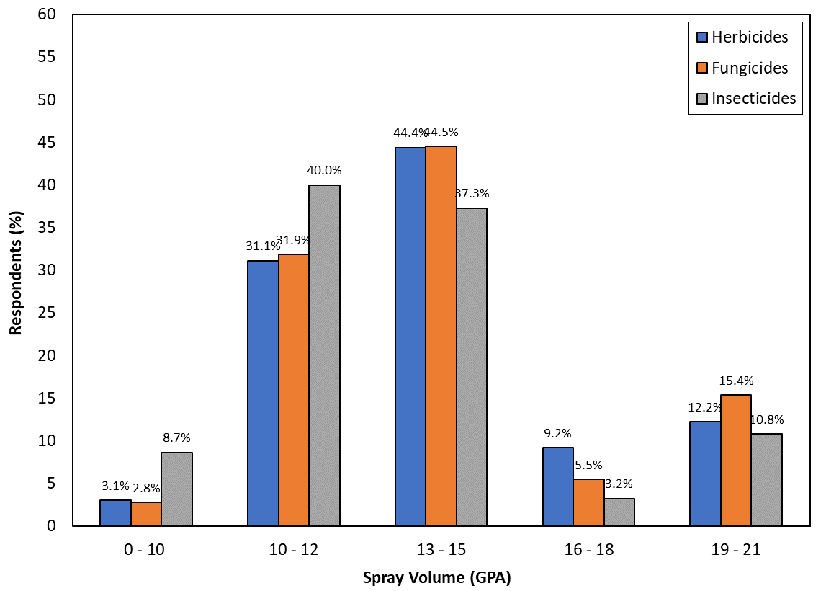
Q16: What spray volume do you typically use for pesticide applications. [n = 171]

Slide 21
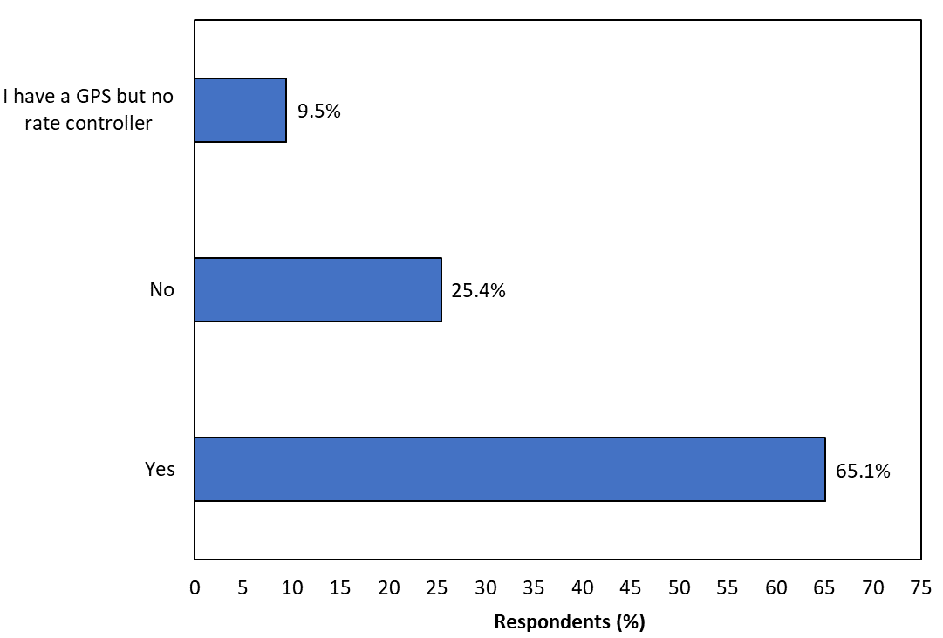
Q17: Do you have a GPS and rate controller on your sprayer? [n = 169]

Slide 22
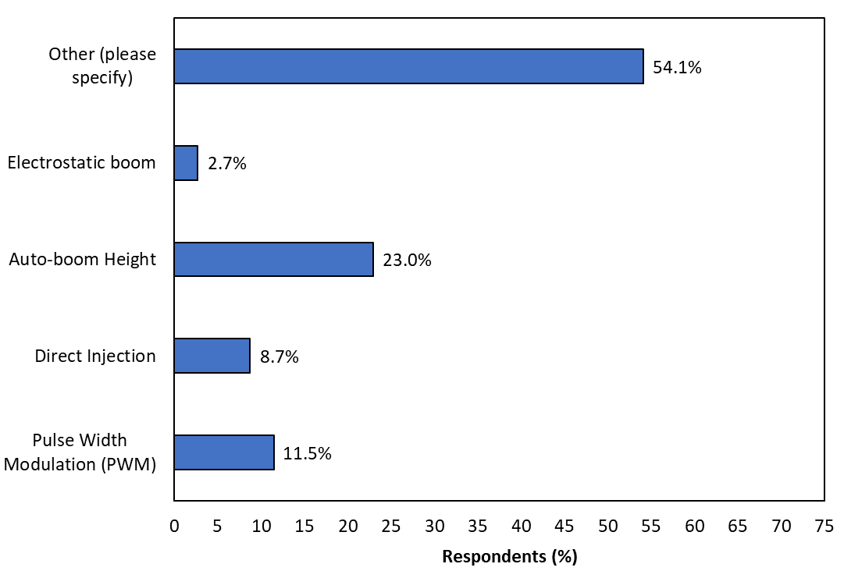
Q18: What all precision spray technologies do you have or use on your sprayer? (select all that apply) [n = 169]

Slide 23
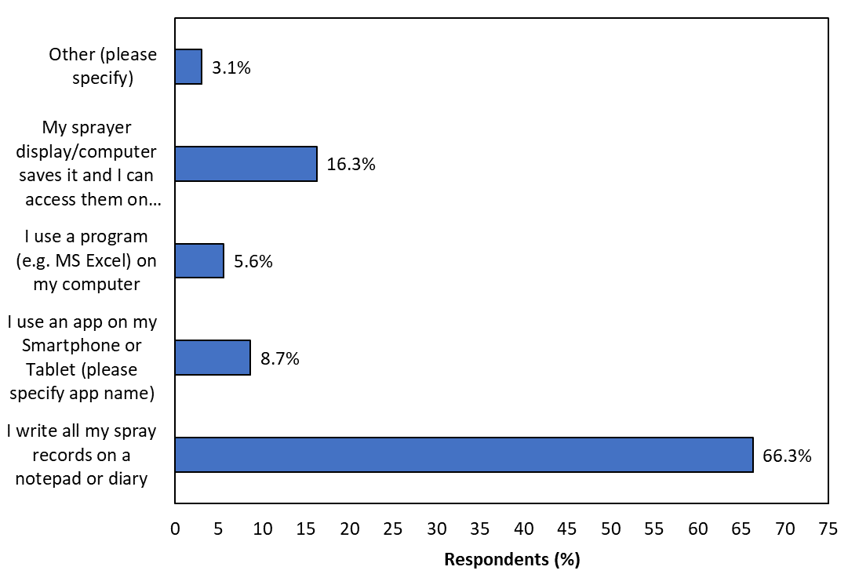
Q19: How do you (or the farm manager) log spray records during the season? [n = 169]

Slide 24
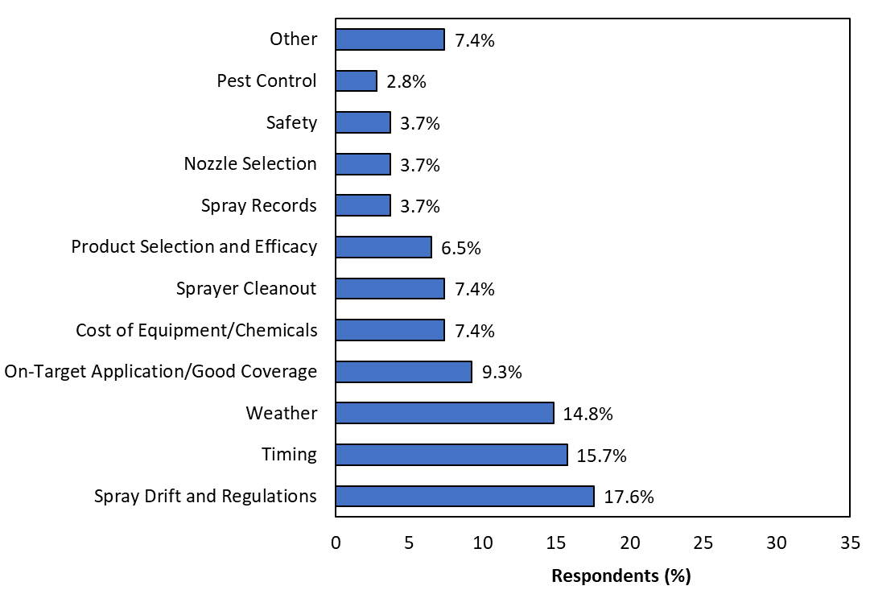
Q20 (a): What is your biggest challenge related to pesticide applications on your farm? [n = 105]

Slide 25
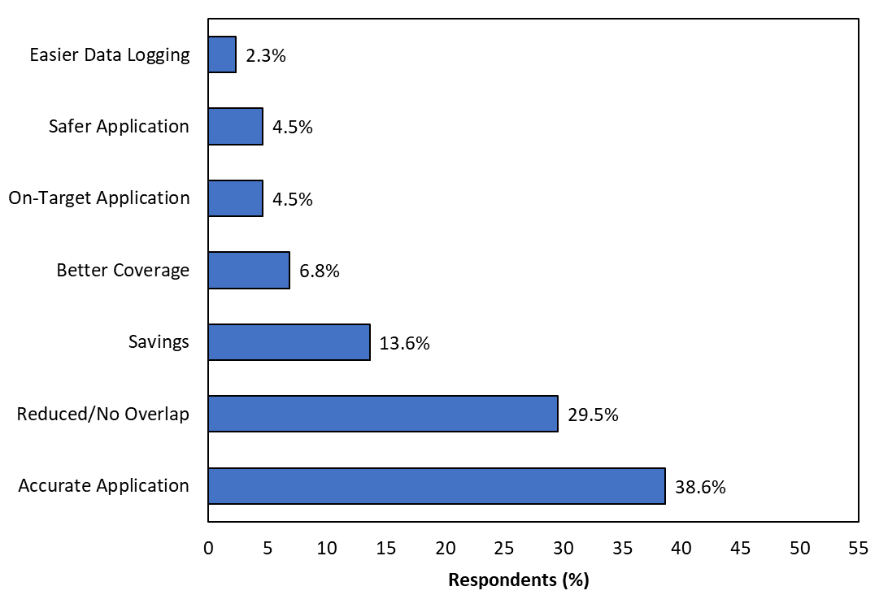
Q20 (b): According to you, what is the biggest advantage with using new application technologies? [n = 105]

Slide 26
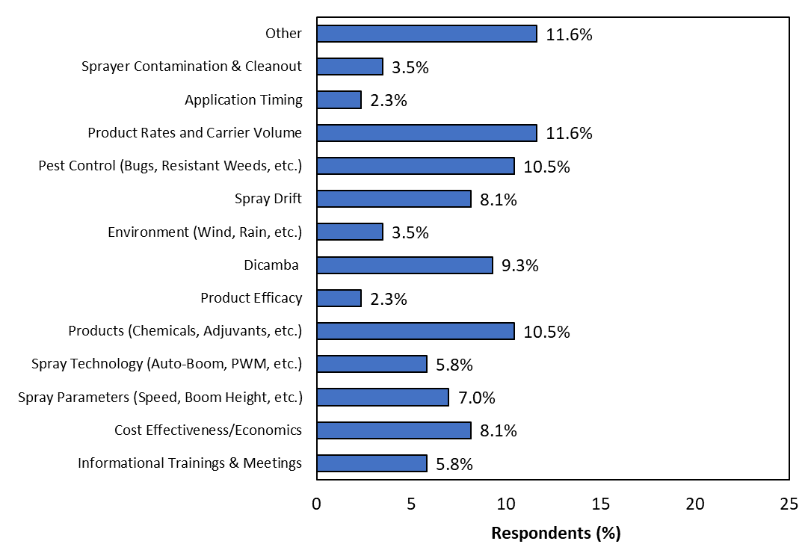
Q21: What pesticide application research would you like to see the University of Georgia conduct that can help address your pesticide application issues or concerns? [n = 73]

Slide 27
Questions/Comments?
eprostko@uga.edu
www.gaweed.com

