Slide 1

2021 Soybean Weed Control Update
Eric P. Prostko
Professor and Extension Weed Specialist
Dept. Crop & Soil Sciences

Slide 2
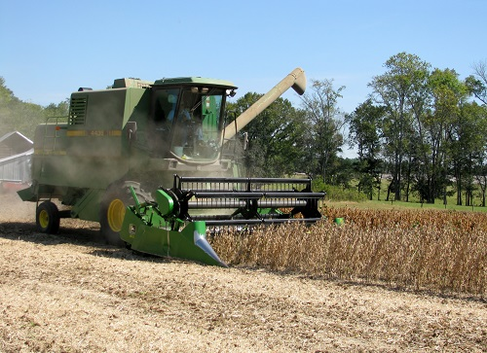
Soybean Weed Control (Currently)
Start clean, use residuals, timely POST
Narrow rows (<30”)
Systems
Conventional
RR (glyphosate)
LL (glufosinate)
LL-GT27 (glufosinate + glyphosate + isoxaflutole)
Alite 27 (BASF)
Balance Bean (Bayer)
Xtend (dicamba)
XtendFlex (dicamba + glyphosate + glufosinate)
Enlist (2,4-D choline)

Slide 3
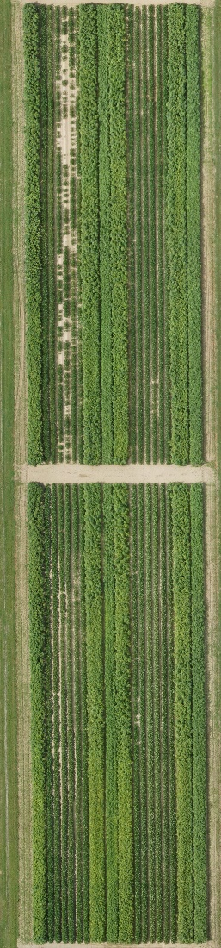
Soybean Weed Control - 2019
Enlist
XtendFlex
Liberty
Xtend
SB-02-19
July 7
53 DAP

Slide 4
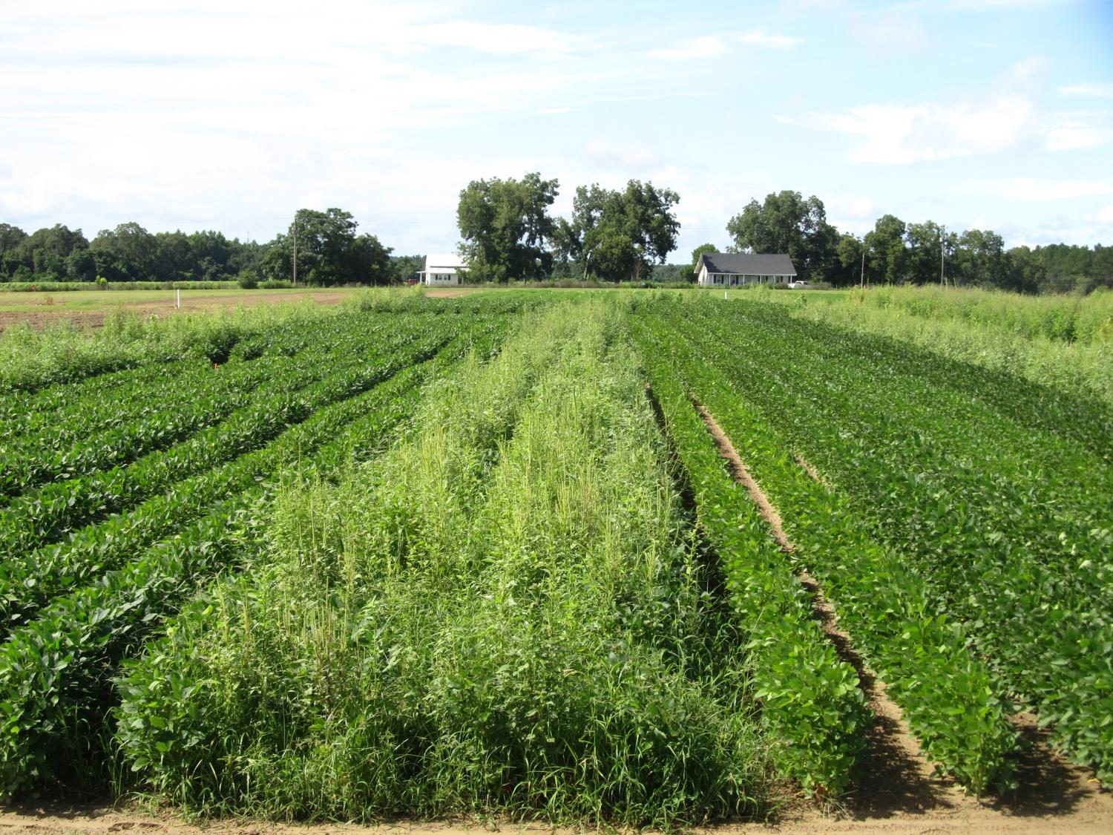


Soybean Weed Control - 2018
SB-01-18
August 3
SB-01-18
July 20

Slide 5
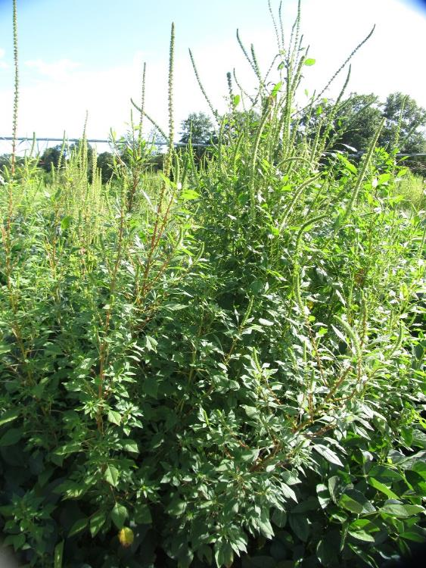
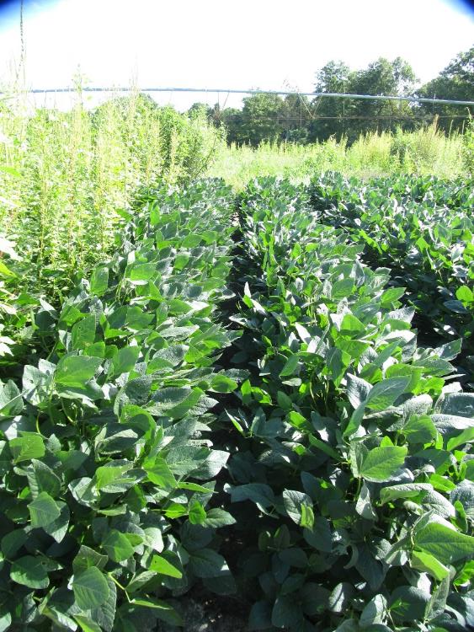
Soybean Weed Control - 2019
NTC
Tricor 4L @ 8 oz/A (PRE)
Roundup Powermax 5.5SL @ 32 oz/A +
Reflex 2SL @ 24 oz/A (22 DAP)
SB-04-19
July 22
69 DAP

Slide 6


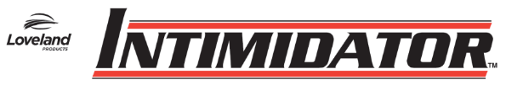
Old + Cheap + Still Good (i.e. metribuzin)
Not a PPO (Valor or Reflex)
Good on pigweed and sicklepod
Can be applied PPI
Dryland fields?
Issues (Be careful!!)
soil texture, OM, pH
Varieties
Rotations
TriCor 75DF
Metribuzin 75DF

Slide 7
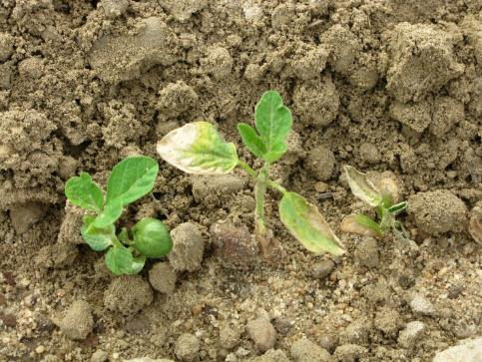
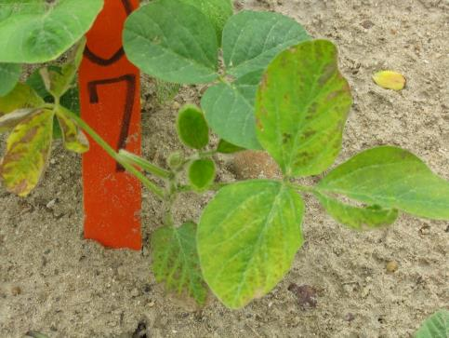
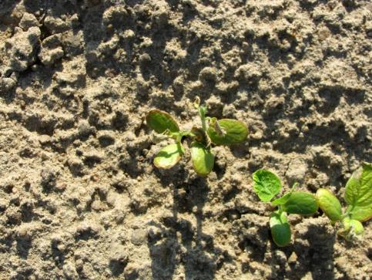
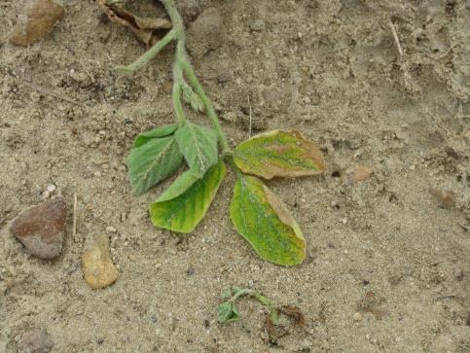
Metribuzin Injury

Slide 8


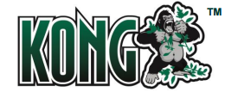


Liberty-Link® Soybeans
Liberty 2.34SL @ 32-43 oz/A or generics
VE-R1 (beginning bloom)
2 applications (5 days apart)
(87 oz/A/year total)
Tank-mixes with POST grass herbicides may reduce grass control
Assure (10-21%); Fusilade (8-12%); Poast (25-41%); Select (4-22%)
Residuals still needed
15 GPA, medium-coarse droplet size, small weeds, 9 am - 6 pm

Slide 9
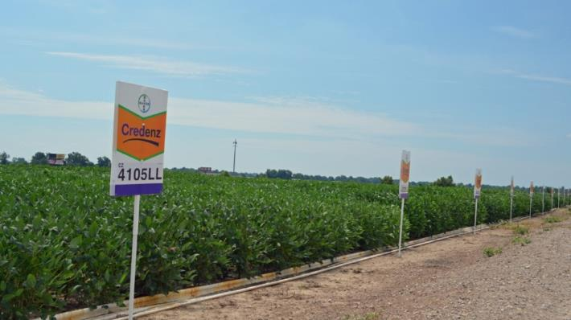
Liberty-Link Soybean Varieties
Getting better and better!
G13LL-7 and G13LL-44 developed by UGA Soybean Breeding Team
Group VII’s
AGS 747LL (G13LL-7)
AGSouth
Southern Harvest 7418LL (G13LL-44)
Meherrin
Others

Slide 10
Statewide Average Yield of UGA Developed LL Soybeans*
*Source: UGA OVT (6 locations/year, irrigated)

Slide 11










2,4-D/Dicamba Technologies
2,4-D choline
dicamba

Slide 12

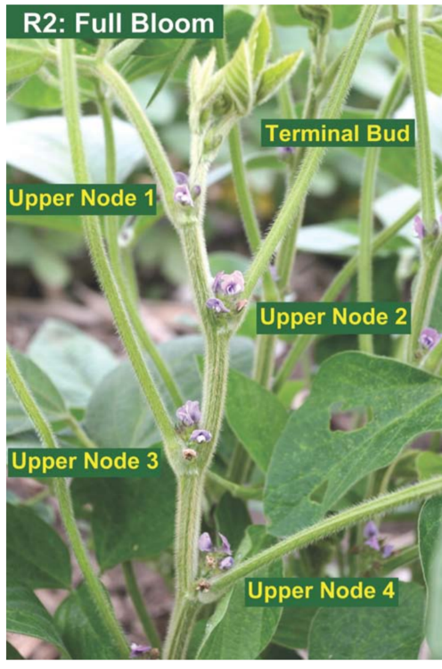

Enlist™ Soybeans
China approval in Jan 2019
Enlist One®
2,4-D choline
Enlist Duo®
2,4-D choline + glyphosate
POST up to R2 (full bloom)
2 apps (12 days)
Can be tank-mixed with glufosinate (Liberty) or others
Check label/web-sites for restrictions (nozzles, wind speed, buffers, etc.)
Varieties for GA????
P53T90E (ind)

Slide 13


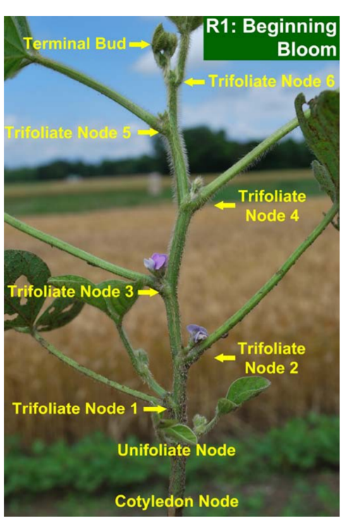
Xtend®/XtendFlex® Soybeans
Xtendimax® 2.9SL, Engenia® 5SL
Dicamba
POST up to R1 (beginning bloom) or June 30
2 apps (7 days)
Add a residual
Tavium® 3.38SC
dicamba (1.12 ae) + s-metolachlor (2.26 lb)
56.5 oz/A
POST up to V4 or June 30
1 PPLNT/PRE + 1 POST
tank-mixes
Check Xtendimax label/web-sites for tank-mixes and restrictions (nozzles, wind speed, buffers, etc.)
Engenia information
Photo: Dr. Shaun Casteel, Purdue Univ.

Slide 14

Xtendflex® Soybeans
Full approval 09/28/2020
Dicamba, glyphosate, glufosinate (Liberty)
Cannot tank-mix dicamba + Liberty
Roundup + Liberty?

Slide 15

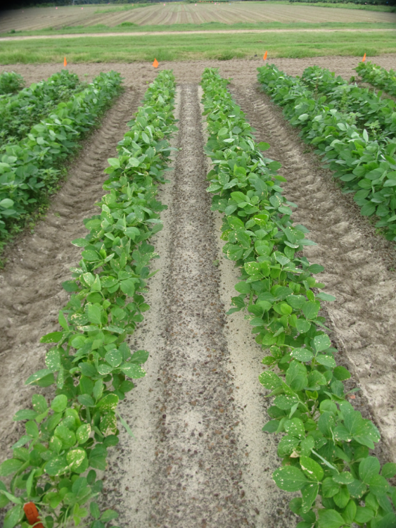
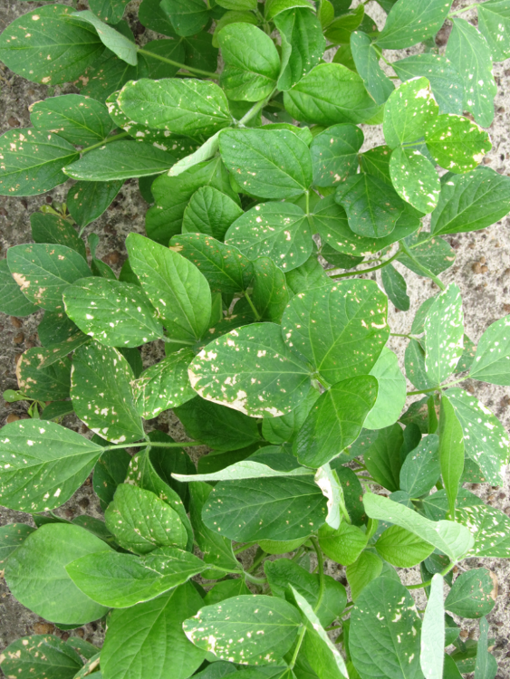
Roundup P-Max @ 28.4 oz/A + Tavium (VG) 56.5 oz + Intact @ 0.5% v/v + Class Act Ridion @ 1% v/v
SB-07-18, June 15, 2 DAT, Plot #402

Slide 16
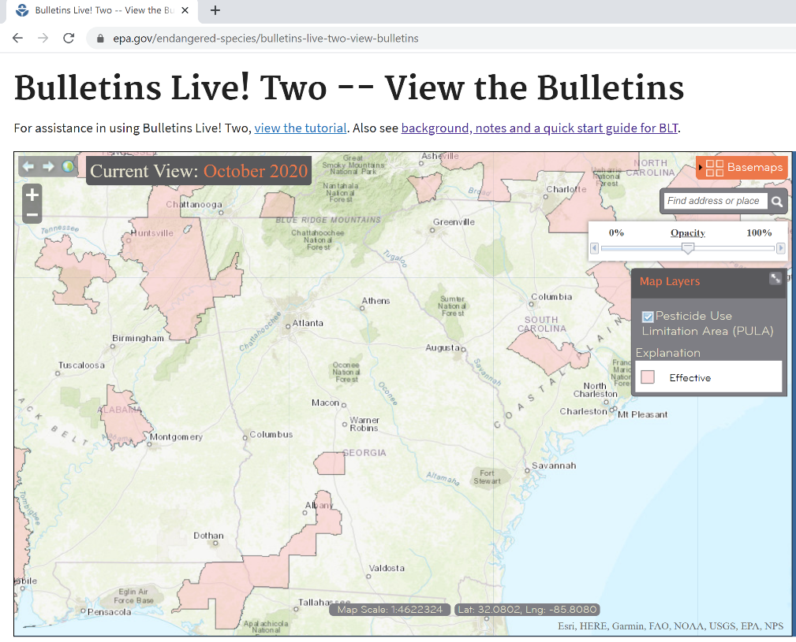
GA Endangered Species Concerns for DT Soybeans
- 310’ downwind buffer
57’ omni buffer
Seminole, Decatur, Mitchell,
Worth, Dooly
parts of Floyd, Chattooga, Bartow

Slide 17
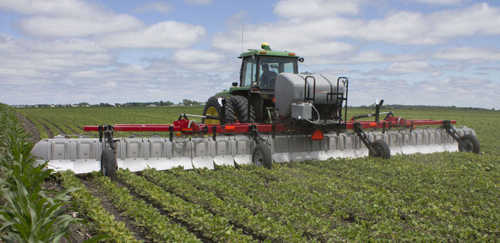
Hooded Sprayer Reduces Downwind Buffer Requirement (240’ to 110’ and 310’ to 240’)
Redball 642E is the only approved hooded sprayer

Slide 18
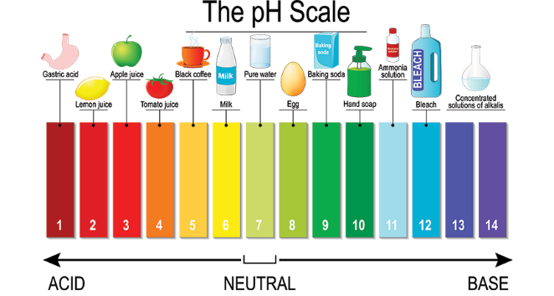
Dicamba Soybeans - 2021 DRA, VRA, pH Buffers
Drift Reduction Adjuvant (DRA)
Volatility Reduction Adjuvant (VRA)
pH Buffering Adjuvant (PHBA)
DRA + VRA
Xtendimax, Tavium
DRA + PHBA
Engenia

Slide 19
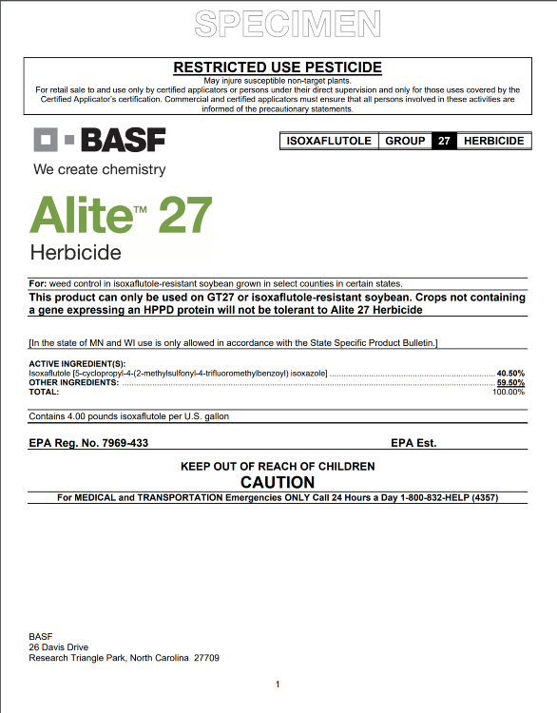
Alite™ 27
Isoxaflutole
WSSA Group 27 (HPPD)
GT27 soybeans only
Only labeled for use in these GA counties
Atkinson, Berrien, Clinch, Echols, Evans, Lanier, Lowndes
PPI or PRE
1.5-2.0 oz/A
Restricted use
Varieties/Data?
Rotations: field corn = 0 months; small grains = 4 months; grain sorghum = 6 months; peanut = 11 months; cotton = 10 months

Slide 20
Harvest Aids Soybeans
Herbicide | Rate/A (oz) | Adjuvant | Time of Application |  | PHI (days)
 |  |  | Determinate | Indeterminate
paraquat 2 lb gal 3 lb/gal | 16 10.7 | NIS @ 0.25% v/v | Fully mature 50% leaf drop Yellow leaves | <30% moisture or 65% of pods mature brown | 15
Sharpen 2.85SC | 1-2 | MSO @ 1% v/v | Fully mature 50% leaf drop Yellow leaves | > 65% mature brown pods and > 70% leaf drop or < 30% seed moisture | 3
*Glyphosate and Aim are also labeled (more for weed control than
crop dessiccation).

Slide 21
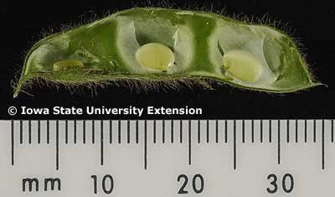
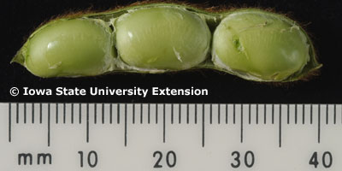
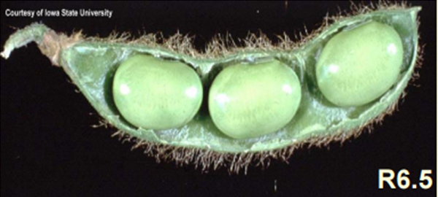
Important Soybean Stages for Harvest Aids
R5-BS
R6-FS
or later
R5-R6 = 11-20 days (15 avg.)
R6-R7 = 9-30 days (18 avg.)

Slide 22
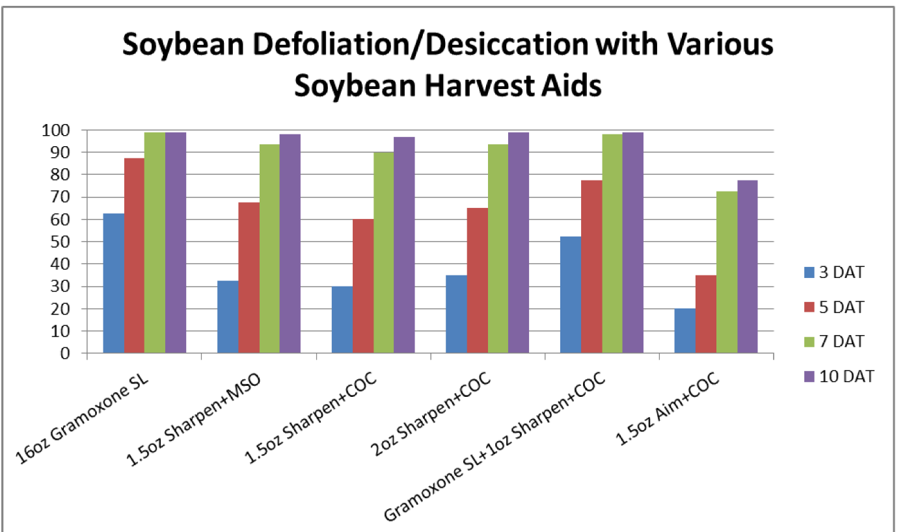
Harvest Aids
Source: Mississippi State Univ.

Slide 23
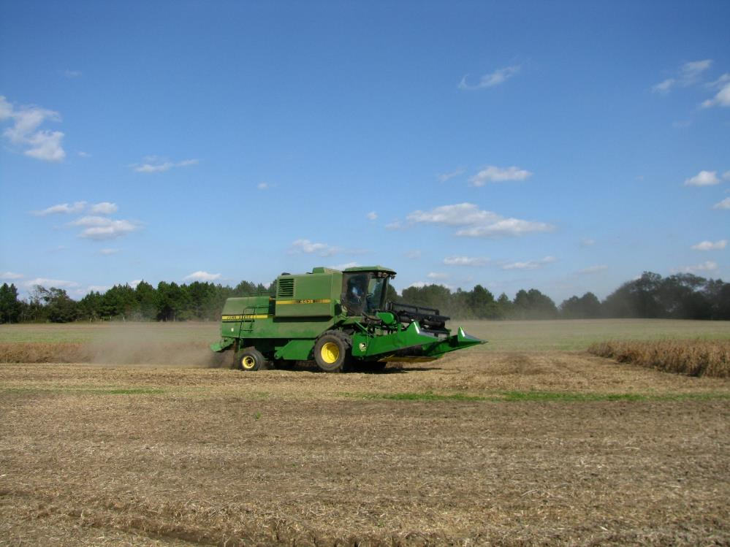
Questions/Comments

