Slide 1
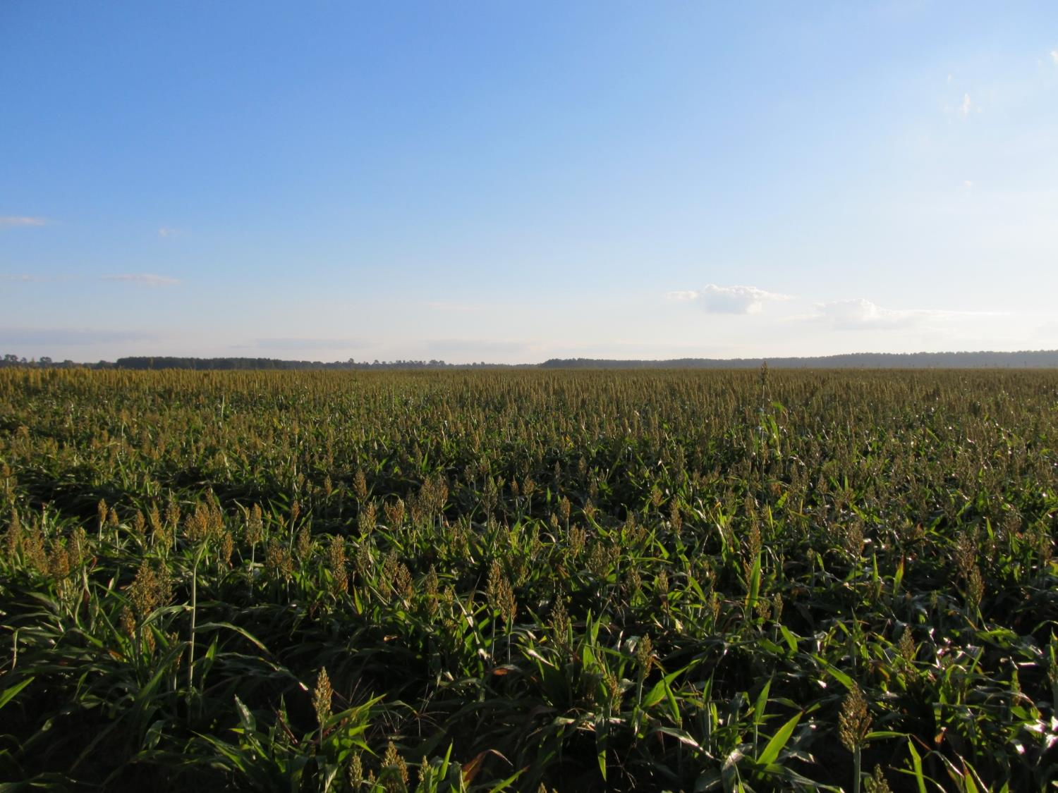
GRAIN SORGHUM WEED CONTROL UPDATE - 2021
Eric P. Prostko, Ph.D.
Professor/Extension Weed Specialist
Dept. Crop & Soil Sciences

Slide 2
Grain Sorghum Weed Control
Start clean!
Concep treated seed
Dual Magnum or Outlook or Warrant (PRE)
Atrazine 4L @ 1.5 QT/A (EPOST)
Add Huskie if you have ATZ resistance
Paraquat (Hooded sprayer)
Mechanical Cultivation

Slide 3
A New Product to Consider?
Huskie 2.06EC
Bayer CropScience
Buctril (1.75 lbs/gal) + pyrasulfotole (0.31 lbs/gal)
MOA = 6 + 27
Postemergence (13-16 oz/A)
3-leaf to 12” tall sorghum
Broadleaf weeds, good on pigweed
Tank-mix with atrazine (16 oz/A)

Slide 4
Grain Sorghum Weed Control – 2020
NTC
Outlook 6EC @ 12.8 oz/A (PRE)
Huskie 2.06EC @ 16 oz/A (20 DAP)
Atrazine 4L @ 16 oz/A (20 DAP)
AMS @ 1% v/v (20 DAP)
Induce @ 0.25% v/v (20 DAP)
GS-02-20
July 9
57 DAP

Slide 5
Huskie Injury – 7 DAT
GS-02-20
June 9

Slide 6
Huskie @ 16 oz/A + Atrazine @ 16 oz/A + AMS @ 1% v/v + Induce @ 0.25% v/v
June 9
7 DAT
June 15
13 DAT
GS-02-20

Slide 7
Huskie Injury on Sorghum

Slide 8
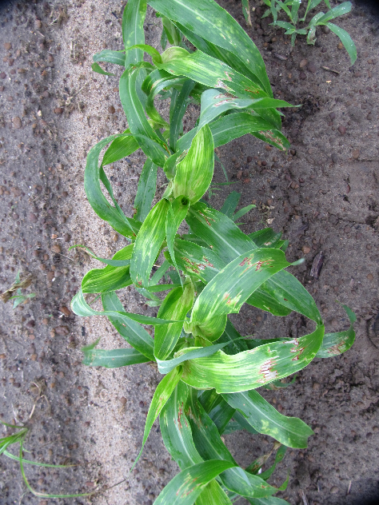
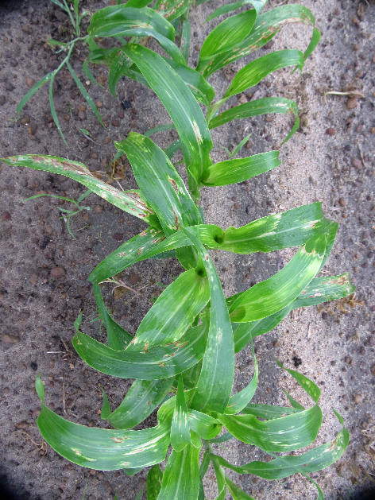
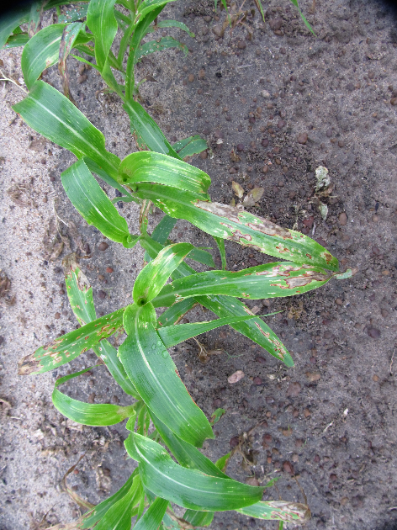
Huskie Tank-Mixes in Grain Sorghum - 2020
Huskie @ 16 oz/A +
Atrazine @ 16 oz/A +
AMS @ 1% v/v +
Induce @ 0.25% v/v
Huskie @ 16 oz/A +
Atrazine @ 16 oz/A +
Warrant @ 48 oz/A +
AMS @ 1% v/v +
Induce 0.25% v/v
Huskie @ 16 oz/A +
Atrazine @ 16 oz/A +
Dual Magnum @ 16 oz/A +
AMS @ 1% v/v +
Induce 0.25% v/v
GS-02-20, June 8, 6 DAT

Slide 9
Other Sorghum Options
Inzen™ Z?
Zest (nicosulfuron)
Sandea/Permit
nutsedge
Prowl??
TX panicum
Auxin Herbicides
2,4-D or Dicamba
Rate
Weed size
Injury
Off-target movement

Slide 10
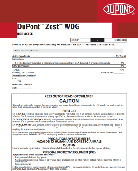
Inzen™ Z Grain Sorghum
Kansas State Univ.
DuPont/Corteva
Resistance to POST applications of ALS herbicides
Zest (nicosulfuron)
Non-GMO
Gene from wild genotype of sorghum
Varieties for GA?
2022
Stewardship!
Inzen™ Cultivar (left row)
Conventional Cultivar (right row - dead)
Ponder Farm 2012

Slide 11
Grain Sorghum Atrazine + Prowl + Agridex Applied June 2 (20 DAP)
GS-02-20
June 23
21 DAT

Slide 12
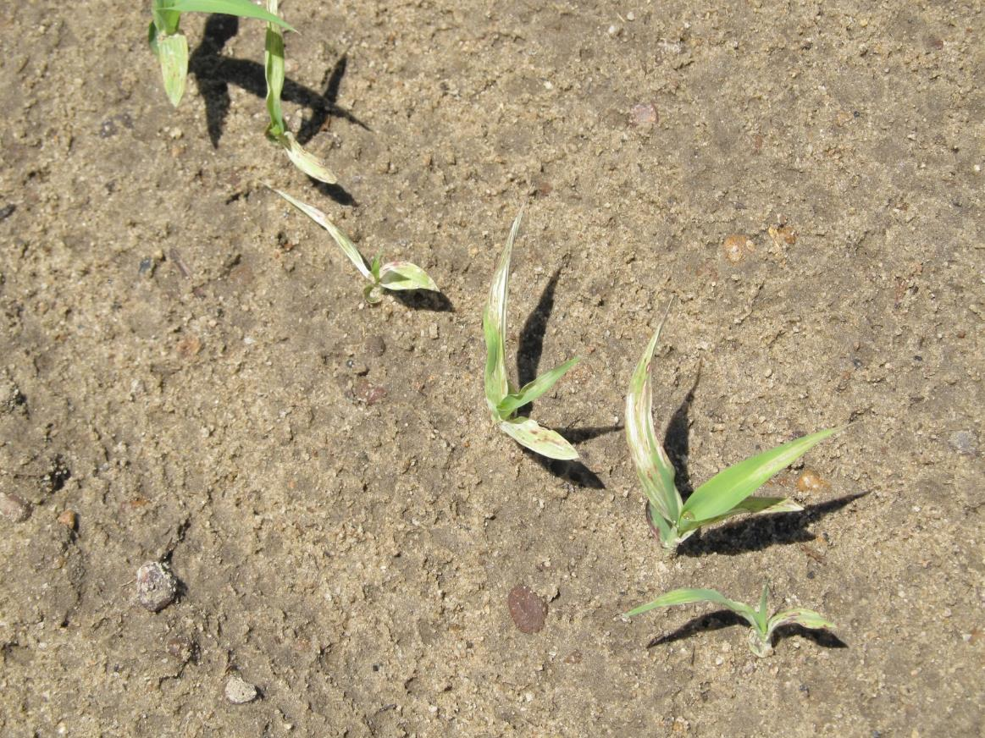
Grain Sorghum After Reflex? (10 month rotation restriction)
**Average ½-life in south GA soils was 80 to 128 days (~100 days) Potter et al. 2016. J. Agric. Food Chem. 64:5156-5163

Slide 13
Reflex Concentrations in Soil After PRE Applications Under Assorted Mulches
*Myakka sand (1% OM, 6.8 pH; 95% sand, 4% silt, 1% clay); Reflex concentration at application was 139-176 µg/kg
Source: Reed et al. 2017. Weed Science (FL)

Slide 14
Reflex 2SL @ 12 oz/A Injury on Sorghum Applied 94 DBP
GS-01-20
August 11
Plot #207
21 DAP

Slide 15
Grain Sorghum Yield Following Herbicides Applied to Bare-Ground - 90 DBP - 2019
Bu/A
Treatment
GS-01-19
October 28
LSD (0.10) = 8.9
CV = 10.52

Slide 16
Grain Sorghum Yield Following Herbicides Applied to Bare-Ground - 94 DBP - 2020
Bu/A
Treatment
SG-01-20
November 5
P = 0.3865
CV = 19.42

Slide 17
2020 Grain Sorghum Problem Anthracnose

Slide 18
Ratoon Grain Sorghum Demo – 2018 July 27 – 1 DAT
Gramoxone @ 3 pts/A + Dual Magnum @ 16 oz/A
(Applied 2 days after mowing stalks to ~4’-8” tall)

Slide 19
Ratoon Grain Sorghum Demo – 2018 August 14 - 19 DAT

Slide 20
Ratoon Grain Sorghum Demo – 2018 September 4 - 40 DAT

Slide 21
Questions/Comments?
eprostko@uga.edu
gaweed.com

