Slide 1
Peanut Weed Control Update - 2021
Eric P. Prostko, Ph.D.
Professor/Extension Weed Specialist
Department of Crop & Soil Sciences

Slide 2
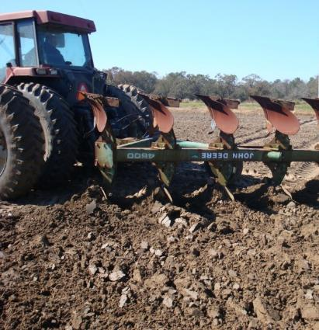
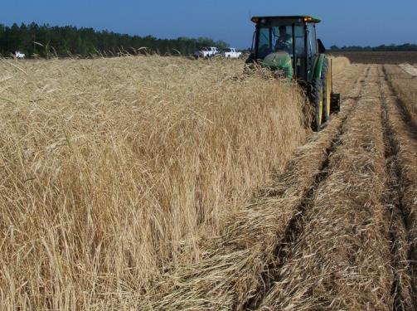
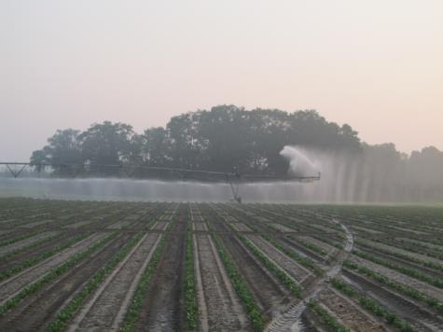
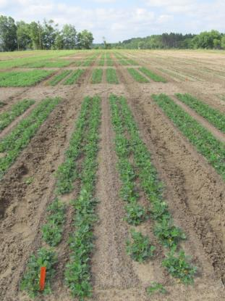
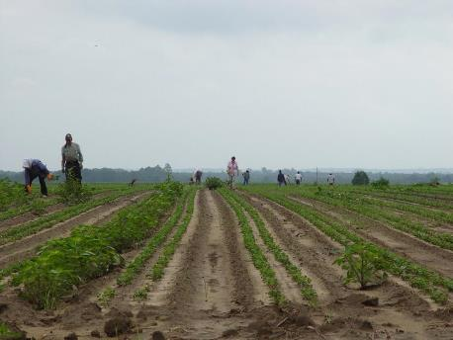
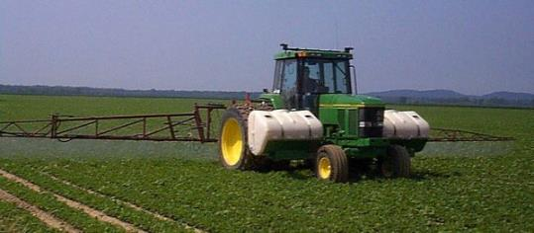
Peanut Weed Control Integrated Program Approach
Tillage
Irrigation
Rye Cover Crop
Hand-Weeding
Twin Rows
Herbicides

Slide 3
Peanut Weed Control – 2020 Program Approach
Prowl H₂0 @ 32 oz/A (PRE)
Valor EZ @ 3 oz/A (PRE)
Strongarm @ 0.225 oz/A (PRE)
Cadre @ 4 oz/A (29 DAP)
Warrant @ 48 oz/A (29 DAP)
2,4-DB @ 16 oz/A (29 DAP)
Induce @ 0.25% v/v (29 DAP)
Started CLEAN!
Twin Rows
4 residuals
Timely POST
PE-05-20
July 21
71 DAP
NTC
NTC

Slide 4
Prowl vs. Sonalan??

Slide 5
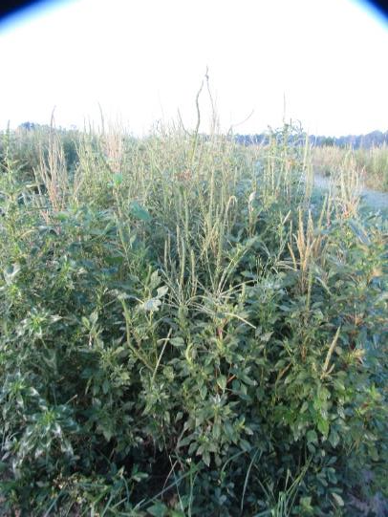
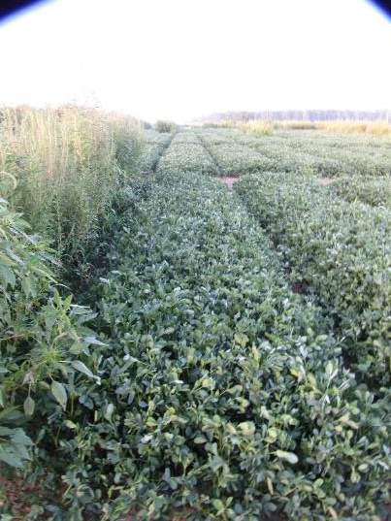
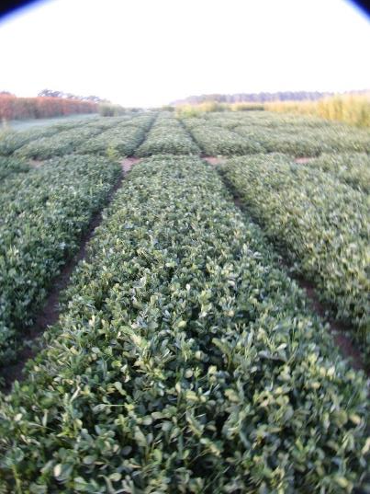
Peanut Weed Control – 2020 Sonalan or Prowl?
NTC
Prowl H₂0 @ 32 oz/A +
Valor SX @ 3 oz/A (PRE)
Cadre @ 4 oz/A +
Dual Magnum @ 16 oz/A +
2,4-D @ 16 oz/A (30 DAP)
Sonalan @ 32 oz/A +
Valor SX @ 3 oz/A (PRE)
Cadre 4 oz/A +
Dual Magnum @ 16 oz/A +
2,4-DB @ 16 oz/A (30 DAP)
PE-11-20
August 3
84 DAP

Slide 6
Peanut Weed Control – 2020 Gramoxone Program
Prowl H₂0 3.8ASC @ 32 oz/A (PRE)
Gramoxone 3SL @ 8 oz/A (14 DAP)
Storm 4SL @ 16 oz/A (14 DAP)
Dual Magnum 7.62EC @ 16 oz/A (14 DAP)
Cadre 2AS @ 4 oz/A (29 DAP)
Dual Magnum 7.62EC @ 16 oz/A (29 DAP)
2,4-DB 1.75SL @ 16 oz/A (29 DAP)
NTC
PE-05-20
June 18
38 DAP

Slide 7
Peanut Weed Control – 2020 Do you really need a “cracking” spray?
Prowl H₂0 @ 32 oz/A
Valor EZ @ 3 oz/A
Strongarm @ 0.225 oz/A
(PRE)
NTC
PE-13-20
June 3
22 DAP

Slide 8
Wrong Mixing Order
Was: 1) Gramoxone; 2) Storm; 3) Zidua SC
Should have been: 1) Zidua SC; 2) Storm;
3) Gramoxone
June 11, 2020

Slide 9
WSSA Group 15 Herbicides?

Slide 10
WSSA Group 15’s in Peanut How much?
Herbicide | Peanut Registration | Normal Use Rate (oz/A) | Total Amount Season (oz/A) | Latest Application | PHI (days)
Anthem Flex 4SE | 2020 | 3.0 | 9.12 | R3 (beginning pod) | NL
Dual Magnum 7.62EC | 1997 | 16.0 | 45.0 | -- | 90
Outlook 6EC | 1999 | 12.8 | 21.0 | -- | 80
Warrant 3ME | 2014 | 48.0 | 128.0 | R1 (Beginning bloom) | NL
Zidua 4.17SC | 2017 | 2.5 | 8.25 | R3 | 0

Slide 11
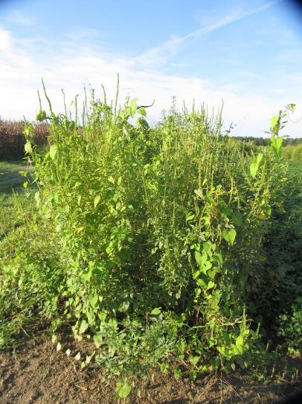
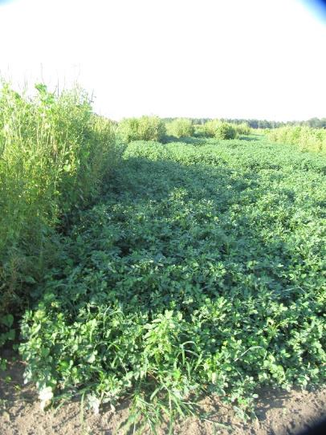
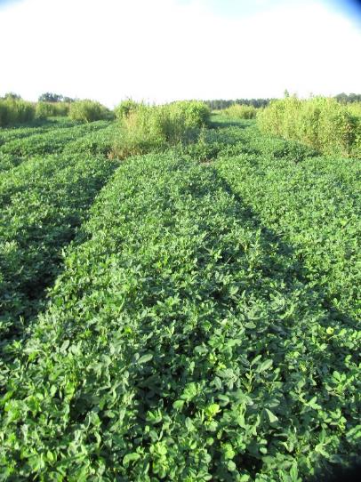
Peanut Weed Control – 2020 Dual Magnum/Cadre Programs
NTC
Prowl H₂0 @ 32 oz/A (PRE)
Gramoxone 3SL @ 8 oz/A +
Storm @ 16 oz/A +
Dual Magnum @ 16 oz/A (14 DAP)
Cadre @ 4 oz/A +
Dual Magnum @ 16 oz/A +
2,4-DB @ 16 oz/A (29 DAP)
Prowl H₂0 @ 32 oz/A +
Valor EZ @ 3 oz/A + Strongarm
@ 0.225 oz/A (PRE)
Cadre @ 4 oz/A +
Dual Magnum @ 16 oz/A +
2,4-DB @ 16 oz/A (29 DAP)
PE-05-20
August 20
101 DAP

Slide 12
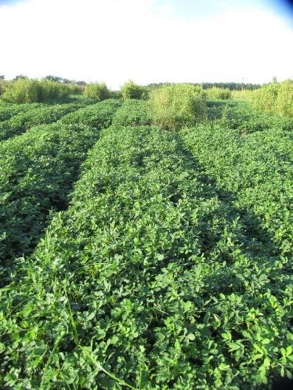
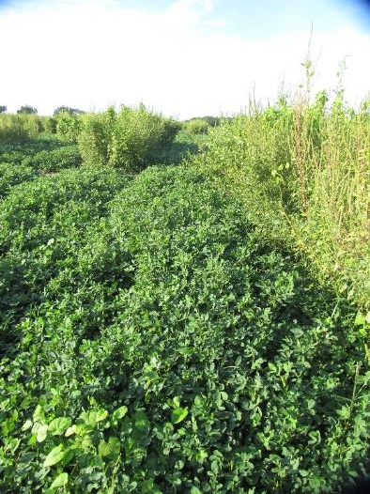
Peanut Weed Control – 2020 Outlook/Cadre Programs
NTC
Prowl H₂0 @ 32 oz/A (PRE)
Gramoxone 3SL @ 8 oz/A +
Storm @ 16 oz/A +
Outlook @ 10.5 oz/A (14 DAP)
Cadre @ 4 oz/A +
Outlook @ 10.5 oz/A +
2,4-DB @ 16 oz/A (29 DAP)
Prowl H₂0 @ 32 oz/A +
Valor EZ @ 3 oz/A +
Strongarm @ 0.225 oz/A (PRE)
Cadre @ 4 oz/A +
Outlook @ 12.8 oz/A +
2,4-DB @ 16 oz/A (29 DAP)
PE-05-20
August 20
101 DAP

Slide 13
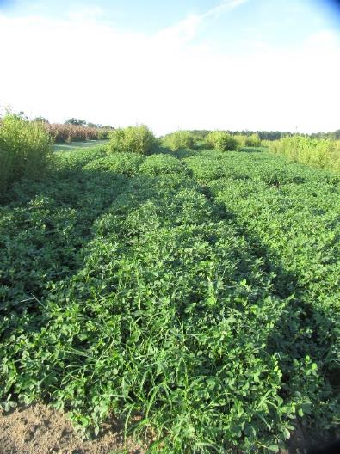
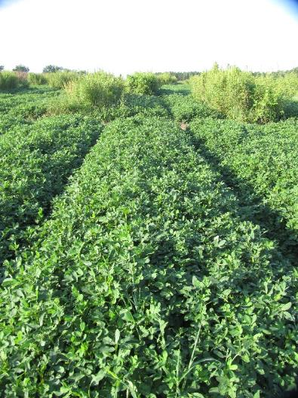
Peanut Weed Control – 2020 Warrant/Cadre Programs
NTC
Prowl H₂0 @ 32 oz/A (PRE)
Gramoxone 3SL @ 8 oz/A +
Storm @ 16 oz/A +
Warrant @ 48 oz/A +
Induce @ 0.25% v/v (14 DAP)
Cadre @ 4 oz/A +
Warrant @ 48 oz/A +
2,4-DB @ 16 oz/A
Induce @ 0.25% v/v (29 DAP)
Prowl H₂0 @ 32 oz/A +
Valor EZ @ 3 oz/A +
Strongarm @ 0.225 oz/A (PRE)
Cadre @ 4 oz/A +
Warrant @ 48 oz/A +
2,4-DB @ 16 oz/A +
Induce @ 0.25% v/v (29 DAP)
PE-05-20
August 20
101 DAP

Slide 14
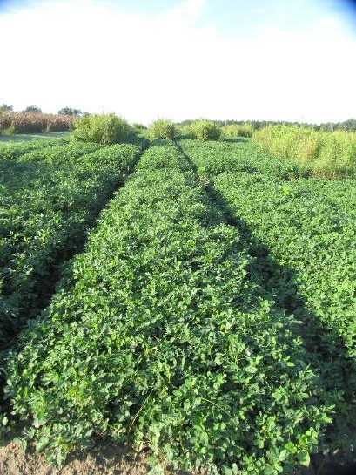
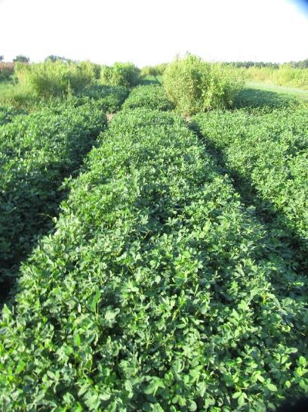
Peanut Weed Control – 2020 Zidua/Cadre Programs
NTC
Prowl H₂0 @ 32 oz/A (PRE)
Gramoxone 3SL @ 8 oz/A +
Storm @ 16 oz/A +
Zidua SC @ 2.5 oz/A +
Induce @ 0.25% v/v (14 DAP)
Cadre @ 4 oz/A +
Zidua SC @ 2.5 oz/A +
2,4-DB @ 16 oz/A
Induce @ 0.25% v/v (29 DAP)
Prowl H₂0 @ 32 oz/A +
Valor EZ @ 3 oz/A +
Strongarm @ 0.225 oz/A (PRE)
Cadre @ 4 oz/A +
Zidua SC @ 2.5 oz/A +
2,4-DB @ 16 oz/A +
Induce @ 0.25% v/v (29 DAP)
PE-05-20
August 20
101 DAP

Slide 15
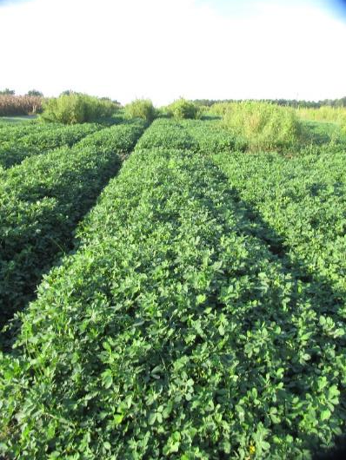
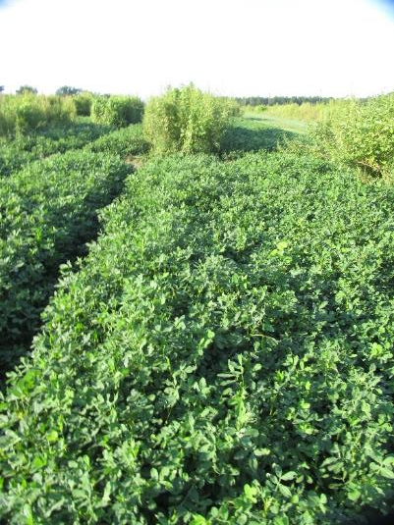
Peanut Weed Control – 2020 Anthem Flex/Cadre Programs
NTC
Prowl H₂0 @ 32 oz/A (PRE)
Gramoxone 3SL @ 8 oz/A +
Storm @ 16 oz/A +
Anthem Flex @ 3 oz/A +
Induce @ 0.25% v/v (14 DAP)
Cadre @ 4 oz/A +
Anthem Flex @ 3 oz/A +
2,4-DB @ 16 oz/A
Induce @ 0.25% v/v (29 DAP)
Prowl H₂0 @ 32 oz/A +
Valor EZ @ 3 oz/A +
Strongarm @ 0.225 oz/A (PRE)
Cadre @ 4 oz/A +
Anthem Flex @ 3 oz/A +
2,4-DB @ 16 oz/A +
Induce @ 0.25% v/v (29 DAP)
PE-05-20
August 20
101 DAP

Slide 16
Peanut Yield (lbs/A) Response to WSSA Group 15’s - 2020
PE-18-20
GA-06G
Weed-free
P = 0.6901
CV = 7.26
DM @ 15 oz/A
W @ 43 oz/A
DM (PRE + 15 + 29 DAP)
W (42 + 56 DAP)

Slide 17
Cobra vs. Blazer

Slide 18
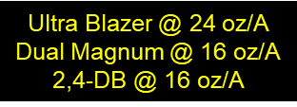
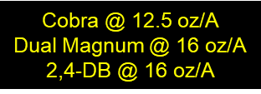
Ultra Blazer or Cobra – 2020 15 GPA, AIXR
2”-10” tall AMAPA
13 DAT
June 17

Slide 19
Ultra Blazer or Cobra – 2020 15 GPA, AIXR Tips
NTC
2”-10” tall AMAPA
25 DAT
June 29

Slide 20
Strip-Tillage Peanut Weed Control
1) cereal rye planted Dec 18, 2019 (70 lbs/A) – broadcast
2) 45 lbs/A N on Jan 22, 2020
3) Burndown on March 30 - Roundup + Valor (2 oz/A)
4) strip-till rig on April 29
5) Planted May 25 - Twin row
6) Gramoxone + Prowl + Valor + Strongarm at planting
7) Cadre + Dual Magnum + 2,4-DB (~40 DAP)
8) hard-hose irrigation
Commercial Field
Tift Co.
July 19, 2020
56 DAP

Slide 21
Other Research

Slide 22
Wild Radish Seedlings
July 7, 2020
Ponder Farm

Slide 23
Strongarm 84WG @ 0.3 oz/A + Induce @ 0.25% v/v on Large Wild Radish (20” flowering/pods) – 6 DAT (June 8 )
11002AIXR Tips
15 GPA

Slide 24
Strongarm 84WG @ 0.3 oz/A + Induce @ 0.25% v/v on Large Wild Radish (20” flowering/pods) – 20 DAT (June 22 )
untreated
treated
11002AIXR Tips
15 GPA

Slide 25
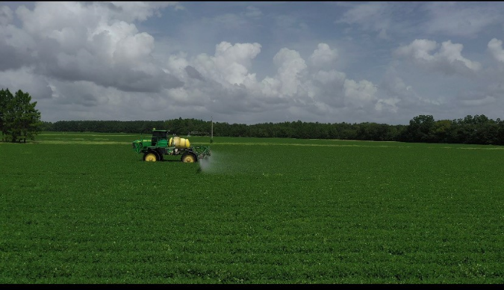
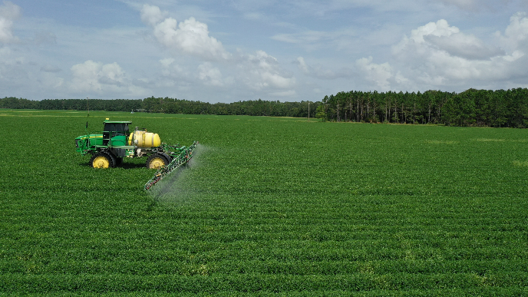
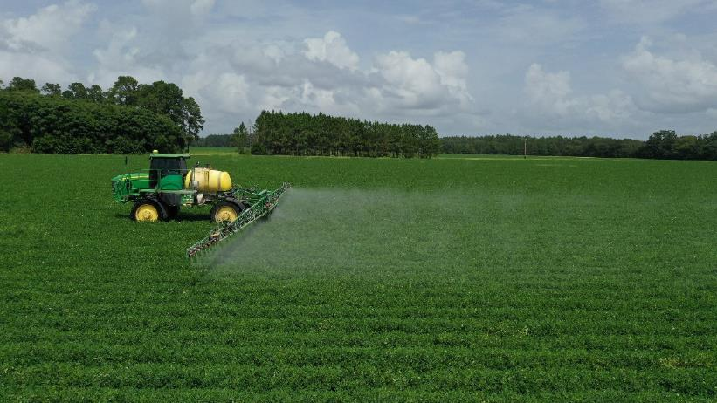
Nozzle Type and Off-Target Movement (JD4630, 90’ boom, 15” nozzle spacing, 13 GPA, 13.6 MPH, 41 PSI)
TTI-11004
TTI60-11004
XRC-11004
NZ-01-20
August 25
116 DAP
Bulloch Co.

Slide 26
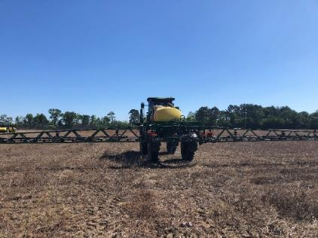
Nozzle Type Effects on Insect, Disease, and Yield of Peanut with a Commercial Sprayer – 2020*
Nozzle Type | 3-CAH (#/10 swps) 08-05-20 | Leaf Spot (1-10) 08-27-20 | Above-Ground White Mold (%) 08-27-20 | Under-Ground White Mold (%) 09-17-20 | Peanut Yield (lbs/A)
XRC-11004 | 5.5 | 1 | 5.8 | 11.5 | 4665
TTI60-11004 | 5.8 | 1 | 3.3 | 20.3 | 4776
TTI-11004 | 4.3 | 1 | 4.8 | 21.1 | 4526
LSD (0.10) P-Value CV | NS 0.7176 52.51 | NS 1.0 0 | NS 0.7389 97.3 | NS 0.2610 46.4 | NS 0.3234 4.59
*JD4630, 90’ boom, 15” nozzle spacing, 13.6 MPH, 13 GPA, 41 PSI
NZ-01-20
Bulloch Co.

Slide 27
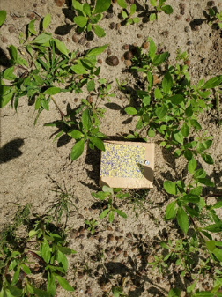
Influence of Boom Height on Spray Coverage - 2020
RoGator 700B
TTJ60-03 nozzle
15 GPA
5 MPH
June 29

Slide 28
Glyphosate in Soils*
Average ½ life in soils is about 30 days with range of 5.7 to 40.9 days.
Once in the soil, glyphosate is bound tightly by mostly non-organic soil components, particularly charged minerals such as aluminum and iron oxides (Borggaard and Gimsing 2008).
Glyphosate is more tightly bound to soils than most other herbicides and competes for adsorption sites in soil with phosphate, so phosphate fertilizers can cause remobilization of glyphosate (Bott et al. 2011). In extreme cases, this phenomenon can result in phytotoxicity to plants from unbound glyphosate (greenhouse-soybean).
Also, in very sandy soils without enough binding sites, glyphosate residues can cause phytotoxicity (Cornish 1992). (tomato transplants)
*Source: Duke, S.O. 2020. Glyphosate: environmental fate and impact. Weed Science 68:201-207

Slide 29
Peanut Response to Glyphosate
PE-16-20
June 17
44 DAP
NTC
Roundup P-Max II 5.5SL
160 oz/A
Applied 1 DAP

Slide 30
Peanut Response to Glyphosate
PE-16-20
July 7
64 DAP
NTC
Roundup P-Max II 5.5SL
160 oz/A
Applied 1 DAP

Slide 31
Peanut Response to Glyphosate
PE-16-20
July 22
79 DAP
NTC
Roundup P-Max II 5.5SL
160 oz/A
Applied 1 DAP

Slide 32
Peanut Response to Glyphosate
PE-16-20
August 17
105 DAP
NTC
Roundup P-Max II 5.5SL
160 oz/A
Applied 1 DAP

Slide 33
Peanut Yield As Influenced by Soil Applied Glyphosate*
Roundup P-MAX II 5.5SL (oz/A)
PE-16-20
P = 0.4057
CV = 4.8
*Averaged over 2 timings (PPLNT - 6 DBP and PRE – 1 DAP)

Slide 34
Is this glyphosate? No, it’s diuron!
Planting Date: April 20
Sprayed: June 7
Picture: June 20
Tift Co. 2018
5900+ lbs/A

Slide 35
Peanut Yield Loss from Diuron 4L (2019-2020).
Tukey-Kramer (P=0.10)

Slide 36
Preplant Liberty (glufosinate) for Peanut?
Why?
used extensively in GA cotton so its around the farm and growers are very familiar with it.
Could be helpful for horseweed, morningglory, and pigweed control prior to planting
Peanut control for replant
prevent off-label usage
Current labeled rotation = 180 days

Slide 37
Peanut Response to Liberty
PE-21-20
June 25
30 DAP
No Liberty
Liberty @ 64 oz/A
7 DBP + 1 DAP

Slide 38
Peanut Response to Liberty
PE-21-20
July 20
55 DAP
No Liberty
Liberty @ 64 oz/A
7 DBP + 1 DAP

Slide 39
Peanut Response to Liberty
PE-21-20
August 20
86 DAP
No Liberty
Liberty @ 64 oz/A
7 DBP + 1 DAP

Slide 40
Peanut Response to Liberty
PE-21-20
September 21
118 DAP
No Liberty
Liberty @ 64 oz/A
7 DBP + 1 DAP

Slide 41
Liberty Timing and Rate Effects on Peanut Yield (lbs/A)
Time of Application
P = 0.5675
CV = 6.4
Liberty 2.34SL Rate (oz/A)
P = 0.2322
CV = 4.5
PE-21-20

Slide 42
Future Products?
Brake
fluridone
SePRO
WSSA #12
Vulcarus
trifludimoxazin
BASF
WSSA #14
variety tolerance
efficacy

Slide 43
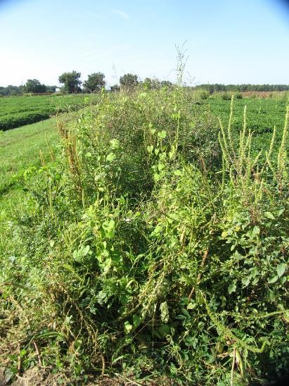
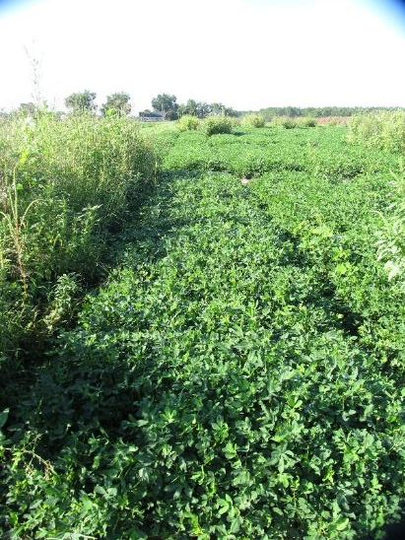
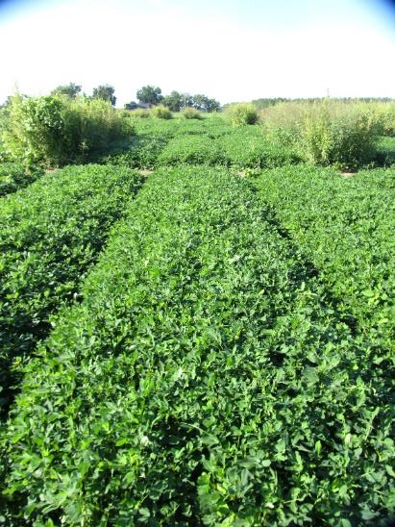
Weed Control in Peanut with Brake - 2020
NTC
Prowl H₂0 @ 32 oz/A (PRE)
Valor @ 3 oz/A (PRE)
Strongarm @ 0.225 oz/A (PRE)
Cadre @ 4 oz/A (23 DAP)
Dual Magnum @ 16 oz/A (23 DAP)
2,4-DB @ 18 oz/A (23 DAP)
Prowl H₂0 @ 32 oz/A (PRE)
Brake @ 12 oz/A (PRE)
Strongarm @ 0.225 oz/A (PRE)
Cadre @ 4 oz/A (23 DAP)
Dual Magnum @ 16 oz/A (23 DAP)
2,4-DB @ 18 oz/A (23 DAP)
PE-13-20
August 17
97 DAP

Slide 44
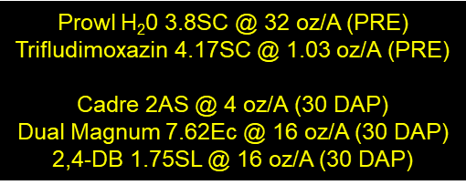
Weed Control in Peanut with Trifludimoxazin - 2020
PE-14-20
August 18
98 DAP
NTC

Slide 45
Hairy Indigo in Peanut - 2020
Valor (PRE)
Cobra (POST)
Classic (LPOST)
J. Shealey
August 3

Slide 46
Hairy Indigo Control with Cobra (12.5 oz/A) + 2,4-DB (16 oz/A) + Agridex (1% v/v)
Grower Applied
August 25
6 DAT
NTC

Slide 47
Hairy Indigo Control with Classic @ 0.5 oz/A + NIS (15 DAT)
PE-41-20
10”-20” tall

Slide 48
Questions/Comments?

